Slide 1
Laser and decay spectroscopy of neutron-deficient Tl isotopes at CERN ISOLDE.
Céline Van Beveren
Instituut voor Kern- & Stralingsfysica KULeuven
June 9th 2013

Slide 2
Outline
Motivation
Experimental set-up
Decay spectroscopy of ¹⁸⁴Tl
Laser spectroscopy of neutron-deficient Tl isotopes
(preliminary) Conclusions and outlook

Slide 3
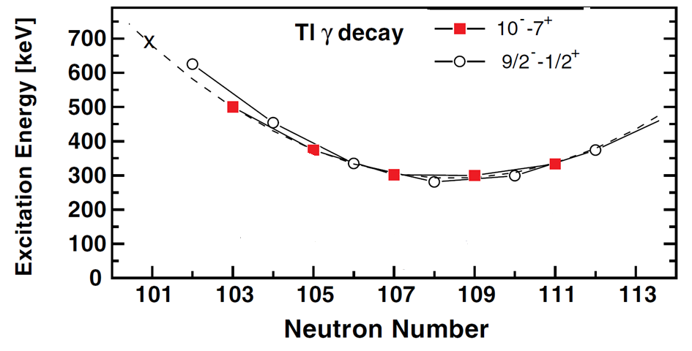
Motivation: why Tl?
Tl
proton configuration
Tl
neutron configuration
1h_{9/2}
126
82
3p_{3/2}
πs_{1/2} ⊗ νi_{13/2} => 7⁺
πh_{9/2} ⊗ νi_{13/2} => 10⁻
3s_{1/2}
2f_{5/2}
2d_{3/2}
3p_{3/2}
Motivation
Experimental set-up
Decay spectroscopy
of 184Tl
Laser spectroscopy
of Tl
Conclusions and outlook
1h_{11/2}
1i_{13/2}
2d_{5/2}
1h_{9/2}
1g_{7/2}
2f_{7/2}
50
82
183Tl
184Tl
K. Heyde, J. Wood, Reviews of Modern Physics, 83, 2011

Slide 4
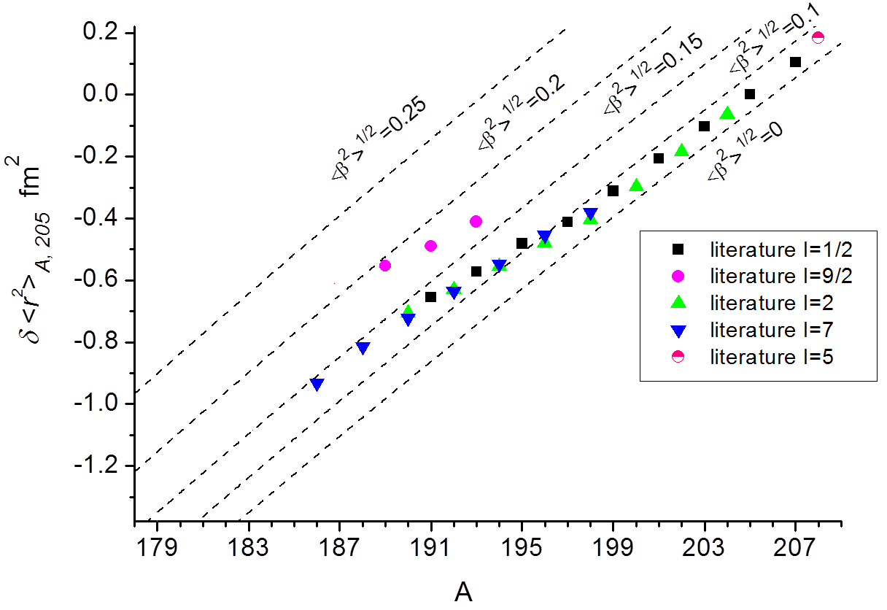
Motivation: why Tl?
Motivation
Experimental set-up
Decay spectroscopy
of 184Tl
Laser spectroscopy
of Tl
Conclusions and outlook
[Courtesy of A. Barzakh]

Slide 5
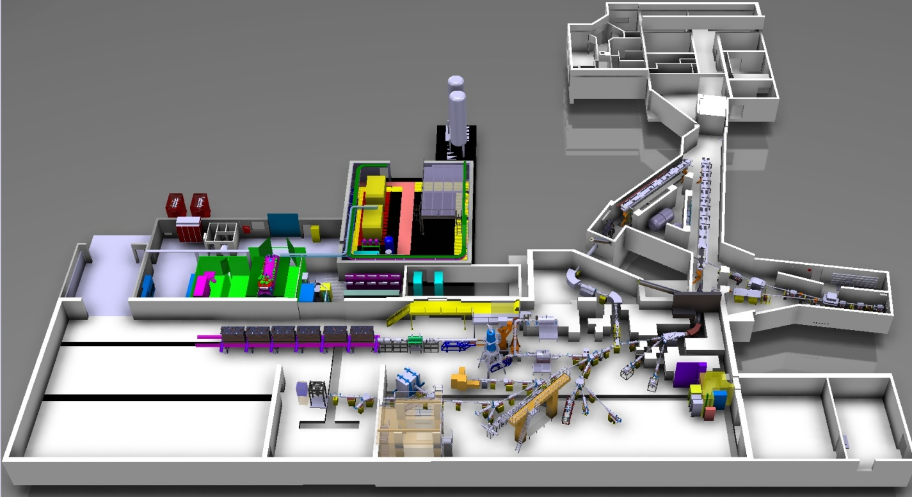
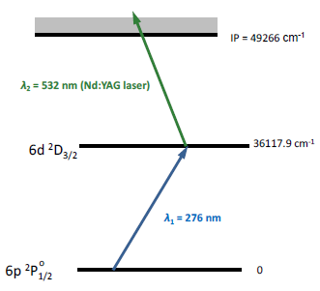
Experimental set-up
Layout of the ISOLDE hall at CERN
GPS target
RILIS
Shape coexistence
Motivation
Experimental set-up
Decay spectroscopy
of 184Tl
Laser spectroscopy
of Tl
Conclusions and outlook
Proton Beam
GPS
LA1
http://isolde.web.cern.ch/ISOLDE/
Photoionization scheme for Tl atoms
Narrow band dye laser for scanning the laser wavelength across the optical transition at 276 nm
High-power Nd:YAG laser for pumping the narrow band dye laser and for non-resonant ionization of the excited atom of interest
http://isolde-project-rilis.web.cern.ch/isolde-project-rilis/

Slide 6
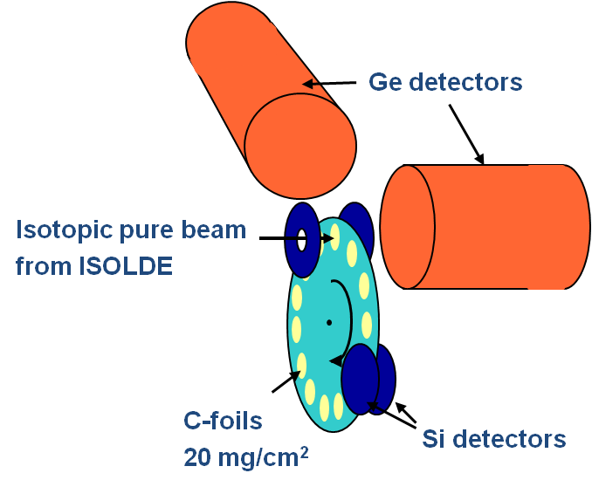
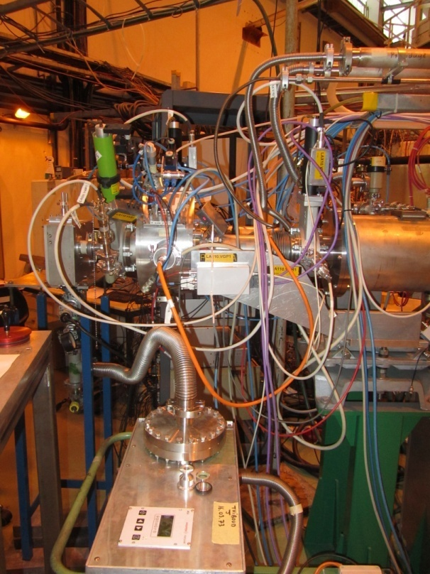
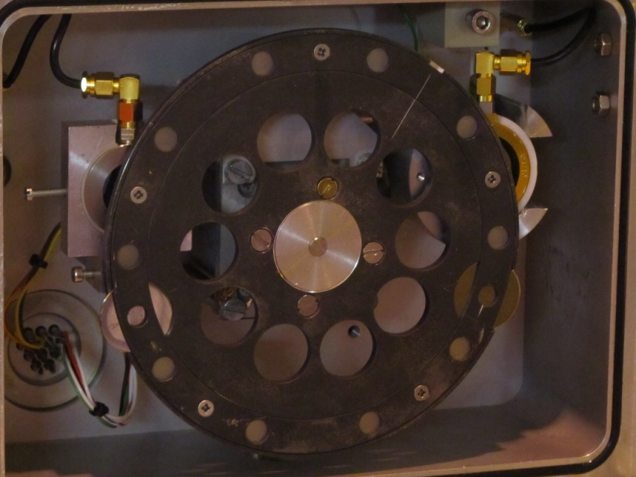
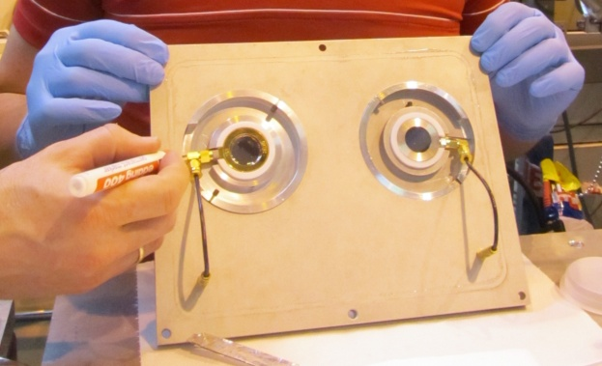
Experimental set-up
Shape coexistence
Motivation
Experimental set-up
Decay spectroscopy
of 184Tl
Laser spectroscopy
of Tl
Conclusions and outlook
Incoming beam
Windmill
Si detector
(decay side)
C-foils
Annular Si detector (implantation side)
Si detector (implantation side)
Si detector
(decay side)

Slide 7
Decay spectroscopy of ¹⁸⁴Tl
¹⁸⁴Tl
10⁻
α
506 keV
2⁻
7⁺
β⁺/EC
[β⁺/EC: talk by E. Rapisarda]
Shape coexistence
Motivation
Experimental set-up
Decay spectroscopy
of 184Tl
Laser spectroscopy
of Tl
Conclusions and outlook
α
β⁺/EC
α
¹⁸⁴Hg
β⁺/EC (98.74%)
α (1.26%)
¹⁸⁰Au
¹⁸⁴Au
¹⁸⁰Pt
Three sets of data:
No laser → Surface Ionization of Tl
Laser set on 10⁻ isomer
HFS data

Slide 8
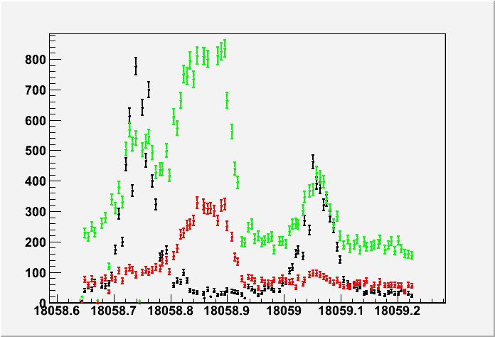
Decay spectroscopy of ¹⁸⁴Tl
¹⁸⁴Tl
10⁻ (35ms)
α
506 keV [Andreyev et al. Eur. Phys. J. A 18, 39–54 (2003)]
Shape coexistence
Motivation
Experimental set-up
Decay spectroscopy
of 184Tl
Laser spectroscopy
of Tl
Conclusions and outlook
2⁻ (11s)
7⁺ (11s)
β⁺/EC
α
β⁺/EC
α
Number of counts
Gate on 506 keV ( pure 10⁻)
Gate on 340 keV (pure 7⁺)
Gate on 616 keV (pure 2⁻)
340 keV
-> 6⁺ to 4⁺ transition in ¹⁸⁴Hg, only fed by 7⁺
616 keV
-> 2₂⁺ to 2₁⁺ transition in ¹⁸⁴Hg, only fed by 2⁻
wavenumber cm⁻¹

Slide 9
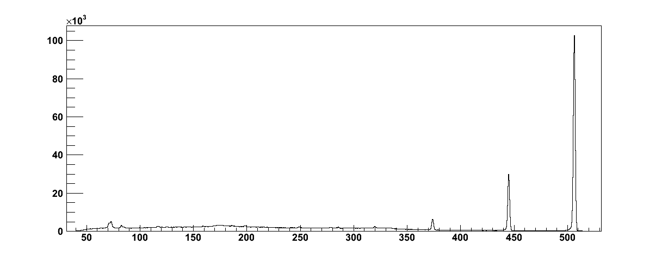
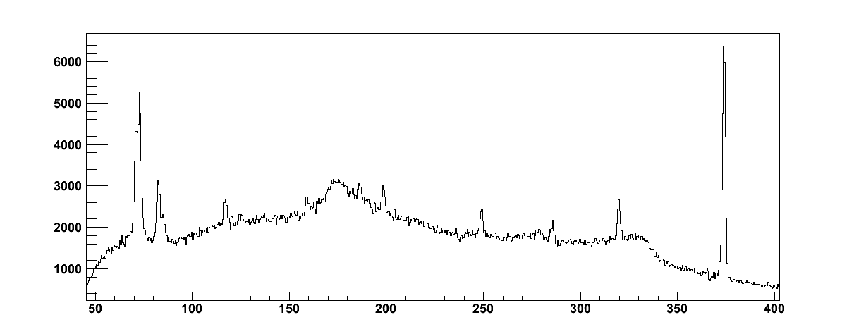
Analysis of ¹⁸⁴Tl: 10⁻ isomer
γ spectrum coming purely from the decay of the 10- isomer
# γ
506
Shape coexistence
Motivation
Experimental set-up
Decay spectroscopy
of 184Tl
Laser spectroscopy
of Tl
Conclusions and outlook
445
320
Energy [keV]
445
# γ
445
# γ
186
186
320
249
320
249
Energy [keV]
Energy [keV]

Slide 10
Analysis of ¹⁸⁴Tl: 10⁻ isomer
Internal decay scheme of 10- isomer
186 0.18
506 100
61 0.16
(10⁻)
374 4.4
506
35(2)ms
445 26
Shape coexistence
Motivation
Experimental set-up
Decay spectroscopy
of 184Tl
Laser spectroscopy
of Tl
Conclusions and outlook
M2
(8⁺)
445
E3
E3
320 0.57
249 0.34
(7⁺)
320
<100 ns *
M1
E2
M1
M1
70.5 0.96
(6⁺)
70.5
<100 ns **
M1
(7⁺)
* Observed coincidences α-γ
** Prompt coincidence with 249

Slide 11
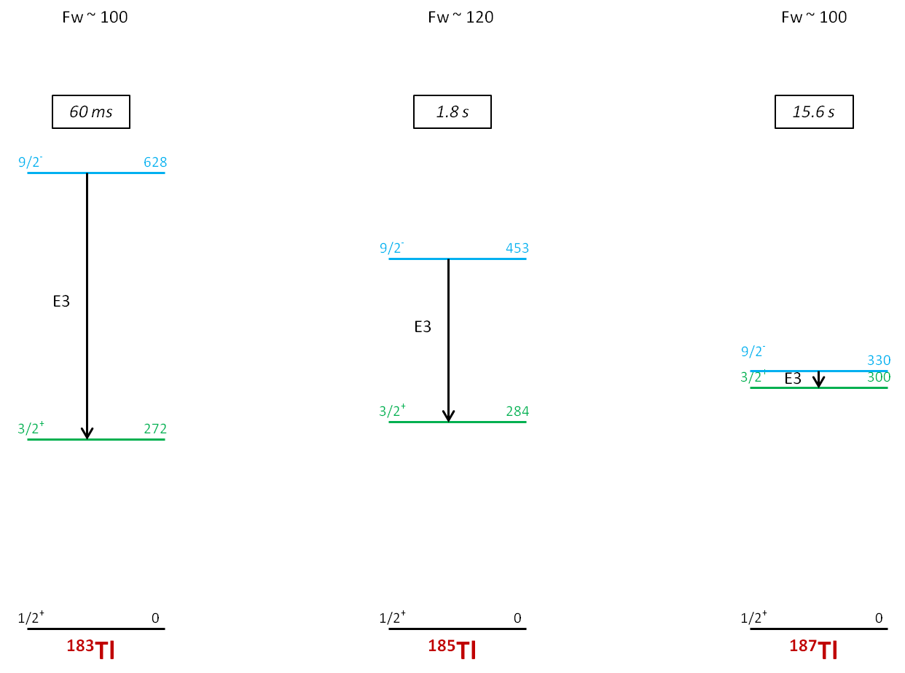
Analysis of ¹⁸⁴Tl: 10⁻ isomer
Shape coexistence
Motivation
Experimental set-up
Decay spectroscopy
of 184Tl
Laser spectroscopy
of Tl
Conclusions and outlook

Slide 12
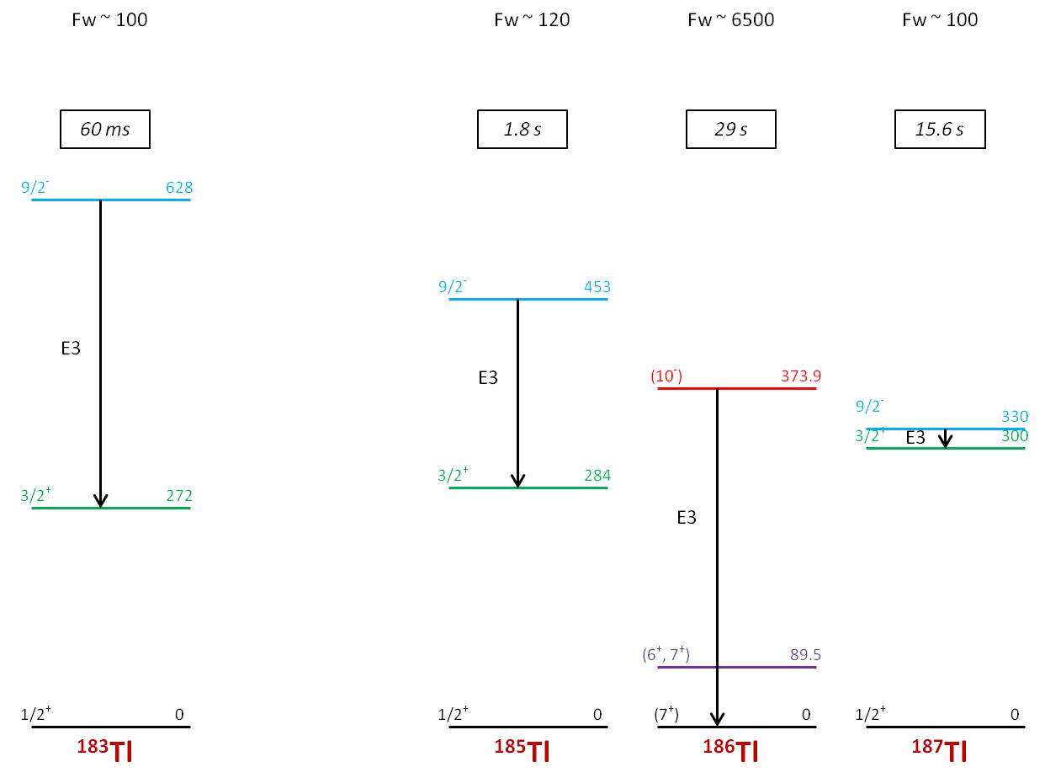
Analysis of ¹⁸⁴Tl: 10⁻ isomer
Shape coexistence
Motivation
Experimental set-up
Decay spectroscopy
of 184Tl
Laser spectroscopy
of Tl
Conclusions and outlook

Slide 13
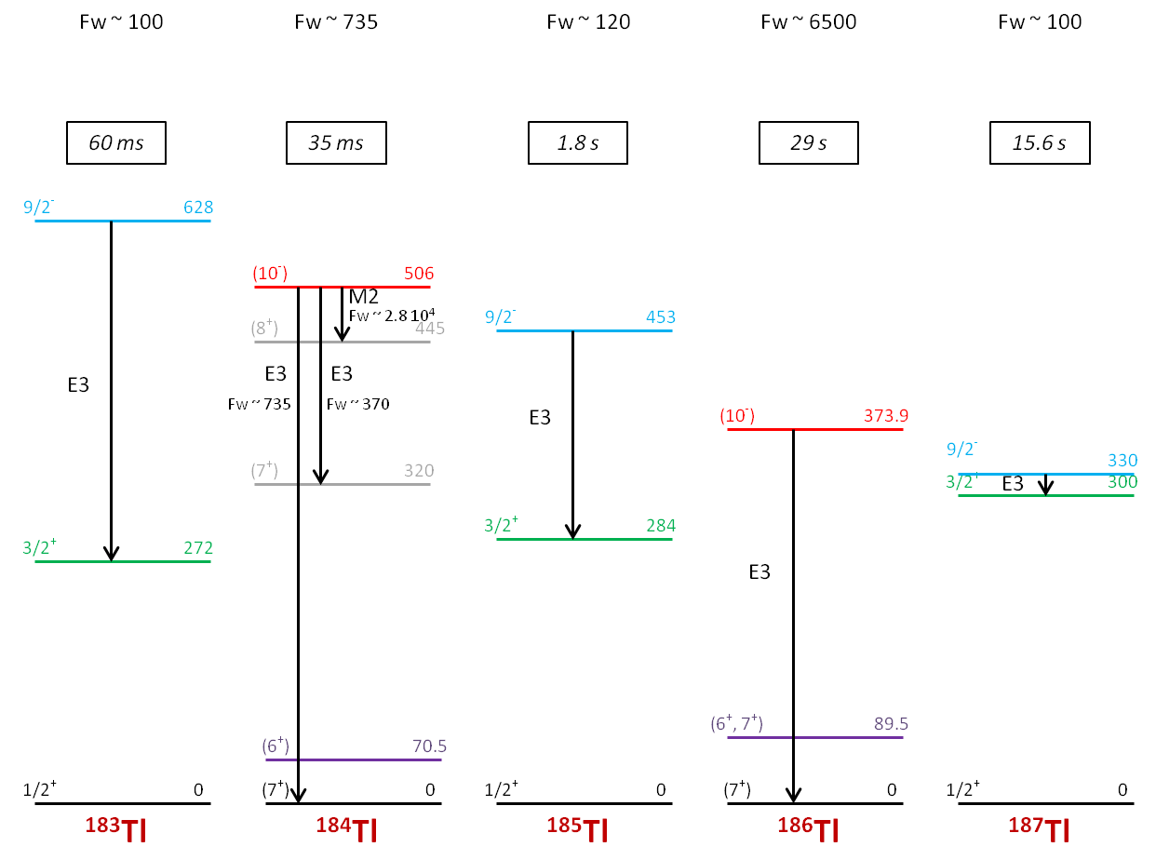
Analysis of ¹⁸⁴Tl: 10⁻ isomer
Shape coexistence
Motivation
Experimental set-up
Decay spectroscopy
of 184Tl
Laser spectroscopy
of Tl
Conclusions and outlook

Slide 14
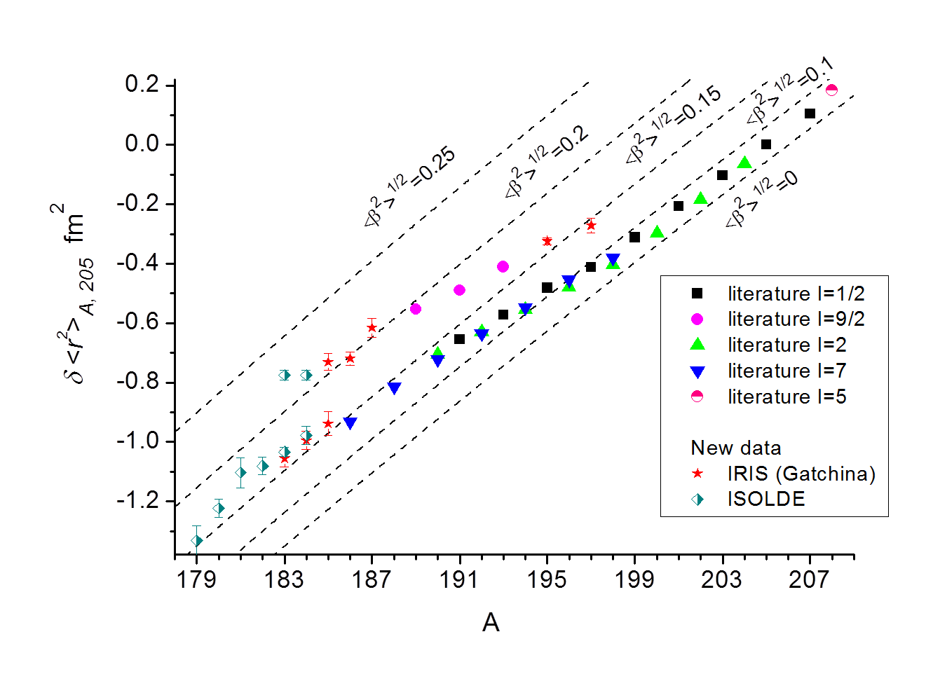
Tl laser spectroscopy
9/2⁻
Shape coexistence
Motivation
Experimental set-up
Decay spectroscopy
of 184Tl
Laser spectroscopy
of Tl
Conclusions and outlook
9/2⁻
10⁻
7⁺
1/2⁺
[Courtesy of A. Barzakh]

Slide 15
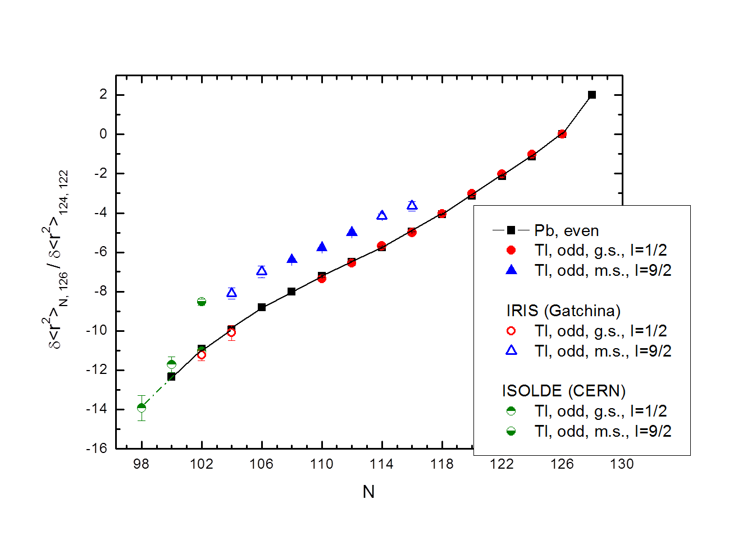
Tl laser spectroscopy
Shape coexistence
Motivation
Experimental set-up
Decay spectroscopy
of 184Tl
Laser spectroscopy
of Tl
Conclusions and outlook
[Courtesy of A. Barzakh]

Slide 16
(preliminary) Conclusions and Outlook
New decay and laser spectroscopy data for neutron-deficient Tl isotopes
(ISOLDE: ¹⁷⁹⁻¹⁸⁴Tl, IRIS)
Identified the 10⁻ intruder based retarded transition in ¹⁸⁴Tl
Disentangled α and β⁺/EC decay schemes for 10⁻, 7⁺ and 2⁻ in ¹⁸⁴Tl
(talk by E. Rapisarda)
Determined isomer shift in other Tl isotopes away from N = 104 (midshell)
(A. Barzakh)
Outlook: look to magnetic moments for Tl isotopes, detailed decay spectroscopy to connect Bi-Tl-Au chain (laser spectroscopy of Au isotopes, talk by A. Barzakh), …
Shape coexistence
Motivation
Experimental set-up
Decay spectroscopy
of 184Tl
Laser spectroscopy
of Tl
Conclusions and outlook

Slide 17
The collaboration:
C. Van Beveren¹ A.N. Andreyev², A. Barzakh³, T.E. Cocolios⁴, D. Fedorov³, V. Fedosseev⁴, R. Ferrer¹, M. Huyse¹,
U. Köster⁵, J. Lane⁶, V. Liberati⁶, K.M. Lynch^{4,7},T.J. Procter⁷, D. Radulov¹, E. Rapisarda⁴, K. Sandhu⁶, M. Seliverstov⁴, P. Van Duppen¹, M. Venhart⁸, M. Veselsky⁸
¹Instituut voor Kern- en Stralingsfysica, KU Leuven, Belgium
²University of York, UK
³St. Petersburg Nuclear Physics Institute, Gatchina, Russia
⁴ISOLDE, CERN, Geneva, Switzerland
⁵ILL, Grenoble, France
⁶UWS, University of the West of Scotland, Paisley, UK
⁷University of Manchester, UK
⁸Slovak Academy of Sciences, Bratislava, Slovakia
Thank you very much for your attention

Slide 19
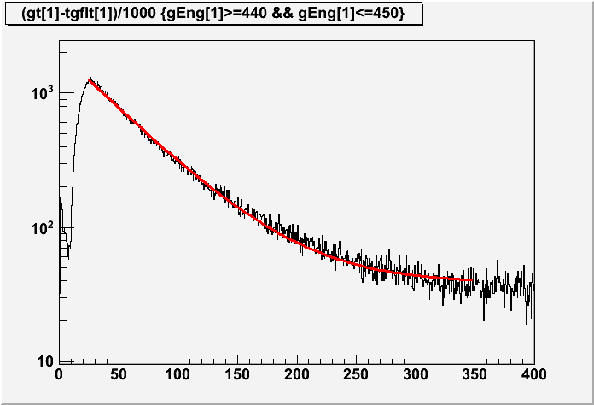
Analysis of ¹⁸⁴Tl: 10⁻ isomer
Using the 445 keV γ line, deduced T_{1/2} ~ 35 (0.2) ms
Shape coexistence
Motivation
Experimental set-up
Decay spectroscopy
of 184Tl
Laser spectroscopy
of Tl
Conclusions and outlook
Consistent with deduced T_{1/2} based on other γ & α from the decay of the 10⁻ isomer

Slide 20
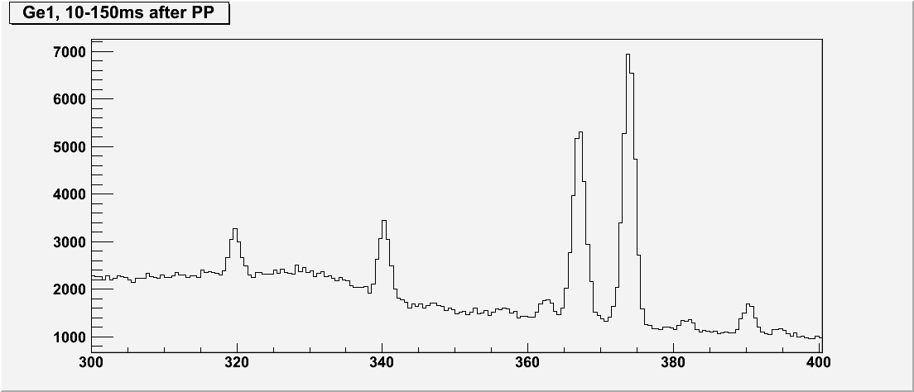
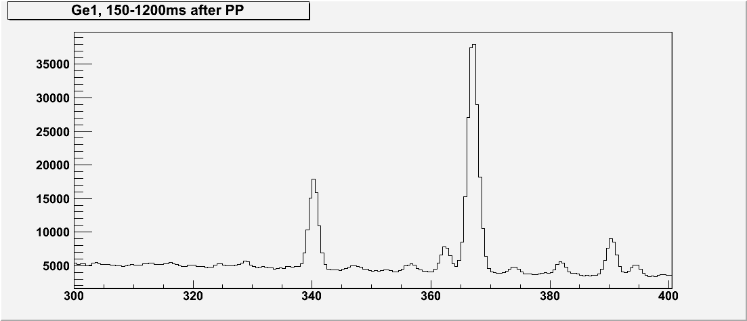
Analysis of ¹⁸⁴Tl: 10⁻ isomer
Shape coexistence
Motivation
Experimental set-up
Decay spectroscopy
of 184Tl
Laser spectroscopy
of Tl
Conclusions and outlook
I1 = 366.7keV, 10-150ms after PP: 17465(297) counts in Ge1
I2 = 366.7keV, 150-1200ms after PP: 146936(625) counts in Ge1
I1/I2 = 0.1189 (0.0175)

Slide 21
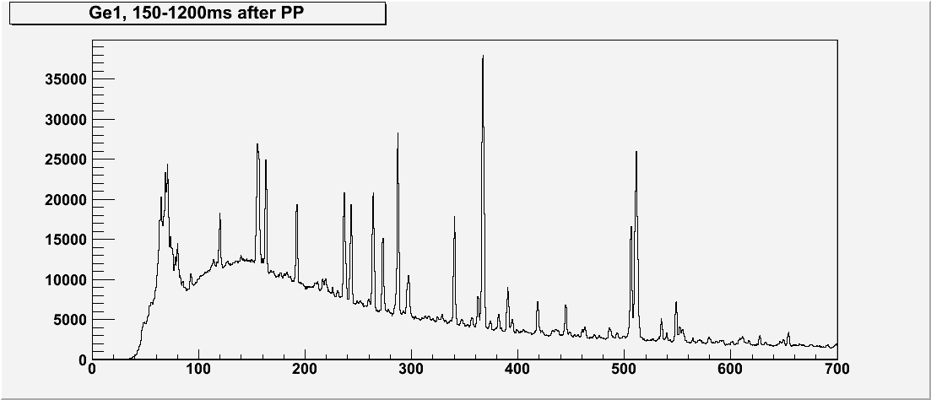
Pure 10⁻ spectrum: γ
A
B
pure10⁻ γ spectrum = A – I₁/I₂ * B = A – 0.1189 * B

Slide 22
Pure 10⁻ spectrum: γ
pure10⁻ γ spectrum
pure10⁻ γ spectrum = A – I₁/I₂ * B = A – 0.1189 * B

Slide 23
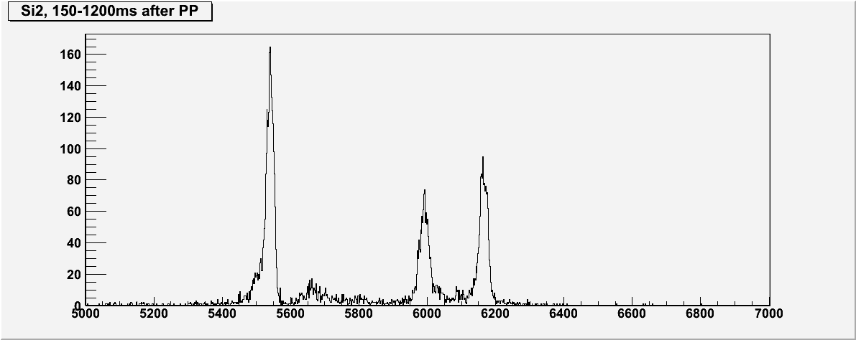
Pure 10⁻ spectrum: α
A
B
pure10⁻ α spectrum = A – I₁/I₂ * B = A – 0.1189 * B

Slide 24
Pure 10⁻ spectrum: α
pure10⁻ α spectrum
pure10⁻ α spectrum = A – I₁/I₂ * B = A – 0.1189 * B

Slide 25
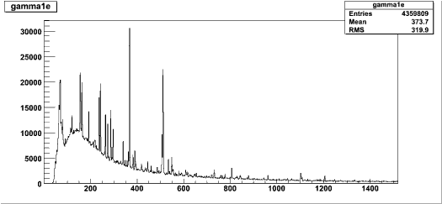
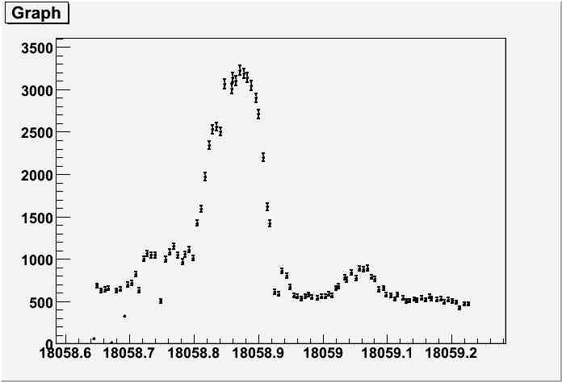
184Hg (366.7)
ϒ
Gate on 366.7 keV
¹⁸⁴Tl
7⁺ and 2⁻
506
10⁻
374
10⁻
10⁻
7⁺
2⁻
¹⁸⁴Hg
418
8⁺
wavenumber cm⁻¹
340
6⁺
616
2⁺
ϒ
4⁺
Gate on 506 keV ( pure 10⁻)
Gate on 340 keV (pure 7⁺)
Gate on 616 keV (pure 2⁻)
366.7
2⁺
0⁺
Disentangle and identify different isomers by gating on different γ lines
wavenumber cm⁻¹

Slide 26
Note the long chain (N from 102 to 116) of the (intruder) isomeric states with the deformation markedly greater than the deformation of g.s. (shape coexistence). Previously known isomeric chain is extended for both sides (N>112, N<106). For the first time the great isomer shift was found for odd-odd nuclei also (A=186, 184).

Slide 27
The similarities between the different isotopic chains can be elucidated by comparing relative changes in the mean-square charge radii δ<r²>. The values of δ<r²>_{N,126} are normalized within each isotopic chain to δ<r²>_{122,124} in order to allow a comparison between these chains. For the sake of clarity, only the results for the even-neutron nuclei are presented. The corresponding picture for odd-neutron nuclei is quite similar. It is clearly seen that the Tl radii perfectly follow the pattern of the Pb radii even below the midshell at N = 104 where the well known pronounced deviation from this behavior, connected with the onset of permanent prolate deformation, was found for the adjacent Hg (Z = 80) and Au (Z = 79) nuclei.

Slide 28
Newly measured magnetic moments for Tl isotopes at and below the midshell
(N≤104) perfectly follow the trends for heavier Tl isotopes with the same spin.

Slide 29
The most striking finding is the unexpected growth of the isomer shift between
ground (1/2⁺) and isomeric (intruder) states (9/2⁻) in odd Tl nuclei. It is well-known
that the excitation energy for these isomeric states has the minimum at A=187-189.
Correspondingly, all calculations predicted that the difference in deformation (i.e.,
isomer shift) between g.s. and m.s. is nearly constant or even decreases after A=187.

