Slide 1

Onset of collectivity in neutron-rich Sr and Kr isotopes:
Prompt spectroscopy after Coulomb excitation at REX-ISOLDE, CERN and after neutron induced fission of ²³⁵U at EXIIL, ILL-Grenoble
E.Clément-GANIL

Slide 2
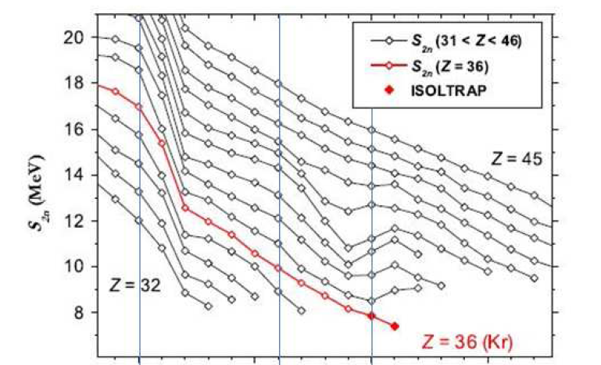
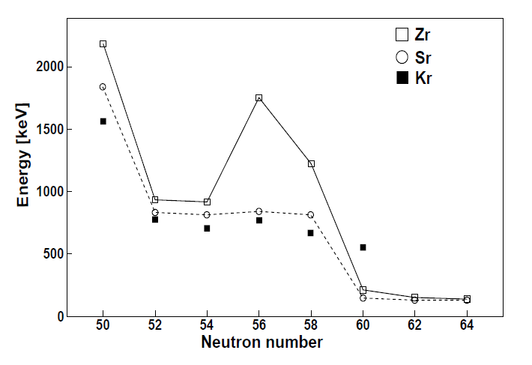
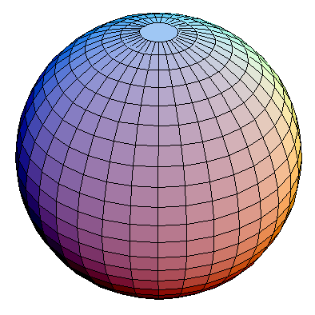
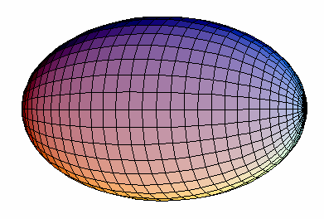
Shape Transition at N=60
The n-rich nuclei between Z=37 and Z=42 present at N=60 one of the most impressive deformation change in the nuclear chart
Systematic of the 2⁺ energy
(Raman’s formula : β₂~0.17 → 0.4)
Localized within the Z degree of freedom
  → Point to an effect related to specific π−ν combinaison
S. Naimi et al., Phys. Rev. Lett. 105, 032502 (2010).
+ 2ν
( )
→
M. Albers et al., Phys. Rev. Lett. 108, 062701 (2012)

Slide 3
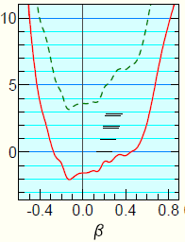
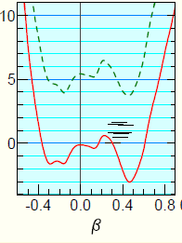
0⁺₂
E(0⁺) [keV]
Low lying 0⁺ states were observed in Sr and Zr isotopes
Shape isomer in the odd-mass Sr, Zr
Shape coexistence scenario ?
+ 2ν

Slide 4
Toward a microscopical description
The sharp transition and amplitude of the deformation remain still a challenge for theories which fail in reproducing spectroscopic data
40
(1h_{11/2})
1g_{7/2}
0⁺₂ state created by 2p-2h excitation across Z=40
3s_{1/2}
ll
1g_{7/2}
ll
Beyond N=60, g_{7/2} is populated, the π−ν interaction participates to the lowering 0⁺₂ state and to the high collectivity of 2⁺₁ state.
2d_{5/2}
2d_{5/2}
ll
ll
ll
1g_{9/2}
50
50
2p_{1/2}
In the current valence space, need higher effective charge to reproduce the known B(E2)
→ π and ν orbital from the core or higher shells.
40
1f_{5/2}
ll
ll
ll
2p_{3/2}
ll
ll
28
K. Sieja et al PRC 79, 064310 (2009)

Slide 5
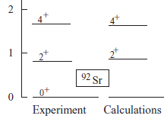
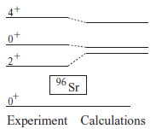
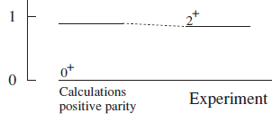

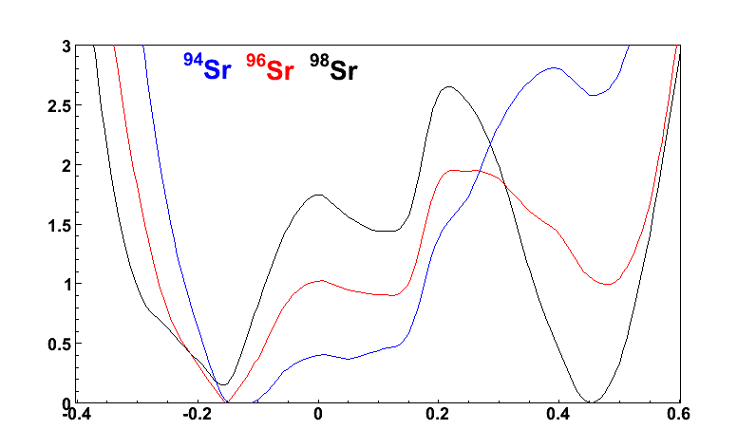
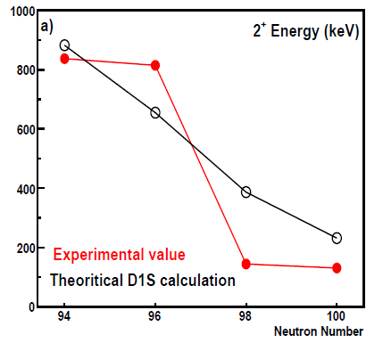
T. Rzaca-Urban Phys. Rev C 79, 024319 (2009) – SM calculations
CEA-Bruyère-Le-Chatel Private communication, HFB+GCM(GOA) force D1S
Mean-field calculations reproduce the near spherical and highly deformed configuration away from N=60
Discrepancies at the transitional region

Slide 6
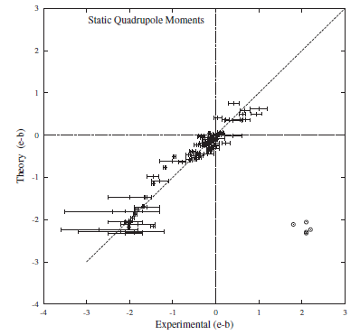
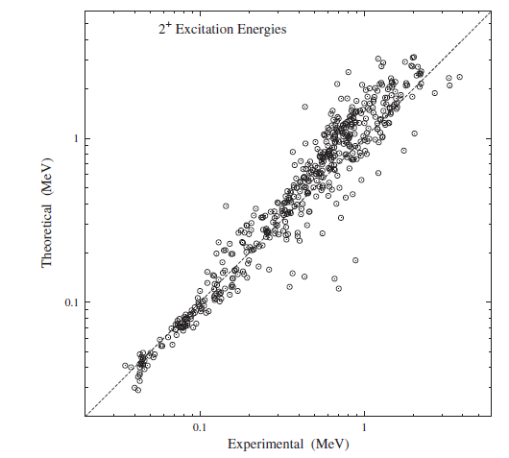
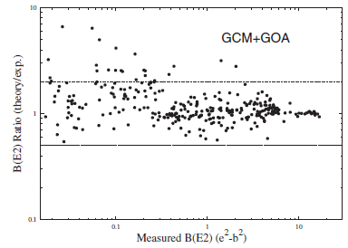
Best examples of the interplay between single-particle and collective modes of excitation in the nuclear matter
Important constraints for the nuclear models
98 values
519 values
Motivate the need for more spectroscopic data
318 B(E2,0⁺→2⁺)
2⁺
Q₀ ~ < 2⁺| Q |2⁺>
B(E2) ~ < 2⁺| Q |0⁺> ²
0⁺
G. F. Bertsch, M. Girod, S. Hilaire, J.-P. Delaroche, H. Goutte, and S. Péru , PRL 99, 032502 (2007)

Slide 7
IS451 – ISOLDE-CERN : Investigation of the shape transition at N=60 in the Sr isotopes through the electromagnetic probe : B(E2) & Q₀
B(E2)’s connecting states to probe the collectivity and the mixing of configurations
Q_{o} to determine the deformation
Well established level scheme from prompt spectroscopy using fission source
Coulomb excitation of RIB
N=58
N=60

Slide 8
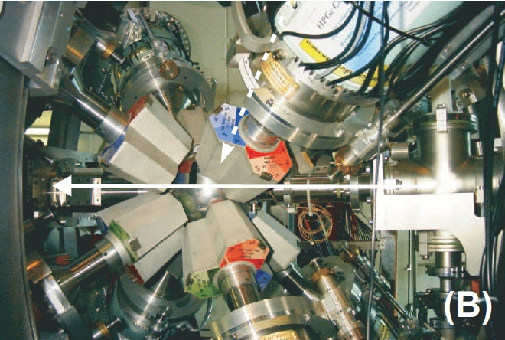
Post-accelerated radioactive ^{96,98}Sr beam at REX-ISOLDE (2.8 MeV/A)
Safe Coulomb excitation
B(E2)’s and Q₀ extracted from the Coulomb excitation cross section
Molecular extraction: Pure ⁹⁶Sr²³⁺
1 to 0.5 ~10⁴ pps
REX beam
Target
Atomic extract and in-trap β-decay →80 % ⁹⁸Sr
6.10⁴ pps
8 HPGe Clusters from MINIBALL (~ 7% efficiency)
Stripped silicon detector for particles detection
(Doppler correction and differential cross section)
N. Warr and the MINIBALL collaboration Eur. Phys. J. A (2013) 49: 40
Notes:
8

Slide 9
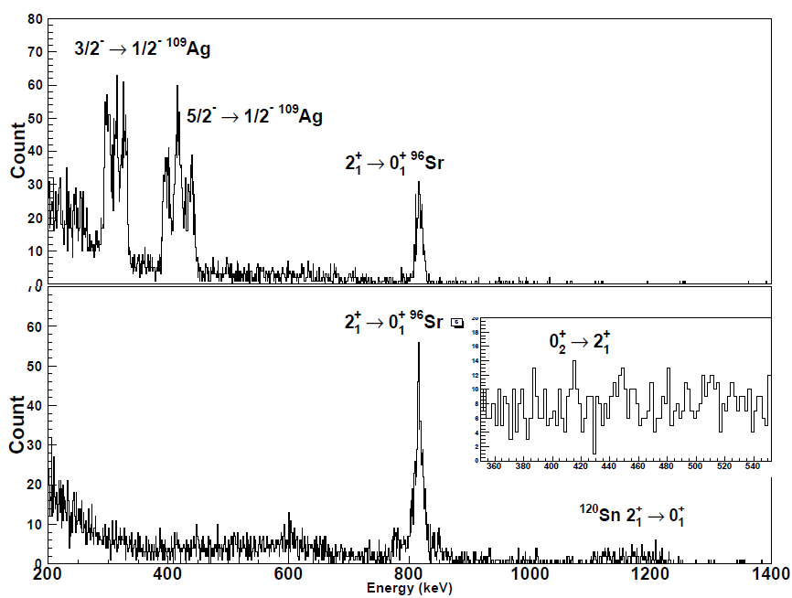
Coulomb excitation results
Coulomb excitation on ¹⁰⁹Ag and ¹²⁰Sn
1st excited 2⁺ state populated
N=60

Slide 10
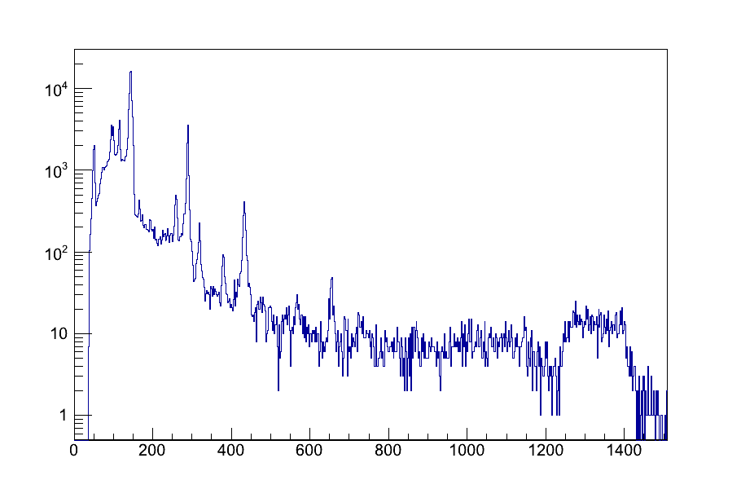
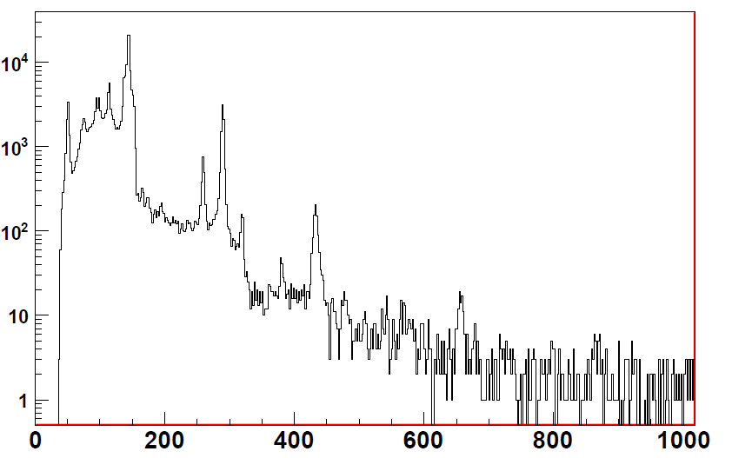
Coulomb excitation results
2⁺ ⁶⁰Ni
Coulomb excitation on ²⁰⁸Pb and ⁶⁰Ni
Ground state and non-yrast states populated
2⁺
4⁺
²⁰⁸Pb target
6⁺
2⁺₂
N=60
8⁺

Slide 11
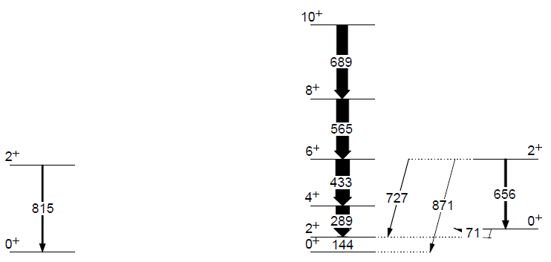
⁹⁶Sr :The Electric spectroscopic Q₀ is null as its B(E2) is rather large
→ Purely vibrator character
→ No quadrupole deformation
IS451 - Preliminary
⁹⁸Sr
→ The ground state band is a perfect rotor
→ Excited configuration similar to ⁹⁶Sr
B(E2↓) = 696(186)e²fm⁴
B(E2↓) = 75(46)e²fm⁴
B(E2↓) = 3407(838) e²fm⁴
B(E2↓) = 37 (6)e²fm⁴
Q_{s} = -6 (9) efm²
B(E2↓) = 3527(541) e²fm⁴
B(E2↓) = 5635(1755)e²fm⁴
B(E2↓) = 462 (11) e²fm⁴
B(E2↓) = 3573(300) e²fm⁴
B(E2↓) = 2588(99) e²fm⁴
⁹⁶Sr ; N=58
⁹⁸Sr ; N=60
B(E2↓) = 2382(209)e²fm⁴

Slide 12
⁹⁶Sr :The Electric spectroscopic Q₀ is null as its B(E2) is rather large
→ Purely vibrator character
→ No quadrupole deformation
IS451 - Preliminary
⁹⁸Sr
→ The ground state band is a perfect rotor
→ Excited configuration similar to ⁹⁶Sr
β ~ 0.4
|β| < 0.16
Q_{s} = -116(88) efm²
Q_{s} = 2(46) efm²
|Q_{s}| < 48 efm²
Q_{s} = -6 (9) efm²
Q_{s} = -146(200) efm²
B(E2↓) = 462 (11) e²fm⁴
Q_{s} = -197 (20) efm²
⁹⁶Sr ; N=58
⁹⁸Sr ; N=60

Slide 13
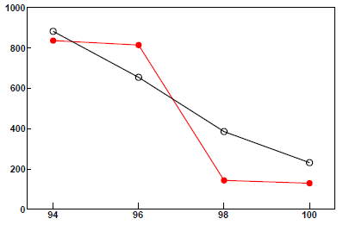
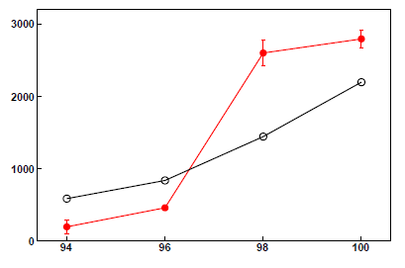
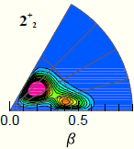
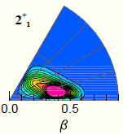
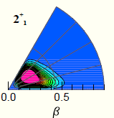
Comparison with theory
Calculations with the Gogny force restricted to axial symmetry (overestimate the mixing ?)
Influence of the interaction (Gogny – Skyrme)
Interplay between collective and single-particle structure in the mean field approach
Relatively good agreement between theory and experimental data
2⁺ energy
B(E2↓) e²fm⁴
IS451 - Preliminary
Theory
Data
|β| < 0.16
β ~ 0.4
|Q_{s}| < 48 efm²
β_{th}= 0.28 (30% K=2)
Q_{s} = -116(88) efm²
Q_{s} = -6 (9) efm²
Q_{th}= -18 efm²
Q_{th}= +68 efm²
β_{th}=0.34 (66% K=2)
|β| < 0.1
β_{th}=0.43 (2%K=2)
Q_{s} = -146(200) efm²
Q_{s} = -197 (20) efm²
Q_{th}= -214 efm²
β_{th}=0.37 (10%K=2)
⁹⁶Sr ; N=58
⁹⁸Sr ; N=60
CEA-Bruyère-Le-Chatel Private communication, HFB+GCM(GOA) force D1S

Slide 14
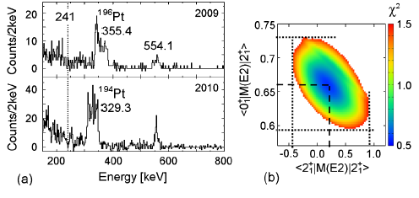
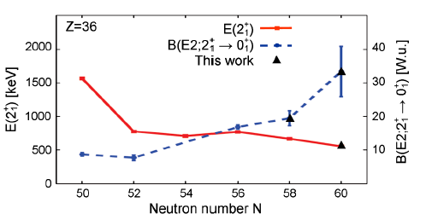
Futures prospective : toward ⁹⁶Kr
M. Albers et al PRL 108, 062701 (2012)
First excited state known
→Evolution of the yrast band and Non-yrast band ?
→Shape isomer ?
Extending the level scheme and measure the electromagnetic properties are the purpose of experiments at EXOGAM@ILL (2012-2013) and SPIRAL2 Phase 2

Slide 15
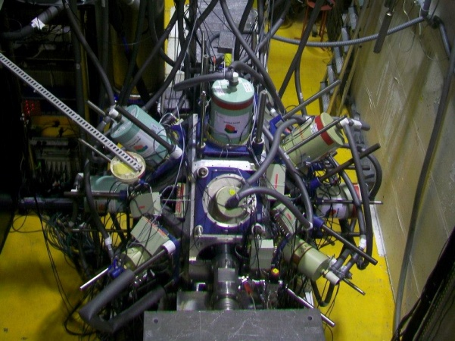
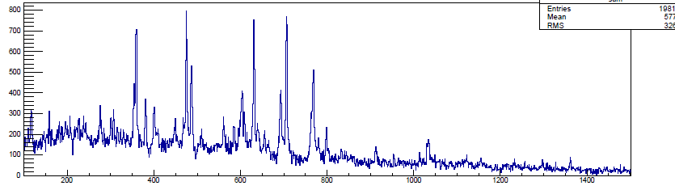
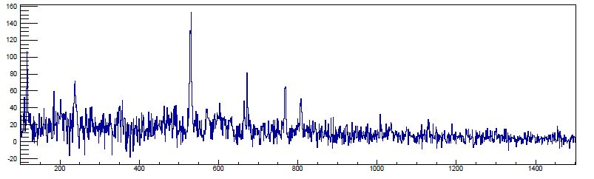
Toward ⁹⁶Kr at EXILL
See more in the G. de France’s talk
²³⁵U,²⁴¹Pu(n_{th},ff)
10 HPGe Clover + 6 GASP
20 days of irradiation
Prompt spectroscopy of FF
From the heavy fragment ¹⁴²Ba (4⁺→2⁺→0⁺) γγ
12h of data
¹⁴²Ba
¹⁴⁰Ba
¹⁴⁰Ba (4⁺→2⁺→0⁺) γγ
⁹⁰Kr
⁹³Kr
⁹²Kr
⁹⁴Kr

Slide 16
Conclusions
We investigated the collectivity and the deformation in ^{96,98}Sr at the shape transition using RIB and the Coulomb excitation technique at REX-ISOLDE, CERN
Quadrupole moment have been extracted and are compatible with the shape inversion/shape coexistence scenario between a deformed and a spherical configuration
HFB+GCM(GOA) Gogny force D1S calculations are in very good agreement with the data
Microscopical interpretation based on Shell Model or Monte Carlo shell model calculations
QRPA calculations ?
Next steps is the study of ^{94,96}Kr at high spins at EXILL and SPIRAL2 phase2
Future investigation of the Zr isotopes at the transition and odd-mass nuclei (coulex, transfer)

Slide 17
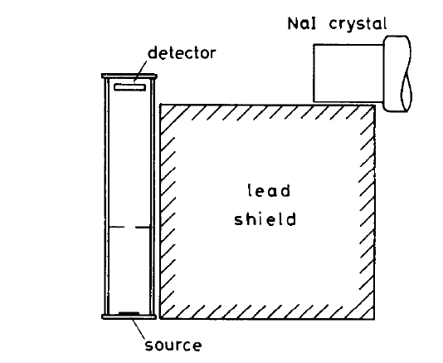
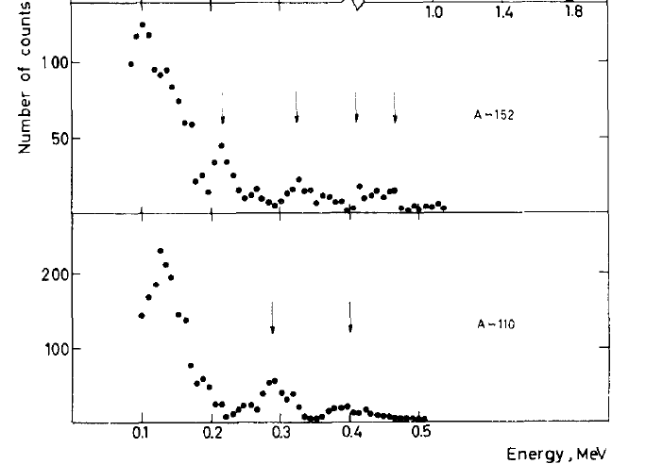
The light fission products A ~ 90-110 have motivated an
experimental effort in γ-ray spectroscopy since decades
²⁵²Cf → strongly populate the heavy Zr, Mo, Ru with A ≈ 100-110
    Probing shell and shape evolution far from stability with a high N/Z ratio
    Constraining advanced theoretical model
Its has been established in the 60’s that light elements with A~ 110 belong to a new island of stable deformation similar to the rare earth region
S. A. E. Johansson, Nucl. Phys. 64 (1965) 147

Slide 18
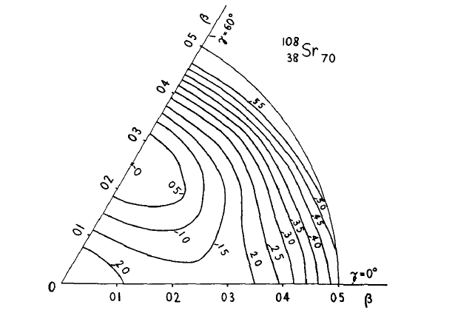
Semi-phenomenological theoretical approaches
Region for which the equilibrium shape is an axially symmetric oblate distribution
Maximum of deformation in ⁹⁸⁻¹⁰²Sr and ⁹⁶⁻¹⁰²Kr
Transition from nearly spherical nuclei at N=50 to highly deformed nuclei at N=60-70
D. A Arseniev, A Sobiczewski,V G. Soloviev Nuclear Physics A139 (1969) 269--276

Slide 19
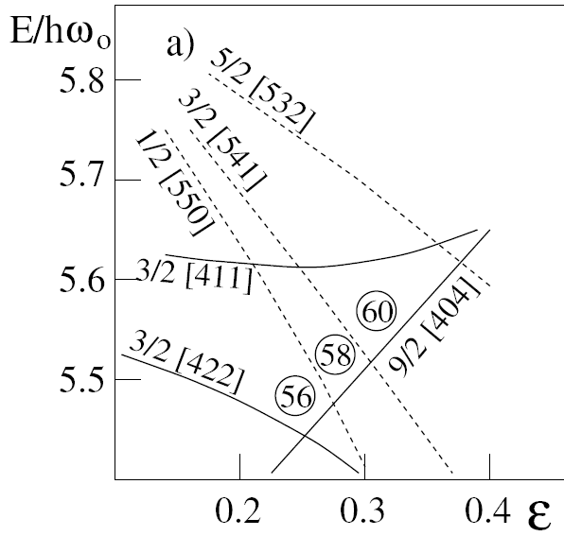
Shape Transition at N=60
h_{11/2}
g_{9/2} from core
γ-ray spectroscopy of odd-mass nuclei
9/2^{+m} isomer state identified pointing the νg_{9/2}[404] orbit
→ extruder neutron orbital from ⁷⁸Ni core
Create the N=60 deformed gap
Neutron excitation from d_{5/2} to h_{11/2}
→Octupole correlation ?
g_{7/2}
2d_{5/2}
W. Urban et al., Eur. Phys. J. A22, 241 (2004)
W. Urban J.A Pinston ., Eur. Phys. J. A16, 11 (2003)

Slide 20
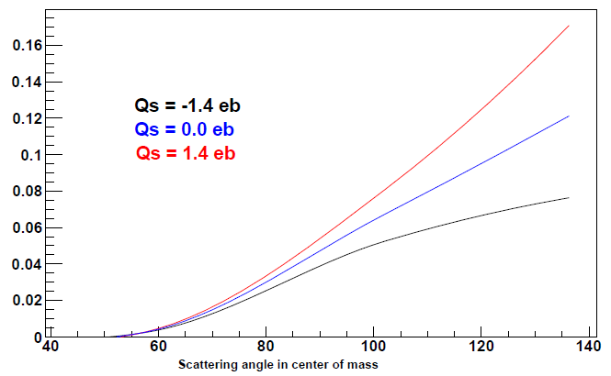
1er ordre:
2nd ordre:
Reorientation effect
2⁺
2⁺
a⁽¹⁾
a⁽¹⁾
a⁽²⁾
a⁽²⁾
0⁺
0⁺
→ Q₀
dσ
dσ_{Ruth}
__
__
P_{i→f}
6⁺ excitation probability ⁹⁸Sr+²⁰⁸Pb
=
dΩ_{i→f}
dΩ
∝ B(E2) ∝ β²
Notes:
20

Slide 21
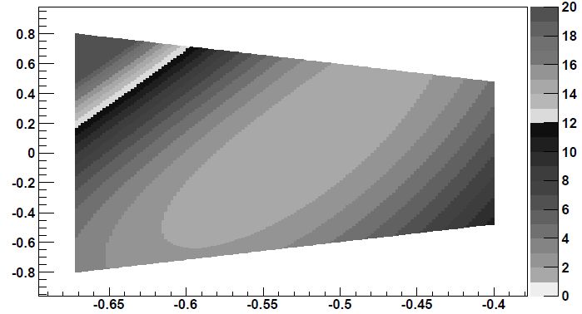
Coulomb excitation Analysis
The Coulomb excitation cross section is analysed using the least-squares fitting code GOSIA
T. Czosnyka, D. Cline, and C. Y. Wu, Bull. Am. Phys. Soc. 28, 745 (1983).
Coulomb excitation
cross section
Inputs:
*Level scheme
*Experimental setup
*Iγ (θ_{cm})
*known τ,BR,δ(Eλ/Mλ)
Complete set of Elect. Matrix Element
Electromagnetic
Matrix Element
χ² minimization
Calculated decay intensities
vs
Observed decay
⁹⁶Sr case :
Sn target
Qs 2⁺
B(E2, 2⁺→0⁺)

Slide 22
Post-accelerated radioactive ^{96,98}Sr beam at REX-ISOLDE (2.8 MeV/A) ⁹⁶Sr T_{1/2} = 1s, ⁹⁸Sr T_{1/2} = 0.6 s
Safe Coulomb excitation
B(E2)’s and Q₀ extracted from the Coulomb excitation cross section
HRS A= 115
UCx Target
⁹⁶Rb
7 to 1.3 10⁵
⁹⁶Sr¹⁹F⁺/μC
Trap
Separator
A/Q = 4.17
Molecular extraction
EBIS
Pure ⁹⁶Sr²³⁺ REX-beam
2.87 MeV/u
1 to 0.5 ~10⁴ pps
CERN PSB
1.4 GeV Proton beam
1-2μA
¹¹⁵In
Notes:
22

Slide 23

UCx Target
HRS A= 98
⁹⁸Rb (>95 % ) + ⁹⁸Sr (< 5%)
Trap
After several ⁹⁸Rb periods : 161 + 158 ms
Separator
Atomic extraction
EBIS
80 % ⁹⁸Sr
REX-beam
2.82 MeV/u
6.10⁴ pps
CERN PSB
1.4 GeV Proton beam
1-2μA
Notes:
23

Slide 24
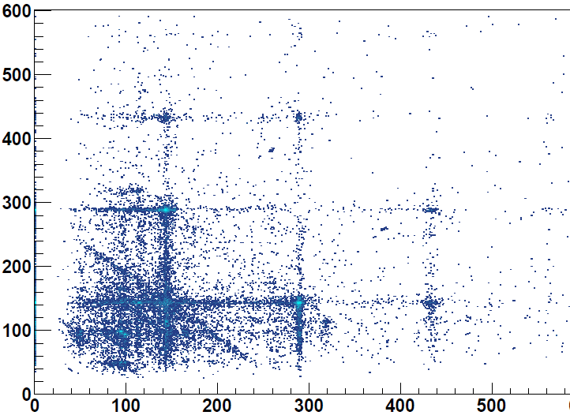
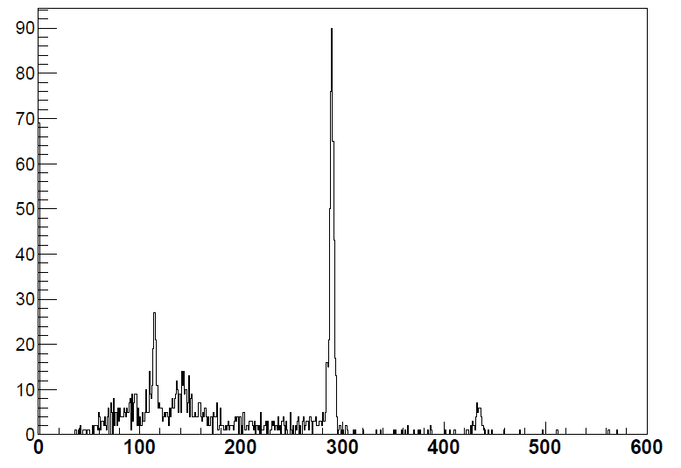
Coulomb excitation results
γ−γ coincidences after Coulomb excitation of a post-accelerated (2.8 MeV/A) RIB with T_{1/2}= 600 ms
4⁺
115 keV
Gated on the 2⁺ decay
6⁺

Slide 25
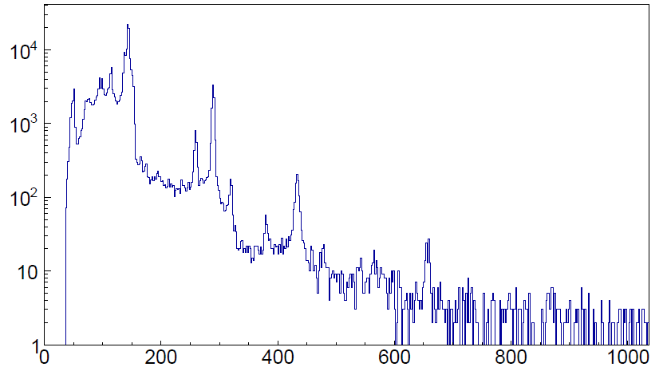
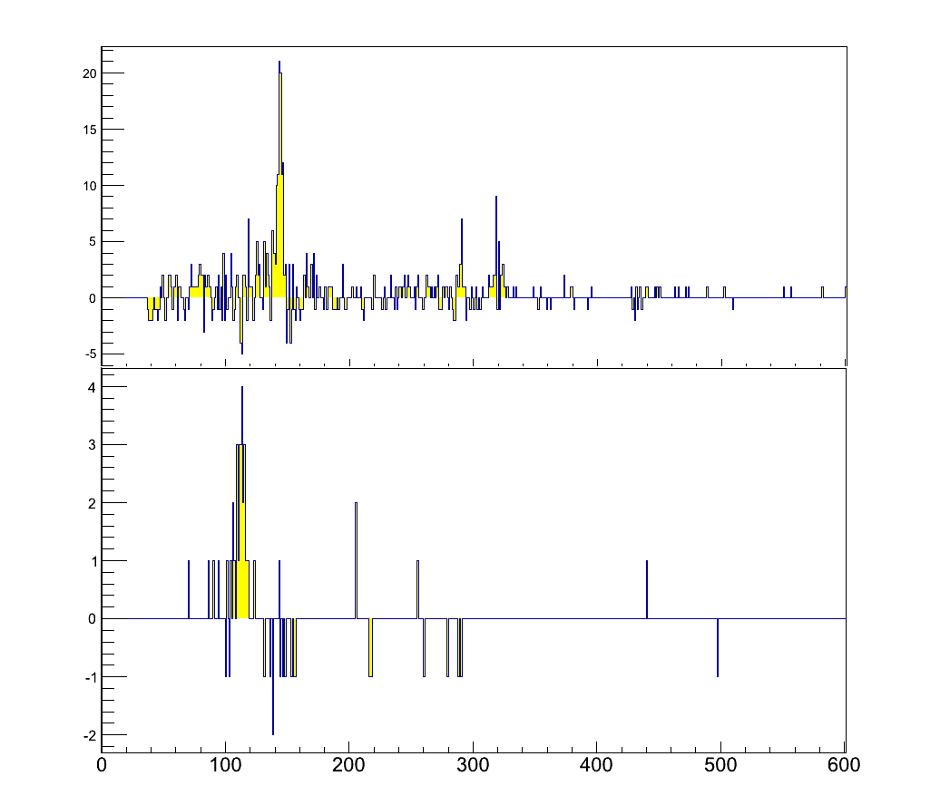
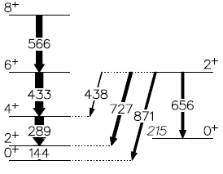

Coulomb excitation results
Gate on 115 keV
Gate on 319 keV
(319)
(115)
Other unknown transitions might belong to ⁹⁸Rb

