Slide 1



Isospin mixing at finite temperature in ⁸⁰Zr
Simone Ceruti
Università degli Studi di Milano

Slide 2
Outline
    Isospin Mixing at T = 0 and T > 0
    Isospin Mixing at T > 0 using GDR γ decay
    Measurement of Isospin Mixing
    Preliminary results from T = 2.2 MeV
    Conclusions

Slide 3
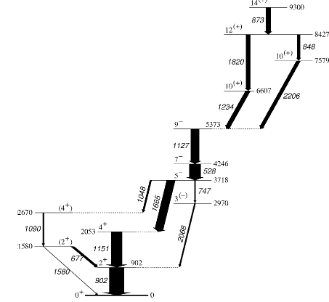
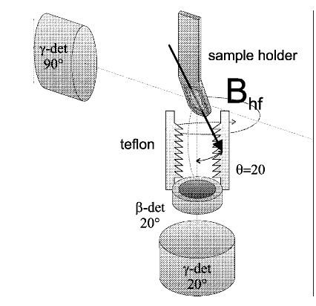

Physics case
Isospin I is almost a good number for a nuclear system
Isospin symmetry is broken by Coulomb potential V_{c}, which mixes states with different isospin
We need an observable sensitive to isospin:
E1 transition between two I=0 states is forbidden
Measurement of Fermi forbidden β decay
E.Farnea et al., PLB 551 (2003), 56
P. Schuurmans et al. / Nuclear Physics A 672 (2000) 89–98
N. Severijns PHYSICAL REVIEW C 71, 064310 (2005)
N. Auerbach PHYSICAL REVIEW C 79, 035502 (2009)
Notes:
The mixing can explain why forbbidden transitions actaully occur, for example E1 transition……

Slide 4
Physics case
Isospin I is almost a good number for a nuclear system
It’s important to know the mixing for different A.
Mixing increases as A increases
For large A the measurement are difficult
Isospin symmetry is broken by Coulomb potential V_{c}, which mixes states with different isospin
We need an observable sensitive to isospin:
E1 transition between two I=0 states is forbidden
Measurement of Fermi forbidden β decay
E.Farnea et al., PLB 551 (2003), 56
P. Schuurmans et al. / Nuclear Physics A 672 (2000) 89–98
N. Severijns PHYSICAL REVIEW C 71, 064310 (2005)
N. Auerbach PHYSICAL REVIEW C 79, 035502 (2009)
Notes:
The mixing can explain why forbbidden transitions actaully occur, for example E1 transition……

Slide 5
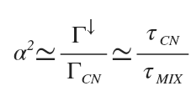
Physics case What happens at T>0 ?
At low excitation energy, nuclear states lie too far from each other to have a mixing.
The energetic distance between levels decreases as the energy excitation (E*) increases, hence the the mixing increases
Compound nucleus finite lifetime τ doesn’t allow to achieve a complete mixing.
E*
τ_{CN}
LOW ENERGY
MODERATE ENERGY
HIGH ENERGY E*>20 MeV
Almost a good quantum number
Simmetry is broken
Simmetry is restored
SMALL MIXING
MIXING
SMALL MIXING
This dynamical beahavior is descripted by the parameter α², defined as:
Coulomb spreading width
Observable to be measured
Compound nucleus decay width
Known from statistical decay calculation
H.L. Harney et al. Rev. Mod. Phys. 58(1986)607

Slide 6

Physics case Why is it interesting T>0 ?
Theoretical model describes the relation between E* and α²:
Γ↓_{IAS} is the coulomb spreading width of the
Isobaric Analog State. FROM DATA
Γ_{M} is the width of the monopole resonance at the
energy of the IAS PARAMETER
Γ_{C} is the decay width of the nucleus. KNOWN
FROM CN DECAY
J=0
AIM OF THE PROJECT
²⁰⁸Pb
Using this model with two or more measurements we can evaluate the mixing at T=0, from the values at T≠0.
We measured ⁸⁰Zr at T=2.2 and 3 MeV
Sagawa et al Physics Letters B 444 1998. 1–6
Colo’ et al .PRC 54(1996)-M.N. Harakeh et al. Phys. Lett. B 176(1986)297 - A.Behr et al. Phys. Rev. Lett. 70(1993)3201
Sagawa et al Physics Letters B 444 1998. 1–6 - Satula et al PRL 103, 012502 (2009)
Notes:
A teorical model describes the trend f alfa sqaure parameter with the exitation energy.
Andamento = trend
Piombo = lead

Slide 7
Experimental technique
We form a I=0 Compound Nucleus with
a heavy ions fusion reaction
We form a I≠0 Compound Nucleus with a heavy ions fusion reaction
⁴⁰Ca + ⁴⁰Ca ⇒ ⁸⁰Zr*
³⁷Cl + ⁴⁴Ca ⇒ ⁸¹Rb*
We measure the γ-rays yield from the E1 decay of the GDR built on the CN (first step)
We measure the γ-rays yield from the decay of the GDR built on the CN
I=0 ⇒ I=0
E1 Transition
are forbidden
I=0 ⇒ I=1
E1 Transitions are allowed
I=1 ⇒ I=0
E1 Transition
are allowed
mixing doesn’t affect the GDR γ yeld
We can use this reaction to determine the GDR’s parameters.
The GDR’s parameters (centroid, width, strenght) are expeted to be the same for both reactions
Few I=1 states
If α² > 0
This results in a strong inhibition of the GDR γ-decay from the hot ⁸⁰Zr compound
mixing, increases the GDR γ yield
From the data fit we can extract Γ↓ quantity
Notes:
So to study the isospin mixing in 80Zr at high exitation energy we form a CN with fusion reaction and with I=0 and we measure the yeld of GDR gamma decay. T’s expected tha the isospin mixing increases the GDR yeld. In order to determinate ina good way the coulomb spreading width I need to know the GDR parameters. For this reason we use another similar CN reaction, which form a CN with the same GDR parameters but without mixing effects in the gamma decay.

Slide 8
Experimental technique
Experiments performed at Laboratori Nazionali di Legnaro (LNL):
Proj. | target | CN | E_{beam}(MeV) | E*(MeV) | I | setup
⁴⁰Ca | ⁴⁰Ca | ⁸⁰Zr | 200 | 83 | 0 → isospin mixing | HECTOR + GARFIELD
³⁷Cl | ⁴⁴Ca | ⁸¹Rb | 153 | 83 | 7/2 → reference
⁴⁰Ca | ⁴⁰Ca | ⁸⁰Zr | 136 | 54 | 0 → isospin mixing | HECTOR⁺ + AGATA
³⁷Cl | ⁴⁴Ca | ⁸¹Rb | 95 | 54 | 7/2 → reference
⁴⁰Ca+⁴⁰Ca → ⁸⁰Zr* I = 0
0 → 0 forbidden
0 → 1 allowed but ρ(I=1)<ρ (I=0)
1 → 0 via isospin mixing
³⁷Cl+⁴⁴Ca → ⁸¹Rb* I = 7/2
7/2 → 7/2, 9/2 allowed
Test reaction
Notes:
At the moment two experiments was performed at different exitation energy. The first one it has already analisied by Anna Corsi and it has published.

Slide 9
Experimental technique
Experiments performed at Laboratori Nazionali di Legnaro (LNL):
Proj. | target | CN | E_{beam}(MeV) | E*(MeV) | I | setup
⁴⁰Ca | ⁴⁰Ca | ⁸⁰Zr | 200 | 83 | 0 → isospin mixing | HECTOR + GARFIELD
³⁷Cl | ⁴⁴Ca | ⁸¹Rb | 153 | 83 | 7/2 → reference
⁴⁰Ca | ⁴⁰Ca | ⁸⁰Zr | 136 | 54 | 0 → isospin mixing | HECTOR⁺ + AGATA
³⁷Cl | ⁴⁴Ca | ⁸¹Rb | 95 | 54 | 7/2 → reference
T(J=0)≈3 MeV
Fit of GDR parameters on ⁸¹Rb γ-ray spectrum using Γ↓=0
  S=90%, E_{GDR}=16.2 MeV, WIDTH (Γ)=10.6 MeV
2) Using GDR parameters of 1), fit of Γ↓ on ⁸⁰Zr spectrum
  Γ↓=10±3 keV→ α²= 0.013±0.004
A.Corsi et al. PRC 84, 041304(R) (2011)
Notes:
Here the results of the experiment for both reactions. From this analisys we have a value of coulomb spreading width of 10 keV, which gives a value of alfa square parameter of about 4%

Slide 10
Experimental technique
Experiments performed at Laboratori Nazionali di Legnaro (LNL):
Proj. | target | CN | E_{beam}(MeV) | E*(MeV) | I | setup
⁴⁰Ca | ⁴⁰Ca | ⁸⁰Zr | 200 | 83 | 0 → isospin mixing | HECTOR + GARFIELD
³⁷Cl | ⁴⁴Ca | ⁸¹Rb | 153 | 83 | 7/2 → reference
⁴⁰Ca | ⁴⁰Ca | ⁸⁰Zr | 136 | 54 | 0 → isospin mixing | HECTOR⁺ + AGATA
³⁷Cl | ⁴⁴Ca | ⁸¹Rb | 95 | 54 | 7/2 → reference
⁴⁰Ca+⁴⁰Ca → ⁸⁰Zr* I = 0
0 → 0 forbidden
0 → 1 allowed but ρ(I=1)<ρ (I=0)
1 → 0 via isospin mixing
³⁷Cl+⁴⁴Ca → ⁸¹Rb* I = 7/2
7/2 → 7/2, 9/2 allowed
T(J=0)≈2 MeV
Test reaction
Notes:
Now we are analising the second experiment where we produced 80Zr at 54 MeV of exitation energy.

Slide 11
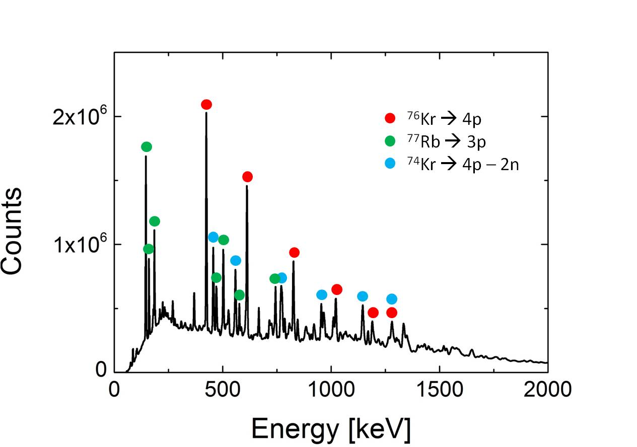
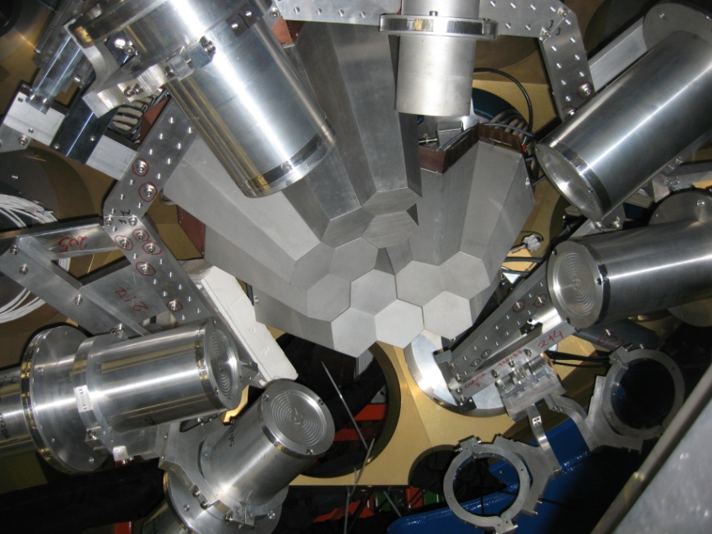
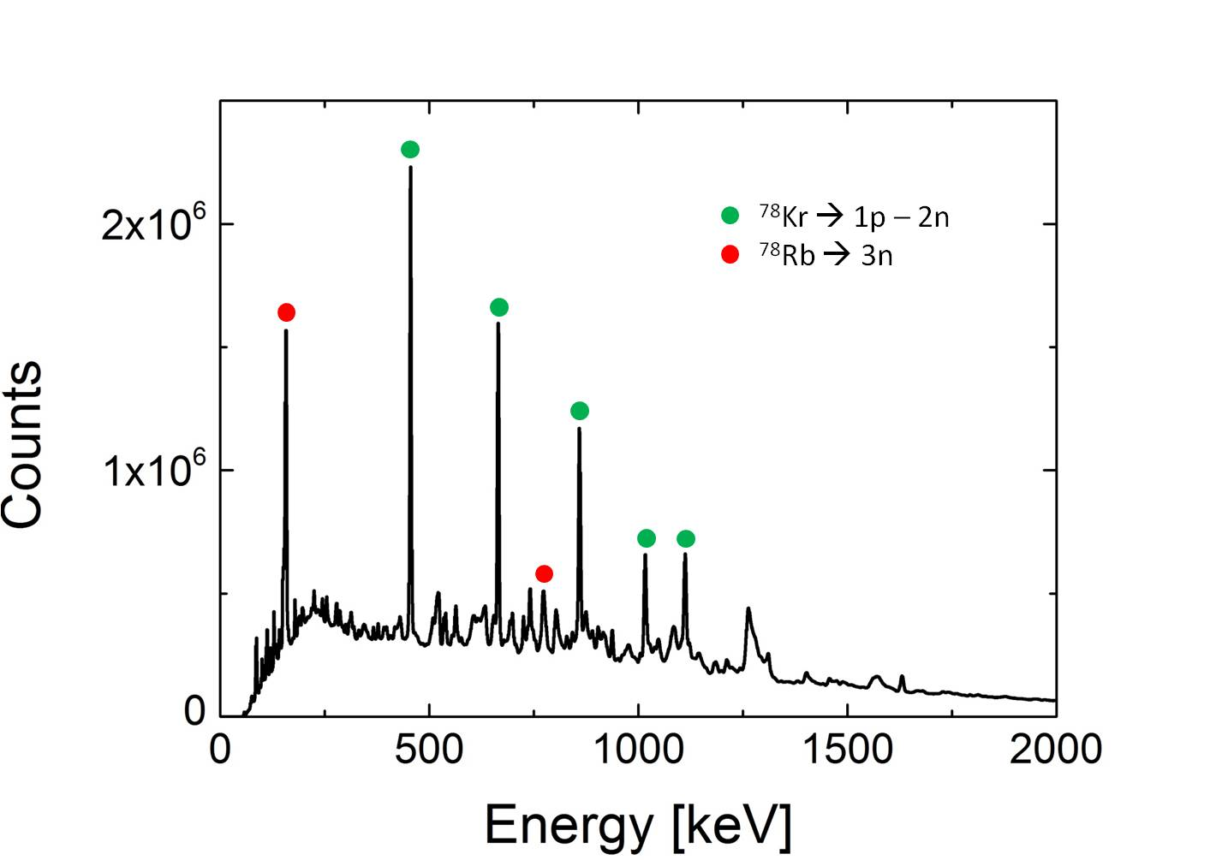
Measurements and Analisys
AGATA – HECTOR⁺ array @ LNL
With AGATA we measure the evaporation residues to tune statistical model
4 AGATA Clusters (12 capsules)
6 LaBr₃:Ce (3.5” x 8”)
1 LaBr₃:Ce (3 x 3”)
Notes:
For this measurement we used two detectors: agata setector, which is an array of segmented hpge and the other one is HECTOR plus, wich is an array of labr detector with big dimension. AGATA permits to have a good identification of nuclei populatated in the CN cascade decay.

Slide 12
Measurements and Analisys
AGATA – HECTOR⁺ array @ LNL
With HECTOR+ we have a good time selection to reject eliminate neutron contribution and background
Time resolution ≈ 1.8 ns
Good efficiency for high energy gamma rays
4 AGATA Clusters (12 capsules)
6 LaBr₃:Ce (3.5” x 8”)
1 LaBr₃:Ce (3 x 3”)
neutrons
In 40Ca+40Ca reaction we don’t have neutron emission
Notes:
While labr detectors have a good time resolution and so the permit a good time selection of event, in order to eliminate neutron bakground and casual coincidence

Slide 13
Measurements and Analisys
Preliminary fit results→⁸¹Rb
Fit procedure:
E_{GDR} fixed to 16.2 MeV→ from teory it’s expected not to change with excitation energy
χ² test to determiate the best Γ→ from teory it’s expected to change with energy
PRELIMINARY
PRELIMINARY
E_{GDR} = 16.2 MeV
Γ_{GDR}≈ 7 ± 0.4MeV

Slide 14
Measurements and Analisys
Preliminary fit results→⁸⁰Zr
Fit procedure:
E_{GDR} fixed to 16.2 MeV.
Γ fixed to 7 MeV
χ² test to determinate the best Γ↓
  Preliminary fit result→Γ↓=12±3 keV
PRELIMINARY
PRELIMINARY

Slide 15
Conclusions and Perspectives
Conclusions:
We studied Isospin mixing at T > 0 with GDR γ-decay
  two dataset are available T=2.2 and 3 MeV on ⁸⁰Zr
Using theoretical help it is possible to extract the T=0 mixing from
measured mixing at T>0
Preliminary analisys shows for the two dataset:
  Same centroid and consistent GDR width
  the same value of Coulomb spreading width (Γ↓) within error bar
Future:
a 3D fit procedure in order to have a good evaluation of parameters
compare the theoretical model with experimental α² data
Extract an experimental value of isospin mixing at T=0 in ⁸⁰Zr

Slide 16
Thank you for your attention

Slide 17
Isospin mixing
A. Corsi

Slide 18
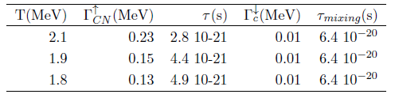

Isospin mixing ⁸⁰Zr

Slide 19
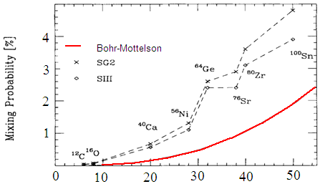
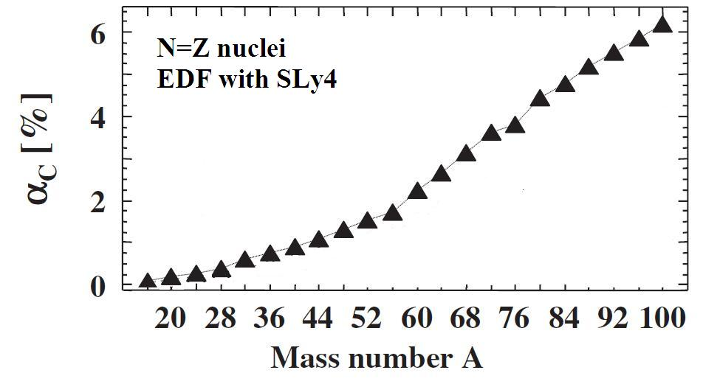
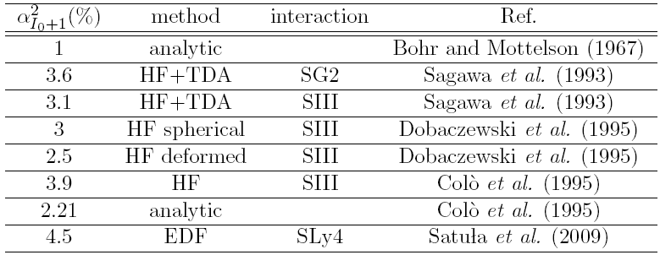
Isospin mixing ⁸⁰Zr
Hamamoto & Sagawa, PRC 48, R960 (1993)
Satula et al., PRL 103, 012502 (2009)
Atomic Number Z

Slide 20
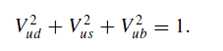
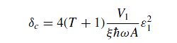
Coulomb corrections to superallowed β decay in nuclei and the
Cabibbo-Kobayashi-Maskawa (CKM) matrix
In the standard model (SM) this matrix satisfies the unitarity condition, that is, the sum of the squares of the matrix elements in each row(column) is equal to one, departures from 1 may indicate physics not described by the SM.
Nuclear structure determine the corrections one has to introduce in the evaluation of the β-decay matrix elements for superallowed transitions in T = 1, Tz = +1 (or Tz = −1) nuclei. Using the measured f t values one can relate these to the u-quark to d-quark transition matrix element Vud
V_{ud} ⇒ (1-δ_{c} ² ) ⇒ ε²
(1-δ_{c} ² ) ⇒ is isospin symmetry breaking term
ε² ⇒ is the isospin admixture of the T + 1 state into the T,Tz = T ground state
N. Auerbach PHYSICAL REVIEW C 79, 035502 (2009)

Slide 21
Analisys
Evaluation of spin sensibility with transitions intensity
Statistical simulation (CASCADE MONTECARLO code)
Experimental region
Experimental calculation for two different folds
RESIDUES | AGATA1LABR1 | AGATA2LABR2
4p | 49% | 35%
α2p | 21% | 20%
3p | 23% | 38%

Slide 22
Analisys
Identification of the background at high energy (cosmic ray)
We observes a costant background at high energy (E>2 MeV) in LaBr spectra
Background is in time coincidence, hence with the temporal gate we can’t eliminate it
We observe that the energy gamma spectrum in coincidence with gammas, wich have an energy between 10-20 MeV
This spectrum can be a good estimate of the background, because in the CN decay the probability to have 2 gammas at this energy is small, hence the gammas source isn’t the CN but probably ownig by cosmic rays
The background is basically the same for both reactions
The background contribution is basically costant

Slide 23
Analisys
Preliminary fit results→⁸¹Rb
This experiment:
Egdr fixed to 16.2 MeV
Width GDR≈ 7 MeV
<J>≈20 h
T≈2.2 MeV for both reactions
Previous experiment:
Egdr fixed to 16.2 MeV
Width GDR≈ 10 MeV
<J>≈40 h
At fixed T, Γ_{GDR} increases with angular momentum owing the different shape deformation of CN.
In letterature we have found the same Width_{GDR} value for a similar nucleus (⁷⁶Kr) at the same exitacion enegy and mean spin value (Schiller, Nucl. Phys. A 788, 231c (2007)).

Slide 24
Analisys
Preliminary fit results→⁸¹Rb
Fit procedure:
E_{GDR} fixed to 16.2 MeV→ from teory it’s expected not to change with exitation energy
χ² test to determiate the best Γ→ from teory it’s expected to change with energy
Well defined minimum
E_{GDR} = 16.2 MeV
Width_{GDR}≈ 7 ± 0.4MeV

Slide 25
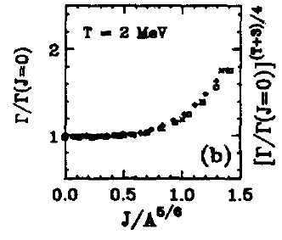
Comparison between two measurements
In Ca+Cl reaction (T≈2.3 MeV):
Second m first measurement <J> = 45 h
easurement <J> = 15 h
Γ increases with angular momentum owing the major deformation
Second reaction, J EFFECT
Second reaction, NO J EFFECT
Kusnezov, Nuclear Physics A649 (1999) 193c-196c

Slide 26
First measurement
The set of parameters giving the best fit has been determined with X² test:
Fit of GDR parameters on ⁸¹Rb γ-ray spectrum using Γ↓=0
  S=90%, E_{GDR}=16.2 MeV, WIDTH (Γ)=10.6 MeV
2) Using GDR parameters of 1), fit of Γ↓ on ⁸⁰Zr spectrum
  Γ↓=10±3 keV
10 keV
A.Corsi et al. PRC 84, 041304(R) (2011)
A.Corsi et al. PRC 84, 041304(R) (2011)
³⁷Cl + ⁴⁴Ca ⇒ ⁸¹Rb*
E* = 83 MeV
⁴⁰Ca + ⁴⁰Ca ⇒ ⁸⁰Zr*
E* = 83 MeV

Slide 27
Experimental technique
Experimental details:
Proj. | target | CN | E_{beam}(MeV) | E*(MeV) | I | setup
⁴⁰Ca | ⁴⁰Ca | ⁸⁰Zr | 200 | 83 | 0 → isospin mixing | HECTOR + GARFIELD
³⁷Cl | ⁴⁴Ca | ⁸¹Rb | 153 | 83 | 7/2 → reference
⁴⁰Ca+⁴⁰Ca → ⁸⁰Zr* I = 0
0 → 0 forbidden
0 → 1 allowed but ρ(I=1)<ρ (I=0)
1 → 0 via isospin mixing
³⁷Cl+⁴⁴Ca → ⁸¹Rb I = 7/2
7/2 → 7/2, 9/2 allowed
Test reaction
Notes:
Dividere le slides

