Slide 1
Asymmetry Dependence of the Nuclear Caloric Curve
Nuclear Caloric Curve: Background & Motivation
The Measurement: Reconstructing Highly Excited Nuclei & Extracting Their Temperatures
Result: Temperature Decreases Linearly with Increasing Asymmetry
A.B. McIntosh, A. Bonasera, Z. Kohley, S. Galanopoulos, K. Hagel, L.W. May,
P. Marini, D.V. Shetty, W.B. Smith, S.N. Soisson, G.A. Souliotis, B.C. Stein,
R. Tripathi, S. Wuenschel, S.J. Yennello
Department of Energy & Robert A Welch Foundation
Notes:
Session G11, 8:30am, Sunday, April 1 (G11.00007 9:42am-9:54am)

Slide 2

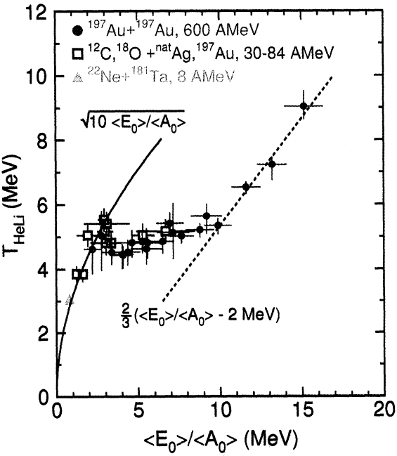
Nuclear Caloric Curve
Essential Piece of Nuclear Equation of State: T vs E*/A
Search for & Study of Phase Transition
  Liquid to Vapor
  Evaporation to Multifragmentation
Pochodzalla et al. PRL 75, 1040 (1995)

Slide 3


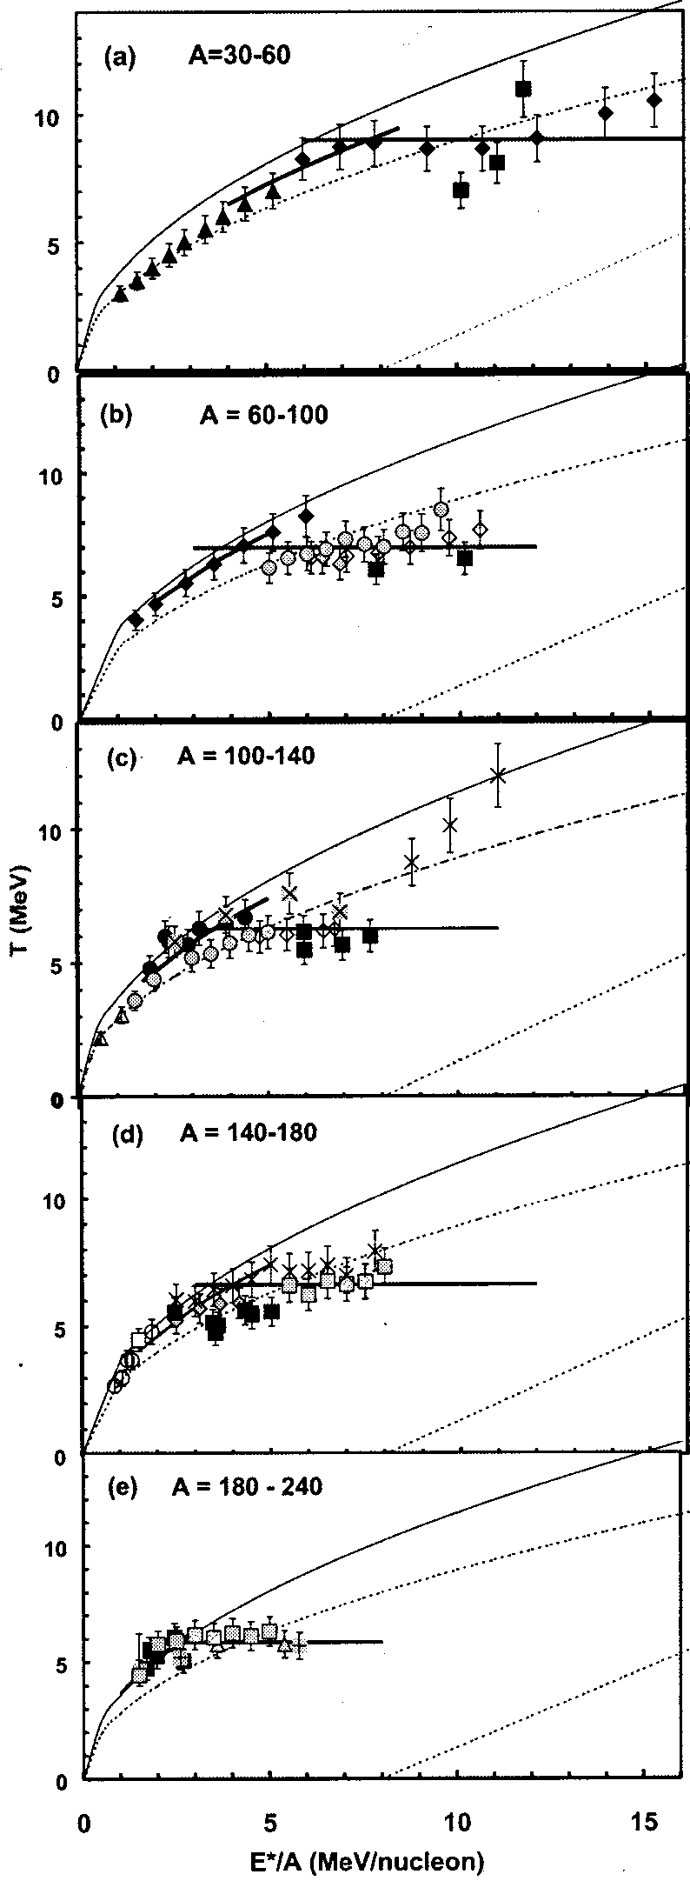
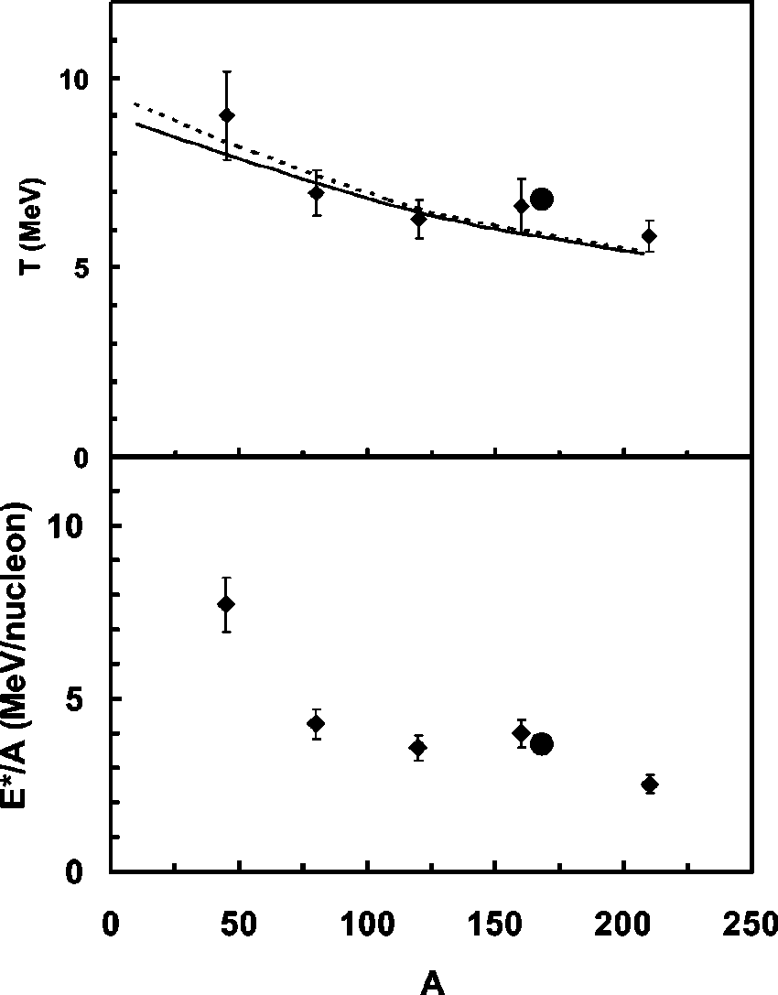
Nuclear Caloric Curve: Mass Dependence
T_{lim} (MeV)
T (MeV)
E*/A (MeV)
A
With increasing mass:
Limiting temperature decreases
Onset of Tlim moves to lower Excitation energy
E*/A (MeV)
Natowitz et al., PRC 65, 034618 (2002)
Notes:
Spend some more time.
Talk about both figures.
Plateau may represent the Coulomb instability temperature, which would be expected to decrease with increasing Z (and thus increasing A).

Slide 4
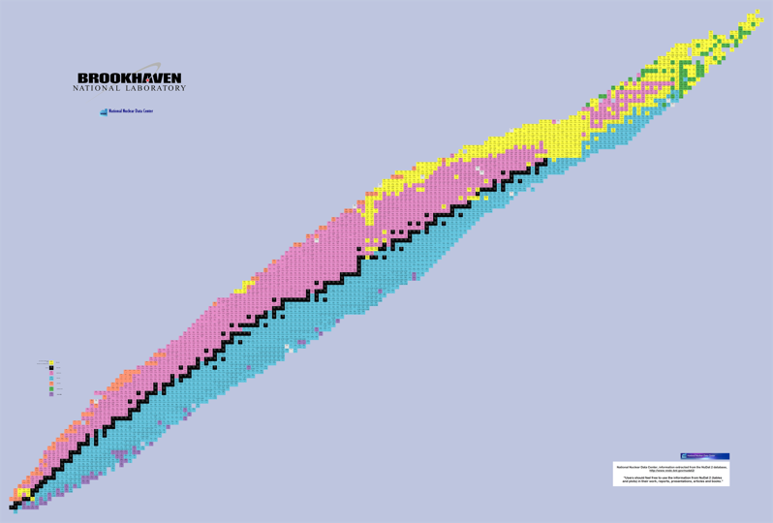
Caloric Curve: Asymmetry Dependence?
asymmetry
dependence
Mass Dependence of the caloric curve is measured.
Asymmetry Dependence:
Does it exist?
Which way does it go?
How strong is it?
mass
dependence
http://en.wikipedia.org/wiki/File:NuclideMap_stitched_small_preview.png

Slide 5
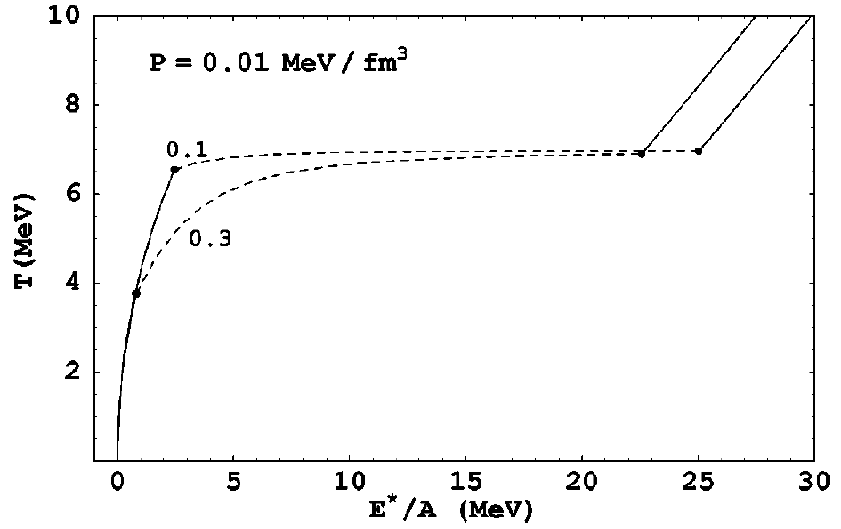
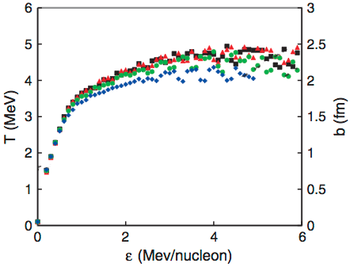
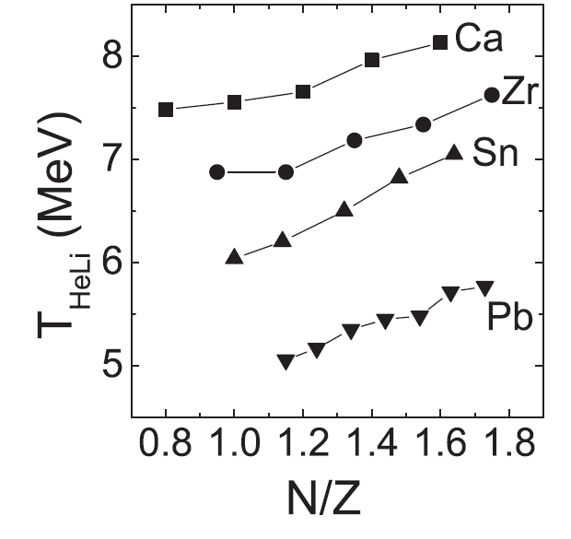
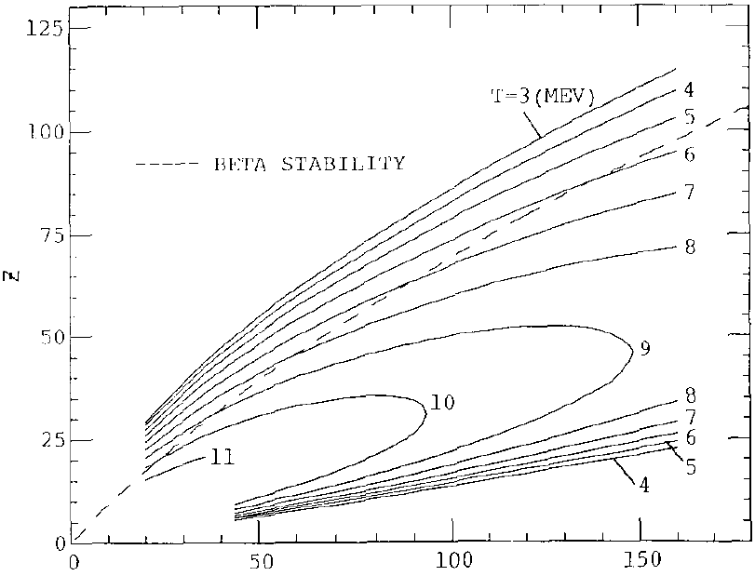
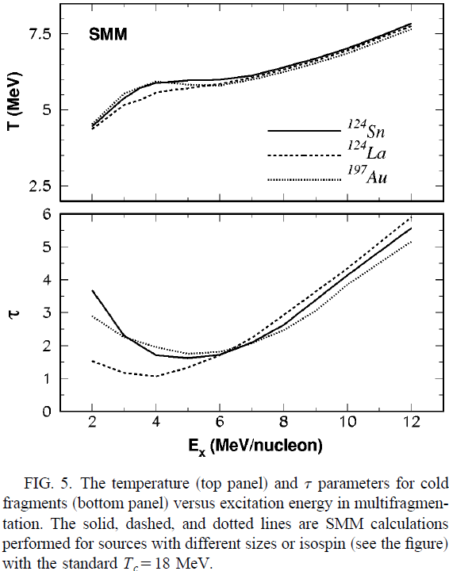
Caloric Curve: Asymmetry Dependence?
Theory
Different models make very different predictions about how the caloric curve depends on neutron-proton asymmetry
n-Poor
n-Poor
n-Rich
n-Rich
Thermal Thomas-Fermi Model
Kolomietz et al,
Phys. Rev. C 64, 024315 (2001)
Mononuclear Model
Hoel, Sobotka & Charity,
PRC 75, 017601 (2007)
n-Rich
n-Poor
n-Poor
n-Rich
n-Poor
n-Rich
Isospin-Dependent
Quantum Molecular Dynamics
Su & Zhang, Phys. Rev. C 84, 037601 (2011)
Hot Liquid Drop Model
Besprosvany & Levit
Phys. Lett B 217, 1 (1989)
Statistical Multifragmentation Model
Ogul & Botvina, Phys. Rev. C 66, 051601 (2002)
Notes:
lines on mononuclear plot are “surface widths”: the scale is chopped off on the right side.

Slide 6
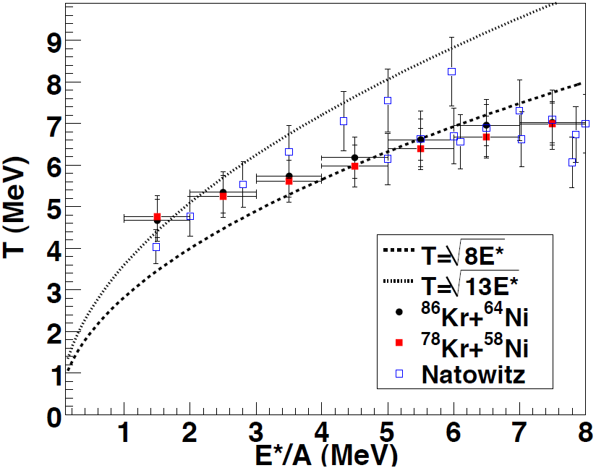
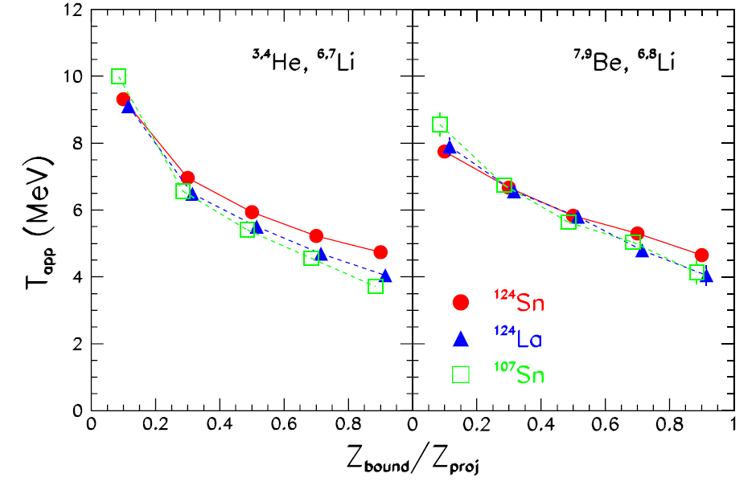
Caloric Curve: Asymmetry Dependence?
Experiment
System
E = 600A MeV
E = 35A MeV
Sfienti et al., PRL 102, 152701 (2009)
S. Wuenschel, Ph.D. Thesis, 2009
Slight offset of neutron-rich system, but not statistically significant
Possible dependence on asymmetry, but not for all impact parameters.
Non-observation:
Selection was on system composition.
Should use reconstructed-source composition.
Notes:
Slight systematic shift between the two systems,
but within experimental uncertainty.
No clear dependence for ALADIN data,
Mixed message for Be/Li.

Slide 7
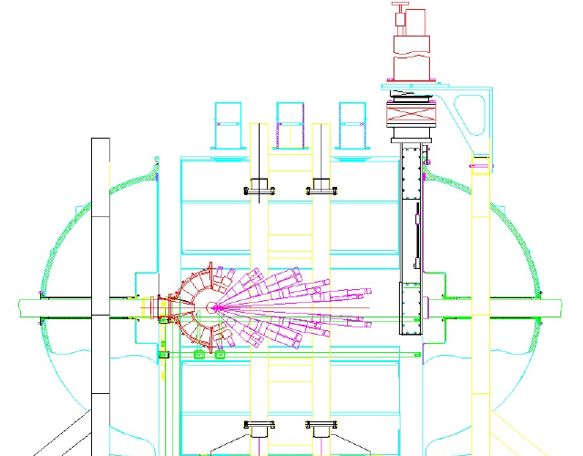
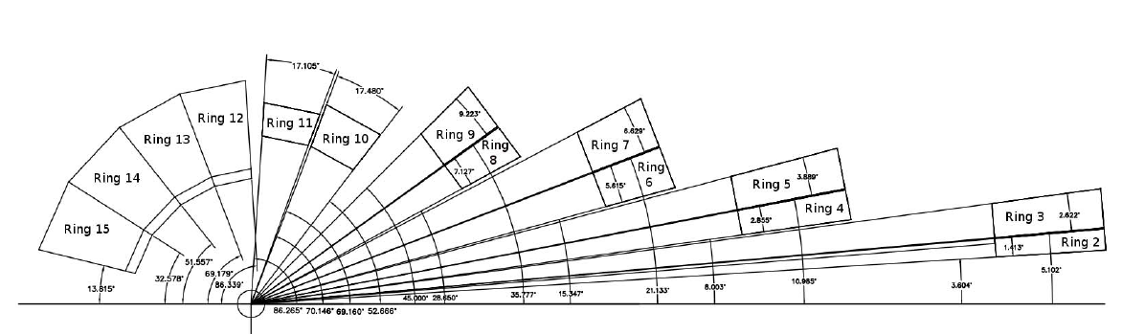
⁷⁰Zn + ⁷⁰Zn
⁶⁴Zn + ⁶⁴Zn
⁶⁴Ni + ⁶⁴Ni
E = 35A MeV
NIMROD-ISiS Array
Full Silicon Coverage (4π)
Isotopic Resolution to Z=17
Elemental Resolution to Z_{projectile}
Neutron Ball (4π)

Slide 8
Reconstructed QP
1
2
3
4
Target &
Projectile
Quasi-Target &
Quasi-Projectile
Non-Central
Collision
De-excitation via particle decay
Excited!
Expanded!
Density Gradients!

Slide 9
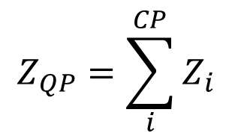
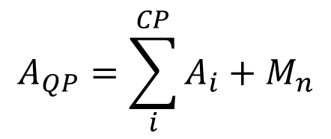
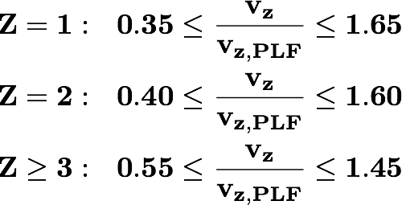
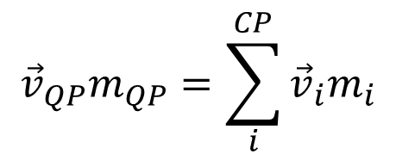
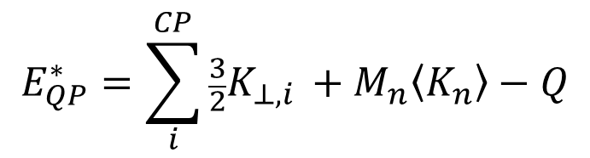

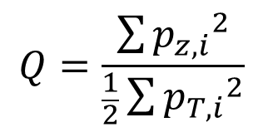

Event Selection & QP definition
Remove particles that clearly do not belong (on average) to a statistically emitting projectile-like source
Identity
Reference Frame
Select events with a well-measured QP:
Excitation
Strength of the Measurement
Excellent isotopic resolution
4π charged particle detection
Neutron multiplicity measurement
Excellent energy resolution
→ Well defined quasi-projectile source
Select events with near-zero average momentum quadrupole.
$$−0.3≤\log{Q}≤0.3$$
S. Wuenschel et al., PRC79, 061602 (2009)
J.C. Steckmeyer et al., NPA686, 537 (2001)

Slide 10

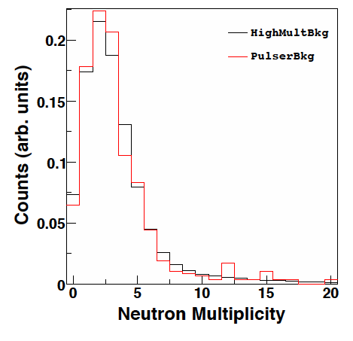
Free Neutrons
Used HIPSE-SIMONE[1] to link M_{exp} to M_{QP}
Mult_{exp} = neutrons in experimental signal gate
Mult_{bkg} = neutrons in experimental background gate
Eff_{QP} = fraction of QP source neutrons detected
Eff_{QT} = fraction of QT source neutrons detected
Simulation/Experimental Correction Factor
1- D. Lacroix et al. PRC 69, 054604 (2004)
Notes:
HIPSE-SIMONE and Filter to estimate efficiency for QP vs QT neutrons
Effqp=.65
Effqt=.40

Slide 11
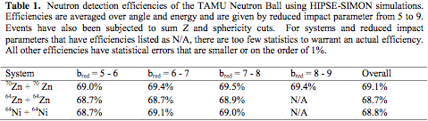
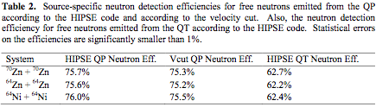
Neutron ball efficiency
A. Zarella, NN2012 proceedings

Slide 12
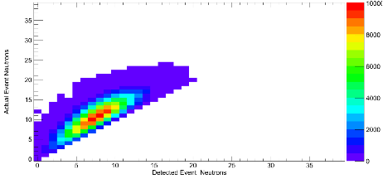

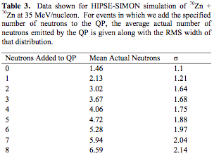
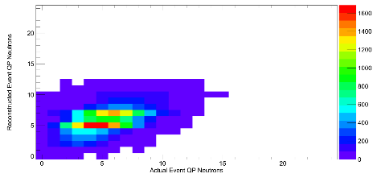

Slide 13


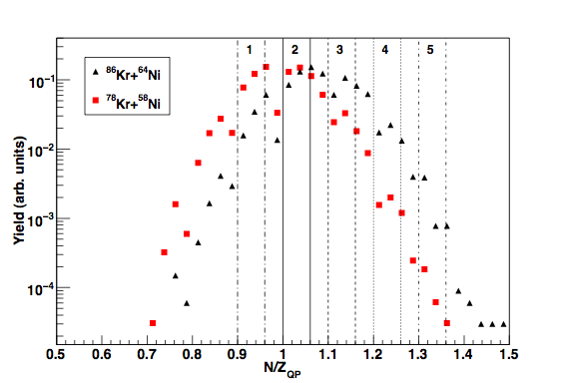
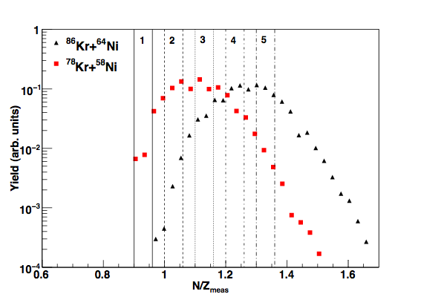
Source N/Z
Bound
Measured
 | ⁸⁶Kr+⁶⁴Ni Bound | ⁷⁸Kr+⁵⁸Ni Bound | ⁸⁶Kr+⁶⁴Ni Measured | ⁷⁸Kr+⁵⁸Ni Measured
Mean | 1.07 | 0.99 | 1.26 | 1.12
Sigma | 0.080 | 0.076 | 0.093 | 0.086
Notes:
Bound N/Z - only includes neutrons bound in charged particles
Width is large as compared to diff in mean
Neutrons part of particle identity?
Measured N/Z - includes bound and free neutrons
Shift and separate
Larger difference in mean, still large width
Bins: Contend that diffusion of N,P during interaction produces a range of source N/Z, can define the source N/Z into bins to study observables with more precise knowledge of source composition

Slide 14



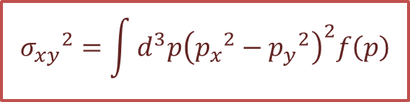
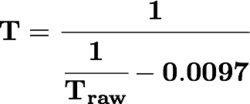

Nuclear Thermometers
Momentum Quadrupole
Fluctuation Temperature
Albergo Yield Ratio Temperature
The quadrupole momentum distribution
Account for binding energy differences
and spin-degeneracies
Contains information on the temperature through its fluctuations
~3% correction
for secondary decay
If f(p) is a Maxwell-Boltzmann distribution
H. Zheng & A. Bonasera, PLB 696, 178 (2011)
S. Albergo et al., Il Nuovo Cimento 89, 1 (1985)

Slide 15
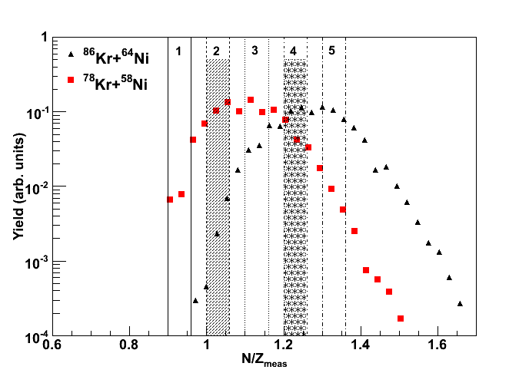
S. Wuenschel, Phys Rev C 79, 061602(R) (2009).

Slide 16
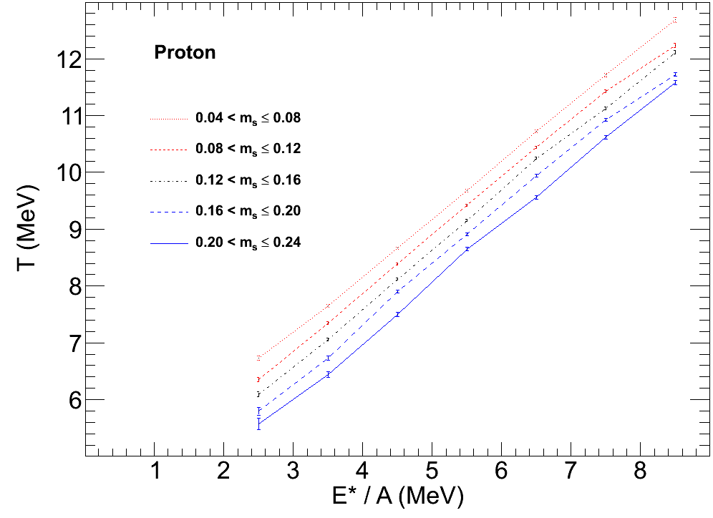

MQF (protons) Temperature
48 ≤ A_{QP} ≤ 52
5 narrow asymmetry bins
Neutron-poor
Larger Asymmetry
Lower Temperature
> 1 MeV shift!
Evenly Spaced
Neutron-rich

Slide 17
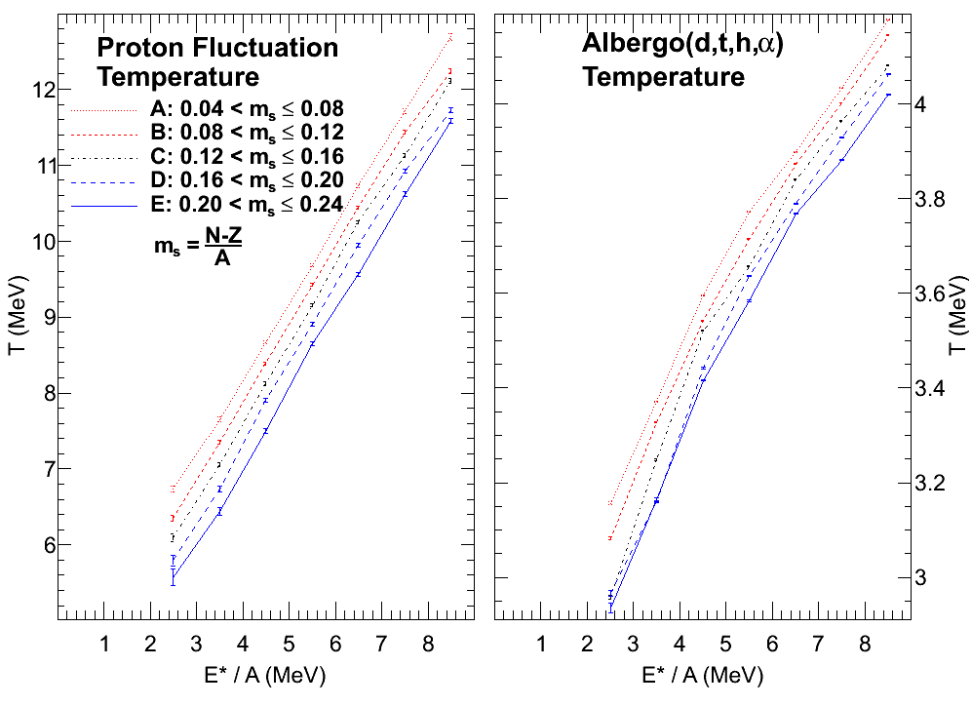
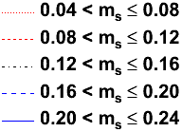
MQF & Albergo Temperatures
48 ≤ A_{QP} ≤ 52
5 narrow asymmetry bins
Fluctuation
Albergo
Both Thermometers:
Larger Asymmetry
Lower Temperature
Evenly Spaced

Slide 18
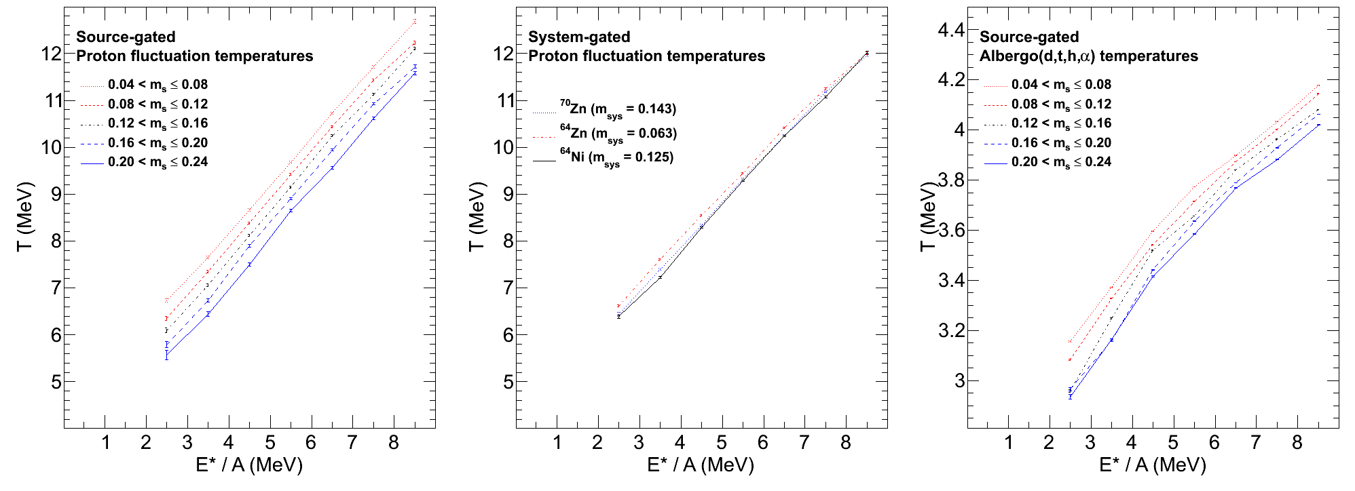
Importance of Reconstruction
Asymmetry of Isotopically
Reconstructed Source
Asymmetry of
Initial System
Each system:
Broad range of asymmetry
Larger Asymmetry
Lower Temperature
Observed either way, but…
Much more pronounced
for selection on
source composition

Slide 19
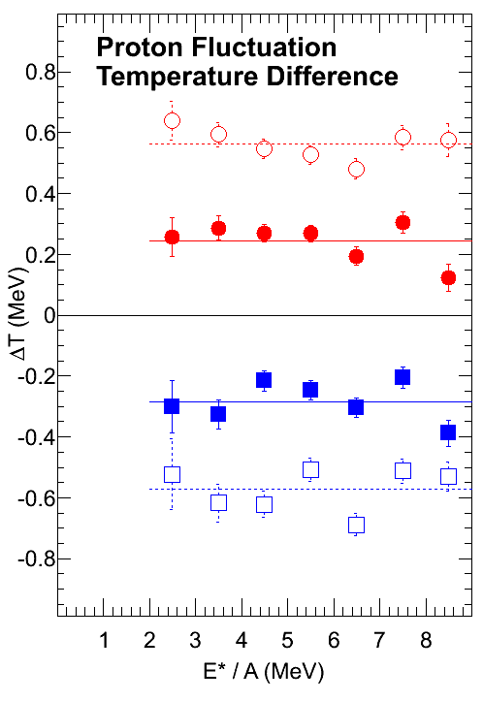
Excitation Independence
averages
Larger Asymmetry
Lower Temperature
Temperature shift does
not show a trend
with excitation.
4 of 10 pairwise
differences shown

Slide 20
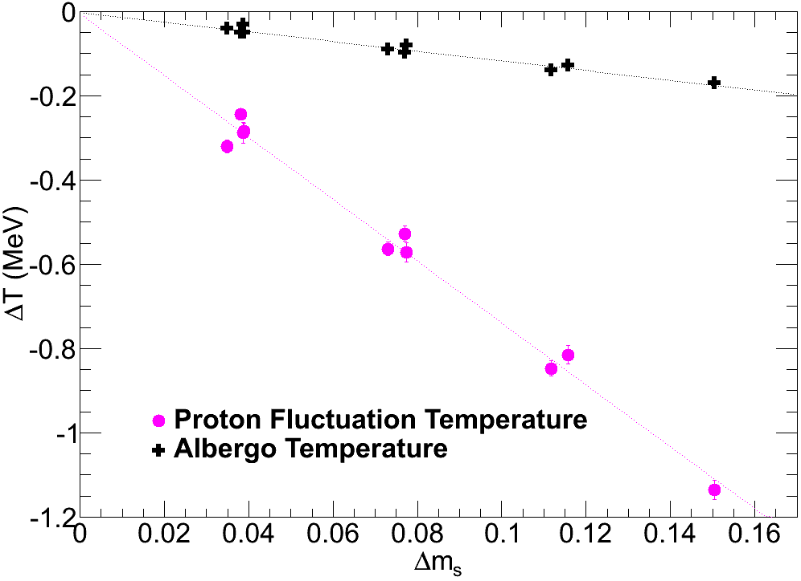
Asymmetry Dependence of Temperature
Slope = -1.15MeV
T_Albergo:
→ ∆T = -0.2MeV
Slope = -7.34MeV
T_Fluctuation:
→ ∆T = -1.2MeV

Slide 21
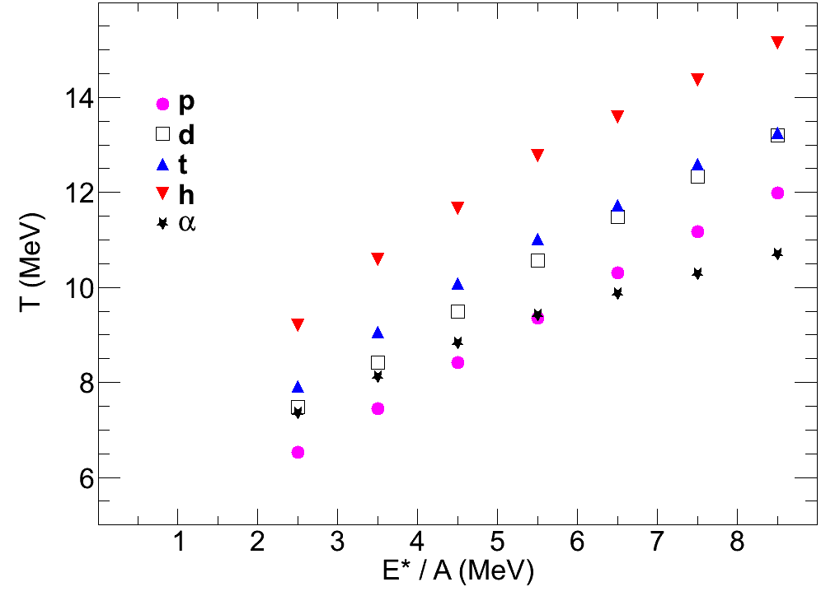
Caloric Curves for Light Charged Particles
Tα, Tp < Td < Tt < Th
Q-value for emission:
~10MeV for proton, alpha
~15MeV for deuteron
~20MeV for triton, helion
Ordering of Temperatures
Expensive Particles:
Early times
∴Highest temperature
Different particles may also probe regions with different average density.
Emission Order:
S. Hudan et al., arXiv 0308031 (2003)
L. Chen et al., Nucl. Phys. A 729, 809 (2003)
R. Ghetti et al., Nucl. Phys. A 765, 307 (2006)
Z. Kohley et al., Phys. Rev. C 86, 044605(2012)
Notes:
why are alphas lower than protons at hight E*/A?
may be something to do with the importance of clusterization for these type of events.

Slide 22
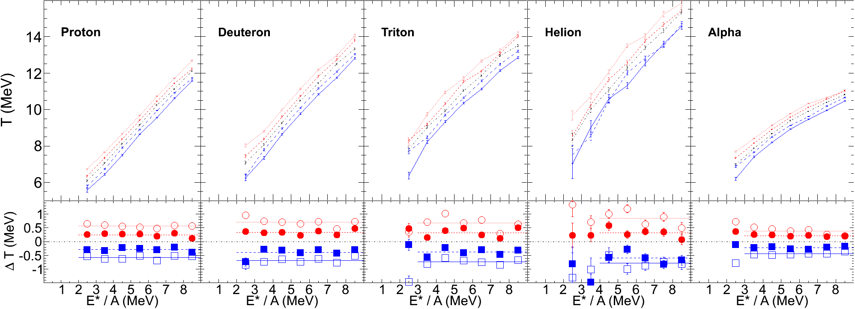
Caloric Curves for LCPs:
Dependence on Composition
For All LCPs:
Larger Asymmetry
Lower Temperature
Temperature shift does
not show a trend
with excitation.

Slide 23
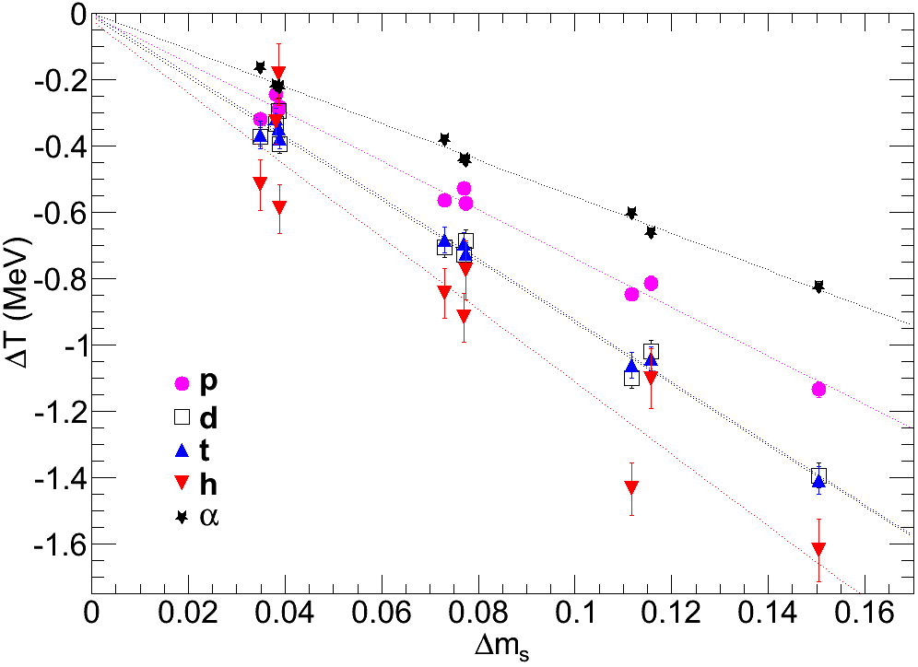
Asymmetry Dependence of Temperature
∆T / ∆m_{s}
α: -5.5
p: -7.3
d: -9.2
t: -9.3
h: -10.9
Same ordering as for temperature:
Tα, Tp < Td < Tt < Th
Strength of correlation:
Source composition may evolve with time

Slide 24
Summary
Nuclear temperature depends on asymmetry
  (↑Neutron content) ➔ (↓Temperature)
  Linear correlation
  Seen for 2 thermometers
  Seen for all light charged particles
Source composition matters, not initial system
  Intermediate energy
Excitation: no influence on asymmetry dependence ( 2.5 < E*/A < 8.5 MeV )
Temperature ordering of LCPs
  Consistent with emission time ordering
  Impact of local density?

