Slide 1
The 2012 Atomic Mass Evaluation and the Mass Tables
INPC2013, June 6, 2013, Florence
WANG Meng
On behalf of AME collaboration
IMP,China; CSNSM,France; MPIK,Germany

Slide 2
Outline
Introduction
experimental data, example
Present status
publication of AME2012
Some considerations about future
workload, correlation … …

Slide 3
Introduction
Atomic mass
Nuclear mass
Standard mass table required, as reference
Ame1961, Ame1964, Ame1971, Ame1977
Ame1983, Ame1993, Ame2003, Ame2012

Slide 4
How atomic masses measured?
Mass measurement:
inertial mass
energy
Relative
Measurements
Energy released from neutron capture of ³²S
³²S + n - ³³S = 8641.6398(33) keV
Mass ratio M[³³S⁺]/M[³²SH⁺]
³³S- (³²S + H) = -8437.29682(30) μu

Slide 5
Example
1970Bo29 7624.6(1.5)
2006Fi.A 7625.6(0.9)
2011Go23
1203.27(0.36)
¹⁰²Pd
¹⁰³Pd
1958Ro09 764(4)
1965Mu09 760(6)
1970Pe04 762(5)
1982Oh04 769(4)
1961Hi06 1150（6）
¹⁰²Rh
¹⁰³Rh
1961Hi06 2317(10)
1963Bo17 2325(10)
1986Be53 543.0(0.8)
¹⁰²Ru
¹⁰³Ru
1982Ba69 6232.2(0.3)
2006Fi.A 6232.00(0.17)

Slide 6
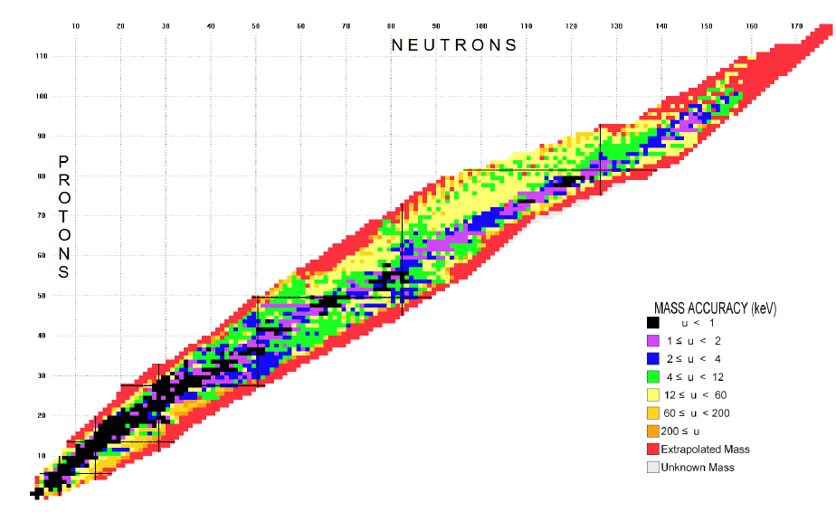
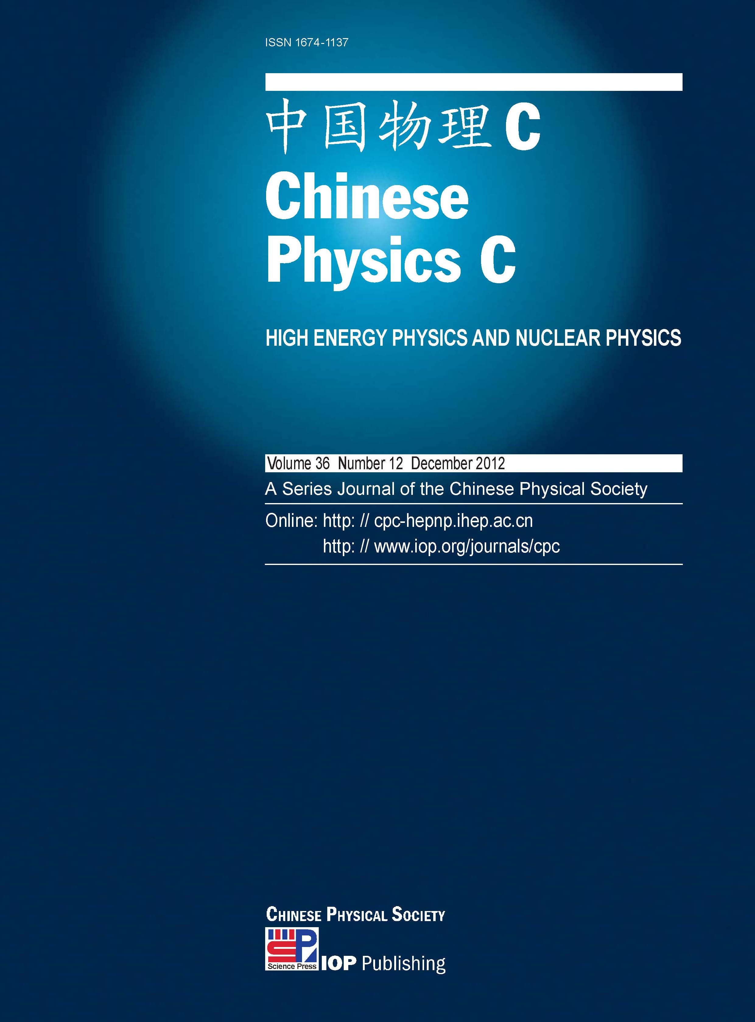
AME2012+NUBASE2012
AME2012+NUBASE2012 published
in the December issue of
Chinese Physics C.
3827 masses, including
2438 experimental masses for ground state

Slide 7
For reprints, write to me:
wangm@impcas.ac.cn
or
amdc.wang@gmail.com

Slide 8
Statistics
Input equations
masses

Slide 9
Amount of work: reference + equation

Slide 10
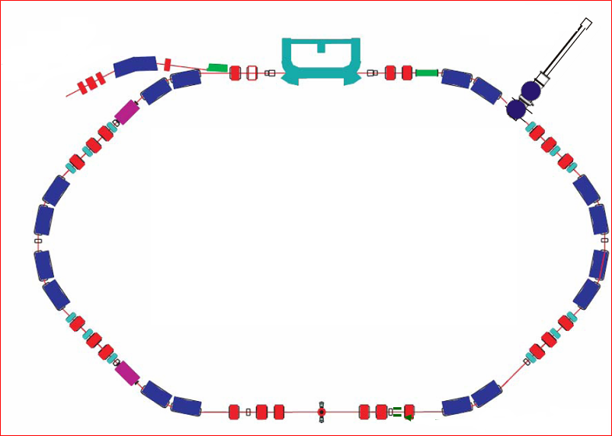
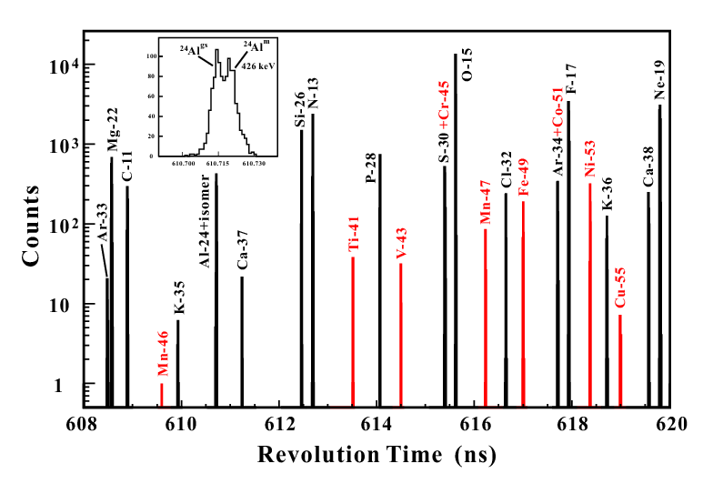
Correlation: mass measurement with a storage ring
ToF
Injection

Slide 11
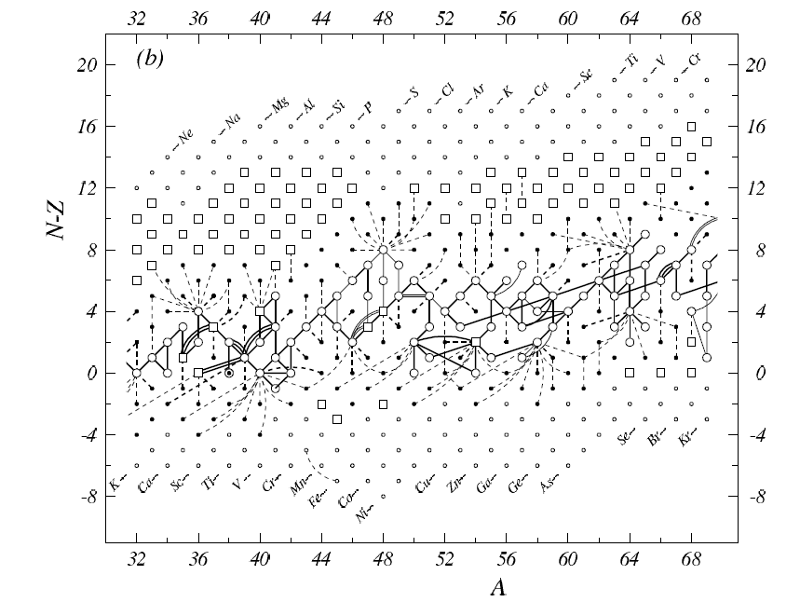

Slide 12
Collaboration
Author list of AME2012
G.Audi, M.Wang, A.H.Wapstra, F.G.Kondev, M.MacCormick, X.Xu, B.Pfeiffer
a.CSNSM-Orsay b.IMP-Lanzhou c.GSI-Darmstadt
d.ANL-Argonne e.MPIK-Heildelberg f.IPN-Orsay
Still working on
WANG Meng as new coordinator
Next Tables Foreseen 2015.

Slide 13
Thank you!
谢 谢！

Slide 14
Introduction: procedure
Read a paper
Private communication
Extract equation
Agree with
available data?
yes
Implant new data
no
Examine all relevant reference
Calculation
Accept new data?
yes
no
Mark new data with special labels

Slide 15
Amount of work: reference per year

