Slide 1
Mass Measurements of
Short-lived Nuclei at HIRFL-CSR
INPC2013, June 6, 2013, Florence
WANG Meng
Institute of Modern Physics, Chinese Academy of Sciences
Lanzhou, China

Slide 2
Outline
1.Motivation
2.Experiments at HIRFL-CSR
principle, facility, procedure, data analysis, …
3.Results and discussion
rp-process, IMME…

Slide 3
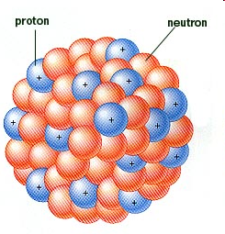
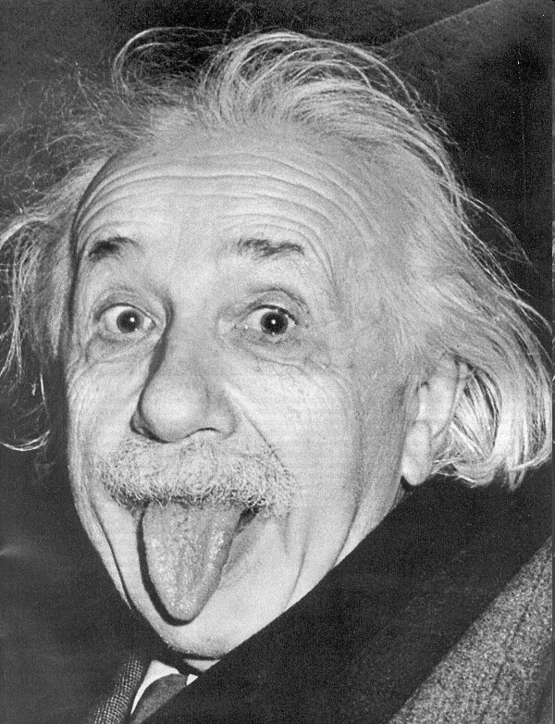
Nuclear mass
E = mc²
Nuclear physics
Atomic physics
Nuclear astrophysics
Atomic energy
Fundamental symmetries
Metrology
…..
Nuclear mass
Binding energy

Slide 4
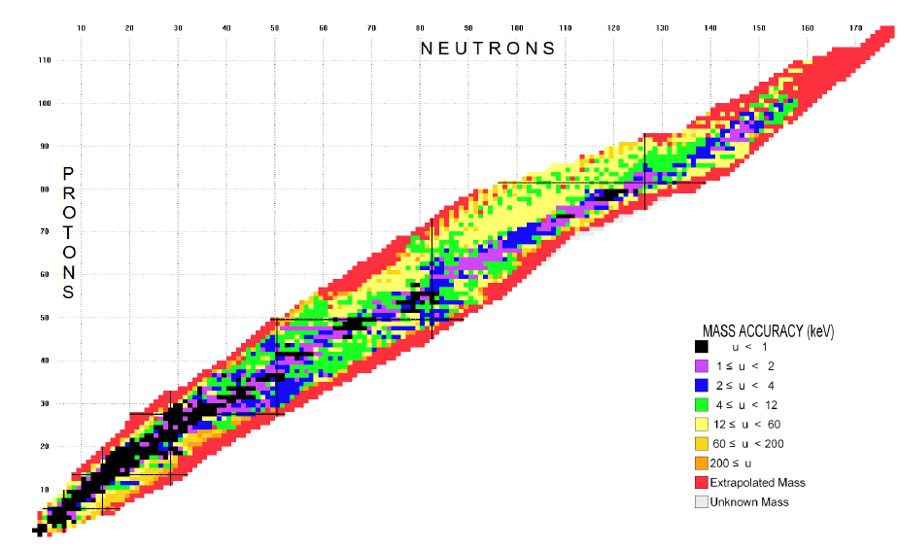
Nuclear mass

Slide 5
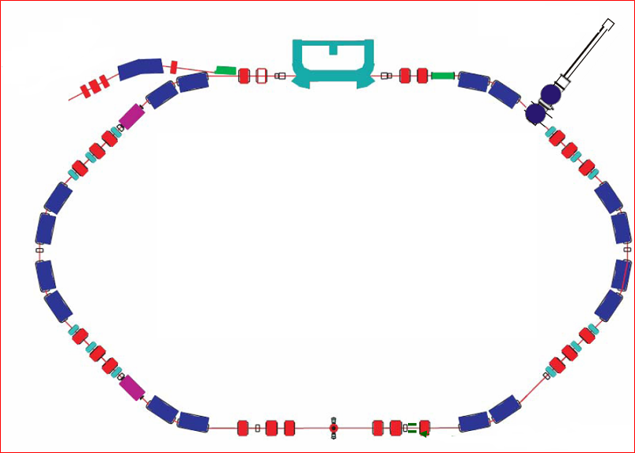
Experiment: Principle
ToF
Injection

Slide 6
Experiment: Principle
ToF
Injection
Isochronous Mass Spectrometry (IMS mode)

Slide 7
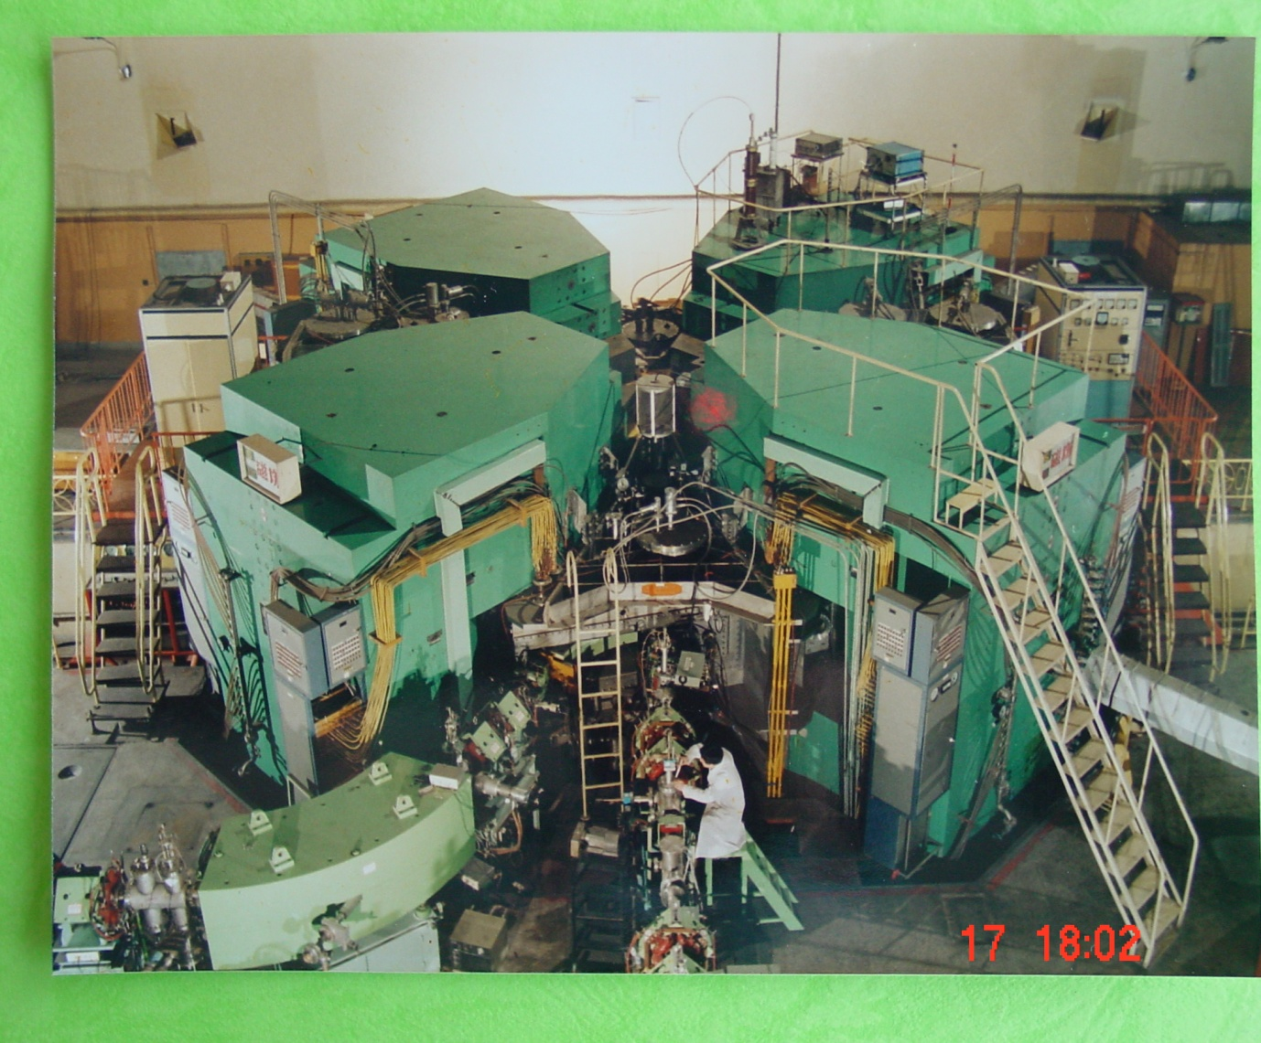
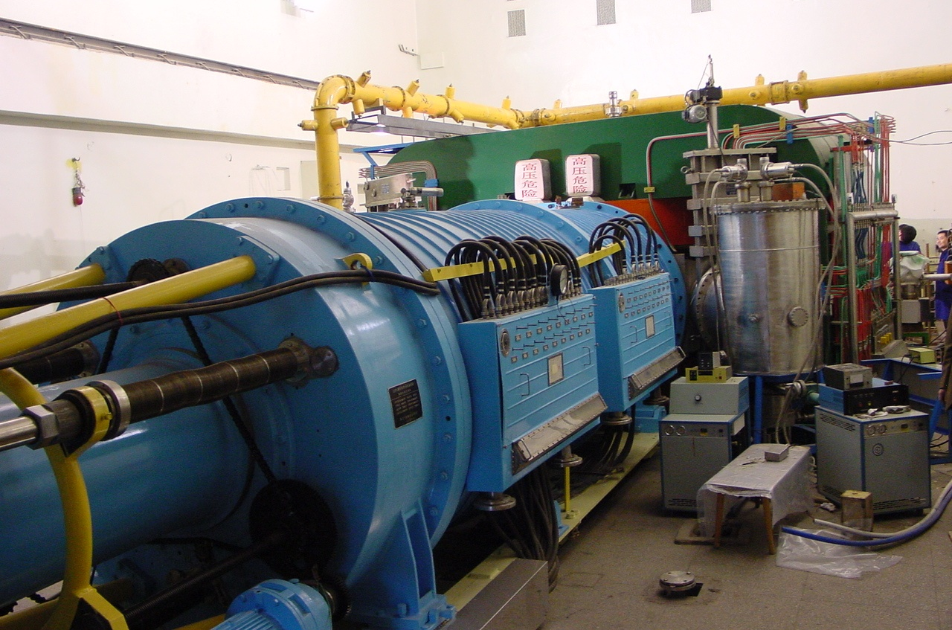
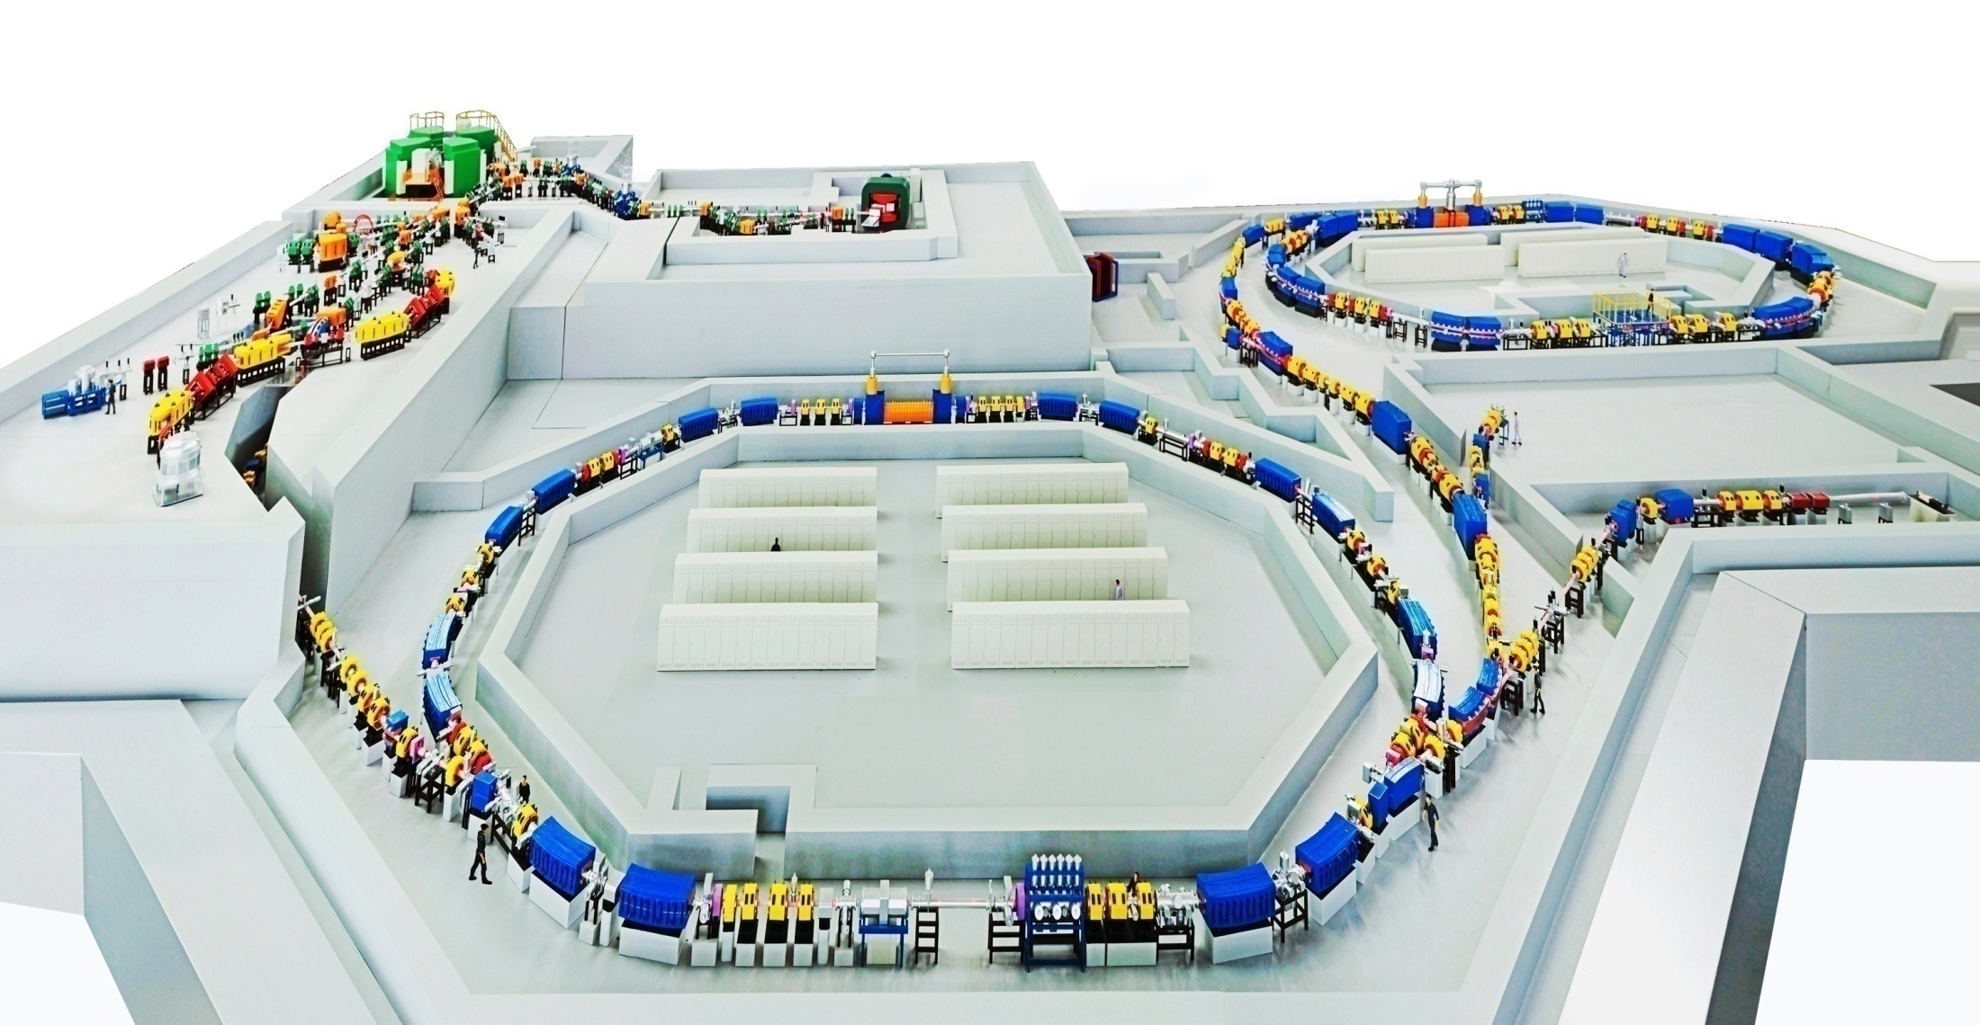
Introduction: facility
SSC(K=450)
100 AMeV (H.I.), 110 MeV (p)
SFC (K=69)
10 AMeV (H.I.), 17~35 MeV (p)
CSRe
RIBLL1
RIBs at tens of AMeV
RIBLL2
RIBs at hundreds of AMeV
CSRm
1000 AMeV (H.I.), ≤ 2.8 GeV (p)
HIRFL (Heavy Ion research facility in Lanzhou)

Slide 8

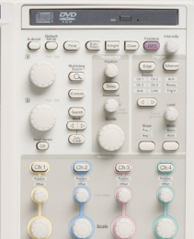

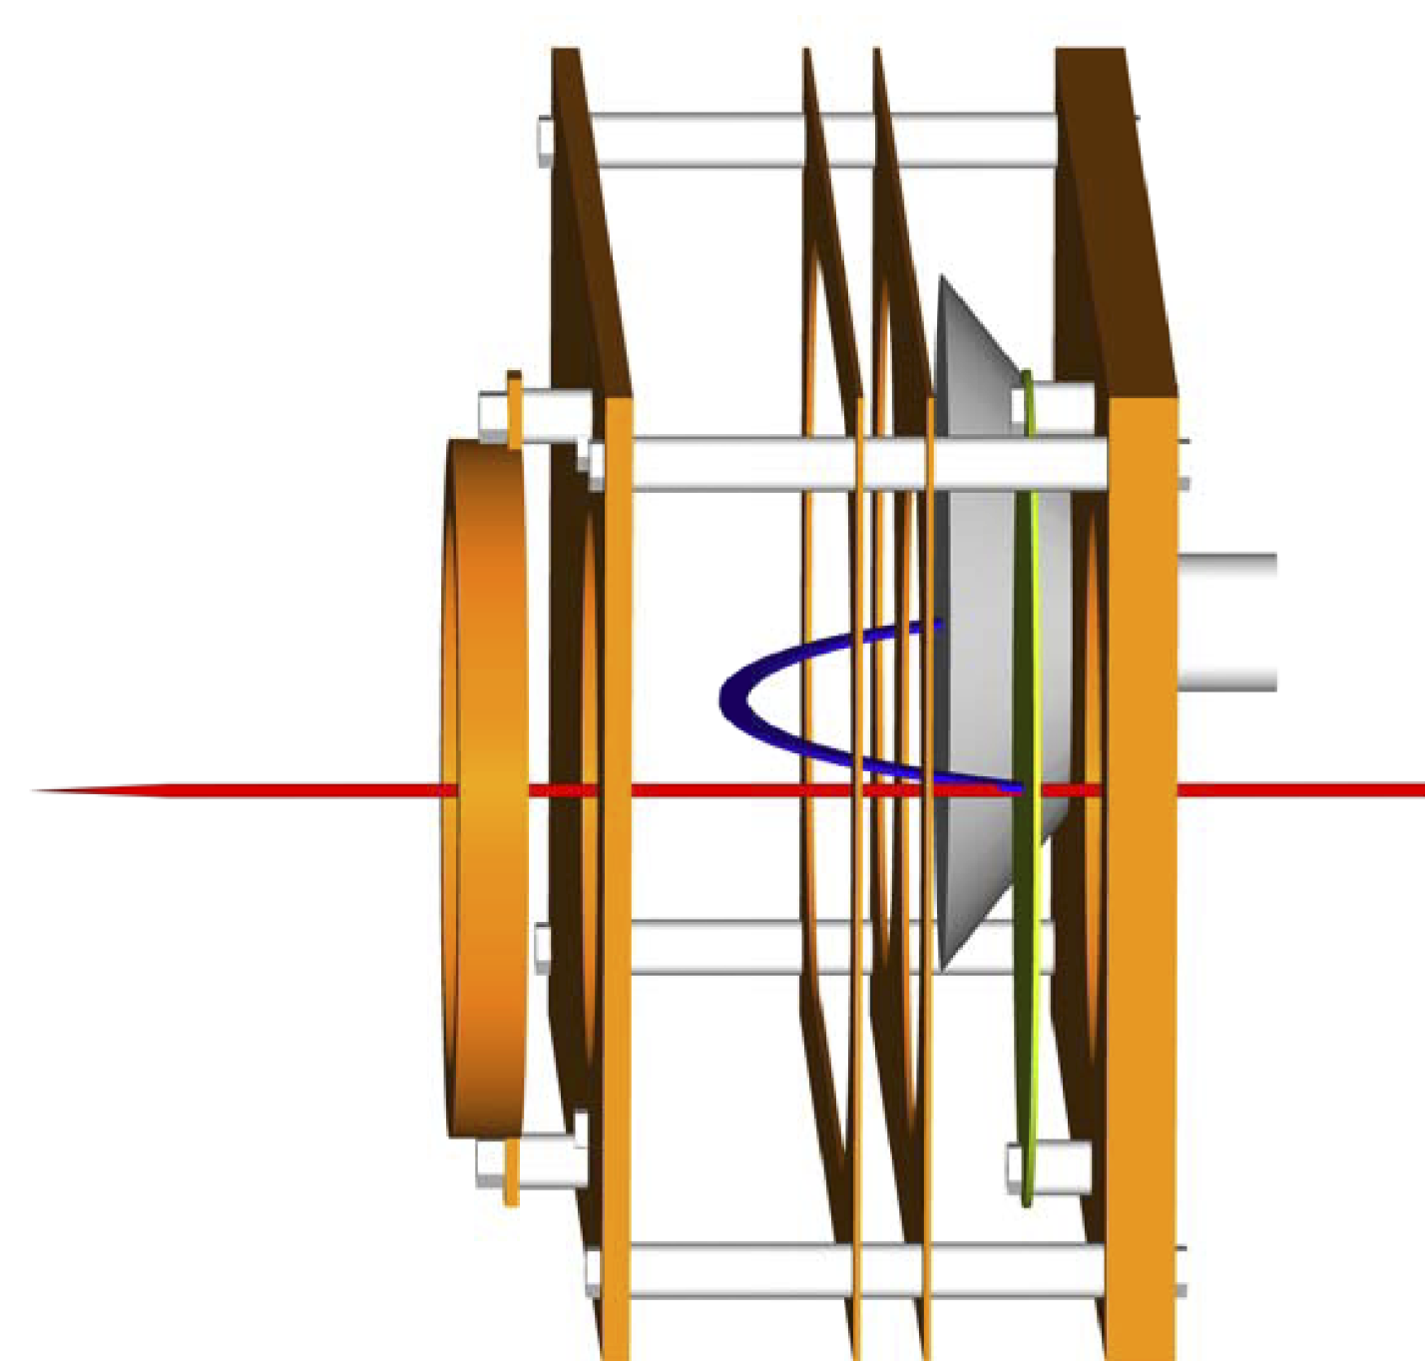
Experiment
DT
Detector

Slide 9
Procedure of Data analysis
Ions Identification
Signals in Oscilloscope
Simultion.
Exp.
P2

Slide 10
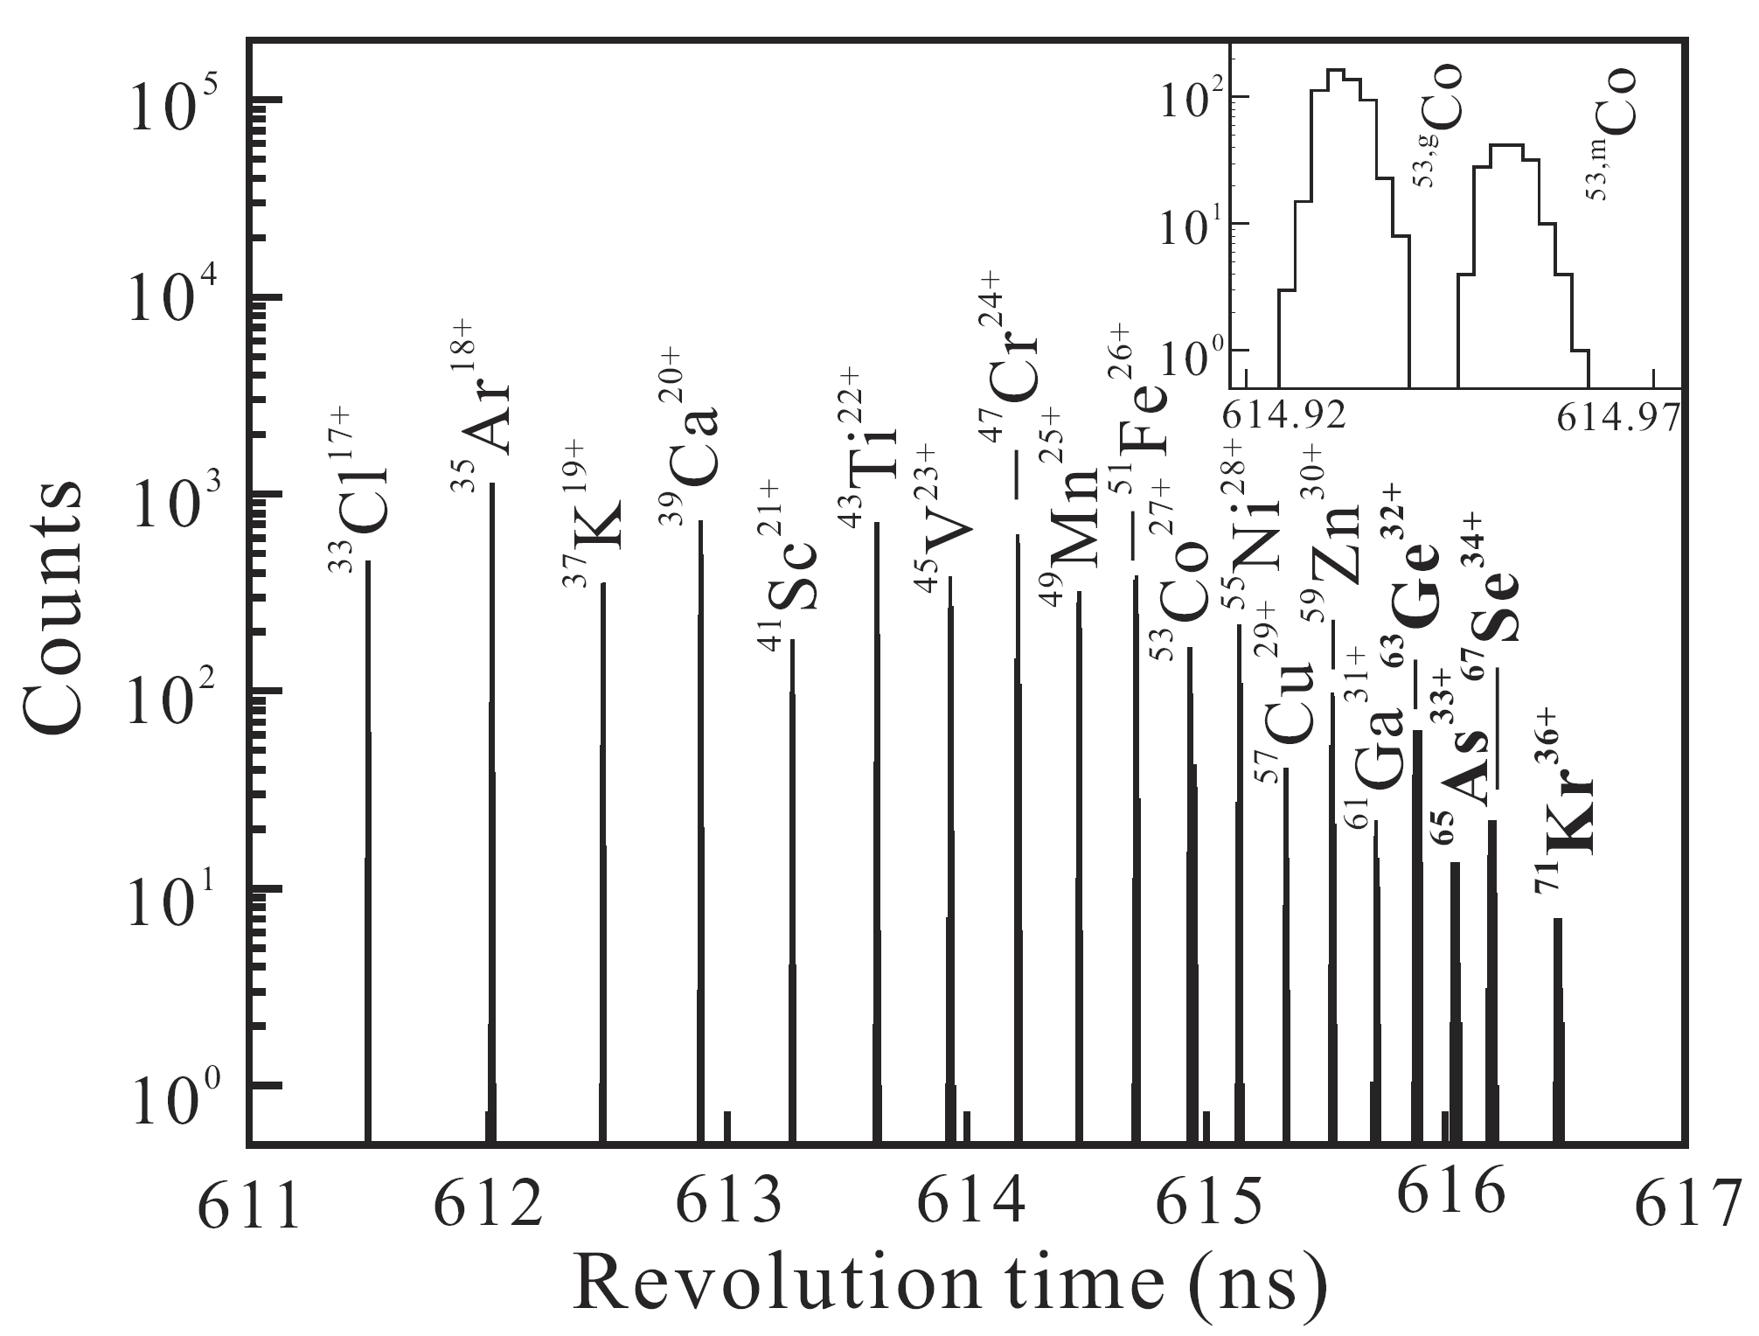
⁷⁸Kr beam: Revolution Time Spectrum

Slide 11
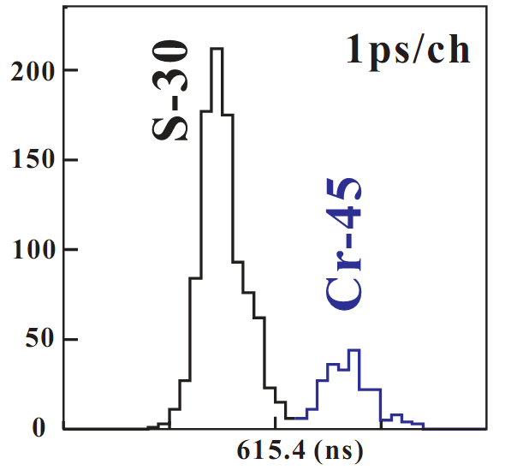
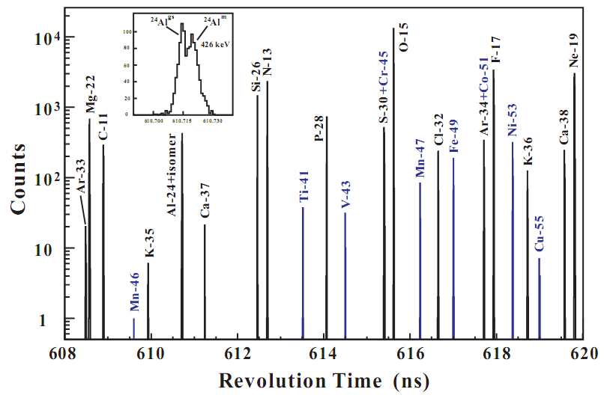
⁵⁸Ni beam: Revolution Time Spectrum
³⁴Ar, ⁵¹Co:
same m/q

Slide 12
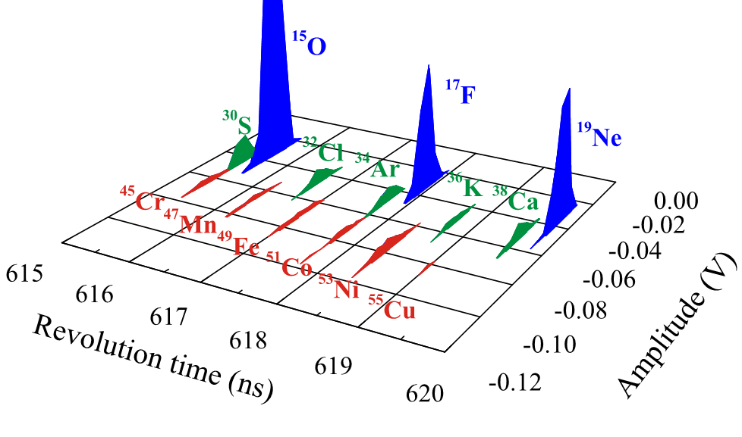
Time-Amplitude identification: ⁵¹Co

Slide 13
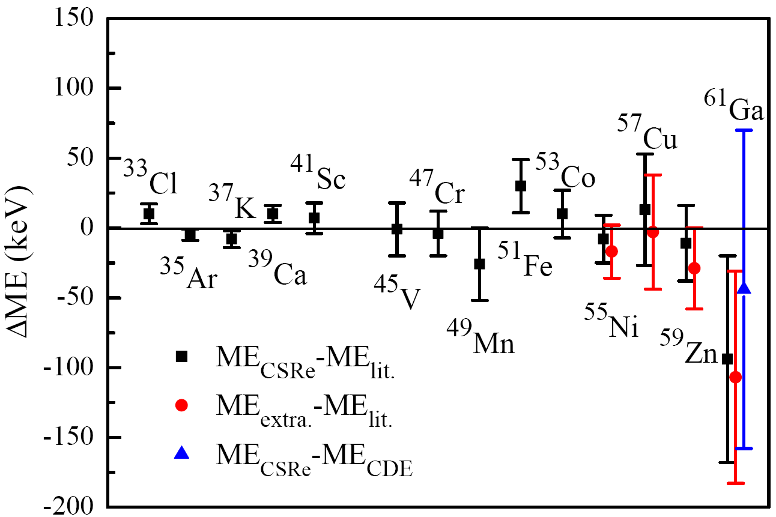
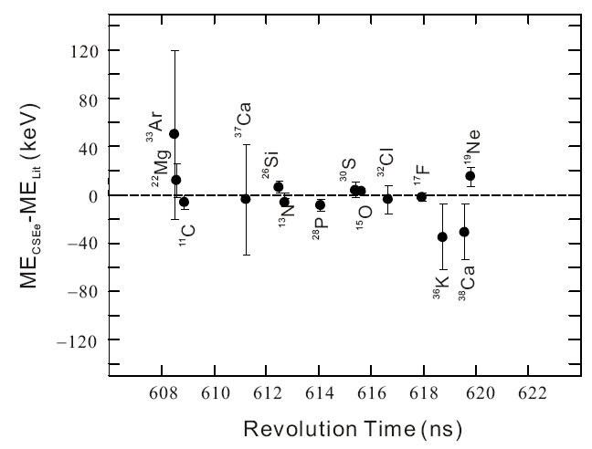
Mass Excess
M/q = a＋ b T +c T ² + d T ³
⁷⁸Kr beam
⁵⁸Ni beam
X.L. Tu etal., PRL 106, 112501 (2011)
X.L. Tu et al., NIMA A 654, 213 (2011)
Y.H. Zhang et al., PRL 109,102501 (2012)
X.L. Yan et al. ApJ 766, L8 (2013)

Slide 14
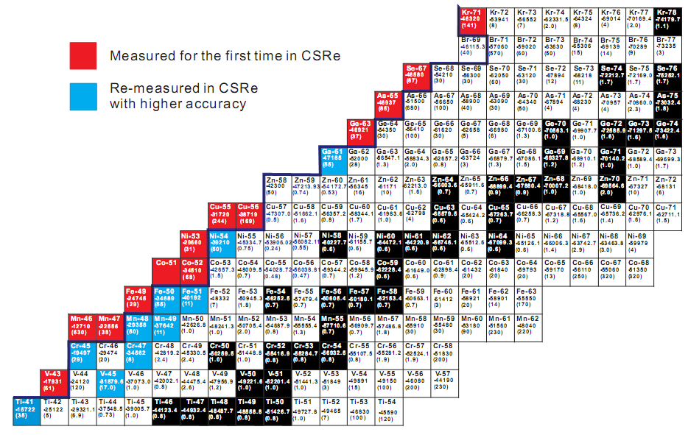
Results and Discussion
Tz=-1/2, ( ⁷⁸Kr Beam)
Tz= -1, -3/2, ( ⁵⁸Ni Beam)

Slide 15
Test the Isospin Multiplet Mass Equation
N = Z
Degenerate if no
charge-dependent
Interaction, and Δ_{nH}
corrected for.
Charge-dependent
effects
- 3/2 g.s
- 1/2 IAS
Tz
+ 1/2 IAS
Proton
- 3/2
+ 3/2 g.s
- 1/2
+ 1/2
(A,T,J^{π})
+ 3/2
Neutron
+ d(A,T)T_{z}³ or
+ e(A,T)T_{z}⁴
M(A,T,T_{z})=a(A,T)+b(A,T)T_{z}+c(A,T)T_{z}²
Any charge-dependent effects are two body interactions and be regarded as a perturbation.

Slide 16
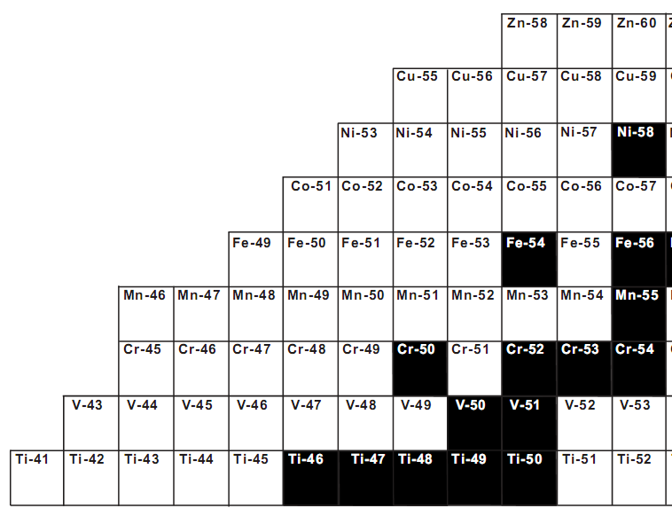
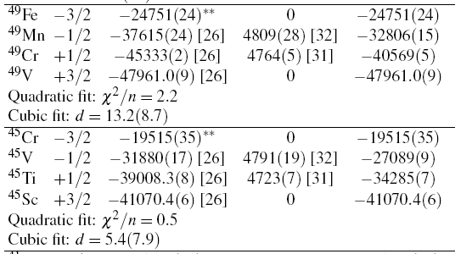
Test the IMME in fp shell nuclei
M(A,T,T₃)=a(A,T)+b(A,T)T₃+c(A,T) T₃²
+ d(A,T)T₃³
N=Z
?
?
?
?

Slide 17
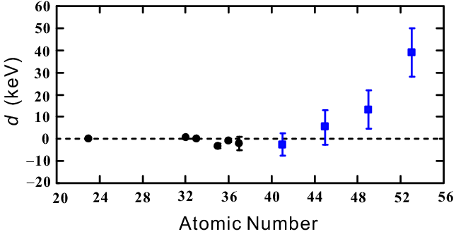
Test the IMME in fp shell nuclei
d coeficients increase gradually up to A=53
for which d is 3.5σ deviated from zero.
Y.H.Zhang et al., PRL 109, 102501 (2012)

Slide 18
Rp-process: 64Ge: waiting point?
X-ray burst model calculations with the new mass excess of 65As suggest that the majority of the reaction flow passes through 64Ge via proton capture, indicating that 64Ge is not a significant rp-rocess waiting point.
X.L.Tu et al., PRL 106, 112501 (2011)

Slide 19
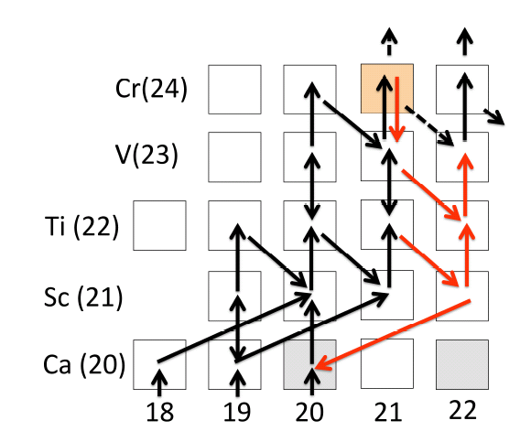
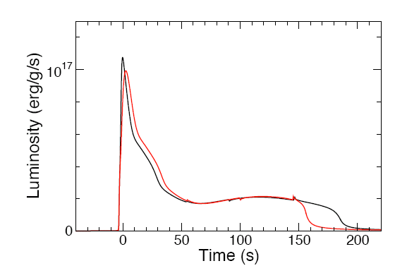
Rp-process: Sc-Ca cycle
Measurement of the 45Cr mass and the Sc-Ca cycle in X-ray bursts
X.L. Yan et al., APJ, 766 (2013) L8.

Slide 20
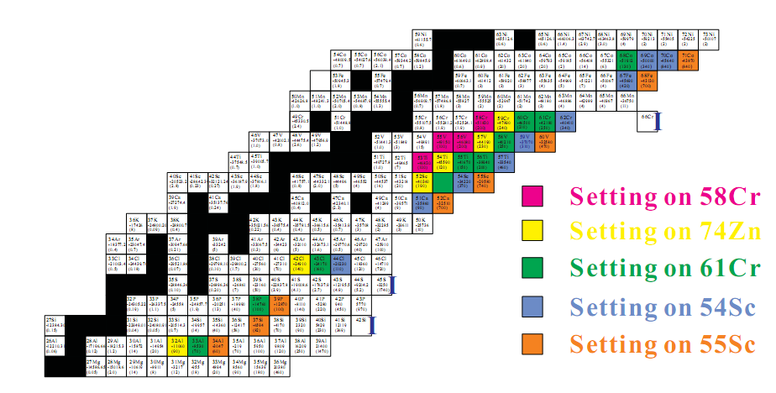
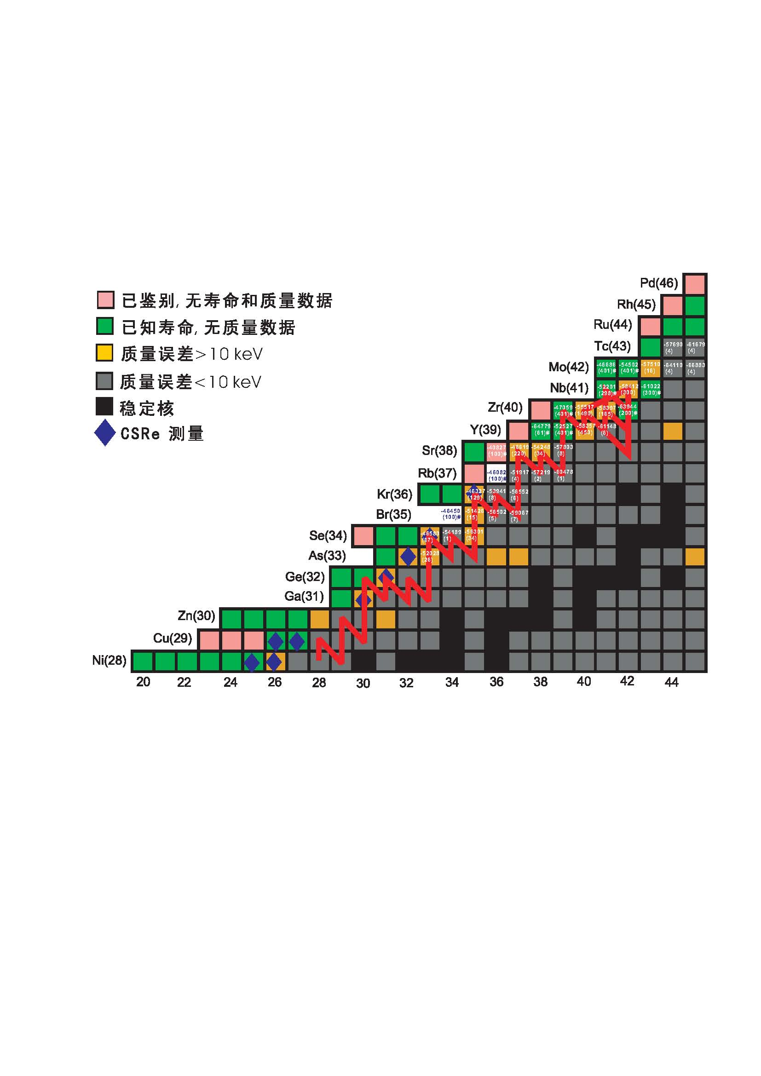
Other measurements
⁸⁶Kr, ¹¹²Sn

Slide 21
CSRe Collaboration
H. S. Xu, M. Wang, Y. H. Zhang, X. L.Tu, X. L. Yan, X. H. Zhou,Y. J. Yuan, J. W. Xia,
J. C. Yang, X. C.Chen, G. B. Jia, Z. G. Hu, X. W. Ma, R. S. Mao, B. Mei, P. Shuai,
Z. Y. Sun, S. T. Wang, G. Q. Xiao, X. Xu, Y. D. Zang, H. W. Zhao, T. C. Zhao,
W. Zhang, W. L. Zhan (IMP-CAS, Lanzhou, China)
Yu.A. Litvinov, S.Typel (GSI, Darmstadt, Germany)
K. Blaum (MPIK, Heidelberg, Germany)
Y. Sun (Shanghai Jiao Tong University, Shanghai, China)
H. Schatz, B. A. Brown (MSU, USA)
G. Audi (CSNSM-IN2P3-CNRS, Orsay, France)
T. Yamaguchi (Saitama University, Saitama, Japan}
T. Uesaka, Y. Yamaguchi (RIKEN, Saitama, Japan)
Thank you for your attention!

Slide 22
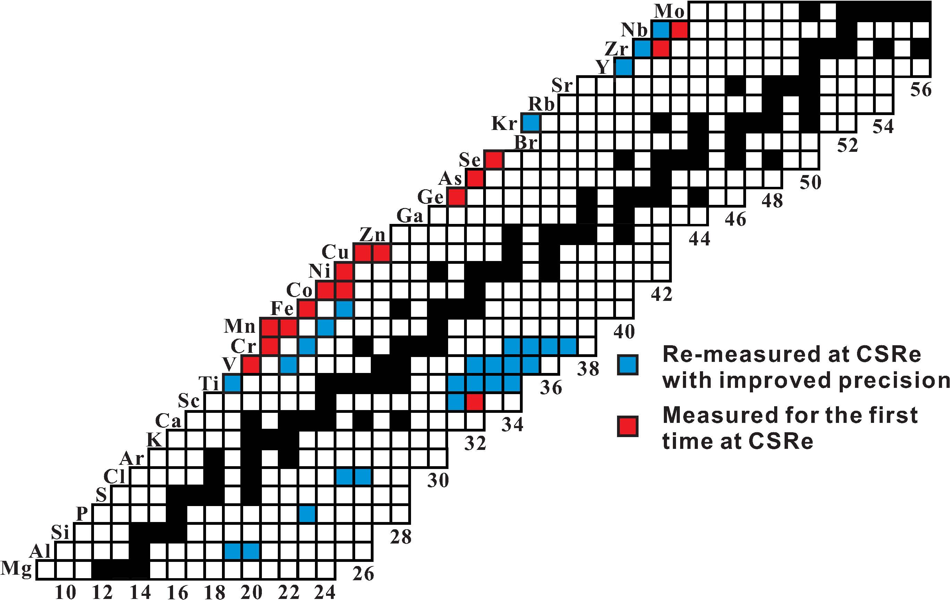
Mass measurement results at CSRe-Lanzhou
B. Mei et al., NIMA A 624, 109 (2010)
X.L. Tu etal., PRL 106, 112501 (2011)
X.L. Tu et al., NIMA A 654, 213 (2011)
Y.H. Zhang et al., PRL 109, 102501
(2012)
X.L. Yan et al. Astrophys. J. Lett.
766 (2013) L8
⁵³Ni, ⁶⁵As, ⁴⁵Cr
Measured for the first time: 16
Precision improved 27

Slide 23
Experiment: ⁵⁸Ni beam
Magnetic field stability was improved
Dec. 2010
Feb. 2011

Slide 24
Results
Mass excess (keV)
33Cl | -20993(7)
35Ar | -23052(4)
37K | -24808(6)
39Ca | -27273(6)
41Sc | -28635(11)
45V | -31881(9)
47Cr | -34562(8)
49Mn | -37642(11)
51Fe | -40192(11)
53Co | -42647(17)
55Ni | -45343(17)
57Cu | -47294(40)
59Zn | -47225(27)
61Ga | -47184(55)
63Ge | -46921(37)
65As | -46937(85)
67Se | -46580(67)
71Kr | -46320(141)
X.L. Tu, M. Wang et al., NIM A 654, 213 (2011)

Slide 25
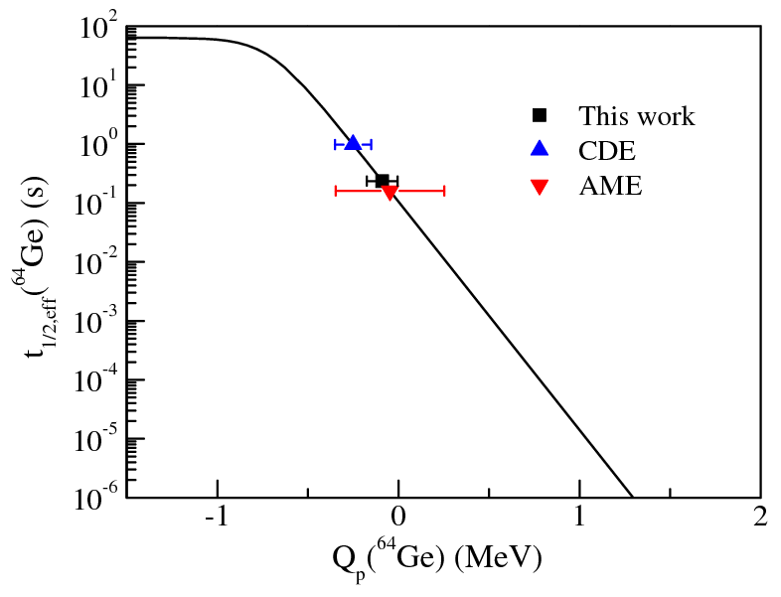
Impact on the rp-process of x-ray bursts
X.L. Tu etal., PRL 106, 112501 (2011)
2σ
Effective half-life of ⁶⁴Ge
Light curve of Type I x-ray burst
1σ
S_{p}(⁶⁵As) = −90 (85) keV
89%–90% of the reaction flow passes
through 64Ge via proton capture
indicating that:
⁶⁴Ge is not a significant rp-process
waiting point.
Abundance of burst ashes

Slide 26
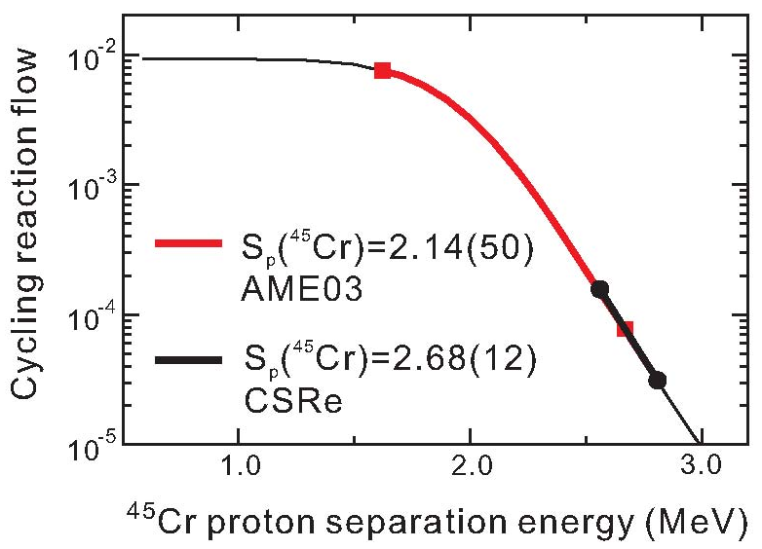
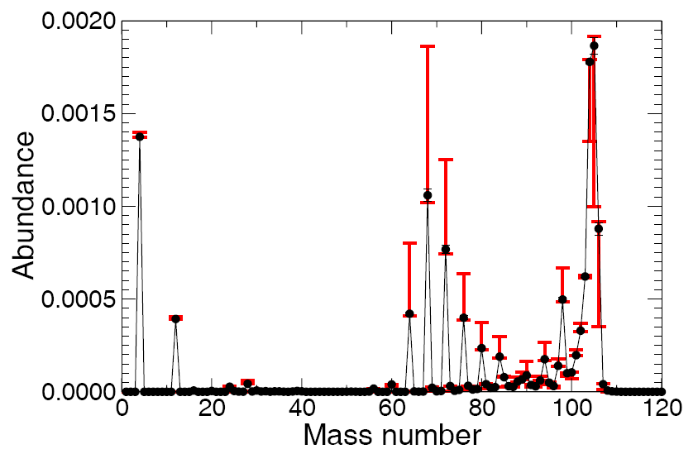
Inpact of the ⁴⁵Cr mass on the Sc-Ca cycle
AME03 up limit >>> S_{p}+3σ
X. L. Yan et al. 2013 ApJ 766 L8
AME03 low limit >>> S_{p}−3σ

