Slide 1


The 25th International Nuclear Physics Conference
Florence, 2-7 June 2013
Indirect measurements of the -3 keV resonance in the ¹³C(α, n)¹⁶O reaction: the THM approach
Marco La Cognata

Slide 2
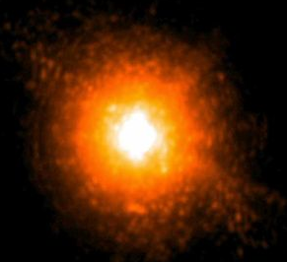
The ¹³C(α,n)¹⁶O reaction
The ¹³C(α,n)¹⁶O reaction is the main neutron source in low mass AGB stars at temperatures between 0.8 and 1 x 10⁸ K in radiative conditions.
It provides a neutron density of about 10⁶ - 10⁸ n/cm³. These neutrons are fundamental for the s-process.
¹³C is produced starting from ¹²C present in the instershell region when protons squeeze in during the third dredge-up.
In the typical stellar environment the energy region of astrophysical interest, the so-called Gamow window, corresponds to 150-230 keV at a temperature of about 10⁸ K.
In this energy range the not well known influence of the broad (124 keV) subtreshold state J=1/2⁺, corresponding to the excited level of ¹⁷O at E_{x} = 6.356 MeV ( E_{r}=-3keV), can be important.

Slide 3
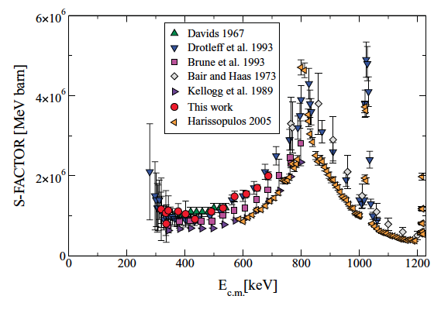
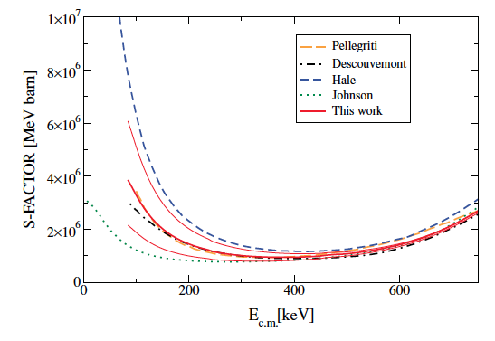
State of the art
Direct data → several open issues
Normalization especially at low energies
Extrapolation to astrophysical energies
Correction for the electron screening enhancement
Why?
Low energies, neutron detection, theory
Extrapolation to astrophysical energies
Heil et al. 2008
At astrophysical energies an error as large as a factor of 2 is obtained
Change on the cross section influences the neutron abundance and so the yield of some elements like Rb and Sr.

Slide 4
Direct vs. indirect measurements
Indirect measurements:
Complicated but rewarding
High energy experiments: up to several hundreds MeV
→ no Coulomb barrier suppression
→ negligible straggling
→ no electron screening
Indirect measurements are the only techniques allowing us to measure down to astrophysical energies with the present day facilities
Nuclear reaction theory required
→ cross checks of the methods needed
→ possible spurious contribution
→ additional systematic errors (is the result model independent?)
... Indirect techniques are complementary to direct measurements
Examples: Coulomb dissociation, ANC and Trojan horse method

Slide 5
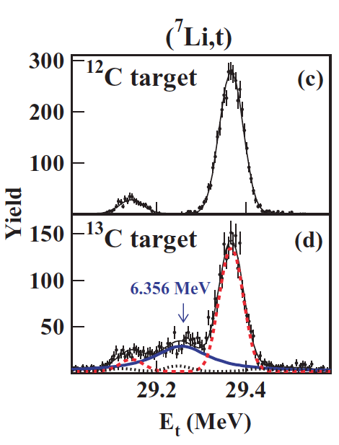
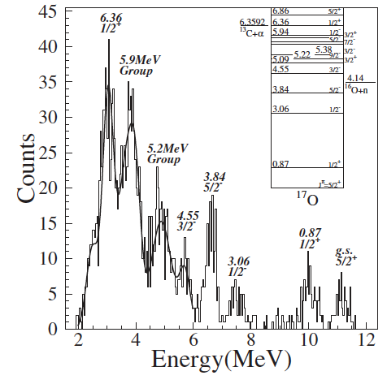
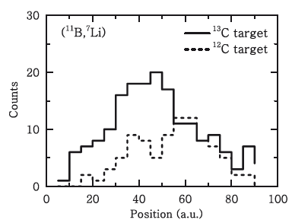
Indirect measurements
Pellegriti et al.
Johnson et al.
Guo et al.
Reference | ANC² (fm⁻¹)
Johnson et al. | 0.89±0.23
Pellegriti et al. | 4.5±2.2
Kubono et al. | 0.14 (SF)
Keeley et al. | 2.4, 3.2 (SF)
Guo et al. | 4.0±1.1
Transfer reactions are used to extract the ANC or the spectroscopic factor of the subthreshold resonance at -3 keV.
→ Anyway, contradictory results are obtained making extrapolation to low energies very uncertain.

Slide 6

Exploring negative energies with THM
a
s
x
Using the kinematics of three body reactions:
c
A
F*
C
Upper vertex: direct a breakup
M_{i}(E) is the amplitude of the transfer
It is possible to achieve negative energies in the A-x channel…
Out of reach for direct measurements
How to deal with negative energies?
Standard R-Matrix approach cannot be applied to extract the resonance parameters of the A(x,c)C reaction because x is virtual → Modified R-Matrix is introduced instead (A. Mukhamedzhanov 2010)
In the case of a resonant THM reaction the cross section takes the form:
M2 is proportional to the ANC of the F state populated in the transfer reaction
Merging together ANC and THM → deep connection of these two indirect methods

Slide 7
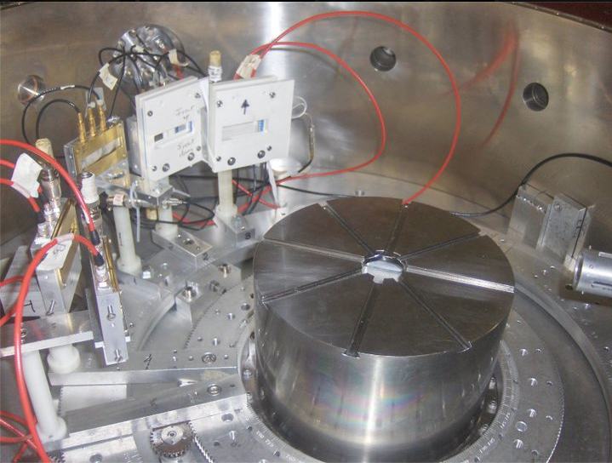

Measurement of the ¹³C(α,n)¹⁶O reaction through the THM
⁶Li
d
α
¹⁶O
¹³C
n
The experiment was performed at the Florida State University applying the indirect THM. Our experiment was performed by measuring the sub-Coulomb ¹³C(α,n)¹⁶O reaction through the ¹³C(⁶Li,n¹⁶O)d reaction in the quasi-free kinematics regime.
⁶Li beam (8 MeV)
on ¹³C target
Pros and cons of the experimental approach:
Deuteron detection in PSD 1-2-3 → No need for neutron detectors
Better detection efficiency and lower chances of systematic errors (see direct measurements!)
However d is emitter at zero degrees → the QF peak cannot be accessed in the experiment

Slide 8
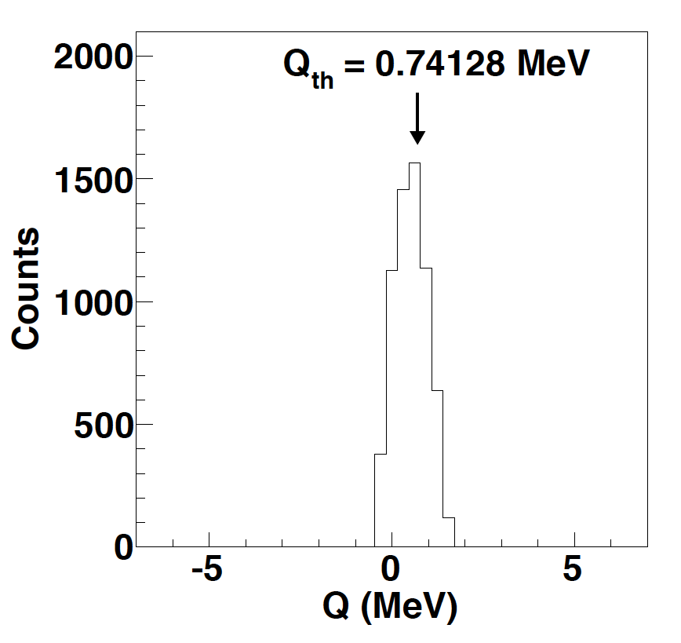
Selection of the reaction channel: Q-value
The figure shows the Q-value spectrum for the three-body reaction for the coincidence events after applying the cuts seen in the previous slide.
Q_{3B} = E₁+E₂+E₃-E_{projectile}
A well separated peak, shown in figure, is centered around the theoretical value of 741 keV.
The good agreement between the experimental and the theoretical Q values confirms the identification of the reaction channel as well as the accuracy of the calibration.
E.G.: No contamination from ⁶Li breakup on ¹³C
(Q=-1.47 MeV)

Slide 9
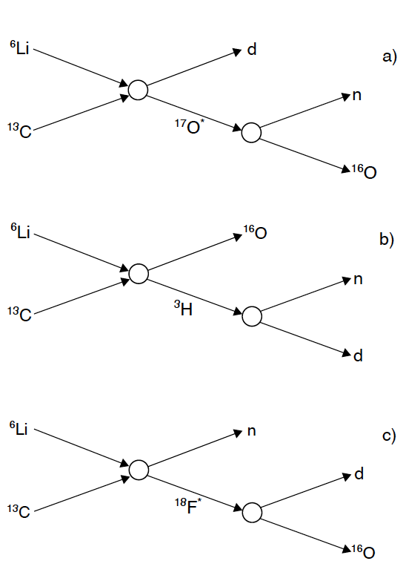
Are sequential mechanisms (SD) present?
Relative energy plots are used to investigate the reaction mechanisms through which the 3body reaction occurs
Further analysis is needed!
¹⁷O→¹⁶O+n threshold=4.143 MeV
We see a clear signature of ¹⁷O levels (horizontal lines in panel b). No vertical lines (³H states) neither horizontal lines in panel a.
Are ¹⁷O levels populated through QF or SD?

Slide 10
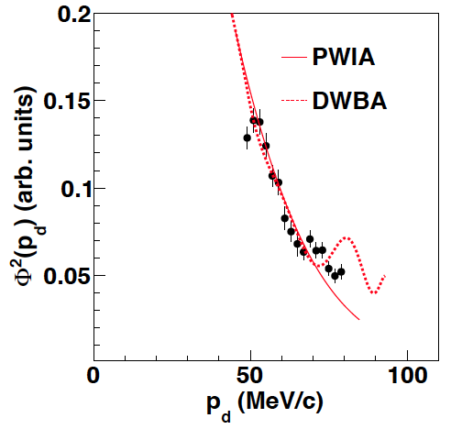
Selection of QF-mechanism
Levels in ¹⁷O can be populated both in QF and SD dynamics → a further test is needed
QF vs. SD = direct reaction vs. compound nucleus formation → totally different dynamics!
If the process is QF, d should have the same momentum distribution as inside ⁶Li
Black points: experimental dmomentum distribution
Full Line: theoretical α-d momentum distribution as calculated by B. Irgaziev using a realistic α-d potential
Dotted Line: theoretical α-d momentum distribution calculated with FRESCO
PWIA & DWBA
In PWIA the momentum distribution is given by the squared Fourier transform of the α-d relative motion wave function → a single free parameter (normalization)
In the DWBA many more parameters (optical potentials → taken from Johnson et al.)

Slide 11
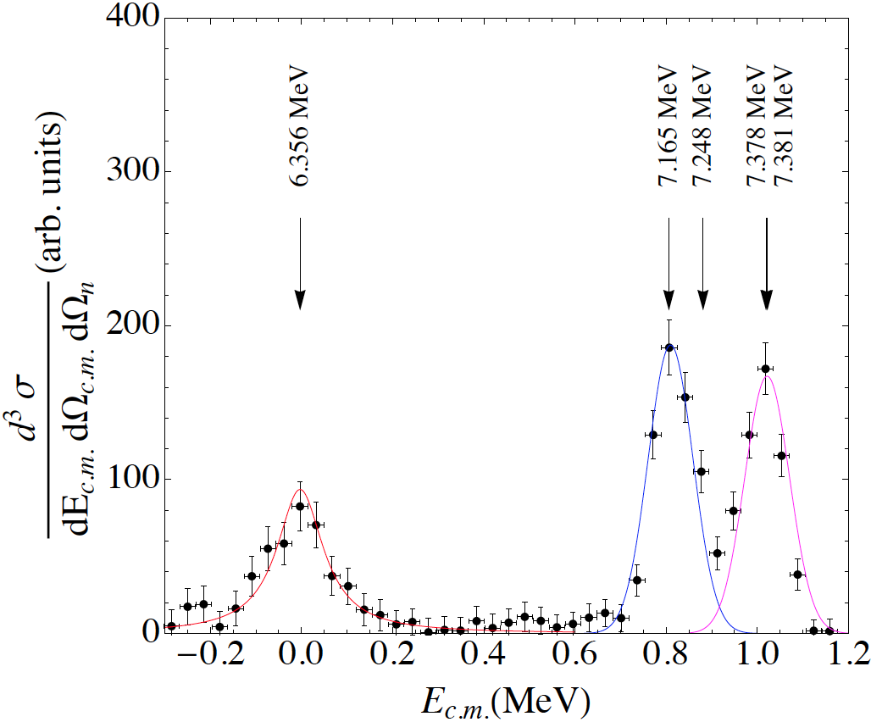
Raw THM data – background subtracted
No center-of-mass angular integral performed.
Large error bars due to flat background subtraction.
3 groups of resonances observed: 7.378 and 7.381 MeV not resolved, 7.248 MeV much smaller than the other resonances → not visible
Clear evidence of the -3 keV resonance!

Slide 12
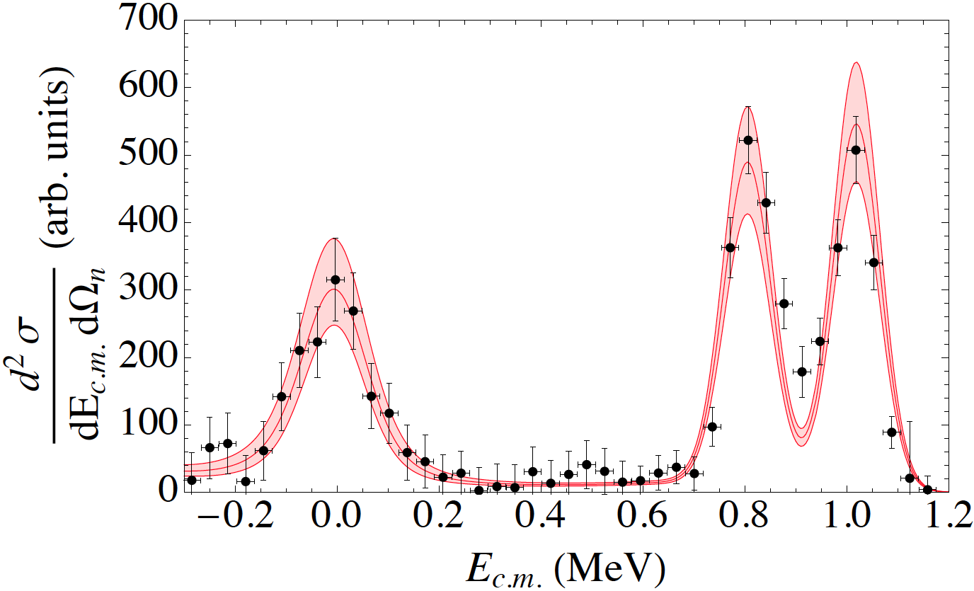
Fitting THM data with the HOES R-matrix
Fitted HOES cross section:
2 parameters, the reduced n- and α- widths.
Channel radii fixed at the Heil et al. ones [5.2 and 4 fm for the α- and n- channels]
Coulomb corrected ANC² of the -3 keV resonance is:
6.7^{+0.9}_{-0.6} fm⁻¹ (maximum error)
Γ_{n} of the -3 keV resonance is:
0.083^{+0.009}_{-0.012} MeV
Normalization region:
Scaling factor and energy resolution obtained (this one in agreement with the calculated one, 46 keV)
Effect of DW: 9.5%, included into the normalization error as it modifies the 2-peak relative height

Slide 13
6.356 MeV
Only about 50% of the total statistics analyzed so far
Pellegriti et al.
Johnson et al.
Guo et al.

Slide 14
6.356 MeV
PRELIMINARY:
Full statistics plot
→ Perfect agreement with previous results (ANC a bit larger and Γ_{α} in better agreement with the value in the literature)
Pellegriti et al.
Johnson et al.
Guo et al.

Slide 15
Comparison with the parameters in the literature
Reference | CC-ANC² (fm⁻¹) | G_{n} (MeV)
Present work | 6.7^{+0.9}_{-0.6} | 0.083^{+0.009}_{-0.012}
Heil et al. | - | 0.1581
Johnson et al. | 0.89±0.23 | -
Tilley et al. | - | 0.124±0.12
Pellegriti et al. | 4.5±2.2 | -
Kubono et al. | 0.14 (Spectr. F.) | -
Keeley et al. | 2.4, 3.2(Spectr. F.) | -
Guo et al. | 4.0±1.1 | -
Tilley et al. is a summary of the older data. Γ_{n} was obtained through the R-matrix analysis of n-induced reactions, with n-channel radius 3.86 fm and fit obtained “visually”. No mention on how broad subthreshold resonances were accounted for.
Only in our measurement we are sensitive to both Γ_{n} and n-¹⁶O ANC of the subthreshold state. In other cases Γ_{n} from Tilley et al. was used to extrapolate the astrophysical S-factor. Apart from Drotleff et al., no mention of electron screening enhancement is made

Slide 16
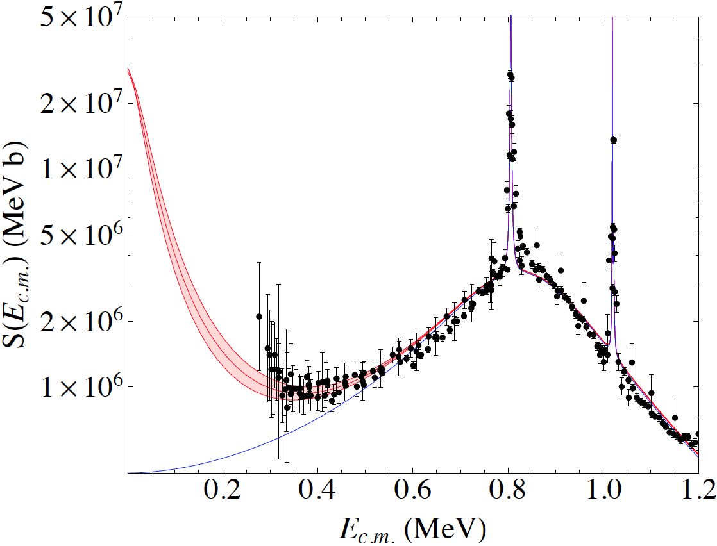
OES THM S(E) factor and available experimental data following the prescription of Heil et al.
OES R-matrix with the parameters from the THM data
Γ_{n} and ANC from THM data
Normalization region → R-matrix function parameters from Heil et al.
No -3 keV resonance
The displayed uncertainty band includes statistical and normalization error → maximum error as the minimum and the maximum normalization constants are used
The interference with the -400 keV resonance is accounted for following Heil et al. approach

Slide 17
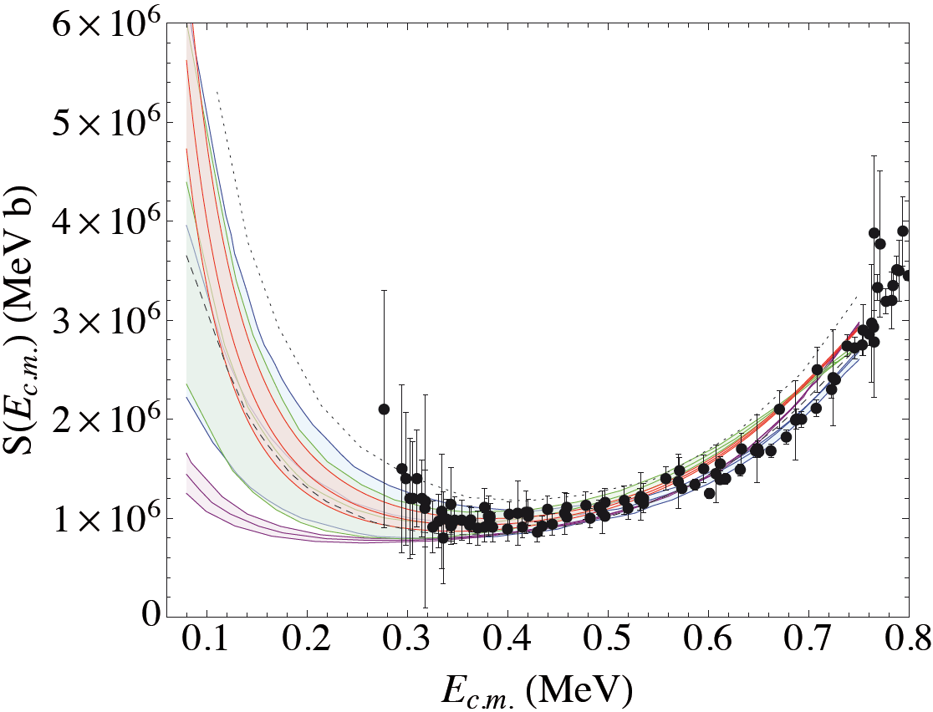
Comparison of our low-energy S-factor with some of the others present in the literature
Dotted line → Hale (Nacre)
Dashed line → Drotleff et al.
Present work
Green and blue bands (barely distinguishable) are Pellegriti et al. and Heil et al.
Johnson et al.
Several extrapolations are available, we show the most recent ones or those commonly in astrophysical modeling → Nacre (essentially the R-matrix by Hale) and Drotleff et al. (the type of calculation is not disclosed).
Electron screening? Included in Drotleff et al. calculation, not included by Heil et al.

Slide 18
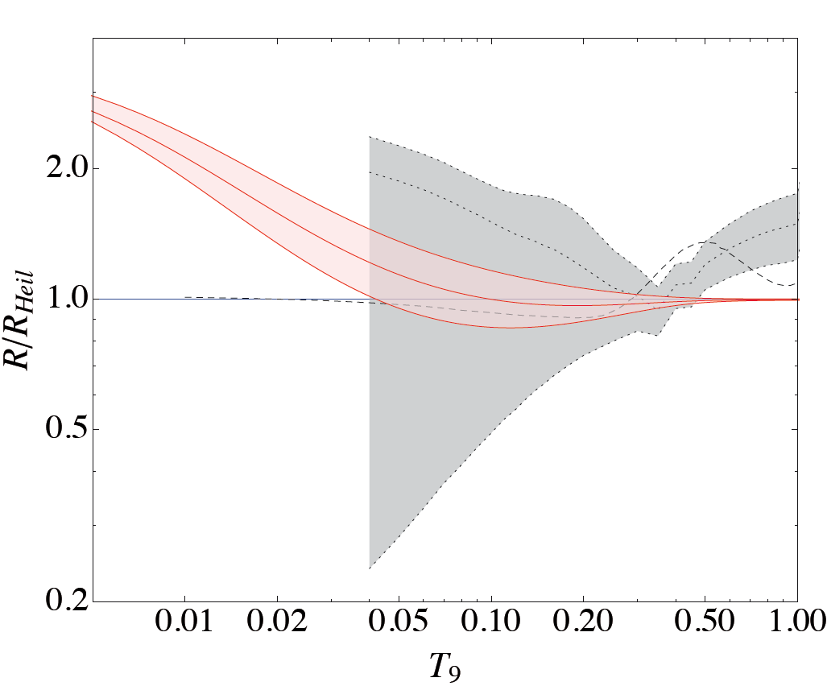
Comparison of the reaction rate with the one Heil et al. one
Present work / Heil et al. reaction rate
Nacre rate / Heil et al.
Drotleff et al. / Heil et al.
Heil et al. rate = 1
in this scale
Good agreement with NACRE rate at temperatures of astrophysical importance but much better accuracy!
The rates that are usually used in astrophysics are the one by Drotleff et al., which is in agreement with the Heil et al. one in the range of interest of astrophysics, and the Nacre one.
For the Drotleff et al. rate no uncertainty is given.
Nacre have about 100% indetermination.

Slide 19
Please come to Poster NA052 for more details
Thanks for your attention

Slide 20
