Slide 1


Current quests in nucleosynthesis: present and future neutron-induced reactions measurements
Javier Praena
Universidad de Sevilla, Seville, SPAIN
Centro Nacional de Aceleradores, Seville, SPAIN

Slide 2
Motivation
An overview of the status of the measurement of the Maxwellian averaged (n,γ) cross section (MACS) of branching points (BPs) and new methods.
MACS by time-of-flight: n_TOF @ CERN.
MACS by activation: overview of the production of stellar (or maxwellian) neutron spectrum.
Present: neutron source at small facility at CNA.
Future: in situ neutron beam and RIB at SPES?
Javier Praena – INPC2013, Firenze 06/2013

Slide 3
Motivations: nucleosynthesis.
Neutrons play a central role in the production of the elements in the stars.
In particular, the elements beyond Fe are produced mainly by successive neutron-capture and subsequent β-decays: the so called s- and r-processes.
slow-process:
10^{6-7,10} n/cm^{3,}, 1-3.5 10⁸ K. 10⁶ years.
AGB, Red Giants. ¹³C(α,n)¹⁶O, ²²Ne(α,n)²⁵Mg
rapid-process
10²⁰ n/cm³ , 10¹⁰ K, seconds, Explosive sites(?)
(n,γ), (n,α), (n,p) reaction cross-sections are fundamental quantities in astrophysical models.
BBFH, Reviews of Modern Physics 29, 4 (1957)
A.G.W Cameron, CRL-41 (1957)
Javier Praena – INPC2013, Firenze 06/2013

Slide 4
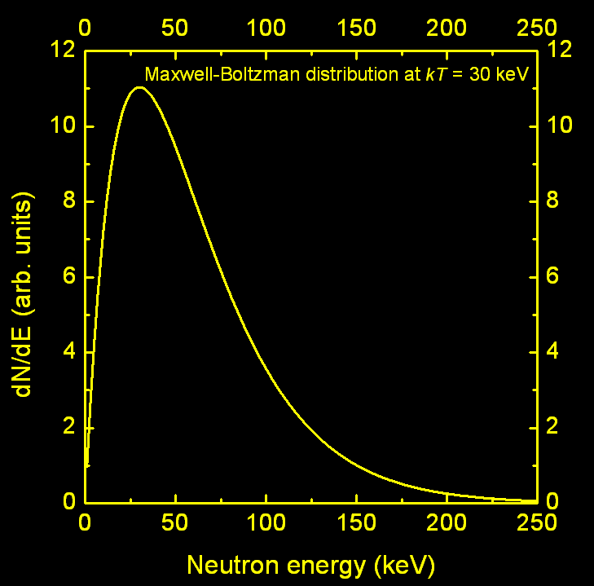
Motivations: nucleosynthesis.
At stellar sites where the nucleosynthesis of the elements by neutron capture takes place, particles are quickly (10⁻¹¹ s) thermalized through elastic scattering and the associated velocity probability distribution is a Maxwell-Boltzmann [*].
The maximum probability corresponds to the T of the stellar medium (or thermal energy kT) which depends on the mass and evolutionary stage of the star.
[*] Allen et al. , Adv. Nuc. Phys. 4 (1971).
REACTION RATE (cm⁻³s⁻¹)
Reaction rates are needed over an energy range from kT=5 to 100-120 keV [+].
MACS are needed at least at few points 5 keV < kT < 120 keV.
[+] Z. Y. Bao et al. , ADNDT 76, 70 (2000).
4
Javier Praena – INPC2013, Firenze 06/2013
Notes:
The neutron reaction rate of an element A in this environment can be calculated with this expression. Where v is the reduced velocity and Sigma de cross-section of the neutron-induced reaction considered. Folding this expression with the probability distribution, thus the MB distribution of the velocities we arrive to this expression. From the point of view of the experimentalist this is the expression to be measured. As I will show later these measurements normally are carried out by TOF or activation technique. And the quantity obtained in these experiments is the MACS at the stellar energy (kT) of interest.

Slide 5
Experimental techniques:
TOF and Activation
The most of the critical stellar features, such as time scales, temperature, neutron density depends on the <σν>, therefore on the Maxwellian-averaged cross-section.
Branching points are isotopes with (n,γ) cross-section and β-decay comparable.
Time-of-flight.
    (n,γ) are detected via the prompt γ-cascades. Whatever isotope can be measured. Excellent energy resolution. Low uncertainty.
    Flight paths reduces neutron flux at sample position (Branching↓)
Activation.
    (n,γ) leads to an unstable nucleus. Detection of induced activity (HPGe). High neutron flux (Branching↑). Possibility of some AMS measurements.
Javier Praena – INPC2013, Firenze 06/2013

Slide 6
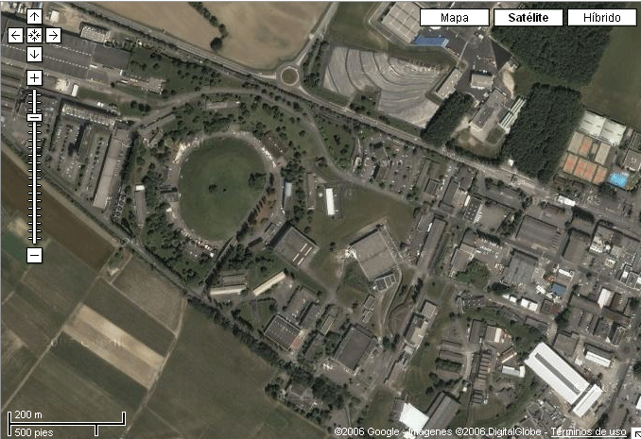

n_TOF facility @ CERN
Proton beam momentum | 20 GeV/c
Intensity (dedicated) | 7 x 10¹² p/pulse
Repetition frequency | 1 pulse/2.4 s
Pulse width | 6 ns (rms)
n/p | 300
Lead target dimensions | 80x80x60 cm³
Cooling & moderation | Borated H₂O
Moderator thickness in the exit face | 5 cm
EAR-1
EAR-2
20m
SPALLATION TARGET
NEUTRONS are “cleaned”
In 185 m flight path
Booster
1.4 GeV
Linac
50 MeV protons
PS 20GeV
6
6
Javier Praena – INPC2013, Firenze 06/2013

Slide 7
n_TOF @ CERN: features.
n_TOF features | Advantages
Broad neutron energy range | Neutron cross sections in the range meV – 1 GeV
High instantaneous neutron flux | Radioactive samples (good ratio Signal/Background)
Excellent energy resolution | Resonance dominated cross sections
Equipment: flash ADC DAQ and detectors | Accurate cross section measurements
Javier Praena – INPC2013, Firenze 06/2013

Slide 8
n_TOF branching points: ⁶³Ni.
⁶³Ni(n,γ) cross section from 0.1 eV to 0.2 MeV.
C. Lederer et al., Phys. Rev. Letters 110 (2013)
During the He core burning the N_{n}<< and the T=0.3 GK (24 keV) lead to the decay of ⁶³Ni to ⁶³Cu (90%).
C shell burning, N_{n}~10¹¹⁻¹² cm⁻³, 1 GK (90 keV) the material is partly reprocessed and the ⁶³Cu is bypassed.
He
C
More than a factor 2 in comparison with the recommended value used in astrophysical models.
The major challenge was the production of the sample. Irradiation of highly enriched ⁶²Ni sample in a thermal reactor 20 years ago. ⁶³Cu impurity was chemically separated.
More details can be asked to C. Massimi. Thursday
8
Javier Praena – INPC2013, Firenze 06/2013

Slide 9
n_TOF branching points: ⁶³Ni.
The impact of the results were studied for s-process in a full stellar model for 25M_{SUN} (Z=0.02). NuGrid code MPPNP follows the nucleosynthesis.
The calculated abundance in the Fe-Zr region shows an enhancement of 20% in ⁶⁴Ni, ⁶³Cu is depleted in 15%, ⁶⁵Cu remains unchanged, ⁶⁴Zr depleted in 30%.
⁶³Ni(n,γ) cross section from 0.1 eV to 0.2 MeV. C. Lederer et al., Phys. Rev. Letters 110 (2013)
9
Javier Praena – INPC2013, Firenze 06/2013

Slide 10
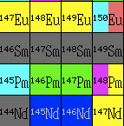
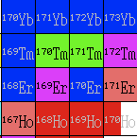
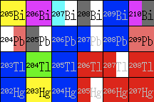
n_TOF branching points: future.
It is planned the measurement of the (n,γ) cross-section involving branching points such as:
¹⁴⁷Pm->2.62 years, ¹⁷¹Tm->1.92 years, ²⁰⁴Tl->3.78 years
10
Javier Praena – INPC2013, Firenze 06/2013

Slide 11
What about activation?
The neutron activation technique allows the irradiation of samples with a high flux making feasible some MACS measurements of radioactive isotopes (or very low mass samples).
In principle, the sample can be activated with neutrons following whatever distribution.
Then, in order to obtain the MACS the spectrum must be folded with the cross-section as a function of the energy.
But to fold you need to know at least the trend of the cross-section that you are measuring.
Many cases it is supposed σ≈1/v for the cross-section in all the astrophysics energy range (resonances are negligible?)
11
Javier Praena – INPC2013, Firenze 06/2013

Slide 12
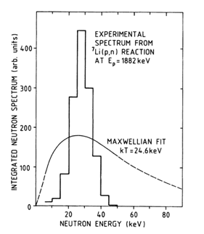
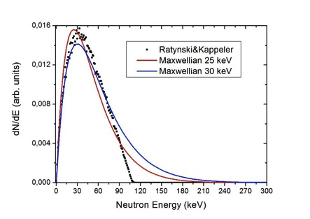
MACS & activation: Karlsruhe.
Beer&Käppeler, Karlsruhe. (1980)
Phys. Rev. C 21 (1980).
Ratynski&Käppeler, Karlsruhe (1988)
Phys. Rev. C 37 2 (1988)
W. Pönitz, Karlsruhe.(1966).
Journal of Nuclear Energy 20 (1966). Pergamon Press Ltd.
⁷Li(p,n) for 30 keV
Near-threshold
⁷Li(p,n) for 25 keV
Near-threshold->Ep=1912 keV
12
Javier Praena – INPC2013, Firenze 06/2013

Slide 13
In consequence, to obtain the MACS at kT=30 keV the spectrum must be corrected. Moreover Käppeler needs to extrapolate from 25 to 30 keV.
For both the knowledge or the assumption of the cross-section trend is mandatory.
What is the importance of these corrections?
Let us compare the MACS of Au(n,γ) at 30 keV between Pönitz (act.), Käppeler (act.) and n_TOF:
Au MACS at 30 keV | MACS (mbarn) | Uncertainty (mb)
Pönitz | 600 | 12
Ratynski & Käppeler | 582 | 9
N_TOF (*) | 611 | 22
Is needed to generate a maxwellian neutron spectrum at 30 keV?
Not, it is not, if you know the cross-section that you are measuring.
But if you do not know, or if you want to measure wide energy range….
[*] Lederer et al., Phys. Rev. C 83 034608 (2011).
13
Javier Praena – INPC2013, Firenze 06/2013

Slide 14
Is it needed to generate a maxwellian? Yes, it is. Indeed more than one.
In order to demonstrate the importance of the production of maxwellian neutron spectrA we have studied Se82[*]. It is 1/v at thermal in the evaluations with few differences in the resonances.
We have calculated the MACS for the relevant astrophysics energies relying on evaluations and on theoretical HF calculations [21].
The large discrepancy among libraries is apparent not only in the MACS value but also in the trend.
ENDF/B-VI.8 –VII differ in the magnitude of 2-3 resonances.
[*] G. Martin-Hernandez et al., App. Rad. Iso. 70 (2012).
14
Javier Praena – INPC2013, Firenze 06/2013

Slide 15
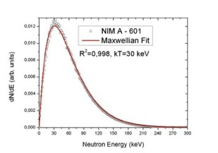
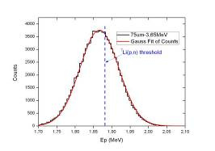
MACS & activation: Mastinu et al.
P. Mastinu, G. Martín-Hernández and J. Praena. (Italy) (2008)
Nuclear Instruments and Methods A 601 (2009).
Protons are shaped to a distribution close to the
⁷Li(p,n) threshold
Protons
NEUTRONS
Aluminium
Proton shaper
Lithium
It will be possible to produce maxwellian from kT=30 to 60 keV by changing only the Ep with the same proton shaper.
Recently, we have measured the spectrum at JRC-IRMM (Geel, Belgium).
Preliminary results of the analysis confirm the method and the simulations
15
Javier Praena – INPC2013, Firenze 06/2013

Slide 16

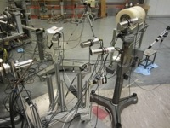
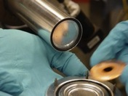
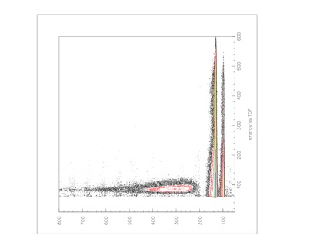
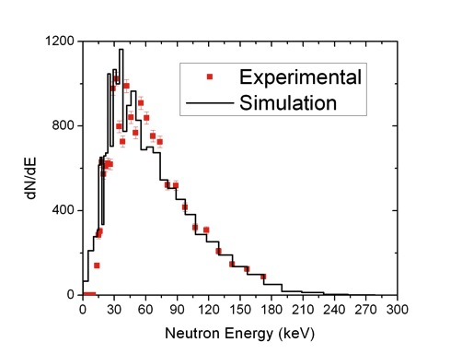
Checking Mastinu’s method:
experiment @ JRC-IRMM
Ep=3663 keV
QGPD ~ 1860 keV, σ=64 keV
Flight path = 52 cm
Frequency = 625 kHz , ~2ns
Li6 glass:
IR7-> ½ “
FJH-> 1”
SOR-> 1”
Al 75 μm
Proton Shaper
LiF target
Neutron Spectrum @ 0º
Pulse Height
Preliminary result
Javier Praena – INPC2013, Firenze 06/2013
16

Slide 17
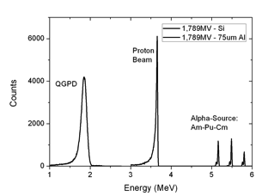
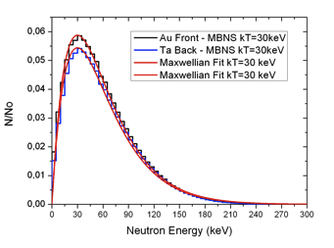
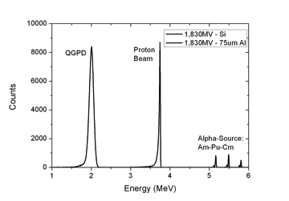
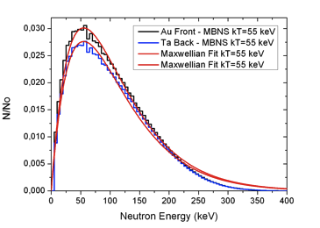
Present application: CNA, Seville (SPAIN)
Measurement of the proton distributions
shaped by the same 75 μm Aluminium foil
Simulated neutron spectra activating Au and Ta/Tb sample
Ep=3665 keV
Ep=2003 keV
Javier Praena – INPC2013, Firenze 06/2013

Slide 18
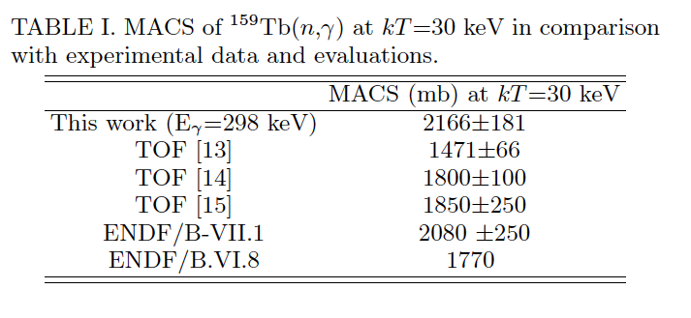
MACS of ¹⁸¹Ta(n,γ) and ¹⁵⁹Tb(n,γ) at kT=30 keV
with ¹⁹⁷Au(n,γ) as reference
MACS of ¹⁸¹Ta(n,γ) has been measured several times with TOF and activation techniques. Test case.
MACS of ¹⁵⁹Tb(n,γ) has not been measured by activation. It is of interest in astrophysics, fission and fusion reactor design since is a fission product poison.
J. Praena et al., in press, NIM A (2013).
J. Praena et al., accepted for publication NDSheets(2013).
Javier Praena – INPC2013, Firenze 06/2013

Slide 19





Future? MACS with RIB at SPES-LNL:
¹³⁹Ba(n,γ) at 30keV
RFQ Proton
5 MeV, 50mA
250 kW
C-12 substrate
Protons
Ep>1.88 MeV
Li target
Neutrons
Energy Shaper
Radioactive
Ion Beam
10¹⁰⁻¹¹ n/(s⋅cm²)
Ba-139, T_{1/2}= 86 min. Saturation,
RIB Intensity=1e10s⁻¹.
Number of Ba-139=6e13
In situ neutron irradiation = 7 days
Number of Ba-140=5.5e5
Cross-section=0.1 b (?)
Cooling time = 2 days
Eff=0.09
I (537keV)=0.25
Measuring time=11 d
Counts Ba-140=5e3
Javier Praena – INPC2013, Firenze 06/2013

Slide 20
Summary 1/2
An overview of the n_TOF@CERN has illustrated as an example of measurements of MACS of BPs by the TOF technique.
Pönitz, Käppeler and Mastinu show an evolution in the generation of stellar neutron spectrum to be used in the measurement of MACS at 30 keV by activation.
We have tried to demonstrate the importance of the generation of neutron spectrum as close as possible to maxwellian in a wide range for activation measurements.
Javier Praena – INPC2013, Firenze 06/2013

Slide 21
Summary 2/2
Mastinu’s method provides stellar neutron spectrum in a wide energy range (30-60 keV) (5 and 90 keV).
Preliminary analysis results of the JRC-IRMM experiment show good perspectives of Mastinu’s method confirmation.
New methods such as Mastinu ’s method push the use of small neutron sources facilities as CNA at Seville.
Amazing and very difficult experiments combining high intensity neutron beam and high intensity Radioactive Ion Beam could be performed in the future in facilities as SPES-LENOS at Laboratori Nazionali di Legnaro.
Javier Praena – INPC2013, Firenze 06/2013

Slide 22
Thank you very much to the Committee for the invitation and for your attention
Javier Praena
Universidad de Sevilla, Seville, SPAIN
Centro Nacional de Aceleradores, Seville, SPAIN

Slide 23
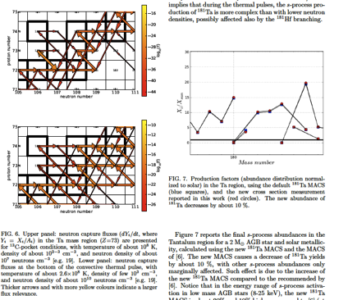
MACS of ¹⁸¹Ta(n,γ) and ¹⁵⁹Tb(n,γ) at kT=30 keV
with ¹⁹⁷Au(n,γ) as reference
Experimental conditions for both experiments:
Au, Ta and Tb samples of d=2.4 cm. Proton current≈ 3 μA. Beam spot= 1 cm
HPGe detector: ¹⁹⁸Au (2.6 d, 411 keV)¹⁸¹Tb (114 d, 1121 keV) ¹⁶⁰Tb (72 d, 298 keV)

Slide 24
⁶⁷⁻⁷³Ga, ⁶⁹⁻⁸⁵As, ⁸¹⁻⁸⁸Se, ⁸³⁻⁹¹Br, ⁸⁷⁻⁹¹Kr, ¹²⁶⁻¹³⁴Sb, ¹³⁵⁻¹³⁹Xe
Javier Praena – INPC2013, Firenze 06/2013
Notes:
flux. We proposed also to irradiated radioactive sample made by using the RIB of the SPES facility

Slide 25
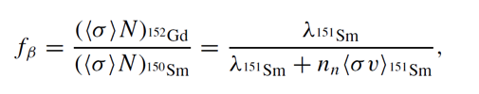
n_TOF branching points: ¹⁵¹Sm.
¹⁵¹Sm(n,γ) cross section from 0.6 eV to 1 MeV.
S. Marrone et al., Phys. Rev. C 73 (2006)
¹⁵¹Sm, s-process branch point with pronounced λ(T).
In the classical s-process approach , N_{n}(t) and T(t) are assumed to be constant, the former equation provides the T, if N_{n} is determined by other branching not sensitive to the T.
The major challenge was the production of the sample. 206 mg of Sm₂O₃ powder pressed to a solid pellet. Prepared at ORNL (USA). 150 GBq!
25
Javier Praena – INPC2013, Firenze 06/2013

Slide 26
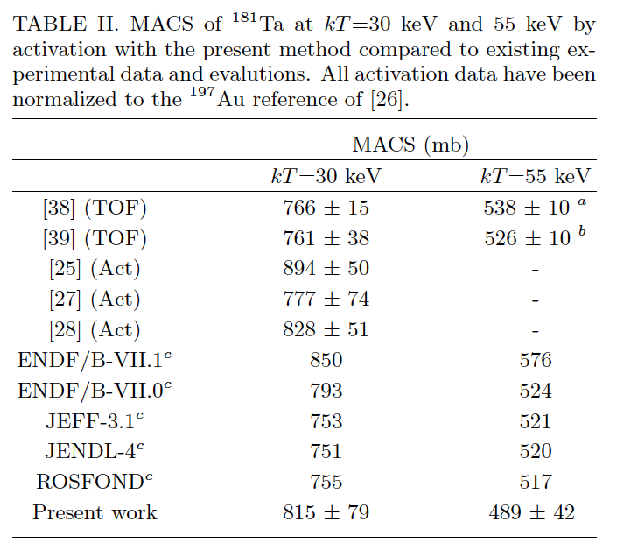
MACS of ¹⁸¹Ta(n,γ)/¹⁹⁷Au(n,γ) at kT=30 and 55 keV
This measurement has been done as a test of the method.
2 weeks ago accepted for publication.

Slide 27
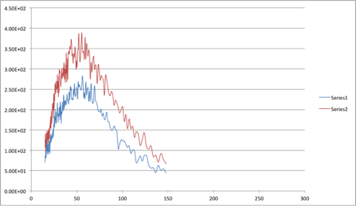
Test of the method: experiment @ JRC-IRMM
Preliminary Experimental Data
10°
20°
Javier Praena – INPC2013, Firenze 06/2013
27

