Slide 1
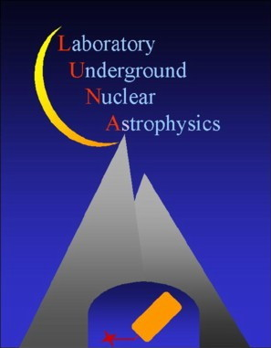

Astrophysical S-factor for the ¹⁷O(p,γ)¹⁸F reaction at Novae energy
Roberto Menegazzo
replacing
Antonio Caciolli
INFN Padova
INPC 2013 - Firenze 2-7 june 2013

Slide 2
outlook
LUNA: Why going underground to measure nuclear fusion reactions in a laboratory ?
¹⁷O(p,γ)¹⁸F
    Astrophysical Motivation
    Target Studies
    Results

Slide 3
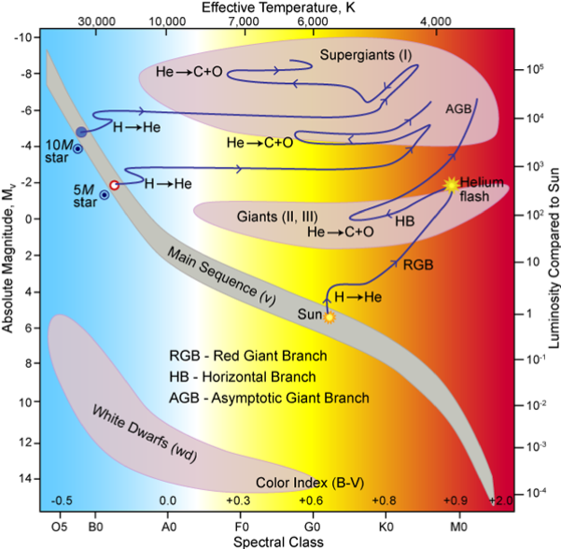
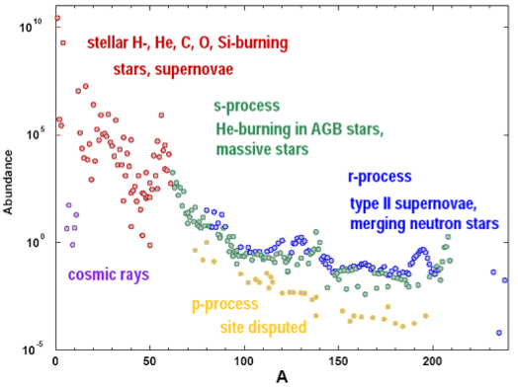
Nucleosynthesis
H burning → He
He burning → C, O, Ne
C/O ... Si burning → Fe
explosive burning
Solar Neutrinos and
element abundances in stars and BBN
TSUN = 0.015 GK
TRGB = 0.1 GK
Tnovae = 0.3 GK

Slide 4
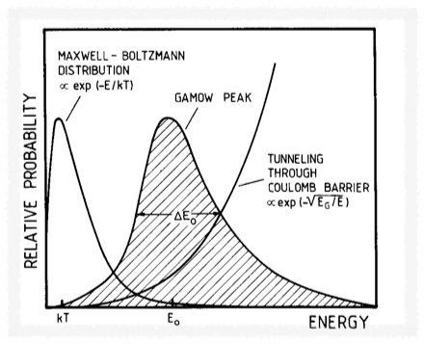
Reaction Rate for Charged Particles
Astrophysical factor
Gamow factor
Nuclear reactions that generate energy and synthesize elements take place inside the stars in a relatively narrow energy window: the Gamow peak
Gamow Energy for H-burning reactions:
few to several tens keV
pbarn < σ < nbarn
in the Sun: T = 1.5 10⁷ K
KT = 1 keV << Ecoul (0.5-2MeV)

Slide 5


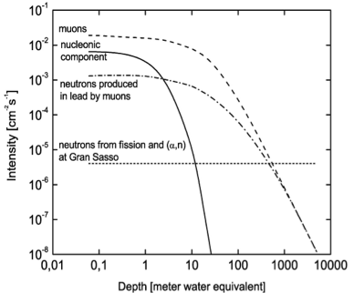
Why Going Underground ?
Surface
Gran Sasso
@ LNGS
muons: 1 /(m^{2.}h), E > 1 TeV
neutrons: 4 x 10⁻⁶ cm⁻²s⁻¹ with fission and (α,n)

Slide 6
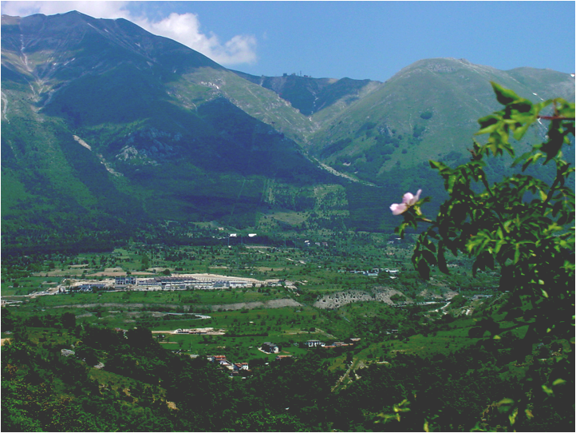
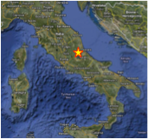
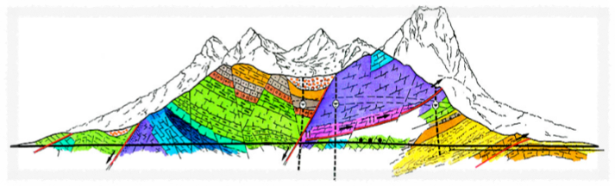
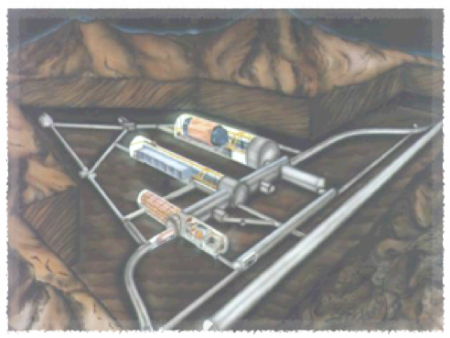
Laboratori Nazionali del Gran Sasso
1400 m rock overburden
Flux attenuation: n 10⁻³
μ 10⁻⁶
underground area 18000 m²
support facilities on the surface
LUNAII

Slide 7
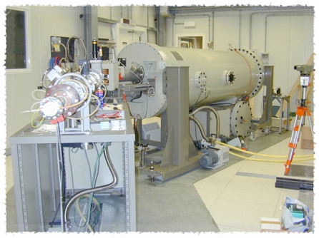
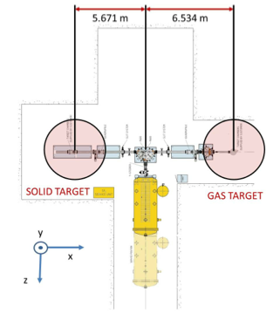
Laboratory for Underground Nuclear Astrophysics
Future Development:
LUNA MV
(partly financed)
LUNA II
Cockcroft-Walton Accelerator
High current p and α beams
Voltage range 50 - 400 kV
absolute Energy error ±300 eV
Energy spread < 100 eV
long term stability (1h) 5 eV

Slide 8


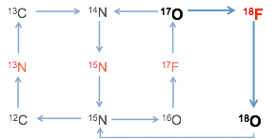
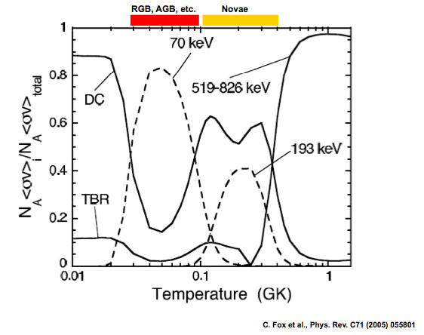
¹⁷O(p,γ)¹⁸F
of paramount importance for understanding hydrogen-burning in different stellar environments:
AGB and RGB stars
massive stars
classical novae
LUNA
important for galactic synthesis of ¹⁷O, ¹⁸F, and predicted O isotopic ratios in presolar grains
It affects directly the production of ¹⁷O,¹⁸O, ¹⁸F, and ¹⁹F in Classical Novae

Slide 9
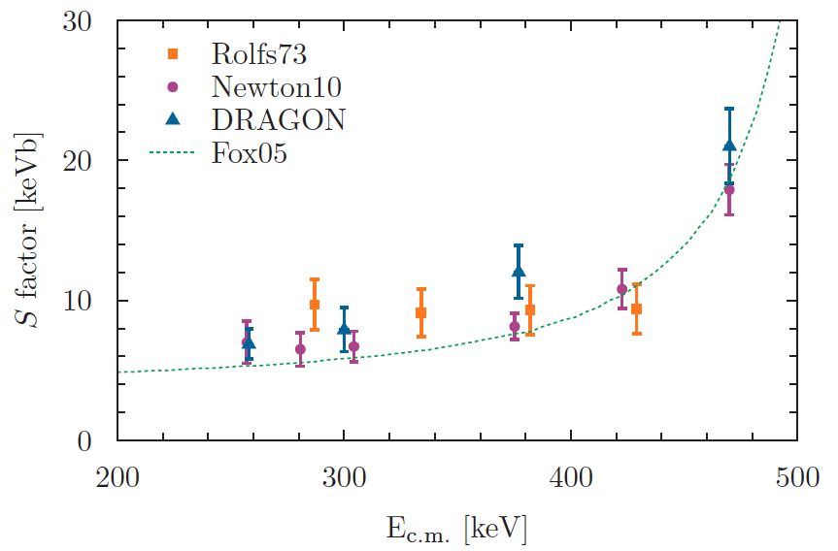
state of the art
LUNA range
Rolfs et al. Nuc. Phys. A217 29-70 (1973) – 1st investigation of the ¹⁷O(p,γ)¹⁸F reaction
Fox et al. Phys. Rev. C 71, 055801 (2005) – 1st 193 keV res. meas. : ωγ193= (1.2±0.2) μeV
Chafa et al. Phys. Rev. C 75, 033810 (2007) – Activation meas. : ωγ193= (2.2±0.4) μeV
Newton et al. Phys. Rev. C 81, 045801 (2010): cross section measurements
Hager et al. Phys Rev. C 85,035803 (2012): cross section measurements

Slide 10
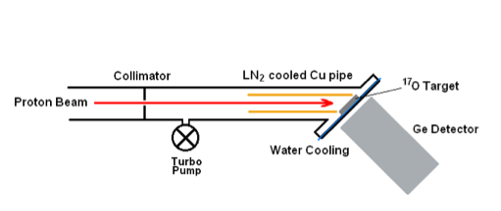
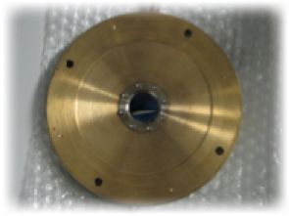
Solid Target Setup
beam current: 150 - 200 μA
irradiated charge: 30 C
Ta2O5 enriched targets: ¹⁷O up to 69% and ¹⁸O up to 96%
5 cm lead shielding for background suppression below 3 MeV
Energy range (CM): 165 keV - 379 keV
Activation
&
Prompt Gamma

Slide 11
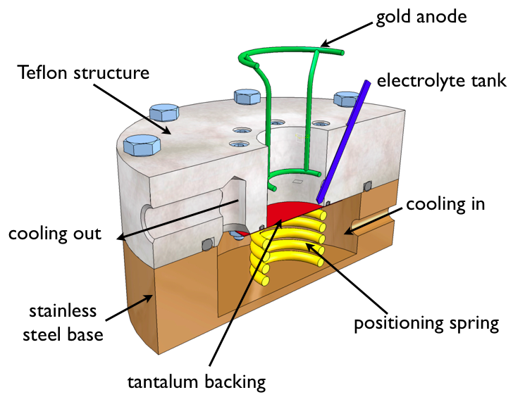
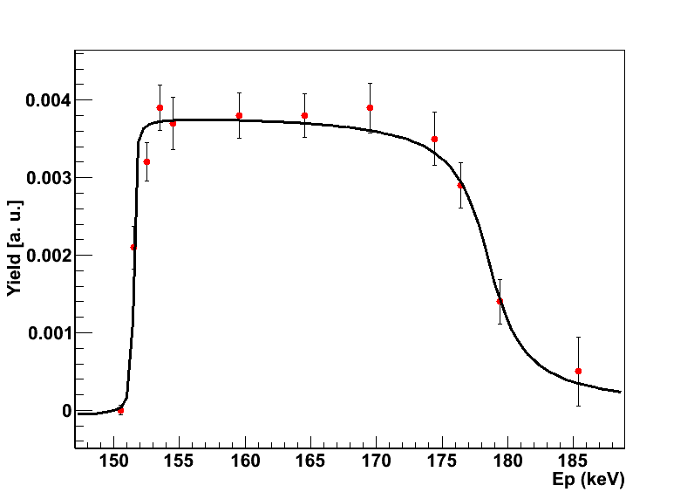

target preparation
Ta2O5 targets
¹⁷O enrichment up to 69% (with 5% ¹⁸O)
backing treated with citric acid and cooled to 25 °C during the anodization process
stoichiometry and isotopic ratio from 151 keV ¹⁸O(p,γ)¹⁹F resonance scans, RBS and SIMS measurements
Targets stable up to ~ 20 C
Caciolli et al. EPJ A 48 (2012) 144
28 keV @ 151 keV

Slide 12
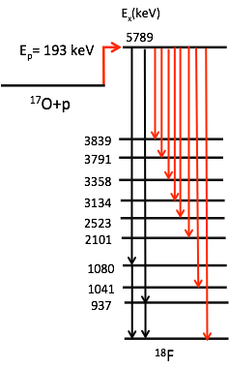
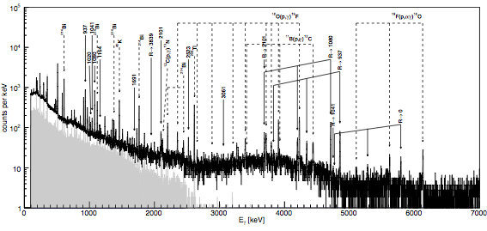
¹⁷O(p,γ)¹⁸F: Prompt Gamma Spectroscopy
efficiency measured at three different distances to correct for summing effect
lead shielding to reduce the natural background at low γ energies by a factor of 2
new branchings observed

Slide 13
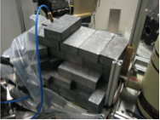
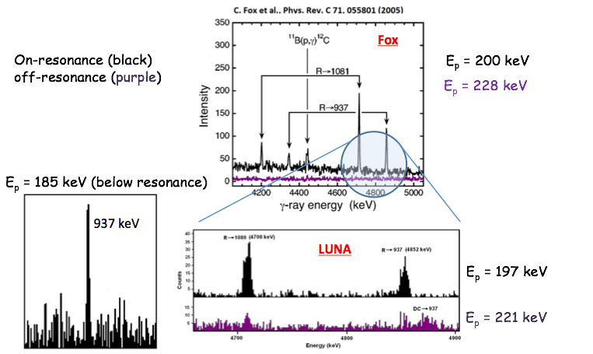
¹⁷O(p,γ)¹⁸F: Prompt Gamma Spectroscopy
surface
underground

Slide 14
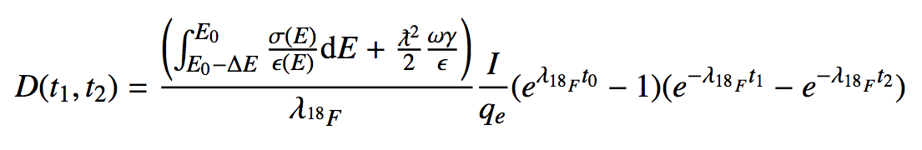
¹⁷O(p,γ)¹⁸F: Activation
¹⁸F decays (T1/2 = 110 min) are measured at the Low Level Counting Laboratory in Gran Sasso
6 h irradiation and 6 h counting performed on every run
resonance strength measured by using 6 runs on 3 different targets

Slide 15

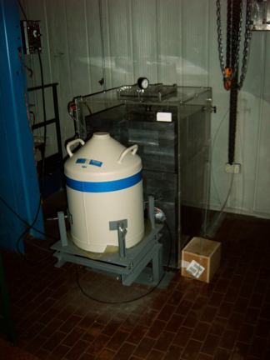
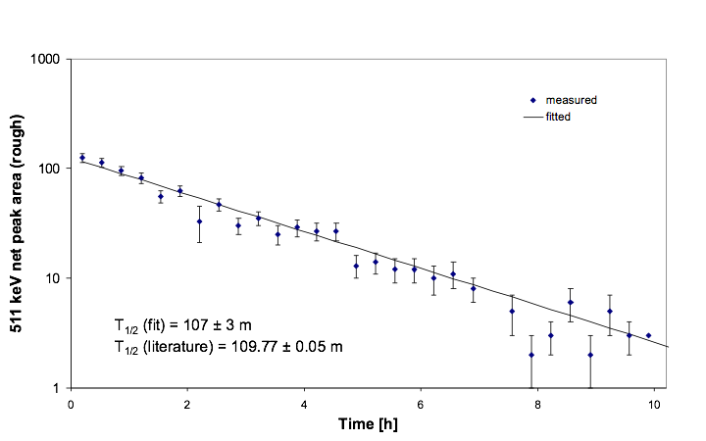
¹⁸F Measurements
efficiency measured using ¹³⁷Cs, ⁶⁰Co, and ⁸⁵Sr

Slide 16
183.3 keV resonance Strength
Activation: ωγ = (1.66 ± 0.03 stat ± 0.12 syst)10⁻⁶ eV
Prompt Gamma: ωγ = (1.69 ± 0.06 stat ± 0.13 syst)10⁻⁶ eV
good agreement
most of the systematics totally independent
Literature
ωγ193= (1.2±0.2)×10⁻⁶ eV FOX
ωγ193= (2.2±0.4)×10⁻⁶ eV CHAFA
the non resonant contribution has been obtained measuring the cross section below (ECM = 165 keV) and above the resonance

Slide 17
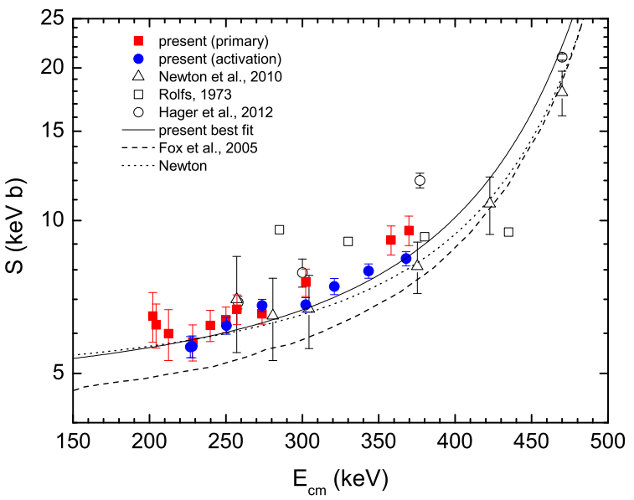
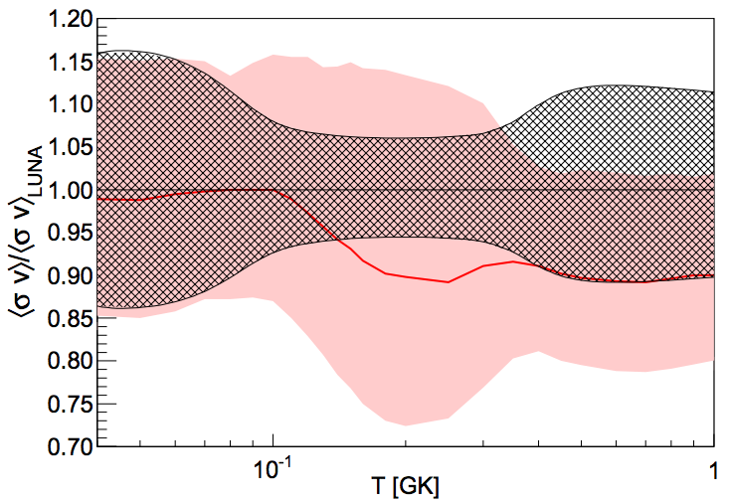
S-Factor
S-factor measured for the First time down to 200 keV
Uncertainty reduced by a factor of 4 with respect to previous works
Novae Gamow Peak totally covered for the first time with experimental data
Scott et al. Phys. Rev. Lett. 109, 208001 (2012) Editors’ Suggestion

Slide 18
GRAZIE!
Atomki (Zs. Fülöp, Gy. Gyürky, E. Somorjai, T. Szücs)
Bochum (F. Strieder)
Dresden (D. Bemmerer, M. Anders, Z.Elekes)
Edinburgh (M. Aliotta, D. Scott, T. Davinson)
Genova (A. Bellini, P. Corvisiero, P. Prati, C. Salvo)
GSI (M. Marta)
LNL (V. Rigato)
LNGS (A. Formicola, M. Junker, M. Laubenstein)
Milano (A. Guglielmetti, D. Trezzi, M. Campeggio)
Napoli (G. Imbriani, V. Roca, F. Terrasi, A. Di Leva)
Padova (C. Broggini, A. Caciolli, R. Menegazzo, R. Depalo, E. Napolitani)
Roma (C. Gustavino)
Teramo (O. Straniero)
Torino (G. Gervino)

