Slide 1


Charged particle capture and elastic scattering experiments relevant to the astrophysical p-process
György Gyürky
Institute for Nuclear Research (Atomki)
Debrecen, Hungary
International Nuclear Physics Conference (INPC 2013), Firenze, Italy, 2-7 June 2013

Slide 2
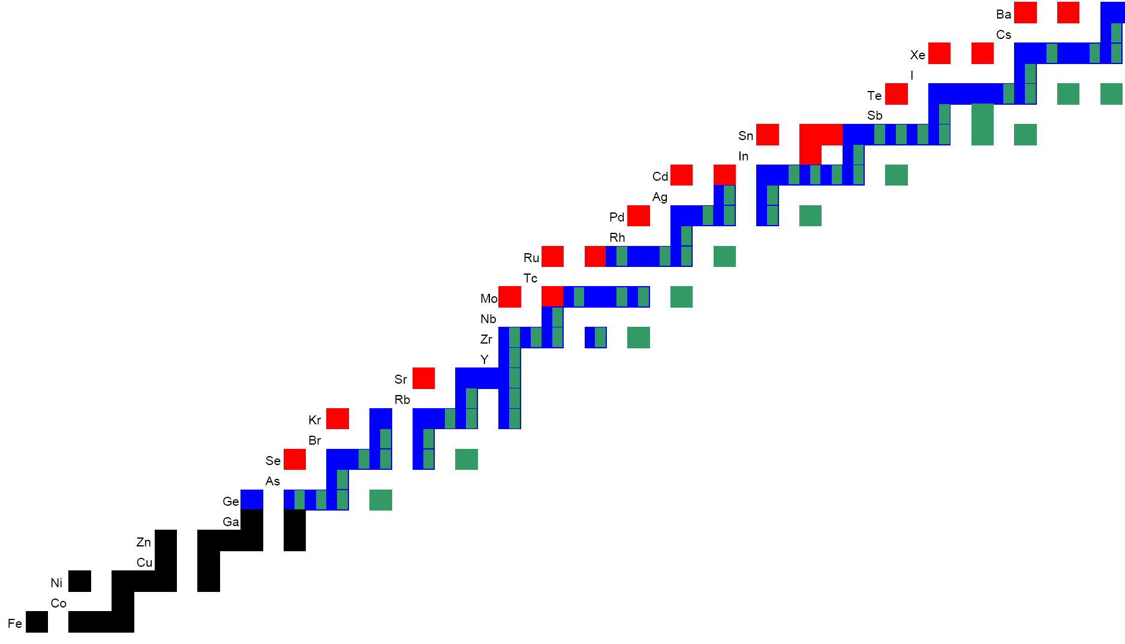
Heavy element nucleosynthesys
n capture
β⁻ decay
β⁺ decay
s-process

Slide 3
Heavy element nucleosynthesys
n capture
β⁻ decay
β⁺ decay
r-process

Slide 4
Heavy element nucleosynthesis
p-isotopes
p-process
n capture
β⁻ decay
β⁺ decay
r-process
4

Slide 5
P-process: several sub-processes
only groups of p-isotopes
rp-process
pn-process
νp-process
ν-process
γ-process
proton capture reactions
neutrino-induced reactions
gamma-induced reactions
the whole mass range

Slide 6
Gamma-process network
T. Rauscher et al.
Rep. Prog. Phys. 76, (2013) 066201
(γ,n)
¹⁰⁸Sn
¹⁰⁹Sn
¹¹⁰Sn
¹¹¹Sn
¹¹²Sn
¹¹³Sn
¹¹⁴Sn
¹¹⁵Sn
¹¹⁶Sn
(γ,p)
(γ,α)
(γ,p)
¹⁰⁶Cd
¹⁰⁸Cd

Slide 7
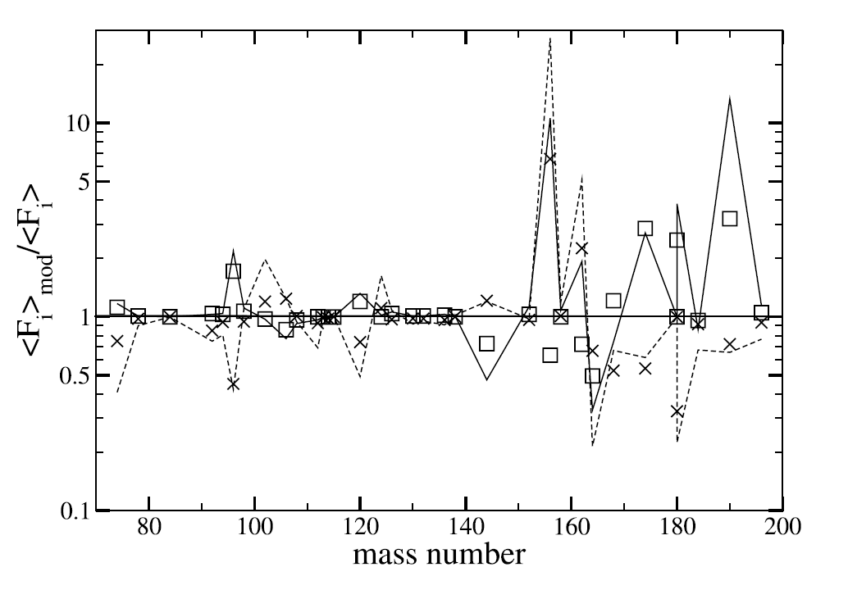
(γ,α) reactions /from inverse (α,γ)/
Lack of
experimental data
Strong sensitivity
of the models
W. Rapp et al., AJ 653, (2006) 474.

Slide 8
(α,γ) experiments on heavy isotopes at Atomki, Debrecen, Hungary
¹²⁷I(α,γ)¹³¹Cs
¹²¹Sb(α,γ)¹²⁵I
¹¹⁵In(α,γ)¹¹⁹Sb
¹⁰⁷Ag(α,γ)¹¹¹In
¹⁹¹Ir(α,γ)¹⁹⁵Au
¹⁶⁹Tm(α,γ)¹⁷³Lu
¹⁶²Er(α,γ)¹⁶⁶Yb
¹³⁰Ba(α,γ)¹³⁴Ce
Starting Grant

Slide 9
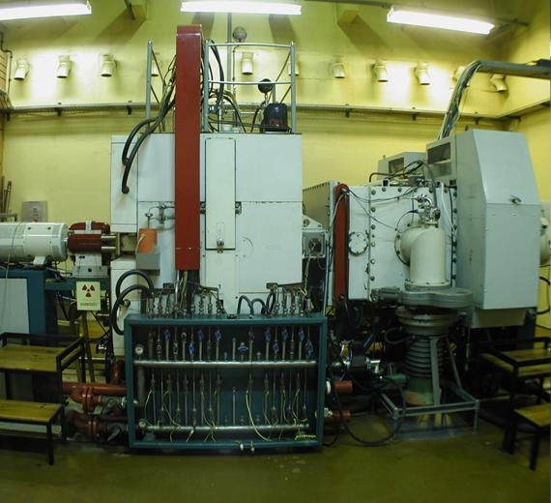
Experiments
20 MeV cyclotron of Atomki, Debrecen, Hungary
Activation method

Slide 10
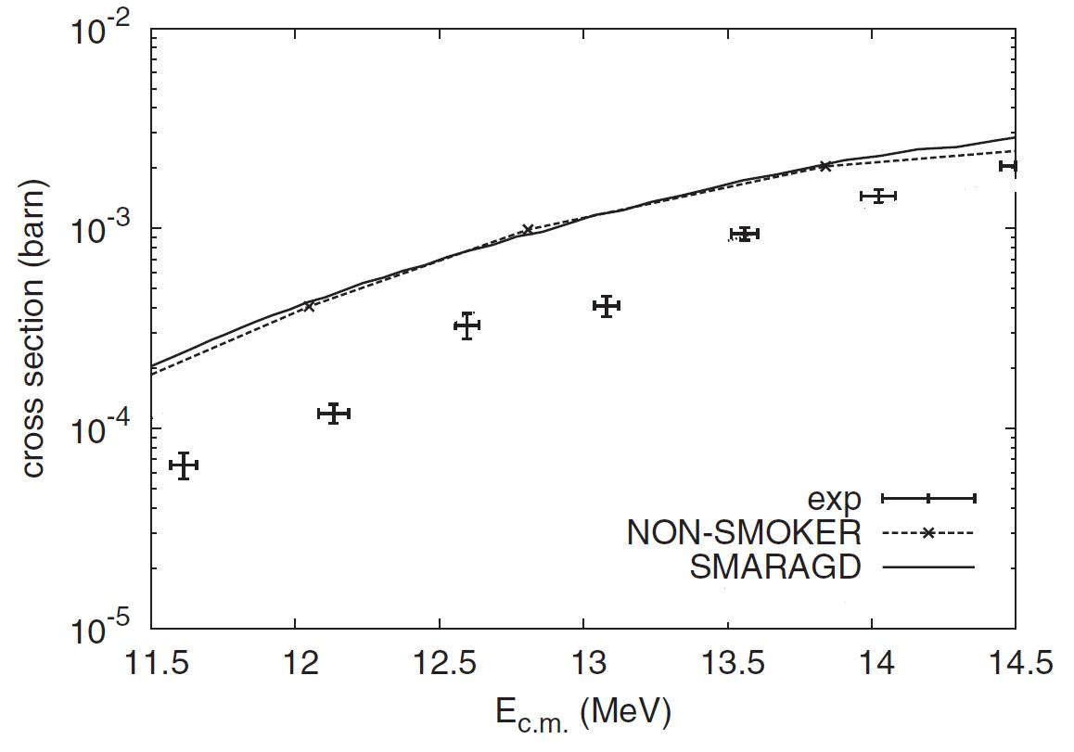
¹³⁰Ba(α,γ)¹³⁴Ce
Z. Halász et al., Phys. Rev. C 85, 025804 (2012).

Slide 11
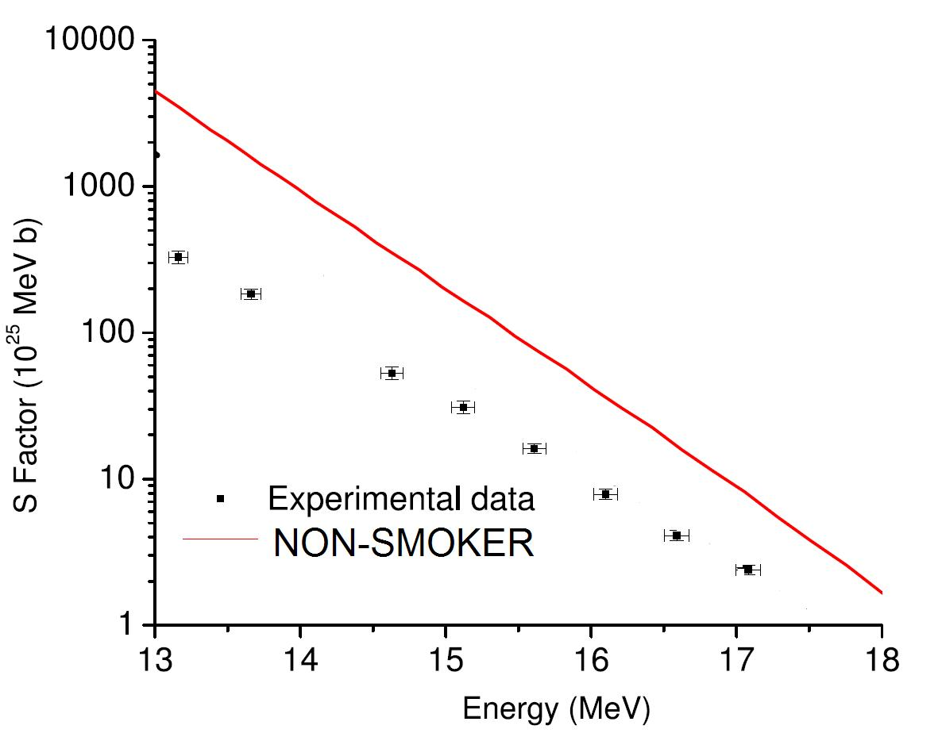
¹⁶⁹Tm(α,γ)¹⁷³Lu
G.G. Kiss et al., Phys. Lett. B 695, 149 (2011).

Slide 12
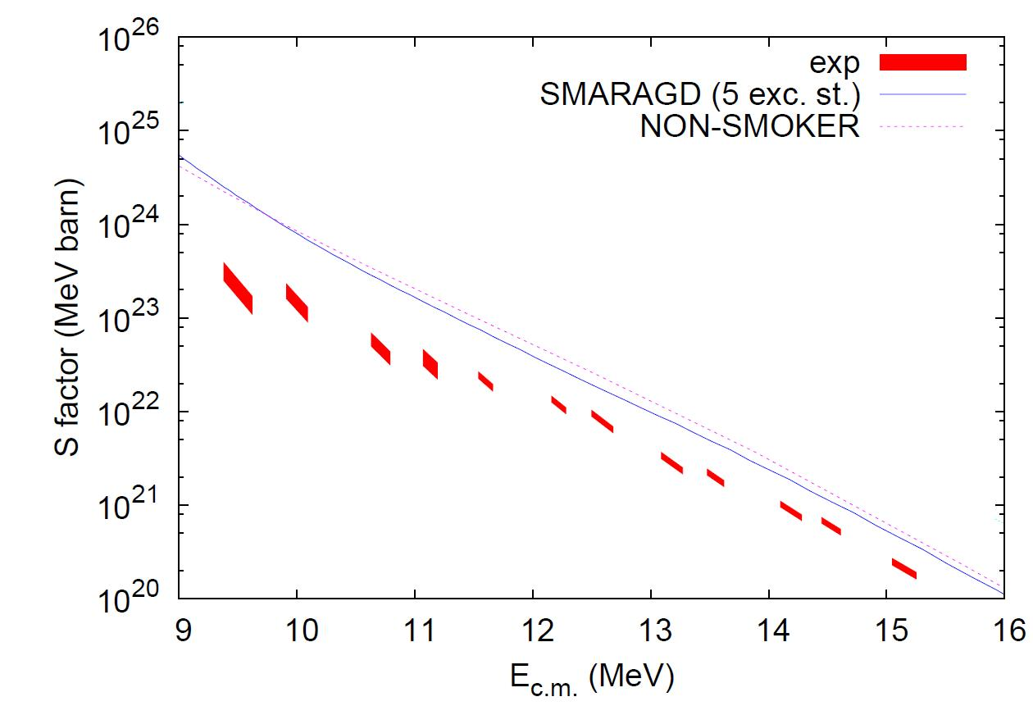
¹²⁷I(α,γ)¹³¹Cs
G.G. Kiss et al., Phys. Rev. C 86, 035801 (2012).

Slide 13
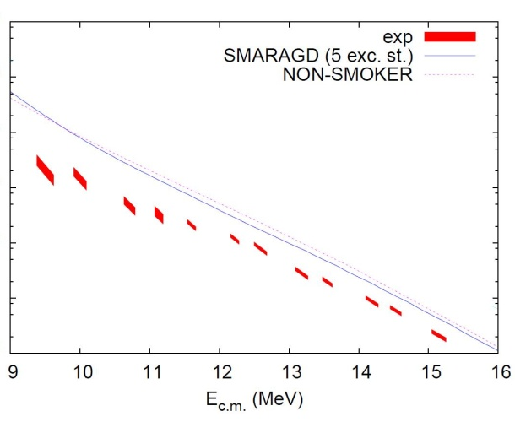
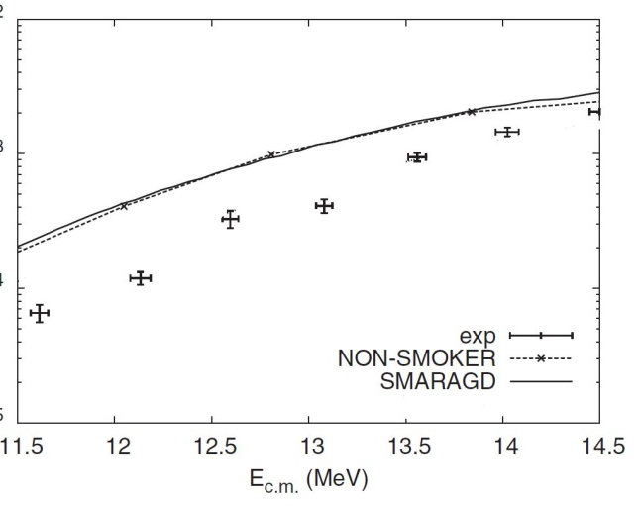

Gamow windows* at T₉ = 2.5
5.8-9
MeV
¹²⁷I(α,γ)¹³¹Cs
6.1-9.3
MeV
¹³⁰Ba(α,γ)¹³⁴Ce
Extrapolations
inevitable!
7.2-10.2
MeV
¹⁶⁹Tm(α,γ)¹⁷³Lu
*T. Rauscher, PRC 81, 045807 (2010).

Slide 14
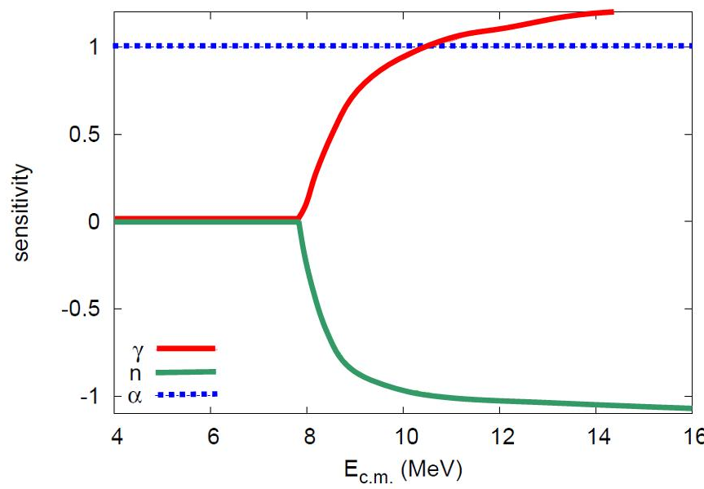
Cross section sensitivity on input parameters
¹²⁷I(α,γ)¹³¹Cs
Gamow
window
Experimental
data

Slide 15
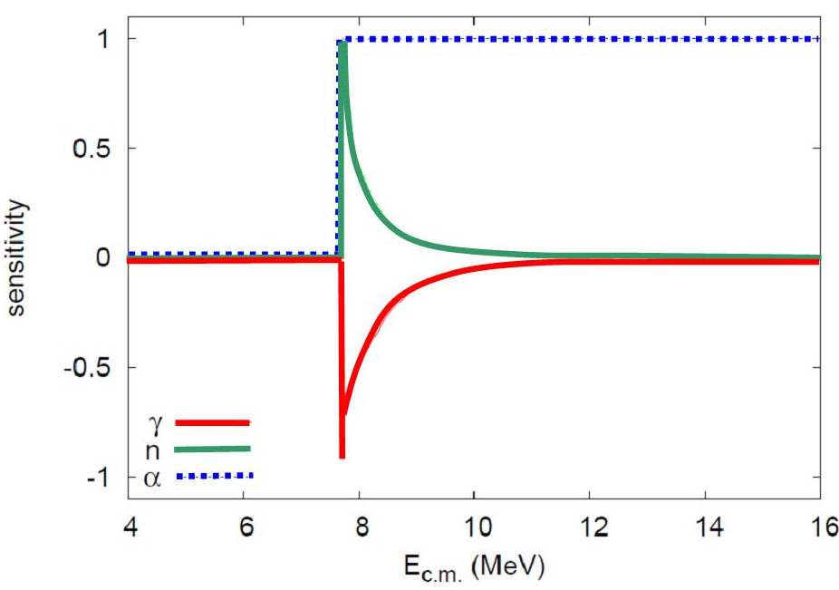
Cross section sensitivity: (α,n) reactions
¹²⁷I(α,n)¹³¹Cs
Experimental
data

Slide 16
(α,n) cross section measurements: activation often possible

Slide 17
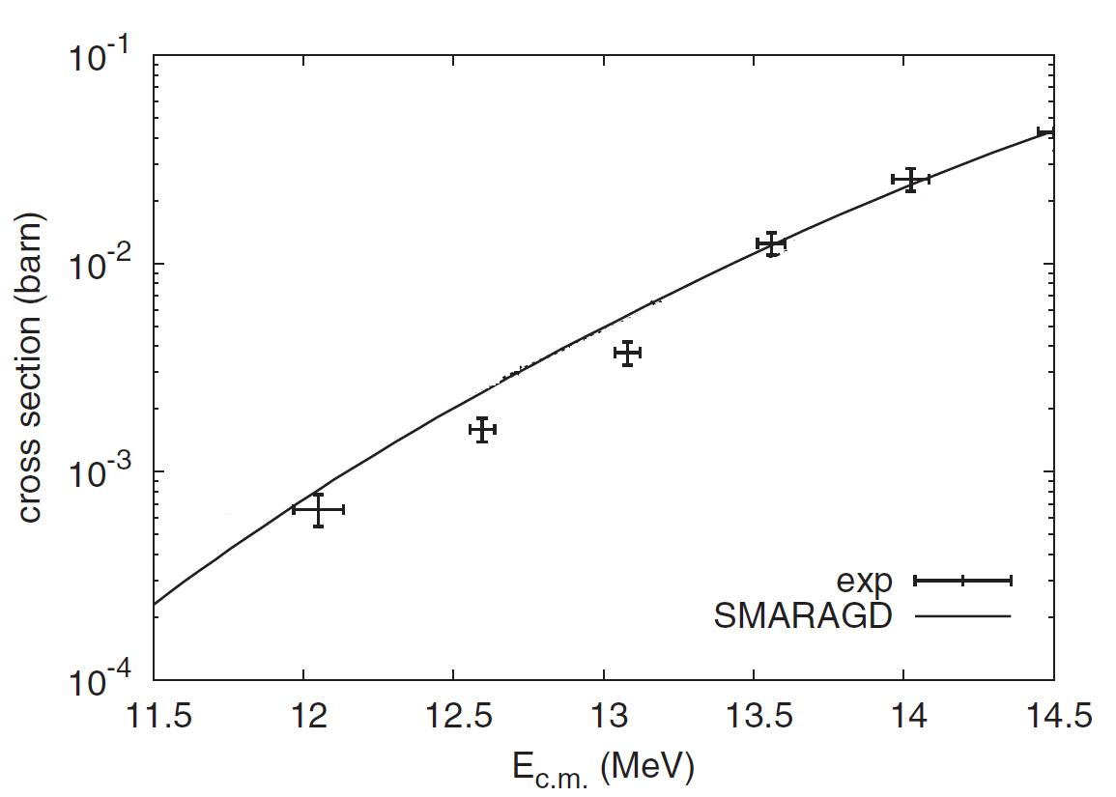
(α,n) cross section measurements
Z. Halász et al., Phys. Rev. C 85, 025804 (2012).
¹³⁰Ba(α,n)¹³³Ce
¹³⁰Ba(α,γ)¹³⁴Ce

Slide 18
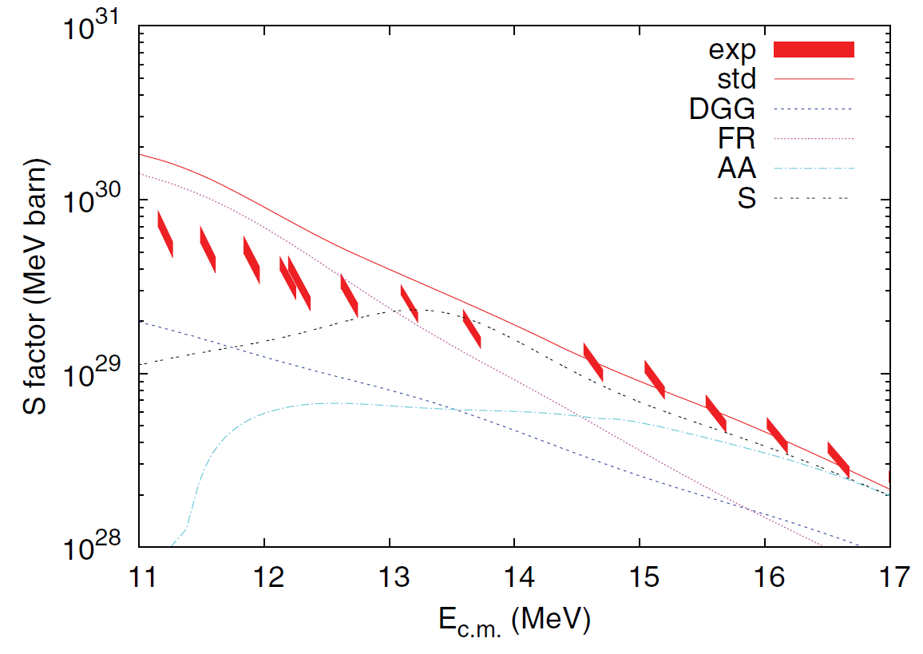
(α,n) sensitivity on optical potential
¹⁶⁹Tm(α,n)¹⁷²Lu
Experimental data
McFadden & Satchler
Demetriou et al.
Fröhlich & Rauscher
Avrigeanu & Avrigeanu
Sauerwein et al.
T. Rauscher et al., PRC 86, 015804 (2012).

Slide 19
Direct study of optical potential
High precision, low energy elastic scattering experiments
Suggestion for a new global potential
systematic (α,α)
elastic scattering
experiments
Starting Grant

Slide 20
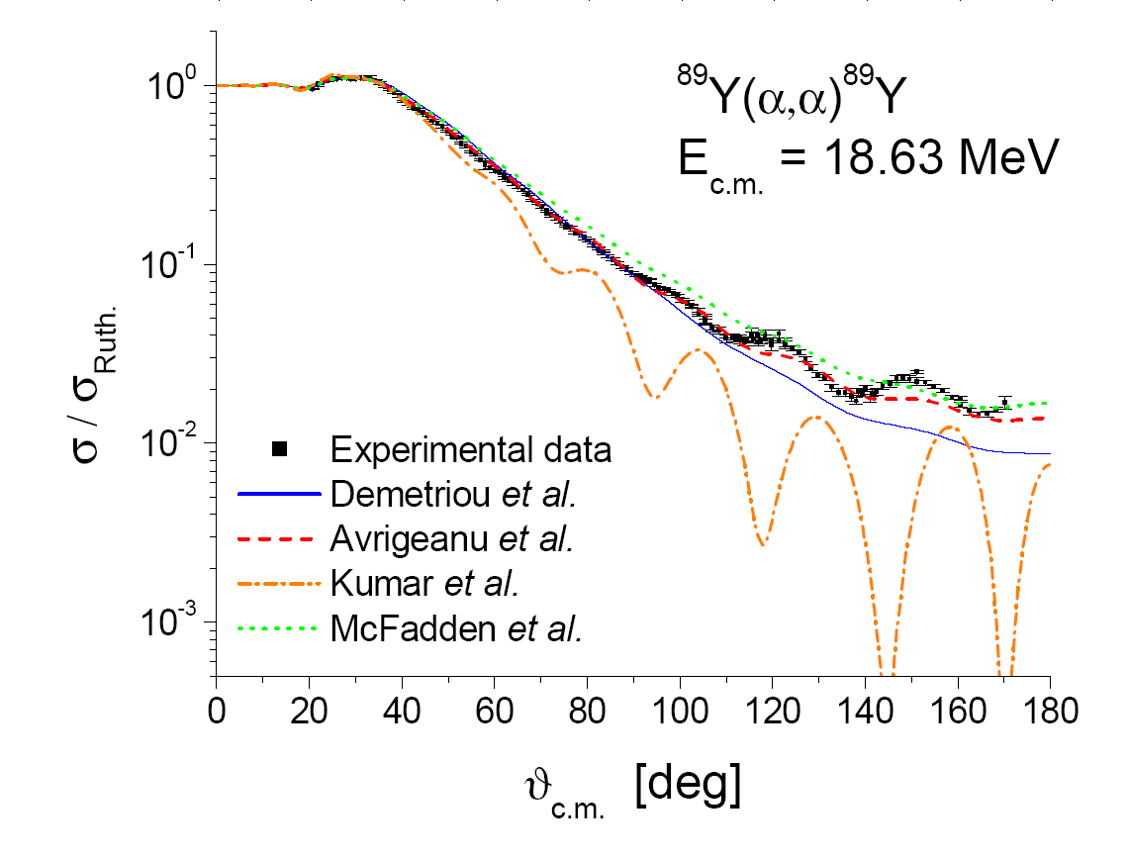
Comparison with global potentials
G.G. Kiss et al.,
Phys. Rev. C 80
(2009) 045807

Slide 21
Construction of local potentials

Slide 22
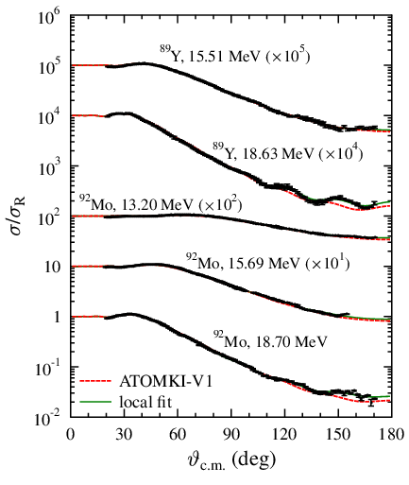
Towards a new global potential
Based on scattering data
Double folding + surface WS
Few (5) adjustable parameters
Optimized for low energy
In progress...
Local fit
New global pot.

Slide 23
Further progress needed
Study of possible astrophysical sites
Charged particle induced reactions
Experiments off-stability
⁹⁶Ru(p,γ)⁹⁷Rh reaction
in inverse kinematics
at ESR, GSI

Slide 24
Novel approaches with stable targets
X-ray detection based activation
Activation with AMS
Thick target yield measurements
Total cross section determination (from combining scattering and capture)
Inelastic scattering measurements
...

Slide 25
Thank you for your attention!
ATOMKI nuclear astrophysics group:
Zs. Fülöp
Gy. Gyürky
Z. Halász
G.G. Kiss
E. Somorjai
T. Szücs
Z. Korkulu
C. Yalcin
A. Ornelas
P. Mohr (external member from
  Schwäbisch Hall,
  Germany)
In collaboration with:
Kocaeli University, Turkey
University of Lisbon, Portugal
...
Continuous theoretical
support from
T. Rauscher (Uni. Basel, Switzerland)
http://astro.atomki.hu/
25

Slide 26


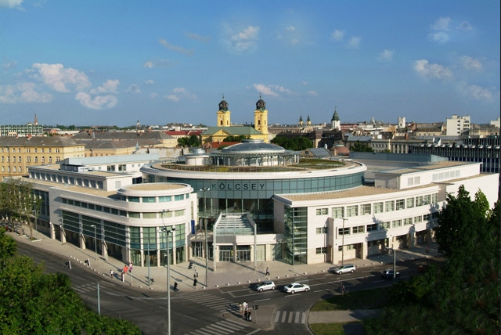
Nuclei in the Cosmos - XIII
Debrecen, Hungary,
7-11 July 2014
http://www.nic2014.org/

