Slide 1


The nucleosynthesis of heavy elements in Stars: the key isotope ²⁵Mg
C. Massimi
on behalf of the n_TOF collaboration
International Nuclear Physics Conference
Firenze, 2-7 June 2013

Slide 2

Motivations
New measurements:
  Ongoing:
    ²⁵Mg(n,γ) @ n_TOF
    ²⁵Mg(n,tot) and ²⁵Mg+n γ-ray spectrum @ GELINA
  Planned:
    ²⁵Mg(n,α)²²Ne @ EAR2 - n_TOF
Preliminary results and implications

Slide 3
Motivations
²⁵Mg(n,γ)
^{25,26}Mg are the most important neutron poisons due to neutron capture on Mg stable isotopes in competition with neutron capture on ⁵⁶Fe (i.e. the basic s-process seed for the production of heavy isotopes).
The ²²Ne(α,n)²⁵Mg is one of the most important neutron source in Red Giant stars. Its reaction rate is very uncertain because of the poorly known property of the states in ²⁶Mg. Information can come from neutron measurements (knowledge of J^{π} for the ²⁶Mg states).

Slide 4
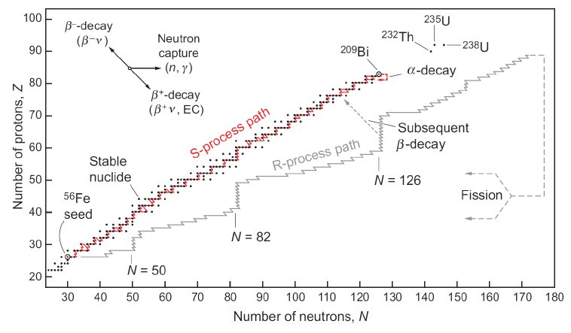
Motivation 1/2
²⁵Mg(n,γ)
The s process and Mg stable isotopes: neutron poison
“Main component”
²²Ne(α,n)²⁵Mg is a neutron source in AGB stars:
1M_{sun} < M < 3M_{sun}
  kT=8 keV and kT=23 keV
“Weak component”
²²Ne(α,n)²⁵Mg is the main neutron source in massive stars: M > 10 – 12M_{sun}
  kT=25 keV and kT=90 keV

Slide 5
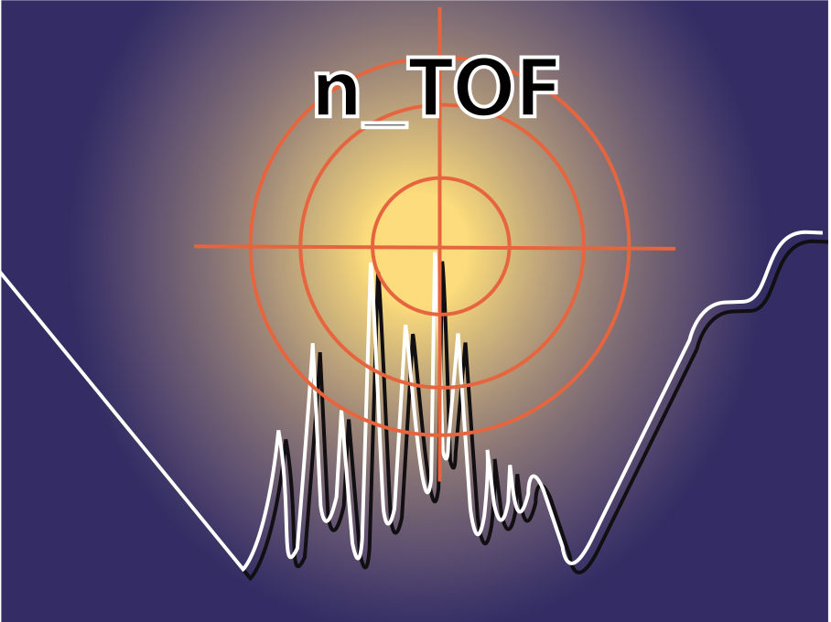
Motivation 1/2
²⁵Mg(n,γ)
The s process and Mg stable isotopes: neutron poison
“Main component”
²²Ne(α,n)²⁵Mg is a neutron source in AGB stars:
1M_{sun} < M < 3M_{sun}
  kT=8 keV and kT=25 keV
“Weak component”
²²Ne(α,n)²⁵Mg is the main neutron source in massive stars: M > 10 – 12M_{sun}
  kT=25 keV and kT=90 keV
From neutron TOF measurements:
→ ²⁵Mg(n, γ) cross section

Slide 6
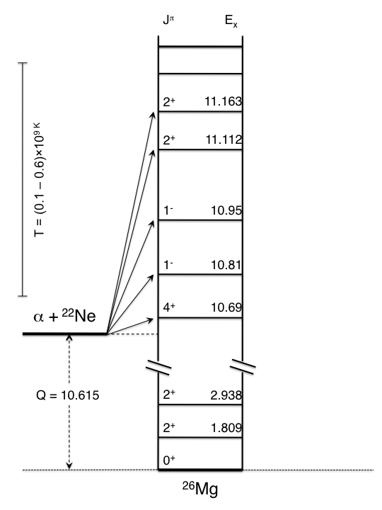
Motivation 2/2
Constraints for the
²²Ne(α,n)²⁵Mg reaction
Element | Spin/parity
²²Ne | 0⁺
⁴He | 0⁺
Only natural-parity (0⁺, 1⁻, 2⁺, 3⁻, 4⁺, …) states in ²⁶Mg can participate in the
²²Ne(α,n)²⁵Mg reaction
MeV

Slide 7
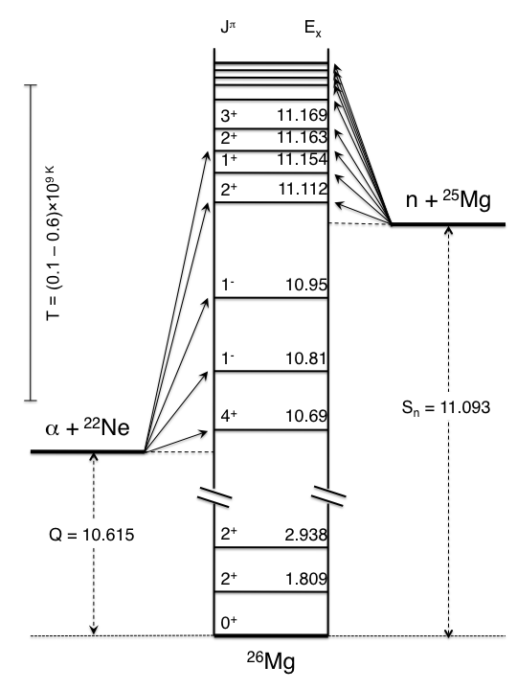
Motivation 2/2
²⁵Mg(n,γ)
²⁵Mg(n,tot)
²⁵Mg(n,α)
Constraints for the
²²Ne(α,n)²⁵Mg reaction
Element | Spin/parity
²⁵Mg | 5/2⁺
neutron | 1/2⁺
MeV
MeV
s-wave → J^{π}= 2⁺, 3⁺
p-wave →J^{π}= 1⁻, 2⁻, 3⁻, 4⁻
d-wave →J^{π}= 0⁺, 1⁺, 2⁺, 3⁺, 4⁺, 5⁺
States in ²⁶Mg populated by ²⁵Mg+n reaction

Slide 8
Motivation 2/2
²⁵Mg(n,γ)
²⁵Mg(n,tot)
²⁵Mg(n,α)
Constraints for the
²²Ne(α,n)²⁵Mg reaction
Element | Spin/parity
²⁵Mg | 5/2⁺
neutron | 1/2⁺
²²Ne | 0⁺
⁴He | 0⁺
MeV
MeV
From neutron TOF measurements:
→ J^{π} for the ²⁶Mg states

Slide 9
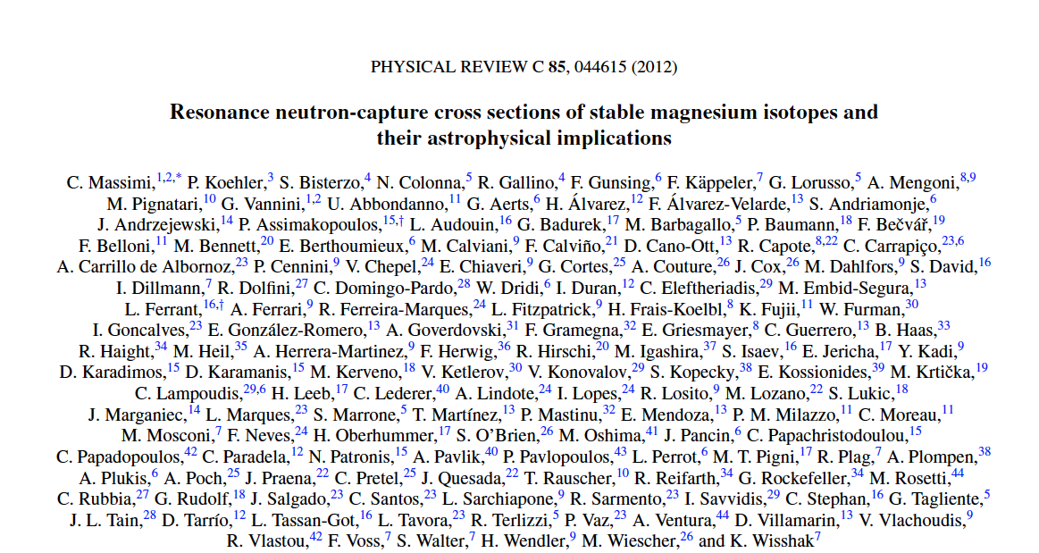
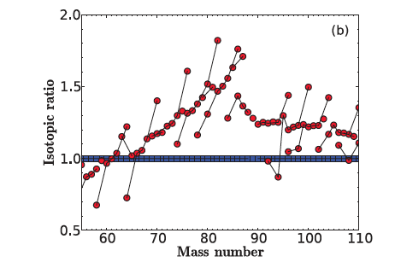
Motivations
²⁵Mg(n,γ)
@ n_TOF
Results from previous (2003) measurement:

Slide 10
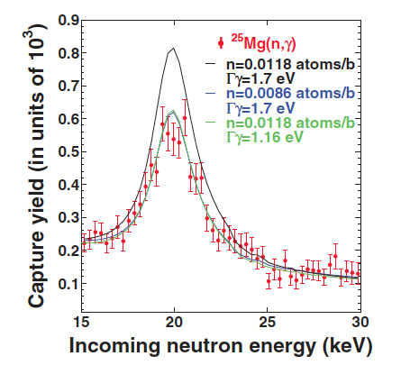
Motivations
²⁵Mg(n,γ)
@ n_TOF
Results from previous (2003) measurement:
Oxide Sample → Large uncertainty in the mass of the Mg sample

Slide 11
Motivations
New measurement: improvements
Sample
  Capture on a metal ²⁵Mg-enriched sample → no data in literature
  Transmission on the ²⁵Mg-enriched sample → no data in literature
n_TOF facility Phase-II:
  Borated water as neutron moderator → γ-ray background reduced

Slide 12

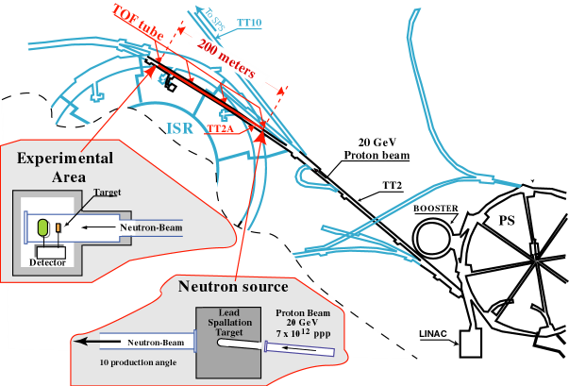
New Measurement
²⁵Mg(n,γ)
@ n_TOF
n_TOF is a neutron spallation source based on 20 GeV/c protons from the CERN PS hitting a Pb block (~360 neutrons per proton). Experimental area at 200 m.
n_TOF, the neutron
time-of-flight facility at CERN

Slide 13
New Measurement
²⁵Mg(n,γ)
@ n_TOF
2003
OLD sample (powder)
2012
New sample (metal)
Science-Technical Centre “Stable Isotopes” (Obninsk, Russia)
National Isotope Development Center (ORNL, USA)
Property | Value
Mass MgO | 3.19 g
Diameter | 22 mm
Thickness | 2.3 mm
Areal density | 1.234x10⁻² at/b
Property | Value
Mass Mg | 3.94 g
Diameter | 20 mm
Thickness | 7 mm
Areal density | 3.00x 10⁻² at/b
Enrichment 95.75%
²⁴Mg ~ 3%,
²⁶Mg ~ 1.2%
Enrichment 97.86 %
²⁴Mg ~ 1.83 %
²⁶Mg ~ 0.31 %
Neutrons ≈ 1.1x10¹⁰
1 eV < E_{n} < 1 MeV
Neutrons ≈ 1.9x10¹⁰
0.03 eV < E_{n} < 1 MeV

Slide 14
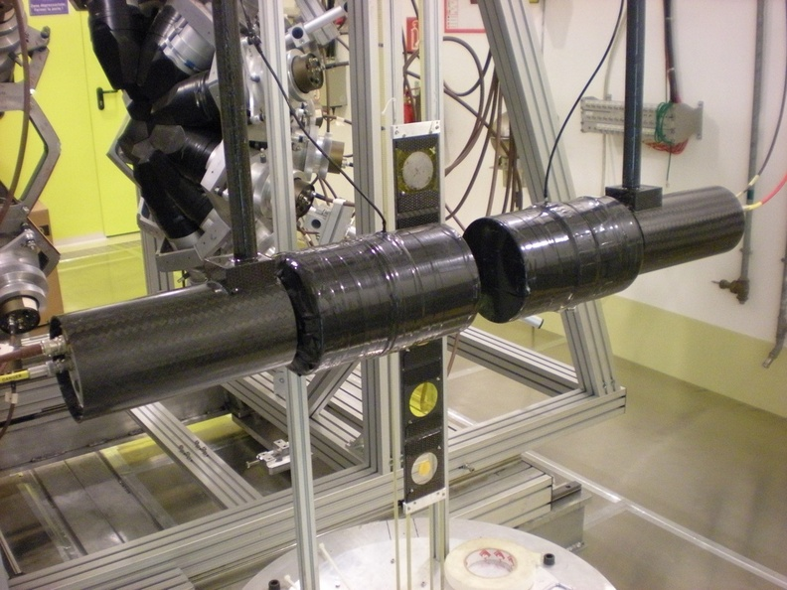
New Measurement
²⁵Mg(n,γ)
@ n_TOF
Typical capture set-up:
2 C₆D₆ liquid scintillators
“Total Energy Detection System”
C₆D₆
C₆D₆
Sample changer
Neutron beam

Slide 15
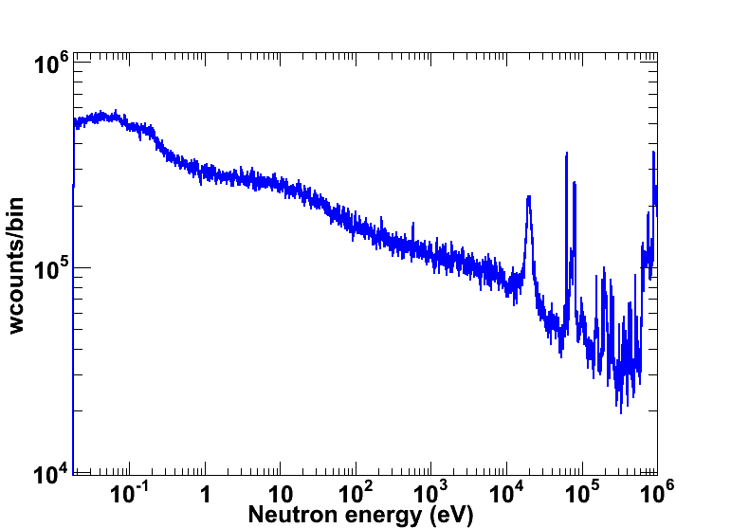
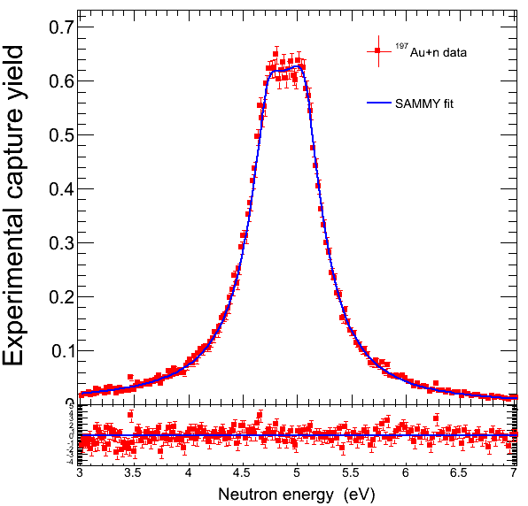
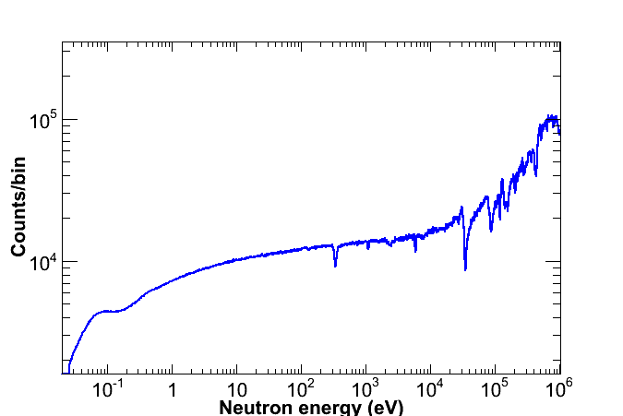
Data Analysis
²⁵Mg(n,γ)
@ n_TOF
Experimental capture yield

Slide 16
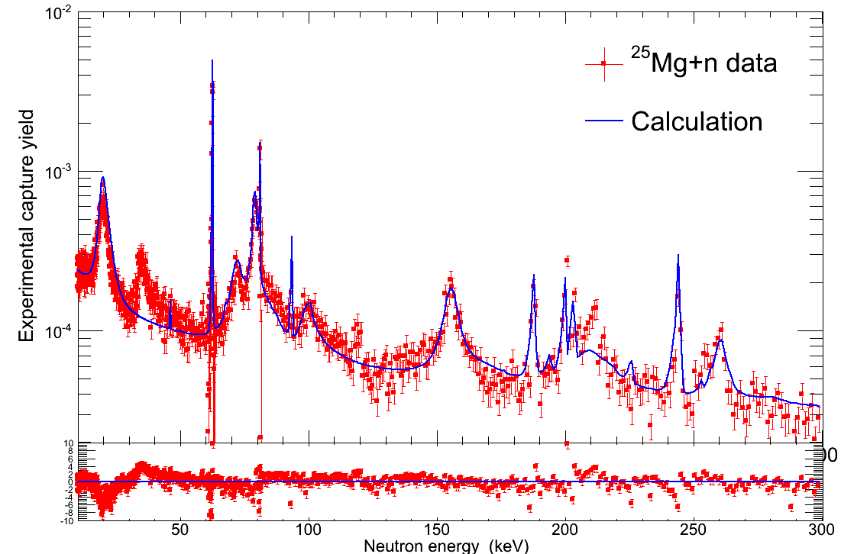
Preliminary Results
2012
data
Previous evaluation
Al

Slide 17
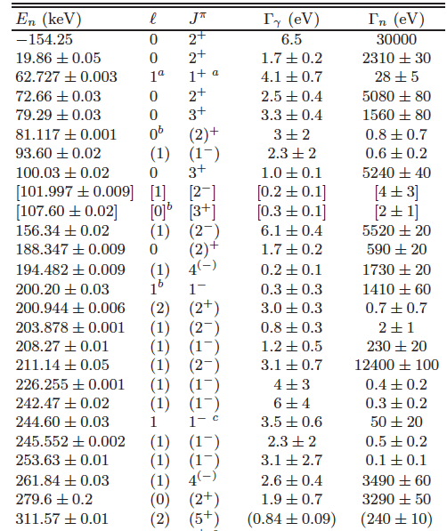
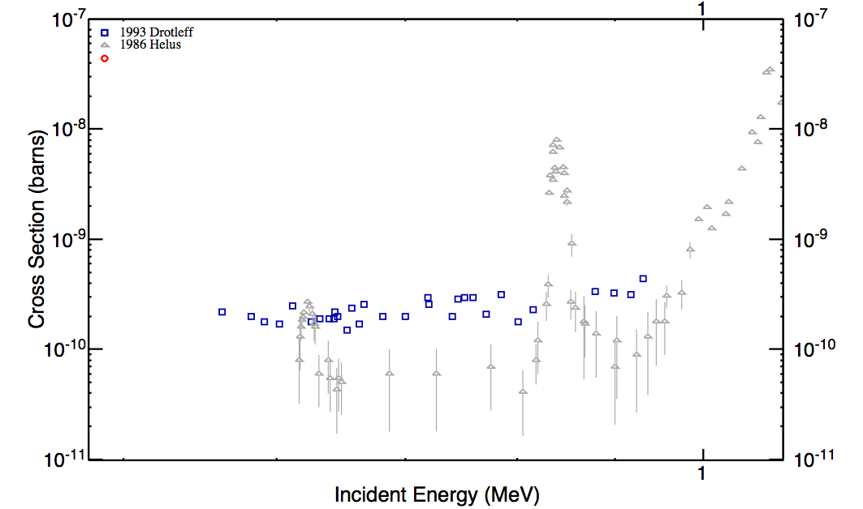
Results from ²⁵Mg(n,γ)
²⁵Mg(n,γ)²⁶Mg resonances
²²Ne(α,n)²⁵Mg
Constraints for the
²²Ne(α,n)²⁵Mg reaction

Slide 18
Results from ²⁵Mg(n,γ)
²⁵Mg(n,γ)²⁶Mg resonances
²²Ne(α,n)²⁵Mg
Neutron energy Lab.
0
30
294
E_{n} (keV)
Constraints for the
²²Ne(α,n)²⁵Mg reaction
Observed ~ 30 resonances in the
energy region of interest

Slide 19
Results from ²⁵Mg(n,γ)
Stellar site | Temperature keV | MACS (this work) | MACS (KADoNiS)
He - AGB | 8 | 4.9±0.6 mb | 4.9 mb
He - AGB | 23 | 3.2±0.2 mb | 6.1 mb
30 | 30 | 4.1±0.6 mb | 6.4±0.4 mb
He – Massive | 25 | 3.4±0.2 mb | 6.2 mb
C - Massive | 90 | 2.6±0.3 mb | 4.0 mb
s-process abundances

Slide 20
Results from ²⁵Mg(n,γ)
Stellar site | Temperature keV | MACS (this work) | MACS (KADoNiS)
He - AGB | 8 | 4.9±0.6 mb | 4.9 mb
He - AGB | 23 | 3.2±0.2 mb | 6.1 mb
30 | 30 | 4.1±0.6 mb | 6.4±0.4 mb
He – Massive | 25 | 3.4±0.2 mb | 6.2 mb
C - Massive | 90 | 2.6±0.3 mb | 4.0 mb
s-process abundances
Reduced poisoning
effect in Massive Stars

Slide 21
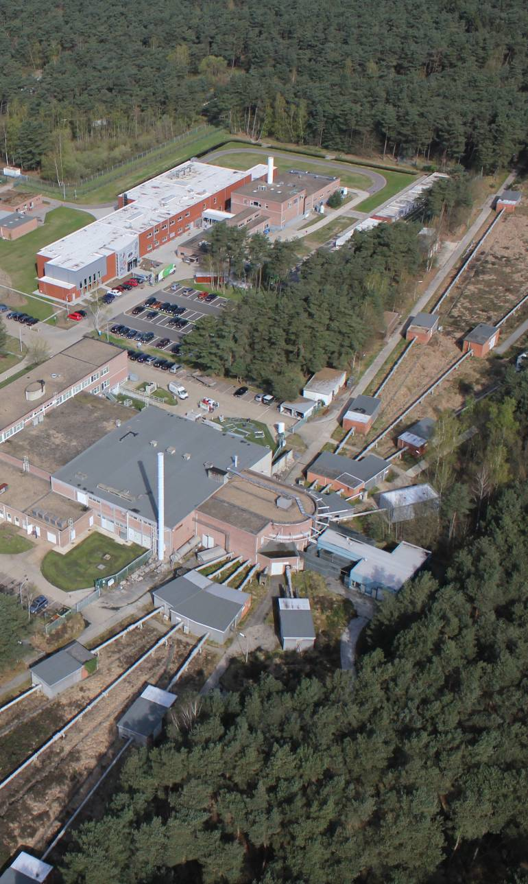


New Measurement
²⁵Mg(n,tot)
@ GELINA
GELINA is a photonuclear neutron source based on 140 MeV e⁻ impinging on a U target. 10 Experimental areas at different flight paths (10 m - 400 m).
FLIGHT PATHS NORTH
ELECTRON LINAC
TARGET HALL
FLIGHT PATHS SOUTH

Slide 22
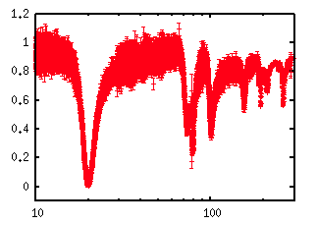
New Measurement
²⁵Mg(n,tot)
@ GELINA
Transmission
Neutron energy (keV)

Slide 23
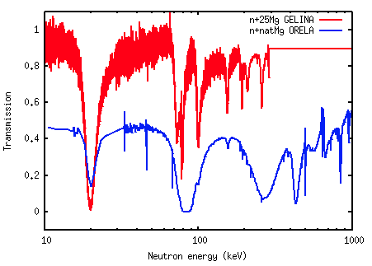
New Measurement
²⁵Mg(n,tot)
@ GELINA
- n+²⁵Mg @ GELINA 2012
- n+^{nat}Mg @ ORELA 1976
Transmission
Neutron energy (keV)

Slide 24
New Measurement
²⁵Mg(n,tot)
@ GELINA
- n+²⁵Mg @ GELINA 2012
- n+^{nat}Mg @ ORELA 1976
Transmission
Isotope | ORELA | GELINA
²⁵Mg | 10.13 % | 97.86 %
²⁴Mg | 78.80 % | 1.83 %
²⁶Mg | 11.17 % | 0.31 %
Neutron energy (keV)

Slide 25
Future program
Complete the study of the most important neutron source in Red Giants by measuring ²⁵Mg(n,α)²²Ne reaction cross-section

Slide 26
Future program
Complete the study of the most important neutron source in Red Giants by measuring ²⁵Mg(n,α)²²Ne reaction cross-section
Challenge:
Cross section very small
Q-value 480 keV (→ thin sample)
A. + B. = Extremely low count rate expected

Slide 27
Future program
Complete the study of the most important neutron source in Red Giants by measuring ²⁵Mg(n,α)²²Ne reaction cross-section
Challenge:
Cross section very small
Q-value 480 keV (→ thin sample)
A. + B. = Extremely low count rate expected
Solution:
High neutron flux
Flux delivered in a short time interval
a) + b) = n_TOF new experimental area (EAR2)

Slide 28
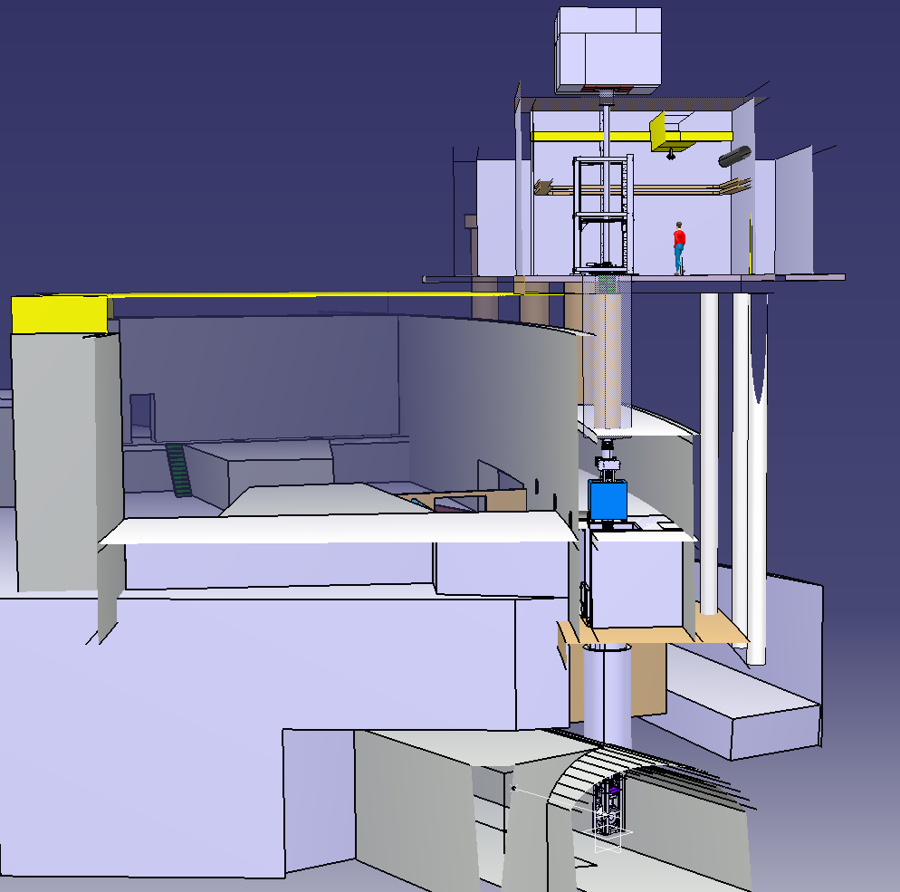
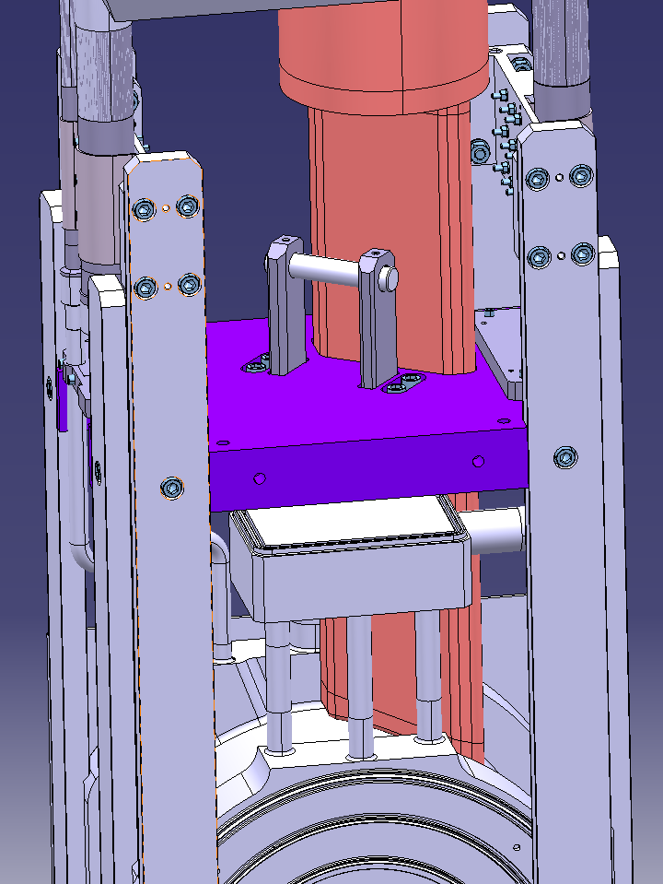
Neutron beam dump
CERN
n_TOF - EAR2
EAR2 bunker
20 m from Target
Collimator
ISR
Permanent magnet
Existing shaft
Commissioning starts in April 2014 !
Spallation Target

Slide 29
n_TOF EAR2
Higher fluence,
by a factor of 25, relative to EAR1.
The shorter flight path implies a factor of 10 smaller time-of-flight.
Global gain by a factor of 250 in the signal/background ratio

Slide 30
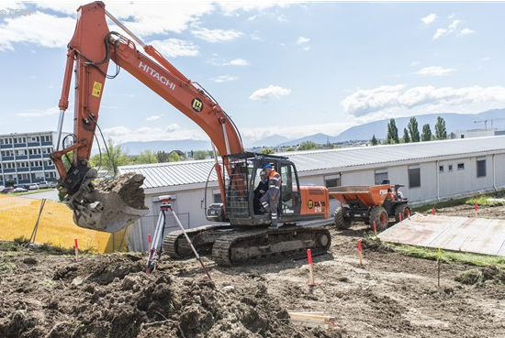
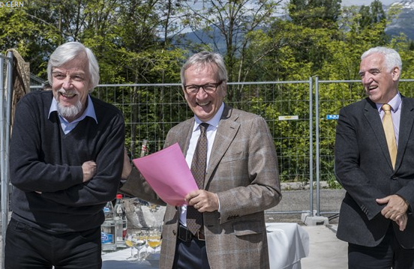
n_TOF EAR2
23 May 2013 – “1er coup de pelle n-Tof2”
Enrico Chiaveri, spokesperson of the n_TOF Collaboration
Rolph Heuer, CERN General Director
Frederick Bordry
http://cds.cern.ch/record/1550732

Slide 31
Conclusion
The ²⁵Mg(n,γ) reaction cross-section was measured at n_TOF in 2003 and in 2012 with an improved measurement set up.
Additional (n,tot) and (n,γ) measurements have been performed at the GELINA facility in 2012.
Final analysis will be a simultaneous resonance shape analysis of capture and transmission data:
  accurate ²⁵Mg(n,γ) cross section;
  J^{π} information on ²⁶Mg.
Future program: ²⁵Mg(n,α)²²Ne at n_TOF EAR2
Complete the study of the key isotope ²⁵Mg

Slide 32

Acknowledgement
The n_TOF Collaboration
EC-JRC-IRMM, GELINA team
Paul Koehler (ORNL-USA, now at Department of Physics, University of Oslo, N-0316 Oslo, Norway) → partially funded the 2012 experiment.
Italian Institute of Nuclear Physics – INFN → partially funded the 2012 experiment.

Slide 33

Cristian Massimi
Dipartimento di Fisica e Astronomia
INFN – Sezione di Bologna
massimi@bo.infn.it
www.unibo.it

Slide 34
Motivation 2
²⁵Mg(n,γ)²⁶Mg
Constraints for the
²²Ne(α,n)²⁵Mg reaction

Slide 35
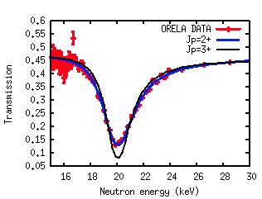
Motivation 2
²⁵Mg(n,γ)²⁶Mg
Constraints for the
²²Ne(α,n)²⁵Mg reaction
EXAMPLE
Of SPIN ASSIGNMENT

Slide 36
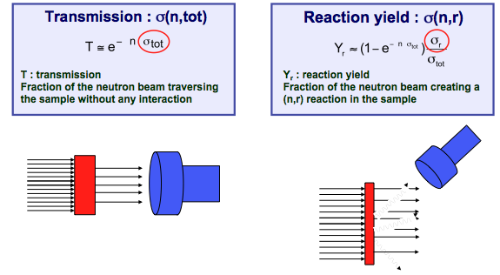
Measurements

Slide 37
Time reversal invariance
  Relation between the ²⁵Mg(n,α)²²Ne and the ²²Ne(α,n)²⁵Mg cross-section by “detailed balance technique”
a
A
B
b
  Energy region of interest:
  0 < E_{n} < few MeV

Slide 38
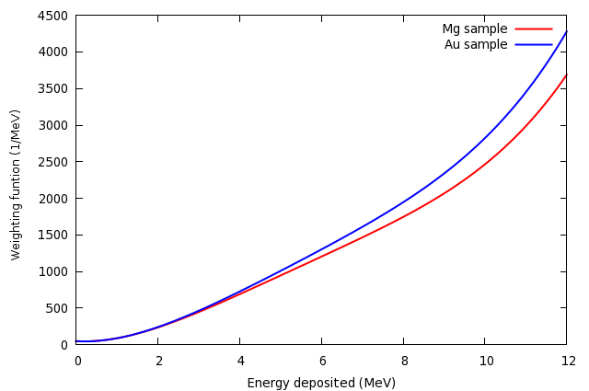
Weighting functions

Slide 39
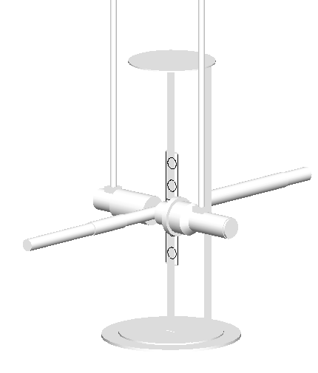
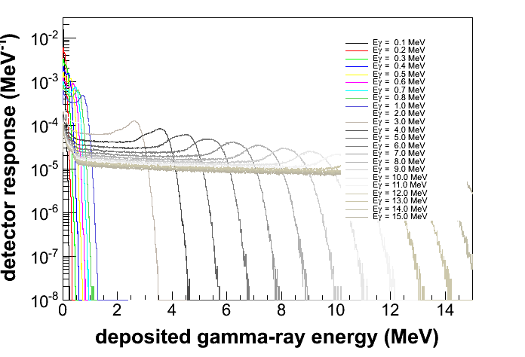
Data Analysis
²⁵Mg(n,γ)
@ n_TOF
Detailed Monte Carlo simulation
Pulse Height Weighting Function

Slide 40
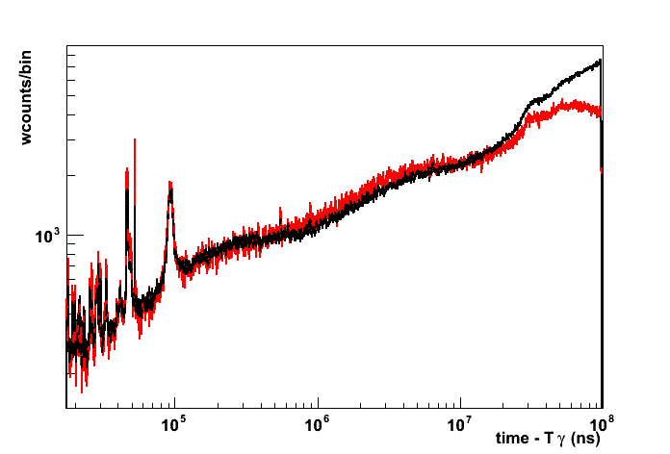
TOF spectra
NO WF
WITH WF

Slide 41
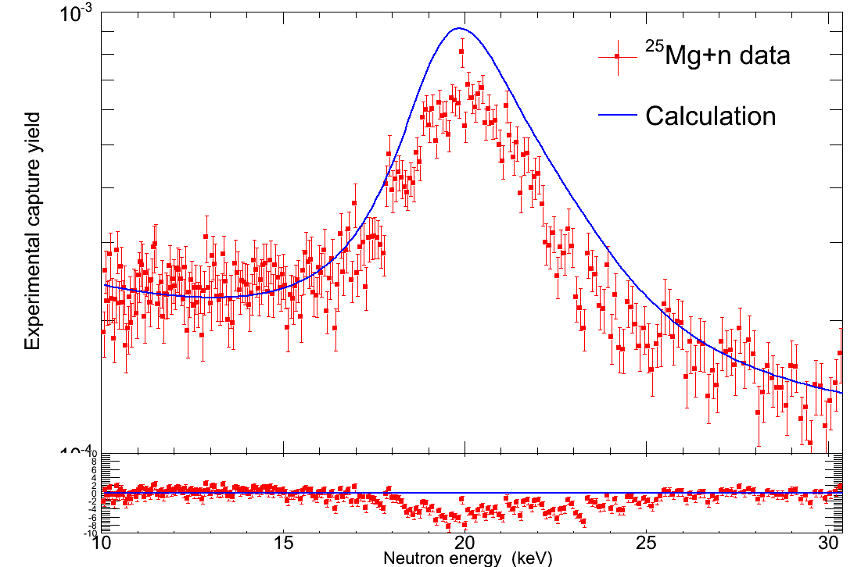
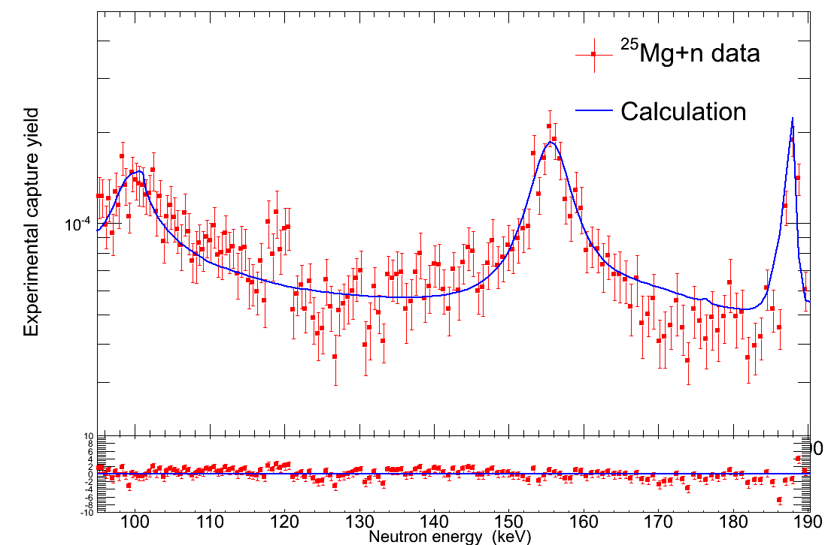
Preliminary Results
2012
data
First s-wave resonance at ~ 20 keV
Other resonances at ~ 150 keV
Previous evaluation
Previous evaluation
Energies relevant to s process

Slide 42
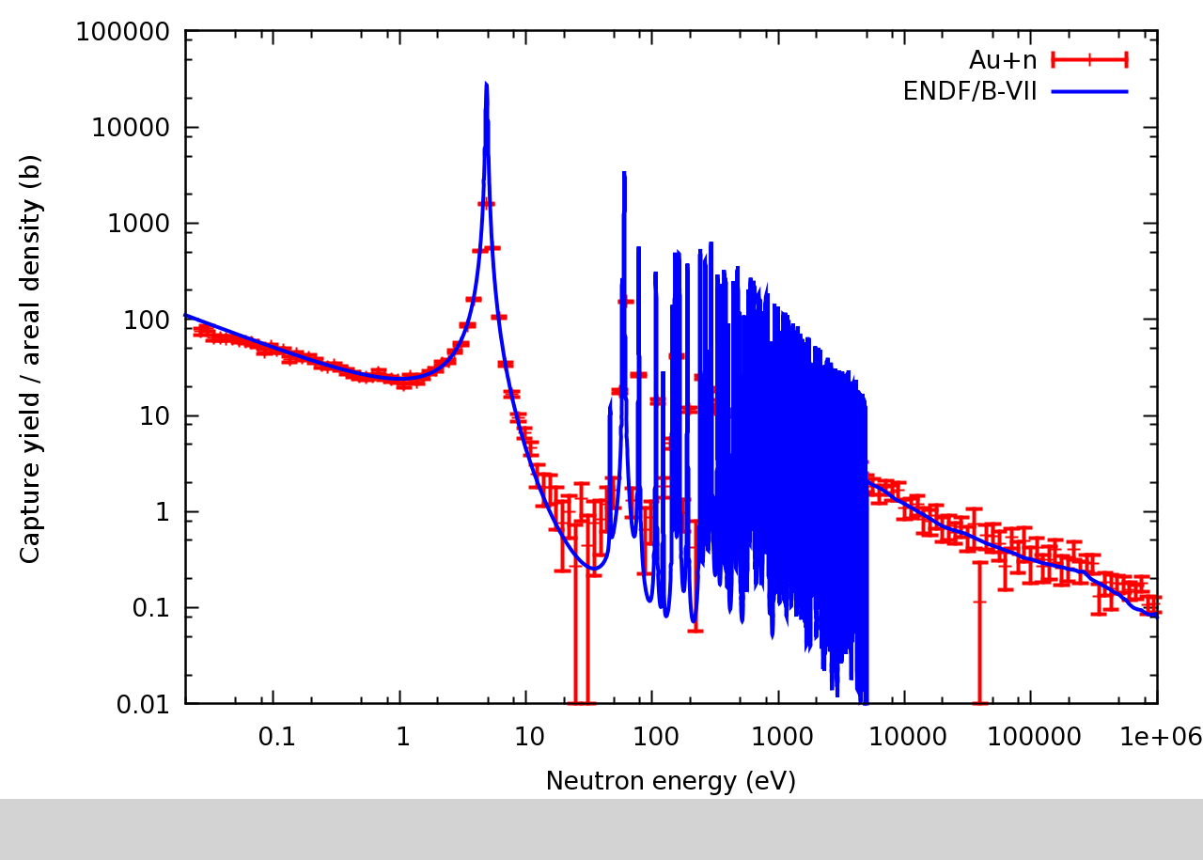
Au URR

Slide 43
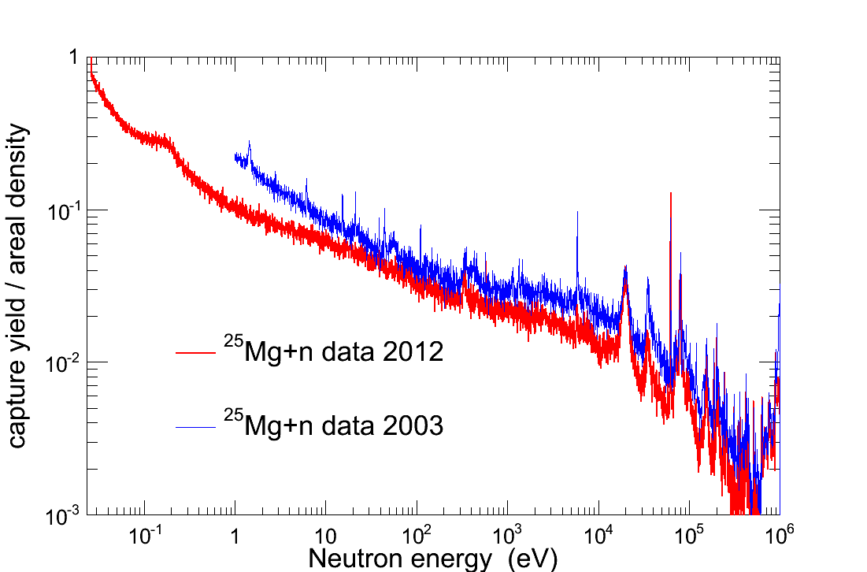
Preliminary Results
Contaminants

