Slide 1
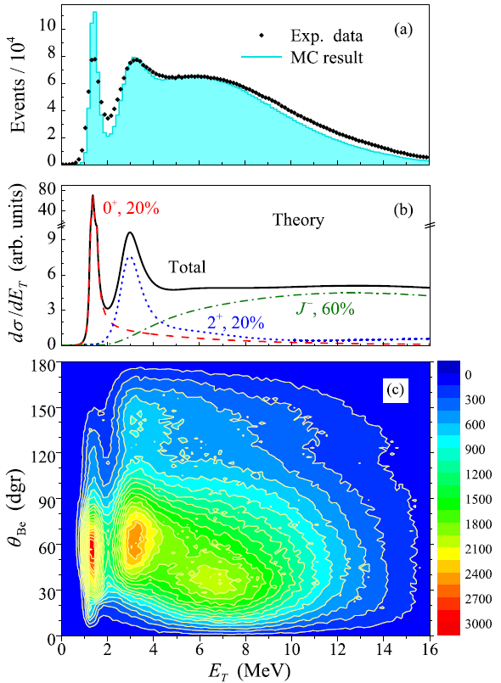
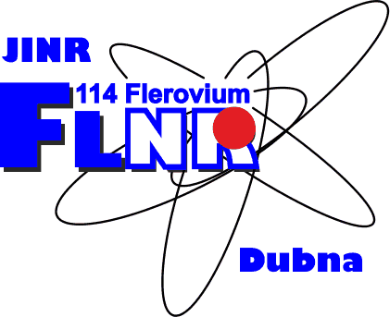

Theoretical studies of isovector soft dipole mode
A. Egorova,
S. N. Ershov,
A. S. Fomichev,
L. V. Grigorenko,
M. S. Golovkov,
Yu. L. Parfenova
???
Bogoliubov Laboratory of Theoretical Physics
Flerov Laboratory of Nuclear Reactions,
JINR, Dubna, Russia
International Nuclear Physics Conference INPC2013
2-7 June 2013, Firenze, Italy
Notes:
First of all I would like to express gratitude to organizers for kind invitation (for opportunity to give this talk) and provided financial support of my visit. I am going to speak about Theoretical studies of isovector soft dipole mode in 6Be. I am from Bogoliubov Lab of Theoretical physics at JINR. However this work was done in close collaboration with experimentalists and theoreticians from Flerov Lab of Nuc. Research also. Because our studies are based on experimental results which were recently obtained there.

Slide 2
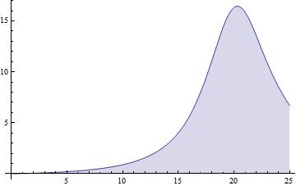
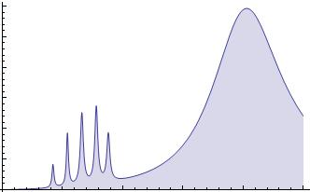
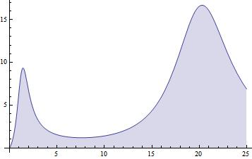
SDM in few-body physics
core
n
p
Pigmy
SDM
GDR
Low-energy off-springs of GDR:
  Neutron skin: pigmy dipole resonance (set of E1 states)
  Neutron halo: soft dipole mode (continuum state)
  Few-body vs. many-body physics
Original idea of K. Ikeda (1988) – “soft dipole mode” or “soft mode of the giant dipole resonance”:
  Extreme radial extension for halo systems
  Dipole operator ~ r further enhances the long-range part of the WF
  Cluster part of the dipole strength is split away from GDR and settles straight above the threshold
Notes:
Just a couple of words about best known dipole excitations.
1.The GDR \Джаент дайпол резонанс\ is formed by oscillations of all protons relative to all neutrons.
2.In the case of nucleons with significant neutron excess a neutron skin is formed. The neutron skin can oscillate with respect to the rest of nucleons. In this case part of dipole strength split away from GDR and can be found at low energy. This fraction is called Pigmy Resonance.
3.In the nucleon halo systems the SDM can be found. The continuous E1 spectrum forms a sharp peak straight at a nucleon breakup threshold.
Original idea of SDM was proposed by Ikeda. The low line dipole strength is connected with extreme radial extension of wave function. Due to dipole operator proportional to the radius, we have further enhancement of the long-range part of wave function. As a result a сluster part of the dipole strength is split away from GDR and settles straight above the nucleon breakup threshold.

Slide 3
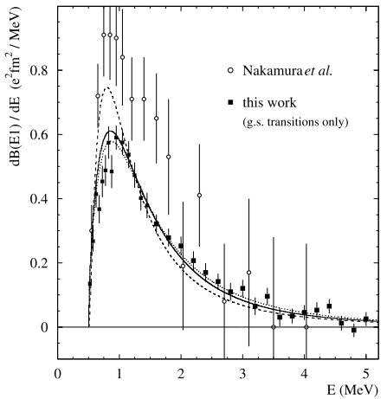
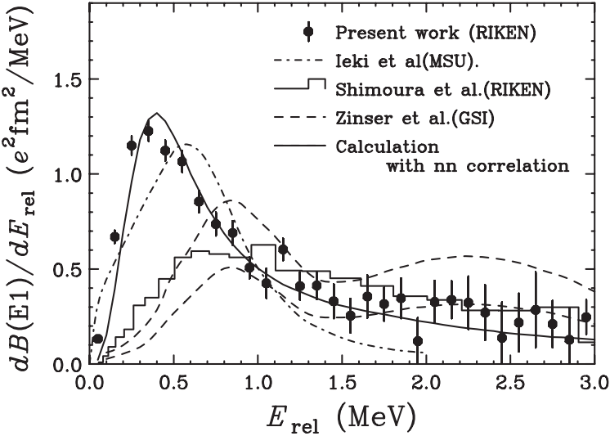
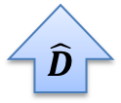







SDM for one- and two- nuclei halo
$l$’
Reasonably well understood for 1-nucleon haloes
Highly uncertain and strongly debated for 2-nucleon haloes
$$l′ −nonresonant$$
$$l$$
$$\hat{D}$$
$$\hat{D}$$
$$l$$
$$l −resonant$$
$$l$$
¹¹Be
¹¹Li
Palit et al., PRC 68 (2003) 034318
Nakamura et al., PRL 96 (2006) 252502
Notes:
It should be noted that there is important difference between SDM for one- and two- nuclei halos.
This mechanism reasonably well understood for 1-nucleon haloes. Dipole operator transfers nuclei from resonant single particle state (natural parity) to nonresonant state in continuum (belonging to the next shell).
However for 2-nucleon haloes this mechanism is more complicated and highly uncertain. While the dipole operator transfers one nucleon to nonresonant state the other nucleon remains in a resonant state.
This produce complicated dynamical effects which are difficult to account. The measurements of two-neutron coincidences \коинседенсес\ are also complicated providing controversial data.

Slide 4
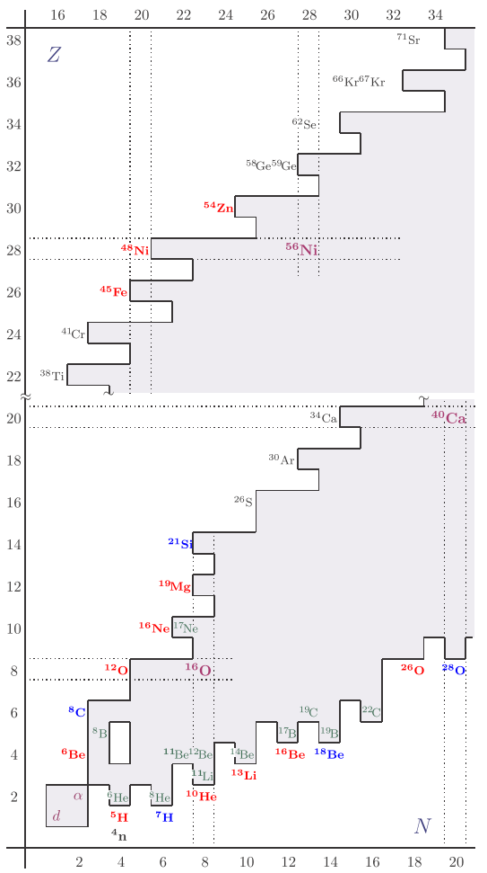
Few-body dynamics at the driplines
Borromean 2n halo systems
[Zhukov et al., Phys.Rep. 231 (1993) 151]
True three-body decay (2p radioactivity)
[Goldansky, NP 19 482 (1960)]
“Democratic” decay
[Bochkarev at al. NPA, 505, 215 (1989)]
“Soft excitations” in three-body systems
[K. Ikeda (1988)]
Notes:
SDM in 2-nucleon halo systems we regard as notable (important) representative of few-body dynamics near dreaplines.
In even systems close to driplines the lowest threshold is often 3-body core+2ns or core+2ps. In these regions the three-body dynamics becomes important. The most known example of such dynamics is “Borromean” 2p or 2n halo systems.
These schemes are illustrating the energy conditions for different types of few-body phenomenon.
The partner effects of Borromean halo in continuum are true three-body decay and democratic decay.
The difference SDM from others mechanism is asymmetry in channels.
Three-body phenomena of Borromean type and true 2n/2p decays are widespread near the driplines. Analogically we can expect that soft dipole type excitations are widespread in the excitation spectra of the dripline systems.

Slide 5
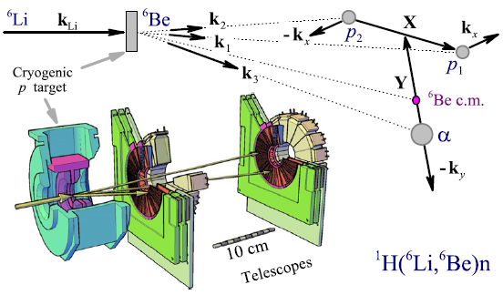
IsoVector Soft Dipole Mode in ⁶Be
A.S.Fomichev et al., PLB 708 (2012) 6.
Studies of ⁶Be spectra excitation in charge-exchange reaction at FLNR, JINR (Dubna)
Excellent agreement with the previous data for the resonant 0 ⁺ and 2⁺ states.
Broad structure above 2⁺ state is identified as combination of dipole {0⁻,1⁻,2⁻} excitations.
Surprise! Nonresonant dipole continuum has much higher integral cross section than the expectedly dominant resonant 0 ⁺ and 2⁺ contributions.
IVSDM as a specific form of SDM
Notes:
1. There is presented results by studies of ⁶Be spectra excitation in charge-exchange reaction at FLNR, JINR (Dubna).
2. Here you can see the excitation spectra, presented by dots. Theoretical input for reconstruction and blue histogram is result of MC simulation.
3. Excellent agreement with the previous data for the resonant 0 ⁺ and 2⁺ states can be noted.
4. Broad structure above 2⁺ state is identified as combination of dipole {0⁻,1⁻,2⁻} excitations.
5. Surprise! Nonresonant dipole continuum has much higher integral cross section than the expectedly dominant resonant 0 ⁺ and 2⁺ contributions.
6. On the contour plot of the spectrum you may see that peak tends to small angles, thus transfer momenta delta L=1. Therefore it is some kind of a dipole excitation. However it cannot be SDM because of 6Be haven’t ground state.
We think that it is exceptional mode based on the spatially extended g.s. of 6Li (lithium).

Slide 6




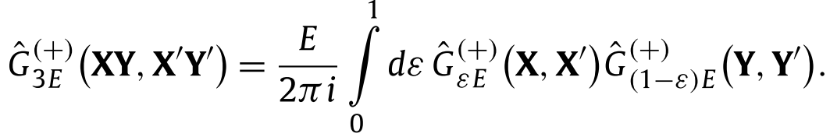

Formalism for change-exchange reaction
Three-body dynamics from
Cross section is defined via flux
The “source function” can be constructed
in a PWIA approximation :
For dipole excitations:
For change-exchange reactions :
Resonance part: HH method with consistent three-body Hamiltonian
Soft contribution: simplified Hamiltonian, providing analytical GF
Observables in reactions:
Nuclear structure +
Reaction mechanism +
Final state interaction
Notes:
Here I describe briefly the theoretical formalism for charge-exchange reactions.
Generally several types of direct nuclear reaction populating continuum states can be reformulated via Schrodinger eq. with source.
Cross section are defined via flux as follows.
The “source function” can be constructed in a PWIA approximation.
For dipole excitations the ground state WF is the WF of 6He and transition operator is described as follows.
For change-exchange reactions the ground state WF is the WF of 6Li and transition operator has a general form of isovector operator.
Resonance part of spectrum is consistent within HH method with consistent three-body Hamiltonian.
For calculation for soft contribution a simplified Hamiltonian, providing analytical GF was used.

Slide 7
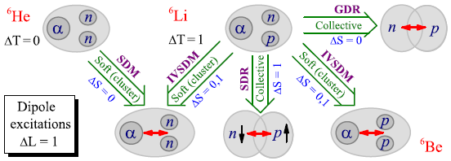
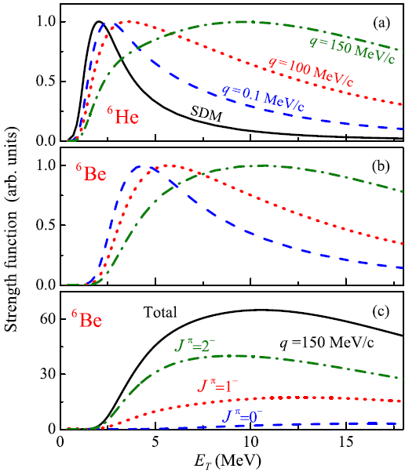
IVSDM vs. SDM
Mode vs. resonances: Large cross section above 2⁺ but no resonance
SDM vs. IVSDM:
SDM: based on spatially extended g.s. WF.
IVSDM: No particle stable g.s. – cannot be built on spatially extended g.s. Built on the spatially extended ⁶Li g.s by isovector dipole operator.
SDM in ⁶He: only 1⁻ state
IVSDM in ⁶Be: 0⁻, 1⁻, 2⁻ states
IVSDM: dependence on q
Isobaric symmetry aspect:
Differences between SDM in ⁶He and IVSDM in ⁶He
Differences between IVSDM in ⁶He and IVSDM in ⁶Be
Important dipole excitation modes in A=6 isobar
Notes:
What is difference between SDM and IsoVector DM?
1. We have Large cross section above 2⁺ but no resonance in the experimental spectra.
2. This is schematic illustration of soft excitation in nuclei with A=6. IVSDM can go to the both nuclei 6Be and 6He systems. And in 6He it can be compared with SDM.
3. The SDM is based on spatially extended g.s. WF. However in 6Be there is no particle stable g.s. and IVSDM cannot be built on spatially extended g.s. It is built on the spatially extended ⁶Li g.s by isovector dipole operator.
(4. While the SDM in ⁶He consists of only 1⁻ state, the IVSDM in ⁶Be consists of 0⁻, 1⁻, 2⁻ states.
5. Also we can compare IVSDM across the isobar (in ⁶He and in ⁶Be). (comparing figure (b) and (c).)
6. There is high degree of isobaric symmetry.

Slide 8
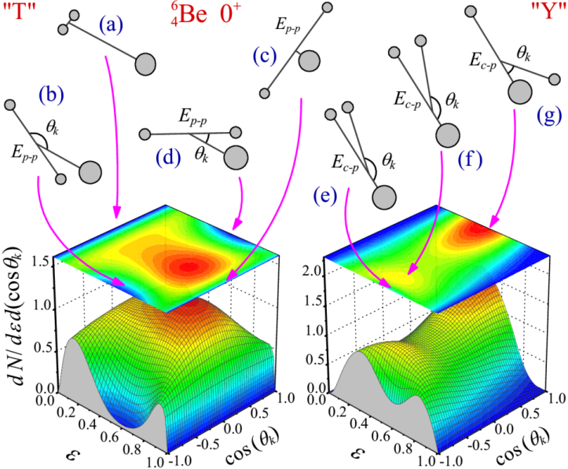
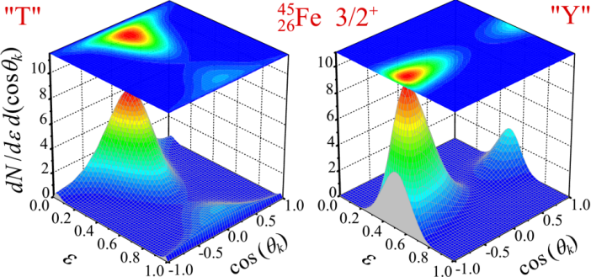
Three-body correlations in direct reactions.
{k₁, k₂, k₃} ( or {k’, k_{x} ,k_{y} } in Jacoby system) -> 9 degrees of freedom.
All the degrees of freedom, we split into two groups: 2D “internal” (energy-angular) and 5D “external” (associated with orientation of the system).
For direct reactions the evident selected direction defining orientation of the system is momentum transfer vector.
Three-body energy-angular correlations for the g.s. of ⁶Be and ⁴⁵Fe
Notes:
1. This scheme demonstrates kinematic of reaction with three-body decay in momenta space. Through some time a projectile decays on three fragments: core and two protons in this case. We want to observe evolution vectors of core and two protons {Kcore,Kp1, Kp2} or {K’,Kx,Ky} in Jacoby system. Three vectors in the space are described by nine degrees of freedom.
2. All degrees of freedom, we split into two groups: internal and external.
Internal degrees of freedom determine the position vector on a plane. We parameterize them values epsilon (it is energy corresponding momenta Кх normalized to total energy (Ех+Еу)) and angle between Кх and Ку. So we construct internal distributions from these parameters and example of the distributions is shown here. It is internal distributions for 6be and 45 iron. For two similar particles we have two independent Jacoby systems: “T” and “Y” systems.
( 3. Different range of parameters corresponding to the different positions of the particles in space.
External degrees of freedom define the position of the plane in space. These are Euler angels. Feature is the presence of direct reactions along the preferred direction of the momentum transfer q. This helps to simplify the problem set of Euler angles. )

Slide 9
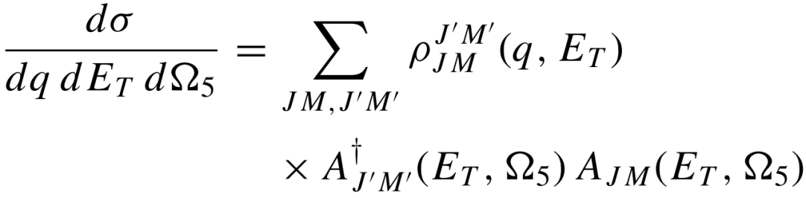
Interface between theory and experiment.
Monte-Carlo codes.
Density matrix formalism:
Density matrix has especially simple form in the system of transferred momentum for direct reactions
Three-body decay -> eightfold differential cross section
Theoretical calculations
(quantum mechanical amplitudes)
Theory
MC event generator
MC simulations
Virtual exp. setup (Apparatus model)
M.S.Golovkov et al., PRL 93 (2004) 262501
M.S.Golovkov et al., PRC 72 (2005) 064612
L.V.Grigorenko et al., PRC 82 (2010) 014615
A.S.Fomichev et al., PLB 708 (2012) 6
I.A. Egorova et al., PRL 109 (2012) 202502
Experiment
DAC, Detectors
Notes:
For studies of correlations we need not only theory and not only experiment. We need an interface between theory and experiment.
Here you can see a full scheme of such research including comparison theoretical calculation with experimental results.
We work on the theoretical part of this scheme. We calculate a cross section use density matrix formalism.
Density matrix has especially simple form in the system of transferred momentum for direct reactions
However we deal with eightfold differential cross section. So for studies of correlations we developed codes for fully quantum-mechanical Monte Carlo simulations. This is important and complicated part of work and there is list of publications where these developments were undertaken.

Slide 10
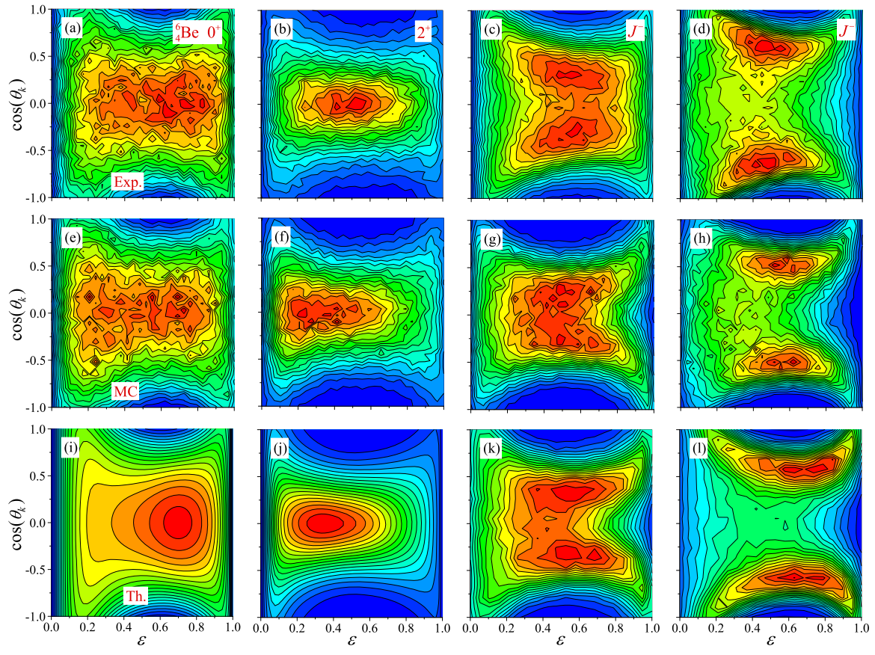
Internal energy-angular correlations in ⁶Be
0⁺
2⁺
J ⁻ (5-7 MeV)
J ⁻ (9-11 MeV)
experiment
Monte Carlo
theory
Very good agreement with previous experimental data on 0⁺ and 2⁺ resonant states. Nice agreement between theory and experiment.
Major features of the J ⁻ excitations are reproduced.
Notes:
Here we can see the reconstruction of internal energy–angle correlations for different states of 6Be in Jacobi T system.
Results are presented for the resonant 0+, 2+ and J− states.
The correlation data provide the additional support for our interpretation.

Slide 11
Conclusions
Strong population of ΔL = 1 cross section is known in ⁶Be and it was observed in much details in our work [A.S. Fomichev et al., PLB, 708 6, (2012)].
The resonant states of ⁶Be were studied in the PWIA based three-body reaction model demonstrating good agreement in the excitation spectra, angular distributions, and three-body correlations
Main result obtained in the experiment @FLNR: the spectrum above 2⁺ state of ⁶Be was interpreted as providing evidence for novel phenomenon – IsoVector Soft Dipole Mode build on the ⁶Li g. s.
IVSDM was studied in a three-body model with simplified Hamiltonian providing semianalytical 3-body GF. Important qualitative differences between SDM and IVSDM are established.
THANK YOU FOR ATTENTION!

Slide 13
Conclusions
Впервые была разработана теоретическая модель для описания Кулоновского непрерывного спектра трех частиц заселяемого в прямых реакциях с последовательным учетом механизма реакции. Она позволяет изучать спектр экзотических систем на границе ядерной стабильности в широком диапазоне энергий.
Для сравнения теории с экспериментом для сложных корреляционных данных был разработан последовательно квантово-механический Монте-Карло генератор. На сегодняшний аналогов ему нет. Мы работаем с различными группами из ведущих мировых центров помогая в анализе и интерпретации данных.
Основной результат, полученный в эксперименте в MSU: вплоть до весьма высоких энергий возбуждения ⁶Ве распад идет не последовательно, а имеет сложную трехчастичную динамику.
Основной результат, полученный в эксперименте в ЛЯР: часть спектра, лежащего выше состояния 2+ была интерпретирована, как новый феномен – ИзоВекторная Мягкая Дипольная мода.
THANK YOU FOR ATTENTION!
Notes:
1. Впервые была разработана теоретическая модель для описания Кулоновского непрерывного спектра трех частиц заселяемого в прямых реакциях с последовательным учетом механизма реакции. Она позволяет изучать спектр экзотических систем на гнанице ядерной стабильности в широком диапазоне энергий.
2. Для сравнения теории с экспериментом для сложных корреляционных данных был разработан последовательно квантово-механический Монте-Карло генератор. На сегодняшний аналогов ему нет. Мы работаем с различными группами из
Ведущих мировых ценров и помогая в анализе и интерпретации данных.
3. Основной результат, полученный в эксперименте в МСЮ: вплоть до весьма высоких энергий возб. 6Ве распад идет не последовательно а имеет сложную трехчастичную динамику.
4. Основной результат, полученный в эксперименте в ЛЯРЕ: часть спектра, лежащего выше состояния 2+ была интерпретирована, как дающее доказательство для нового феномена – Изовекторной мягкой дипольной моды.
Анализ эксп. Данных. Полученных в ЛяР показал, что в спектре выше 2+ найден новый тип моды – так называемая изовекторная мягкая дипольная мода возбуждения.
For the first time theoretical methods for studies of the Coulomb three-body continuum populated in direct reactions was developed.
This allows to study the excitation spectra of exotic dripline systems in a broad energy range.
Впервые были получены экспериментальные данные с высокой точностью и разрешением в широком диапазоне энергий.
Для сравнения теории с экспериментом был разработан последовательно квантово-механический Монте-Карло генератор.
For comparison theory and experiment fully quantum-mechanical MK generator was developed. So far this is a unique development.
Structure of 6Be was studied theoretically based on two independent experiments with different reaction mechanisms.
The obtained high-statistics and high-resolution data provide very detailed view of the evolution of correlation patterns with excitation energy. This allows deep insight into the mechanism of two-proton decay. The result is very solid demonstration of counterintuitive character of evolution of the decay mechanism with excitation energy and confirmation of the theoretical ideas.
Спектр 6Ве был изучен теоретически с анализом механизма реакции.
Важность учета механизма реакции в таких моделях следует из анализа экспериментальных данных.

Slide 14


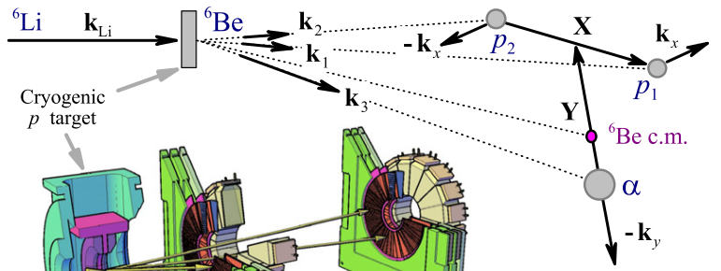
Model for charge-exchange reaction
Model for charge-exchange reaction
[A.S. Fomichev et al., PLB, 708 6, (2012) ]
Source WF was constructed in PWIA approximation
Using effective spin-spin ch.-ex. interaction
Notes:
In our model for charge-exchange reaction source WF was constructed in PWIA approximation
Excellent agreement with the data for the resonant 0 + and 2 + states and good results for dipole contribution have got.
Major discovery here: Broad structure above 2⁺ state is identified as combination of dipole {0⁻,1⁻,2⁻} excitations.
And
Nonresonant dipole continuum has much higher integral cross section than the expectedly dominant resonant 0 ⁺ and 2⁺ contributions.

Slide 15
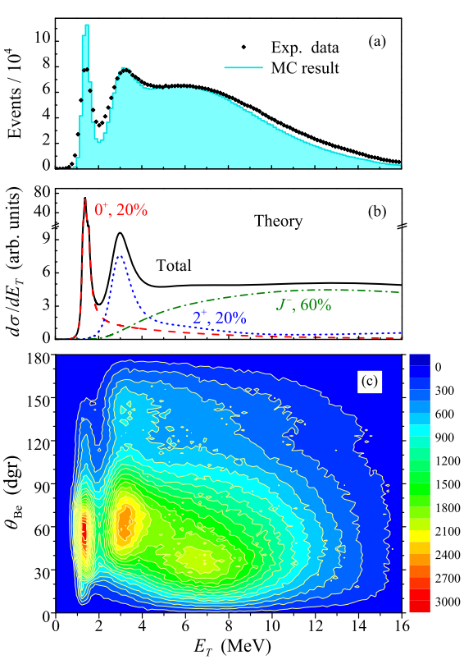
Status of the three-body decay studies in ⁶Be
Status of the three-body decay studies in ⁶Be
[A.S. Fomichev et al., PLB, 708 6, (2012) ]
Very well studied 0⁺ g.s. of ⁶Be
L.V. Grigorenko at al. PRC 80, 034602 (2009)
R.J. Charity et al., PRC 82, 041304 (2010)
P. Papka et al., PRC 81, 054308 (2010)
A.S. Fomichev et al., PLB, 708 6, (2012)
Theoretical description:
the three-body cluster model based on the HH method
[Grigorenko PRC 80, 034602 (2009)]
Recent results:
⁶Be(0+), ¹⁹Mg(1/2⁻), ⁴⁵Fe(3/2⁺)
L.V. Grigorenko et al. PLB 677, 30–35 (2009)
I. Mukha et al., Phys. Rev. Lett. 99, 182501 (2007)
K. Miernik et al., Phys. Rev. Lett. 99, 192501 (2007)
Explaining three-body correlations
[I.A. Egorova et al., PRL 109, 202502 (2012)]
Notes:
Здесь представлены спектры 6Ве, полученные в разных экспериментах (этот в ЛяРе, этот в МСЮ) с помощью разных механизмов реакции. Можно видеть, что основное состояние 6Ве довольно узкое. Оно было хорошо изучено. Теоретическое описание было сделано в рамках трехкластерной модели с помощью метода гиперсферических гармоник.
Что касается возбужденных состояний, то как видно из картинок они довольно широки и их заселение сильно зависит от механизма реакции.
Для описания 3хчастичного спектра в широком диапазоне энергий требуется специальный формализм, учитывающий механизм реакции.
1. In the recent years there was a revival of interest to 6Be system. In particular the g.s. of 6Be was studied both theoretically and experimentally very well.
2. Our theoretical description of three-body decay is based on the three-body cluster model using the HH method.
3. The dynamics of 3-b. continuum is described by solving inhomogeneous three-body Schrödinger equation for WF with outgoing asymptotic. The widths of several known 2p emitters are well reproduced on this model. Recent results were obtained for 6Be, 19Mg and 45Fe.
5. It is challenge to explain three-body correlations also.

Slide 16
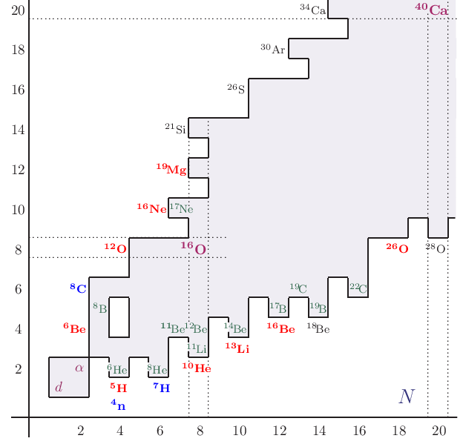
Few-body dynamics at the driplines
Every second nucleus beyond the proton dripline is or is expected to be true 2p emitter!
Recently discovered 2p radioactivity cases: 19Mg, 45Fe, 48Ni, 54Zn.
Recent studies of democratic decay in 6Be:
(i) Texas A&M (USA) in transfer reaction
(ii) ITEMBa (South Africa) in charge-exchange
(iii) MSU (USA) in knockout reaction
(iv) Dubna in charge-exchange reaction
Known true 2p emitters: ⁶Be, ¹²O, ¹⁶Ne, ¹⁹Mg, ⁴⁵Fe, ⁴⁸Ni, ⁵⁴Zn.
Two-neutron g.s. emission studied recently in ¹⁰He (Dubna and GSI), ¹³Li (GSI), ¹⁶Be (MSU), ²⁶O (MSU)
Pretending to understand asymmetric nuclear matter EOS, nucleosynthesis, few-body dynamics one need to extend our knowledge as far as possible beyond the driplines.
Green – halo systems
Red – true 2p/2n emitters
Blue – 4p/4n emitters
Black – few-body decay, but nothing is known
Notes:
Может показаться, что трехчастичная динамика (задача нескольких тел) это довольно редкое и экзотическое явление, которое редко встречается в природе (экзотический объект исследования, который редко встречается в практике (природе)). Но давайте посмотрим на карту нуклидов. Здесь на границе стабильности в каждом втором ядре проявляется такая динамика. И это только из известных на сегодняшний день.
Зеленым цветом показаны ядра с гало.
Красным – истинно 2р\2н распадчики. Синим – ожидаемые 4р\4н распадчики.
Если мы хотим претендовать на понимание и описание несимметричной ядерной материи, нуклеосинтеза и динамики нескольких тел, необходимо расширять наши знания как можно дальше за границу стабильности.
Из недавно открытых 2р распадчиков можно отметить 19Mg, 45Fe, 48Ni, 54Zn. Демократический распад активно исследовался в последние годы в 6Ве в разных научных центрах в америке южной африке и у нас в дубне.

Slide 17
Exotic nuclei +
Direct reactions +
Correlation studies

Slide 18
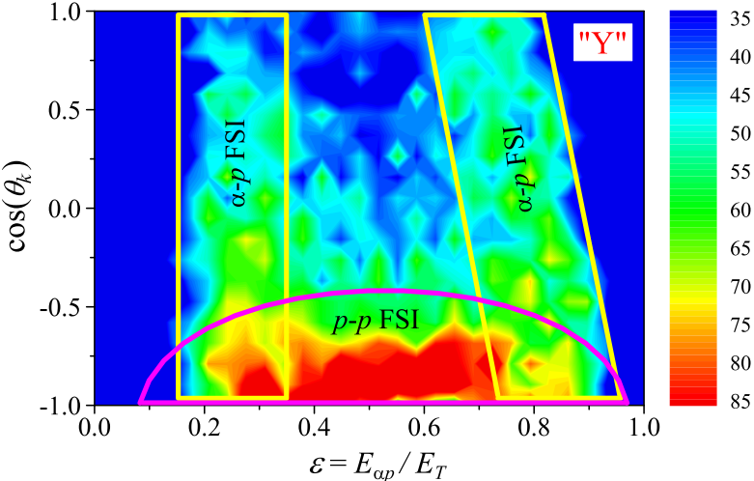
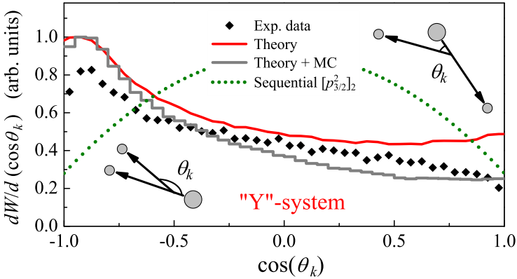
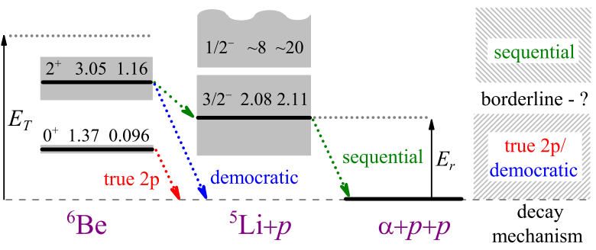
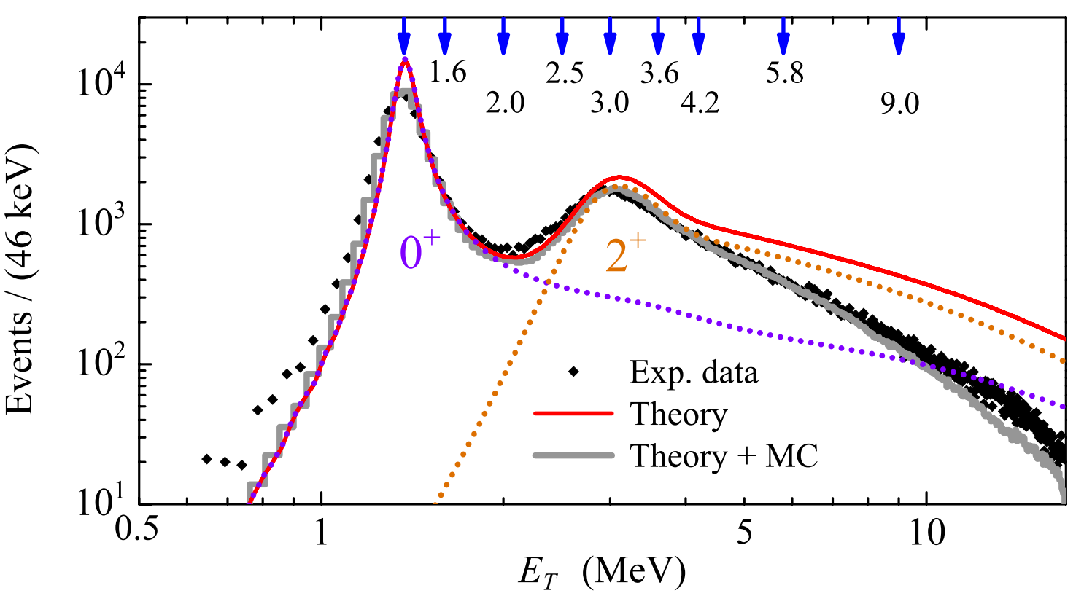
⁶Be at MSU: where is borderline democratic/sequential?
I.A. Egorova et al., PRL 109, 202502 (2012).
Highly detailed data allows deep insights in the decay dynamics
Notes:
Здесь представлены результаты по анализу и интерпретации эксперим. Данных, полученных в МСЮ и опубликованных в физревлеттерс.
- Надо отметить, что Данные полученные в этом эксперименте имеют безпретендентную статистику и разрешение (какую?) для работ с пучками радиоактивных ядер.
Спектр 6Ве был описан в широком диапазоне энергий с очень хорошей точностью.
В результате впервые мы смогли посмотреть эволюцию динамики распада сростом энергии и сделать неожиданные выводы, касательно динамики демократических распадов. В частности, было показано, что вплоть до весьма высоких энергий возб. 6Ве распад идет не полностью последовательно, как предполагалось, а имеет сложную трехчастичную динамику.

Slide 19
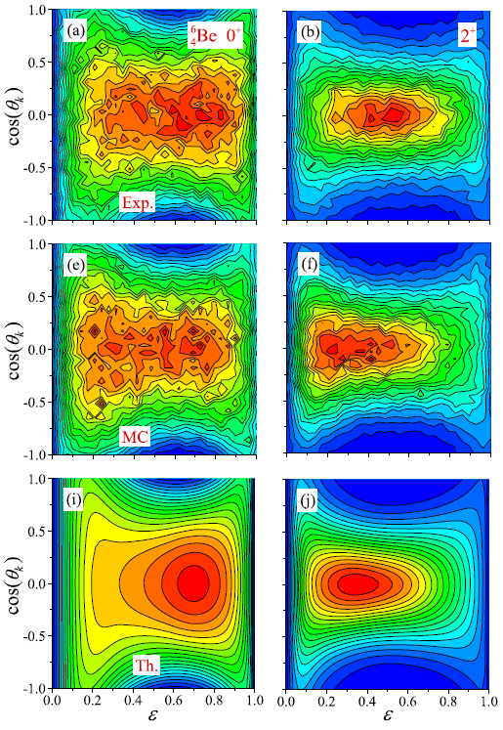
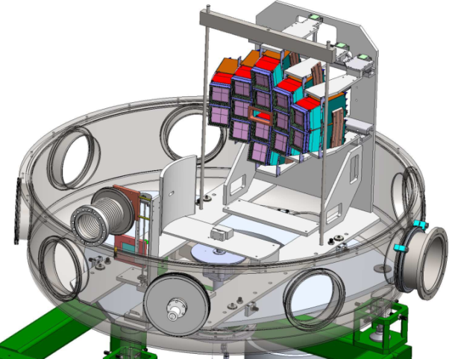
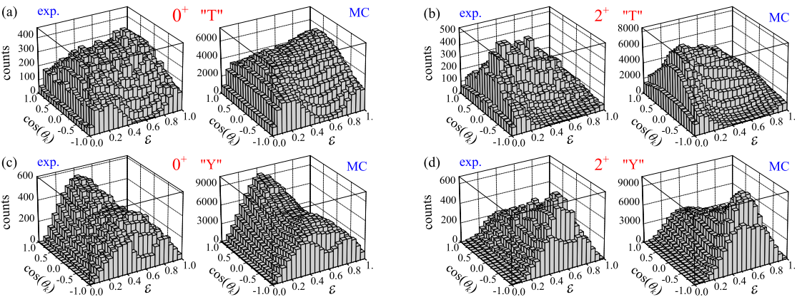
Correlations on resonances in ⁶Be
A.S.Fomichev et al., PLB 708 (2012) 6.
I.A. Egorova et al., PRL 109, 202502 (2012).
Exp.
X
MC
⁷Ве
⁶Ве
р
р
α
Th.
0⁺
2⁺
0⁺
2⁺
0⁺ and 2⁺ in ⁶Be: latest MSU data vs. JINR data
Benchmark of true 2p/ democratic 2p decay

Slide 20
Выводы:
Эта работа дает важный качественный взгляд на вопрос, какие аспекты трехчастичных распадов могут быть поняты на основе динамического описания конечного состояния и которые также требуют адекватного описания начального состояния и механизма реакции.
Основными и новыми наблюдениями этой работы являются следующие:
Заселение основного состояния 6Ве (0+ _1) является очень стабильным к изменению начального состояния структуры и механизма реакции. Тем не менее, последние эффекты становятся все более важными с ростом возбуждения. Ни одно разумное описание континуума выше 5 - 7 МэВ не может быть дано без их надлежащего описания.
Спектр возбуждения трехчастичного континуума 6Ве до 15 - 20 МэВ оказывается очень чувствительным к составу спинов в функции источника. В наших расчетах они были параметризованны относительно спинового содержания прекурсора. Таким образом, мы видим, что трехчастичный распад может быть использован в качестве чувствительного инструмента ядерной спектроскопии, если механизм реакции хорошо известен.
Была предложена процедура идентификации второго 0 + _2 и 2 + _2 состояния в 6Be, открывая возможность их экспериментального обнаружения. Эти состояния являются спиновыми дополнениями известных 0 + -1 и 2 + _1 состояний.
Выстроенность и интерференционные эффекты наблюдаются в экспериментальных данных в связи с неидеальностью экспериментальной установки. Они оказывают значительное влияние на измерения трехчастичных корреляций. Протон-протонные распределения энергии особенно страдают. Это означает, что необходимо проявлять осторожность при исследовании корреляций в распадах возбужденных (и /или широкий) трехчастичных состояний в целом.
Notes:
Эта работа дает важный качественный взгляд на вопрос, какие аспекты трехчастичных распадов могут быть поняты на основе динамического описания конечного состояния и которые также требуют адекватного описания начального состояния и механизма реакции. Основными и новыми наблюдениями этой работы являются следующие.
(I) Заселение основного состояния 6Ве (0+ _1) является очень стабильным к изменению начального состояния структуры и механизма реакции. Тем не менее, последние эффекты становятся все более важными с ростом возбуждения. Ни одно разумное описание континуума выше 5 - 7 МэВ не может быть дано без их надлежащего описания.
(II) Спектр возбуждения трехчастичного континуума 6Ве до 15 - 20 МэВ оказывается очень чувствительным к составу спинов в функции источника. В наших расчетах они были параметризованны с точки зрения спинового содержания прекурсора. Таким образом, мы видим, что трехчастичный распад может быть использован в качестве чувствительного инструмента ядерной спектроскопии, если механизм реакции хорошо известен.
(III) Была предложена процедура идентификации второго 0 + _2 и 2 + _2 состояния в 6Be, открывая возможность их экспериментального обнаружения. Эти состояния являются спиновыми дополнениями известных 0 + -1 и 2 + _1 состояний.
(IV) Выстроенность и интерференционные эффекты наблюдаются в экспериментальных данных в связи с неидеальностью экспериментальной установки. Они оказывают значительное влияние на измерения трехчастичных корреляций. Протон-протонные распределения энергии особенно страдают. Это означает, что необходимо проявлять осторожность при исследовании корреляций в
распадах возбужденных (и /или широкий) трехчастичных состояний в целом.

