Slide 1
Study of pairing and clusterization
in light nuclei
through nuclear break-up
The Towing Mode (nuclear break-up) …
Configuration mixing
Alpha clusterisation in medium-mass nuclei
nn pairing in dilute matter
M. Assié (IPNO)

Slide 2
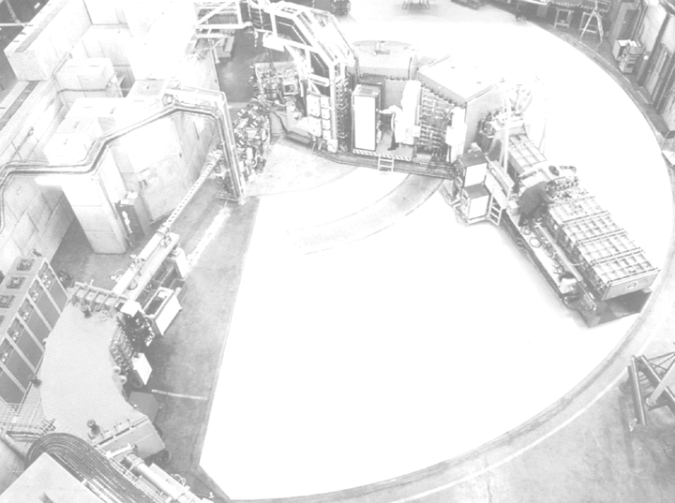
Reaction mechanism : Towing Mode
Beam
Energy
5 MeV/A
Fusion
4π emission
Forward emission
<30º
10 MeV/A
A
A
A
Transfer
~90º
A
Side
emission
10⁻²² s
Target
Break-up
(Nuclear,
Coulomb)
50 MeV/A
A
A+1
Projectile
A
Knock-out
Inelastic
Scattering
Knock
Out
Pick-up
Break-up
Towing
Mode
100 MeV/A
1 or several
Emitted particle
1 emitted particle
Spectroscopic tools
Notes:
Bien introduire le fait qu’on résout complètement la densité à deux corps

Slide 3
…the one particle Towing Mode
⁴⁰Ar+⁵⁸Ni @ 44 MeV/A Proton & neutron
Inelastic channel
E_{fin}
E_{target}
E_{nucleon}
TM
E_{init}
J.A.Scarpaci et al.,
Physics Letters B428 (1998) 241
E_{miss}= E*- E^{Kcm}_{recoil}- E^{Kcm}_{α}

Slide 4
…the one particle Towing Mode
⁴⁰Ar+⁵⁸Ni @ 44 MeV/A Proton & neutron
Inelastic channel
E_{fin}
E_{target}
E_{nucleon}
E_{init}
J.A.Scarpaci et al.,
Physics Letters B428 (1998) 241
Decay of an excited state
(two step process)
1f_{7/2}
2p_{3/2}
2s_{1/2}
x
1d_{5/2}
x
1p_{1/2}
1p_{3/2}
1s_{1/2}
Coulomb or nuclear

Slide 5
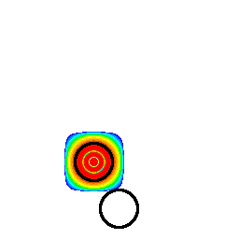
…the one particle Towing Mode
⁴⁰Ar+⁵⁸Ni @ 44 MeV/A Proton & neutron
Inelastic channel
E_{fin}
E_{target}
E_{nucleon}
E_{init}
J.A.Scarpaci et al.,
Physics Letters B428 (1998) 241
Theory: Time Dependent Schrödinger Equation
Direct decay through the
Towing Mode (one step process)
Probability density of a nucleon WF
(44 MeV/A,b= 8 fm)
D. Lacroix et al, NPA(1999)
Side emission

Slide 6
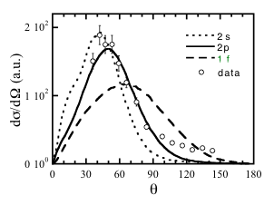
…the one particle Towing Mode
⁴⁰Ar+⁵⁸Ni @ 44 MeV/A Proton & neutron
Inelastic channel
E_{fin}
E_{target}
E_{nucleon}
E_{init}
J.A.Scarpaci et al.,
Physics Letters B428 (1998) 241
TM
1f_{7/2}
x
2p_{3/2}
2s_{1/2}
1d_{5/2}
1p_{3/2}
1p_{1/2}
1s_{1/2}
D.Lacroix et al., Nuclear Physics A658 (1999) 273
The TM probes the GS
The TM is sensitive to the initial WF

Slide 7
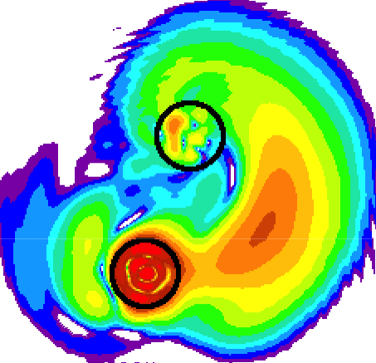
1. Configuration mixing in exotic nuclei
(¹¹Be and neutron halo)
What type of studies
can we do with
nuclear break-up ?
TDSE model
¹⁰Be
γ
V.Lima et al., Nuclear Physics A795 (2007) 1

Slide 8
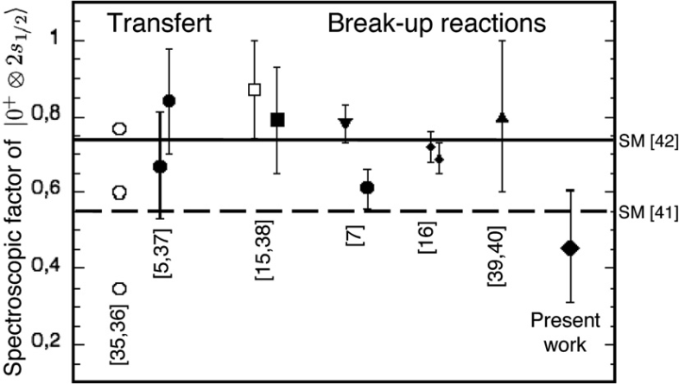
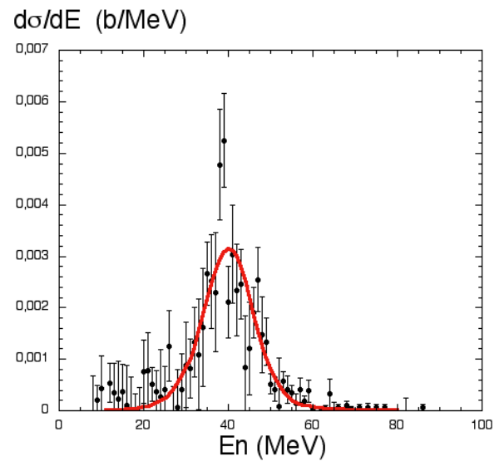
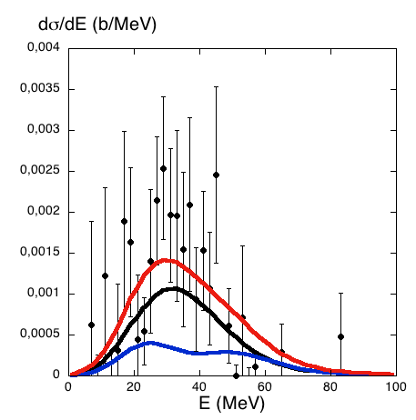
One-nucleon Nuclear Break-Up Mechanism :
The case of configuration mixing
Configuration mixing in ¹¹Be:
|GS>= α |2s_{1/2} ⊗ 0⁺> + β |1d_{5/2} ⊗ 2⁺>
Deformation
β₂=0.74
γ
no-γ in coincidence
γ in coincidence
S_{1d}= 0,50 ± 0,20
S_{1p}= 3.9
S_{2s} = 0,47± 0,04
TDSE 2s
4*1p
0.5*1d
V.Lima et al., Nuclear Physics A795 (2007) 1

Slide 9
1. Configuration mixing in exotic nuclei
(¹¹Be and neutron halo)
What type of studies
can we do with
nuclear break-up ?
TDSE model
¹⁰Be
γ
V.Lima et al., Nuclear Physics A795 (2007) 1
2. Probing alpha clusterization in
medium mass-nuclei and in light nuclei
TDSE model
α
³⁶Ar*
J-A. Scarpaci et al PRC (2010)

Slide 10
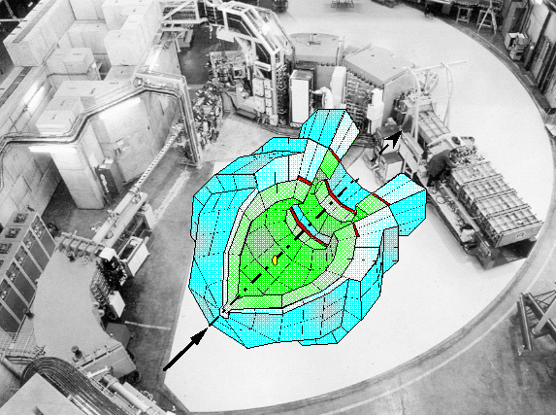
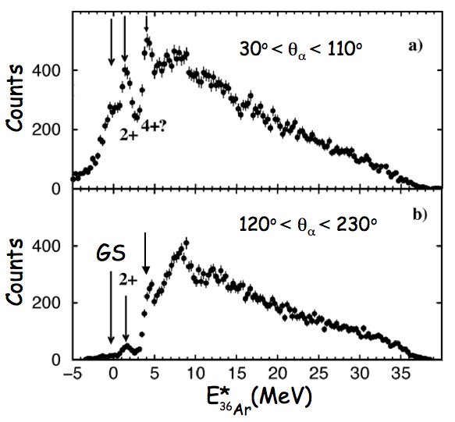
Alpha clusters in ⁴⁰Ca
Alpha clusters in ⁴⁰Ca
⁴⁰Ca(⁴⁰Ca,⁴⁰Ca+LCP) @ 50 MeV/A
SPEG + 240 INDRA CsI
e=200 μg/cm², ΔE_{SPEG} =350 keV
⁴⁰Ca
Q_{α}
p
E_{miss}
0 5 10 15 20 25 30
⁴⁰Ca
E_{fin}
Direct decay through the
Towing Mode
(one step process)
E_{recoil}
E_{α}
4+?
Statistical decay
of an excited state
CASCADE
⁴⁰Ca
E_{init}
Missing energy spectrum for
the reaction ⁴⁰Ca(⁴⁰Ca,⁴⁰Ca+α)
(E_{miss}= E* - E^{K}_{recoil}- E_{α})
Nuclear only
E_{36Ar}=E_{miss}-S_{α}
Resolution of 1.15 MeV

Slide 11
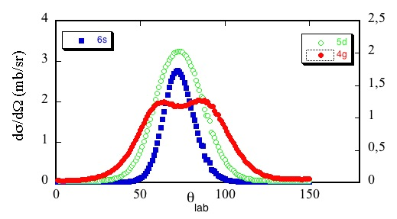
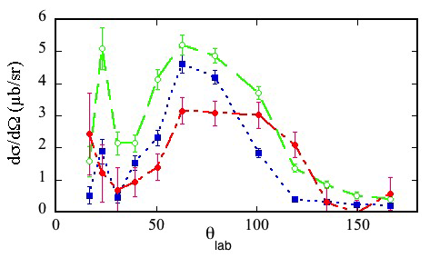
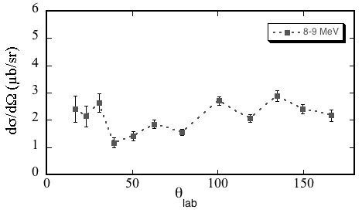
Alpha clusters in ⁴⁰Ca : angular distribution
TDSE calculation
Buck et al potential to reproduce rotational bands in ⁴⁰Ca
B. Buck et al., Phys. Rev. C52, 1840 (1995)
K.F. Pal & R.G Lovas, Phys. Lett. B96, 19, (1980)
Statistical decay
SF ~ 1.2% for the GS
When Umeda et al. NPA429, (1984), ⁴⁰Ca(d,⁶Li)
obtain 13%!!! (18% for 2+, 37% for 4+)
Shell Model Calc, Chung et al. PL 79B, 381, (1978) ~4%

Slide 12
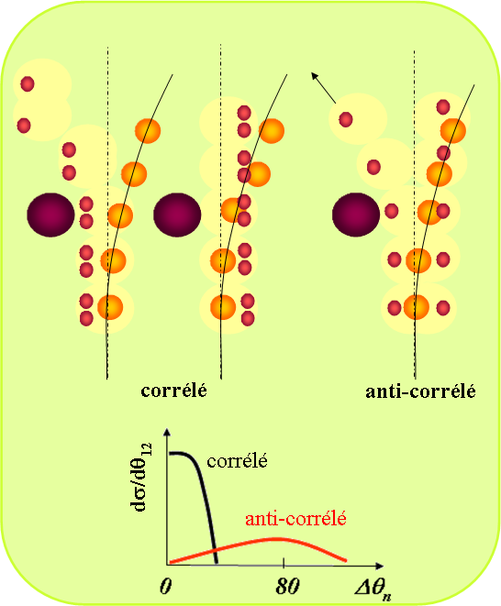
1. Configuration mixing in exotic nuclei
(¹¹Be and neutron halo)
What type of studies
can we do with
nuclear break-up ?
TDSE model
¹⁰Be
γ
V.Lima et al., Nuclear Physics A795 (2007) 1
3. Probing spatial correlation in borromean nuclei (⁶He)
2. Probing alpha clusterization in
medium mass-nuclei and in light nuclei
Δθ_{n}
TDDM^{P} model
Δθ_{n}
TDSE model
α
M.Assié et al., EPJA (ENAM2008)
M. Assié and D. Lacroix, PRL 102, 202501 (2009)
³⁶Ar*
J-A. Scarpaci et al PRC (2010)

Slide 13
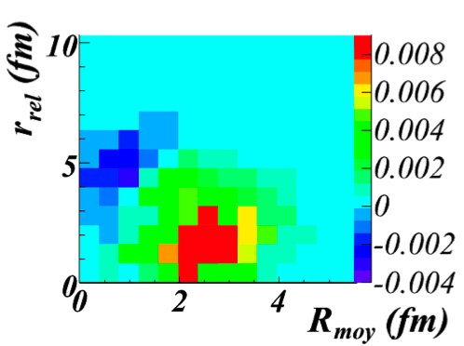
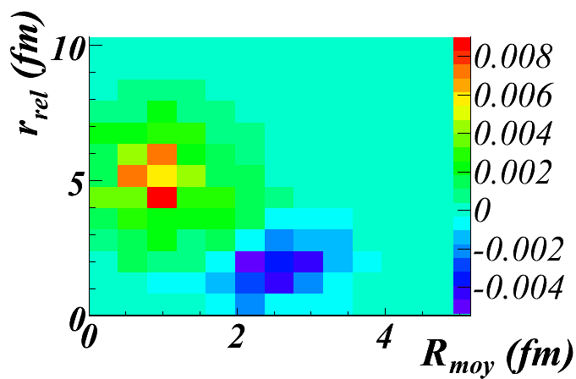
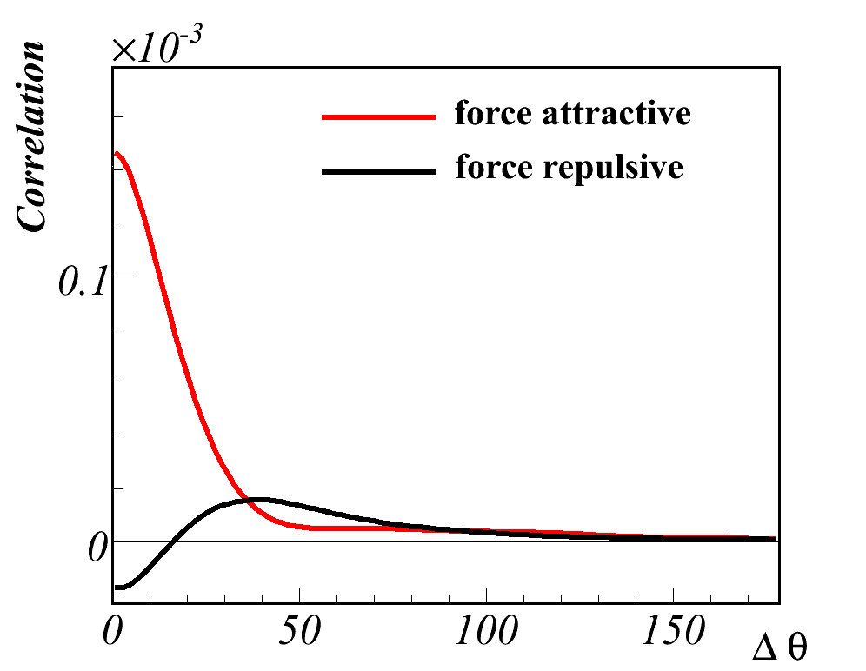
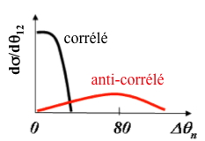
Sensitivity to the residual nn pairing interaction :
TDDM^{P} calculations
Nuclear break-up picture
Theoretical calculation : TDDM^{P}
. TDHF + 2-body correlations (beyond mean-field)
. fully microscopic 3D calculations
R_{moy}
r_{rel}
correlated anti-correlated
correlated
anti-correlated
Nuclear break-up can probe nucleons configurations

Slide 14
Sensitivity to the residual nn pairing interaction :
TDDM^{P} calculations
Nuclear break-up
Theoretical calculation : TDDM^{P}
. TDHF + 2-body correlations (beyond mean-field)
. fully microscopic 3D calculations
volume
mixed
surface
correlated anti-correlated
correlated
anti-correlated
Nuclear break-up is sensitive to the type of residual interaction

Slide 15
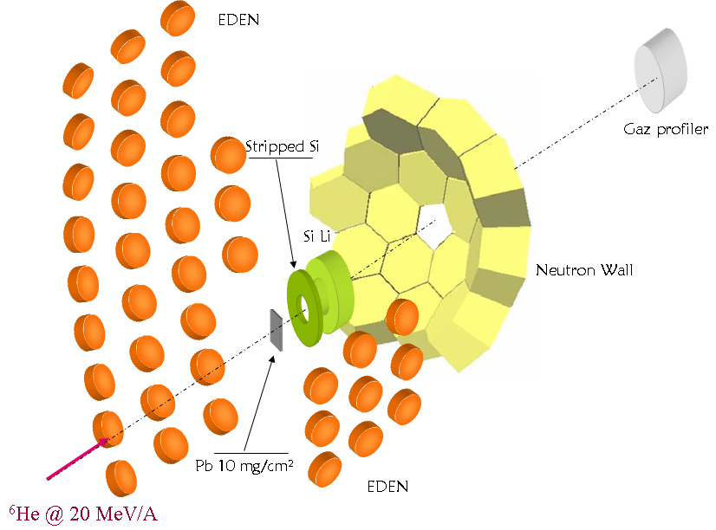
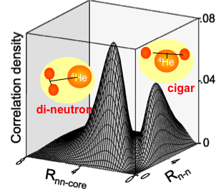
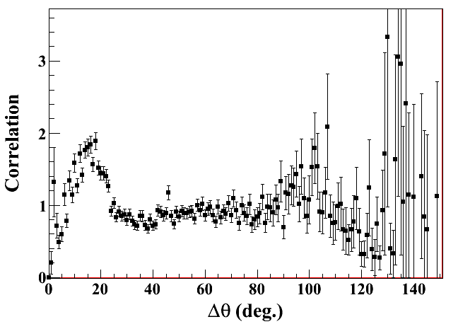
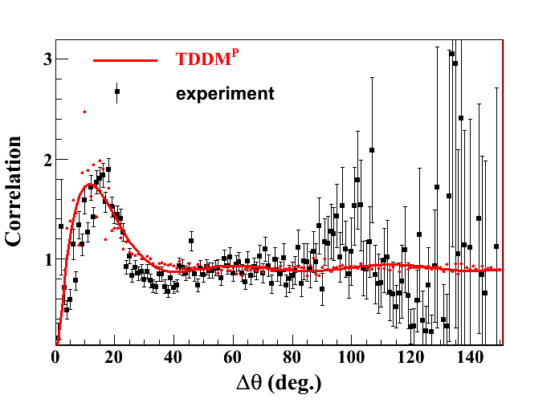
Sensitivity to residual interaction for nn pairing :
The case of ⁶He
Experiment @ GANIL (Caen)
M. Assié, J-A. Scarpaci et al, EPJA (2009)
θ₁orθ₂>30°
preliminary
preliminary
Correlation function
^{with SKI4}
experimental distribution :
emission of correlated neutrons
P(n₁,n₂)
C₁₂=
P(n₁) P(n₂)
independent emission

Slide 16
1. Configuration mixing in exotic nuclei
(¹¹Be and neutron halo)
What type of studies
can we do with
nuclear break-up ?
TDSE model
¹⁰Be
γ
V.Lima et al., Nuclear Physics A795 (2007) 1
3. Probing spatial correlation in borromean nuclei (⁶He)
2. Probing alpha clusterization in
medium mass-nuclei and in light nuclei
Δθ_{n}
TDDM^{P} model
Δθ_{n}
TDSE model
α
M.Assié et al., EPJA (ENAM2008)
M. Assié and D. Lacroix, PRL 102, 202501 (2009)
³⁶Ar*
J-A. Scarpaci et al PRC (2010)

Slide 17
Thank you
IPNO : J.A Scarpaci, D. Beaumel, Y. Blumenfeld,
M. Fallot, N. Frascaria, C. Bhar,
P. Désesquelles, H. Idbarkach, E. Khan, J.L.
Laville, L. Lefebvre, E. Plagnol, J.C. Roynette,
A. Shrivastava, T. Zerguerras, M. Chabot, C.
Monrozeau, C. Petrache, F. Skaza, T. Tuna
GANIL : Ph. Chomaz, A. Chbihi, D. Lacroix, P. Roussel-Chomaz, J. Frankland, A. Chatterjee
LPC Caen : J.C. Angélique
CEA/Saclay : E.C. Pollacco
MSU : D. Bazin
University of Surrey : W. Catford
Univeristy of Camerino : D. Mengoni
Uppsala University : J. Nyberg

Slide 18
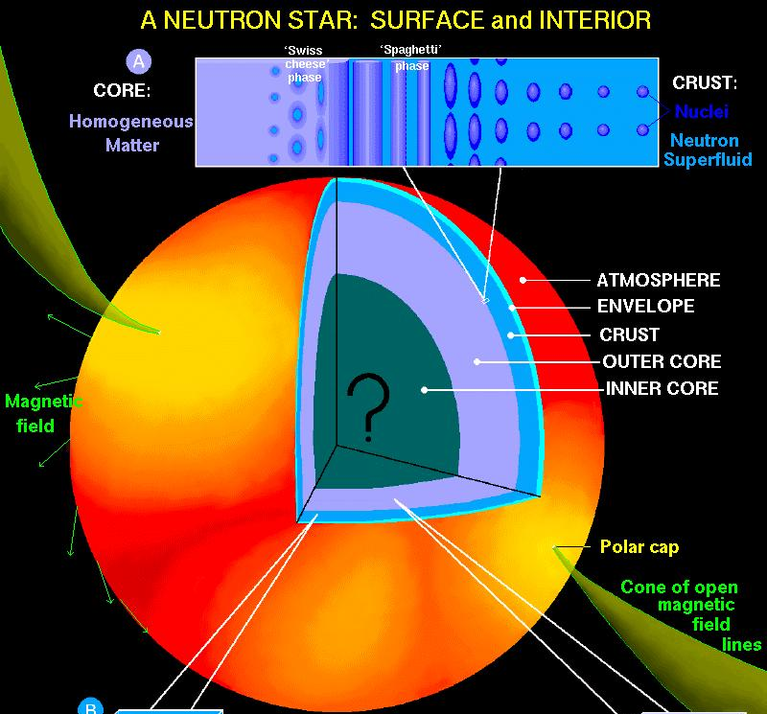
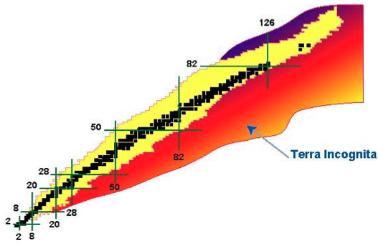
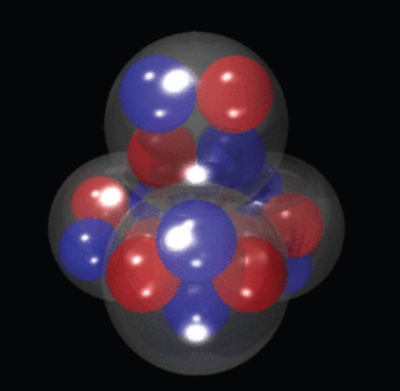
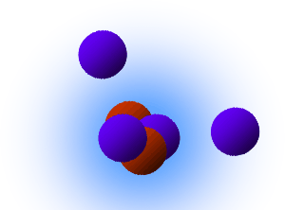
Clusterization in nuclei landscape
Close to driplines : clustering ?
proved for light nuclei
Hoyle state in ¹²C
maybe in ¹⁶O ?
=
Halo nuclei
dilute matter
⁶He
²⁰⁸Pb
Marlène Assié

Slide 19
Our tool : nuclear break-up (called Towing Mode)
Mechanism : “Towing Mode”
Theory: Time Dependent Schrödinger Equation
J.A. Scarpaci et al PLB(1998)
⁵⁷Ni
⁵⁸Ni
⁴⁰Ar
Probability density of a nucleon WF
(44 MeV/A,b= 8 fm)
emission of nucleons :
- with large angle with respect to the
beam axis
- in the same plane and on the same side
as the perturbative potential
- with a velocity lower than the beam
D. Lacroix et al, NPA(1999)

Slide 20
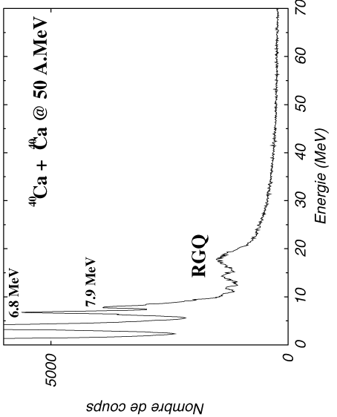
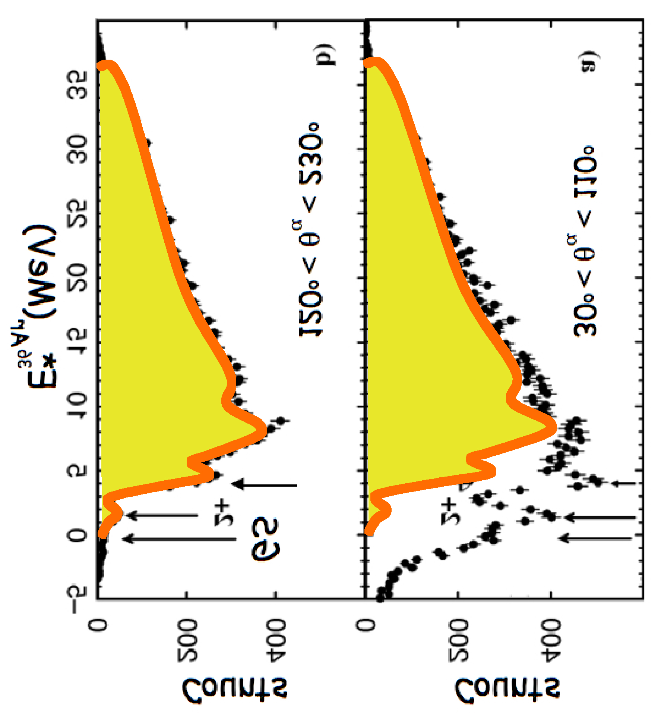
Alpha clusters in ⁴⁰Ca
⁴⁰Ca(⁴⁰Ca,⁴⁰Ca+LCP) @ 50 MeV/A
SPEG + 240 INDRA CsI
e=200 μg/cm², ΔE_{SPEG} =350 keV
⁴⁰Ca
p
⁴⁰Ca
⁴⁰Ca
E_{miss}= E*- E^{Kcm}_{recoil}- E^{Kcm}_{α}
α
E*
α
Statistical decay
50
E_{α}
30º < θ_{α} < 110º
120º < θ_{α} < 230º
20
6⁺
E*_{36Ar}(MeV)
4⁺
2⁺
0⁺
GS
7 MeV
³⁶Ar
⁴⁰Ca

Slide 21
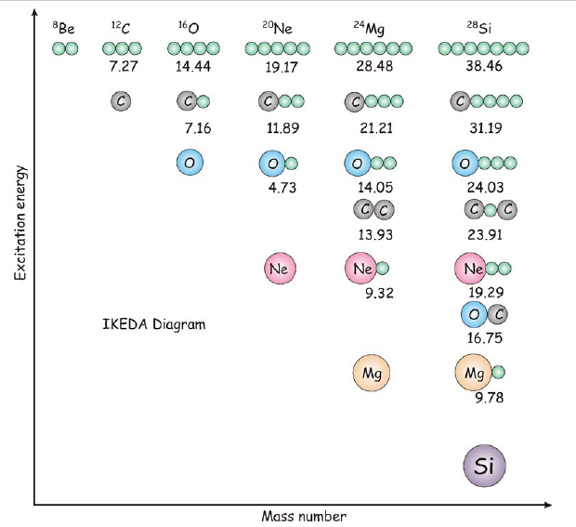
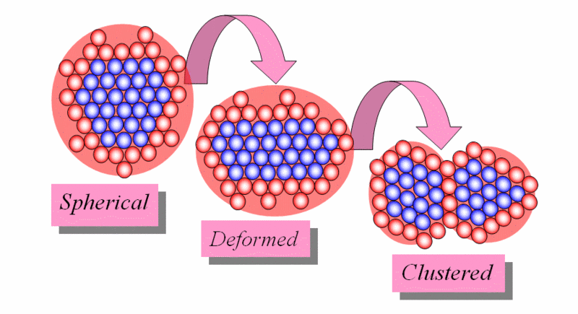
Clusterization in nuclei landscape
Clusterization in matter
at saturation density
α
³⁶Ar*
Close to driplines : clustering ?
proved for light nuclei
Hoyle state in ¹²C
maybe in ¹⁶O
=
Halo nuclei
dilute matter
⁶He
²⁰⁸Pb

Slide 22
From pairing in the nuclei to pairing in NS
Halo nuclei (dilute matter)
unbound neutrons
Matsuo et al, PRC (2006)
di-neutron in two-neutron halo nuclei (⁶He,¹¹Li)
BEC-BCS
normal density
low density
BCS

Slide 23
…the one particle Towing Mode
Inelastic channel
⁴⁰Ar+⁵⁸Ni @ 44 MeV/A Proton & neutron
E_{fin}
E_{target}
E_{miss}= E*- E^{Kcm}_{recoil}- E^{Kcm}_{α}
E_{nucleon}
E_{init}
J.A.Scarpaci et al.,
Physics Letters B428 (1998) 241
Statistical decay
E*
GS
E_{α}
g.s.
Sp
⁵⁸Ni
⁵⁷Co

