Slide 1
Quasi-free Reactions for spectroscopic factors of oxygen-20
Ali Najafi
For the LAND-R³B collaboration
INPC2013, Firenze, Italy
Spectroscopic factors
The experiment
Analysis & results

Slide 2
Quenching of Spectroscopic Factors
Cross section of nucleon knock-out reaction
quasifree scattering
Spectroscopic factor
A measure of the occupancy
of an energy level
Calculated cross section
Single-particle model

Slide 3
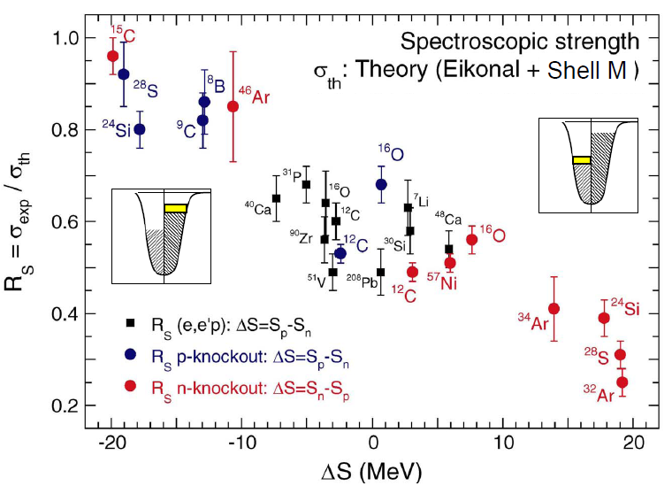
Quenching of Spectroscopic Factors
²⁸S
Z = 16
N = 12
Neutron deficient
A. Gade et al., PHYSICAL REVIEW C 77, 044306 (2008)

Slide 4
The Experiment @ GSI
Fragment
separator
Primary beam: ⁴⁰Ar (500 MeV/u)
Primary target: Be
The detection setup

Slide 5
Secondary ion Beams
²⁰O

Slide 6
The Setup
Reaction chamber,
Crystal ball
Neutron detector
Beam diagnostic
Scintillating fiber detectors
²⁰O
neutrons
fragments
Targets
CH2 (458 mg/cm²)
Carbon (558 mg/cm²)
protons
Drift chambers
Proton time-of-flight
scintillator wall
Fragment time-of-flight
scintillator wall

Slide 7
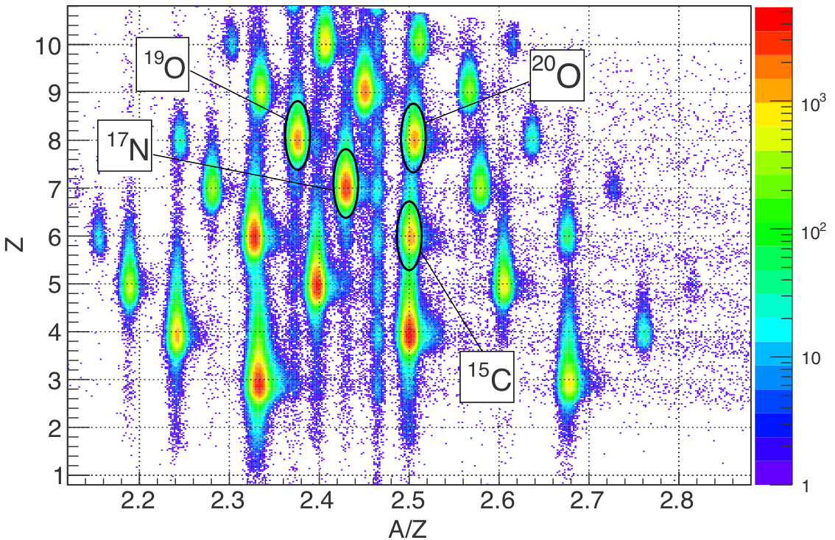
Incoming Particle Identification

Slide 8
Results [I]: cross sections
Normalised yields [mb]. Uncertainties are statistical.
Efficiency of detection of two protons: 62(17)%
p (²⁰O , pp ¹⁹N): σ_{obs} = 10.0(8)_{stat}(37)_{sys} mb
σ_{th} = 42.9 mb *
PRELIMINARY
* Carlos Bertulani

Slide 9
Results [I]: quenching factor
²⁰O
PRELIMINARY
A. Gade et al., PHYSICAL REVIEW C 77, 044306 (2008)

Slide 10
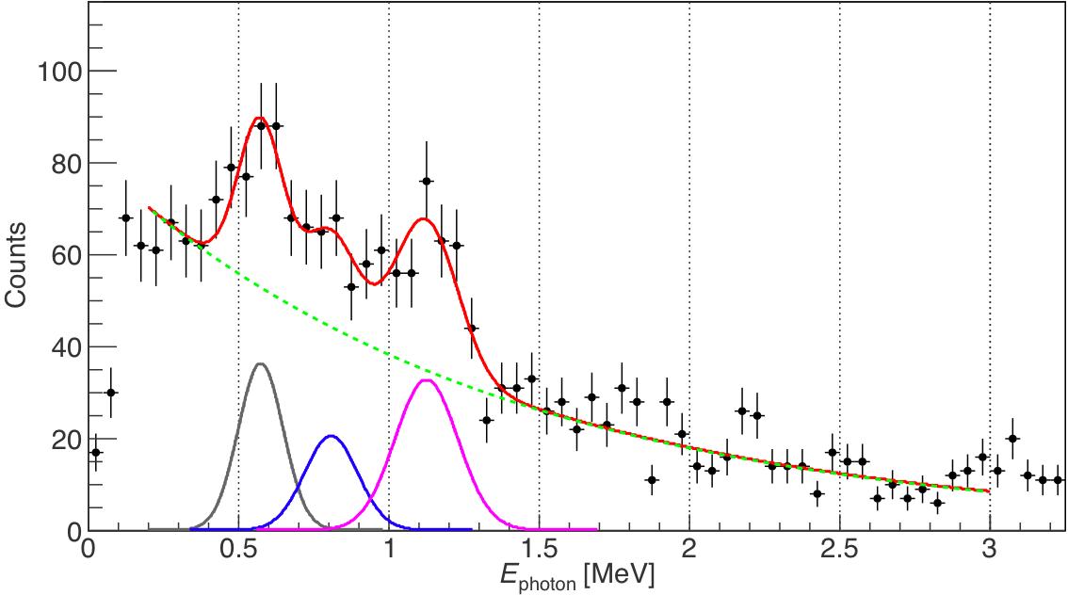
Results [II]: bound excited states of ¹⁹N
574(22)
1126(18)
808(35)
Sohler D., et al. Physical Review C 77, 044303 (2008).

Slide 11
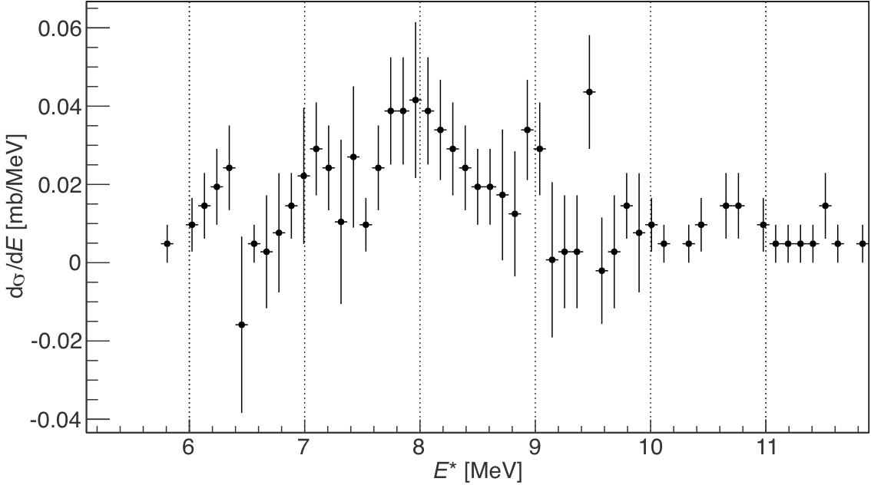
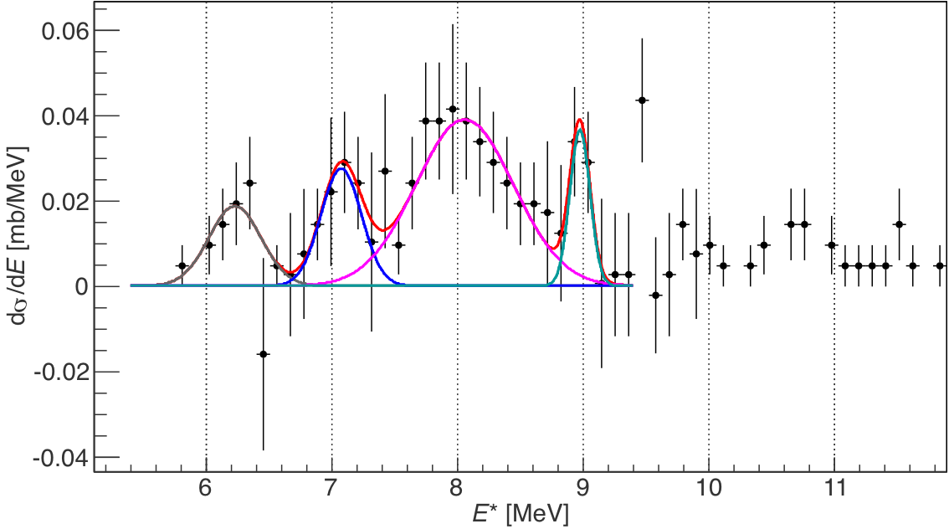
Results [II]: unbound states of ¹⁹N
Neutron separation energy of ¹⁹N has been reproduced.
Four excited states have been observed.
S_{n} = 5.3 MeV
8.07(6)
9.00(4)
7.14(9)
PRELIMINARY
6.20(6)
²⁰O → ¹⁹N* → ¹⁸N + n + photon , E_{photon} >300 keV

Slide 12
Summary
The cross sections of the quasi-free proton and neutron knockout from ²⁰O have been measured.
A preliminary evaluation of the spectroscopic factor is reported.
Three bound and four unbound excited states of ¹⁹N have been observed.
Momentum distributions have also been measured.

Slide 13
THANK YU
LAND-R³B collaboration:
T. Adachi, Y. Aksyutina, J. Alcantara, S. Altstadt, H. Alvarez-Pol, N. Ashwood, T. Aumann, M. Barr, S. Beceiro, D. Bemmerer, J. Benlliure, C. A. Bertulani, K. Boretzky, G. Burgunder, M. Caamano, C. Caesar, E. Casarejos, W. Catford, B. Cederwall, S. Chakraborty, M. Chartier, L. Chulkov, D. Cortina-Gil, U. Datta Pramanik, P. Diaz Fernandez, I. Dillmann, J. Enders, O. Ershova, A. Estrade, F. Farinon, L. M. Fraile, M. Freer, M. Freudenberger, D. Galaviz Redondo, H. Geissel, R. Gernhauser, D. Gonzalez Diaz, M.N. Harakeh, J. Hagdahl, T. Heftrich, M. Heil, M. Heine, A. Heinz, A. Henriques, M. Holl, J. D. Holt, G. Ickert, A. Ignatov, H. Johansson, B. Jonson, N. Kalantar-Nayestanaki, R. Kanungo, A. Kelic-Heil, R. Knobel, T. Kroll, R. Krucken, J. Kurcewicz, M. Labiche, C. Langer, T. Le Bleis, R. Lemmon, O. Lepyoshkina, J. Machado, M. Mahjour-Shafiei, J. Marganiec, V. Maroussov, J. Menendez, A. Movsesyan, T. Nilsson, C. Nociforo, V. Panin, A. Perea, S. Pietri, R. Plag, A. Prochazka, A. Rahaman, G. Rastrepina, R. Reifarth, G. Ribeiro, M.V. Ricciardi, C. Rigollet, K. Riisager, M. Reoder, D. Rossi, J. Sanchez del Rio, D. Savran, H. Scheit, A. Schwenk, H. Simon, J. Simonis, O. Sorlin, V. Stoica, B. Streicher, J. Taylor, O. Tengblad, S. Terashima, R. Thies, Y. Togano, E. Uberseder, J. Van de Walle, P. Velho, V. Volkov, A. Wagner, F. Wamers, H. Weick, M. Weigand, C. Wheldon, G. Wilson, C. Wimmer, J. Winﬁeld, P. Woods, D. Yakorev, A. Zilges, M. Zoric, K. Zuber

Slide 14
Back-up slides

Slide 15
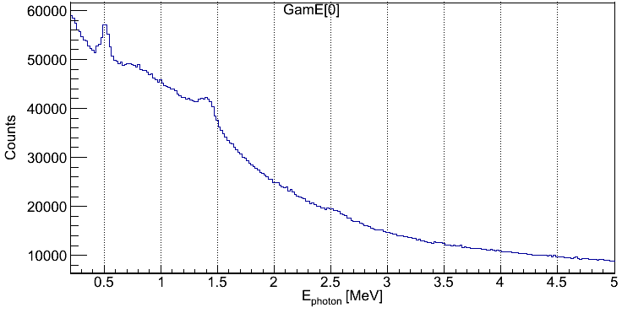
Crystal Ball
Photon energy spectrum of environmental background data
1.46 MeV
From ⁴⁰K
511-keV
background
2.6 MeV
From ²³²Th

Slide 16
Photon spectrum of ¹⁸N
452(15)
646(11)
896(20)

Slide 17
Motivation
Observation of the nuclei beyond the neutron dripline;
¹³Be, ¹⁴Be, ²⁵O, ²⁶O
Study of the cluster structure of neutron rich nuclei;
⁸Be = α + α
(n,γ) rates of light neutron rich nuclei for r-process nucleosynthesis;
¹⁷C(n,γ)¹⁸C
Spectroscopic factors of exotic nuclei in the p and sd shells;
Spectroscopic studies of oxygen-20 isotopes using (p,pp) and (p,pn)

Slide 18
Spectroscopic Factors
4
1d_{3/2}
20
2
2s_{1/2}
1d_{5/2}
6
2
1p_{1/2}
4
8
1p_{3/2}
1s_{1/2}
2
2
O. Jensen et al., PHYSICAL REVIEW LETTERS 107, 032501 (2011)

Slide 19
Outgoing Fragment Identification
Selection of charge
oxygen
nitrogen
carbon
Energy (SSD) [Channels]

Slide 20
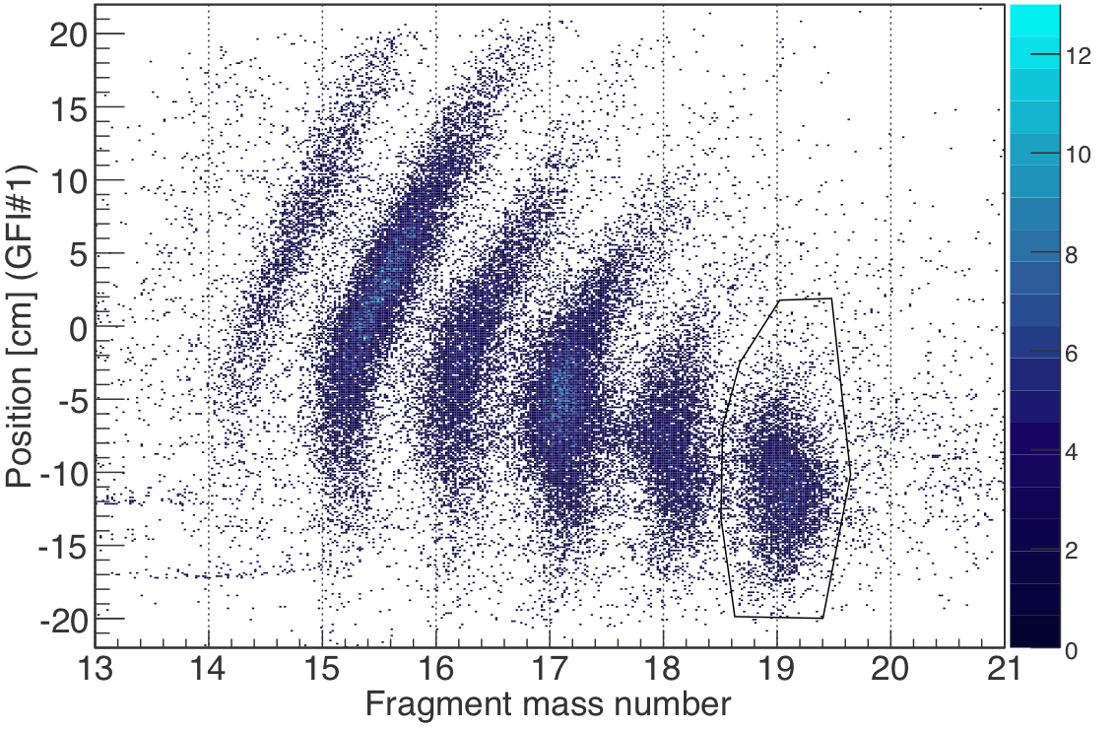
Outgoing Fragment Identification
Selection of mass
¹⁷N
¹⁸N
¹⁹N

Slide 21
Results [II]: bound excited states of ¹⁹N
The neutron separation energy is reproduced.

Slide 22
Results [III]: momentum distributions
Momentum distributions could be used to determine the s-wave and d-wave contributions to the reaction.
PRELIMINARY
PRELIMINARY
Momentum resolution of the setup:
δp_{x} = 43.8(1)
δp_{y} = 75.5(1)
δp_{z} = 99.6(3)

