Slide 1


Shape evolution of Ne isotopes and Ne hypernuclei:
The interplay of pairing and tensor interactions
LI ANG
李 昂
liang@xmu.edu.cn

Slide 2
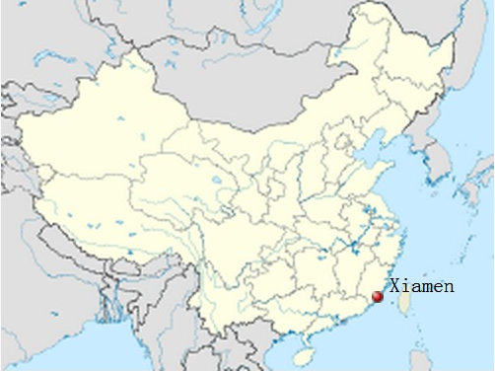

Department of Astronomy
Amoy

Slide 3
Content
(looong) Introduction
Neon isotope and hypernuclei with a microscopically determined Lambda-nucleon interaction based on Brueckner theory
  The curial role of tensor force and pairing in the deformation of
  some neon isotopes;
  Interplay of nuclear force and hyperon force present in
  hyperonuclei.
Summary and next plans
*A. Li (RIKEN & Xiamen), E. Hiyama(RIKEN), X.-R. Zhou (Xiamen), H. Sagawa (Aizu & RIKEN), Phys. Rev. C 87, 014333 (2013)

Slide 4
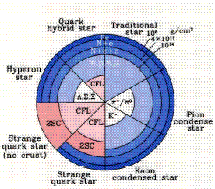
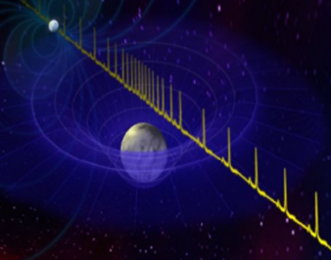
Introduction
Structure of neutron stars (NSs): The hyperon puzzle?! ([E2]Pagliara’ talk, [Award]Gandolfi’s talk, [P8]Steiner’s talk)
  2M_{ʘ} NS observed recently;
  Hyperons appear for sure (2~3ρ₀), but too soft EoS;
  Ways out: A universal repulsive baryonic 3BF, a stiff
  quark core, more exotic scenario (modified gravity,
  dark matter, etc.)
Demorest et. al, Nature 2010

Slide 5
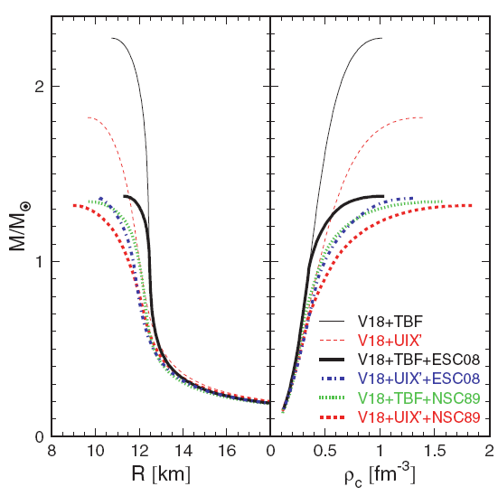
The hyperon puzzle (eg. the Brueckner theory)
Burgio, Schulze, AL, 2011
Schulze & Rijken, 2011
2M_{ʘ}!
< 1.4M_{ʘ}
2N + 3N + YN;
Contradicted with observed pulsar masses.

Slide 6
Introduction
Structure of neutron stars (NSs): The hyperon puzzle?! ([E2]Pagliara’ talk, [Award]Gandolfi’s talk, [P7]Khan’s talk, [P8]Steiner’s talk)
  2M_{ʘ} NS observed recently;
  Hyperons appear for sure, but too soft EoS;
  Ways out: A universal repulsive baryonic 3BF, a stiff
  quark core, more exotic scenario (modified gravity,
  dark matter, etc.)
No enough information of (realistic) hyperon (Y) interactions for the microscopic study.
  No phase shift data for YY scattering, only a few for YN scattering;
  one can only refer to hypernuclei data.
Demorest et al., Nature 2010

Slide 7
Scheme
Realistic hyperon interaction
①
use
③
Suggest improvements of
the phenomenological modeling
④
Predictions for the stellar matter relevant for NSs and supernovae.
Accurate structure calculations
②
Compare between the theoretical results
and the experimental data of the binding
energy, deformation, spin-orbit splitting, etc.
Light hypernuclei system
(up to ⁸Be)
D. J. Millener, 2007, 2008
E. Hiyama et al. 2000, 2006, 2010
Hypernuclei data
Single-, double-, multi-Λ hypernuclei; Ξhypernuclei (updated quickly)

Slide 8
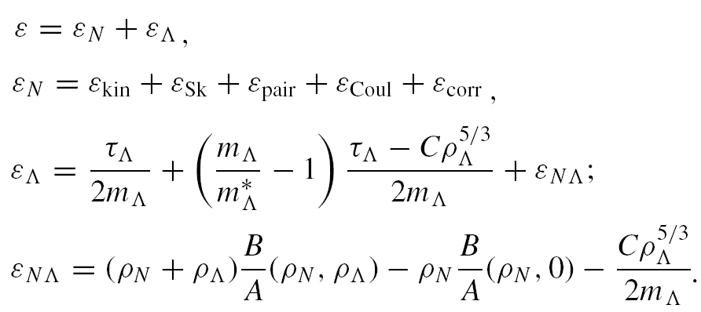
Deformed-Skyrme-Hatree-Fock (SHF) + BCS model
Vautherin 1973
Blum, et al. 1992
Extended to include hyperons;
Cugnon, Lejeune, & Schulze 2000
Zhou, Schulze, Sagawa, et al. 2007
[P7]Khan’s talk
B/A and m_{Λ}∗ from Brueckner calculations of infinite
hypermatter using realistic baryonic interactions.

Slide 9
Deformed-Skyrme-Hatree-Fock (SHF) + BCS model
Vautherin 1973
Blum, et al. 1992
Two different Nijmegen hyperon interactions in Brueckner calc.
The NSC97f model
Include phenomenological extensions to the YY sector based on
SU(3) symmetry;
The ESC08b model
Most recent; More consistent descriptions of existing hypernuclei
data (But not the 2M⊙ neutron star mass measurement).
The ESC08c model, to be done
Include repulsive hyperon three-body force.
Stoks & Rijken, 1999
T. Rijken, et al 2010
E. Hiyama et al. 2010

Slide 10
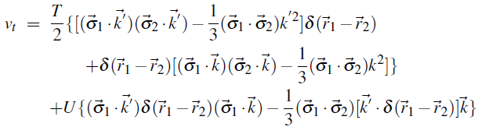
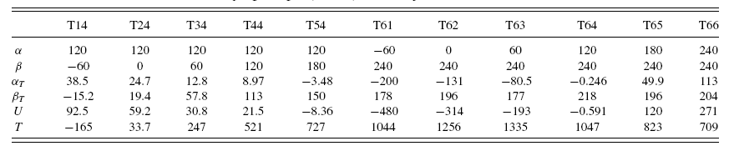
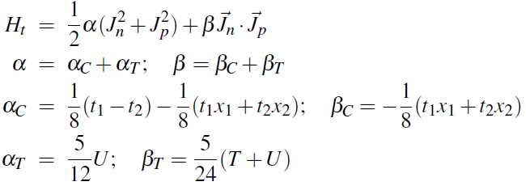


Deformed-Skyrme-Hatree-Fock (SHF) + BCS model
Vautherin 1973
Blum, et al. 1992
G. Colò et al. 2007
Brink & Stancu 2007
T. Lesinski,et al. 2007
Tensor force included:
Pairing energy functional:
G. Audi, et al 2003
V_{pair}≡ V ^{full} from the empirical N pairing gaps extracted by using the 3-point mass difference formula
(Satula, Dobaczewski, Nazarewicz 1998).

Slide 11
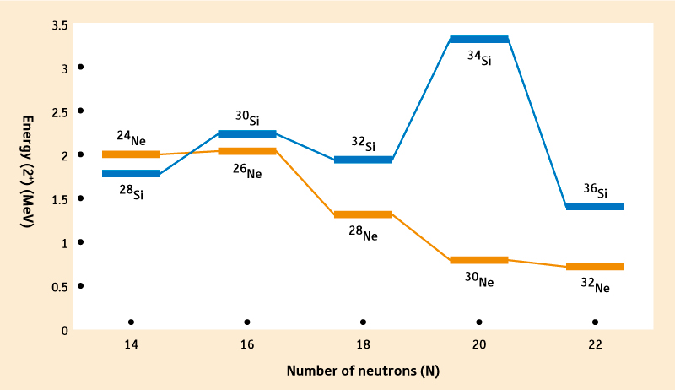
Core nuclei
Ne-hypernuclei are planned;
Ne isotope is very interesting itself: Non-magic N=20!
Tensor and pairing is crucial and must be included properly.
([P1]Sorlin’s talk, [C1]Utsuno’s talk, [D2]Kobayashi’s talk, [P3]Obertelli’s talk, [C3]Bai’s talk, [Award]Cakirli’s talk, [P7]Khan’s talk)
T. Motobayashi, http://www.rikenresearch.riken.jp/eng/frontline/6441

Slide 12
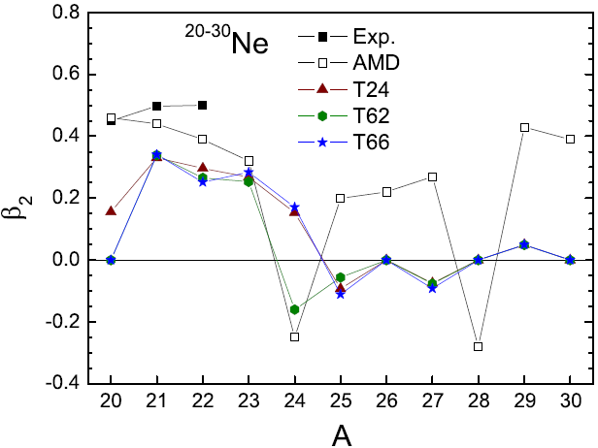
Core nuclei
Several neutron-rich Ne isotopes are suggested to be deformed by Exp.;
²⁶Ne,³⁰Ne always spherical, why?
Raman, et al. 2001
L. A. Riley et al. 2003
Y. Yanagisawa et al. 2003
W. Geithner et al. 2005
H. Iwasaki et al. 2005
J. Gibelin et al. 2007
T. Nakamura et al. 2009
M. Takechi et al. 2012
AMD
K. Minomo, et al. 2012
T. Sumi, et al. 2012
V_{pair}≡ V ^{full}

Slide 13
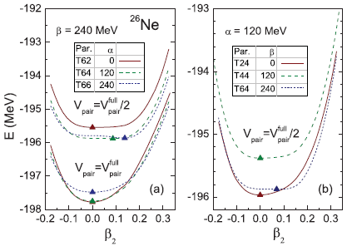


Core nuclei ²⁶Ne
For reduced pairing, small tensor gives spherical shape, larger tensor gives prolate shape;
A weak nucleon pairing: Pairing interaction tends to form the J = 0+ pairs of identical particles which have spherically symmetric wave functions.
T. R. Werner, et al 1996

Slide 14
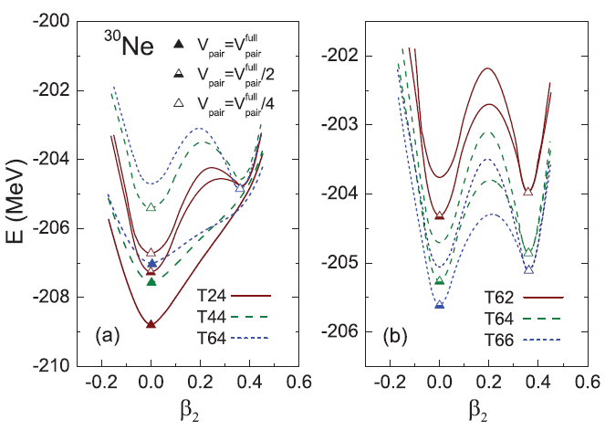
Core nuclei ³⁰Ne
Reduced pairing lifts spherical minimum but affect little the prolate one;
Well-deformed ground states achieved with the help of tensor;
Large tensor: Reduced shell gaps and more orbits mixing around the Fermi surface.
20
16
14
f_{7/2}
d_{3/2}
s_{1/2}
d_{5/2}

Slide 15
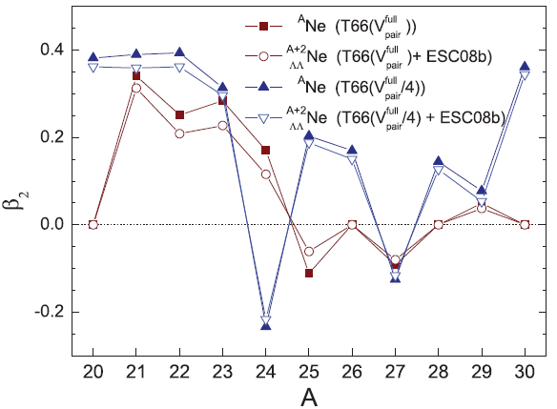
Adding Λs on Ne cores
Tensor force should not be small; Favorable para. sets have been chosen;
Paring should be weaker than the values deduced from gap data (Isospin dependence?! Can be further improved.)
Bertulani, et al 2012
A smaller deformation of the same sign is found for the corresponding hypernuclei：
Glue-like role
([P7]Nakamura’s talk)

Slide 16
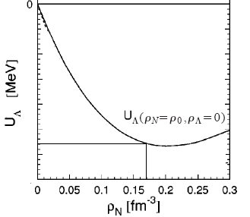
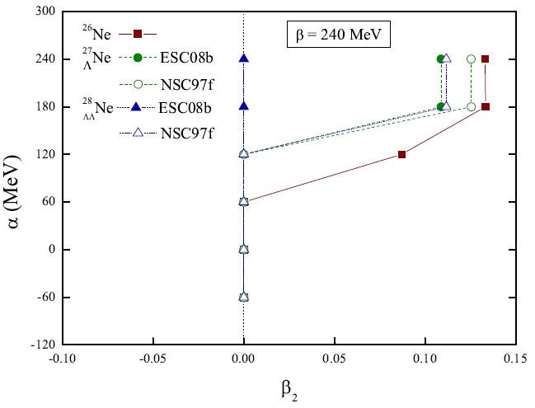
Distinguish different hyperon interactions?
Glue-like role of hyperons;
A hyperon interaction with deeper Lambda well depth -> more spherical results: ESC08b (-40MeV) vs. NSC97f (-36MeV)
Core nuclei
Single-Λ hypernuclei
Double-Λ hypernuclei
Λ well depth from
Brueckner calculations
To be checked
by Exp.

Slide 17

Next plans
To include hyperon spin-orbit force;
W_{Λ}
To calculate multi-Λ hypernuclei (Ne+nΛ) up to the Λ drip line;
To calculate Ξ hypernuclei (J-PARC E05) in the same framework for Λ hypernuclei.
Scheerbaum 1976
[F4]Iwasaki’s talk
[P7]Nakamura’s talk

Slide 18
Summary
It demands the multiplay of a small pairing and a large tensor to give a reasonable description for ^{26,30}Ne;
The conclusion holds also for the corresponding Lambda hypernuclei, only a small glue effect of hyperons is present as expected,
A hyperon-nucleon interaction, the ESC08b model, having a deeper Lambda potential makes smaller deformations for hypernuclei then those of the NSC97f interaction.
Towards a unique determination of both hyperon interactions and NS structures;
Thanks to the upcoming high-accuracy hypernuclei data.
Thank you very much for your attention!

