Slide 1
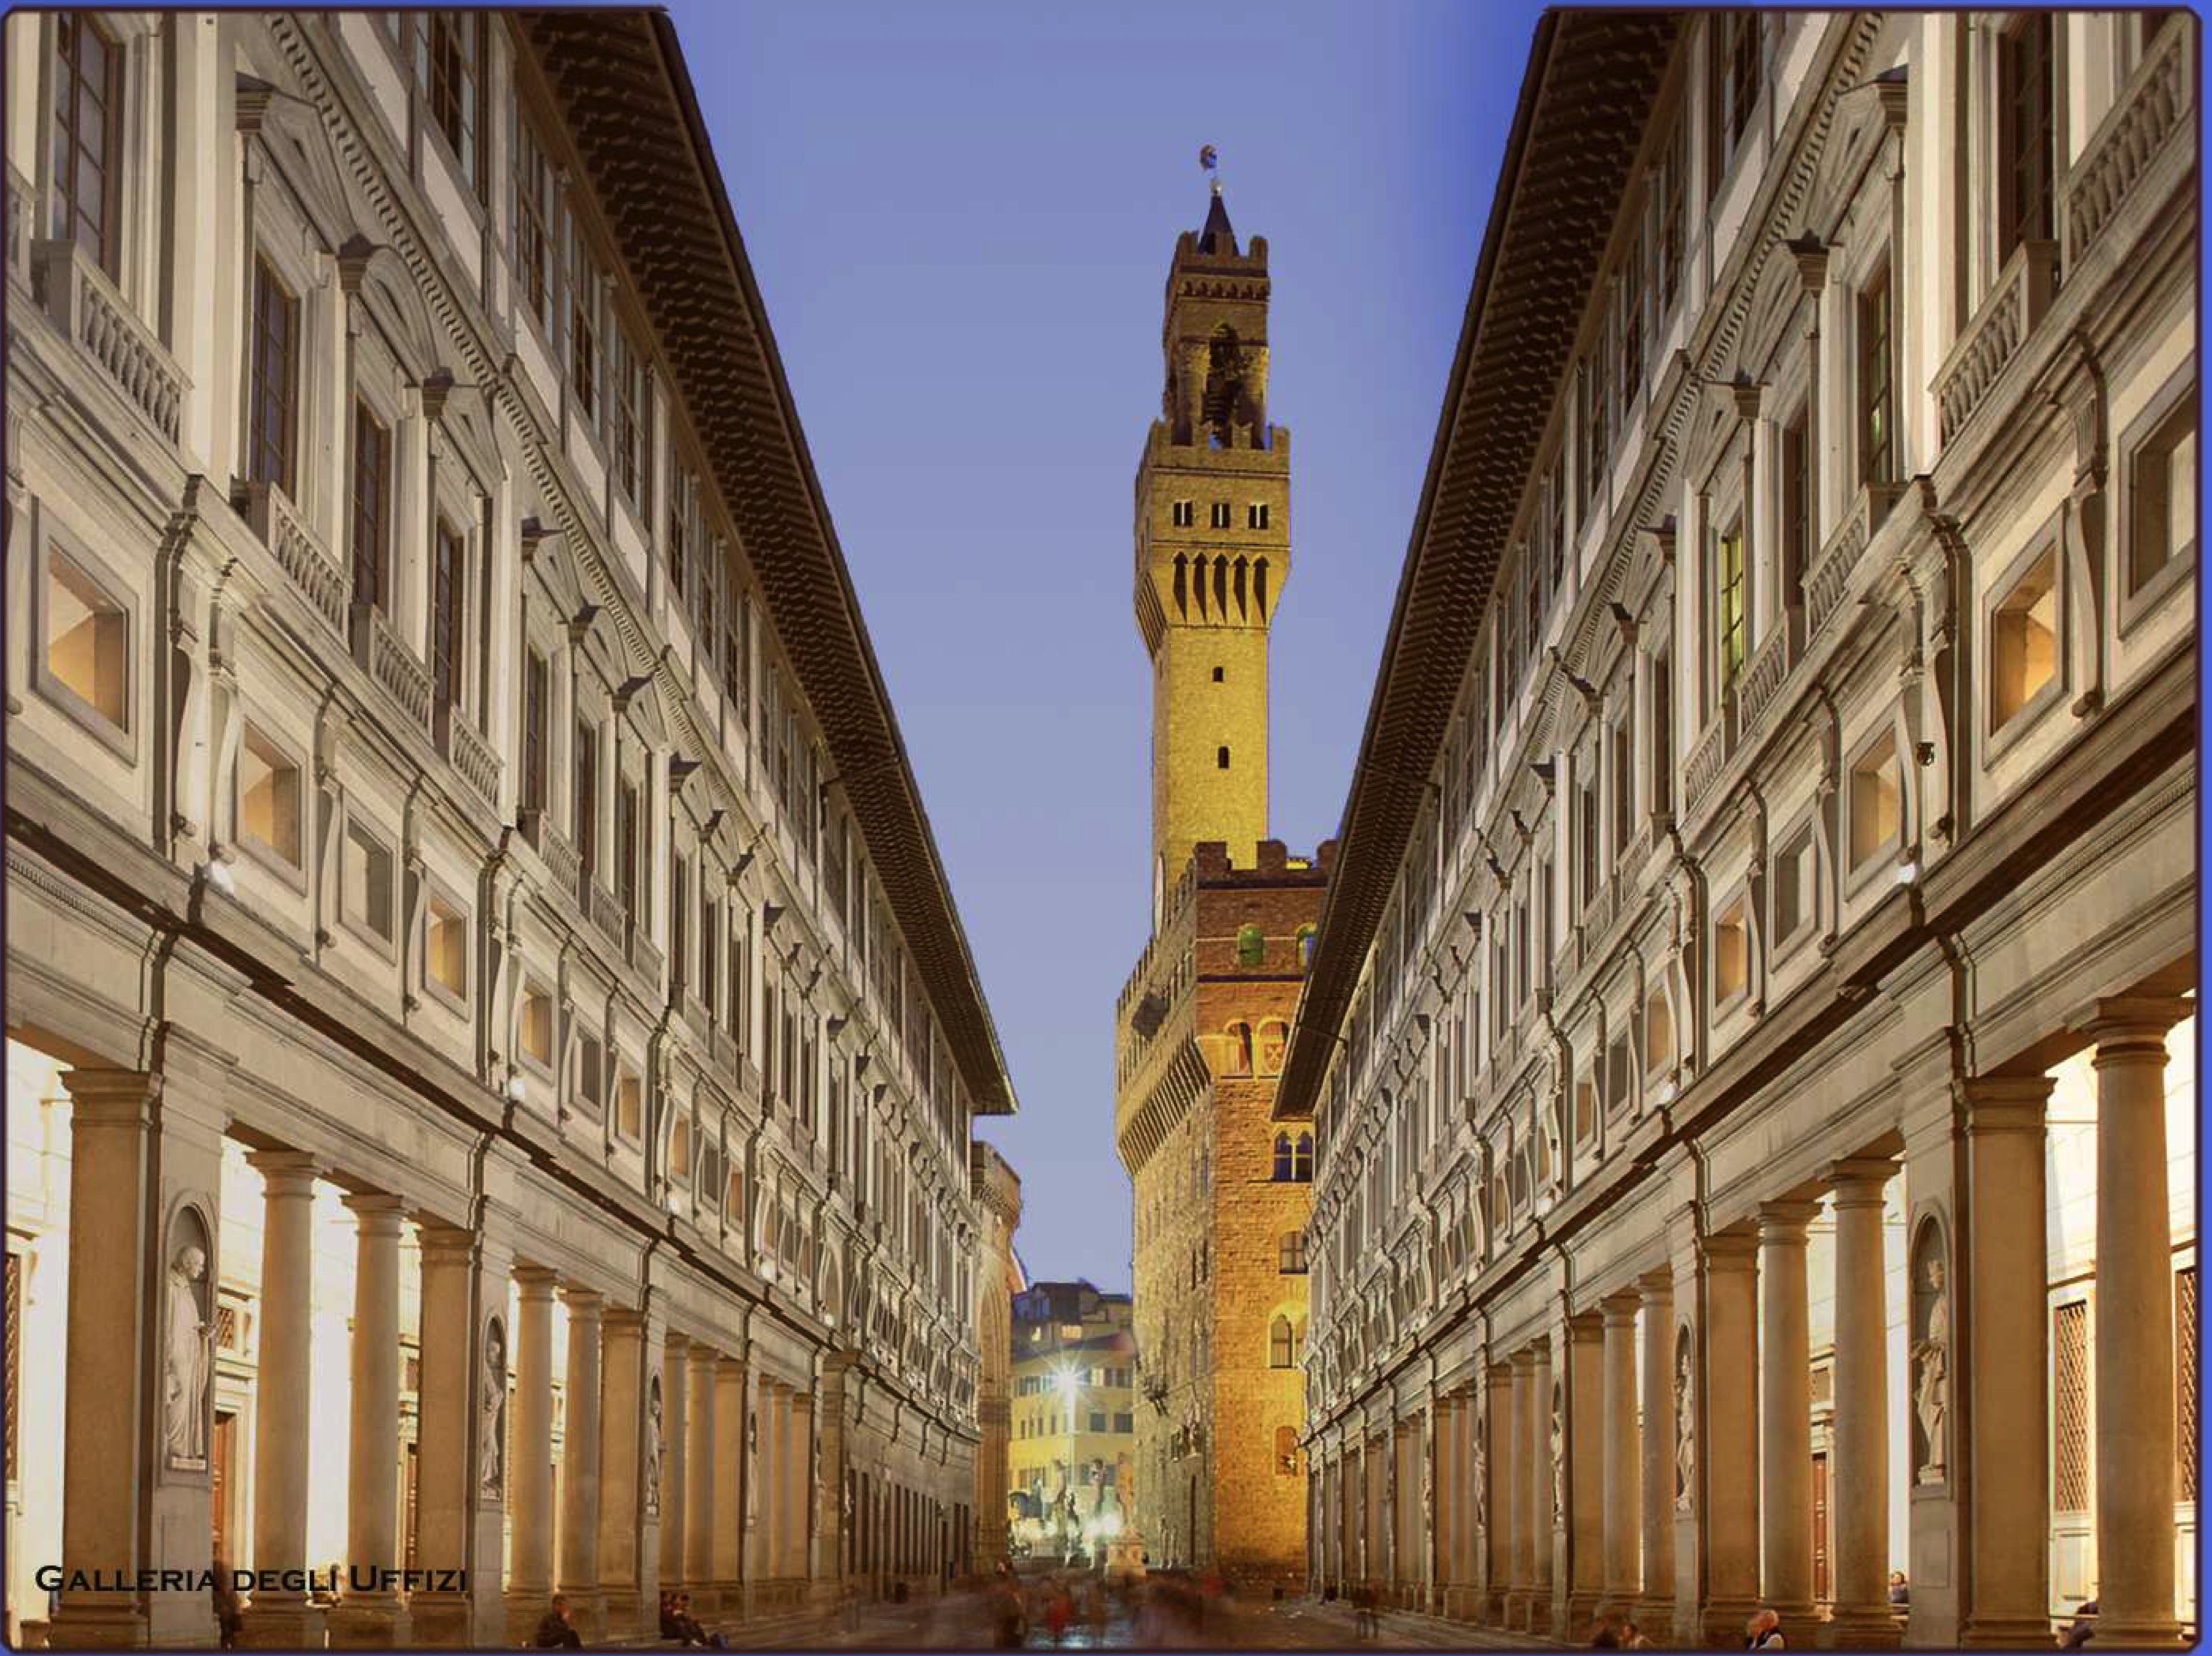
Neutron-rich Λ-hypernuclei
study with the FINUDA
experiment
Elena Botta
INFN-Torino and Torino University

Slide 2




Overview
physics motivations
the FINUDA experiment
n-rich hypernuclei search with FINUDA
  ⁶_{Λ}H
  ⁹_{Λ}He
Notes:
Cenni: notes, mention
Remaining physics motivations

Slide 3
Search for light n-rich hypernuclei
physics motivations
Hypernuclei with a large neutron excess: R.H. Dalitz, R. Levi Setti., N. Cim. 30 (1963) 489, L. Majling, NP A 585 (1995) 211c, Y. Akaishi et al., Frascati Physics Series XVI (1999) 59.
The Pauli principle does not apply to the Λ inside the nucleus + extra binding energy (Λ “glue-like” role) ⇒ a larger number of neutrons can be bound with respect to ordinary nuclei.
Neutron (proton) drip-line:
response of neutron halo on embedding of Λ hyperon, hypernuclear species with unstable nuclear core, extending the neutron drip line beyond the standard limits of n-rich nuclei
Hypernuclear physics:
ΛN interactions at low densities, the rôle of 3-body forces, nuclear core compression (⁷_{Λ}Li vs ⁶Li: H.Tamura et al., Phys.Rev. Lett. 84 (2000) 5963)
Notes:
Cose gia’ dette da Hiyama e Gibson
6LHe, 7LBe, 8LHe, 9LBe, 10LB

Slide 4

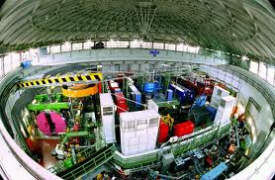
Hypernuclear Physics @FINUDA
e⁺ + e⁻ → φ (1020) → K⁺ + K⁻ (127 MeV/c)
K⁻_{stop} + ^{A}Z → ^{A}_{Λ}Z + π⁻
^{A}_{Λ}Z →^{A}(Z+1) + π⁻
^{A}_{Λ}Z →^{A-2}(Z-1) + p + n
^{A}_{Λ}Z →^{A-3}(Z-1) + p + n + n
Spectroscopy
Γ_{π−} MWD
1N induced Γ_{p}
NMWD
2N induced Γ_{np}
very thin targets (0.1 ÷ 0.3 g/cm²)
transparency ➥ “high” resolution spectroscopy
different targets in the same run
➥ high degree of flexibility
coincidence measurement with large acceptance (ΔΩ∼2π srad)
complete event ➥ decay mode study
- simultaneous tracking of μ⁺ from the K⁺ decay
K⁺→ μ⁺ ν_{μ}➥ energy and rate calibration
FINUDA key features
Notes:
Ridurre la parte sul NMWD?
Decadimento: coincidenza: si sa quale stato sta decadendo!

Slide 5
Search for light n-rich
hypernuclei in FINUDA
Production reaction
(K⁻_{stop}, π⁺)
K⁻ + p → Λ + π⁰ π⁰ + p → n + π⁺ (2-step) S-EX + C-EX
K⁻ + p → K⁰ + n K⁰ + p → Λ + π⁺ (2-step) C-EX + S-EX
K⁻ + p → Σ⁻ + π⁺ Σ⁻ + p n + Λ (1-step) S-EX
K.Kubota et al, NPA 602 (1996) 327.
⁹_{Λ}He (⁹Be) U.L.=2.3 10⁻⁴/K⁻_{stop}; ¹²_{Λ}Be(¹²C) U.L.=6.1 10⁻⁵/K⁻_{stop};
¹⁶_{Λ}C(¹⁶O) U.L.=6.2 10⁻⁵/K⁻_{stop}
PLB 640 (2006) 145: upper limits ⁶_{Λ}H, ⁷_{Λ}H and ¹²_{Λ}Be
oct 2003 - jan 04: ~220 pb⁻¹
⁶_{Λ}H (⁶Li) U.L.= (2.5 ± 1.4) 10⁻⁵/K⁻_{stop}; ⁷_{Λ}H(⁷Li) U.L.= (4.5± 1.4) 10⁻⁵/K⁻_{s};
¹²_{Λ}Be(¹²C) U.L.= (2.0 ± 0.4) 10⁻⁵/K⁻_{stop} (inclusive π+ spectra analysis)
PRL 108 (2012) 042501, NPA 881 (2012) 269: ⁶_{Λ}H observation
PRC 86 (2012) 057301: upper limits ⁹_{Λ}He
Notes:
LS mixing is equivalent to S p → L n

Slide 6
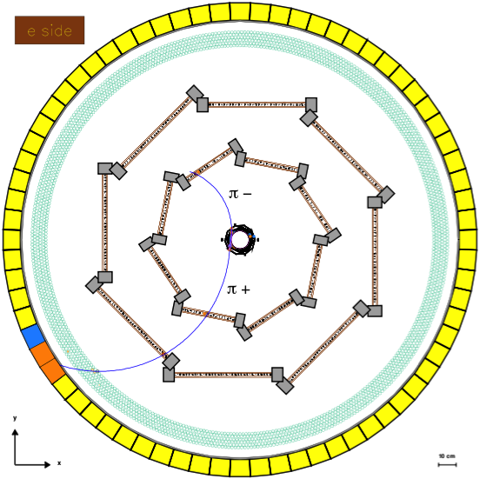
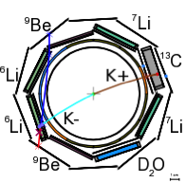
Coincidence measurement
nov 2006 - jun 2007: 960 pb⁻¹
Detector capabilities:
Selective trigger based on fast scint. detectors
precise K⁻ vertex identification (< 1 mm³)
(P.ID.+ x,y,z resolution + K⁺ tagging)
p, K, p, d, … P.ID. (OSIM and LMDC dE/dx)
High momentum resolution
(tracker resolution + He bag + thin targets)
K⁻ _{stop} + ⁶Li → ⁶_{Λ}H + π⁺
⁶_{Λ}H →⁶He + π⁻
D-CEX
~252 MeV/c
MWD
~134 MeV/c
π⁻
B = 1T
π⁺
Notes:
Event display program.
The kaon stopping point was determined with a reso- lution of about 800 μm due to the angular and energy straggling.

Slide 7
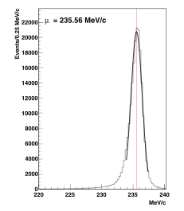
FINUDA momentum resolution
π− production of ⁴_{Λ}H hyperfragment on ⁶Li
2-body MWD π-
= 1.1±0.1 MeV/c
  = 132.6±0.1 MeV/c (132.8 MeV/c)
  = 1.2±0.1 MeV/c
χ²/ndf = 79.1/74
partial and cumulative spectra
performance stability monitoring
π+ momentum resolution
(235 MeV/c): K_{μ2} decay
(PLB 698 (2011) 219)
Notes:
pi+: mu+ da 0.5 a 0.9% FWHM cioe’ 1.18 MeV/c a 2.12 MeV/c FWHM (da 0.5 a 0.90 MeV/c sigma); BR=63.51%
Risoluzione pi- su 9Be: 1.6 MeV/c

Slide 8
Coincidence measurement
K⁻_{stop} + ⁶Li → ⁶_{Λ}H + π⁺
⁶_{Λ}H → ⁶He + π⁻
(τ(⁶He)~801 ms)
M(K⁻) + 3 M(n) + 3M(p) – B(⁶Li) = M(⁶_{Λ}H) + T(⁶_{Λ}H) + M(π⁺) + T(π⁺)
M(⁶_{Λ}H) = 4 M(n) + 2M(p) – B(⁶He) + T(⁶He) + M(π⁻) + T(π⁻)
T(π⁺) + T(π⁻) =
M(K⁻) + M(p) – M(n) – B(⁶Li) + B(⁶He) –T(⁶He) – T(⁶_{Λ}H) – M(π⁺) – M(π⁻)
= 203.0 ± 1.3 MeV (203.5÷203.3 MeV with B_{Λ}= 0÷6 MeV)
cut on T(π⁺) + T(π⁻): 202÷204 MeV
if ⁶_{Λ}H is a particle-stable (bound) system
independent 2-body reactions:
decay at rest
Notes:
203.2→203.3
Two-body reactions if 6LH exists as stable system vs strong interaction; MWD is the signature of the stability of the system!!
203 e’ insensitive on the BL between 0 and 6 MeV→ BL=4.5 MeV instead of 4.0 MeV is OK; the the correction to the 0.7 sigma correction is negligible with respect to the errors.

Slide 9
selection:
T(π⁺)+T(π⁻) = 202÷204 MeV
Finuda Coll. and A. Gal,
NPA 881 (2012) 269.
absolute energy scale:
μ+(235.6 MeV/c) from K_{μ2}
Δ_{p}< 0.12 MeV/c systematic errors
π-(132.8 MeV/c) from ⁴_{Λ}H σT_{sys} = 0.17 MeV
Δ_{p}< 0.2 MeV/c
σT (π+) = 0.96 MeV, σT (π−) = 0.84 MeV
σT_{exp} = 1.3 MeV
σT = 1.3 MeV
continuous monitoring: stability
Notes:
L’errore sistematico sull’impulso del mu+ (→ pi+) quotato e’ lo scostamento massimo nel tempo per i bersagli di 6Li; continuous monitoring
Uncertainty of Ttot due to uncertainty on BL
uncertainty on T(π+) +T(π−) = 0.2 MeV due
to B_{Λ} variation → sensitivity of 30 keV per MeV of B_{Λ}(⁶_{Λ}H)

Slide 10
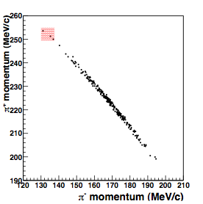
250÷255 MeV/c (σ_{p}= 1.1 MeV/c)
130÷137 MeV/c (σ_{p}= 1.2 MeV/c)
Finuda Coll. and A. Gal,
NPA 881 (2012) 269.
blue bars: p _{π+/π−} selection regions
including ⁶_{Λ}H lowest particle stability threshold ⁴_{Λ}H+2n (p_{π+}=251.9 MeV/c, p_{π−}=135.6 MeV/c) B_{Λ}=2.3÷7.1 MeV
3 candidate events
2.7 10⁷ K⁻_{stop} events
Notes:
Controllare nel pdf l’ombreggiatura rossa e blu.
total 4.5 sigma on p(pi+)
Total 6 sigma on p(pi-)

Slide 11
Search for bound ⁶_{Λ}H
⁵H + Λ
0.0 MeV
³H + 2n + Λ
-1.7 MeV
2.3 MeV
⁴_{Λ}H + 2n
-3.74 MeV
explored
B_{Λ} interval
bound
⁶_{Λ}H
p(π⁺) and p(π⁻)
selections
T(π⁺) + T(π⁻) cut
for 2-body
reactions
7.1 MeV
Notes:
Ricontrollare gli estremi di BL: 1.5-6 MeV → 2..3-7.1 MeV (3.74-2.3 = 1.44 MeV che corrisponde a 1.5 sigma (0.96 MeV) o 1.7 sigma (0.84 MeV)

Slide 12
π+ momentum (MeV/c)
momentum
cut: π-
π- momentum (MeV/c)
202 204
7.7 MeV
B_{Λ}=2.7 MeV
Ttot = 206 MeV
B_{Λ}=6.5 MeV
π+ momentum (MeV/c)
momentum
cut: π+
200 MeV
B_{Λ}=7.1 MeV
B_{Λ}=1.9 MeV
B_{Λ}=2.3 MeV
π- momentum (MeV/c)
Mprod = Mdecay
cut: Ttot

Slide 13
T(π⁺)+T(π⁻) cut : systematics
T(π⁺)+T(π⁻) = 202÷204 MeV
T(π⁺)+T(π⁻) = 200÷206 MeV

Slide 14
⁶_{Λ}H/K⁻_{stop} production rate
Background sources:
fake coincidences: T(π⁺)+T(π⁻)(202÷204 MeV) & π+(250÷255 MeV/c) &
π⁻(130÷137 MeV/c) 0.27±0.27 ev.
K⁻_{stop} + ⁶Li → Σ⁺ + π⁻ + ⁴He + n (end point ~190 MeV/c)
n + π⁺ (end point ~282 MeV/c) 0.16±0.07 ev.
K⁻_{stop} + ⁶Li → ⁴_{Λ}H + n + n + π⁺ (end point ~252MeV/c) negligible
⁴He + π⁻ (p(π⁻) = 132.8 MeV/c) T(π⁺)+T(π⁻) cut
⁶_{Λ}H/K⁻_{stop} production rate
Total background: BGD1 + BGD2 = 0.43 ± 0.28 events on ⁶Li
Poisson statistics: 3 events DO NOT belong to pure background: C.L.= 99%
R * BR(π-) = (3 – BGD1 – BGD2) / [ε(π-) ε(π+) (n. K⁻_{stop} on ⁶Li)]
R * BR(π-) = (2.9 ± 2.0) 10⁻⁶/K⁻_{stop}
R = (5.9 ± 4.0) 10⁻⁶/K⁻_{stop} (2.5 ± 0.4^{+0.4}_{-0.1}) 10⁻⁵/K⁻_{stop}
Agnello et al., PLB 64(2006) 145
H. Tamura, et al.,
PRC 40 (1989) R479
BR(π−) ⁴_{Λ}H = 0.49
FINUDA Coll. and A. Gal, PRL 108 (2012) 042501, NPA 881 (2012) 269
Notes:
Taglio s +/- 0.77 sigma in Ttot
Tamura per BR 4LH
efficiencies: practically monochromatic pions → no acceptance spectra: eff = 0.074; relative error 3% (0.002)
BR(π−) = 49%, in analogy to the weak decay Λ4H → 4He + π−
H. Tamura, et al., Phys. Rev. C 40 (1989) R479.
Mettere frase conclusioni Gal PRL!!
Fondi: Sigma+: BR per K-stop + p → Sigma+ + pi-; Sigma+ + n → Lambda + p; Sigma+ → n + pi+
Fondo 4LH: phase space fraction (Tot cut!); BR K-stop + 6Li→ 4LH + other (Tamura); BR (pi-) → 2.8 10-8 prob.

Slide 15
first evidence of ⁶_{Λ}H based on 3 events that cannot be attributed to pure instrumental and physical background
kinematics
T_{tot} (MeV) | p(π⁺) (MeV/c) | p(π⁻) (MeV/c) | M(⁶_{Λ}H) formation (MeV/c²) | M(⁶_{Λ}H) decay (MeV/c²) | ΔM (⁶_{Λ}H) (MeV)
202.5±1.3 | 251.3±1.1 | 135.1±1.2 | 5802.33±0.96 | 5801.41±0.84 | 0.92±1.28
202.7±1.3 | 250.0±1.1 | 136.9±1.2 | 5803.45±0.96 | 5802.73±0.84 | 0.71±1.28
202.1±1.3 | 253.8±1.1 | 131.2±1.2 | 5799.97±0.96 | 5798.66±0.84 | 1.31±1.28
FINUDA Coll. and A. Gal, PRL 108 (2012) 042501,
NPA 881 (2012) 269
B_{Λ} determination
formation – decay mass difference
Notes:
Vedere bene errori e compatibilita’ con 0 deile differenze: errore su DM=sqrt(.96^2+.84^2)
Eventi “sparsi”: vedere articolo di Davis.

Slide 16
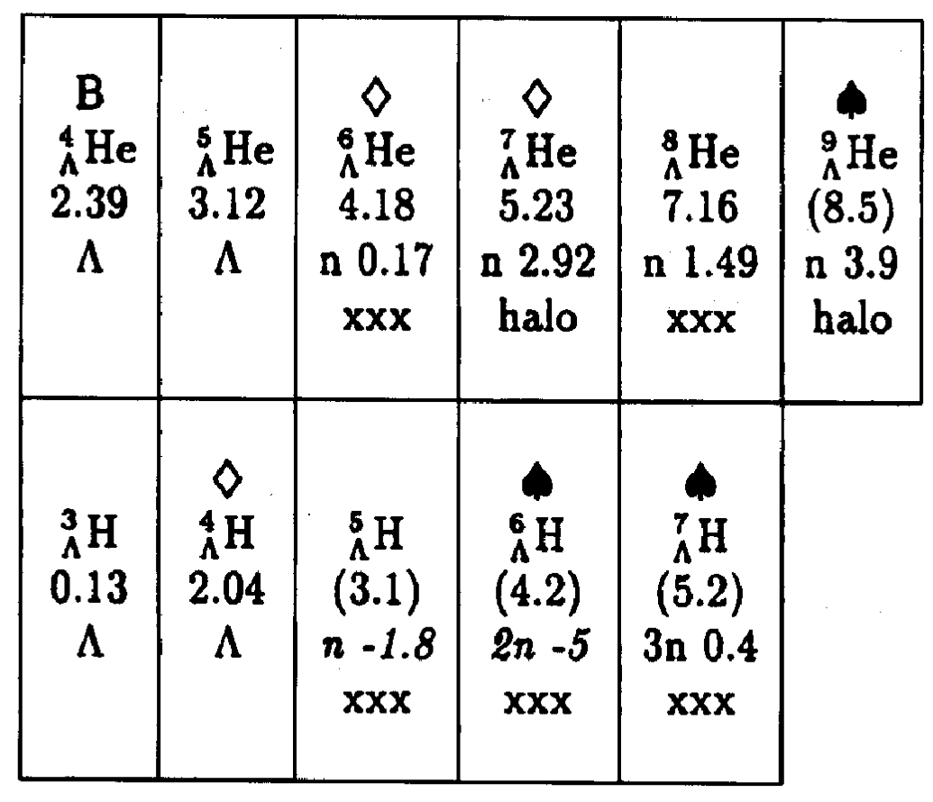
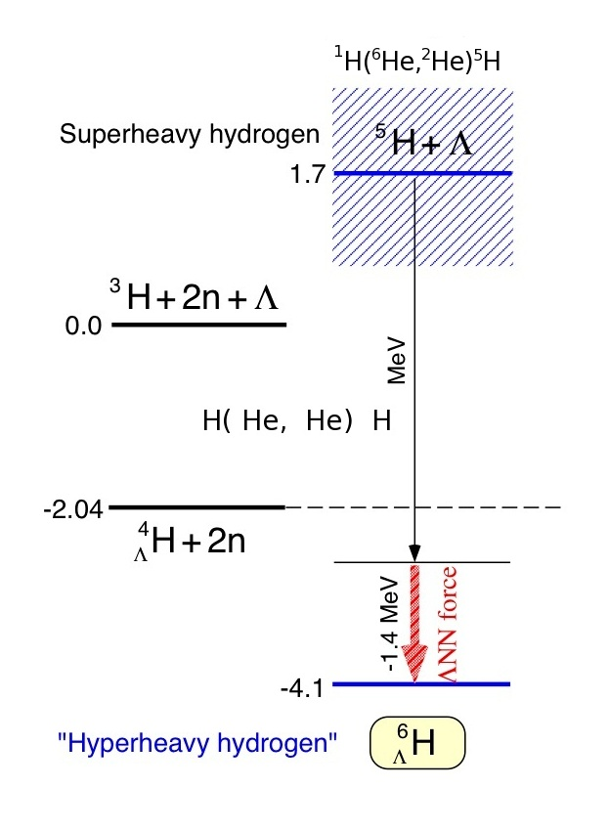
⁶_{Λ}H binding energy
(N+Y)/Z=5
Dalitz et al., N. Cim. 30 (1963) 489 (binding energy 4.2 MeV)
L. Majling, NPA 585 (1995) 211c
binding energy
prod. rate ~ 10⁻² * hyp. prod. rate in (K⁻_{stop}, π⁻)
4.2 MeV
Y. Akaishi et al., AIP Conf. Proc. 1011 (2008) 277
K.S. Myint, et al., Few Body Sys. Suppl. 12 (2000) 383
Y. Akaishi et al., Frascati Phys. Series XVI (1999) 16
“coherent” Λ−Σ coupling in 0+ states
ΛNN three body force:
B_{ΛNN} = 1.4 MeV, ΔE(0⁺_{g.s.} – 1⁺) = 2.4 MeV
model originally developed for ⁴_{Λ}H and ⁴_{Λ}He
5.8 MeV
4.4
Notes:
Espandere un pochino la parte di Akaishi/Gal/Millener; leggere Dalitz: cenni al calcolo
Leggere bene I commenti del NPA
N/Z=3 per 8He, max per I nuclei normali.
Figura Akaishi: non e’ esattamente, ma … AIP Conf. Proc. 1011 (2008) 277 con modifiche chieste da Gal

Slide 17
B_{Λ}(⁶_{Λ}H) determination
mass mean value = 5801.4±1.1
B_{Λ} = 4.0±1.1 MeV (⁵He + Λ)
B_{Λ}= 5.8 MeV (⁵He + Λ)
ΛNN force: 1.4 MeV
5803.94
B_{Λ} interval
1⁺ 5801.9 MeV
Dalitz, Majling
0⁺ 5800.9 MeV
(0⁺)
Akaishi
5799.44
formation – decay = 0.98±0.74 MeV
Notes:
Massa calcolata come valore medio globale o media sui tre valori medi (e’ la stessa cosa, ovviamente)
Errore dallo spreading dei valori (dev. st.)
Spread dei valori: vedi 8LHe, M. Juric et al NPB35, 160 (1971) → decadimento verso primo stato eccitato di 8Li→ BL overestimate di 0.98 MeV; errore 1.2 MeV
DM: valore = media dei 3 valori, errore =propagazionbe dei 3 errori uguali: 1.28/sqrt(3)=0.74

Slide 18
formation – decay ∆M
Spin flip is forbidden in production at rest:
K⁻_{stop}+ ⁶Li (L_{i}=0, S=1) → ⁶_{Λ}H(L_{f}, S=1) + π⁺
L_{f} = 0 → ⁶_{Λ}H(1⁺_{exc.}) followed by :
⁶_{Λ}H(1+exc.) → γ + ⁶_{Λ}H(0+g.s.) (∼ 10⁻¹³ s) M1 (p-wave, spin-flip)
(ii) ⁶_{Λ}H(0+g.s.) → π− + ⁶He(0+g.s.) (∼ 10⁻¹⁰ s)
→ B_{Λ}(⁶_{Λ}H) = (4.5 ± 1.2) MeV vs ⁵He+Λ from decay mass only
little neutron-excess effect compared to B_{Λ}(⁶_{Λ}He) = (4.18 ± 0.10) MeV
Excitation energy of the 1⁺ spin-flip state from a systematic difference ∆M = 0.98 ± 0.74 MeV between values of ⁶_{Λ}H mass derived separately from production and from decay.
J-PARC E10
Notes:
Per 6Li L=0 deriva da calcoli di Millener: D.J. Millener, Lect. Notes Phys. 724 (2007) 31: S=1 to better than 98%.
Decadimento gamma: dipolo magnetico: M1 (6LH→4LH+n+n richiederebbe: onda p e spin flip di tutti e 3 I corpi nello stato finale)
Allegerire…
Attenzione: lo stato eccitato 1+ ha massa > Λ4H(0+g.s.) + 2n (di 0.2 MeV) ma the low Q-value for two neutron emission plus the associated 􏰂S = 1 spin flip required in the decay to Λ4H(0+g.s.) + 2n are likely to make the Λ6H(1+exc → 0+g.s.) M1 γ -ray transition competitive with the strong decay of the 1+exc level.

Slide 19
⁹_{Λ}He search with FINUDA
(N+Y)/Z = 3.5
stable nuclear core
n-halo
⁸He+Λ
Finuda Coll. and A. Gal,
PRC 86 (2012) 057301.
5 MeV
explored
B_{Λ} interval
Majling, NPA 585 (1995) 211c
binding energy = 8.5 MeV
10 MeV
Notes:
expected particle-stable levels (2+ state of particle unstable 8He) and neutron emission thresholds
BL degli stati non completamente legati da Davis HYP2003 →Juric, NPA 52 (1973), 1.
7LHe da HYPX presentazione e proceedings Hashimoto JLAb Hall C NPA 835 (2010) 121. (e+p→e’+L+K^+): (5.68+-0.03 +-0.025) MeV
Nakamura et al., PRL 110 (2013) 012502.
Vedere draft PRC: si cerca in 5=10 MeV ipotizzando che l’eccesso di neutroni non modifichi sostanzialmente l’andamento lineare di BL con A

Slide 20
⁹_{Λ}He search with FINUDA
K⁻_{stop} + ⁹Be → ⁹_{Λ}He + π⁺
⁹_{Λ}He → ⁹Li + π⁻
(τ(⁹Li)~178 ms)
M(K⁻) + 5 M(n) + 4 M(p) – B(⁹Be) = M(⁹_{Λ}He) + T(⁹_{Λ}He) + M(π⁺) + T(π⁺)
M(⁹_{Λ}He) = 6 M(n) + 3M(p) – B(⁹Li) + T(⁹Li) + M(π⁻) + T(π⁻)
T(π⁺) + T(π⁻) =
M(K⁻) + M(p) – M(n) – B(⁹Be) + B(⁹Li) –T(⁹Li) – T(⁹_{Λ}He) – M(π⁺) – M(π⁻)
= 195.8 ± 1.3 MeV (195.8÷195.7 MeV with B_{Λ}= 0÷10 MeV)
cut on T(π⁺) + T(π⁻): 194.5÷197.5 MeV
independent 2-body reactions:
decay at rest
Notes:
+/- 1.15 sigma; intervallo piu’ largo perche’ il fondo e’ minore grazie alla binding energy maggiore del sistema

Slide 21
selection:
T(π⁺)+T(π⁻) = 194.5÷197.5 MeV
Finuda Coll. and A. Gal,
PRC 86 (2012) 057301.
Notes:
Indicare e spiegare gli intervalli di impulso
Dare l’intervallo di Tpi- + Tpi+

Slide 22
B_{Λ} ~ 3.5 MeV
253.5÷259 MeV/c (σ_{p}= 1.1 MeV/c)
114.5÷122MeV/c (σ_{p}= 1.2 MeV/c)
B_{Λ} = 5÷10 MeV
Finuda Coll. and A. Gal,
PRC 86 (2012) 057301.
B_{Λ} ~ 1 MeV
Notes:
I valori di impulso cambiano molto con la BL: quelli scelti sono compatibili con quelli calcolati per BL=7.8 MeV (?? 8.5!!) entro _+/-2 sigma per pi^- e entro +/- 2.5 sigma per pi^- e vanno bene per BL tra 5 e 10 MeV. 5 MeV e’ quite unbound, 10 MeV e’ in linea con la scaling law con A. (con BL=7.8 MeV p(pi^-)=118 MeV/c, p(pi^+)=256.5 MeV/c (256.7?).
Spiegare la scarsita’ dei dati: diminuzione del BR del mesonico (efficienza)
Aggiungere linee verdi per impulsi attesi con BL=8.5 MeV
BR mesonico 7Li, 9Be per diminuzione

Slide 23
⁹_{Λ}He/K⁻_{stop} production rate
upper limit evaluation
0 observed events
ε(π−), ε(π+)
n. K⁻_{stop} on ⁹Be (2.5 10⁷ K⁻_{stop} events)
R * BR(π-) < (2.3±1.9)10⁻⁶ / (n. K⁻_{stop} on ⁹Be) (90% C.L.)
BR(⁹_{Λ}He_{gs} → ⁹Li_{gs} + π⁻) = 0.261
R < 1.6 10⁻⁵ / (n. K⁻_{stop} on ⁹Be) (90% C.L.)
from A. Gal, Nucl. Phys. A 828, 72 (2009)
PRC 86 (2012) 057301
K.Kubota et al, NPA 602 (1996) 327.
⁹_{Λ}He (⁹Be) U.L.=2.3 10⁻⁴/K⁻_{stop}
Notes:
Scrivere I conti (senza dire se gaussiana o poissoniana) quotando la differenza di efficienza, il diverso BR per il mesonico carico, l’upper limit e il confronto con I dati KEK.
N.B.: efficienza=0.047, BR(pi-) = 0.154 FINUDA, ma qui si usa il calcolo di Gal; si considera la correzione per 1.15 sigma su Ttot.
Il decay allo stato eccitato del 9Li (2.691 MeV) e’ escluso dal taglio sul pi- (sarebbe 112.6 MeV)
Mettere ref per BR 5LH
Il taglio sul p(pi-) non consente di prendere il primo stato eccitato del 9Li. (0.094 → 0.355)
Fattore 15-20 di riduzione vs KEK
Efficienze: 6Li 0.074, 9Be 0.047 (~64%), variazione numero K-stop (Sandra – noi) +13%

Slide 24
Conclusions
(K⁻_{stop}, π⁺) production rate vs A
2.3 10⁻⁴
¹²_{Λ}Be
¹⁶_{Λ}C
6
FINUDA: inclusive spectra
FINUDA: coincidence
KEK
full bars: U.L., 90% C.L.
experimental and theoretical efforts needed (H. Sugimura and A. Gal talks)
R (/K-stopped) * 10⁻⁵
⁷_{Λ}H
5
4
⁹_{Λ}He
3
⁶_{Λ}H
2
1
6
7
9
12
16
A
24

Slide 26
… coincidence method limits
target | hypernucleus | 2-b MWD daughter nucleus | lifetime | MWD ‘model’ | MWD ‘model’ BR(π−) R*BR(π−)
⁶Li | ⁶_{Λ}H | ⁶He | 801 ms | ⁴_{Λ}H | 0.49 H. Tamura, et al., PRC 40 (1989) R479
⁷Li | ⁷_{Λ}H | ⁷He | unstable | ⁴_{Λ}H | 0.49 H. Tamura, et al., PRC 40 (1989) R479
⁹Be | ⁹_{Λ}He | ⁹Li | 178 ms | ⁵_{Λ}He | 0.323 FINUDA PLB 681 (2009) 139
¹²C | ¹²_{Λ}Be | ¹²B | 20 ms | ⁹_{Λ}Be | 0.154 FINUDA PLB 681 (2009) 139
¹³C | ¹³_{Λ}Be | ¹³B | 17.3 ms | ⁹_{Λ}Be | 0.154 FINUDA PLB 681 (2009) 139
¹⁶O | ¹⁶_{Λ}C | ¹⁶N | 7.13 s | ¹²_{Λ}C | 0.099 Y.Sato et al., PRC 71 (2005) 025203
production and decay
from the same energy level
2-body processes
production&decay
decreasing MWD BR
26

Slide 27
K⁻_{stop} + ⁶Li → ⁶_{Λ}H + π⁺
reactions at rest
⁶_{Λ}H → ⁶He + π⁻
T(π⁺) + T(π⁻) =
M(K⁻) + M(p) – M(n) – B(⁶Li) + B(⁶He) –T(⁶He) – T(⁶_{Λ}H) – M(π⁺) – M(π⁻)
= 203.0 ± 1.3 MeV (203.5÷203.3 MeV with B_{Λ}= 0÷6 MeV)
K⁻_{stop} + ⁶Li → ⁶_{Λ}H(1⁺) + π⁺
⁶_{Λ}H(1⁺) →⁴_{Λ}H_{g.s.}+n +n reactions at rest
⁴_{Λ}H_{g.s.} → ⁴He_{g.s.} + π⁻
T(π⁺) + T(π⁻) = [T(π⁺) + T(π⁻)] (⁶_{Λ}H) - 203 MeV
[M(⁶_{Λ}H(1⁺)) – M(⁴_{Λ}H_{g.s.}) – 2M(n)] – ⁶_{Λ}H(1⁺) available decay energy: (1±1) MeV
[B(⁶He) - B(⁴He)] + 1 MeV
[T(⁶He) – T(⁴He)] << 1 MeV, neglected
= 201 MeV
Notes:
Negli intervalli 200-202 e 201-203 non c’e’ nulla, in 199-201 c’e’ un evento.

Slide 28
selection:
T(π⁺)+T(π⁻) = 199÷201 MeV
p_{π+}= 250.4 MeV/c
M_{form} = 5803.2 MeV/c²
p_{π−}= 131.9 MeV/c
M_{dec}ay = 5799.1 MeV/c²
ΔM = 4.1 MeV/c²
250÷255 MeV/c (σ_{p}= 1.1 MeV/c)
130÷137 MeV/c (σ_{p}= 1.2 MeV/c)
red bars: p _{π+/π−} selection regions
including ⁶_{Λ}H lowest particle stability threshold ⁴_{Λ}H+2n (p_{π+}=251.9 MeV/c, p_{π−}=135.6 MeV/c) B_{Λ}=2.3÷7.1 MeV

Slide 29
kinematics compatibility: events scan
π-
π-
π+
μ+
π+
Notes:
Percentuale di eventi con mu+ in coincidenza: 15%

Slide 30
Search for light n-rich hypernuclei
Production reactions
(K⁻_{stop}, π⁺)
K⁻ + p → Λ + π⁰ π⁰ + p → n + π⁺ (2-step) S-EX + C-EX
K⁻ + p → K⁰ + n K⁰ + p → Λ + π⁺ (2-step) C-EX + S-EX
K⁻ + p → Σ⁻ + π⁺ Σ⁻ + p n + Λ (1-step) S-EX
K.Kubota et al, NPA 602 (1996) 327.
⁹_{Λ}He (⁹Be) U.L.=2.3 10⁻⁴/K⁻_{stop}; ¹²_{Λ}Be(¹²C) U.L.=6.1 10⁻⁵/K⁻_{stop};
¹⁶_{Λ}C(¹⁶O) U.L.=6.2 10⁻⁵/K⁻_{stop}
T.Y.Tretyakova et al., Nucl. Phys. A 691 (2001) 51c (10⁻⁶-10⁻⁷/K⁻_{stop})
M. Agnello et al. Phys. Lett. B 640 (2006) 145
⁶_{Λ}H (⁶Li) U.L.= (2.5 ± 1.4) 10⁻⁵/K⁻_{stop}; ⁷_{Λ}H(⁷Li) U.L.= (4.5± 1.4) 10⁻⁵/K⁻_{s};
¹²_{Λ}Be(¹²C) U.L.= (2.0 ± 0.4) 10⁻⁵/K⁻_{stop}
(π⁻, K⁺)
π⁻ + p → π⁰ + n π⁰ + p → Λ + K⁺ (2-step) C-EX + AP
π⁻ + p → K⁰ + Λ K⁰ + p → n + K⁺ (2-step) AP + C-EX
π⁻ + p → K⁺ + Σ⁻ Σ⁻ + p n + Λ (1-step) AP
P.K.Saha et al., PRL 94 (2005) 052502: ¹⁰_{Λ}Li (¹⁰B) dσ/dΩ = 11.3±1.9 nb/sr
T.Y.Tretyakova et al., Phys. At. Nucl. 66 (2003) 1651
Notes:
LS mixing is equivakent to S p → L n

Slide 31
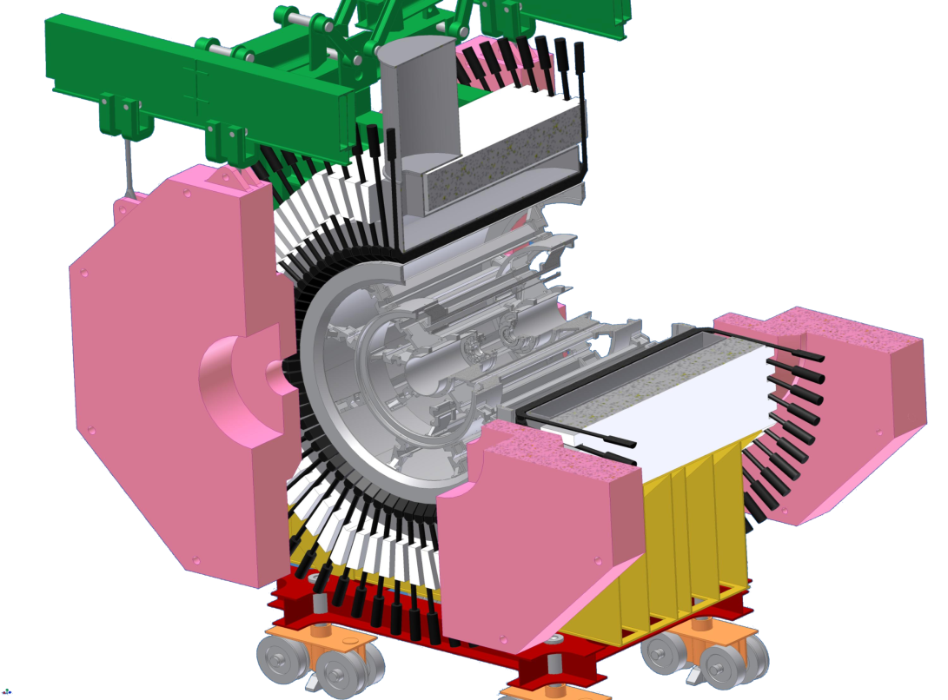
The FINUDA detector
Outer scintillator barrel – 72 slabs
(TOFONE)
Magnet yoke
B = 1.0 T
e⁺
Magnet
end-cap
e⁻
Super-
conducting
Coil
Mechanical support
2424 Straw Tubes (longitudinal + stereo)
16 Low-Mass Drift Chambers (LMDC)
18 μ-strip vertex detectors (ISIM/OSIM)
Inner scintillator barrel – 12 slabs (TOFINO)
8 Targets
Apparatus designed for a typical collider experiment:
Cylindrical geometry
large solid angle (~ 2π sr)
multi-tracks analysis
Simultaneous study of formation and decay of strange
hadronic systems by full event reconstruction

Slide 32
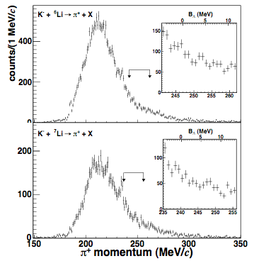
⁶_{Λ}H and ⁷_{Λ}H (¹²_{Λ}Be) search with FINUDA
M.Agnello et al., PLB 640 (2006) 145
oct 2003 - jan 04: ~220 pb⁻¹
background:
K⁻ + p → Σ⁺ + π⁻ K⁻ + pp → Σ⁺ + n
Σ⁺ → n π⁺ Σ⁺ → n π⁺
cut on K⁻/π⁺ distance
K⁻_{stop} + ⁶Li → ⁶_{Λ}H + π⁺
K⁻_{stop} + ⁷Li → ⁷_{Λ}H + π⁺
background subtracted spectrum
raw inclusive spectrum
R⁽⁶_{Λ}H) U.L.= (2.5 ± 1.4) 10⁻⁵/K⁻_{stop} 90% C.L.
Notes:
Fondo: taglio su una distanza massima tra stopping point del K- ed origine del pi^+ su un piano nel bersaglio → taglio sul decadimento in volo della Sigma+; il valore di 2mm per il taglio e’ stato scelto simulando MC il fondo e il segnale e vedendo le corrispondenti distribuzioni della distanza in oggetto.
La reazione su un solo p popola la regione 130-250 MeV/c e nella regione del segnale c’e’ solo la coda ad alto impulso; la reazione su pp da contributi in 100-320 MeV/c.
Regione del segnale: Kmu2 in volo (K+ preso per K-), K-pp e coda K-p.
250-254 MeV/c → circa 1.5-5.5 o 2-6 MeV=BL

Slide 33
⁶Li
⁶_{Λ}He
⁶_{Λ}H
⁶_{Λ}Li (⁵_{Λ}He+p)

Slide 34
Background sources: Σ+ production and decay
K⁻_{stop} + ⁶Li → Σ⁺ + π⁻ + ⁴He + n
n + π⁺
quasi free approach: 0.743 ± 0.019
4-body interaction: 0.257 ± 0.017
⁴He + n and “⁵He” final state
Finuda Coll. and A. Gal, NPA 881 (2012) 269.
Notes:
5He ~0.8 MeV above 4He+n threshold, width~1.36 MeV
a fit of the experimental spectrum was performed with fractions of the two simulated templates; a standard likelihood fitting method, using Poisson statistics, was applied in which both data and Monte Carlo statistical uncertainties were taken into account

Slide 35
Background sources [π+(249÷255 MeV/c) & π⁻(130÷138 MeV/c)]:
K⁻_{stop} + ⁶Li → ⁴_{Λ}H + n + n + π⁺ (end point ~252MeV/c)
⁴He + π⁻ (p(π⁻) = 133 MeV/c) negligible
(2.8±0.5)•10⁻⁸
K⁻_{stop} + ⁶Li → Σ⁺ + ³_{Λ}H + d + π⁻ (p(π⁻) < 165 MeV/c)
                (p(π⁺) < 250 MeV/c)
K⁻_{stop} + ⁶Li → ³_{Λ}H + 3n + π⁺ (p(π⁺) < 242 MeV/c)
³He + π⁻ (p(π⁻) ~ 115 MeV/c)
K⁻_{stop} + ⁶Li → Λ + ³H + 2n + π⁺ (p(π⁺) < 247 MeV/c)
p + π⁻ (p(π⁻) < 195 MeV/c)
K⁻_{stop} + ⁶Li → ⁶_{Λ}He + π⁰ (p(π⁰) ~ 280 MeV/c)
⁶Li + π⁻ (p(π⁻) ~ 108 MeV/c)
π⁰ + ⁶Li → ⁶He + π⁺ (p(π⁺) ~ 280 MeV/c forw. dir.)
n + π⁺

Slide 36
formation – decay ∆M: hints
Spin flip is forbidden in production at rest:
K⁻_{stop}+ ⁶Li (L_{i}=0, S=1) → ⁶_{Λ}H(L_{f}, S=1) + π⁺
L_{f} = 0 → ⁶_{Λ}H(1⁺_{exc.}) followed by :
⁶_{Λ}H(1+exc.) → γ + ⁶_{Λ}H(0+g.s.) (∼ 10⁻¹³ s) M1
(ii) ⁶_{Λ}H(0+g.s.) → π− + ⁶He(0+g.s.) (∼ 10⁻¹⁰ s)
→ B_{Λ}(⁶_{Λ}H) = (4.5 ± 1.2) MeV vs ⁵He+Λ from decay mass only
little neutron-excess effect compared to B_{Λ}(⁶_{Λ}He) = (4.18 ± 0.10) MeV
The excitation energy of the 1⁺ spin-flip state is identified with a systematic ∆M = 0.98 ± 0.74 MeV between values of ⁶_{Λ}H mass derived separately from production and from decay. ∆M is consistent with the 1.04 MeV for the analogous spin-flip excitation in ⁴_{Λ}H, according to shell-model estimates.
ΔE(1⁺ - 0⁺_{g.s.}) = 2.4 MeV from ΛNN three body force calculations.
J-PARC E10
Notes:
Per 6Li L=0 deriva da calcoli di Millener: D.J. Millener, Lect. Notes Phys. 724 (2007) 31: S=1 to better than 98%.
Decadimento gamma: dipolo magnetico: M1
Allegerire…
Attenzione: lo stato eccitato 1+ ha massa > Λ4H(0+g.s.) + 2n (di 0.2 MeV) ma the low Q-value for two neutron emission plus the associated 􏰂S = 1 spin flip required in the decay to Λ4H(0+g.s.) + 2n are likely to make the Λ6H(1+exc → 0+g.s.) M1 γ -ray transition competitive with the strong decay of the 1+exc level.

Slide 37
connected fields: astrophysics
n-stars: essential inputs from hypernuclear physics
Y in neutron stars
first exotic species (N, e, μ) in n-star core; strongly interacting matter:
Λ ~ 2n₀, Σ ~ n₀ (repulsive), Ξ ~ 4-5 n₀ (attractive?)
YN, YY interaction; short range repulsion of BB ΛNN for YN for additional stability to n-star (Pauli blocking)
Cooling on n-star: Y-URCA process
volume emission of ν by slow modified-URCA processes: N+p+e⁻→ N+n+ν_{e} and
N+n→ N+p+e⁻+ν⁻_{e} (p_{p}+p_{e}≥p_{n}, charge neutrality: n_{p}/n≥11%, n≥1.5 n₀)
Y-URCA direct process: Λ→ p+e⁻+ν_{e} no n threshold, no charge neutrality
fast cooling, critical n-star mass, suppressed by YY int. strength, Y superfluidity.
Maximum n-star mass, mass-radius relation
Y appearence lowers overall Fermi energy and momentum of B and l → total system pressure @ n lowers → softening of equation of state
stiffness of hadronic e.o.s. above 2.5 n₀ controls maximum n-star mass → repulsive YY interaction is needed → ΛNN forces to increase maximum mass (M_{obs}=1.44 solar-mass for Hulse-Taylor pulsar, 2-solar mass NS (PSR J1614-2230) recently observed).
Gravitational wave emission
rotating n-stars can emit gravitational waves due to the r-mode instability which is controlled by the viscosity of dense matter; NMWDs in dense medium control the bulk viscosity→ NMWD rates knowledge needed
S. Balberg and A. Gal, Nucl. Phys. A 625 (1997) 435.
J. Schaffner-Bielich, Nucl. Phys. A 804 (2008) 309, Nucl. Phys. A 835 (2010) 279.
S. Tsuruta, Astroph. Jou. 571 (2002) L143.
Notes:
n0 = nuclear matter density
cooling: volume emission of neutrinos up to aboput 1 million years by modified URCA process with a bystander nucleon to conserve energy and momentum.
The Fermi momenta have to satisfy: p_p+p_e >= p_n; direct Y URCA process controlled by hyperon pairing gaps
NMWDs riportano all’equilibrio le n-stars che ruotando sono fuori dall’equilibrio debole in una regione del diagramma temperatura-periodo piu’ ampia delle reazioni deboli standard dei N

Slide 38
connected fields: astrophysics
n-stars: essential inputs from hypernuclear physics (Vidana talk)
Y in neutron stars: composition
first exotic species (N, e, μ) in n-star core; strongly interacting matter:
Λ ~ 2n₀, Σ ~ n₀ (repulsive), Ξ ~ 3 n₀ (attractive?)
YN interaction; short range repulsion of ΛNN for additional stability to n-star (Pauli blocking)
Cooling of n-star: Y-URCA process
Maximum n-star mass, mass-radius relation
stiffness of hadronic e.o.s. above 2.5 n₀ controls maximum n-star mass → repulsive YN interaction is needed → ΛNN forces to increase maximum mass (M_{obs}=1.44 solar-mass for Hulse-Taylor pulsar, 2-solar mass NS (PSR J1614-2230) recently observed).
Gravitational wave emission
S. Balberg and A. Gal, Nucl. Phys. A 625 (1997) 435.
J. Schaffner-Bielich, Nucl. Phys. A 804 (2008) 309, Nucl. Phys. A 835 (2010) 279.
S. Tsuruta, Astroph. Jou. 571 (2002) L143.
Notes:
n0 = nuclear matter density
cooling: volume emission of neutrinos up to aboput 1 million years by modified URCA process with a bystander nucleon to conserve energy and momentum.
The Fermi momenta have to satisfy: p_p+p_e >= p_n; direct Y URCA process controlled by hyperon pairing gaps
NMWDs riportano all’equilibrio le n-stars che ruotando sono fuori dall’equilibrio debole in una regione del diagramma temperatura-periodo piu’ ampia delle reazioni deboli standard dei N

