Slide 1
Scissors strength in the
quasi-continuum of actinides
Magne Guttormsen
Department of Physics and SAFE
University of Oslo

Slide 2
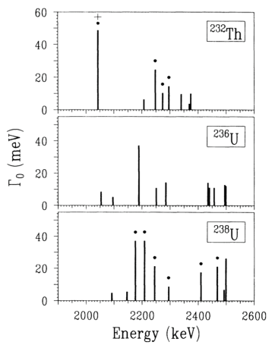
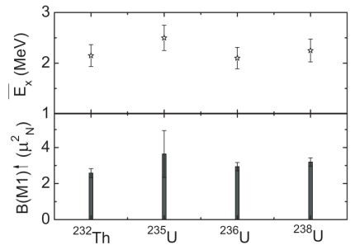
Scissors mode built on ground state
J. Magraf et al., Phys. Rev. C 42, 771 (1990)
O. Yevetska et al., Phys. Rev. C 81, 044309 (2010)

Slide 3
The Oslo method in quasi-continuum
Number of levels per MeV
Nuclear entropy
Nuclear temperature and heat capacity
NUCLEAR LEVEL DENSITY (NLD)
Average, nuclear electromagnetic response
Independent on the number of levels
Related to partial decay width and reduced transition probabilities
γ-RAY STRENGTH FUNCTION (γSF)
ΔE
i
γ
ΔE
f

Slide 4
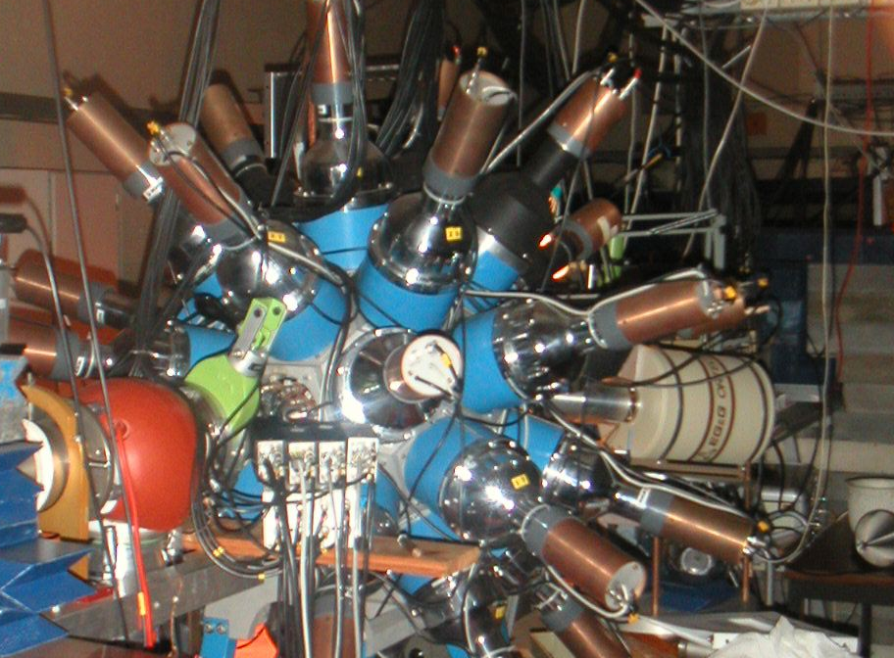
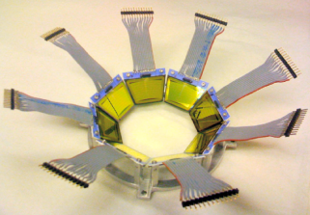
Experiments at OCL
12 MeV d on ²³²Th
24 MeV ³He on ²³²Th
15 MeV d on ²³⁸U
Backwards:
ϑ = 40º – 54º
5”x5” NaI
γ
³He –beam
³He, α,d,t
∆E-E
^{M.Guttormsen,} A.Bürger, T.E.Hansen, N.Lietaer,
^{NIM A648(2011)168}

Slide 5
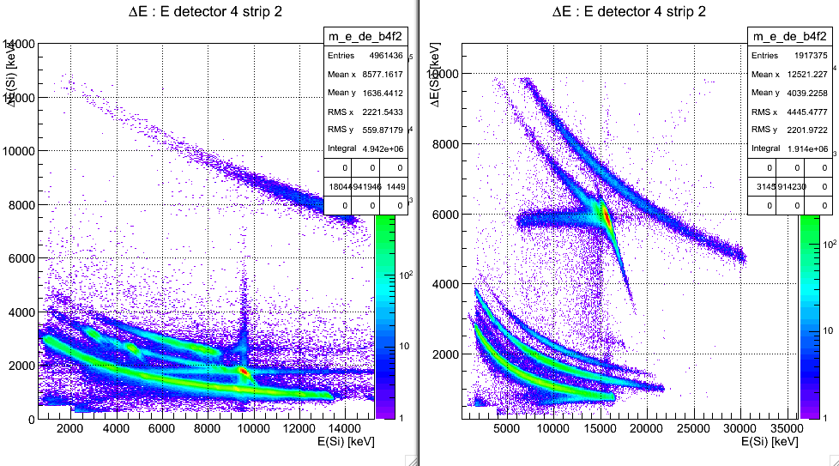
∆E-E bananas
(³He,α)²³¹Th
(d,d’)²³²Th (d,p)²³³Th
(³He,t)²³²Pa (³He,d)²³³Pa

Slide 6
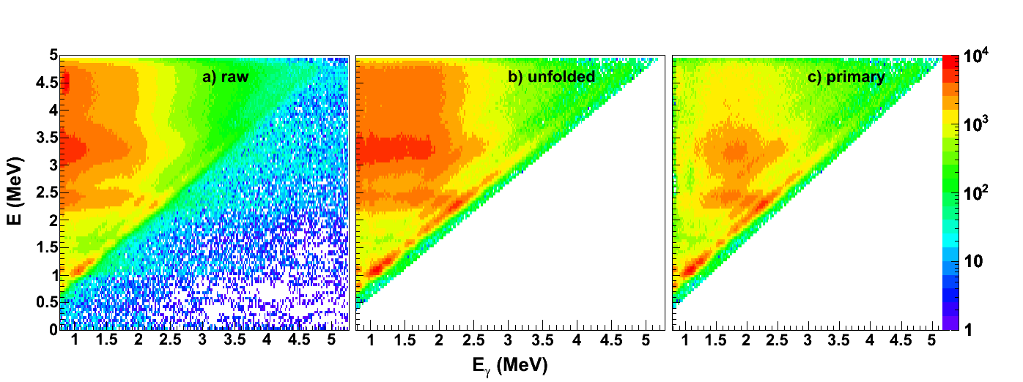
Simultaneous extraction of γSF and NLD
P(E,E_{γ})
Level density Trans. coeff.
ρ(E_{f}) T(E_{γ})
Fermi’s golden rule Brink hypothesis
M. Guttormsen et al., NIM A374 (1996) 371
M. Guttormsen et al., NIM A255 (1987) 518
A. Schiller et al., NIM A447 (2000) 498
Analysis of possible systematic errors:
A.C. Larsen et al., Phys. Rev. C 83, 034315 (2011)

Slide 7
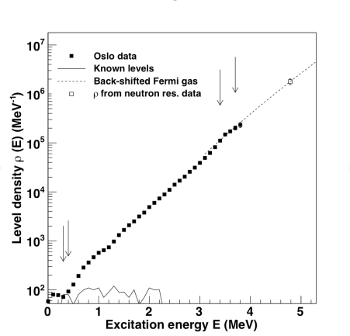
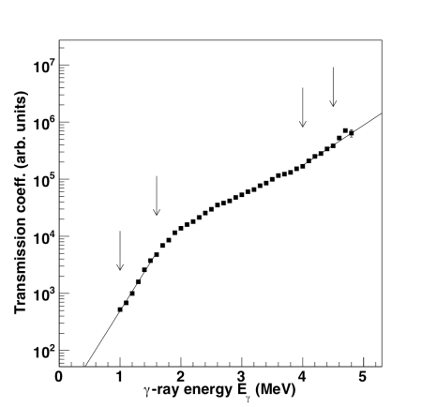
ρ(E_{f}) and T(E_{γ})

Slide 8
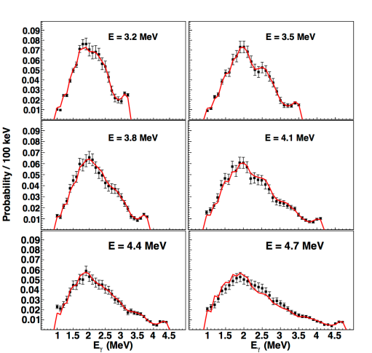
P(E,E_{γ}) = ρ(E_{f}) . T(E_{γ}) ?

Slide 9
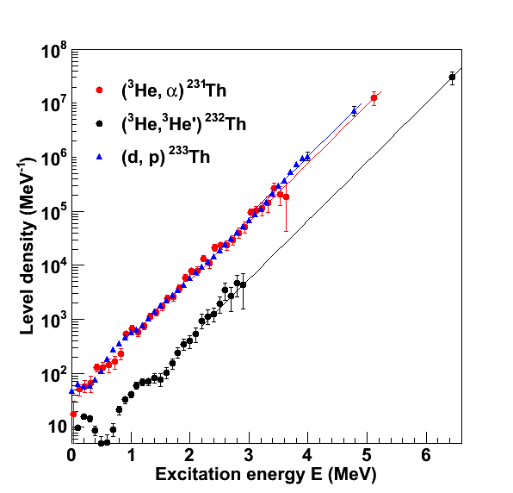
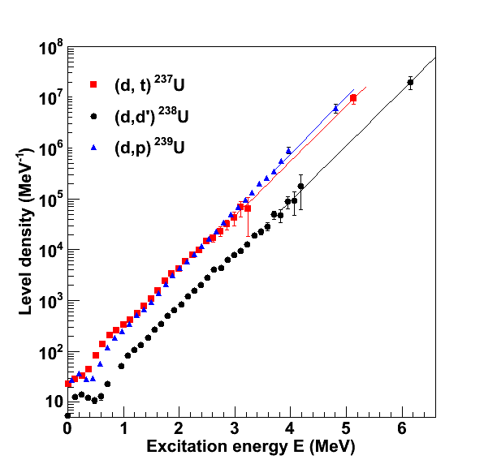
Constant-temperature level densities

Slide 10
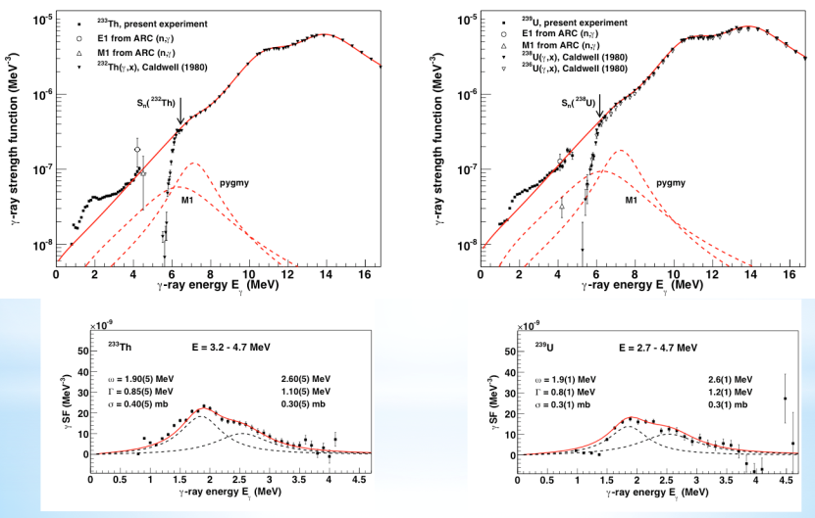
γ-ray strength function

Slide 11
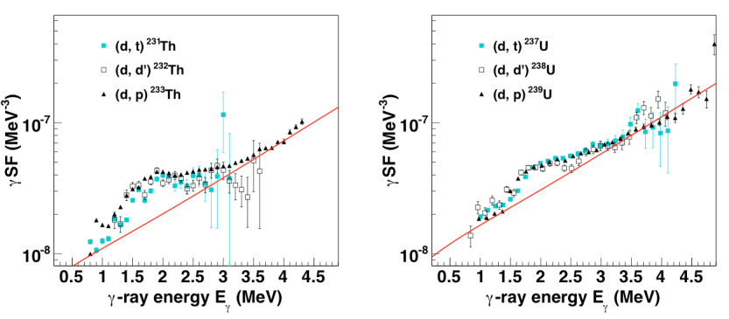
γ-SF in ²³¹⁻²³³Th and ²³⁷⁻²³⁹U

Slide 12
Summed γ-ray strength
Nuclide ω_{Μ1}( MeV) B_{M1} (μ²_{N}) ω_{Μ1}S₋₁ (μ²_{N})
²³³Th 2.2 10.8(20) 15.9
²³⁸U 2.2 8.1(20) 16.6
Inverse energy-weighted sum rule:
K. Heyde, P. von Neumann-Cosel, A. Richter, Rev. Mod. Phys., 82, 2365 (2010)

Slide 13
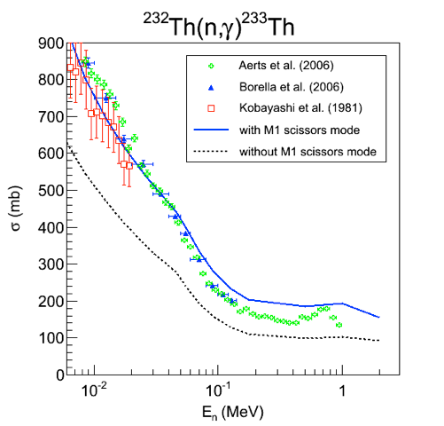
Implications for (n,γ) cross sections
Preliminary

Slide 14
Summary
Large scissors strength of B(M1) ≈ 8 -11 μ_{Ν}²
E_{γ} = 2 – 2.5 MeV versus 2.5 – 3 MeV in rare earth region
Splits into two components
The scissors strength is important for (n,γ) rates
Parts of the results are published in
M. Guttormsen et al., PRL 109, 162503 (2012)
and more is to come: ^{238,239}Np, ^{233,234}U, ...

Slide 15
Thanks to all collaborators
M. Guttormsen, B. Jurado, J.N. Wilson, M. Aiche, L.A. Bernstein, Q. Ducasse,
F. Giacoppo, A. Görgen, F. Gunsing, T.W. Hagen, A.C. Larsen, L. Lebois, T. Renstrøm, S.J. Rose, S. Siem, T. Tornyi, G.M. Tveten, and M. Wiedeking
University of Oslo, CENBG Gradignan, LLNL, IPN Orsay, CEA Saclay, iThemba LABS

