Slide 1
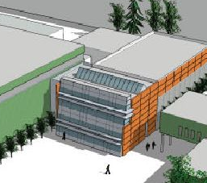
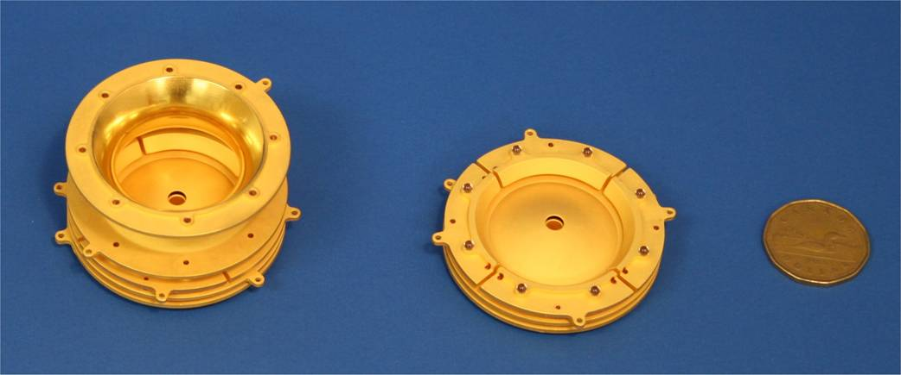
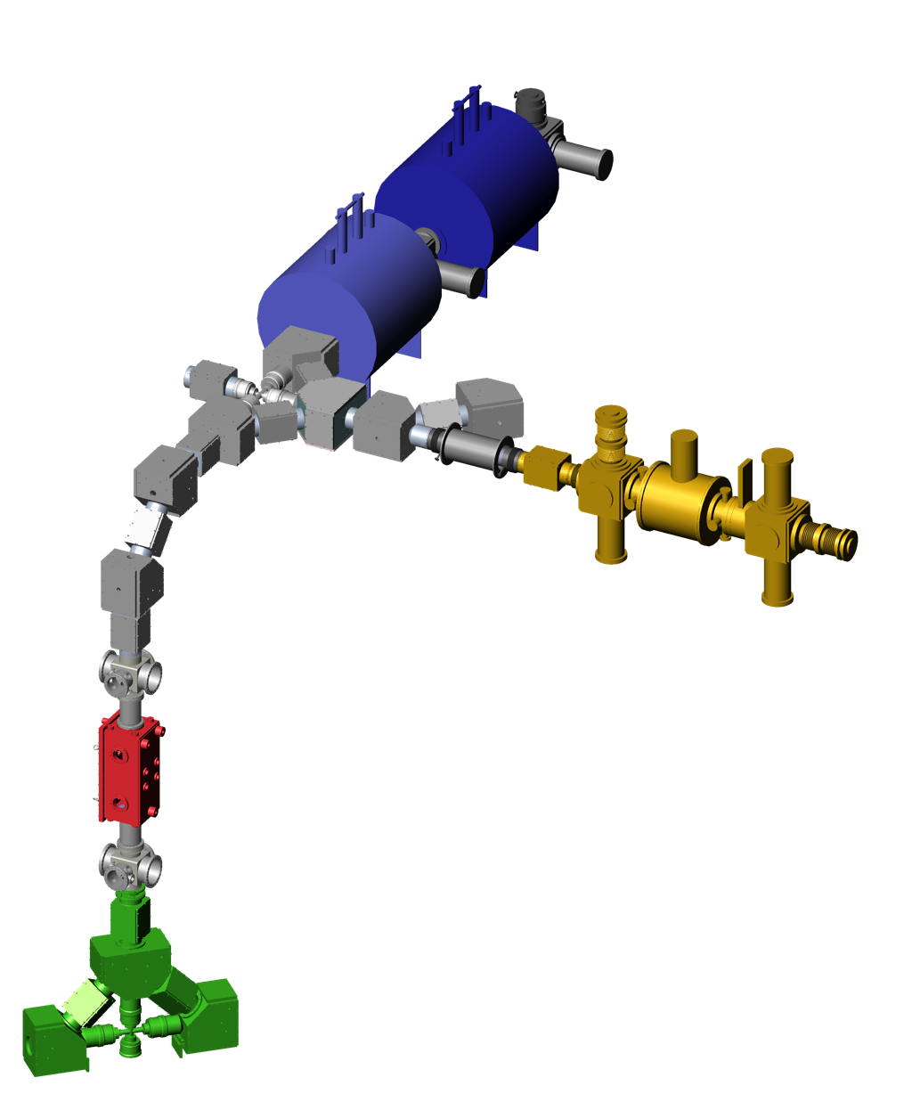

Canada’s National Laboratory for Particle and Nuclear Physics
Laboratoire national canadien pour la recherche en physique nucléaire
et en physique des particules
Precision TITAN mass measurement for nuclear structure studies
J. Dilling
TRIUMF/University of British Columbia
Vancouver, Canada
INPC 2013
Firenze, Italy
June 2013
Owned and operated as a joint venture by a consortium of Canadian universities via a contribution through the National Research Council Canada
Propriété d’un consortium d’universités canadiennes, géré en co-entreprise à partir d’une contribution administrée par le Conseil national de recherches Canada

Slide 2
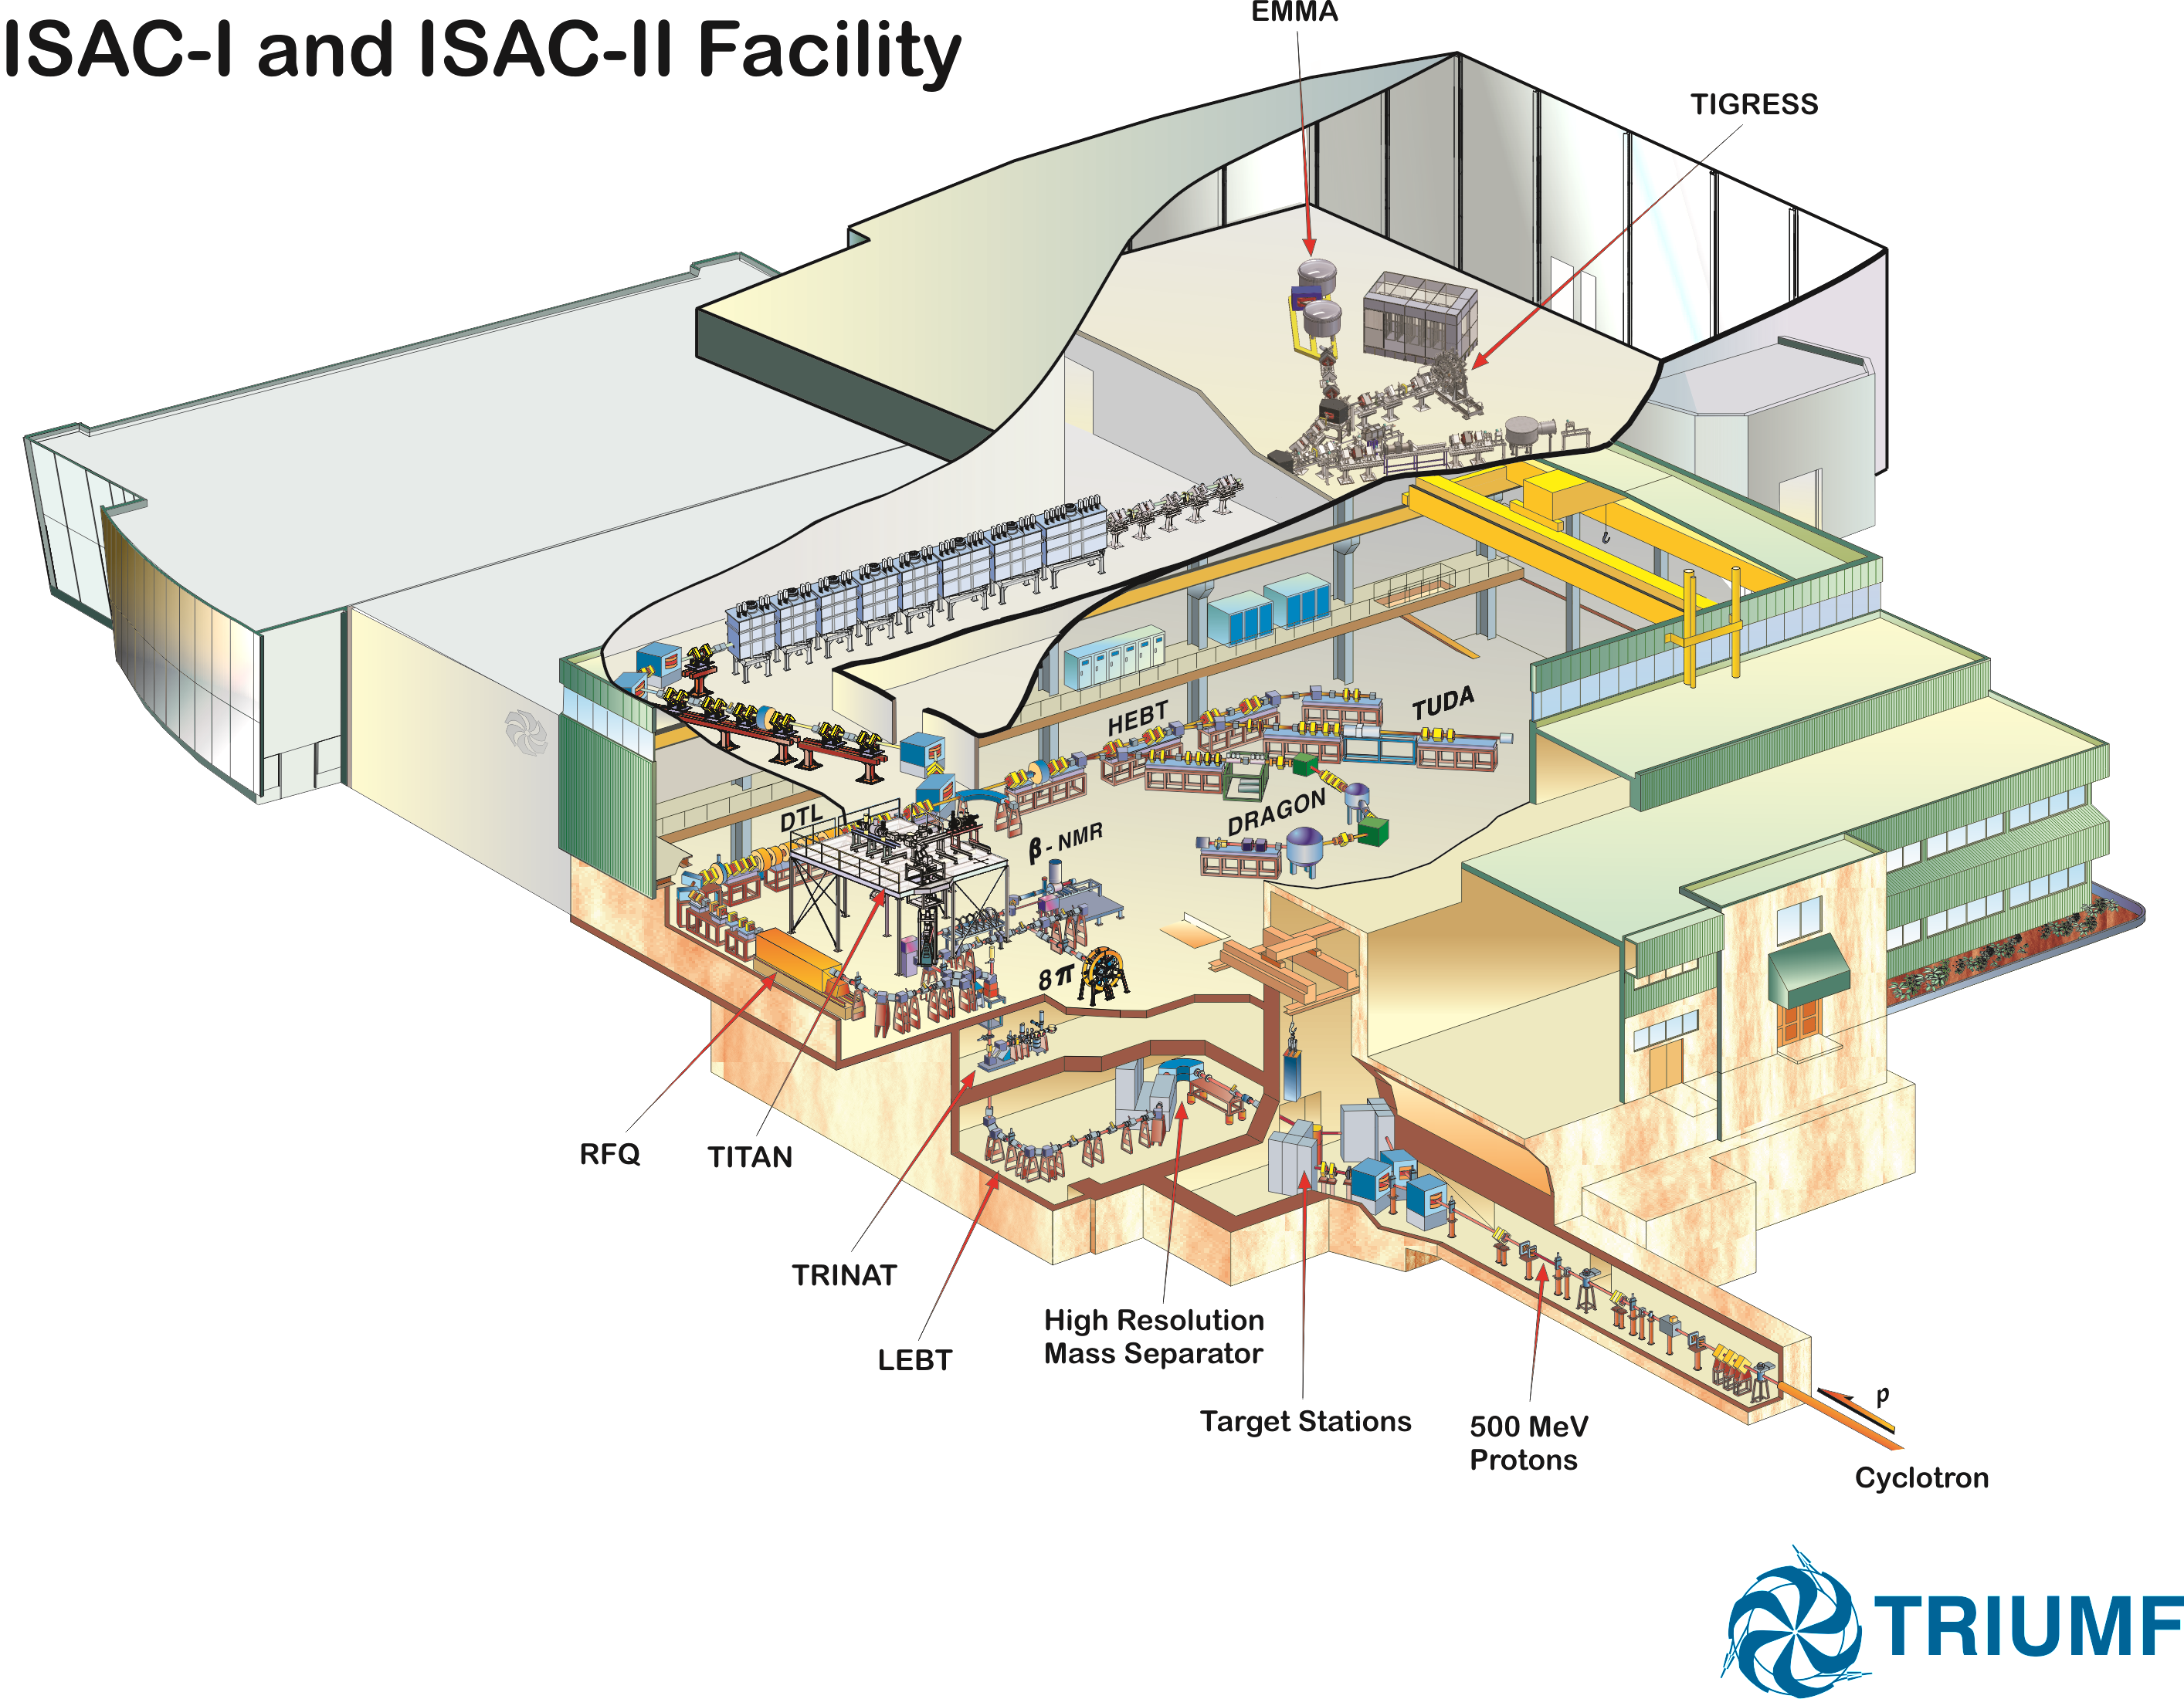
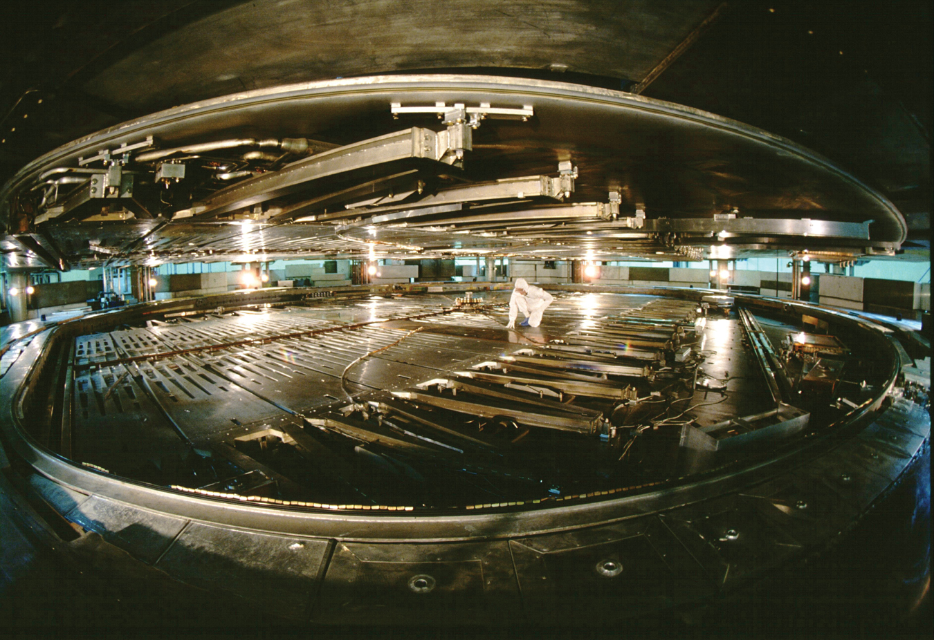
ISAC rare isotope facility
ISAC II:
> 6 AMeV for A<150
Programs in
Nuclear Structure & Dynamics
Nuclear Astrophysics
Electroweak Interaction Studies
Material Science
ISAC I:
60 keV & 1.7 AMeV
ISOL facility with highest primary beam intensity (100 μA, 500 MeV, p)

Slide 3
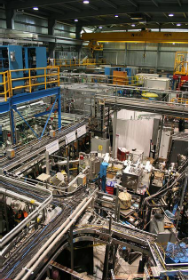
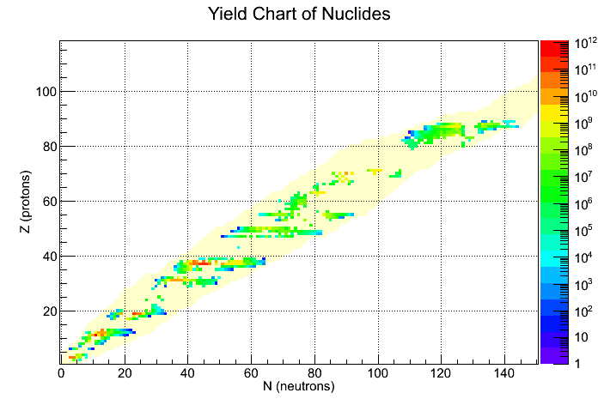
ISAC rare isotope facility
Isotopes delivered at ISAC
symmetry program
nuclear structure
program
N=Z program
r-process
We have now:
a full set of targets
a large range of ion sources
developing fast target
module exchange
off-line test capabilities
N-rich isotopes
N-halo program
But: single user facility

Slide 4

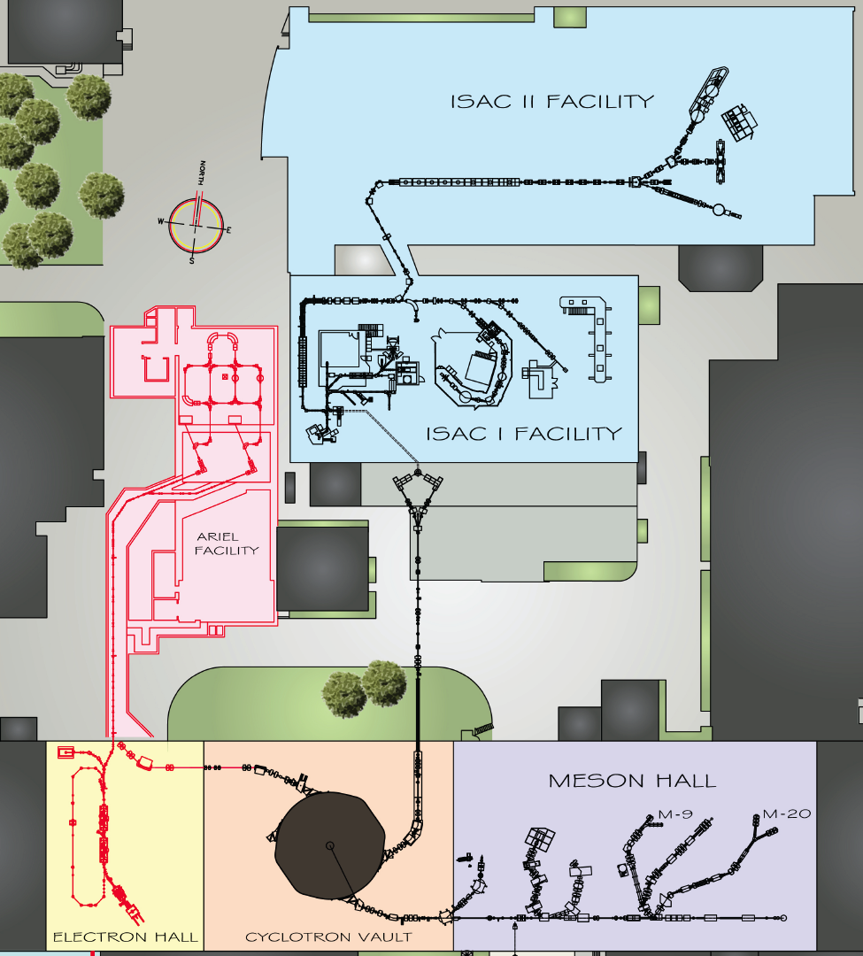
The Future @ TRIUMF:
ARIEL
expand RIB program with:
3 simultaneous beams
increased number of
hours delivered per year
new beam species
enable long beam times (nucl. astro, fund. symm.)
increased beam
development capabilities
New electron linac driver
for photo-fission
New proton beamline
New target stations and
front end
staged installation, first beam 2015 on target

Slide 5
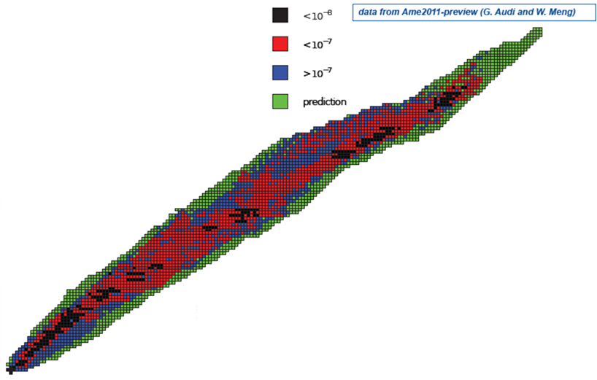
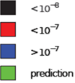
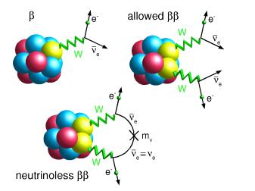
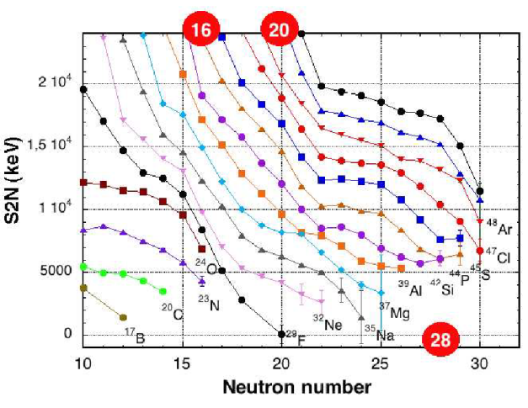
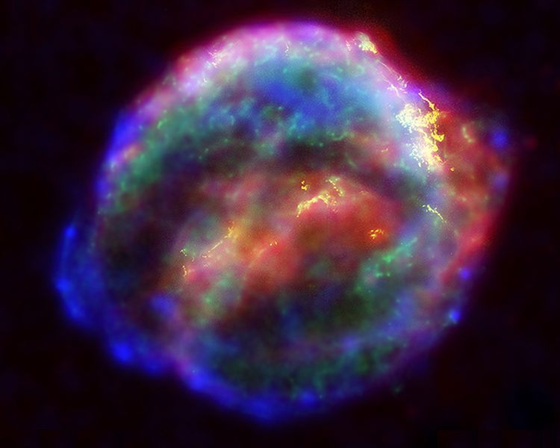
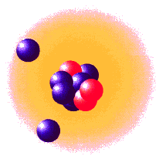
Key answers to questions from atomic mass measurements!
Physics with radioactive beams opens new doors!
Binding energy includes
all effective interactions
and reflects the nuclear potential
Mass difference of 2 nuclei
gives energy gain in reactions (like in stars)
and for beta decay
Abundance vs. A
Element Synthesis
via r-process (supernova)
Here
Neutron rich examples
Island of inversion
Proton rich examples
IMME for Mg
10⁻⁷< δm/m < 10⁻⁶
The nature of neutrinos
from double beta decay
Halos and skins
δm/m < 10⁻⁸
Evolution of
Nuclear Shells
10⁻⁶< δm/m < 10⁻⁵
Kepler's supernova
remnant, SN 1604
δm/m = 10⁻⁷
Notes:
Motivation:
different fields → different precision
nuclear structure, since masses = nuclear binding energies (by weighing nuclides)
nuclear structure: shells, magic numbers, shell quenching towards drip lines, halos
nuclear astrophysics, nucleosynthesis in stars and supernovas → r-process
nucleosynthesis & structure: precision not a big problem, but many nuclides need to be measured
fundamental tests: Quark mixing matrix, solar neutrino physics
5

Slide 6
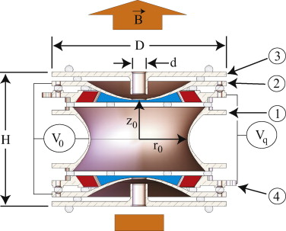
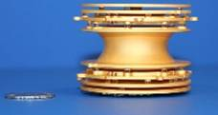
Penning Trap:
Single ion quantum manipulation for mass determinations
Cyclotron frequency:
Superposition
strong magnetic field
weak electrostatic
quadrupole field
Mass measurement via the determination
of the cyclotron-frequency:
Measurement is done with one ion in the trap,
repeat to scan over frequency range.
Results in accurate and precise measurements
with understood systematics.

Slide 7
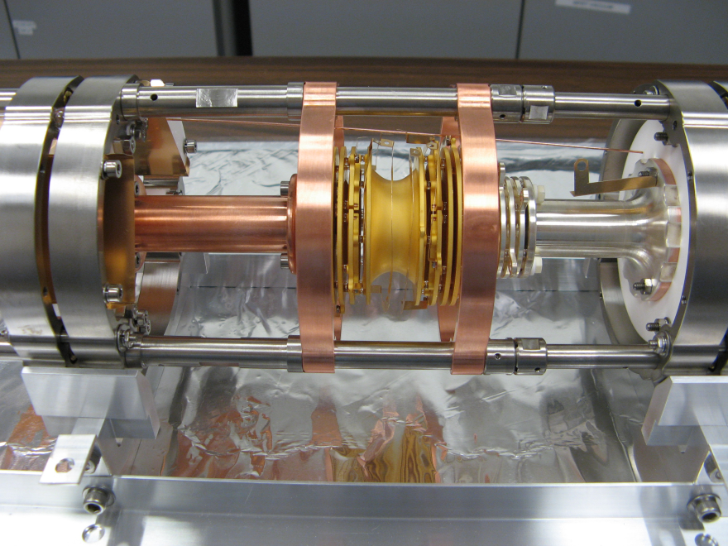
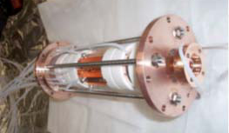
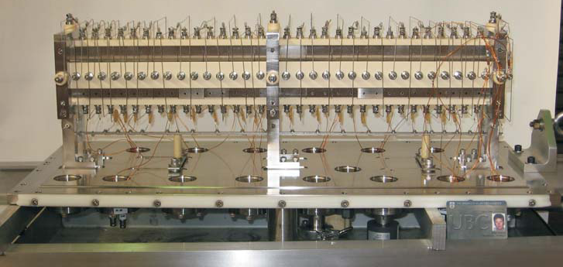
TITAN
Triumf’s Ion Trap for Atomic and Nuclear science
Penning Trap
Mass Measurement
Optimized for fast
measurements
EBIT
Charge State Breeding
ms breeding with high efficiency
7 m
RFQ
Cooling and Bunching
Sq-W driven system with
He or H coolant
reverse extraction
Cooler Penning Trap
p or e-cooling of highly charged ions
5 m
ISAC Beam

Slide 8
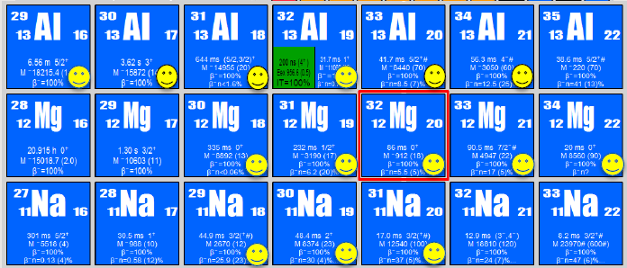
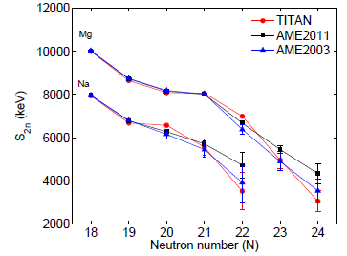
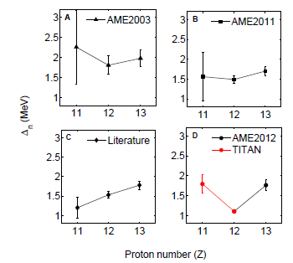
Island of Inversion
First discovered by mass
measurements
Well studied field with complex nuclear structure
  Ground state experiments
  can help to confirm theory
  Direct mass measurements
S_{2n} re-measured
New trend in shell gap (Δn)
Need to confirm with theory how trend can be explained
More exp. to come
A. Chaudhuri et al.,

Slide 9
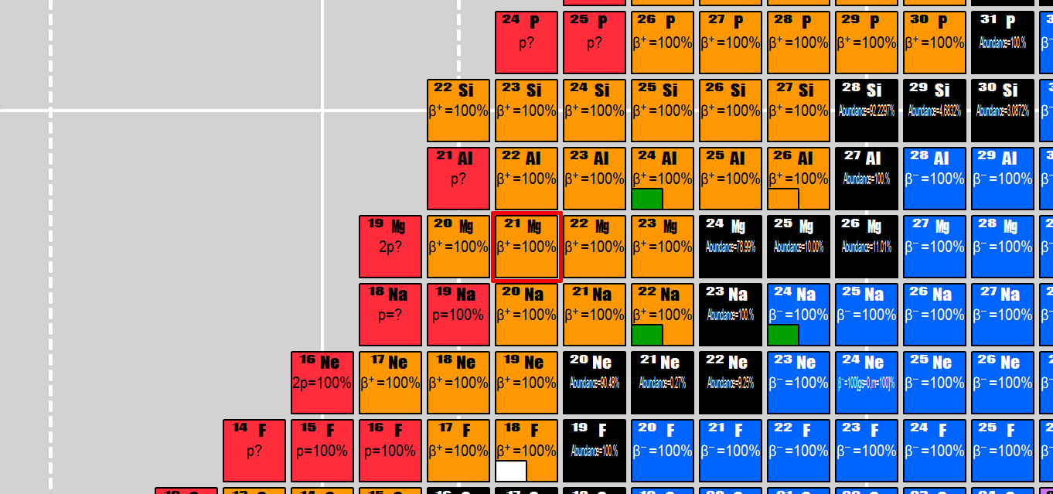
IMME for ^{20,21}Mg
IMME (Isobaric Multiplet Mass Equation) introduced by E. Wigner as a result of charge independence and iso-spin concept
Used to test isospin symmetry and test detailed theories, used for FT values
Quadratic behavior in Tz
Need precision mass measurements (and excitation energies) to test quadratic form
Experiments often difficult due to isobaric contamination
In case of Mg: overwhelming background of Na

Slide 10
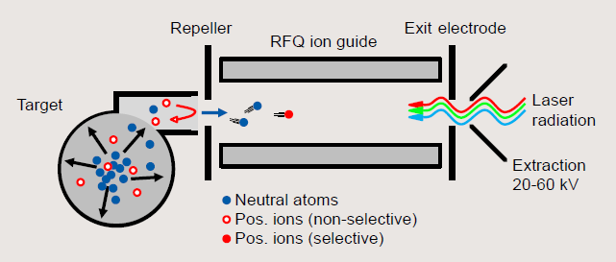
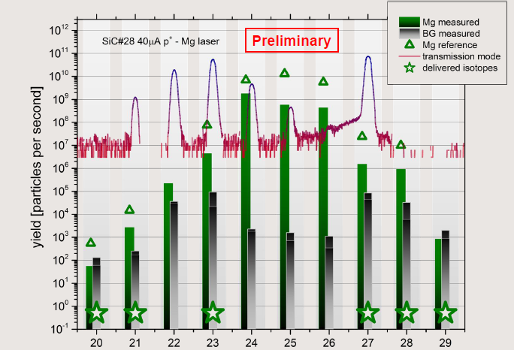
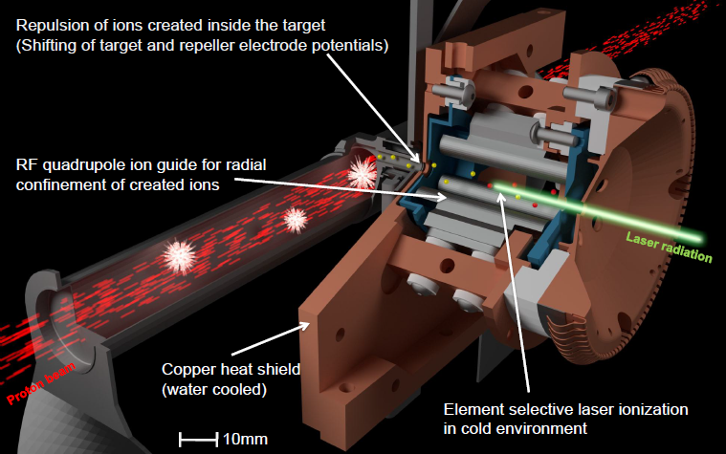
New, clean target approach:
Ion -guide laser ion source (IG-LIS)
Laser ion source, coupled to ion guide RFQ structure.
Repeller to suppress surface ions
  TRIUMF: J. Lassen & TRILIS team
  Idea: K. Blaum et al., NIMB 204 (2003)

Slide 11
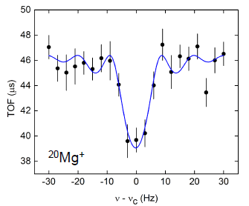
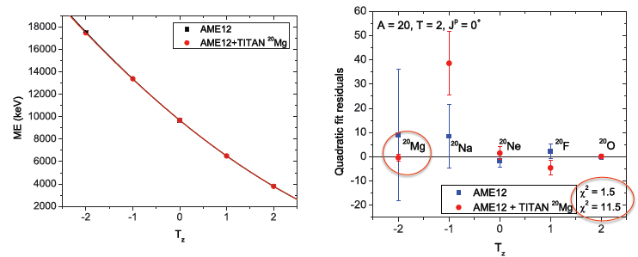
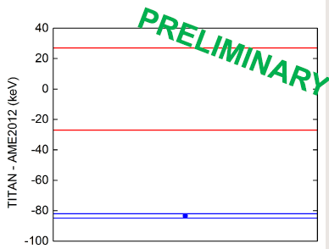
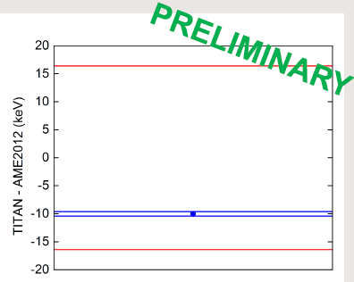
IMME for ^{20,21}Mg
²⁰Mg⁺
New precision mass measurements possible due to large suppression of contamination (up to factor ~10⁶ ) with new IG-LIS (Lassen et al.,)
for A=20,21 IMME changed and possible cubic term needed (prelim.)
A. Gallant et al.,
²¹Mg⁺

Slide 12
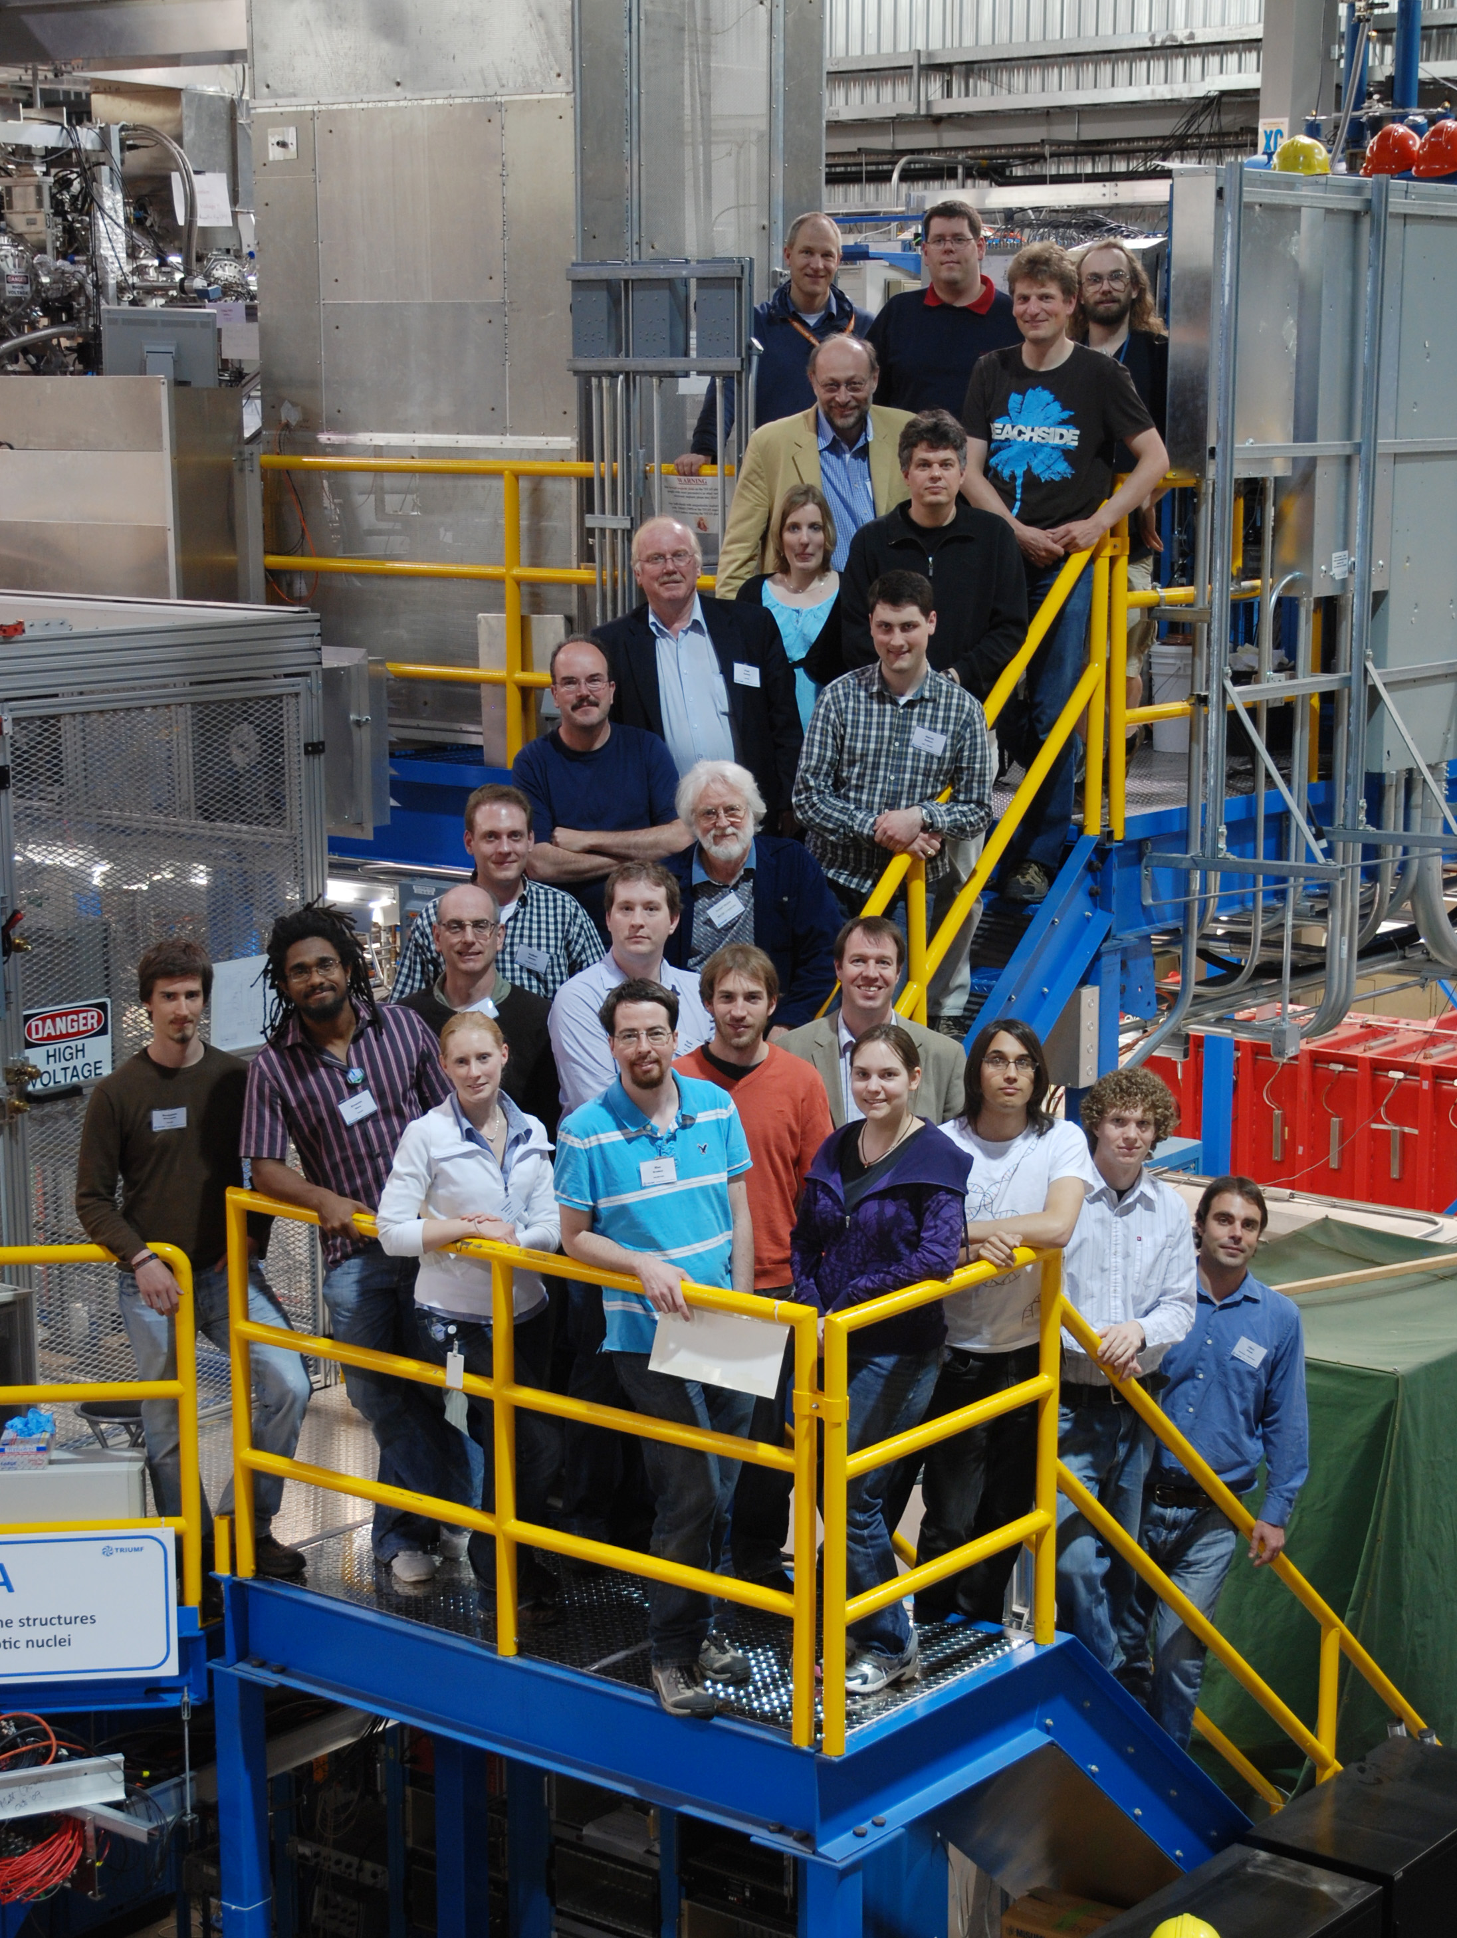


Thank You!
Thanks to the TITAN grad. students:
S. Ettenauer (Vanier & Killiam)*,
A. Gallant (NSERC A.G. Bell fellowship),
T. Macdonald (NSERC A.G. Bell fellowship)
V. Simon (DAAD + Deutsche Studienstiftung)*,
T. Brunner (Villigst fellowship)*
U. Chowdhury, B. Eberhard*, A. Lennarz (DAAD)
R. Klawitter, A. Bader
and the post docs:
M. Simon, B. Schultz, A. Chowdhury,
A. Grossheim, A. Kwiatkowski, K. Leach
long term collaborators:
D. Lunney (Orsay), R. Ringle (MSU),
M. Brodeur (MSU/ ND), D. Frekers (Muenster)
G. Gwinner (Manitoba), C. Andreoiu (SFU)
And the rest of the collaboration:
* Have graduated and are now at Harvard, Stanford, and Mainz
|titan.triumf.ca JDilling@triumf.ca
Giessen

Slide 13
ISAC
ion beam
RFQ
cooler &
buncher
EBIT
charge
breeder
TITAN
Triumf’s Ion Trap for
Atomic and Nuclear science
laser
spectroscopy
Giessen
Multi-
TOF
laser
spectroscopy
m/q
Selection
B/N gate
Mass measurements on isotopes
with short half-life T_{1/2}≈ 10 ms and
low production yields (≈ 10 ions/s)
with high precision δm/m ≈ 10-8.
Laser spectroscopy with enhanced resolution
and sensitivity, access to very exotic isotopes
Cooler
Trap
(soon)
Precision
Penning
trap

Slide 14
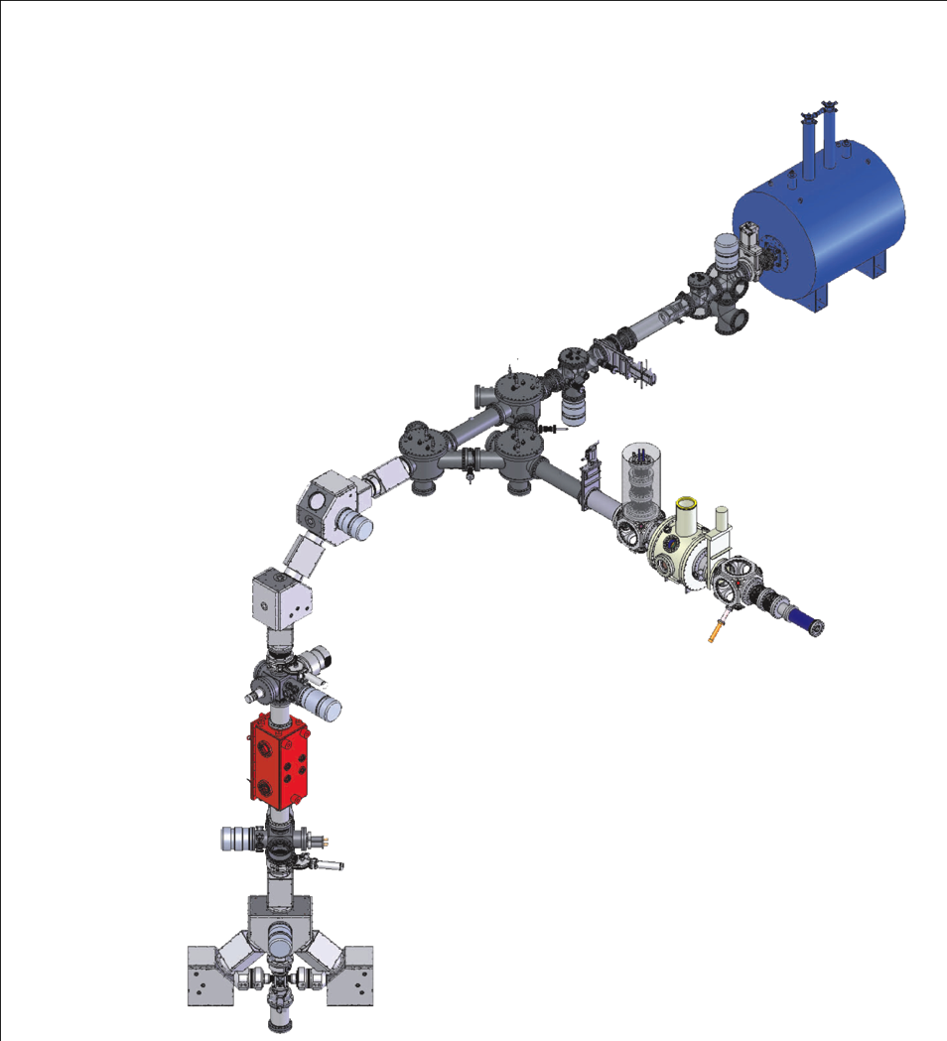

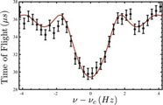
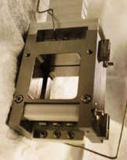
Time-of-Flight Spectra
TITAN HCI mass measurements
Collaboration:
Physics Departments, Stanford University
G. Gratta, A. Mueller, K. O’Sullivan
BNG
Bradbury-Nielsen
TOF ion gate
MCP
switch yard
section
A^{q+}
counts
A^{q+}
A⁺
SCI injection
HCI extraction
gun
Time of flight [μs]
A⁺
collector
trap
(magnet)
Th. Brunner et al. IJMS 309, 97 (2012)

Slide 15
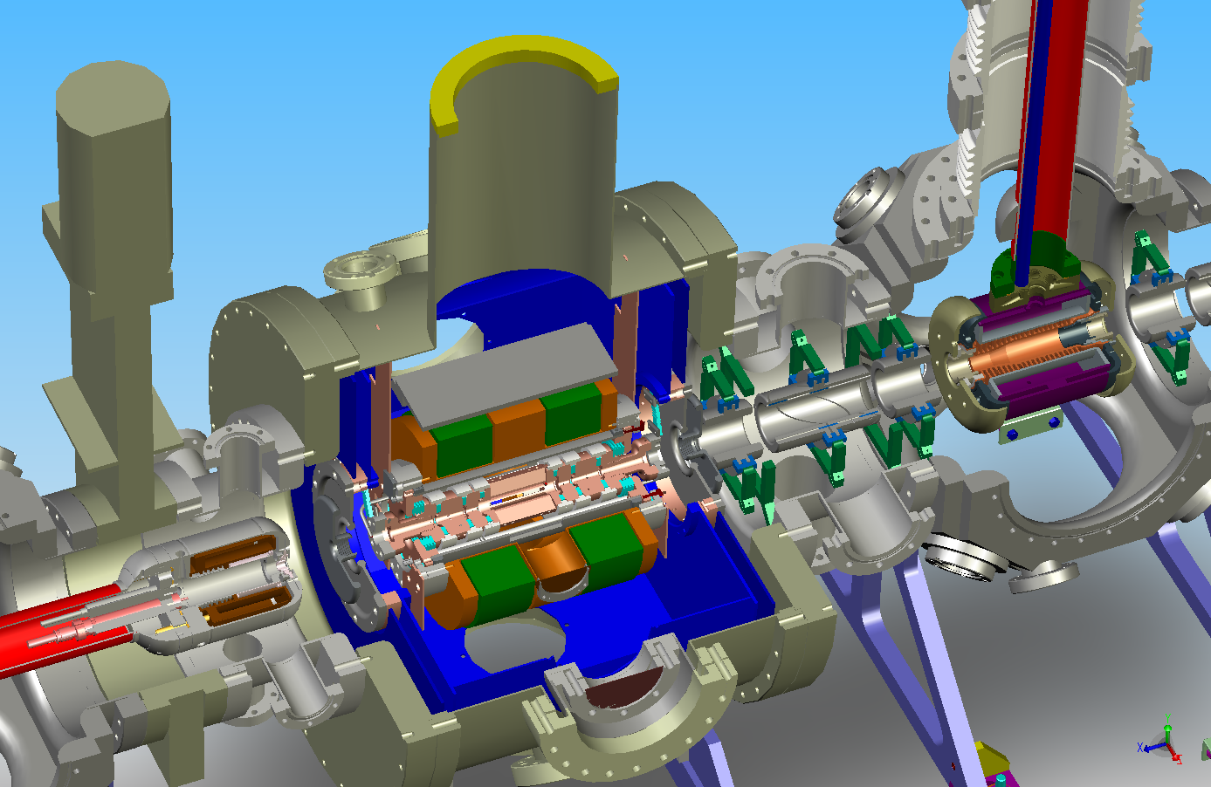
The use of highly charged ions
How effective is it to use highly charged ions:
charge breeding on precision
have to consider losses in efficiency as well due to decay
Set up simulation tool to:
atomic physics of breeding
breeding parameters
  E-beam energy
  intensity (density)
decay during breeding
gain in precision

Slide 16
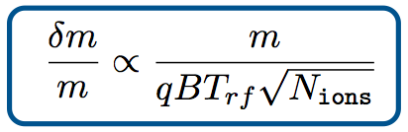

effective HCI precision gain
transport, injection, extraction
→ no principal limitations
nuclear decay during breeding
→ T_{cb}, T_{1/2}
charge state distribution
→ η_{pop}
include calculation of effective precision gain through charge breeding in simulations with CBSIM
charge exchange (CX) and damping effects lead to less pronounced resonances
→ not a linear increase in precision
however: T_{CX} > T_{1/2} sufficient
special thanks to Oliver Kester for supplying CBSIM
simulations performed by T. Macdonald,

Slide 17
simulations of HCI gain

Slide 18

The TITAN-EBIT
superconducting magnet 4Kelvin, 6Tesla
Helmholtz configuration
and drift tube assembly
electron
collector
Sikler lens
Gun
450mA achieved
upgradeable to 5A
soon -60kV bias

Slide 19
EXTRA

Slide 20
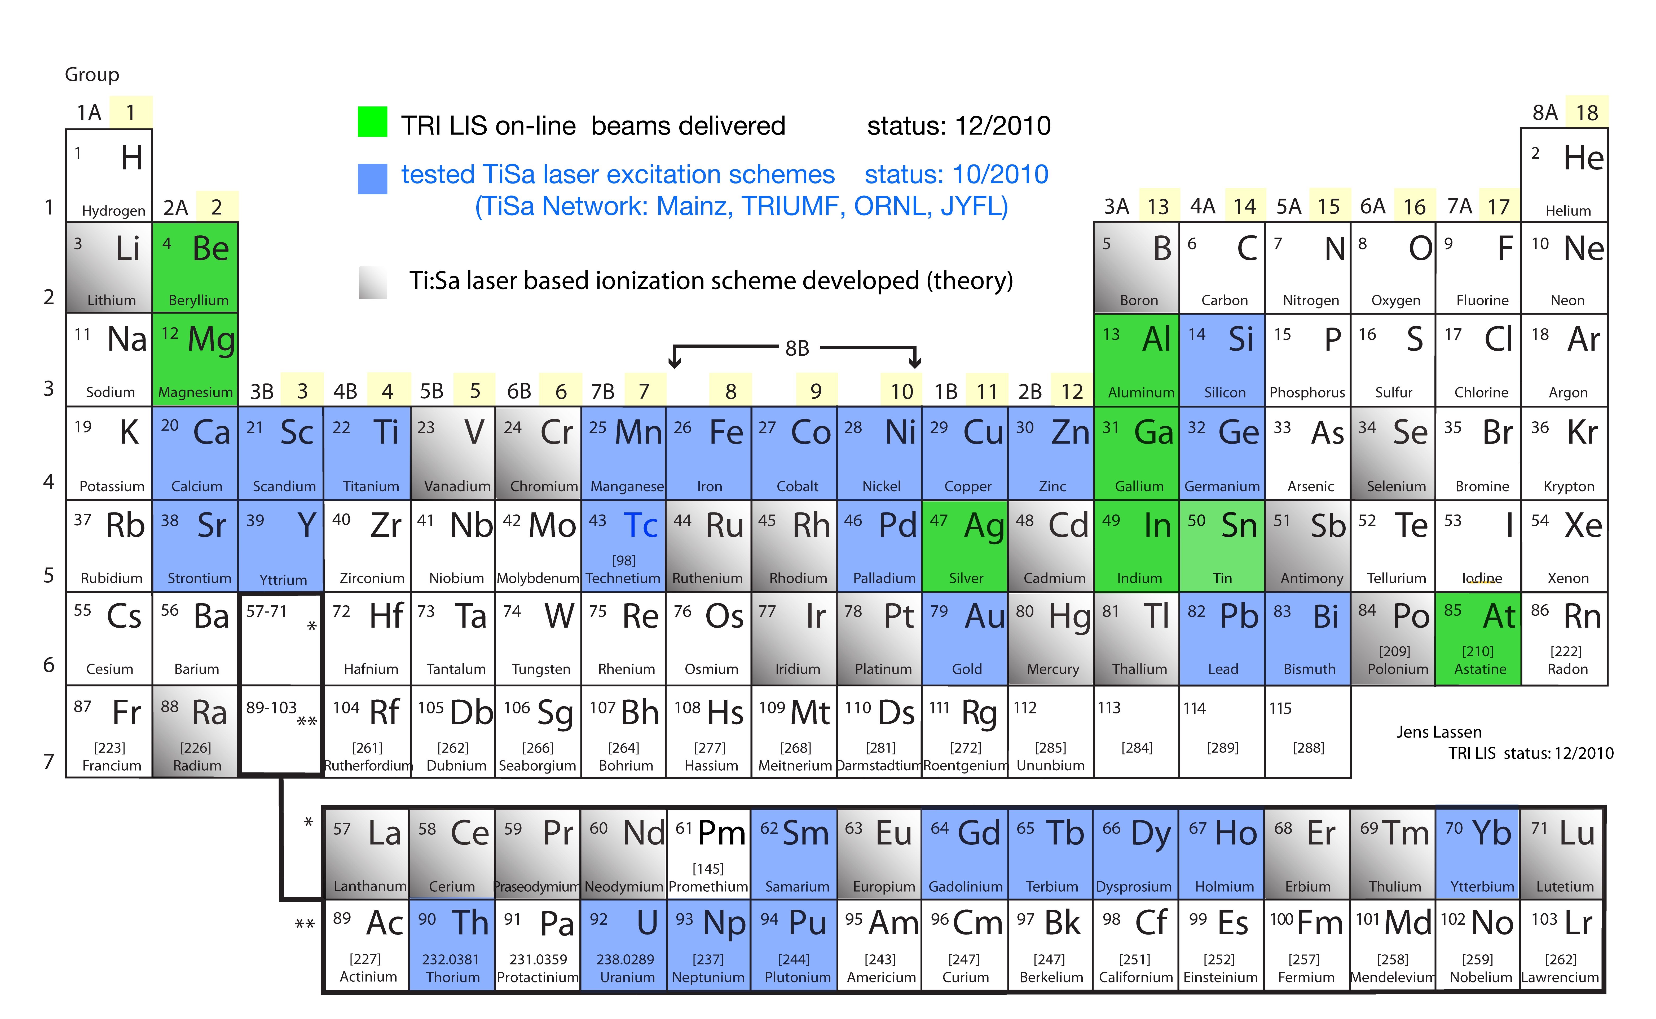
TiSa laser excitation schemes & RIB at TRIUMF
TiSa based LIS turned “35 ⁽⁺⁾ elements” developed
now at par with dye-laser based RILIS
TRIUMF-ISAC yield database: http://www.triumf.info/facility/research_fac/yield.php
Jens Lassen | TRIUMF Resonant Ionization Laser Ion Source Group

