Slide 1

Evolution of octupole collectivity in ²²¹Th
Centre for Basic
Sciences, Mumbai
Sujit Tandel
UM-DAE Centre for Basic Sciences, Mumbai

Slide 2
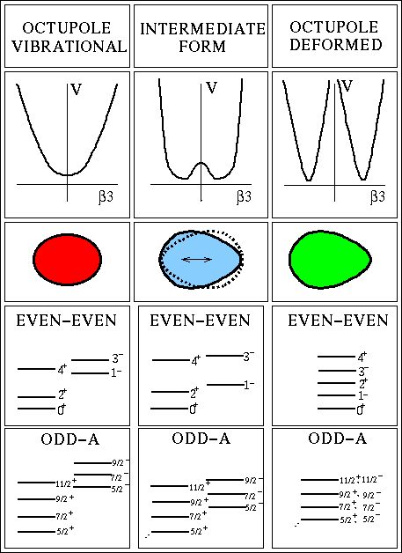
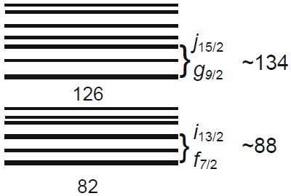
Octupole collectivity in A≈220 region
Centre for Basic
Sciences, Mumbai
N
Z
Enhanced octupole collectivity due
to closely-spaced high-j proton and
neutron orbitals near the Fermi
surface with Δj, Δl=3

Slide 3
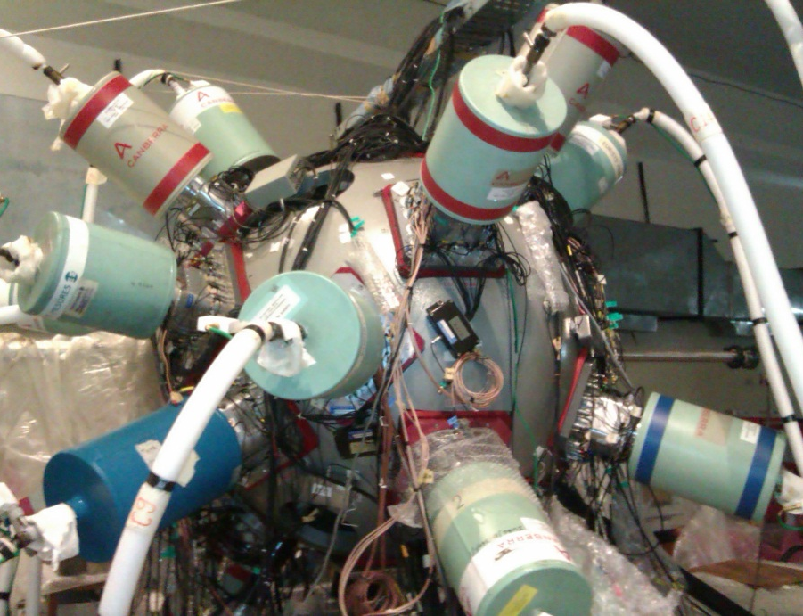
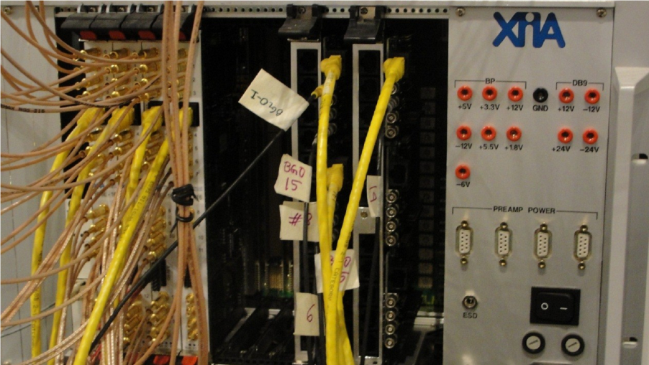
Experiment
Centre for Basic
Sciences, Mumbai
²⁰⁸Pb (¹⁶O, 3n) ²²¹Th @ 86 MeV
from 14UD BARC-TIFR Pelletron
(≈18% cross-section for fusion-evaporation)
99.6% enriched ²⁰⁸Pb target (5.5 mg/cm²)
19 Compton-suppressed clover Ge
detectors:
Indian National Gamma Array (INGA)
Triggerless DSP-based Data Acquisition
γ-γ and γ-γ-γ coincidences

Slide 4
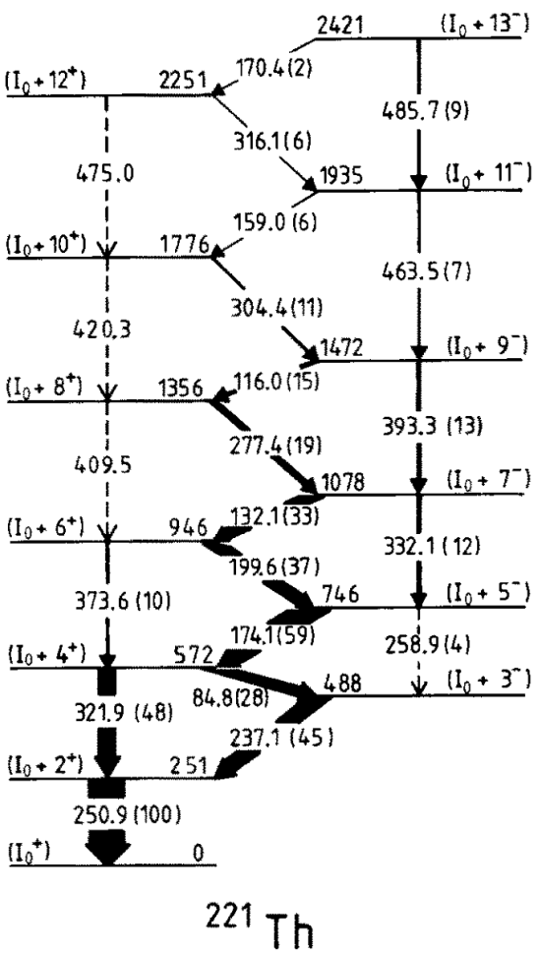
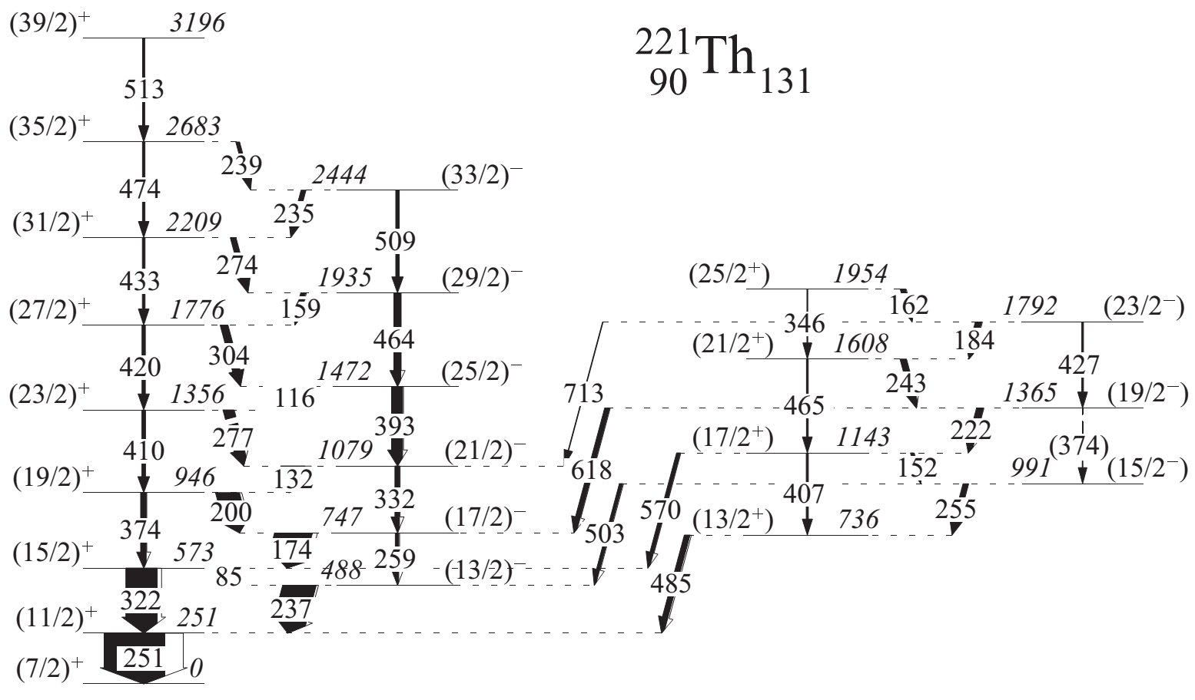
Excited level structure of ²²¹Th
Centre for Basic
Sciences, Mumbai
Yrast
Non-Yrast
(≈20-25% of yrast)
New
Deleted
Two alternating parity sequences in ²²¹Th
Transitions at high spin in yrast structure modified
New non-yrast structure established
M. Dahlinger et al.,
Nucl. Phys. A 484, 337 (1988)

Slide 5
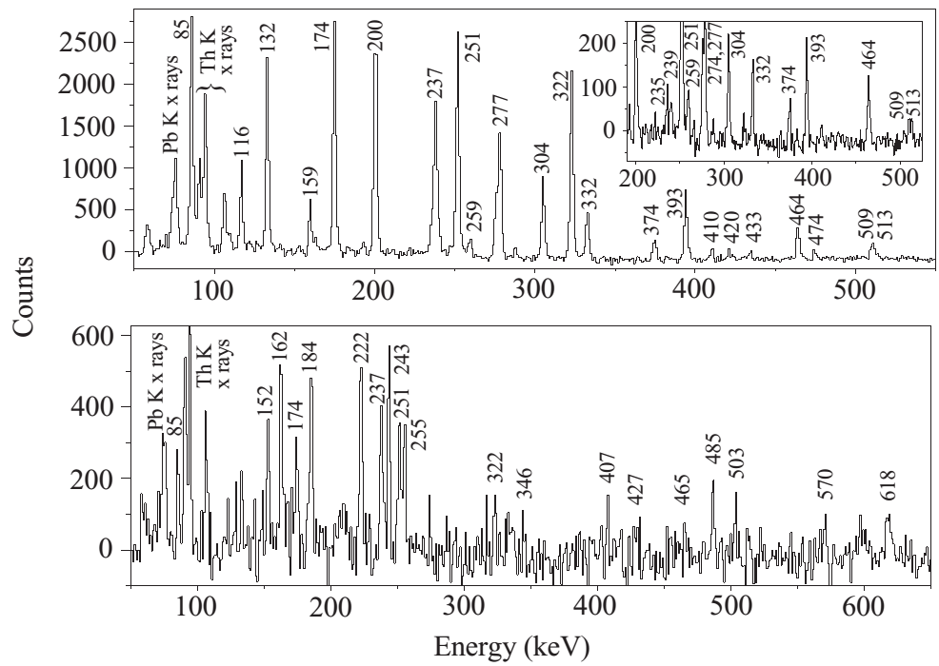
Alternating parity sequences in ²²¹Th
Centre for Basic
Sciences, Mumbai
Yrast
Non-Yrast

Slide 6
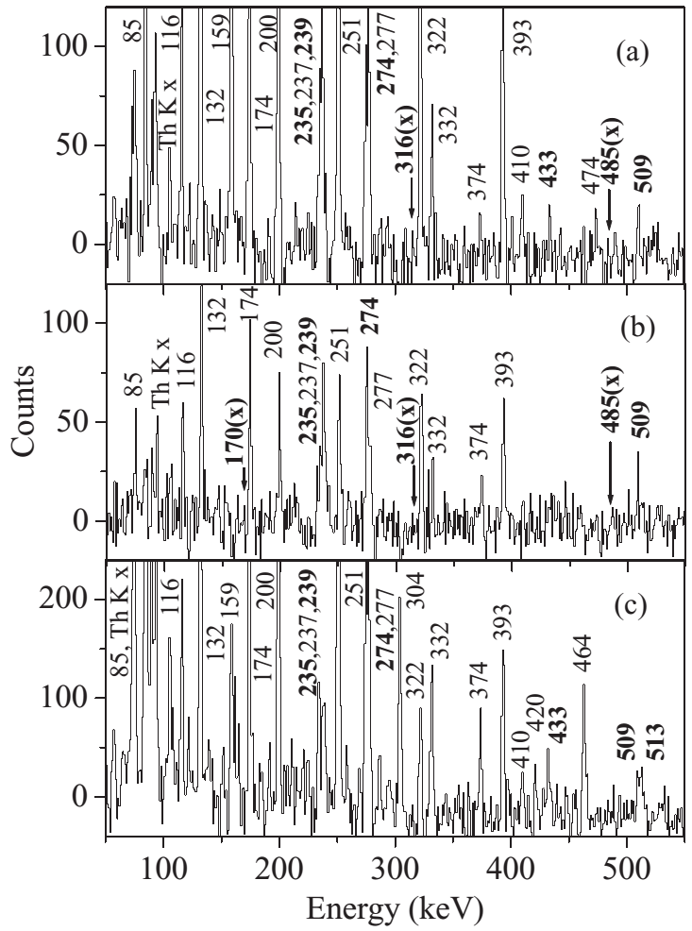
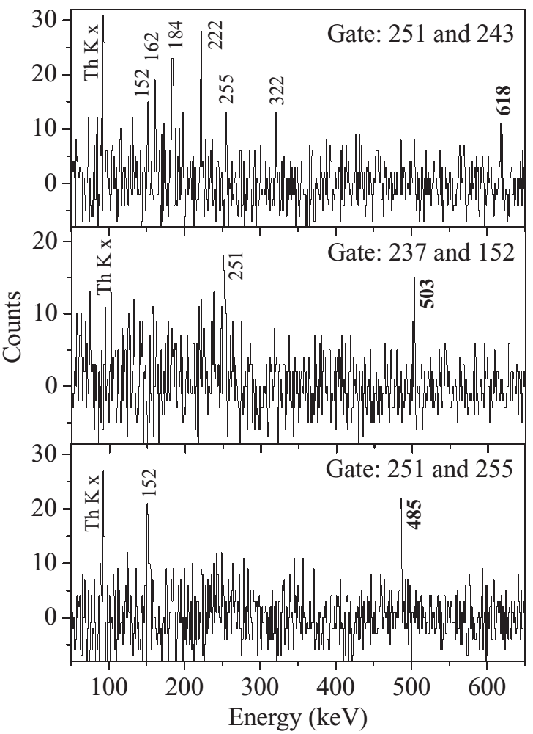
Placement of new transitions in ²²¹Th
Centre for Basic
Sciences, Mumbai
Incorrectly assigned
Newly assigned
Interband transitions
New E1 transitions
Yrast structure
Non-yrast structure

Slide 7
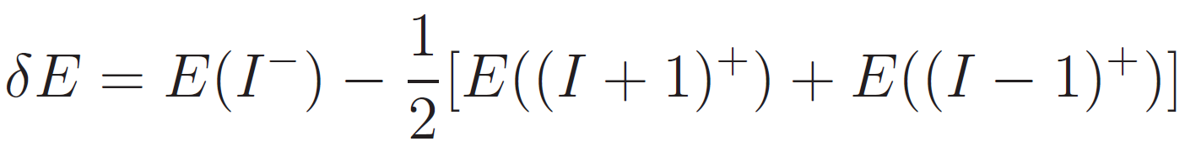
Energy splitting for alternating parity states
Centre for Basic
Sciences, Mumbai
N=129
Yrast
Non-yrast
N=131
No parity doublets in ²²¹Th since ground
state has predominantly low-K configuration
N=133
²²³Th: textbook example of nucleus with
near-static octupole deformation
N=135
δE → 0 for static octupole deformation
(parity doublets)

Slide 8
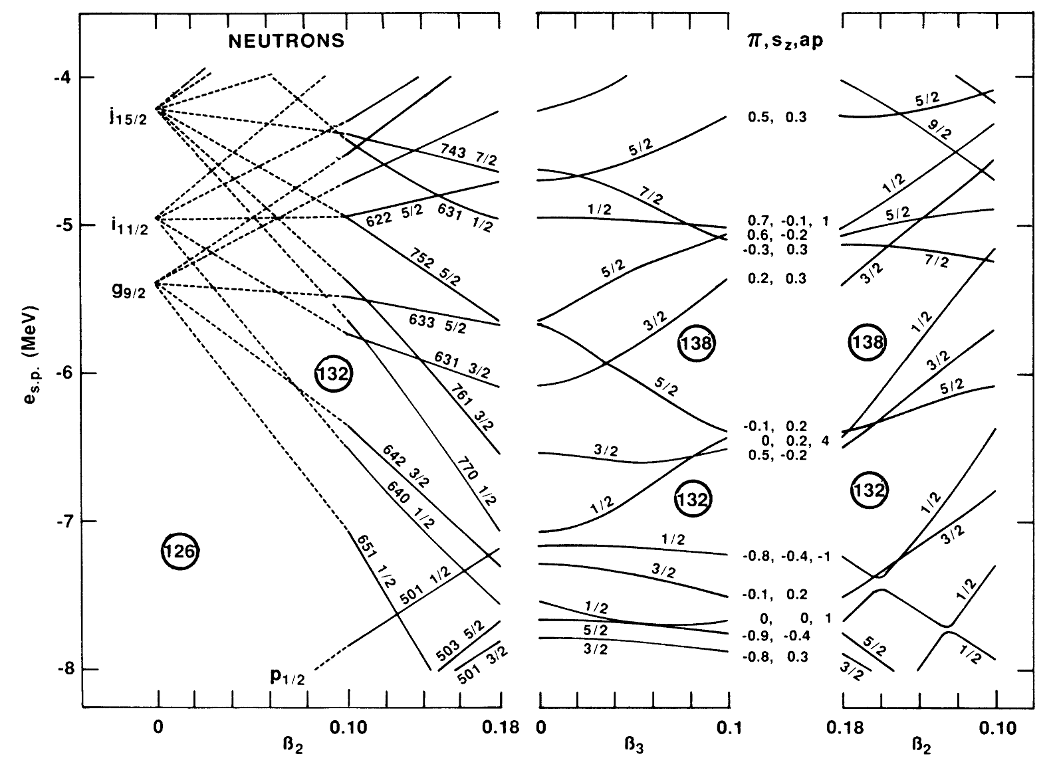
Neutron single particle levels (Woods-Saxon potential)
Centre for Basic
Sciences, Mumbai
β₃=0.0
β₂=0.18
β₃=0.1
Low-K components near N=132
Ω = 5/2
Ω = 1/2
Ω = 3/2
G.A. Leander and Y.S. Chen, Phys. Rev. C 37, 2744 (1988)

Slide 9
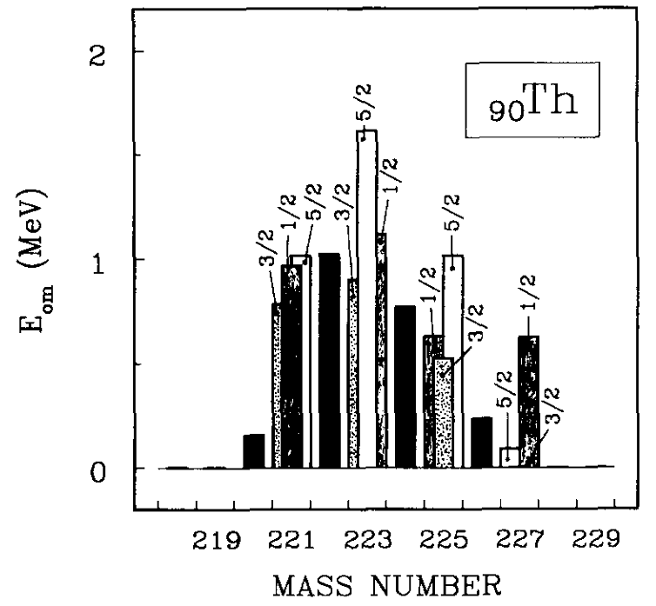
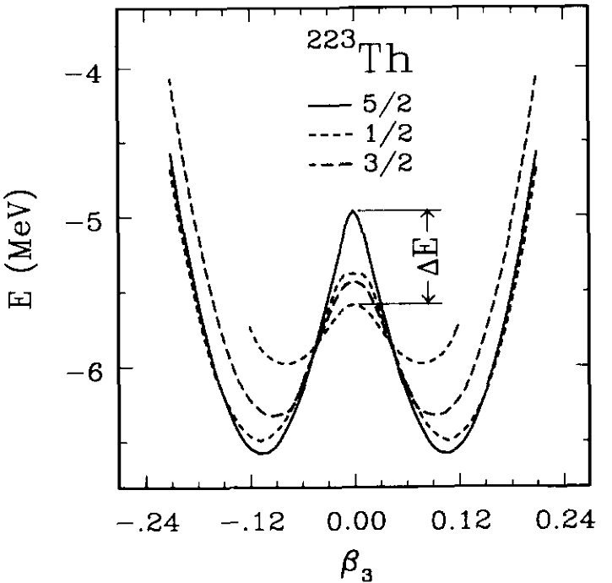
Configurations and octupole barriers
Centre for Basic
Sciences, Mumbai
Octupole barriers quite substantial in ²²¹Th; highest for Ω=5/2 in ²²³Th
S. Cwiok and W. Nazarewicz, Phys. Lett. B 224, 5 (1989)

Slide 10
Evolution of quadrupole and octupole collectivity
Centre for Basic
Sciences, Mumbai
²²¹Th
MOI for –ve parity higher than +ve parity:
larger underlying quadrupole deformation
(confirmed by self-consistent Hartree Fock)
Octupole collectivity in ²²¹Th increases,
then stays constant, while quadrupole
deformation increases at highest spins

Slide 11
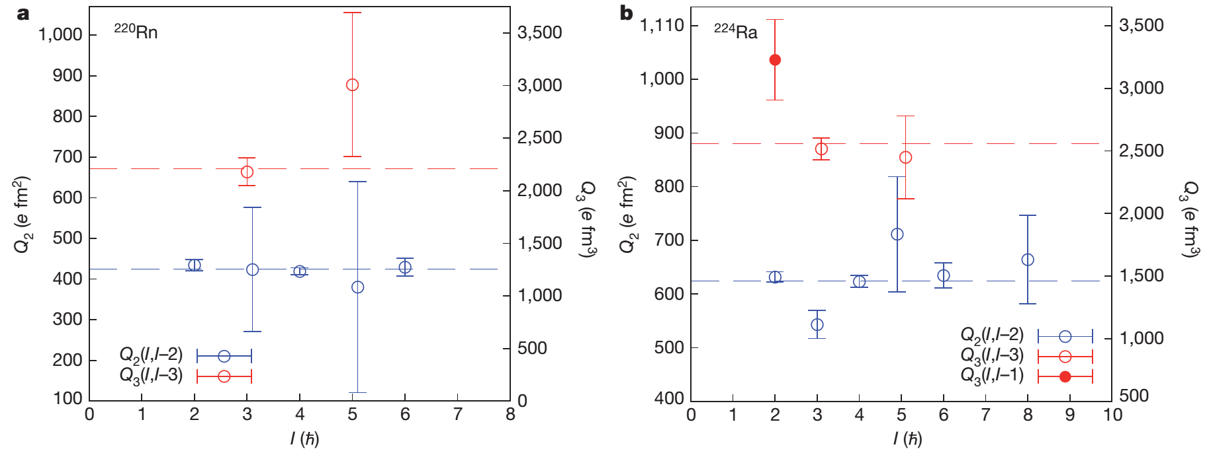
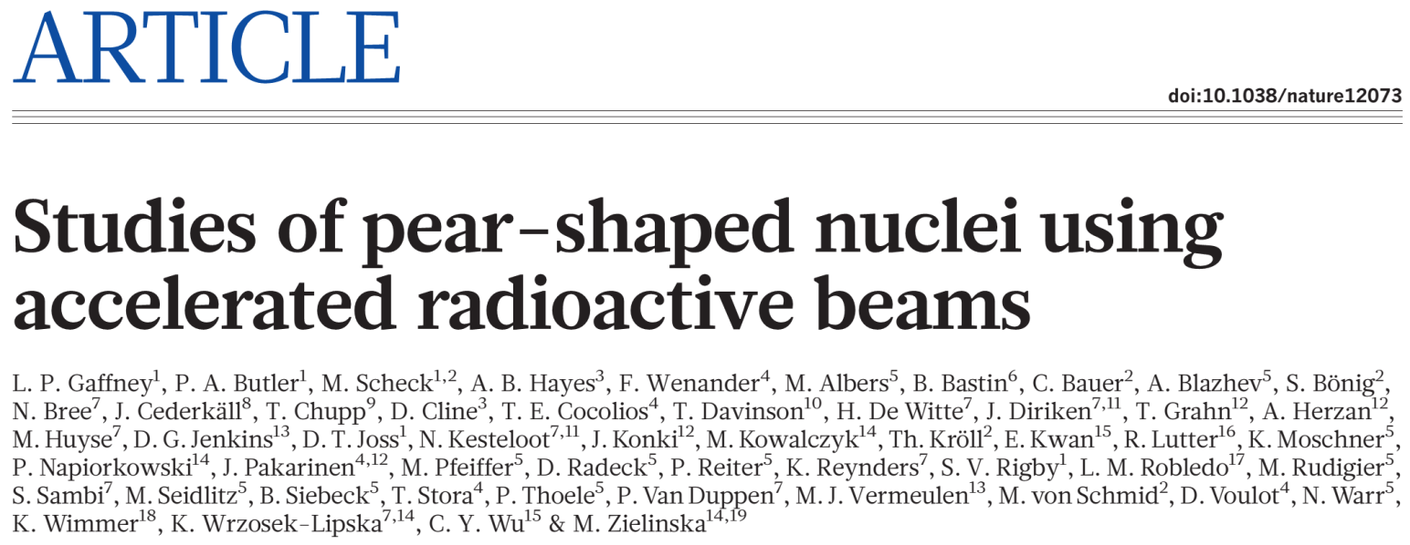
E2 and E3 moments in A≈220 region
Centre for Basic
Sciences, Mumbai

Slide 12
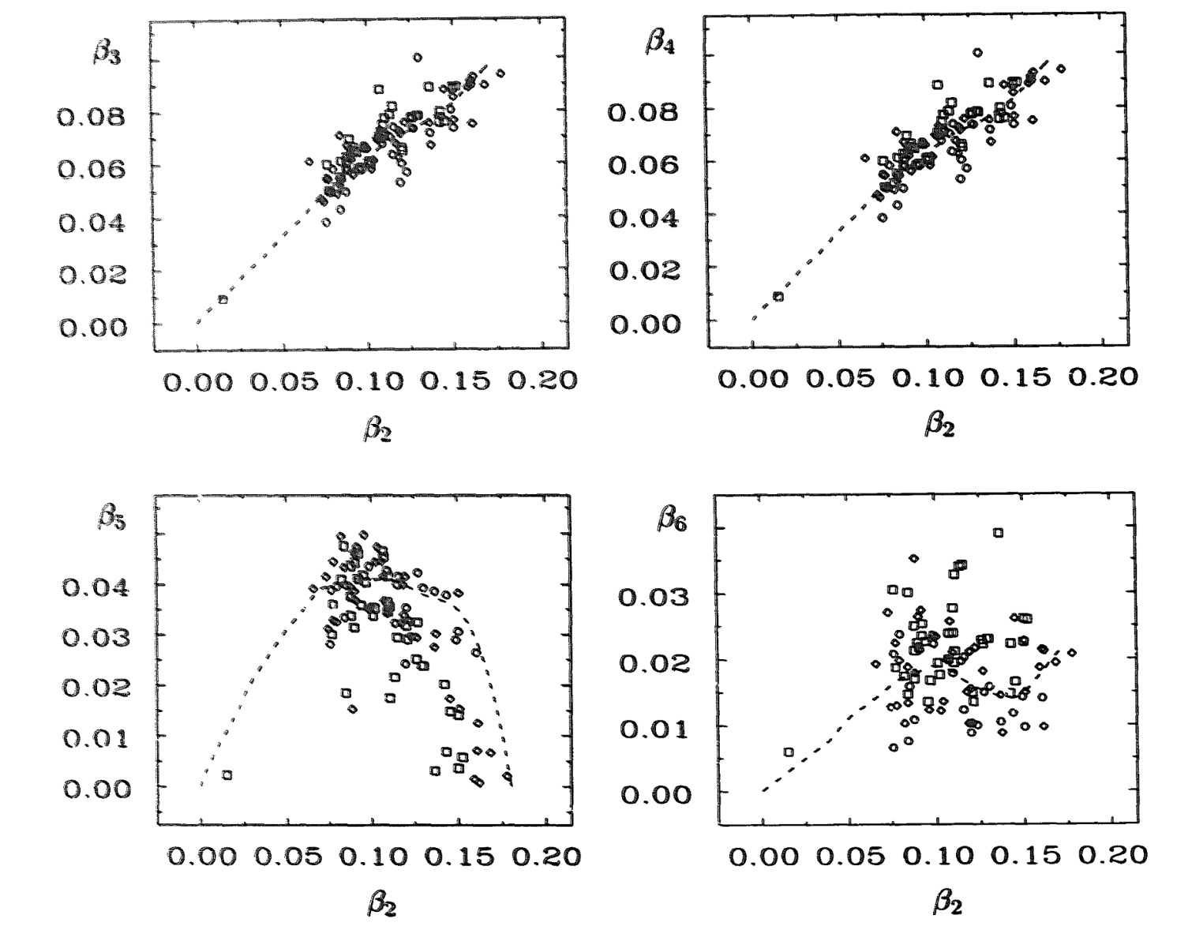
Contributions from higher-order deformations
Centre for Basic
Sciences, Mumbai
Dotted line:
average deformation path
Equilibrium deformations for calculated 1-qp bandheads with Ω<9/2 in odd-A (≈220) nuclei
S. Cwiok, W. Nazarewicz, Nucl. Phys. A 529, 95 (1991)

Slide 13
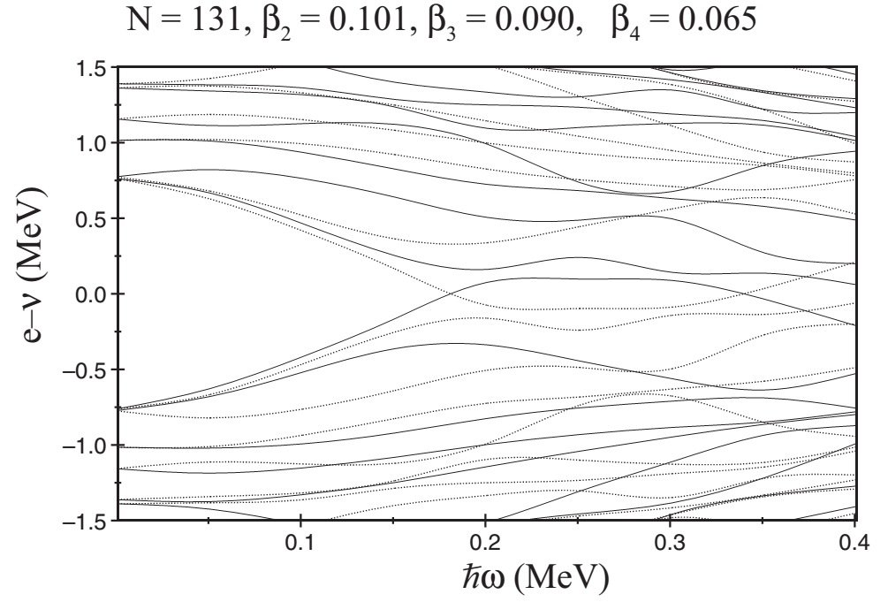
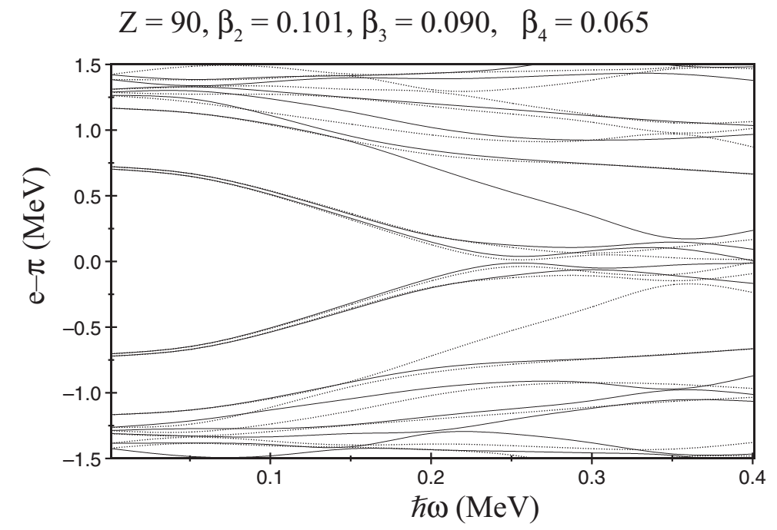
Predicted neutron and proton band crossings
Centre for Basic
Sciences, Mumbai
Woods-Saxon potential
with “universal” parameters
Strong octupole collectivity correlated with delay or absence of nucleon alignments
Neutron alignment for i_{11/2} blocked; j_{15/2} orbital far from Fermi surface for β₃≈0.1
Proton i_{13/2} alignment expected beyond 0.25 MeV
Observed increase in moment of inertia at high spins in yrast structure may be due to
larger quadrupole deformation.

Slide 14
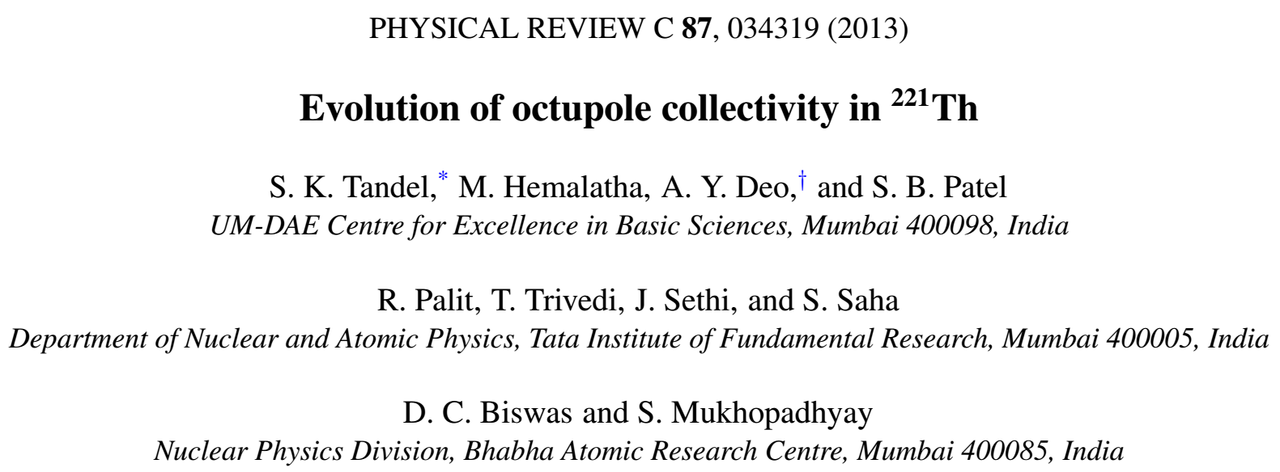
Summary
Centre for Basic
Sciences, Mumbai
Yrast octupole structure in ²²¹Th modified and extended to high spins;
new, non-yrast alternating parity sequence identified
Parity doublets absent in odd mass ²²¹Th due to low-K value of
ground-state configuration
Negative parity states have higher moment of inertia arising from
larger underlying quadrupole deformation
Dynamic variation in both quadrupole deformation and octupole
collectivity as a function of angular momentum observed

Slide 15
Collaboration
Centre for Basic
Sciences, Mumbai
S.K. Tandel, M. Hemalatha, A.Y. Deo, S.B. Patel
UM-DAE Centre for Excellence in Basic Sciences, Mumbai
R. Palit, T. Trivedi, J. Sethi, S. Saha
Tata Institute of Fundamental Research, Mumbai
D.C. Biswas, S. Mukhopadhyay
Bhabha Atomic Research Centre, Mumbai
INGA

