Slide 1

Investigating the strength of the
N = 34 subshell closure in ⁵⁴Ca
International Nuclear Physics Conference, Firenze, Italy. June 2–7, 2013.
D. Steppenbeck,¹ S. Takeuchi,² N. Aoi,³ H. Baba,² N. Fukuda,² S. Go,¹
P. Doornenbal,² M. Honma,⁴ J. Lee,² K. Matsui,⁵ M. Matsushita,¹ S. Michimasa,¹
T. Motobayashi,² D. Nishimura,⁶ T. Otsuka,^{1,5} H. Sakurai,^{2,5} Y. Shiga,⁶
P.-A. Söderström,² T. Sumikama,⁷ H. Suzuki,² R. Taniuchi,⁵
J. J. Valiente-Dobón,⁸ H. Wang^{2,9} and K. Yoneda²
¹Center for Nuclear Study, University of Tokyo, 2-1, Hirosawa, Wako, Saitama 351-0198, Japan
²RIKEN Nishina Center, 2-1, Hirosawa, Wako, Saitama 351-0198, Japan
³Research Center for Nuclear Physics, Osaka University, Osaka 567-0047, Japan
⁴Center for Mathematical Sciences, University of Aizu, Aizu-Wakamatsu, Fukushima 965-8580, Japan
⁵Department of Physics, University of Tokyo, Bunkyo, Tokyo 113-0033, Japan
⁶Department of Physics, Tokyo University of Science, Tokyo 278-0022, Japan
⁷Department of Physics, Tohoku University, Aramaki, Aoba, Sendai 980-8754, Japan
⁸Legnaro National Laboratory, Legnaro 35020, Italy
⁹Department of Physics, Beijing University, Beijing 100871, People’s Republic of China
INPC 2013
Slide 1/15

Slide 2

Neutron-rich Ca isotopes: Outline
General scientific motivation for experimental studies of exotic Ca, Ti and Cr isotopes around N = 34
In-beam γ-ray spectroscopy at RIBF: Some details relevant to the present work
New results (^{53,54}Ca γ-ray transitions & level schemes) and the significance of the N = 34 subshell closure
Shell-model predictions: Successes and developments
INPC 2013
Slide 2/15

Slide 3
Mechanism: Evolution of shell structure
Neutron-rich fp shell bounded by Z = 20–28 and N = 28–40
Attractive interaction between the π1f_{7/2} and ν1f_{5/2} orbitals is important; responsible for characteristics of nuclear shell evolution in this mass region
As protons are removed from the πf_{7/2} orbital (from Ni to Ca) the strength of the π-ν interaction weakens, causing the νf_{5/2} orbital to shift up in energy relative to νp_{1/2} and νp_{3/2}
0f_{5/2}
N = 34?
1p_{1/2}
0f_{5/2}
1p_{1/2}
1p_{1/2}
N = 32
1p_{1/2}
0f_{5/2}
0f_{5/2}
1p_{3/2}
N = 32
N = 32
1p_{3/2}
Z = 28
N = 28
1p_{3/2}
1p_{3/2}
Z = 28
N = 28
Z = 28
0f_{7/2}
N = 28
Z = 28
N = 28
0f_{7/2}
0f_{7/2}
0f_{7/2}
₂₀Ca
₂₆Fe
₂₄Cr
₂₂Ti
Consequently have changing nuclear shell structure and potential new magic numbers at N = 32, 34 that require experimental investigation
INPC 2013
Slide 3/15

Slide 4
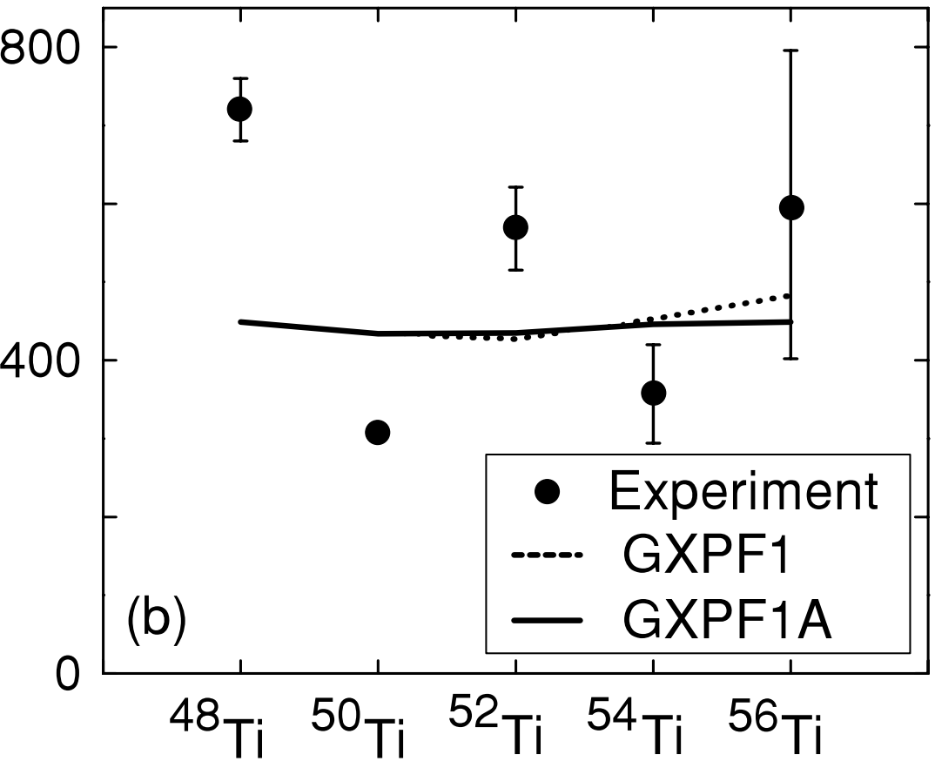
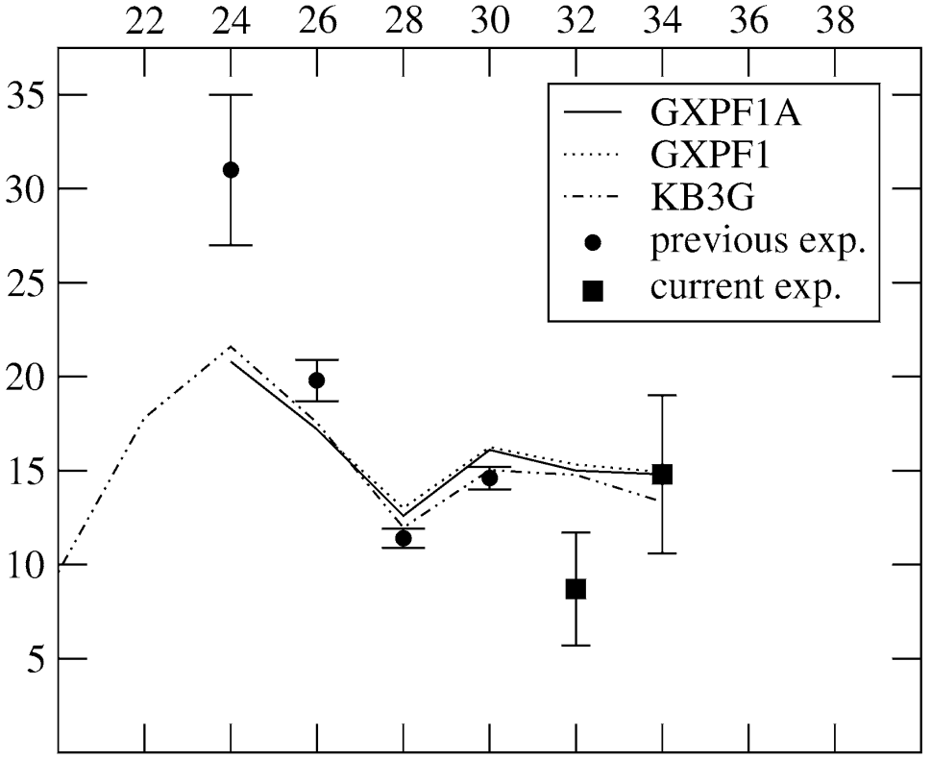
Motivation: The story so far…
Significant N = 32 subshell gaps observed in ⁵²Ca [2,3], ⁵⁴Ti [4,5] and ⁵⁶Cr [6,7] from E(2⁺) and B(E2) transition rates
[2] A. Huck et al., Phys. Rev. C 31 (1985) 2226
[3] A. Gade et al., Phys. Rev. C 74 (2006) 021302(R)
[4] R. V. F. Janssens et al., Phys. Lett. B 546 (2002) 55
[5] D.-C. Dinca et al., Phys. Rev. C 71 (2005) 041302(R)
[6] J. I. Prisciandaro et al., Phys. Lett. B 510 (2001) 17
[7] A. Bürger et al., Phys. Lett. B 622 (2005) 29
[8] S. N. Liddick et al., Phys. Rev. Lett. 92 (2004) 072502
First 2⁺ energies
?
However, no significant N = 34 subshell gap in ⁵⁶Ti [5,8] or ⁵⁸Cr [6,7], which is predicted by some shell models
Expt.
B(E2)
₂₂Ti
₂₄Cr
INPC 2013
Slide 4/15

Slide 5
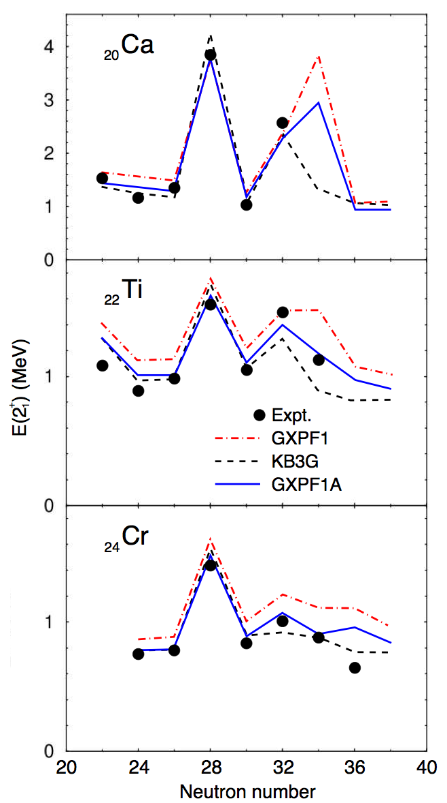
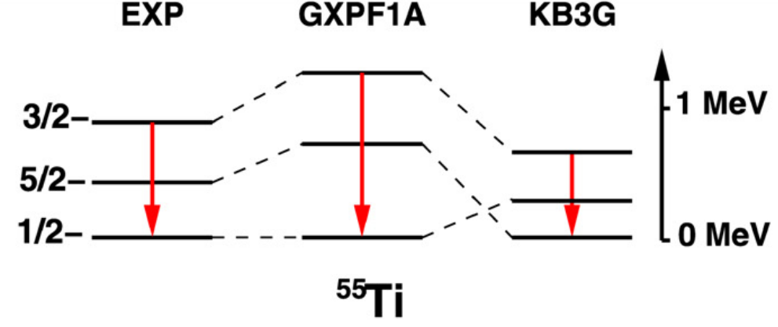
Motivation: SM predictions
Ground-state spin-parity of ⁵⁵Ti is ½⁻
GXPF1 [10] generally fails beyond N = 32
[10] M. Honma et al., Phys. Rev. C 65 (2002) 061301(R)
1f_{5/2}
Modified interactions were introduced, GXPF1A/GXPF1B [11], with adjusted matrix elements
[11] M. Honma et al., Eur. Phys. J. A 25 (2005) 499; RIKEN Accel. Prog. Rep. 41 (2008) 32
2p_{1/2}
N = 32
2p_{3/2}
Z = 28
N = 28
1f_{7/2}
⁵⁵Ti
Reduced first 2⁺ energy for ⁵⁶Ti and systematic improvement along the isotopic chains
Importantly, a significant N = 34 subshell closure still resides in the ⁵⁴Ca prediction
N = 34 shell closure is not predicted by other Hamiltonians, such as KB3G [12] and FPD6 [13]; consequences for shell-model interactions irrespective of the strength of the gap
[12] A. Poves et al., Nucl. Phys. A 694 (2001) 157
[13] W. A. Richer et al., Nucl. Phys. A 523 (1991) 325
P. Maierbeck et al., Phys. Lett. B 675, 22 (2009)
INPC 2013
Slide 5/15

Slide 6
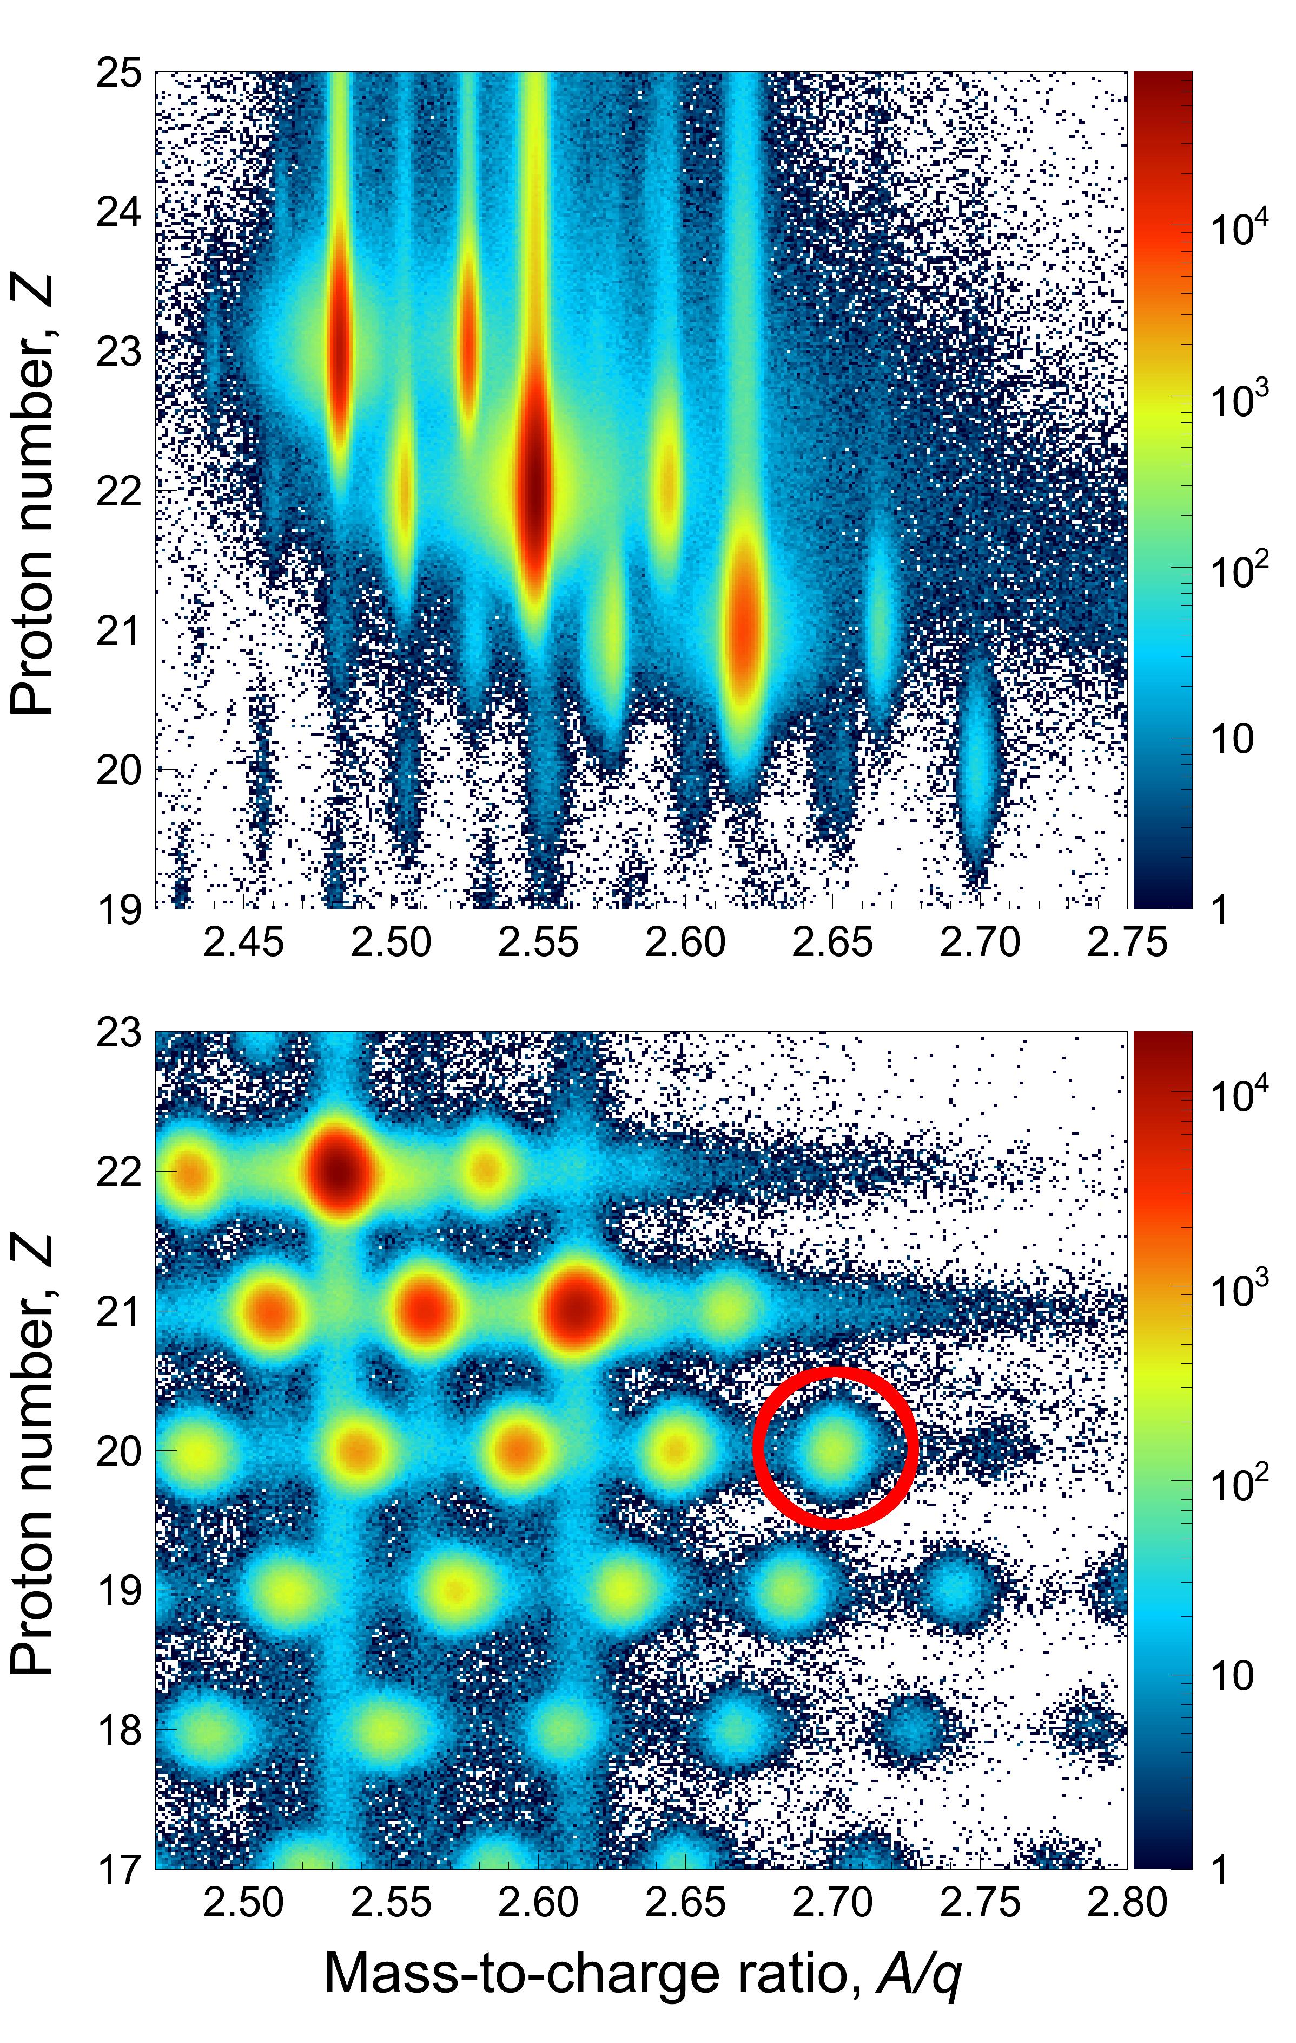
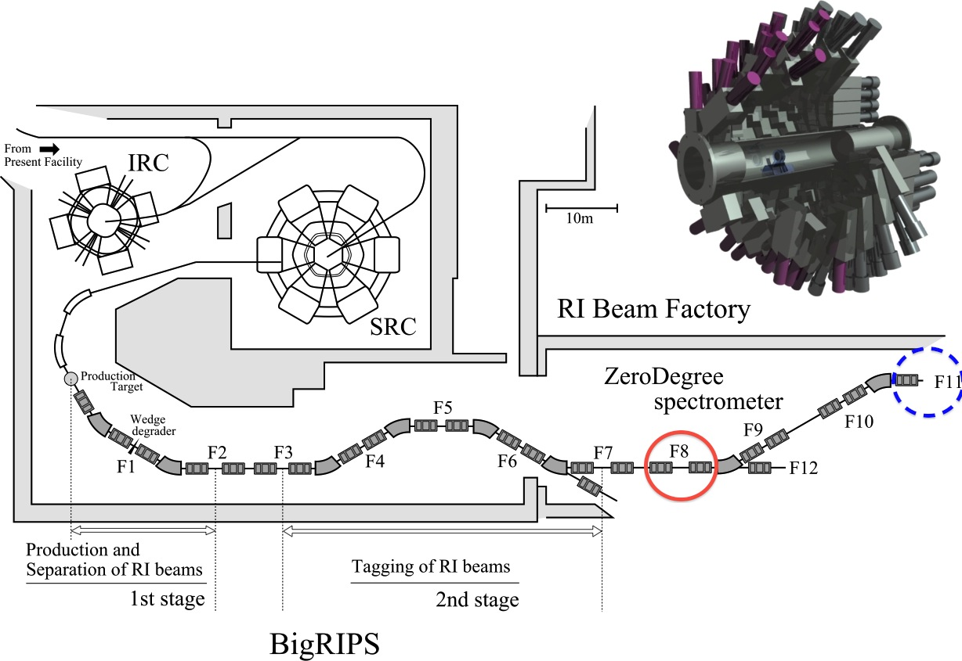
Experiment at RIBF: Brief outline
⁵⁷V
Typical BigRIPS rates
⁵⁵Sc ~ 12 pps/pnA (purity ~ 5.3%)
⁵⁶Ti ~ 125 pps/pnA (purity ~ 57%)
Data were accumulated for ~ 40 hours over 3 days
Coincidence events
⁵⁵Sc -> ⁵⁴Ca + γ^{n} ~ 1.4 × 10⁴ events
⁵⁶Ti -> ⁵⁴Ca + γ^{n} ~ 9.1 × 10³ events
Preliminary result
⁹Be(⁵⁵Sc,⁵⁴Ca)X σ_{inc} ~ 2.5(5)_{stat} mb
First ⁷⁰Zn experiment at RIBF (July 2012)
~ 60 pnA @ 345 MeV/u (max. ~ 100 pnA)
DALI2 NaI array
⁵⁶Ti
⁵⁵Sc
⁵⁴Ca
F0: 10-mm^{t} Be
production target
ZeroDegree
tuned for ⁵⁴Ca
BigRIPS separator
optimised for ⁵⁵Sc,
⁵⁶Ti within acceptance
F8: 10-mm^{t} Be
reaction target
INPC 2013
Slide 6/15

Slide 7
Results: Spectroscopy of ⁵⁴Ca
Exponential
GEANT4 simulation
Total fit
INPC 2013
Slide 7/15
Notes:
Statistical errors:
1184 +/- 22 (stat) keV
1656 +/- 14 (stat) keV
2043 +/- 7 keV
Systematic errors:
~ 0.7% calibration/gaindrift
~ 0.5% lifetime (30 ps)

Slide 8
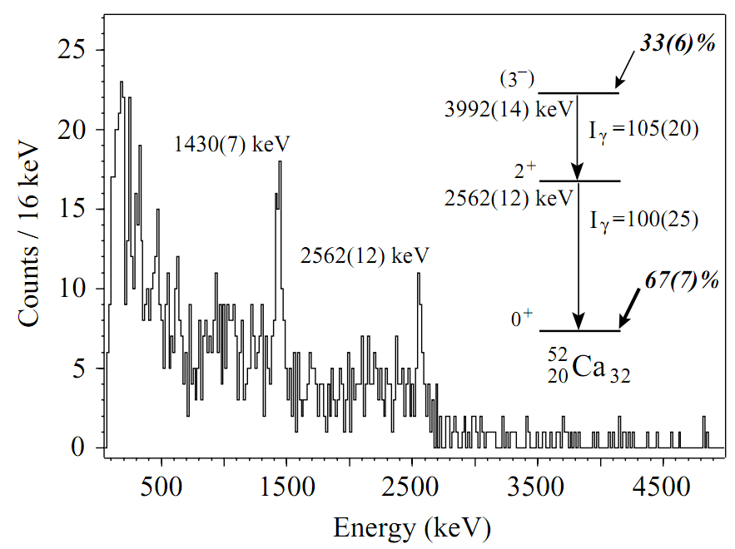
Results: J ^{π} assignments & systematics
Systematics of lower-mass isotopes
Present work
A. Gade et al., Phys. Rev. C 74 (2006) 021302(R)
(3⁻)
3,699(28)
Note the same general structure observed for ⁵²Ca following proton knockout reactions
(2⁺)
2,043(19)
Based on relative γ-ray intensities
0⁺
0
⁵⁴Ca
Systematics for Ca
E(2⁺) for neighbouring nuclei
Conclusions
E(2⁺) lower but comparable to that of ⁵²Ca
Enhanced relative to ⁵⁰Ca, E(2⁺) ~ 1 MeV
E(2⁺) is also enhanced relative to N = 34 isotones
New subshell closure at N = 34 for Ca isotopes
INPC 2013
Slide 8/15

Slide 9
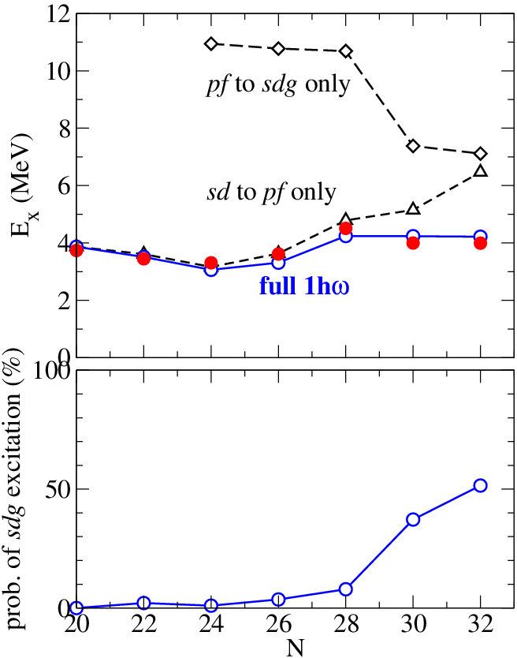
Results: SM calculations for ⁵⁴Ca
Shell-model calculations based on a modified GXPF1B effective interaction (fp model space) and cross-shell excitations within the sd-fp-sdg model space
Y. Utsuno et al., Phys. Rev. C 86 (2012) 051301(R)
Y. Utsuno et al., Prog. Theor. Phys. Suppl. 196 (2012) 304
(i) First 2⁺ state understood as neutron particle-hole excitation across N = 34 (i.e. νp_{1/2}⁻¹ x νf_{5/2}¹)
(ii) Effective single-particle energies indicate that, despite the lower E(2⁺), the magnitude of the N = 34 subshell gap is in fact similar to the N =32 gap for exotic Ca isotopes
(νf_{5/2}–νp_{1/2} effective energy gap is comparable to the νp_{1/2}–νp_{3/2} gap: both ~ 2.4 MeV)
Reasonable agreement supports tentative 3⁻ assignment
INPC 2013
Slide 9/15
Notes:
-0.15 MeV adjustment to the neutron p_{3/2} – f_{5/2} monopole interaction

Slide 10
Results: Spectroscopy of ⁵³Ca
Exponential
GEANT4 simulation
Total fit
INPC 2013
Slide 10/15
Notes:
Statistical errors:
1753 +/- 2 (stat) keV
2227 +/- 5 (stat) keV

Slide 11
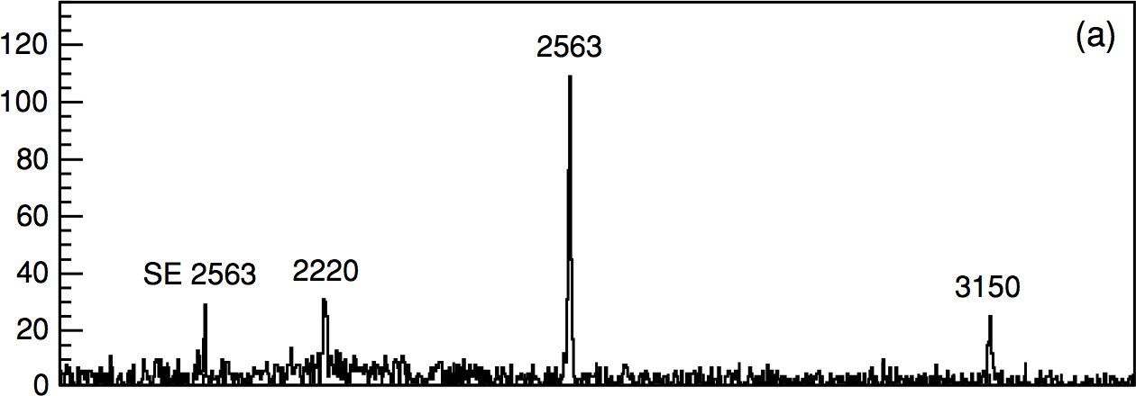
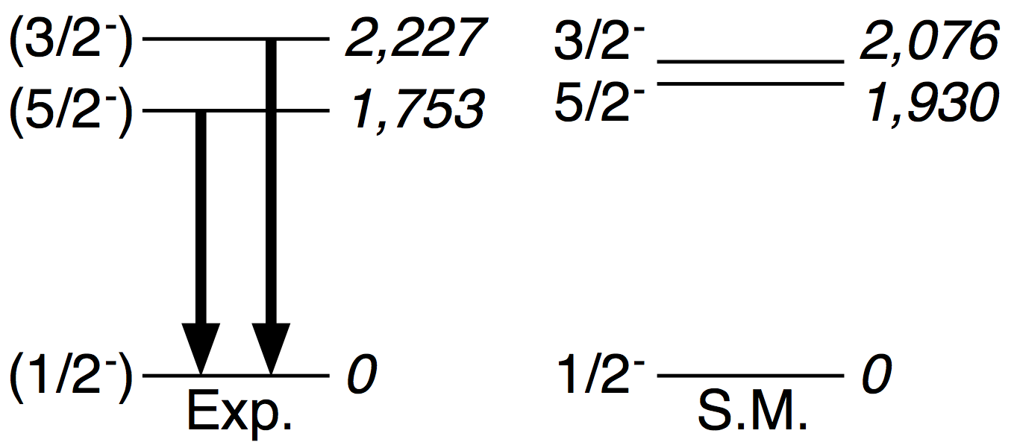
Results: J ^{π} assignments for ⁵³Ca
1f_{5/2}
Previous study:
β decay of ⁵³K
J ^{π} = (3/2⁺) G.S.
N = 34
2p_{1/2}
N = 32
⁵³Ca
2p_{3/2}
Z = 28
N = 28
1f_{7/2}
⁵³Ca
F. Perrot et al., Phys. Rev. C 74 (2006) 014313
Transition energy consistent with decay study by Perrot et al.
Non-observation of 1753-keV line in decay of ⁵³K & relative intensities measured in the present study support the proposed level scheme
Shell-model calculations (same interaction presented for ⁵⁴Ca)
INPC 2013
Slide 11/15

Slide 12
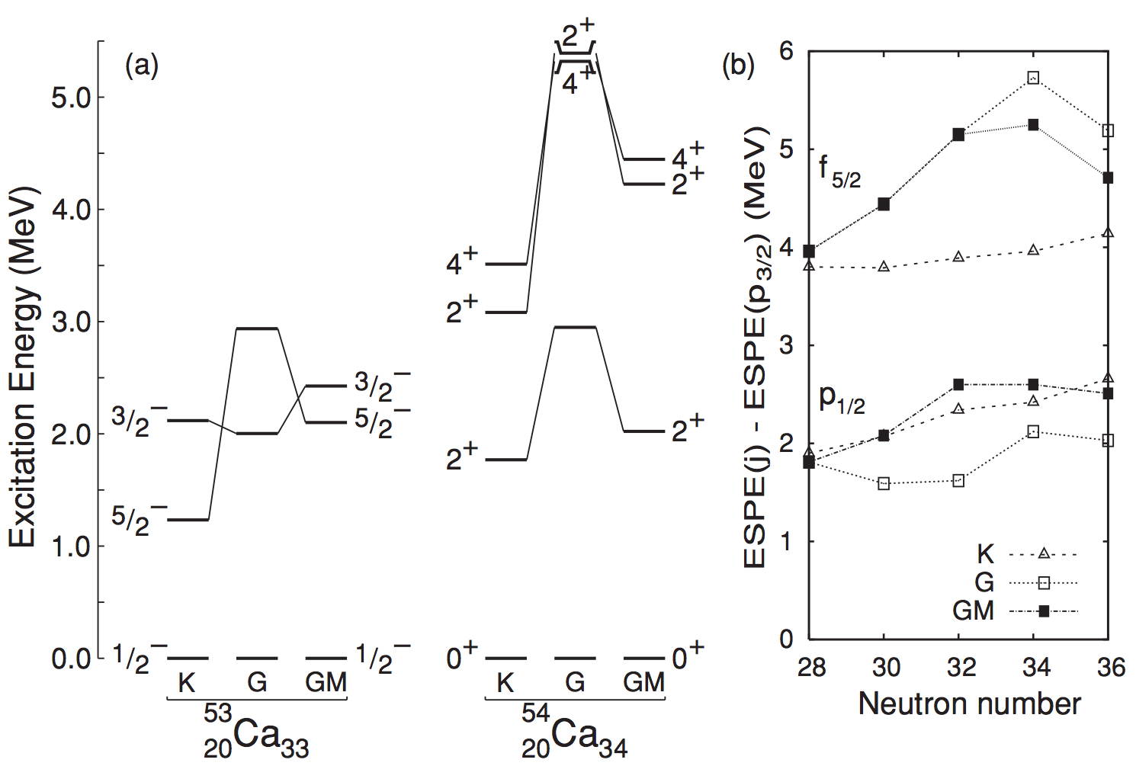
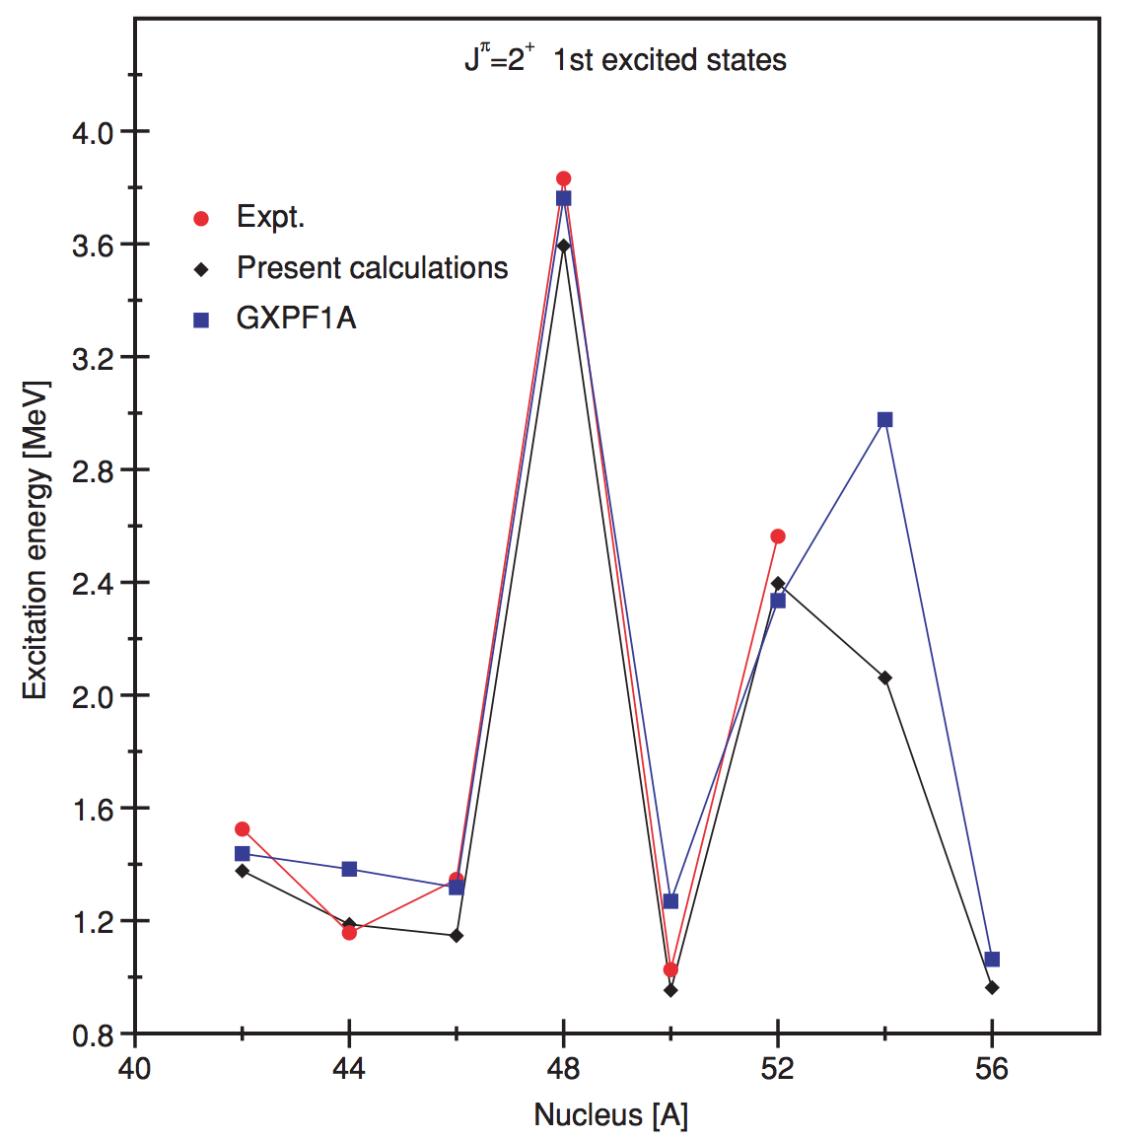
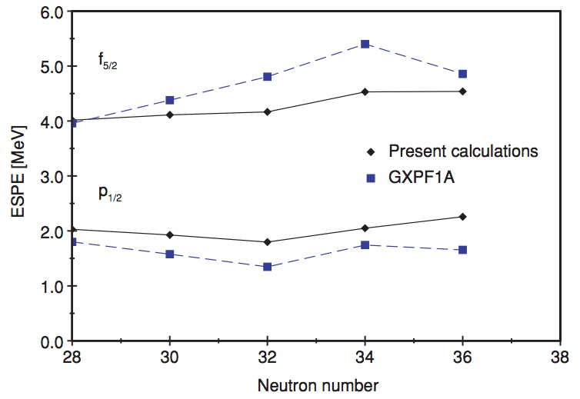
Theory: SM calculations continued…
Much effort on the theoretical side over recent years, for example:
M. Rejmund et al., Phys. Rev. C 76 (2007) 021304(R)
Based on a modified GXPF1A interaction to reproduce experimental states in ⁵⁰Ca
L. Coraggio et al., Phys. Rev. C 80 (2009) 044311
Based on a realistic effective interaction
INPC 2013
Slide 12/15

Slide 13
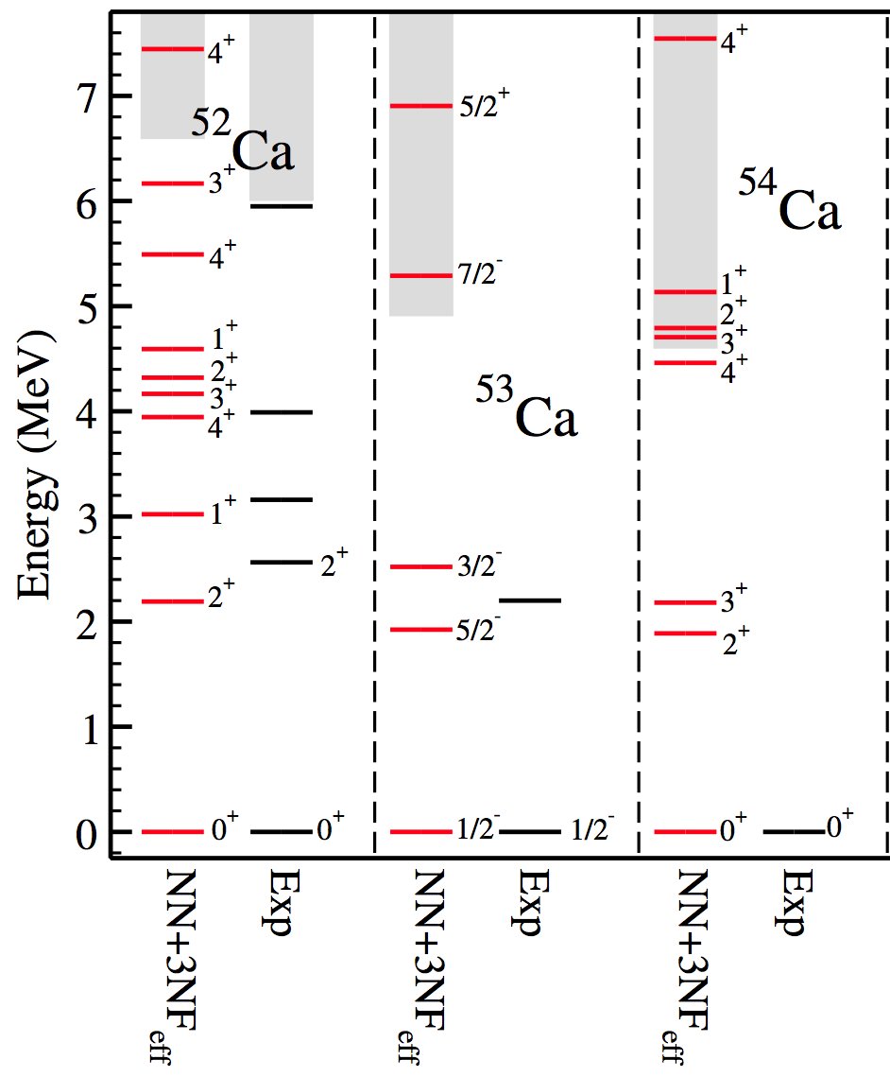
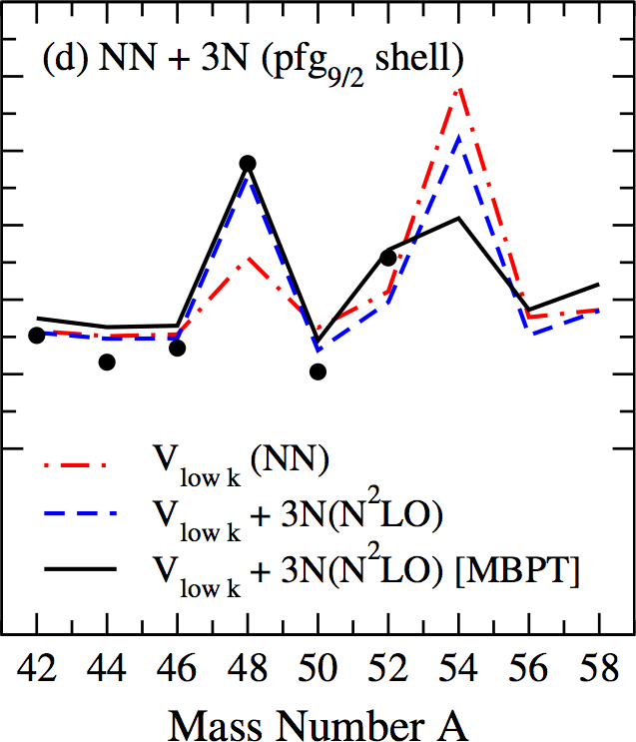
Theory: SM calculations continued…
Chiral EFT and effects of three-nucleon forces, for example:
G. Hagen et al., Phys. Rev. Lett. 109 (2012) 032502
J. D. Holt et al., J. Phys. G: Nucl. Part. Phys. 39 (2012) 085111
Present study
6
4
Previous results
2
(3⁻)
0
(3/2⁻)
(2⁺)
(5/2⁻)
INPC 2013
Slide 13/15

Slide 14
Spectroscopy of Ca isotopes: Summary
Performed in-beam γ-ray spectroscopy with an high-intensity ⁷⁰Zn beam at the RIBF to investigate the strength of the N = 34 subshell gap in exotic Ca isotopes
Strong candidate for the first 2⁺ state in ⁵⁴Ca at 2043(19) keV, giving first direct evidence for a significant subshell closure at N = 34
Despite lower 2⁺ energy, SM calculations with modified GXPF1B Hamiltonian indicate an effective single-particle energy gap at N = 34 for ⁵⁴Ca of similar magnitude to the N = 32 gap in ⁵²Ca
Transitions in ⁵³Ca support this conclusion, though firm spin-parity assignments for the ground state and the two excited states are desired
INPC 2013
Slide 14/15

Slide 15







Thanks for your attention
D. Steppenbeck,¹ S. Takeuchi,² N. Aoi,³ H. Baba,² N. Fukuda,² S. Go,¹
P. Doornenbal,² M. Honma,⁴ J. Lee,² K. Matsui,⁵ M. Matsushita,¹ S. Michimasa,¹
T. Motobayashi,² D. Nishimura,⁶ T. Otsuka,^{1,5} H. Sakurai,^{2,5} Y. Shiga,⁶
P.-A. Söderström,² T. Sumikama,⁷ H. Suzuki,² R. Taniuchi,⁵
J. J. Valiente-Dobón,⁸ H. Wang^{2,9} and K. Yoneda²
¹Center for Nuclear Study, University of Tokyo, 2-1, Hirosawa, Wako, Saitama 351-0198, Japan
²RIKEN Nishina Center, 2-1, Hirosawa, Wako, Saitama 351-0198, Japan
³Research Center for Nuclear Physics, Osaka University, Osaka 567-0047, Japan
⁴Center for Mathematical Sciences, University of Aizu, Aizu-Wakamatsu, Fukushima 965-8580, Japan
⁵Department of Physics, University of Tokyo, Bunkyo, Tokyo 113-0033, Japan
⁶Department of Physics, Tokyo University of Science, Tokyo 278-0022, Japan
⁷Department of Physics, Tohoku University, Aramaki, Aoba, Sendai 980-8754, Japan
⁸Legnaro National Laboratory, Legnaro 35020, Italy
⁹Department of Physics, Beijing University, Beijing 100871, People’s Republic of China
INPC 2013
Slide 15/15

