Slide 1

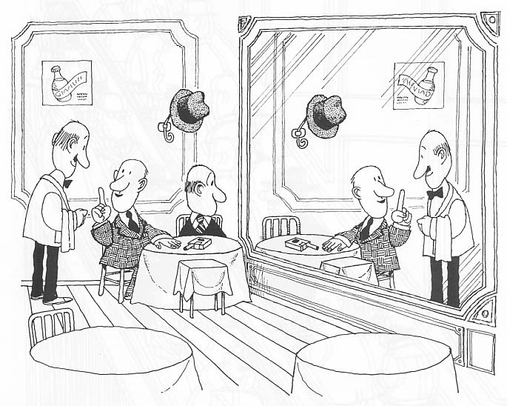

Mirror Symmetry
Nuclear structure of neutron-rich nuclei around N=40
Silvia M. Lenzi
Department of Physics and Astronomy “Galileo Galilei”
University of Padua and INFN
Silvia Lenzi
University of Padova and INFN

Slide 2
The physics of neutron-rich nuclei
How does the shell structure change far from stability?
How do new regions of deformation develop at “magic” numbers?
How does the effective interaction describe shape evolution and
shape coexistence?
New dynamical symmetries or new shapes?
Connection with Astrophysics

Slide 3
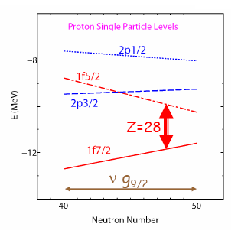
The effective interaction
A multipole expansion
monopole
Multipole
represents a spherical mean field extracted
from the interacting shell model
- determines the single particle energies or ESPE
Deformation
correlations
energy gains

Slide 4
Interplay: Monopole and Multipole
The interplay of the monopole with multipole terms,
like pairing and quadrupole, determines the different phenomena we observe.
In particular, far from stability new magic numbers appear and new regions of deformation develop giving rise to
new phenomena such as islands of inversion, shape phase transitions, shape coexistence, haloes, etc.

Slide 5
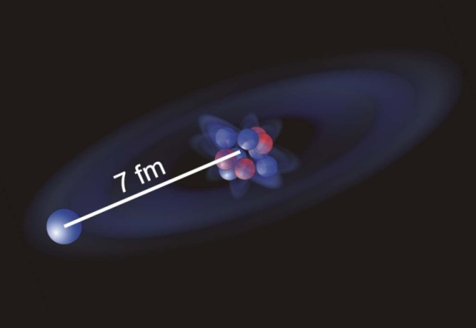
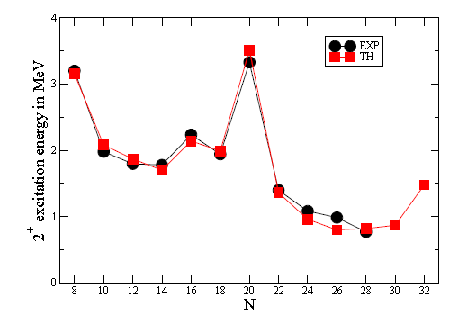
The islands of inversion (N=8,20,28)
At N=8 and N=20 the h.o. shell gap
vanishes for very neutron rich nuclei.
N=8
Deformed intruder configurations fall below the spherical ones
N=20
Si
N=28
Island of
inversion
⁴²Si
T. Otsuka EPJ S. Top. 156, 169 (2008)
A. Poves, 2011

Slide 6
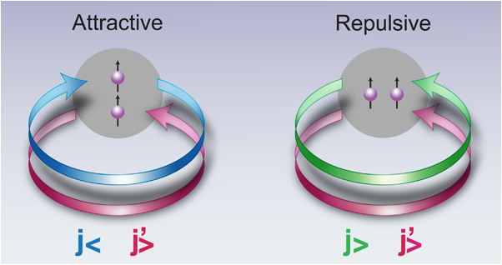
Neutron excess and shell migration
νg_{9/2}
Monopole shifts
40
νf_{5/2}
νp_{1/2}
32
νp_{3/2}
neutrons
πf_{7/2}
A new Island of Inversion
appears at N=40
protons
0g_{9/2}
0g_{9/2}
Z = 28
40
Z = 20
0f_{5/2}
0f_{5/2}
1p_{1/2}
32
1p_{1/2}
1p_{3/2}
1p_{3/2}
28
28
0f_{7/2}
0f_{7/2}
0f_{7/2}
0f_{7/2}
protons
neutrons
protons
neutrons

Slide 7
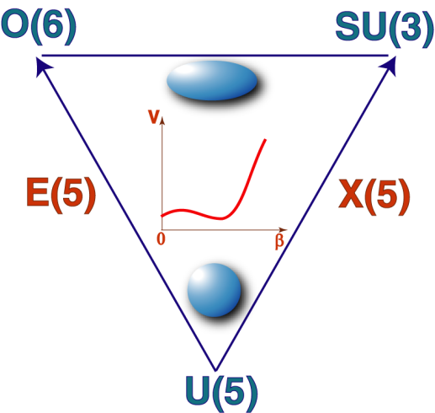
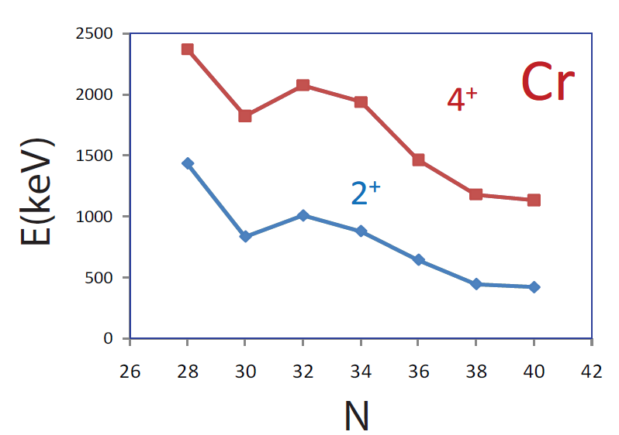
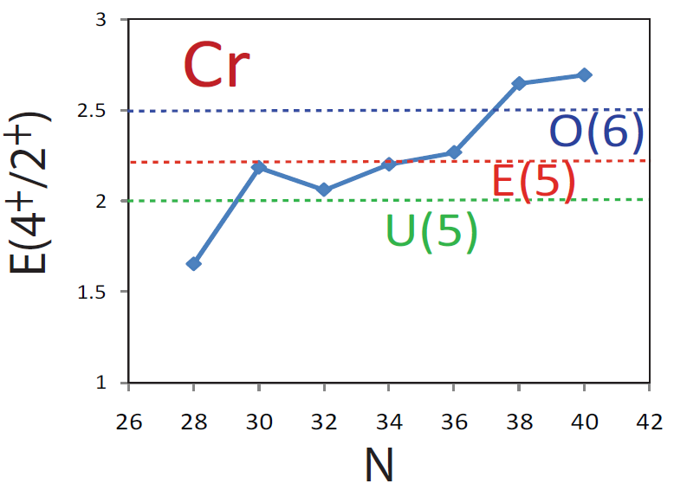

Shape changes along isotopic chains
⁵⁸Cr
⁶⁴Cr
⁵⁶Cr
We populate these nuclei with different experimental methods
Beta decay: O. Sorlin et al., EPJA 16, 55 (2003)
Multinucleon transfer: N. Marginean et al., PLB 633, 696 (2006)
S. Zhu et al., PRC 74, 064315 (2006)
(p,p.): N. Aoi et al., PRL 102 012502 (2009)
Inelastic scattering: A. Gade et al., PRC 81, 051304(R) (2010)
Recent plunger experiment at MSU to measure the lifetimes and test the E(5).

Slide 8
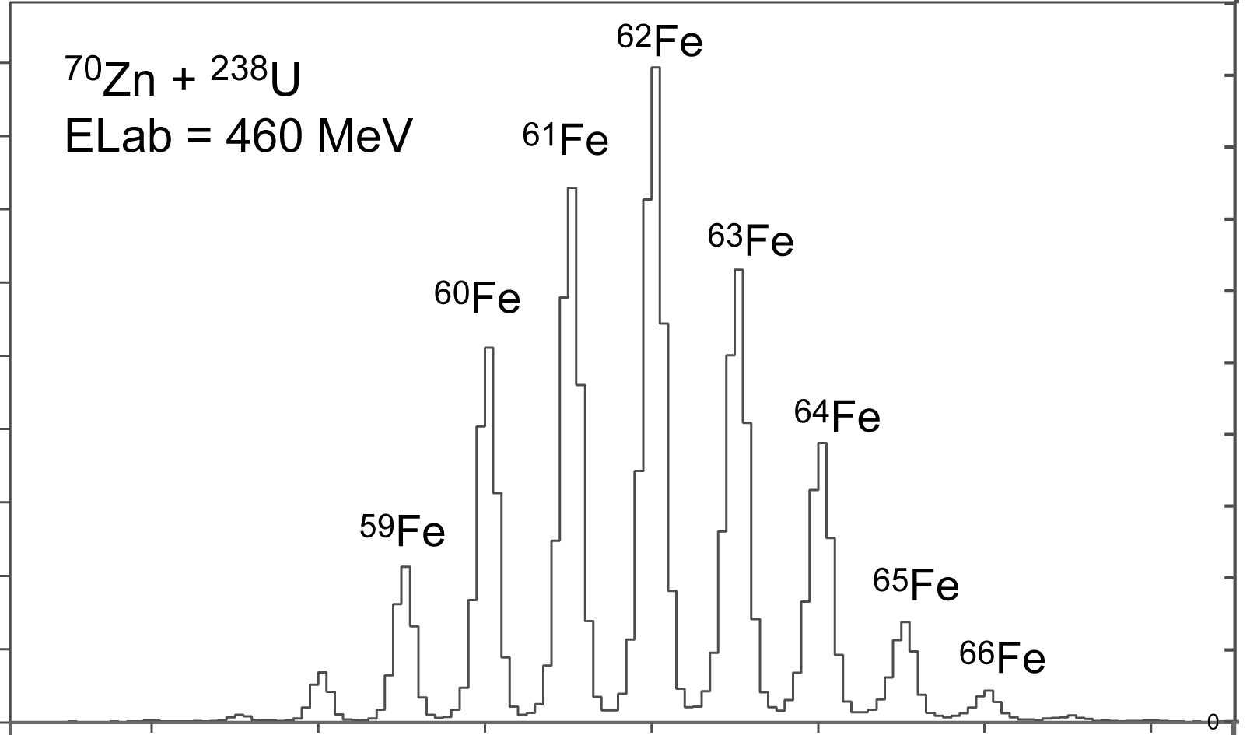
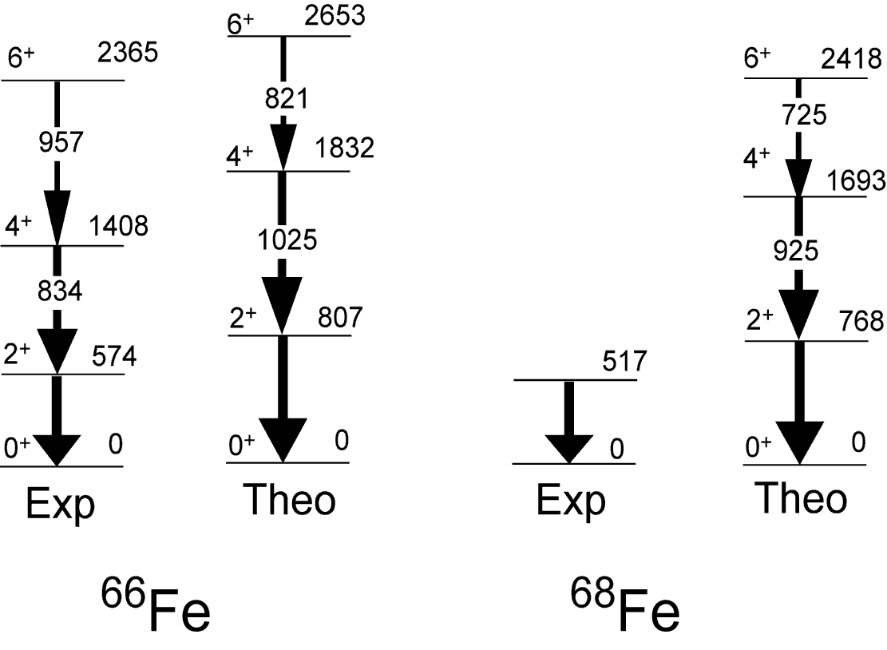
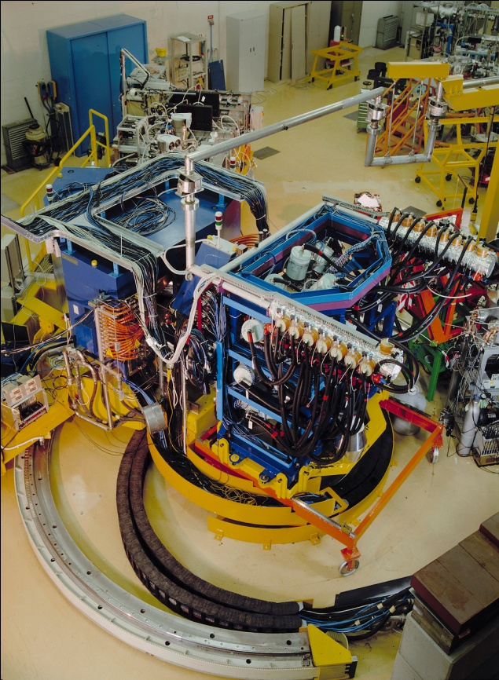
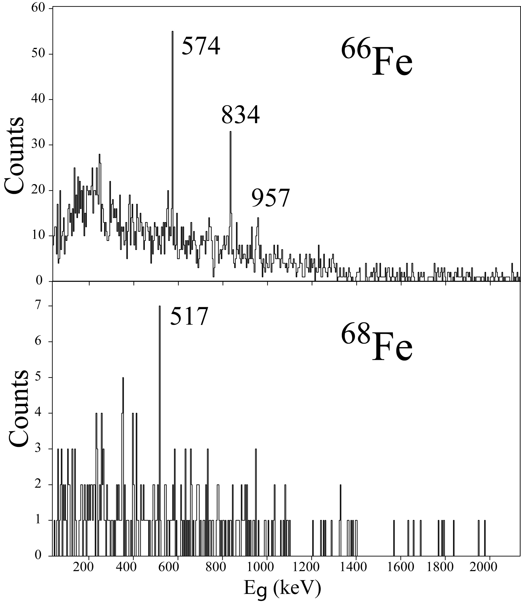
At and beyond N=40
g_{9/2}
N=40
40
fp
Prisma
N=42
Clara
SML et al.,
LNL Ann. Rep. 2008
The fpg model space is not able to reproduce the increase of
collectivity of Cr and Fe isotopes approaching N=40

Slide 9
Islands of inversion and symmetries
¹²Be₈
N=2
Islands of Inversion at the magic numbers can be understood in terms of symmetries
d_{5/2}
s_{1/2}
quasi
SU3
8
p
pseudo
SU3
N=1
⁶⁴Cr₄₀
N=4
d_{5/2}
g_{9/2}
quasi
SU3
³²Mg₂₀
N=3
p_{3/2}
f_{7/2}
quasi
SU3
40
20
pf
pseudo
SU3
sd
pseudo
SU3
N=2
N=3
A.P. Zuker et al., PRC 52 (1995)

Slide 10

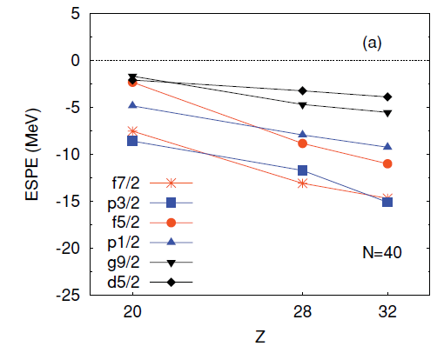
Deformation and SM in the fpgd space
LNPS interaction: renormalized realistic interaction
+ monopole corrections
⁴⁸Ca core
protons: full pf shell
neutrons: p_{3/2},f_{5/2}, p_{1/2}, g_{9/2}, d_{5/2}
N=40
d_{5/2}
fp-gds gap
g_{9/2}
40
f_{5/2}
p_{1/2}
p_{3/2}
f_{7/2}
28
28
π
⁴⁸Ca
ν
Note: the ground-state deformation properties result from the total balance between the monopole and the correlation energies
SML, F. Nowacki, A. Poves and K. Sieja
(LNPS), PRC 82, 054301 (2010)

Slide 11
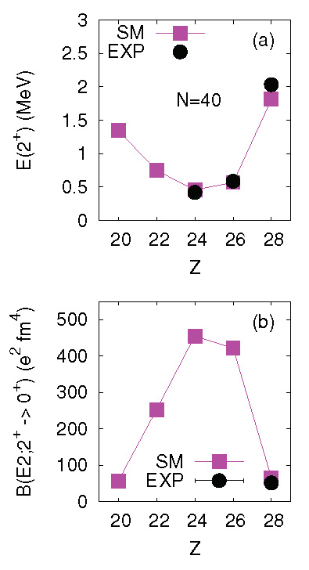
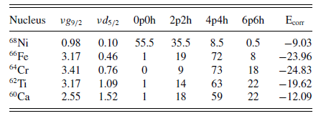
The N=40 isotones
A change of structure is
observed along the isotonic
chain in good agreement
with the available data
Occupation of intruder orbitals and
percentage of p-h in g.s. configurations
B(E2;2⁺→0⁺)
LNPS, PRC 82, 054301 (2010)

Slide 12
Shape coexistence in ⁶⁷Co and ⁶⁸Ni
⁶⁷Co
2273
(9/2⁻)
The deformation driven by the neutrons induces a reduction of the Z=28 gap and gives rise to a deformed low-lying 1/2- state
(11/2⁻)
1613
680
(3/2⁻,5/2⁻)
491
(1/2⁻)
(7/2⁻)
F. Recchia et al., PRC 85, 064305 (2012)
D. Pauwels et al., PRC 78, 041307 (2008)
and PRC 79, 044309 (2009)
The LNPS interaction is able
to reproduce these structures

Slide 13
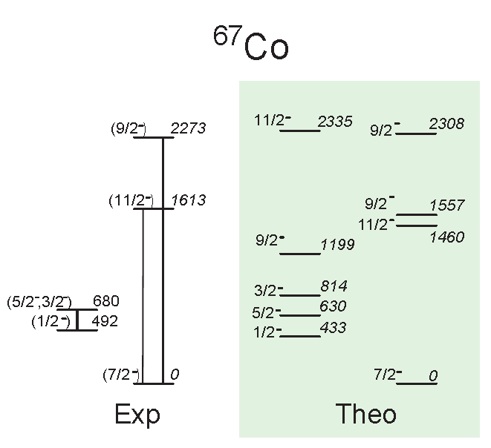
Shape coexistence in ⁶⁷Co
⁶⁸Ni
Up to 11p-11h excitations across
the N=40, Z=28 gap
0₃⁺
~2200
2⁺
2034
the largest
B(E2) in the
region
0⁺
F. Recchia et al., PRC 85, 064305 (2012)

Slide 14
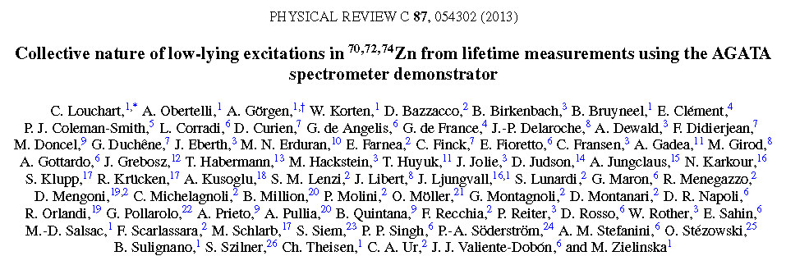
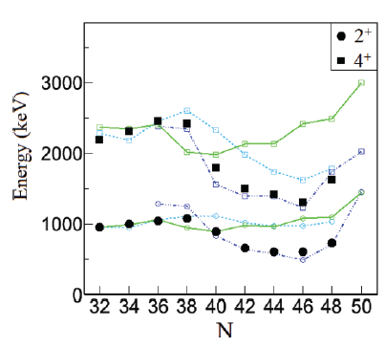
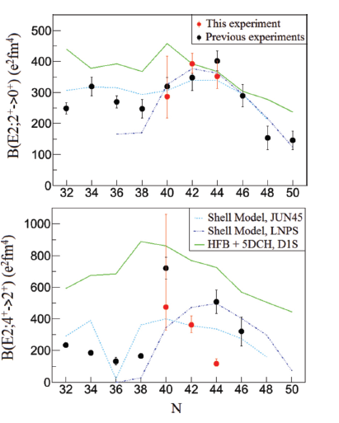

Beyond Z=28: Zn isotopes with AGATA at LNL
Lifetimes obtained with the
RDDS method
LNPS calculations in very good
agreement for the energies
and B(E2)
Energy
B(E2)
HFB*
2+→0+
LNPS
4⁺
fpg
fpg
LNPS
2⁺
HFB*
4+→2+

Slide 15
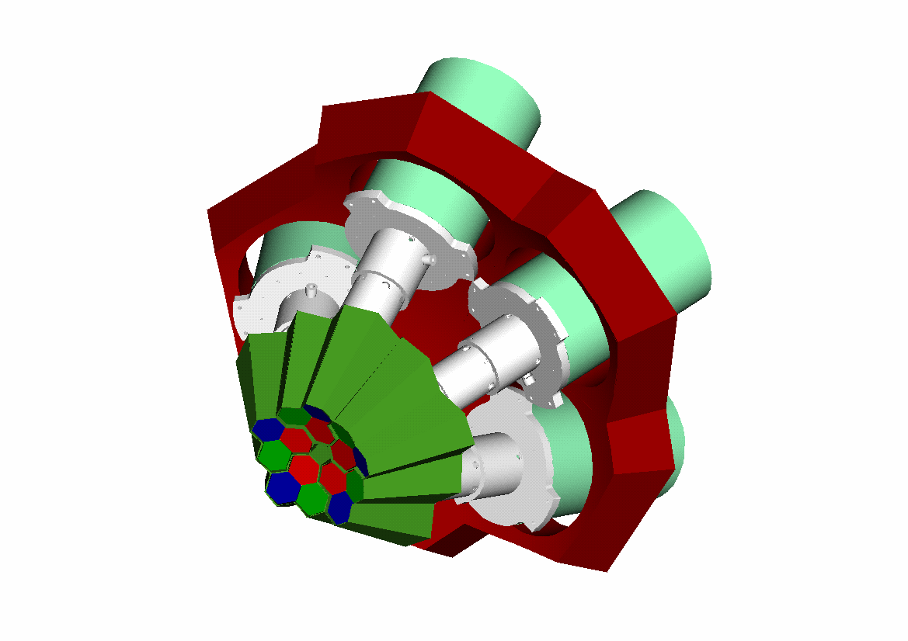
AGATA Demonstrator at PRISMA
Conclusions
The mass region south of ⁶⁸Ni shows a development of collectivity
towards N=40 with rapid changes of shape along the isotopic chains.
A candidate for critical point of the shape phase transition, shape coexistence phenomena and the development of an Island of Inversion are observed experimentally for Z<28.
The clover array CLARA is now replaced with the AGATA demonstrator
  5 triple-clusters
  36-fold segmented crystals
  540 segments
The LNPS effective interaction in the fpgd space is able to describe
these rapid changes of structure along isotopic and isotonic chains.
The model gives also a very good description of isotopes above Z=28.
The large amount of data becoming available from the different
experimental facilities, with particular regard to the transition probability measurements, will be a stringent test for these theoretical predictions.

Slide 16
Thanks to
Theory:
F. Nowacki, A. Poves, K. Sieja
Experiments:
F. Recchia, S. Lunardi, D. Bazzacco, E. Farnea, N. Marginean, J.J. Valiente-Dobon, A. Gadea, D.R. Napoli, G. de Angelis, D. Mengoni, R. Orlandi, A. Bracco, G. Benzoni, S. Leoni, B. Million, O. Wieland, J. Wrzesinski et al.
H. Crawford, A.O. Macchiavelli et al.
T. Baugher, A. Gade et al.
C. Louchart, A. Obertelli et al.

