Slide 1
Neutron Skin Thickness of 208Pb
and Constraints on Symmetry Energy
Atsushi Tamii
Research Center for Nuclear Physics (RCNP)
Osaka University, Japan
I.Poltoratska, P. von Neumann-Cosel
and RCNP-E282 Collaboration
INPC2013, June 2-7, 2013, Firenze

Slide 2
Contents
Symmetry Energy, Neutron Skin,
and Electric Dipole Response of ²⁰⁸Pb
Experimental Method
proton inelastic scattering from ²⁰⁸Pb
Results

Slide 3
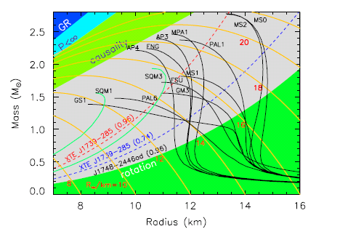
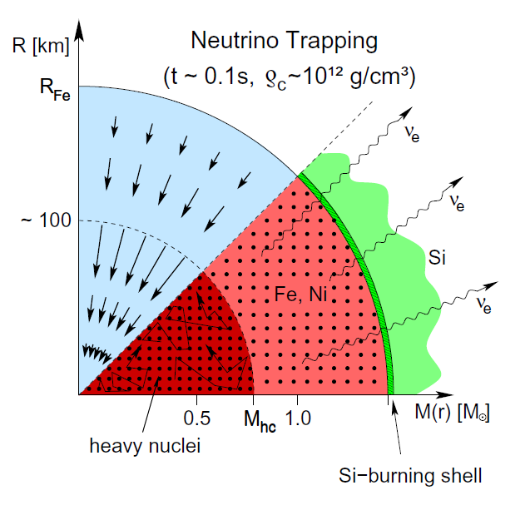
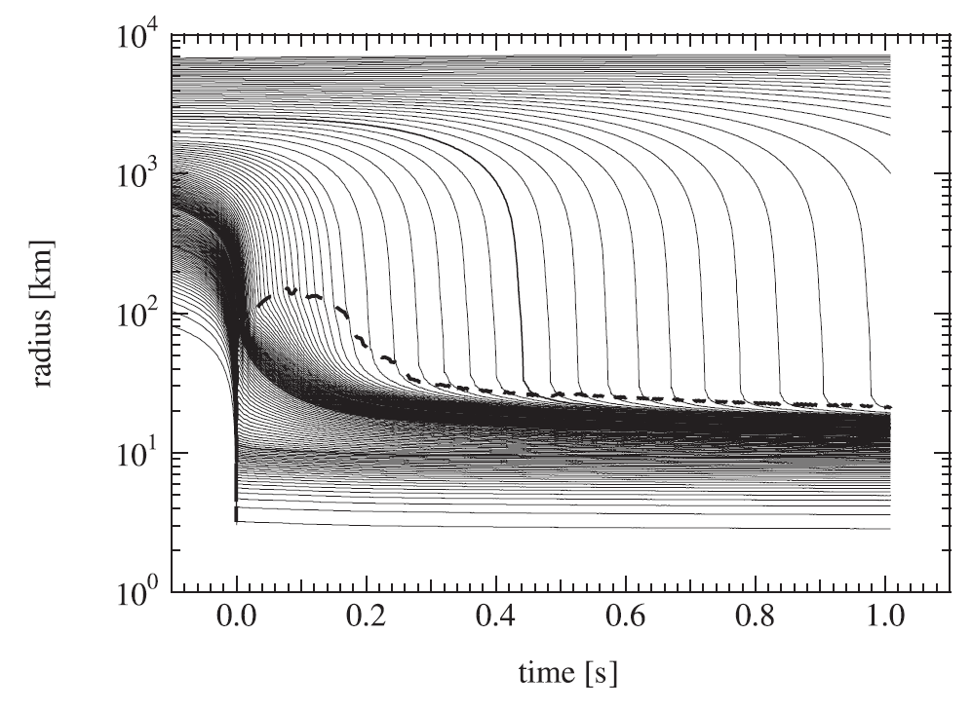

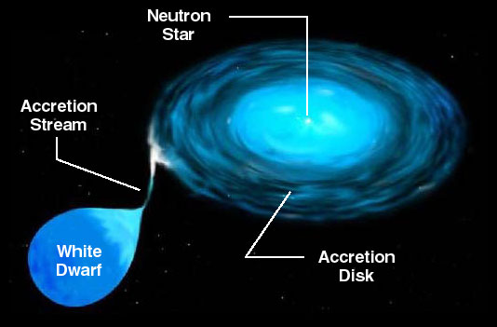
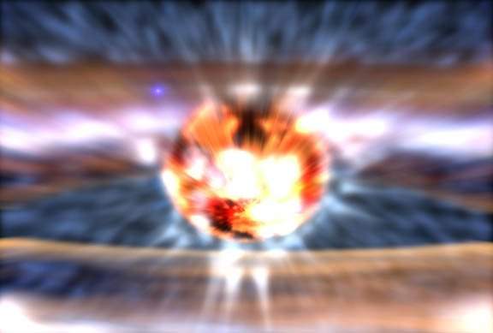
Determination of the Symmetry Energy Term in EOS.
Core-Collapse Supernova
Neutron Star Mass and Radius
K. Sumiyoshi, Astrophys. J. 629, 922 (2005)
Nucleosynthesis
Langanke and Martinez-Pinedo
Neutron Star Cooling
Lattimer et al., Phys. Rep. 442, 109(2007)
Neutron Star Structure
Accreting neutron star/white dwarf,
X-Ray burst, Superburst
http://www.astro.umd.edu/~miller/nstar.html

Slide 4
Nuclear Equation of State (EOS)
EOS for Energy per nucleon
Saturation Density
~0.16 fm⁻³
Symmetry energy
K_{sym} is discussed from studies of e.g. isoscalar giant monopole resonances (ISGMRs).
Determination of L is becoming important.
L: Slope Parameter
(Baryonic Pressure)

Slide 5
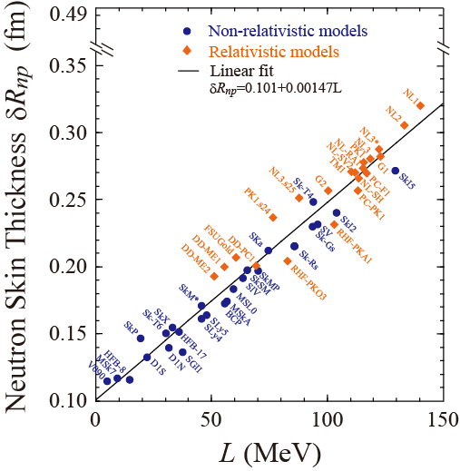
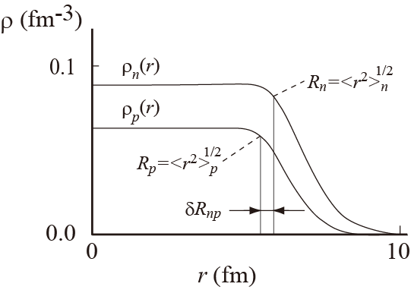
Neutron Skin and the Density Dependence of the Symmetry Energy
X. Roca-Maza et al., PRL106, 252501 (2011)
Density distribution of protons and neutrons in a nucleus
Neutron density
Proton density
Neutron skin thickness
Neutron rms radius
Proton rms radius
Density dependence of the symmetry energy

Slide 6
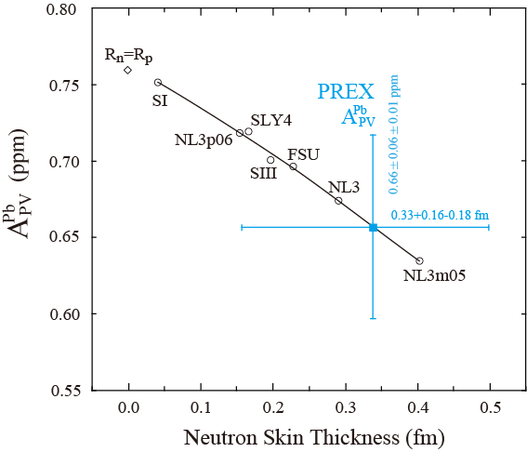
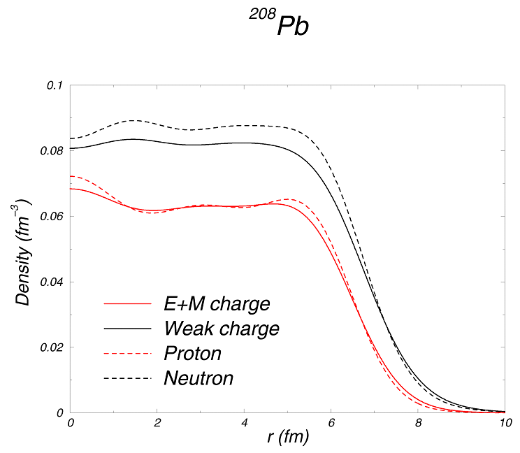
PREX at J-Lab: Z⁰ of weak interaction : sees the neutrons
Neutron Skin Thickness Measurement by Electroweak Interaction
 | p | n
Electric charge | 1 | 0
Weak charge | 0.08 | 1
Parity Violating Asymmetry
C.J. Horowitz
S. Abrahamyan et al., PRL108, 112502 (2012)
Model independent determination of the neutron skin thickness
Notes:
6

Slide 7
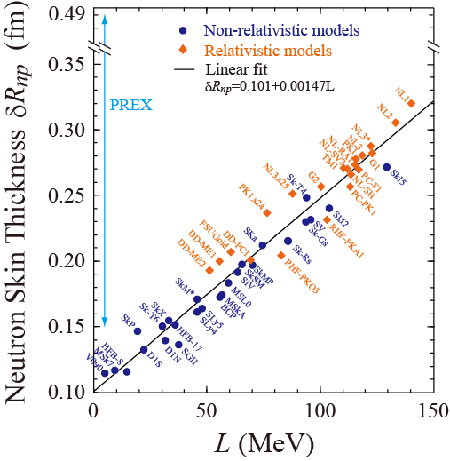
Neutron Skin Thickness Measurement by Electroweak Interaction
PREX
PREX Result: S. Abrahamyan et al.,
PRL108, 112502 (2012)
Theor. Calc.: X. Roca-Maza et al.,
PRL106, 252501 (2011)
The model independent determination of δR_{np} by PREX is quite important but the present accuracy is limited.

Slide 8
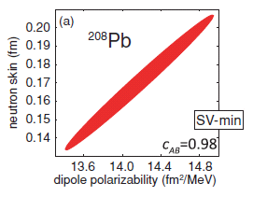
Neutron Skin Thickness Measurement
by Electromagnetic Interaction
Covariance analysis of energy density functional calculations with Skrym SV-min effective interaction.
P.-G. Reinhard and W. Nazarewicz, PRC 81, 051303(R) (2010).
Strong correlation between the (electric) dipole polarizability and the neutron skin of ²⁰⁸Pb

Slide 9
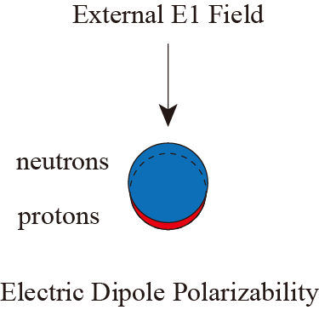
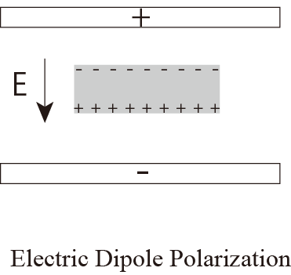
(Electric) Dipole Polarizability
Inversely energy weighted sum-rule of B(E1)

Slide 10

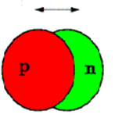
Electric Dipole (E1) Response
Particle （neutron） separation energy
E1 1⁻
oscillation of neutron skin against core?
oscillation between neutrons and protons
Low-Lying
Dipole Strength
core
neutron skin
(PDR)
g.s.
GDR
0
S_{n}
S_{p}
E1 response, PDR, and M1 of other nuclei
covered by P. von Neumann-Cosel (in this session)
PDR of a deformed nucleus, ¹⁵⁴Sm
NS115 poster by A. Krugmann
Notes:
10

Slide 11
Probing EM response of the target nucleus
Real Photon Measurements, NRF and (γ,xn)
Decay γ-rays or neutrons are measured.
Target Nucleus
Excited State
Missing Mass Spectroscopy with Virtual Photon
Insensitive to the decay channel.
Total strengths are measured.
Only the scattered protons are measured.
Select low momentum transfer (q~0) kinematical condition,
i.e. at zero degrees
Coulomb Excitation at 0 deg.
q,ω
EM Interaction is
well known
(model independent)
Target Nucleus
Excited State

Slide 12
Proton Inelastic Scattering at Forward Angles
An electromagnetic probe (Coulomb excitation)
High-resolution (20-30keV), high (~90%)/uniform efficiency
Covers a broad Ex of 5-25MeV
Insensitive to the decay property
Requires small amount of target (several mili-gram)
and a few days of beam time
Applicable to stable nuclei

Slide 13
Experimental Method
High-resolution polarized (p,p’) measurement
at zero degrees and forward angles

Slide 14
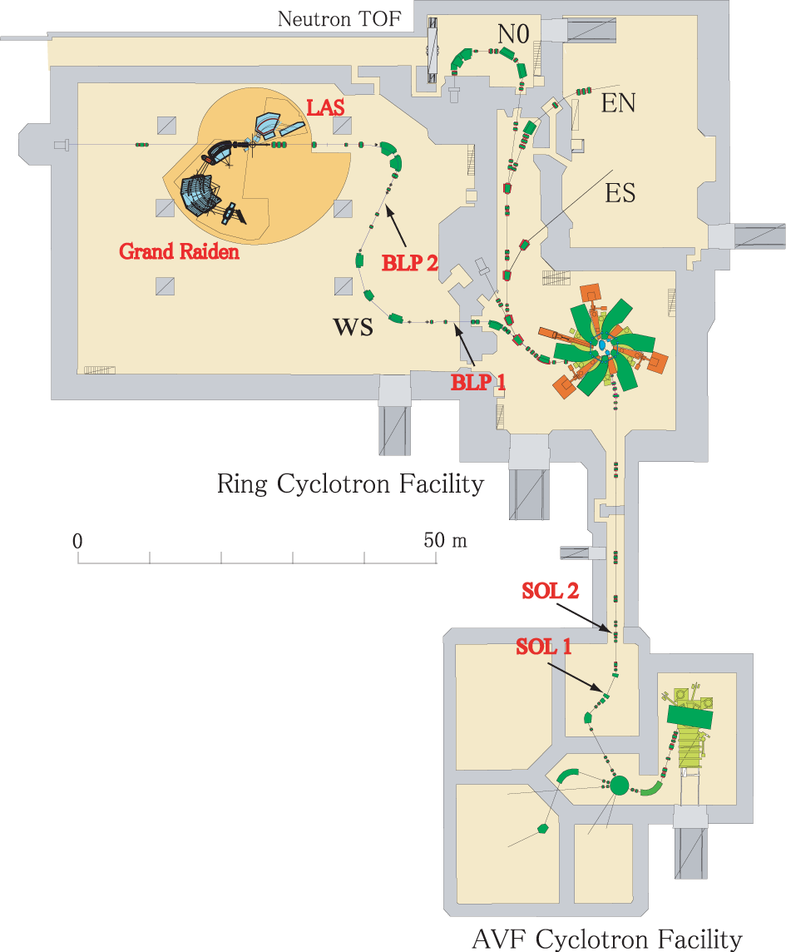
Research Center for Nuclear Physics,
Osaka Univ.
High-resolution
WS beam-line
(dispersion matching)
High-resolution Spectrometer
Grand Raiden

Slide 15
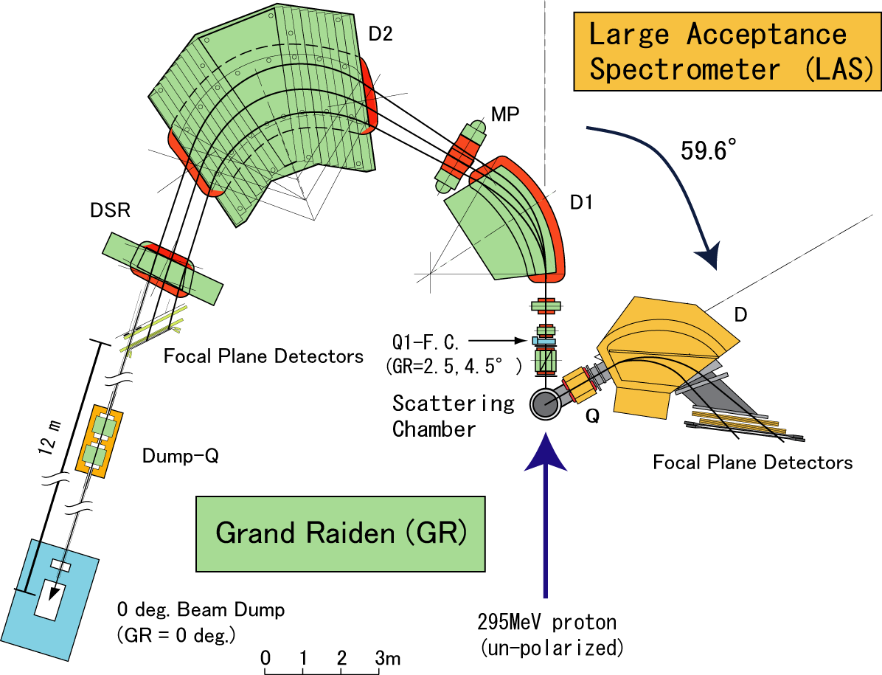
Spectrometers in the 0-deg. experiment setup
AT et al., NIMA605, 326 (2009)
As a beam spot monitor
in the vertical direction
Focal Plane Polarimeter
²⁰⁸Pb target: 5.2 mg/cm²
Dispersion Matching
Intensity : 1-8 nA
Polarized Proton Beam at 295 MeV

Slide 16
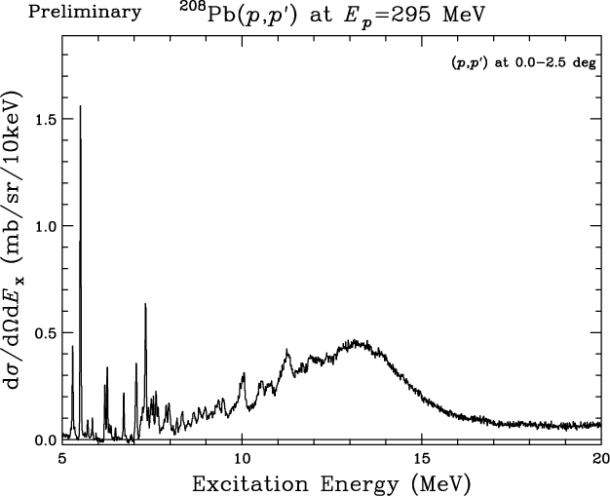
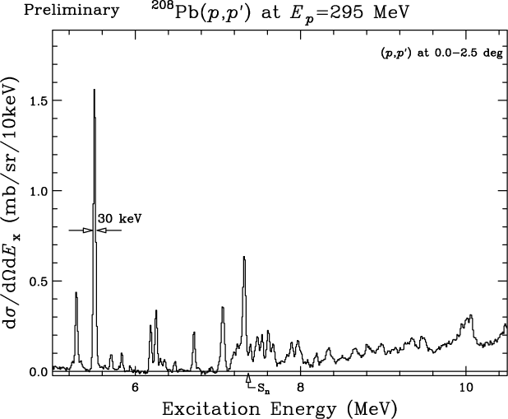

Slide 17
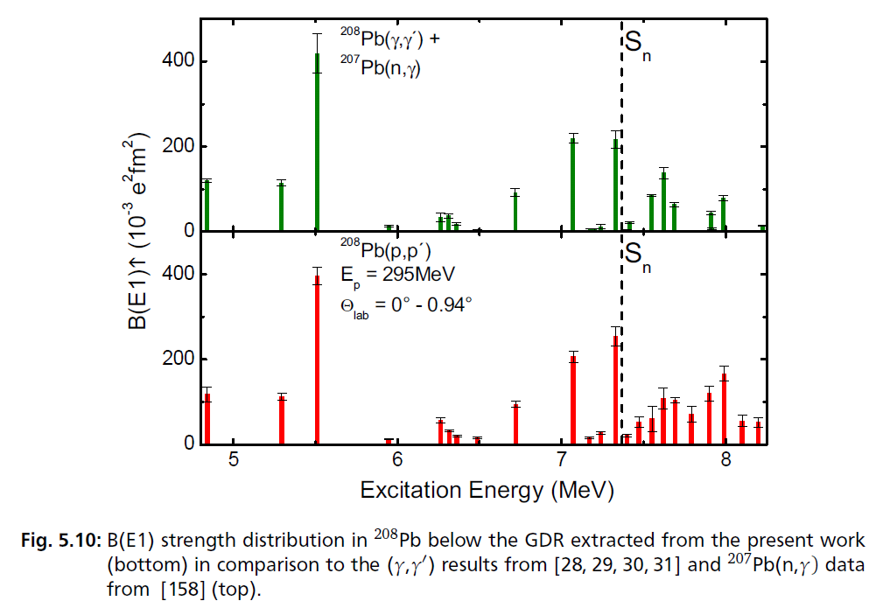
B(E1): low-lying discrete states
Excellent agreement between (p,p’) and (γ,γ’) below ~S_{n}
I. Poltoratska, PhD thesis

Slide 18
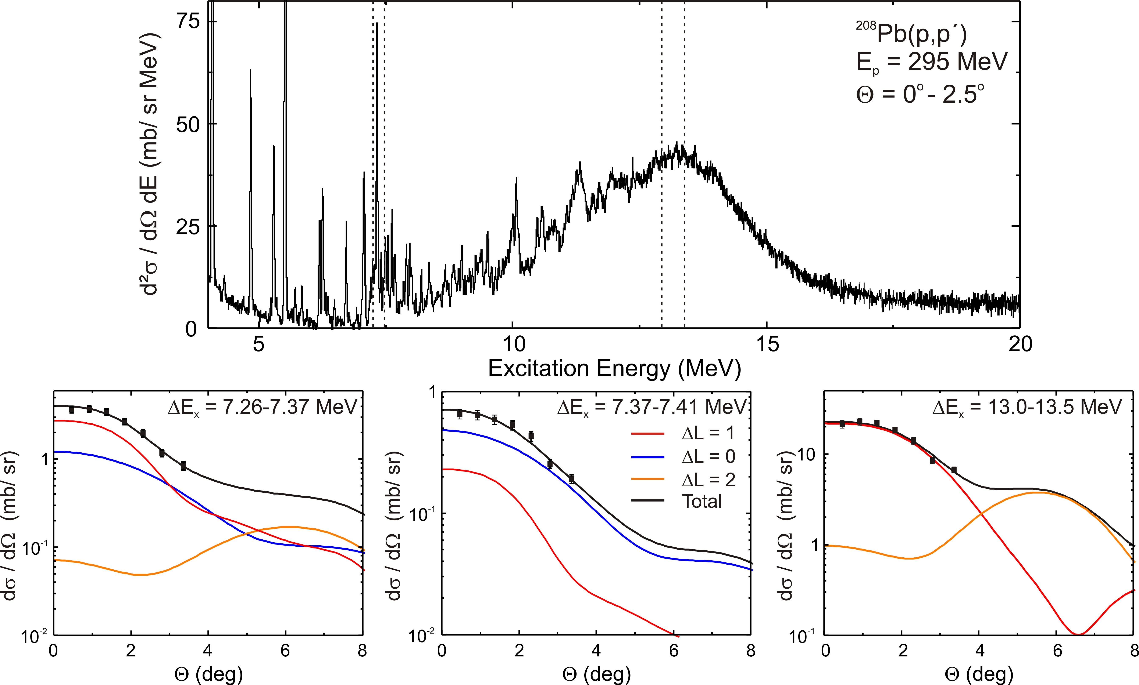
B(E1): continuum and GDR region
Method 1: Multipole Decomposition
Neglect of data for Θ>4: (p,p´) response too complex
Included E1/M1/E2 or E1/M1/E3 (little difference)

Slide 19
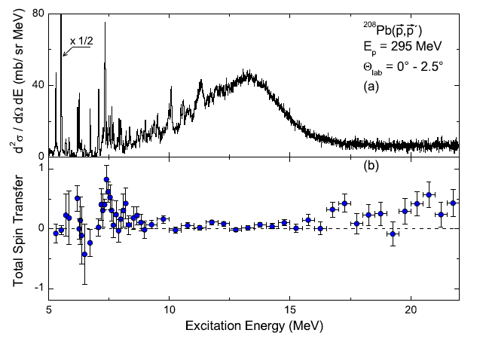
B(E1): continuum and GDR region
Method 2: Decomposition by Spin Observables
Polarization observables at 0°
spinflip / non-spinflip separation
model-independent
E1 and M1 decomposition
T. Suzuki, PTP 103 (2000) 859
M1
E1

Slide 20
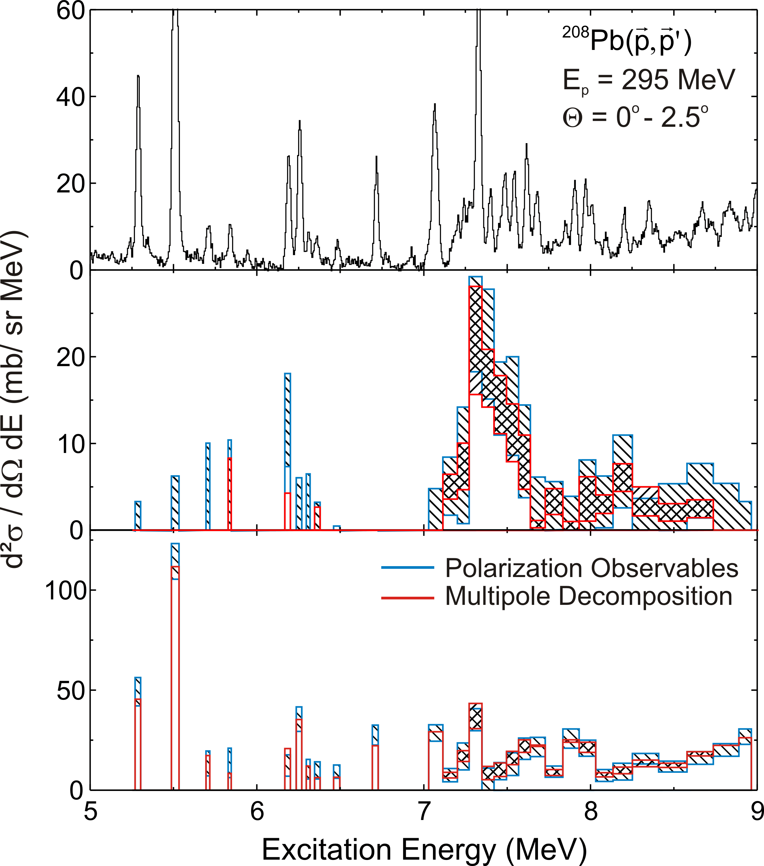
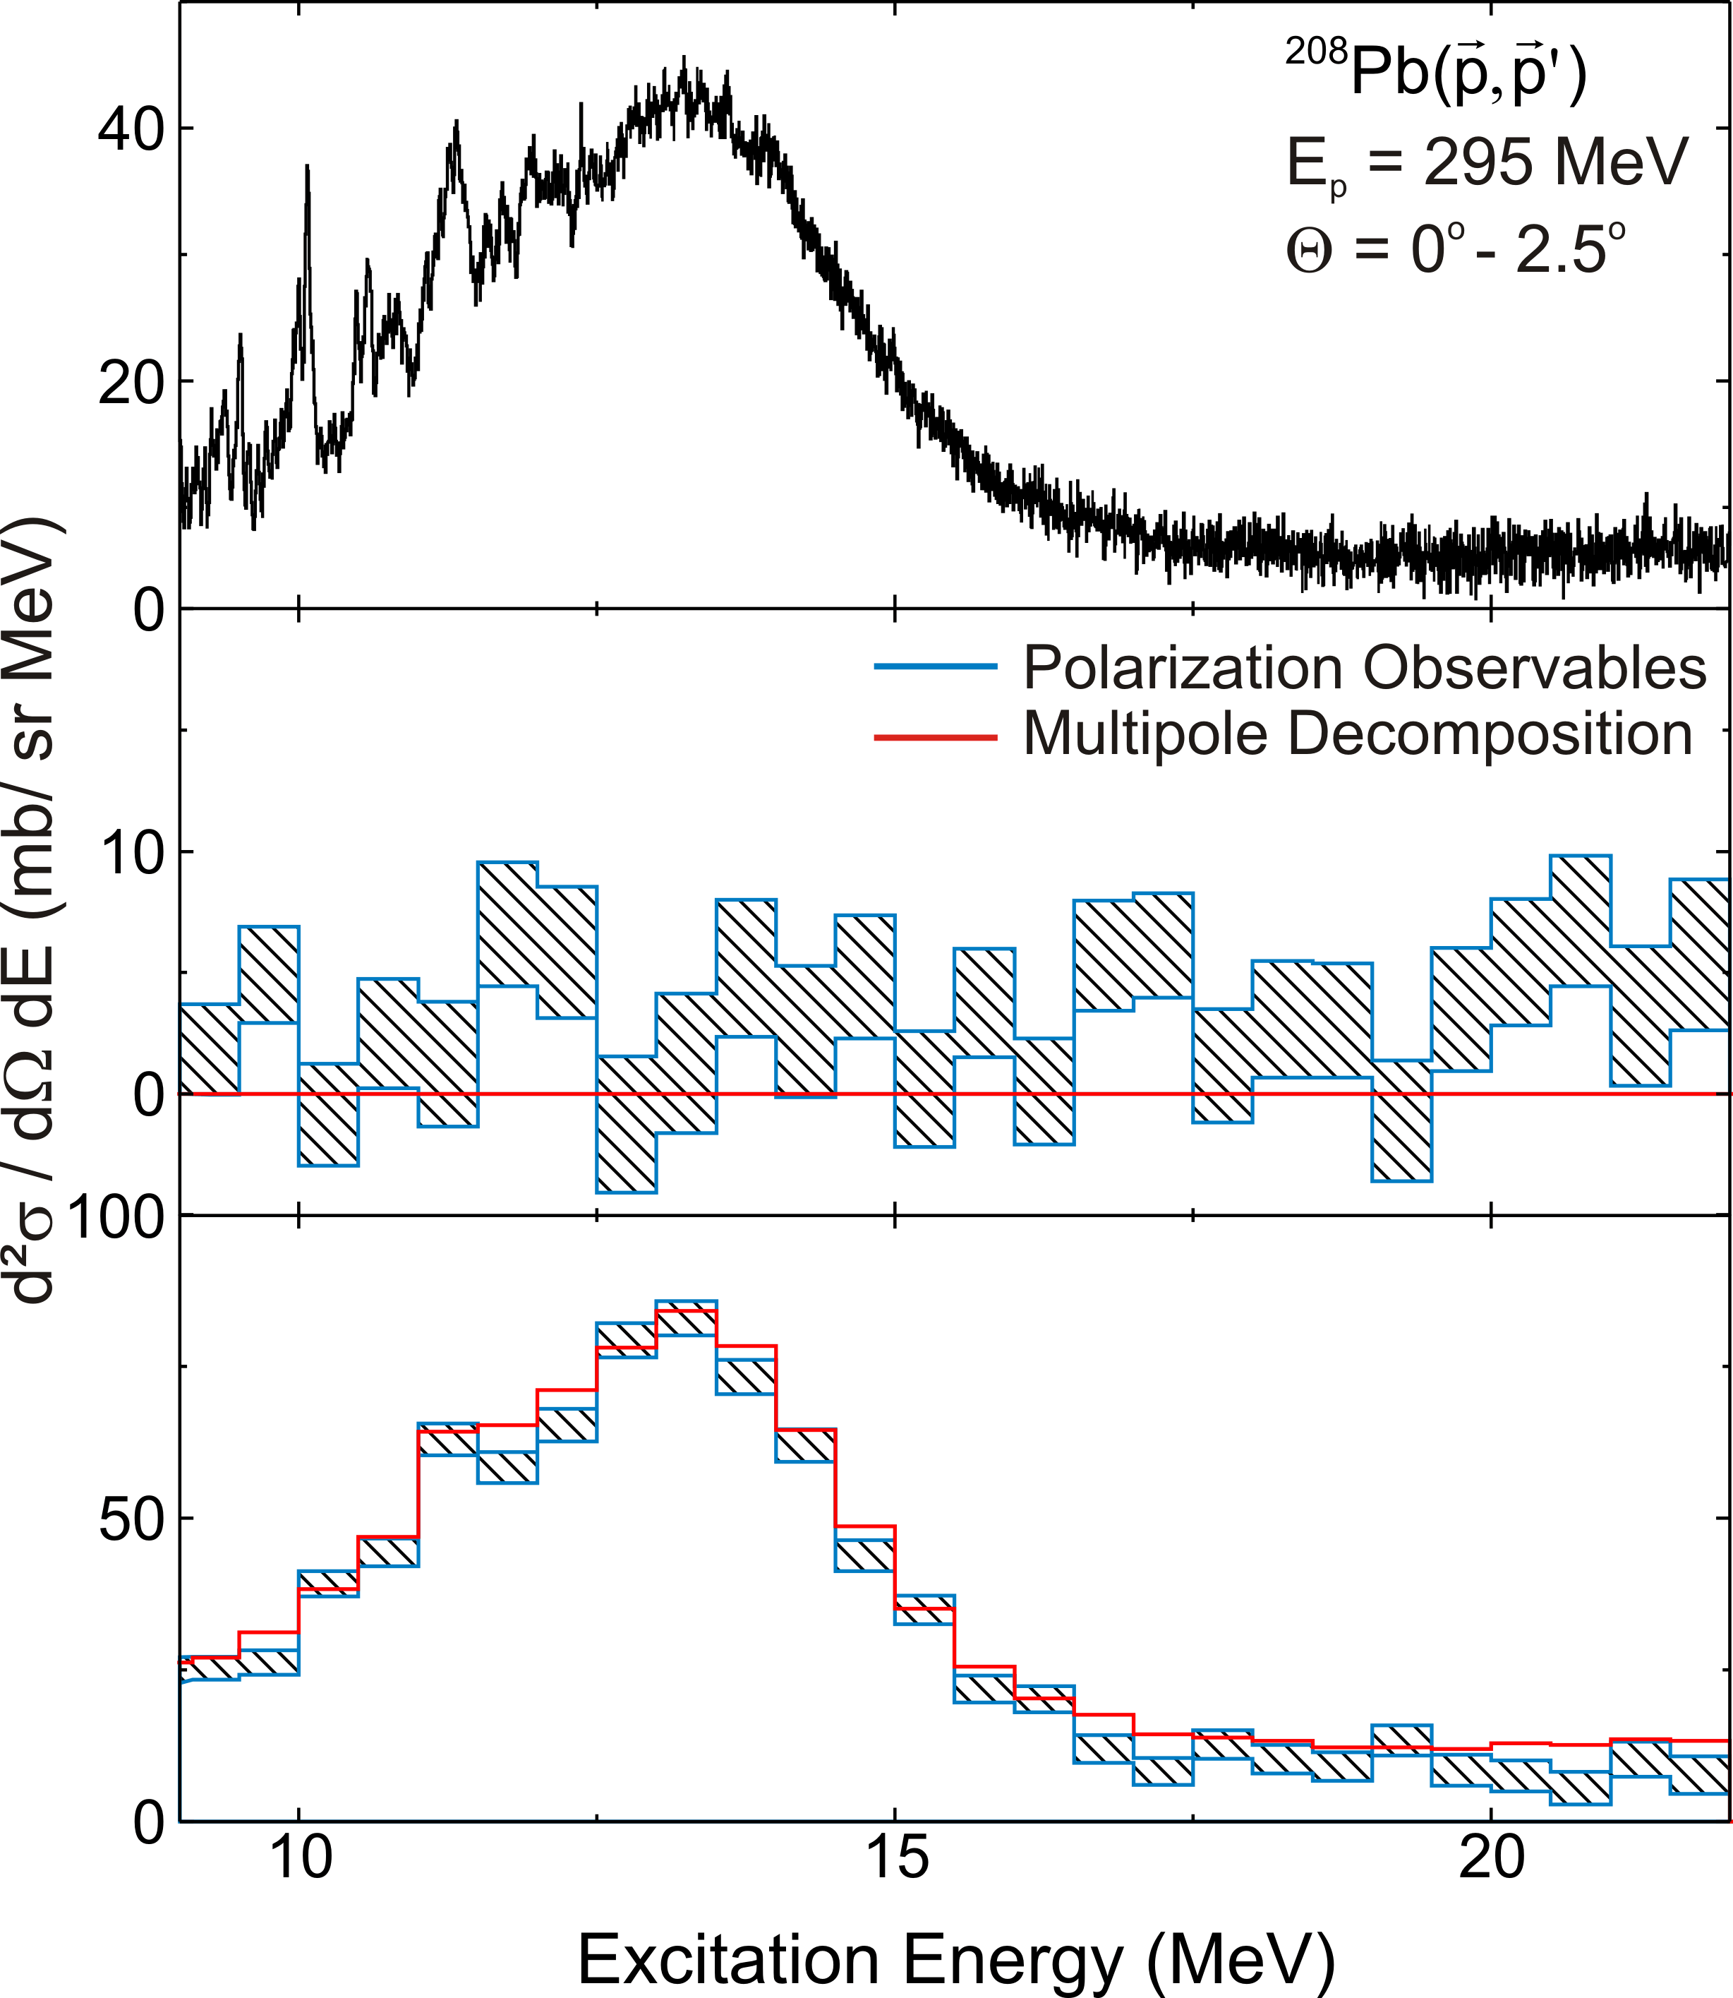
Comparison between the two methods
Total
ΔS = 1
ΔS = 0

Slide 21
Excellent agreement among three measurements
around the GDR bump region
I. Poltoratska, PhD thesis

Slide 22
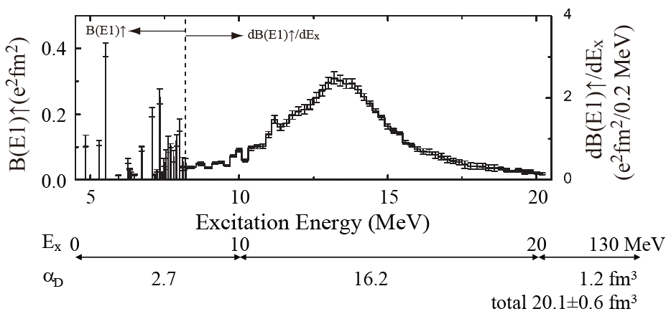
E1 Response of ²⁰⁸Pb and α_{D}
combined data
The dipole polarizability of ²⁰⁸Pb has been precisely determined.
AT et al., PRL107, 062502(2011)

Slide 23
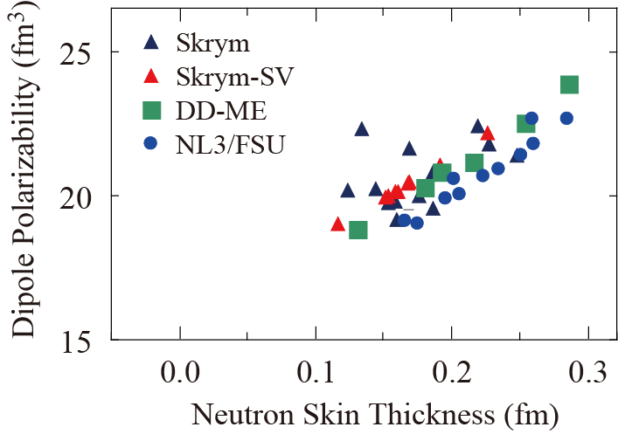
Correlation Between Dipole Polarizability
and Neutron Skin Thickness
J. Piekarewicz et al., PRC85, 041302(2012)

Slide 24
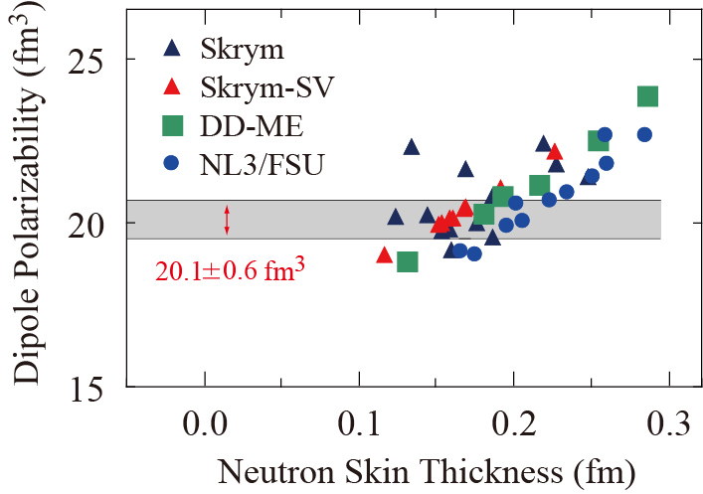
Correlation Between Dipole Polarizability
and Neutron Skin Thickness
Theoretical models can be much constrained if precise data on the neutron skin thickness is also available (but not).

Slide 25
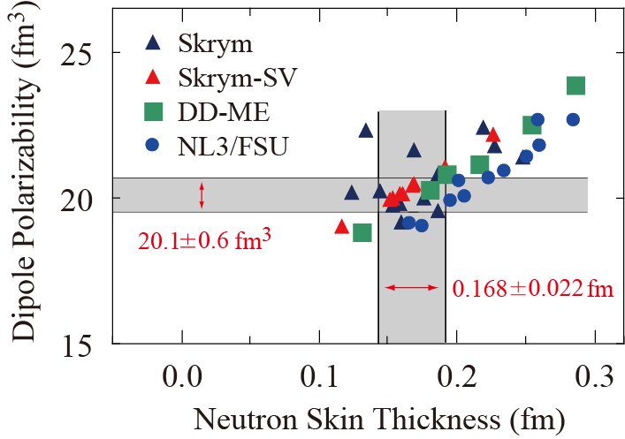
Correlation Between Dipole Polarizability
and Neutron Skin Thickness

Slide 26
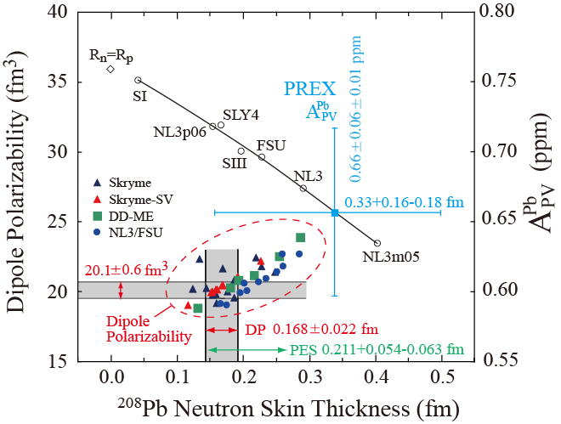
Neutron Skin Thickness Measurement
by Electromagnetic Interaction
PES: Proton Elastic Scattering, Zenihiro et al., PRC.

Slide 27
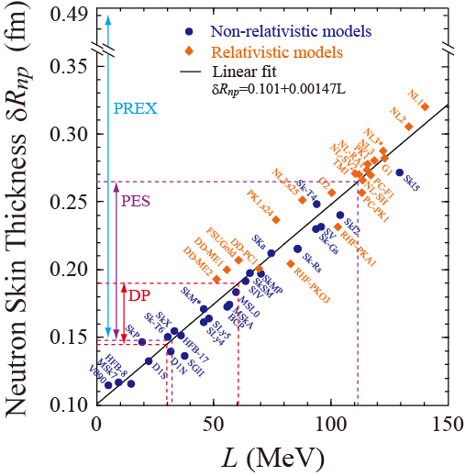
DP: Dipole Polarizability
L=46±15 MeV
Based on the work by X. Roca-Maza et al., PRL106, 252501 (2011)

Slide 28
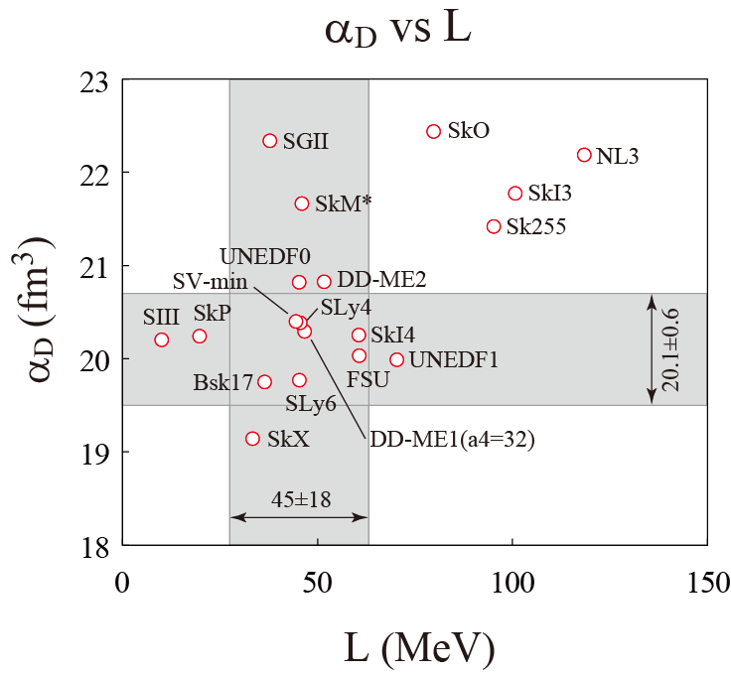

Determination of Symmetry Energy
Gaussian weight func.
L=45±18 MeV

Slide 29
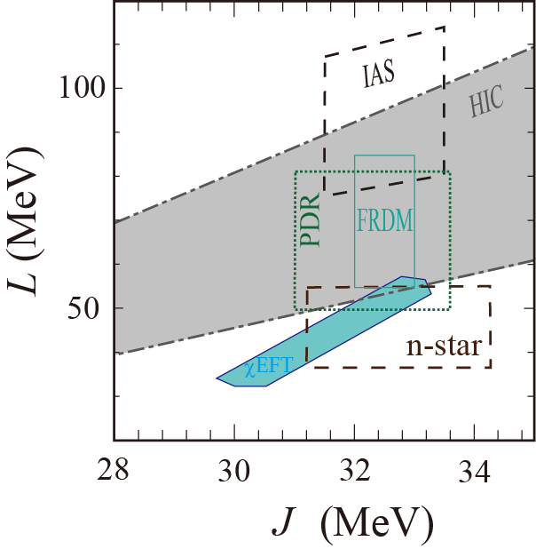
Determination of Symmetry Energy
M.B. Tsang et al.,
PRC86, 015803 (2012).
I. Tews et al., PRL110, 032504 (2013)
DP: Dipole Polarizability
HIC: Heavy Ion Collision
PDR: Pygmy Dipole Resonance
IAS: Isobaric Analogue State
FRDM: Finite Range Droplet
Model (nuclear mass analysis)
n-star: Neutron Star Observation
χEFT: Chiral Effective Field Theory

Slide 30
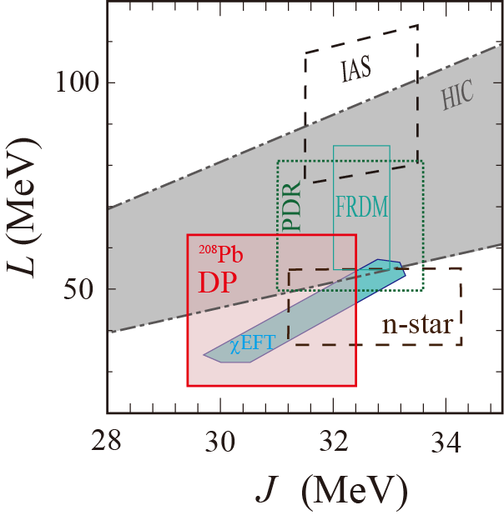
Determination of Symmetry Energy
M.B. Tsang et al.,
PRC86, 015803 (2012).
I. Tews et al., PRL110, 032504 (2013)
and this work
DP: Dipole Polarizability
HIC: Heavy Ion Collision
PDR: Pygmy Dipole Resonance
IAS: Isobaric Analogue State
FRDM: Finite Range Droplet
Model (nuclear mass analysis)
n-star: Neutron Star Observation
χEFT: Chiral Effective Field Theory
L=45±18 MeV
J=30.9±1.5 MeV
DP:

Slide 31
Summary
The dipole polarizability of ²⁰⁸Pb has been precisely measured
as
α_{D}=20.1±0.6 fm³/e²
Theoretical models will be much constrained if a precise
model-independent data on neutron skin thickness becomes
available.
By using theoretical models, the measured α_{D} of ²⁰⁸Pb
constraints the symmetry energy parameters as
L=45±18 MeV and J=30.9±1.5 MeV.
The obtained constraints and those from other works
look quite consistent with each other.

Slide 32
Collaborators
RCNP-E282
RCNP, Osaka University
A. Tamii, H. Matsubara, H. Fujita, K. Hatanaka,
H. Sakaguchi Y. Tameshige, M. Yosoi and J. Zenihiro
IKP, TU-Darmstadt
P. von Neumann-Cosel, A-M. Heilmann,
Y. Kalmykov, I. Poltoratska, V.Yu. Ponomarev,
A. Richter and J. Wambach
KVI, Univ. of Groningen
T. Adachi and L.A. Popescu
IFIC-CSIC, Univ. of Valencia
B. Rubio and A.B. Perez-Cerdan
Sch. of Science Univ. of Witwatersrand
J. Carter and H. Fujita
iThemba LABS
F.D. Smit
Texas A&M Commerce
C.A. Bertulani
GSI
E. Litivinova
Dep. of Phys., Osaka University
Y. Fujita
Dep. of Phys., Kyoto University
T. Kawabata
CNS, Univ. of Tokyo
K. Nakanishi,
Y. Shimizu and Y. Sasamoto
CYRIC, Tohoku University
M. Itoh and Y. Sakemi
Dep. of Phys., Kyushu University
M. Dozono
Dep. of Phys., Niigata University
Y. Shimbara
32
Notes:
32

Slide 33
Thank You

Slide 34
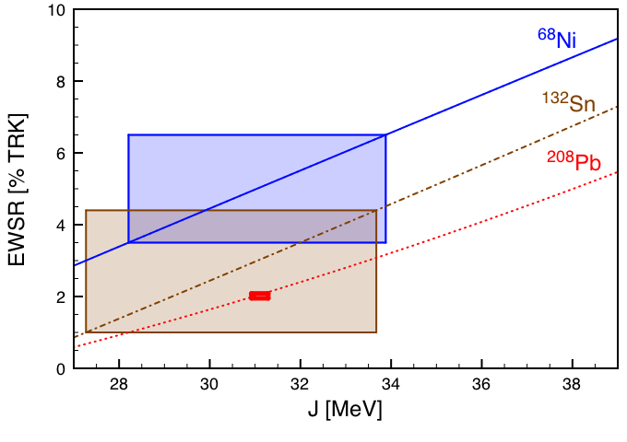
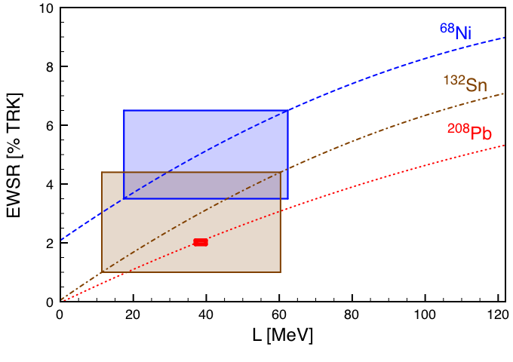
Application of the PDR : constraints on the symmetry energy
Theoretical dependences of pygmy EWSR on J and L are determined using
relativistic energy density functionals spanning the range of J and L values.
Available experimental data provide constraints on theoretical models.
DD-ME
Similar approach but different theory ➔ A. Carbone et al, PRC 81, 041301(R) (2010)
Exp. Data: ⁶⁸Ni : O. Wieland et al, PRL 102, 092502 (2009)
^{132,130}Sn: A. Klimkiewicz et al., PRC 76, 051603 (R) (2007)
²⁰⁸Pb: I. Poltoratska et al., PRC 85, 041304 (R) (2012)

Slide 35
Determination of Symmetry Energy
M.B. Tsang et al.,
PRC86, 015803 (2012).
I. Tews et al., PRL110, 032504 (2013)
and this work
DP: Dipole Polarizability
HIC: Heavy Ion Collision
PDR: Pygmy Dipole Resonance
IAS: Isobaric Analogue State
FRDM: Finite Range Droplet
Model (nuclear mass analysis)
n-star: Neutron Star Observation
χEFT: Chiral Effective Field Theory
L=45±18 MeV
J=30.9±1.5 MeV
²⁰⁸Pb PDR EWSR Analysis
with DD-ME by N. Paar
DP:

Slide 36
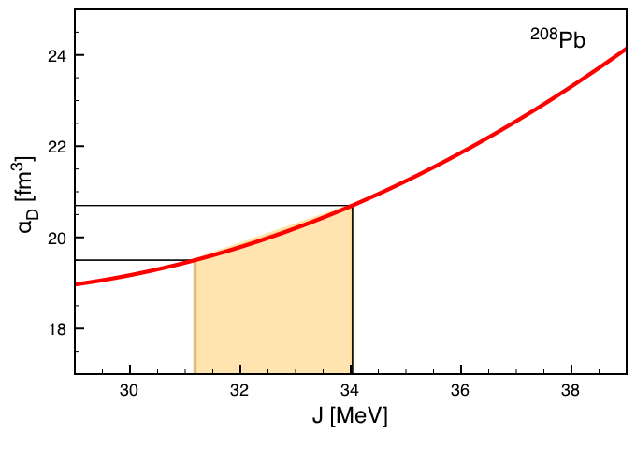
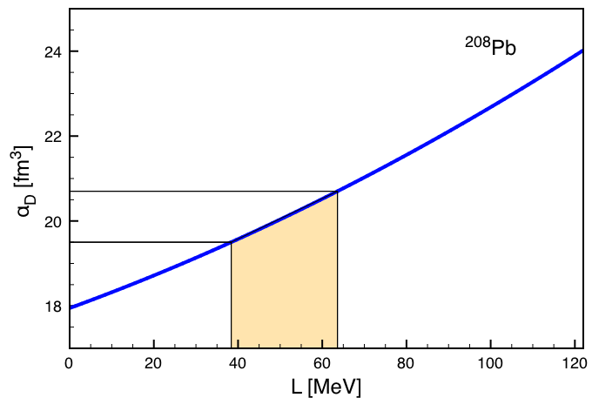
Constraining the symmetry energy from dipole polarizability
Theoretical constraints on the symmetry energy at saturation density (J)
and slope of the symmetry energy (L) from dipole polarizability (α_{D})
using relativistic nuclear energy density functionals
Exp. data from polarized proton inelastic scattering, α_{D}=18.9(13)fm³/e²
A. Tamii et al., PRL. 107, 062502 (2011)
DD-ME
J=(32.6±1.4) MeV
L=(50.9±12.6) MeV

Slide 37
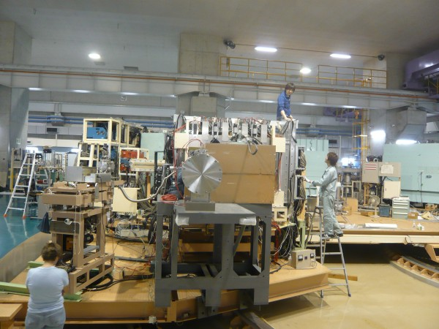
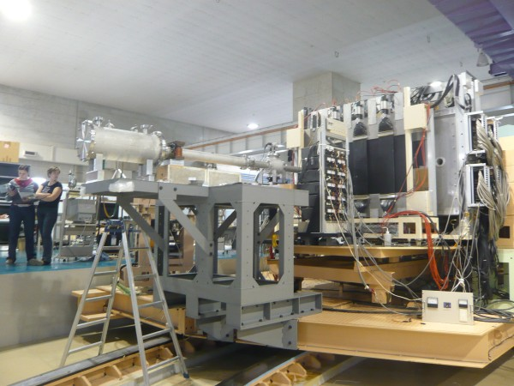
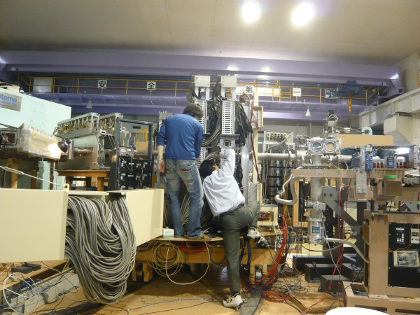
Setup for E282&E316

Slide 38
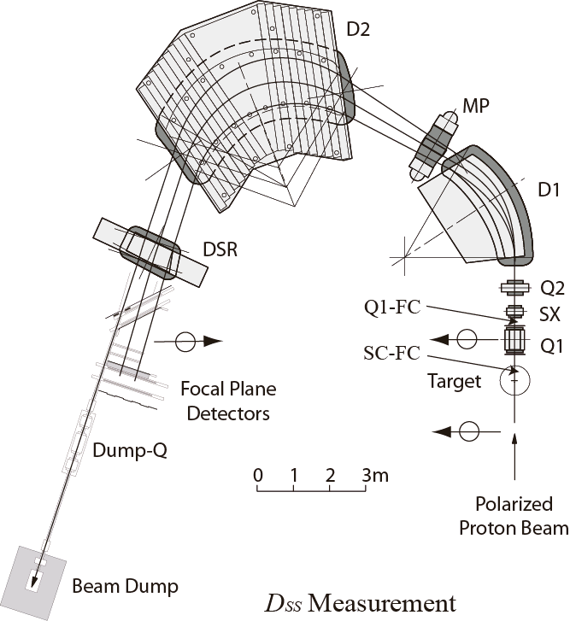
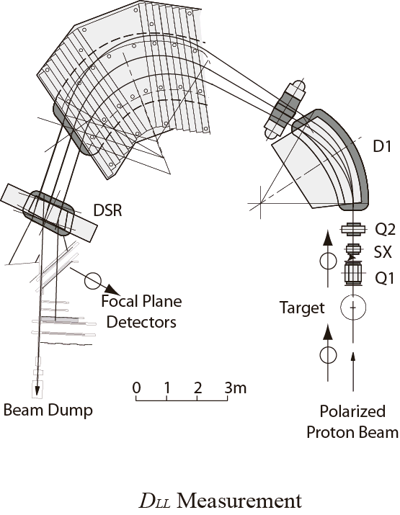
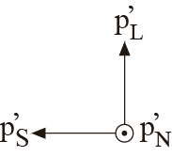
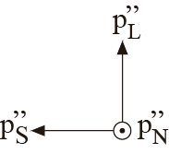
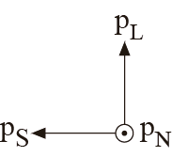
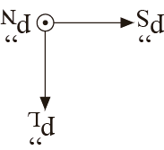
Spin Precession in the Spectrometer
θ_{p}: precession angle with respect to the beam direction
θ_{b}: bending angle of the beam
g: Lande’s g-factor
γ: gamma in special relativity

Slide 39
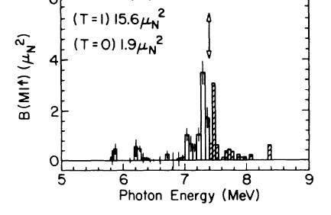
Electric Dipole (E1) Response
Particle （neutron） separation energy
Discrete (Small Strength)
GR and Continuum (Main Strength)
NRF
(γ,γ’)
(γ,xn)
(p,p’)
g.s.
PDR
IVGDR
0
S_{n}
S_{p}
²⁰⁸Pb(γ,γ)
M1 strength measured by
R.M. Laszewski et al, PRL61(1988)1710

Slide 40
Electric Dipole Polarizability
up to 130 MeV
20.1±0.6 fm³/e²
Quasiparticle Phonon Model
Relativistic Quasiparticle Time Blocking Approximation
I. Poltoratska, PhD thesis

Slide 41
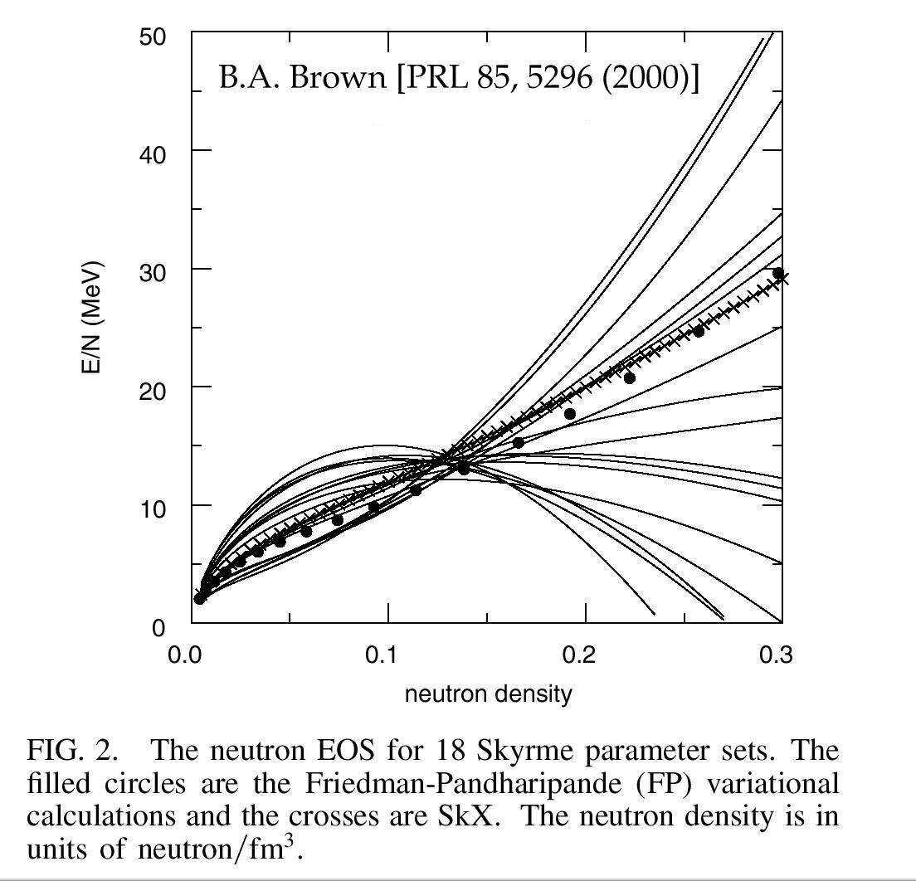
Nuclear Equation of State (EOS)
Neutron Matter
(δ=1)
Neutron Matter
(δ=1)
E/N (MeV)
核子当たりのエネルギー
E/A (MeV)
Symmetry Energy
(and Coulomb)
Nuclear Matter (δ=0)
Neutron Density (fm⁻³)
Nucleon Density (fm⁻³)
Steiner et al., Phys. Rep. 411 325(2005)
Prediction of the neutron matter
EOS is much model dependent.

Slide 42
Determination of Symmetry Energy
Determination of the dipole polarizability of ²⁰⁸Pb strongly constrains the symmetry energy.
Calc. for ²⁰⁸Pb dipole polarizability
by J. Piekarewicz
Slope Parameter of the Symmetry Energy
“The concordance of experimental, theoretical and observational analyses suggests that neutron star radii, in the mass range 1 M -2 M , lie in the narrow window 11 km < R < 12 km.”
Constant term of the Symmetry Energy
Lattimer et al., arXiv1203.4286v1(2012)
See also, M.B. Tsang et al., PRC86, 015803 (2012).

