Slide 1


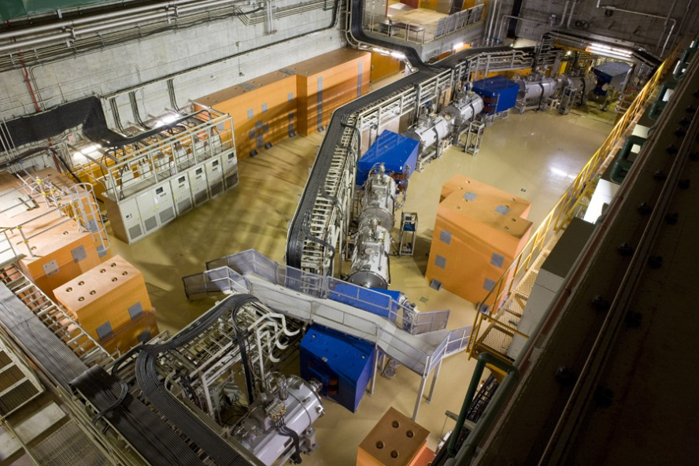
Overview of the Search for New Isotopes and New Isomers at RIKEN RI Beam Factory
T. Kubo, RIKEN Nishina Center
expand accessible regions of exotic nuclei
BigRIPS separator
Presented on June 4, 2013 @INPC2013 conference, Palazzo dei Congressi, Firenze, Italy, June 2-7, 2013
Notes:
Thank you chairman for the introduction.
Today I would like to tell about overview of the search for new isotopes and new isomers, which we performed at RIKEN RI Beam Factory in order to expand accessible regions of exotic nuclei.
This photo shows the BigRIPS in-flight separator, the device we used for this study.

Slide 2
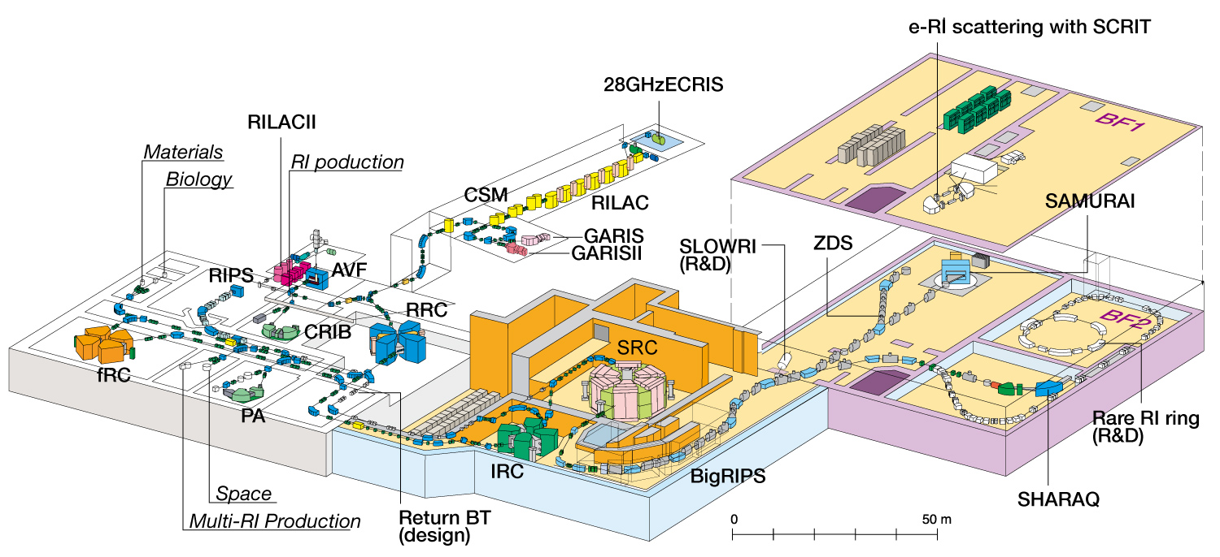
Layout of RI Beam Factory (RIBF)
E ~350 MeV/u up to U
Goal intensity 1 pμA
A new-generation in-flight RI beam facility
Major features of BigRIPS separator
Large acceptances Comparable with the spreads of in-flight fission of ²³⁸U
Two-stage separator scheme with excellent particle identification (PID)
PID scheme based on TOF-Bρ-ΔE method with track reconstruction → Z and A/Q
A/Q resolution is high enough to identify charge state events
Notes:
This is to remind you of the layout of RIKEN RI Beam Factory, RIBF.
The BigRIPS separater is located here after the cyclotrons, and followed by several major research instruments.
The BigRIPS is characterized by large acceptances which are comparable with spreads of in-flight fission of U beam at RIKEN energies, allowing efficient production of rare isotope beams.
Another important feature of BigRIPS is two-stage separator scheme with high PID power.
The PID is based on TOF-Bρ-ΔE method with track reconstruction, in which Z and A/Q are deuced.
The A/Q resolution is high enough to identify charge state events, such as .fully-stripped and hydorgen-like peaks.

Slide 3
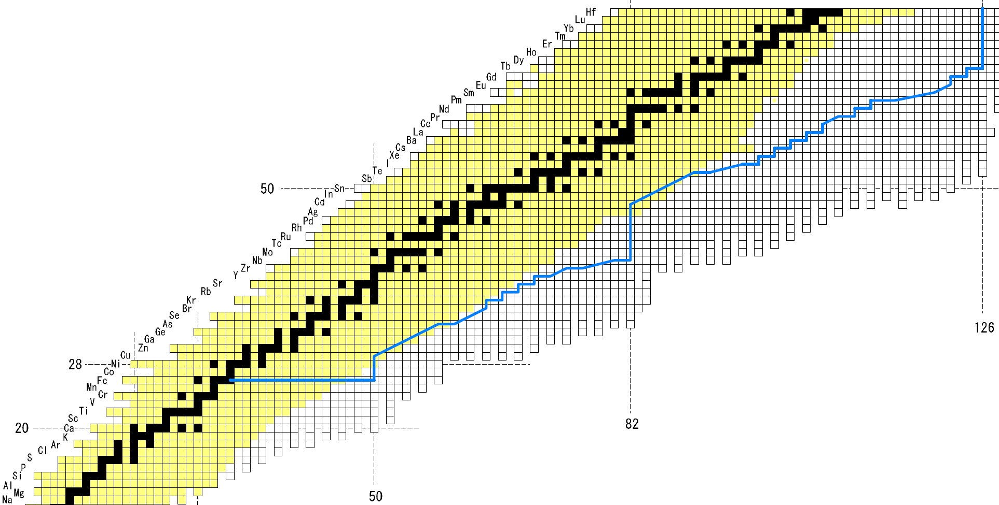
Search for new isotopes and new isomers that has been performed since 2007
Neutron-rich isotopes using in-flight fission of ²³⁸U at 345 MeV/u
May 2007 (~0.007 pnA, 4 x 10⁷pps)
Nov. 2008 (~0.22 pnA, 1 x 10⁹ pps)
Oct. 2011 (~0.5 pnA, 3 x 10⁹ pps)
Fall 2012 and spring 2013 (~10 pnA) during EURICA campaign
²³⁸U
Proton-rich isotopes using projectile fragmentation of ¹²⁴Xe at 345 MeV/u
70
Dec. 2011 (~9 pnA)
60
¹²⁴Xe
50
Z
126
40
r-process path
28
82
20
By using BigRIPS separator at RIBF
50
N
Notes:
This slide summarizes search for new isotopes and new isomers which have been performed using BigRIPS Separator at RIBF since the commissioning of RIBF in 2007.
We searched these neutron-rich regions using using in-flight fission of a U beam at 345 MeV/u in May 2007, November 2008 and October 2011 with these beam intensities.
The U beam intensities were like order of 10**9 pps then, but recently the intensity has increases by an order of magnitude.
Some new isotopes are identified during EURICA campaign for decay measurementsusing Ge ball.
We also searched this proton-rich region using projectile fragmentation of a ¹²⁴Xe beam in December 2011 with this intensity.
We ran the search for new isotopes and new isomers simultaneously.

Slide 4
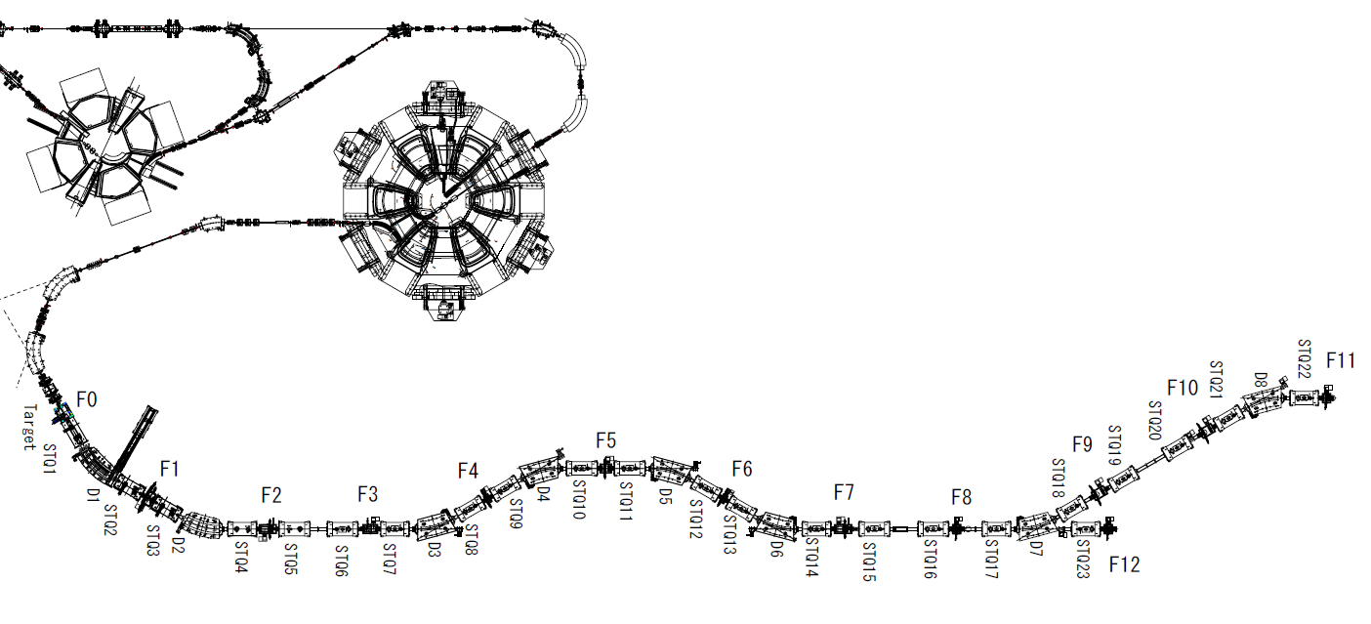
Experimental setups
Isomer setup
Standard beam-line detectors at BigRIPS for TOF, Bρ, ΔE measurement for PID
Clover-type Ge detectors for isomer measurement
Clover-Ge
X 3 or 4
Plastic
CsI(Na)
RI beam
Al stopper
or Si stack
TOF, Bρ, ΔE→ Z, A/Q
2008
2007
2011
Target
MUSIC
IC
PPAC x2
ΔΕ
PPAC x2
Plastic
Plastic
ZDS
Bρ35
Bρ57
PPAC x2
PPAC x2
PPAC x2
Plastic
Degrader
Degrader/stripper
TOF
BigRIPS
Isotope separation: F1 degrader/stripper + F5 degrader
Notes:
This slide shows the experimental setups.
We used standard beam-line detectors at BigRIPS, such as PPAC, IC and plastic, for TOF, Bρ, ΔE measurement for particle identification of RI beams. As shown here.
We used Clover-type Ge detectors for isomer measurement at these focus points, as shown here.

Slide 5
2007 U experiment
First experiment at RIBF!
²³⁸U⁸⁶⁺ + Be at 345 MeV/u
I ~0.007 pnA (4 x 10⁷ pps )
Running time: ~1 day
Two new isotopes ¹²⁵Pd and ¹²⁶Pd identified!
(demonstrated the potential of BigRIPS)
¹²³Pd
¹²⁵Pd
¹²⁵Pd(new)
known
¹²⁶Pd(new)
T. Ohnishi et al.: J. Phys. Soc. Jpn. 77 (2008) 083201.
Notes:
This slide shows the results of the 2007 U-beam experiment, which was the first experiment at RIBF.
We could identify two new isotopes ¹²⁵Pd and ¹²⁶Pd, although the beam intensity was as low as 4 x 107 pps and the running time was only one day, which demonstrated the potential of the BigRIPS separator.
These are Z versus A/Q PID plots and this is A/Q spectrum for Pd isotopes.
You see neighboring fully-stripped peak and hydrogen-like peak are clearly separated in the PID plots, thanks to the excellent A/Q resolution..

Slide 6
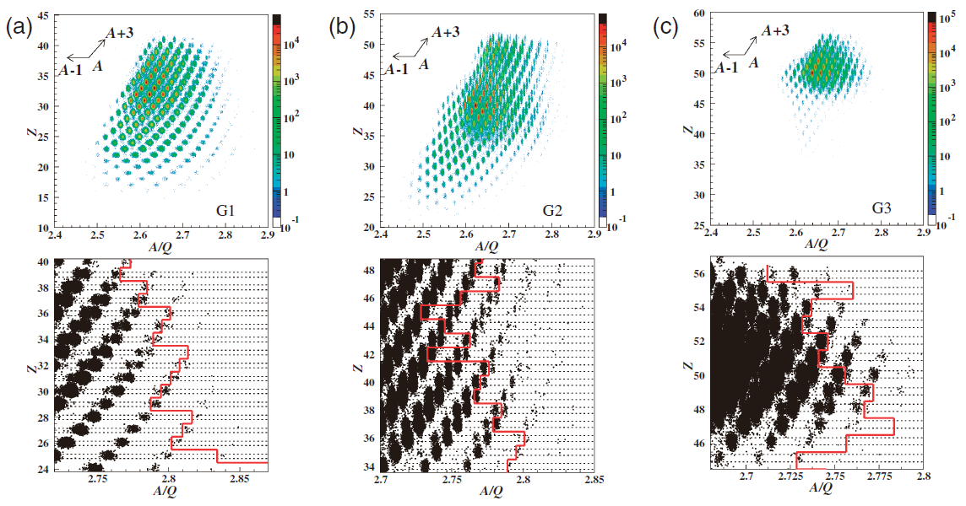
2008 U experiment
²³⁸U + Be/Pb 345MeV/u
3 different settings
~0.22 pnA (1 x 10⁹ pps)
~30 times larger intensity than in 2007
Setting 1 Z~30
Setting 2 Z~40
Setting 3 Z~50
²³⁸U + Be
²³⁸U + Be
²³⁸U + Pb
Unknown
Unknown
Enlarged plots
Unknown
45 new isotopes in a wide range of neutron-rich exotic nuclei!
T. Ohnishi et al.: J. Phys. Soc. Jpn. 79 (2010) 073201.
Notes:
This slide shows the results of the 2008 U-beam experiment.
We made measurements for these three settings, which were aimed at Z = 30 region, Z=40 region, and Z=50 region.
The average beam intensity was more than 30 times higher than in the 2007 experiment.
We identified 45 new isotopes in this experiment.

Slide 7
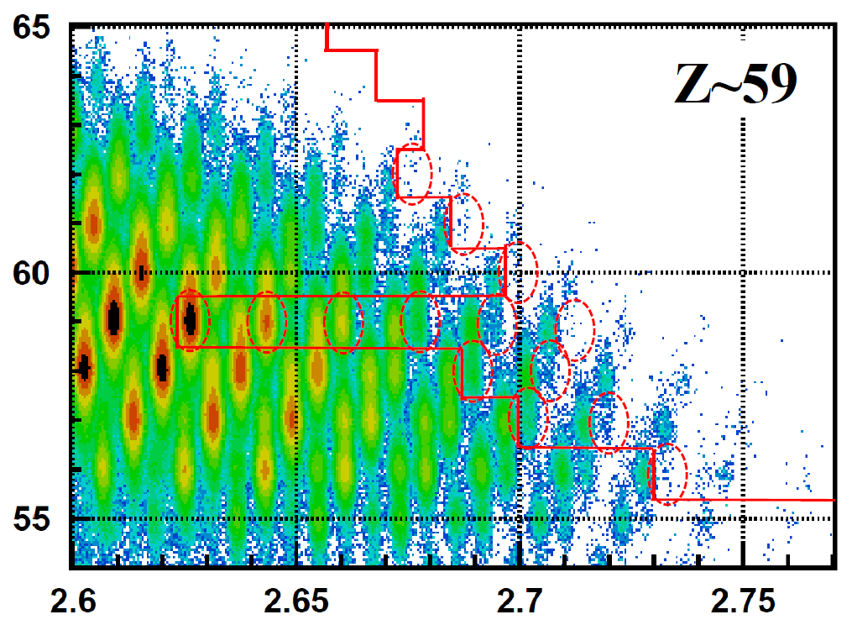
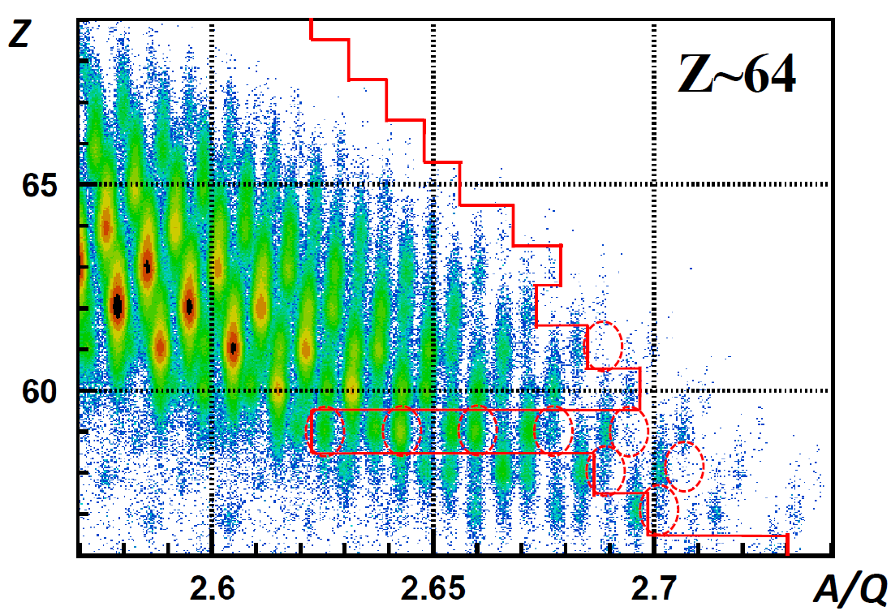
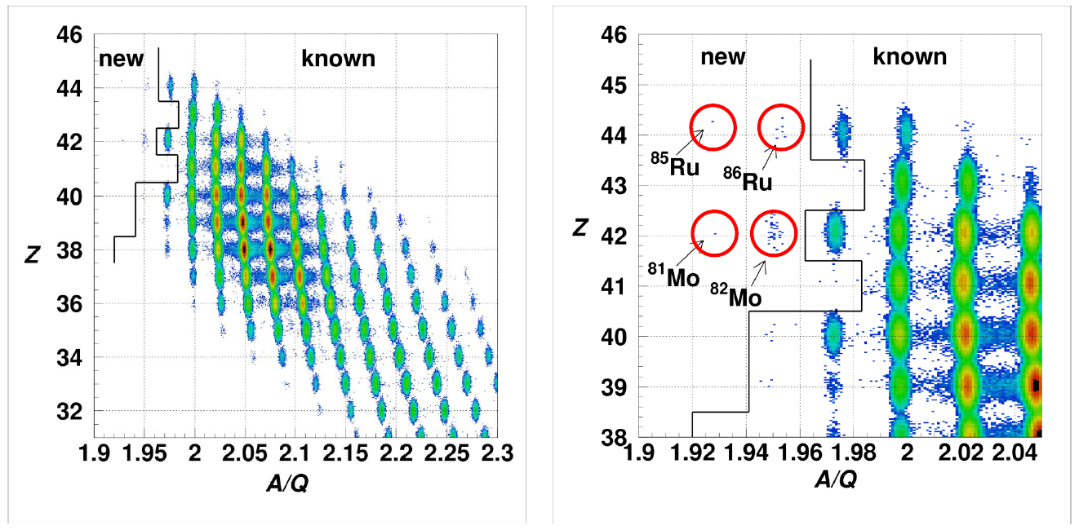
2011 U experiment
Setting1 Z~59
Setting2 Z~64
Z
Unknown
Preliminary!
²³⁸U⁸⁶⁺ + Be at 345 MeV/u
Unknown
~0.5 pnA
(3 x 10⁹ pps)
Z~60 region
A/Q
14 new isotopes (preliminary)
¹²⁴Xe experiment
Preliminary!
¹²⁴Xe + Be at 345 MeV/u
~9 pnA
Search for proton drip-line isotopes in Z~40-50 region
Notes:
This slide shows the results of the 2011 U-beam experiment, in which we searched for Z=60 region.
We ran the measurement for these two settings, and identified 14 new isotopes.
This shows the results of the Xe-124 experiment, in which we search for the proton-trip line in this Z region.
We identified these 4 new isotopes.

Slide 8
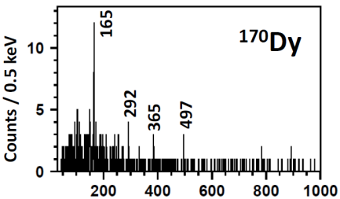
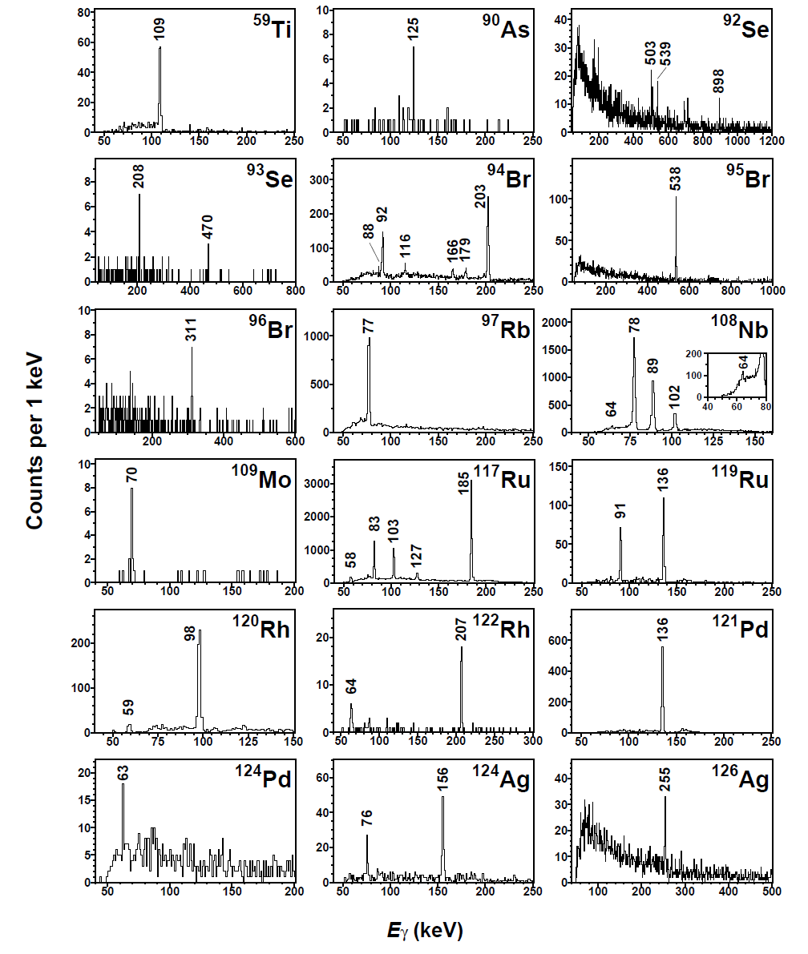
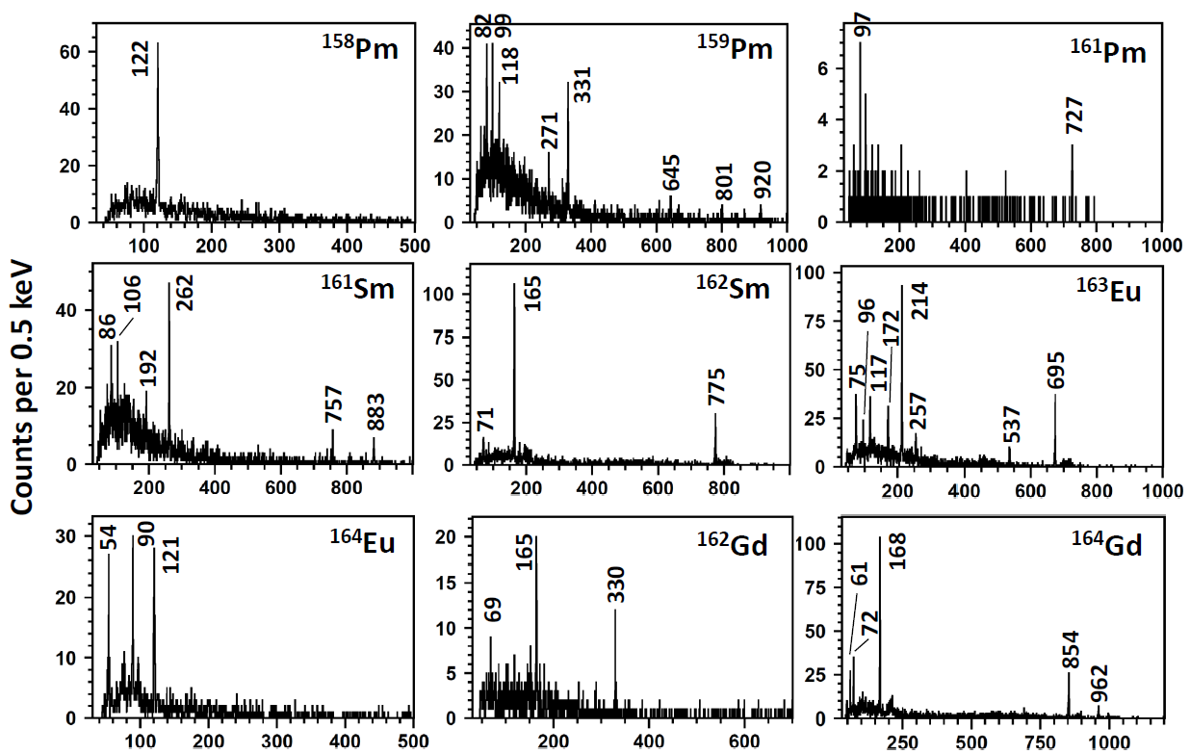
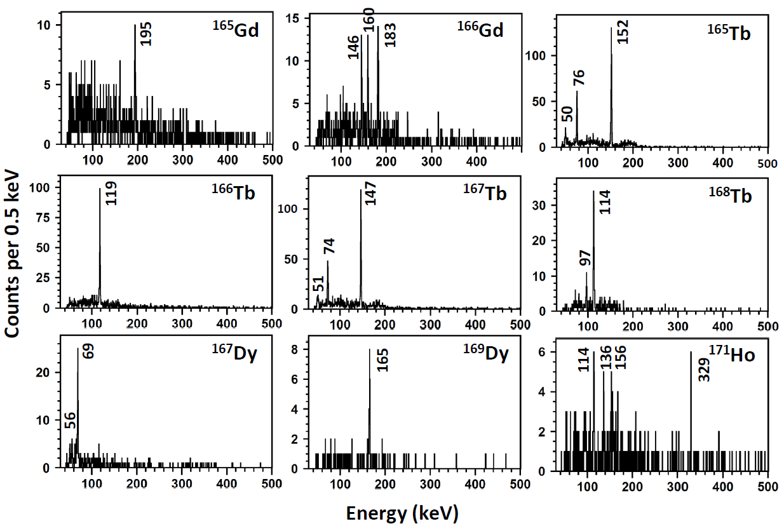
Delayed γ-ray spectra from new isomers
2011 U experiment
2008 U experiment
18
19
Preliminary!
Preliminary!
Notes:
This slide shows the delayed gamma-ray energy spectra for the new isomers we discovered in the 2008 U experiment.
We identified 18 new isomers.
This shows the new isomers we discovered in the 2011 U experiment.
We identified 19 new isomers.

Slide 9
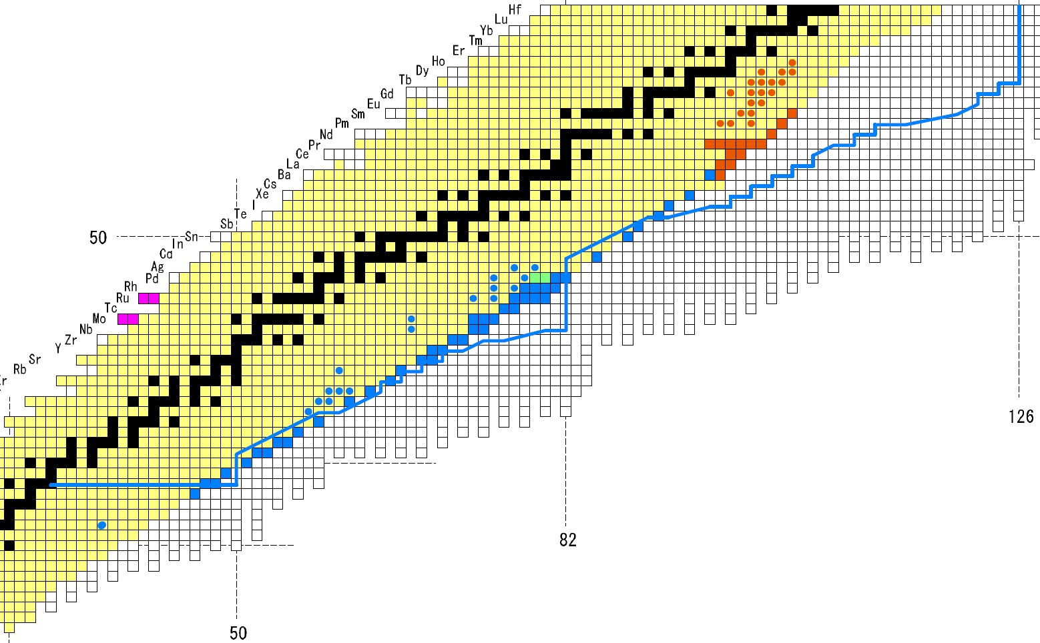
Summary of the results
r-process path
70
New isotopes: 65
New isomers: 37
60
126
40
New isotopes 2011 (14)
New isomers 2011 (19)
²³⁸U: ~0.5 pnA
30
82
New isotopes 2008** (45)
New isomers 2008*** (18)
New isotopes 2011 (4)
²³⁸U: ~0.22 pnA
¹²⁴Xe: ~9 pnA
50
New isotopes 2007* (2)
²³⁸U: ~0.007 pnA
*T. Ohnishi, T. Kubo et al.: J. Phys. Soc. Jpn. 77 (2008) 083201.
**T. Ohnishi, T. Kubo et al.: J. Phys. Soc. Jpn. 79 (2010) 073201.
***D. Kameda, T. Kubo et al.: Phys. Rev. C 86 (2012) 054319.
Notes:
This is the summary of the results.
In total we identified 65 new isotopes and 37 new isomers in a wide range of nuclear chart.
We identified many new isotopes on and near the r-process path which are indicated as a blue line.

Slide 10
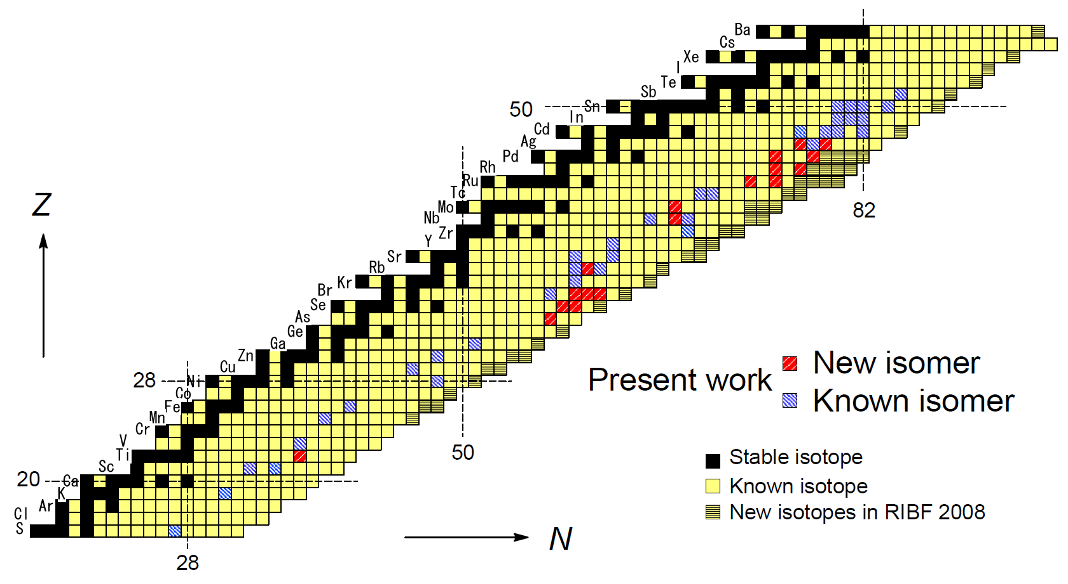

Overview of isomer measurements in 2008 U experiment
A variety of spectroscopic information in a very wide range of neutron-rich exotic nuclei
Proposed level schemes and isomerism
Investigated the evolution of nuclear structure
Spherical isomers: seniority isomer and spin-gap isomer
See D. Kameda et al: Phys. Rev. C 86 (2012) 054319.
¹³²Sn
Spherical isomer: seniority isomer
75
- N~75 region:
never studied before
- New deformed region?
- Shape isomers due to
shape coexistence
68
60
⁷⁸Ni
- N~68 region: a variety of nuclear shapes (prolate, oblate, triaxial) and coexistence
- Shape isomers, K-isomer, etc.
34
- N~60 region: famous for shape coexistence
- Several new isomers including shape isomers
- Investigate the evolution of shape coexistence
Spherical isomers due to shell evolution
Notes:
This slide shows an overview of the isomer measurements in 2008 U experiment, which have been published in PRC at the end of last year.
New isomers we observed are indicated by red color and known isomers we observed are by blue color.
We obtained a variety of spectroscopic information in a very wide rage of neutron-rich exotic nuclei and proposed level schemes and nuclear isomerism, which allows us to investigate the evolution of nuclear structure.
We observed spherical isomers near the magic number nuclei, such as seniority isomer, spin-gap isomer and so on.
On the other hand, in these regions between 78Ni and 132Sn we observed a variety of isomers caused by nuclear deformation and shape coexistence, such as shape isomer and high-K isomer.
Look at our publication for the details.
The N=60 region is famous for a sudden onset of ground state deformation and shape coexistence.
We observed new isomers including some shape isomers, allowing us to investigate the evolution of shape coexistence in this region.
The N=68 region is characterized by a variety of nuclear shapes and shape coexistence.
We observed shape isomers, K-isomer and so on in this region.
The N=75 region here has never been studied in detail before.
We speculate that this is a new deformed region.
We possibly observed shape isomers due to shape coexistence.
Here we observed spherical isomers due to shell evolution.

Slide 11
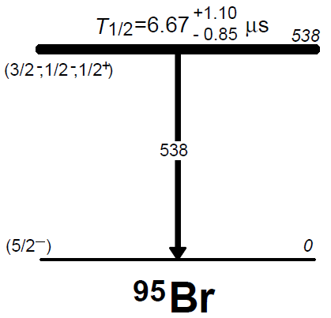
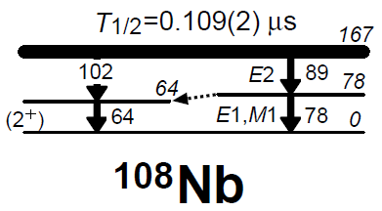
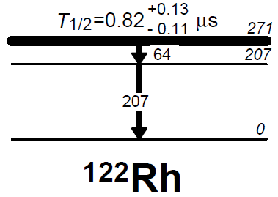
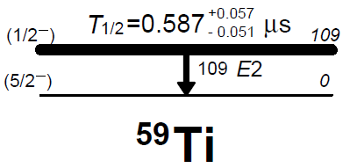
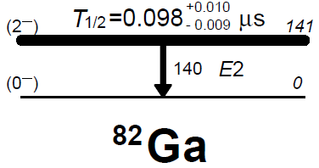
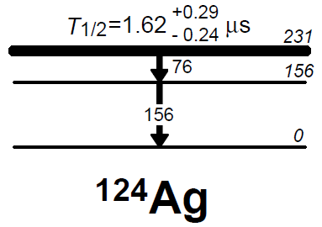
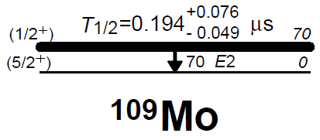
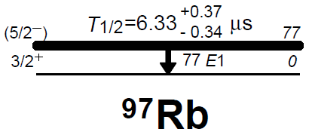
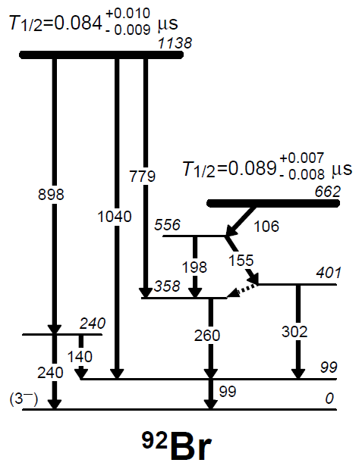
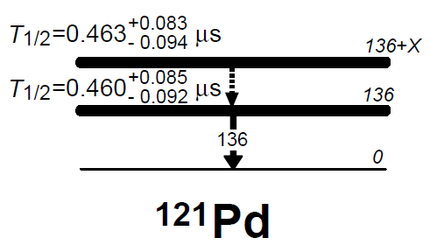
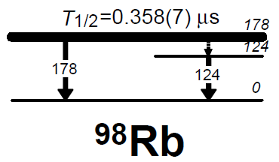
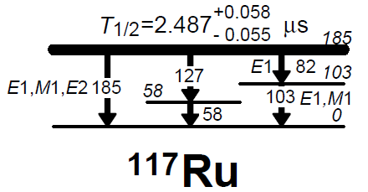
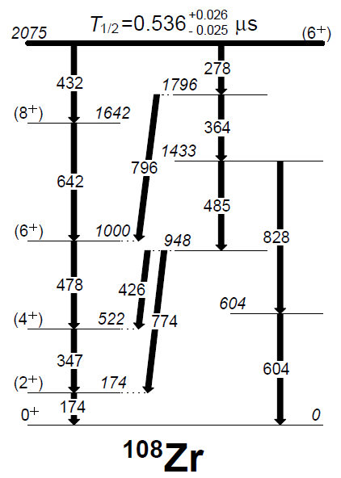
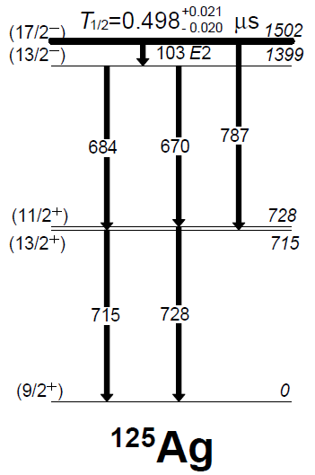
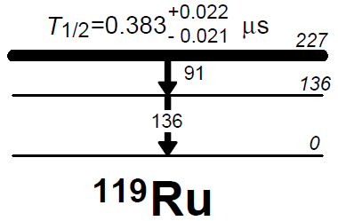
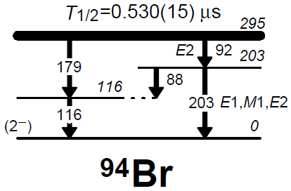
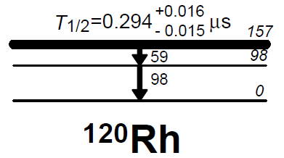
Level schemes and isomerism we proposed
(Shape isomer)
oblate-def. or prolate-def.
prolate-def.
Spherical isomer
Shape isomer
Low-E isomer or Shape isomer
prolate-def.
spherical
(Shape isomer)
prolate-def. + tirax.
Spherical isomer
spherical
Shape isomer
Low-E isomer
prolate-def. + tirax.
prolate-def.
(Shape isomer)
Spherical isomer
Shape isomer
Shape isomer
prolate-def.
K-isomer
Spherical isomer
Shape isomer
(Shape isomer)
Spherical isomer
prolate-def.
Notes:
This slides show our prosed level schemes and nuclear isomerism.

Slide 12
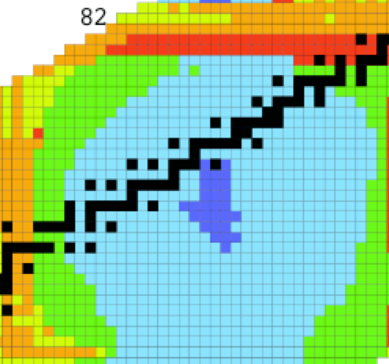
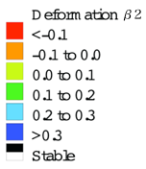
Overview of isomer measurements in 2011 U experiment
 | 92 | 93 | 94 | 95 | 96 | 97 | 98 | 99 | 100 | 101 | 102 | 103 | 104 | 105
67 | 159Ho | 160Ho | 161Ho | 162Ho | 163Ho | 164Ho | 165Ho | 166Ho | 167Ho | 168Ho | 169Ho | 170Ho | 171Ho | 172Ho
66 | 158Dy | 159Dy | 160Dy | 161Dy | 162Dy | 163Dy | 164Dy | 165Dy | 166Dy | 167Dy | 168Dy | 169Dy | 170Dy | 171Dy
65 | 157Tb | 158Tb | 159Tb | 160Tb | 161Tb | 162Tb | 163Tb | 164Tb | 165Tb | 166Tb | 167Tb | 168Tb | 169Tb | 170Tb
64 | 156Gd | 157Gd | 158Gd | 159Gd | 160Gd | 161Gd | 162Gd | 163Gd | 164Gd | 165Gd | 166Gd | 167Gd | 168Gd | 169Gd
63 | 155Eu | 156Eu | 157Eu | 158Eu | 159Eu | 160Eu | 161Eu | 162Eu | 163Eu | 164Eu | 165Eu | 166Eu | 167Eu | 168Eu
62 | 154Sm | 155Sm | 156Sm | 157Sm | 158Sm | 159Sm | 160Sm | 161Sm | 162Sm | 163Sm | 164Sm | 165Sm | 166Sm | 167Sm
61 | 153Pm | 154Pm | 155Pm | 156Pm | 157Pm | 158Pm | 159Pm | 160Pm | 161Pm | 162Pm | 163Pm | 164Pm | 165Pm | 166Pm
60 | 152Nd | 153Nd | 154Nd | 155Nd | 156Nd | 157Nd | 158Nd | 159Nd | 160Nd | 161Nd | 162Nd | 163Nd | 164Nd
59 | 151Pr | 152Pr | 153Pr | 154Pr | 155Pr | 156Pr | 157Pr | 158Pr | 159Pr | 160Pr | 161Pr | 162Pr | 163Pr
58 | 150Ce | 151Ce | 152Ce | 153Ce | 154Ce | 155Ce | 156Ce | 157Ce | 158Ce | 159Ce | 160Ce
Observed isomers
Er
New
Known
Known, not observed
19 new isomers in Z~64, N~100 region!
It is predicted that nuclei in this region exhibits large prolate-deformation.
Preliminary!
100
Interpretation of nuclear isomerism is still going on.
Some of new isomers have been interpreted as a high K-isomer.
¹⁷⁰Dy
64
Visit posters by S. Go et al. and by R. Yokoyama et al. for details
Moller et al., Nucl. Data.Tables 59, 185 (1995)
Notes:
This slide shows an overview of isomer measurements in 2011 U experiment.
New isomers we observed are indicated by blue color and known isomers are by orange color.
It is predicted that nuclei in this region exhibits large prolate-deformation, as shown here.
Interpretation of nuclear isomerism for these isomers is still going on.
Some of new isomers have been interpreted as a K-isomer, which is caused by high-K hindrance.
Visit posters by S. Go et al. and by R. Yokoyama et al. for details.

Slide 13
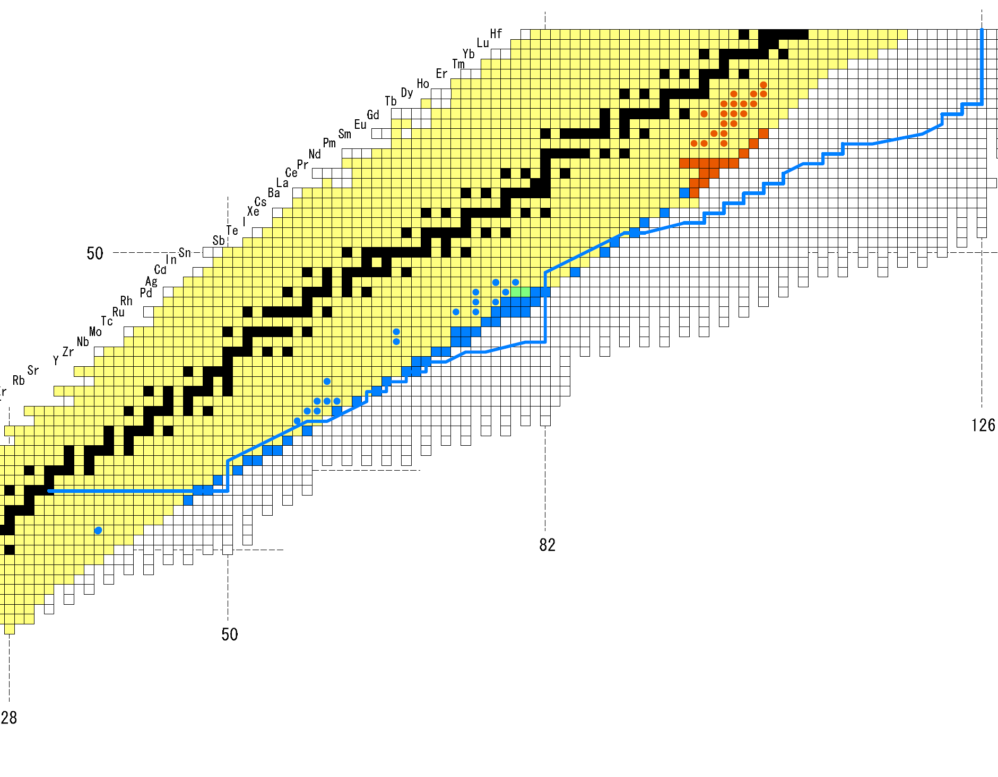
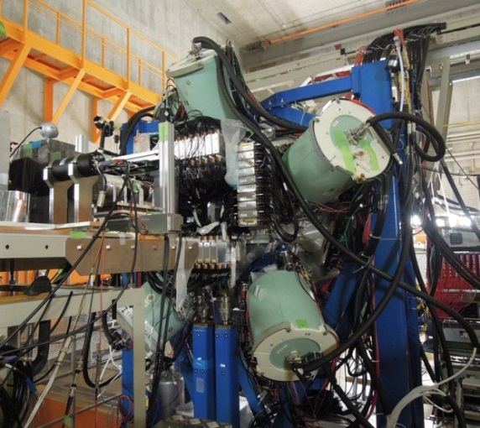
Regions studied in recent EURICA campaign at RIBF
decay measurements for very neutron-rich exotic nuclei using a Ge ball
²³⁸U 345 MeV/u ~10 pnA
2012 Fall campaign
2013 Spring campaign
New isotopes discovered
EURICA
(EUROBALL RIKEN Cluster Array)
Notes:
This slide show the regions that were studied in the recent EURICA campaign.
The U beam intensity was as high as 10 pnA, which allowed discovery of new isotopes.
This figure shows the planned schedule of intensity upgrade at RIBF.
It is expected that the U beam intensity reaches 100 pnA in couple of years.

Slide 14
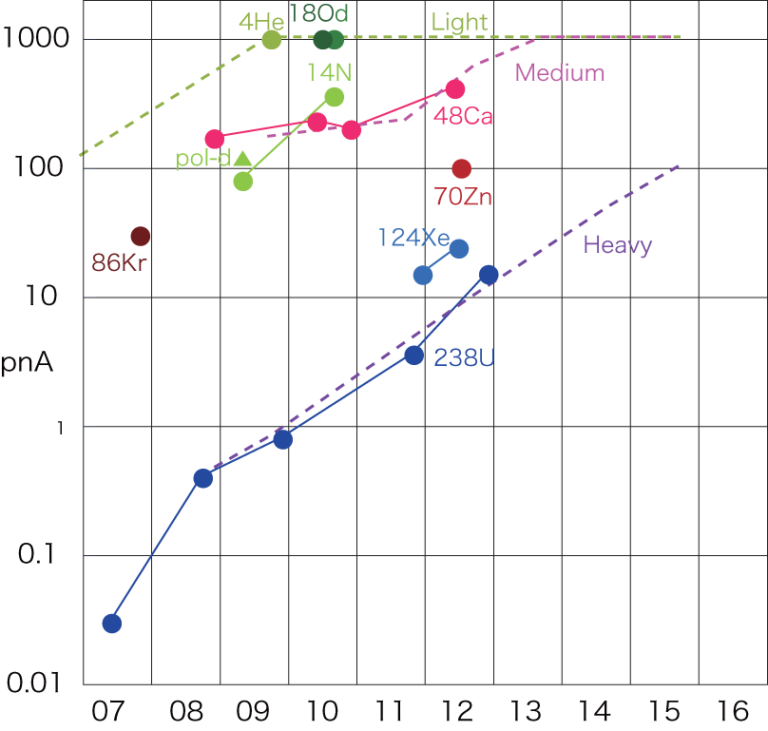
Summary
The results of search for new isotopes and new isomers using BigRIPS separator at RIKEN RI Beam Factory (RIBF) have been reviewed.
The region of accessible exotic nuclei is expanding at RIBF with increasing beam intensity (e.g. ~10 pnA ²³⁸U) and the research on exotic nuclei is being promoted.
Planned schedule of intensity upgrade at RIBF
Intensity in pnA
From RIKEN accelerator group
238U
Year
Notes:
This is a summary of my talk.

Slide 15
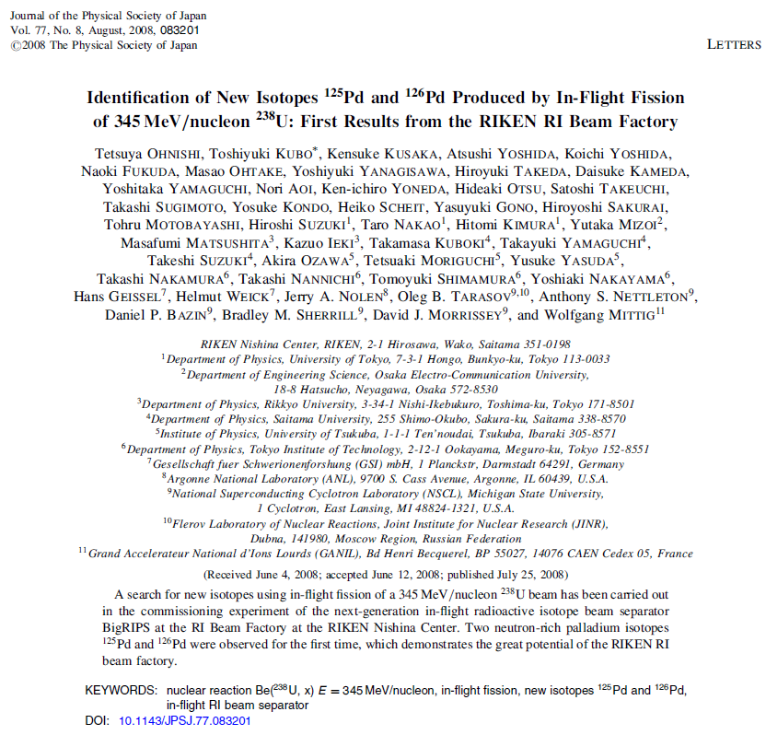


2007 experiment collaboration

Slide 16
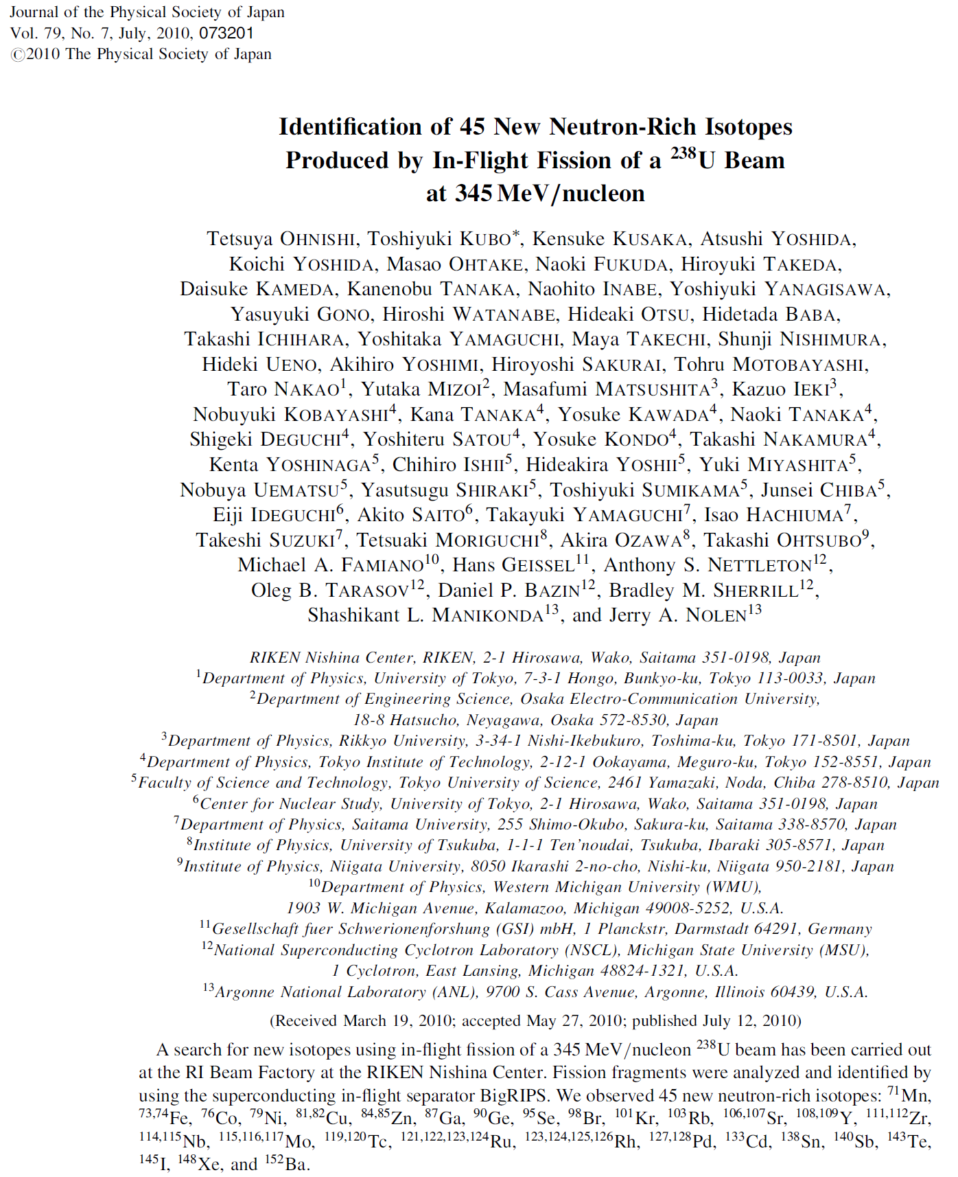

2008 experiment collaboration

Slide 17


2011 238U-experiment collaboration (Oct. 2011)
RIKEN Nishina Center, Japan
T. Kubo, N. Inabe, N. Fukuda, H. Takeda, D. Kameda, H. Suzuki, K. Yoshida, K. Kusaka,
K. Tanaka, Y. Yanagisawa, M. Ohtake, H. Sato, Y. Shimizu, H. Baba, M. Kurokawa,
D. Nishimura, T. Ohnishi
Center for Nuclear Study (CNS), University of Tokyo, Japan
S. Go, R. Yokoyama, T. Fujii, E. Ideguchi
Tohoku University, Japan
A. Chiba, T. Yamada, N. Iwasa
Rikkyo University, Japan
D. Murai, K. Ieki
Kochi University of Technology, Japan
S. Momota
Osaka University, Japan,
H. Nishibata
NSCL/MSU, U.S.A.
O. B. Tarasov, D. J. Morrissey, B. M. Sherrill
Seoul University, South Korea
J. Hwang, S. Kim, Y. Sato
LPSC-IN2P3, France
G. Simpson

Slide 18
2011 124Xe-experiment collaboration (Dec. 2011)
RIKEN Nishina Center, Japan
T. Kubo, N. Inabe, N. Fukuda, H. Takeda, D. Kameda, H. Suzuki, K. Yoshida, K. Kusaka,
K. Tanaka, Y. Yanagisawa, M. Ohtake, H. Sato, Y. Shimizu, H. Baba, M. Kurokawa, D. Nishimura
Center for Nuclear Study (CNS), University of Tokyo, Japan
S. Go, R. Yokoyama, T. Fujii, E. Ideguchi
Tohoku University, Japan
A. Chiba, Y. Okoda, N. Iwasa
Rikkyo University, Japan
D. Murai, K. Ieki
Kochi University of Technology, Japan
S. Momota
Osaka University, Japan,
H. Nishibata
GANIL, France
M. Lewitowicz, G. de France, I. Celikovic
TU-Munchen, Germany
K. Steiger
NSCL/MSU, U.S.A.
D. Bazin, O. B. Tarasov, D. J. Morrissey, B. M. Sherrill

Slide 19
Thank you for your attention.

Slide 21
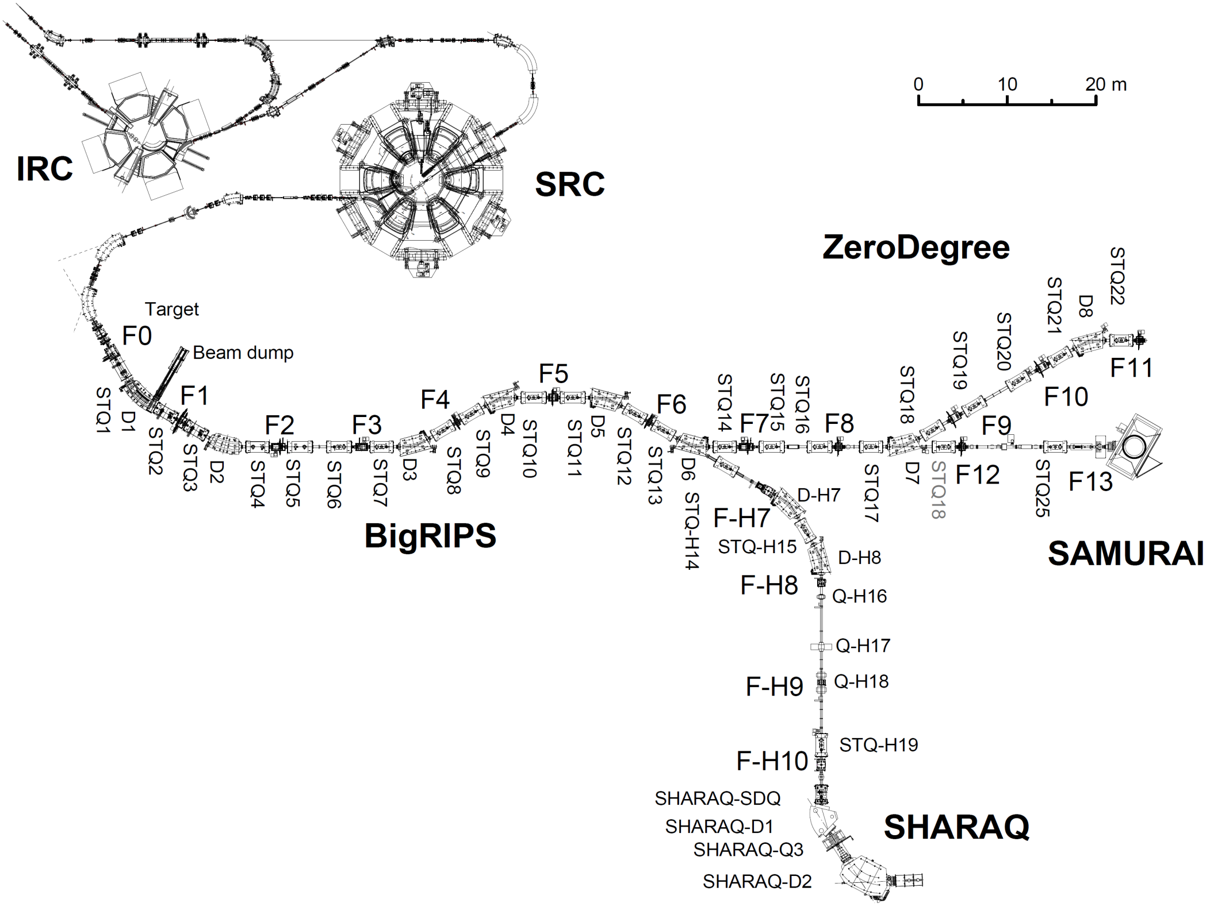
Present RIBF layout
F0-F11: 125.983m
ZeroDegree
BigRIPS
SAUMURAI
High-resolution beam line
Maximum energy is ~350 MeV/u for heavy ions up to U ions.
Goal beam intensity is 1 pμA (6 x 10¹² particles/sec).
SHARAQ
by CNS
Max. beam power ~100 kW

Slide 22
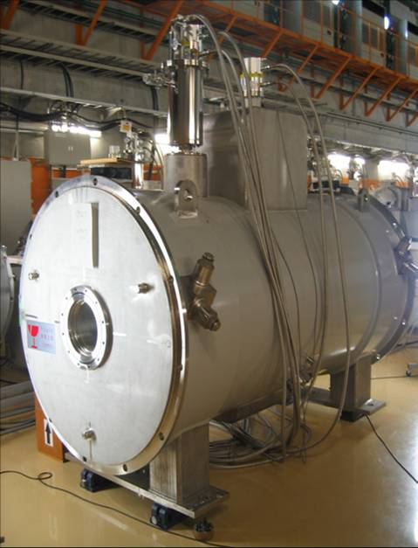
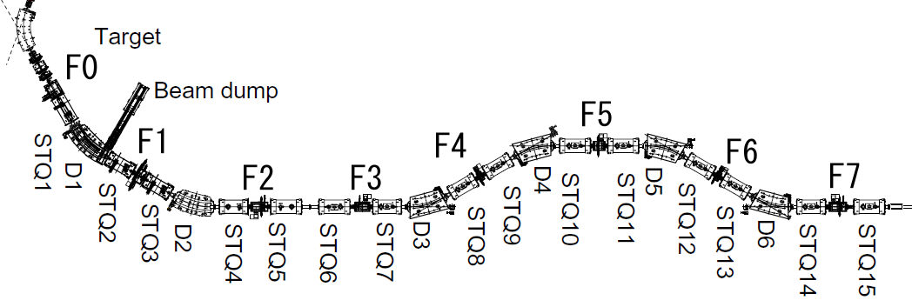
Layout and major features of BigRIPS separator
Comparable with spreads of in-flight fission at RIBF energies: ±50 mr, ±5 %
Large acceptances
Superconducting quadrupoles having a large aperture
Pole-tip radius= 17cm, pole tip field= 2.4-2.5T
Two-stage separator scheme
2nd stage with high resolution
Excellent particle identification without measuring TKE →PID including charge states
STQ
Superferric Q
Parameters:
Δθ = ±40 mr
Δφ = ±50 mr
Δp/p = ±3 %
Bρ = 9 Tm
L = 78.2 m
From SRC
Two-stage separator
Wedge
Wedge
STQ1-14: superconducting Q triplets D1-6: R.T. dipoles (30 deg)
F1-F7: focuses
1st stage
2nd stage
Production & separation
Particle identification & two-stage separation

Slide 23
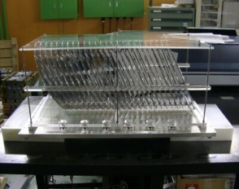
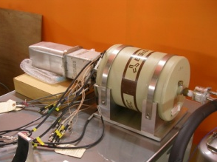
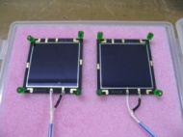
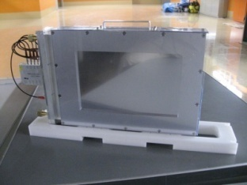
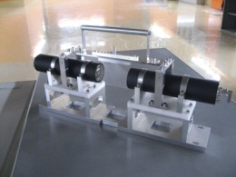
Particle identification scheme at BigRIPS
TOF-Bρ-ΔE method with track reconstruction
→ Improve Bρ and TOF resolution
Measure TOF, Bρ, ΔE @ 2nd stage
+ isomeric γ-rays
Z, A/Q
ΔE: MUSIC, Si Isomer γ-ray: Ge
Bρ with track reconstruction
β₃₅, Bρ₃₅
β₅₇, Bρ₅₇
PPAC x2
Wedge
Wedge
PPAC x2
PPAC x2
1st stage
2nd stage
TOF: β
PID without measuring TKE
Plastic scinti.

Slide 24
Particle identification
TOF-Bρ-ΔE method with track reconstruction
TOF, trajectories (Bρ), ΔE→ Z, A/Q
β₃₅, Bρ₃₅
X₅, θ₅
β₅₇, Bρ₅₇
X₃, θ₃
Wedge (energy loss)
X₅, θ₅, ΔE
Wedge
1st stage
2nd stage
TOF₃₇
Bρ determination by track reconstruction
Ion optics
β determination by the simultaneous equations
1st half:
X₃, θ₃ & X₅, θ₅
Bρ₃₅
TOF₃₇ = L₃₅/β₃₅c + L₅₇/β₅₇c
2nd half:
X₅, θ₅ & X₇, θ₇
Bρ₅₇
Bρ₃₅/Bρ₅₇ = (βγ)₃₅/(βγ)₅₇
β₃₅ (1st half), β₅₇ (2nd half)

Slide 25
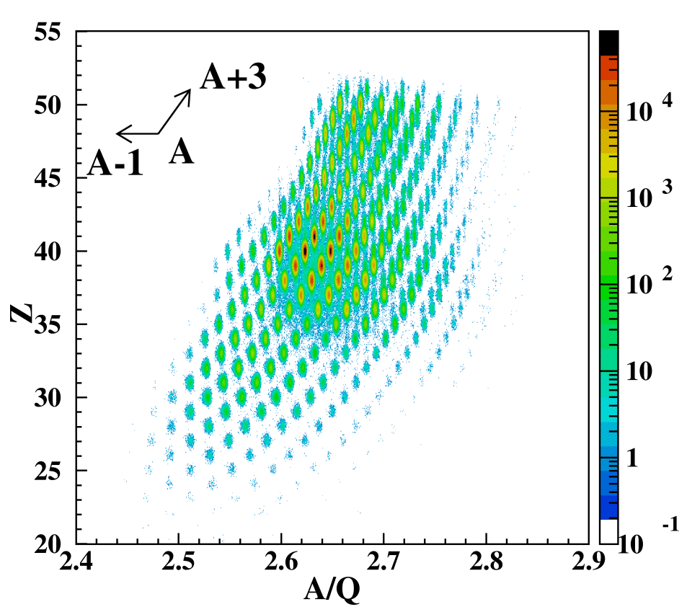
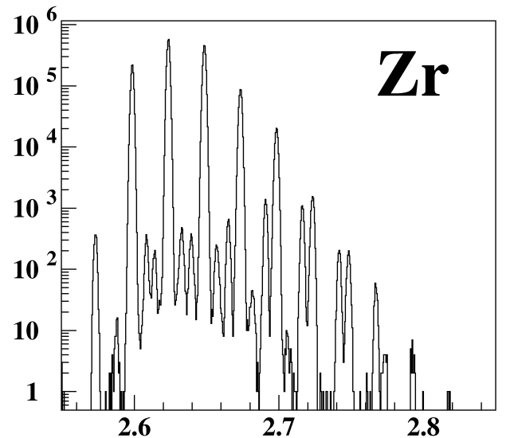
Excellent particle identification (PID) power for fission fragments
TOF-Bρ-ΔE method with track reconstruction
High enough to well identify charge states of fragments
Z vs. A/Q plot
A/Q spectrum for Zr isotopes (Z=40)
¹⁰⁶Zr³⁹⁺
¹⁰⁹Zr⁴⁰⁺
¹⁰⁷Zr³⁹⁺
¹¹⁰Zr⁴⁰⁺
¹⁰⁸Zr³⁹⁺
¹¹¹Zr⁴⁰⁺
¹⁰⁹Zr³⁹⁺
¹¹²Zr⁴⁰⁺
U+Be 2.9 mm Bρ 01 = 7.990 Tm
F1 deg Al 2.18mm
ΔP/P =+-3%
A/Q
G3 setting in J. Phys. Soc. Jpn. 79 (2010) 073201.
r.m.s. A/Q resolution: 0.035 %

Slide 26
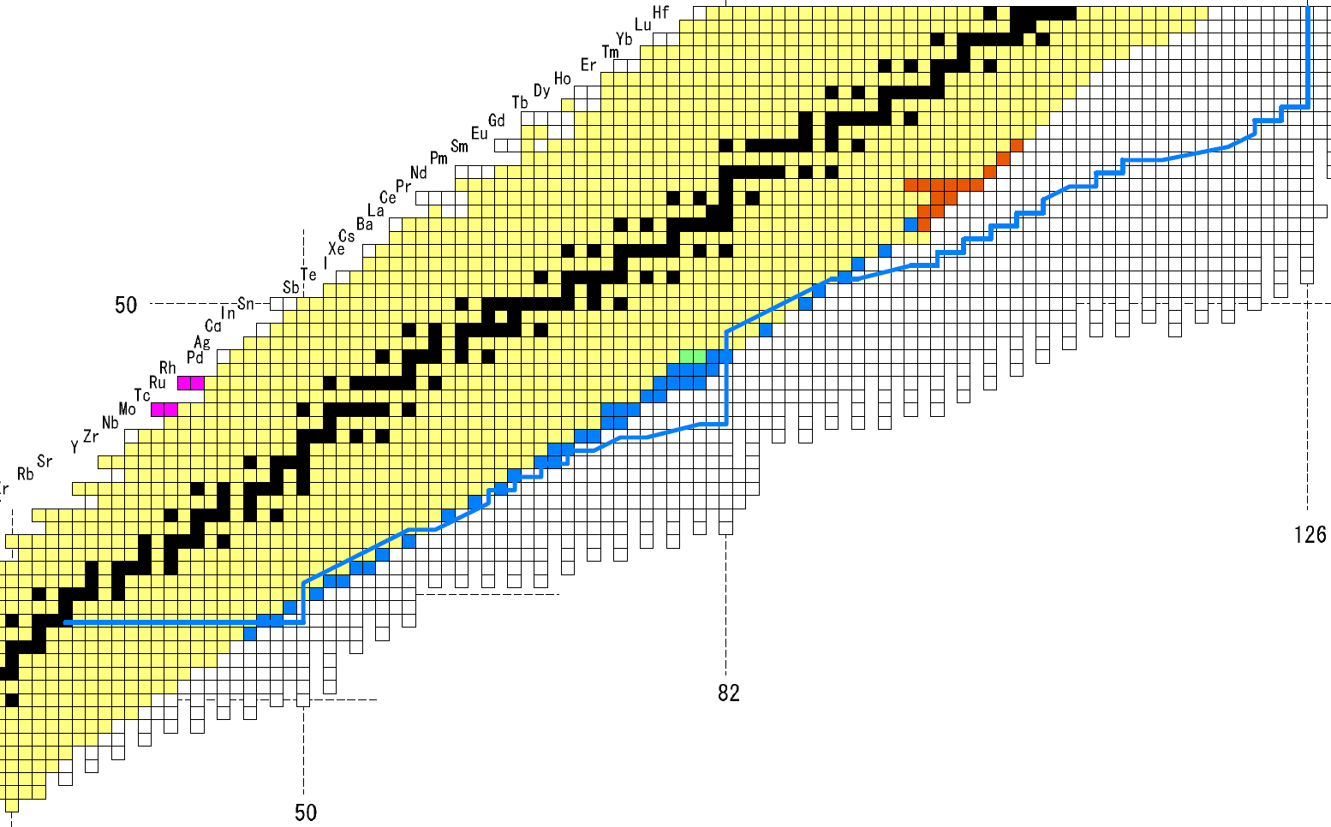
Summary of search for new isotopes
Neutron rich: 61
Proton rich: 4
70
60
40
New isotopes 2011
²³⁸U: ~0.5 pnA
New isotopes2008
30
²³⁸U: ~0.22 pnA
New isotopes 2007
²³⁸U: ~0.007 pnA
New isotopes 2011
¹²⁴Xe: ~9 pnA

Slide 27
Results using in-flight fission of a ²³⁸U beam at 345 MeV/u
Runs | ²³⁸U intensity | New isotopes | New isomers
May 2007 | ~0.007 pnA (4 x 10⁷pps) | 2 : ¹²⁵Pd, ¹²⁶Pd * | None
Nov. 2008 | ~0.22 pnA (1 x 10⁹ pps) | 45 : Mn(Z=25) ~ Ba(Z=56) ** | 18 : Z=22~47 ***
Oct. 2011 | ~0.5 pnA (3 x 10⁹ pps) | 14 : Z =56~60 | 19 : Z =59~66
~10 pnA during EURICA campaign (Fall 2012 and Spring 2013)
*T. Ohnishi, T. Kubo et al.: J. Phys. Soc. Jpn. 77 (2008) 083201.
**T. Ohnishi, T. Kubo et al.: J. Phys. Soc. Jpn. 79 (2010) 073201.
***D. Kameda, T. Kubo et al.: Phys. Rev. C 86 (2012) 054319.
Results using projectile fragmentation of a ¹²⁴Xe beam at 345 MeV/u
2011 Dec. (¹²⁴Xe) | ~9 pnA | 4 : Z =41~44 | none

