Slide 1
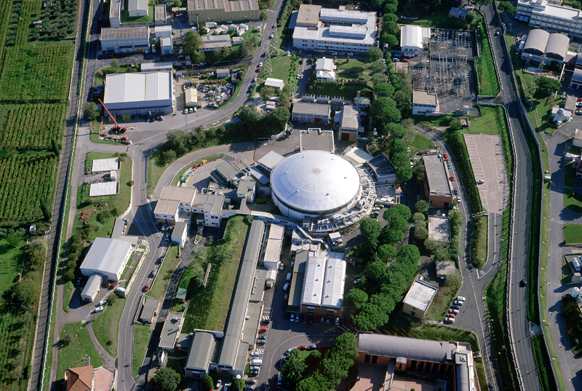
Unveiling the strangeness secrets: low-energy
kaon-nucleon/nuclei
interactions studies at DAFNE
Catalina Curceanu
(On behalf of SIDDHARTA and AMADEUS collaborations)
LNF – INFN, Frascati
INPC 2013, Firenze, 3-7 May 2013

Slide 2
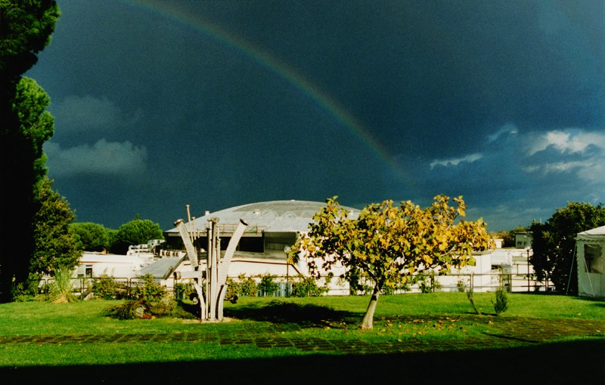

Slide 3
The DAFNE collider or the best possible beam of low energy kaons

Slide 4
The DAFNE principle
K+
e⁺
e⁻
e⁺
e⁻
e⁺
Φ
e⁻
e⁻
e⁻
e⁺
e⁺
e⁺
e⁻
e⁺
e⁻
e⁻
e⁺
e⁻
e⁻
K-
Flux of produced kaons: about 1000/second

Slide 5
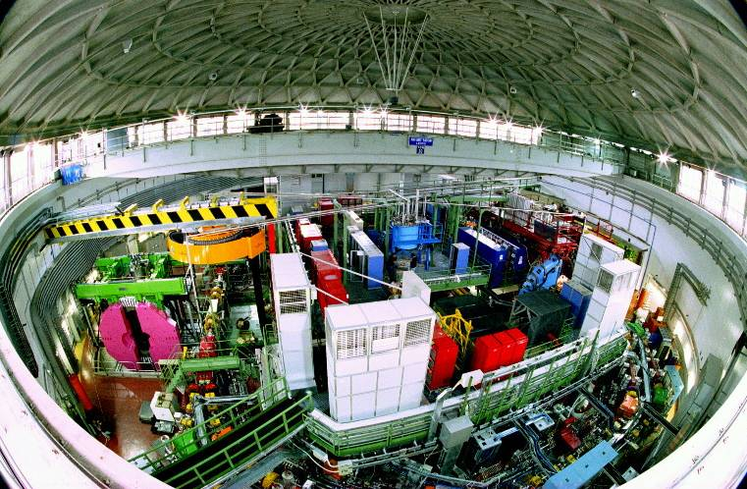
DAΦNE, since 1998

Slide 6
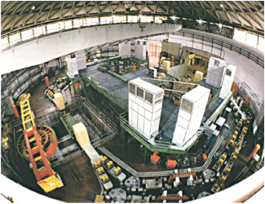

Φ → K⁻ K⁺ (49.1%)
Monochromatic low-energy K⁻ (~127MeV/c)
Less hadronic background due to the beam
( compare to hadron beam line : e.g. KEK /JPARC)
Suitable for low-energy kaon physics:
kaonic atoms
Kaon-nucleons/nuclei interaction studies

Slide 7
KAONNIS (Integrated Initiative):
Unique studies of the low-energy kaon-nucleon/nuclei interactions -> low-energy QCD in strangeness sector with implications from particle (Λ(1405)) and nuclear (kaonic nuclear clusters?) physics to astrophysics (equation of state -> role of strangeness)
exotic atoms: SIDDHARTA data analyses and SIDDHARTA-2 experiment
kaon-nuclei interactions at low-energies: AMADEUS - AMADEUS carbon target and KLOE 2002-2005 data analyses in collaboration with KLOE
Support from : HP3 – WP9: WP24; WP28 is fundamental

Slide 8










SIDDHARTA
SIlicon Drift Detector for Hadronic Atom Research by Timing Applications
LNF- INFN, Frascati, Italy
SMI- ÖAW, Vienna, Austria
IFIN – HH, Bucharest, Romania
Politecnico, Milano, Italy
MPE, Garching, Germany
PNSensors, Munich, Germany
RIKEN, Japan
Univ. Tokyo, Japan
Victoria Univ., Canada

Slide 9
The scientific aim
the determination of the isospin dependent
KN scattering lengths through a
~ precision measurement of the shift
and of the width
of the K_{α} line of kaonic hydrogen
and
the first measurement of kaonic deuterium
Measurements of kaonic Helium 3 and 4 as well (2p level)

Slide 10
Kaonic atom formation
n ~ sqrt(M*/me) n’ ~ 25 (for K-p)
(M* : K-p reduced mass)
e⁻
highly-excited state
Auger Electron
K⁻
1) Initial capture
deexcite
K⁻
X-ray
2) Cascade
K⁻
Nucleus
3) Strong interaction
4) Absorption
Shift and Width
of last orbit
The strong int. width > Radiative trans. width
stopped in a target medium
e.g.
1s for K-p, K-d
2p for K-He

Slide 11
Kaonic cascade and the strong interaction
n
s p d f
4
3
2
E_{2p}
K_{β}
Γ
K_{α} ∼ 6.3 keV
= ΔE_{2p→1s}
ε
E_{1s}
1
}

Slide 12
Antikaon-nucleon scattering lengths
Once the shift and width of the 1s level for kaonic hydrogen and
deuterium are measured -) scattering lengths
(isospin breaking corrections):
ε + i Γ/2 => a_{K}-_{p} eV fm⁻¹
ε + i Γ/2 => a_{K}-_{d} eV fm⁻¹
one can obtain the isospin dependent antikaon-nucleon scattering lengths
a_{K}-_{p} = (a₀ + a₁)/2
a_{K}-_{n} = a₁

Slide 13
SIDDHARTA Scientific program
Measuring the KN scattering lengths with the precision of a few percent will drastically change the present status of low-energy KN phenomenology and also provide a clear assessment of the SU(3) chiral effective Lagrangian approach to low energy hadron interactions.
Breakthrough in the low-energy KN phenomenology;
Threshold amplitude in QCD
Information on Λ(1405)
Contribute to the determination of the KN sigma terms, which give the degree of chiral symmetry breaking;
4 related alado with the determination of the strangeness content of the nucleon from the KN sigma terms

Slide 14
SIDDHARTA

Slide 15
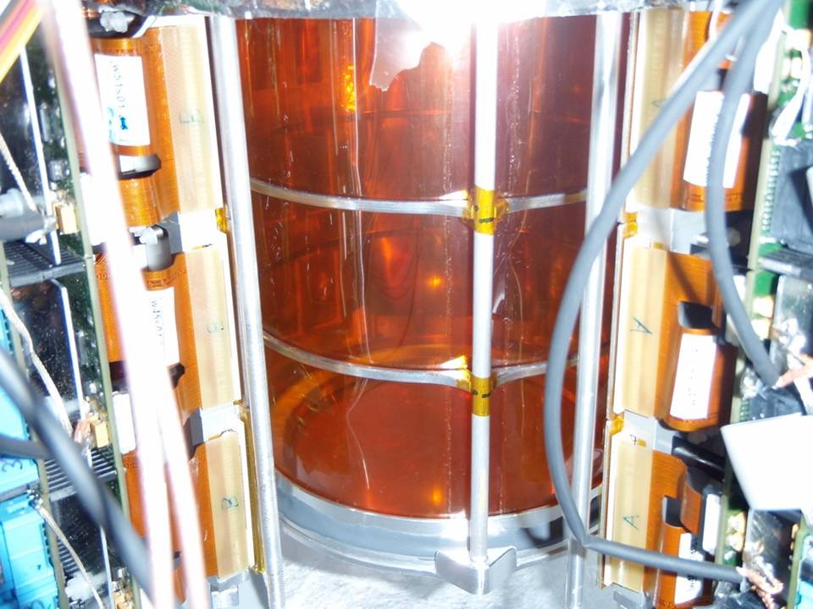


Slide 16
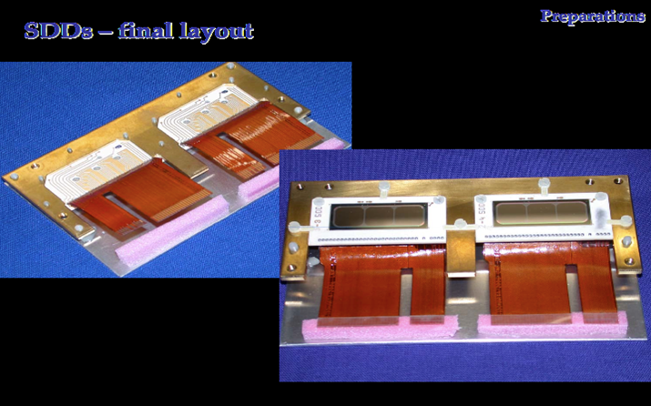
Silicon Drift Detector - SDD
1Chip : 1 cm²

Slide 17
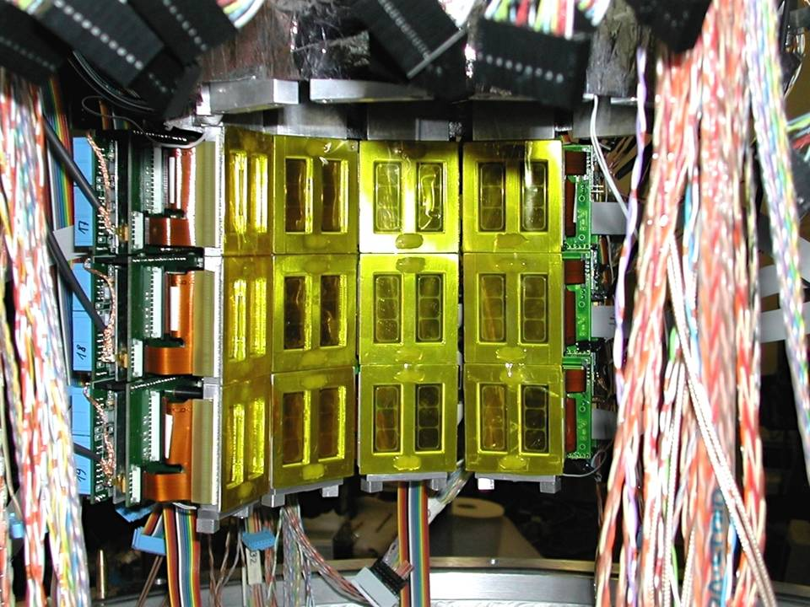

1 cm² x 144 SDDs

Slide 18
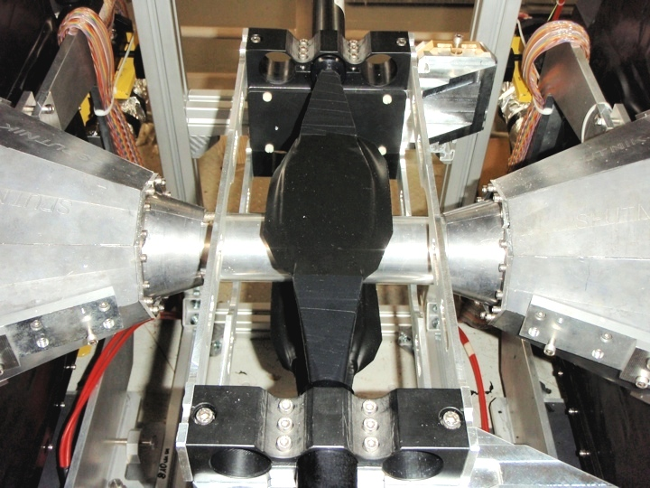


Slide 19
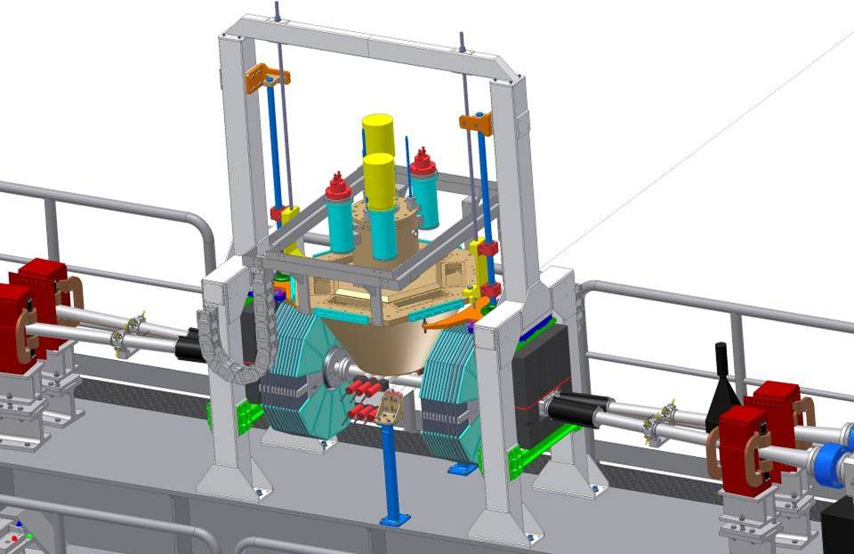

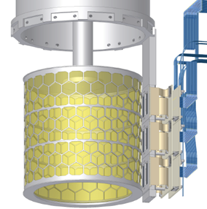

SIDDHARTA overview
Target
Detect
by SDDs
K⁻
e⁻
Detect by two scintillators
Φ
510 MeV/c
e⁺
127 MeV/c
Δp/p=0.1%
K⁺
510 MeV/c
y
x
z
19

Slide 20
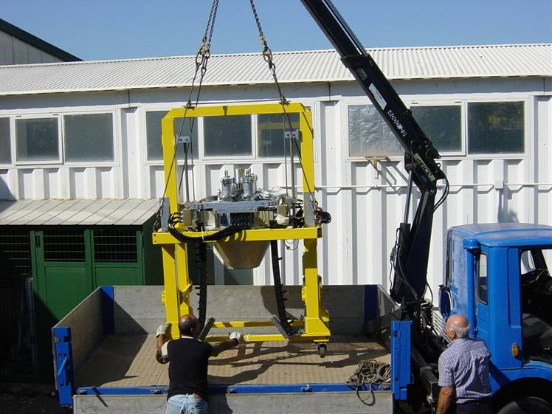

Slide 21
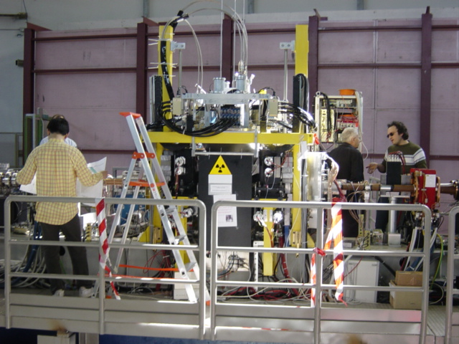

Slide 22
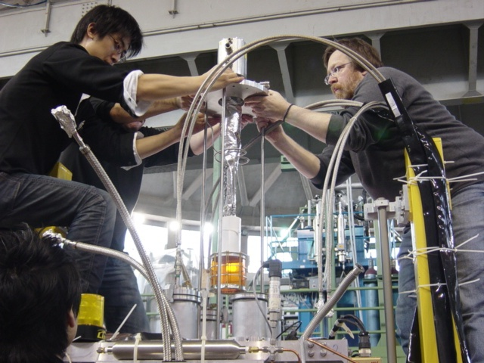

Slide 23
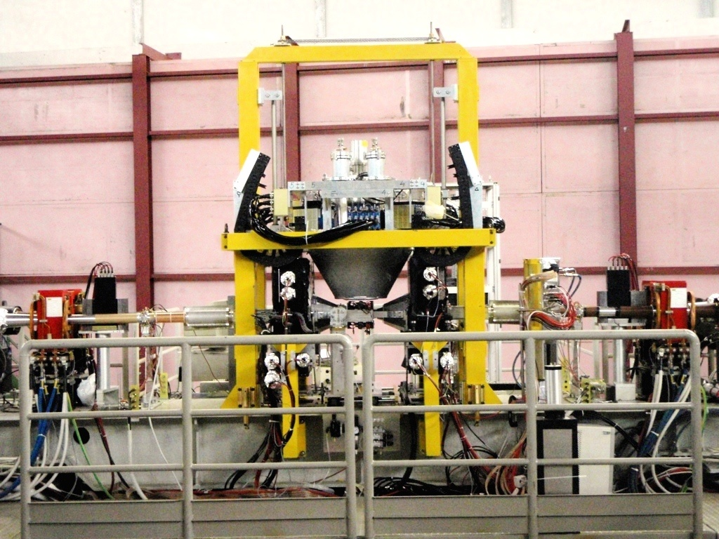

SDDs & Target
(inside vacuum)
Kaon detector

Slide 24
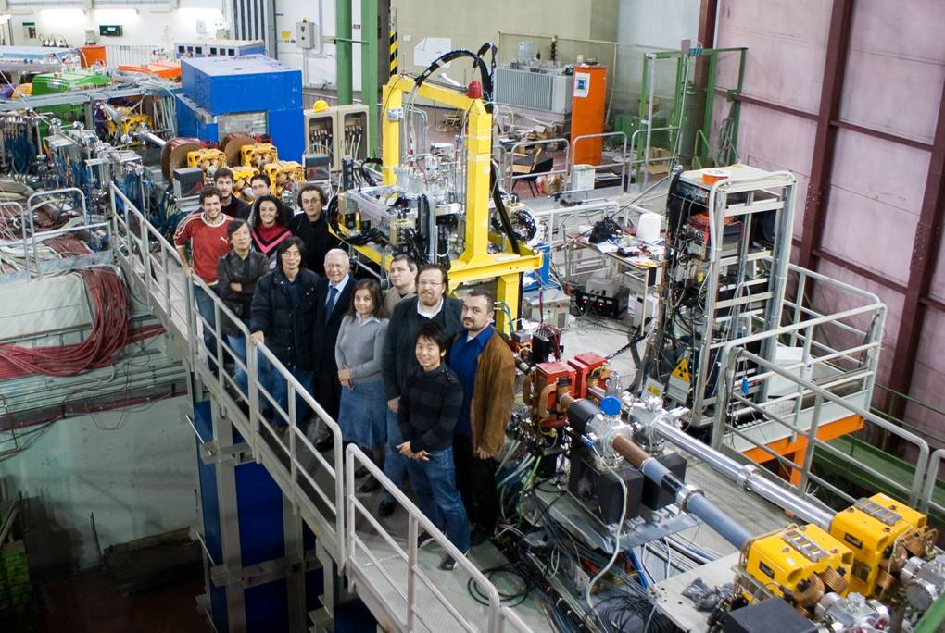

Slide 25
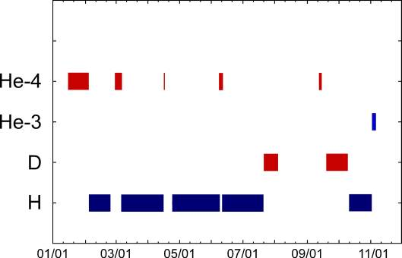
SIDDHARTA data

Slide 26
SIDDHARTA results:
- Kaonic Hydrogen: 400pb⁻¹, most precise measurement ever,Phys. Lett. B 704 (2011) 113, Nucl. Phys. A881 (2012) 88; Ph D
- Kaonic deuterium: 100 pb⁻¹, as an exploratory first measurement ever, Nucl. Phys. A907 (2013) 69; Ph D
- Kaonic helium 4 – first measurement ever in gaseous target; published in Phys. Lett. B 681 (2009) 310; NIM A628 (2011) 264 and Phys. Lett. B 697 (2011);; PhD
- Kaonic helium 3 – 10 pb⁻¹, first measurement in the world, published in Phys. Lett. B 697 (2011) 199; Ph D
- Widths and yields of KHe3 and KHe4 - Phys. Lett. B714 (2012) 40; ongoing: KH yields; kaonic kapton yields -> draft for publications
SIDDHARTA – important TRAINING for young researchers

Slide 27
Kaonic Helium 3 and 4

Slide 28
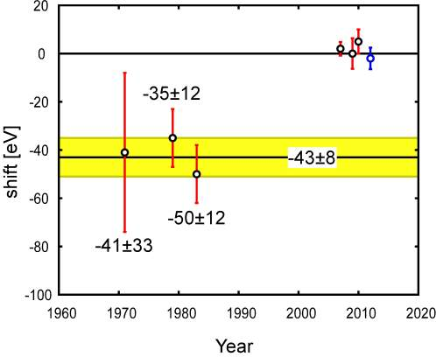
Kaonic 4 old data
KHe4

Slide 29
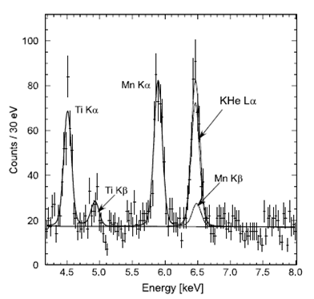
Data taking periods of SIDDHARTA in 2009
PLB681(2009)310
K-He4 data with Fe source
Use of
Mn Ka (5.9 keV) from ⁵⁵Fe
55Fe source:
Good for reduce sys. error on K-⁴He
Bad for “background” events on K-H,K-D
Removed ⁵⁵Fe source in other data
Systematic error = +/-2 eV

Slide 30

KHe-4 energy spectrum at SIDDHARTA
K-He data taking
PLB681(2009)310; NIM A 628(2011)264
Ti foil
No-coincidence
Target
Fe55
Degrader
coincidence

Slide 31
Data taking periods of SIDDHARTA in 2009
DAFNE shutdown in Summer
New alignment of setup
→Improve S/N ratio
K-He3 data (~4days)
55Fe source:
Good for reduce sys. error on K-⁴He
Bad for “background” events on K-H,K-D
Removed ⁵⁵Fe source in other data

Slide 32
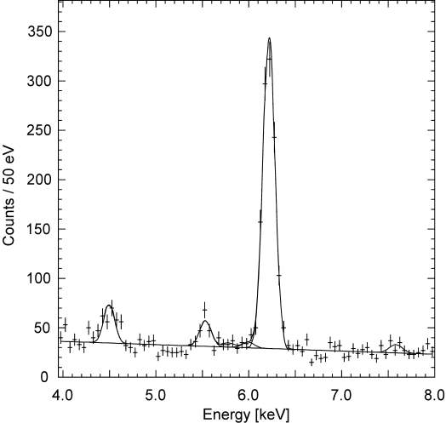
Kaonic Helium-3 energy spectrum
X-ray energy of K-3He 3d-2p
K-³He (3d-2p)
QED value:
Ti Ka
K-C
K-O
K-N
World First！
Observation of K-³He X-rays
Determination of
strong-interaction shift
arXiv:1010.4631v1 [nucl-ex], PLB697(2011)199

Slide 33
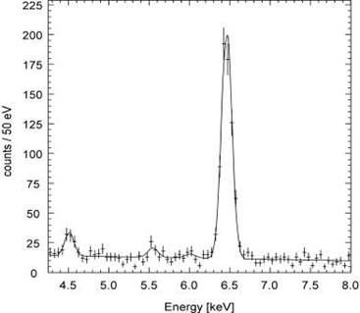
K-4He (3d-2p)
PLB697(2011)199
K-3He (3d-2p)
DAFNE shutdown in Summer

Slide 34
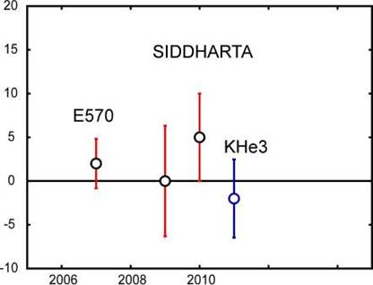
Comparison of results
 | Shift [eV] | Reference
KEK E570 | +2±2±2 | PLB653(07)387
SIDDHARTA (He4 with 55Fe) | +0±6±2 | PLB681(2009)310
SIDDHARTA (He4) | +5±3±4 | arXiv:1010.4631, PLB697(2011)199
SIDDHARTA (He3) | -2±2±4
*error bar

Slide 35
the strong-interaction width of the kaonic 3He and 4He
2p state http://arxiv.org/abs/1205.0640v1
Phys. Lett. B714 (2012) 40

Slide 36
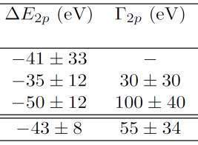
Old kaonic He4 measurements
Average
Theory: -0.13+-0.02 1.8+-0.05

Slide 37
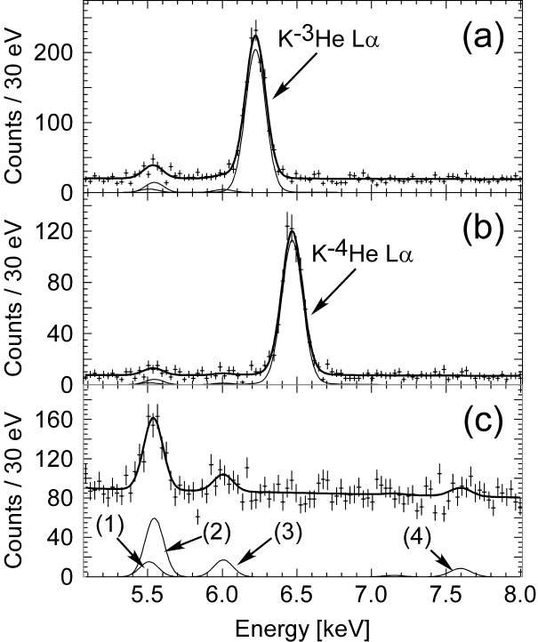


K-d

Slide 38
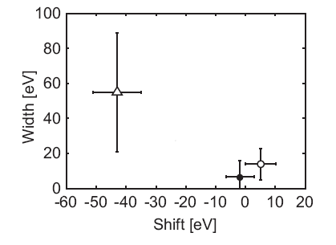
Old average
K-3He width
Figure 5: Comparison of experimental results. Open circle: K-4He 2p
state; filled circle: K-3He 2p state. Both are determined by the SIDDHARTA
experiment. The average value of the K-4He experiments performed in the 70’s and 80’s is plotted with the open triangle.
K-4He width

Slide 39
Kaonic Helium results:
- first measurements of KHe3 and in gas He4
- if any shift of 2 p level is present – is small
- KHe3 measurement took 3 days!!! – proves how EXCELLENT is SIDDHARTA-like method at DAFNE
- SIDDHARTA-2 – can do much better: KHe3,4 at eV and try measurement of 1s levels!

Slide 40
Kaonic Hydrogen

Slide 41
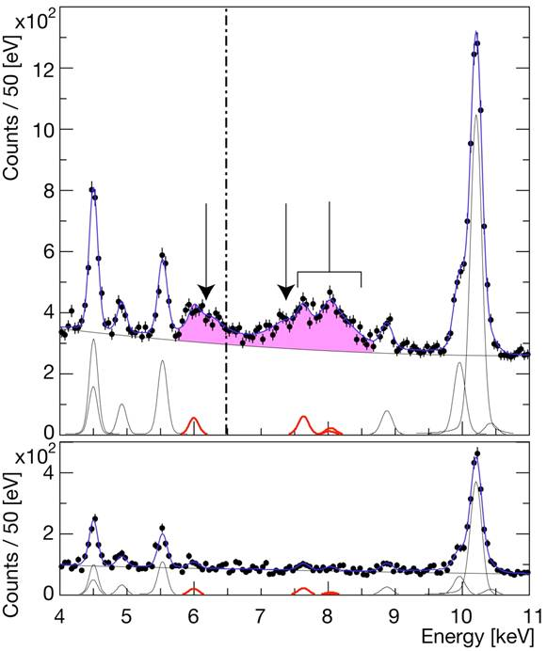
Hydrogen
spectrum
EM value
K-p Kα
Kaonic hydrogen
Kα
Kβ
higher
KC54
Ti Kα
KC65
simultaneous
fit
Ti Kβ
KC75
KO65
KO76
KN65
Cu
KAl87
Deuterium
spectrum
Background estimation

Slide 42
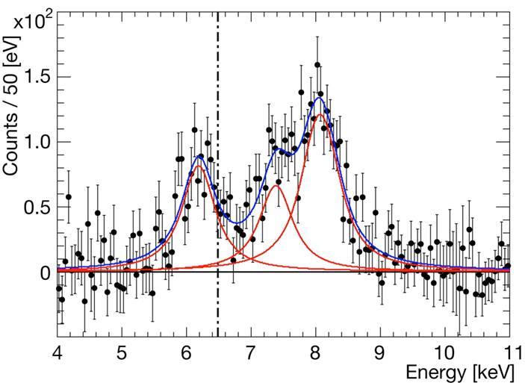
Residuals of K-p x-ray spectrum
after subtraction of fitted background
Kaonic hydrogen
higher
Kα
Kβ
EM value
K-p Kα

Slide 43
KAONIC HYDROGEN results
ε_{1S}= −283 ± 36(stat) ± 6(syst) eV
Γ_{1S}= 541 ± 89(stat) ± 22(syst) eV

Slide 44
Kaonic Deuterium exploratory measurement

Slide 45
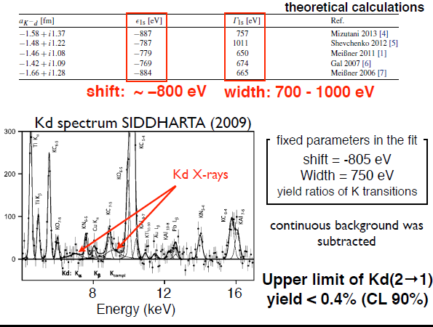

Slide 46
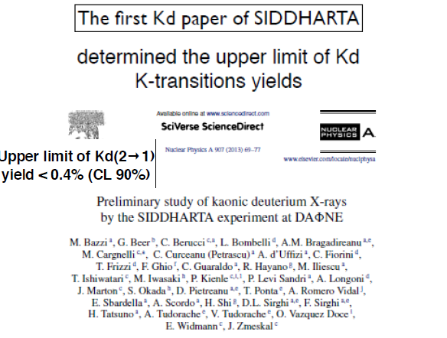

Slide 47

Kaonic Hydrogen results:
- most reliable and precise measurement ever
- need to go for Kd! -> SIDDHARTA-2

Slide 48
DAFNE represents (as always did) an (THE) EXCELLENT FACILITY in the sector of
low-energy interaction studies of kaons with nuclear matter.
It is actually the IDEAL facility for kaonic atoms studies as SIDDHARTA has demonstrated
SIDDHARTA-2 team is ready to restart the measurements, having a multi-step strategy, strating with the Kaonic deuterium

Slide 49
SIDDHARTA–2
49

Slide 50
The SIDDHARTA-2 setup,
essential improvements
      new target design
      new SDD arrangement
      vacuum chamber
      more cooling power
      improved trigger scheme
      shielding and anti-coincidence (veto)
50

Slide 51
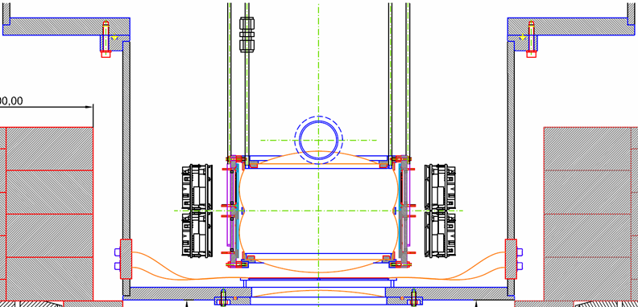
Target cell
SDDs
SDD-
electronic
Kaon monitor
upper scintillator
K⁻
Interaction
region
Veto counter
Kaon monitor
lower scintillator
K⁺
Kaonstopper:
K⁺-K⁻ discrimination
51

Slide 52
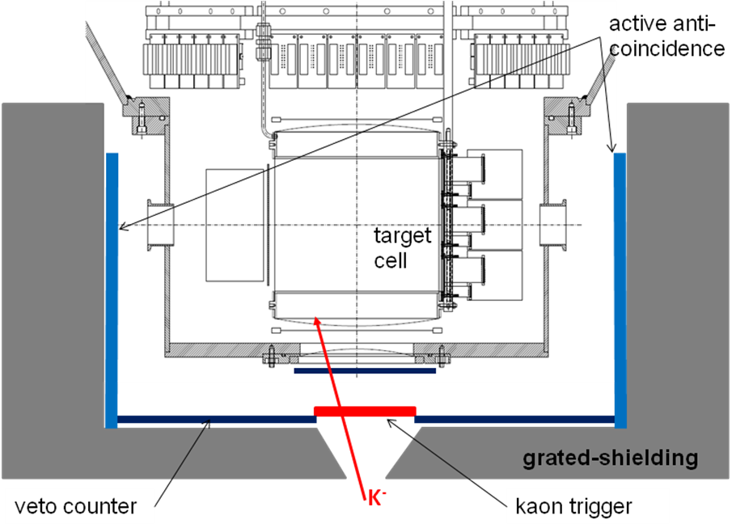
52

Slide 53
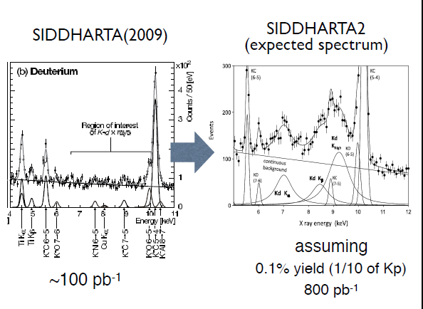

53

Slide 54
1) Kaonic deuterium measurement - 1st measurement: and R&D for other measurements
2) Kaonic helium transitions to the 1s level – 2nd measurement, R&D
3) Other light kaonic atoms (KO, KC,…)
4) Heavier kaonic atoms measurement (Si, Pb…)
5) Kaon radiative capture – Λ(1405) study
6) Investigate the possibility of the measurement of other types of hadronic exotic atoms (sigmonic hydrogen ?)
7) Kaon mass precision measurement at the level of <10 keV
SIDDHARTA-2 scientific program
ECT* Workshop in Otctober 2013
Strangeness in the Universe?
Theoretical and experimental challenges and progress

Slide 55
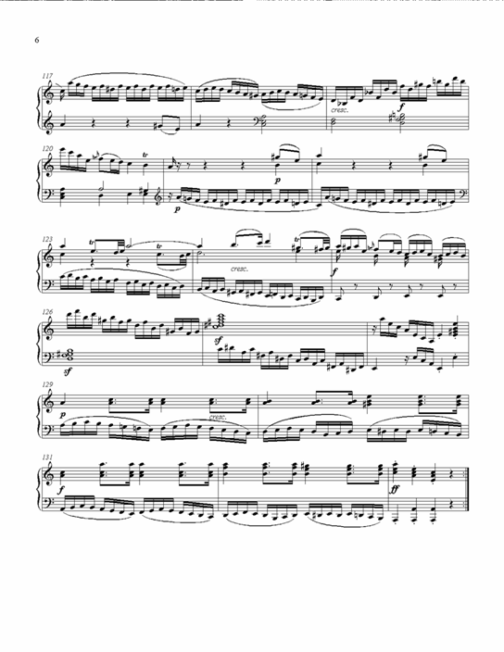
Antikaonic
Matter
At
DAΦNE: an
Experiment
Unraveling
Spectroscopy
AMADEUS

Slide 56
AMADEUS
AMADEUS collaboration
116 scientists from 14 Countries and 34 Institutes
lnf.infn.it/esperimenti/siddharta
and
LNF-07/24(IR) Report on lnf.infn.it web-page (Library)
AMADEUS started in 2005 and
was presented and discussed in all the LNF Scientific Committees
Antikaon Matter At DAΦNE: Experiments with Unraveling Spectroscopy
EU Fundings FP7 – I3HP2:
Network WP9 – LEANNIS;
WP24 (SiPM JRA);
WP28 (GEM JRA)

Slide 57
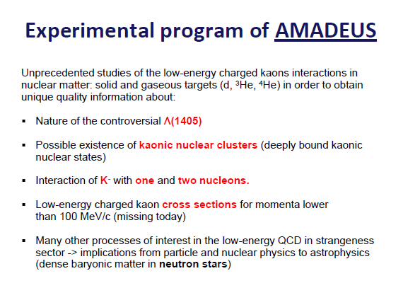

Slide 58
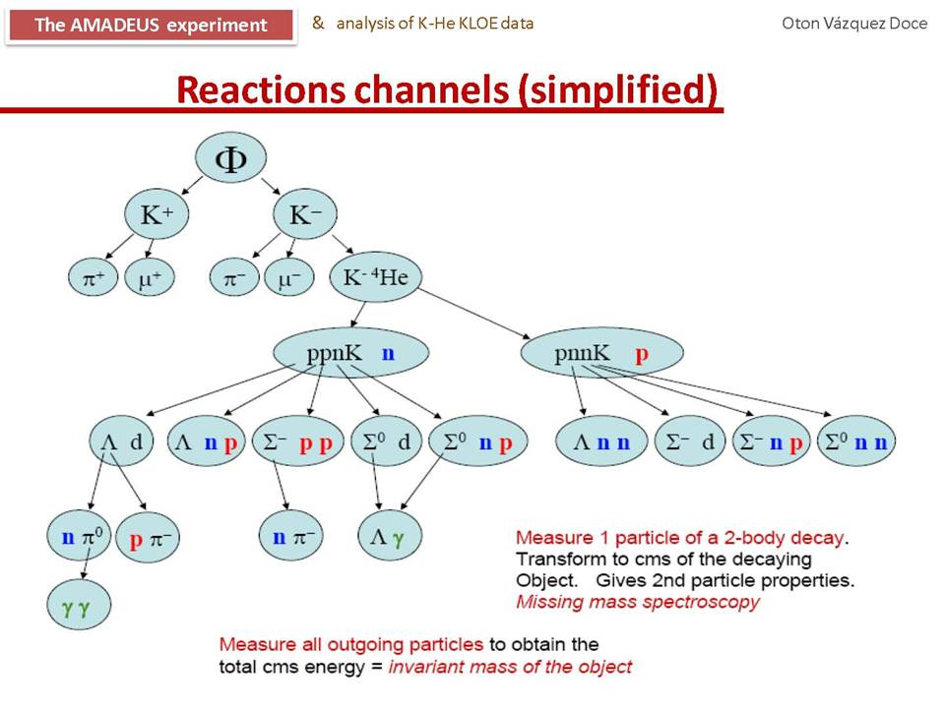

Slide 59
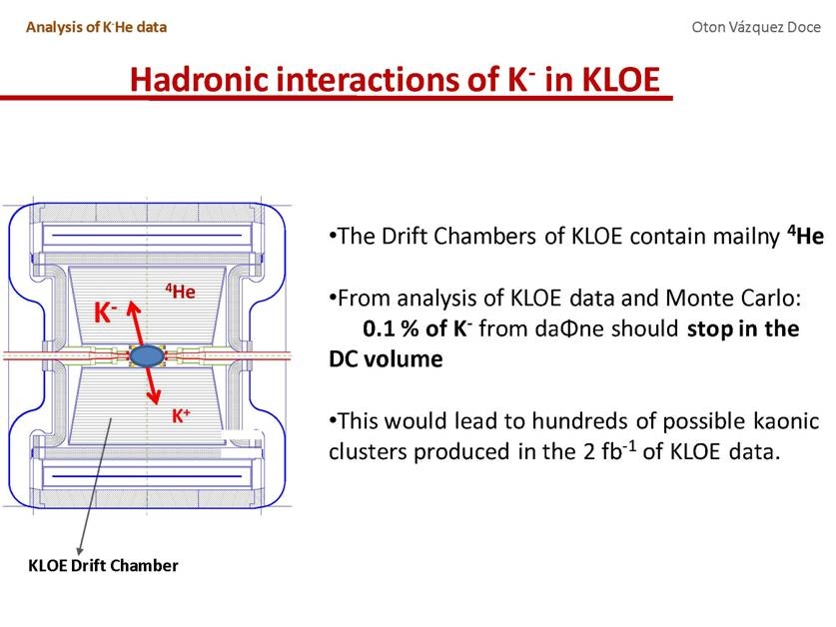

Slide 60
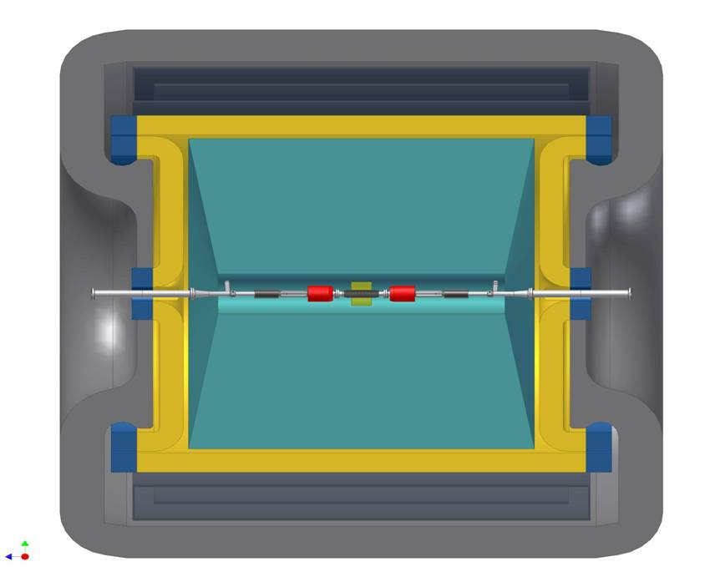
AMADEUS @ KLOE

Slide 61
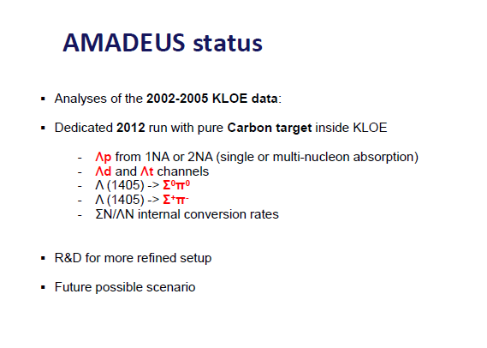

Slide 62
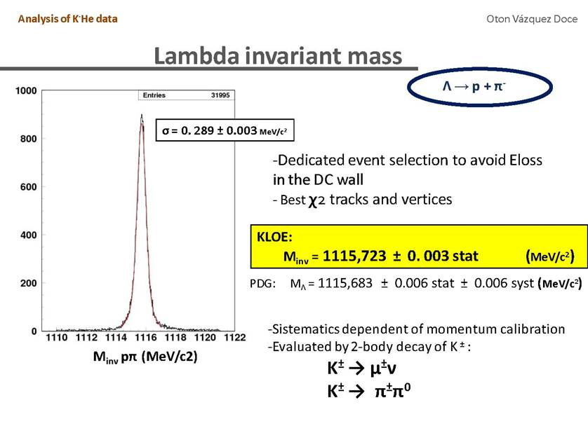
Energy loss
PRELIMINARY
Preliminary evaluation with 2-body decay

Slide 63
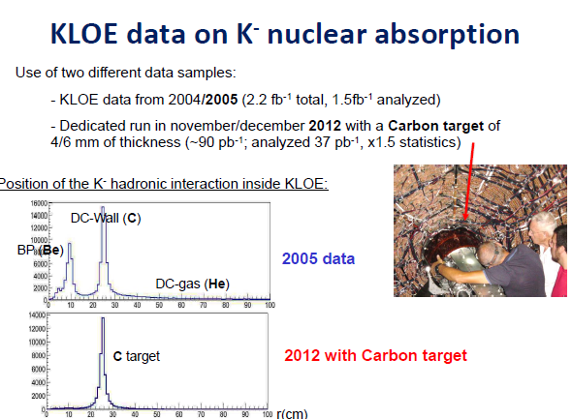

Slide 64
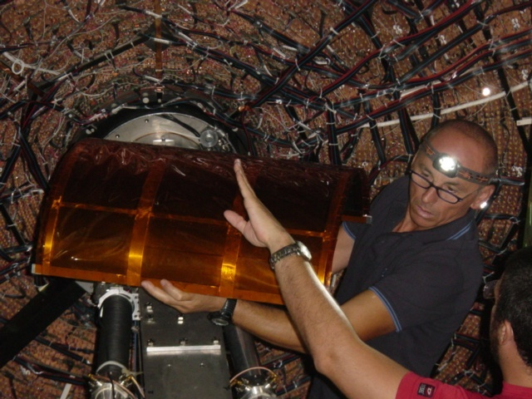
Pure carbon target inserted in KLOE end of August 2012 ; data taking till December 2012

Slide 65
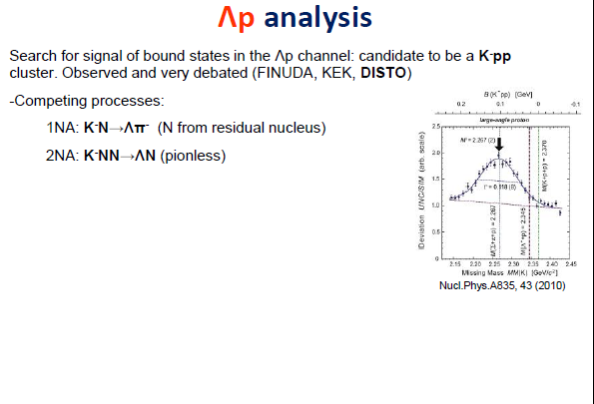

Slide 66
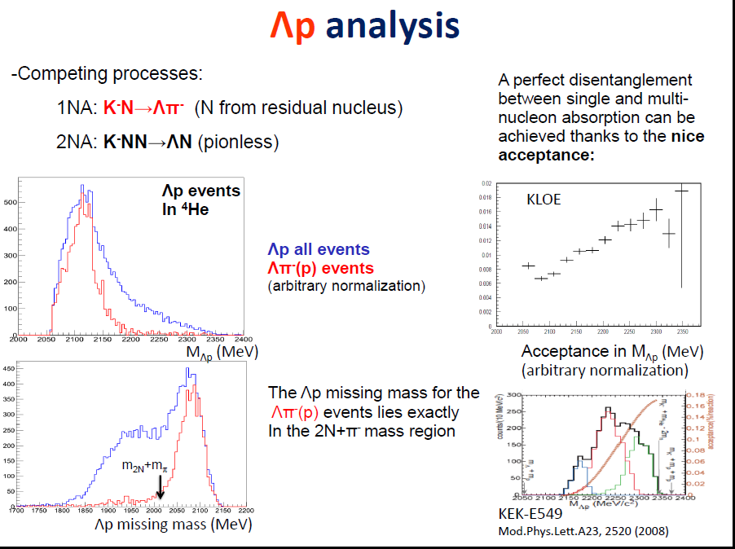

Slide 67
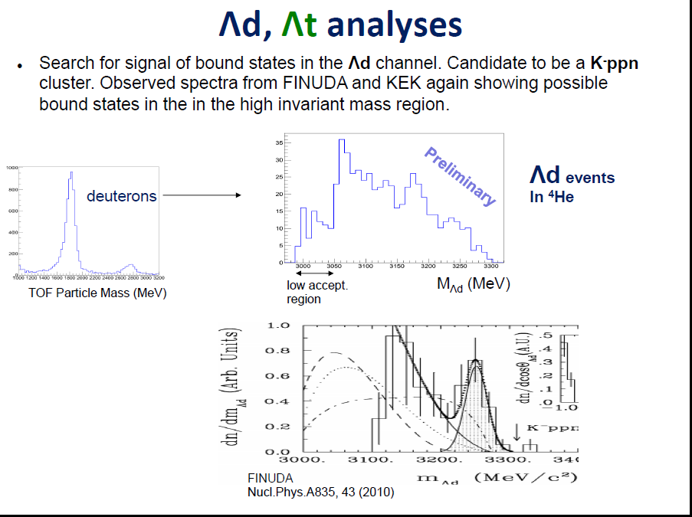

Slide 68
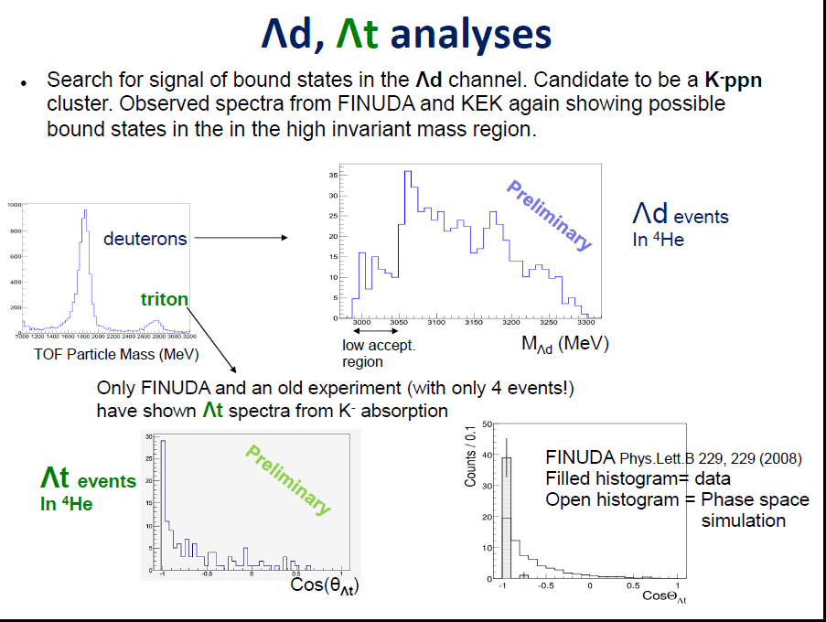

Slide 69
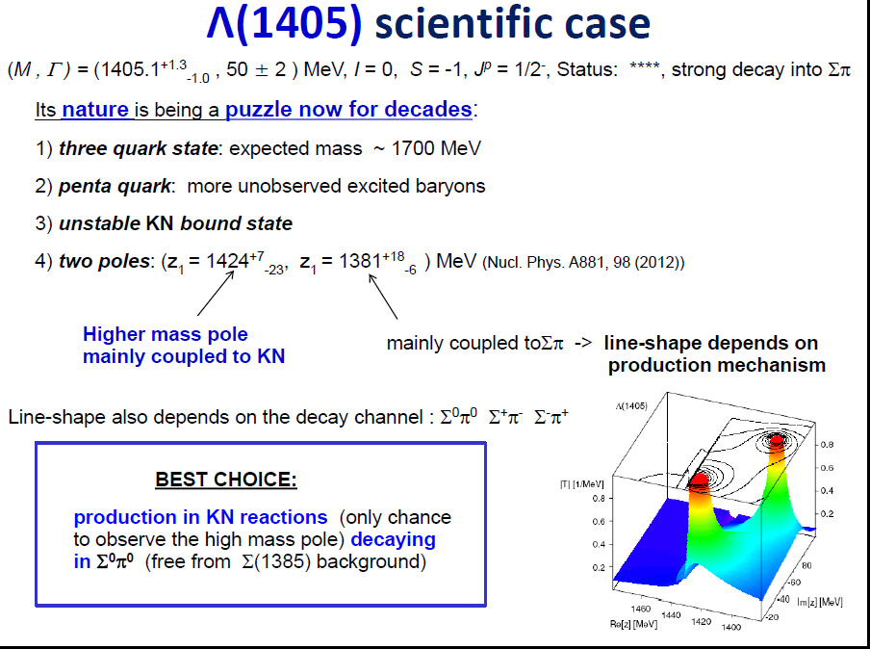

Slide 70
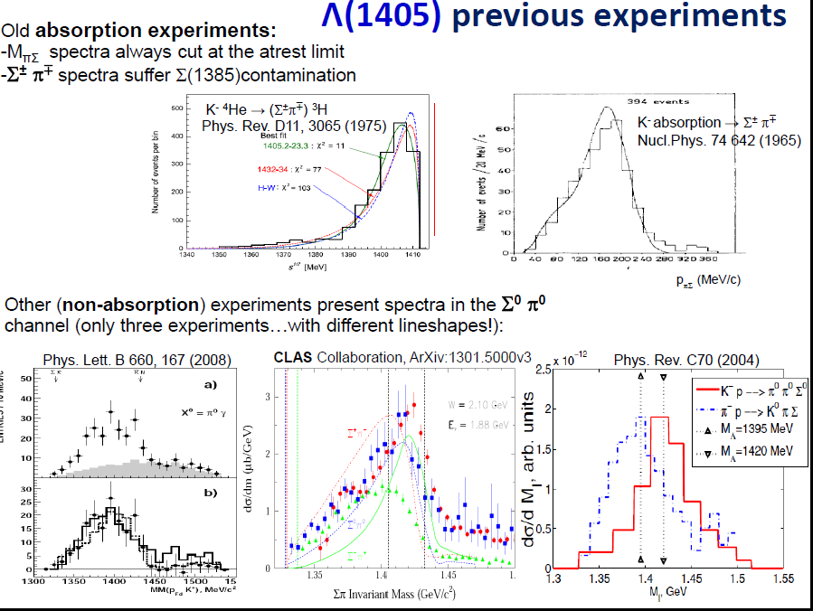

Slide 71
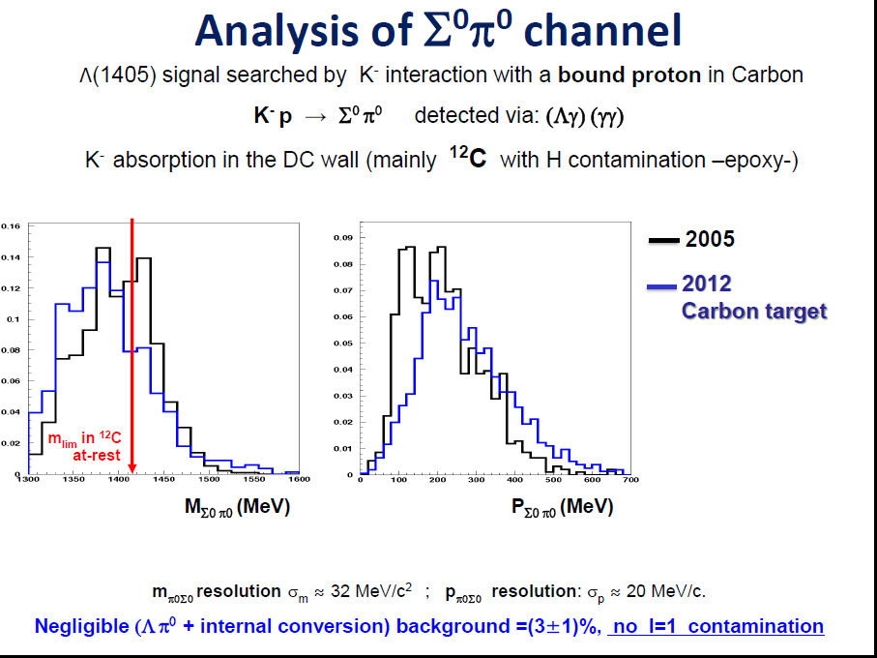

Slide 72
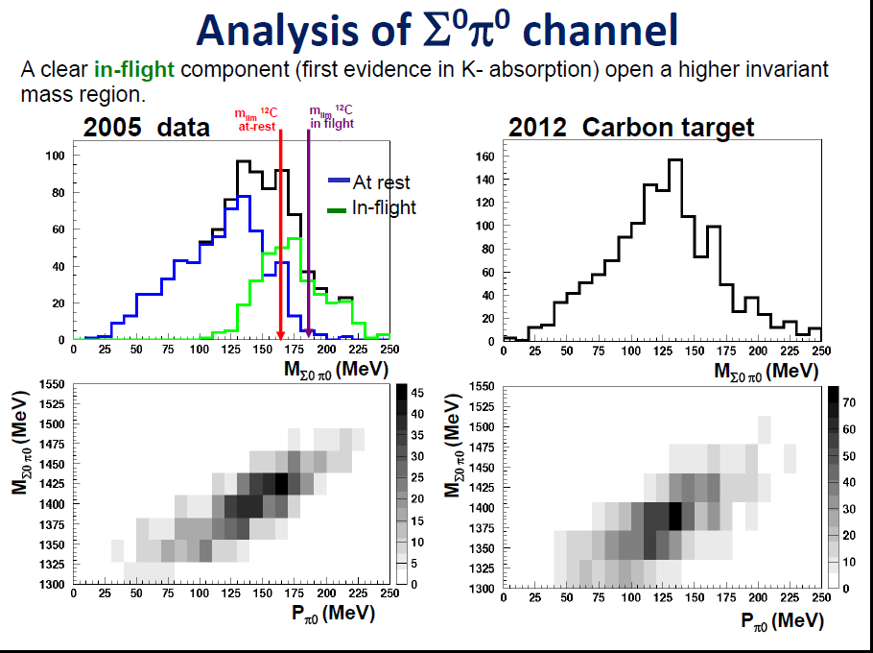

Slide 73
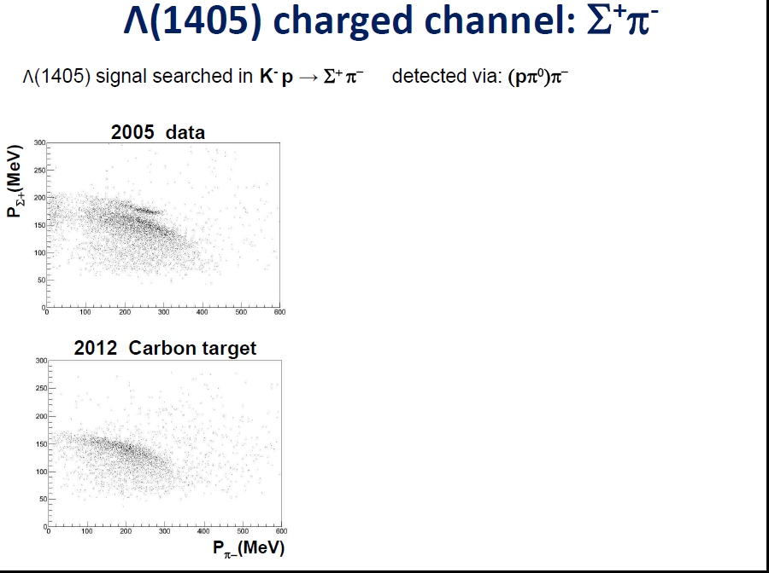

Slide 74
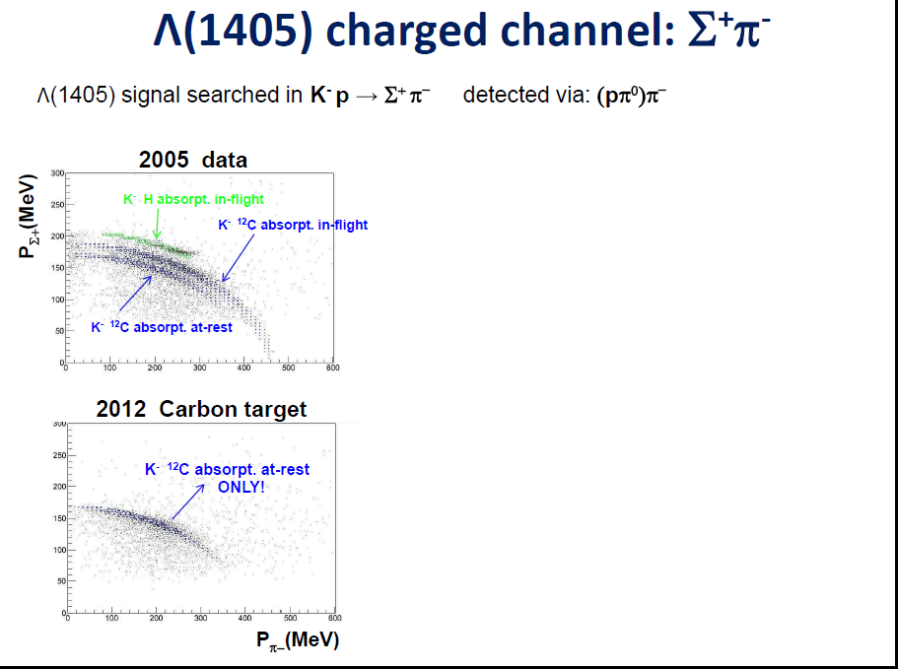

Slide 75


Slide 76
Conclusions for AMADEUS
AMADEUS has an enomous potential to perform complete measurements of low-energy kaon-nuclei interactions in various targets
Data analyses ongoing
For future: use of other dedicated targets (gas and solid)

Slide 77

DAFNE represents an unique
opportunity to unveil the
secrets of the kaon-nucleon/nuclei
interaction at low energy

