Slide 1
Detecting the Anti-helium 4 and anti-hypertriton from the RHIC
Yu-Gang Ma
Shanghai Institute of Applied Physics (SINAP),
Chinese Academy of Sciences
Introduction
Detecting the antimatter nuclei at RHIC-STAR
--The 1st anti-hypernucleus: anti-hypertriton
--The heaviest antimatter nucleus (so far): anti-Helium 4
Production mechanism of anti-nuclei
Searching for anti-He4 in cosmos
Summary & outlook
2013/6/2－6/7 @ INPC2013
（Firenze, Italy）

Slide 2

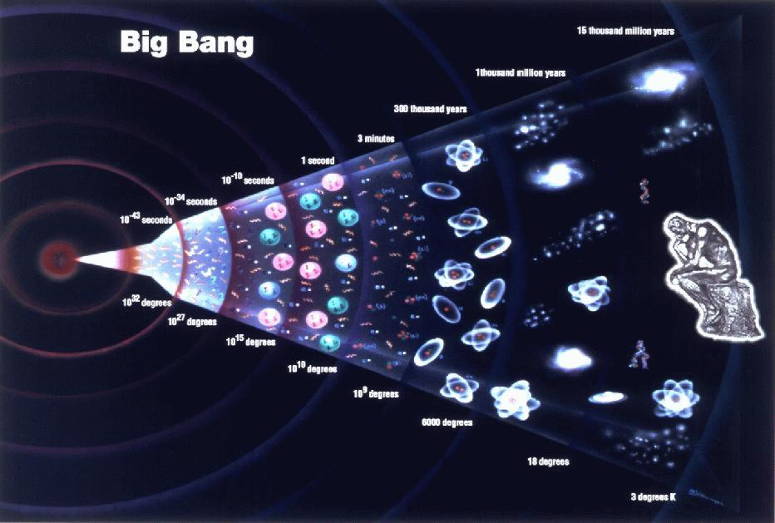
From Big Bang to Little Bang
Time evolution of relativistic heavy-ion collisions
Equal amounts
of matter &
antimatter
Matter Dominates !

Slide 3
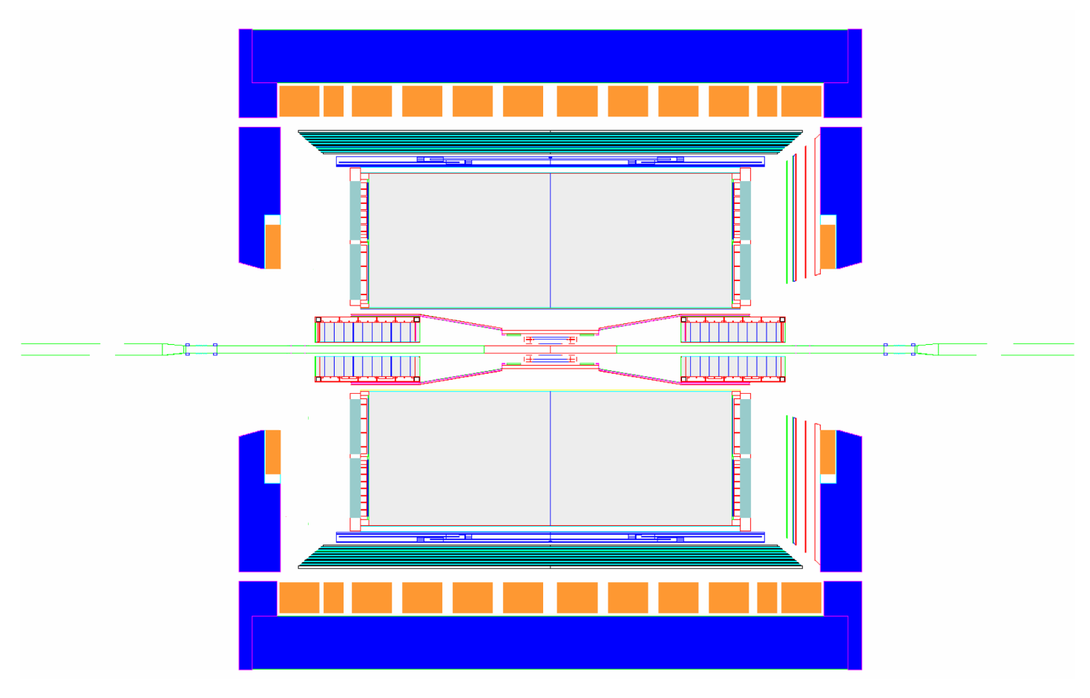
Key Components of RHIC-STAR detector for this Search
MRPC ToF Barrel
_{MTD}
_{EMC Barrel}
_{EMC End Cap}
_{FMS}
_{BBC}
_{FHC}
_{FPD}
TPC
_{pp2pp’}
_{pp2pp’}
_{PMD}
_{FTPC}
_{trigger}
_{computing}
_{DAQ1000}
_{COMPLETE}
HLT
_{HFT}
_{FGT}
_{Ongoing}
_{R&D}
Aihong Tang
3
Notes:
3

Slide 4
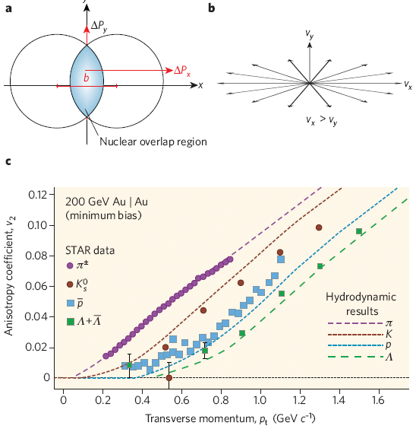
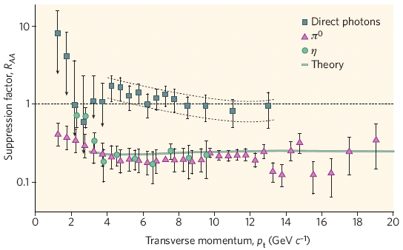
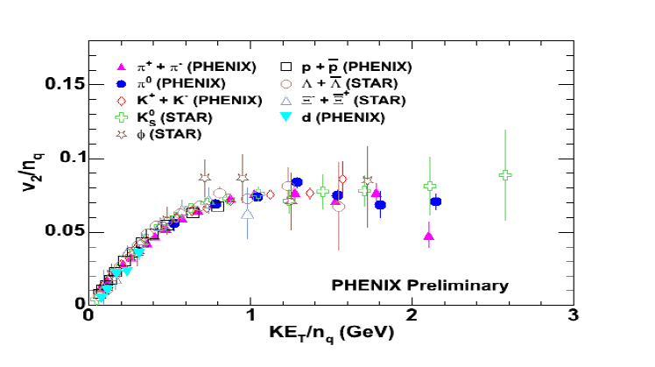
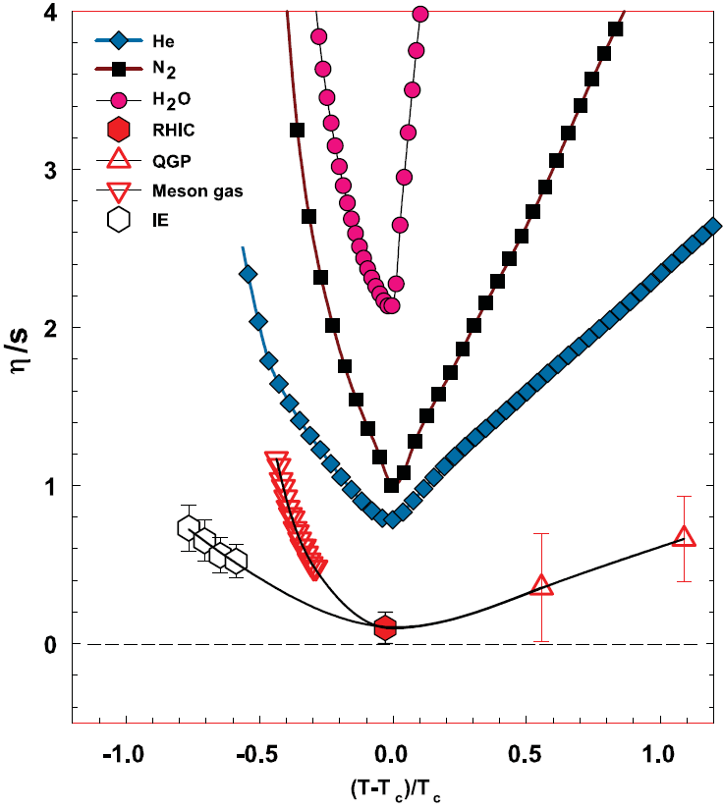
RHIC is not only a machine for sQGP
(Some talks in this conferences.)
The sQGP
Jet quench: Hot dense matter
Ideal hydrodynamics flow @ low Pt
the lowest shear viscosity/entropy
Middle Pt
Partonic collectivity
The evidence is strong that one has made a system of quarks and gluons which is to a good to fair approximation explained by a Quark Gluon Plasma
McLerran, QM06

Slide 5

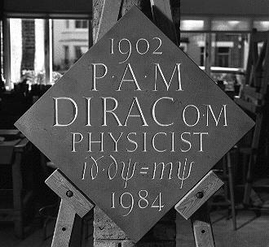
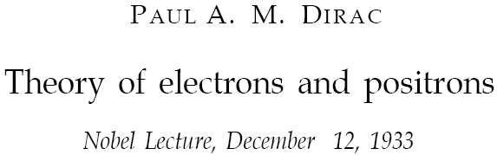
But also for Anti-matter particles
1928: Dirac equation unifies
Quantum Mechanics and Special Relativity:
Paul A.M. Dirac
1) Negative energy solutions can be seen as particles traveling backwards in time, equivalent to anti-particles traveling forward in time (Feynman & Stückelberg)
2) The # of particles is NOT conserved but #particles - #antiparticles is conserved)
Westminster Abbey

Slide 6
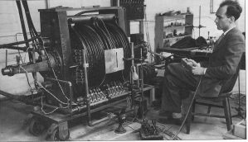
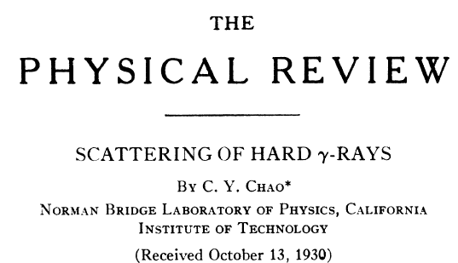
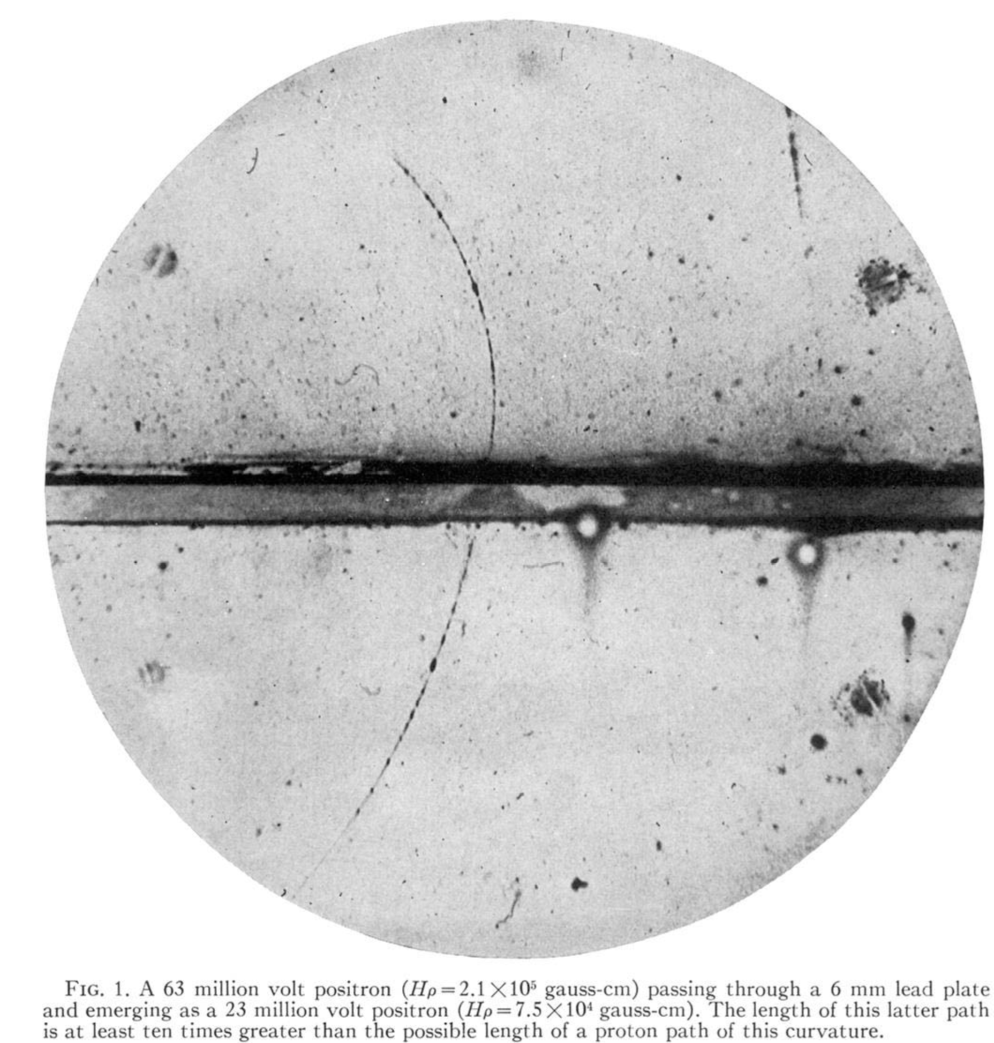
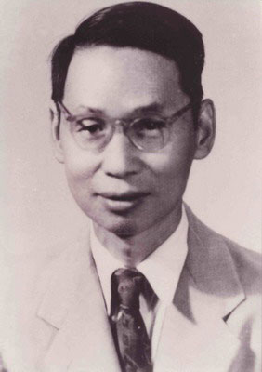
Discovery of the first antiparticle: positron
In 1930, C.Y. Chao
Observed an “abnormal”-absorption of hard-gamma rays in heavy elements: an indirect evidence of positron
On August, 1932, C. D. Anderson identified 15 positive tracks by photographing the cosmic rays with a vertical Wilson chamber.

Slide 7
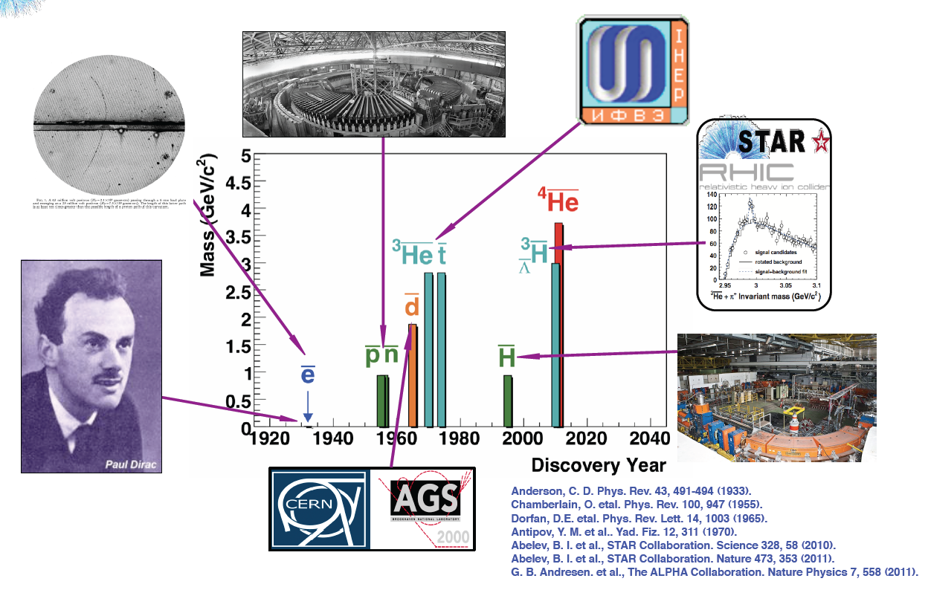
History of antimatter particles
IHEP, Russia
Bevatron facility
CERN

Slide 8
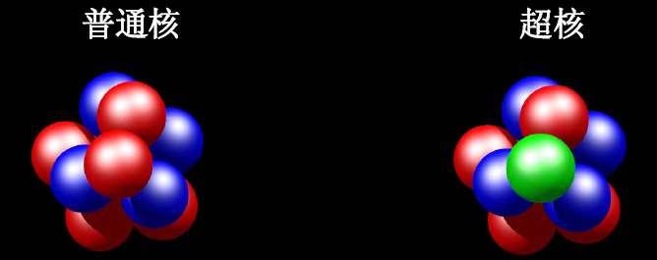
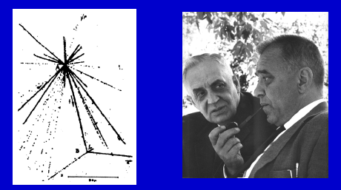
Hypernucleus
(仅含 u,d夸克)
(含有: s夸克)
Nucleus which contains at least one hyperon in addition to nucleons.
Hypernuclei of lowest A
Y-N interaction: a good window to
understand the baryon potential
Binding energy and lifetime are
very sensitive to Y-N interactions
Hypertriton: ΔB=130±50 KeV; r~10fm
Production rate via coalescence
at RHIC depends on overlapping wave
functions of n+p+Λ in final state
Important first step for searching for
other exotic hypernuclei (double-Λ)
The first hypernucleus was discovered by Danysz and Pniewski in 1952. It was formed in a cosmic ray interaction in a balloon-flown emulsion plate.
M. Danysz and J. Pniewski, Phil. Mag. 44 (1953) 348
No one has ever observed
any antihypernucleus
Notes:
8

Slide 9
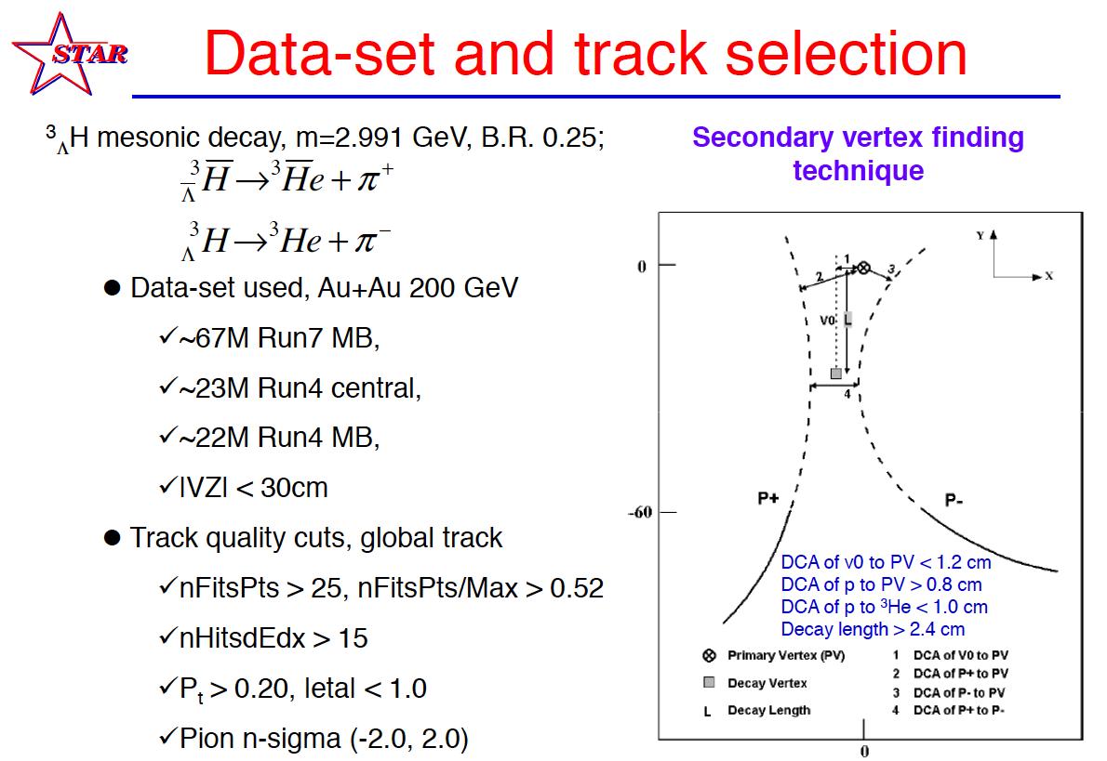

Slide 10


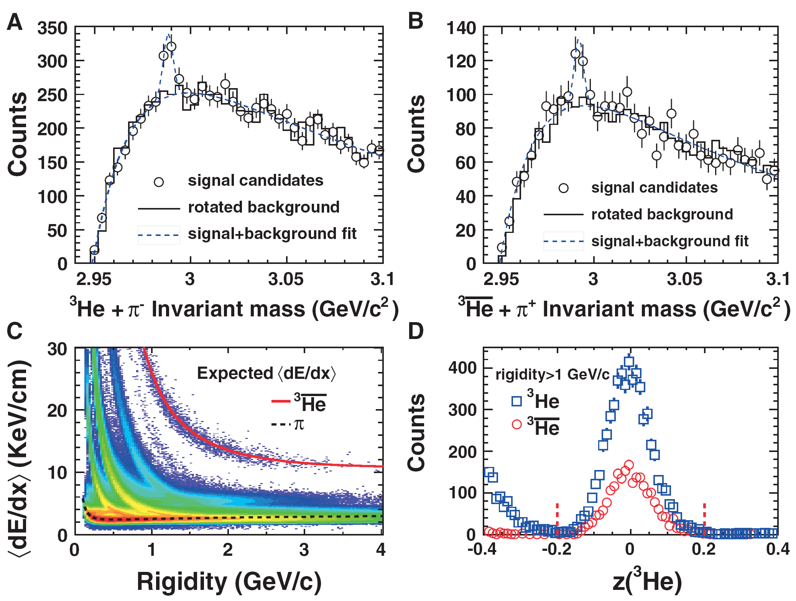
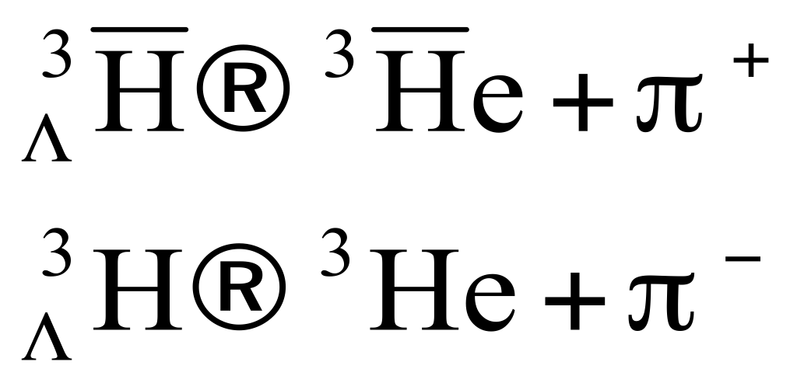
Observation of anti-hypertriton from RHIC-STAR
Decay channel : , branch ratio 25%
STAR, Science 328 (2010) 58
70±17 antihypertritons
157 ±30 hypertritons
About 89 million minimum-bias events
22 million most central collisions events

Slide 11
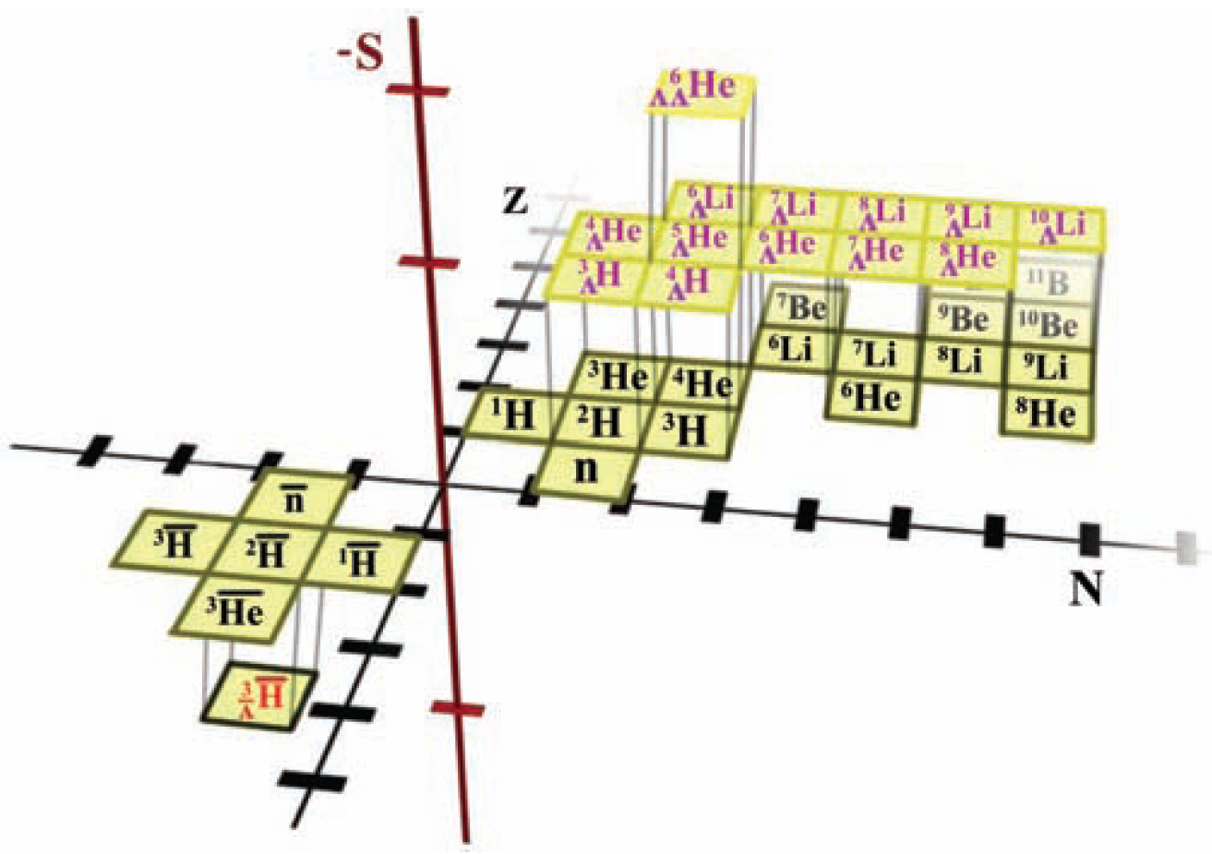
Tracks in TPC
It is the first nucleus with anti-strange quark;
Extend the nuclear chart into a new anti-strangeness region
J. H. Chen (SINAP), NUCL. PHYS. A 835, 117 (2010) (HYP2009 Plenary talk)
Z. B. Xu (BNL), BNL Physics Seminar, 2010
J.H. CHEN, Z. B. XU ET AL.

Slide 12
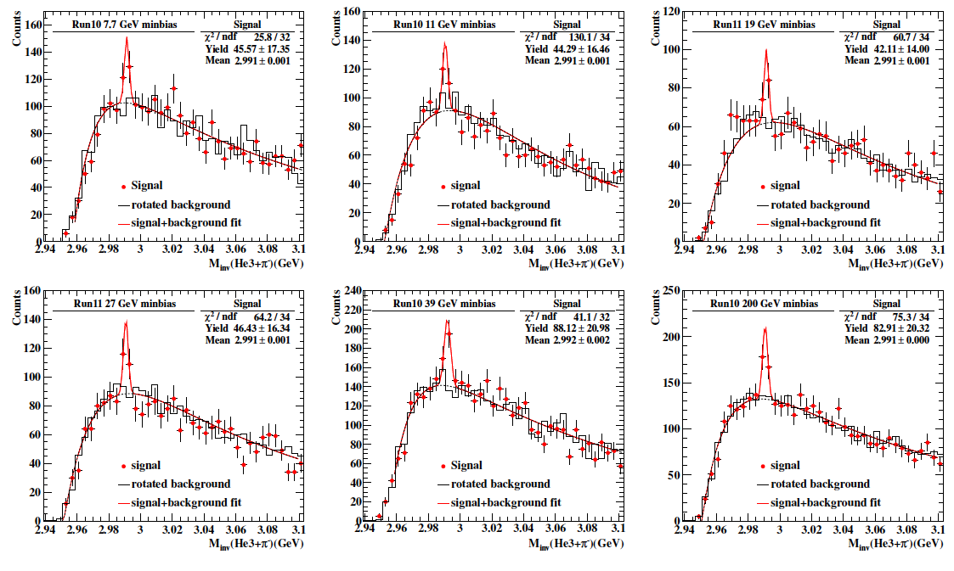
Hypertriton signal from STAR BES at =7.7, 11.5, 19.6, 27, 39, 200GeV
STAR preliminary
STAR preliminary
Zhu Yuhui（SINAP)， PhD thesis, 2013

Slide 13
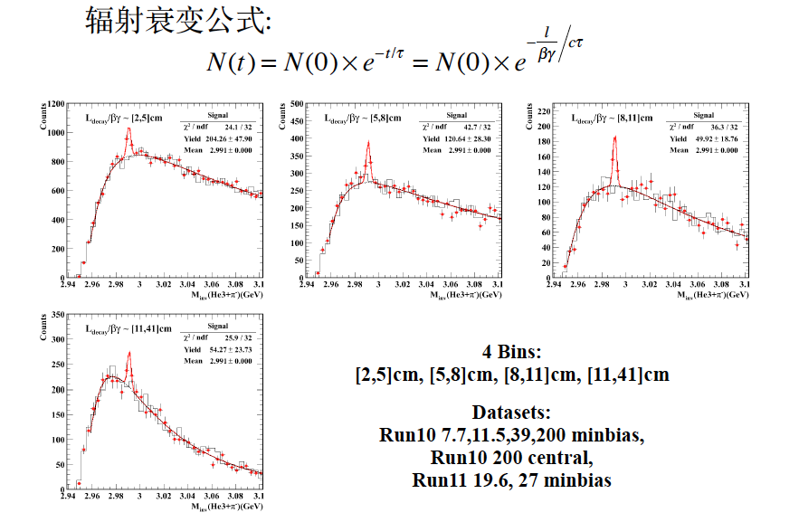
Lifetime measurement formula: radiation decay
STAR preliminary
Zhu Yuhui（SINAP)， PhD thesis, 2013

Slide 14
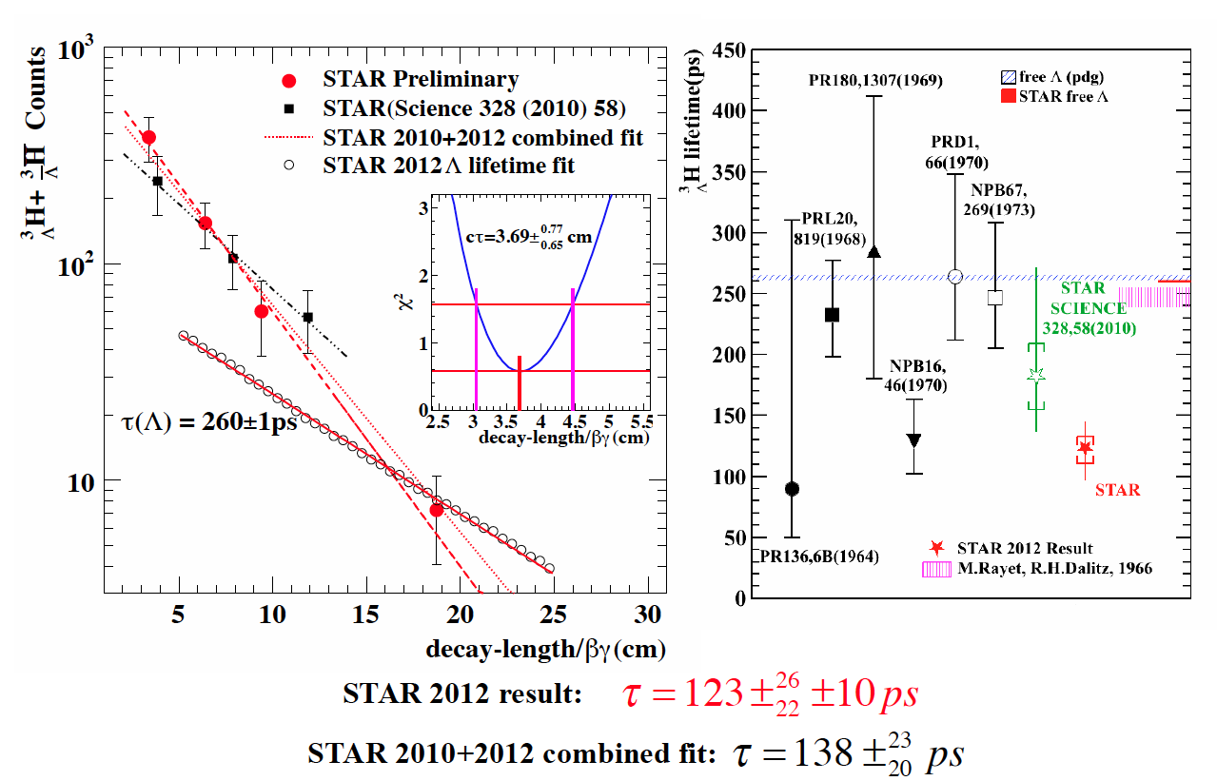
Lifetime puzzle: So short?
Zhu Yuhui（SINAP)， PhD thesis, 2013

Slide 15
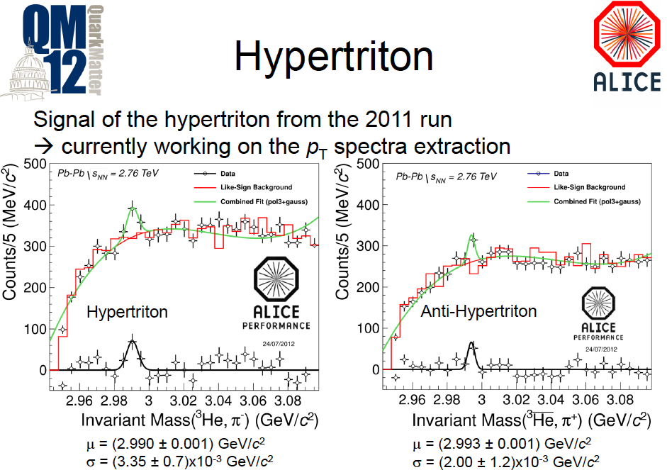
ALICE’s observation for (anti-)hypertriton

Slide 16
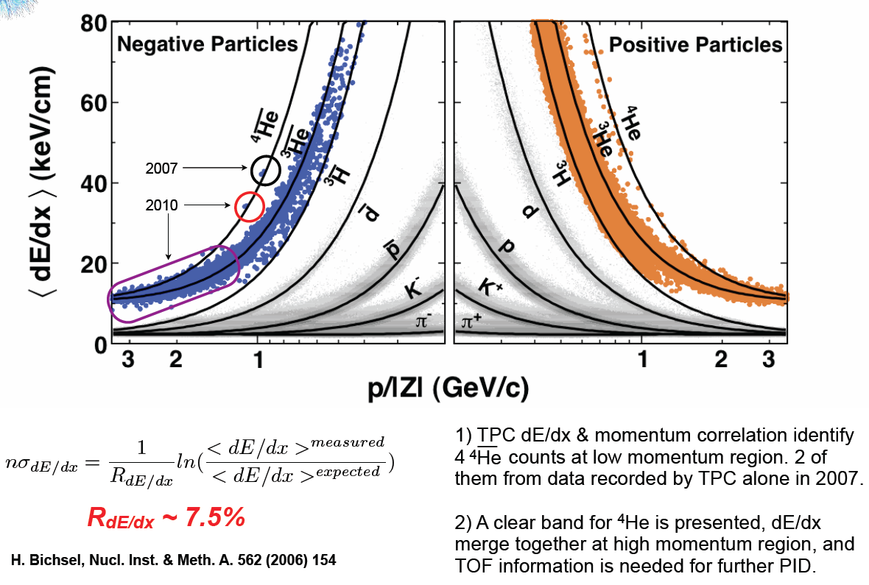
dE/dx vs Rigidity
~1 billion AuAu STAR events sampled
HLT has processing power to do rudimentary event reconstruction in real time, allowing events with a |Z| = 2 track to be tagged and fast-tracked via the normal offline calibration & reconstruction chain.
Nature (2011) DOI: doi:10.1038/nature10079 || STAR Experiment
Received 14 March 2011 | Accepted 04 April 2011 | Published online 24 April 2011
L. Xue (SINAP) for the STAR Collaboration, J. Phys. G 38 (2011) 124072 (QM2011 talk).
A.H. Tang (BNL) for the STAR Collaboration, BNL Physics Colloquium, April 2011
just because something is impossible today doesn’t mean it will be impossible in the future.

Slide 17
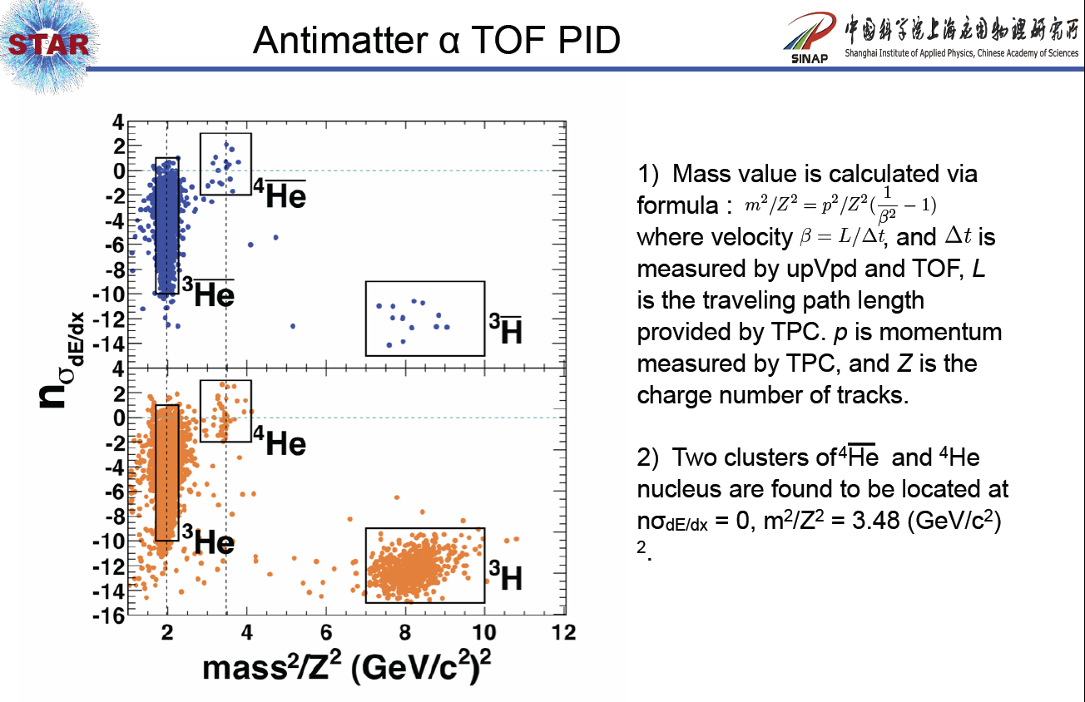

Combined PID (TPC+TOF)
_{Preliminary}
just because something is impossible today doesn’t mean it will be impossible in the future.

Slide 18
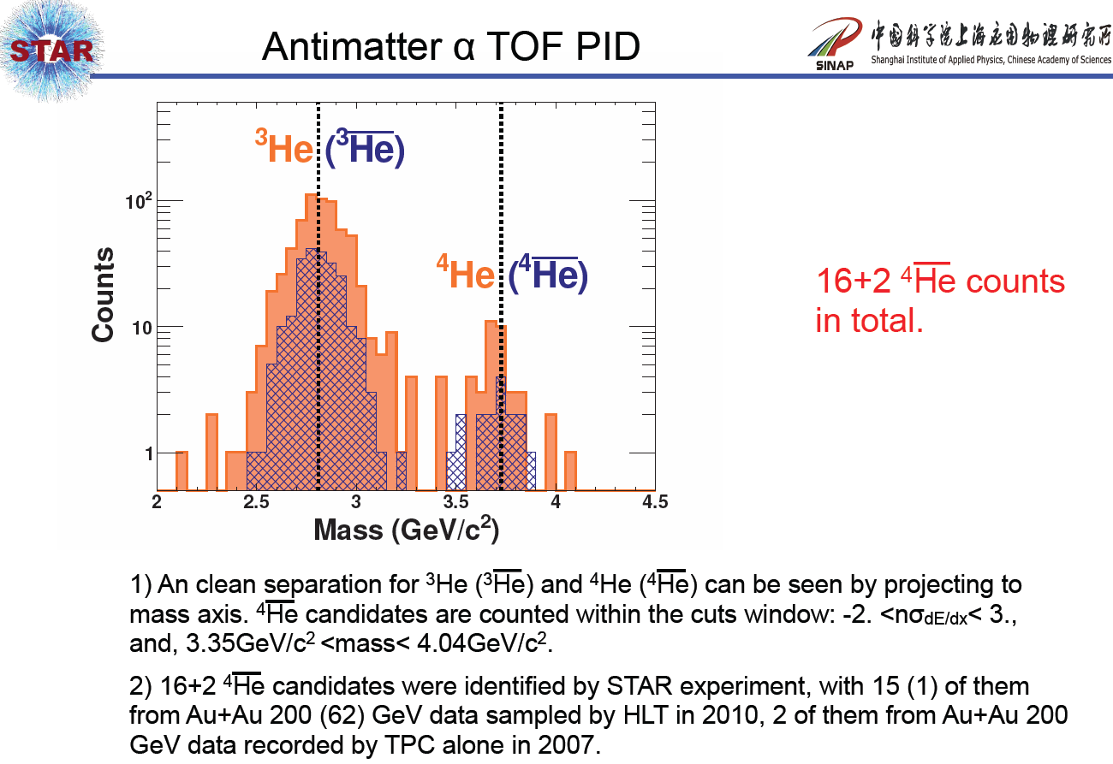

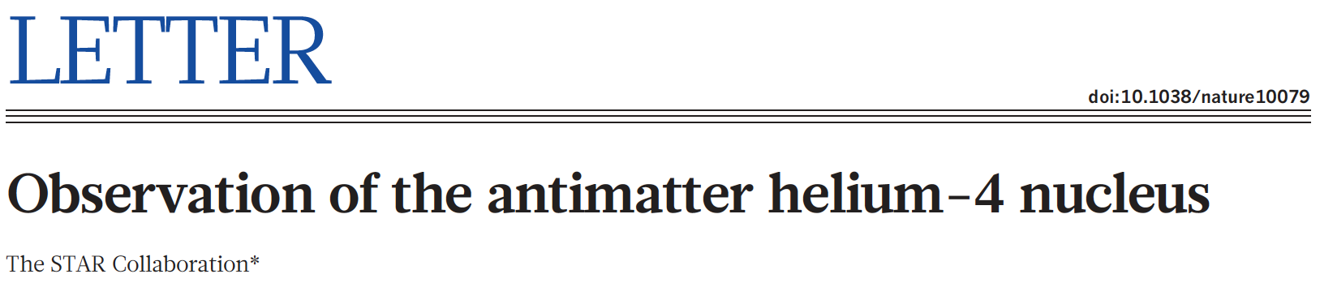
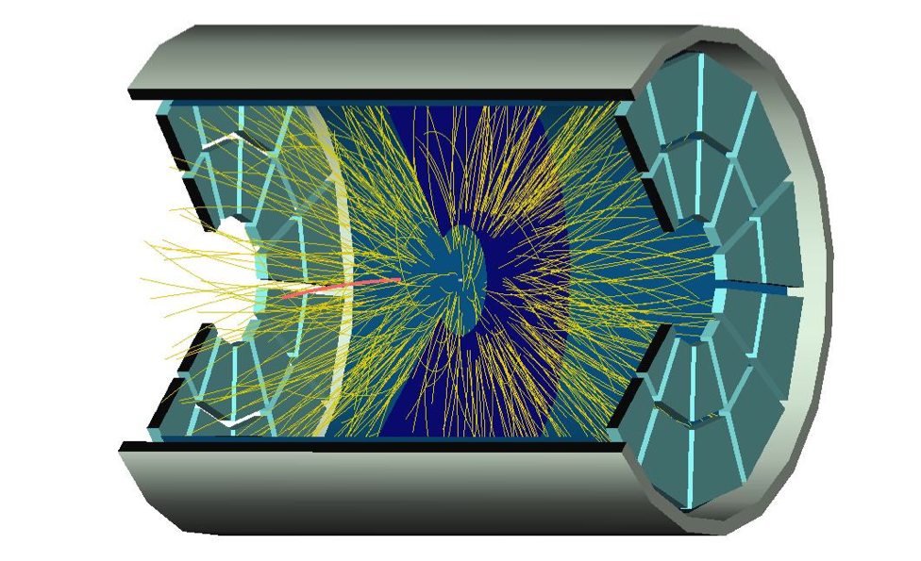
Combined PID (TPC+TOF)
just because something is impossible today doesn’t mean it will be impossible in the future.
Very clean identification after search of > half-trillion tracks
from almost one billion gold-gold collisions.

Slide 19
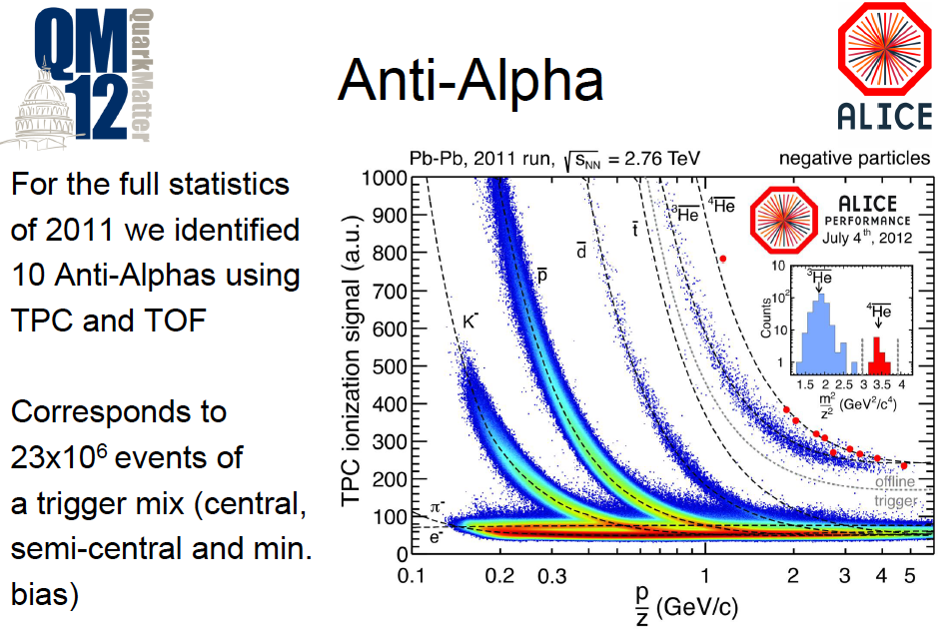
ALICE’s observation for anti-Helium 4

Slide 20
Production rate

Slide 21
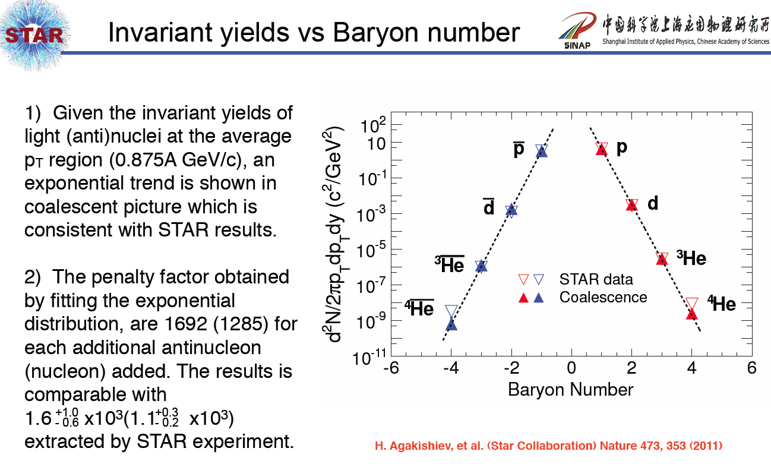
Coalescence model: L. Xue, YGM et al., Phys. Rev. C 85, 064912 (2012)

Slide 22
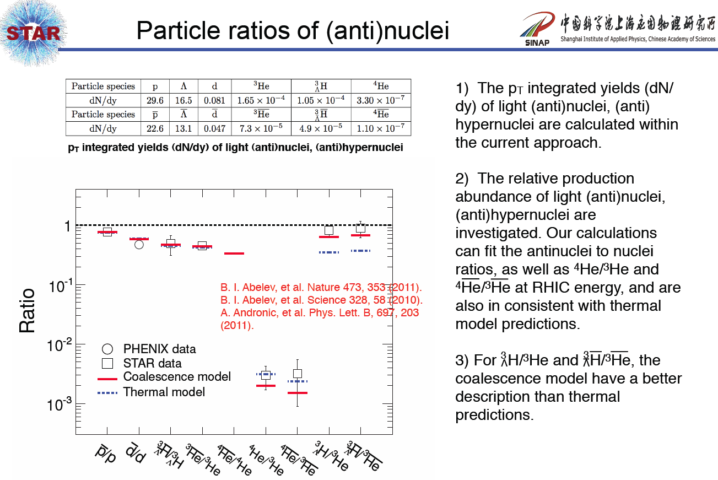
Coalescence model: L. Xue, YGM et al., Phys. Rev. C 85, 064912 (2012)

Slide 23

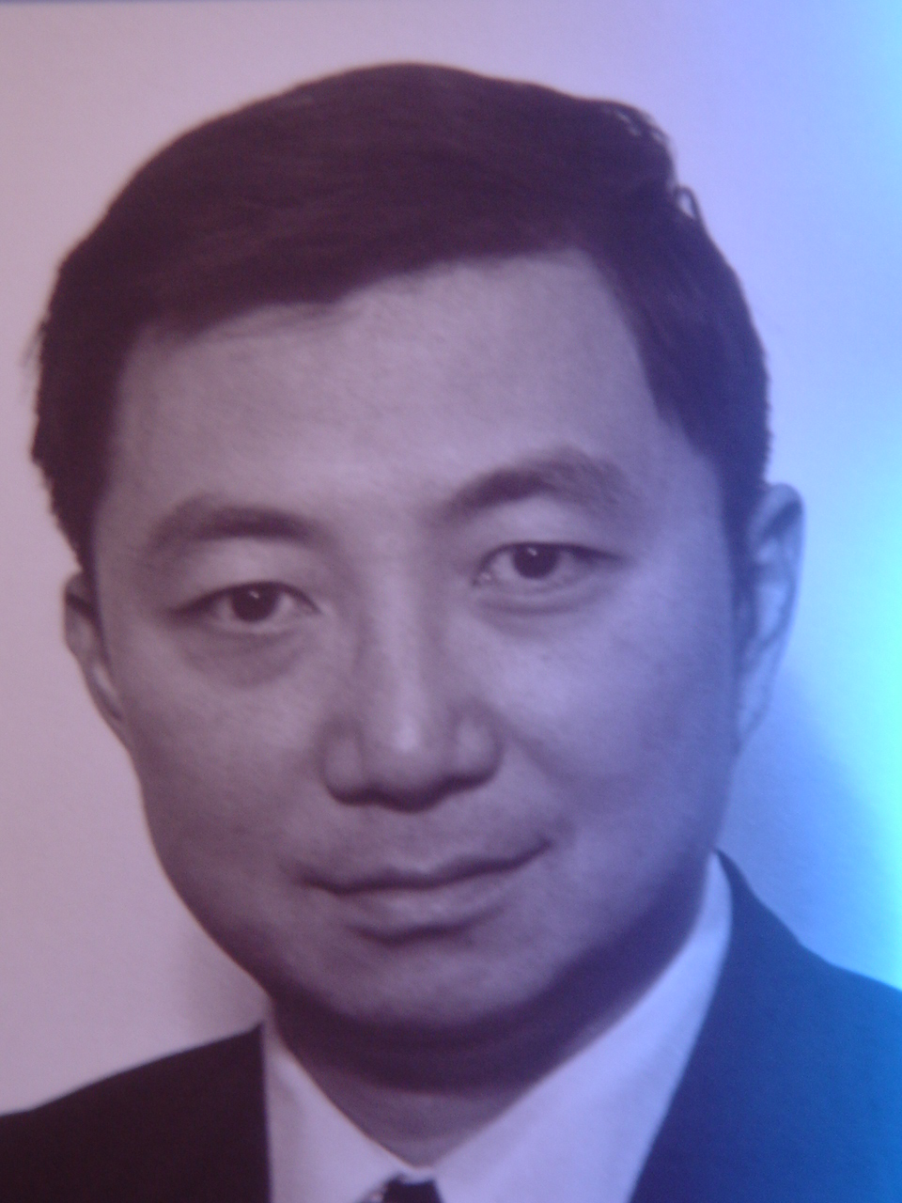
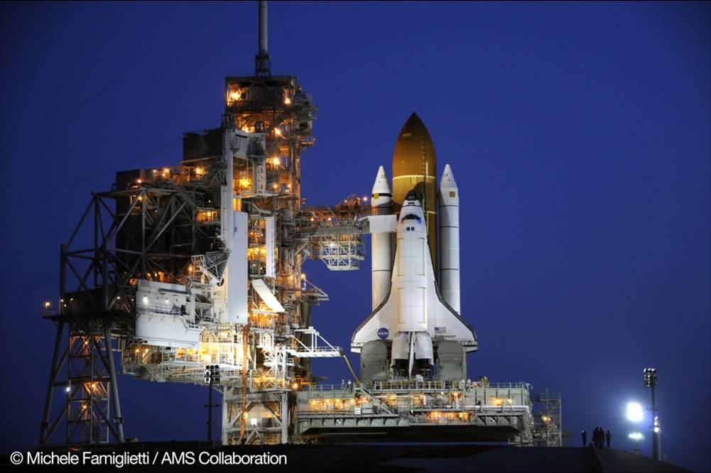
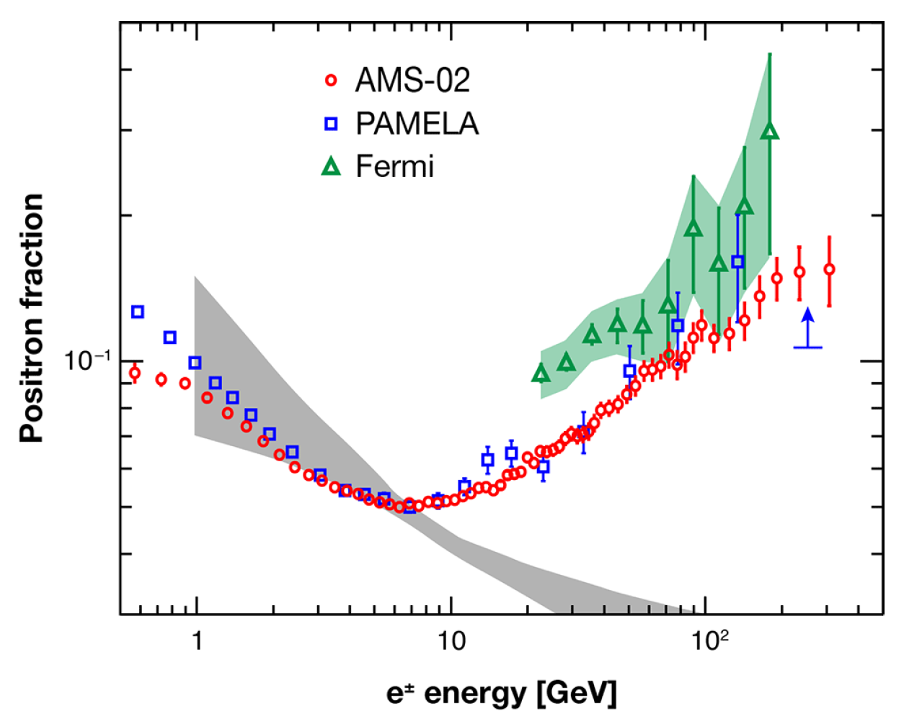
Searches for Antimatter in the Cosmos
AMS-02 was launched in May 2011, to search antimatter in universe
AMS-02
Phys. Rev. Lett. 110, 141102 (2013)
  If anti-α in the cosmos were from coalescence, the ratio of anti-α/α would be 10⁻¹⁶. With a sensitivity of 10⁻⁹, even a single anti-α count seen by the AMS experiment would be a strong evidence of anti-star.

Slide 24
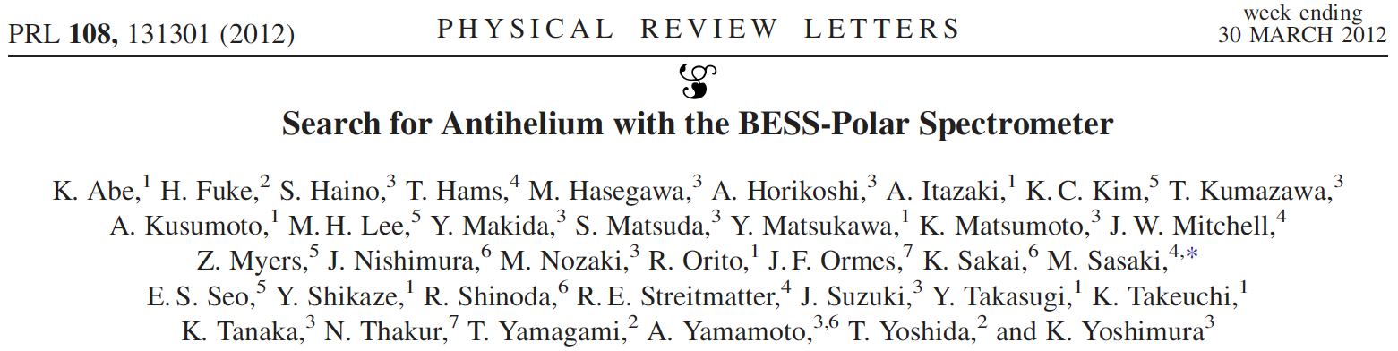
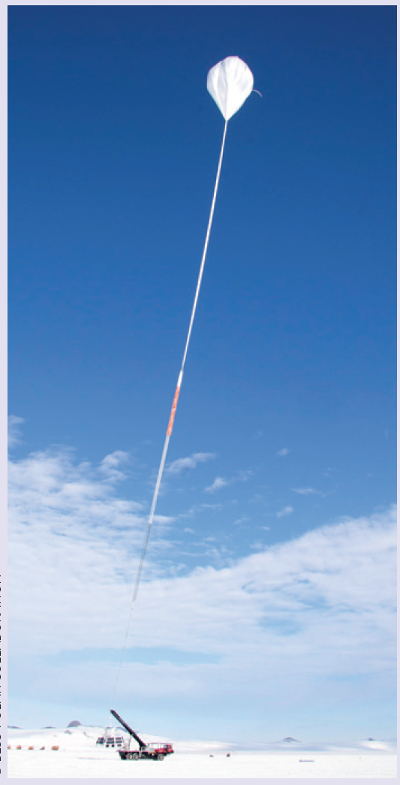
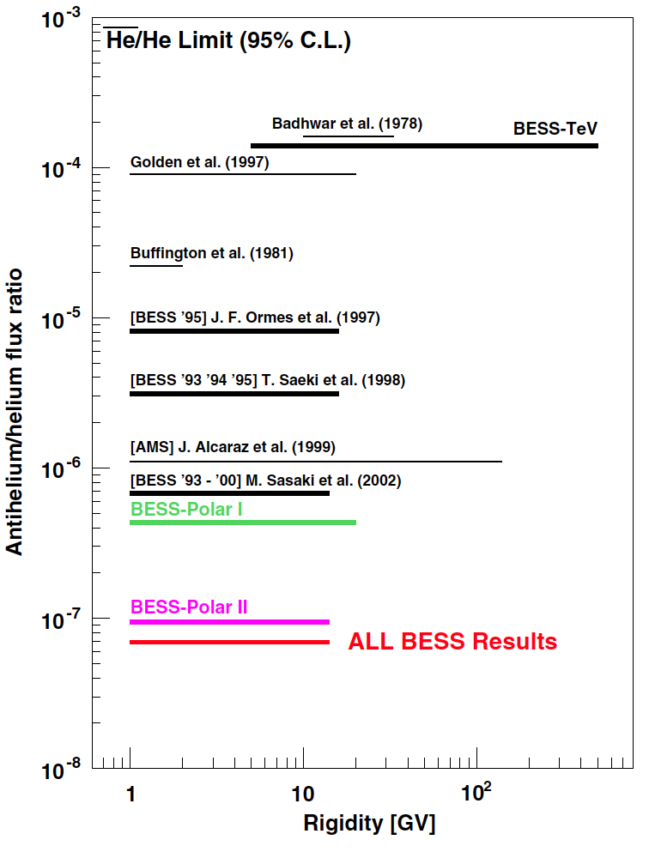
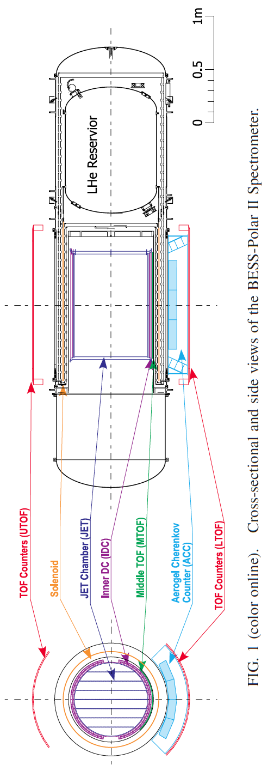
An upper limit of antihelium relative to helium of
1.0 *10⁻⁷
from 1.6 to 14 GV (Rigidity) was determined for the combined BESS-Polar data!
[RHIC: ~0.48]

Slide 25
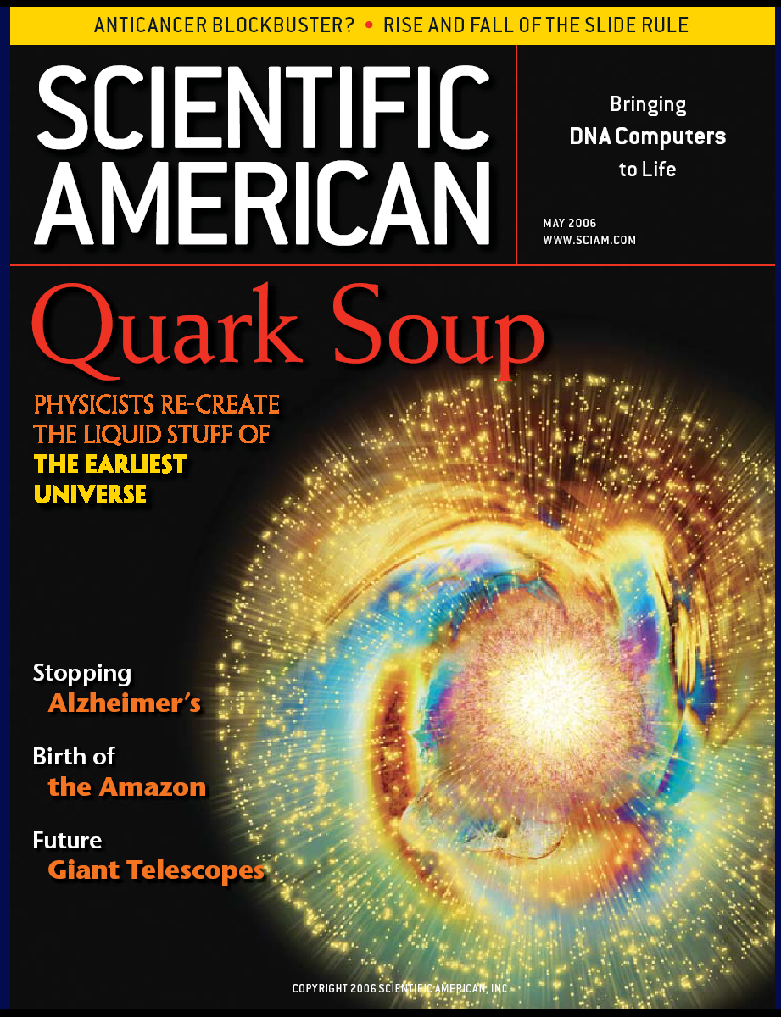
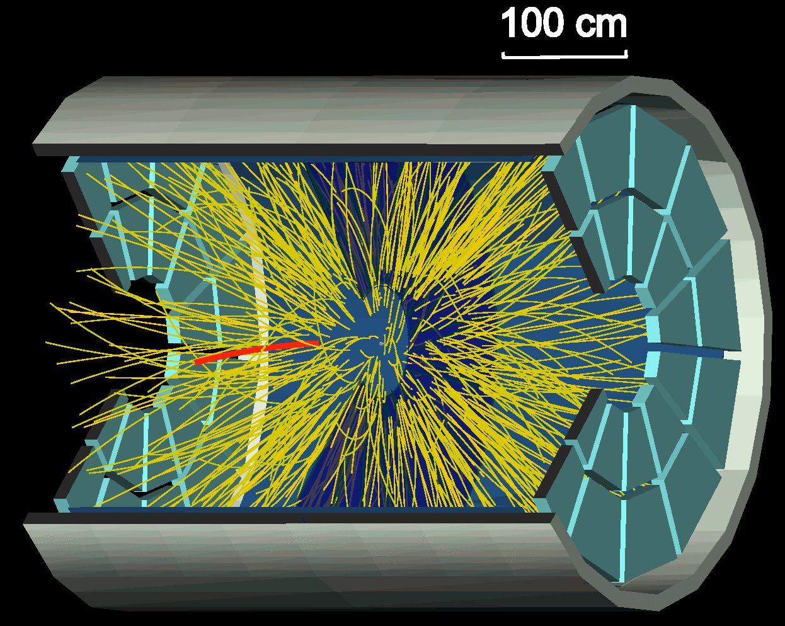
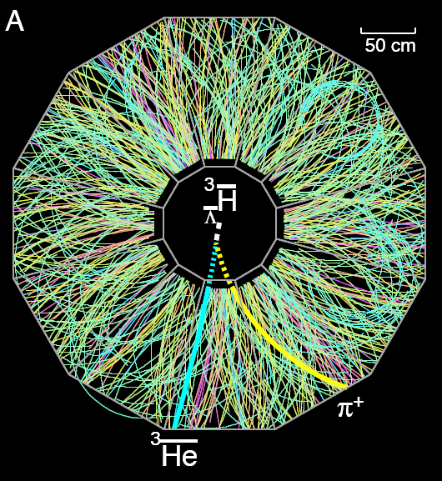
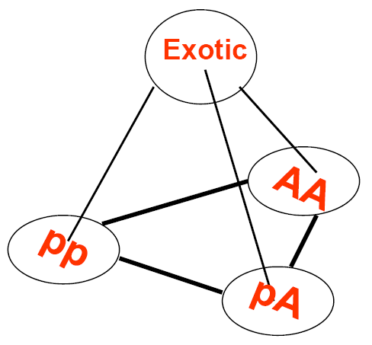

Conclusion and outlook
RHIC is not only a facility for exploring QGP bus also for hunting antimatter nuclei and exotic particles:
-- First observation of anti-hypertriton (1st antinucleus with anti-strange quark) (Science (2010))
-- First observation of anti-alpha (the heaviest anti-nucleus so far) (Nature (2011))
Antinuclei were produced in hadron freeze-out stage, either by the bayron coalescence or thermal model.
Waiting for new discovery:
Exotic state：
H,NΩ,Nφ, etc.
Heavier antimatter
bottom, charm hypernuclei?
Double hypernucleus?

Slide 26
Thanks a lot for
the STAR collaboration
and
your attentions!

Slide 27
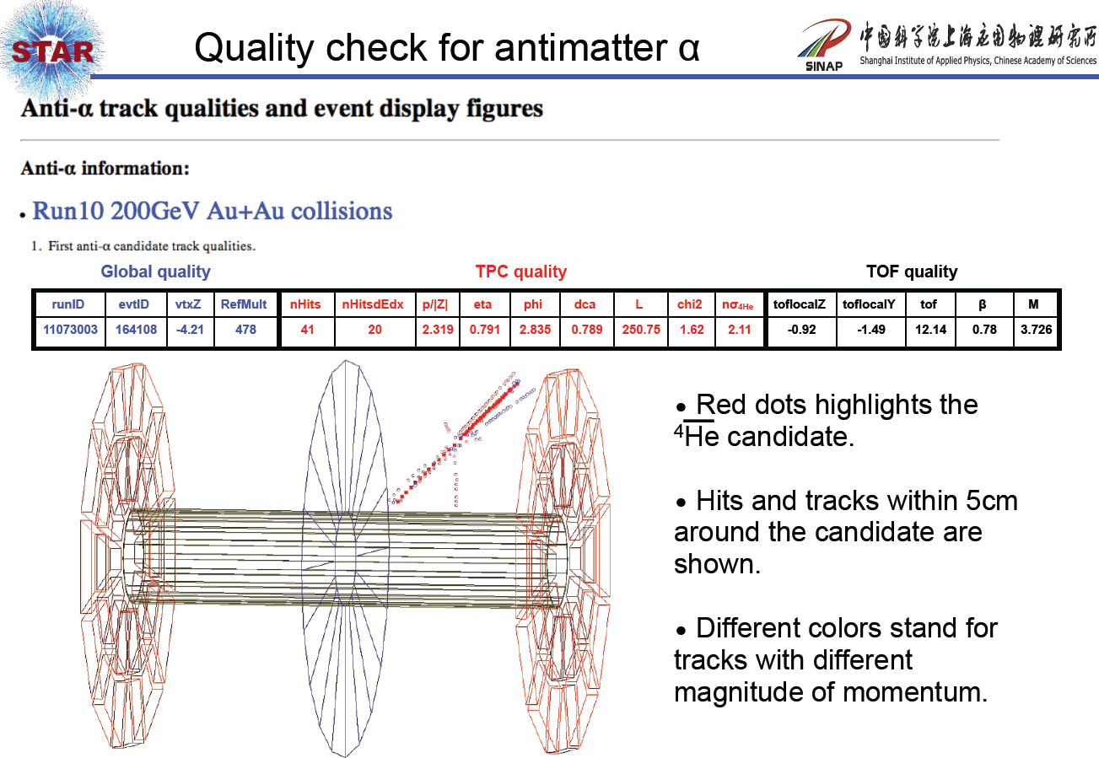

Slide 28
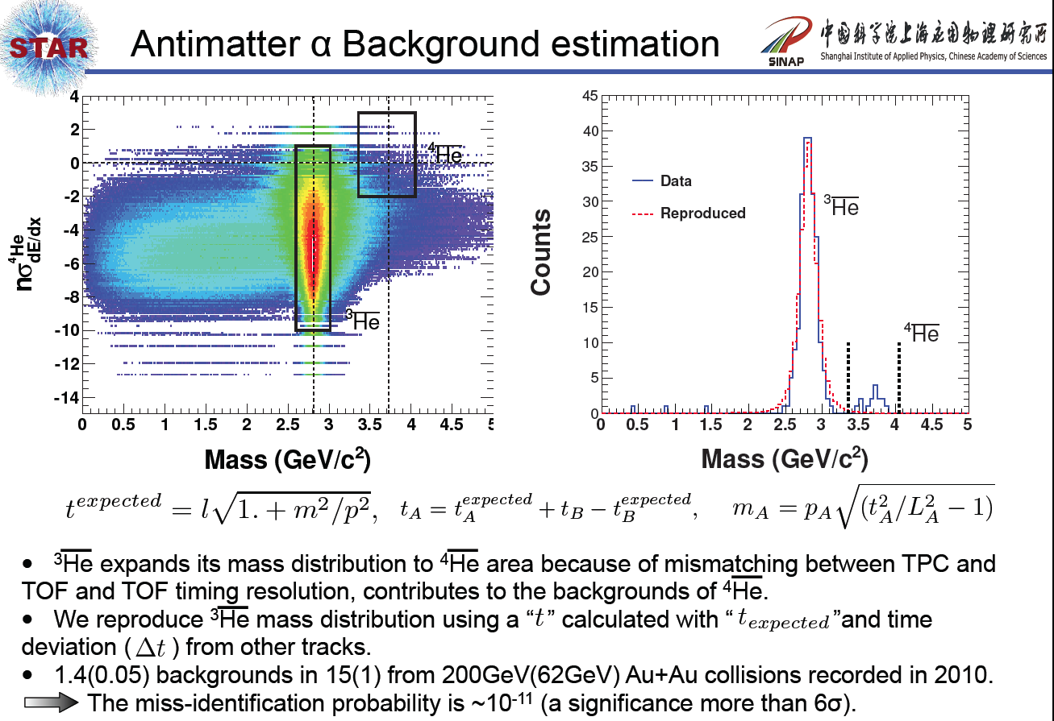

Slide 29
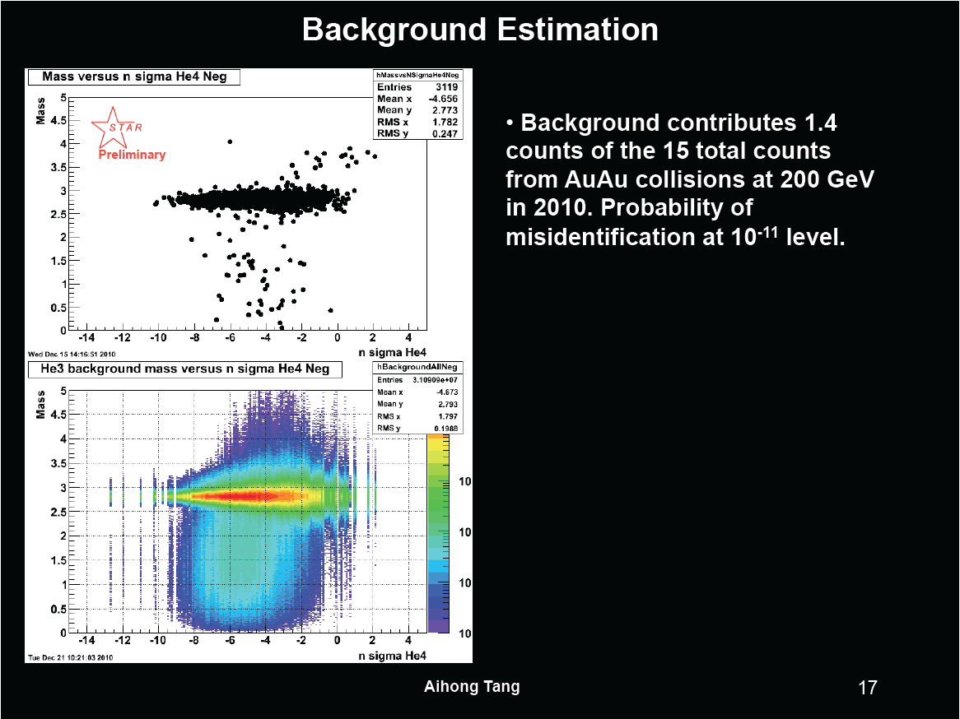

Slide 30
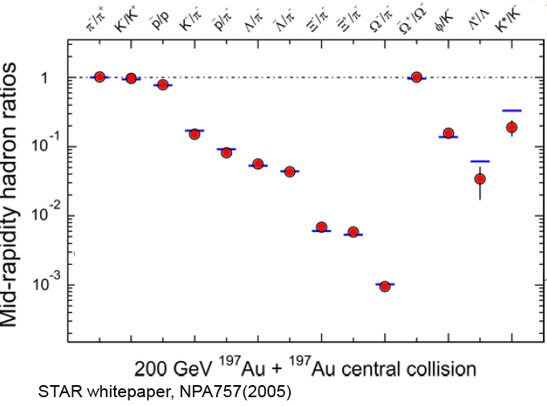
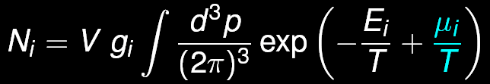
Production Mechanisms
Coalescence
Thermal production
Relativistic Heavy Ion collisions :
  High antibaryon density
  High temperature
Favorable environment for both production mechanisms.
just because something is impossible today doesn’t mean it will be impossible in the future.
30
Notes:
Temperature 4 trillion degrees Celsius, 250,000 times hotter than the center of the sun.
30

Slide 31
Thermal model calculation
A. Andronic et al., PLB 697, 203 (2011)
Notes:
Anti-3He/3He = 0.45, anti-alpha/alpha ~ 2.4/3.1*.45 ~ 0.39

Slide 32
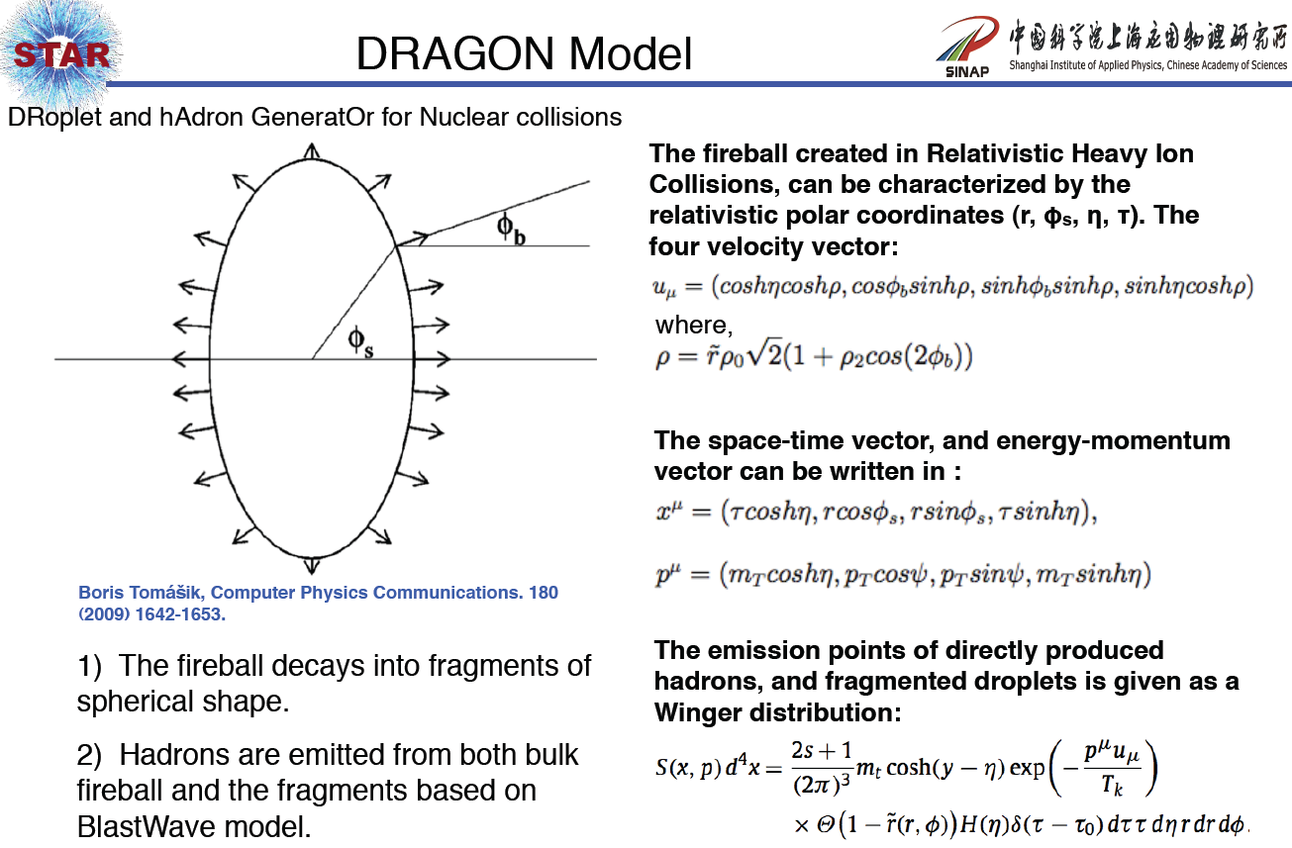

Slide 33
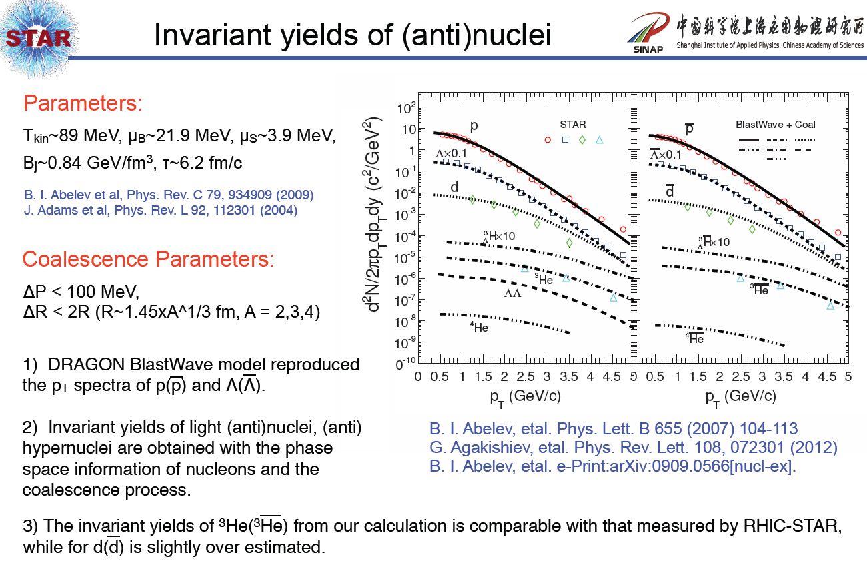

Slide 34
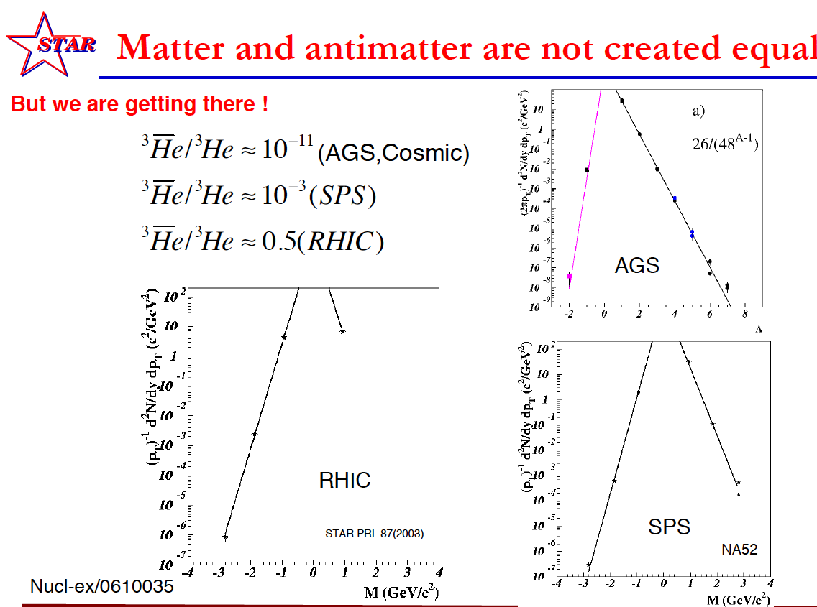

Slide 35




Hadron/Electron/muon PID capability (w/ TOF)
TPC dE/dx PID: pion/kaon: pT ~ 0.6 GeV/c; proton pT ~ 1.2 GeV/c
0.15<pT<0.25 GeV/c, DCA < 3 cm
|1/β-1|<0.03
electrons
Hadron PID: (π, K) ~1.6 GeV/c , p ~ 3 GeV/c.
STAR Collaboration, PLB616(2005)8
Clean electron PID can be obtained up to P_{T}< 3 GeV/c. →
This is used to measure the semileptonic decay of open charm.
(STAR Collaboration, PRL94(2005) 062301(L. Ruan, Z. Xu, X. Dong et al.)
Nucl-ex/0607011, Chen Zhong, Y.F. Zhang, Zhangbu Xu et al.
Significantly reduce the systematic uncertainty on the charm cross section measurement.
Now, Muon Telsecope Detector (MTD) based on MRPC is in good progress.

