Slide 1
New Extraction of the Flavor Decomposition of the Nucleon Electromagnetic Form Factors
Issam A. Qattan⁽¹⁾ and John Arrington⁽²⁾
⁽¹⁾ Department of Applied Mathematics and Sciences
Khalifa University of Science, Technology and Research,
P.O. Box 573, Sharjah, UAE.
⁽²⁾ Physics Division, Argonne National Laboratory, Argonne, Illinois 60439, USA.

Slide 2
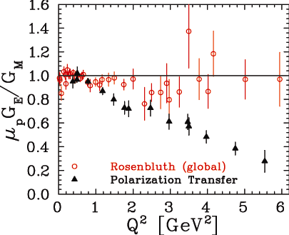
Electron Scattering: Brief Introduction
The proton EM interactions:
described in terms of two form
factors: G_{E} (Q²) and G_{M}(Q²)
Two methods of extraction:
Rosenbluth (LT) Separation in
OPE using: σ_{R} = τG_{M}² + εG_{E}²
(b) Recoil Polarization (PT) in OPE
using: G_{E} /G_{M} α p_{T} /p_{L}
Their results don’t agree (Q² > 1 GeV²)
Leading candidate is two-photon exchange (TPE)
Negligible (small contributions) of TPE to PT measurements
In general, nucleons EM FFs are expressed in terms of the Dirac and Pauli FFs as:
G_{E} = F₁(Q²) – τF₂(Q²) , G_{M} = F₁(Q²) + F₂(Q²), where τ=Q²/4M²_{N}
As Q² → 0: F₁^{(p,n)}(0) = e(0), F₂^{(p.n)}(0) = κ_{(p,n)}
J. Arrington, PRC 68, 034325 (2003),
J. Arrington, PRC 69, 022201(R) (2004).

Slide 3
Two-Photon Exchange Corrections (2γ)
Interference of OPE-TPE amplitudes: Is the leading TPE corrections to e-p scattering cross section.
Recoil Polarization: R_{p} confirmed experimentally to be essentially independent of ε.
Account for TPE contribution to e-p: σ_{R} = σ_{1γ} + σ_{2γ}
Theoretically: Several studies estimated the function F(Q²,ε).
Experimentally: Mainly focus on search for nonlinearities of LT plots.
Phenomenologically: Reanalyzing experimental data using proposed TPE
parametrizations.
In our work, we use Borisyuk-Kobushkin (BK) parametrization (linear in ε):
F(Q²,ε) → 0, when ε → 1 as expected from charge conjugation and crossing symmetry, and as observed in comparisons of e⁺-e⁻ scattering.
M. Meziane et al., PRL 106, 132501 (2011)
Extensive Review: J. Arrington , P. Blunden, and W. Melnitchouk Prog. Part. Nucl. Phys. 66, 782 (2011); C. E. Carlson and M. Vanderhaeghen, Ann Rev. Nucl. Part. Sci. 57, 171 (2007); I. A. Qattan, A. Alsaad, and J. Arrington, PRC 84, 054317 (2011); I. A. Qattan and A. Alsaad, PRC 83, 054307 (2011).
D. Borisyuk and A. Kobushkin, PRD 83, 057501 (2011)

Slide 4
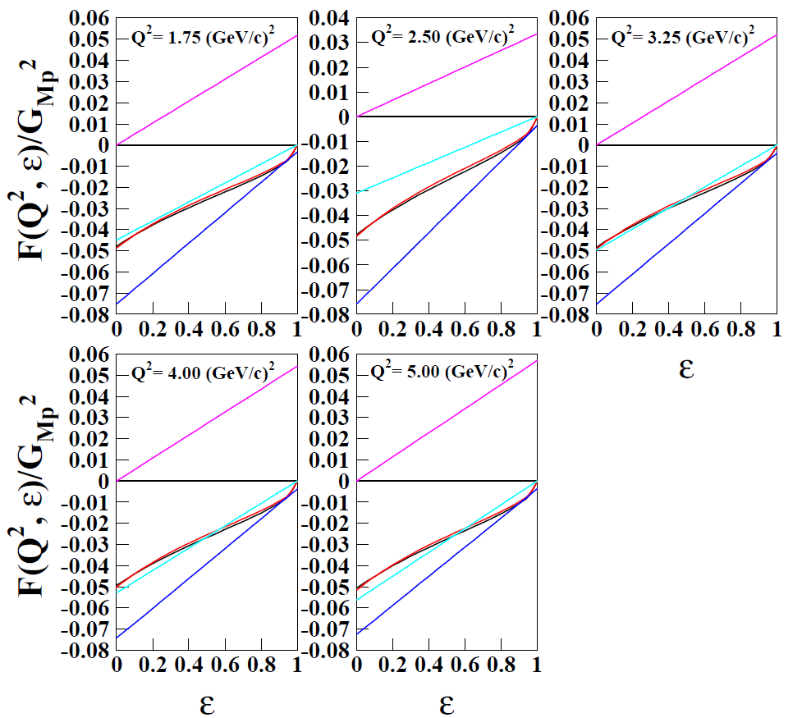
The TPE parameter a(Q²) was best fit using:
I. A. Qattan, A. Alsaad, and J. Arrington, PRC 84, 054317 (2011)
The full spread of the fit is below 0.005 for 1 < Q² < 4 GeV²
However, behavior is largely unconstrained below 1.5 GeV²
F(Q²,ε): Increases slowly with Q²

Slide 5
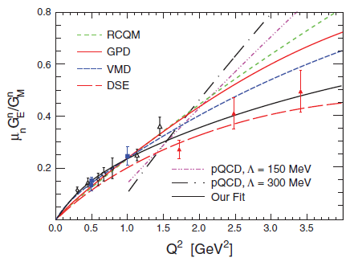
Extraction of the Nucleon EM FFs
The pioneering work of Cates, de Jager,
Riordan, and Wojteskhowski (CJRW) allowed for
the first time a separation of the up- and down-
quark contributions to FFs and the ratios
F₂^{(p,n)}/F₁^{(p,n)}
Motivated by the recent R_{n}=μ_{n} G^{n}_{E} /G^{n}_{M}
measurements ranging 0.30 < Q² 3.40 GeV²
S. Riordan et al., PRL 105, 262302 (2010)
Combined with R_{p} data in the same range
(total of 13 Q² points)
Used the Kelly’s parametrizations for G^{p}_{E},
G^{p}_{M}, and G^{n}_{M}
However:
Only uncertainty from R_{n} was included in the
analysis (largest source of uncertainty)
Did not account for FFs associated
uncertainties
G^{p}_{E} and G^{p}_{M} were not TPE corrected
Used Kelly’s G^{n}_{M}, however, recent CLAS data
at high Q² showed deviation from the dipole
form factor G_{D}(Q²) = 1/(1+Q²/0.71)²
Cates, de Jager, Riordan, and Wojtsekhowski, PRL 106,
252003 (2011)
J. Kelly, PRC 70, 068202 (2004)
J. Lachniet et al., (CLAS Collaboration) PRL 102, 192001 (2009)

Slide 6
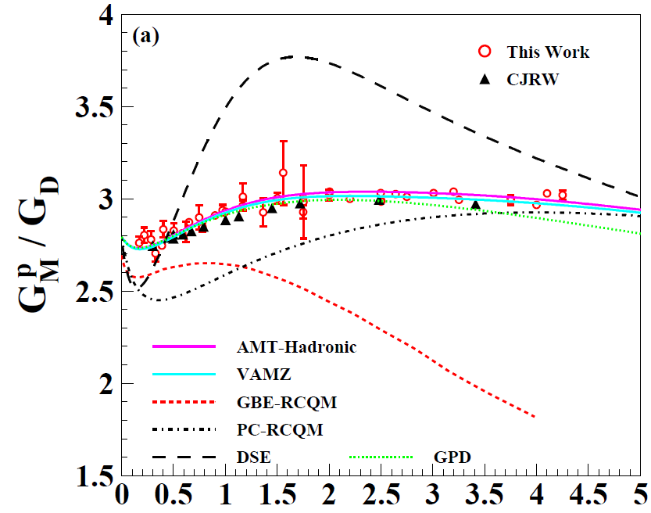
Extraction of the Nucleon EM FFs
We expand on their analysis but account
for the following: I. A. Qattan and J. Arrington, PRC
86, 065210 (2012)
For the Proton:
Updated extractions of the proton FFs
(39 Q² data points ranging 0.169 < Q² 4.25
GeV² were included)
Constraining the low Q² behavior
by including Janssens et al. (8 data points)
Constraining the ratio R=R_{p} to
that of PT:
Fit e-p cross sections to BK
parametrization and extract G^{p}_{M}, G^{p}_{E}, and
a(Q²) :
Include additional uncertainty of δR_{p}=
0.01Q² in R_{p}

Slide 7
Extraction of the Nucleon EM FFs
For the Neutron:
Use updated parametrization for G^{n}_{M} (Fit
G^{n}_{M} to the same form as Kelly including world
data on G^{n}_{M} plus the CLAS data)
Take uncertainty on G^{n}_{M} to be the same as
in the Kelly’s original fit (taking full error
correlation matrix)
Error band is fairly consistent with the
experimental uncertainties with the new CLAS
data included
Use the new Riordan et al. fit for R_{n} (taking
Full error correlation matrix)
Extract G^{n}_{E}
However, uncertainties on G^{n}_{E} are
significantly smaller than uncertainties on
individual measurements
Scale up the uncertainties on G^{n}_{E} by a factor
of 2 (provide more realistic uncertainties in the
flavor separated results)
For flavor decomposition, include
uncertainties associated with all of the FFs

Slide 8
Extraction of the Nucleon EM FFs
Our results for G^{n}_{E} and G^{n}_{M} reflect the values and uncertainties of the FFs from parametrizations
No uncertainty on G^{n}_{M} from CJRW
Noticed the difference in the VAMZ (including our new G^{n}_{M} fit) and VAMZ-Kelly fits for Q²> 1 GeV²

Slide 9
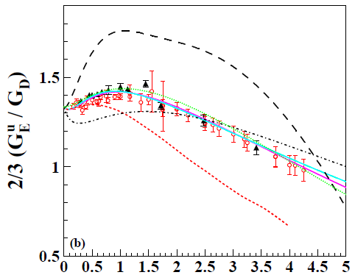
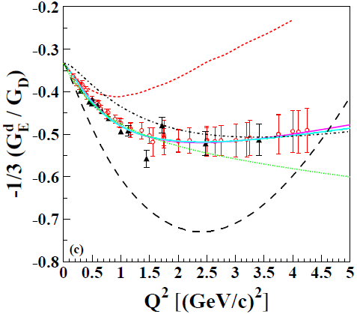
Flavor Decomposition of the Nucleon EM FFs
Assuming isospin and charge symmetry
and neglecting strange quarks contribution:
G^{p}_{E,M} = (2/3) G^{u}_{E,M} – (1/3) G^{d}_{E,M} ,
G^{n}_{E,M} = (2/3) G^{d}_{E,M} – (1/3) G^{u}_{E,M}
Similar expressions for F^{(p,n)} _{(1,2)}
As Q² →0: G^{u}_{E} = 2, G^{d}_{E} = 1,
G^{u}_{M} = μ_{u}= (2μ_{p}+ μ_{n}) = 3.67 μ_{N} ,
G^{d}_{M} = μ_{d} = (μ_{p}+ 2μ_{n}) = – 1.03 μ_{N}
Include uncertainties on all of the FFs
See: Cates et al., PRL 106, 252003 (2011) and references therein; G. A. Miller et al., Phys. Rep. 194, 1, (1990); D. H. Beck and R. D. McKeown, Annu. Rev. Nucl, Part. Sci, 51, 189 (2001)

Slide 10
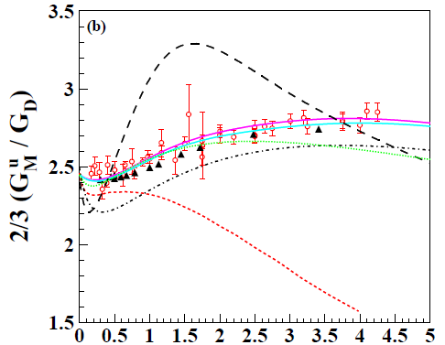
Flavor Decomposition of the Nucleon EM FFs
Small deviations from G_{D} for both the up and down quarks
At low Q²: Both have slightly increasing behavior → 10% increase in G^{p}_{M} (0 < Q² < 1 GeV²)
Above that: Near-perfect agreement with G_{D}
Again: The up-quark dominates both G^{p}_{E} and G^{p}_{M}

Slide 11
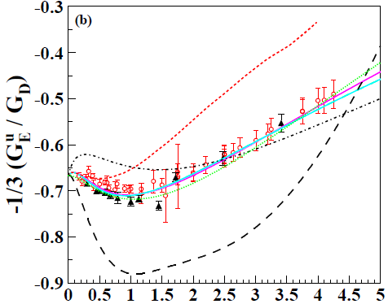
Flavor Decomposition of the Nucleon EM FFs
Unlike the proton, both the up- and down -quark have large contributions
Clear deviations from G_{D} for both the up and down quarks
At low Q²: The increasing down-quark, and the relatively flat up-quark contributions → increase in G^{n}_{E}

Slide 12
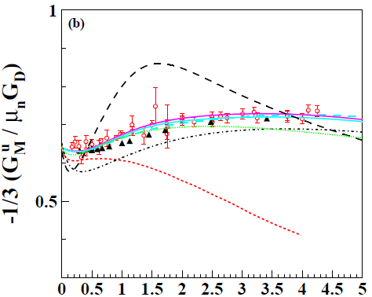
Flavor Decomposition of the Nucleon EM FFs
As with the proton: Small deviations from G_{D} for both the up- and down-quarks
At large Q²: the down-quark has larger deviation → small Q² dependence in G^{n}_{M}

Slide 13
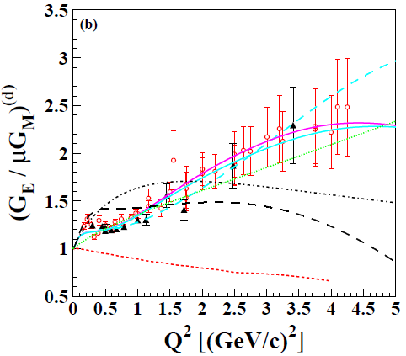
Flavor Decomposition of the Nucleon EM FFs
For the up-quark: The extractions disagree at
low Q²
Fits (including complete TPE treatment) agree better with CJRW below Q² ≈ 1 GeV², and with our results above
At large Q²: G_{E} /G_{M} has a roughly linear falloff (but slower than seen in the proton)
For the down-quark: The primary disagreement comes from the difference in the G^{n}_{M} parametrizations (VAMZ vs. VAMZ-Kelly)
G_{E} /G_{M} increases with Q². Not seen in any of the calculations, except for GPD model. (Sufficiently flexible parametrization as it is mainly a fit to CJRW data)

Slide 14
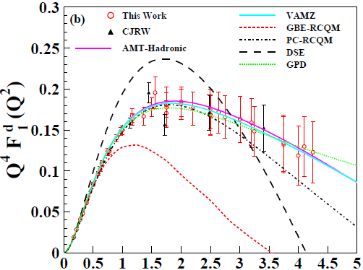
Flavor Decomposition of the Nucleon Structure Functions
F^{d}₁ is falling slightly with respect to the 1/Q⁴
scaling behavior reported by CJRW results
above 1 GeV²
This deviation or falloff is fairly clear for F^{d}₂
(shown next)
However, F^{d}₁ falls more rapidly than F^{d}₂ at high Q²

Slide 15
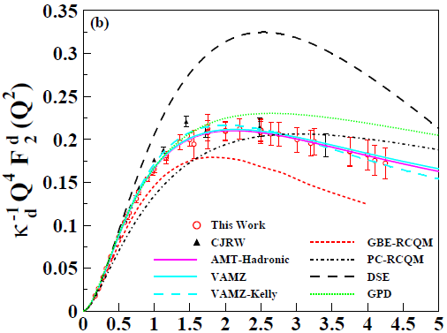
Flavor Decomposition of the Nucleon Structure Functions
Higher F^{u}₂ than the CJRW at low Q² (due in part to different G^{n}_{M} but mainly due to TPE effect on proton’s FFs)
F^{d}₂ is falling fairly clearly and does not support the 1/Q⁴ scaling reported by CJRW results above 1 GeV²
The impact of higher F^{u}₂ at low Q² is seen in the ratio F^{d}₂ / F^{u}₂

Slide 16
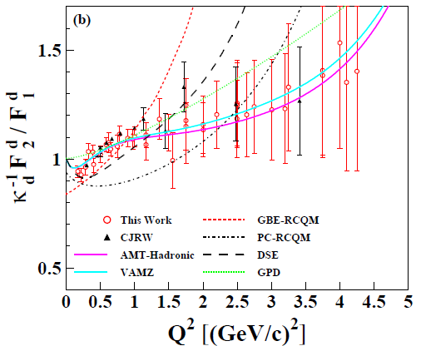
Flavor Decomposition of the Nucleon Structure Functions
Again, the somewhat larger F^{u}₂ values than those obtained in the CJRW results affect
the ratio F^{u}₂ / F^{u}₁ for Q² < 1.5 GeV²
Consistent results from data and fits for F^{d}₂ / F^{d}₁ with a slight increase at low Q², and nearly constant (slightly rising !!) above 1 GeV² → Future G^{n}_{E} measurements at higher Q² are crucial
However, all calculations show different behavior

Slide 17
Summary
We find large differences between the up- and down-quark contributions to G_{E} and G_{M} which imply significant flavor dependence in the charge and magnetization distributions.
The rapid falloff of G^{p}_{E} /G^{p}_{M} does not appear in the individual quark FFs, but arises from a cancellation between the up- and down-quark contributions.
We see indications that the down-quark contribution to the Dirac and Pauli FFs (F^{d}₁ and F^{d}₂ ) deviate from the suggested 1/Q⁴ scaling behavior reported by the CJRW analysis.
Generally, recent models provide good qualitative description of the data, the down-quark contribution to G_{E}/G_{M} and F₂ /F₁ is not reproduced by any of the models.
Inclusion of G^{n}_{M} from the CLAS data modifies the high-Q² behavior slightly, the tension between these data and previous measurements at lower Q² has a more significant impact suggesting the need for additional data in this region.

