Slide 1




Nuclear microprobes in biomedicine and environment: technical developments and applications
Ph. Moretto,
Interface Physique-Chimie pour le Vivant
Centre d'Etudes Nucléaires de Bordeaux-Gradignan
Chemin du Solarium, 33175 Gradignan cedex, FRANCE
INTERNATIONAL NUCLEAR PHYSICS CONFERENCE
INPC2013, 2-7 June 2013, Firenze, Italy
Notes:
Thank the organisers.

Slide 2

0
Outline
Microbeam lines @ AIFIRA
Analysis techniques and elemental mapping
Nanotoxicology
STIM-PIXE Tomography
Neurobiology
Conclusions
INPC2013, 2-7 June 2013, Firenze, Italy
2
Notes:
The aim of this talk is to give you some example of achievements in the biomedical field using nuclear microprobes. Mainly nanotoxicology which is a fast growing field.
I’ll start by a brief technical description of the neamlines.
I’ll limit the Scope of this talk to analytical appplications of nuclear micrprobes.

Slide 3
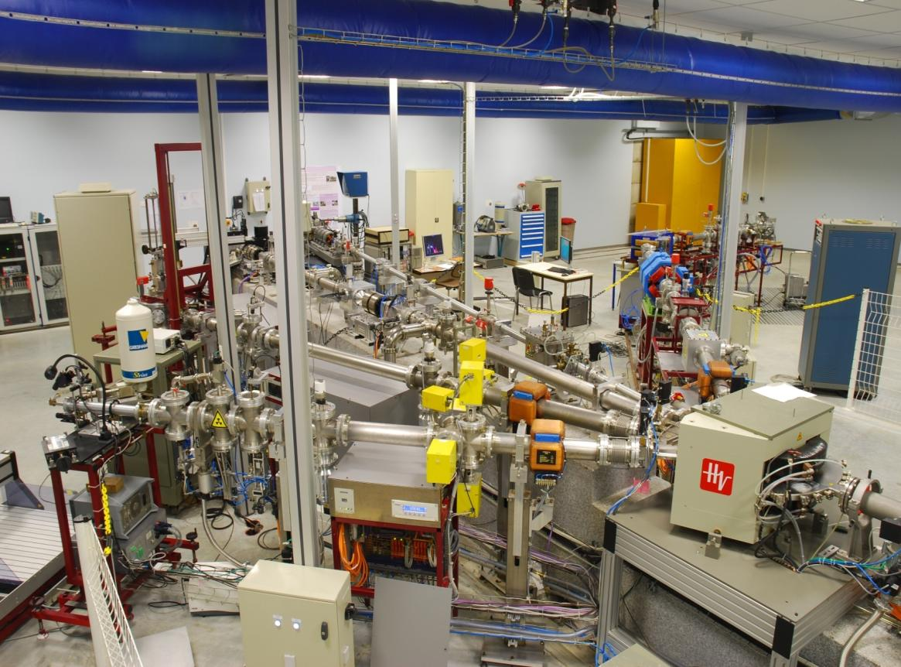
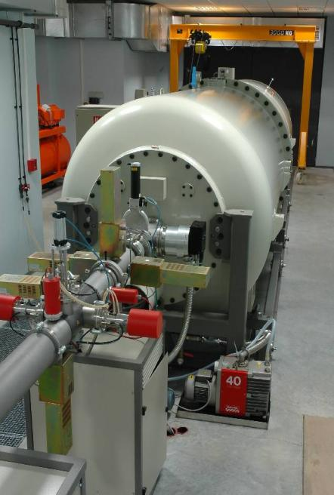
1
The AIFIRA facility : experience room and
HVEE 3.5 MV In Line Singletron Accelerator
INPC2013, 2-7 June 2013, Firenze, Italy
3
Notes:
1st microbeam developed in Bx in the early ninetees
AIFIRA facility (small scale commissonned in 2006)
View of the experience room
Singletron dedicated to such applications (high brigthness/ high enegu stability)

Slide 4
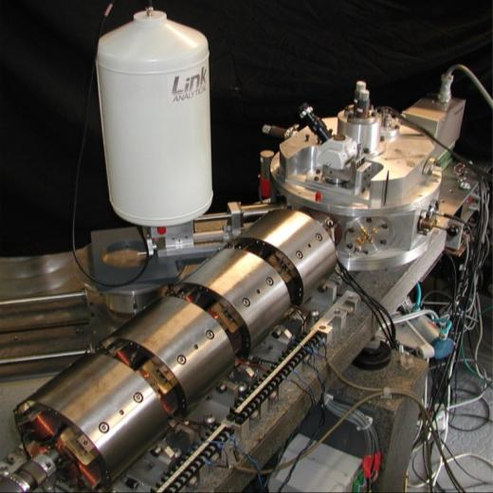
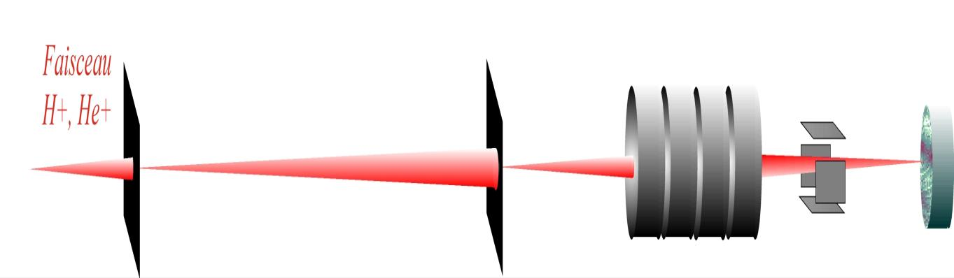
1
Microbeam line for micron lateral resolution
The first microbeam line at CENBG
Demagnification factors (1/10)
Object Collimator
Aperture diaphragm
Magnetic quadrupoles
Electrostatic deflexion plates
Sample
INPC2013, 2-7 June 2013, Firenze, Italy
4
Notes:
Typical microbeam line based on a focusing system composed of magnetic quadrupoles.
The layout on this scheme (very similar to a centred optical system) object, lens, image and magnification factor.. Aberration..

Slide 5
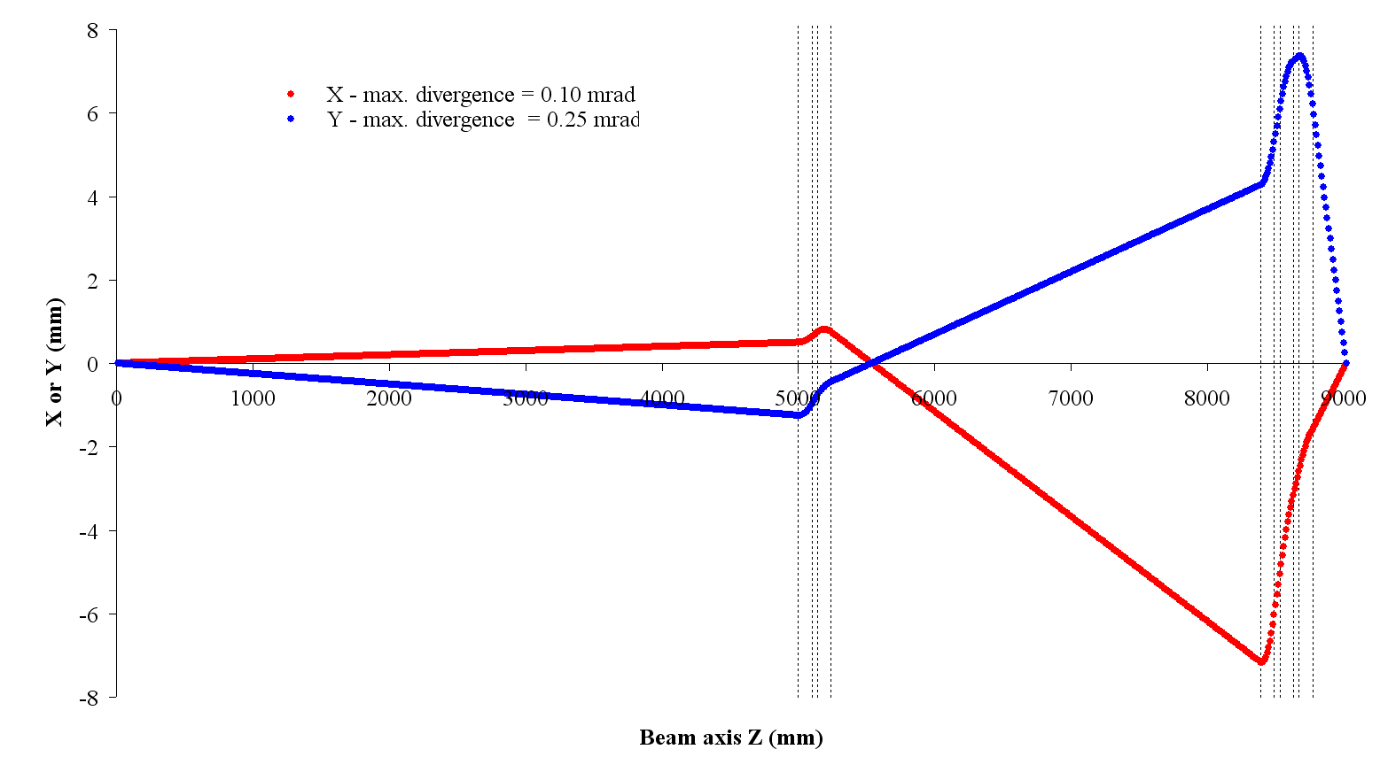
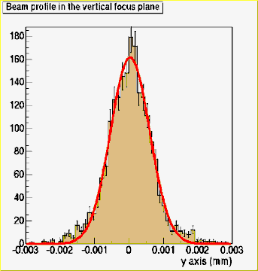
1
The high resolution CENBG microbeam line
object
image
beam axis
-A
B
C
-D
-C
INPC2013, 2-7 June 2013, Firenze, Italy
5
Notes:
Two stages system
Raytracing showing the enveloppe of the beam the horizontal and vertical planes
Demagnification 100 and 69 at the price of higher aberartion coefficients

Slide 6
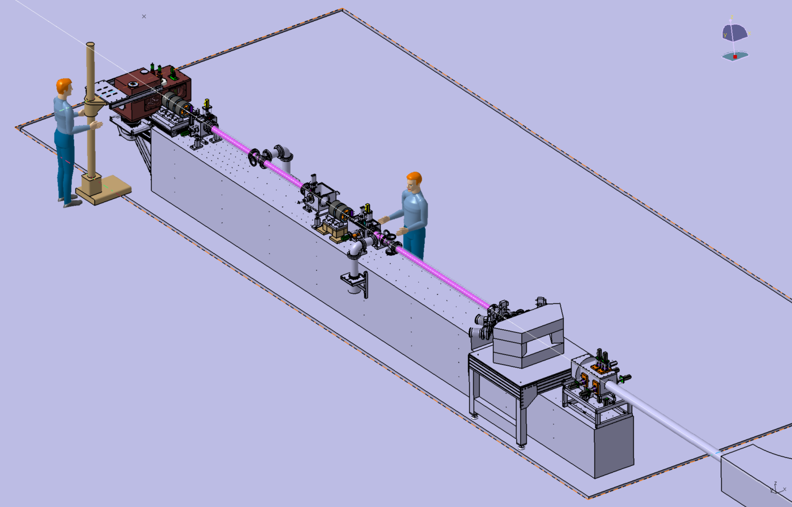
1
Triplet
9.12 m long beam line
Doublet-Triplet configuration
Intermediate image
Doublet
Magnetic shielding
Switching magnet
Object aperture
Massive granit block
Ref : F. Andersson et al., Nucl. Instr. Meth. B266(8) (2008)1653
S. Incerti et al., Nucl. Instr. and Meth. B260 (2007) 20
INPC2013, 2-7 June 2013, Firenze, Italy
6
Notes:
Doublet-Triplet – crossover and diagnostic box
Mounted on a standalone granit stone to avoid any vibration

Slide 7
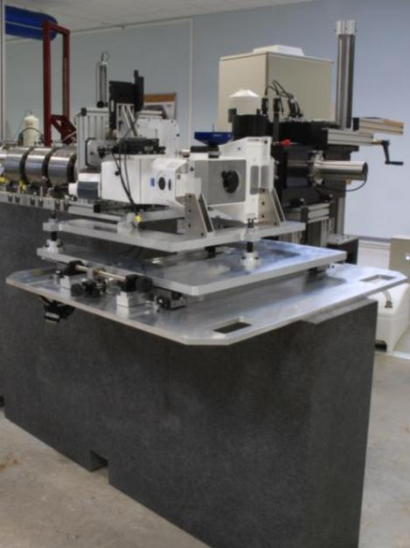
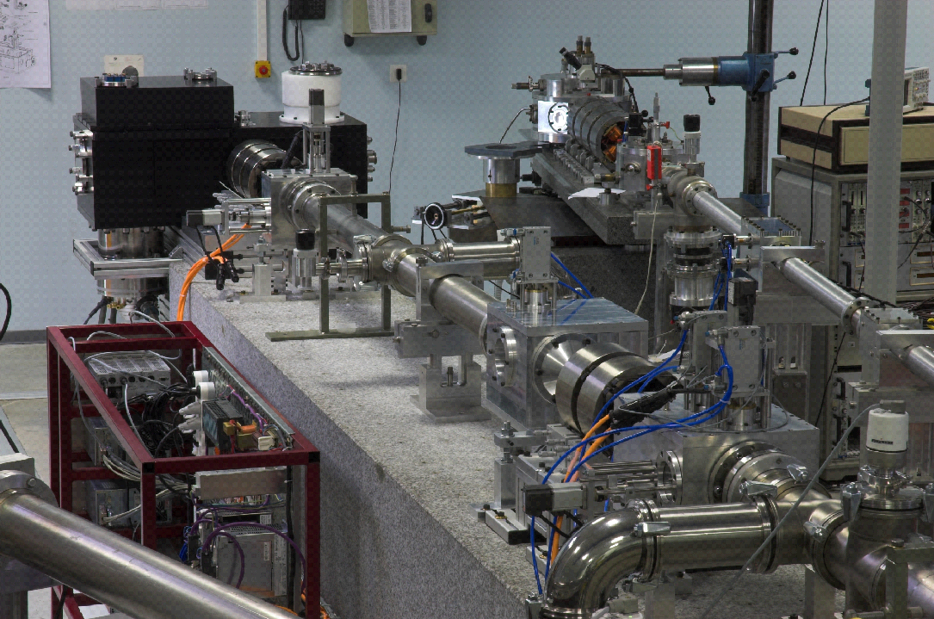
1
Microbeam lines @ AIFIRA
INPC2013, 2-7 June 2013, Firenze, Italy
7

Slide 8
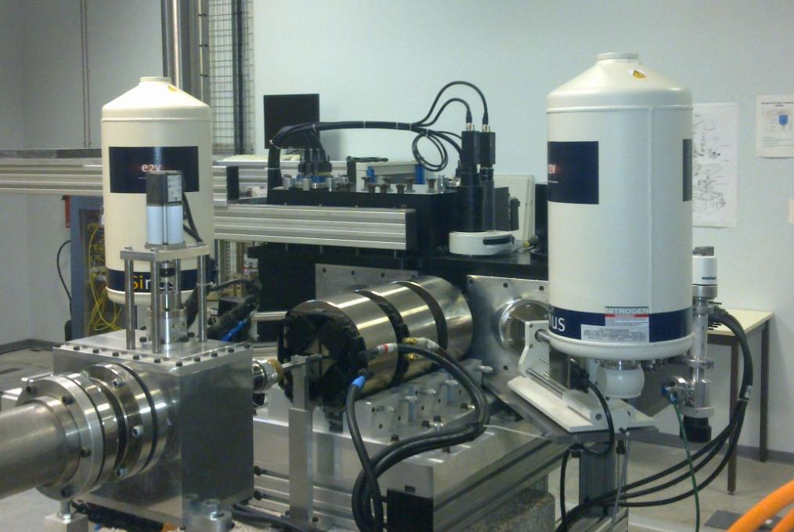
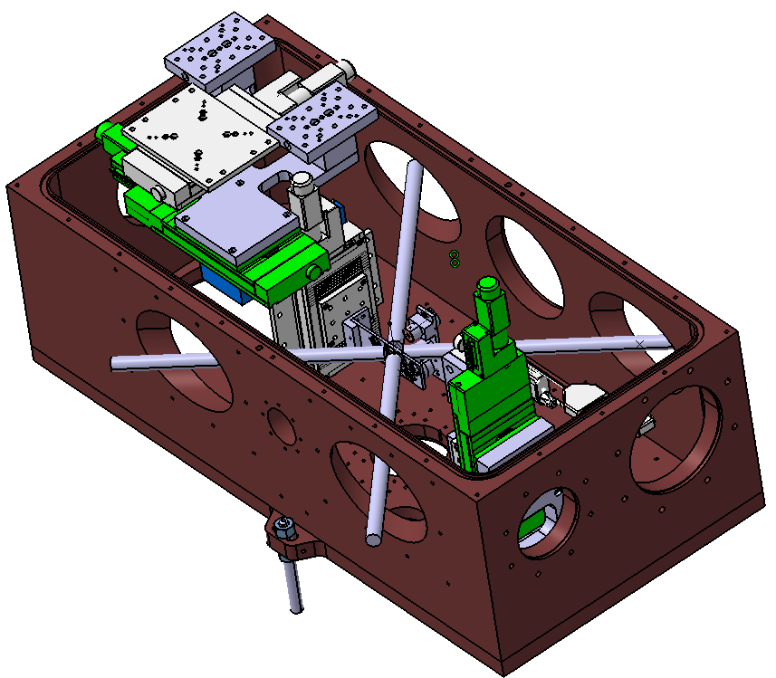
1
Microbeam lines @ AIFIRA
The chamber can be equipped with up to 4 Si(Li) detectors.
Line fully remote controlled using a network loop (other beamlines as well) for safe operation of micron D⁺ beam…
Ref : Barberet P. et al., Technical description of the CENBG nanobeam line, Nucl. Instr.
Meth. B2009; 267: 2003-2007
Beam
INPC2013, 2-7 June 2013, Firenze, Italy
8
Notes:
The endstation equiped with precision stage to position samples and different kind of detection (X-ray, particle).

Slide 9
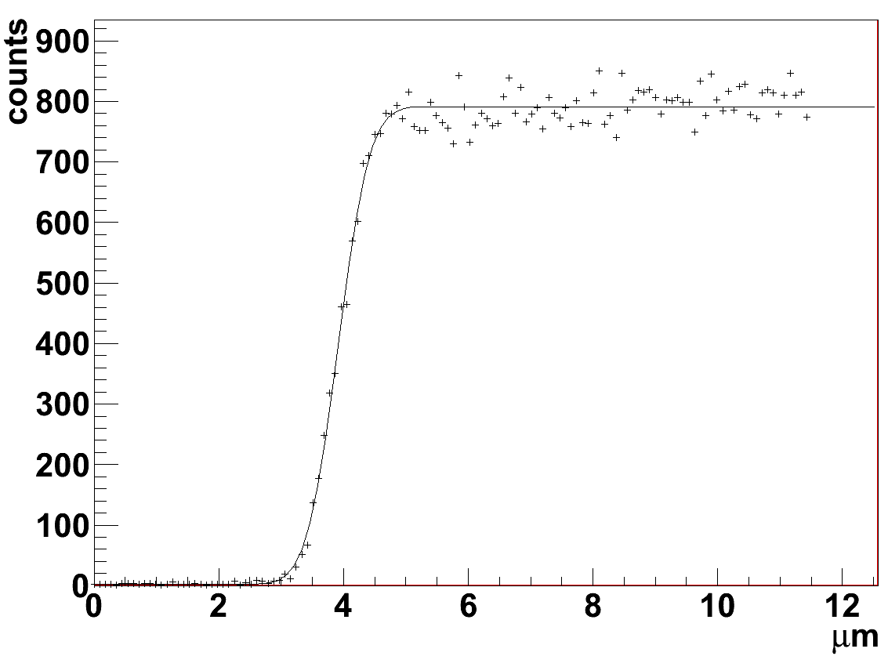
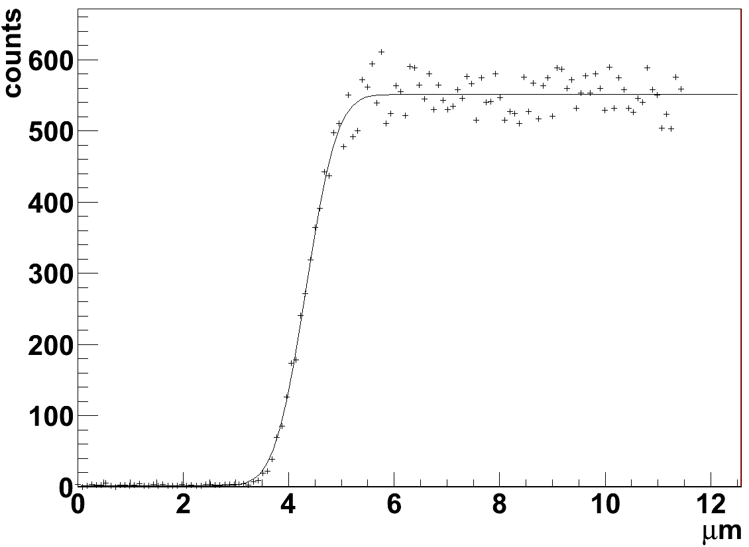
1
Performances
Triplet configuration : High current mode (1.5 MeV protons)
X
Y
Beam FWHM = 0.938 µm
Beam FWHM = 1.099 µm
Object size = 20 µm
Beam current on target ~ 500 pA
Method : linear scanning over the edge of a Si wafer
Using the triplet only :
~ 1 µm beam size in typical PIXE configuration
INPC2013, 2-7 June 2013, Firenze, Italy
9
Notes:
Performances : two modes of operation triplet (high intensity) or quintuplet (low intensity mode)
How to measure the lateral resolution : scan the beam over the sharp edge of a wafer. Deconvolution of the signal using a gaussian shape for the beam FWHM…

Slide 10
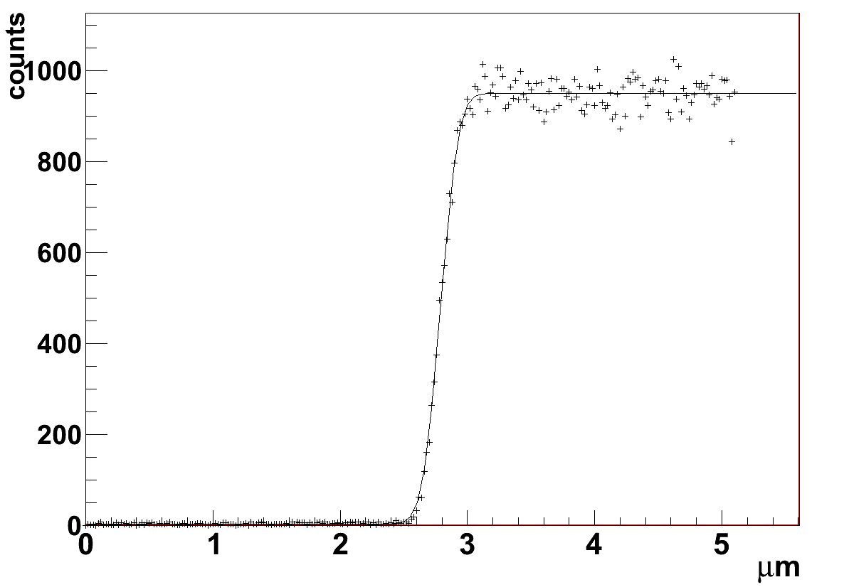
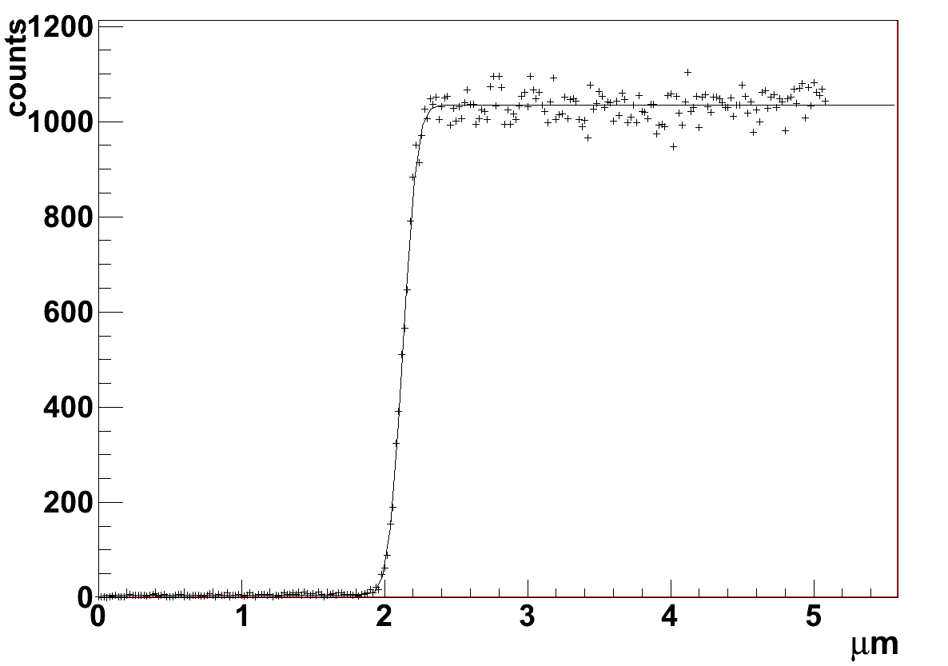
1
Performances
Quintuplet configuration : Low current mode (1.5 MeV protons)
X
Y
Beam FWHM = 256 nm
Beam FWHM = 187 nm
Object size = 5 µm
Beam current on target ~ 10000 ions / second
Method : linear scanning over the edge of a Si wafer
Using the quintuplet:
~ 200x250 nm beam size in typical STIM configuration
INPC2013, 2-7 June 2013, Firenze, Italy
10

Slide 11
2
Analysis and imaging techniques in Biology, Medicine and Environment
Emerging techniques : MeV-SIMS, Ion Induced fluorescence, Confocal PIXE…
INPC2013, 2-7 June 2013, Firenze, Italy
11
Notes:
Basically There are three main techniques available for working in the biomedical field… and their extension in 3D mode…
To study cellular or tissue mechanisms (toxicity, uptake, translocation, accumulation, efflux)
Combination of spatial distribution and sensitivity (metal in organic matrix, animal or vegetal), easy to use, few spectral interferences, possibility to quantify in absolute mode, concentrations expressed in terms of overall organic mass of samples… Cryotechniques, cryosection, no contamination of specimens during sample preparation…

Slide 12
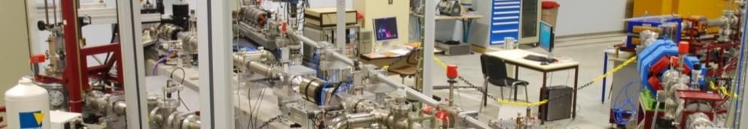
3
Nanotoxicology
Mechanisms of translocation in cells and tissues
Mechanisms of translocation in plants
Bioaccumulation of nanoparticles in the environment
Imaging techniques and nano-vectors
Nanoparticles as sensitisers for radio-therapy
12
INPC2013, 2-7 June 2013, Firenze, Italy
12
Notes:
Potential toxicity of nanoparticles massively employed nowadays in household products, cosmetics, industry, …
The impact on the environment is questioned and on long term effect on human beeings.
Those particles are employed as vector for drug delivery in situ.

Slide 13
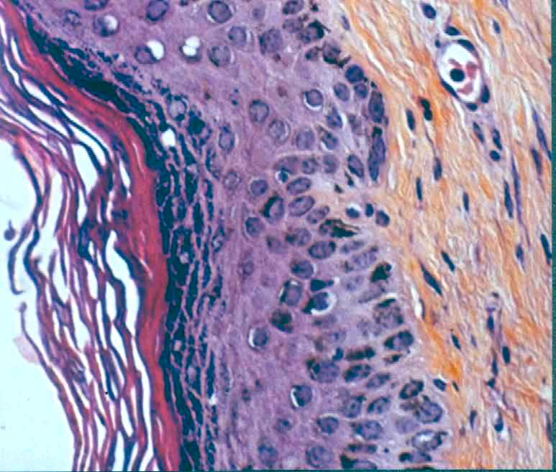
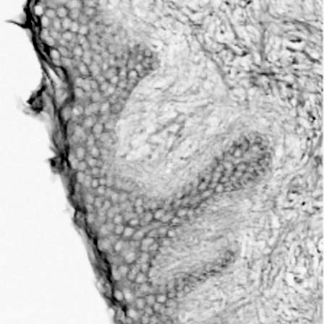
3
Human epidermis and STIM imaging
20µm
Stratum
Corneum
Stratum
Granulosum
Stratum
Spinosum
STIM
13
INPC2013, 2-7 June 2013, Firenze, Italy
13
Notes:
We started in european programme FP5 (Nanoderm) 15 years ago.
Penetration studies for solar formulation (TiO2 had been perfered to some chemical UV filters)
Percutaneous penetration ?
Left : histological section stained with hematoxilin on the right, the STIM image (frozen virgin section - no staining)

Slide 14
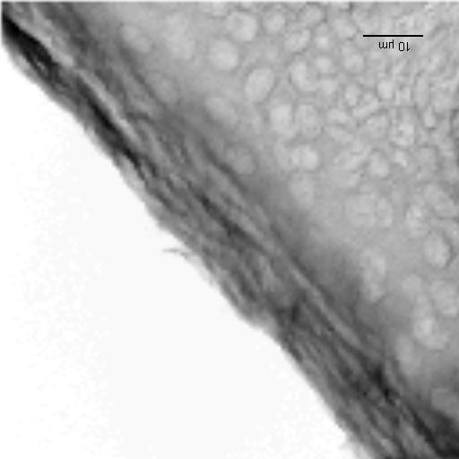
3
Human epidermis and STIM imaging
10µm
STIM
Stratum
corneum
Stratum
Granulosum
Stratum
Spinosum
Ref : Skin morphology and layer identification using different STIM geometries, P. Aguer et al.
NIM B 231 (2005) 292-299
14
INPC2013, 2-7 June 2013, Firenze, Italy
14
Notes:
Zoom with higher resolution. Single corneocytes are visible in stratum corneum. (the highest organic density in srat. Corneum)

Slide 15
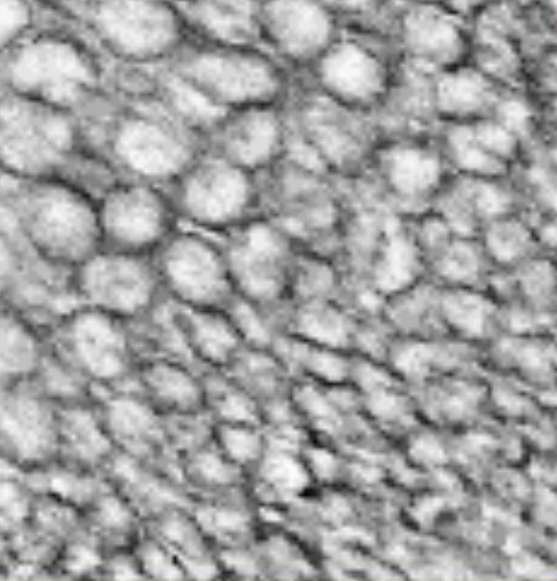
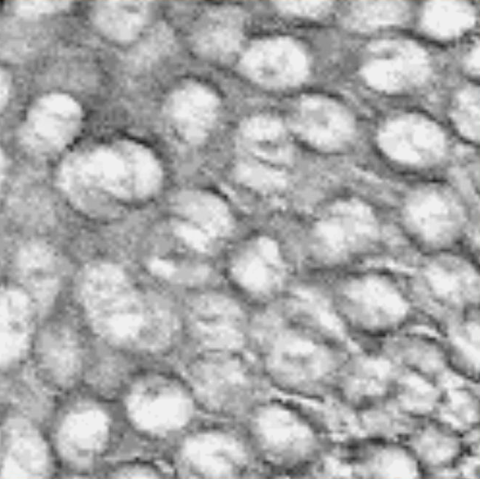
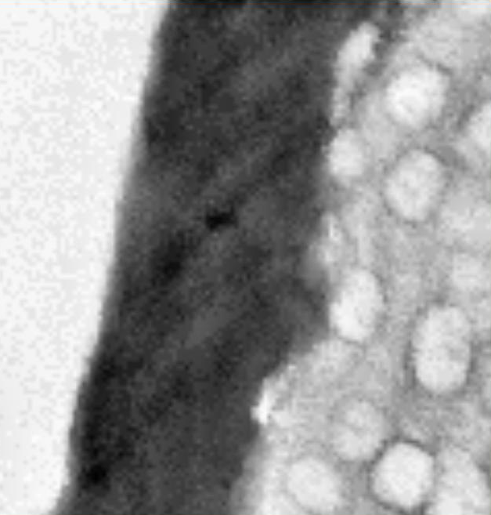
3
The barrier function controlled by ionic concentrations
PIXE
The barrier effect is a physiological function that involves also other epidermal strata where complex homeostasic mechanisms regulate mineral ions.
Any change in the barrier efficiency modify the calcium gradient and is the trigger for barrier repair process
Calcium
PIXE
Phosphorus
STIM
Ref : Simon M. et al., The skin barrier function: a micro-PIXE study, X-Ray Spectrometry, 2009; 38: 132-137 3
15
INPC2013, 2-7 June 2013, Firenze, Italy
15
Notes:
The barrier function is one of the most important physiological function. It preserves the body homeostasis by controlling the water loss.
The technique allows the measurement of the Ca gradient through he epidermis

Slide 16
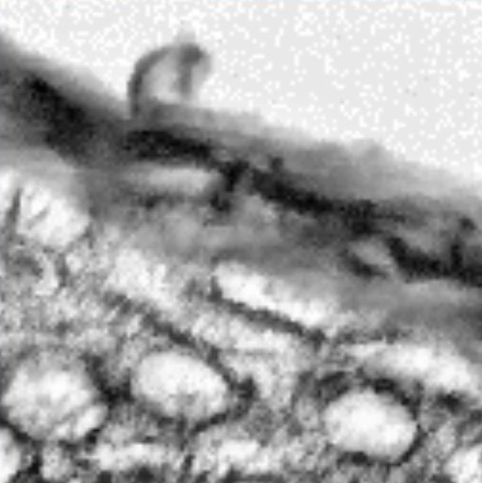
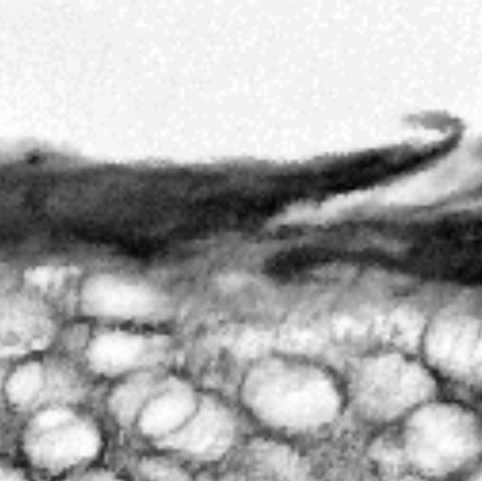
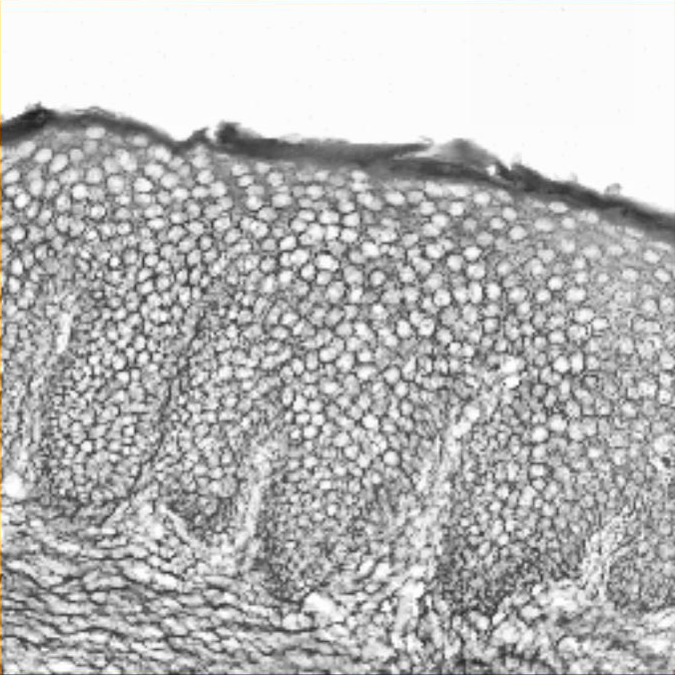
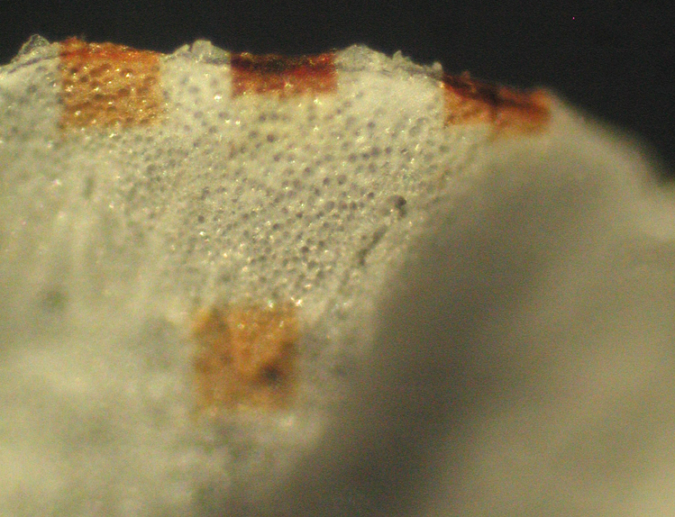
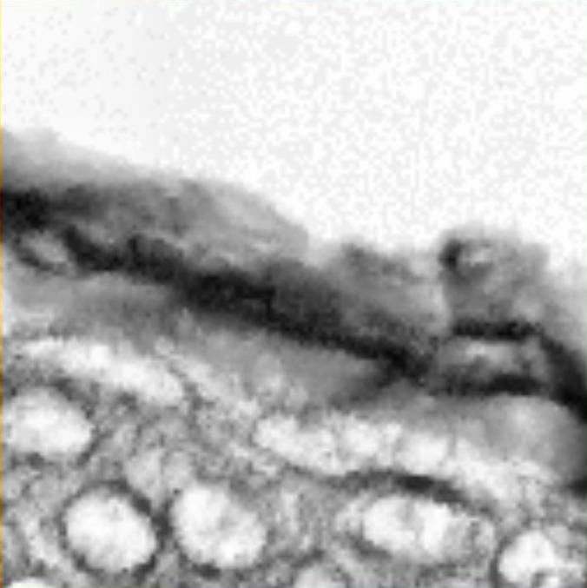
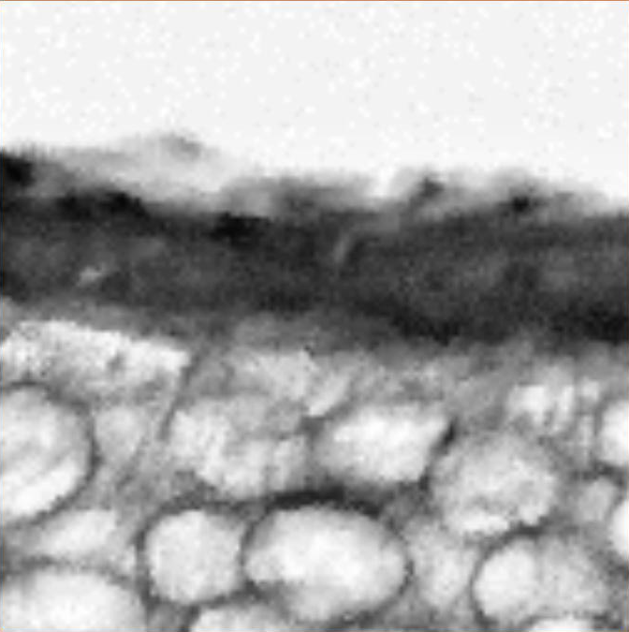
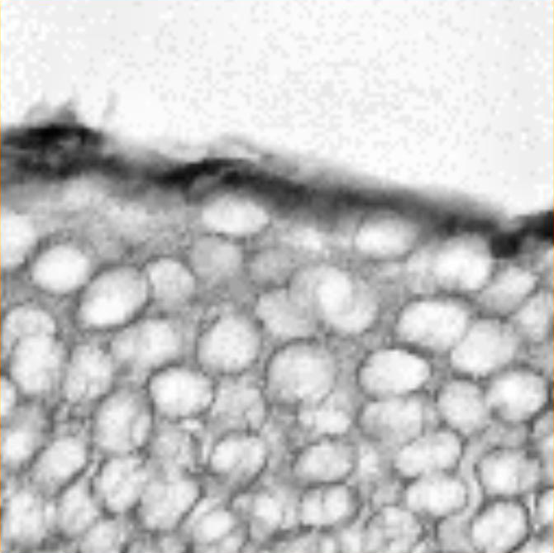
3
Trans-epidermal penetration of TiO₂
Anthelios XL 60 F / 24H
100 µm
INPC2013, 2-7 June 2013, Firenze, Italy
16
Notes:
Model of animal native skin after exposure to a solar formulation cpntaininf TiO2 nanoparticles. Three scans performed on the epidermis…

Slide 17
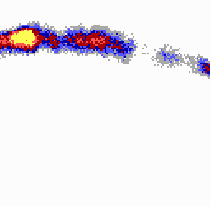
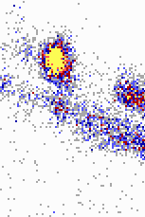
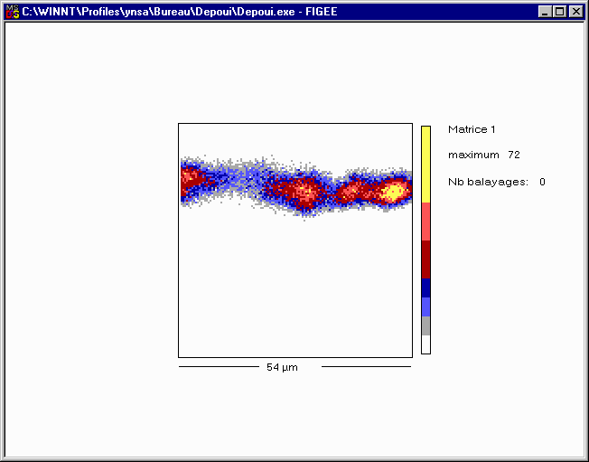
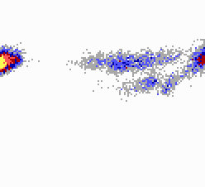
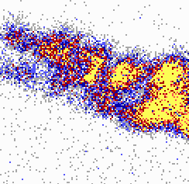
3
Trans-epidermal penetration of TiO₂
Ti
Anthelios XL 60 F / 24H
100 µm
Ref : Gontier E. et al., Is there penetration of titania nanoparticles in sunscreens through skin? A comparative electron and ion microscopy study.
Nanotoxicology. 2008; 2(4): 218-31.
INPC2013, 2-7 June 2013, Firenze, Italy
17
Notes:
TiO2 are detected via their chemical fingerprint (Titatnium) using PIXE.
No penetration in depth (at least in the living stratum) in healthy skin. The conclusion of the study was to evaluate skin with imparied barrier function

Slide 18
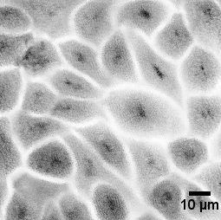
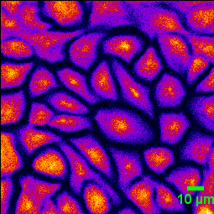

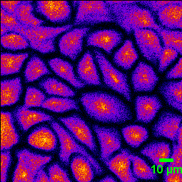
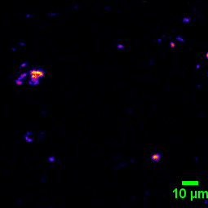

3
HaCat Cells exposed to TiO₂ Nanoparticles in vitro
STIM
Phosphorus
Potassium
Titanium
Multi-detectors analysis
HaCat Cells / P25 NPs
IPCV/Seznec H., AIFIRA/TITANIUMS
INPC2013, 2-7 June 2013, Firenze, Italy
18
Notes:
In vitro studies on cell lines to evaluate the penetration in cells.
The HaCat human keratinocyte model and Ti determination after exposure in vitro to TiO2 P25 nanoparticles.
Monolayer.

Slide 19
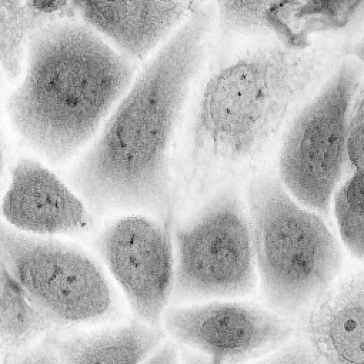

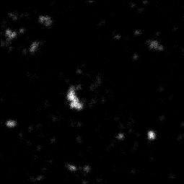
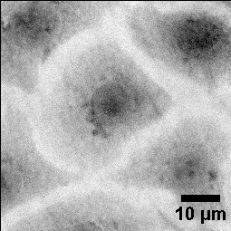
3
HaCat Cells exposed to TiO₂ Nanoparticles in vitro
max
HaCaT
Titanium map
Scan size: : 70 x 70 µm
max
N
C
N
C
N
Density
C
N
C
STIM
Scan size: 58 x 58 µm
min
STIM: 2 Mev He⁺
IPCV/Seznec H., AIFIRA/TITANIUMS
50 µm
INPC2013, 2-7 June 2013, Firenze, Italy
19
Notes:
Quantitative technique (See micro-domains…) :
The TiO2 NPs agregates may be observed both in STIM and PIXE mode…

Slide 20
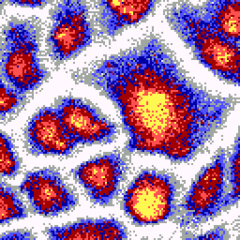
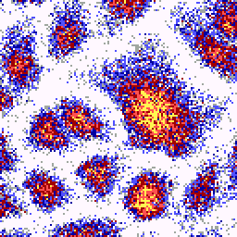
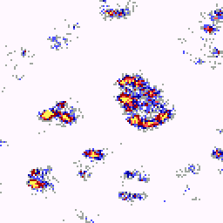
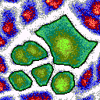

3
Increase of Ca in cells exposed to uncoated nano-TiO₂
Phosphorus
Potassium
Titanium
ROI
120
100
Control
TiO₂-P25
80
FITC-TiO₂-P25
Region of Interest
60
3
mg/g Dry Mass
40
2
mg/g D.M
20
1
0
0
Na
Mg
P
S
Cl
K
Ca
Ti
Ca
Ref: TiO2 nanoparticles induced intracellular calcium homeostasis modification in primary human keratinocytes. Towards an in vitro explanation of TiO2 nanoparticles toxicity, Marina Simon et al., Nanotoxicology, 5,2 (2011) 125-139.
INPC2013, 2-7 June 2013, Firenze, Italy
20
Notes:
There are optical fluorescence techniques avalaible via the functionalisation of NPs using fluorescent probes like fluorescin.
FITC-NPs could induce different cell response !! Main drwback for this technique!!!

Slide 21
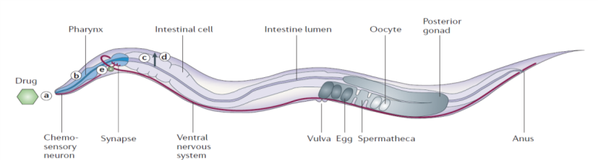
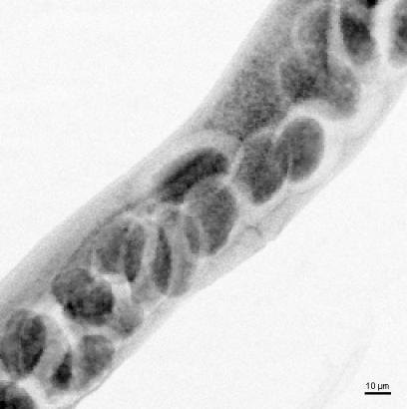

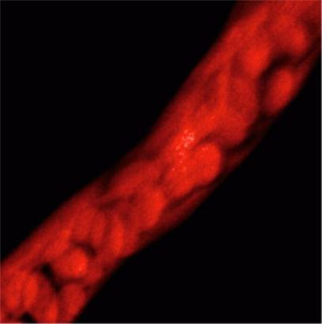

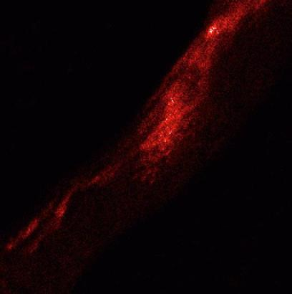

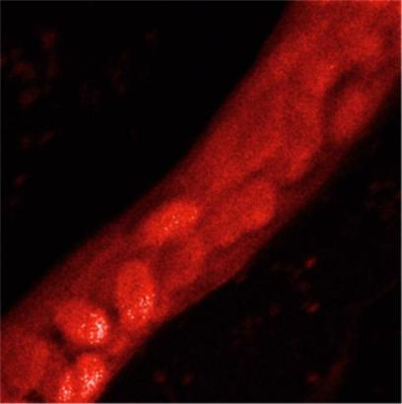

3
C.Elegans : STIM-PIXE microanalysis
B.
STIM
Anatomy of an adult hermaphrodite
1.5 MeV H⁺ MICROBEAM
256 x 256 pixels
Scale bar 10 µm
Phosphorus
Calcium
Sulfur
INPC2013, 2-7 June 2013, Firenze, Italy
21
Notes:
Future : multicellular organisms because of the possibilty to use it as a marker of the environment.
We use the C. elegans nematode.
To study the translocation in organs at the full body scale.

Slide 22







3
C.Elegans exposed to TiO2 nanoparticles: head/pharynx
STIM-3D
PIXE-3D
Phosphorus
PIXE-3D
Sulfur
PIXE-3D
Potassium
PIXE-3D
Calcium
PIXE-3D
Titanium
pharynx
intestin
Experimental Conditions: 1.5 MeV H⁺ - STIM : 15 min, PIXE : 1h00
INPC2013, 2-7 June 2013, Firenze, Italy
22
Notes:
The heads of two worms collapsed. You can the two pharynx structures...

Slide 23
4
Principle of STIM- and PIXE-Tomography
z
SAMPLE
H⁺, He⁺ beam
Energy of transmitted
protons
x
Horizontal line scan
⇒ Horizontal tomographic slice
across the specimen
X rays
X-ray
detector
On axis STIM detector
y
θ
x
To reconstruct an horizontal slice, scan the beam along the transverse horizontal axis
⇒ Linear projection : to determine the local sample thicknesss (areal density in g/cm²)
Repeat the same measurements at different angles ⇒ set of linear projections
Reconstruct the distribution of the mass density (g/cm³) using analytical or algebraic
reconstruction algorithm (filtered backprojection , ART, ...).
Reconstruction performed slice by slice. Slices are numerically stacked for 3D map
Notes:
To obtain the full 3D structure, we have developed a tomography techniques

Slide 24

4
Experimental conditions
Y
Sample
Sample holder
X
Z
Micrometric screws
Rotation axis
EXP. CONDITIONS (STIM): Very low beam intensity (< 1 fA)
Spatial resolution < 1 μm
Non destructive (no section, no radiation damage)
INPC2013, 2-7 June 2013, Firenze, Italy
24
Notes:
The experimental device with the gonometer (4 degrees of freedom) and the sample mmounted on the tip of a capilary/needle

Slide 25



4
C.Elegans nematode : Tomography of adult worms
3D STIM
1.5 Mev H⁺
Scan: 200 x 100 μm
3D projections
DIC optical microscopy
INPC2013, 2-7 June 2013, Firenze, Italy
25
Notes:
On the right a few slices…

Slide 26

4
C.Elegans nematode : Tomography of adult worms
3D STIM
1.5 Mev H⁺
Scan: 200 x 100 μm
3D projections
DIC optical microscopy
INPC2013, 2-7 June 2013, Firenze, Italy
26
Notes:
Differential optical interferometry (left)
STIM

Slide 27
4
C.Elegans nematode : Tomography of adult worms
3D STIM
1.5 Mev H⁺
Scan: 200 x 100 μm
3D projections
DIC optical microscopy
INPC2013, 2-7 June 2013, Firenze, Italy
27
Notes:
On the right a few slices…

Slide 28

4
C.Elegans nematode : PIXE-Tomography of adult worms
Slice 1
P
S
K
Ca
Ti
P
S
K
Ca
Ti
Slice 2
Slice 3
P
S
K
Ca
Ti
Scale bar: 10 µm
INPC2013, 2-7 June 2013, Firenze, Italy
28
Notes:
Three slices shown on the previous slide…

Slide 29
5
Neurobiology
Role of metals in neurodegenerative diseases
Altered brain functions and cerebral biochemistry
Anatomy of the brain and trace elements…
INPC2013, 2-7 June 2013, Firenze, Italy
29

Slide 30
5
Parkinson’s disease and dopaminergic Cell
Background - In Parkinson’s disease (PD):
- selective loss of dopaminergic neurons from Substantia Nigra pars compacta (SNpc)
Loss of the enzyme Tyrosine Hydroxylase (TH) activity (involved in dopamine biosynthesis)
Fe is increased in dopaminergic neurons of the SNpc
Is iron involved in the aetiology of PD ?
Hydroxydopamine (6-OHDA) is a neurotoxin known to selectively kill dopaminergic
neurons.
Experimental models : - Rats treated with 6-hydroxydopamine (6-OHDA)
            - PC12 dopaminergic cultured cells treated with 6-OHDA
Main objectives:
to establish whether the experimental models of PD (known to present a decreased TH activity) would also show an increased Fe content ?
to determine the subcellular distribution of iron, iron proteins (transferrin,…) and dopamine related proteins (TH, …) and if these distributions are modified in experimental models of PD ?
30
INPC2013, 2-7 June 2013, Firenze, Italy
30
Notes:
SNpc : substencia Nigra (pc ?)

Slide 31

5
Chemical Imaging of the Dopaminergic Cell
Combined use of hard X-ray phase contrast imaging and X-ray fluorescence microscopy for sub-cellular metal quantification, E.Kosior, S.Bohic, H.Suhonen, R.Ortega et al., Journal of Structural Biology 2012;177(2):239-47
- X-ray fluorescence (a) – ID22/ESRF
- X-ray Phase contrast (b) – ID22/ESRF
- STIM (c) map of the cell C – AIFIRA
The cell nucleus is highlighted in red.
On the phase map there are 2 areas selected for thickness calculation
On the STIM map there are 3 selected areas X, Y, Z, which were chosen to calculate the areal mass.
b
C
31
INPC2013, 2-7 June 2013, Firenze, Italy
31
Notes:
Multimodality using SXRF (X-ray fluorescence er Phase Contrats ESRF ID22 and STIM (AIFIRA) for imaging and mass determination

Slide 32


5
Quantification of iron in dopaminergic cells
STIM PIXE
C: cytoplasm
N: nucleus
Nu: nucleoli
Pr: perinuclear region
17,5 µm
STIM and PIXE analysis of a single PC12 cell exposed 100 μM FeSO4.
32
INPC2013, 2-7 June 2013, Firenze, Italy
32
Notes:
Voir report AIFIRA (2011-2)

Slide 33
5
Quantification of iron in dopaminergic cells
Trace element concentration in PC12 dopaminergic cells (preliminary results)
The number of analyses for each condition were respectively N= 6, 8, 5 and 4. Each analysis corresponds to a cell monolayer of about 200 cells.
In order to evaluate whether differences are statistically significant, 15 analyses for each condition are required
33
INPC2013, 2-7 June 2013, Firenze, Italy
33

Slide 34
7
Conclusions
Nowadays, most relevant experiments are conducted using a multimodal approach, combining tabletop techniques usually employed in cellular or molecular biology, advanced optical microscopy (fluorescence, confocal,…) and bulk analytical techniques (ICP-MS,…).
When trace element distribution is concerned on a microscopic scale in biological matrix, Nuclear Microscopy is a versatile technique that easily takes place in the panel of the high resolution methods such as SIMS or SXRF.
The number of papers in dedicated Bio-Journals is increasing . The use of our techniques by the « bio » community is slowly progressing together with the expertise of the IBA groups.
European networks and programmes : NANODERM (FP5), CELLION (FP6), SPIRIT (FP7), SPRITE(FP7),… Possibility of TNA
INPC2013, 2-7 June 2013, Firenze, Italy
34

Slide 35

7
Thank you for your attention …
INPC2013, 2-7 June 2013, Firenze, Italy
35

Slide 36

Geant4 Intern. Conference at the Physics-
Medicine-Biology frontier (7-11 Octobre, Bordeaux)
8
http://geant4.in2p3.fr/2013/
INPC2013, 2-7 June 2013, Firenze, Italy
36

Slide 37

Microbeam Workshop 2013
October 3-4, 2013
Bordeaux
8
www.cenbg.in2p3.fr/microbeam2013/
INPC2013, 2-7 June 2013, Firenze, Italy
37

