Slide 1
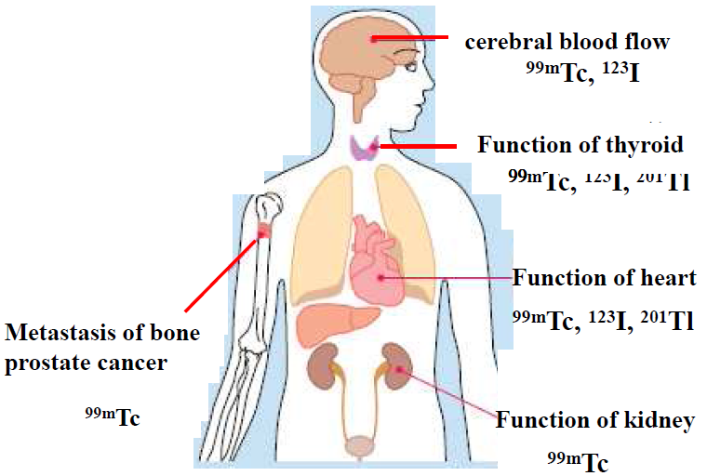
INPC2013 Firenze
⁹⁹Mo production via ¹⁰⁰Mo(n,2n)⁹⁹Mo using accelerator neutrons
Yasuki Nagai
Japan Atomic Energy Agency
^{99m}Tc-labeled radiopharmaceuticals
^{99m}Tc
medical diagnostics
>25 million/year
Constant supply of ⁹⁹Mo
key issue to ensure
the routine application
of ^{99m}Tc.
Shortage of ⁹⁹Mo
⁹⁹Mo: fission product of highly enriched ²³⁵U (HEU) at five research reactors
♦ 45 – 54 years since their first operation: unexpected accidents

Slide 2
Alternative production method
Points to be considered:
1) Production yield: meet a significant part of the domestic demand of ⁹⁹Mo
2) Safety & efficacy of ^{99m}Tc radiopharmaceutical preparation: ensured
♦ Radionuclide purity of ^{99m}Tc: {United States Pharmacopeia (USP)}
⇒ ⁹⁹Mo & concentration of other β- & γ-emitters in ^{99m}Tc < 0.015 & < 0.01%
⇒ labeling efficiency of ^{99m}Tc radiopharmaceutical complex > 90%
3) Without HEU (public concern due to the proliferation of nuclear weapons)
4) Cost of produced ⁹⁹Mo: (facility & operation cost)
Reactors: • ²³⁵U(n,f)⁹⁹Mo using low enriched ²³⁵U • Mo(n,γ)⁹⁹Mo
2. Accelerators:
• ¹⁰⁰Mo(p,2n)^{99m}Tc direct ^{99m}Tc production Canada
• ¹⁰⁰Mo(γ,n)⁹⁹Mo, ²³⁸U(γ,f)⁹⁹Mo USA, Canada
• ⁹⁸Mo(n,γ)⁹⁹Mo parent ⁹⁹Mo production
• ¹⁰⁰Mo(n,2n)⁹⁹Mo (our proposal)

Slide 3
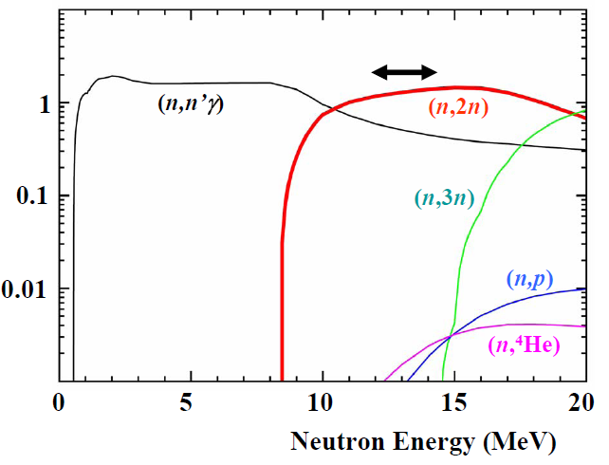
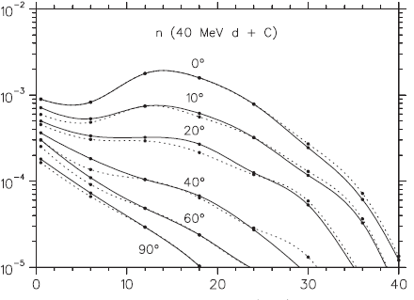
Production yield of ⁹⁹Mo by ¹⁰⁰Mo(n,2n)⁹⁹Mo
Y.Nagai, Y.Hatsukawa: J.Phys.Soc.Japan (2009)
¹⁰⁰Mo(n,x) reaction X-section
14MeV
σ (b)
Neutrons from 40 MeV d + C
Neutron yield
0 10 20 30 40
Neutron energy (MeV)
Lhersonneau et al. NIM (2009)
Characteristic points:
♦σ(n,2n): large at E_{n} ∼ 14 MeV, 10-times larger than that of ⁹⁸Mo(n,γ)⁹⁹Mo.
♦σ(n,X): radioactive waste production are quite small.
♦¹⁰⁰Mo sample of over 200 g: used. (reused)
♦intense φ(n): obtained using an accelerator SPIRAL-2 project, Avilov et al. NIM (2010)

Slide 4
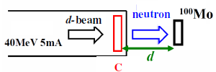
⁹⁹Mo production yield using neutrons from C(d,n)
♦ 40 MeV 5 mA d-beam
Latest neutron data: Lhersonneau et al. NIM (2009)
Evaluated cross section in the Japanese Evaluated Nuclear Data Library (JENDL-4.0)
¹⁰⁰Mo 2days irradiation
d = 1 cm 2 cm 4 cm
Minato & Nagai: J. Phys. Soc. Japan, (2010)
⁹⁹Mo requirement in Japan: 84TBq/week (domestic production)
40 MeV 5 mA d ＋C ⇒ ∼20% of the demand in Japan (¹⁰⁰Mo : d=2 cm)
250g ¹⁰⁰Mo 2days irradiation

Slide 5
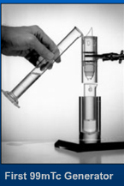
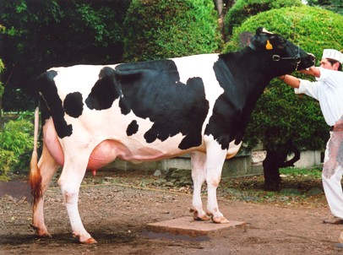
Safety & efficacy of ^{99m}Tc radiopharmaceutical preparation
²³⁵U Fission Accelerator
Specific activity of ⁹⁹Mo 370 TBq/(g ⁹⁹Mo) 37 GBq/(g Mo)
Separation of ^{99m}Tc: Alumina cow (Al₂O₃) ?
Milking of ^{99m}Tc

Slide 6
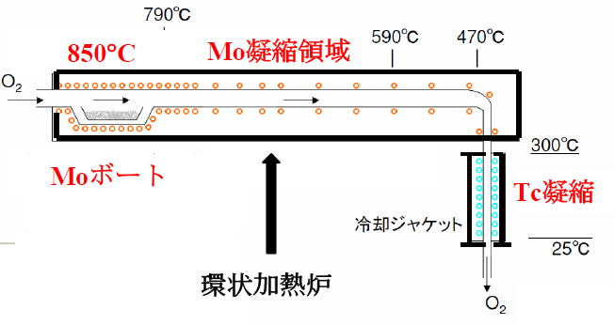
Thermochromatographic Separation of ^{99m}Tc from ⁹⁹Mo
Perrier & Segre J.Chem.Phys. (1937)
points: in ^{99m}Tc
⁹⁹Mo (other RIs) < 0.015 (0.01) %
Mo 凝縮域
310°C
795 °C
照射Mo+Tc
(白金ボート)
Tc condense
(Platinum boat)
Electric Furnace
Tc₂O₇
Vapor pressure (atom)
^{99m}Tc produced in ¹⁰⁰Mo O₃ volatilizes
at a temperature lower than that of
the sublimation of MoO₃.
No chemical processing
Separation process : within one hour
MoO₃
0 200 400 600 800 1000 (°C)
Notes:
1

Slide 7
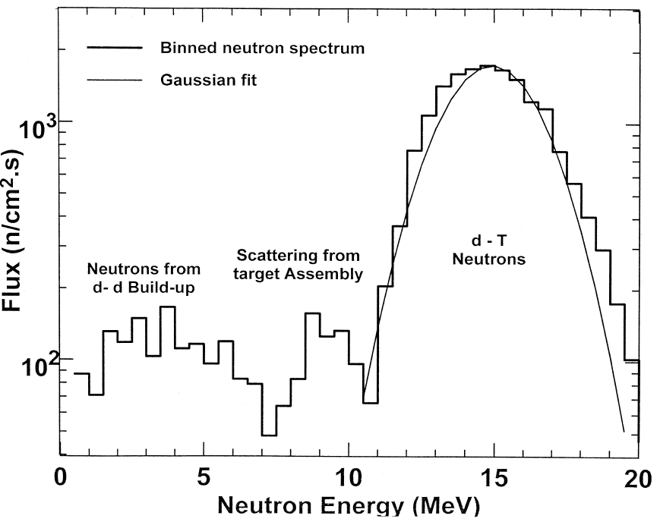
R&D work of ⁹⁹Mo production using 14 MeV neutrons
14 MeV : ³H + d → n + ⁴He {E_{d} ∼ 0.35 MeV}
Insulated
Transformer
High Voltage
Power Supply
Ion Source
Energy spectrum from ³H(d,n)⁴He
Akkus et al.: Ann. Nucl. Energy (2001)
Accelerating
Tube
Quasi monoenergy
Fusion Neutronics Source, JAEA
3 × 10¹² n/s in operation !!

Slide 8
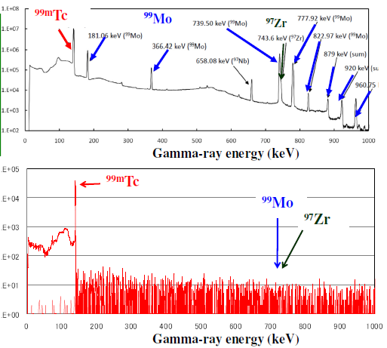
Quality of ^{99m}Tc
♦ before separation
⁹⁹Mo
⁹⁷Zr (T_{1/2}=17 h)
⁹⁷Nb (T_{1/2}=1.2 h)
separation easy
Waste very small
♦ after separation
impurity < 0.01%
♦ Labeling efficiency >99% using a thin layer chromatography plate

Slide 9
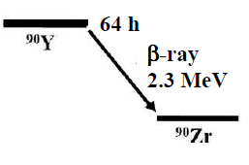
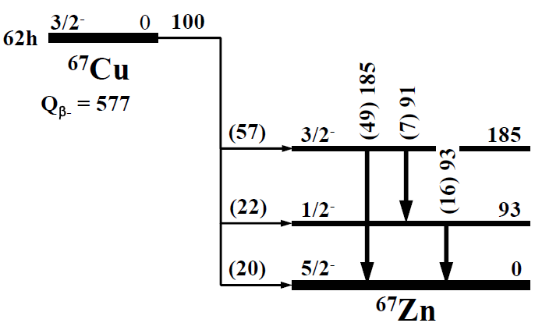
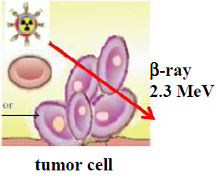
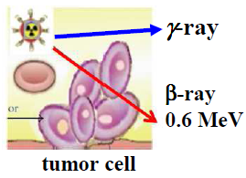
Potential to produce a wide variety of RI production
diagnosis: ^{99m}Tc therapy: ⁹⁰Y therapy & diagnosis: ⁶⁴Cu,⁶⁷Cu
62 h
USA requirement 440 TBq/y
0.45 MeV
reactor (research) reactor (power plant) accelerator (proton)
¹⁰⁰Mo(n,2n)⁹⁹Mo ⁹⁰Zr(n,p)⁹⁰Y ⁶⁴Zn(n,p)⁶⁴Cu, ⁶⁸Zn(n,np)⁶⁷Cu
Y. Nagai et al. JPSJ 78 (2009) T. Kin et al. JPSJ 82 (2013)

Slide 10
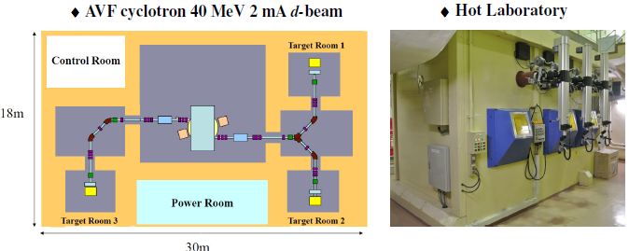
Summary
Since we proposed a new route to produce ⁹⁹Mo via ¹⁰⁰Mo(n,2n)⁹⁹Mo,
we carried out all important steps necessary to obtain ^{99m}Tc with high quality.
Thermochromatographic separation of ^{99m}Tc
from MoO₃
Labeling
accelerator
Neutron
converter
MoO₃
We proposed a new system for
Generation of Radioisotopes with Accelerator Neutrons by Deuterons (GRAND)
Y. Nagai et al, JPSJ 82 (2013)
♦ Prototype facility of GRAND

