Slide 1


Fragmentation cross sections at intermediate energies for Hadrontherapy and Space Radiation Protection
Marzio De Napoli
INFN – Sezione di Catania
for the DREAMS and FRATT Collaboration
Physics Motivation
The Experiments @ LNS-CT
Experimental results
Geant4 Monte Carlo predictions
Conclusions
Firenze, Italy 2-7 June 2013

Slide 2
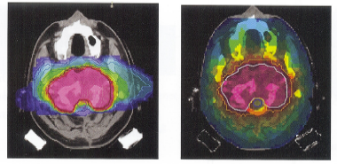

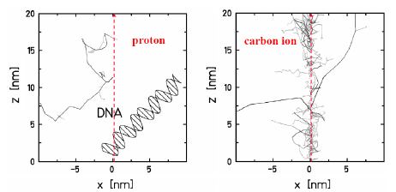
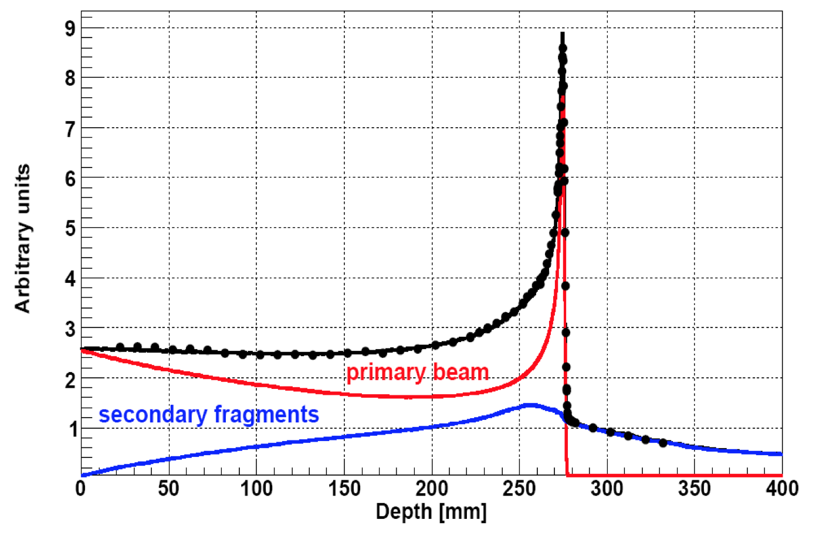
Fragmentation in Hadrontherapy
Carbon therapy has considerable advantages over gamma and proton therapy
goal of radiotherapy
☺
High dose conformation
☺
High biological effectiveness
¹²C
γ
Maximize the damage to the tumor
Spare the surrounding healthy tissues
sparsely ionizing radiation
densely ionizing radiation
Disadvantages of Carbon ions
Tumor
☹
Attenuation of the primary beam
(30% after 2.5 cm)
¹²C fragmentation causes a buildup of lower-Z fragments
☹
Secondary fragments deliver an extra-dose after the Bragg peak in healthy tissues
Relative Dose
☹
Formation of a mixed radiation field with different biological effects
Depth from the body surface
Fragmentation must be carefully estimated in the treatment planning
Physics motivation
Marzio De Napoli – INPC2013

Slide 3
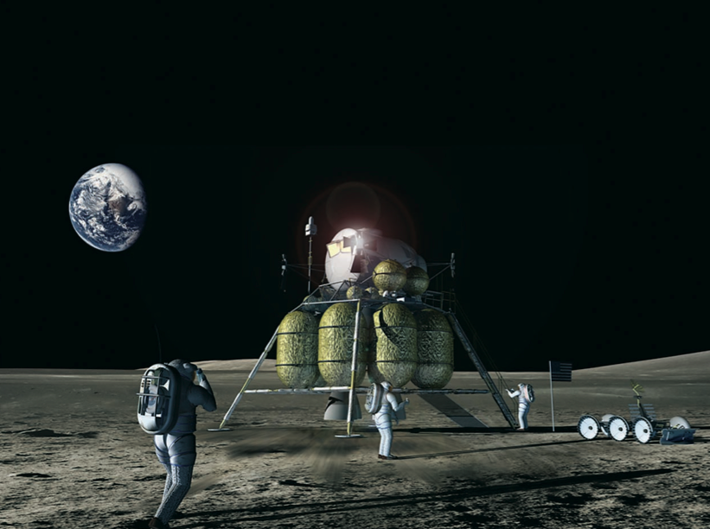
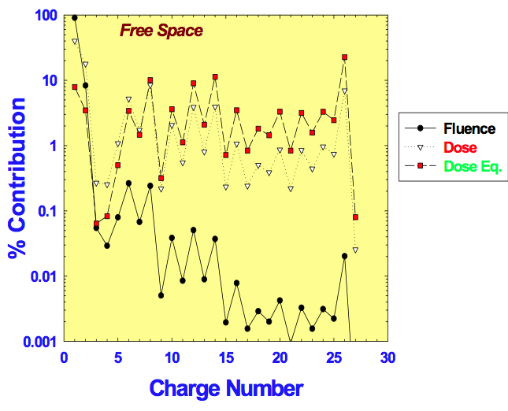
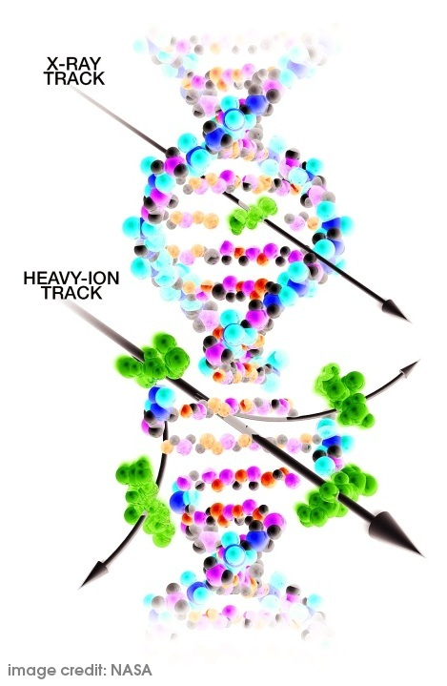
Fragmentation in Space Radiation Protection
Exposure to space radiation is a serious problem for space exploration because of the biological effects of high-energy heavy ions.
Galactic Cosmic Rays composition
NASA/John Frassanito and associates
A correct estimation of the radiobiological risks for the astronauts relies on a correct description of the GCR effects and their fragmentation in shielding materials and astronaut body
Physics motivation
Marzio De Napoli – INPC2013

Slide 4
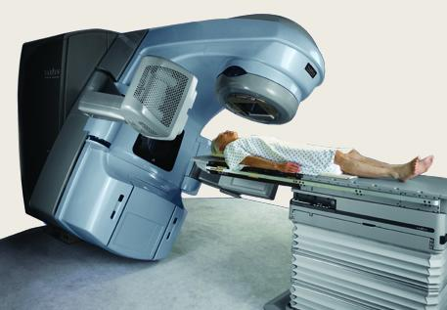
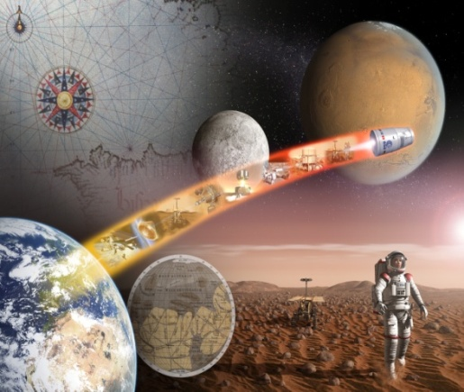
What do we need to measure ?
Hadrontherapy
d²σ(θ)/dEdΩ
Space radiation protection
Fragmentation cross sections are required in both fields for better radiation treatments and safer interplanetary spaceflights
NASA completed a large database of fragmentation measurements* and observed that double differential cross sections (DDCS) for light ions in the energy range of interest for hadrontherapy are missing.
*J.W.. Norbury and 1. Miller ,47th NCRP Annual Meeting
Bethesda , MD , pp. 24 (2011)
Fragmentation DDCS must be also measured at Fermi energies
Tumor
Relativistic Incident Energy
Energy=0
No fragmentation DDCS at intermediate energies are present in literature !
Relative Dose
Energy loss in the tissue
Depth from the body surface
Physics motivation
Marzio De Napoli – INPC2013

Slide 5
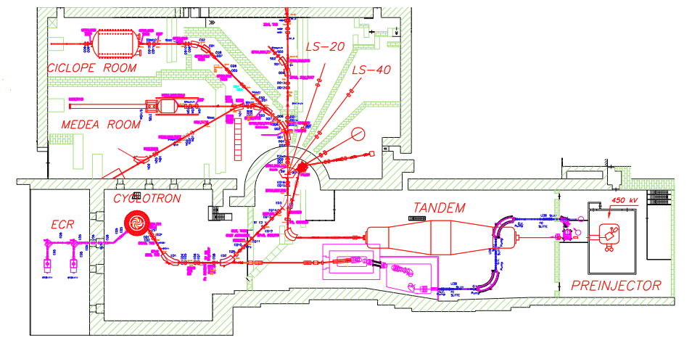
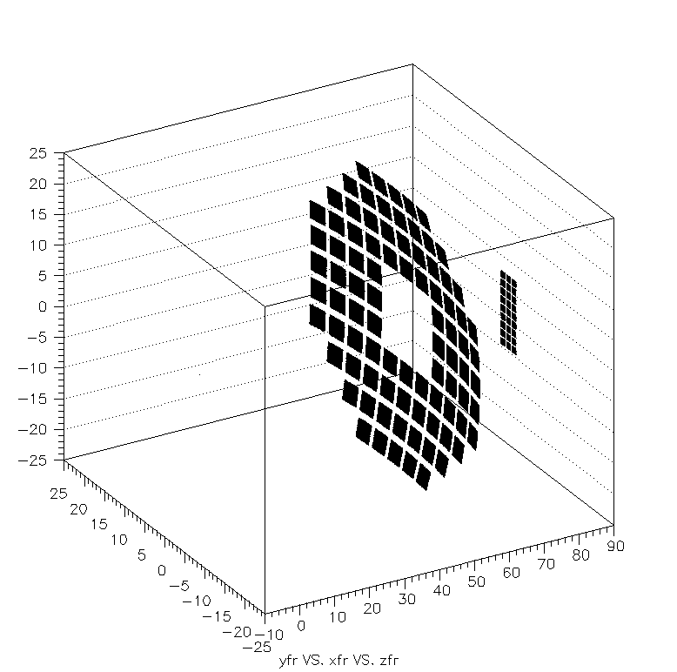
Fragmentation measurements @ LNS
¹²C fragmentation @ 62 AMeV on ¹²C and ¹⁹⁷Au targets
Hodo-Big
Two arrays of Si -CsI telescopes
Hodo-Small
Hodo-Big
Hodo-Small
Beam
Target
(Angular range)_{lab} = 2°-21°
More than 400 detectors to measure Z, A, energy and emission angle of the produced fragments
The Experiments @ LNS-CT
Marzio De Napoli – INPC2013

Slide 6
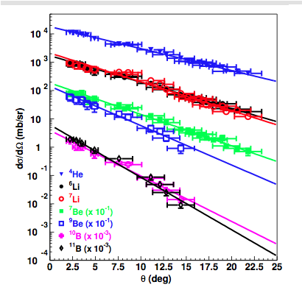
Angular distributions
⁴He
Exponential distributions: fragments are mostly emitted at forward angles
⁶Li,
⁶Li,⁷Li
⁷Be,⁹Be
The slope of heavier fragments is steeper
¹⁰B,¹¹B
α particles are the most produced fragments
¹¹B,
Experimental results
Marzio De Napoli – INPC2013

Slide 7
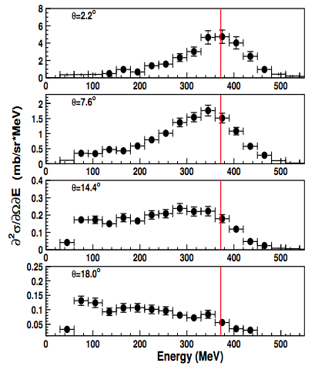
Double differential cross sections
Double-differential cross-sections provide valuable information on reaction mechanisms
⁶Li
2.2°
Fragmentation process
Fragments emitted at small angles with almost the same velocity of the beam in peripheral collisions
Experimental results
Marzio De Napoli – INPC2013

Slide 8
Double differential cross sections
Double-differential cross-sections provide valuable information on reaction mechanisms
⁶Li
2.2°
Fragmentation process
Fragments emitted at small angles with almost the same velocity of the beam in peripheral collisions
7.6°
14.4°
Low-energy tail
Fragments emitted at large angles with low energy, produced in more
central and dissipative collisions
18°
Experimental results
Marzio De Napoli – INPC2013

Slide 9
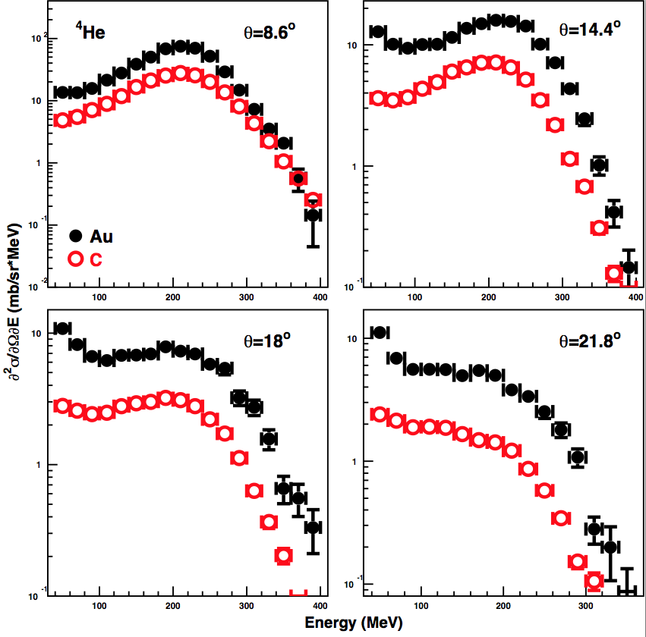
Target dependence
σ(θ)^{Gold}>σ(θ)^{Carbon}
Similar Shapes
Production of low energy fragments favoured in the heavier target
Experimental results
Marzio De Napoli – INPC2013

Slide 10
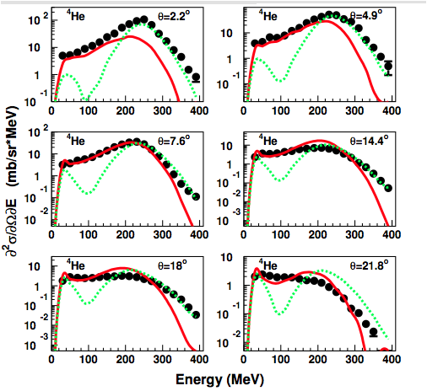
Geant4 vs Data
BIC
QMD
GENT4 version 9.4.p01
¹²C+¹²C @ 62 AMeV
BIC better reproduces fragments emitted at high energies and small angles (peripheral collisions)
QMD better reproduces the low energy part of the spectra (central collisions)
M. De Napoli et al, Phys. Med. Biol. 57, 765 (2012)
Geant4 Monte Carlo predictions
Marzio De Napoli – INPC2013

Slide 11
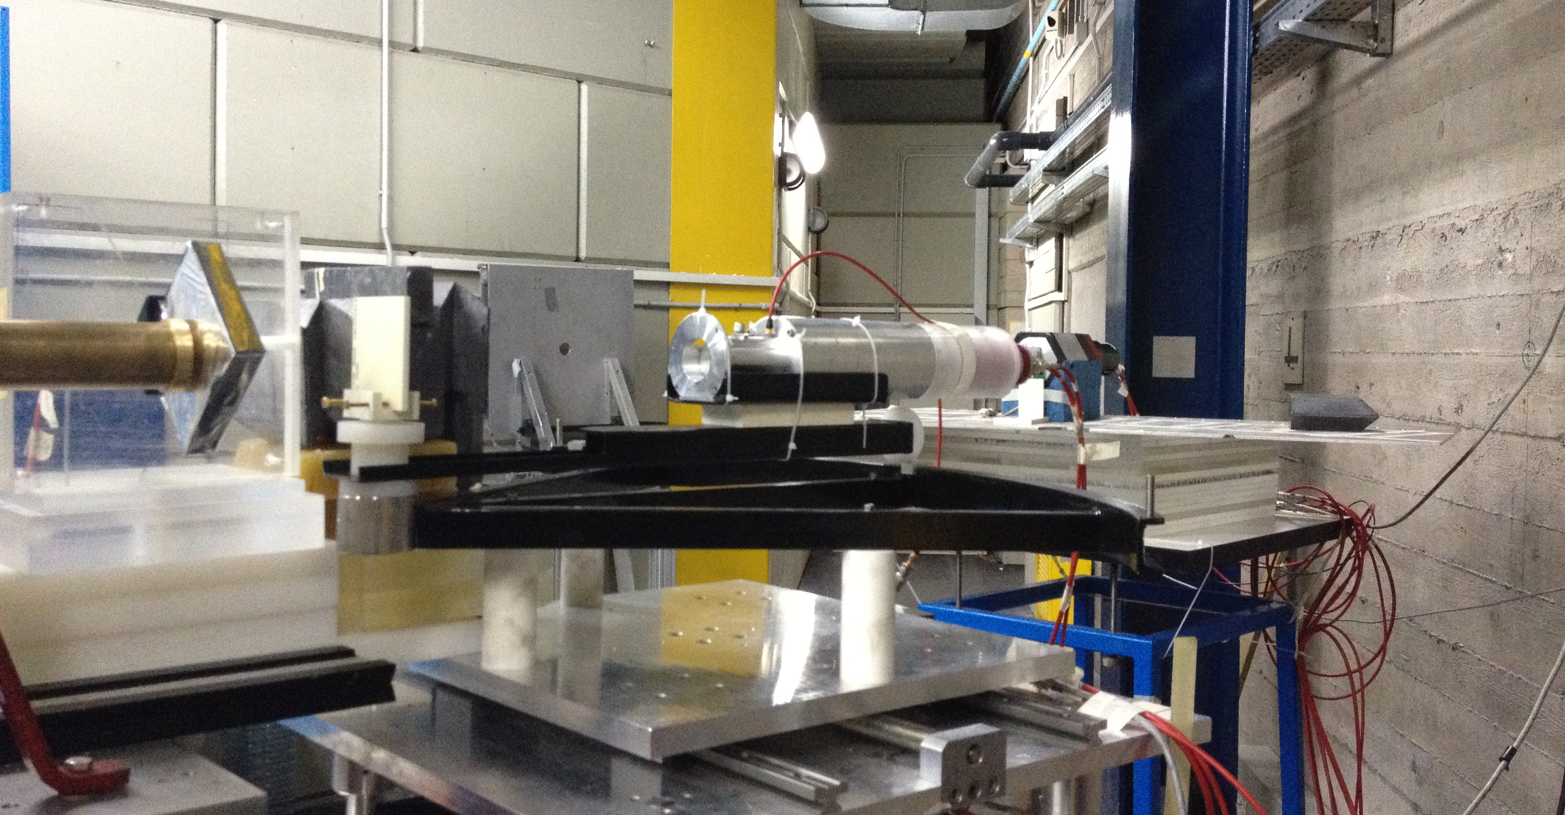
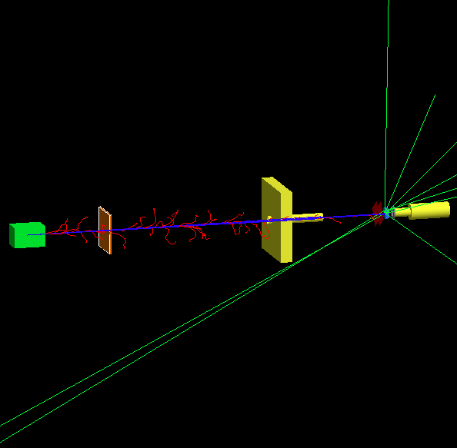
Thick target measurements @ LNS
To measure the fragments produced in conditions closer to the clinical case: thick target experiment in air with tissue-equivalent materials of medical interest
Thick target data available in literature in the range 60-400 AMeV:
  mainly neutrons
  only water or PMMA targets
Experimental setup
Si-CsI telescope
@ 0°
GEANT4 Monte Carlo simulation
Beam
The Experiments @ LNS-CT
Marzio De Napoli – INPC2013

Slide 12
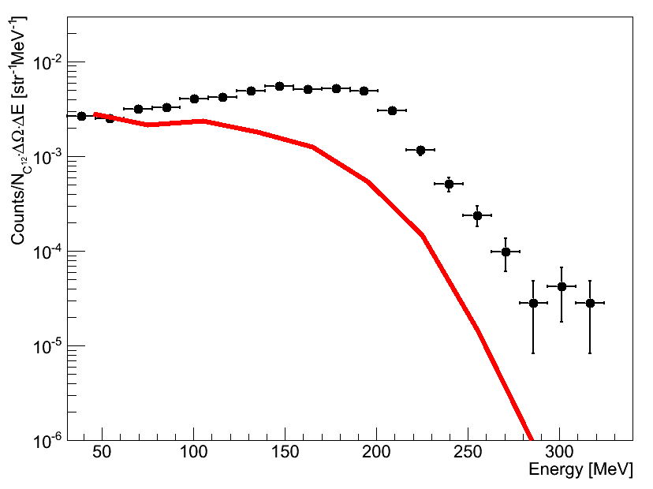
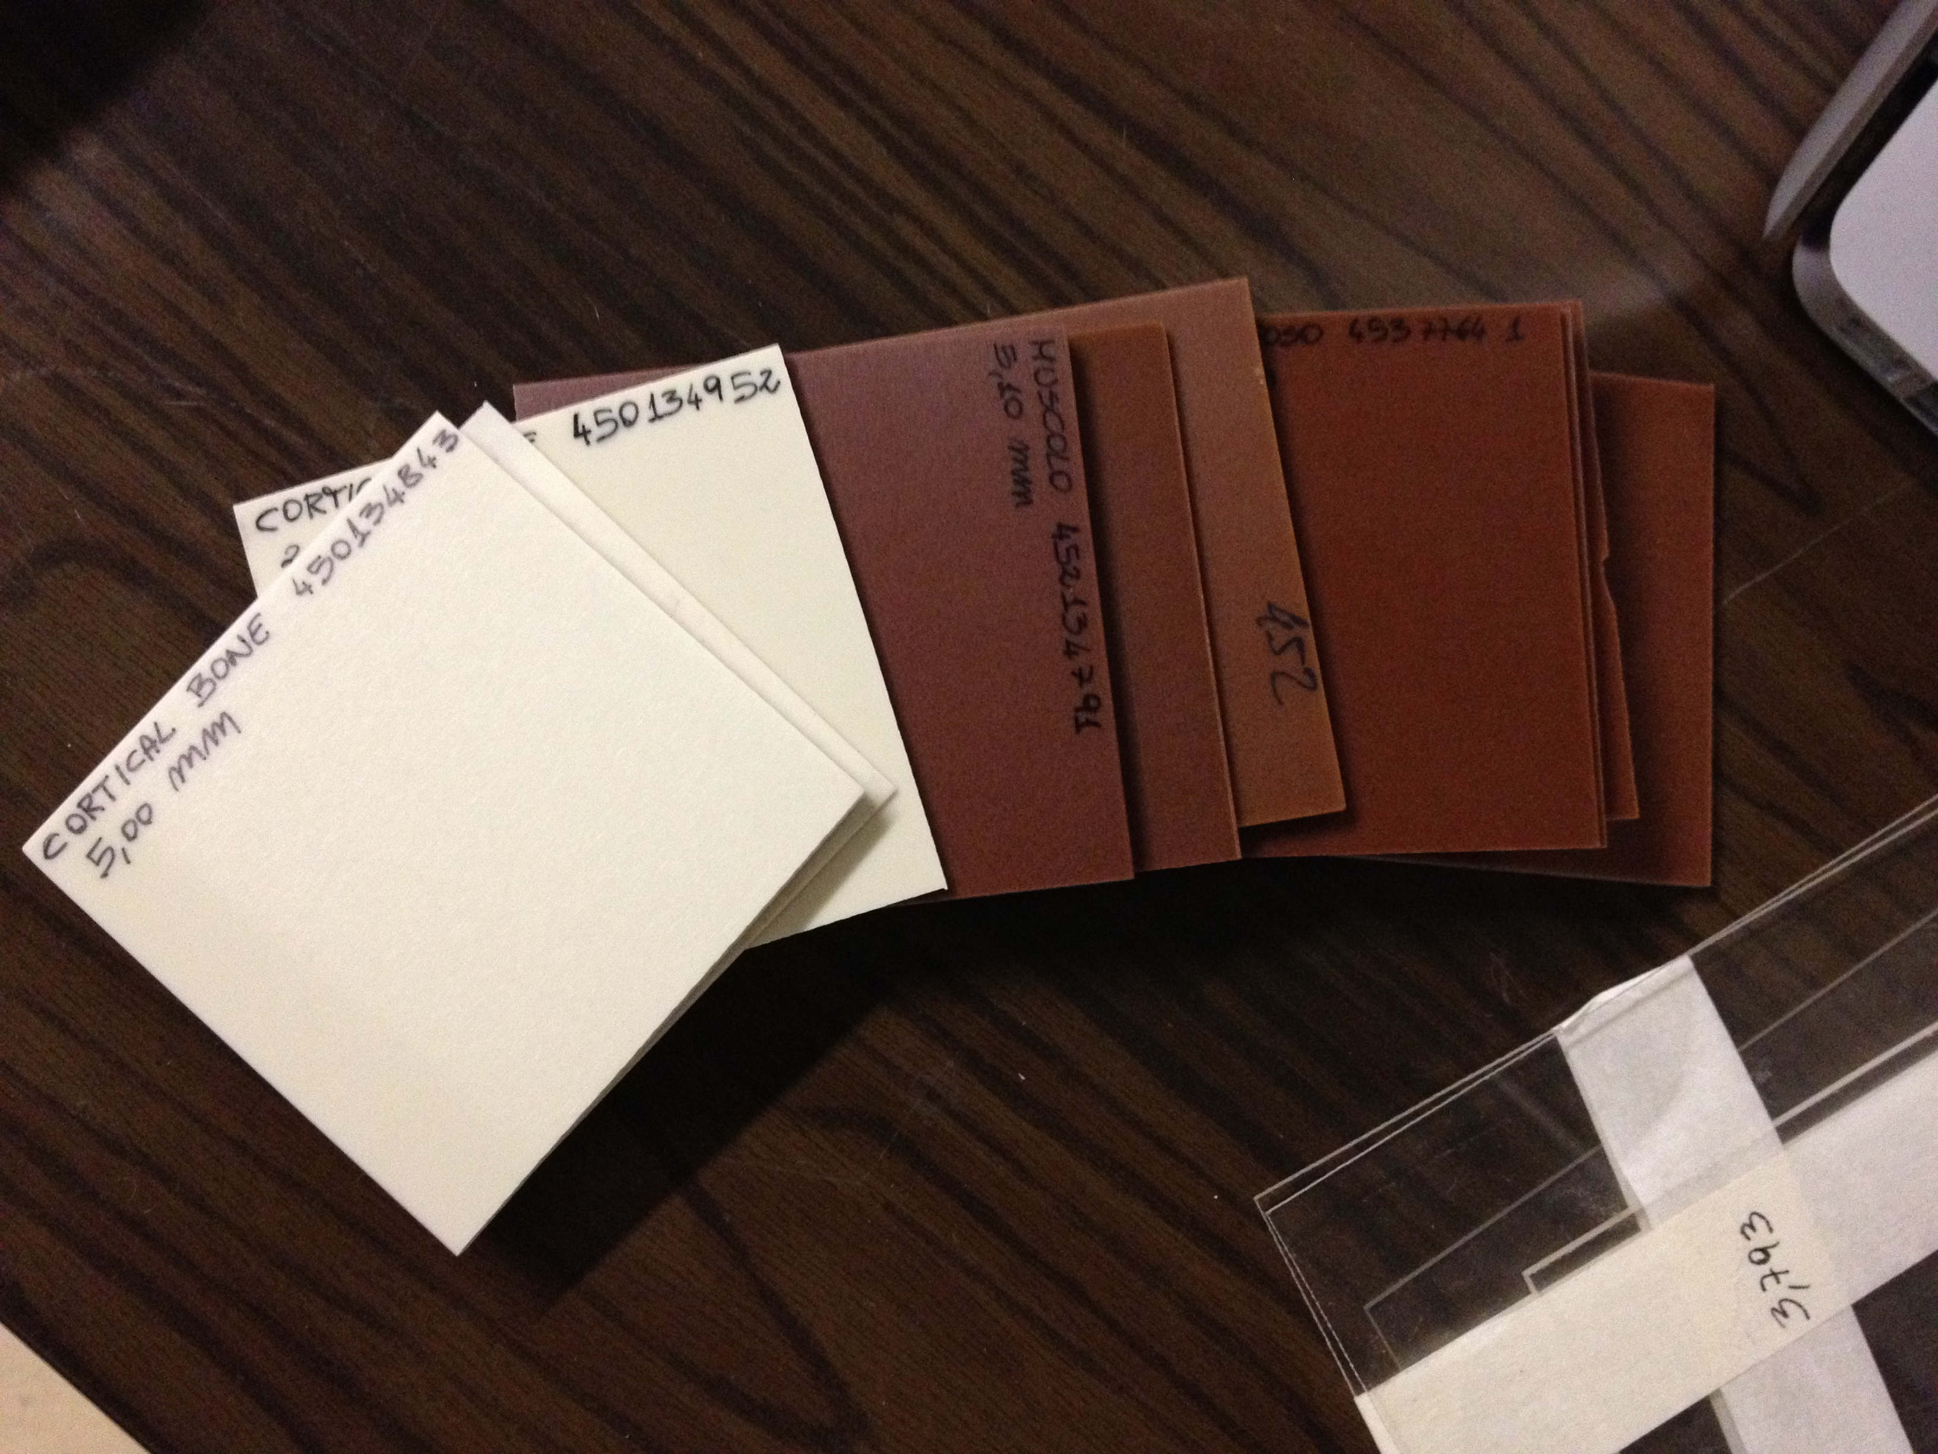
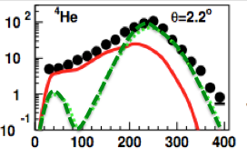
Preliminary results
Number of ⁴He produced at 0° by 62 AMeV ¹²C ions
QMD
Cortical Bone 3 mm
Preliminary
Composition
%H->3,41
%C->31,41
%N->1,84
%O->36,50
%Cl->0,04
%Ca->26,81
The comparison between QMD and data shows the same qualitative behavior observed in the thin target experiment
Experimental results
Marzio De Napoli – INPC2013

Slide 13
Conclusions
Fragmentation cross sections are fundamental inputs for both Hadrontherapy and Space radiation protection communities
For the first time a wide set of fragmentation DDCS were measured @ LNS for the reactions ¹²C+¹²C,¹⁹⁷Au @ 62 AMeV
The data will soon appear in two database:
Nuclear Energy Agency Data Bank (NEADB)
Experimental Nuclear Reaction Data (EXFOR)
Binary Cascade and QMD model of Geant4 have been tested for the first time at Fermi energies: the new data will allow to substantially improve the prediction capability of both models
A new campaign of experiments has started @ LNS to measure ¹²C fragmentation at Fermi energies on thick tissue-like materials for which no data are available in literature
Conclusions
Marzio De Napoli – INPC2013

Slide 14
THANK YOU !
C. Agodi, M. Bondì, G. Candiano, F. Cappuzzello,
D. Carbone, M. Cavallaro, G.A.P. Cirrone, G. Cuttone,
M. De Napoli, D. D’urso, F. Giacoppo, T. Licciardello,
A. Musumarra, D. Nicolosi, L. Pandola, G. Raciti,
E. Rapisarda, F. Romano, D. Sardina, V. Scuderi,
C. Sfienti, S. Tropea

Slide 15
Geant4 Simulations
Geant4 is an object-oriented toolkit to simulate the passage of particles through matter
Two models are potentially able to provide a realistic description of light ions inelastic interaction in the energy range of interest
Binary Light Ion Cascade (BIC)
Nucleons are sequentially propagated
Participant nucleons cannot collide each other
Time – invariant potential
Quantum Molecular Dynamic (QMD)
All nucleons are propagated at the same time
All nucleons can collide each other
The potential dynamically changes along with the time evolution of the nucleons.
Geant4 Monte Carlo predictions
Marzio De Napoli – ND2013

