Slide 1
Nuclear fragmentation measurements for hadrontherapy
Vincenzo Patera
Universita’ di Roma “Sapienza” & INFN-LNF

Slide 2
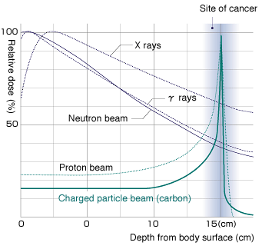
Hadrontherapy Motivation
Light ions advantages in radiation treatments of tumor wrt IMRT:
Better Spatial selectivity in dose deposition: (p,¹²C)
Reduced lateral and longitudinal diffusion (¹²C)
High Biological effectiveness (¹²C)
Treatment of highly radiation resistent tumours, sparing surrounding OAR
INFN has a long standing activity in this field, not only in beam facility realization (CNAO) but also in Treatment Planning System development (TPS INFN-IBA joint project)

Slide 3
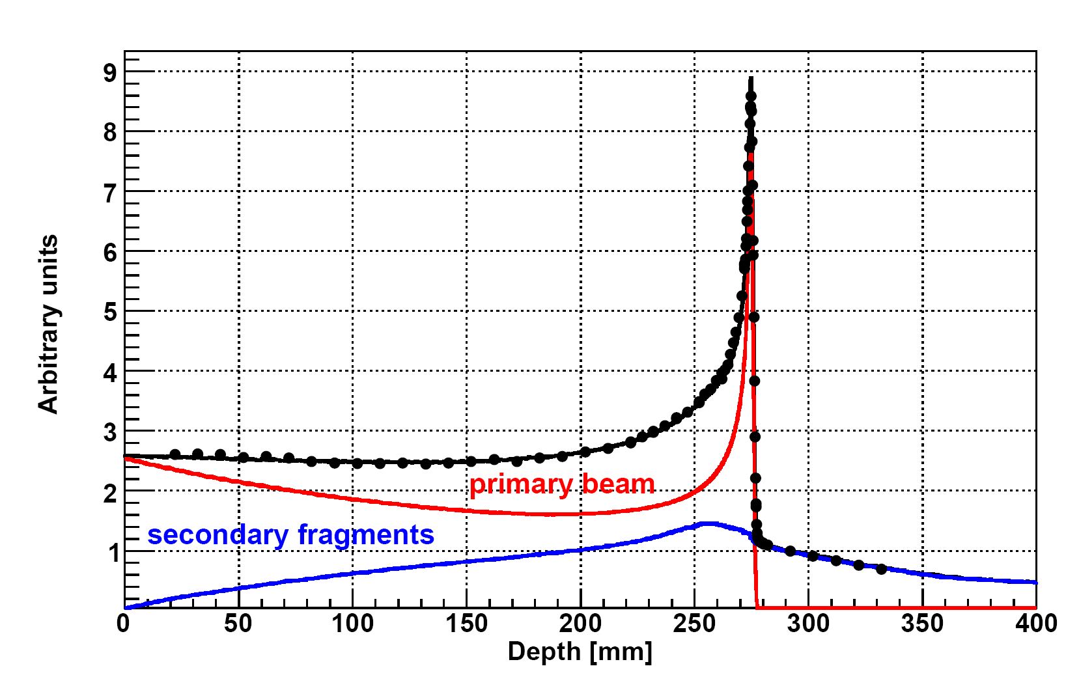
FRAGMENTATION OF ¹²C in bio tissue
Dose release in healthy tissues with possible long term side effects, in particular in treatment of young patients ➔must be carefully taken into account in the Treatment Planning System
Production of fragments with higher range vs primary ions
Production of fragment with different direction vs primary ions
Mitigation and attenuation of the primary beam
Different biological effectiveness of the fragments wrt ¹²C
¹²C (400 MeV/u) on water
Bragg-Peak
Dose over the Bragg Peak :
p ~ 1-2 %
C ~ 15 %
Ne ~ 30 %
Exp. Data (points) from Haettner et al, Rad. Prot. Dos. 2006
Simulation: A. Mairani PhD Thesis, 2007, Nuovo Cimento C, 31, 2008
Courtesy of Andrea Mairani

Slide 4
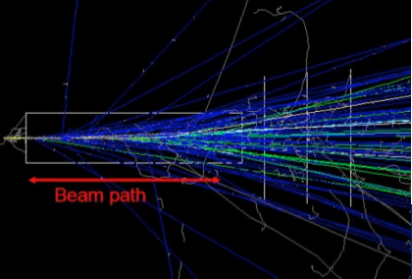
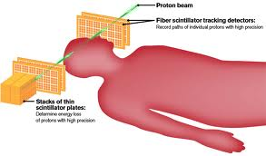
Fragmentation and dose monitoring
Envision WP2 Report
Low energy protons are surely emitted by the Carbon beam.
The detection efficiency is almost one
Can be easily back-tracked to the emission point → can be correlated to the beam profile & BP
MC unreliable for large emission angle, probing the very tail of angular distribution of frag’s
Fragment emission also from region near BP? And with enough energy to exit from the patient body and be detected?
proton
beam
K Gwosch et al Phys. Med. Biol. 58 3755
C Agodi et al Phys. Med. Biol. 57 5667

Slide 5
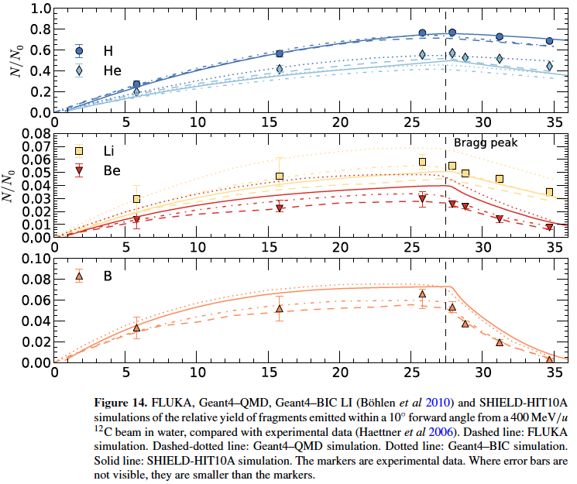
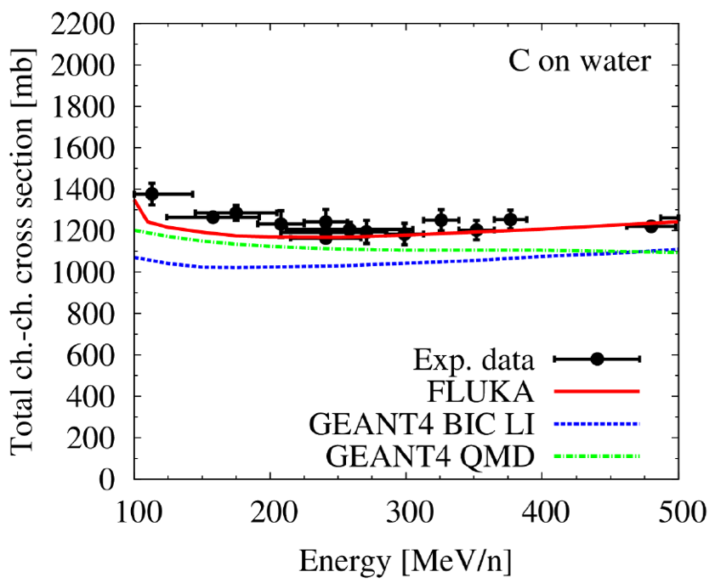
Data - MC comparison: ¹²C ions
Build-up of charged fragments for ¹²C beam @400MeV/n in water
Integral quantities (fragment yields, charge changing cross sections) are generally within 10-30%
Bolhen et al, Phys. Med. Biol. 55 (2010) 5833–5847

Slide 6
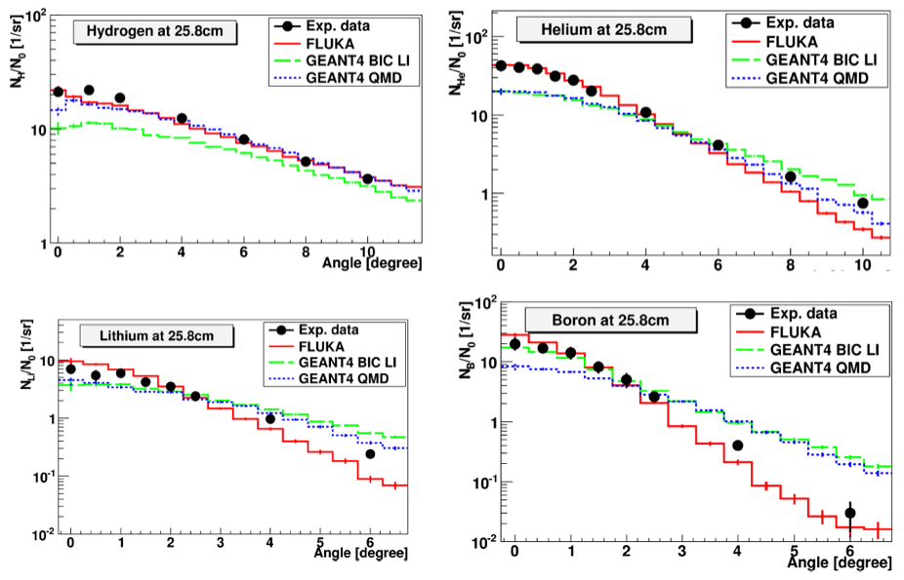

Data - MC comparison: 12C ions
Differential/double- differential quantities (vs angle and/or energy) ➔ larger discrepancies found!
NB: the accuracy on delivered dose MUST be below 3%
Some MC benchmarks:
Sommerer et al. 2006, PMB Garzelli et al. 2006, ArXiv Pshenichnov et al. 2005, 2009 Mairani et al. 2010, PMB Böhlen et al. 2010, PMB Hansen et al. 2012, PMB
Bolhen et al, Phys. Med. Biol. 55 (2010) 5833–5847

Slide 7
What we yet miss to know about ¹²C fragmentation?
Lot of data exists at 0⁰ or on thick target. We need to know, on thin target:
Production yelds of Z=0,1,2,3,4,5 fragments
d²σ/dθdE wrt angle and energy, with large angular acceptance
For any ¹²C energy of interest (100-300 MeV/nucl)
Measurements on thin target of all materials crossed by C beam
X,E_{x},θ_{x},φ_{x}
Not possible a complete DB of measurements
We need to train a nuclear interaction model with the measurements!!
ρ,A,Z
¹²C , E
¹²C , E'
ρ',A',Z'
Y,E_{y},θ_{y},φ_{y}

Slide 8
Recent thin target, Double Diff Cross Section C-C measurements
The community is exploring the interesting region for therapeutical application.
GSI 400Mev C beam
FIRST experiment
This talk (2011)
GANIL 95AMev C beam - E600 collaboration (2011)
LNS 62AMev C beam
See M. De Napoli talk in this session (2009)
Proposal:
GSI 200AMeV C beam
FIRST experiment 2014
?

Slide 9
Measurement @95AMeV : ¹²C beam
Courtesy of M. Labalme
Array of 5 SI + CsI telescopes

Slide 10
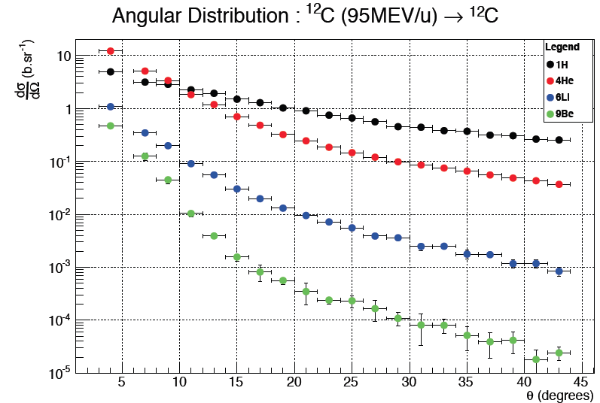
Measurement @95AMeV : ¹²C beam
Courtesy of M. Labalme
Obtained results for Single and Double Diff. X Section.
  one interesting conclusion: Composite targets can be deduced from the cross sections of elemental targets (-> organic tissues)

Slide 11
The FIRST experiment at GSI
FIRST has the aim to measure the C-C fragmentation double differential cross section at GSI ¹²C beam in the 200-400 AMeV range
INFN: Cagliari,LNF,LNS,Milano,Roma3,Torino: C.Agodi, G.Battistoni, A.Brunetti M.Carpinelli, G.A.P.Cirrone, G.Cuttone , M.De Napoli, B.Golosio, Y.Hannan, E.Iarocci, F.Iazzi, R.Introzzi, A.Mairani, F.Marchetto, V.Monaco, M.C.Morone,P.Oliva, A.Paoloni, V.Patera, L.Piersanti, G.Raciti, N.Randazzo, F.Romano, R.Sacchi, P.Sala, A.Sarti, A.Sciubba, C.Sfienti, V.Sipala, E.Spiriti, S.Tropea, H.Younis
DSM/IRFU/SPhN CEA Saclay, IN2P3 Caen, Strasbourg, Lyon: A. Boudard, J.E. Ducret, C. Fink, F. Haas, D.Juliani, J.Krimmer, M. Labalme, C.Ray, S.Leray, M.Rousseau, M.D.Salsac, L.Stuttge
GSI: T.Aumann, K.Boretzky, M.Durante, M.Heil, G.Ickert, A.Kelic, N.Kurz, Y.Leifels, A. LeFevre, R.Pleskac, M.V.Ricciardi, D.Rossi, D.Schardt, C.Scheidenberger, C.Schuy, H.Simon, M.Winkler
University Sevilla & CNA: J.M. Quesada, A.Bocci, J.P.Fernandez-Garcia, M. I. Gallardo, M.A. Cortes-Giraldo, M.A.G. Alvarez
ESA: P.Nieminem, G.Santin
CERN: T.T. Böhlen
R.Pleskac et al. NIM A 678 (2012) 130–138
FIRST stands for: Fragmentation of Ions Relevants for Space and Therapy ➔ S371 is the GSI label

Slide 12
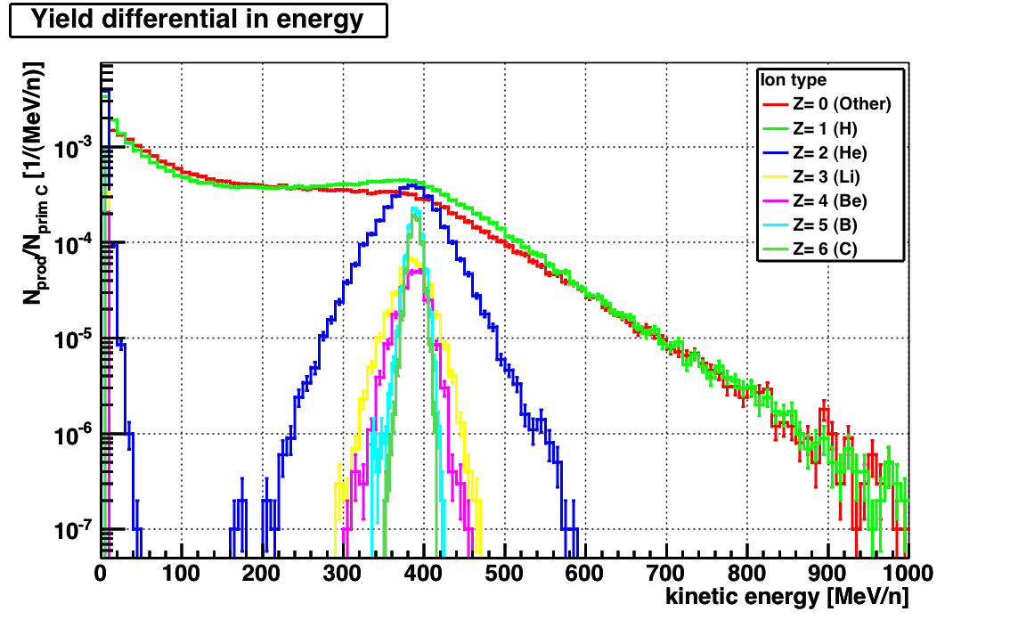
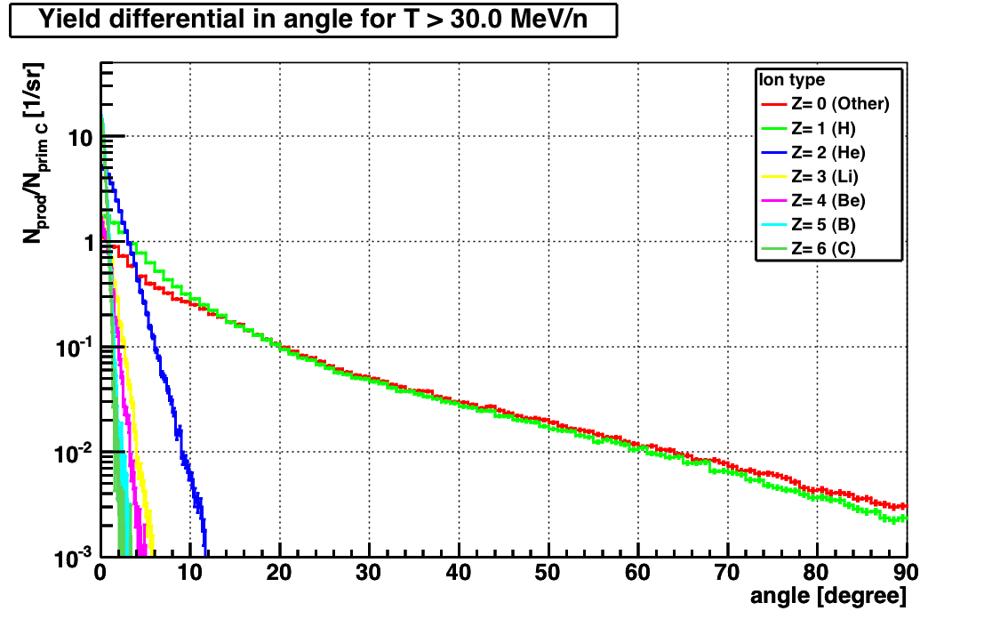
What do we expect from MC (¹²C case) ?
400 MeV/nucl ¹²C on ¹²C
The Z>2 produced fragments approximately have the same velocity of the ¹²C beam and are collimated in the forward direction
The protons are the most abundant fragments with a wide β spectrum 0<β<0.6 and with a wide angular distribution with long tail
The Z=2 fragment are all emitted within 20⁰ of angular aperture
The DE/DX released by the fragment spans from ~2 to ~100 m.i.p.
FLUKA
Kinetic energy (MeV/nucl)
400 MeV/nucl ¹²C on ¹²C
FLUKA
Do not trust MC too much!
Emission angle (Deg)

Slide 13
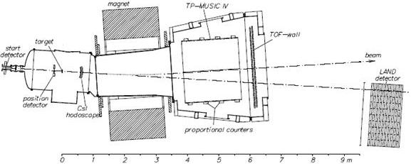
The ALADIN setup @GSI
The choice of GSI has 2 main motivations:
“Terapeutical” beam of ¹²C @ 200-400 MeV/u available
Existing setup designed for higher E and Z fragments: Dipole magnet, Large Volume TPC, TOF Wall, low angle Neutron detector.
New detectors added to optimize the Interaction Region:
silicon Vertex Tracker, Start Counter scintillator counter, Beam Monitor drift chamber, scintillator Proton Tagger/Calorimeter
TPC MUSIC IV
TOF
WALL
Beam
Beam
ALADIN
MAGNET
Interaction
region
Neutron detector

Slide 14
Who measures what...?
TOF WALL
TPC MUSIC IV
Interaction Region
Magnet
P Tagger
Beam Veto
Start
Target
Bmon
Vertex
Land2
Vertex → Frags emission direction θ, φ 
Start → start TOF and trigger
TOF WALL → frags position & TOF, trigger
Beam mon → Beam direction & impact point
Tagger → Large  frags: position, TOF, dE/dX
TPC MUSIC → θ,φ, dE/dx  after bending
LAND2 → low angle neutron
Setup redundancy ➔ allows calibration and systematic checks of the reconstructed fragment features: Z, A, , E.
Beam Veto → Veto of the non interactiong beam

Slide 15
The FIRST simulation
We coded a detailed simulation based on FLUKA 2011 of our setup. During the design phase MC has been used to optimize Space and time resolution, Particle ID, Trigger design, Background and out of target interactions evaluation
Before data taking reconstruction software has been developed using the MC “data”, produced in the same format of the ROOT based actual data
After the data taking the embedding of the actual detector performances in to the simulation give us the direct comparison with the data for acceptance and efficiency evaluation

Slide 16
August 2011 Data taking
Data taking with ¹²C 400 AMeV beam.
7 x10⁶ calibration events (no magnetic field or no target)
28 x10⁶ production with 8 mm graphite target.
3 x10⁶ production events with 0.5 mm gold target.
!! TPC MUSIC IV not in operation. !!
Detector calibration done & finalizing analysis.
Period | Run range | 1 SC | 2 SC & .not.VETO | 4 SC & KENTROS | 6 SC & TOFOR | 7 VETO | 9 LAND-Cosmics | 10 KENTROS-Cosmics | TOT EVENTS
6 | 188-248 | 6835378 | 4949973 | 406379 | 6394124 | 1891499 | 2327865 | NO | 9169110
7 | 249-386 | 11431948 | NO | NO | NO | NO | 1468429 | NO | 12900349
8 | 387-471 | 9043428 | NO | NO | NO | 56924 | 682593 | 301229 | 9963032
10 | 474-525 | 4532646 | NO | NO | NO | 58842 | 710797 | 157656 | 5384078
TOT |  | 31843400 | 4949973 | 406379 | 6394124 | 2007265 | 5189684 | 458885 | 37416569

Slide 17
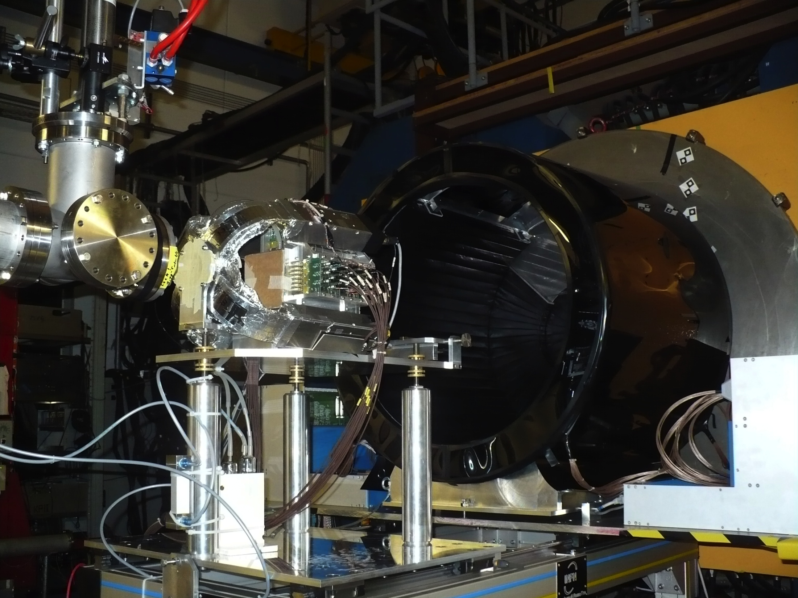

Slide 18
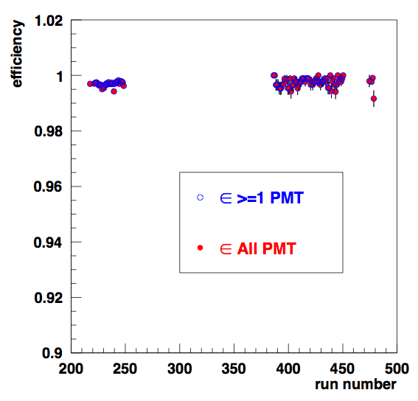
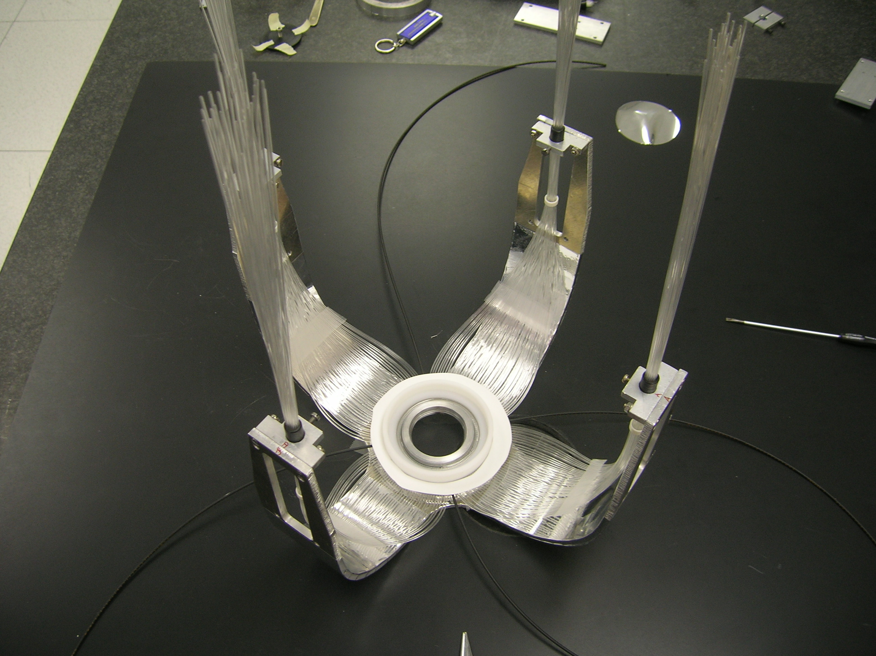
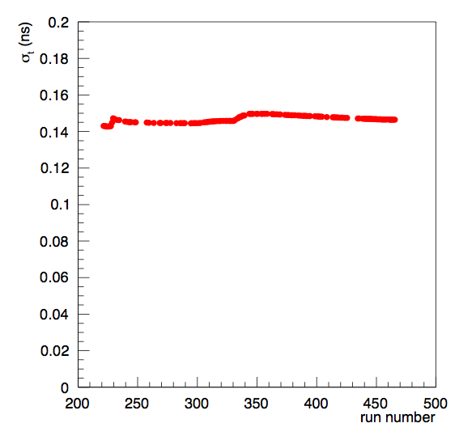
Start Counter
SC
BM
TARGET
VD
Efficiency
BEAM
ε>99% for ALL the RUNS
Ptag
scint
Time resolution : σ_{t} (ns)
Very Stable performance vs run number!
Max variation ~ 5 ps
Trigger & TOF measurement. 150 micron thick fast scintillator, with radial fibers read-out. HAMAMTSU H10721-210 40% q.e. 250ps/"(p.e.)

Slide 19
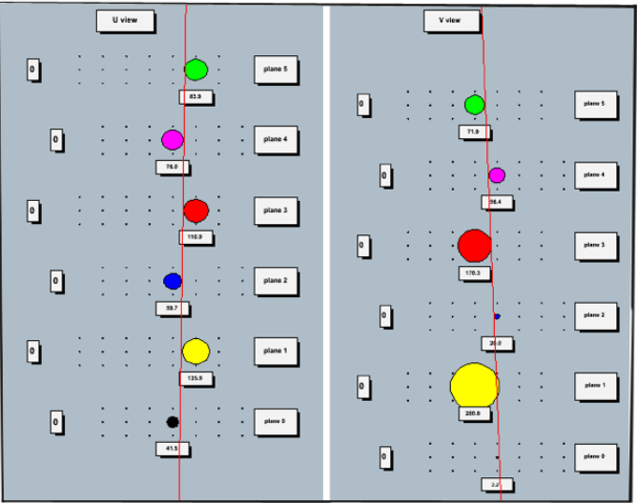
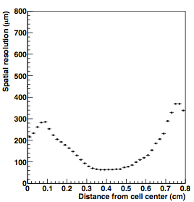
Beam Monitor
SC
TARGET
VD
Drift chamber: measures the direction and the impact point of the beam on the target
3 rectangular cell/plane (8x5 mm²)
6 planes for each U-V views
Ar-CO₂ 80/20 gas mixture @ 2.2 kV©√
BEAM
BM
Ptag
Correct matching of the correct carbon track among possible pile-up beam track in the “slow” vertex detector
Input position and direction of the 12C projectile (beam spot ~ 6mm FWHM)

Slide 20
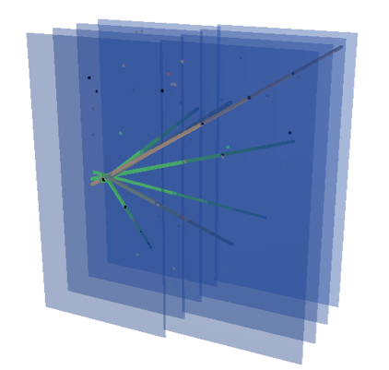
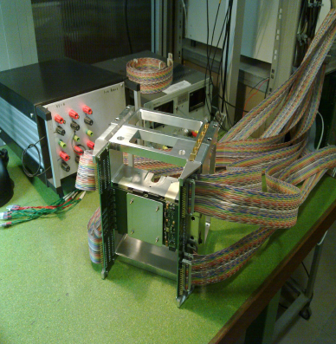
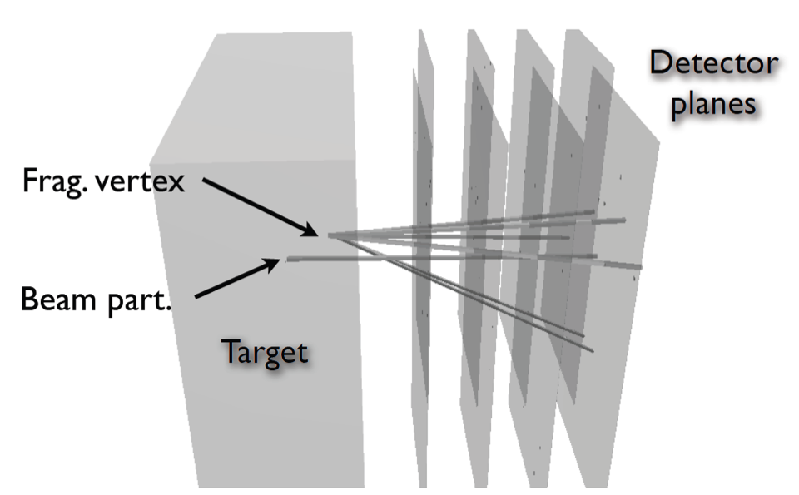
The vertex detector
VD
SC
TARGET
BEAM
Tracks all the charged fragments downstream the target (<40deg).
4 planes of 2x2 cm² active area, each made of two MIMOSA 26 silicon pixel detectors (MAPS), 3mm spaced, 18.4 μm pitch
BM
Ptag

Slide 21
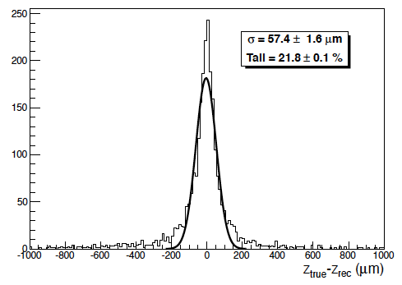
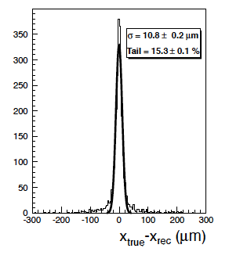
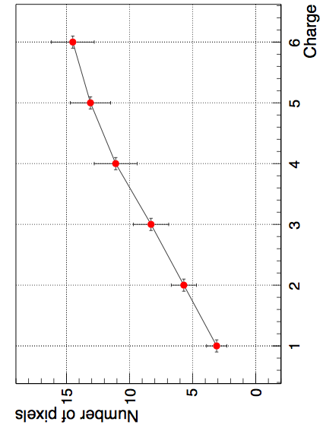
Vertex Detector
Tracking resolution ~ 10 µm (x,y) and 60 µm (z) is fundamental to correctly extrapolate the fragment track along ~ 6m to the TOFWALL
Tracking efficiency for fragments ~ 99%
The vertex provides also information on the fragment charge looking at the number of fired pixels
VD
SC
TARGET
BEAM
BM
Ptag
σ ∼ 10 μm
σ ∼ 60 μm
z Residuals (μm)
x Residuals (μm)
Fragment charge

Slide 22
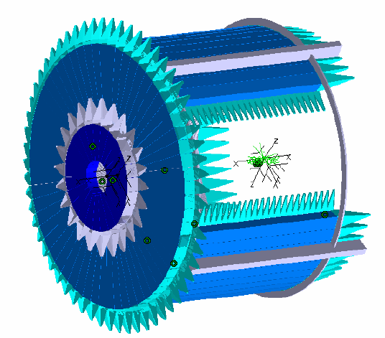
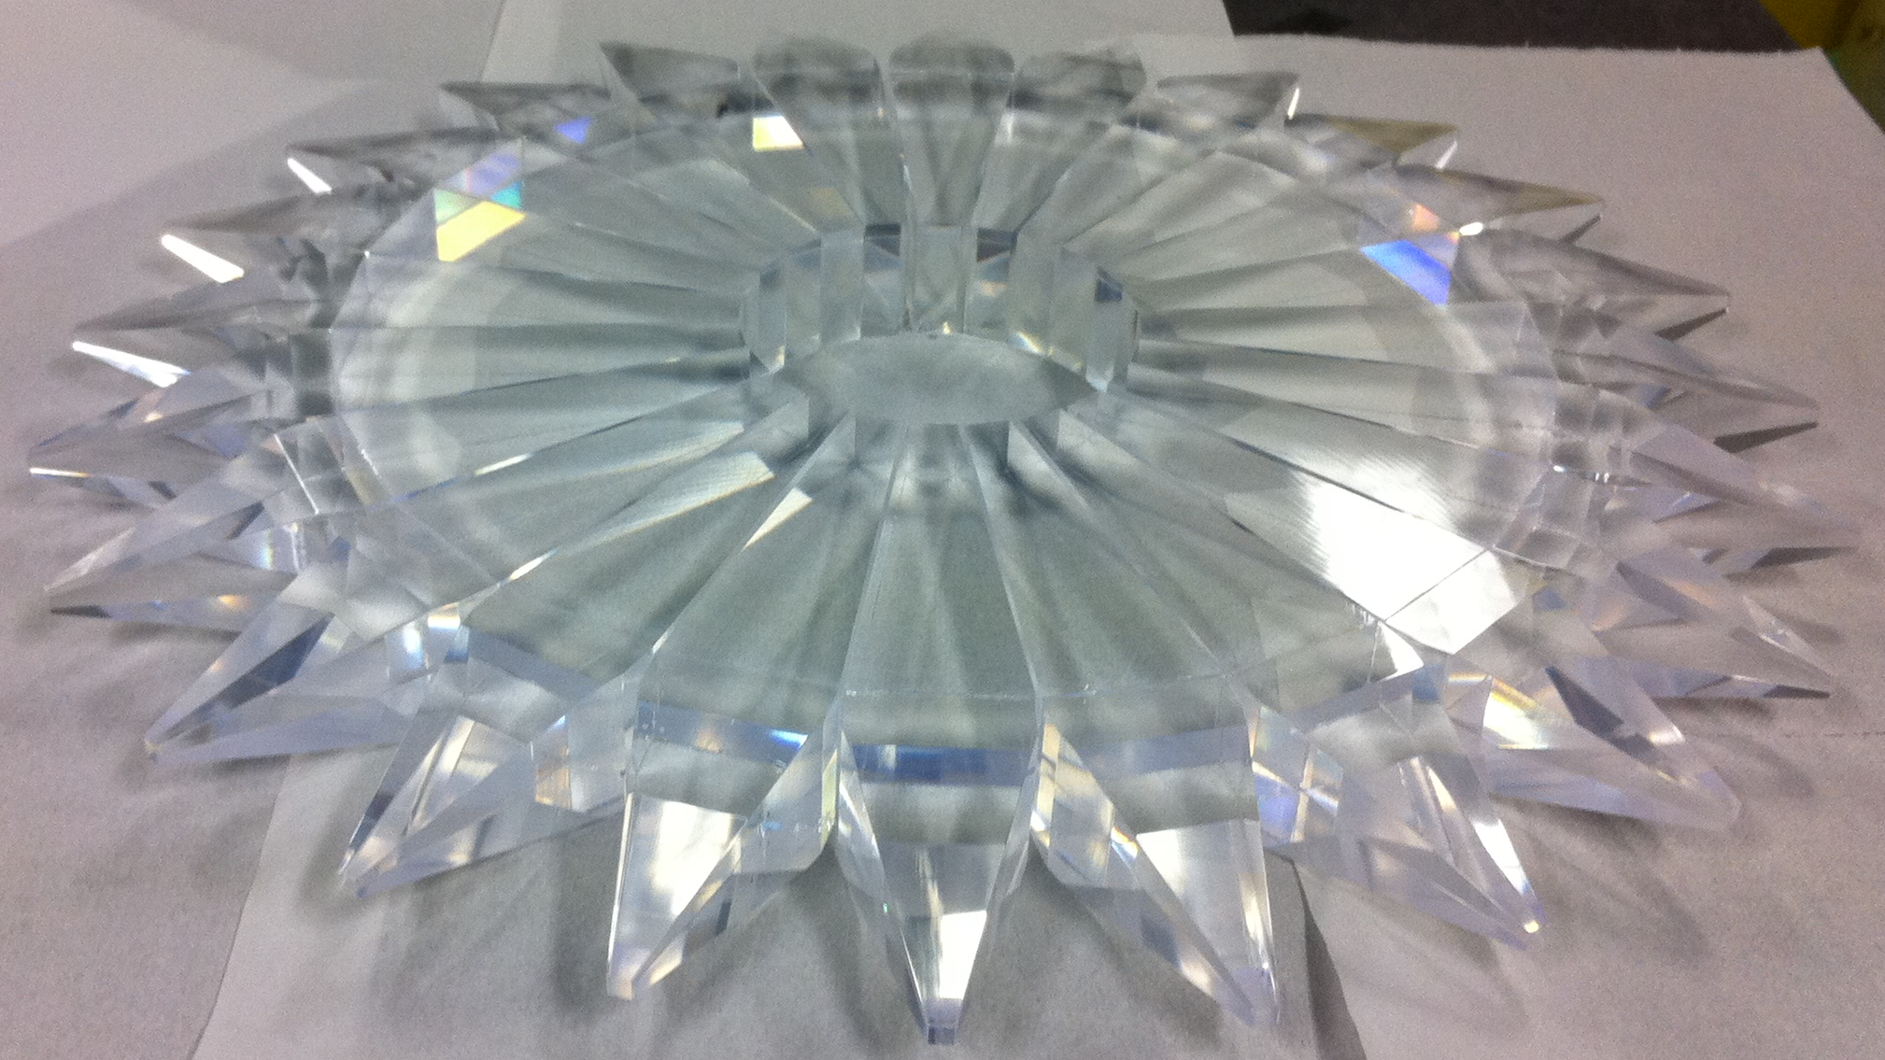
Large angle proton Tagger
SC
TARGET
VD
Detects large angle (10⁰-60⁰) slow protons (He). Measures TOF (expected σ_{t}=250ps), ΔE (expected σ_{E}/E = 10%
EJ-200 fast scintillator ( decay time 2.1 ns, 10000 photons/MeV) read by AvanSiD (IRST/FBK) 4x4 mm² active area SiPM
BEAM
BM
Ptag
BARRELl
Big Endcapl
= 300 ps
No vertex info used
Small Endcapl
TDC time (ns)
Precise impact position given by vertex detector for θ<60⁰. At larger θ (barrel) coarse position given by ring of scintillating fiber that run along φ

Slide 23
Proton tagger: first P/He id
SC
TARGET
VD
Matching hits with vertex tracks improve both TOF & dE/dx measurements ➔ particle Energy.
BEAM
BM
Ptag
Time (ns)
Proton
Helium
ADC counts
p/He PID on Small Endcap: no impact position used yet
Beam
monitor
Proton
Vertex
Helium
ADC counts
An energy calibration of the tagger is scheduled at 80 MeV proton beam of INFN LNS in Catania. Tagger is travelling now…

Slide 24
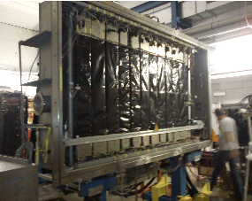
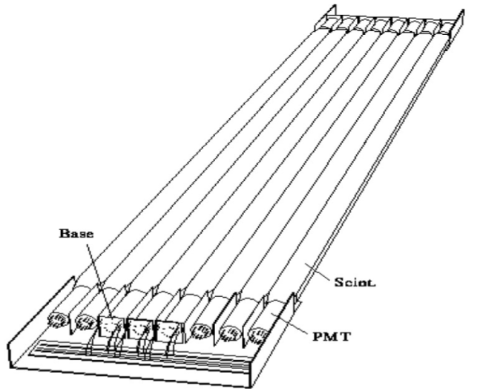
Fragments in TOF WALL
TOF WALL
TPC
IR
Gives arrival time, dE/dx and impinging position of the fragments.
Two walls made of 96 2x1x110 cm³ scintillators read by two PMTs, grouped in 8 slats unit.
With no TPC working only the impact position on the TOFWALL gives the bending of the fragments
Magnet
Land2
Q₁,t₁
Calibration run at high statistic with no B field to align with vertex tracking.
Calibration run with B field sweep with no target at high statistic to calibrate the vertical position
Q₂,t₂

Slide 25
TofWALL resolutions
Comparison between the front/rear slats allows for direct evaluation of the energy and time resolution
The resolution on up-down time difference gives the resolution on the vertical inpinging position Y of the fragment
-100 -50 0 50 100
-30 -20 -10 0 10 20 30
E_{front}-E_{rear} (MeV)
Y_{front}-Y_{rear} (cm)
Y resolution (cm)
σ_{E}(E_{front}-E_{rear})/E_{mean}
TW Energy (MeV)
TW Energy (MeV)

Slide 26
Frags in TOF WALL: data vs MC
The exp data are in fair agreement with MC -> different Z efficiency
TOF (ns)
TOF-T_{trig} (ns)
¹²C 400MeV/u on C
MC (FLUKA)
¹²C 400MeV/u on C
DATA
He
He
p
p
Fragment
definition?
Li
C
Li
B
Be
B
C
Be
Sqrt(ΔE_{TW}/cosθ)/ΔE_{BB}*Z²)
Sqrt(ΔE_{TW}/cosθ)/ΔE_{BB}*Z²)

Slide 27
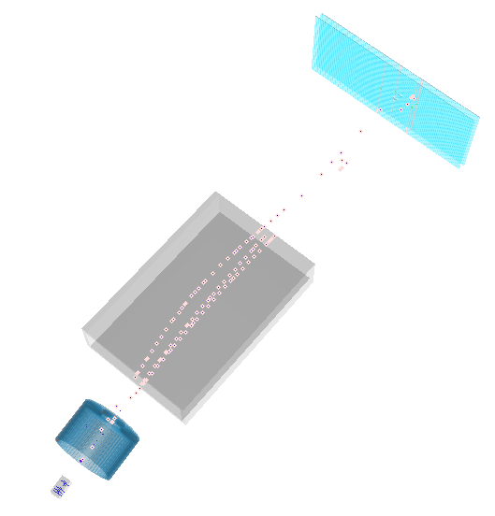
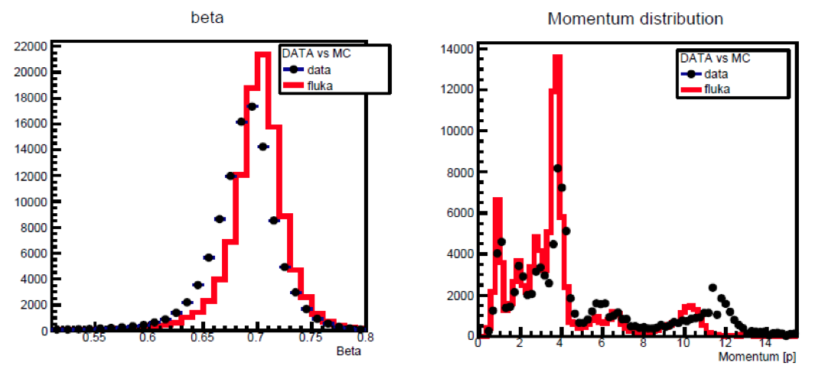
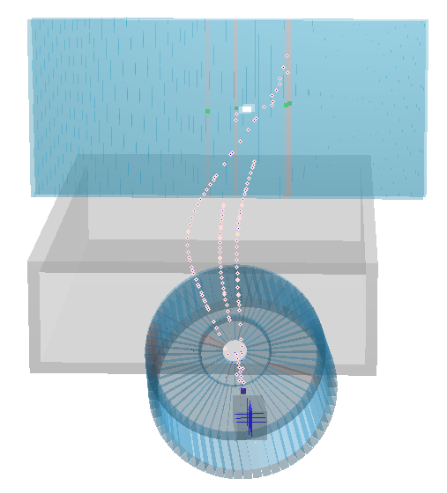
The global reconstruction
The global reconstruction runs in a “transparent” way on data and MC: same algorithms on same data structure
Matches the information of the different region/detector of the setup
Systematic study/comparison of the difference between data/MC is underway: momentum scale, material effect
Care is needed for the difficult estrapolation from IR to the far away detector after the bending magnet
Data
PRELIMIARY
Fragmented events

Slide 28
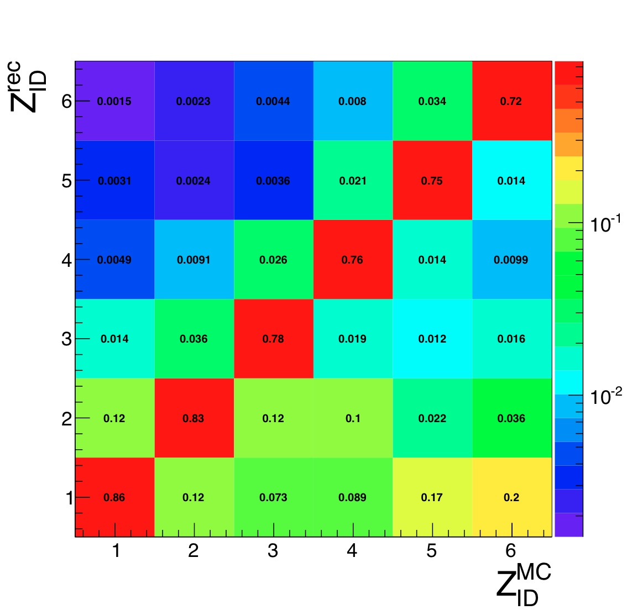
Z_ID performances
  2D algorithm based on ToF vs detected dE/dx in the ToFWall to identify Z regions
  Vertex Z ID capabilities not yet exploited

Slide 29
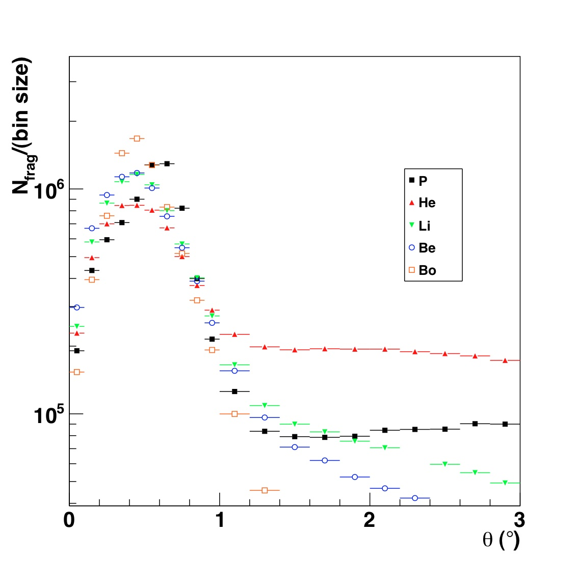
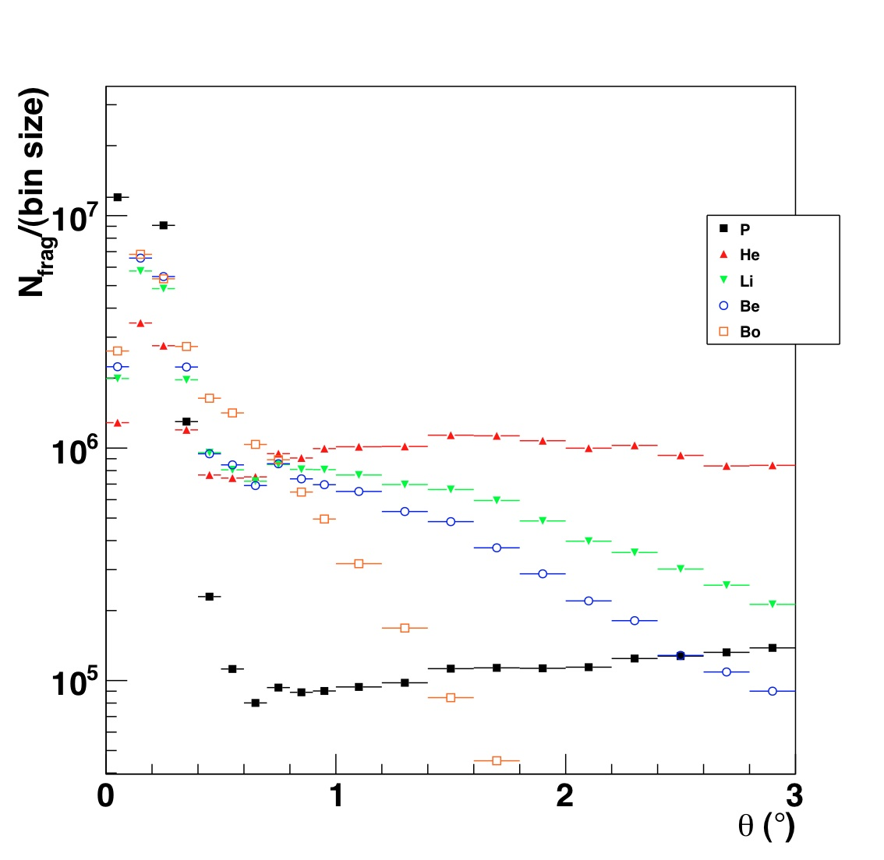
Preliminary frag. yelds at small angles
First look at small angle -> Correspond to the region that induce the dose beyond the distal part of the treatment region.
Reconstructed yelds are heavily distorted by the efficiencies ( tracking/selection/etc..) and by acceptance… to be applied
The data distribution seems to be wider in angle than MC
Data PRELIMINARY
FLUKA MC
MC

Slide 30
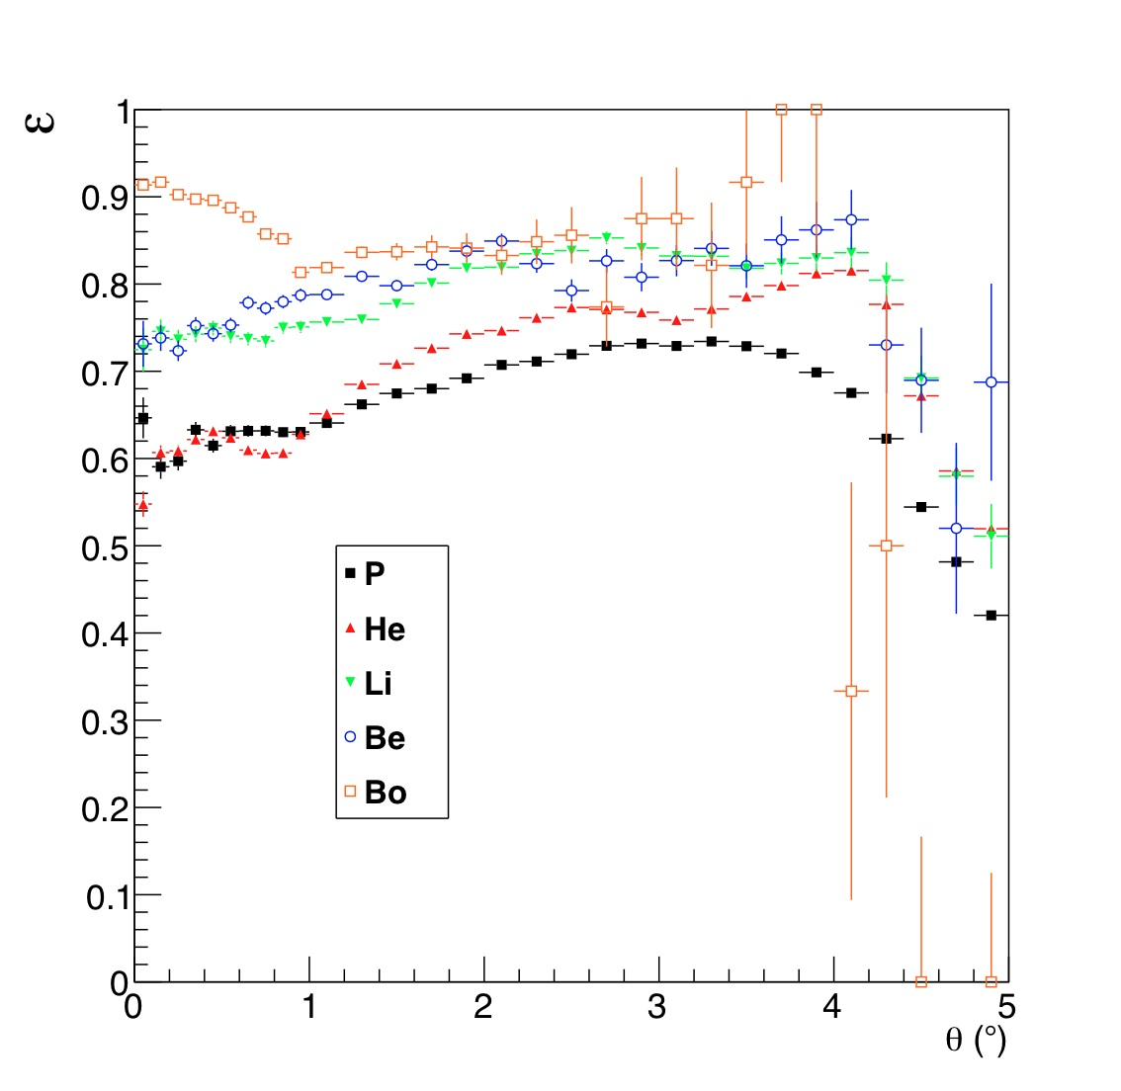
efficiencies., acceptances and all that
Efficiencies are computed using MC and checked on the data
Very CPU intensive process for double differential X section
The selection efficiency accounts for all the PID/selection cuts applied on the already reconstructed tracks

Slide 31
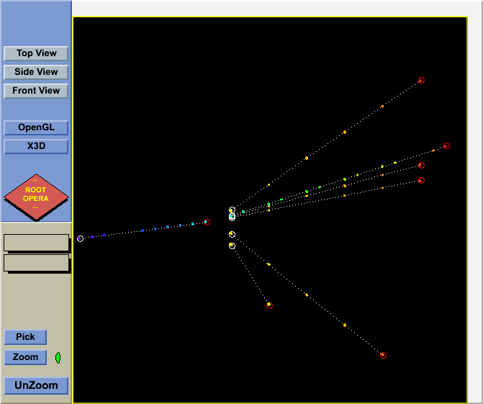
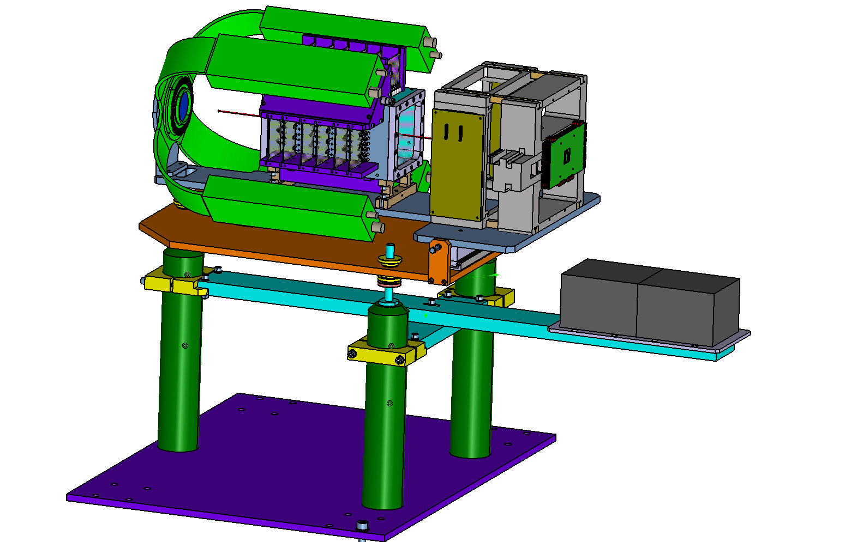
A “side product”: Emulsion Chambers
Density grain is proportional to energy loss . High spatial resolution (~m). High angular resolution (~ mrad). Multiparticle separation
Only low occupancy possible➔ low statistic. Possible calibration with the proton tagger energy and Z distributions
Target + vertex
2 cloud emulsion chambers by OPERA experiment have been exposed to fragments ( 2 hours) by G. De Lellis and coworkers from Napoli University .
Detect fragments at large angle, mainly He and protons, 30⁰<θ<75⁰.
Comparison on going with the proton tagger distributions.
emulsion chambers

Slide 32
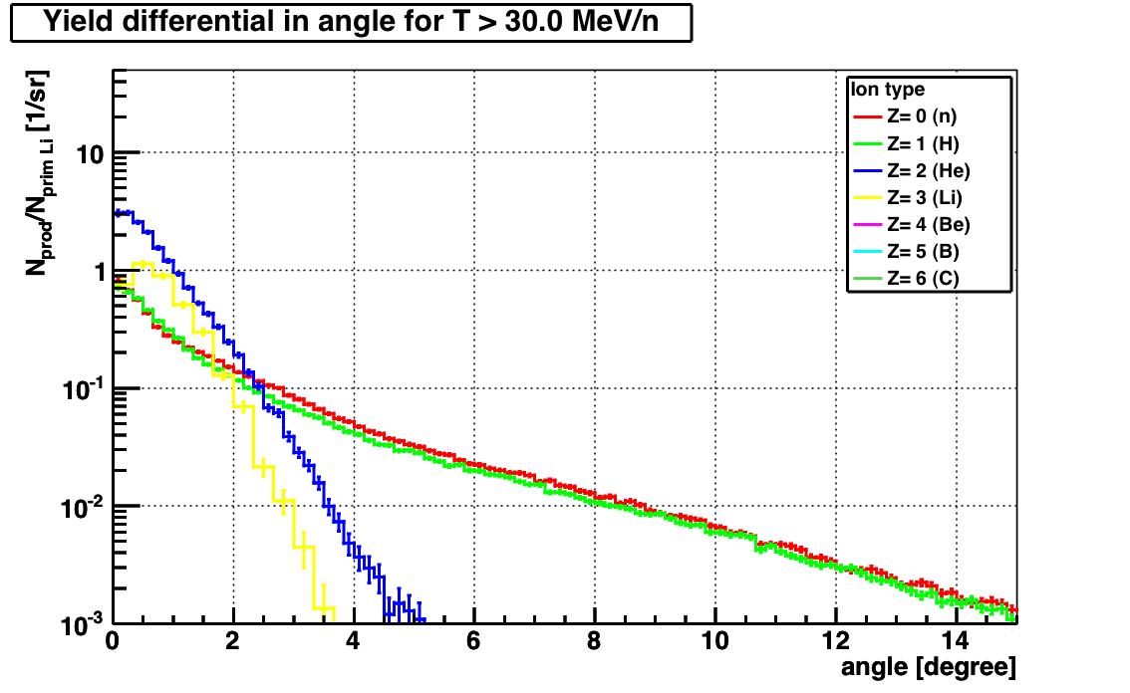
Outlook
There is an interest in light ions use in hadrontherapy different form ¹²C
The FIRST detector can measure the fragmentation cross sections d²σ/dθdE by ions like Helium, Litium or Oxigen
FINUDA Drift Chamber in the setup instead of TPC after the bending magnet
FLUKA MC
⁷Li on ¹²C @250MeV/nucl
The experimental setup is also designed to be able to measure fragmentation cross section also with heavier ions like Fe @ 1Gev/nucl  would be interesting for radioprotection in space. ESA and NASA are also interested in this measures.
The collaboration back up all these options  future largely depends on the GSI interest/possibility to pursue these measurements

Slide 33
Summary & Conclusions
An international collaboration (France, Germany, Italy, Spain) has been created to measure at GSI the d²σ/dθdE fragmentation cross section of interest for hadrontherapy and space radioprotection
The detector is an evolution of a pre-existing setup, optimized for the detection of fragments with large angular acceptance and with an accuracy at the few % level
Fragmentation data with ¹²C already taken in August 2011. Finalizing analysis, first look at small angle results.
In next future the setup could be a facility to measure the fragmentation of light ions (He, Li, O projectiles) and/or of projectiles (Fe) of interest for space radioprotection if GSI will give us a window of opportunity

Slide 34
Spare slides

Slide 35
Summer 2011 dataset: activities on-going
Evaluation on data of detector efficiencies and acceptances.
Alignment of detailed simulation with the detector performance
Refinement of the reconstruction software: geometry survey, global reconstruction development and debugging
Calibration of the Proton Tagger on the 80 MeV proton beam at LNS (Catania)
New tracking system testing with cosmics ( drift chambers from FINUDA, an HyperNuclei experiment at Daφne, the Frascati e⁺e⁻ collider)
Software
Hardware

Slide 36
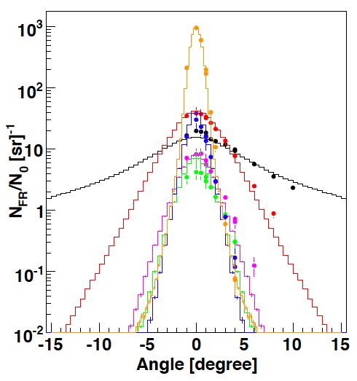
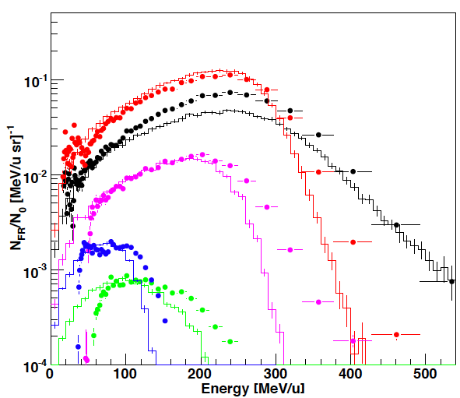
Mixed Radiation Field in ¹²C Ion Therapy
The secondary fragments broad the lateral dose proﬁle and go beyond the tumor region.
Angular distribution
Energy distribution
H He Li Be B C
@ 15.9 cm
@ 31.2 cm
2°
¹²C on water
@400 MeV/u
FLUKA benchmark against thick target data
Exp. Data (points) from Haettner et al, Rad. Prot. Dos. 2006
Simulation: A. Mairani PhD Thesis, 2007, PMB to be published
Courtesy of Andrea Mairani
Notes:
36

Slide 37
What we already know: thick target measurement
A lot of integral measurements measurements are already around.. But very few for the correct triplet of projectile,target and energy
Projectile Energy[MeV/N] Target
⁴He 100, 180 C, Al, Cu, Pb
¹²C 100, 180,400 C, Al, Cu, Pb
²⁰Ne 100, 180,400 C, Al, Cu, Pb
²⁸Si 800 C, Al, Cu, Pb HIMAC by Kurosawa et al.
⁴⁰Ar 400 C, Al, Cu, Pb
⁵⁶Fe 400 C, Al, Cu, Pb
¹²⁶Xe 400 C, Al, Cu, Pb
²⁰Ne 337 C, A, Cu and U BEVALAC by Schimmerling et al.
⁹³Nb 272 Al, Nb BEVALAC by Heilbronn et al.
⁹³Nb 435 Nb
⁴He 155 Al NSRL by Heilbronn et al.
¹²C 155 Nb
⁴He 160 Pb SREL by Cecil
⁴He 180 C, H₂O, steel, Pb
¹²C 200 H₂O GSI by Günzert-Marx et al.
¹²C 400 H₂O GSI by Haettner et al.
Tentative & incomplete list
Courtesy of M. Durante
Notes:
37
Thank you, Mr. Chairman. It’s my great pleasure to give a talk to you. I’ll be speaking about some of the overview of the fragmentation of heavy charged particles in relation to radiotherapy.

Slide 38
What we already know: thin target measurement
A lot of measurements on thin target are already around.. but not wrt production angle and energy
Projectile Energy[MeV/N] Target
⁴He 135 C, Poly, Al, Cu, Pb
¹²C 135 C, Poly, Al, Cu, Pb Sato et al.
²⁰Ne 135 C, Poly, Al, Cu, Pb
⁴⁰Ar 95 C, Poly, Al, Cu, Pb
¹²C 290, 400 C, Cu, Pb
²⁰Ne 400, 600 C, Cu, Pb Iwata et al.
⁴⁰Ar 400, 560 C, Cu, Pb
⁴He 230 Li, C, CH₂, Al, Cu, Pb
¹⁴N 400 Li, C, CH₂, Al, Cu, Pb
²⁸Si 60 Li, C, CH₂, Al, Cu, Pb Heilbronn et al.
⁵⁶Fe 500 Li, C, CH₂, Al, Cu, Pb
¹²C 400 C, Poly Toshito et al.
Tentative & incomplete list
only with
detectors
at ~ 0°
Emulsion Chamber: angle ok
E ~OK, low stat, no corr
Courtesy of M. Durante

