Slide 1
INPC13
R.Rescigno
Simulation toolkit with CMOS detector in the framework of hadrontherapy

Slide 2
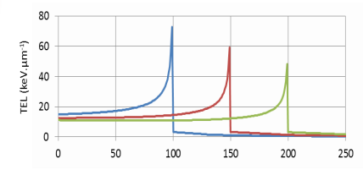
Hadrontherapy
Use of charged particles to treat the cancer
Particles properties:
Finite Range
Bragg peak –BP- curve (energy loss)
BP position depends on electron density material
Steep dose gradient
Mispositioning of this gradient can lead to:
Under-dosage in target volume
Over-dosage of an organ at risk
Tissue thickness(mm)

Slide 3
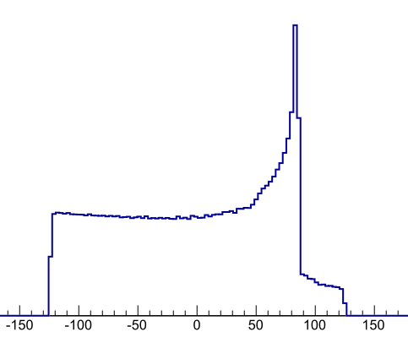
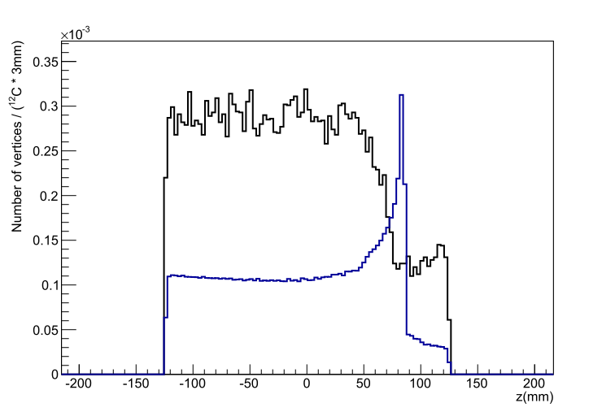
On-line range monitoring
QAPIVI: Quality Assurance by Proton Vertex Imaging
Method: Using protons from ¹²C fragmentation
Correlation between two physics processes
Nuclear interactions
target
detector
¹²C
proton
Ionization
Bragg Peak - BP
target
¹²C
Longitudinal position of proton production point - Vertex
Deposited Energy
¹²C @ 370 MeV/u
BP @ 210 mm
target
Target thickness(mm)
target
In given condition, it was demonstrated that , in theory (without detector information), millimetric precision on Bragg peak position could be achieved*
* P. Henriquet 2012

Slide 4
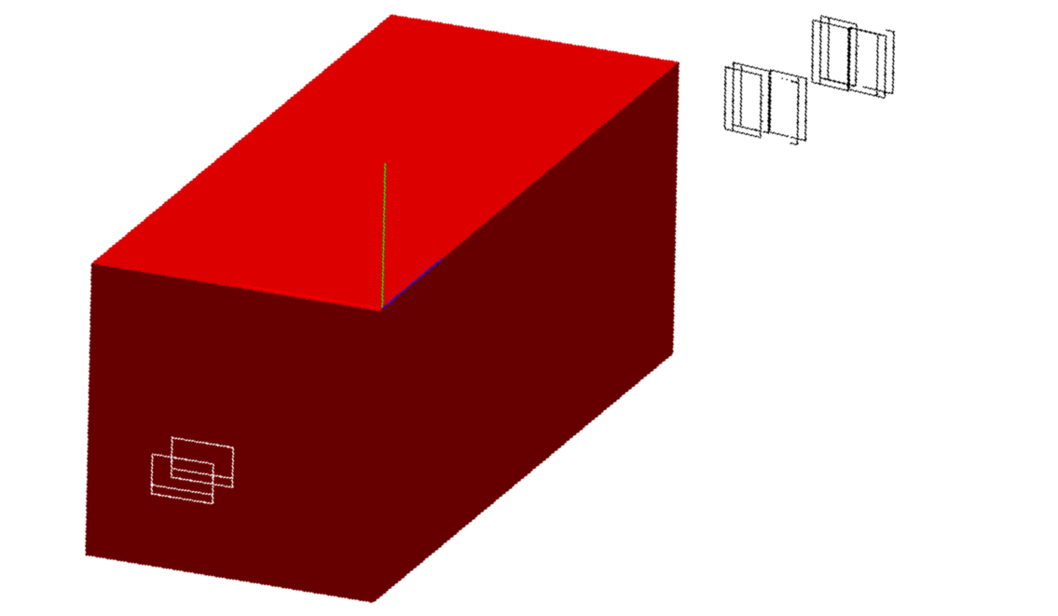
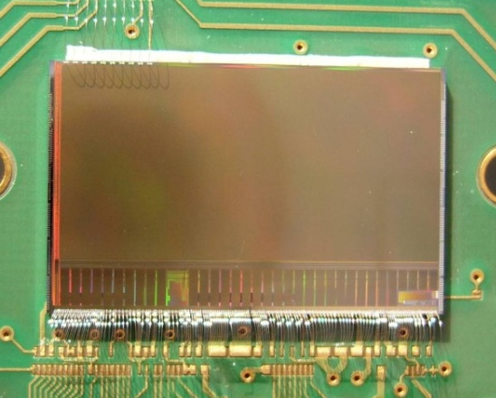
The simulation toolkit
Experimental setup
Simulation toolkit based on GEANT4
100 mm
250 mm
Detector
y
100 mm
Detector:
8 CMOS planes
z
CMOS type
MIMOSA26
x
Target:
PMMA - C₅ H₈ O₂
Beam Monitoring:
2 CMOS plane
Pixel Array: 1152 × 576 pixels
Dimension: 11× 21 mm
Pitch: 18.4 μm
4
Binary output
Particle
Vertex reconstruction steps
Clustering: find out the hits generated by a particle.
Tracking: looks for aligned clusters to built a track.
Vertexing: search for most probable tracks intersection point
∼ 50 μm
Epitaxial layer
Bulk

Slide 5
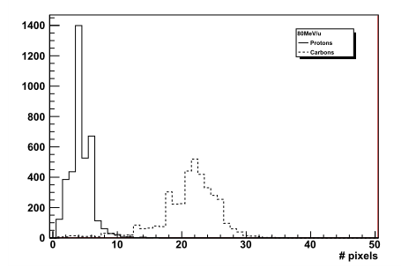
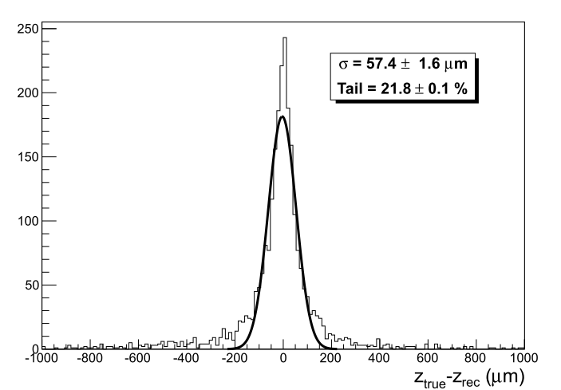
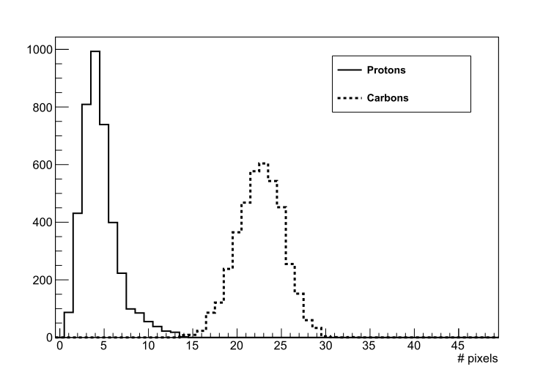
Results
Detector response simulation
Algorithm validation
Phenomenological model based on experimental data
Performed with a thin (8 mm) target
Efficiency tracking & vertexing ~ 99%
Proton 80 MeV
Mean: 4.4
RMS: 1.7
Experimental data
Longitudinal vertex position
Residuals: True – Reconstructed
Carbon: 80 MeV/u
Mean: 21.1
RMS: 4.7
Thin target
8 mm
Proton 80 MeV
Mean: 4.5
RMS: 2
Simulation
Carbon: 80 MeV/u
Mean: 22.5
RMS: 2.6

Slide 6
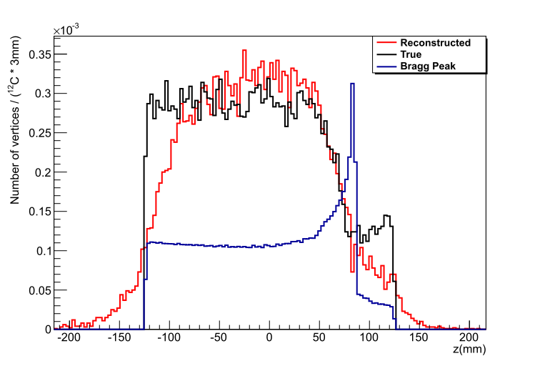
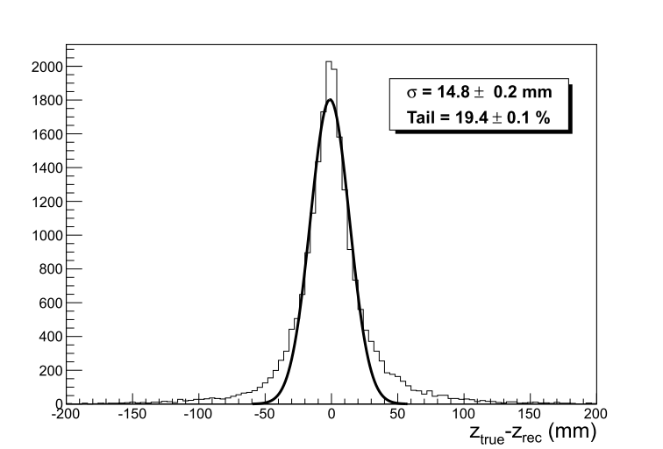
Results thick target
Longitudinal vertex position
Comparison: True vs. Rec
Longitudinal vertex position
Residuals: True - Rec
Thick target
250 mm
target
Conclusion & outlook
Thank you
Detector response and reconstruction chain integrated in simulation
Vertex resolution limited by diffusion process and not by detector/algorithms
Algorithm taking into account diffusion process is under study

