Slide 1
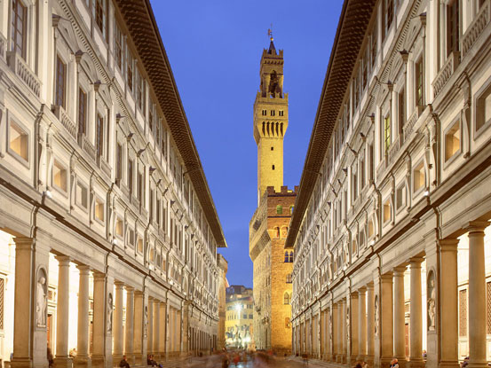


Elliptic flow from kinetic theory at fixed η/s(T)
from a CGC initial condition
V. Greco
UNIVERSITY of CATANIA
INFN-LNS
S. Plumari
A. Puglisi
M. Ruggieri
F. Scardina
INPC 2013 – Florence, 2-7 June 2013

Slide 2
Outline
Transport Kinetic Theory at fixed η/s :
  Motivations
  How to fix locally η/s
One main result for HIC:
  Elliptic flow in Color Glass Condensate (fKLN)
  going beyond ex and implementing both x & p space…

Slide 3
Relativistic Transport approach
Free streaming
Field Interaction
Collisions -> η≠0
f(x,p) is a one-body distribution function or a classical field
C[f₀+δf] ≠ 0 deviation from ideal hydro (finite λ or η/s)
It’s not a gradient expansion in η/s
One can include an expansion over microspic details, but in a hydro language
this is irrelevant only the total dissipative effect of C[f] is important!

Slide 4
Motivation for Transport approach
Free streaming
Field Interaction
Collisions -> η≠0
valid also at intermediate & high p_{T} out of equilibrium
valid also at high η/s -> LHC - η/s(T), cross-over region
CGC p_{T} non-equilibrium phase (beyond the difference in ε_{x}):
Appropriate for heavy quark dynamics
assuming small q transfer -> Fokker-Planck eq.
A unified framework against a separate modelling with a wide range of validity in η, ζ, p_{T} , m_{q}+ microscopic level

Slide 5
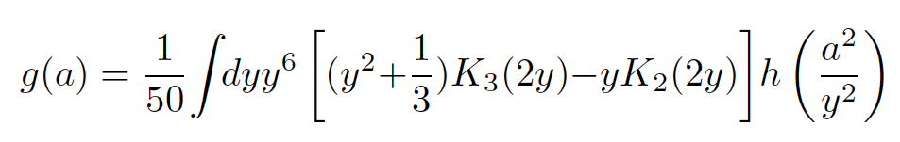
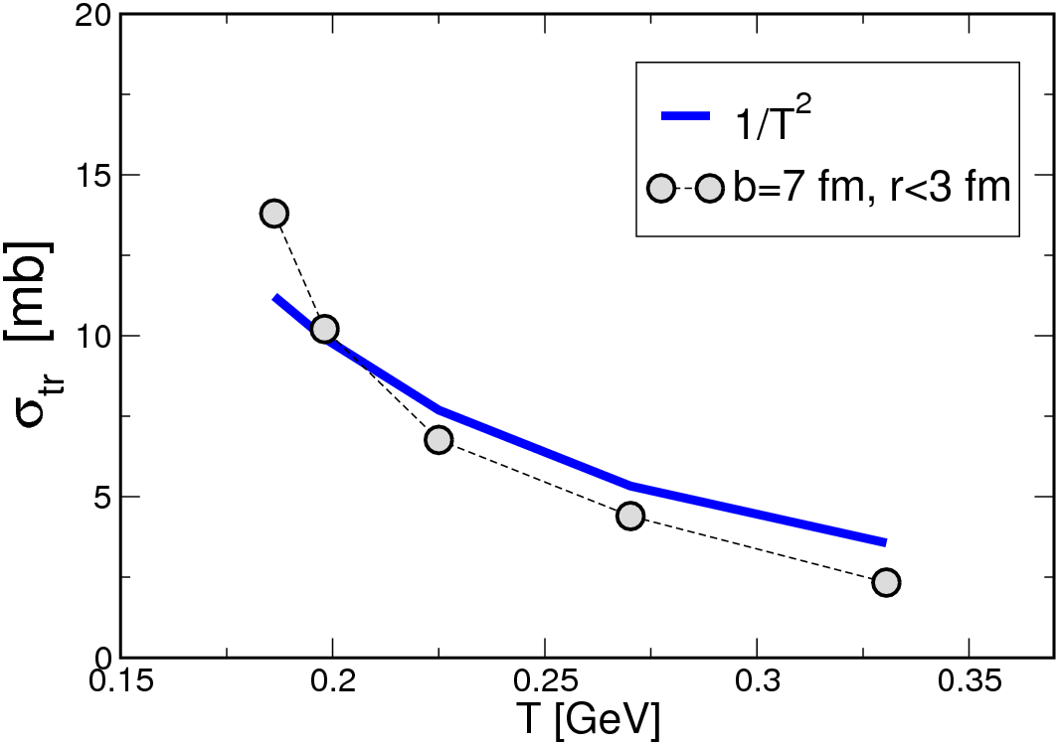
Simulate a fixed shear viscosity
Usually input of a transport approach are cross-sections and fields, but here we reverse
it and start from η/s with aim of creating a more direct link to viscous hydrodynamics
Transport code
g(a=m_{D}/2T) correct function that fix the
relaxation time for the shear motion
Space-Time dependent cross section evaluated locally
S.Plumari et al., PRC86(2012)
α=cell index in the r-space
Viscosity fixed varying σ
G. Ferini et al., PLB670 (09)
similarly in 1+1D to
Molnar and Huovinen, PRC(2009)
Au+Au 200 GeV
Notes:
Bisogna verfiicare che quanto rho diff da quella all’equilibrio sottraendo il flusso radiale

Slide 6
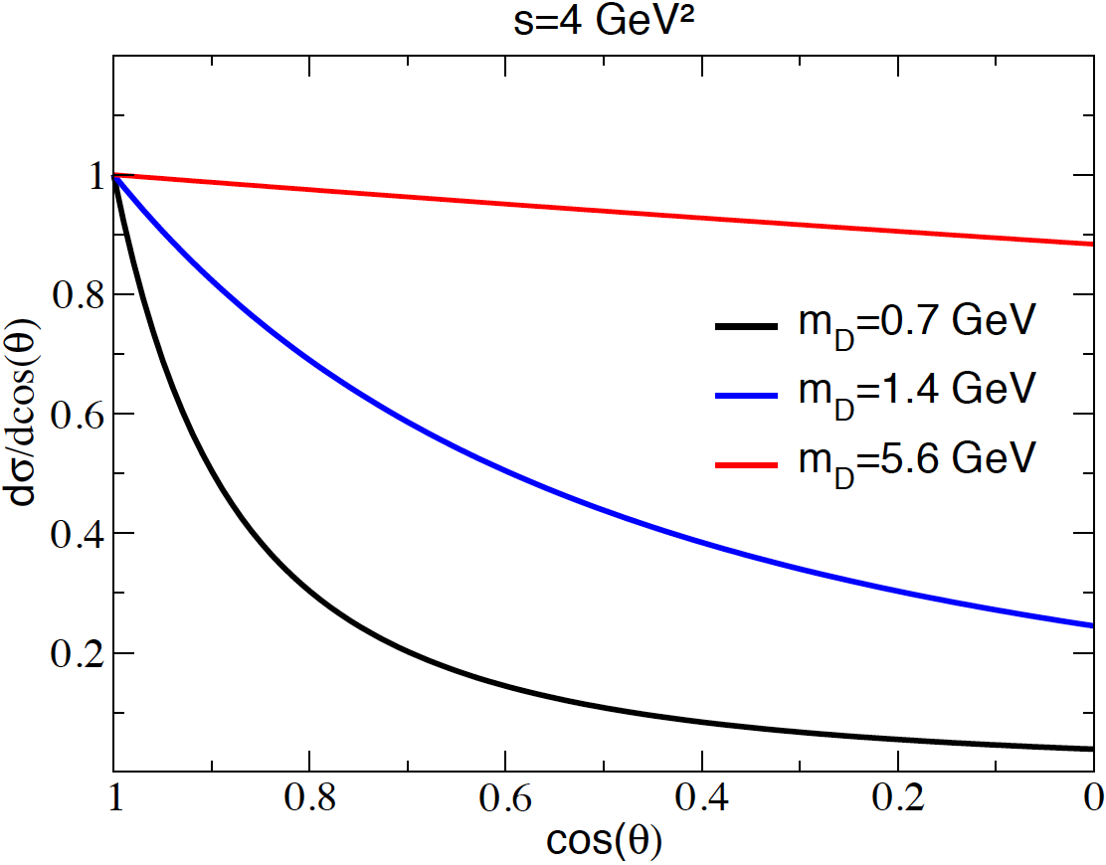
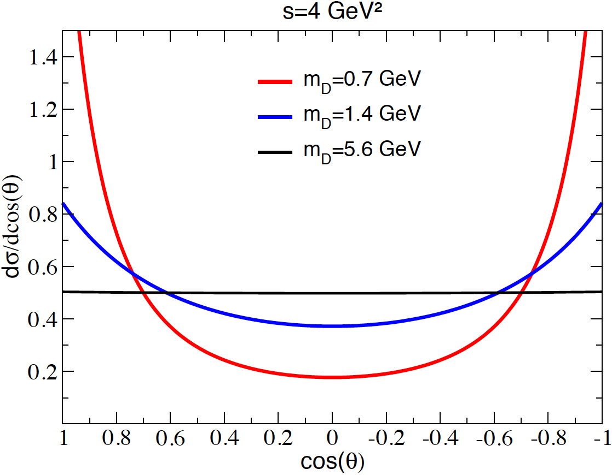
η/s(T) shear viscosity or details of the cross section?
cross section
Keep same η/s means:
for m_{D}=1.4 GeV -> 25% smaller σ_{tot}
for m_{D}=5.6 GeV -> 40% smaller σ_{tot}

Slide 7
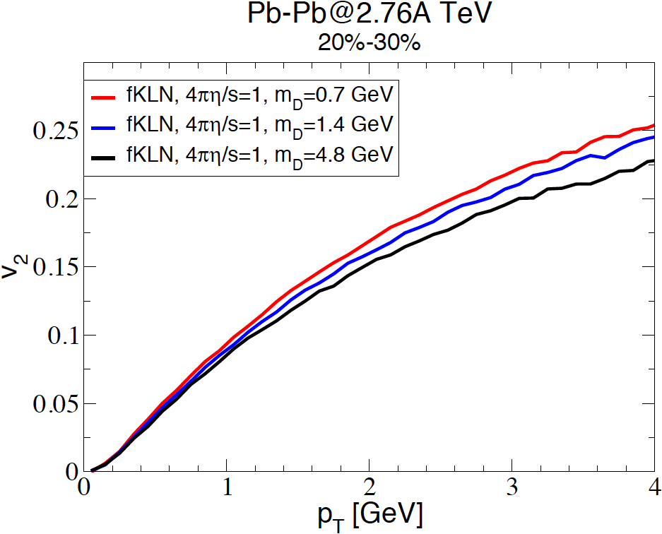
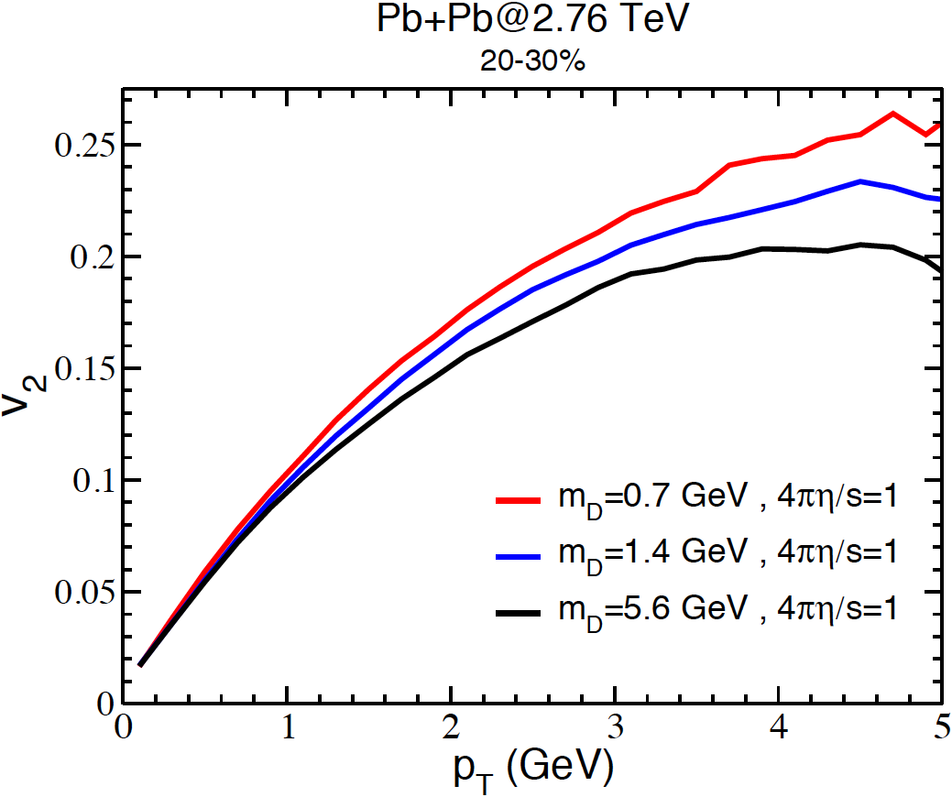
η/s(T) shear viscosity or details of the cross section?
cross section
Keep same η/s means:
η/s is really the physical parameter determining
v₂ at least up to 1.5-2 GeV
microscopic details become relevant at higher p_{T}
First time η/s<-> v₂ hypothesis is verified!
for m_{D}=1.4 GeV -> 25% smaller σ_{tot}
for m_{D}=5.6 GeV -> 40% smaller σ_{tot}

Slide 8
What about Color Glass condensate initial state?
- Kinetic Theory Q_{s} saturation scale
p_{y}
p_{x}
y
z
x

Slide 9
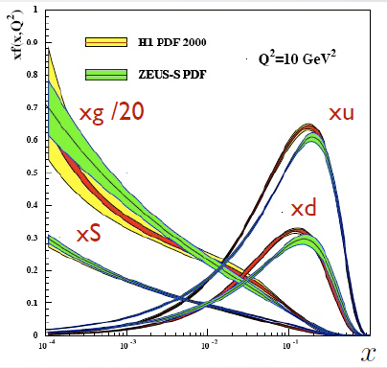
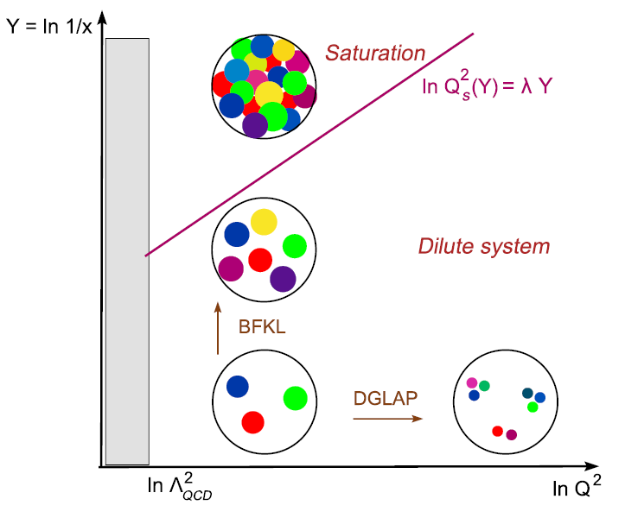
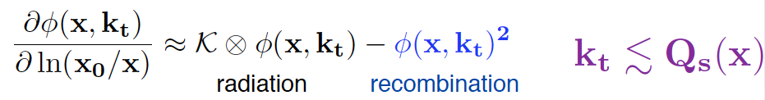
Color Glass Condensate
dN/d²p_{T}
Saturation scale
Q_{sat}(s)
p_{T}
Specific of CGC is a non-equilibrium
distribution function !
At RHIC Q² ~ 2 GeV²
At LHC Q2 ~ 5-6 GeV² ?

Slide 10
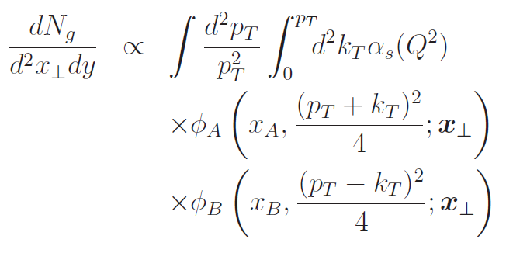

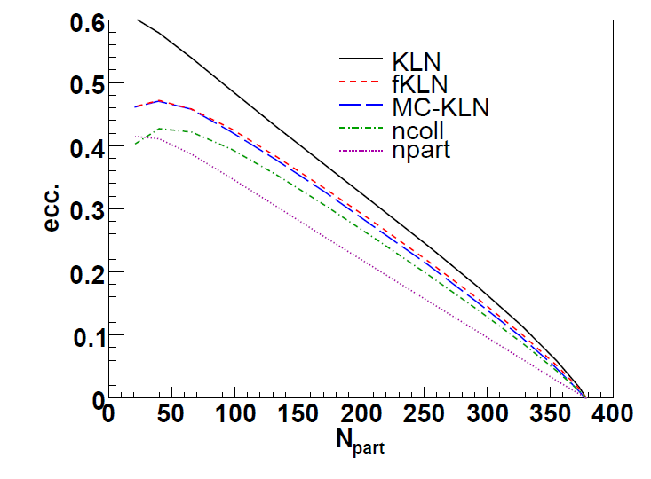
fKLN realization of CGC
(f)KLN spectrum
Factorization hypothesis:
convolution of the distribution
functions of partons
in the parent nucleus.
Unintegrated
distribution
functions
(uGDFs)
p-space
x-space
Saturation scale Qs depends on:
1.) position in transverse plane;
2.) gluon rapidity.
dN/d²p_{T}
Nardi et al., Nucl. Phys. A747, 609 (2005)
Kharzeev et al., Phys. Lett. B561, 93 (2003)
Nardi et al., Phys. Lett. B507, 121 (2001)
Drescher and Nara, PRC75, 034905 (2007)
Hirano and Nara, PRC79, 064904 (2009)
Hirano and Nara, Nucl. Phys. A743, 305 (2004)
Albacete and Dumitru, arXiv:1011.5161[hep-ph]
Albacete et al., arXiv:1106.0978 [nucl-th]
ε_{x}(fKLN)=0.34
ε_{x}(Glaub.)=0.29
Q_{sat}(s)
p_{T}

Slide 11
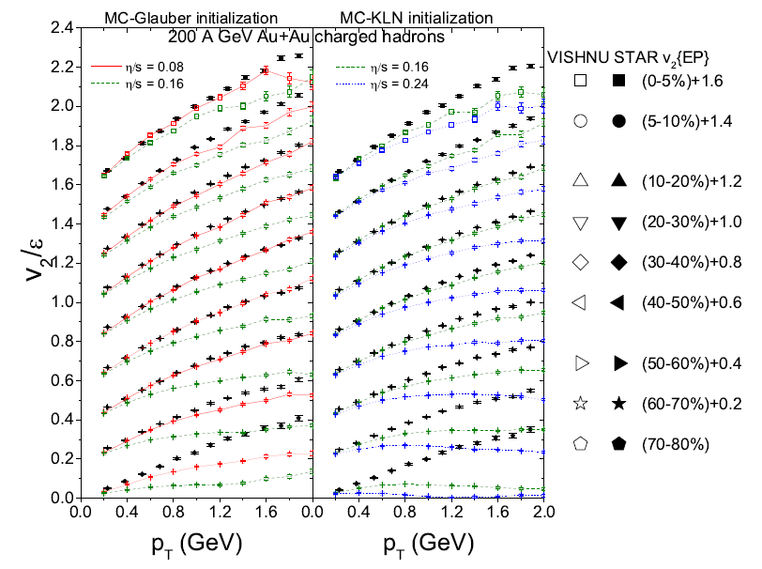
V₂ from KLN in Hydro
What does it KLN in hydro?
1) r-space from KLN (larger ε_{x})
2) p-space thermal at t₀ ≈0.8 fm/c - No Q_{s} scale , We’ll call it fKLN-Th
Heinz et al., PRC 83, 054910 (2011)

Slide 12
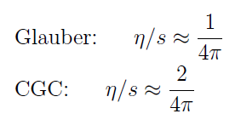
V₂ from KLN in Hydro
What does it KLN in hydro?
1) r-space from KLN (larger ex)
2) p-space thermal at t₀ ≈0.8 fm/c - No Q_{s} scale , We’ll call it fKLN-Th
Larger ε_{x} - > higher η/s to get
the same v₂(p_{T})
Risultati di Heinz da “hadron production………”
Uncertainty on initial conditions implies uncertainty of a factor 2 on η/s
Similar conclusion in
Drescher et al., PRC (2011)

Slide 13
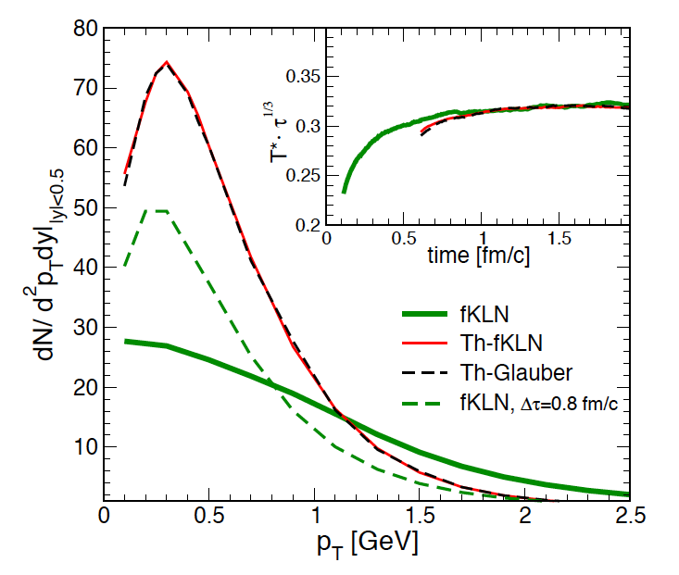

Implementing KLN p_{T} distribution
AuAu@200 GeV – 20-30%
Using kinetic theory at finite η/s
we can implement full KLN
(x & p space) - ε_{x}=0.34, Qs =1.44 GeV
KLN only in x space ( like in Hydro)
ε_{x}=0.34, Qs=0
Glauber in x & thermal in p
ε_{x}=0.289 , Qs=0
Thermalization in less than 1 fm/c, in agreement with Greiner et al., NPA806, 287 (2008).
Not so surprising: η/s is small -> large effective scattering rate -> fast thermalization.

Slide 14
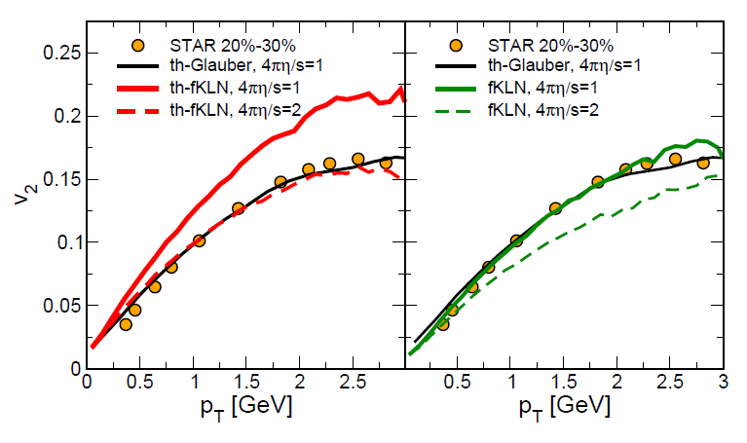
Results with kinetic theory
Hydro - like
AuAu@200 GeV
Full x & p
M. Ruggieri et al., 1303.3178 [nucl-th]
When implementing KLN and Glauber like in Hydro we get the same of Hydro
When implementing full KLN we get close to the data with 4πη/s =1 :
larger ε_{x} compensated by Q_{s} saturation scale (non-equilibrium distribution)

Slide 15
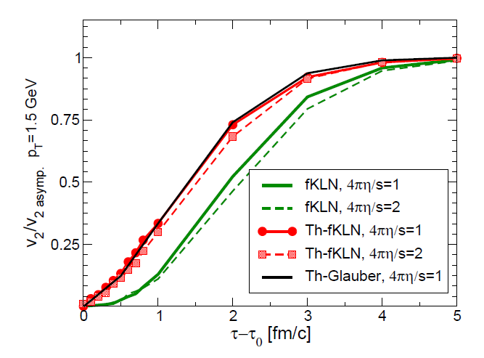
What is going on?
V₂ normalized time evolution
AuAu@200 GeV
M. Ruggieri et al., 1303.3178 [nucl-th]
We clearly see that when non-equilibrium distribution is implemented
in the initial stage (≈ 1 fm/c) v₂ grows slowly respect to thermal one

Slide 16
Summary
  Development of kinetic at fixed η/s(T) :
  Verified that up to ≈ 2 GeV: v₂ <-> η/s and microscopic
  details of the cross section are irrelevant
  Studying the CGC (fKLN):
  Initial non-equilibrium distribution implied by CGC
  damps the v₂(p_{T}) compensating the larger ε_{x}
  -> v₂(p_{T}) can be described by 4πη/s ≈1 also for KLN
  Extension to v_{n} including intial state fluctuations

Slide 17
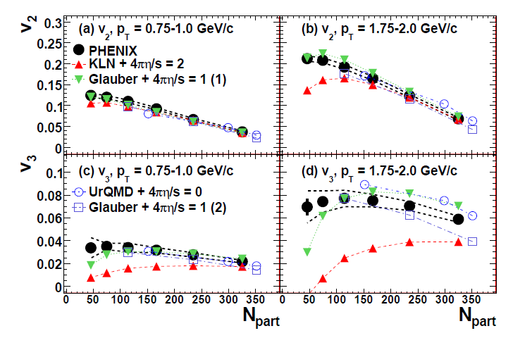
Higher η/s for KLN leads to small v₃
Adare et al., [PHENIX Collaboration], PRL 107, 252301 (2011)
The value of η/s affects more higher harmonics!
Can we discard KLN or CGC?!
Well at least before one should implement both x and p space

Slide 18
Outlook
for a kinetic theory approach
Include initial state fluctuations to study v_{n}:
  more constraints on η/s(T)
  Impact of CGC non-equilibrium distribution
Include hadronization:
  statistical model like in hydro
  coalescence + fragmentation (going at high p_{T})
Heavy quark dynamics within the same framework:
  Fokker-Planck is the small transfer approximation
  is it always a reliable approximation?

Slide 19
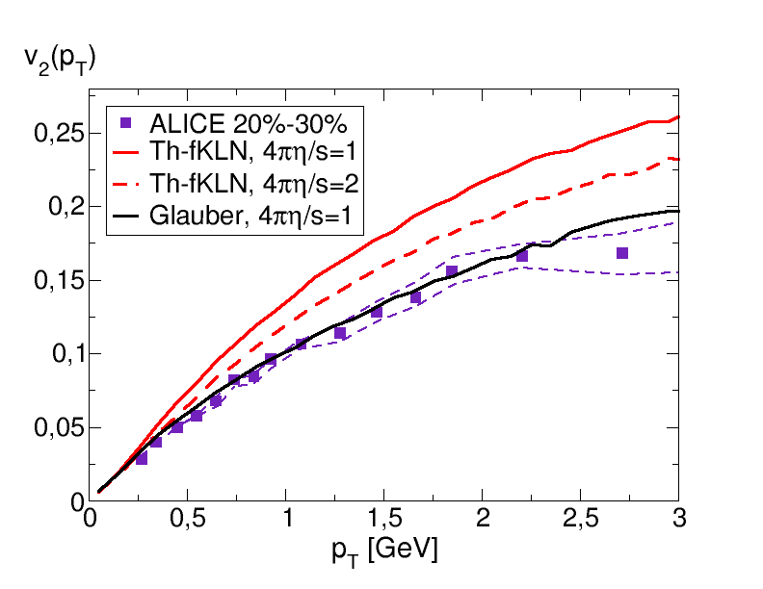
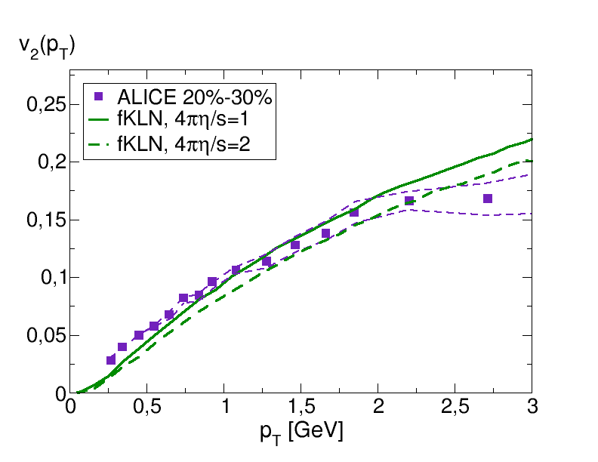
What happens at LHC?
Hydro -like
PbPb@2.76 TeV
Full KLN x & p
At LHC the larger saturation Q_{s} ( ≈ 2.4 GeV) scale makes the effect larger:
- 4πη/s= 2 not sufficient to get close to the data for Th-KLN
- 4πη/s=1 it is enough if one implements both x &p
Full fKLN implemention change the estimate of η/s by about a factor of 3

Slide 20
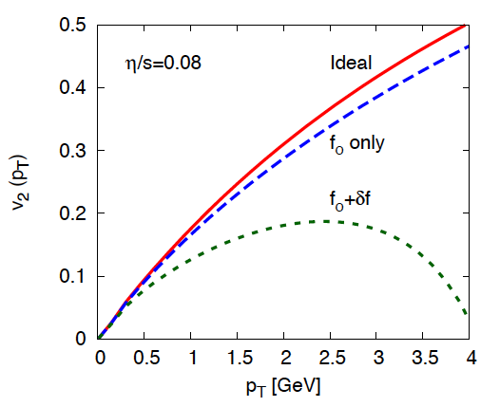
Viscous Hydrodynamics
I⁰ Navier-Stokes, but it violates causality,
II⁰ order needed -> Israel-Stewart
Asantz used
K. Dusling et al., PRC81 (2010)
- this implies Relax. Time and not Chap.Enskog
- at p_{T}~3 GeV !? δf/f≈ 5
Problems related to δf:
dissipative correction to f -> f_{eq}+δf_{neq} just an ansatz
δf_{neq}/f at p_{T}> 1.5 GeV is large
δf_{neq} <-> η/s implies a RTA approx. (solvable)
Π^{μν} (t₀) =0 -> discard initial non-equil. (ex. minijets)
p_{T} -> 0 no problem except if η/s is large
Notes:
Effetto df con l’altra figura
Df comunque non considerata all’inzio e corrisponderebbe ad un valore finito di pmv
Aggiungere ref. di dusling

Slide 21
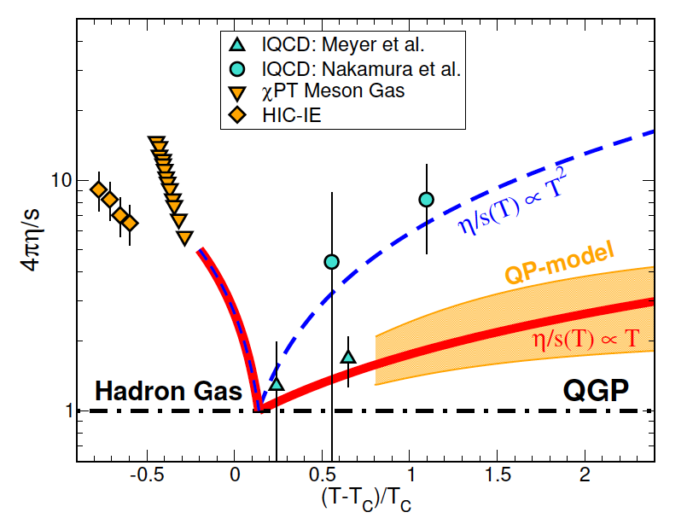
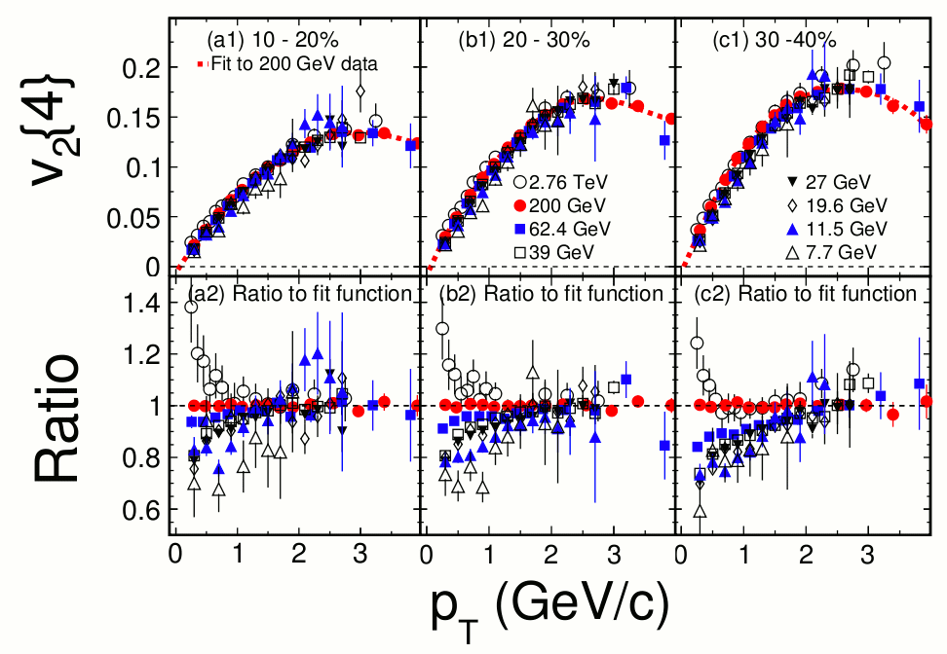
η/s(T) for QCD matter
lQCD some results for quenched
approx. (large error bars)
A. Nakamura and S. Sakai, PRL 94(2005)
H. B. Meyer, Phys. Rev. D76 (2007)
Quasi-Particle models seem to
suggest a η/s~T^{α}, α ~ 1 – 1.5.
S.Plumari et al., PRD84 (2011)
M. Bluhm , Redlich, PRD (2011)
Chiral perturbation theory (χpT)
M. Prakash et al. , Phys. Rept. 227 (1993)
J.-W. Chen et al., Phys. Rev. D76 (2007)
Intermediate Energies – IE ( μ_{B}>T)
W. Schmidt et al., Phys. Rev. C47, 2782 (1993)
Danielewicz et al., AIP1128, 104 (2009)
(STAR Collaboration),
arXiv:1206.5528 [nucl-ex].

Slide 22
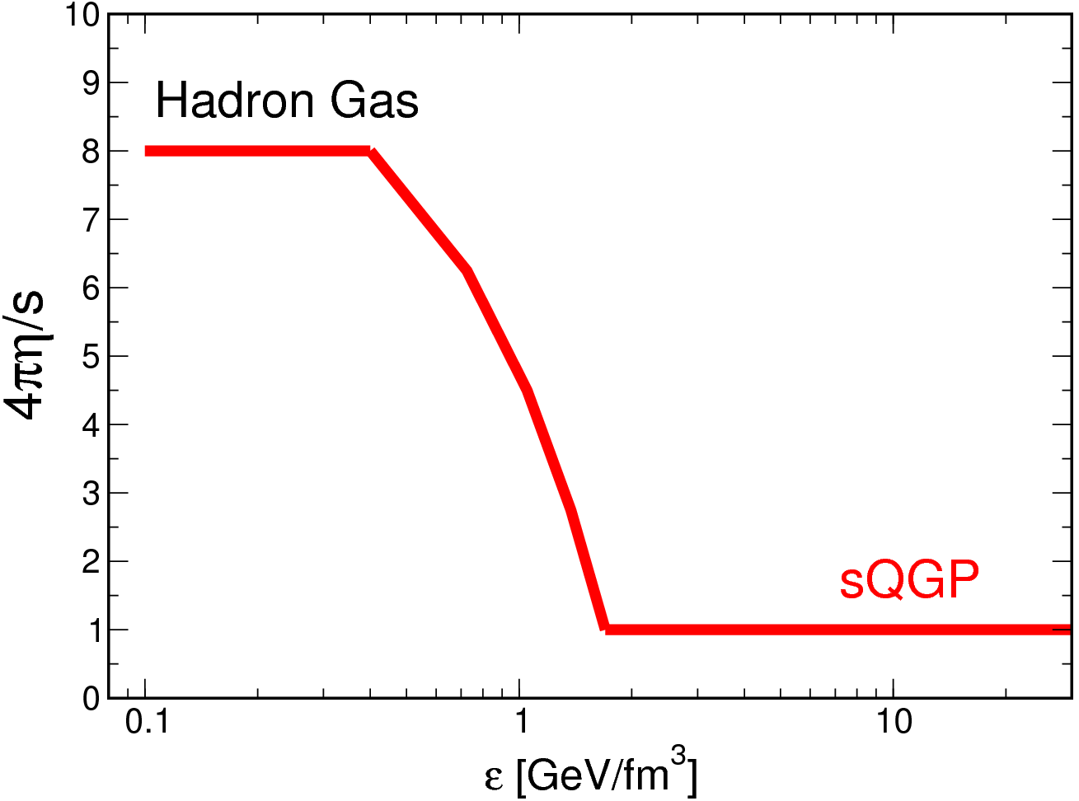
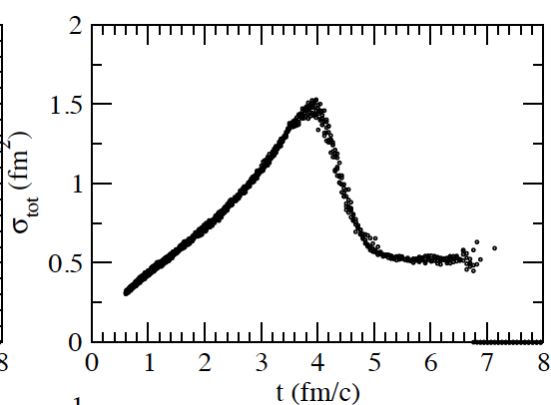
Terminology about freeze-out
Freeze-out is a smooth process: scattering rate < expansion rate
η/s increases in the cross-over region, realizing the smooth f.o.: small σ -> natural f.o.
Different from hydro that is a sudden cut of expansion at some T_{f.o.}
No f.o.
RHIC
B=7.5 fm

Slide 23
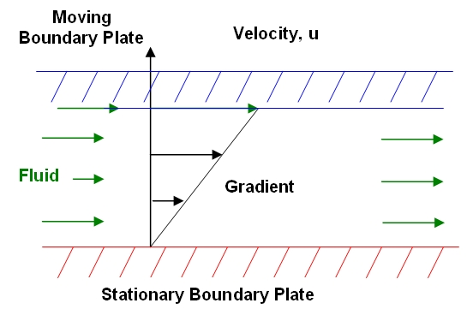
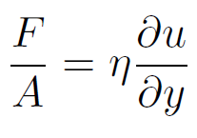
Part I
Do we really have the wanted shear viscosity η
with the relax. time approx.?
- Check η with the Green-Kubo correlator

Slide 24
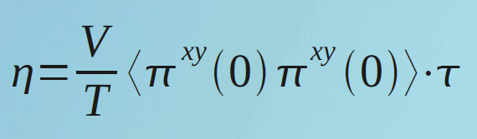
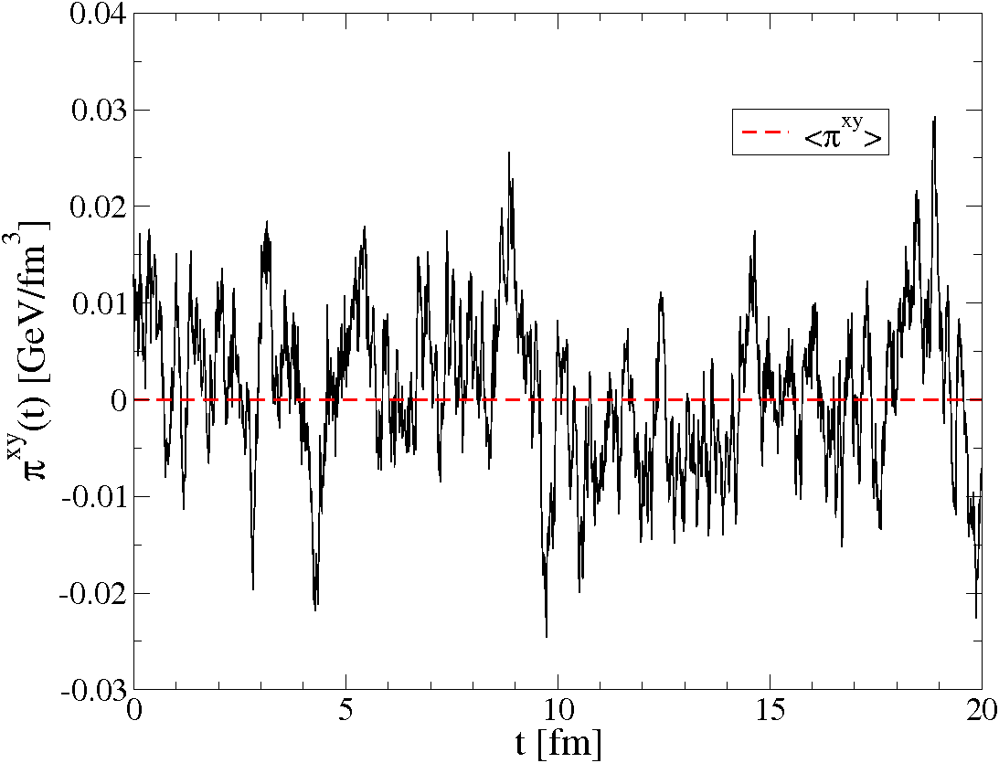
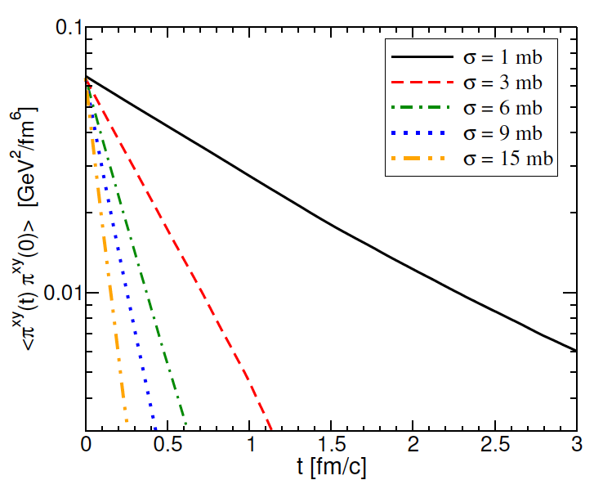
Shear Viscosity in Box Calculation
Green-Kubo correlator
microscopic details
macroscopic
observables
η ↔ σ(θ), ρ, M, T …. ?
S. Plumari et al., arxiv:1208.0481;see also:
Wesp et al., Phys. Rev. C 84, 054911 (2011);
Fuini III et al. J. Phys. G38, 015004 (2011).
Needed very careful tests of convergency
vs. N_{test}, Δx_{cell}, # time steps !

Slide 25
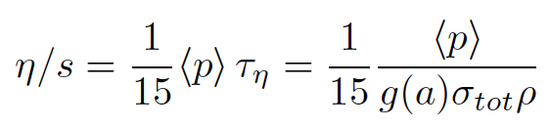
Non Isotropic Cross Section - σ(θ)
Relaxation Time Approximation
RTA is the one usually emplyed to make theroethical estimates: Gavin NPA(1985); Kapusta, PRC82(10); Redlich and Sasaki, PRC79(10), NPA832(10); Khvorostukhin PRC (2010) …
for a generic cross section:
h(a)=σ_{tr}/σ_{tot} weights cross section by q²
Chapmann-Enskog (CE)
m_{D} regulates the angular dependence
Green-Kubo in a box - σ(θ)
g(a) correct function that fix the
momentum transfer for shear motion
CE and RTA can differ by about a factor 2-3
Green-Kubo agrees with CE
S. Plumari et al., PRC86(2012)054902
Notes:
Update figure

Slide 26
Transport vs Viscous Hydrodynamics in 0+1D
Comparison for the relaxation of pressure anisotropy P_{L}/P_{T}
Huovinen and Molnar, PRC79(2009)
Indeed Knudsen number⁻¹
Large K small dissipation
Transport similar viscous hydro within less than a 10%
At least using quadratic form of the δf viscous corrections

Slide 27
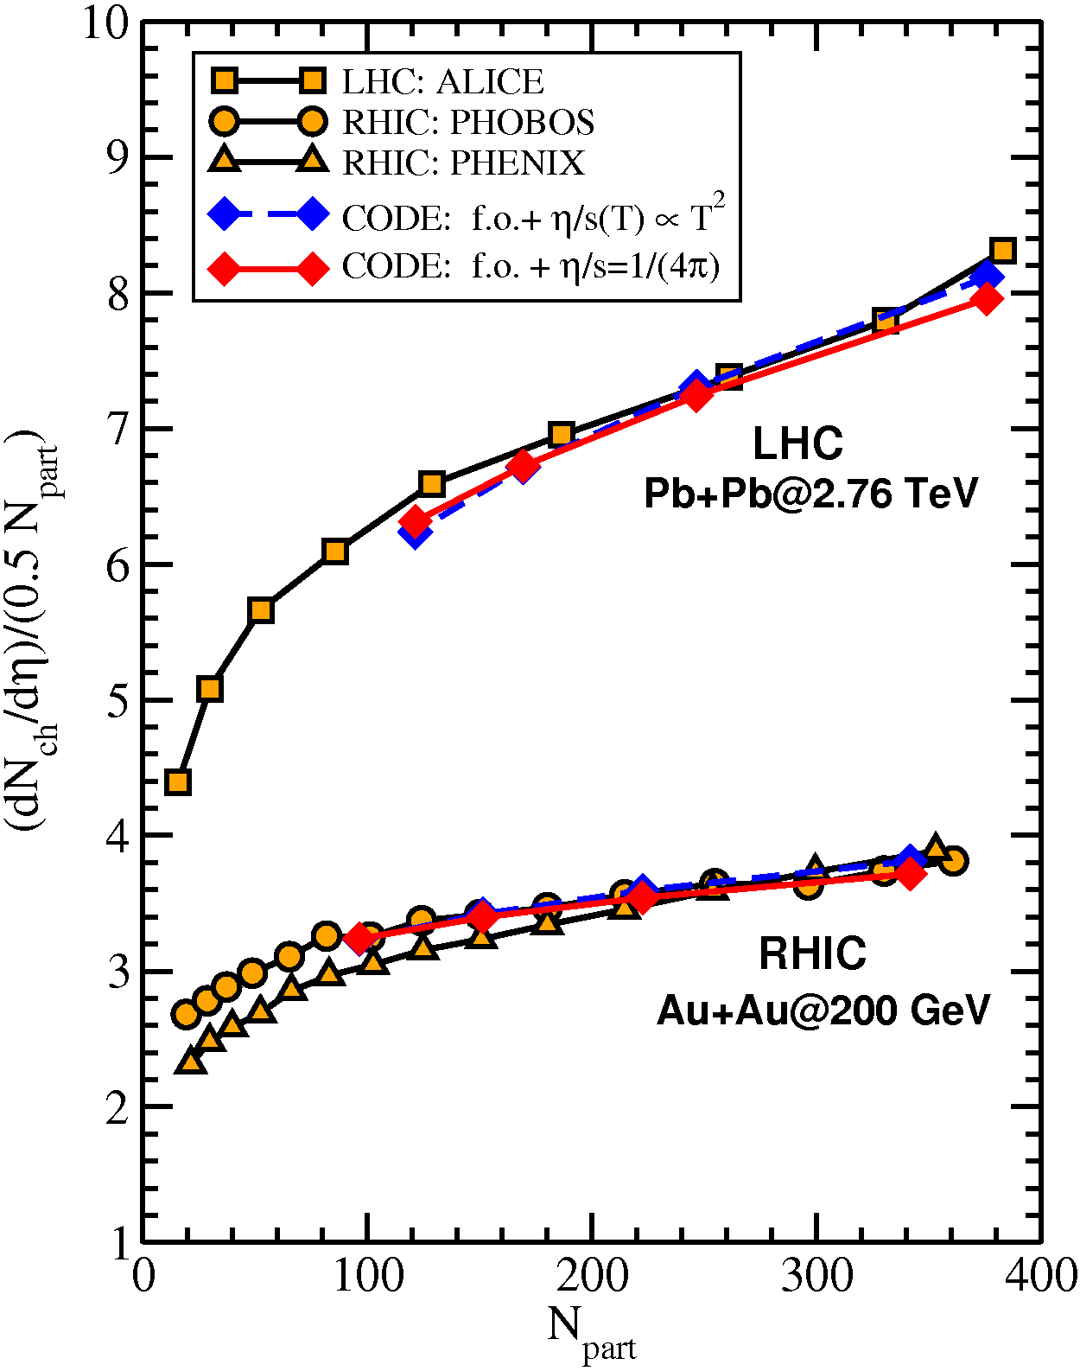
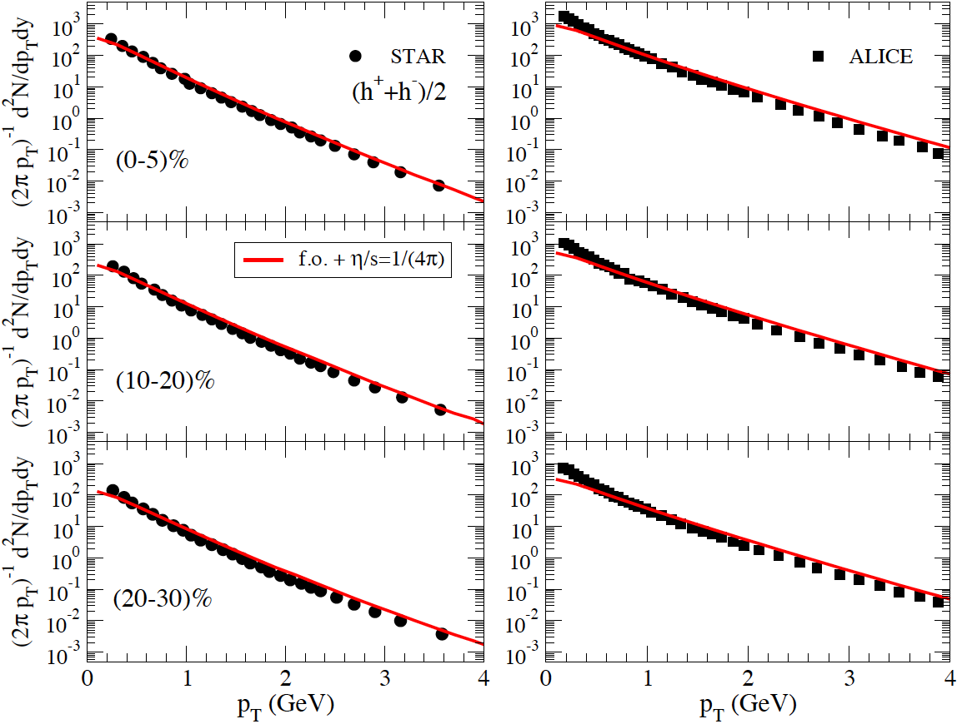
Multiplicity & Spectra
r-space: standard Glauber condition
p-space: Boltzmann-Juttner T_{max}=2(3) T_{c} [p_{T}<2 GeV ]+ minijet [p_{T}>2-3GeV]
No fine tuning

Slide 28
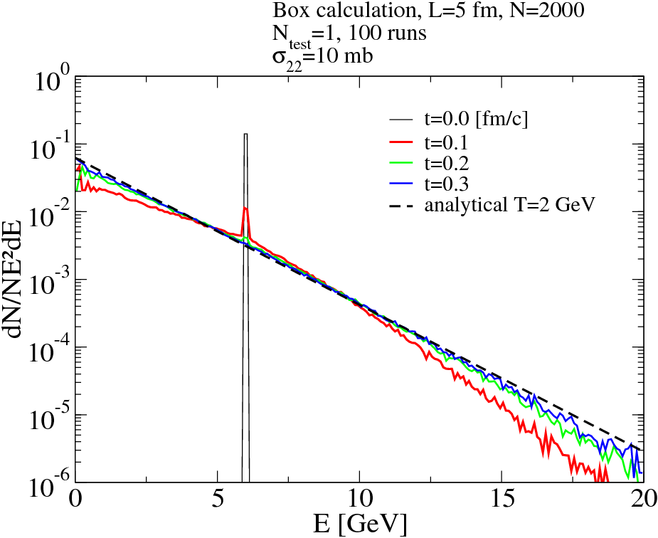
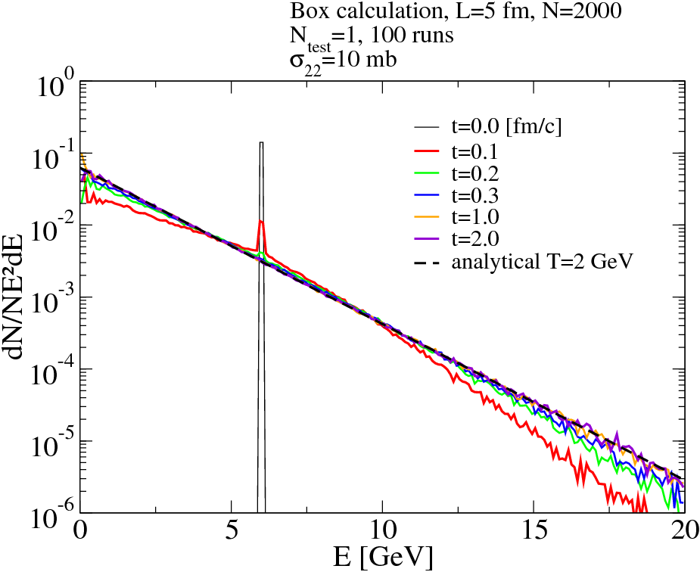
A simple example of kinetic theory application
Particles in a box
Highly non-equilibrated distributions
Going to equilibrium
where the temperature is
This is a problem that cannot be treated in hydrodynamics
that assumes locally an equilibrium distribution!

Slide 29
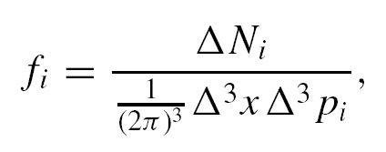
Transport solved on lattice
Solved discretizing the
space in (η, x, y)_{α} cells
Rate of collisions
per unit of phase
space
Δt→0
Δ³x→0
exact
solution
Δ³x
Putting massless partons
at equilibrium in a box
than the collision rate is
See: Z. Xhu, C. Greiner, PRC71(04)

Slide 30
