Slide 1

Pseudorapidity density
& anisotropic flow over a wide η range in
Pb-Pb collisions at 2.76 TeV using ALICE @ LHC
Jens Jørgen Gaardhøje for the ALICE Collaboration
Niels Bohr Institute & Discovery Center
INPC, Firenze, June 2013

Slide 2
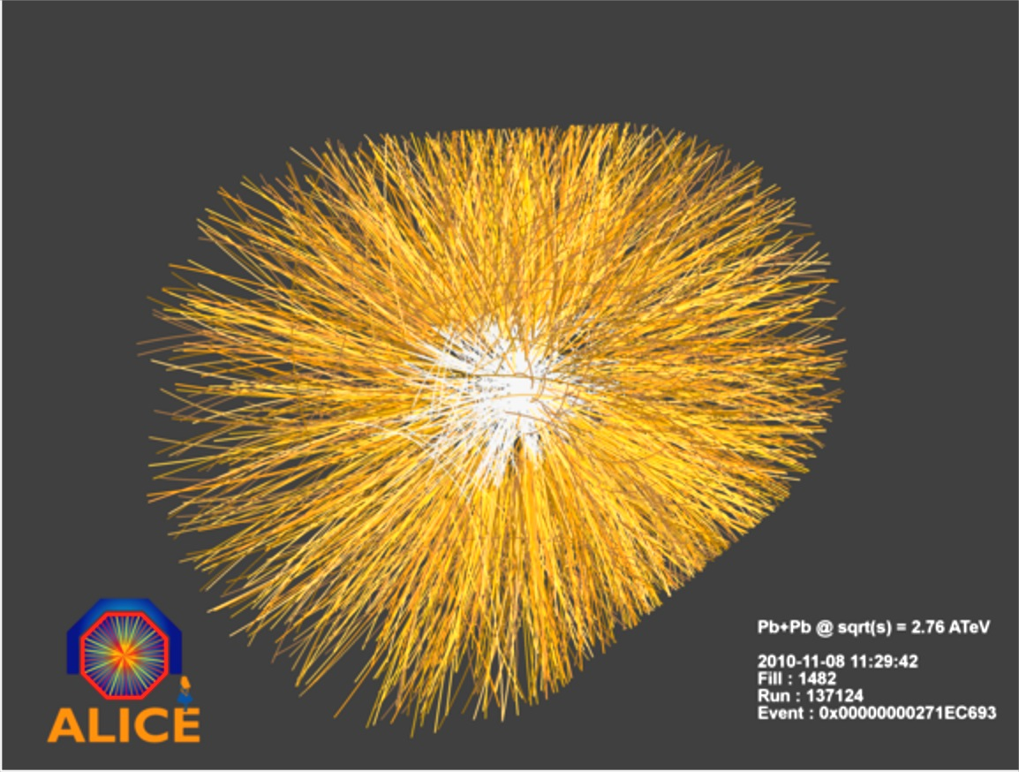
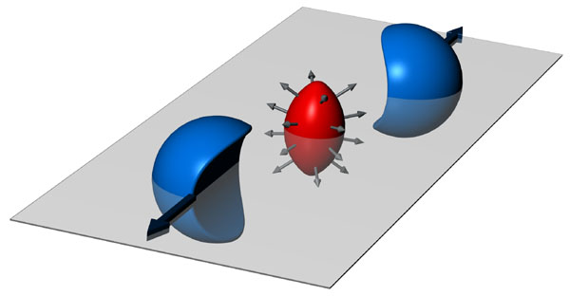
Motivation
Determine distribution of charged particles as a function of pseudorapidity
& collision centrality (impact parameter)
Energy density
Scaling laws in fragmentation region
Reaction mechanism (stopping vs. transparency)
η=0 : θ= 90 deg
η=5.1 : θ= 0.7 deg
Azimuthal flow of charged particles dN/dφ
Collective motion of produced fireball
Viscosity of QGP
Scaling law for fragmentation region
New multiparticle correlation techniques used (Q-cumulants)

Slide 3
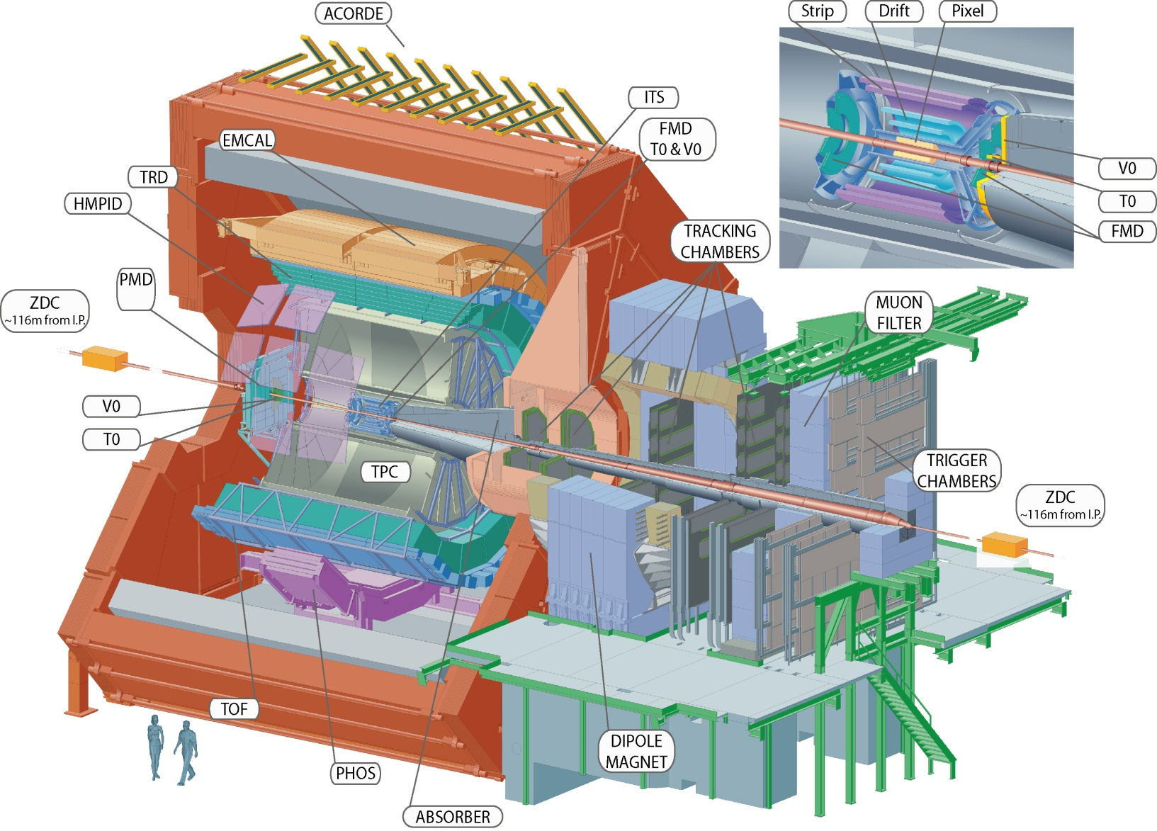
ALICE detectors used
FMD
3.2m to IP

Slide 4
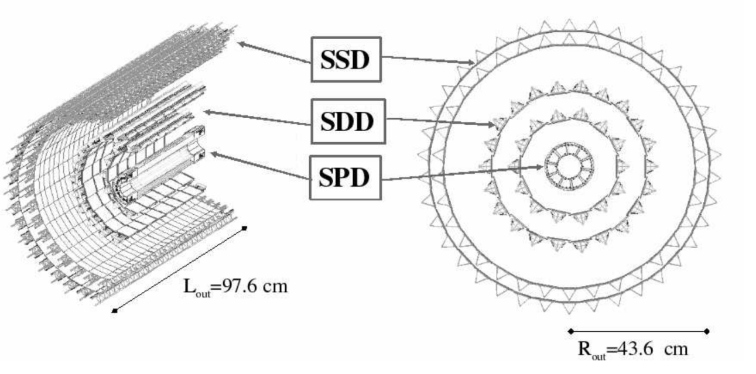
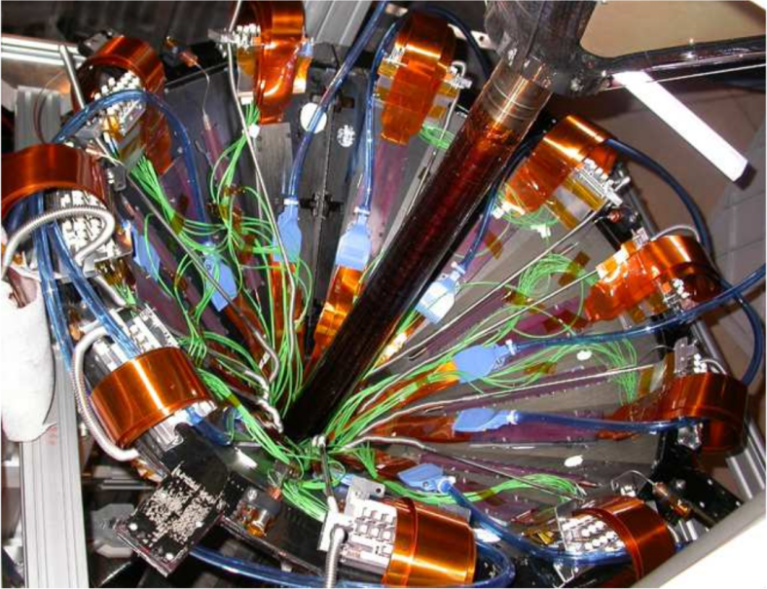
Central barrel: ITS
Silicon Pixel Detector (SPD) used for this study
  Over 3 millions channels (inner layer)
  |η| < 2
  Very few secondary particles (mostly produced in beam pipe)

Slide 5
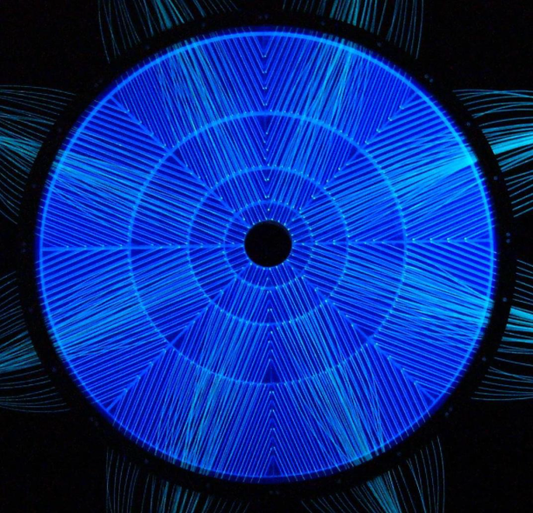
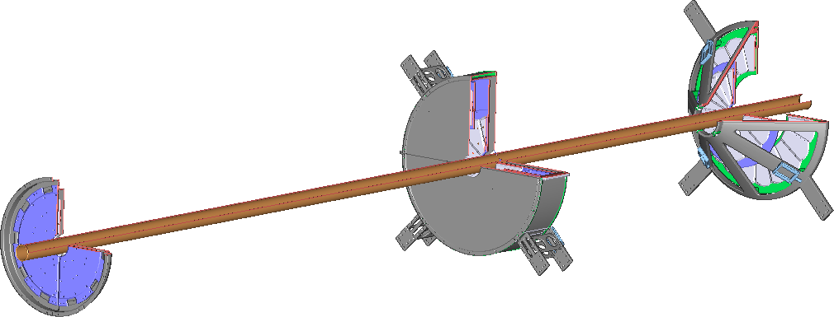
Forward rapidity detectors
VZERO-A (scintillator)
FMD (silicon)
VZERO-C
20 or 40 sectors in φ
Nominal
Interaction
Point
51200 Si-strips
FMD3:-1.7>η>-3.4
5.1>η>2.8
FMD2: 3.7>η>1.7
FMD1: 5.0>η>3.7
FMD and VZERO detectors extend η coverage significantly
  Detectors are single layer => no tracking
  There is significant material in front of detectors

Slide 6

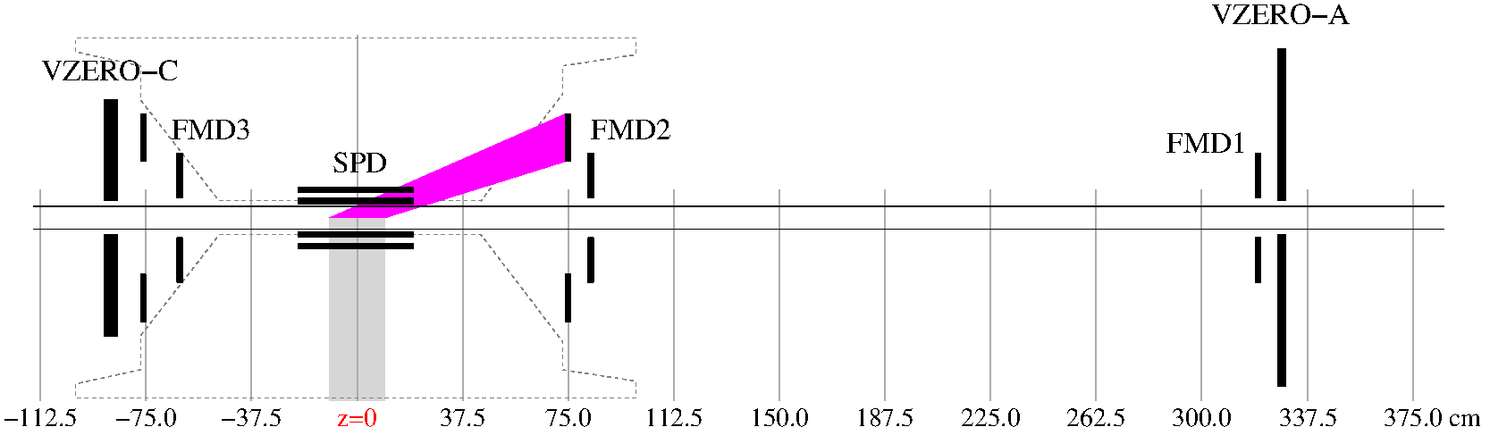
Measuring particle multiplicity : in principle ‘simple’ counting…
In fact, secondary particles are a major problem
Correct for acceptance & sharing between strips
Use Poisson statistics and energy spectrum decomposition methods to determine number of particles per η, φ bin.
Forward detectors see many secondary particles from dense services (cables, cooling, etc…) and beam pipe.
In some regions: Secondaries/Primaries = 2
=> Requires very accurate MC description of geometry and material budget

Slide 7
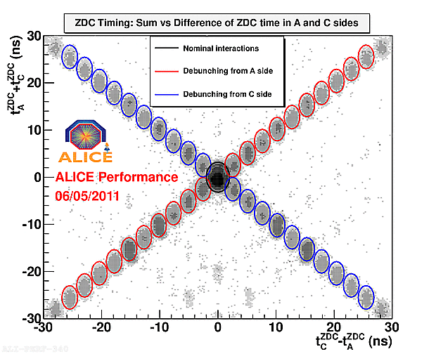
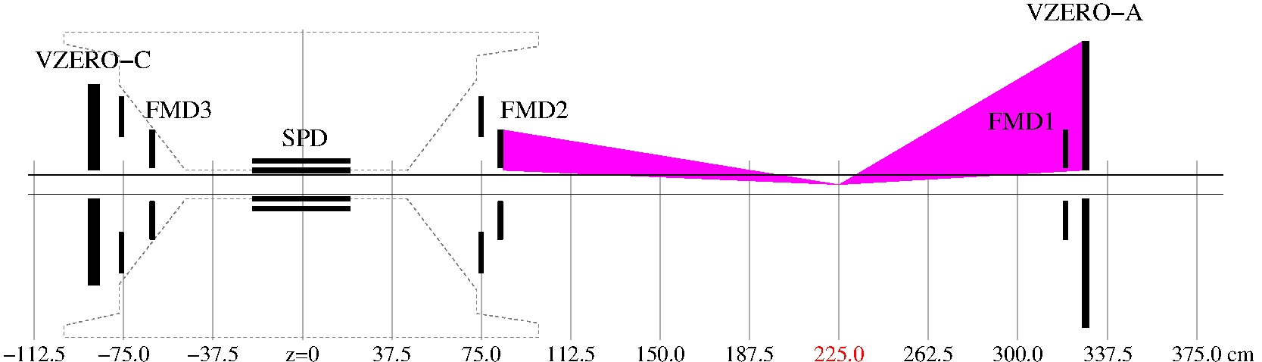
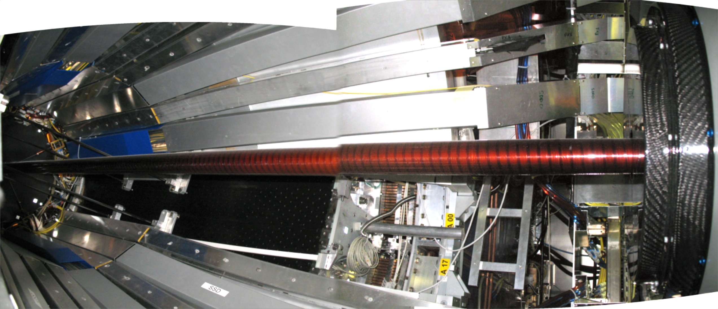
Use satellite collision vertices to reduce contribution of secondary particles
Beam bunch structure (75ns) and zero-crossing angle results in displaced collision vertices every 37.5 cm
Advantage:
  Less material
  Smaller corrections
Extends η coverage to
-5.0 < η < 5.5
Little material present: beam pipe (Be)

Slide 8
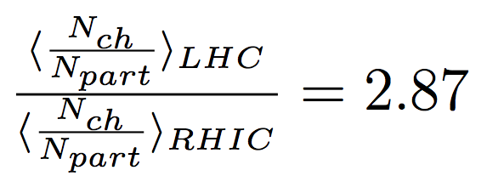
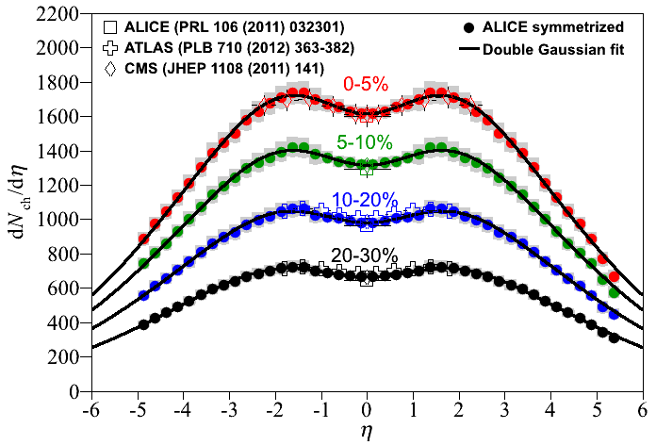
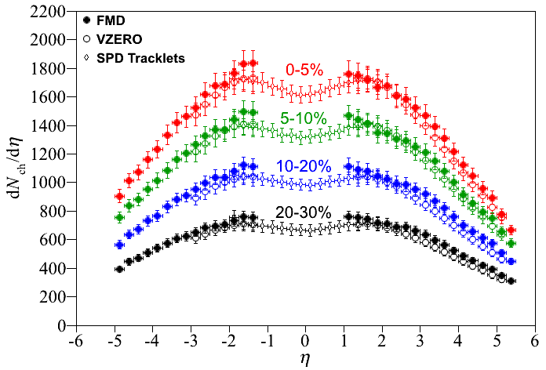
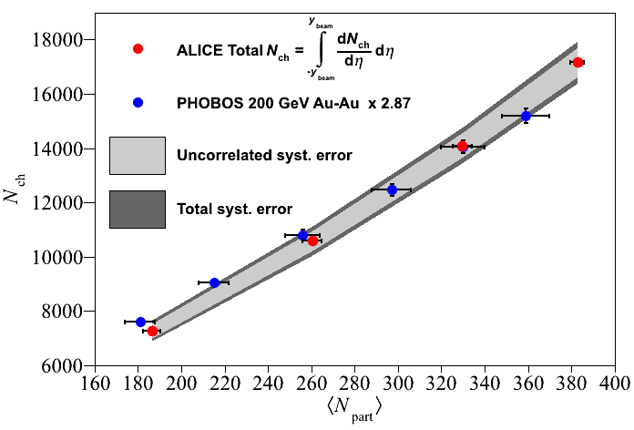
dN_{ch}/dη versus η
17165 ± 722 charged particles produced in 5% most central coll.
First measurement over wide kinematic range at LHC
arXiv:1304.0347
ε ≥ 16 GeV/fm³
x 100 above nuclear density
x 30 above nucleon density
x 20 above lattice-QCD prediction for quark-gluon plasma formation
Bjorken energy density
ε = 1/(πR²τ₀) dE_{t}/dη
dE_{t}=dN • <m_{t}>; τ₀=1 fm/c
dz= τ₀dη
πR²

Slide 9
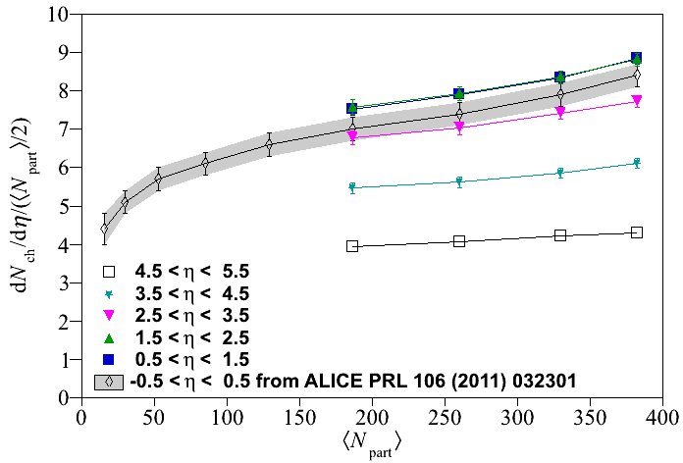
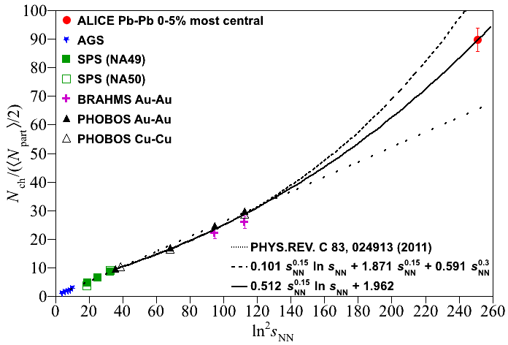
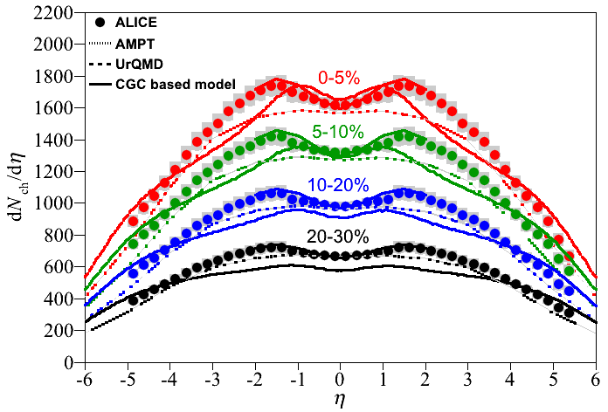
Systematics and comparison to models
arXiv:1304.0347 [nucl-ex]
Particle production per participant grows with increasing centrality
Trapezoidal approximation used at RHIC does not work at LHC
Fit assuming midrapidity plateau works well
Predict: N_{ch} ≈24,000 at √s_{NN}=5.5TeV for 0-5% central collisions
Models (tuned) give reasonable description of data

Slide 10
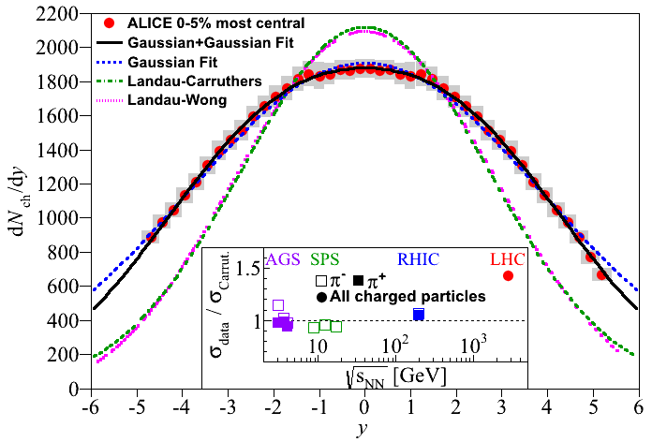
From pseudorapidty density to rapidity density
Pseudorapidity: η = -ln(tan(θ/2) Rapidity: y = ½ ln (1+ βcos(θ))/(1- βcos(θ)) y≈η
(for unidentified particles) (for identified particles) (for large y & p_{T})
Under robust assumptions about particle mix and momentum distribution, calculate the Jacobian and transform dN/dη to dN/dy
Two models for the reaction:
Landau(-Wong): Matter stopped at y=0, 1D-hydrodynamical expansion
Expect:
dN/dy α exp (y_{b}² -y² )^{½}
Bjorken: Transparent collision, particles produced from color field, self-similar longitudinal expansion.
Expect :
dN/dy ≈ cst in central region
A large deviation (40%) from Landau prediction is seen !
arXiv:1304.0347
See also CMS in E_{T}: ArXiv: 1205.2488

Slide 11
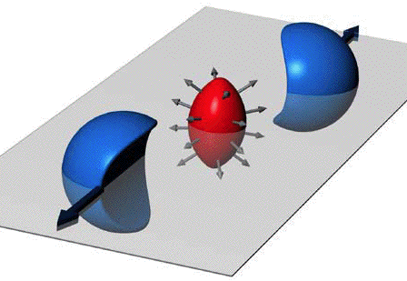
Anisotropic flow
Use Q-cumulants (Correlation technique)
  No need to measure event plane
  Cancels out autocorrelations
  Non-flow suppressed with multiparticle techniques
v₂ sensitive to initial geometrical shape
v_{n>2} sensitive to fluctuations of shape of initial overlap region
This measurement uses nominal vertices
  Less sensitive to material than dN_{ch}/dη
  FMD used to extend η range significantly
v_{n}{2 }= (c_{n}{2})^{½} , v_{n}{4}=(-c_{n}{4})^{¼} , …
c_{n}{2} = <<2>> = <<exp(in(φ₁-φ₂))>>

Slide 12
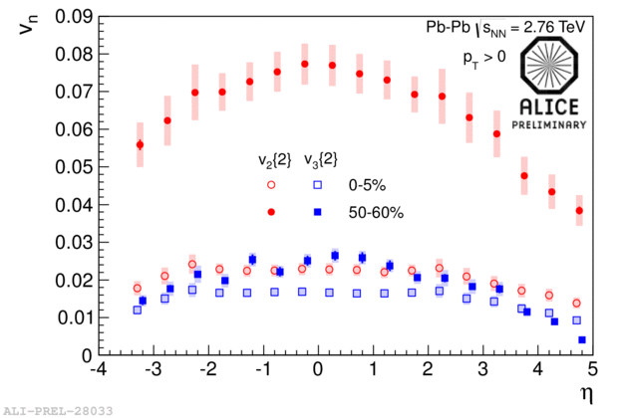
v₂(η)and v₃(η) measured
Large increase in v₂ from central to peripheral collisions
=> Initial anisotropy has large effect
v₃ depends less on centrality
Expected
Main contribution is from fluctuations of initial geometry
y≈0
ALICE (p_{T}≥0.2 GeV)
PRL 107 (2011) 032301

Slide 13
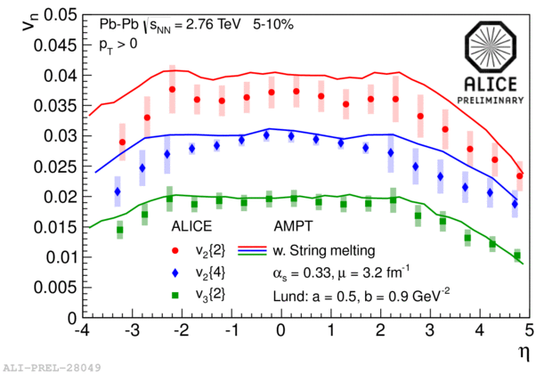
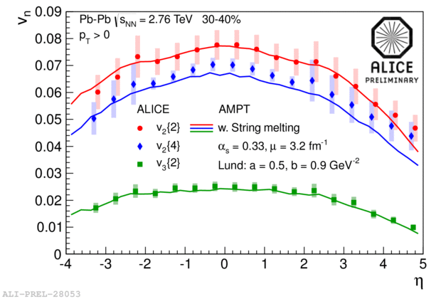
Comparison to models
AMPT (PRC 72, 064901) tested
  Agrees well with results for 30-40% centrality
  Predicts v₂ slightly higher than results for 5-10% centrality

Slide 14
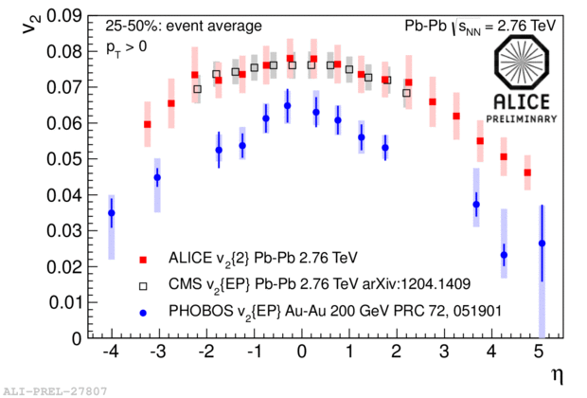
Comparison to other measurements
v₂ {2}- Agreement with CMS at same energy
  Flatter than at RHIC?
General decrease at forward
|η| seen
  similar trend as seen at lower energies
  More yield at forward η as compared to lower energy

Slide 15
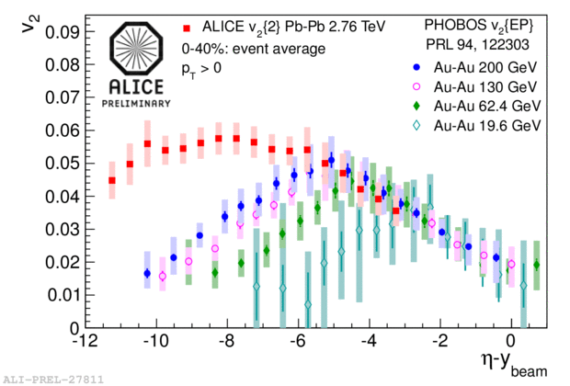
Longitudinal Scaling?
Is particle production in the fragmentation region invariant with beam energy? (Benecke et al., Phys Rev, v188, n5, 1969)
Shift dN_{ch}/dη from RHIC ( 62.4 and 200 GeV) and LHC (2.76 TeV) by respective y_{beam}
Shift v₂(η) from RHIC ( 62.4, 130 and 200 GeV) and LHC (2.76 TeV) by respective y_{beam}
arXiv:1304.0347 [nucl-ex]
Extrapolation of dN_{ch}/dη vs η-y_{beam} coincides with lower energy data
Both measurements are consistent with longitudinal scaling

Slide 16
Summary
First measurements of dN_{ch}/dη vs η over wide η range at LHC for Pb-Pb
> 17000 charged particles produced in central collisions
Landau scaling broken at LHC
First measurement of anisotropic flow over wide η range at LHC
Both dN_{ch}/dη and v₂(η) give results consistent with longitudinal scaling at all energies.

Slide 17
Backup

Slide 18
Transformation from dN/dη to dN/dy
Work of K. Gulbrandsen, NBI

Slide 19
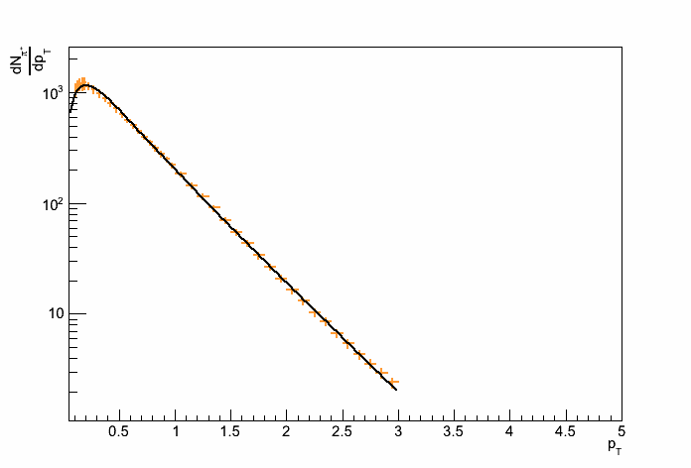
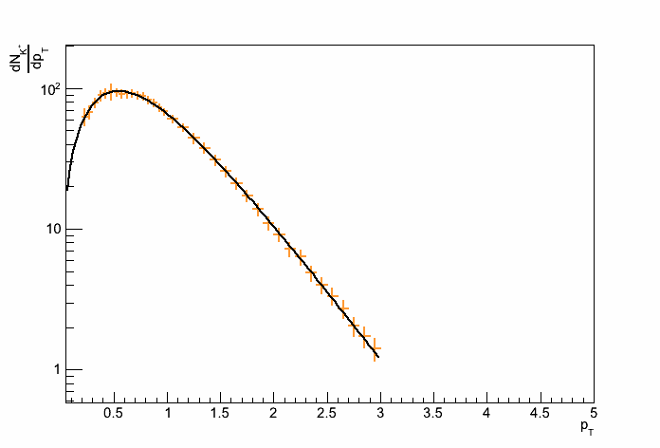
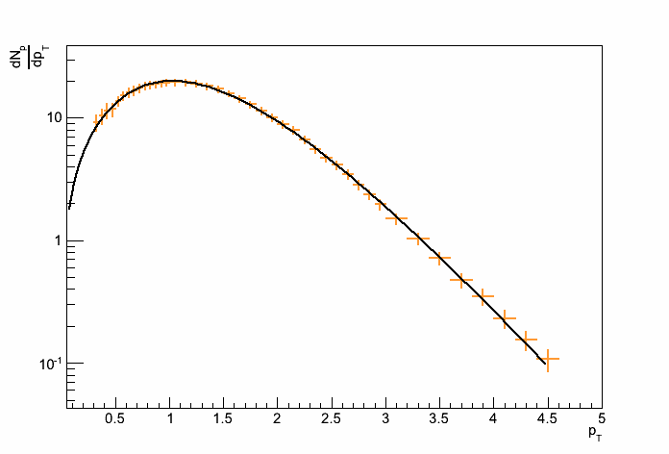

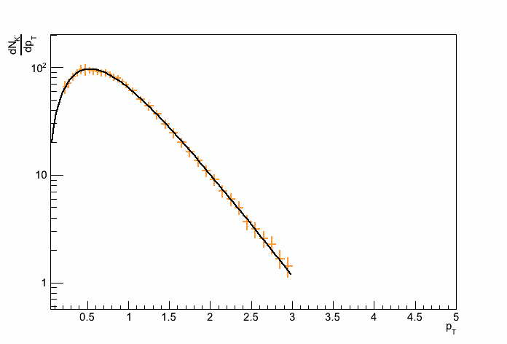
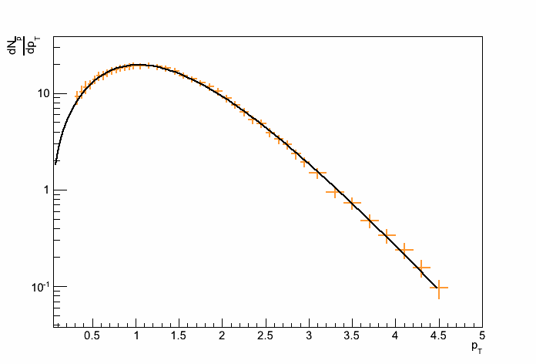
p_{T} Spectra
Blastwave fits to ALICE p_{T} spectra at midrapidity are used
Fit parameters and errors gotten from spectra group
π⁺
K⁺
p
π⁻
K⁻
pbar
Work of K. Gulbrandsen, NBI
19

Slide 20
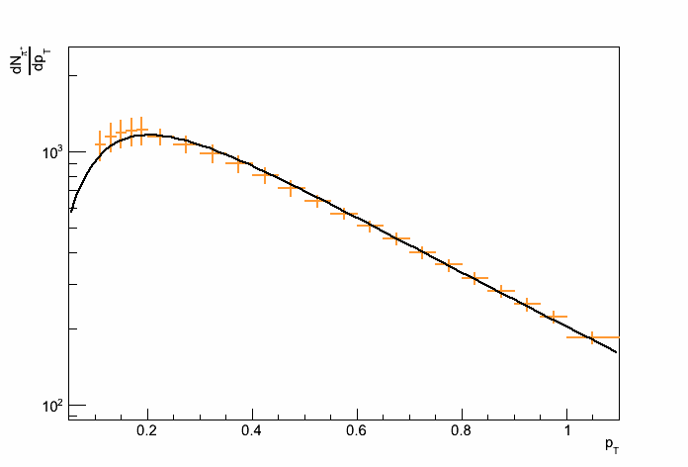
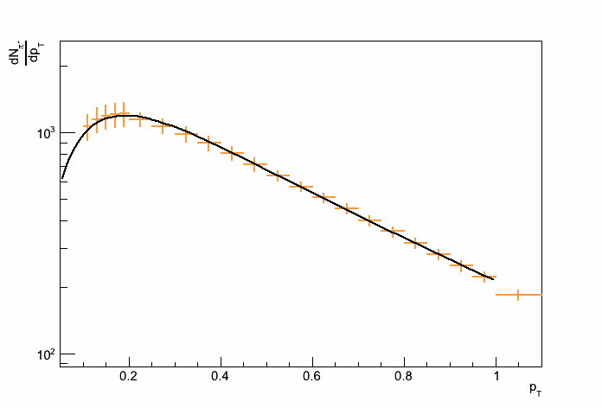
Low p_{T} pions
Low p_{T} pions don’t fit with Blastwave around peak
Pions are refitted in limited range [0,1]
  difference in parameters is also used in systematic error variation
Work of K. Gulbrandsen, NBI
20

Slide 21
Systematic errors: η variation of p_{T} distributions
p_{T} distribution can change with η
  p_{T} spectra also allowed to soften in η linearly
    p_{T}’=(1-α)p_{T}, α=r(η/η₀)
    Took r=0.2 at η₀ = 3
      From looking at RHIC data
This variation is added in quadrature to all other variations
Work of K. Gulbrandsen, NBI
Kristjan Gulbrandsen, PWG-LF Meeting - November 19 2012
21

Slide 22
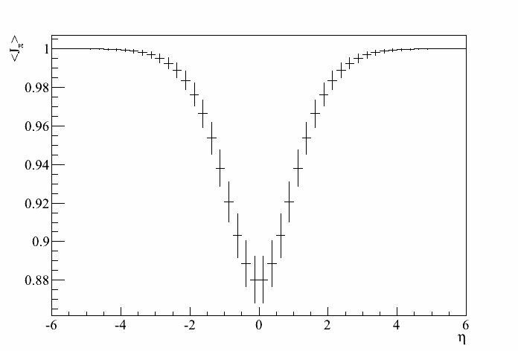
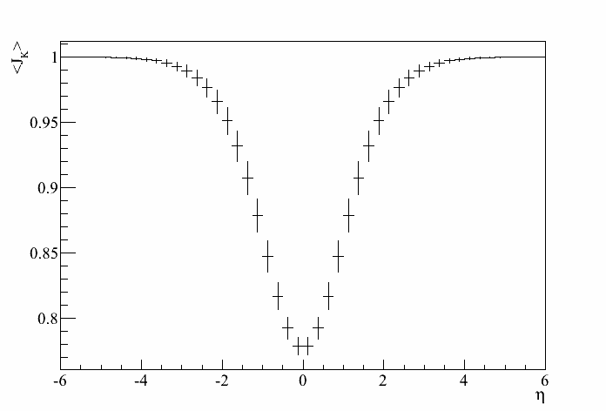
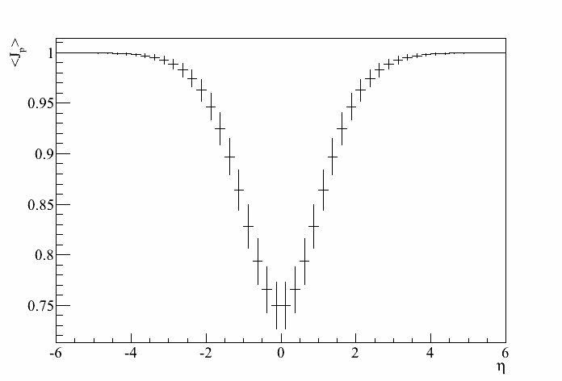
Jacobians for each particle
π
K
All variations are taken into account
Jacobian calculated for each particle
p
Work of K. Gulbrandsen, NBI
22

Slide 23
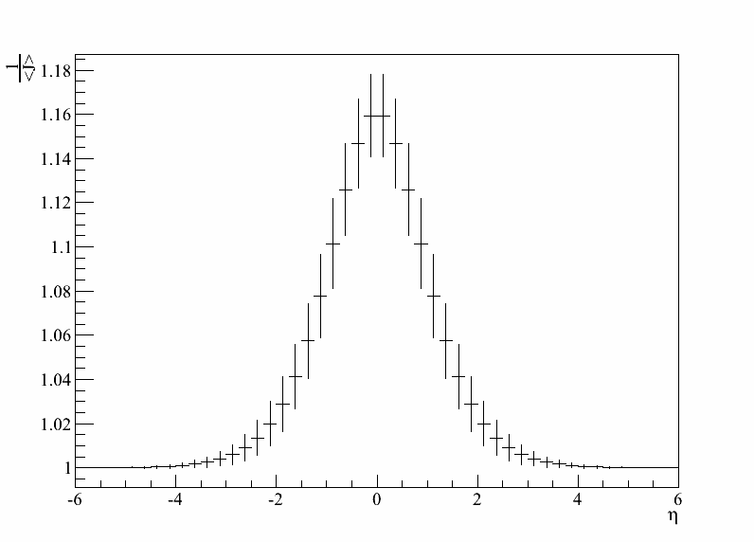
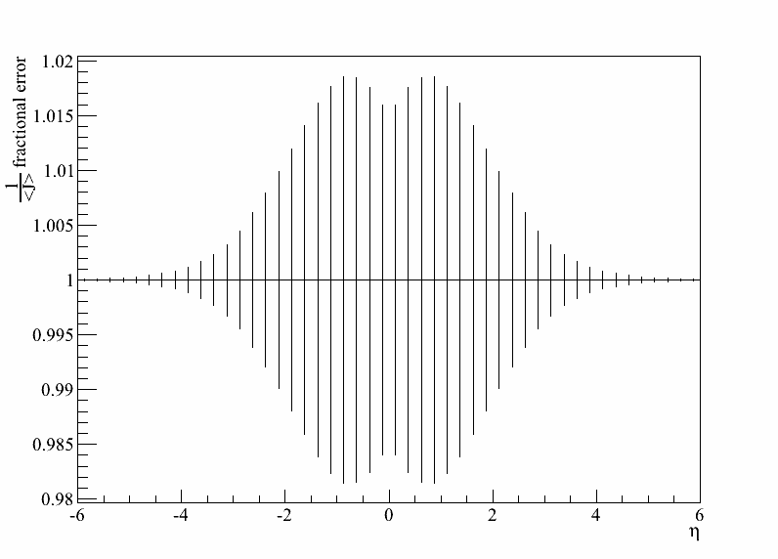
Computing 1/<J>
The net transformation (1/<J>) depends also on particle ratios
(K/π) and (p/π) are varied within ALICE measurement errors
Variations within ±50% on yields at η ≥ 2.5 are used
  Below η=2.5, this variation is linearly reduced (to 0 at η = 0)
Largest variation seen is 2%
Work of K. Gulbrandsen, NBI
Kristjan Gulbrandsen, PWG-LF Meeting - November 19 2012
23

Slide 24
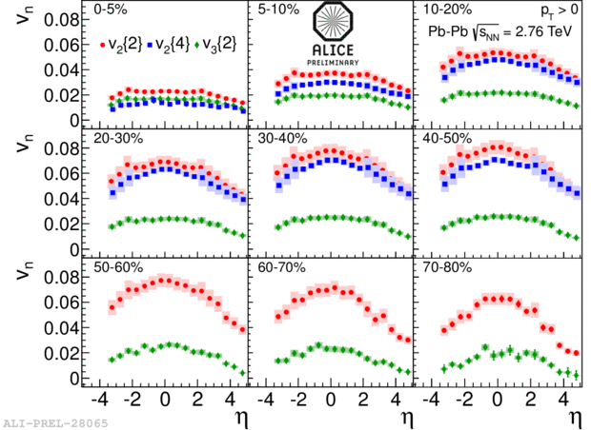
Flow comparison: v₂, v₃, v₄ all centralities
v₂{2}, v₂{4}, and v₃{2} measured at many centralities
v₃{4} difficult to measure for peripheral collisions
Work of A. Hansen, NBI

Slide 25
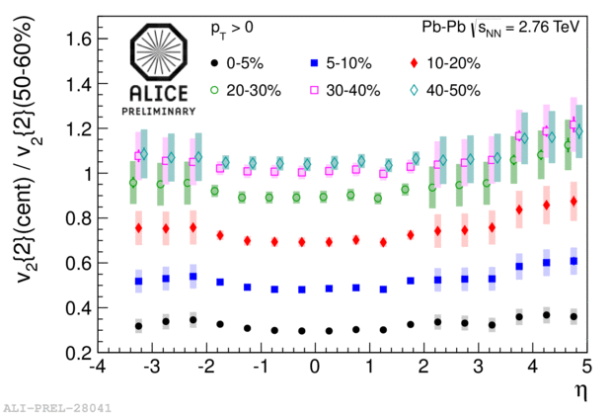
Flow centrality ratios
Shape of v₂{2} same for all centralities
Work of A. Hansen, NBI

Slide 26
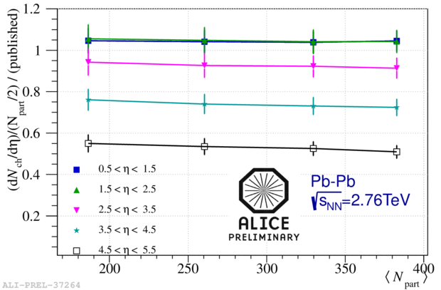
dN_{ch}/dη vs N_{part}
dN_{ch}/dη per participant pair increases vs centrality
Same trend exists for all measured η intervals
  Flat ratio to midrapidity result*
* ALICE Collaboration, Phys. Rev. Lett. 106 (2011) 032301

Slide 27
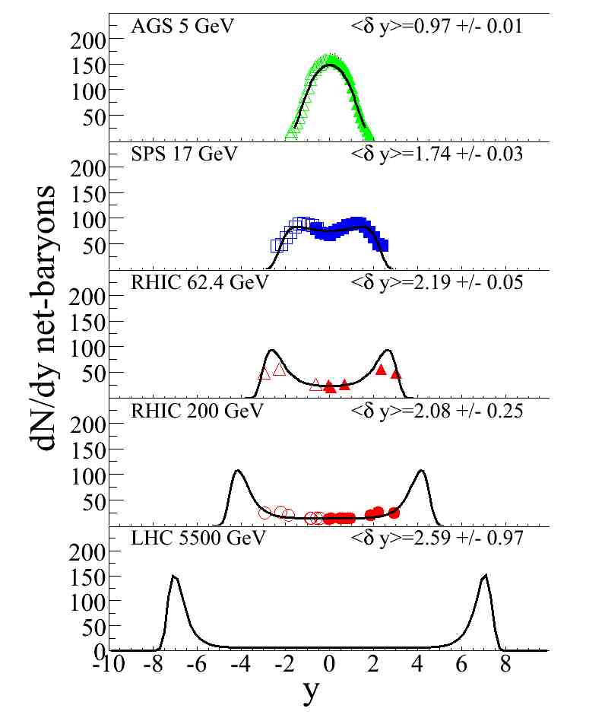
Systematics of Nuclear stopping from AGS to LHC
ybeam
AGS √s_{nn}=5 GeV
SPS √s_{nn}=17 GeV
RHIC √s_{nn}=62 GeV
RHIC √s_{nn}=200 GeV
LHC √s_{nn}=5500 GeV

Slide 28
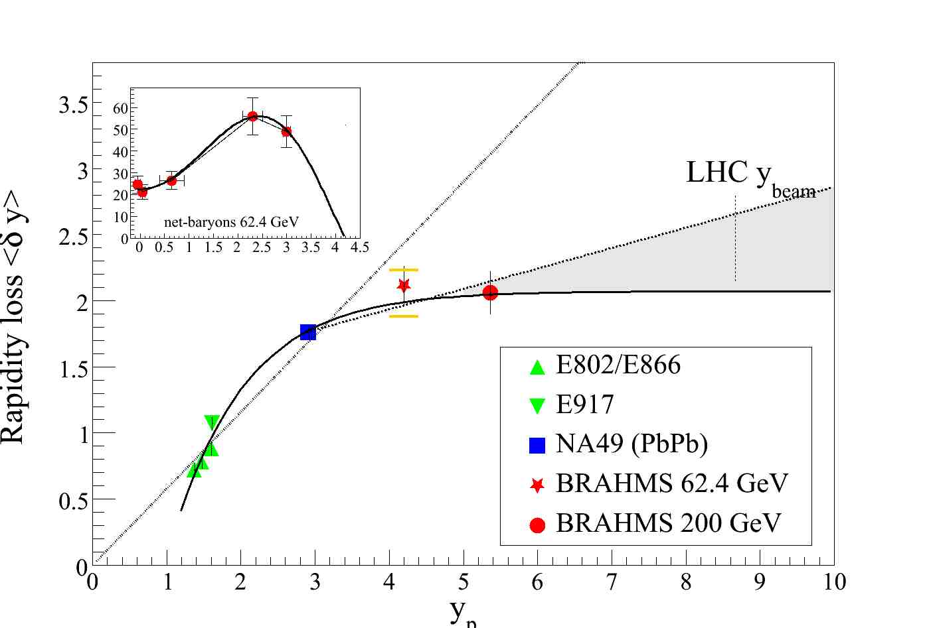
Rapidity loss systematics

Slide 29
BRAHMS@RHIC dN/dη from dN/dy
Good agreement between dN/dη from (measured) dN/dy and dN/dη (measured)
Good agreement between measured dN/dη between BRAHMS & PHOBOS

