Slide 1
1
INPC 2013
Florence
Hadron formation in
relativistic heavy ion collisions meets the QCD phase diagram
R. Stock, University of Frankfurt
together with F. Becattini, M. Bleicher, T. Kollegger, T. Schuster, J. Steinheimer

Slide 2
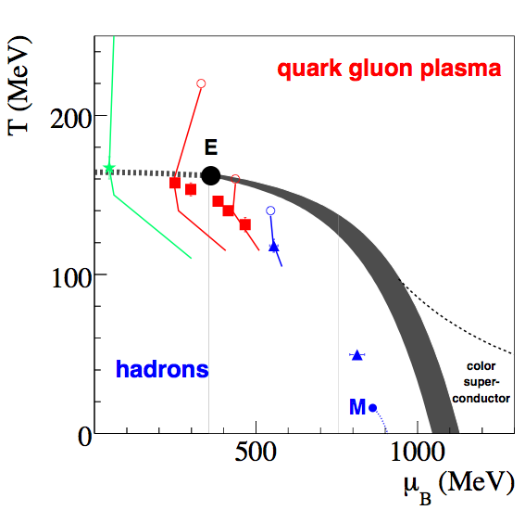

Slide 3
3

Slide 4
4
F. Becattini et al., Phys. Rev. C 85 (2012) 044921

Slide 5
5
F. Becattini et al., arXiv:1212.2431

Slide 6
6

Slide 7
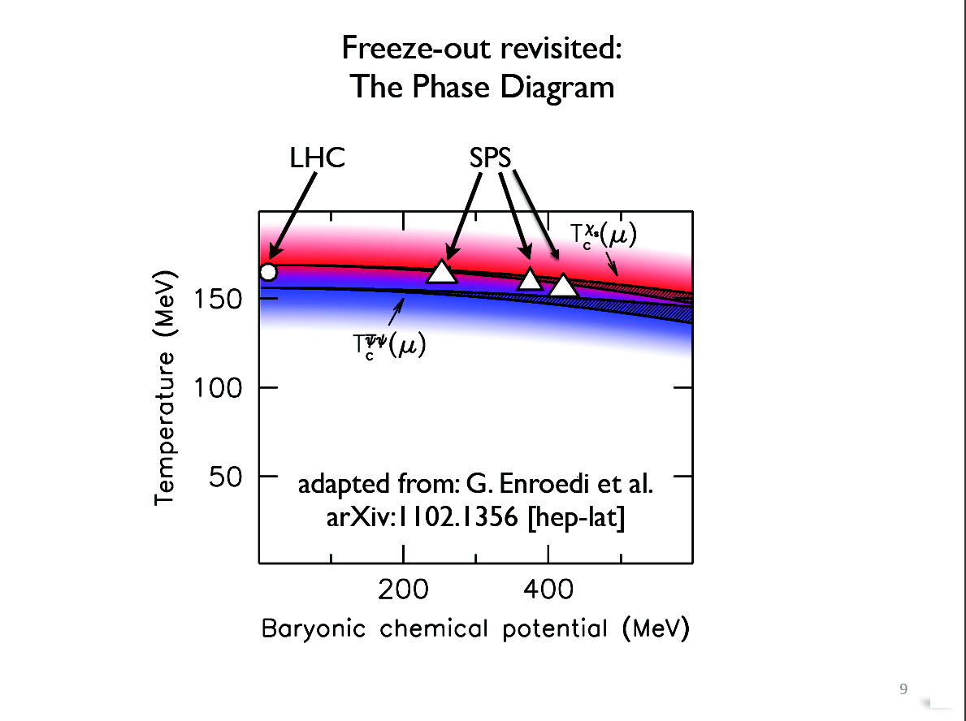
7
Hadronization meets the lattice QCD parton-hadron boundary!

