Slide 1


Di-electron measurements with the Hadron Blind Detector in the PHENIX experiment at RHIC
Ilia Ravinovich
for the PHENIX Collaboration
Weizmann Institute of Science
INPC, Firenze, Italy, June 2-7, 2013

Slide 2
Outline
Published PHENIX results
Hadron Blind Detector (HBD)
Preliminary results with the HBD
Recent progress on the analysis front
Summary

Slide 3
PHENIX dilepton program
PHENIX has measured the dielectron spectrum over a wide range of mass and transverse momentum
The program includes a variety of collision systems at 200 GeV:
  p+p, with and without HBD;
  d+Au without HBD;
  Cu+Cu without HBD;
  Au+Au, with and without HBD;

Slide 4
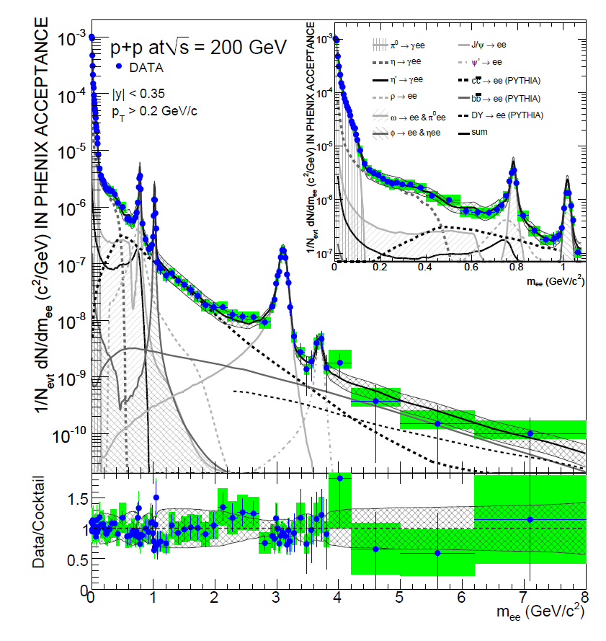
Dilepton continuum in p+p collisions
Phys. Lett. B 670, 313 (2009)
Data and cocktail of known sources represent pairs with
e⁺ and e⁻ in PHENIX acceptance
Data are efficiency corrected
Excellent agreement of data and hadron decay contributions
within systematic uncertainties
Notes:
4
4

Slide 5
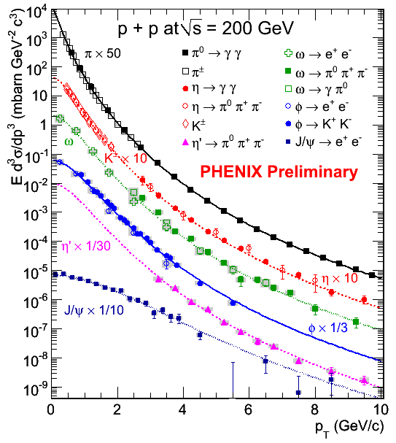
Estimate of expected sources, “Cocktail”
Hadron decays:
  Fit π⁰ and π± data p+p or Au+Au
  for other mesons η, ω, ρ, ϕ, J/Ψ etc use m_{T} scaling and fit normalization to existing data where available
Heavy flavor production:
  s_{c}= N_{coll} x 567±57±193 mb from single electron measurement
Hadron data follows “m_{T} scaling”
Predict cocktail of known pair sources

Slide 6
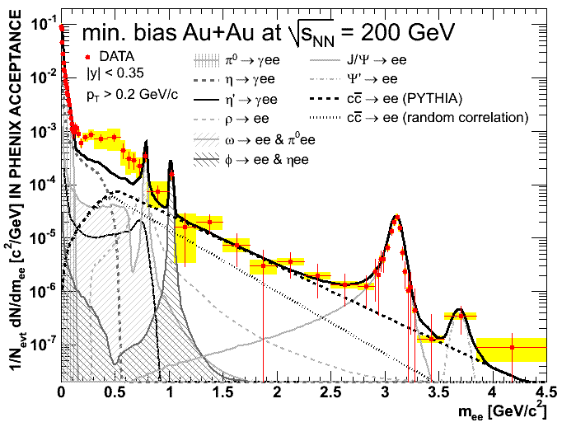
Au+Au dilepton continuum
PRC 81, 034911 (2010
Strong excess of dielectron pairs at low masses:
4.7 +/- 0.4 (stat) +/- 1.5 (syst) +/- 0.9 (model)
Notes:
6
6

Slide 7
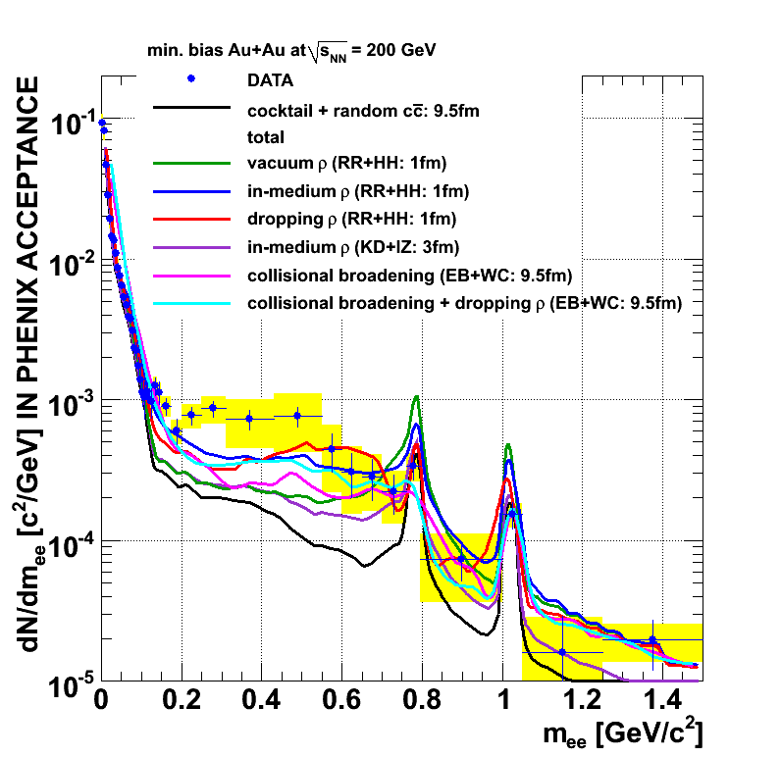
Comparison to theoretical models
All models and groups that successfully described the SPS data fail in describing the PHENIX results

Slide 8
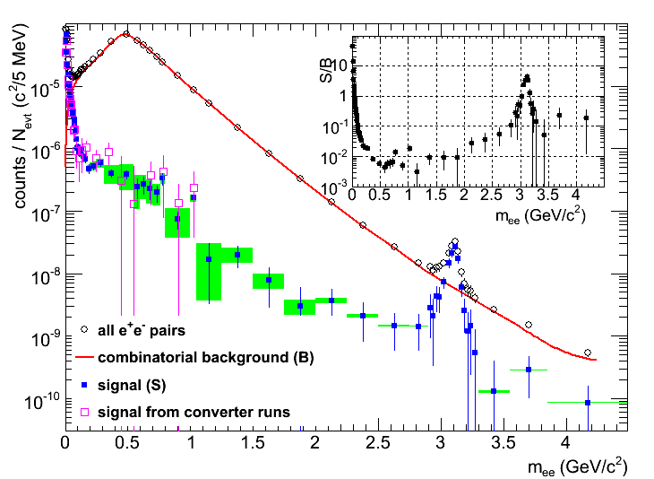
Motivation
The excess at masses 0.2-0.7 GeV/c² is
4.7 +/- 0.4 (stat) +/- 1.5 (syst) +/- 0.9 (model)
It is mainly concentrated in the central collisions.
But in this low mass range we have a very poor S/B ratio (~1/200), especially in the central collisions.
So, the results are limited by this large uncertainty due to the huge combinatorial background.
The goal of the HBD is to improve the signal significance!
Notes:
Dielectrons are an interesting probe of the the RHIC medium…

Slide 9
Key Challenge for PHENIX: Pair Background
No background rejection → Signal/Background ≥ 1/100 in Au-Au
Combinatorial background: e⁺ and e⁻ from different uncorrelated source
unphysical correlated background:
  track overlaps in detectors
Correlated background: e⁺ and e⁻ from same source but not “signal”
  “Cross” pairs “Jet” pairs
e⁻
γ
e⁺
π⁰
e⁺
π⁰
e⁺
X
π⁰
e⁻
e⁻
γ
γ

Slide 10
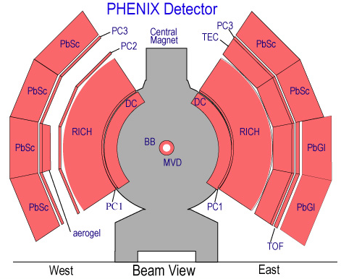
How can we spot the background?
Typically only 1 electron from a pair falls within the PHENIX acceptance:
  the magnetic field bends the pair in opposite directions.
  some spiral in the magnetic field and never reach tracking detectors.
To eliminate these problems:
  detect electrons in field-free region
  need >90% efficiency
~12 m

Slide 11

Separating signal from background
relativistic electrons
Mass spectrum from pion Dalitz decays peaked around 2m_{e}
pads
φ
π
Spectrum from photon conversion tightly peaked around 2m_{e}
Heavier meson decays have large opening angles
Opening angle can be used to cut out photon conversion and Dalitz decays
  must be able to distinguish single hits (“interesting” electrons) from double hits (Dalitz and photon conversion).

Slide 12
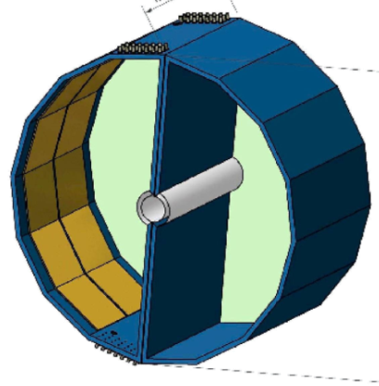
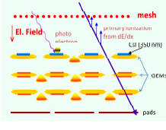
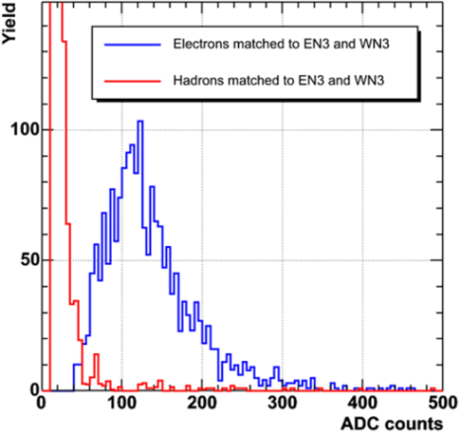
HBD design and performance
NIM A646, 35 (2011)
Single electron
Windowless CF₄ Cherenkov detector
GEM/CSI photo-cathode readout
Operated in B-field free region
Goal: improve S/B by rejecting conversions and π⁰ Dalitz decays
Successfully operated:
2009 p+p data
2010 Au+Au data
Hadron blindness
e-h separation
Figure of merit: N₀ = 322 cm⁻¹
20 p.e. for a single electron
Preliminary results:
S/B improvement of ~5 wrt previous results w/o HBD
Double electron

Slide 13
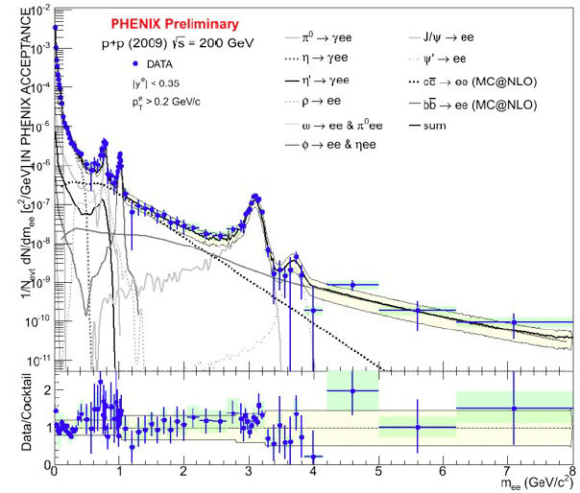
Run-9 p+p dileptons with the HBD
Factor of 5-10 improvement in S/B ratio
  this improvement is achieved using HBD only as an additional eID detector
  more should be possible by using a double rejection cut
Fully consistent with published result
Provide crucial proof of principle and testing ground for understanding the HBD

Slide 14
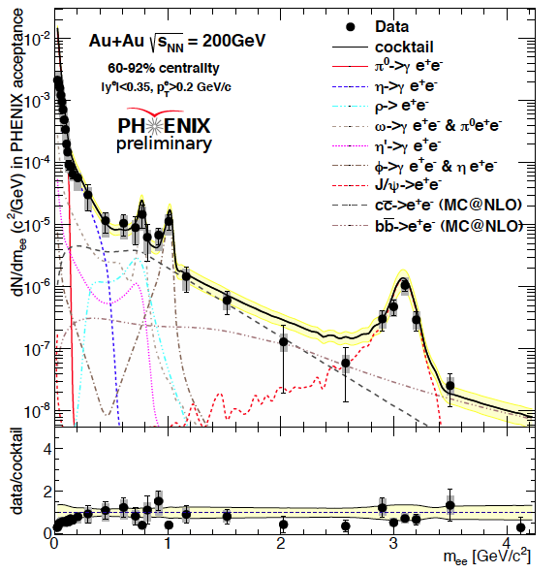
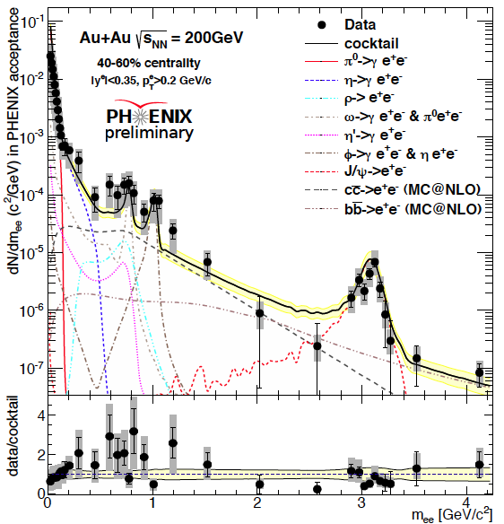
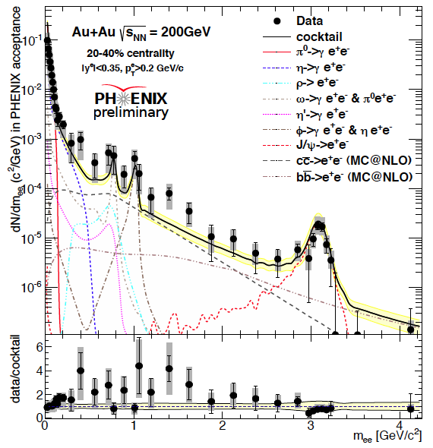
Run-10 Au+Au dileptons with the HBD
Peripheral
Semi-peripheral
Semi-central
+

Slide 15
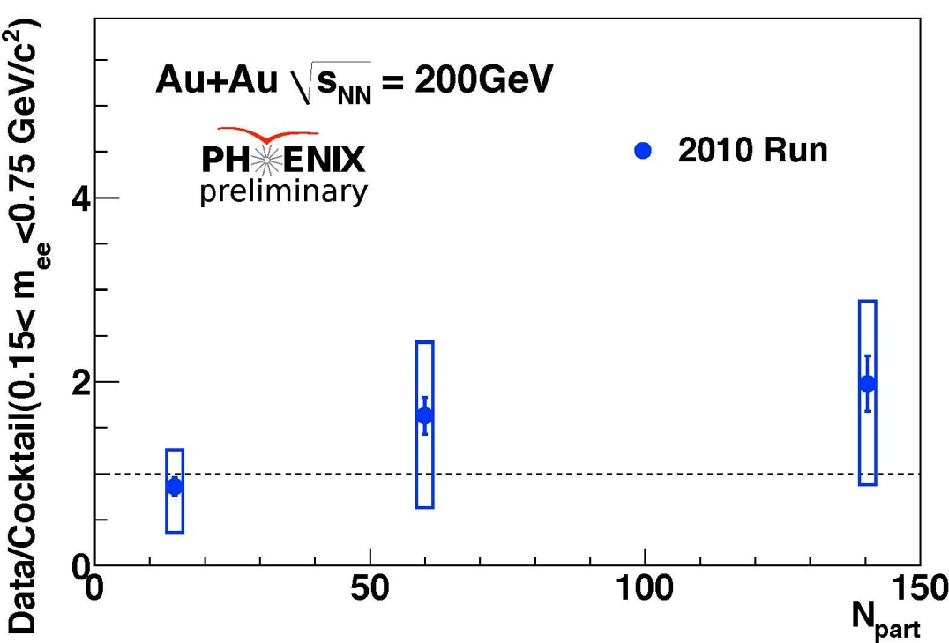
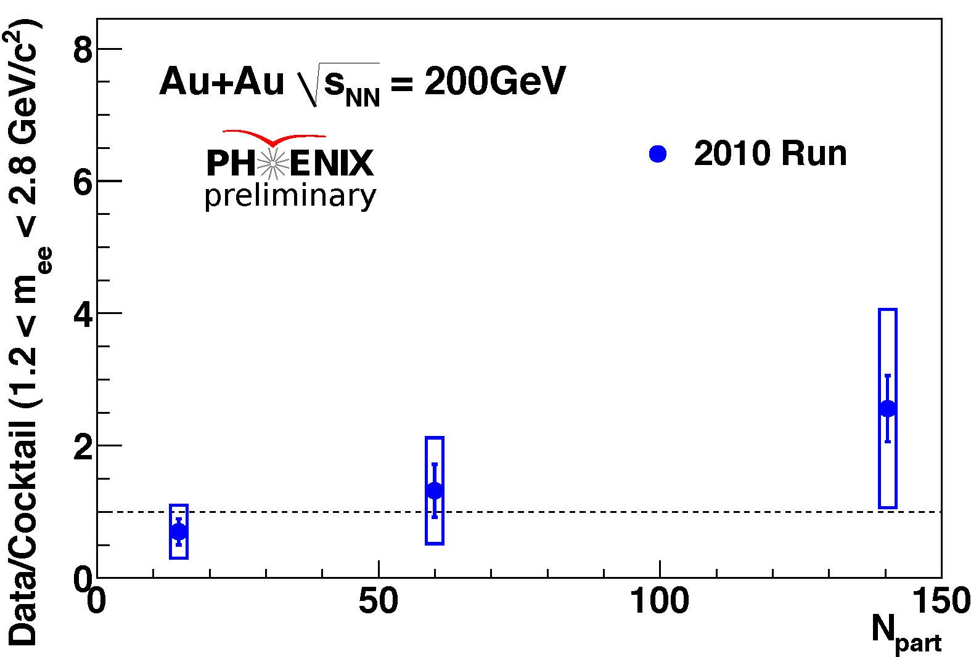
Run-10 data with HBD: data/cocktail
Hint of enhancement for more central collisions
Not conclusive given the present level of uncertainties
LMR (m = 0.15 – 0.75 GeV/c²)
IMR (m = 1.2 – 2.8 GeV/c²)
Similar conclusions for the IMR

Slide 16
Recent progress on the analysis front
Component-by-component background subtraction, namely:
Subtract combinatorial background using mixed event.
Subtract correlated cross pairs generated by MC.
Subtract correlated jet pairs using PYTHIA simulations.
Improved electron sample purity.
Increased statistics.

Slide 17
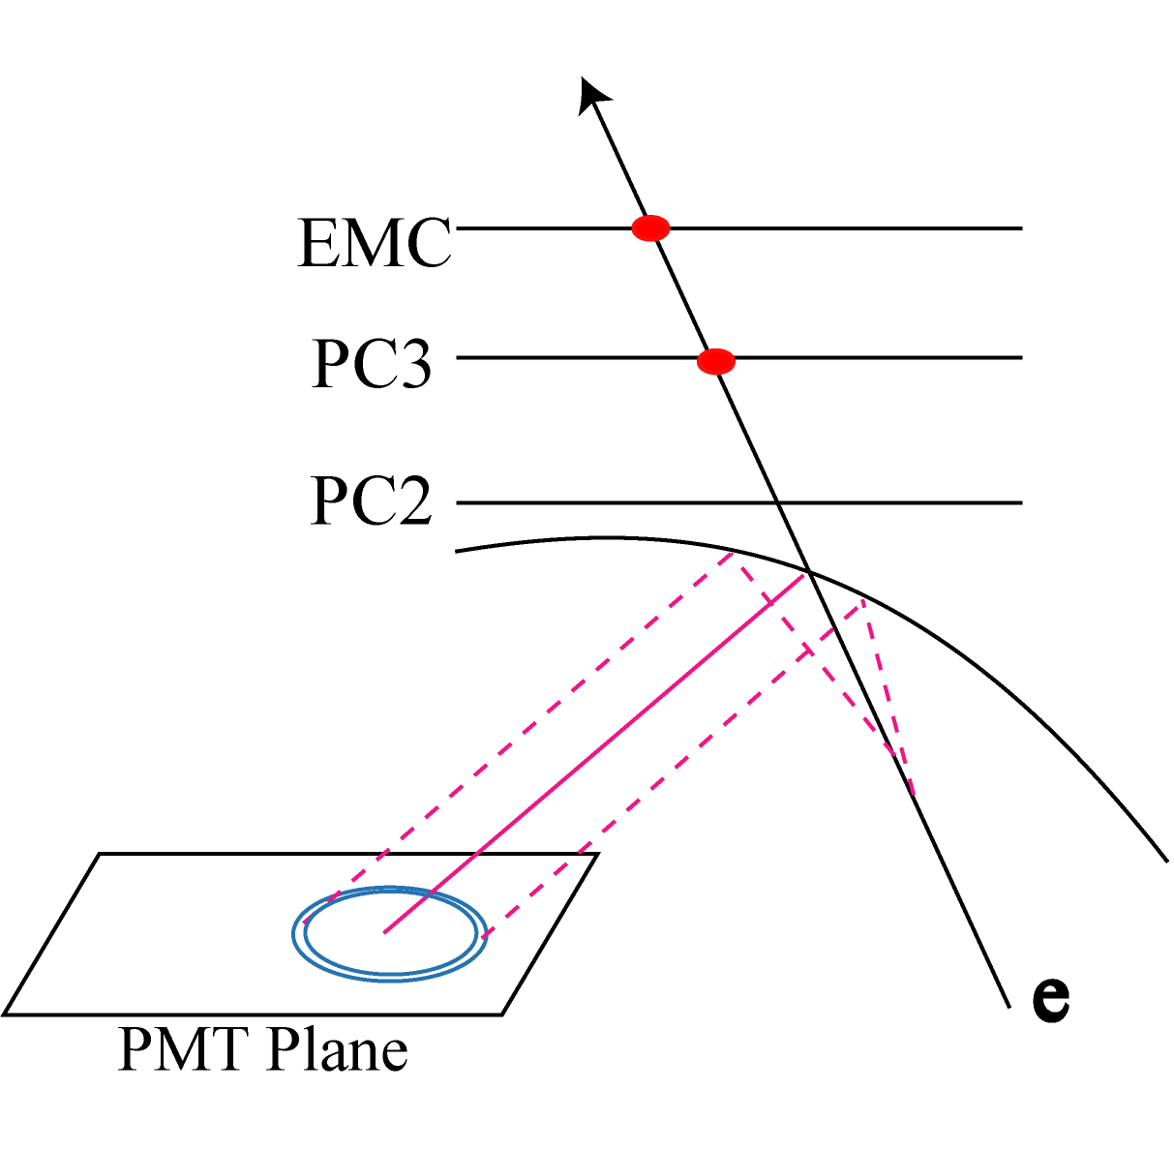
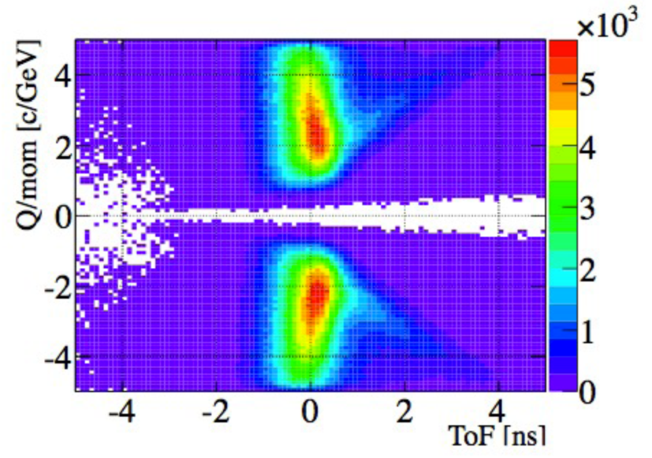
Improved electron sample purity
Improved RICH ring algorithm
  Issue: parallel track point to the same ring in RICH. Hadrons can leak in.
  New algorithm forbids a ring to be associated with multiple tracks →
  associate with electron-like tracks
Including ToF information
  PbSc σ=450 ps, ToF East σ=140 ps
π
MC shows:
electron sample purity > 90% can be achieved in the most central events

Slide 18
Summary
Preliminary results on dielectrons in p+p and Au+Au collisions at 200 GeV in three centrality bins with Hadron Blind Detector in PHENIX.
These results are consistent with previously published PHENIX results without HBD.
The next step is to complete the analysis with the recent newly developed tools which will allow us to release the results for the most central events.

Slide 19
Backup slides

Slide 20
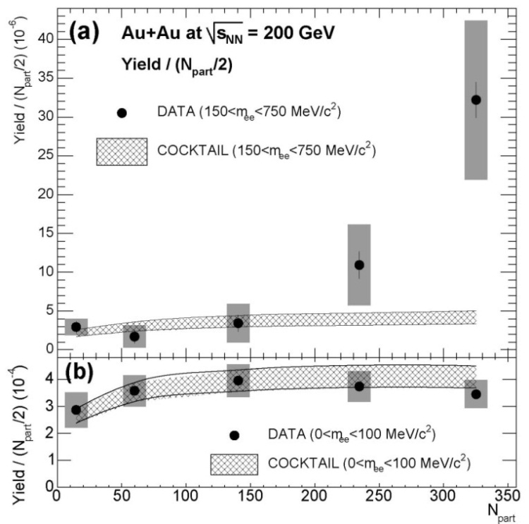
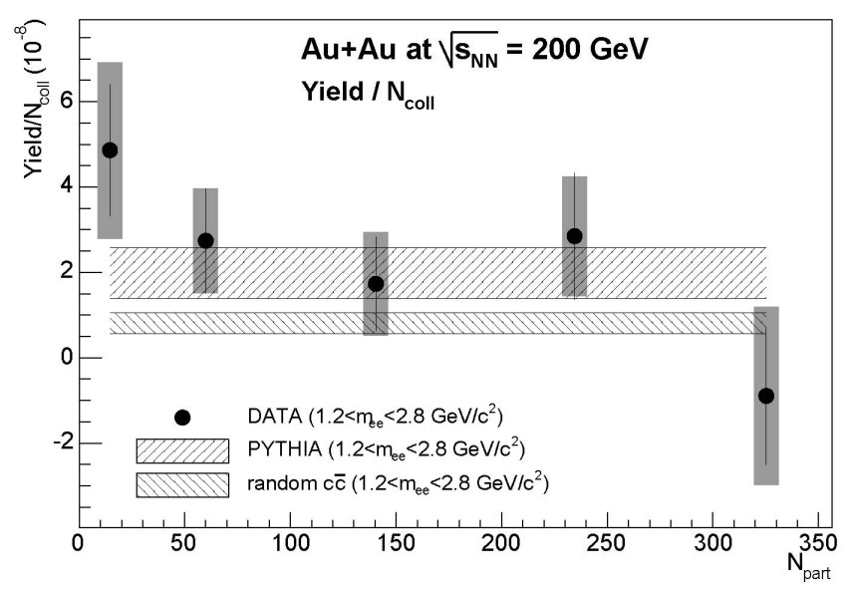
Centrality dependence of the enhancement
In the IMR the normalized yield shows no significant centrality dependence
In the LMR the integrated yield increases faster with the centrality of the collisions than the number of participating nucleons
Notes:
This I not exactly the published figure. The figure in the paper is not of good quality

Slide 21
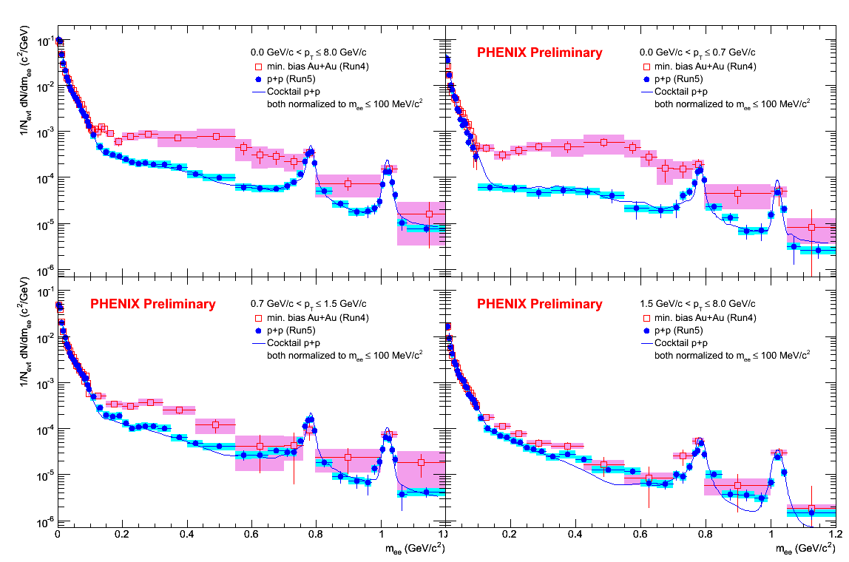
p_{T} dependence of low mass enhancement
Au+Au
p+p
0<p_{T}<8.0 GeV/c
0<p_{T}<0.7 GeV/c
0.7<p_{T}<1.5 GeV/c
1.5<p_{T}<8 GeV/c
Low mass excess in Au-Au concentrated at low p_{T}!
Notes:
21

Slide 22
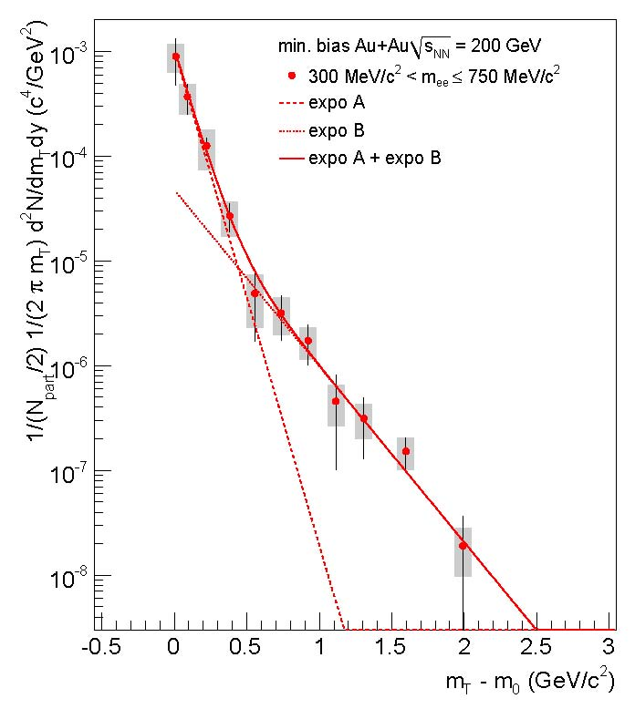
m_{T} distribution of low-mass excess
Excess present at all pair p_{T} but is more pronounced at low pair p_{T}
PHENIX
The excess m_{T} distribution exhibits two clear components
It can be described by the sum of two exponential distributions with inverse slope parameters:
T₁ = 92 ± 11.4^{stat} ± 8.4^{syst} MeV
T₂ = 258.3 ± 37.3^{stat} ± 9.6^{syst} MeV

Slide 23
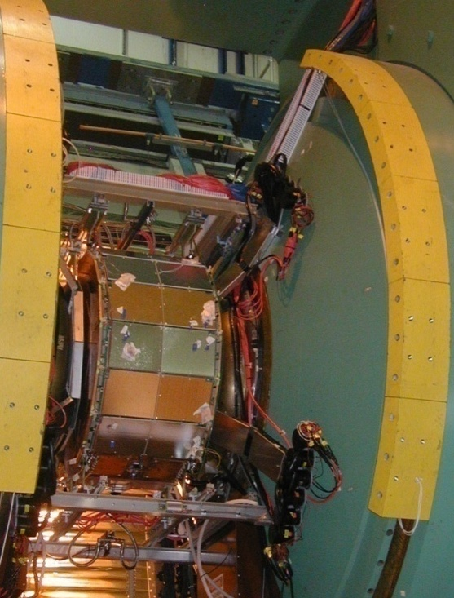
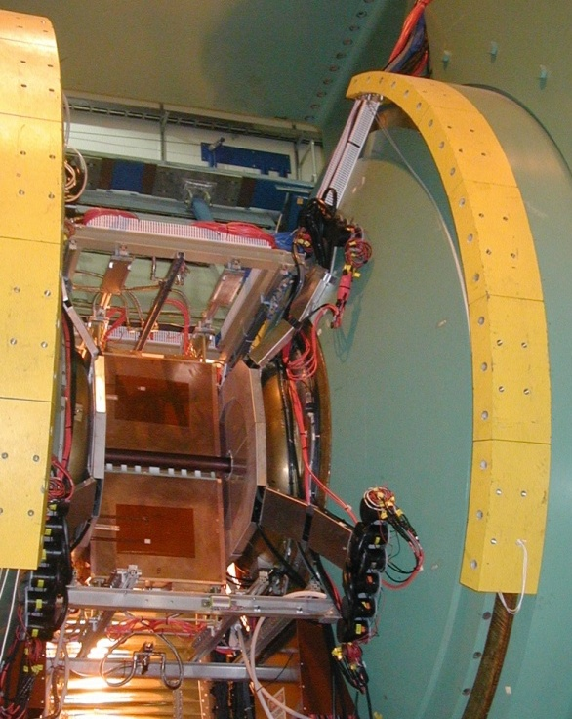
HBD installed in PHENIX IR
HBD West
HBD East

Slide 24
Analysis details of Au+Au with HBD
Strong run QA and strong fiducial cuts to homogenize response of the central arm detectors over time
  large price in statistics and pair efficiency
Two parallel and independent analysis streams: provide crucial consistency check
Stream A
HBD: underlying event subtraction using average charge per pad
Neural network for eid and for single/double electron separation
Correlated background (cross pairs and jets) subtracted using acceptance corrected like-sign spectra
Stream B
HBD: underlying event subtraction using average charge in track projection neighborhood
Standard 1d cuts for both eid and for single/double electron separation
Correlated background subtracted using MC for the cross pairs and jet pairs
Results shown here are from stream A

Slide 25
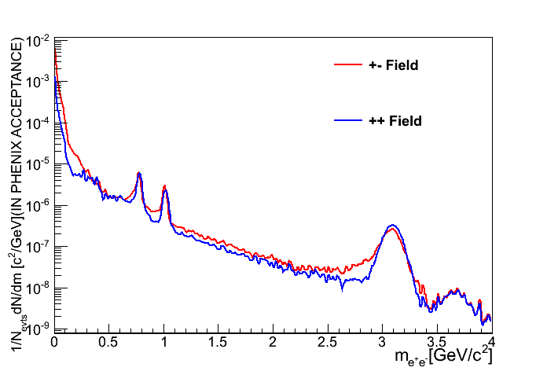
Differences in runs with and without HBD
Data:
Different magnetic field configuration:
  Run-9 (p+p) and Run-10 (Au+Au) with HBD:
+- field configuration
  all other runs:
  ++ field configuration
  larger acceptance of low p_{T} tracks in +- field
More material due to HBD:
  more J/Ψ radiative tail
We can compare results in three centrality bins: 20-40%, 40-60% and 60-92%
Cocktail:
MC@NLO for open heavy flavor (c,b) contribution instead of PYTHIA
MC@NLO(1.2-2.8) = PYTHIA(1.2-2.8) * 1.16

Slide 26
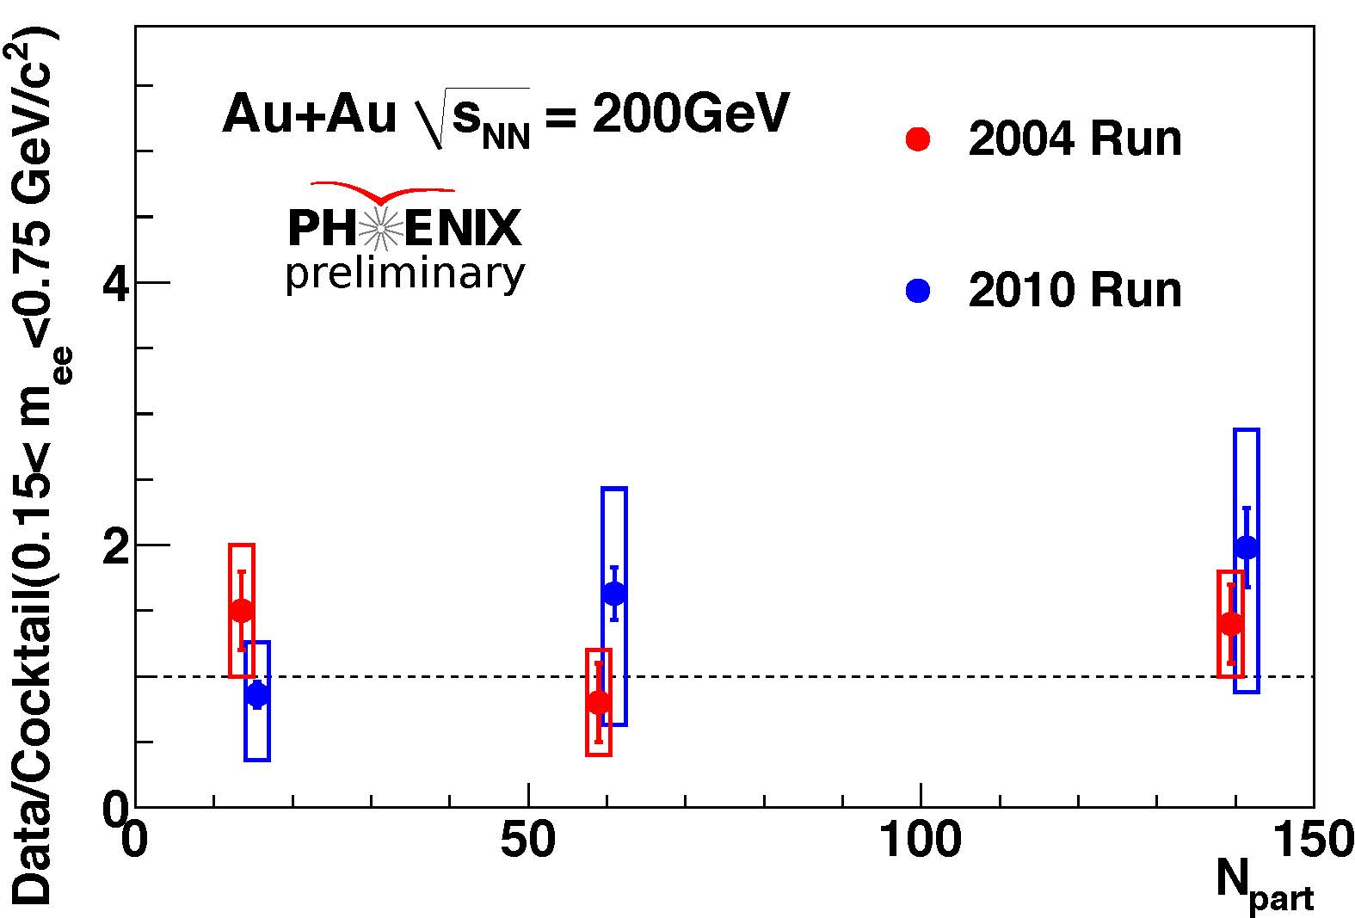
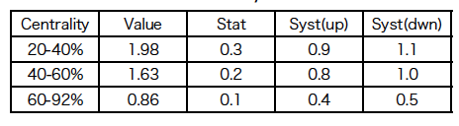
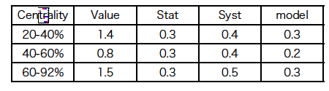
Comparison of run-10 to published run-4 results
LMR (m = 0.15 – 0.75 GeV/c²)
Run 10 – Data/ cocktail
Run 4 – Data/ cocktail
Phys Rev C81, 034911 (2010)
Consistent results

Slide 27
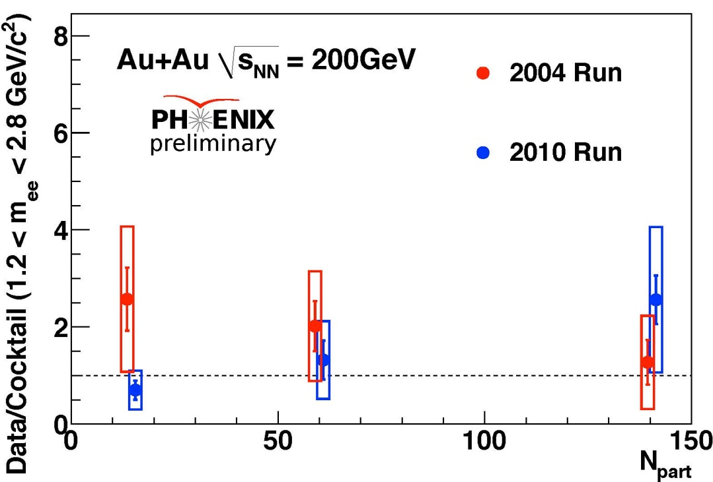
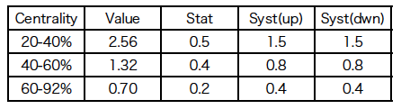
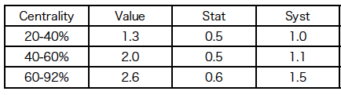
Comparison of run-10 to published run-4 results
IMR (m = 1.2 – 2.8 GeV/c²)
Run 10 – Data/ cocktail
Run 4 – Data/ cocktail
c,b yields based on MC@NLO
MC@NLO = PYTHIA * 1.16
Consistent results

Slide 28
Background subtraction (at QM2012)
p+p: all bckg = relative acceptance corrected like-sign pairs
Au+Au: combinatorial background (mixed events); correlated background (relative acceptance corrected like-sign pairs)
This method does not provide precision needed (~0.1%) for central Au+Au collisions
→ fluctuations due to dead areas, sector inefficiencies, statistics
→ apply component by component subtraction

Slide 29
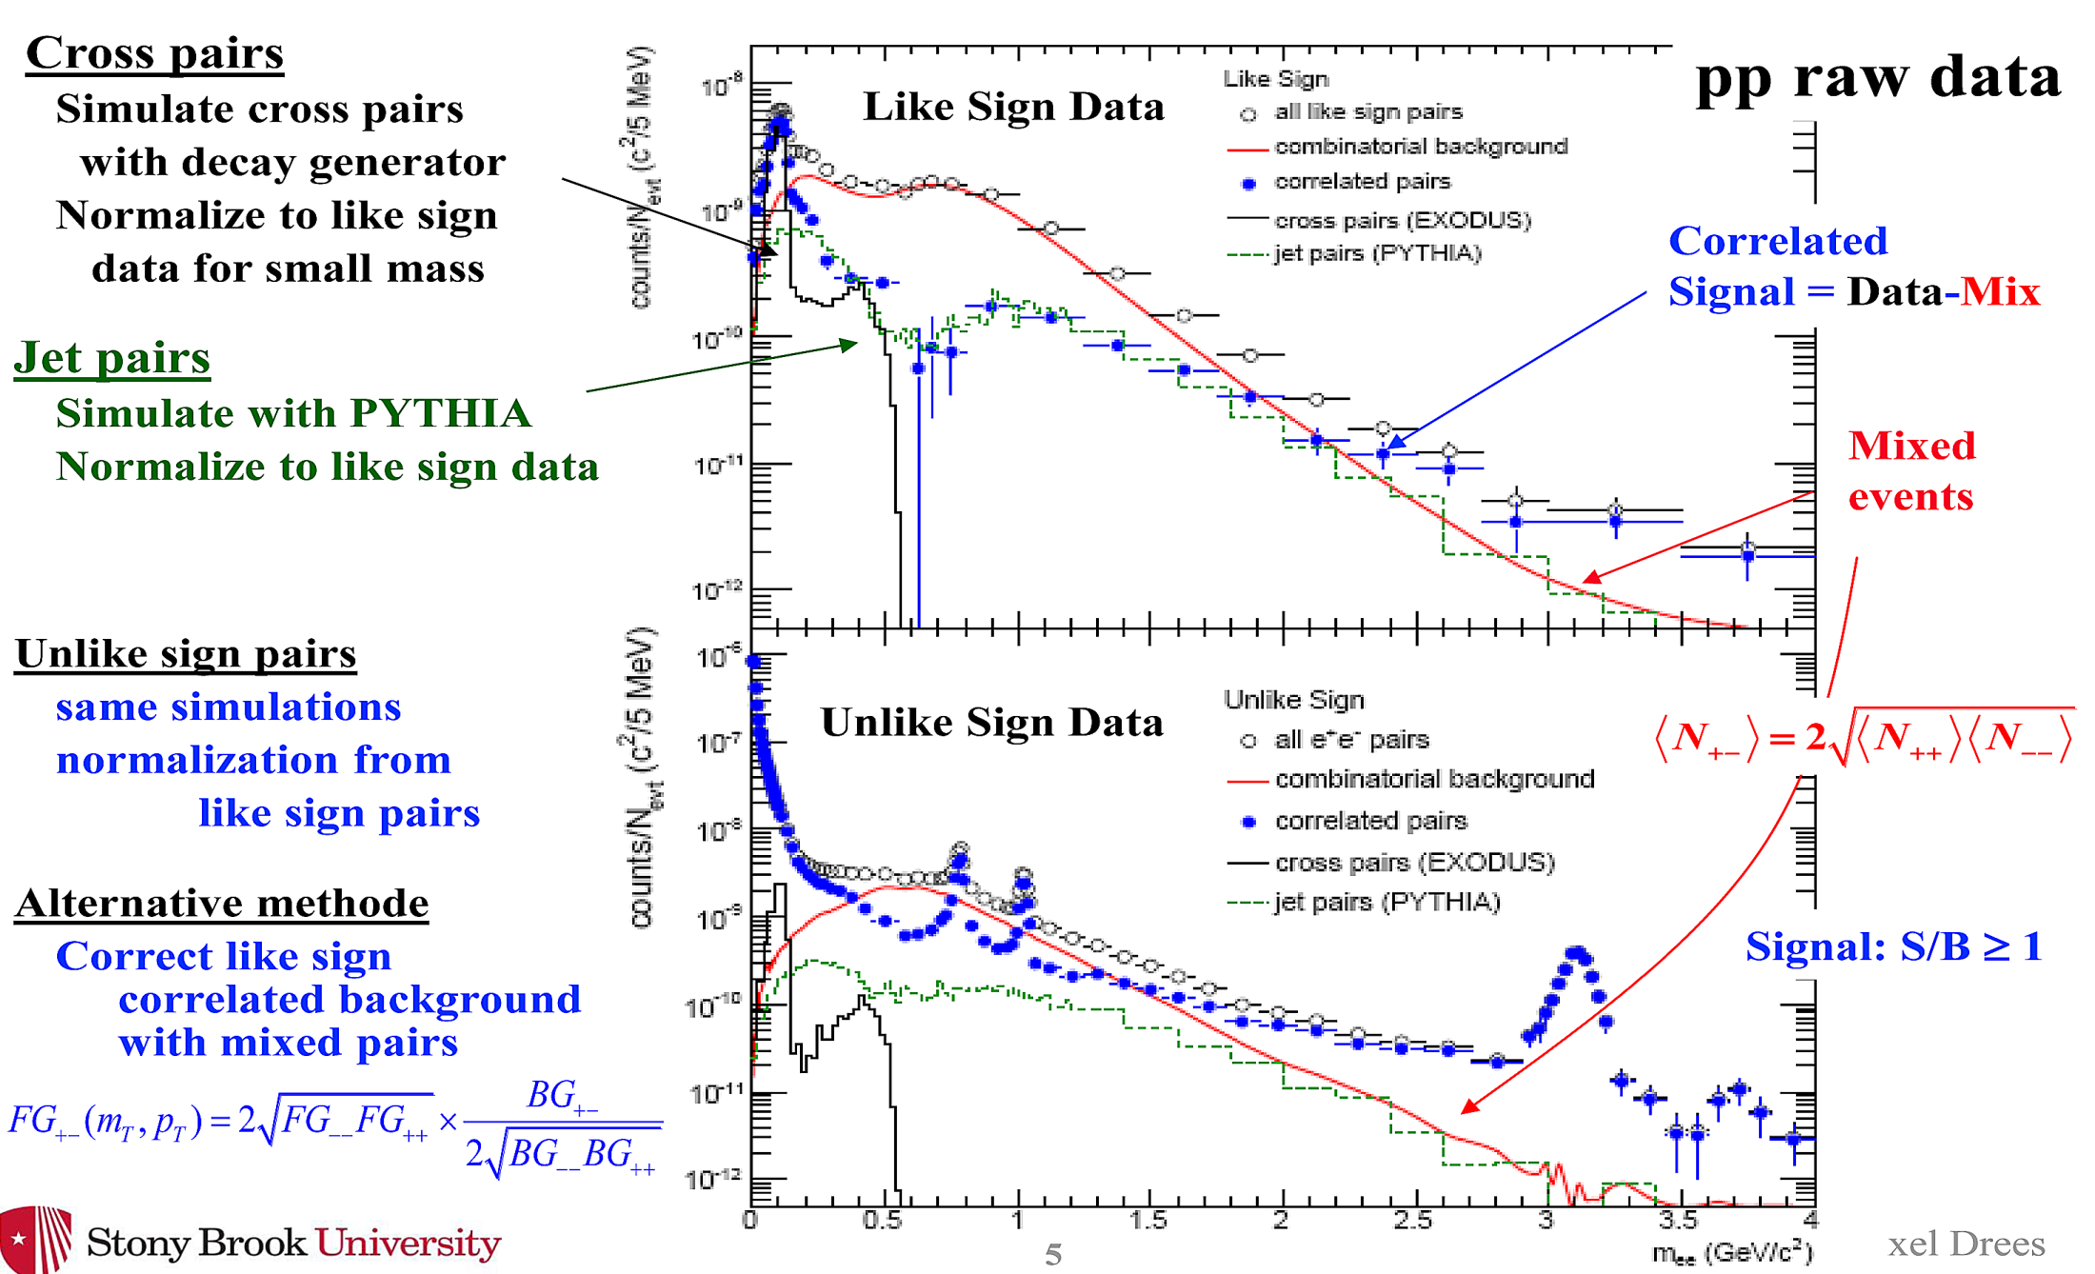
Component by component subtraction
Subtract:
Combinatorial background
(mixed event)
Cross-pairs
(EXODUS)
Jet pairs
(PYTHIA)

