Slide 1

Recent Results from Fluid Dynamics
Int. Nuclear Physics Conference,
Firenze, Italy, June 2-7, 2013
Laszlo P. Csernai,
University of Bergen, Norway

Slide 2
Global Dynamics versus Fluctuations

Slide 3
Central Collisions (A+A)
Global Symmetries
One symmetry axis: z-axis – given by the beam direction
  Azimuthal symmetry
  Longitudinal, +/- z symmetry ➔ rapidity – even
  Spherical or ellipsoidal flow, expansion
  Global v₁, v₂, v₃, … v_{n} = 0 !!
Fluctuations
Perfect conditions for fluctuation studies
  Azimuthal fluctuations - no interference - perfect, odd & even harmonics
  Longitudinal fluctuations - global rapidity-even flow interference
  ➔ (slight) dominance for rapidity-even fluctuations
  Best for critical fluctuation studies :

Slide 4
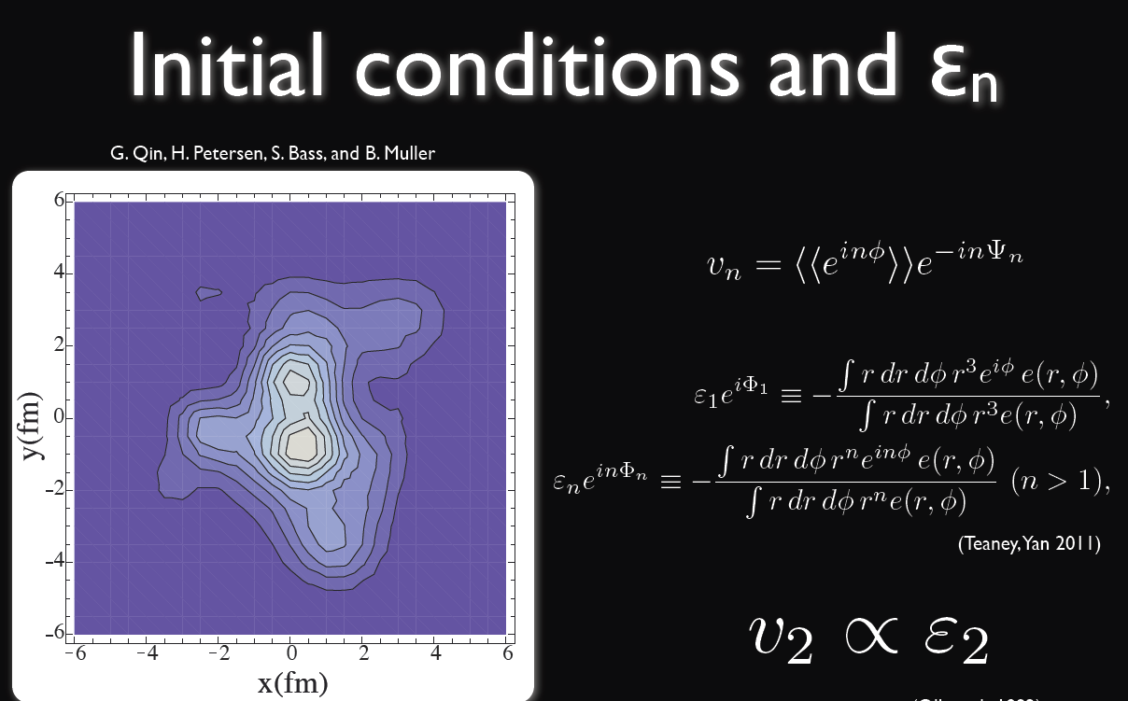
[R. Snellings, Guadeloupe (2013)]
[J.Kapusta, B. Mueller, (2012)] : Not only initial fluctuations but also critical fluctuations !!!

Slide 5
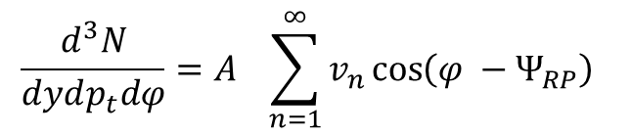


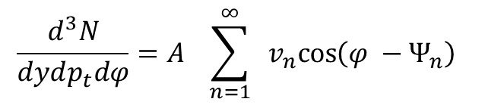


Global Dynamics (traditional):
and for odd n:
Fluctuations (recent):

Slide 6




Slide 7
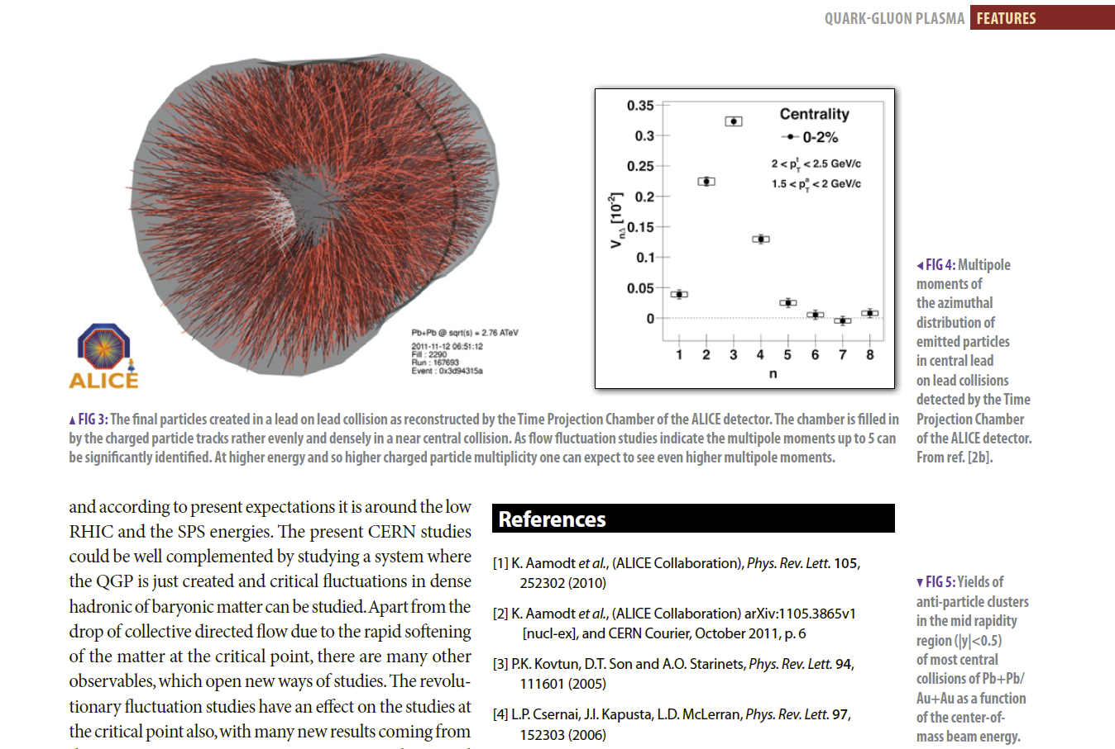
This is a direct proof of low viscosity !

Slide 8
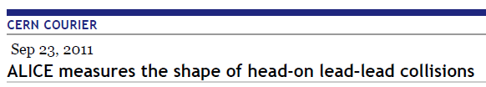
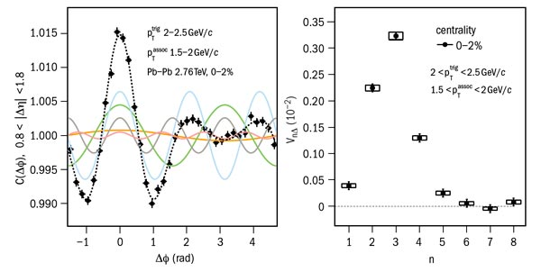
Oct. 2011, p. 6
Flow originating from initial state fluctuations is significant and dominant in
central and semi-central collisions (where from global symmetry no azimuthal
asymmetry could occur) !

Slide 9
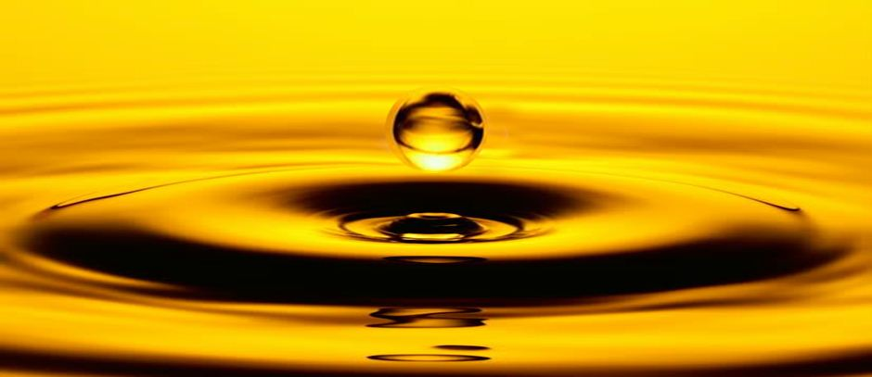

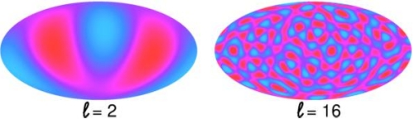
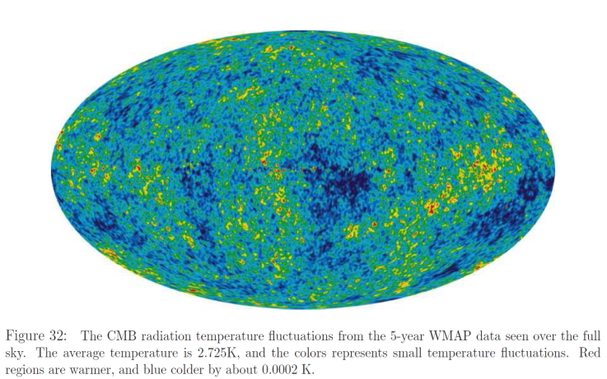
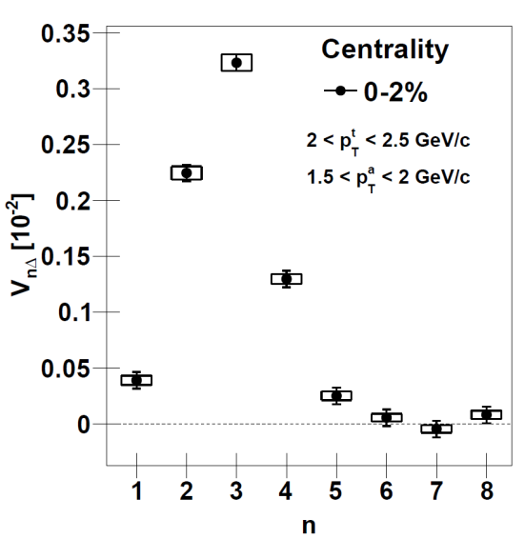
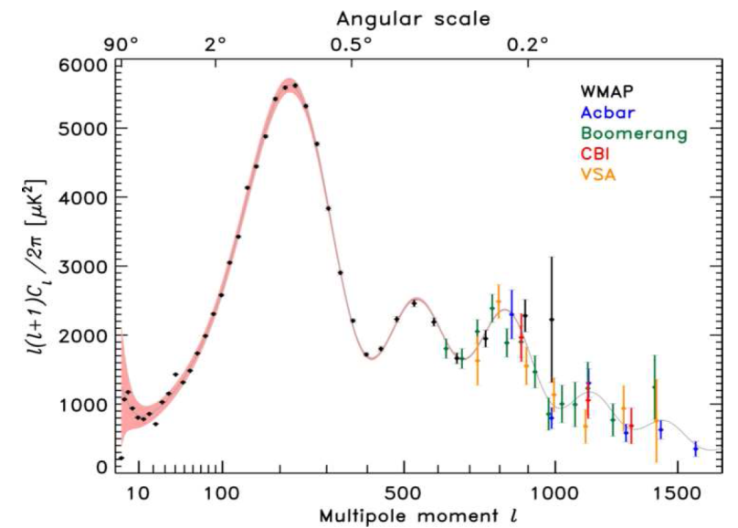
Low viscosity → Fluctuations
oil
water
Measurable azimuthal
fluctuations up to n=8
are evidence for low
viscosity

Slide 10
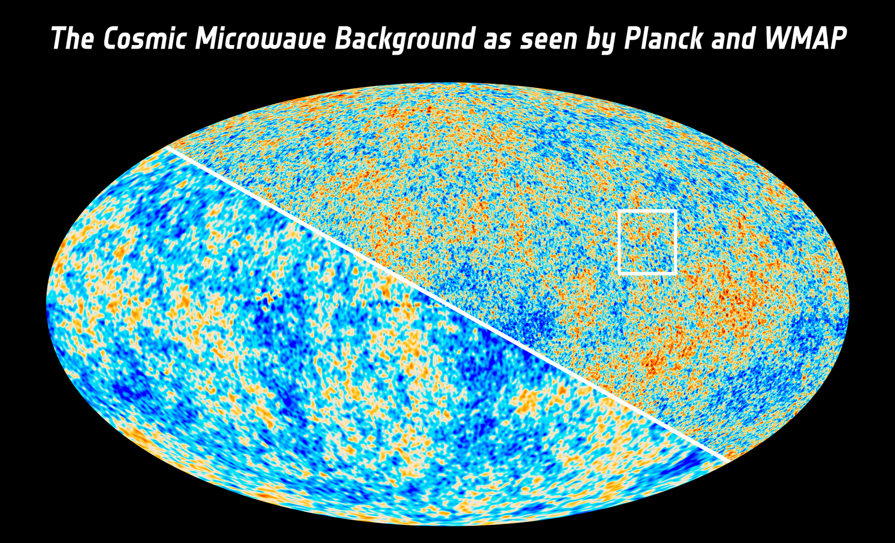
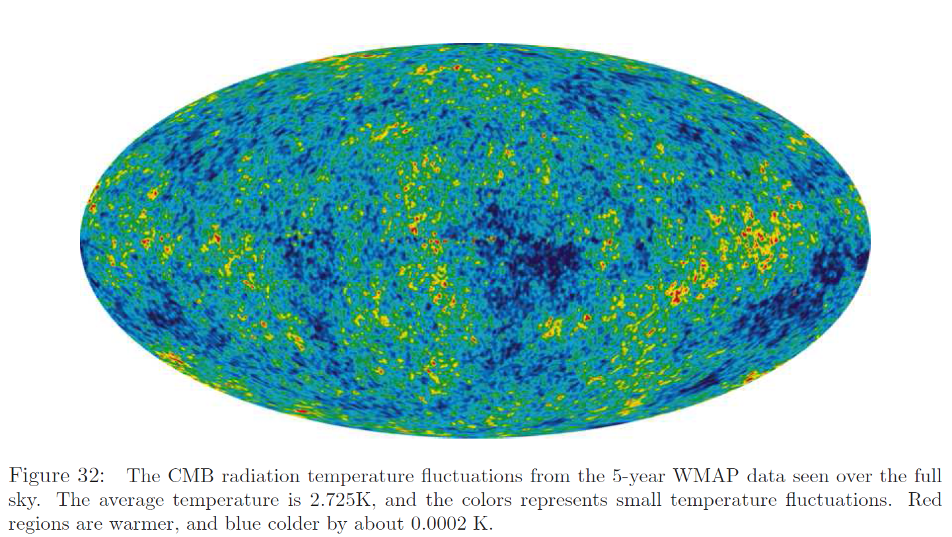
2013

Slide 11
~ spherical with many (16) nearly equal perturbations
~ like Elliptic flow, v₂

Slide 12
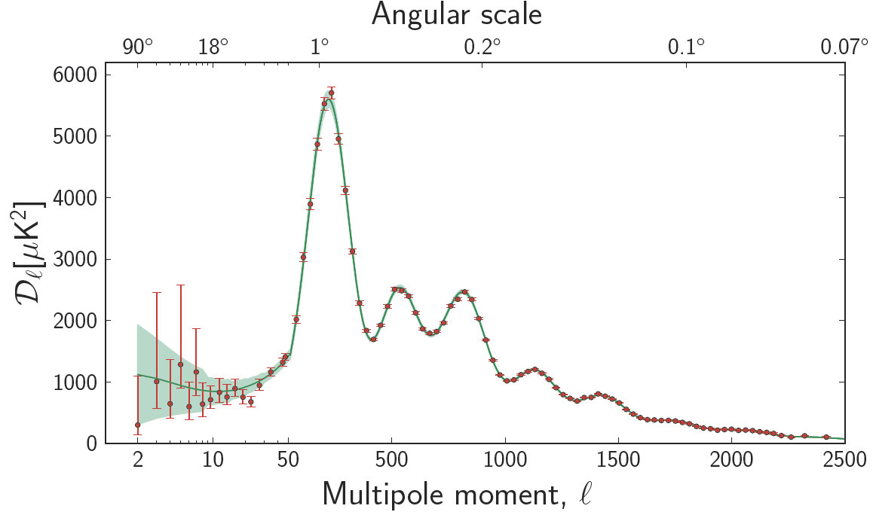

Planc CBM 2013
Longer tail on the negative ( low l ) side ! (see discussion of “Skewness” later)

Slide 13
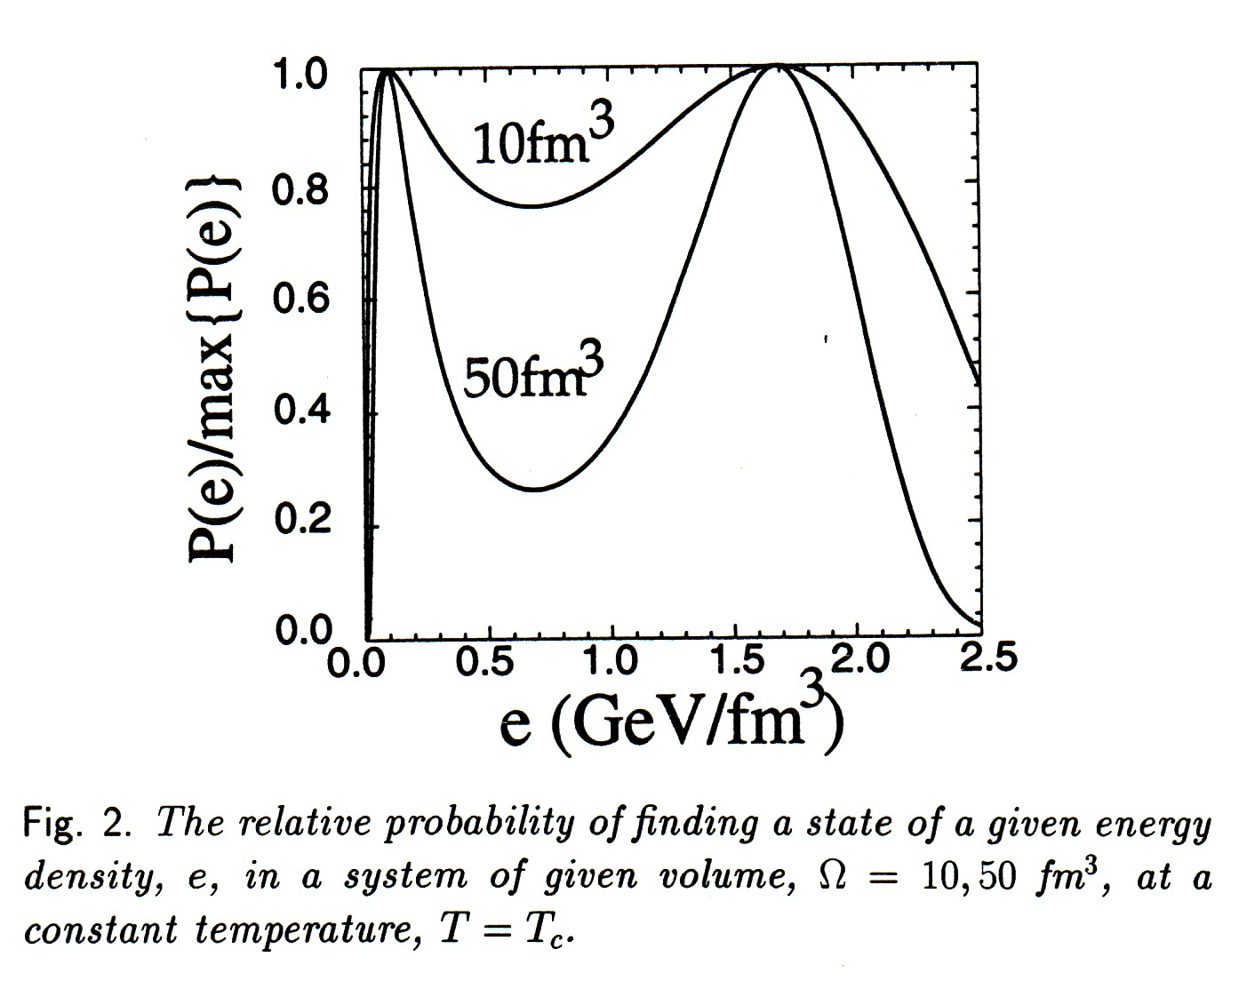

Slide 14
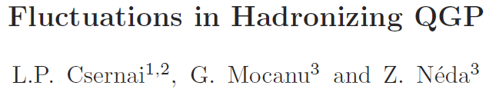
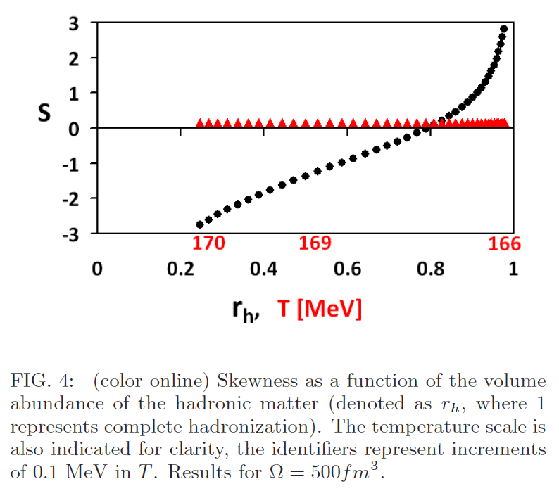
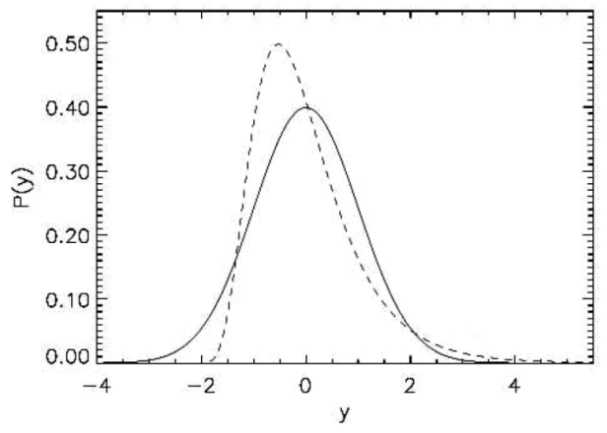
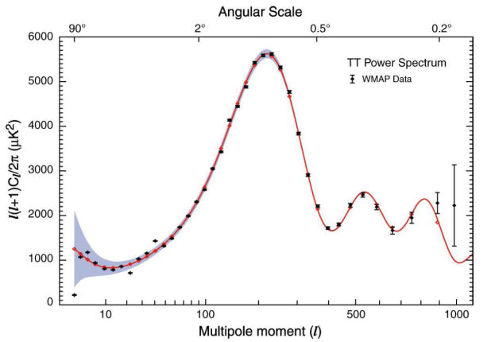
Skewness
Higher order moments can
be obtained from fluctuations
around the critical point. →
Skewness and Kurtosis are
calculated for the QGP → HM
phase transition
Positive Skewness
QGP
HM
Negative Skewness indicates Freeze-out
mainly still on the QGP side.

Slide 15
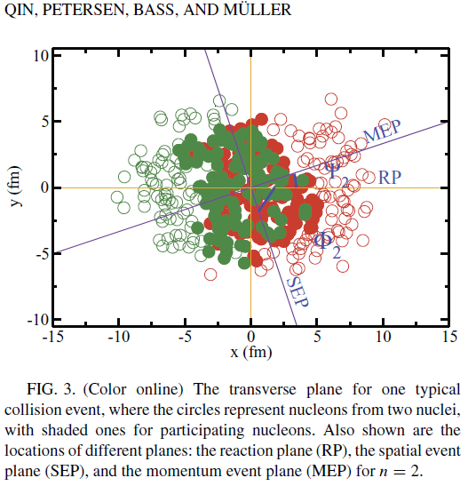
Fluctuations form initial states
[1] Gardim FG, Grassi F, Hama Y, Luzum M, Ollitraut
PHYSICAL REVIEW C 83, 064901 (2011); (v₁ also)
[2] Qin GY, Petersen H, Bass SA, Mueller B
PHYSICAL REVIEW C 82, 064903 (2010)
Cumulative event planes show weak correlation with the global collective reaction plane (RP).
If the MEP is set to zero (by definition) then CM rapidity fluctuations do not appear, and v₁ by definition is zero.
In [2] v1(pt) is analyzed (for RHIC) and the effect is dominated by fluctuations. (Similar to later LHC measurements.)

Slide 16
Flow is partonic @ the LHC
Scaling for partonic flow validated after
accounting for proton blue shift
Larger partonic flow at the LHC

Slide 17
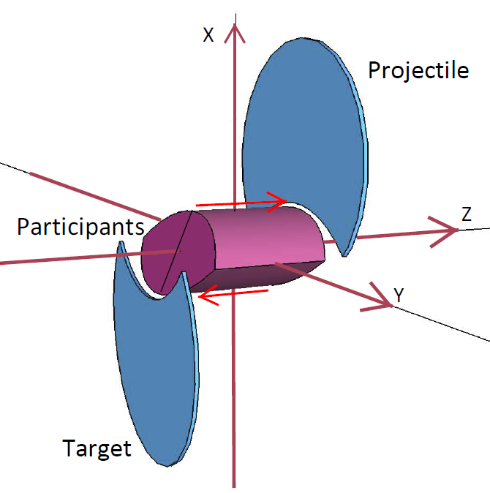
Peripheral Collisions (A+A)
Global Symmetries
Symmetry axes in the global CM-frame:
  ( y ←→ -y)
  ( x,z ←→ -x,-z)
  Azimuthal symmetry: φ-even (cos nφ)
  Longitudinal z-odd, (rap.-odd) for v__{odd}
  Spherical or ellipsoidal flow, expansion
Fluctuations
Global flow and Fluctuations are simultaneously present → Ǝ interference
  Azimuth - Global: even harmonics - Fluctuations : odd & even harmonics
  Longitudinal – Global: v1, v3 y-odd - Fluctuations : odd & even harmonics
  The separation of Global & Fluctuating flow is a must !! (not done yet)

Slide 18
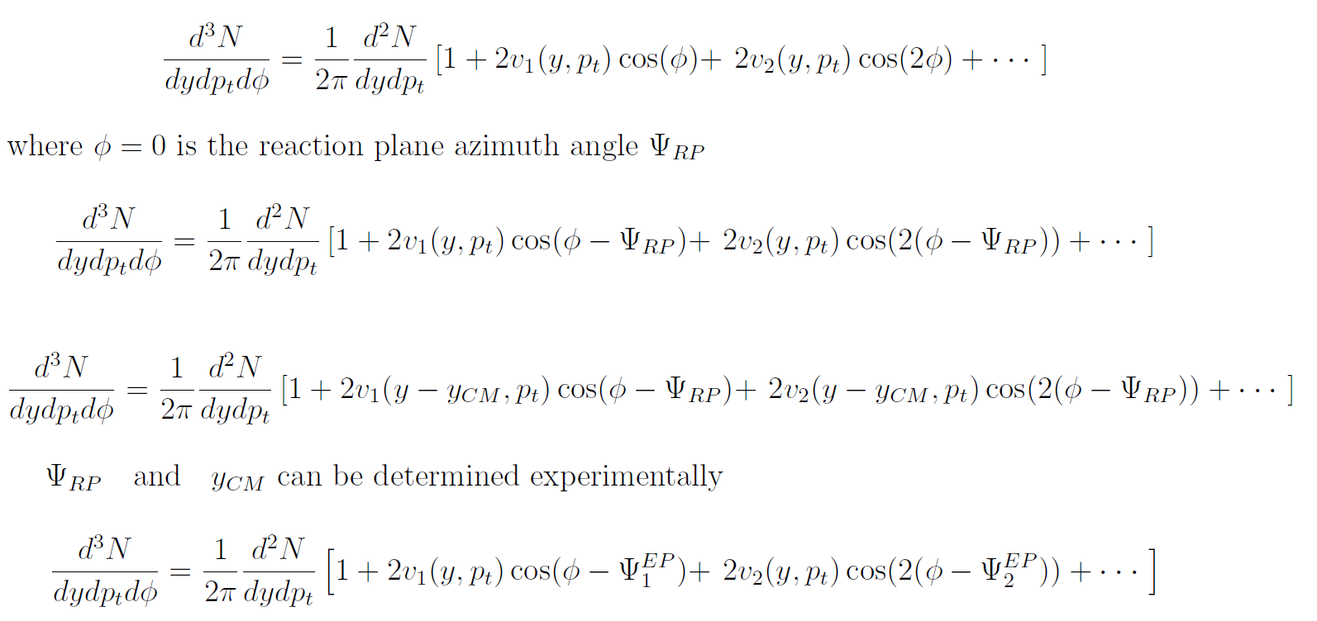


Analysis of Global Flow:
and Fluctuating Flow:

Slide 19
Global Flow in
Peripheral Collisions (A+A)
Many interesting phenomena:
  Historically: Bounce off / Side splash; Squeeze out → pressure & EoS
  3rd flow or Anti-flow (QGP), Rotation, KHI, Polarization, etc
  These occur only if viscosity is low! → viscosity
  With increasing energy flow becomes strongly F/B directed & v₁ decreases

Slide 20
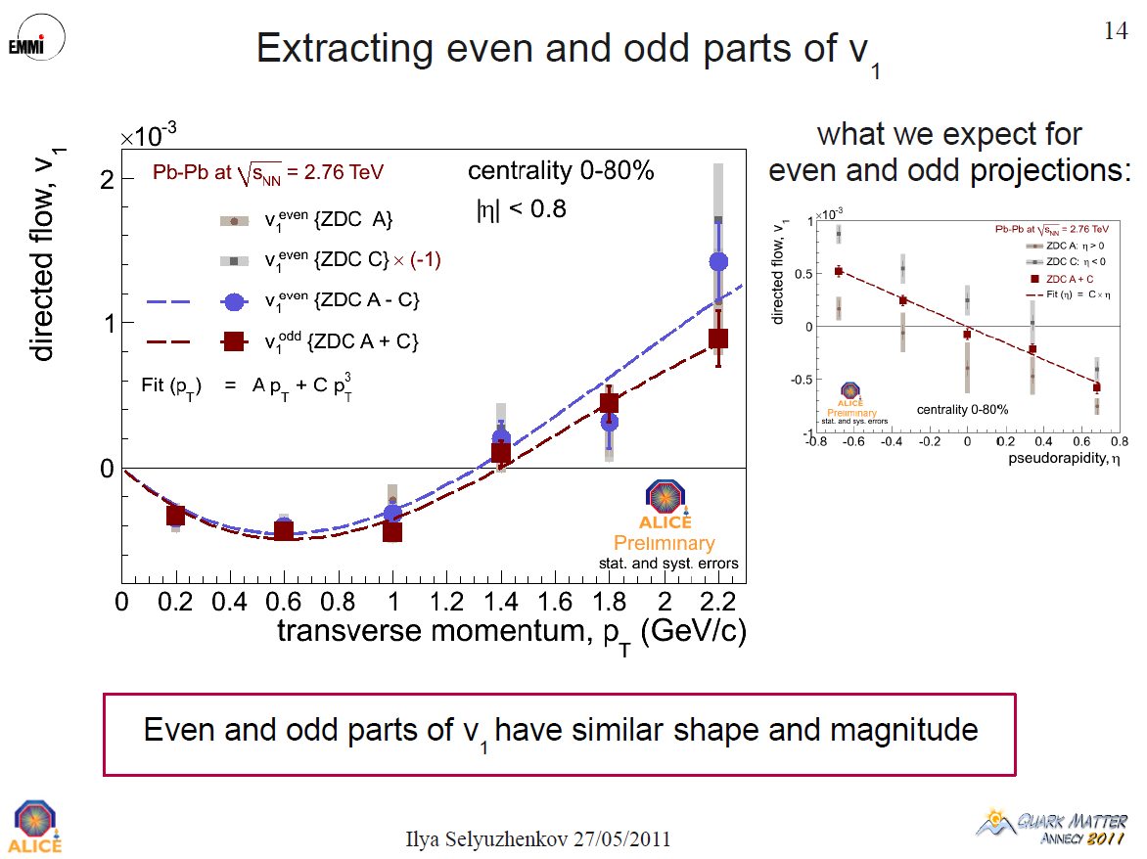
V₁ from Global Collective
flow ➔ v₁(p_{t}) = 0 !!!

Slide 21
Initial States

Slide 22
Collective flow
There are alternative origins:
(a) Global collective flow (RP from spectators)
(b) Asymmetries from random I.S. fluctuations
(c) Asymmetries from Critical Point fluctuations
Goal is to separate the these
➔ This provides more insight
How can we see the flow of QGP?
➔ Rapid hadronization and freeze-out

Slide 23
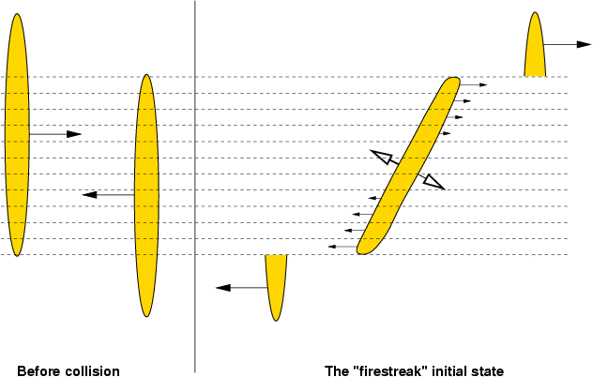
„Fire streak” picture – 3 dim.
Myers, Gosset, Kapusta, Westfall
Symmetry axis = z-axis. Transverse plane divided into streaks.

Slide 24
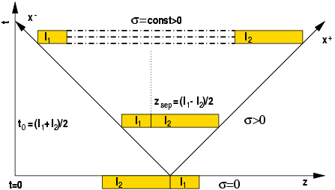
String rope --- Flux tube --- Coherent YM field

Slide 25
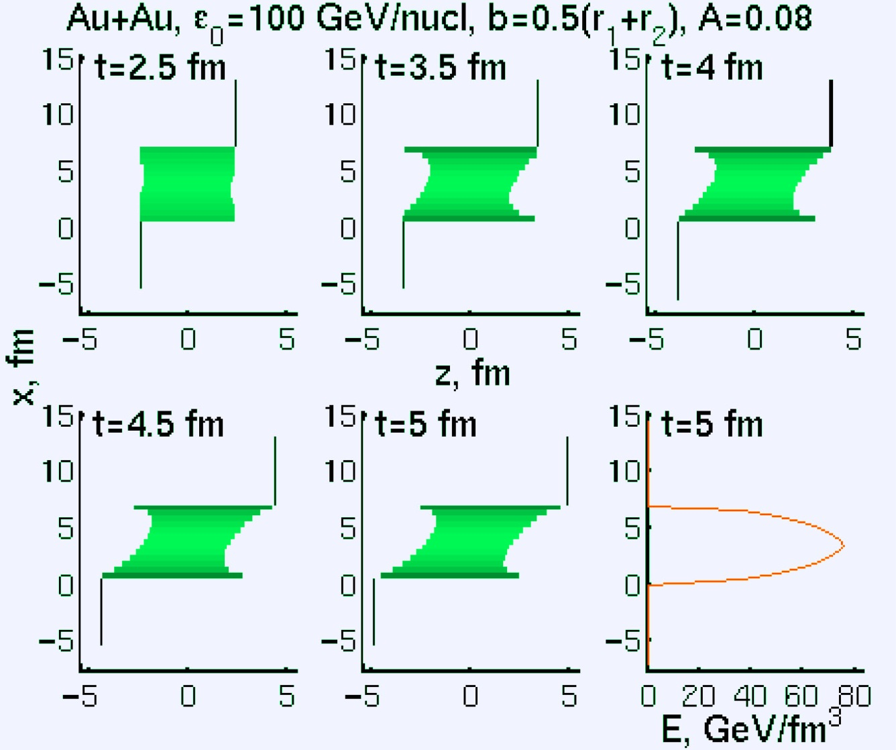
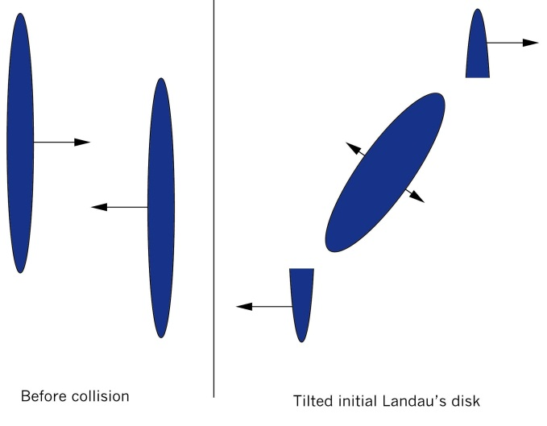
Initial
State
This shape is confirmed by STAR HBT: PLB496 (2000) 1; & M.Lisa &al. PLB 489 (2000) 287.
3rd flow component

Slide 26
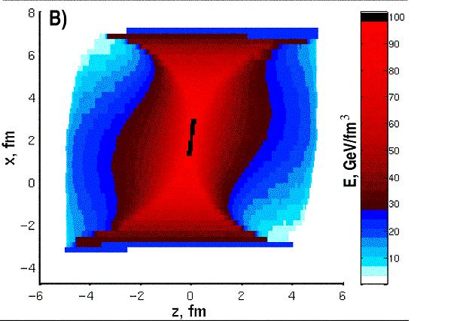
Initial state – reaching equilibrium
Initial state by V. Magas, L.P. Csernai and D. Strottman
Phys. Rev. C64 (01) 014901;
Nucl. Phy. A 712 (02) 167.
Relativistic, 1D Riemann expansion is added to each stopped streak

Slide 27
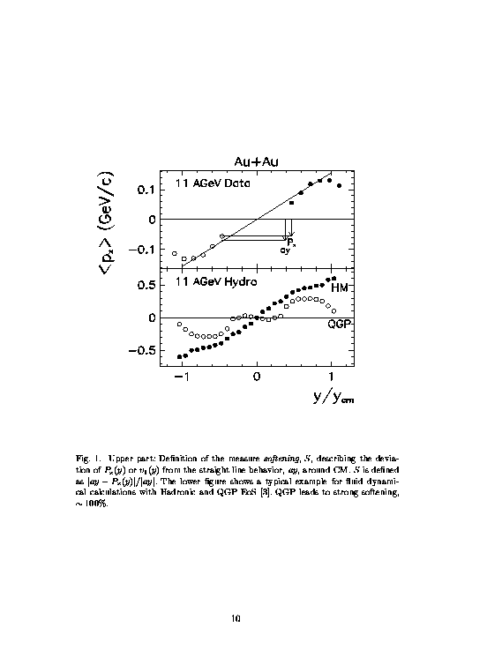
3rd flow component
Hydro
[Csernai, HIPAGS’93] & [Csernai, Röhrich, 1999]

Slide 28
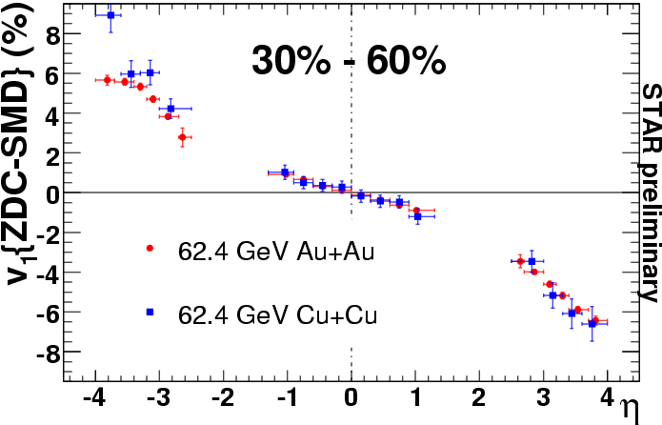
v₁(η): system-size dependence
G. Wang / STAR
QM 2006 :
System size doesn’t seem to influence v₁(η).

Slide 29
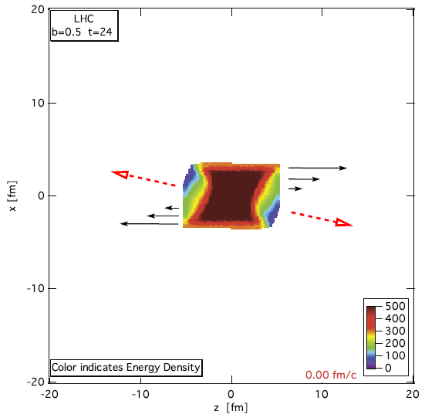
Anti-flow (v1) at LHC
Initial energy density [GeV/fm3] distribution in the reaction plane, [x,y] for a Pb+Pb reaction at 1.38 + 1.38 ATeV collision energy and impact parameter b = 0.5_bmax at time 4 fm/c after the first touch of the colliding nuclei, this is when the hydro stage begins. The calculations are performed according to the effective string rope model. This tilted initial state has a flow velocity distribution, qualitatively shown by the arrows. The dashed arrows indicate the direction of the largest pressure gradient at this given moment.

Slide 30
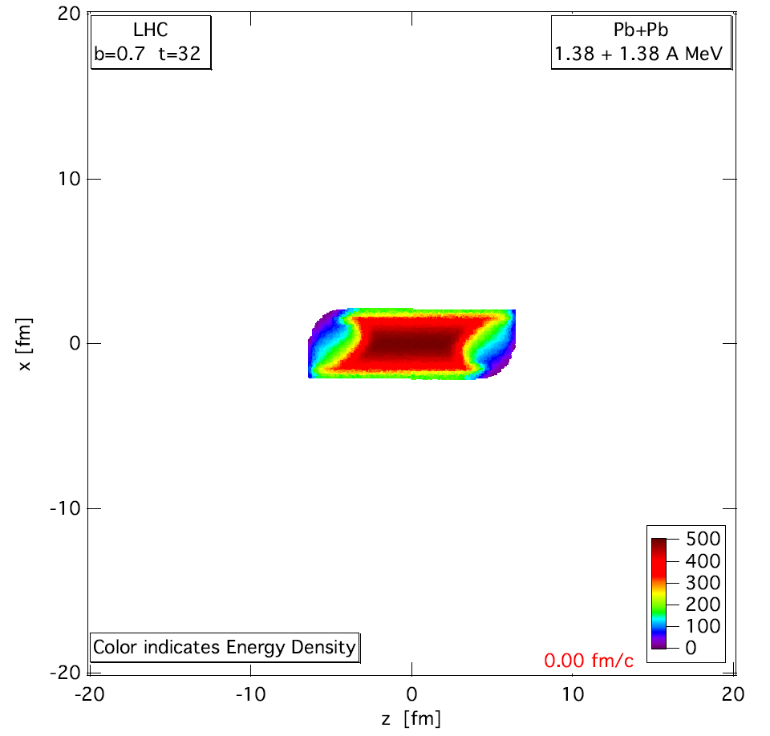


PIC-
hydro
A TeV
ATeV
Pb+Pb 1.38+1.38 A TeV, b= 70 % of b_max
Lagrangian fluid cells, moving, ~ 5 mill.
MIT Bag m. EoS
FO at T ~ 200 MeV, but calculated much longer, until pressure is zero for 90% of the cells.
Structure and asymmetries of init. state are maintained in nearly perfect expansion.
..\zz-Movies\LHC-Ec-1h-b7-A.mov

Slide 31
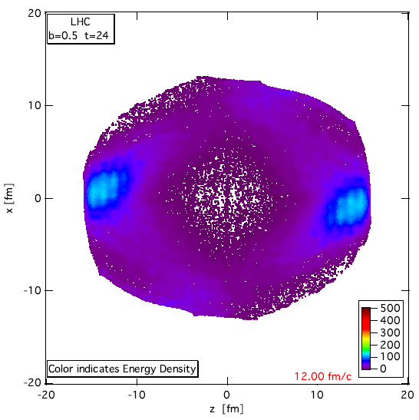
Anti-flow (v1)
The energy density [GeV/fm3] distribution in the reaction plane, [x,z] for a Pb+Pb reaction at 1.38 + 1.38 A.TeV collision energy and impact parameter b = 0.5b_max at time 12 fm/c after the formation of the hydro initial state. The expected physical FO point is earlier but this post FO configuration illustrates the flow pattern.
[ LP. Csernai, V.K. Magas,
H. Stöcker, D. Strottman,
Phys. Rev. C84 (2011) 02914 ]

Slide 32
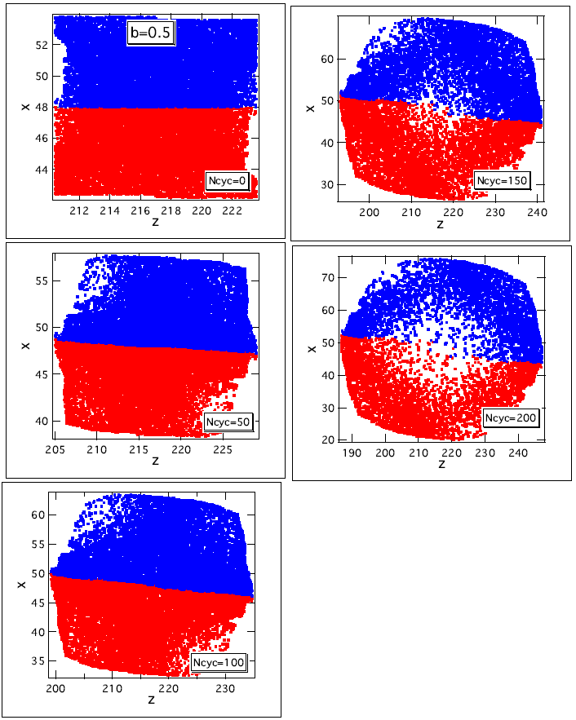
Rotation
F.O.
The rotation is illustrated by dividing the upper / lower part (blue/red) of the initial state, and following the trajectories of the marker particles.
Turbulence ?

Slide 33
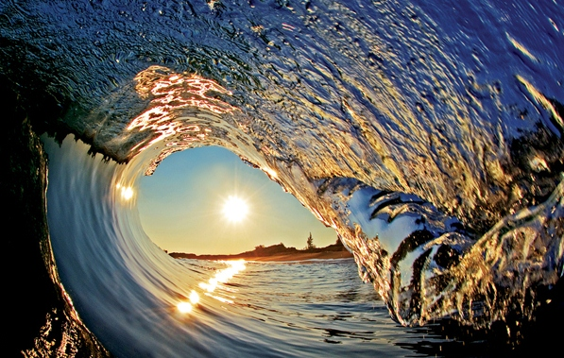

Kelvin-Helmholtz Instability (KHI)
Turbulent fluctuations are common in air* and water*
Usually Ǝ source*
Usually damped, but weakly
Ǝ quasi-stationary and developing instabilities
For KHI the source is shear-flow

Slide 34

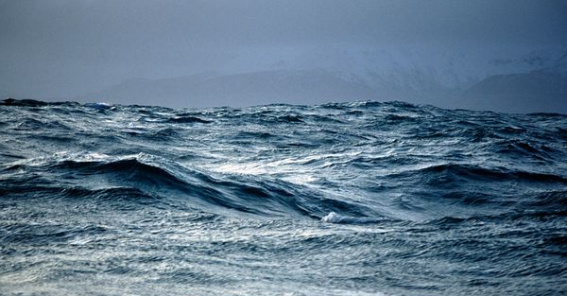
Low viscosity → Turbulence
oil
water
Viscous liquid shows smooth sinusoidal waves, while a non-viscous
fluid has sharp, non-sinusoidal waves, leading to turbulence.
A typical turbulent phenomenon is the Kelvin-Helmholtz instability

Slide 35



KHI in air from above

Slide 36

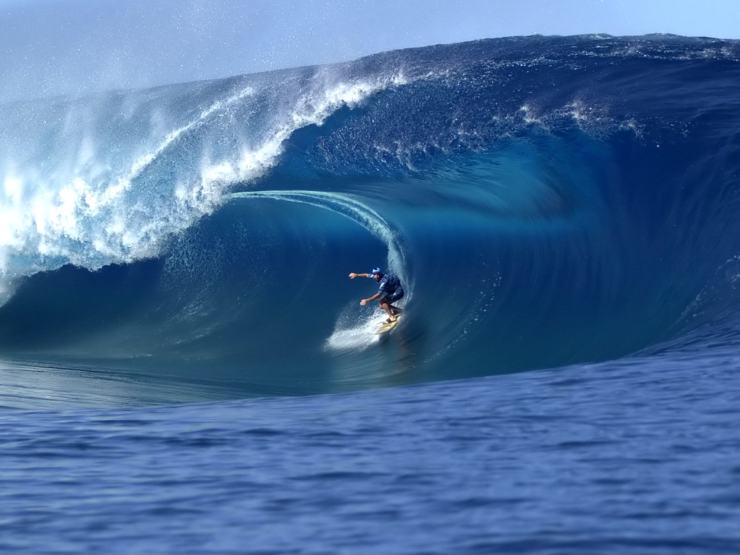
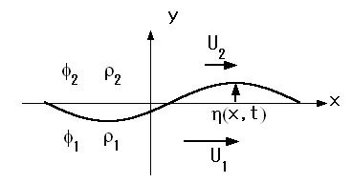
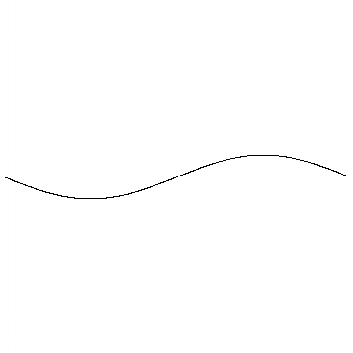
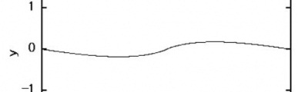
The Kelvin – Helmholtz instability
Initial, almost sinusoidal waves
Well developed, non-linear wave
The interface is a layer with a finite thickness, where viscosity and surface tension affects the interface. Due to these effects singularity formation is prevented in reality. The roll-up of a sheet is observed
[Chihiro Matsuoka, Yong
Guo Shi, Scholarpedia]

Slide 37
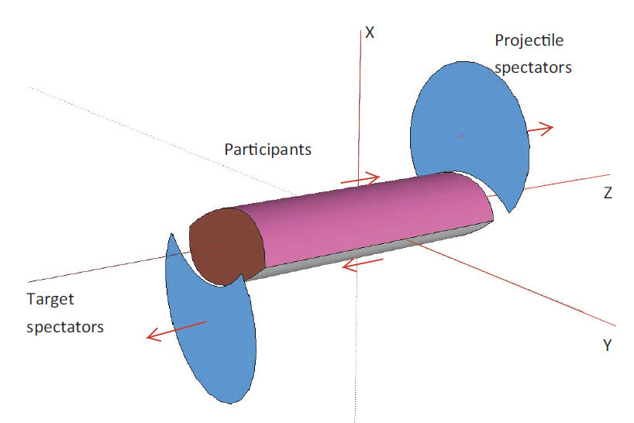
Initial geometry at ultra-relativistic energies

Slide 38
The Kelvin – Helmholtz instability
Initial, almost sinusoidal waves
Well developed, non-linear wave
The interface is a layer with a finite thickness, where viscosity and surface tension affects the interface. Due to these effects singularity formation is prevented in reality. The roll-up of a sheet is observed
[Chihiro Matsuoka, Yong
Guo Shi, Scholarpedia]

Slide 39
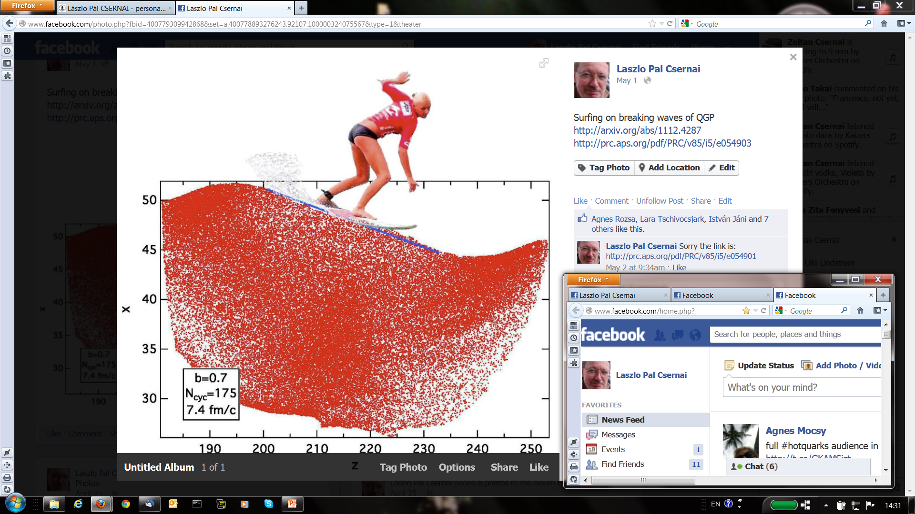
Kelvin-Helmholtz Instability (KHI)

Slide 40
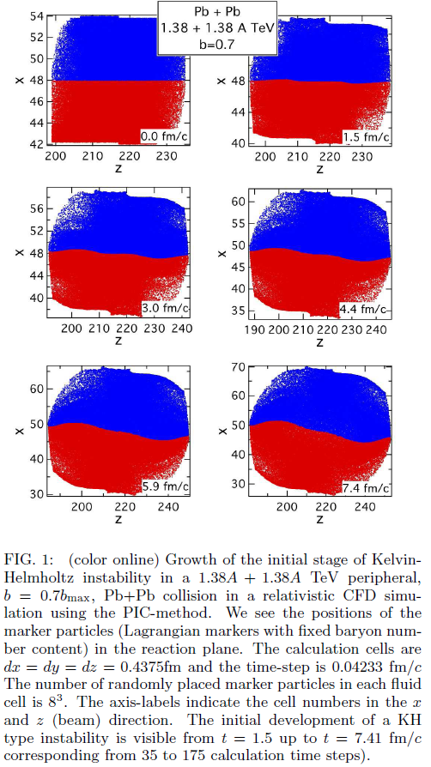

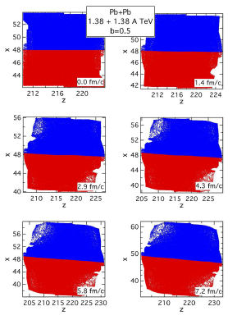
KHI →
ROTATION
KHI
2.4 fm

Slide 41
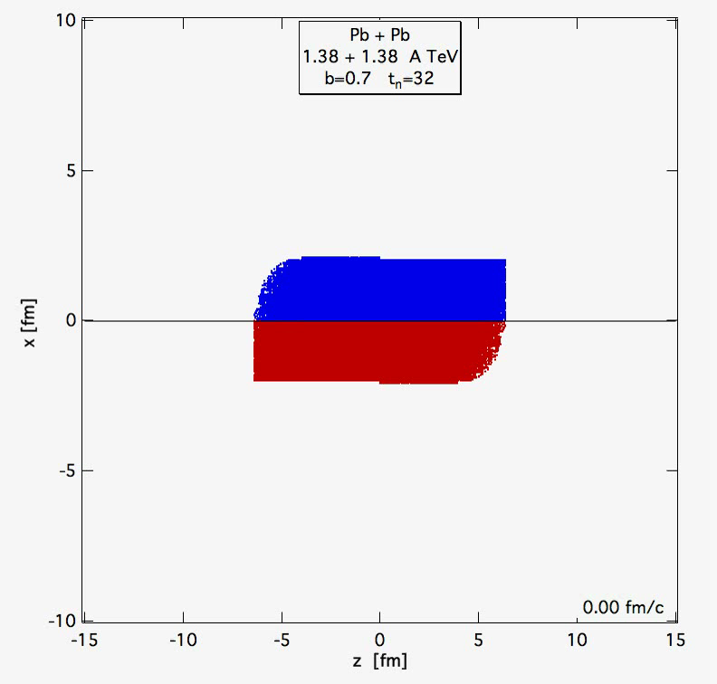

Slide 42
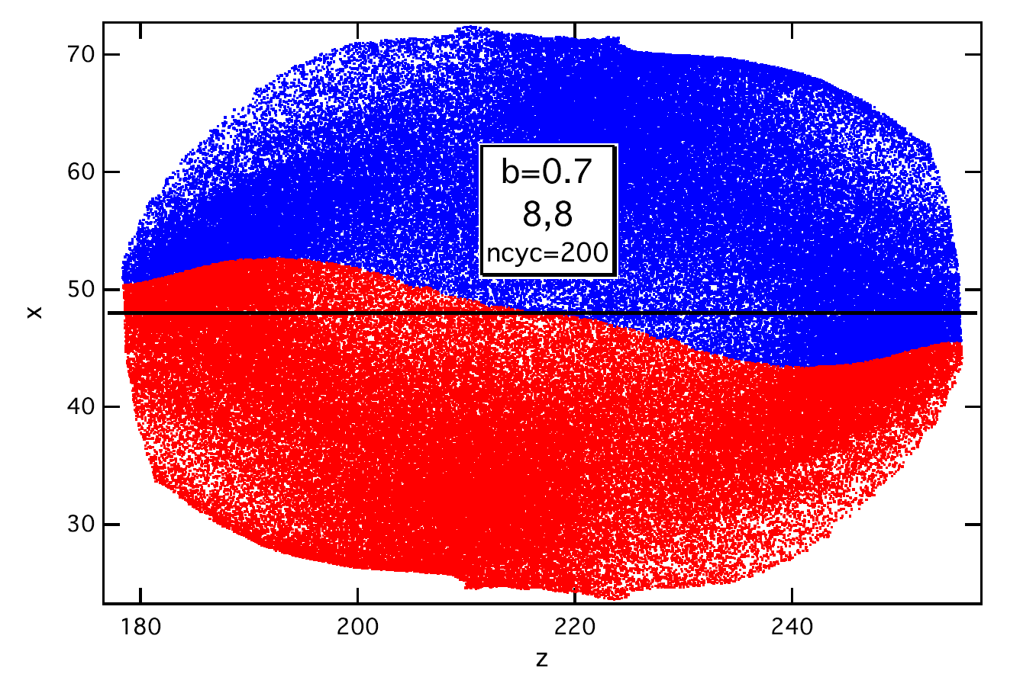


The Kelvin – Helmholtz instability (KHI)
l_{z}
Shear Flow:
L=(2R-b) ~ 4 – 7 fm, init. profile height
l_{z} =10–13 fm, init. length (b=.5-.7b_{max})
V ~ ±0.4 c upper/lower speed →
Minimal wave number is
k = .6 - .48 fm⁻¹
KHI grows as where
→
Largest k or shortest wave-length will grow the fastest.
The amplitude will double in
2.9 or 3.6 fm/c for (b=.5-.7b_{max}) without expansion, and with favorable viscosity/Reynolds no. Re=LV/ν .
→ this favors large L and large V
V
L
V
Our resolution is (0.35fm)³ and
8³ markers/fluid-cell →
~ 10k cells & 10Mill m.p.-s

Slide 43


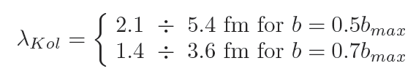



The Kelvin – Helmholtz instability (KHI)
Formation of critical length KHI (Kolmogorov length scale)
Ǝ critical minimal wavelength beyond which the KHI is able to grow. Smaller wavelength perturbations tend to decay. (similar to critical bubble size in homogeneous nucleation).
Kolmogorov:
Here is the specific dissipated flow energy.
We estimated:
It is required that → we need b > 0.5 b_{max}
Furthermore
Re = 0.3 – 1 for and
Re = 3 – 10 for

Slide 44
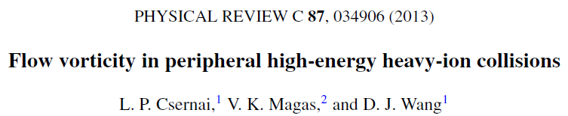

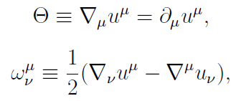

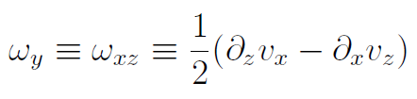






If is negligible
Classical
Relativistic
Max = 3. c/fm
Reaction plane only

Slide 45



Relativistic
Classical
All y-layers

Slide 46



Late (FO) time
Classical
Relativistic

Slide 47



Slide 48

Onset of turbulence around the Bjorken flow
S. Floerchinger & U. A. Wiedemann, JHEP 1111:100, 2011; arXiv: 1108.5535v1
y
x
[fm]
x
nucleons
energy density
[fm]
Transverse plane [x,y] of a Pb+Pb HI collision at √s_{NN}=2.76TeV at b=6fm impact parameter
Longitudinally [z]: uniform Bjorken flow, (expansion to infinity), depending on τ only.
y
Green and blue have the same longitudinal speed (!) in this model.
Longitudinal shear flow is omitted.
P
T
x

Slide 49




Onset of turbulence around the Bjorken flow
S. Floerchinger & U. A. Wiedemann, JHEP 1111:100, 2011; arXiv: 1108.5535v1
y
Max = 0.2 c/fm
Initial state Event by Event vorticity and divergence fluctuations.
Amplitude of random vorticity and divergence fluctuations are the same
In dynamical development viscous corrections are negligible (→ no damping)
Initial transverse expansion in the middle (±3fm) is neglected (→ no damping)
High frequency, high wave number fluctuations may feed lower wave numbers

Slide 50


Typical I.S. model – scaling flow
The same longitudinal expansion velocity profile in the whole [x,y]-plane !
No shear flow. No string tension! Usually angular momentum is vanishing!
X
Zero vorticity
&
Zero shear!
Z
t
Such a re-arrangement of the
matter density is dynamically
not possible in a short time!
Z

Slide 51



Adil & Gyulassy (2005) initial state
x, y, η, τ coordinates → Bjorken scaling flow
Considering a longitudinal “local relative rapidity slope”, based on observations in D+Au collisions:
→

Slide 52

Detecting initial rotation

Slide 53


Detecting initial rotation:
Two particle correlations, Diff. HBT
[L.P. Csernai, S. Velle, subm. to PRC]
[L.P. Csernai, S. Velle, D.J. Wang , in prep.]

Slide 54
Standard Flow Vorticity
Relativistic
Classical

Slide 55






Detecting rotation:
Lambda polarization
← From hydro
[ F. Becattini, L.P. Csernai, D.J. Wang, Submitted to Phys.
Rev. Lett. arXiv:1304.4427v1 [nucl-th] ]

Slide 56
Summary
FD model: Initial State + EoS + Freeze out & Hadronization
In p+p I.S. is problematic, but Ǝ collective flow
In A+A the I.S. is causing global collective flow
Consistent I.S. is needed based on a dynamical picture, satisfying causality, etc.
Several I.S. models exist, some of these are oversimplified beyond physical principles.
Experimental outcome strongly depends on the I.S.
Thank you

