Slide 1
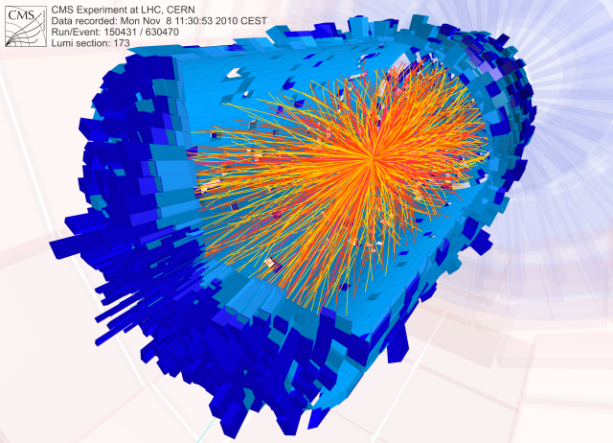
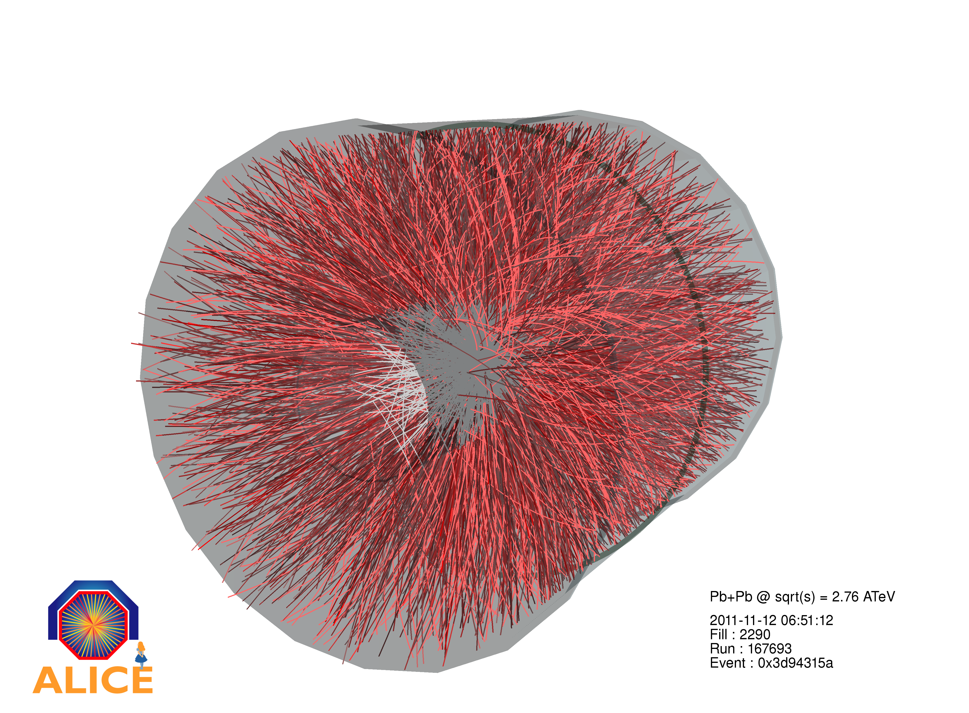

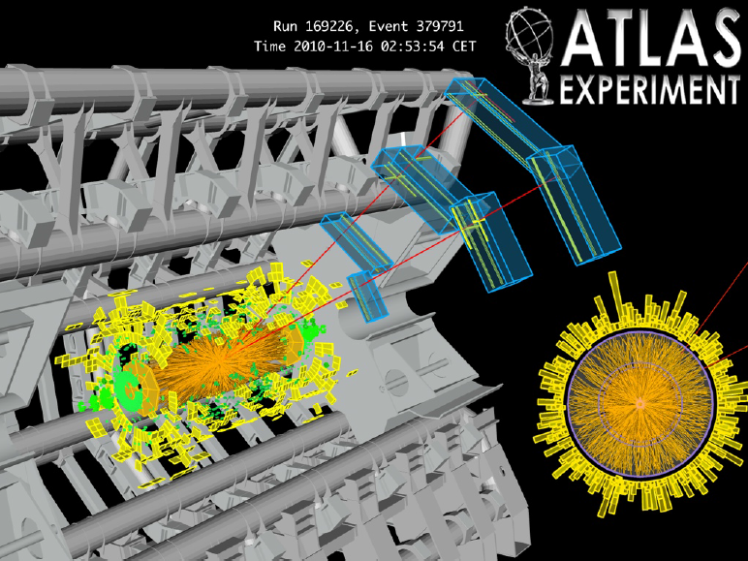
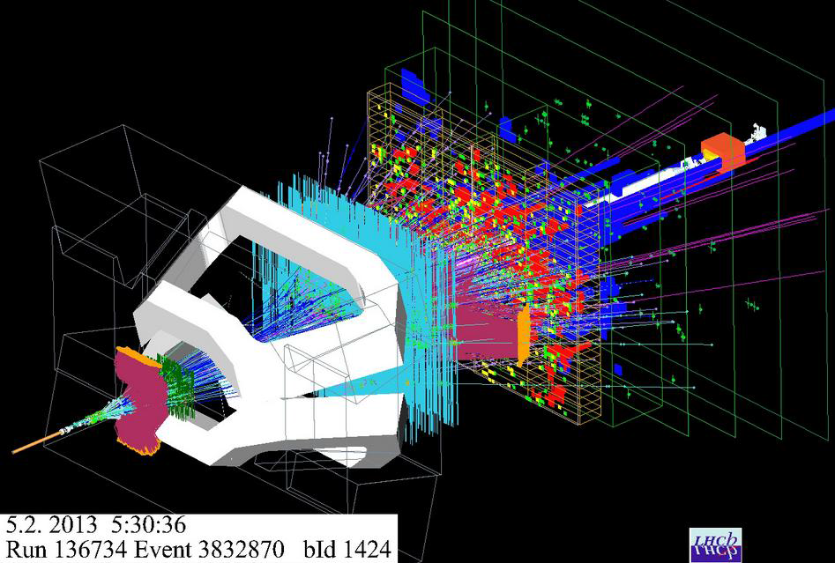
Recent results from heavy-ions collisions at CERN
INPC 2013 Paolo Giubellino
INFN Torino & CERN
June 7, 2013

Slide 2

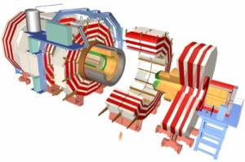
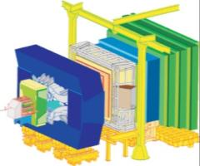
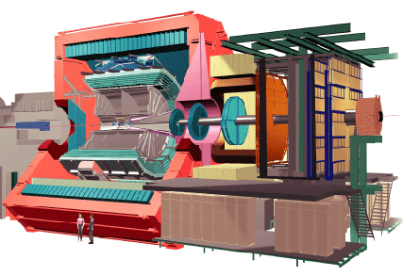
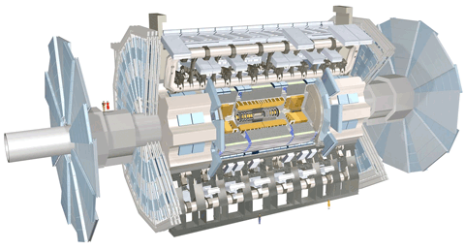
The LHC
27 km circumference
~ 100 m underground
Design Energy 14,000 GeV (pp)
4 Main Experiments
Lake Geneva
CMS
Studying Heavy Ions
LHCb
ALICE
ATLAS

Slide 3
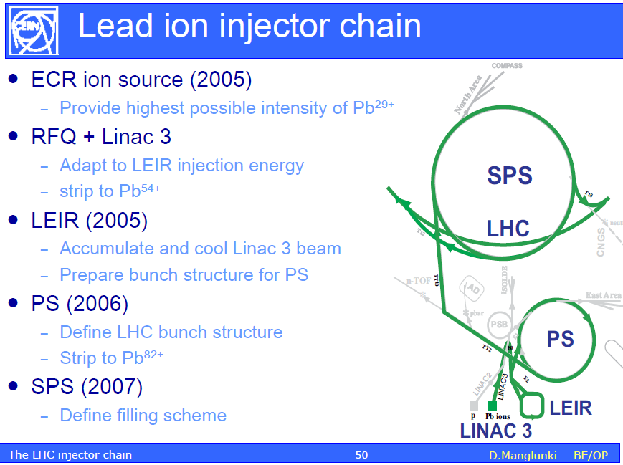
A word from our suppliers

Slide 4
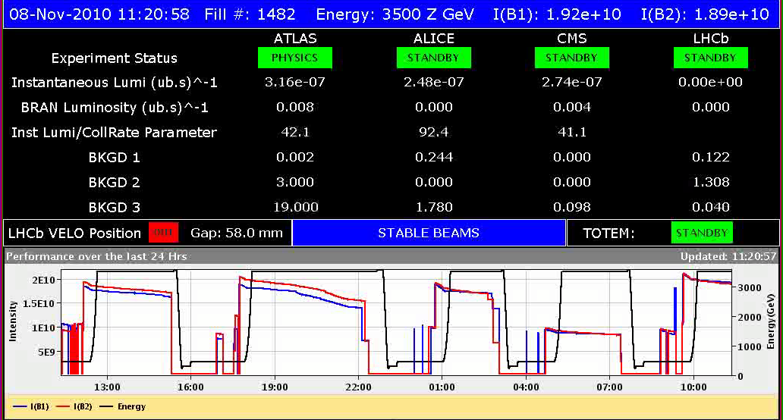
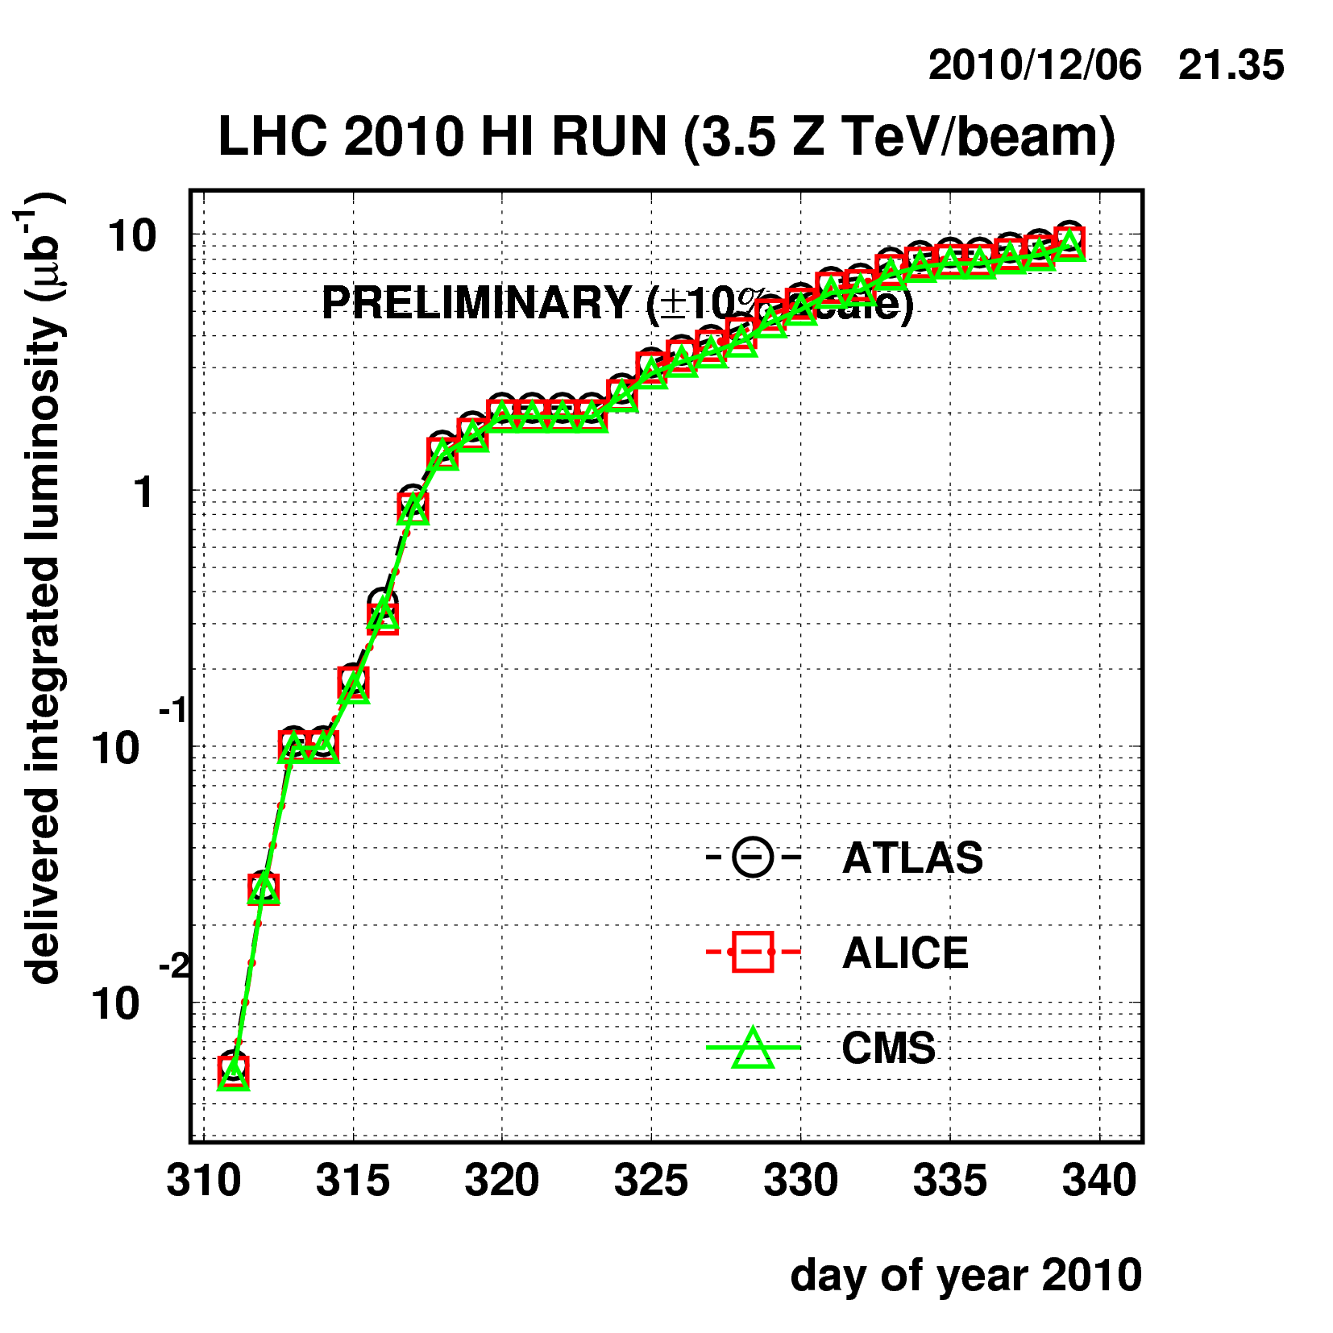
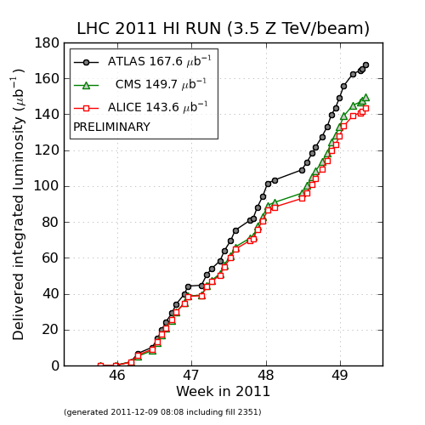
The LHC as a Heavy-Ion Collider
8 November 2010: the beginning of a new era for Heavy Ion Physics: a jump of more than an order of magnitude in energy since the previous record (RHIC @BNL)
Three days to switch from protons to Pb ions
In 2011 exceeded design luminosity
2011: > 10 times larger integrated luminosity + tests for pA
2012: first pA collisions
2013: pA run
2011
2010

Slide 5
The Experiments
ALICE
  Experiment designed for Heavy Ion collision
    only dedicated experiment at LHC, must be comprehensive and able to cover all relevant observables
    VERY robust tracking for p_{T} from 0.1 GeV/c to 100 GeV/c
      high-granularity 3D detectors with many space points per track (560 million pixels in the TPC alone, giving 180 space points/track)
      very low material budget (< 10%X₀ in r < 2.5 m )
    PID over a very large p_{T} range
      use of essentially all known technologies: TOF, dE/dx, RICH, TRD, topology, EM calor.
    Hadrons, leptons and photons + Excellent vertexing
ATLAS and CMS
  General-purpose detectors, optimized for hard processes
    Excellent Calorimetry = > Jets
    Excellent dilepton measurements, especially at high pT
    Very large acceptance tracking
Now Joined by LHCb for pPb
  Excellent dilepton measurement and PID in forward direction
Each required 20 years of work by a worldwide collaboration...

Slide 6
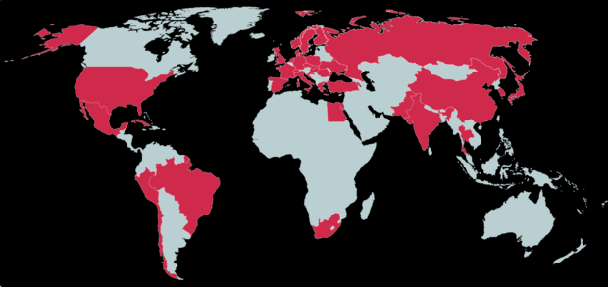
Very large International Collaborations…
ALICE today (ATLAS & CMS even larger!)
1300 scientists, 138 institutions in 36 countries…
Working for over 20 years to develop the technologies and build the detectors, and now to operate them

Slide 7
A program of major impact
A very large community of physicists involved
  over a thousand just in ALICE, hundreds in the other experiments
  Very many theorists
A huge scientific output
  High impact papers: the top cited paper at the LHC after the Higgs discovery ones is the ALICE paper on flow in HI collisions, and out of the 13 top cited physics papers at the LHC 5 are from the Heavy Ion program (3 ALICE, 1 CMS and 1 ATLAS)
  Several hundred presentations at international conferences each year
Here only a small subset of results, see the parallel talks!
  Pelin, Bock, Roland, Badala’, Averbeck, Arnaldi, Gaardhoje, Sharma, Lacey, Kuhn, Steinberg, Cunqueiro, Loizides

Slide 8
A worldwide effort to study the world’s most energetic and most complicated collisions
What for?

Slide 9
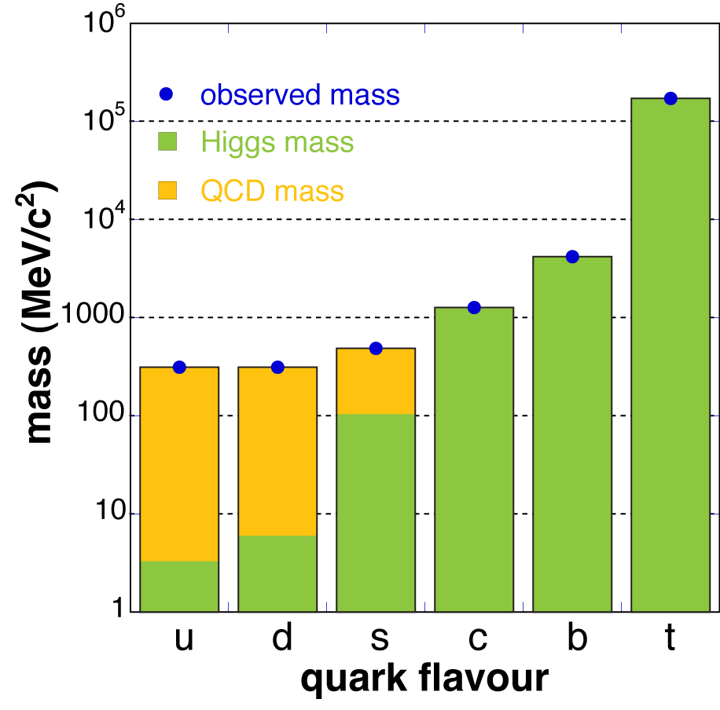
Why HI Collisions?
What are the fundamental properties of strongly interacting matter as a function of temperature and density?
What are the microscopic mechanisms responsible for them?
  What are the microscopic degrees of freedom and excitations of matter at ultra-­‐high temperature and density?
  Which are its transport properties and equation of state?
How did its properties influence the evolution of the early universe?
How is mass modified by the medium it moves in?
How do hadrons acquire mass?
What is the structure of nuclei when observed at the smallest scales, i.e. with the highest resolution?
Most of the observed mass of light quarks is generated by the spontaneous breaking of chiral symmetry
Heavy-­Ion collisions: Laboratory studies of the bulk properties of non­‐Abelian matter
...with deep connections to other fields in physics:
String Theory, Cosmology, Condensed Matter Physics, Ultra-­‐Cold Quantum Gases

Slide 10
Why Heavy Ions @ LHC?
It is a different matter as compared to RHIC (and even more to SpS)
  Larger temperature, volume, energy density and lifetime
    Study QGP properties vs T …
  large cross section for 'hard probes' : high p_{T}, jets, heavy quarks,…
  small net‐baryon density at mid‐rapidity (μB ≈ 0), corresponding to the conditions in the early universe
  First principle methods (pQCD, Lattice Gauge Theory) more directly applicable
  new generation, large acceptance state-of-the-art detectors
    Atlas, CMS, ALICE, [LHCb, for pA]
A comprehensive program, complementary to the one at RHIC

Slide 11
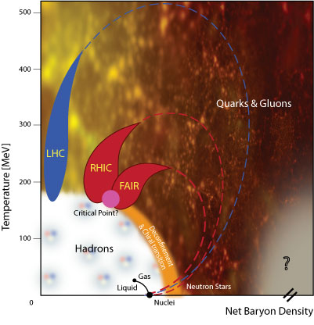
The Phase Diagram of Nuclear Matter

Slide 12
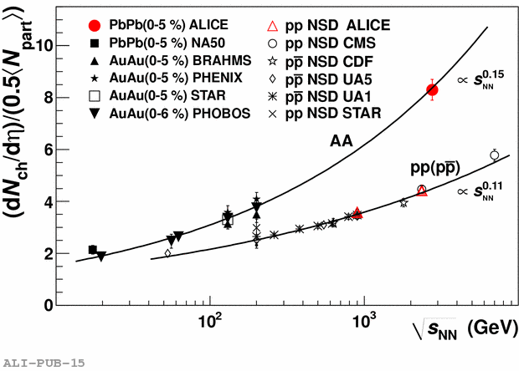
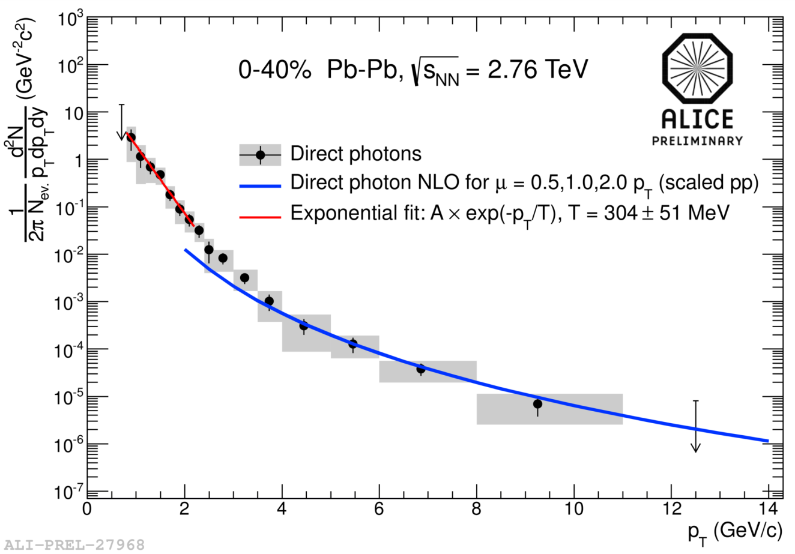
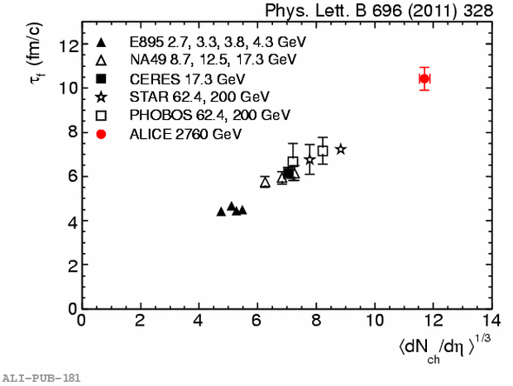
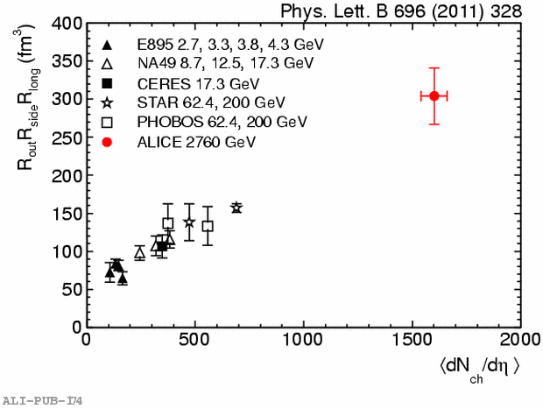
Global properties
From the very first 2010 analysis, fireball at LHC denser, larger and longer lived than at RHIC
    Energy density ≈ 3 x RHIC (p_{T} is larger)
    Volume ≈ 2 x RHIC
    Lifetime ≈ +20% (≈ 10 fm/c)
Now, measure T from photon spectrum
Exponential fit for p_{T} < 2.2 GeV/c
inv. slope T = 304±51 MeV
for 0–40% Pb–Pb at √s 2.76 TeV
PHENIX: T = 221±19±19 MeV
for 0–20% Au–Au at √s 200 GeV

Slide 13
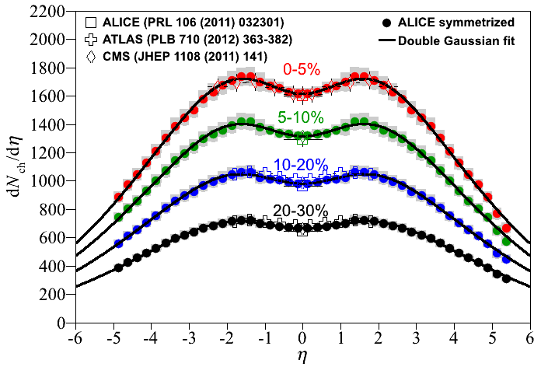
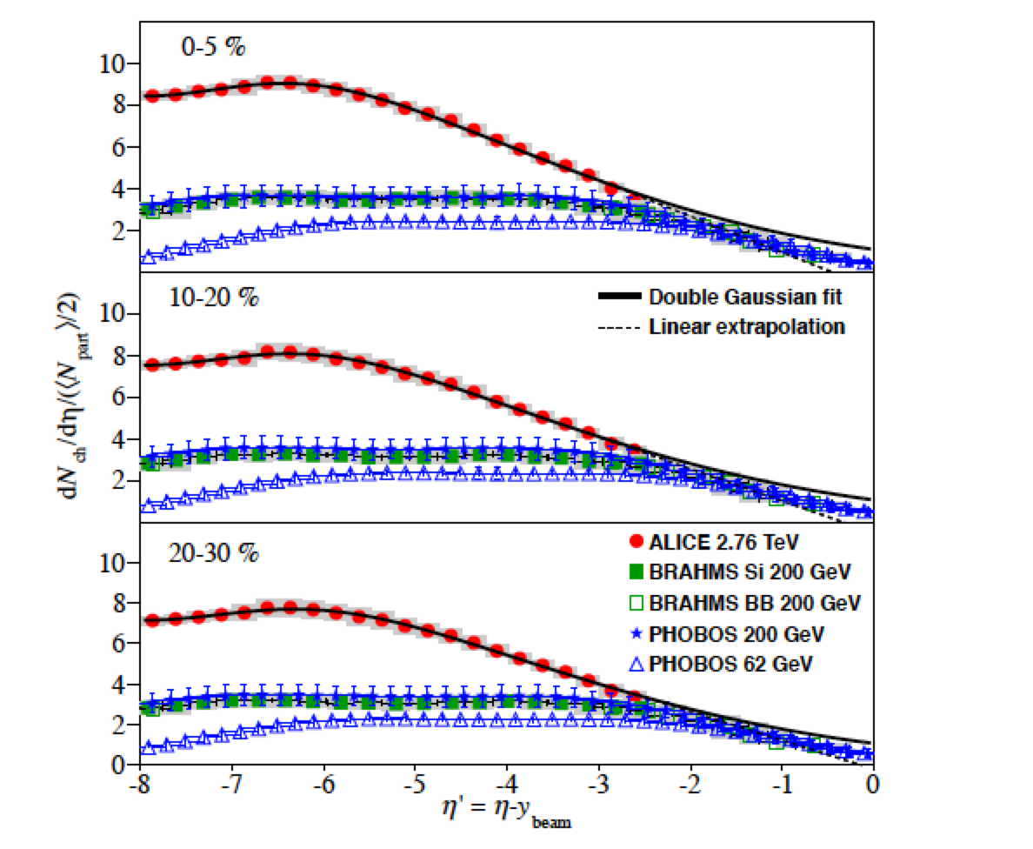
dN_{ch}/dη versus η
First measurements over wide kinematic range at LHC arXiv:1304.0347
17165 ± 722 charged particles produced in 5% most central coll
ε ≥ 16 GeV/fm³
x 100 above nuclear density
x 30 above nucleon density
x 20 above lattice-QCD prediction for quark-gluon plasma formation
Longitudinal Scaling?
  Is particle production in the fragmentation region invariant with beam energy? (Benecke et al., Phys Rev, v188, n5, 1969)
  Extrapolation of dN_{ch}/dη vs η-y_{beam} coincides with lower energy data
  Measurements consistent with longitudinal scaling

Slide 14
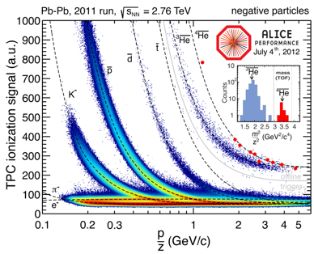
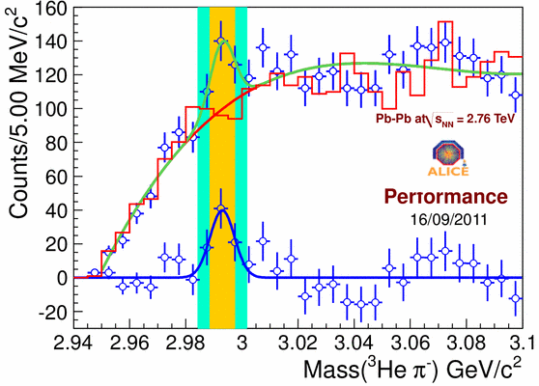
Nucleo-synthesis at LHC
Light Nuclei & anti-Nuclei
  Anti-⁴He is the heaviest anti-nucleus ever observed
  Hypertriton: one proton replaced by Λ particle
³_{Λ}H → ³He + π⁻

Slide 15
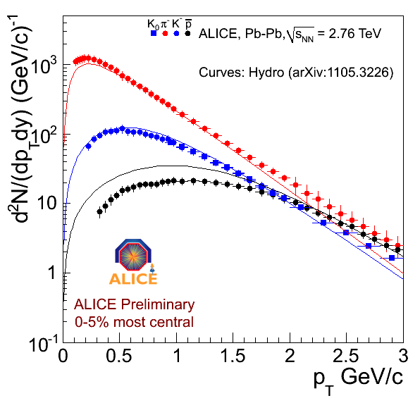
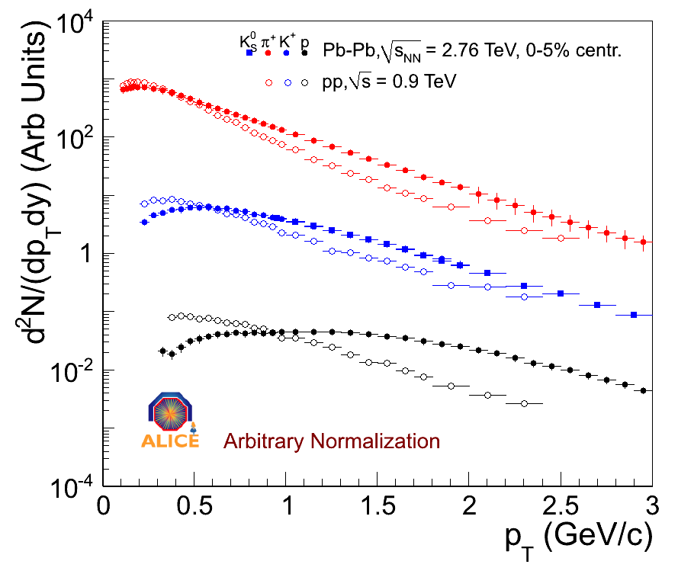
Particle Flow: hydro properties of the plasma
Radial Flow
  pressure P drives expansion
  flow velocity β depends on f(P, τ, EoS,)
  spectra of different particles are influenced differently by flow
  spectra
isotropic radial flow
v₀
P = 0
v₀
π⁻
P >> 0
v₀
Hydro Calculation
π
K
p
PbPb
IDENTIFIED PARTICLE SPECTRA @LHC: significant changes in slope compared to RHIC
Most dramatically for protons
Very strong radial flow, β ≈ 0.66
pp
FLOW pushes spectra depending on mass

Slide 16
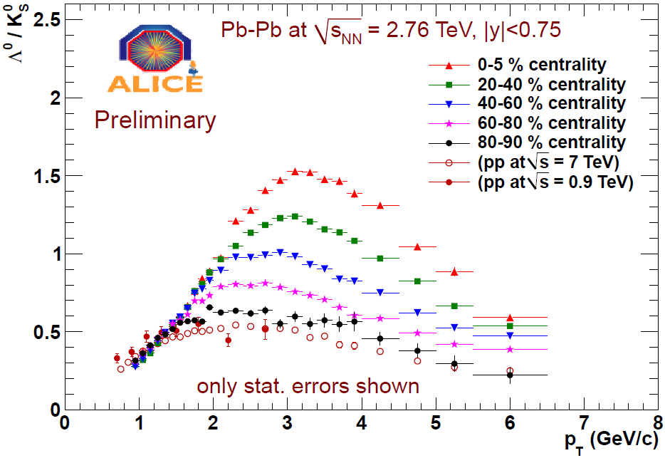
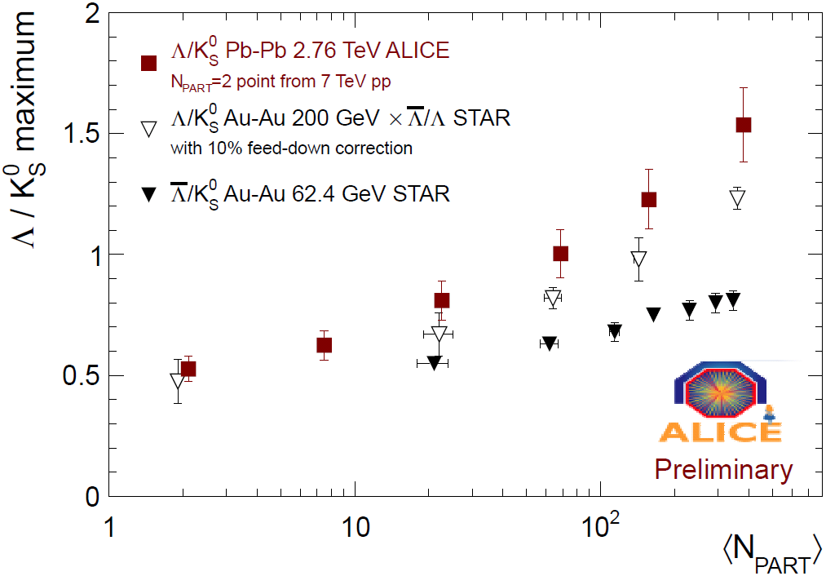
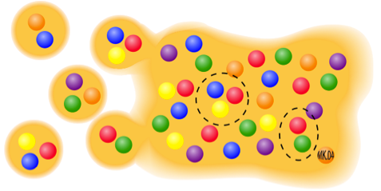
'Baryon anomaly': Λ/K⁰
x 3
RHIC
Λ/K₀
Ratio at Maximum
Baryon/Meson ratio still strongly enhanced
x 3 compared to pp at 3 GeV
Enhancement slightly larger than at RHIC
Still present at 6 GeV/c
- Maximum shift very little in p_{T} compared to RHIC
despite large change in underlying spectra !
Recombination + Radial flow?

Slide 17
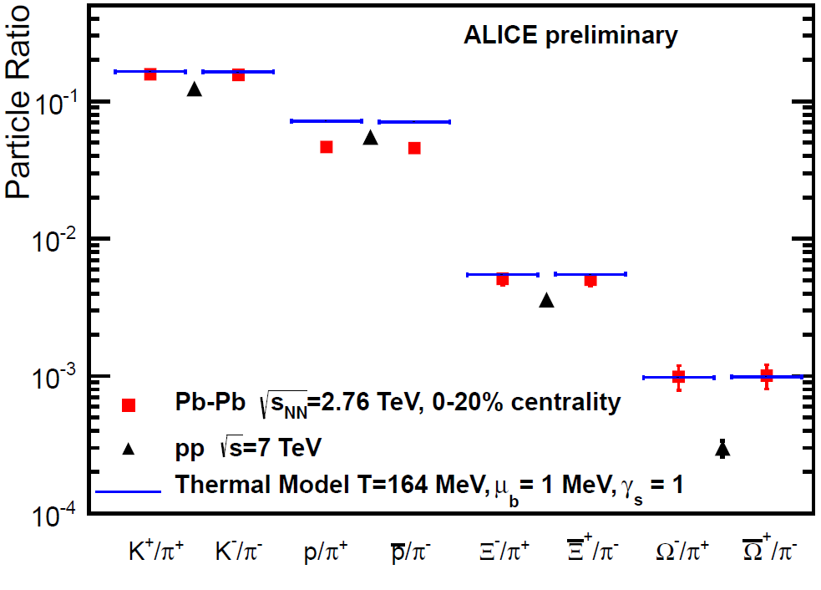
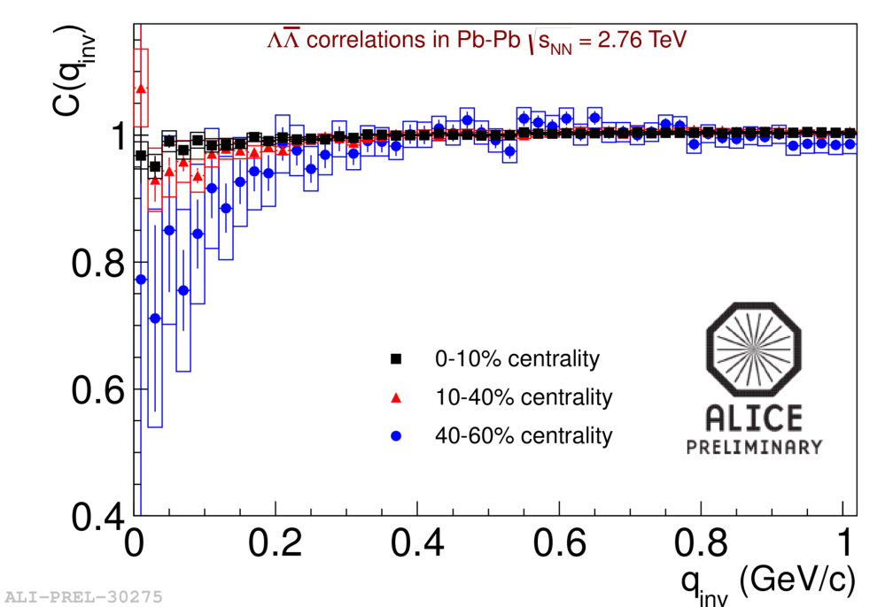
Hadrochemistry at LHC
K(s)
Ξ(ss)
Predicted temperature from lower energies T=164 MeV
  A.Andronic, P.Braun-Munzinger, J.Stachel NP A772 167
p/π (and Λ/π) at LHC lower than at RHIC
Hadronic re-interactions (baryon annihilation? Suggested by proton HBT results ) Open issue
  F.Becattini et al. 1201.6349, J.Steinheimer et al. 1203.5302, R. Bellwied et al. 1305.6297
Ω(sss)
(Prediction, no fit)
Notes:
164 -> limiting temperature

Slide 18
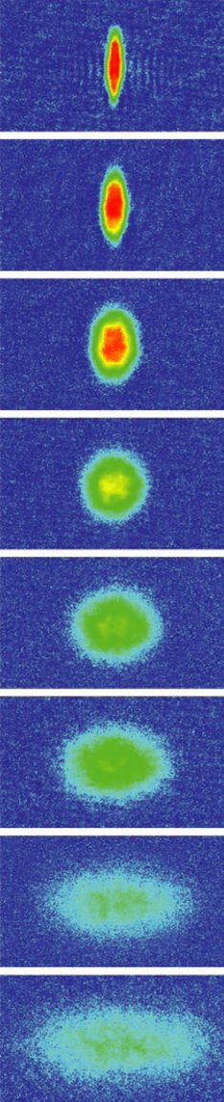
Azimuthal Asymmetry
SCIENCE Vol: 298 2179 (2002) ⁷Li
Fourier expansion of azimuthal distribution:
Flow: Correlation between coordinate and momentum space => azimuthal asymmetry of interaction region transported to the final state
measure the strength of collective phenomena
Large mean free path
  particles stream out isotropically, no memory of the asymmetry
  extreme: ideal gas (infinite mean free path)
Small mean free path
  larger density gradient -> larger pressure gradient -> larger momentum
  extreme: ideal liquid (zero mean free path, hydrodynamic limit)
y
z
x
Ultra-cold ⁷Li 10⁻¹² eV , 2 ms of expansion

Slide 19
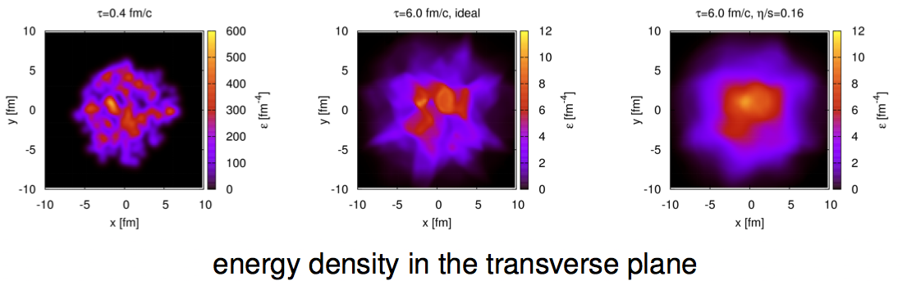
Flow as a tool
Understand initial conditions and fluctuations; measure the transport properties (e.g. η/s) of the medium
Observables (for different event classes):
  Higher harmonics
  Event by Event fluctuations
  Studies as a function of EbyE flow
  Event plane correlations
After 6 fm/c
ideal
viscous
initial

Slide 20
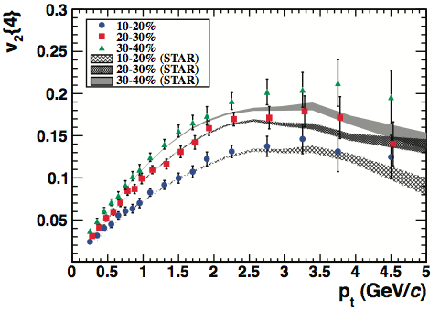
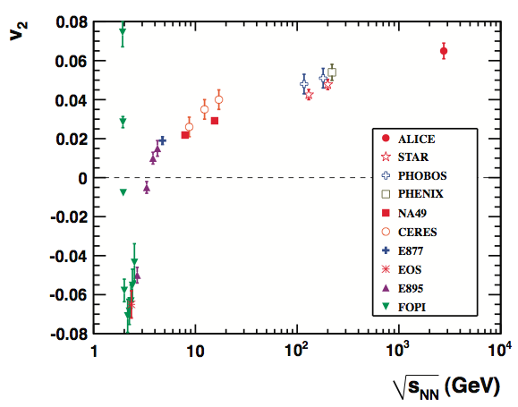
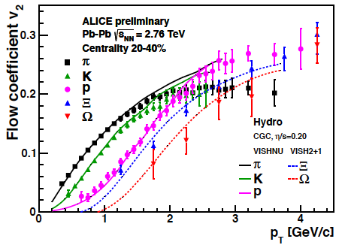
v₂ Measurements at the LHC
semi-central
central
PRL 105, 252302 (2010), already over 290 citations!
Collective behavior observed in Pb-Pb collisions at LHC (+30% vs. v₂^{RHIC})
=> ideal fluid behavior (extremely low ratio of sheer viscosity to entropy density η/s ≈ 0 ), very similar p_{T} dependence and values to RHIC
Testing hydrodynamical evolution
Notes:
Flow is an interesting observable because it provides information on the equation of state and the transport properties of the matter created in a heavy ion collision. The azimuthal anisotropy in particle production is the clearest experimental signature of collective flow, and is caused by multiple interactions between the constituents of the created matter and the initial asymmetries in the spatial geometry of a non-central collision. The second Fourier coefficient of the azimuthal asymmetry is called elliptic flow.The magnitude of the elliptic flow depends strongly on the friction in the created matter, characterized by the shear viscosity over entropy ratio h/s. A good fluid like water has a small value of h/s and supports flow patterns such as the waves in the ocean. In a poor fluid like honey, on the other hand, flow patterns disappear quickly.Measurements of elliptic flow at the Relativistic Heavy Ion Collider (RHIC) revealed the fascinating fact that the created hot and dense matter was flowing as a very good fluid with almost no friction. Surprisingly enough, the first theoretical calculation of h/s in heavy-ion collisions did not come from lattice QCD or transport theory, but from string theory. First calculations showed that in a strongly coupled N = 4 supersymmetric Yang Mills theory with a large number of colors, h/s can be calculated using a gauge gravity duality. The famous AdS/CFT (Anti-de Sitter/Conformal Field Theory) conjecture yields a ratio of h/s = h/4pkB, which was argued to be a lower bound for any relativistic thermal field theory.At RHIC however, a precise determination of the friction in the partonic fluid is complicated by uncertainties in the initial conditions of the collision, the relative contributions from the hadronic and partonic phase, and the unknown temperature dependence of h/s. Because we do not know this temperature dependence it was not even clear if the elliptic flow would increase or decrease when going from RHIC to the LHC. A measurement of elliptic flow at the LHC was therefore one of the most anticipated results.The LHC measurements at 2.76 TeV by ALICE show that the elliptic flow of charged particles increases by about 30% compared to flow measured at the highest RHIC energy of 0.2 TeV. This result indicates that the hot and dense matter created in these collisions still behaves like a fluid with almost zero friction, providing strong constraints on the temperature dependence of h/s.This first measurement also shows that elliptic flow - and thus the properties of the created matter - can be studied with unprecedented precision at the LHC. This is because compared to RHIC the increase in particle multiplicity and the increase in the elliptic flow itself.

Slide 21
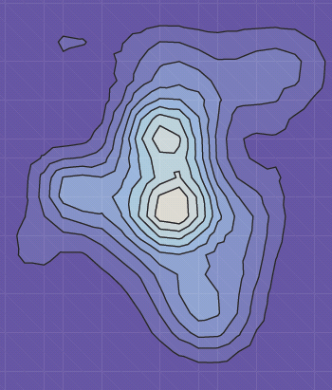
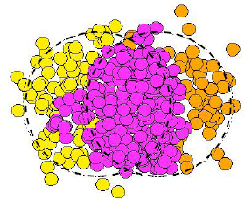
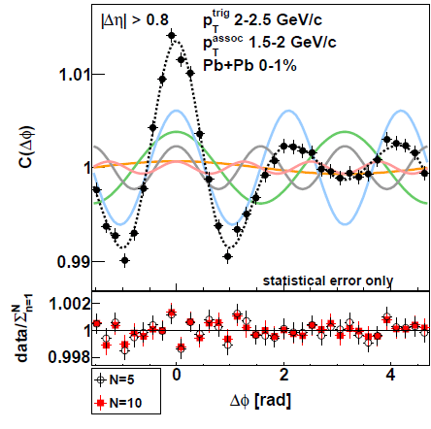
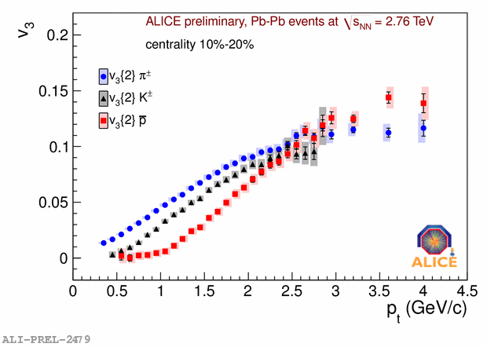
Flow patterns
Fourier series: dN/dφ = 1 + 2 v₁ cos(φ) + 2 v₂ cos(2φ) + 2 v₃ cos(3φ) +…
Triangular, v₃
Elliptic, v₂
v₁+v₂₊v₃₊v₄₊v₅
  all characteristics as expected from hydro:
    strength, mass/centrality/momentum dependence
v₃
v₂
v₄
v₃ for π/K/p
mass dependence typical for hydro !
Two Particle Correlation projection on φ

Slide 22
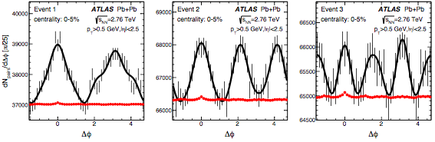
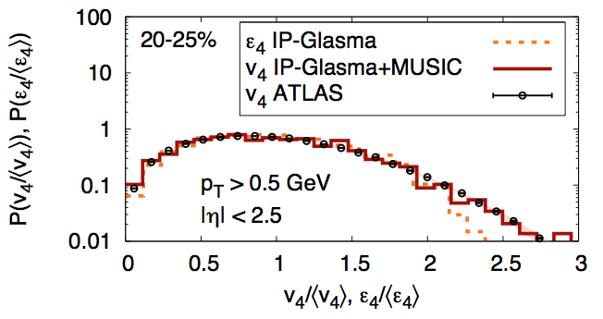
The shape of an individual event!
http://arxiv.org/abs/1305.2942
study of fluctuations and of event features vs. flow patterns
ATLAS, arXiv:1209.6330

Slide 23
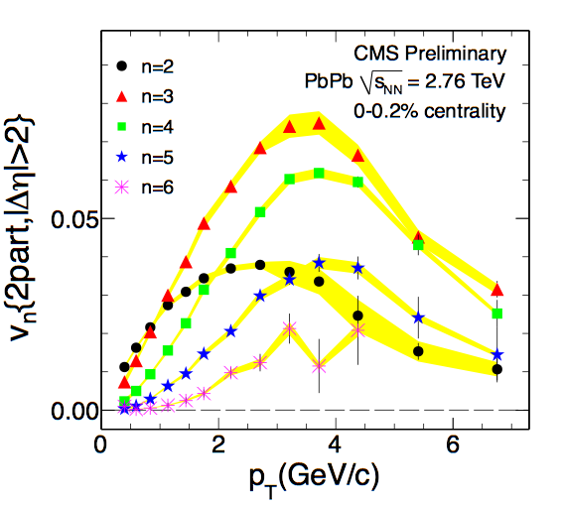
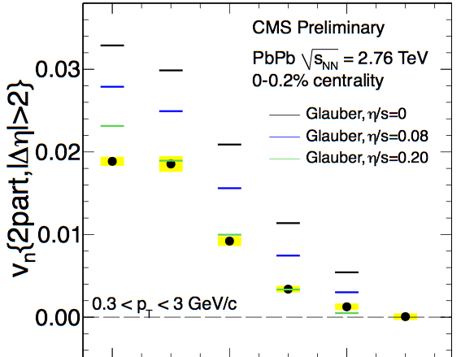
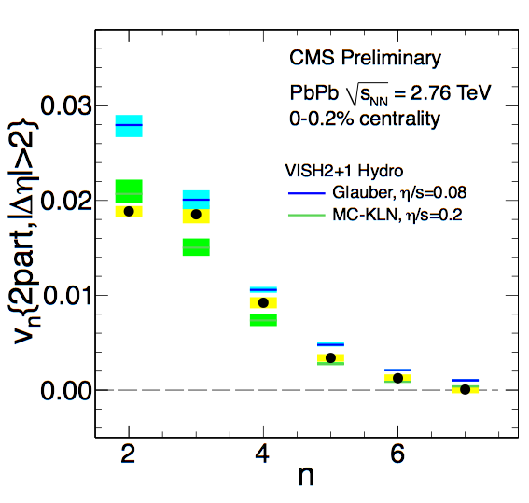
Precision measurements: Ultra Central Collisions
Ultra-central collisions: less uncertainty on initial conditions
Strong constraints on transport coefficients
CMS-HIN-12-011
Notes:
Link to ESE?

Slide 24
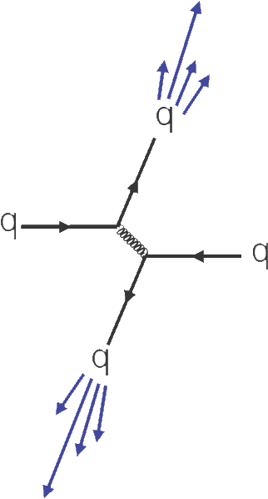
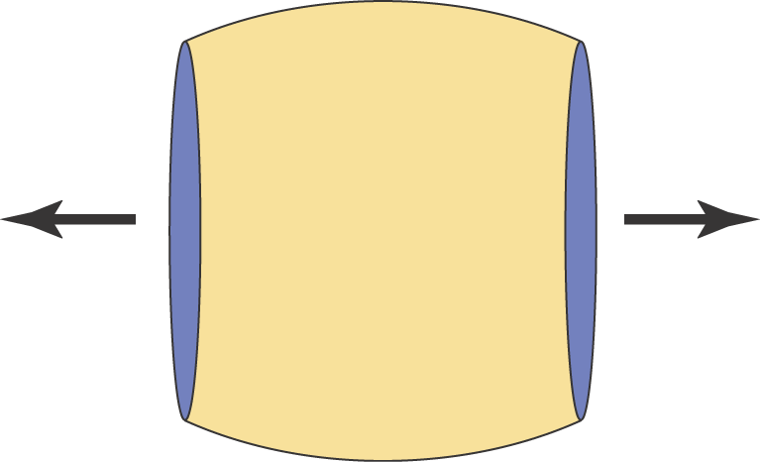
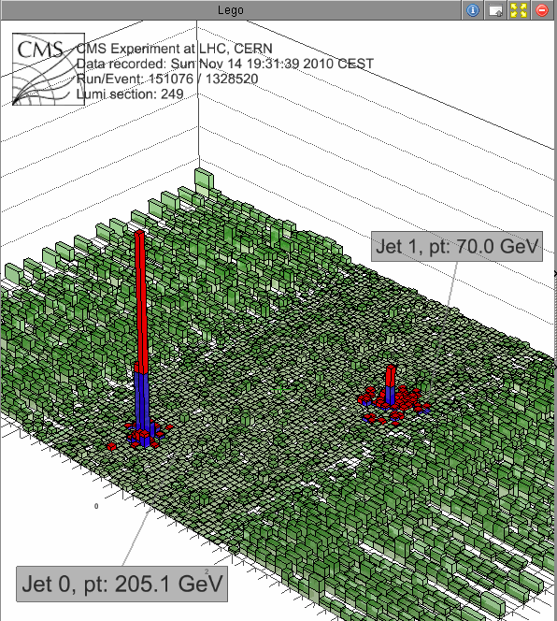
Hard Processes to Probe the Medium (Rutherford experiment...)
initial parton-parton scattering with large momentum transfer
  calculable in pQCD
particle jets follow direction of partons
Jet quenching: observed at RHIC since 2001, very striking at LHC!
nucleus-nucleus collisions
  hard initial scattering
  scattered partons probe traversed hot and dense medium
  ‘jet tomography’

Slide 25
Jet quenching
partons lose energy ΔE when traversing a medium
  Jet(E) → Jet (E’ = E-ΔE) + soft particles(ΔE)
  QCD energy loss ΔE expected to depend on:
    q : 'opacity ' = property of medium ('radiation length of QGP')
    L: size of medium (~ L (elastic) ~ L²(radiative), L³(AdS/CFT))
    c_{q}: parton type (gluon > quark)
    f(m) : quark mass (light q > heavy Q)
    f(E) : jet energy (ΔE = constant or ~ ln(E))
At LHC all aspects of quenching can be addressed, thanks to the large cross section and the quality of the detectors
jet quenching measures
‘stopping power' of QGP
ΔE ~ f(m) x c_{q} x q x L^{n} x f(E)

Slide 26
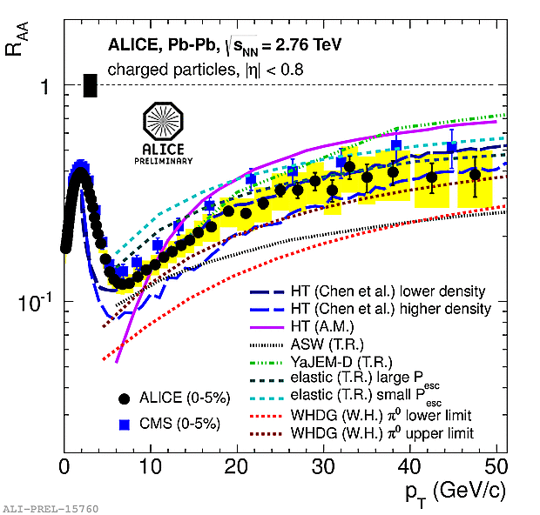
Suppression of High-p_{T} Hadrons
R_{AA} = 1 for hard QCD processes
in absence of nuclear modifications
Strong suppression, even larger than @ RHIC
Nuclear modification factor R_{AA}(p_{T}) for charged particles produced in 0-5% centrality range
  minimum (~ 0.14) for p_{T} ~ 6-7 GeV/c
  then slow increase at high p_{T}
essential quantitative constraint for parton energy loss models!

Slide 27
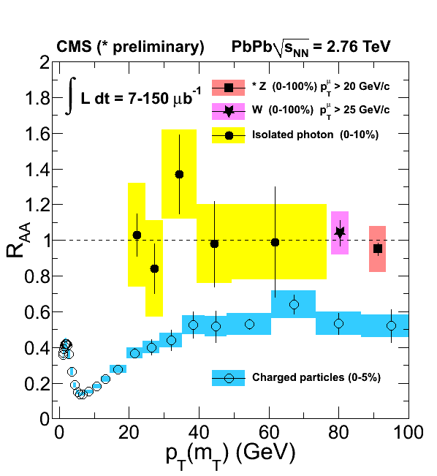
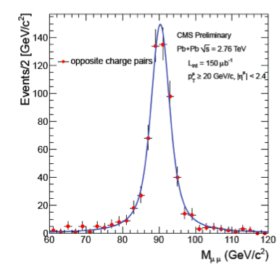

Only for strongly interacting probes!
CMS-PAS HIN-12-008
Z⁰ μ⁺μ⁻
W μν using single muon recoil against missing p_{T}
γ, Z and W scale with number of binary collisions in PbPb – not affected by medium
→ charged particle suppression is medium effect: energy loss in QGP

Slide 28


Sensitive to path length
Significant effect even at high p_{T}

Slide 29

How much Energy does the jet lose?
Di-Jet energy balance A_{j} : First full jet-quenching measurement
A_{j} = (P_{T1}-P_{T2})/(P_{T1}+P_{T2})
ATLAS: Phys.Rev.Lett. 105 (2010) 252303
P_{T1}
P_{T1} ≈ P_{T2}
P_{T1}
Quenching Model
<ΔE> ≈ 20 GeV (wide distribution)
Medium is VERY strongly
interacting ('opaque')
(but within expectations)
P_{T1} >> P_{T2}
Weak Energy dependence (roughly as expected)
(CMS PLB 712 (2012) 176)

Slide 30


γ –Jet Correlations
γ/W/Z
R=0.2
R=0.3
https://cdsweb.cern.ch/record/1473135
Cleaner than Jet-Jet imbalance
For peripheral collisions, compatible with PYTHIA
With increasing centrality shift towards small X_{Jγ}

Slide 31

How is the energy lost ?
Di-jet angular correlation Δφ₁₂
Δφ₁₂
back-to-back
Δφ₁₂=180⁰
pp
Simulation
combinatorial
background
E → E’ + ΔE
Unexpected Result :
- jets remain back-to-back like in pp
(little additional broadening from radiated Energy)
- radiated energy appears in low energy hadrons, far away from the jet (CMS PRC 84 (2011) 024906)

Slide 32


Jet fragmentation
Ratio Central/peripheral of fragmentation functions
Low-z enhancement
Mid-z suppression
No change t high-z
ATLAS-CONF-2012-115): http://cds.cern.ch/record/1472936

Slide 33





Detailed studies: Jet peak shape deformation
Long-range Δη correlations subtracted Near-side “jet” peak
conical jet shape deformed by longitudinal flow ?
2 < p_{T,t} < 3 1 < p_{T,a} < 2 GeV/c
4 < p_{T,t} < 8 2 < p_{T,a} < 3 GeV/c
N. Armesto et al., PRL 93,242301 (2004)
σ_{Δη}
σ_{Δϕ}
σ_{Δϕ} constant whereas σ_{Δη}
increases with centrality.
σ_{Δη} > σ_{Δϕ} predicted by models
including longitudinal flow.

Slide 34





p/π Ratio in jets and bulk
Strong enhancement of baryon/meson
ratio in central PbPb
p/π ratio
Bulk
Peak-Bulk
Bulk
Peak-Bulk
Pythia
Bulk I
Bulk
Inclusive
Δη
Peak
region
p_{T,assoc} (GeV/c)
Bulk II
p/π ratio in the bulk is consistent with inclusive p/π ratio
p/π ratio in peak minus bulk is significantly smaller
Baryon anomaly is a bulk effect
Δϕ (rad.)

Slide 35
Heavy Flavours: ideal probes
study medium with probes of known colour charge and mass
  e.g.: energy loss by gluon radiation expected to be:
  parton-specific: stronger for gluons than quarks (colour charge)
  flavour-specific: stronger for lighter than for heavier quarks (dead-cone effect)
study effect of medium on fragmentation (no extra production of c, b at hadronization)
  independent string fragmentation vs recombination
  e.g.: D⁺_{s} vs D⁰, D⁺
Essential measurement also for quarkonium physics
  open QQ production natural normalization for quarkonium studies
  B meson decays non negligible source of non-prompt J/ψ

Slide 36



Heavy Flavours R_{AA}
hints for the expected hierarchy
ΔE(π) > ΔE(D) > ΔE(B)
but less strong than expected?

Slide 37
And more!
0-7.5% centrality
|y|<0.5
D_{s}
<D⁰,D⁺,D*⁺>
ALICE arXiv: 1305.2707
First measurement of D meson v₂!
  D meson v₂>0 in 30-50% class
  Comparable to v₂ of charged hadrons
Suggests charm quarks taking part in the collective expansion of the system?
HF in-medium hadronisation!
a hint of strangeness enhancement?
More statistics needed…

Slide 38


Quarkonium suppression: a thermometer of the plasma
QGP signature proposed by Matsui and Satz, 1986
In the plasma phase the interaction potential is expected to be screened beyond the Debye length λ_{D} (analogous to QED Debye screening):
Charmonium (cc) and bottomomium (bb) states with r > λ_{D} will not bind; their production will be suppressed
Suppression should depend on Temperature and density => on Energy
Sequential “melting”

Slide 39




Bottomomium at LHC
CMS: Phys. Rev. Lett. 109 (2012) 222301
Υ(1S) suppressed about 50%
  Not melting directly produced Υ, but melting more loosely bound states
Υ(2S) strongly suppressed (5 times more!)
Υ(3S) not visible…
Sequential suppression as expected from deconfinement!
Caveats: feed-down, initial state effects…
directly produced
ϒ(1S)
ϒ(2S)
+ϒ(3S)
χ_{b1}(2P)
+χ_{b2}(2P)
χ_{b1}(1P)+χ_{b2}(1P)

Slide 40



J/ψ suppression ?
R_{AA}
Phenix μμ
less suppression than RHIC
ALICE μμ
Braun-Munzinger & Stachel, Nature Vol. 448 (2007)
melting
regeneration
melting
p_{T} dependence in agreement
with models including
regeneration.
regeneration

Slide 41

Latest news: pPb Collisions
Control experiment for PbPb
  pp and pPb measurement are used as reference for the Pb-Pb ones.
Important measurements in their own right
  Probe nucleus structure in a QCD regime of very small-x (gluon saturation, shadowing,…)

Slide 42


Pseudorapidity density in pPb at 5.02 TeV
Measurement based on tracklets (SPD)
Non-single-diffractive event selection
  Norm. uncertainty: 3.1%
Data favors models that incorporate shadowing
Saturation models predicted steeper η-dependence which is not observed in the data.
Phys. Rev. Lett. 110, 032301 (2013)

Slide 43

The nuclear modification factor in min bias p-Pb collisions
ALICE: PRL 110, 082302 (2013)
High-p_{T} charged particles exhibit binary scaling. Initial state effects are small.
The high-p_{T} suppression observed in PbPb is dominated by hot matter effects.

Slide 44



dijet properties
pp reference
PbPb data
CMS-PAS-HIN-13-001
p_{T} imbalance the same for
all forward energy classes
Large imbalance measured
in AA is final state effect

Slide 45


J/ψ double differential cross section
LHCb-CONF-2013-008
Total cross-sections:
Forward:
Systematic uncertainties
dominated by luminosity,
fit model and data-mc
consistency
Backward:

Slide 46


J/ψ nuclear modification factor
R_{pPb} decreases
towards forward y
Uncertainty dominated
by uncertainty of pp
reference
No apparent
rapidity dependence
in backward region
Forward/backward ratio free of errors from pp reference
Inclusive J/ψ
Comparison with models
Good agreement with models incorporating shadowing (EPS09 NLO) and/or a contribution of coherent parton energy loss
CGC model (Fujii et al.) disfavored by the data

Slide 47





Two-particle angular correlations
pp
PbPb
Near-side ridges
apparent in high
multiplicity events
at LHC energies
CMS, arXiv:1305.0609
CMS, JHEP 1009 (2010) 91
pPb
pPb
pPb
CMS, PLB 718 (2012) 795
ATLAS, arXiv:1212.5198
ALICE, PLB 719 (2013) 29

Slide 48

pPb ridges
Low multiplicity event class
Low multiplicity event class
High multiplicity event class
High multiplicity event class
Excess on both near-side (NS)
and away-side (AS) going from
p-p/low multiplicity ->
high multiplicity events
Phys.Lett. B719 (2013) 29-41
Qualitatively similar
to CMS ridge
Correlations for pairs of trigger and associated particles, p_{T},trig>p_{T},assoc, as f(Δφ,Δη), defined as associated yield per trigger particle
Projection on Δφ – pPb and pp data

Slide 49



Subtracting the low-mult from the high-mult
A double-ridge structure appears, with remarkable properties:
  Same yield near and away side for all classes of p_{T} and multiplicity: suggest common underlying process
  Width independent of p_{T}
  Shape of the distributions decomposed into a Fourier series, in terms of the coefficients v_{n} of the corresponding single particle azimuthal distributions
  - v₂ is the dominant component
  - v₂ and v₃ increase with p_{T} and v₂ also with multiplicity
  possible explanations? CGC?? Flow??
Double-ridge structure
Also observed by ATLAS, with the same method, and CMS

Slide 50

v₃ in PbPb and pPb
CMS, arXiv:1305.0609
Observe essentially the same v3 in pPb as in PbPb
Turn on at around M=50 tracks
Established picture in PbPb
Fluctuations of initial state are transformed into final state through interactions
Hydrodynamical predictions (4.4 TeV, arXiv:1112.0915) consistent with pPb data

Slide 51






P/π and Λ/K⁰_{s} ratio versus p_{T}
p-Pb (60-80%)
p-Pb (0-5%)
Pb-Pb (60-70%)
Ratio shows similar p_{T} dependence as observed in PbPb
  Significant increase at intermediate with increasing V0A multiplicity
  Corresponding significant depletion in the low-p_{T} region
Dependence in Pb-Pb usually explained by radial flow
  Dependence in pPb qualitatively as expected by eg. Shuryak and Zahed, arXiv:1301.4470

Slide 52
The future
So far:
The future:
  RUN2 (2015, 2016, 2017) : will allow to approach the 1 nb⁻¹ for PbPb collisions, with improved detectors and double energy
  RUN3 + RUN4 (2019, 20, 21 and 24, 25, 26): 10 nb⁻¹ with major detector improvements
So: three phases, each jumping one order of magnitude in statistics and progressively improving the detectors
year | system | energy √s_{NN} TeV | integrated luminosity
2010 | Pb – Pb | 2.76 | ~ 0.01 nb⁻¹
2011 | Pb – Pb | 2.76 | ~ 0.1 nb⁻¹
2013 | p – Pb | 5.02 | ~ 30 nb⁻¹

Slide 53
Long term future of the LHC HI Program
  All experiments are building on the success of RUN1 and learning from the results
  June 29th 2012 Town meeting of the whole HI community (at CERN)
    Very important meeting, resulting in a common document of the Community submitted to the Cracow one, and indicating clearly the extension of the LHC HI program, including the ALICE upgrade, as its first priority. Remarkable coherence of ALICE, ATLAS and CMS
      “The top priority for future quark matter research in Europe is the full exploitation of the physics potential of colliding heavy ions in the LHC.”
  All 3 experiments would benefit from the PbPb luminosity upgrade, and in their upgrades would strengthen their complementarity
  NUPECC also submitted a document to Cracow European Strategy Meeting,
    Stresses the commitment of the Nuclear Physics Community to the ALICE long term programs, “top priority for European Nuclear Physics”
  Cracow European Strategy Meeting
    Heavy Ion Physics an integral part of the future LHC program till at least the mid 2020s

Slide 54
HI@LHC after LS2 (~2018)
  ALICE Upgrade
    Major upgrade of the experiment:
      Capability to handle continuous readout of all collisions at 50 kHz of PbPb collisions => 100 times increase in statistics for low-p_{T} observables => needs new readout for all dets, new DAQ, new HLT
      Improved secondary vertex capability and tracking at low-p_{T} => all new Inner Tracker
    Endorsed by LHCC sept 6th 2012
    Approved by Research Board Nov 28th 2012
      THE RB endorses the LHCC recommendation of the ALICE upgrade LOI: ”The Research Board approved the upgrade of ALICE for the physics case that has been made in the LoI, based on up to 10 nb-1 of data taken with lead ions, implying that the experiment will continue to run beyond 2018. The CERN accelerator departments should assess the feasibility of delivering the requested integrated luminosity.”
  Erice final document on the European Strategy for Particle Physics
    Heavy Ions are an integral part of the top priority of the plan: “Europe’s top priority should be the exploitation of the full potential of the LHC, including the high-luminosity upgrade of the machine and detectors with a view to collecting ten times more data than in the initial design, by around 2030. This upgrade programme will also provide further exciting opportunities for the study of flavour physics and the quark-gluon plasma.”

Slide 55
Conclusions
This is an amazing time for the LHC HI program
A rich harvest of Physics results has started, and promises to continue even richer!
  A continuous flow of new results
    global features defined
    QGP strongly interacting liquid even at higher T, access to transport coefficients
    energy loss of partons in QGP: wealth of data from leading particles and reconstructed jets, including heavy quarks
    Heavy quarks also appear to thermalize!
    rich results on both bottomomium and charmonium, well on the way towards proof of deconfinement
  Intriguing, unexpected results from the pA run
    How small a QGP serving to observe collective behaviour?
  An exciting plan for the years to come
We look forward to a great future!

Slide 56


Slide 57
SPARES

Slide 58
ALICE Upgrade Physics Reach
p_{T} coverage (p_{T}^{min}) and statistical error for current ALICE with approved programme and upgraded ALICE with extended programme. Error in both cases at p_{T}^{min} of “approved”.
Topic | Observable | Approved (1/nb delivered, 0.1/nb m.b.) | Upgrade (10/nb delivered, 10/nb m.b.)
Heavy flavour | D meson R_{AA} | p_{T}>1, 10% | p_{T}>0, 0.3%
 | D from B R_{AA} | p_{T}>3, 30% | p_{T}>2, 1%
 | D meson elliptic flow (for v₂=0.2) | p_{T}>1, 50% | p_{T}>0, 2.5%
 | D from B elliptic flow (for v₂=0.1) | not accessible | p_{T}>2, 20%
 | Charm baryon/meson ratio (Λ_{c}/D) | not accessible | p_{T}>2, 15%
 | D_{s} R_{AA} | p_{T}>4, 15% | p_{T}>1, 1%
Charmonia | J/ψ R_{AA} (forward y) | p_{T}>0, 1% | p_{T}>0, 0.3%
 | J/ψ R_{AA} (central y) | p_{T}>0, 5% | p_{T}>0, 0.5%
 | J/ψ elliptic flow (forward y, for v₂ =0.1) | p_{T}>0, 15% | p_{T}>0, 5%
 | ψ’ | p_{T}>0, 30% | p_{T}>0, 10%
Dielectrons | Temperature IMR | not accessible | 10% on T
 | Elliptic flow IMR (for v₂=0.1) | not accessible | 10%
 | Low-mass vector spectral function | not accessible | p_{T}>0.3, 20%
Heavy nuclei | hyper(anti)nuclei, H-dibaryon | 35% (⁴_{Λ}H) | 3.5% (⁴_{Λ}H)

Slide 59





Power Spectrum
2nd maximum ?
=> measure speed of sound in QGP !
2
Flow coefficient v_{n}
5
1
9
Fourier order n
From J. Schukraft

Slide 60
Forward-backward asymmetry
Inclusive J/psi, ALICE preliminary (Trento)
Forward-to-backward ratio in common |y| ranges
  Free of uncertainty from pp reference
Models incorporating shadowing and energy loss consistent with data

Slide 61







ALICE performance
ITS
TPC
TOF
TRD
HMPID
vertexing
  particle identification (practically all known techniques)
  extremely low-mass tracker ~ 10% of X₀
  excellent vertexing capability
  efficient low-momentum tracking – down to ~ 100 MeV/c

Slide 62
ALICE Upgrade: Objectives
(a subset!! The upgrade opens many more opportunities!)
Detailed characterization of the Quark-Gluon-Plasma
Measurement of heavy-flavour transport parameters
  Diffusion coefficient (QGP eq. of state, η/s) → HF azimuthal anisotropy and R_{AA}
  In-medium thermalization and hadronization → HF baryons and mesosn
  Mass dependence of energy loss → HF R_{AA}
Measurement of low-mass and low-p_{t} di-electrons
  Chiral symmetry restoration → ρ spectral function
  γ production from QGP (temp.) → low-mass dilepton continuum
  Space-time evolution of the QGP → radial and elliptic flow of emitted radiation
J/ψ , ψ’, and χ_{c} states down to zero p_{t}
  statistical hadronization vs. dissociation/recombination scenario
  transition between low and high transverse momenta
  density dependence – central vs. forward production
Heavy nuclear states
  mass-4 and -5 (anti-)hypernuclei
  search for H-dibaryon, Λn bound states, etc.
   requires high statistics and precision measurements

Slide 63


Collision geometry
participants
spectators
b
y=0
spectators
rapidity
arXiv:1301.4361
Centrality Determination
  Essential in all HI analysis, in ALICE based on correlation between:
    Number of Pixel clusters measured at central rapidity
    Amplitudes of the signals in the
    forward region detectors:
      VZERO scintillators 2.8 < η < 5.1
      - 3.7 < η < - 1.7
      ZERO Degree Calorimeters
  With the full VZERO detector the resolution ranges from 0.5% in central collisions to 2% for peripheral

Slide 64
A possible running scheme after LS2
ALICE plans to run 6 years with upgraded detector, i.e. until 2026 (assuming start in 2019 and 2 years break of LS3)
Possible scenario:
  2019 – Pb–Pb 2.85 nb⁻¹
  2020 – Pb–Pb 2.85 nb⁻¹ (low magnetic field)
  2021 – pp reference run
  2022 – LS3
  2023 – LS3
  2024 – Pb–Pb 2.85 nb⁻¹
  2025 – ½ Pb–Pb 1.42 nb⁻¹ + ½ p–Pb 50 nb⁻¹
  2026 – Pb–Pb 2.85 nb⁻¹

Slide 65





Space-time Evolution of the Collisions
time
e
φ
jet
p
K
π
Λ
γ
μ
γ
e
Freeze-out
(~ 10 fm/c) (no more elastic collisions)
Hadronization particle composition is fixed (no more inel. Collisions)
→ Expansion →
QGP (~ few fm/c)
Hard Scattering + Thermalization
(< 1 fm/c)
space
Pb
Pb

Slide 66




UPC in PbPb
J/ψ photoproduction
  Probes nuclear gluon distribution at low-x
  Strong constraint to the models (especially mid-rapidity)

Slide 67

An amazing LHC
First pA Collision, september 2012
γ− Ion during the PbPb run
Not only an LHC, but a LIonC, a Lp-IonC, Lγ−ΙonC… an accelerator which opens a world of scientific opportunities!

