Slide 1
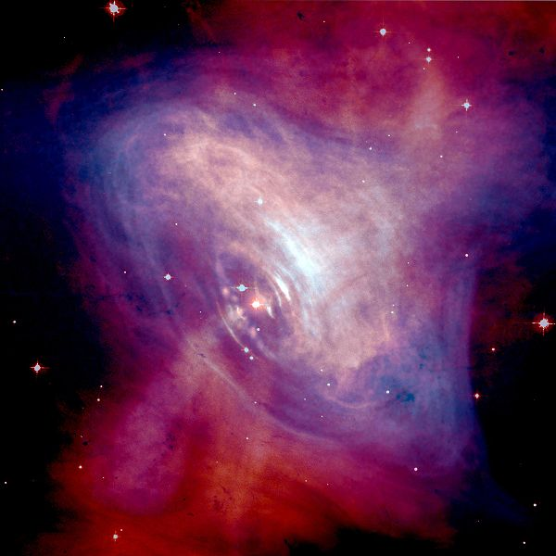
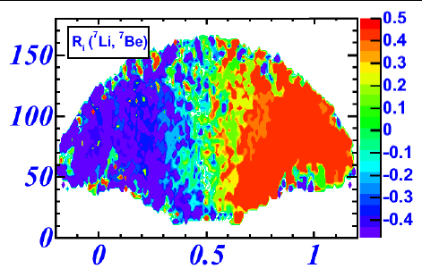
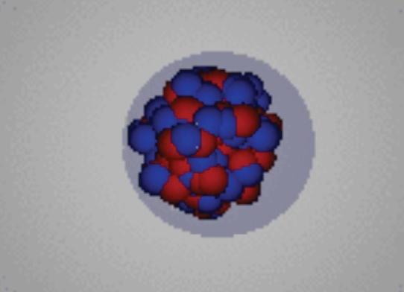
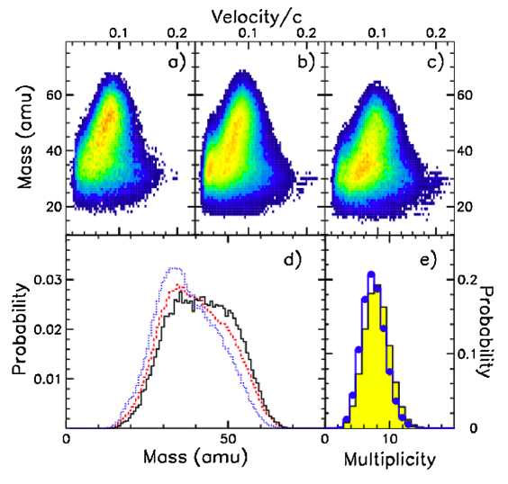
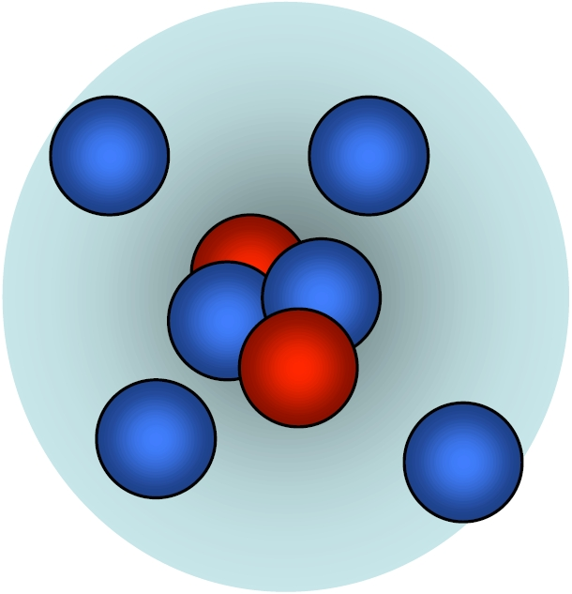
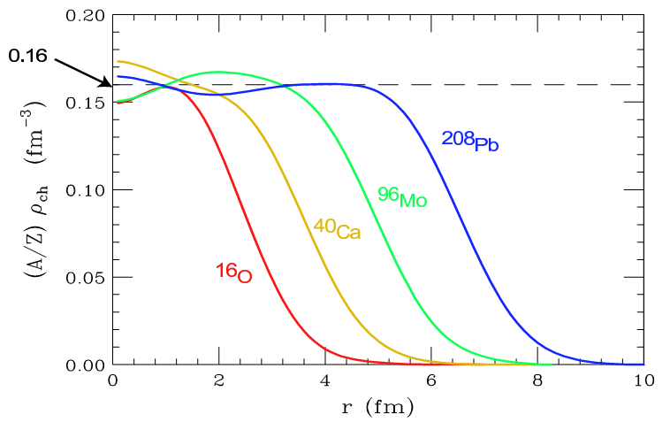
Equation of State and Symmetry Energy in Heavy-Ion Collisions
Astrophysics
G. Verde
INFN, Sez. Catania
Heavy-ion collisions: dynamics/fragmentation
Nuclei structure & collective modes
Supernovae, neutron stars
halos
GDR & PYGMY RESONANCE
Skins

Slide 2
The nuclear Equation of State
Exploring the EoS: “How much energy is needed to compress hadronic matter?”
Why heavy-ion collisions?
this talk: Intermediate (Fermi) energies (E/A=20-70 MeV) & sub-relativistic energies (E/A=100-2000 MeV)
Densities ≈ 0.01ρ₀ – 2.5ρ₀, Temperatures < 15 MeV
What is the role of isospin asymmetry δ=(N-Z)/(N+Z) in nuclear reactions?

Slide 3
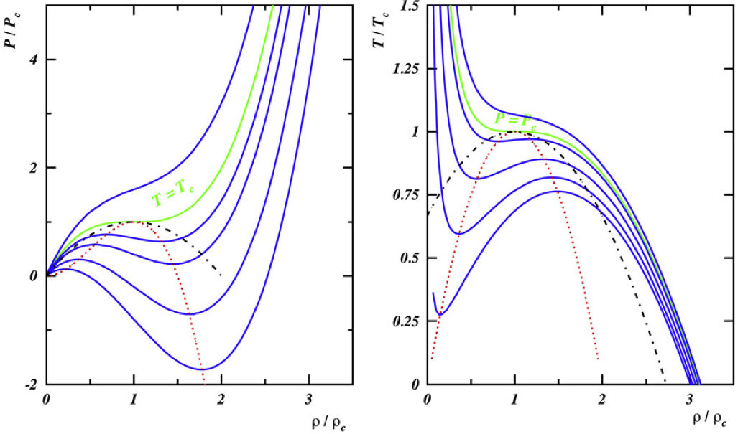
Nuclear Equation of State
Nuclear interaction ≈ van der Waals
P vs ρ
T vs ρ
P=P_{C}
T=T_{C}
Symmetric nuclear matter
Pressure
Compressibility
Borderie, Rivet, Prog.Part.Nucl.Phys. 61 (2008)
Spinodal instability region (K<0): Liquid-gas phase transitions at ρ<ρ₀ and T<15 MeV ?
Gas-like: free nucleons and light clusters
Liquid-drop-like: heavier fragments; density fluctuations… vapor condensation?...
G. Sauer et al., NPA 264, 221 (1976)
H.R. Jaqaman et al., PRC 29, 2067 (1984)

Slide 4
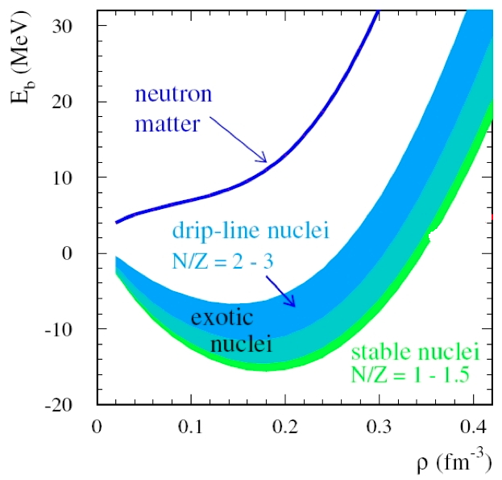
Asy-EoS: asymmetric nuclear matter
P vs ρ
T vs ρ
P=P_{C}
T=T_{C}
Asymmetric nuclear matter
F. De Jong, H. Lenske, PRC57, 3099 (1998)
Pure Neutron matter
Borderie, Rivet, Prog.Part.Nucl.Phys. 61 (2008)
δ
δ
Isospin effects in the liquid-gas coexistence region: fractionation
Gas-like: free nucleons and light clusters
Neutron rich (N>>Z)
Liquid-drop-like: heavier fragments from growth of density fluctuations…
Isospin symmetric (N≈Z)
Mueller & Serot, PRC52, 2072 (1995)
H. Xu et al., PRL75, 716 (2000)

Slide 5
Where and how to explore EoS ?
Astrophysical sites: supernovae, neutron stars…
Excited nuclear systems produced in heavy-ion collisions (HIC)
HIC very different systems…

Slide 6
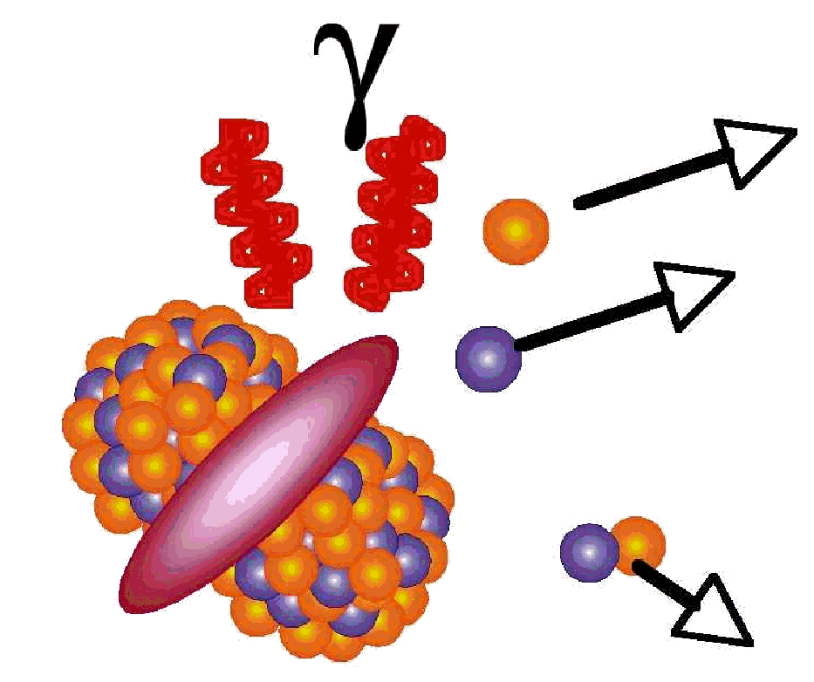
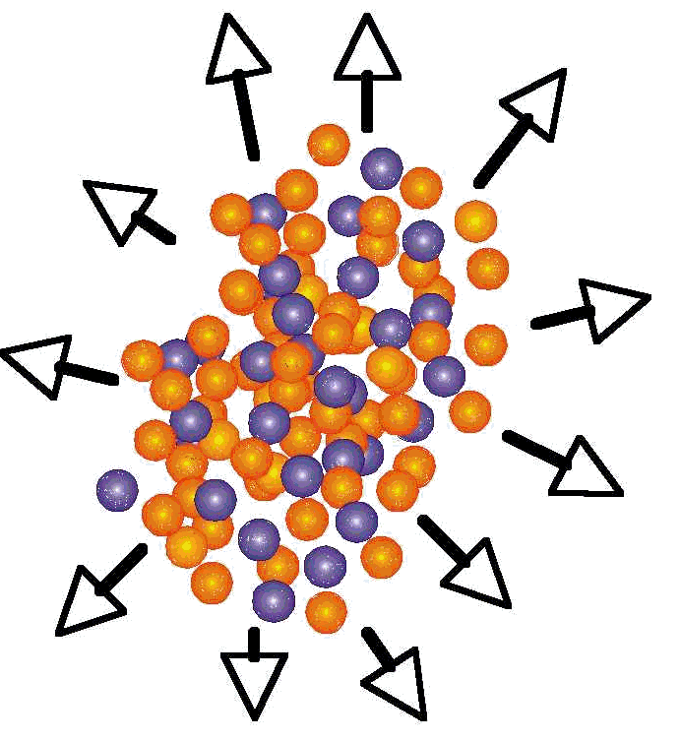
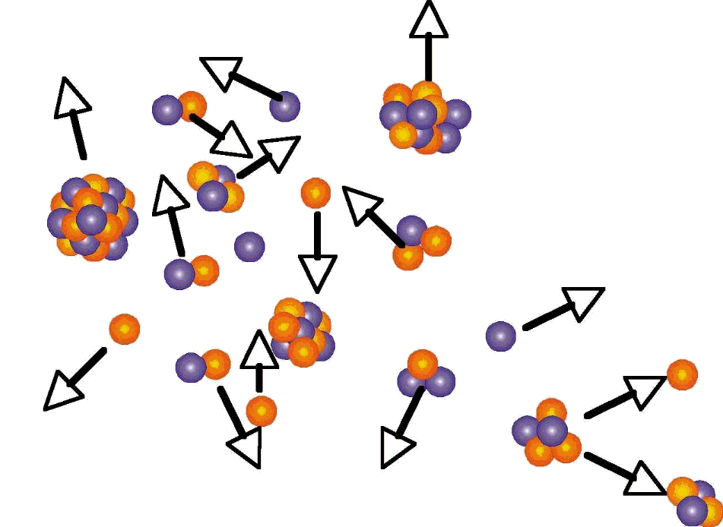
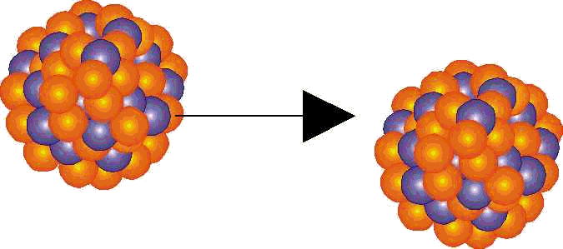
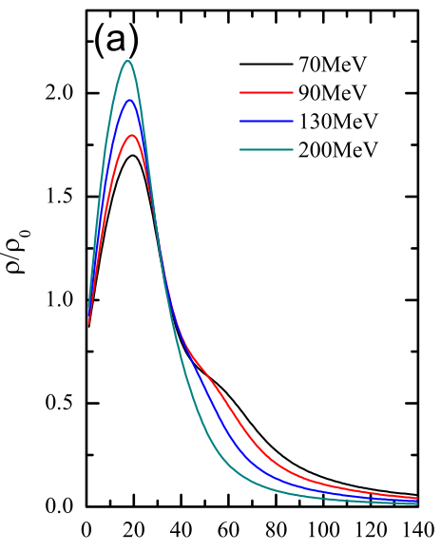
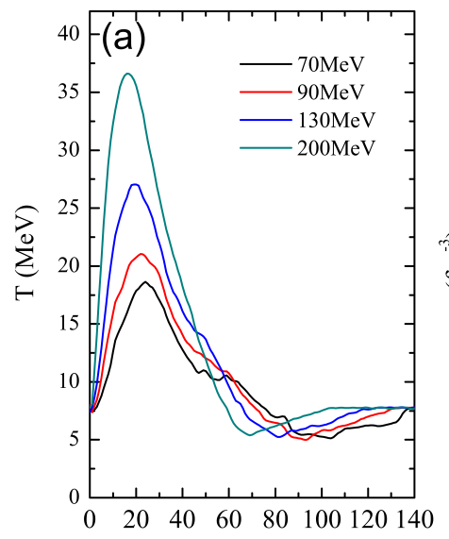
HIC compressing and heating nuclear matter
Laboratory controlled
Projectile
Target
Secondary decays
Pre-equilibrium, stopping, compression
Fragmentation
Flow, expansion
Beam energy, target and projectile (A,Z)
compression and excitation: supra-saturation densities (ρ/ρ₀>1), T>0 MeV
stopping and collective expansion: sub-saturation densities (ρ/ρ₀<1), fragmentation, phase transitions
Proj and target N/Z asymmetry (ex.: ¹²⁴Sn+¹²⁴Sn vs ¹¹²Sn+¹¹²Sn)
enhancement of isotopic N/Z effects (increasing as (N-Z)²/A) → Asy-EoS
Au+Au
Au+Au
ρ/ρ₀
Temperature
QMD
time (fm/c)
time (fm/c)
Excited systems live for a very short time (10⁻²³s-10⁻¹⁶s): need reconstruction of all reaction → 4π detectors and resolution
EoS under laboratory controlled conditions

Slide 7
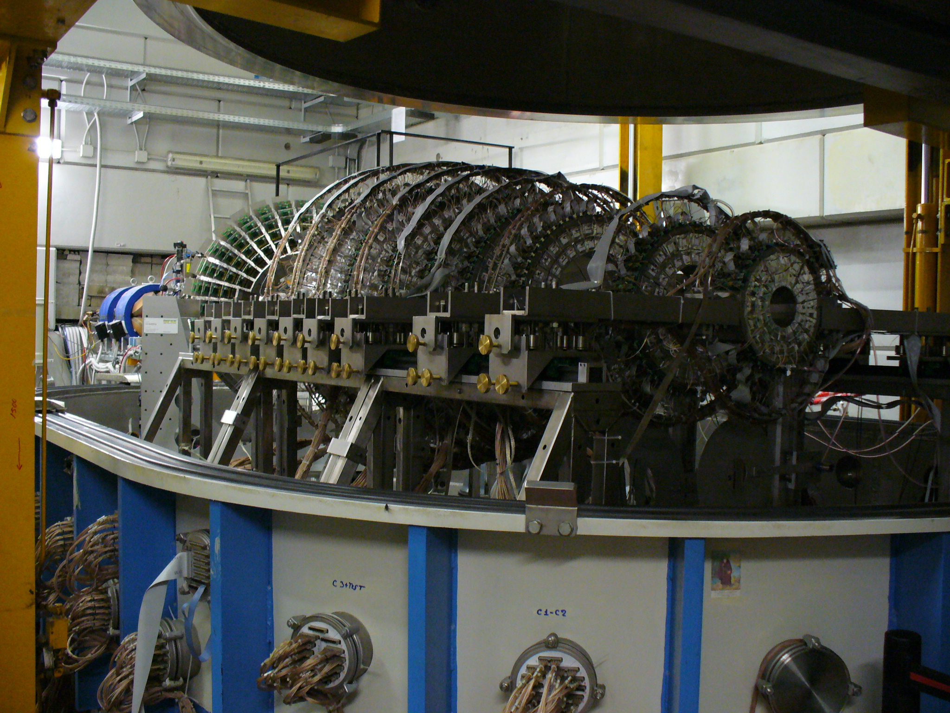
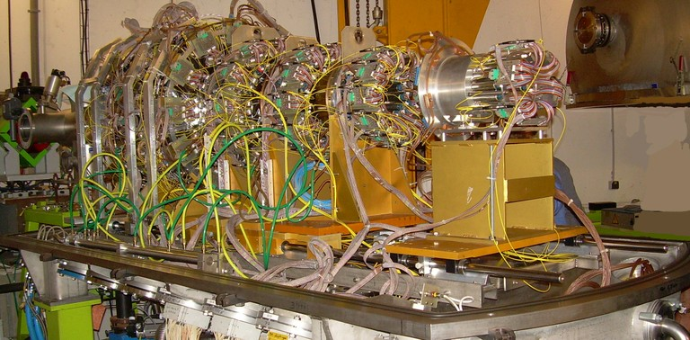
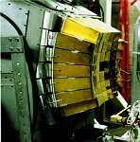
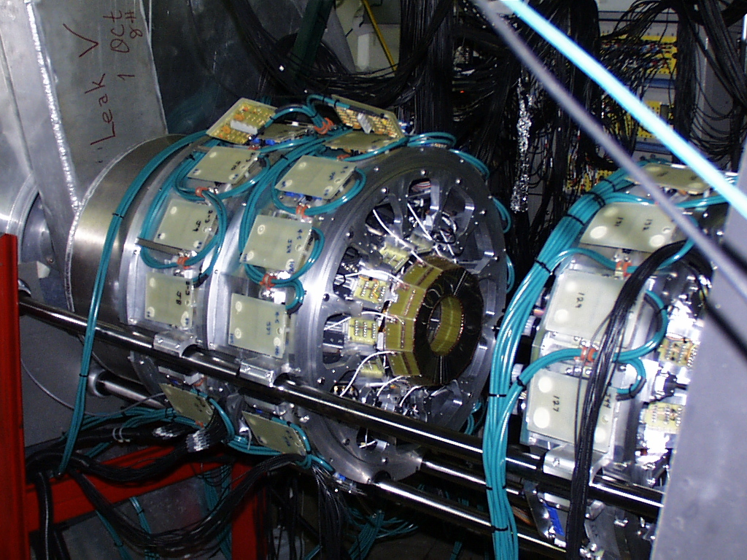
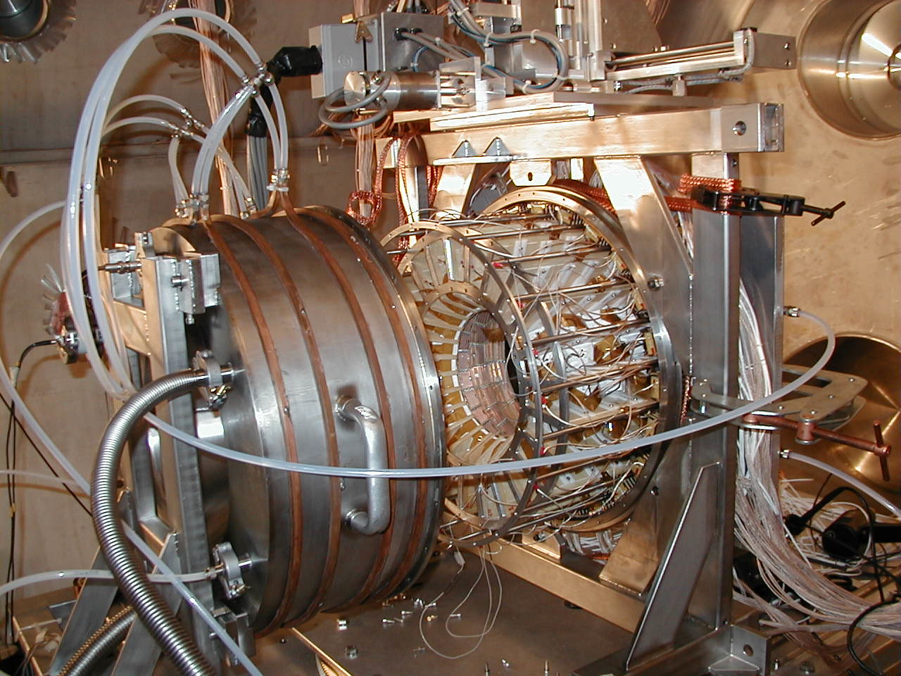
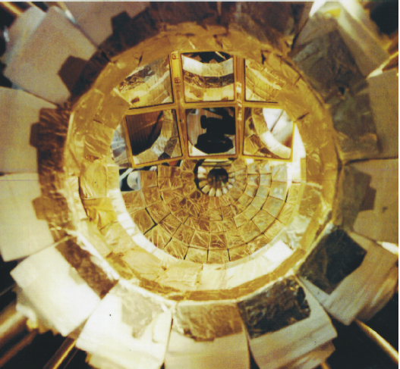
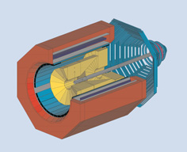
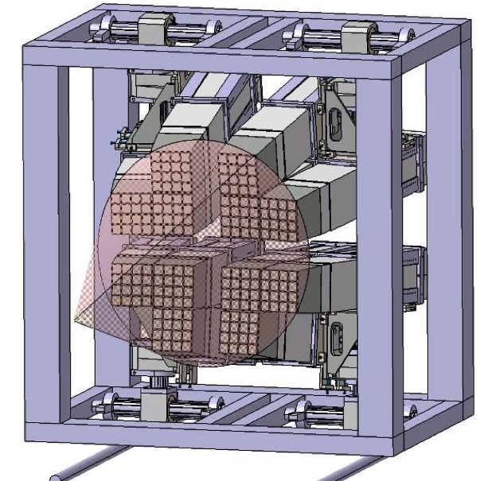
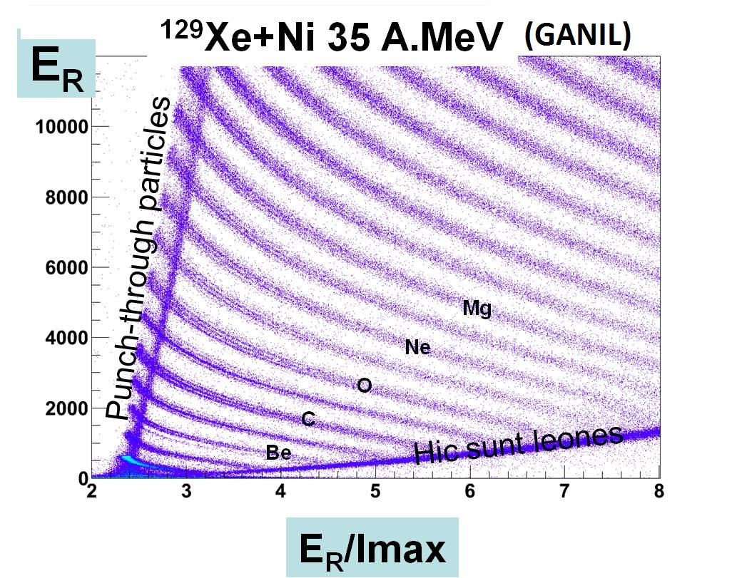
4π and high resolution detectors
Chimera @ LNS
Indra @ GANIL, GSI
Multics @ MSU,LNL,LNS
NIMROD @ TAMU
Garfield @ LNL
Lassa + Miniball @ MSU
FOPI @ GSI
Fazia @ LNL, LNS, GANIL

Slide 8
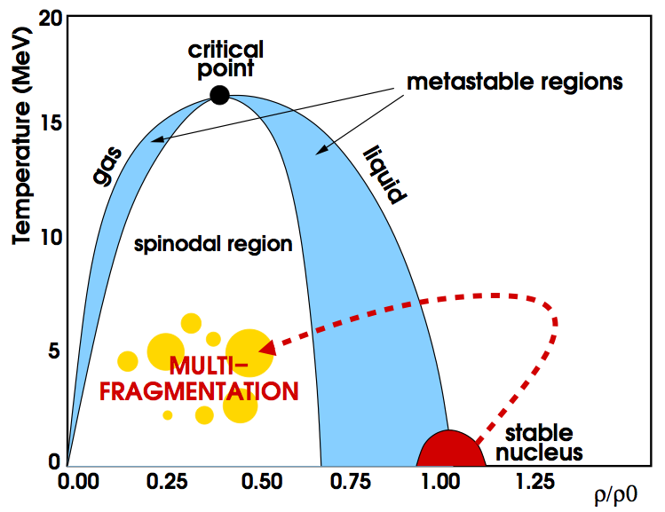
Exciting nuclear matter with HIC
The path to multifragmentation
Increasing excitation to induce signature of LG phase transition?
Caloric Curves
Temperature (MeV)
Central : excitation depends on beam energy
Decay of Quasi-Fused central source
Collective motion important
Peripheral: impact parameter linked to excitation
Excitation energy (MeV/u)
Decay of Quasi-Projectile (Projectile spectators) at forward angles
Size decreases with excitation
Borderie, Rivet, Prog. Part. Nucl. Phys. 61 (2008) 551 and Refs. Therein; WCI Book, Eur. Phys. J. A30 (2006)
J. Pochodzalla, PRL75, 1040 (1995)

Slide 9
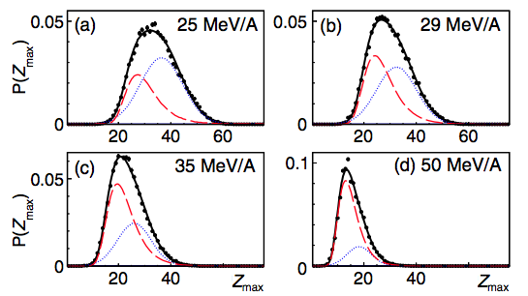
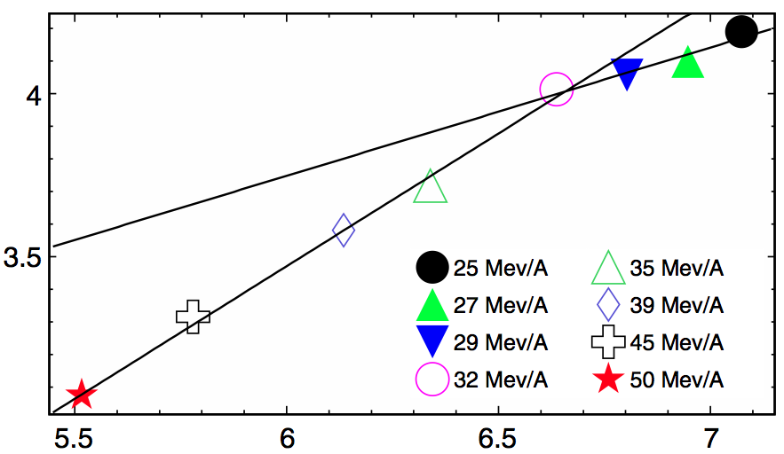
Multifragmentation like vapor condensation?
Z_{max} = Order parameter of the phase transition
Distribtuion and Fluctuations
Xe+Sn E/A=25-50 MeV Central Indra@ GANIL
Z_{max} distributions vs E_{beam}
Δ-scaling
Δ=1/2
D. Gruyer et al., PRL 110, 172701 (2013)
ln(σ²)
Δ=1
ln(<Z_{max}>)
P(Z_{max}) = η f_{Gauss}(Z_{max}) + (1-η) f_{Gumbel}(Z_{max})
Analogy with Out-of equilibrium cluster aggregation models
E/A~ 32 MeV → Transition towards “explosive fragmentation” over shorter time-scales due to stopping and radial flow

Slide 10
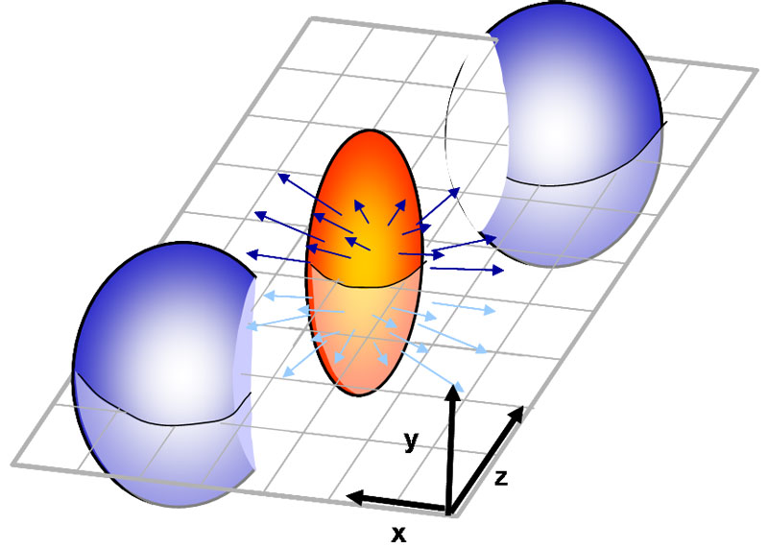
EoS of asymmetric nuclear matter
Symmetric matter
Elliptic flow:
high density EoS
Constraints from directed flow
ρ≈2ρ₀
In-plane directed flow
Central Au+Au
t = 10-20 fm/c
P. Danielewicz, R. Lacey, W.G. Lynch, Science, 298, 1592 (2002)

Slide 11
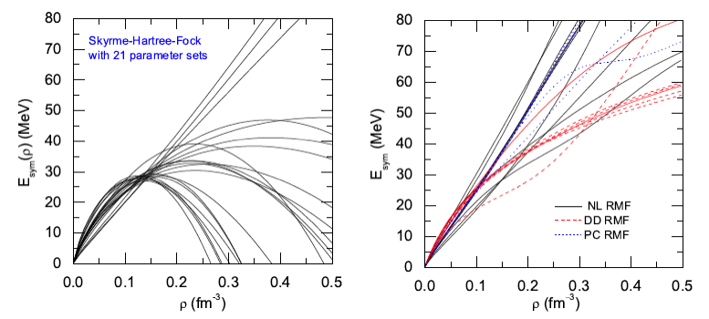
EoS of asymmetric nuclear matter
Asymmetry term
B.A. Li et al., Phys. Rep. 464, 113 (2008)
Many approaches… large uncertainties….
Microscopic many-body, phenomenological, variational, …
Especially at high densities (three-body forces)
ZH Li, U. Lombardo, PRC74 047304 (2006)
Stiff
E_{sym}(MeV)
E_{sym}(MeV)
Soft
Esym enhanced in reactions with large N/Z asymmetries (due to δ²)
Brown, Phys. Rev. Lett. 85, 5296 (2001)
Fuchs and Wolter, EPJA 30, 5 (2006)

Slide 12
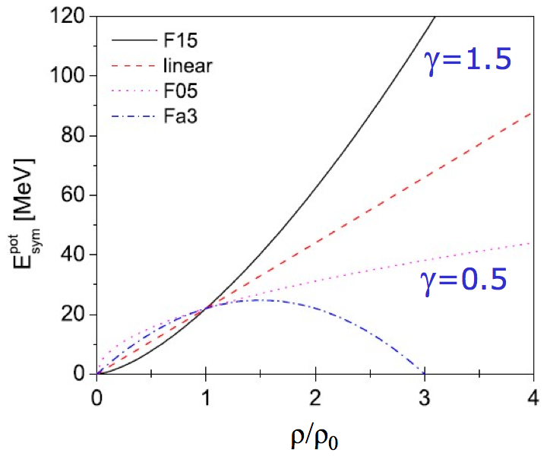
Parameterizations of density dependence
UrQMD by Q. Li
High γ, L
Microscopic transport models:
input AsyEoS parameterizations
compare predictions to observables measured in Heavy-Ion collisions
Low γ, L
strength
curvature
slope

Slide 13
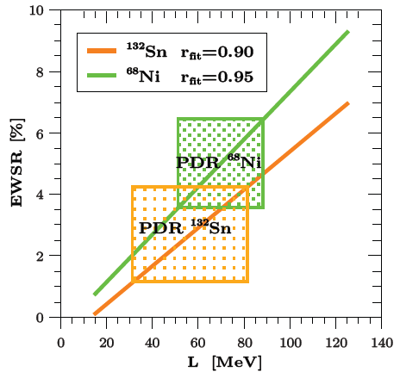
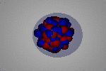
E_{sym} studies with Pygmy Dipole Resonance
Collective oscillation of neutron skin against the Core → Esym around saturation density
M.B. Tsang, NN2012
L=65.1±15.5 MeV
S_{o}=32.3±1.3 MeV
Klimkiewicz et al., PRC 76, 051603(R) (2007)
Wieland et al., PRL102, 092502 (2009)
Carbone et al., PRC 81, 041301 (2010)
dR_{np} (²⁰⁸Pb)= 0.20±0.02 fm

Slide 14
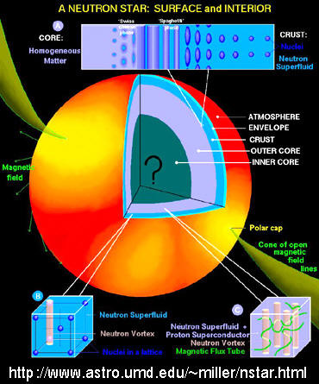
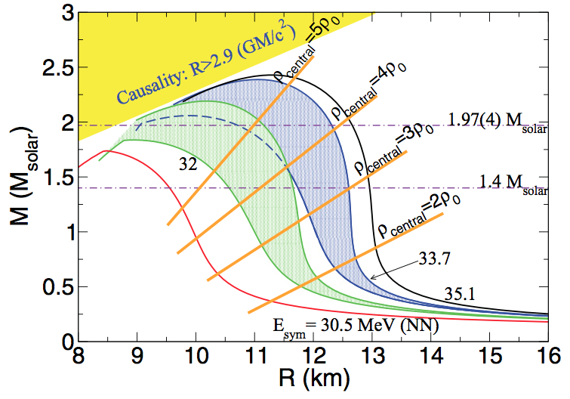
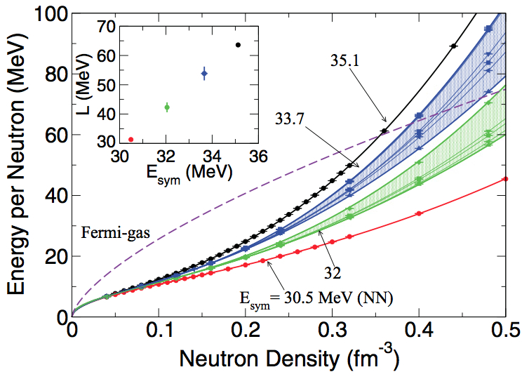
E_{sym} and neutron stars
Neutron Stars
Radii
Frequencies of crustal vibrations
Composition, thickness of inner crust
URCA processes
Phases within the star
S. Gandolfi et al., Physical Review C85, 032801(R)
Monte Carlo (QMC) methods
Symmetry energy
Neutron star Radii and Masses

Slide 15
HIC at Fermi energies: E/A<80 MeV
Pre-equilibrium emission
Flow
Multifragmentation
b=central
b=mid-peripheral
Isospin diffusion & drift
Neck fragments
PLF
TLF
b=peripheral
Isospin diffusion & drift
PLF
TLF

Slide 16
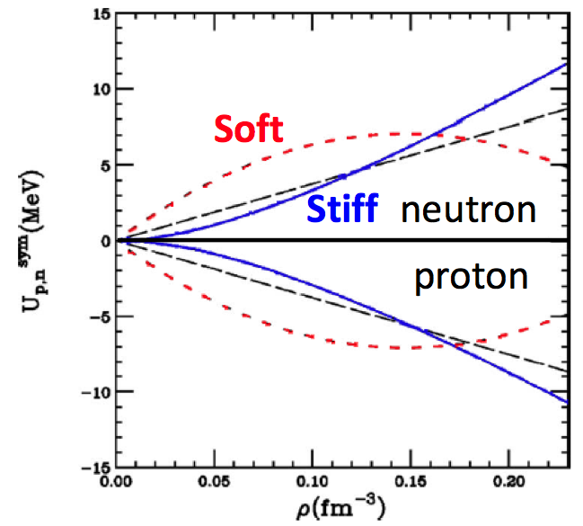
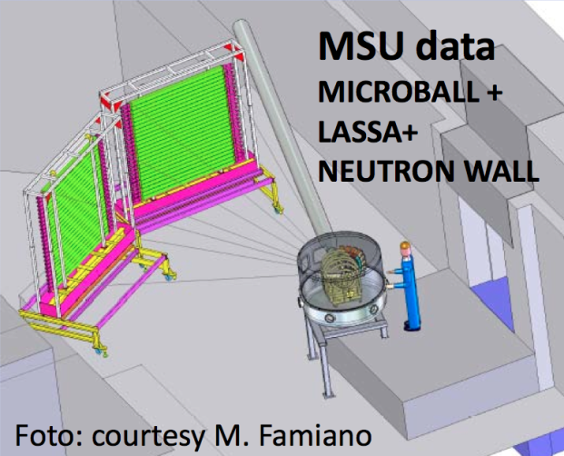
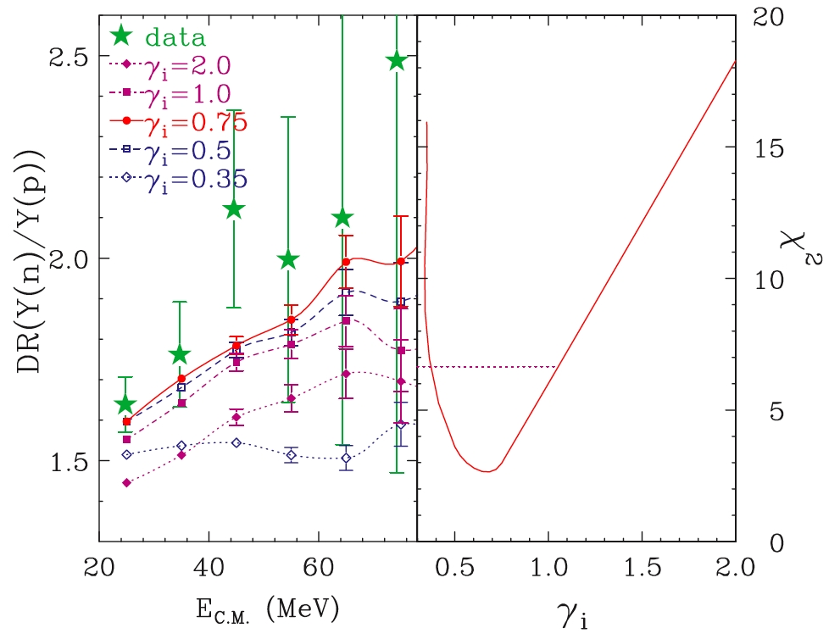
Neutron-proton ratios at pre-equilibrium
V. Baran et al., Phys. Rep. 410 (2005)
¹¹²Sn+¹¹²Sn, ¹²⁴Sn+¹²⁴Sn E/A=50 MeV
B.A. Li et al., PLB 634, 378 (2006)
Y. Zhang et al., PLB664, 145 (2008)
Skyrme-like mean field
Famiano et al., PRL97, 052701 (2006)
ImQMD simulations Vs Data
Asy-Soft more repulsive for neutrons
γ≈0.5-0.9
Y(n)/Y(p) in 124Sn+124Sn
Y(n)/Y(p) in 112Sn+112Sn
Double ratios: enhance N/Z effects & reduce systematic errors and efficiency problems
M.B. Tsang et al., PRL102, 122701 (2009)

Slide 17
HIC at Fermi energies: E/A<100 MeV
Pre-equilibrium emission
Flow
Multifragmentation
b=central
b=mid-peripheral
Isospin diffusion & drift
Neck fragments
PLF
TLF
b=peripheral
Isospin diffusion & drift
PLF
TLF

Slide 18
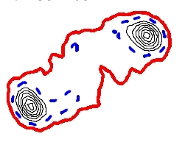
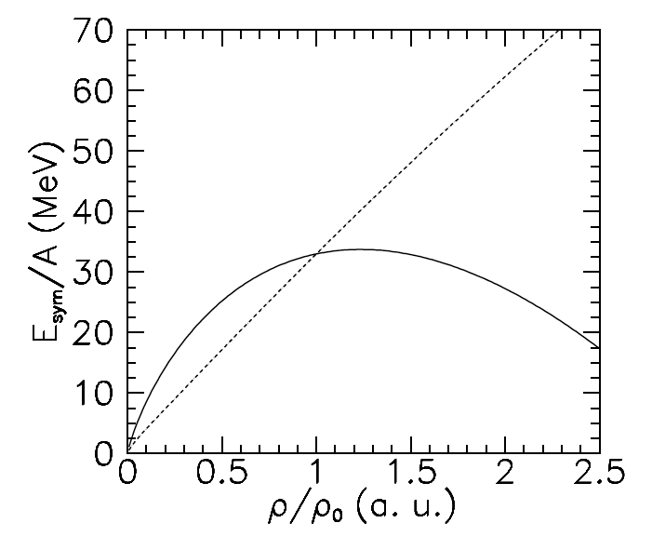
Isospin drift & diffusion
Isospin equilibration
ρ~ρ₀
PLF
PLF
PLF
Long τ_{int}
Targ
Proj
ρ ~1/8ρ₀
TLF
TLF
TLF
ρ ~ρ₀
Short τ_{int}
Isospin drift
Isospin diffusion
Isospin translucency
ρ/ρ₀
Ν/Ζ
Προϕ
Ταργ
1
n drift
n/p diffusion
TLF
Neck
PLF
TLF
Neck
PLF
E_{sym} vs ρ
Asy-Stiff
Low ρ<ρ₀
Asy-Soft
Colonna et al.; Danielewicz et al.
Notes:
This shows a mid-peripheral collision between two heavy ions. Let us assume for the moment that they have the same N/Z. For example 112Sn+112Sn. At this stage we have the formation of a neck region where the density is low while the density in the PLF and the TLF regions is about at saturation. Then this means that in going from TLF to PLF there is a gradient of density. Because of this gradient for neutrons it is convenient to move towards the low density region in the neck and one expect therefore that the neck region is more neutron rich as compared to the PLF and the TLF regions that remain almost symmetric. This is called isospin drift and it occurs even in the case of collisions with nuclei having the same N/Z asymmetry.
Now let’s consider a different case. These two nuclei have different N/Z asymmetries. For example the PLF is more neutron rich than the TLF. The collision proceeds… and the two partners exchange nucleons. The exchange proceeds towards a direction that tends to distribute the N/Z uniformly throughout the dinuclear system. The PLF becomes less neutron rich and the TLF becomes more neutron rich. If the collision time is very long, then the process proceeds until a complete N/Z equilibration is attained. Then we say that isospin diffusion has lead to complete N/Z equilibration. On the other hand, if the interaction time is short, then the isospin diffusion process is interrupted before the attainment of complete equilibration. This condition is commonly indicated as isospin translucency, or partial transparency. The result is that the PLF and TLF keep memeory of their initial isospin asymmetries.
P. Danielewicz and M. Colonna tried to describe this with an equation that provide a quantitative description of the relative neutron-proton currents through the neck. This equation has two terms that correspond to the phenomena that I have just described. A term that is proportional to the gradient in density, that is the isospin drift term. And a term that is proportional to the gradient in isospin asymmetry, that is the isospin diffusion term. The drift coefficient depends on the first derivative of the symmetry energy while the diffusion term depends on the strength of the symmetry energy. Therefore Studying these phenomena one can access information about the density dependence of the symmetry energy at sub-saturation density.

Slide 19
Exploring neck emissions
¹²⁴Sn+⁶⁴Ni @ 35 MeV/u Chimera @ LNS
Three-fragment correlations
PLF fission – long time-scales
t>100 fm/c
Neck emission
Fast time-scales
t<100 fm/c
V_{rel} (IMF-TLF) / V_{Viola}
TLF fission – long time-scales
t>100 fm/c
V_{rel} (IMF-PLF) / V_{Viola}
E. De Filippo et al., Phys. Rev. C (2012)

Slide 20
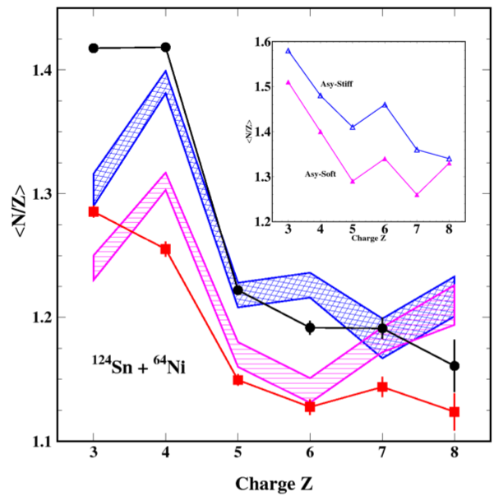
Isospin chronology and E_{sym}(ρ)
N/Z content of neck fragment (dynamical fast emission)
SMF Simulations Vs Experimental data
Dynamical - Neck
N/Z content of statistical emission by PLF and TLF
E. De Filippo et al., Phys. Rev. C (2012)
Statistical
Data consistent with γ ≈ 0.8
SMF: Stochastic Mean Field calculations by M. Colonna et al.

Slide 21
Isospin diffusion and imbalance ratios
¹¹²Sn+¹¹²Sn ¹¹²Sn+¹²⁴Sn ¹²⁴Sn+¹¹²Sn ¹²⁴Sn+¹²⁴Sn
PP
MIX
MIX
NN
Reconstructed (N/Z) of QP*
→ Indra: E. Galichet et al. PRC79, 064614 (2009)
Mirror nuclei ratios: Y(⁷Li)/Y(⁷Be)
→ Lassa: M.B. Tsang et al., PRL102, 122701 (2009)
→ Chimera: Z.Y.Sun et al., PRC82, 051603 (2010)
X=Observable sensitive to N/Z of emitter
QP*
Isospin transparency
R_{i}(X) = 1
¹²⁴Sn
QT*
QP*
Isospin translucency
0 < R_{i}(X) < 1
QT*
¹¹²Sn
INDRA @ GANIL
LASSA @ MSU
Chimera @ LNS
QP*
Isospin equilibration
R_{i}(X) = 0
QT*

Slide 22
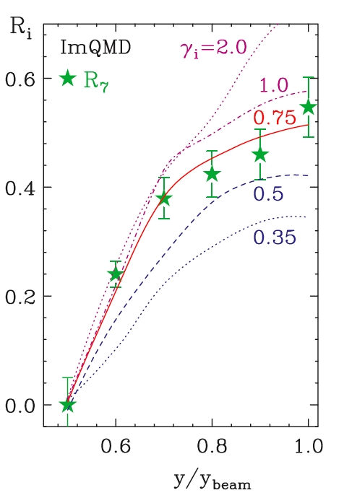
Isospin diffusion probes of E_{sym}(ρ)
^{112,124}Sn+^{112,124}Sn E/A=50 MeV
LASSA @ MSU
N/Z trasluncency
@ Proj rapidity
R_{i}(X₇)
Complete N/Z mixing
@ Mid rapidity
ImQMD Model Simulations
γ = 0.5-0.75
M.B. Tsang et al., PRL102, 122701 (2009)
Z.Y. Sun et al., PRC82 051603 (2010)

Slide 23
HIC at Fermi energies: E/A<100 MeV
Pre-equilibrium emission
Flow
Multifragmentation
b=central
b=mid-peripheral
Isospin diffusion & drift
Neck fragments
PLF
TLF
b=peripheral
Isospin diffusion & drift
PLF
TLF

Slide 24
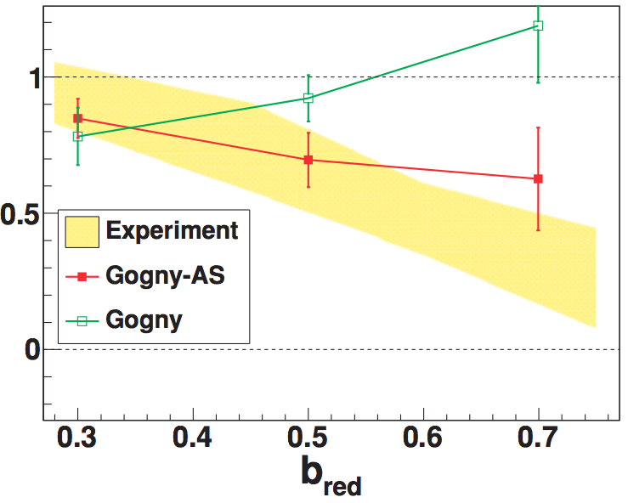
Directed flow and E_{sym}(ρ)
⁷⁰Zn+⁷⁰Zn, ⁶⁴Zn+⁶⁴Zn, ⁶⁴Ni+⁶⁴Ni - E/A= 35 MeV
NIMROD+ISiS + TAMU Nball @ TAMU
Comparison to AMD+Gemini
MASS
Average Flow (MeV/c)
Average flow balance ratio
stiff
soft
CHARGE
R_{flow} = 1 Mass Dependence
R_{flow} = 0 Charge Dependence
Transition from Mass-dependent to Charge-dependent → sensitive to E_{sym}(ρ)
→predicted by different models (AMD, CoMD, SMF)
Constrains on L~50-80 MeV by directed flow w different models
Sensitive to Esym(ρ): L. Scalone et al., PLB461, 9 (1999)
Z. Kohley et al., PRC82, 064601 (2010); PRC 85, 064605 (2012)

Slide 25
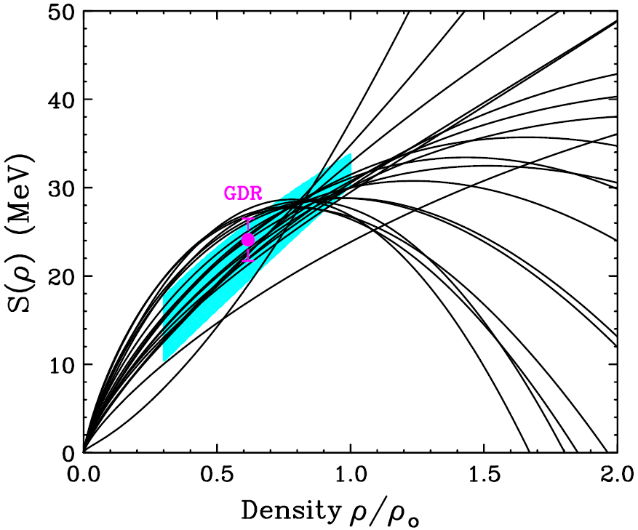
Symmetry Energy at subsaturation densities
Present status from Heavy-ion collision measurements

Slide 26
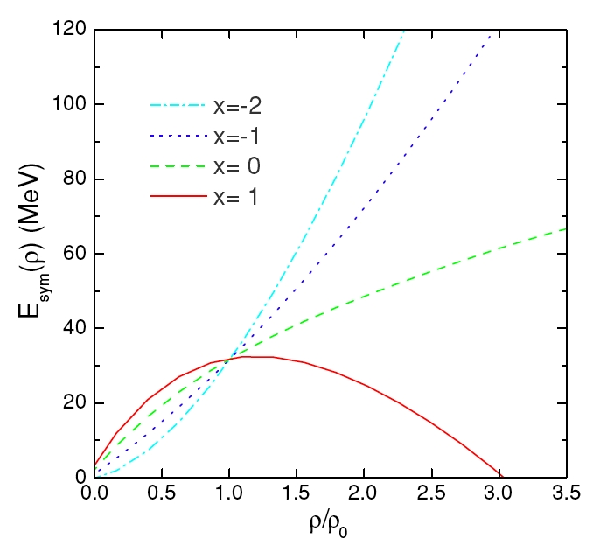
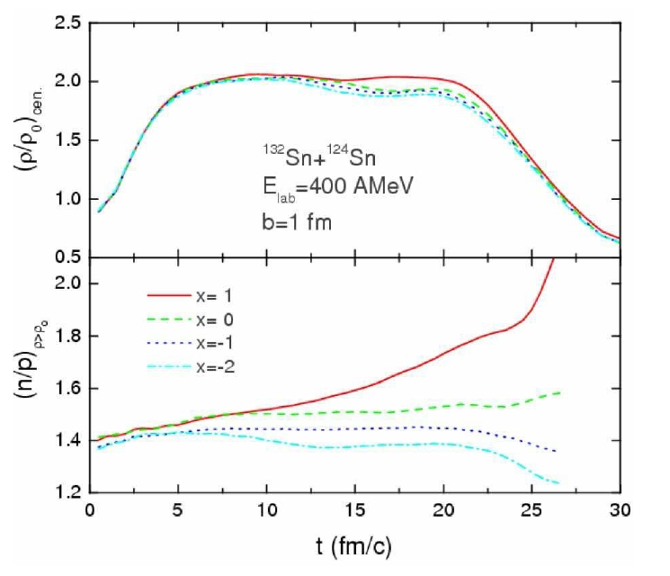
Effects of the E_{sym} at high density Beam energies E/A>100 MeV
Transport model: IBUU ¹³²Sn+¹²⁴Sn
E/A = 400 MeV
B.A. Li et al., PRC71 (2005)
stiffness
≈(ρ/ρ₀)^{γ}
ρ>ρ₀
stiffness
High ρ>ρ₀ : asy-stiff more repulsive on neutrons
Neutron-proton asymmetry at high density sensitive to E_{sym}(ρ)

Slide 27
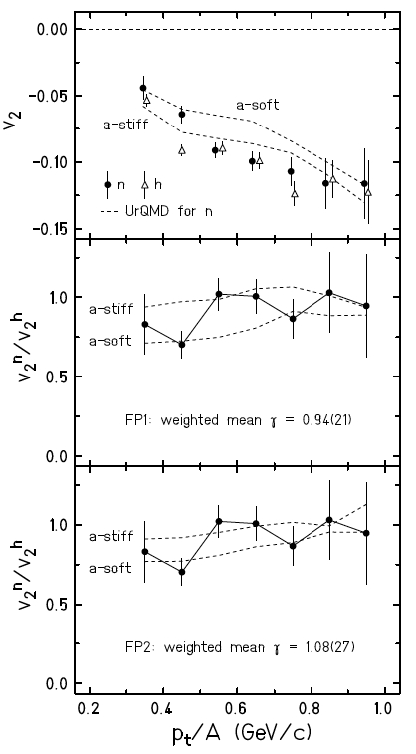
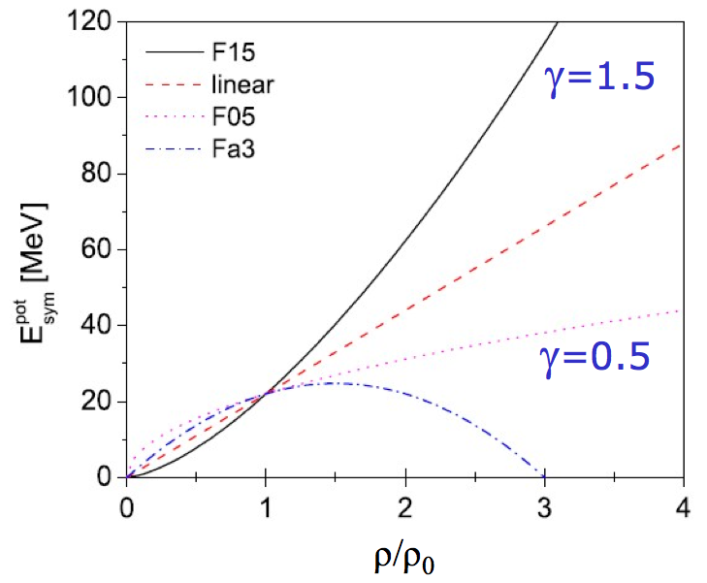
n/p elliptic flow in HIC at GSI energies
y
Out-of-plane flow
Squeeze-out
Au+Au @ 400 A MeV
ρ≈2ρ₀
LAND-FOPI Data vs UrQMD
φ
b<7.5 fm
0.25<y/yp<0.75
Reaction plane
x
z
t = 10-20 fm/c
P.Russotto et al., Phys. Lett. B 697 (2011)
Qingfeng Li, J. Phys. G31 1359-1374 (2005)
pt dependence of n/p v₂ ratio → γ =0.9 ± 0.4
Notes:
27

Slide 28
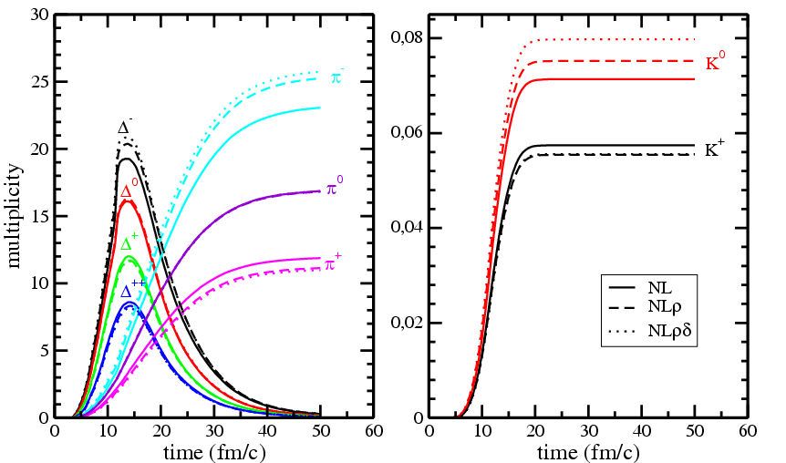
Meson production and ratios at high ρ
Low ρ/ρ₀
High ρ/ρ₀
π⁺, π⁻
K⁺,K⁰
RBUU, Ferini et al., PRL97, 202301
PION ratios π⁺/π⁻ → Perspectives from future SAMURAI-TPC Project (MSU, Riken)
Strongly interacting in medium: high quality measurements required
Present constraints on Esym are controversial (Zhigang Xiao et al. PRL 102 (2009); Zhao-Qing Feng, Gen-Ming Jin, Phys. Lett. B683 (2010), FOPI data)
KAON ratios Κ⁺/Κ⁰
Weakly interacting in medium: good probes of high density
Status: difficult measurements for low statistics (sub-threshold); see X, Lopez et al., PRC75, 011901 (2007), FOPI data)
Notes:
Pions freeze-out when the density is already low

Slide 29
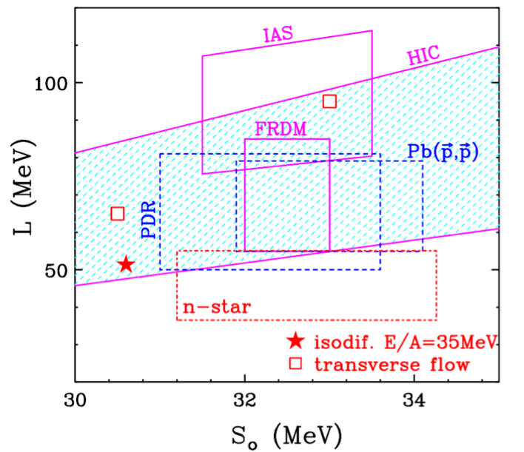
Constraints on density dependence of symmetry energy
Measurements of E_{sym}(ρ), L and S₀ from different experimental approaches
Finite Range Drop Model (FRDM) analysis of binding energies
Heavy-ion collision dynamics
0.4 < γ < 1
Polarized protons elastic scattering on Pb isotopes: → dRnp = 0.21±0.06 fm)
Polarized protons elastic scattering on Pb isotopes → dR_{np}= 0.20±0.02 fm
Astrophysical studies (X-ray data )

Slide 30
Summary and Perspectives
EoS of symmetric nuclear matter largely explored in HIC (liquid-gas phase transitions, elliptic flow)
Asymmetry EoS and symmetry energy need more explorations (sub- and supra-saturation)
Sub-saturation densities: 0.4<γ<1.0: agreement from different methods (HIC, PDR, pp scattering, etc.)
Perspectives:
E_{sym} at very low densities (TAMU)
E_{sym} at supra-saturation densities (AsyEoS@GSI, SAMURAI-TPC@Riken)
Reinforce the study of transport model comparisons to experimental observables

Slide 31
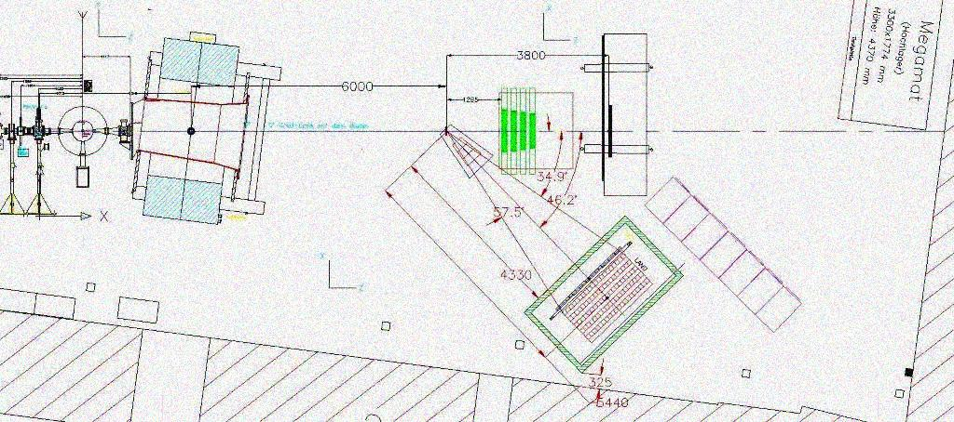
Present & future projects
Asy-Eos experiment @ GSI
Chimera+LAND+KRATTA+Microball
Stable beams
Au+Au @ 400 AMeV
⁹⁶Zr+⁹⁶Zr @ 400 AMeV
⁹⁶Ru+⁹⁶Ru @ 400 AMeV
n/p Elliptic flow
SAMURAI TPC @ Riken
Stable and exotic beams
¹⁰⁵Sn+¹¹²Sn, ¹³²Sn+¹²⁴Sn, ³⁶Ca+⁴⁰Ca, ⁵²Ca+⁴⁸Ca
E/A=200-300 MeV
Yield ratios:
π⁺/π⁺, n/p, t/3He

Slide 32
Symmetry energy at very low densities?
Pre-equilibrium emission
Flow
Multifragmentation
Central
→ ρ ≈ 0.01∙ρ₀
Clustering (~alphas) at small densities affects E_{sym}
E_{sym}(ρ) not vanishing at very low ρ
NIMROD @ TAMU
⁶⁴Zn+⁹²Mo,¹⁹⁷Au
⁴⁰Ar, ⁶⁴Zn+^{112,124}Sn
E/A=35 MeV
E_{sym}(MeV)
Density ρ(fm⁻³)
Perspectives and challenge: access to Symmetry Energy at very low densities
J.B. Natowitz et al, PRL 104 (2010) 202501
R. Wada et al., PRC85, 064618 (2012)
C.J. Horowitz et al., NPA776, 55 (2006), G. Wanatabe et al., PRL103, 121101 (2009)

Slide 33
Acknoledgements
The entire heavy-ion collisions community for the great work in the last ~30 years of explorations on EoS
Special thanks: to colleagues @ GANIL, GSI, INFN, MSU

