Slide 1
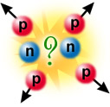

Three-nucleon forces and their importance in three-nucleon systems and heavier nuclei
Nasser Kalantar-Nayestanaki
Kernfysisch Versneller Instituut (KVI), RuG
International Nuclear Physics Conference
6 June, 2013, Florence, Italy

Slide 2
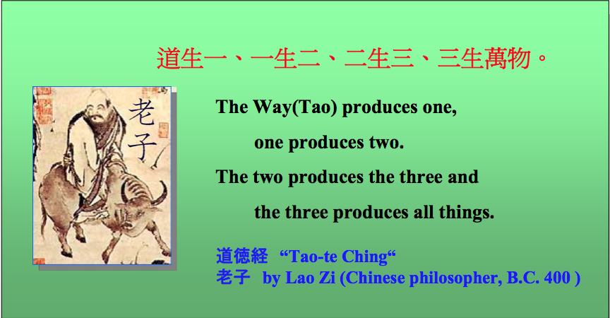
Courtesy: K. Sekiguchi

Slide 3
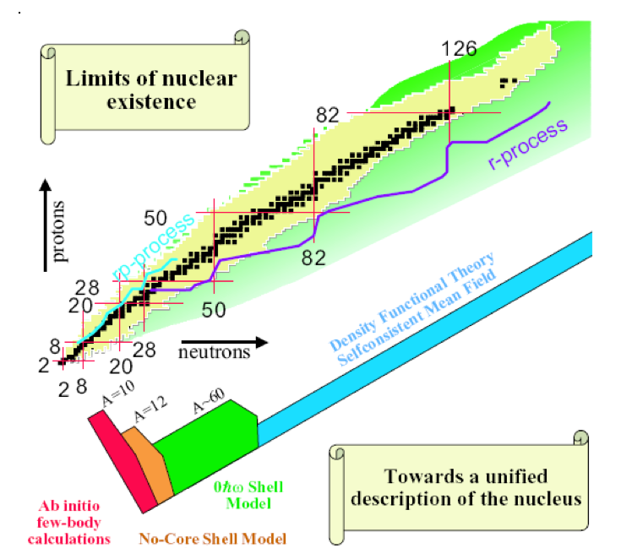

Slide 4
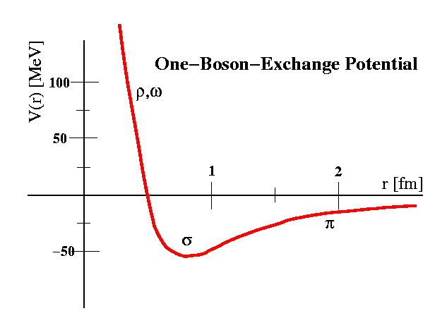
N-N Potentials
Modern phenomenological NN potentials:
Nijmegen I
Nijmegen II
Reid 93
CD-Bonn
Argonne V18
…
Comparison with experimental np&pp database gives:
χ²/data ~ 1

Slide 5
Triton Binding Energy
Model | χ²/data | ³H B.E. [MeV]
NIJM I | 1.03 | 7.72
NIJM II | 1.03 | 7.62
Reid93 | 1.03 | 7.63
Argonne V18 | 1.09 | 7.62

Slide 6
Triton Binding Energy
Model | χ²/data | ³H B.E. [MeV]
NIJM I | 1.03 | 7.72
NIJM II | 1.03 | 7.62
Reid93 | 1.03 | 7.63
Argonne V18 | 1.09 | 7.62
EXPERIMENT | - | 8.48
Modern N-N potentials fail to describe triton B.E.

Slide 7
Beyond phenomenological N-N forces
Phenomenological N-N forces fail to describe A>2 systems! How to resolve?
Three-Nucleon Force!
(3NF)

Slide 8
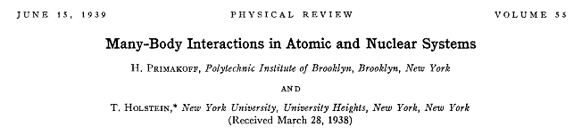
Three-Body Forces in
Nuclear Physics
“...the replacement of field interactions by two-body action-at-a-distance potentials is a poor approximation in nuclear problems.”

Slide 9
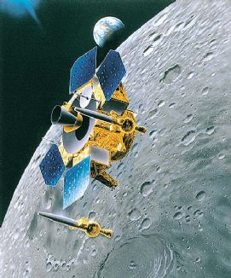
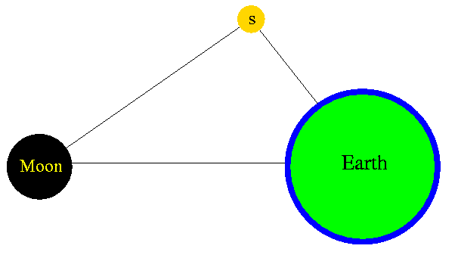
Three-Body Forces in Nature

Slide 10
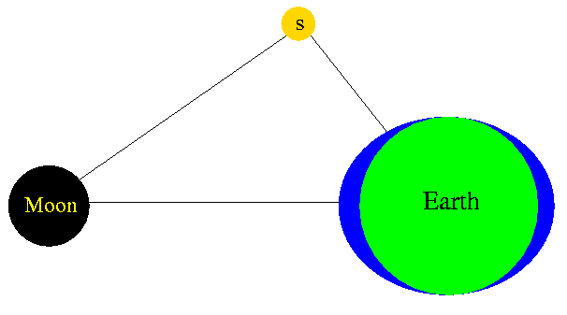
Three-Body Forces in Nature

Slide 11
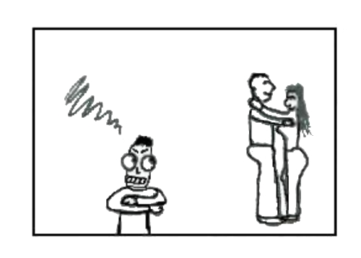
Three-body forces and Wikipedia
A three-body force is a force that does not exist in a system of two objects but appears in a system of three objects (three-body system like in Euler's three-body problem) or more. In physics, an intuitive example of a three-body force is the case of charged, metallic spheres: the charge distribution at the surface of two spheres placed close to each other will be modified, and thus the total force felt by a third sphere cannot be described by the sum of the forces from the two other spheres taken individually. The fundamental strong interaction seems to exhibits such behaviours. In particle physics, the interactions between the three quarks that compose baryons can be described in a diquark model which is equivalent to the hypothesis of a three-body force. There is growing evidence in the field of nuclear physics that three-body forces exist among the nucleons inside atomic nuclei (three-nucleon force).
As an analogy, if we identify bodies with human
beings and forces with emotions, jealousy is a
good example of three-body force: it is not felt
as long as only two persons are acting, but it can
show up as soon as a third person enters into the
scene.

Slide 12
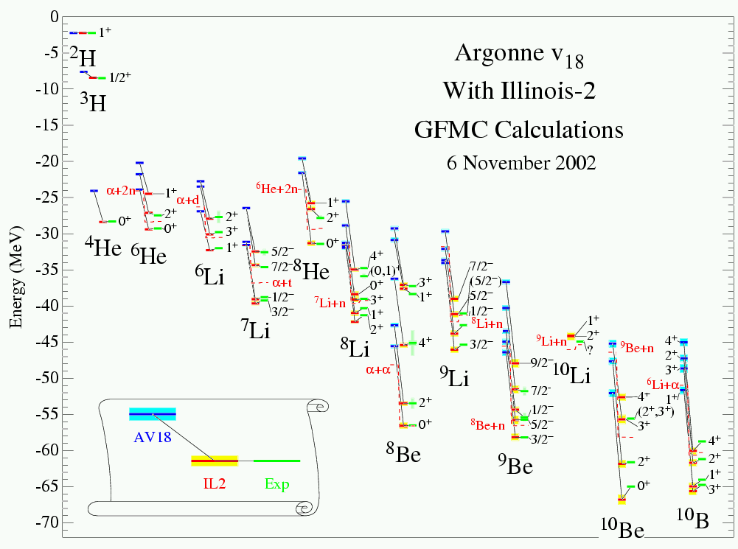
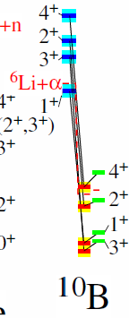
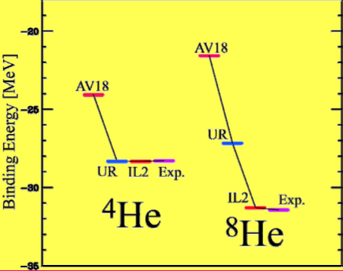
Ab-initio calculations for light nuclei
Courtesy S. Pieper, Argonne
(+3NF)

Slide 13
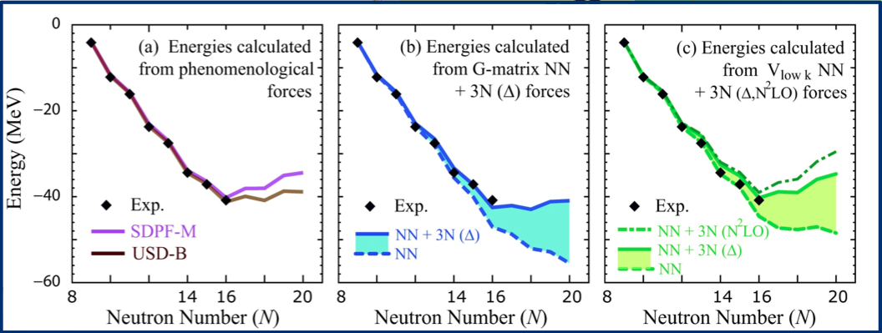
Binding Energies of Oxygen Isotopes
Otsuka, Suzuki, Holt, Schwenk, Akaishi, PRL 105, 032501 (2010)

Slide 14
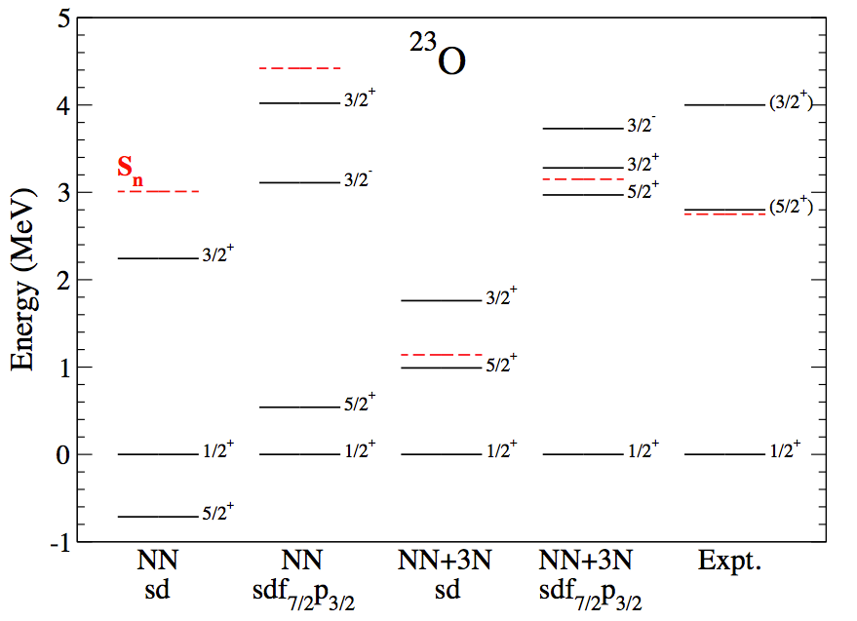
²³O
5/2⁺, 3/2⁺ indicate position of d_{5/2} and d_{3/2} orbits
sd-shell NN-only:
Wrong ground state!
5/2⁺ much too low
3/2⁺ bound
Holt et al., EPJ A49, 39 (2013)

Slide 15
²³O
5/2⁺, 3/2⁺ indicate position of d_{5/2} and d_{3/2} orbits
sd-shell NN-only:
Wrong ground state!
5/2⁺ much too low
3/2⁺ bound
Holt et al., EPJ A49, 39 (2013)

Slide 16
²³O
5/2⁺, 3/2⁺ indicate position of d_{5/2} and d_{3/2} orbits
sd-shell NN-only:
Wrong ground state!
5/2⁺ much too low
3/2⁺ bound
Microscopic NN+3N Great improvements in extended valence space!
Holt et al., EPJ A49, 39 (2013)

Slide 17
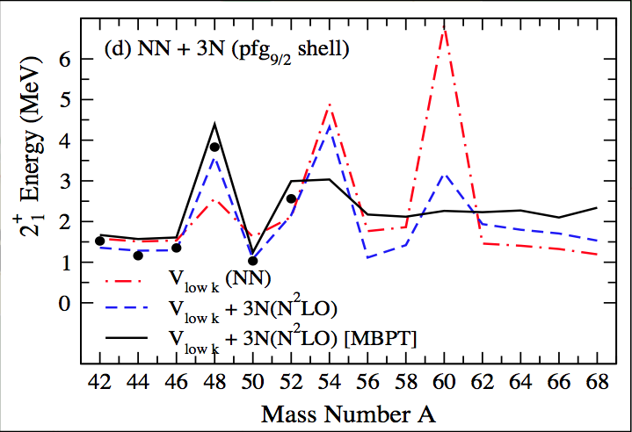
N=28 magic number in Calcium
Holt, Otsuka, Schwenk and Suzuki, J. Phys. G39, 085111 (2012)
Notes:
Energies from Vlowk and 3N(N2 LO) forces in the pfg9/2 shell with empirical GXPF1 SPEs and g9/2 at −1 MeV in 41 Ca, as well as with SPEs in 41 Ca calculated consistently in MBPT.

Slide 18
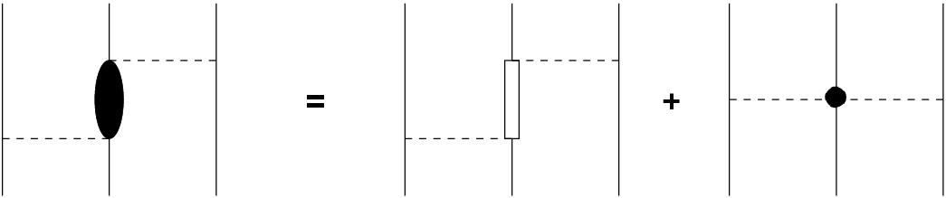
What is this three-nucelon force?
Ggggggg
π
Δ
π
π
π
parametrization of Fuijta-Miyazawa force + 2π rescattering + higher-order interactions
Added to 2N potential as correction
Tucson-Melbourne, Urbana IX, …

Slide 19
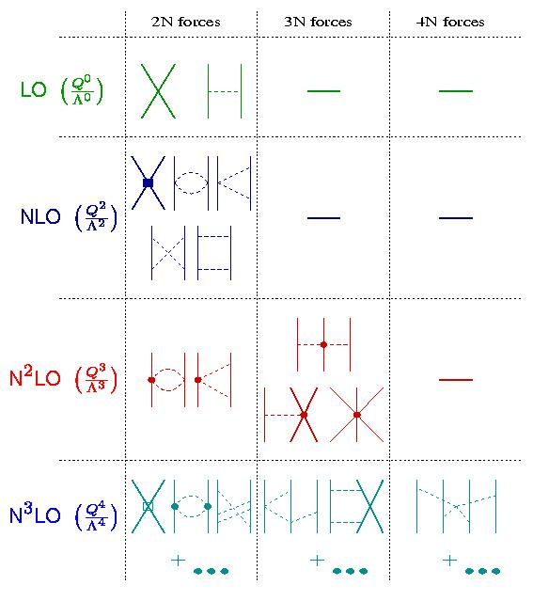
Effective-Field Theory Approach
Developed by Weinberg
Coupling of pions and nucleons in EFT
Predicts structure of 3NF
Self-consistent approach
Only works at energies below pion-mass scale
See Contributions of
R. Machleidt PL020 &
U. Meissner PL021

Slide 20

Study of Three-Body Force in Nuclear Physics
Which reactions (and systems) to study?
- Electromagnetic interaction on 3B systems (talk PL002 Bacca)
- 3B (and more bodies?) Bound states
- 3B Elastic scattering in large parts of phase space
- 3B Break-up reaction in different kinematics
- Many-body systems → Nuclear matter
N + d → N + d
N + d → N + N + N
N + d → ³He(³H) + γ^{(∗)}
γ^{(∗)} + ³He(³H) → N + d
γ^{(∗)} + ³He(³H) → N + N + N

Slide 21
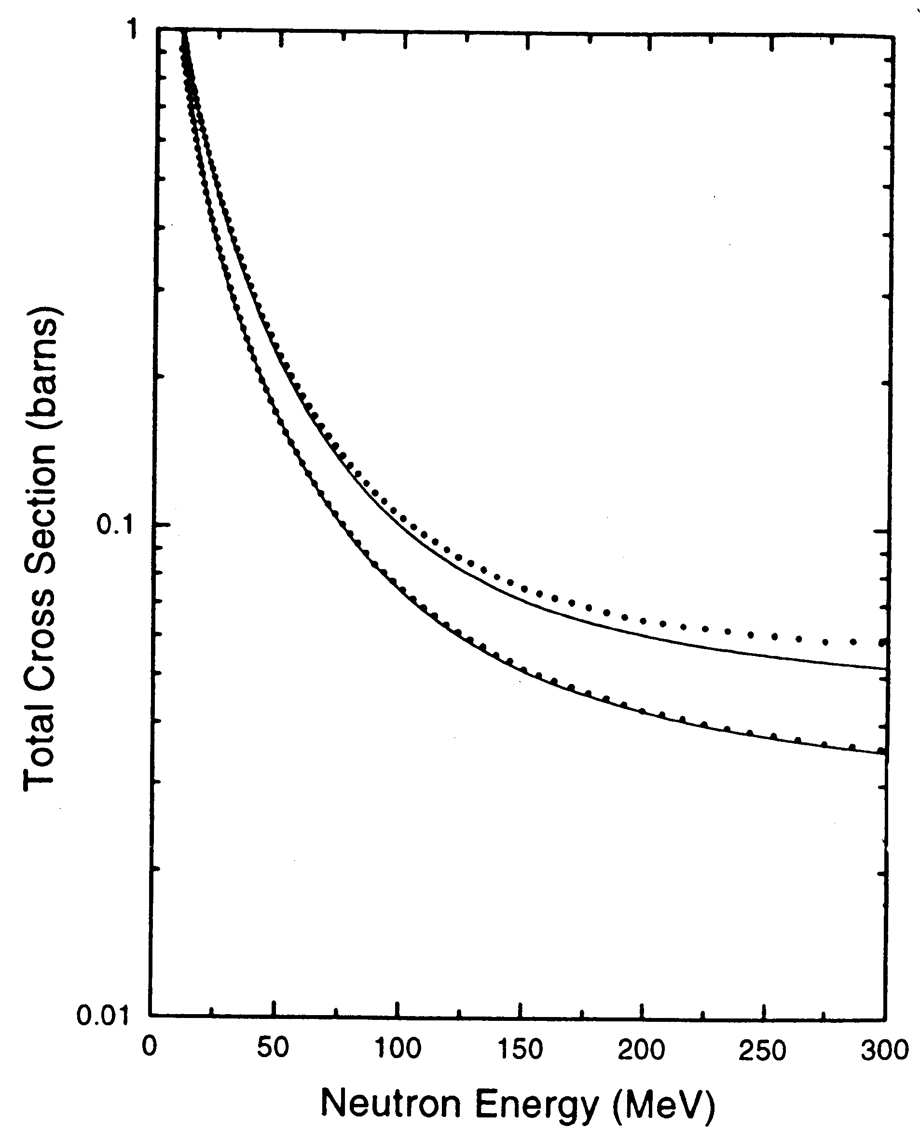
Total nd Cross sections
Effect of 3NF small
High-precision mandatory
In addition, look for sensitivity:
  exclusive channels
  other observables
nd scattering
np scattering
Only 2NF
High precision data from Los Alamos
W.P. Abfalterer et al., PRL 81, 57 (1998)

Slide 22
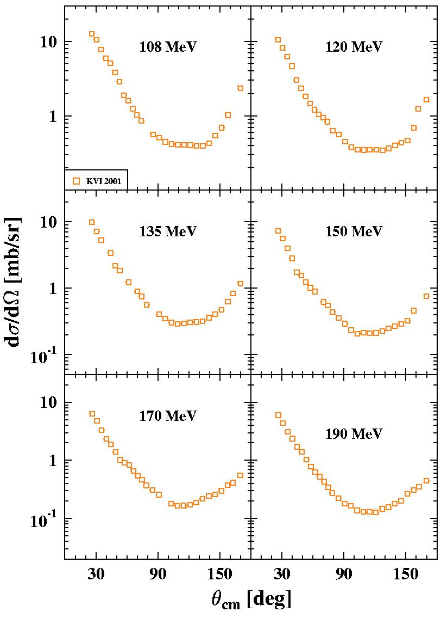
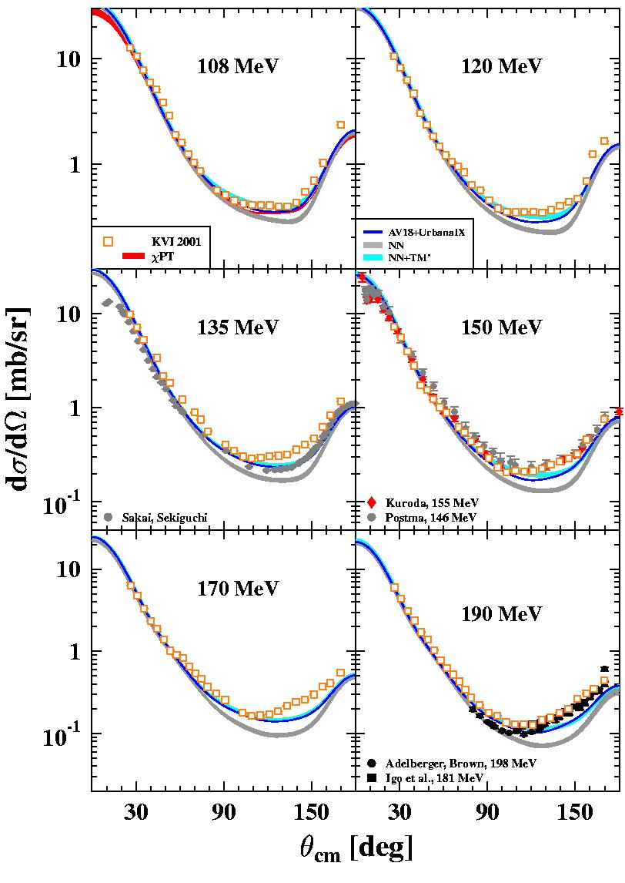
pd elastic scattering cross sections
K. Ermisch et al.,
PRC 68, 054004 (2003),
PRC 71, 064004 (2005)

Slide 23
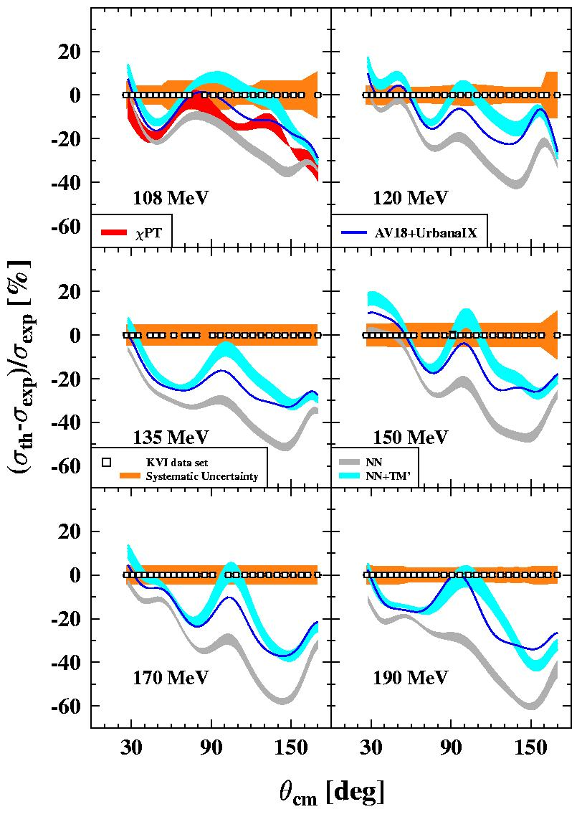
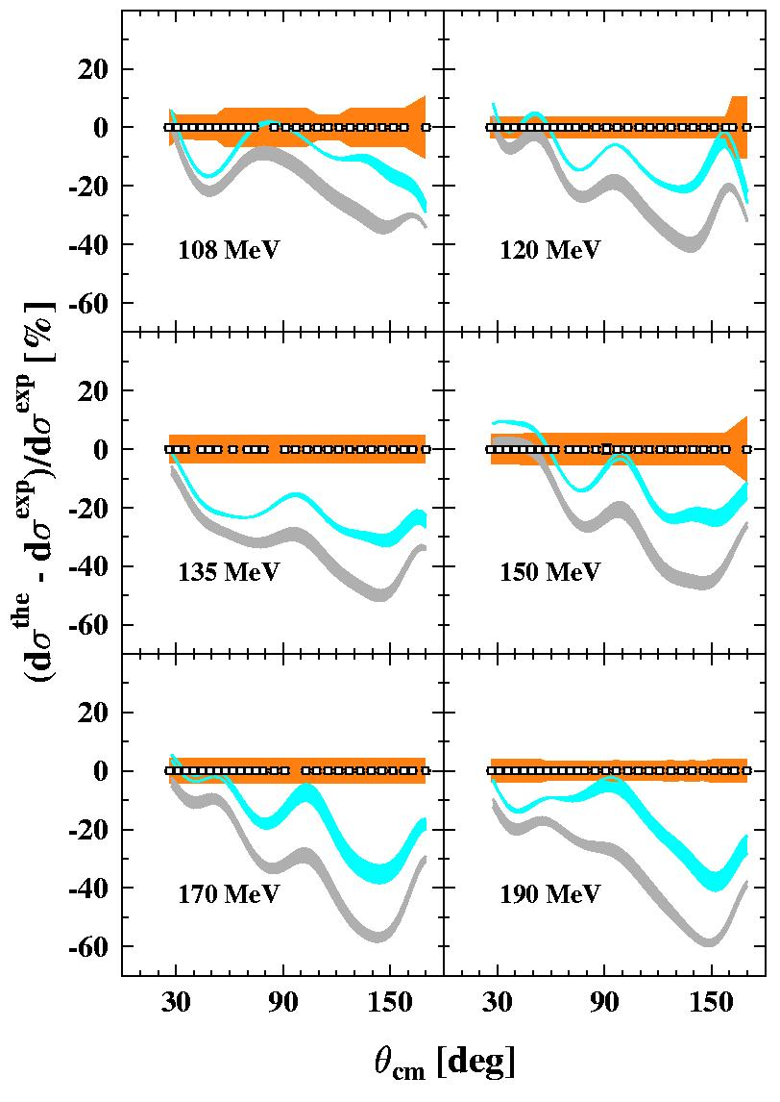
pd elastic scattering cross sections
(theory –data)/data
Hanover Approach of dynamical delta
K. Ermisch et al.,
PRC 68, 054004 (2003),
PRC 71, 064004 (2005)

Slide 24
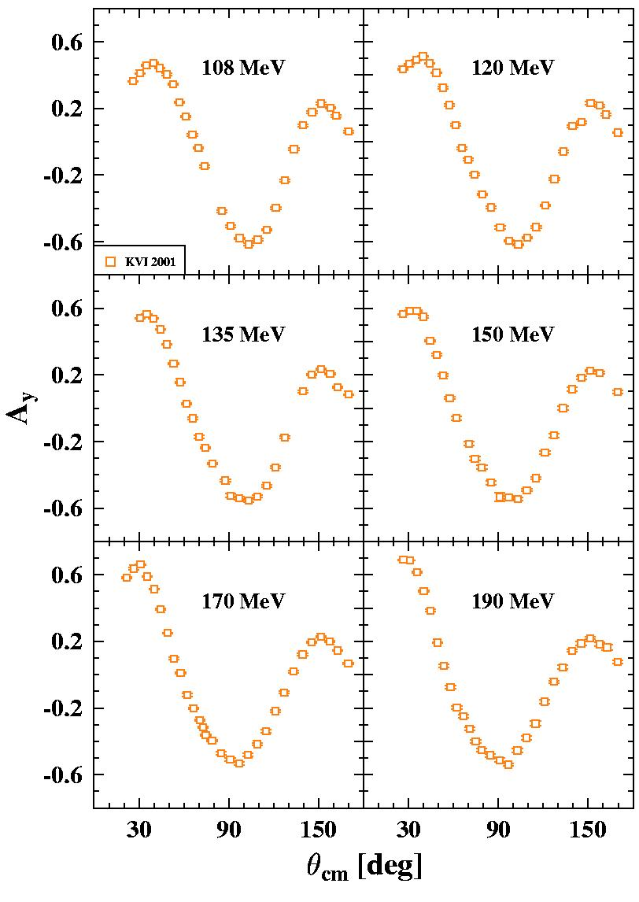
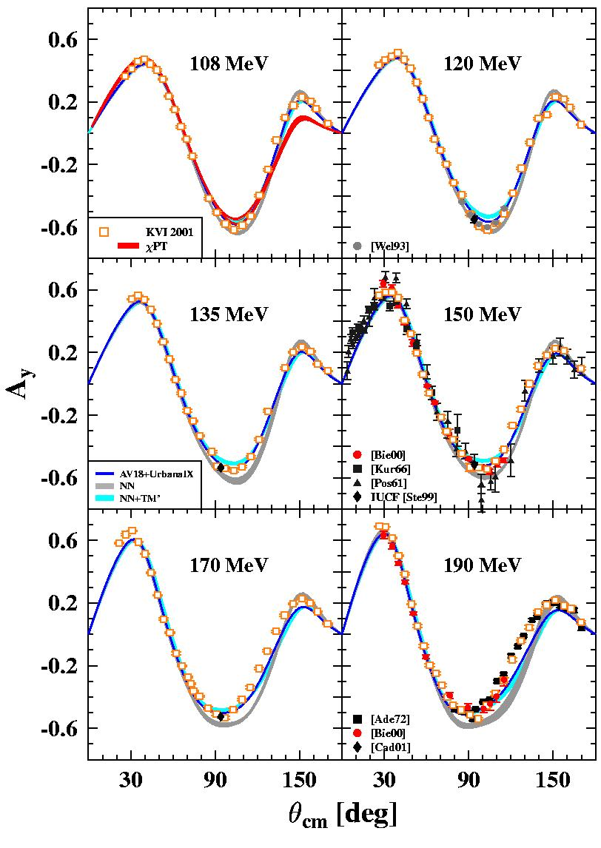
p+d vector analyzing powers
Bieber et al.,
PRL84, 606 (2000)
Ermisch et al.,
PRL86, 5862 (2001)
PRC71, 064004 (2005)

Slide 25
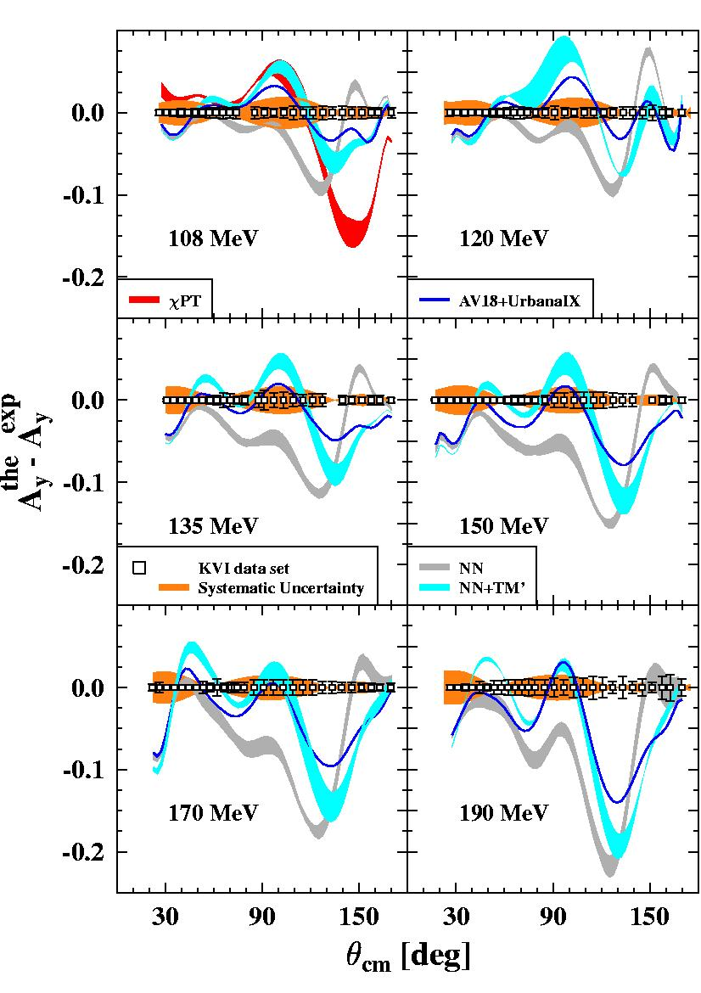
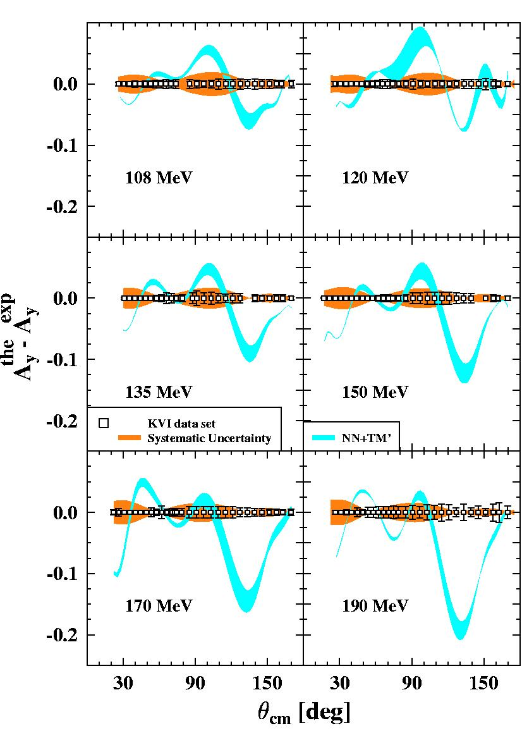
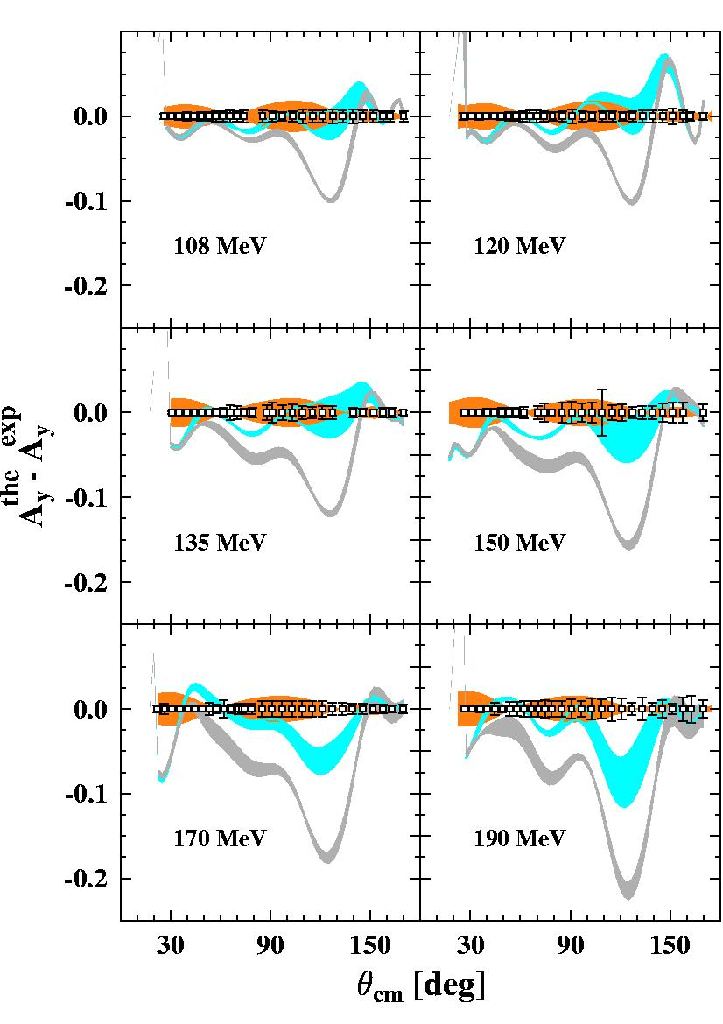
p+d vector analyzing powers
theory-data
Ermisch et al.,
PRC71, 064004 (2005)
Hanover Approach of dynamical delta
Notes:
Hidden in the presentation.

Slide 26
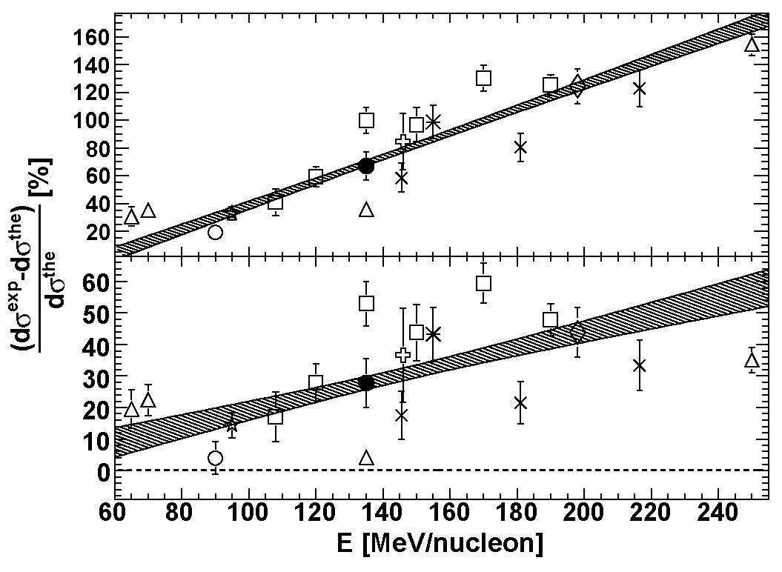
Effect of 3NF as a function of Energy
θ_{cm}=140º
(CDB+C)
PRC 78 (2008) 014006
(CDB+C+Δ)
A. Ramazani et al., Phys. Rev. C78, 014006 (2008)
26
Notes:
26

Slide 27

Break-up channel
5 dimensional phase space (θ₁, θ₂, E₁, E₂, φ₁₂)
i.e. much larger than in the elastic channel (θ)
Allows detailed road-map for the study of
nuclear forces
Requires a setup with large coverage

Slide 28
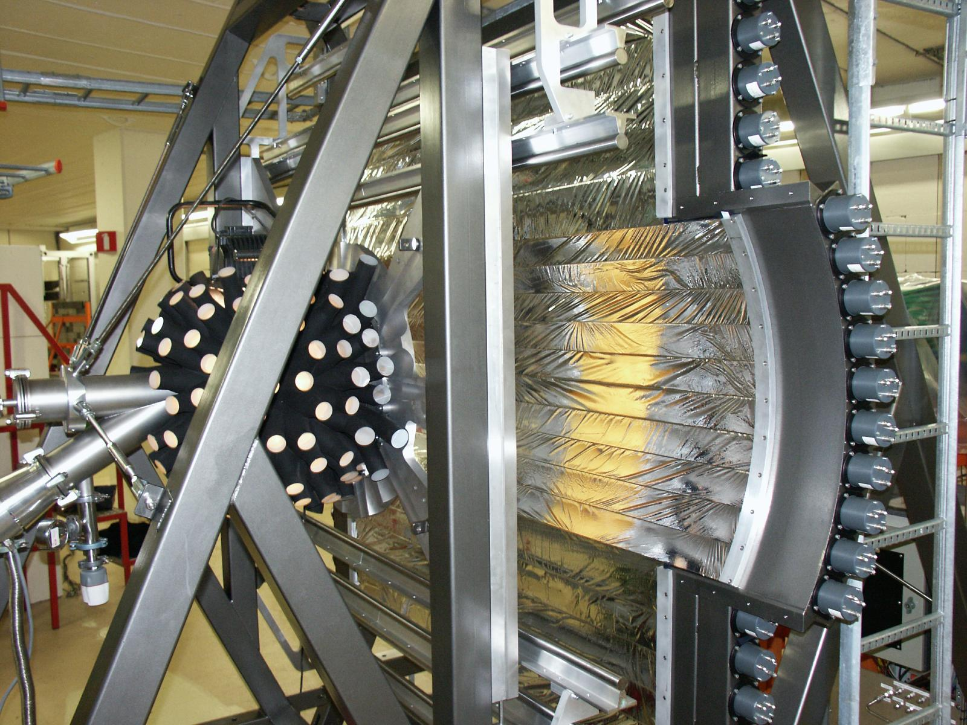
Big Instrument for Nuclear-Polarization Analysis (BINA)

Slide 29
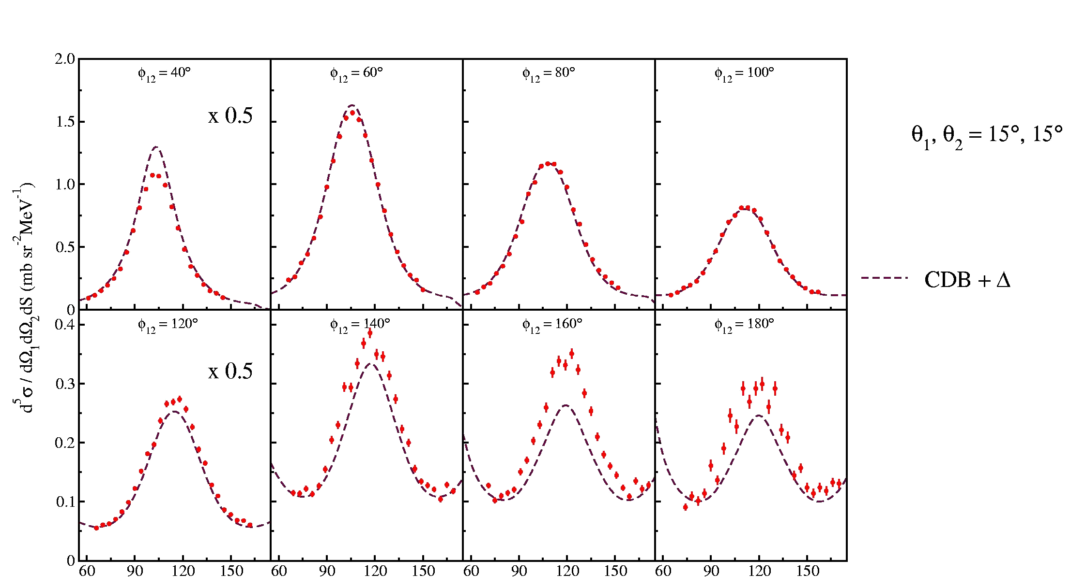
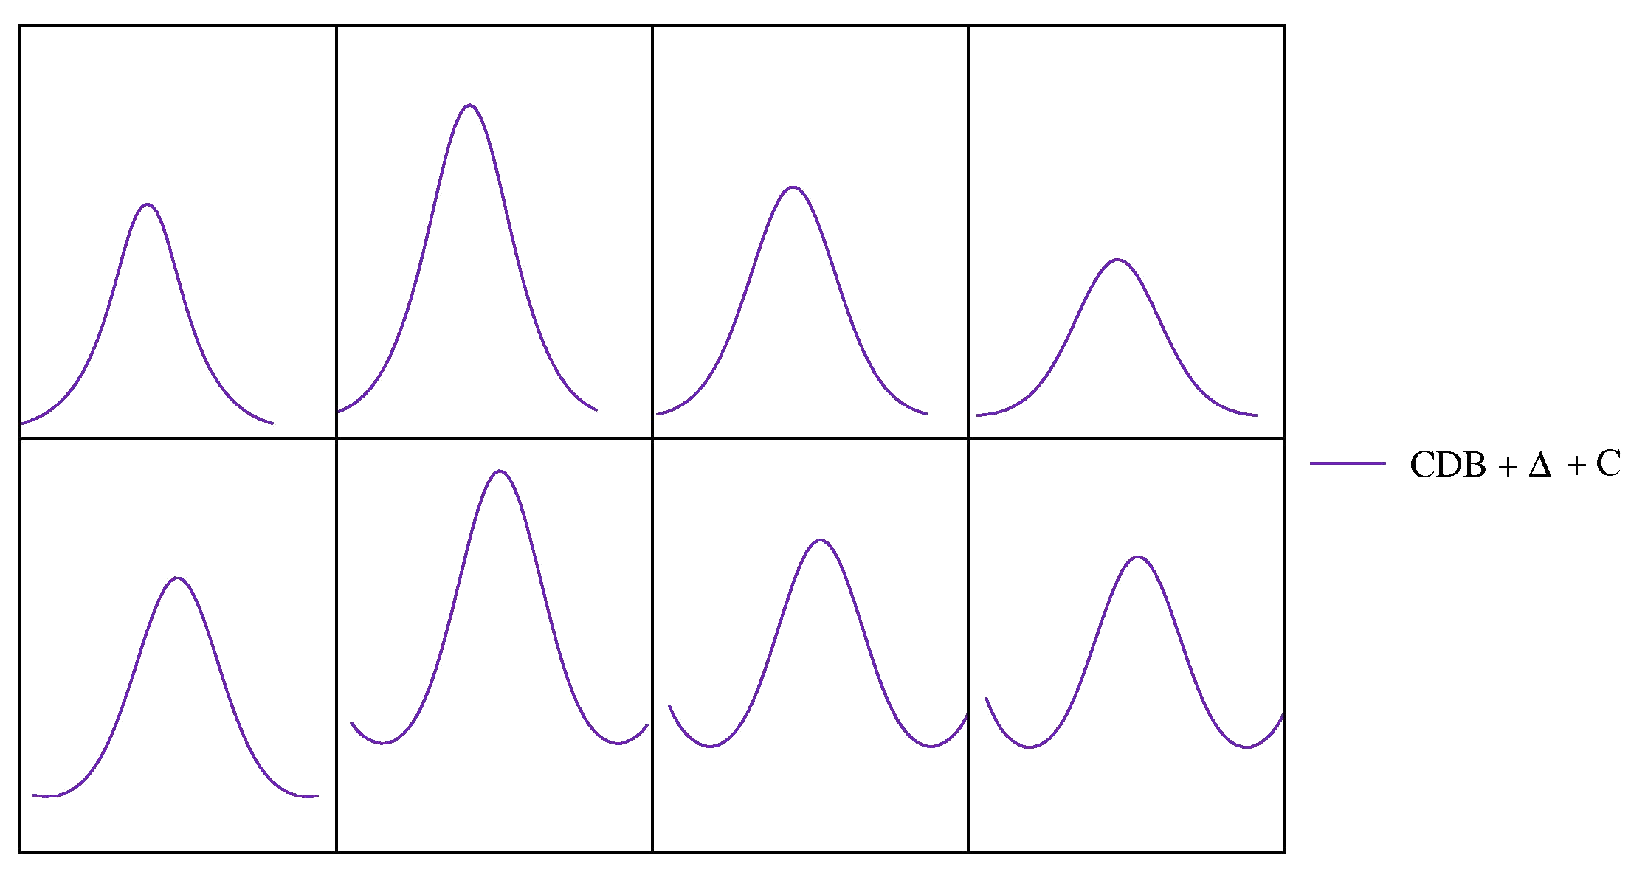
^{Break-up channel at 130 MeV}
Kistryn et al.,
PLB 641, 23 (2006)
S (MeV)

Slide 30
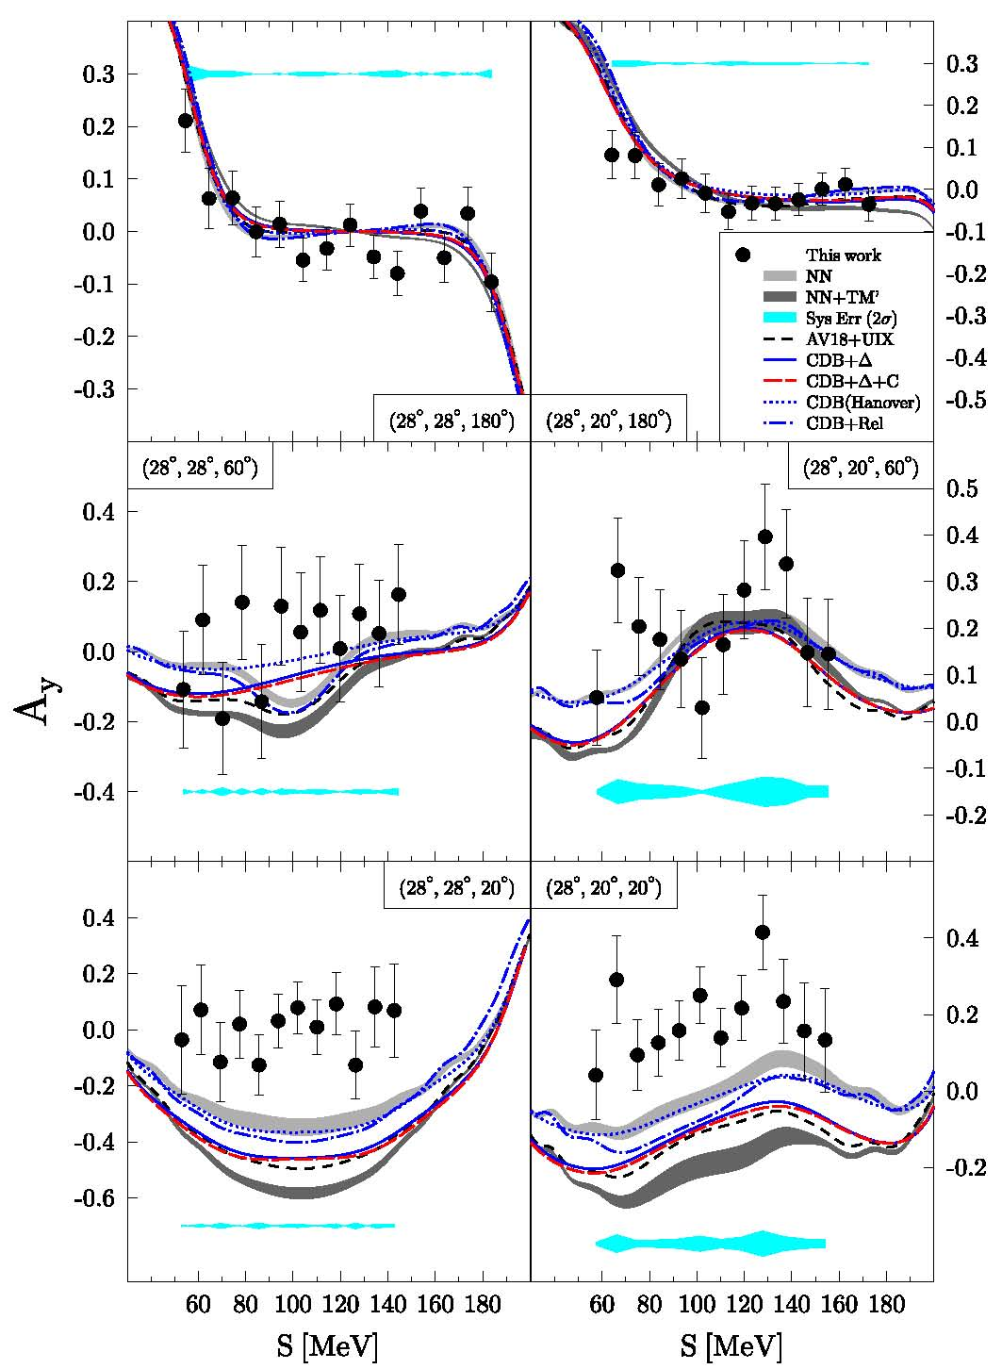
Analyzing power for break-up channel for E_{p}=190 MeV
E_{p} = 190 MeV
θ = 14º - 30º
H. Mardanpour et al.,
Phys. Lett. B687, 149 (2010)
See also contributions
NR175 (K. Sekiguchi)
NR038 (I. Ciepal)
NR207 (H. Witala)
&
St. Kistryn & E. Stephan
JPG 40, 063101 (2013)
30
Notes:
30

Slide 31
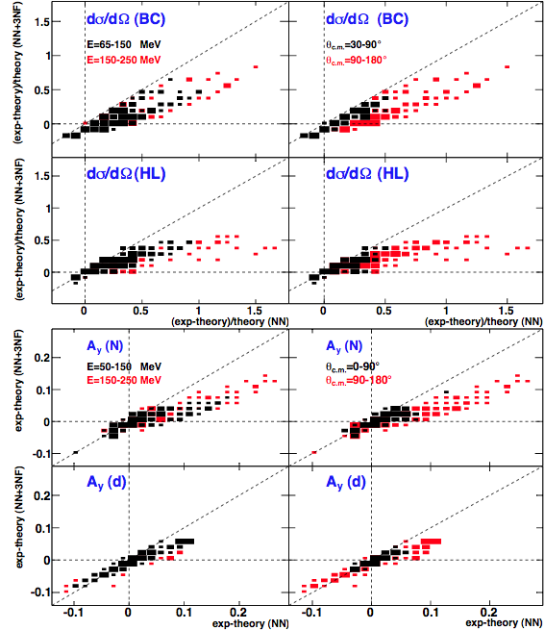

Global Analysis, Elastic channel, 50-250 MeV/nucleon
NK et al.,
Reports on
Progress in
Physics 75,
016301
(2012)
31
Notes:
31

Slide 32
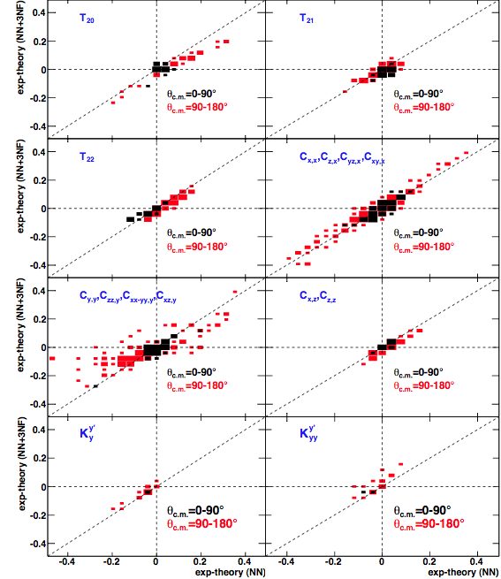
Global Analysis, Elastic channel, 50-250 MeV/nucleon
NK et al.,
Reports on
Progress in
Physics 75,
016301
(2012)
32
Notes:
32

Slide 33
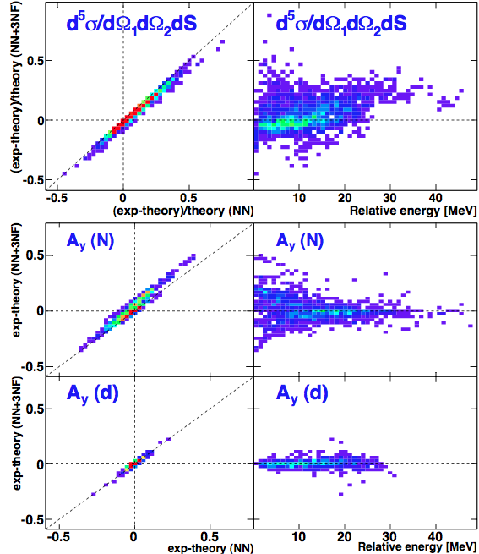
Global Analysis, Breakup Channel, 65-190 MeV/nucl.
NK et al.,
Reports on
Progress in
Physics 75,
016301
(2012)
33
Notes:
33

Slide 34
Limitations of effective field theories
34
Notes:
34

Slide 35
Overview world database elastic & breakup
Courtesy K. Sekiguchi
rich set of observables, allowing a multi-dim. study of 3NF
a sizable fraction has been measured accurately and systematically (RIKEN/RCNP/IUCF/KVI,Jülich)
35
Notes:
35

Slide 36
How about four-body systems?
Viviani, Kievsky et al., private communication
36
Notes:
36

Slide 37
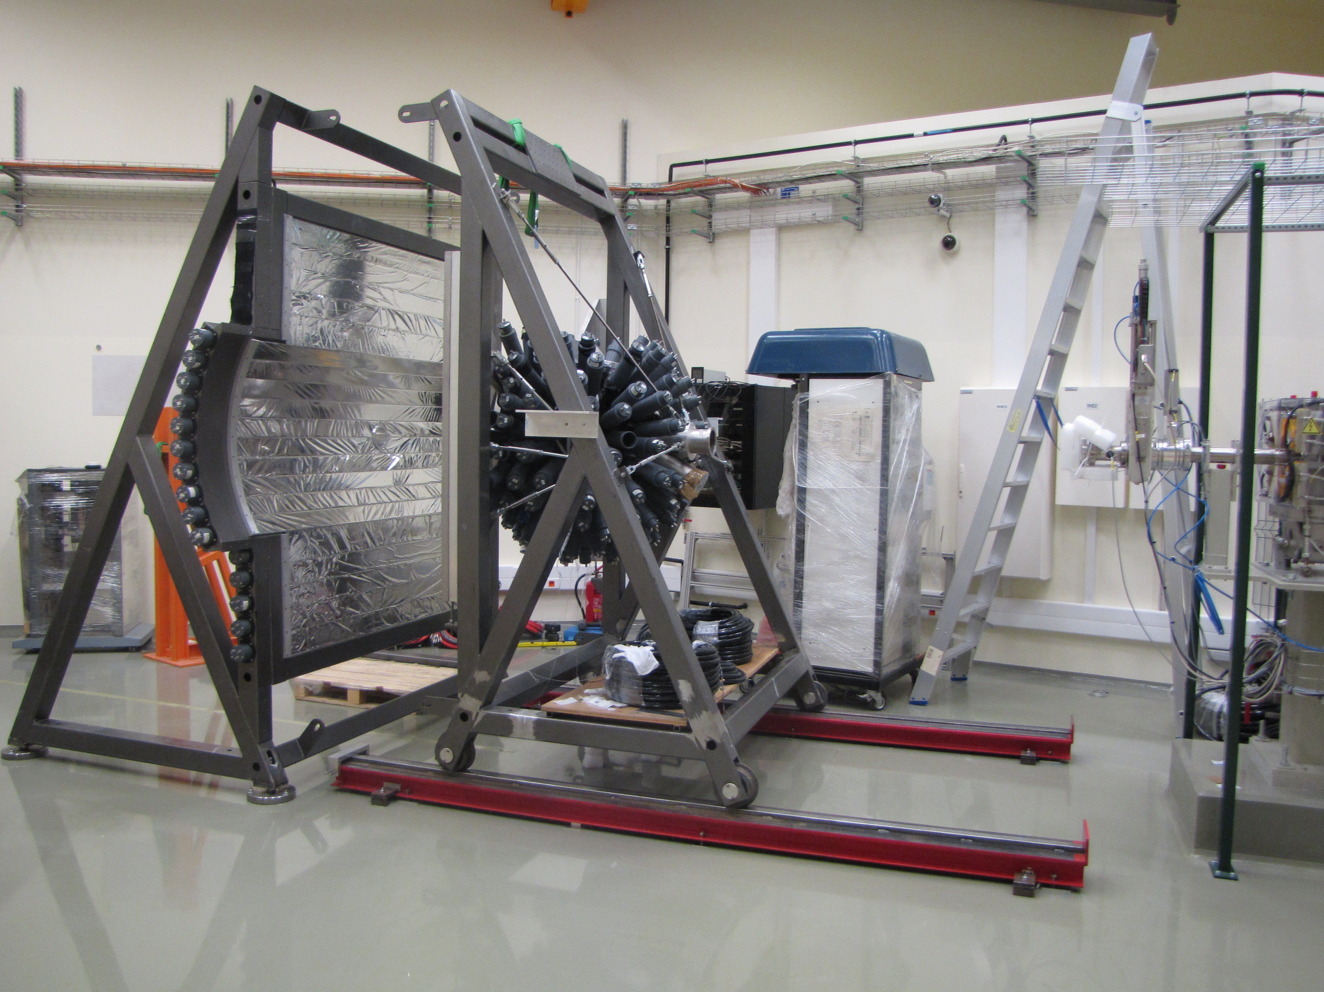
BINA in Cracow

Slide 38
Concluding remarks
Three-body hadronic reactions are the most promising tool for the study of 3NF effects.
A large body of data has been gathered for cross sections and spin observables for elastic and break-up reactions at intermediate energies at KVI, RIKEN, RCNP, IUCF and Jülich. New measurements planned at RIKEN and Cracow. Low-energy data were not discussed due to time constraints.
The Coulomb effect is now well under control.
All data together show unambiguously the effect of 3NF.
There are, however, still discrepancies indicating that the exact nature of 3NF is not yet known (heavy mesons?).
Relativisitc corrections are coming but expected to be small.
Four-body systems underway both exp. and theoretically.
STAY TUNED!

Slide 39
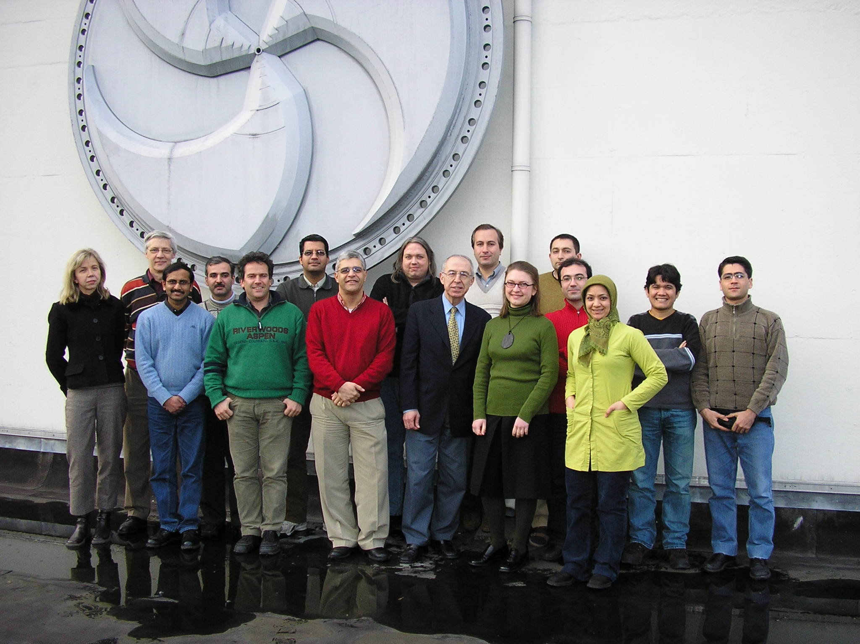
Acknowledgements
H.R. Amir Ahmadi, A.M. van den Berg, R. Bieber, K. Ermisch,
M. Elsami-Kalantari, M.N. Harakeh, H. Huisman, M. Kis, H. Mardanpour, A. Mehmandoost, J.G. Messchendorp, M. Mahjour-Shafiei, A. Ramazani,
E. Van Garderen, M. Volkerts, S.Y. van der Werf, H. Woertche
+ Polish Experimental Group (O. Biegun, K. Bodek, St. Kistryn, A. Kozela,
Micherdzinska, E. Stephan, R. Sworst, J. Zejma and W. Zipper)
+IUCF group (E. Stehpenson, A. Bakker, and C. Bailey)
+ Theoretical support from
Bochum-Cracow
(Gloeckle, Golak, Kamada,
Kuros-Zolnierczuk,
Skibinski and Witala)
Hanover-Lisbonne
(Sauer, Deltuva and Fonseca)
Epelbaum, Nogga

Slide 40
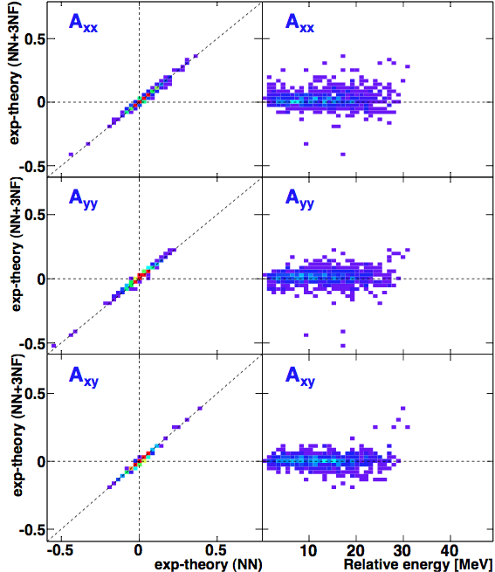
Global Analysis, Breakup Channel, 65-190 MeV/nucl.
Reports on
Progress in
Physics 75,
016301
(2012)
40
Notes:
40

Slide 41
Global Analysis, Elastic channel, 50-250 MeV/nucleon
41
Notes:
41

Slide 42
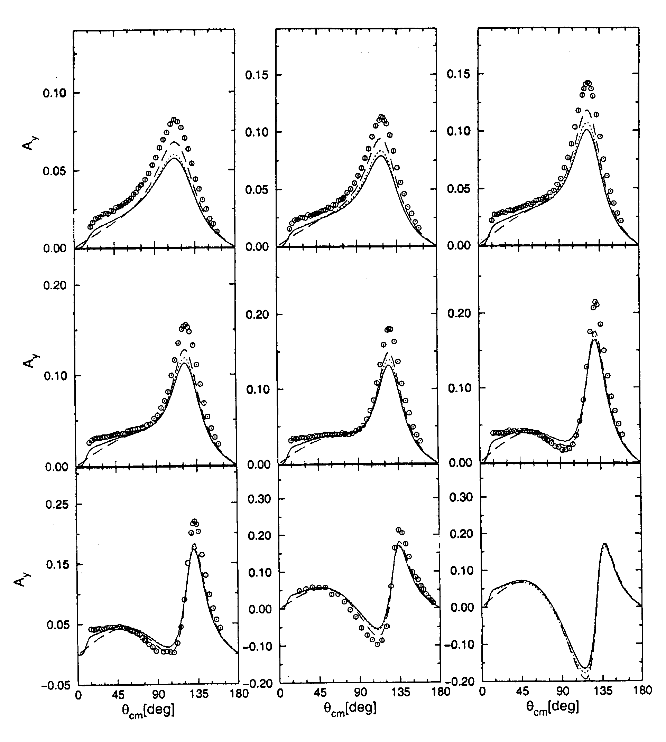
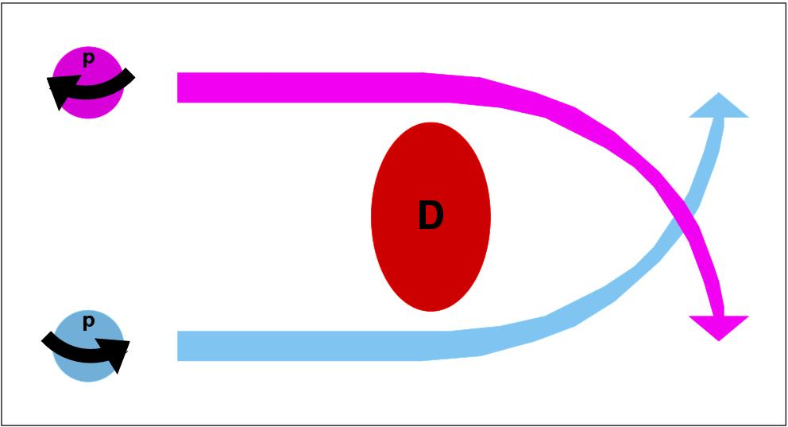
The A_{y} puzzle at low energies
5 MeV
7 MeV
9 MeV
2+3NF
2NF
10 MeV
12 MeV
16 MeV
18 MeV
22.7 MeV
28 MeV

Slide 43
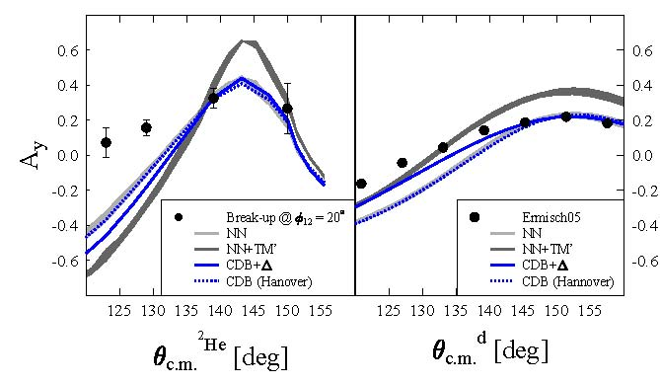
Analyzing power for break-up channel for E_{p}=190 MeV
E_{p} = 190 MeV
θ = 14º - 30º
H. Mardanpour et al.,
Phys. Lett. B687, 149 (2010)
θ₁=θ₂, small φ₁₂
E_{pp} < 1 MeV
(pp) ≈ ²He
I = 1/2, 3/2
I = 1/2
43
Notes:
43

