Slide 1
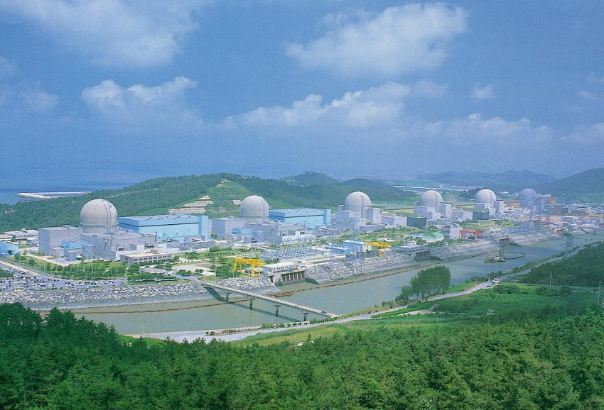
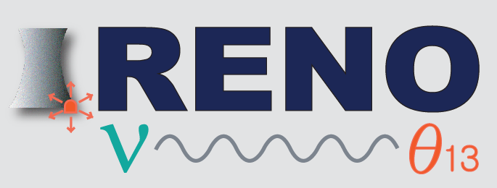

Results on θ₁₃ Neutrino Oscillations from Reactor Experiments
Soo-Bong Kim (KNRC, Seoul National University)
“INPC 2013, Firenze, June 2-7, 2013”

Slide 2

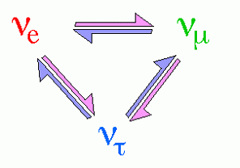
Neutrino Oscillations
PMNS Neutrino Mixing Angles
(1998)
~80%
Solar Neutrinos
ν₁
θ₁₂
ν₂
Reactor Antineutrino Oscillation
θ₁₃
(?)
θ₂₃
Atmospheric Neutrinos
ν₃
(2012)
~100%

Slide 3
Experimental Method of θ₁₃ Measurement
ν_{e}
ν_{e}
Oscillations observed as a deficit of anti-neutrinos
ν_{e}
ν_{e}
ν_{e}
the position of the minimum is defined by Δm²₁₃ (~Δm²₂₃)
ν_{e}
1.0
sin²2θ₁₃
flux before oscillation observed here
Probabilité ν_{e}
Distance
1200 to 1800 meters
Find disappearance of ν_{e} fluxes due to neutrino oscillation as a function of energy using multiple, identical detectors to reduce the systematic errors in 1% level.

Slide 4
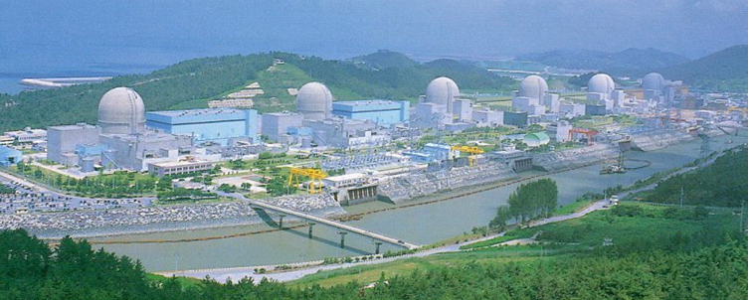
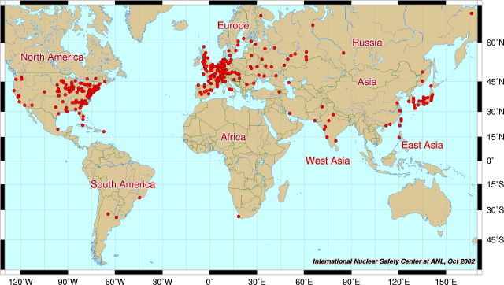
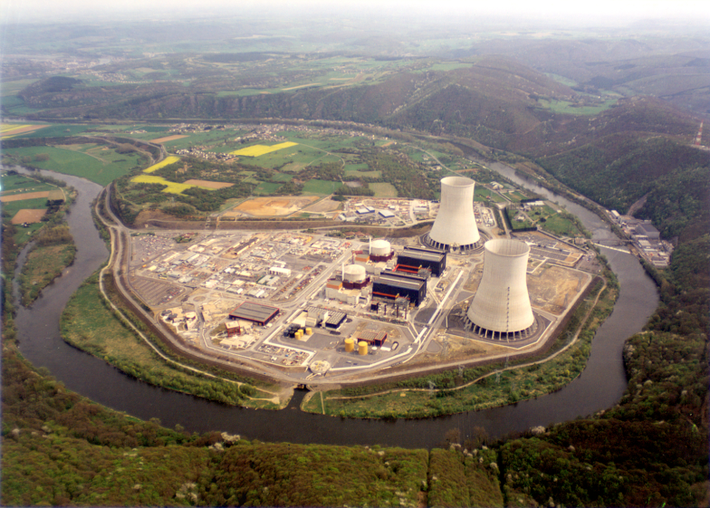
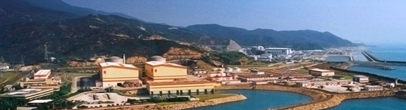
Reactor θ₁₃ Experiments
RENO at Yonggwang, Korea
Daya Bay at Daya Bay, China
Double Chooz at Chooz, France

Slide 5
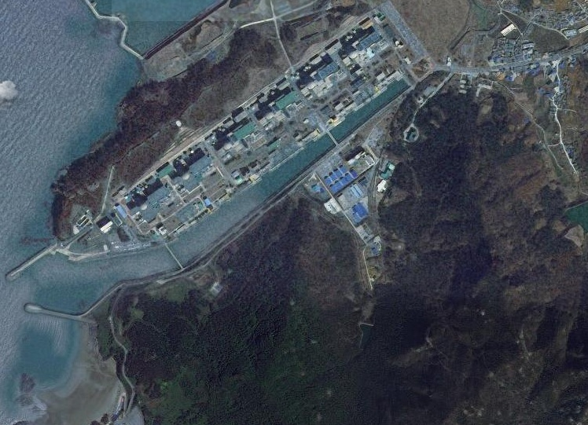

The RENO Experiment
120 m.w.e.
Near Detector
290m
1380m
Far Detector
450 m.w.e.

Slide 6

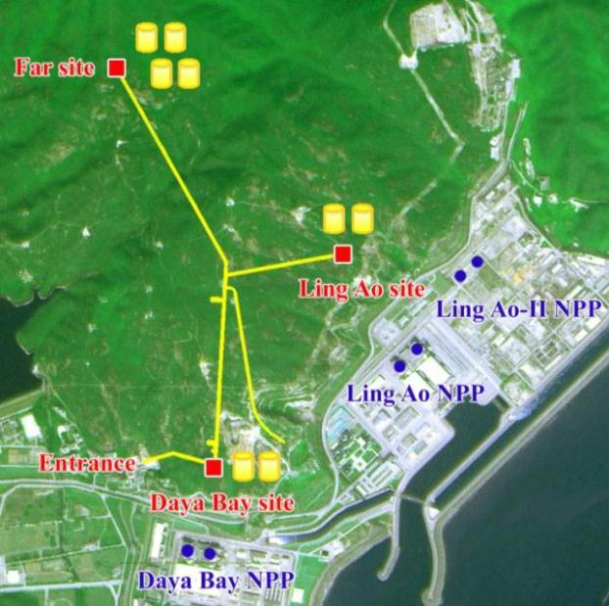
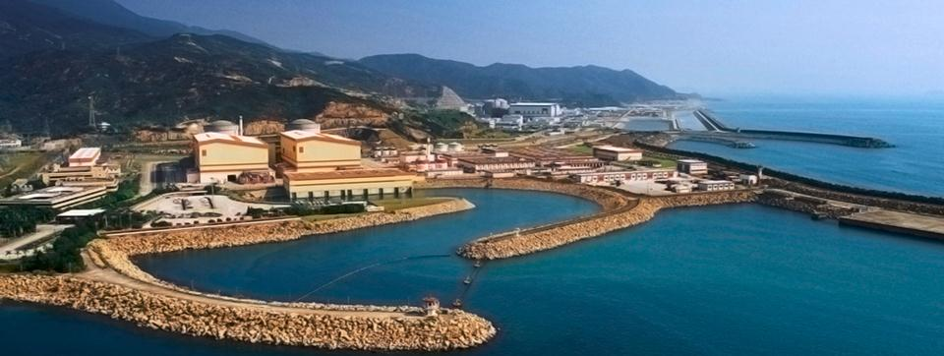

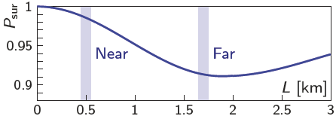
The Daya Bay Experiment
Measuring neutrino mixing angle θ₁₃
6 reactor cores, 17.4 GW_{th}
Relative measurement
  2 near sites, 1 far site
Multiple LS detector modules
  20 ton target, 110 ton total weight
Good cosmic shielding
  250 (860) m.w.e @ near (far) sites
3km tunnel

Slide 7

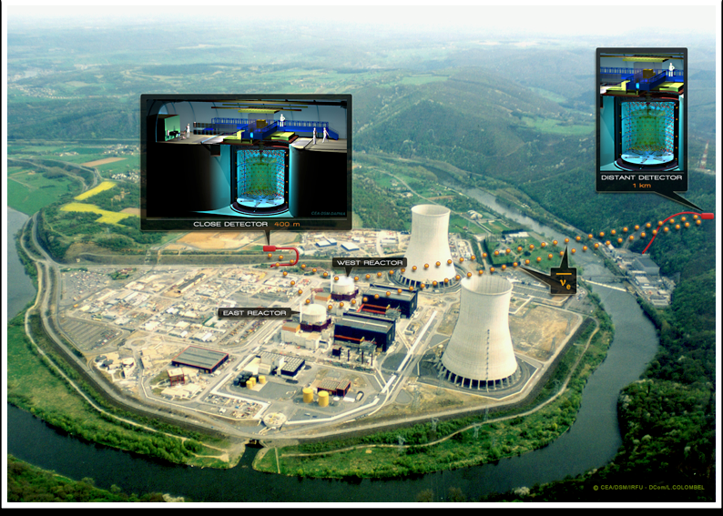
The Double Chooz Experiment
Far Detector
L=1050 m
Depth = 300 m.w.e.
(collecting data since April 2011)
Near Detector
L=400 m
Depth = 115 m.w.e.
(under construction)
Chooz-B Reactors
2× 4.25 GW_{th}

Slide 8
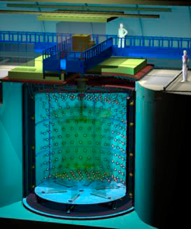
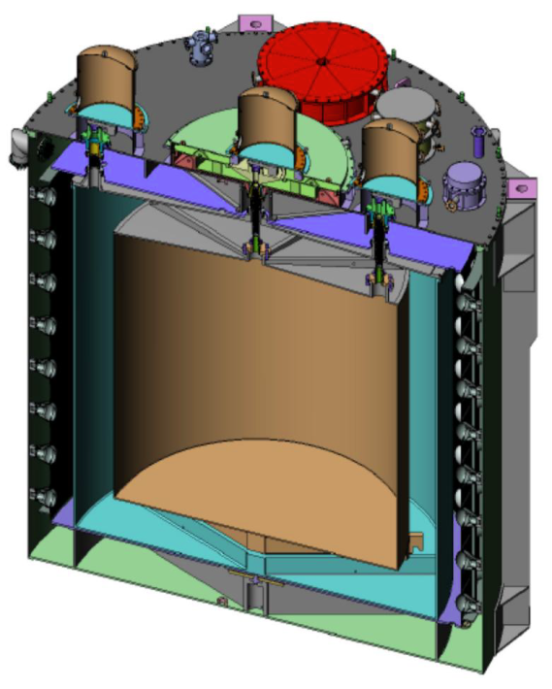

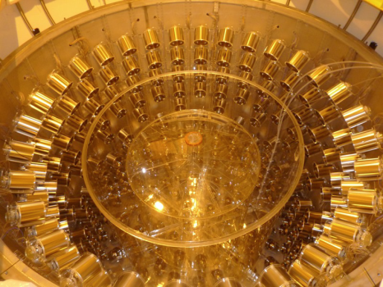
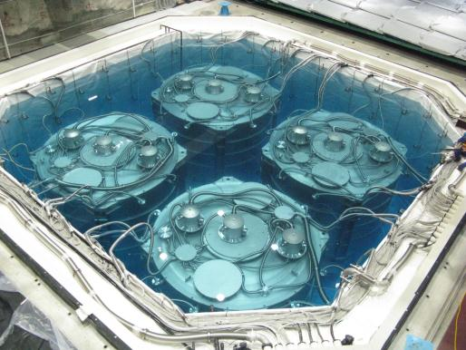
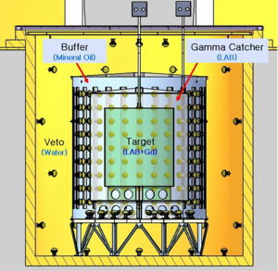
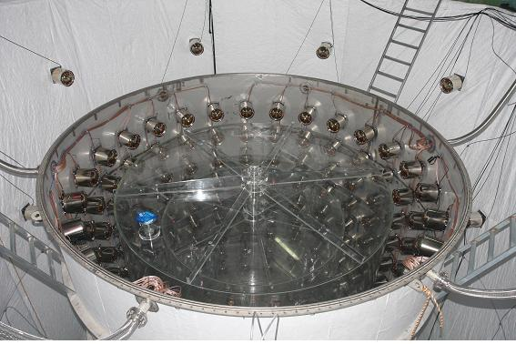
θ₁₃ Reactor Neutrino Detectors
MO
LS
H₂O
Gd-LS

Slide 9
θ₁₃ Reactor Neutrino Experiments
Experiments | Location | Thermal Power (GW) | Flux Weighted Baselines Near/Far (m) | Depth Near/Far (mwe) | Target Mass (tons) | Statistics per year (GW∙ton∙yr)
Double Chooz | France | 8.5 | [410/1050] | 120/300 | 8.6/8.6 | 73
RENO | Korea | 16.7 | 409/1444 | 120/450 | 16/16 | 267
Daya Bay | China | 17.4 | 470(576)/1648 | 250/860 | 40×2/80 | 1392
Daya Bay
Far
Near
Double Chooz
Double
Chooz
Apr.
2011
Spring
2014
RENO
Aug. 2011
Aug. 2011
Daya Bay
Dec. 2011
Sep. 2011
RENO

Slide 10
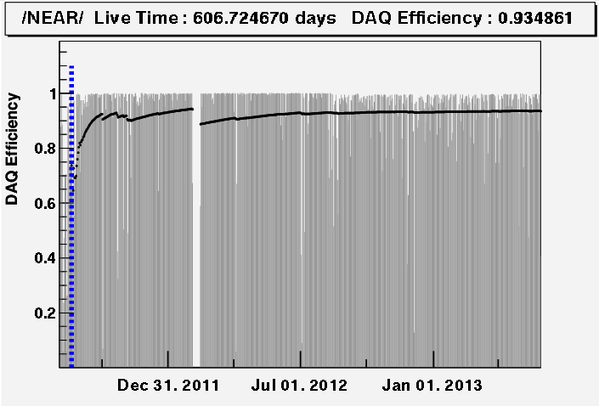
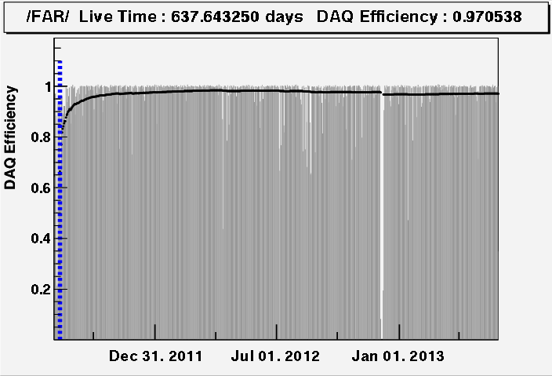
RENO Status
Data taking began on Aug. 1, 2011 with both near and far detectors.
(DAQ efficiency : ~95%)
Near
A (220 days) : First θ₁₃ result
[11 Aug, 2011~26 Mar, 2012]
PRL 108, 191802 (2012)
A
B (403 days) : Improved θ₁₃ result
[11 Aug, 2011~13 Oct, 2012]
NuTel 2013
Far
C (~700 days) : Shape+rate analysis
(in progress)
[11 Aug, 2011~31 Jul, 2013]
B
Absolute reactor neutrino flux measurement in progress
[reactor anomaly & sterile neutrinos]
C

Slide 11
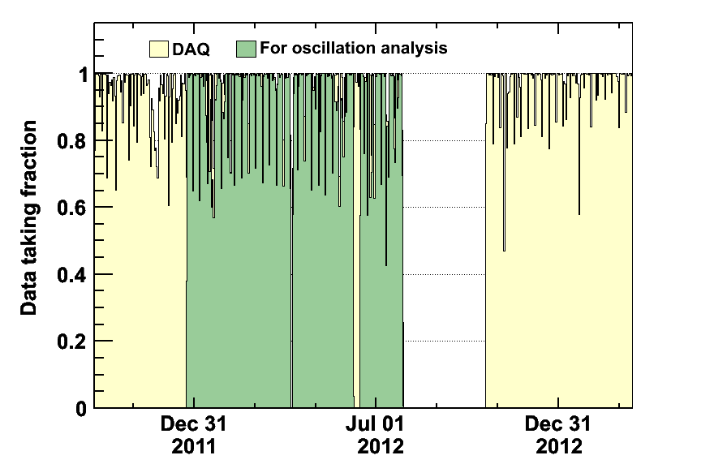
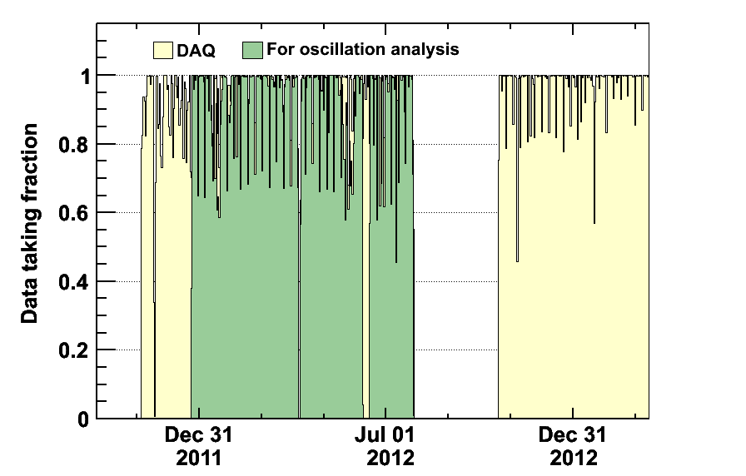
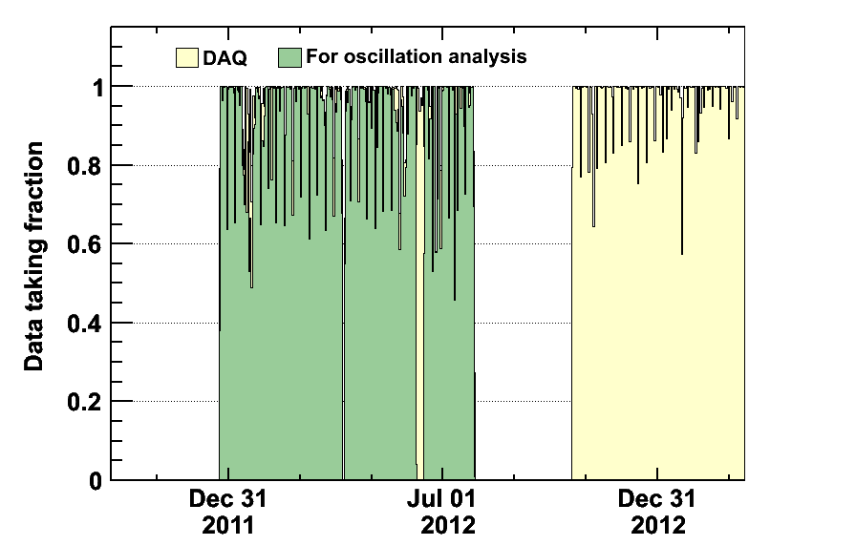
Daya Bay Operation
A→Two Detector Comparison:
Sep. 23, 2011 – Dec. 23, 2011
Nucl. Inst. and Meth. A 685 (2012), pp. 78-97
B→55 days, First Oscillation Result:
Dec. 24, 2011 – Feb. 17, 2012
Phys. Rev. Lett. 108, 171803 (2012)
C→Updated analysis:
Dec. 24, 2011 – May 11, 2012
Chinese Physics C37, 011001 (2013)
  DAQ eff. ~ 96%
  Eff. for physics: ~ 94%
D→Shape+rate analysis, preparation
Dec. 24, 2011 – Jul. 28, 2012
E→ 8 AD, double statistics
Dec. 24, 2011 – Jul. 2013
A
Hall 1
B
Hall 2
C
D
Hall 3

Slide 12
Double Chooz Status
Far detector alone
Data taking has been in progress since April. 2011 with a far detector alone.
New release in 2003 of rate+shape analysis :
improved analysis (energy scale, backgrounds) & more statistics
2 channels (neutron capture on Gd and on Hydrogen) with a potential for a combined analysis → expect the final sensitivity of 0.03
  Fit oscillation through the nuclear power variation :
  measurement with two reactors, one reactor and zero
Near+Far detectors
A near detector is under construction until spring 2014.
The first result of the full experiment will be available in the end of 2014, towards a final sensitivity of 0.01.
(10% measurement of θ₁₃ )

Slide 13
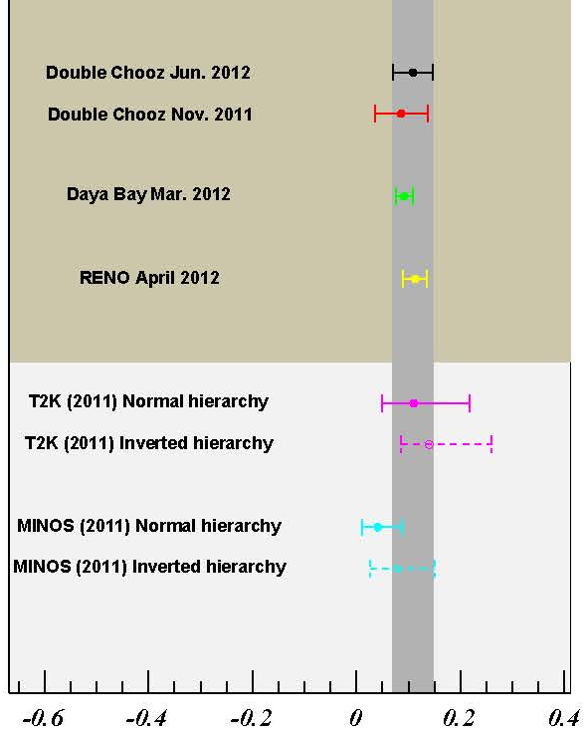
A Brief History of θ₁₃ from Reactor Experiments
Nov. 2011 (Double Chooz )
sin²(2θ₁₃) = 0.086±0.051
March 2012 (Daya Bay)
sin²(2θ₁₃) = 0.092±0.017
(5.2 σ)
Daya Bay Oct. 2012
April 2012 (RENO)
(4.9 σ)
RENO Mar. 2013
sin²(2θ₁₃) = 0.113±0.023
June 2012 (Double Chooz)
sin²(2θ₁₃) = 0.109±0.039
Oct. 2012 (Daya Bay)
sin²(2θ₁₃) = 0.089±0.011
March 2013 (RENO)
Double-CHOOZ, arXiv:1207.6632, (2012)
sin²(2θ₁₃) = 0.100±0.018

Slide 14
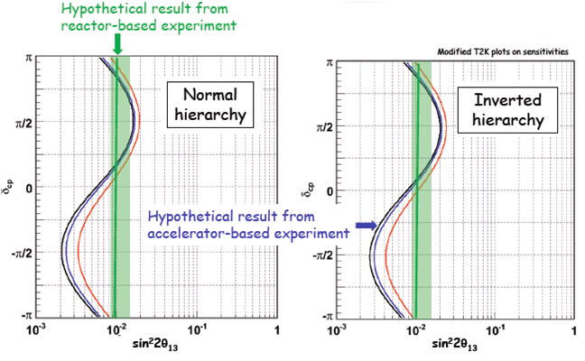
θ₁₃ from Reactor and Accelerator Experiments
* Reactor
- Clean measurement of θ₁₃ with no matter effects
* Accelerator
- mass hierarchy + CP violation + matter effects
Precise measurement of θ₁₃
Complementary :
Combining results from accelerator and reactor based experiments could offer the first glimpse of δ_{CP.}

Slide 15
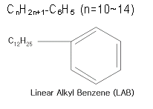

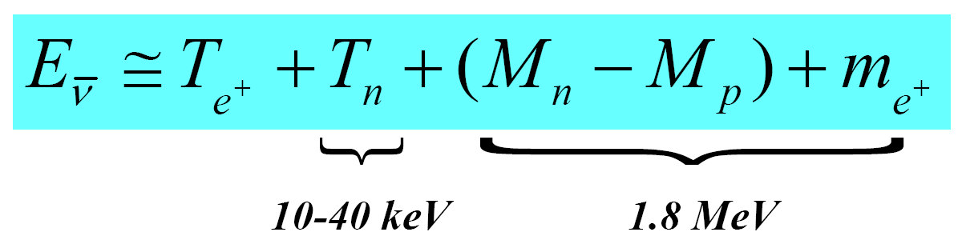
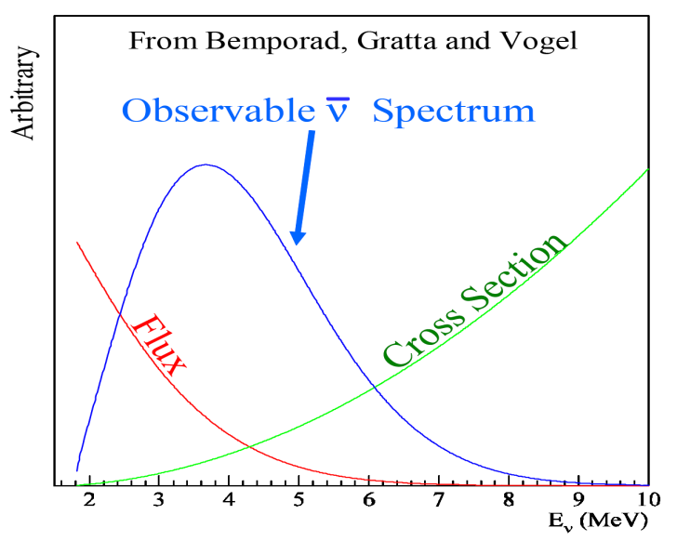
Detection of Reactor Antineutrinos
(prompt signal)
~180 μs
(delayed signal)
+ p → D + γ (2.2 MeV)
~28 μs
(0.1% Gd)
+ Gd → Gd + γ‘s (8 MeV)
Neutrino energy measurement

Slide 16
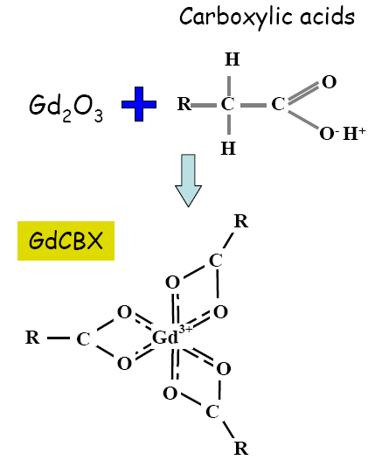
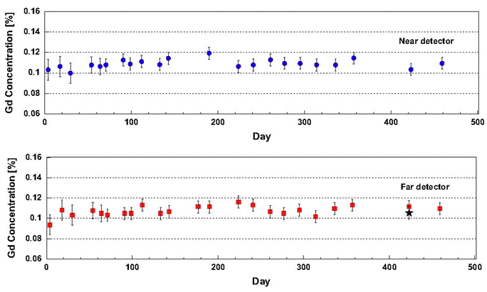
Gd Loaded Liquid Scintillator
Recipe of Liquid Scintillator
Solvent & Flour | WLS | Gd-compound
LAB | PPO + Bis-MSB | 0.1% Gd + (TMHA)³
Steady properties of Gd-LS
Stable light yield (~250 pe/MeV) , transparency & Gd concentration (0.11%)
NIM A, 707, 45-53 (2013. 4. 11)

Slide 17
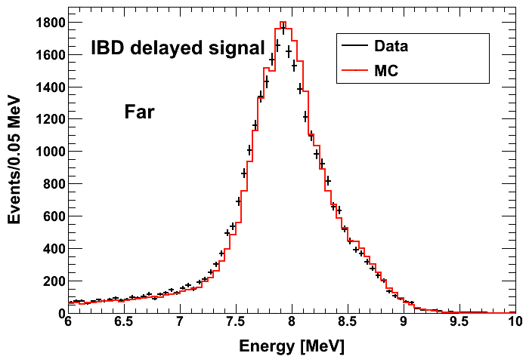
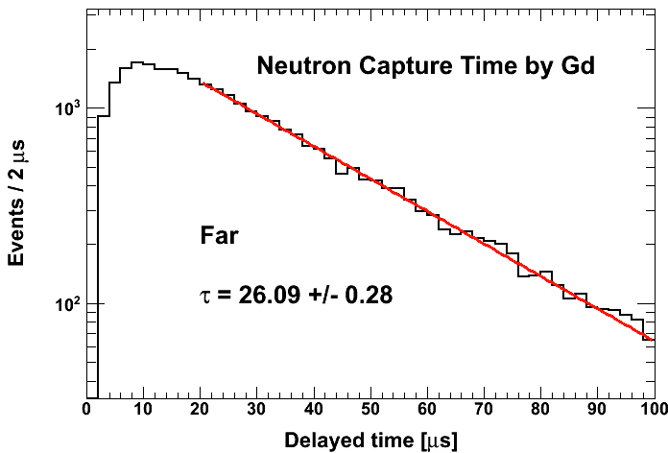
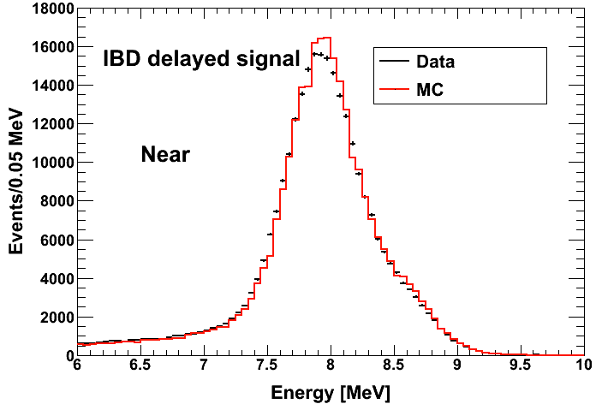
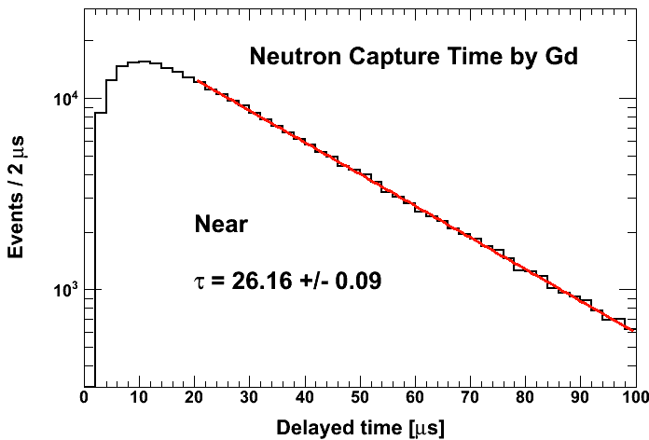
Neutron Capture by Gd

Slide 18
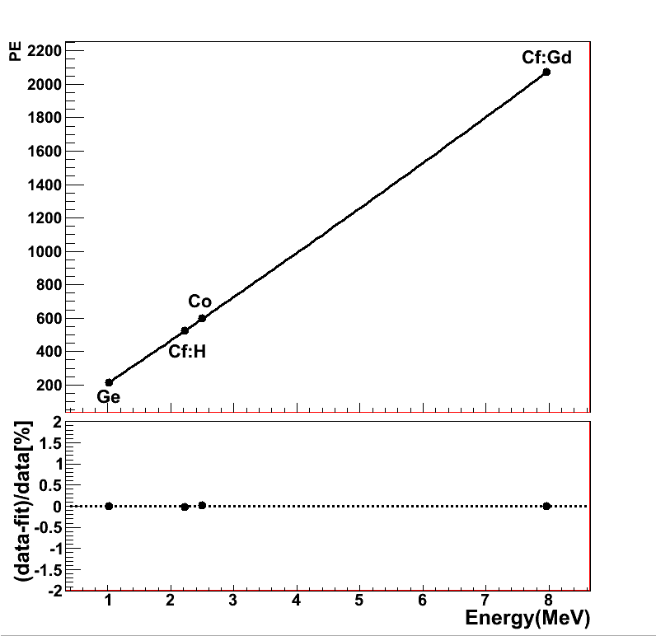
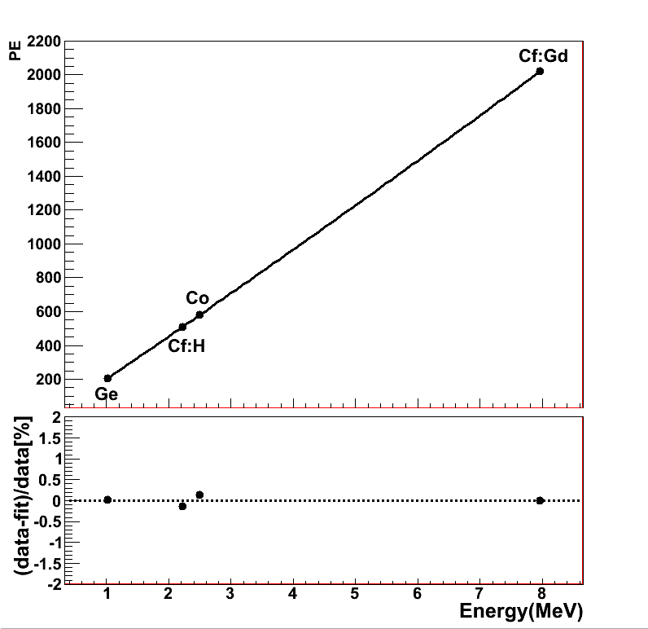
Energy Calibration
Far Detector
Near Detector

Slide 19
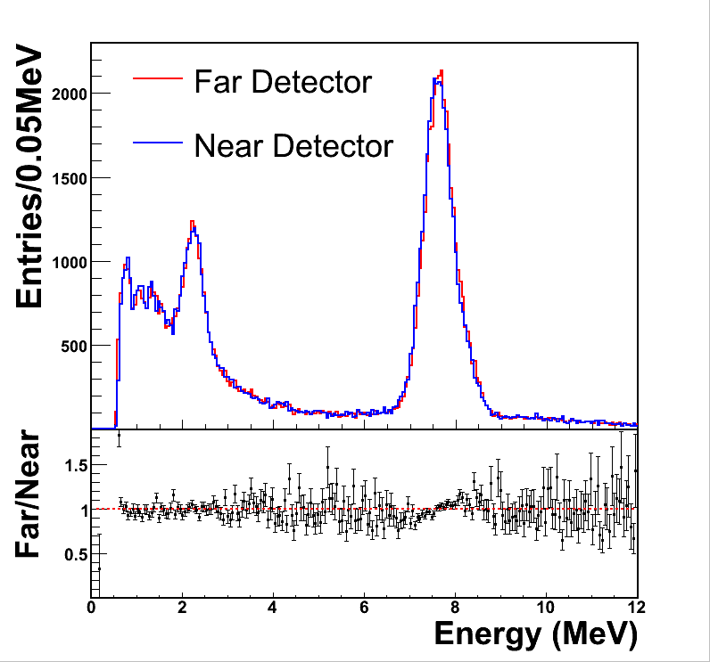
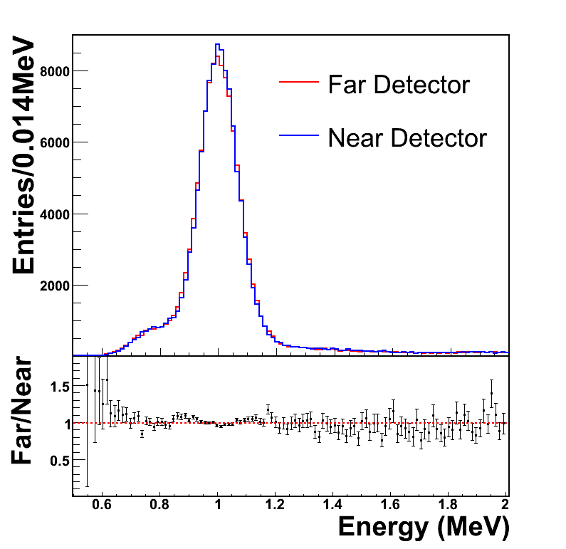
Energy Calibration
Ge 68
Cf 252
(1,022 keV)
(2.2/8.0 MeV)
Cf 252
(2.2/7.8 MeV)

Slide 20
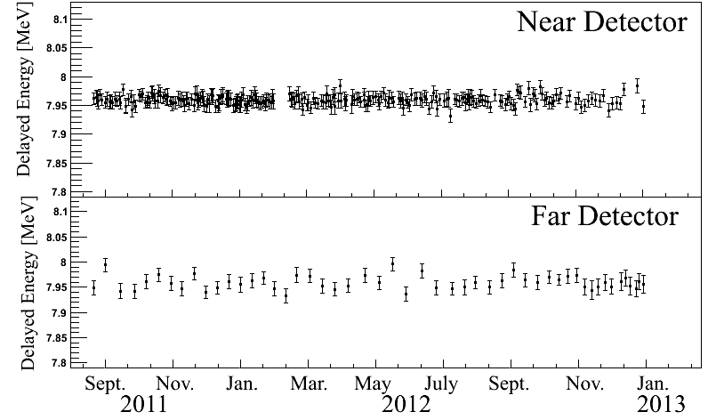
Detector Stability of Energy Scale
IBD candidate’s delayed signals (neutron capture by Gd)

Slide 21
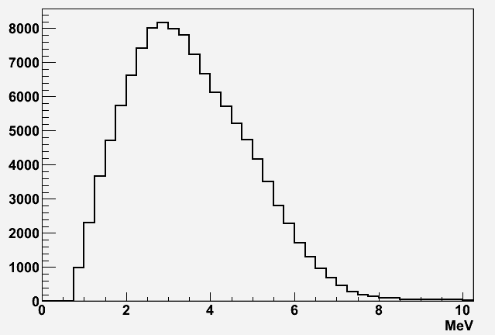
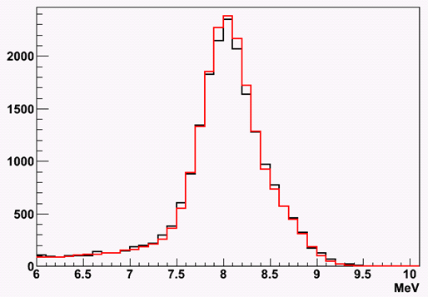
IBD Event Signature
Prompt signal (e⁺) : 1 MeV 2γ’s + e⁺ kinetic energy (E = 1~10 MeV)
Delayed signal (n) : 8 MeV γ’s from neutron’s capture by Gd
~26 μs (0.1% Gd) in LS
→
Prompt Signal
Delayed Signal

Slide 22
Backgrounds
Accidental coincidence between prompt and delayed signals
Fast neutrons produced by muons, from surrounding rocks and inside detector (n scattering : prompt, n capture : delayed)
⁹Li/⁸He β-n followers produced by cosmic muon spallation
Accidentals
Fast neutrons
⁹Li/⁸He β-n followers
μ
μ
μ
γ
p
n
n
⁹Li
e
Gd
Gd
n
Gd

Slide 23
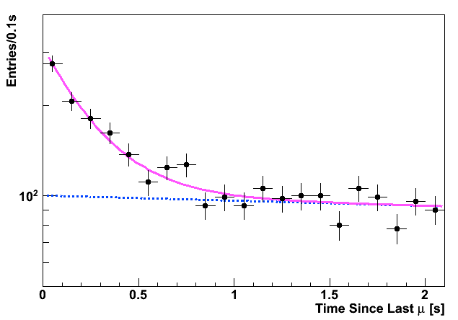
⁹Li/⁸He Background
⁹Li/⁸He are unstable isotopes emitting (β,n) followers and produced when a muon interacts with carbon in the LS.
⁹Li/⁸He
IBD

Slide 24
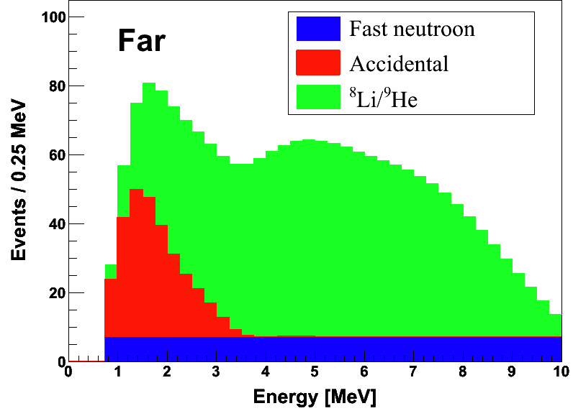
Background Spectra
Background shapes and rates are well understood
Total backgrounds : 6.5% at Far
2.7% at Near

Slide 25
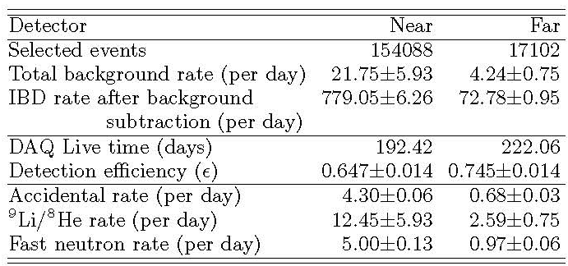
Summary of Final Data Sample
(Prompt energy < 10 MeV)
279787
30211
20.48± 2.13
4.89± 0.60
737.69± 2.58
70.13± 0.75
369.03
402.69
62.0± 0.014
71.4± 0.014
3.61± 0.05
0.60± 0.03
13.73± 2.13
3.61± 0.60
3.14± 0.09
0.68± 0.04

Slide 26
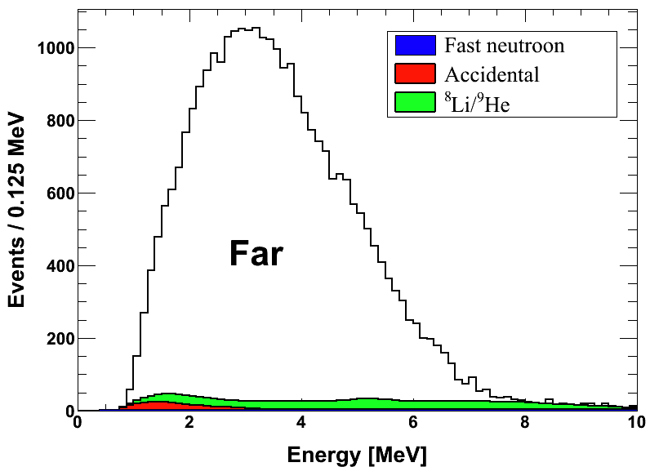
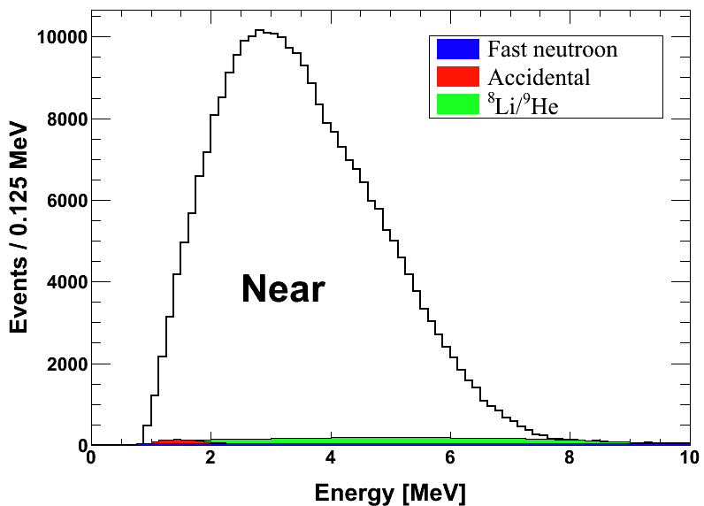
Measured Spectra of IBD Prompt Signal
Live time : 402.7 days
No. of IBD : 30,211
No. of bkg. : 1,970 (6.5%)
Live time : 369.0 days
No. of IBD : 279,787
No. of bkg. : 7,558 (2.7%)

Slide 27
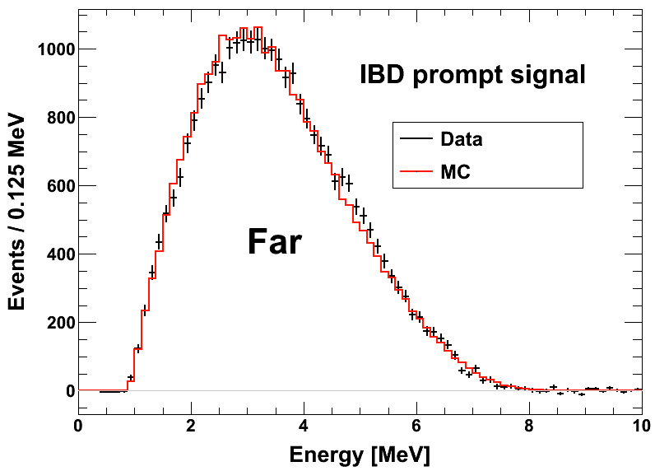
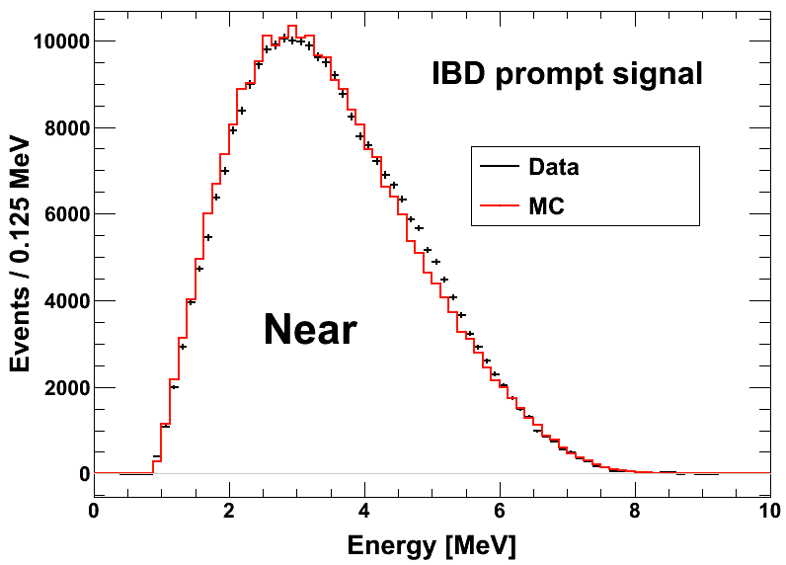
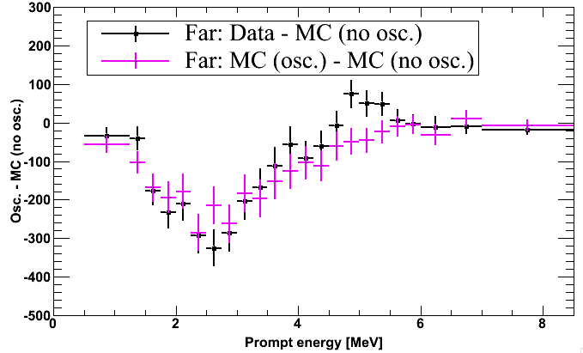
IBD Prompt Signal (Data vs. MC)
Rb ???

Slide 28
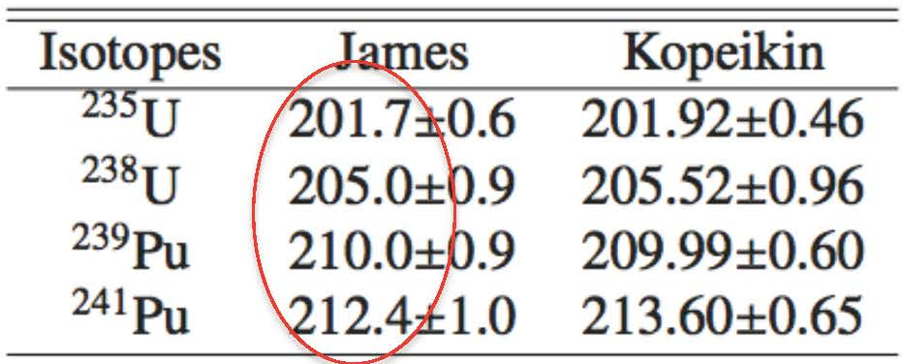

Expected Reactor Antineutrino Fluxes
Reactor neutrino flux
- P_{th} : Reactor thermal power provided by the YG nuclear power plant
- f_{i} : Fission fraction of each isotope determined by reactor core simulation of Westinghouse ANC
- φ_{i}(E_{ν}) : Neutrino spectrum of each fission isotope
[* P. Huber, Phys. Rev. C84, 024617 (2011)
T. Mueller et al., Phys. Rev. C83, 054615 (2011)]
- E_{i} : Energy released per fission
[* V. Kopeikin et al., Phys. Atom. Nucl. 67, 1982 (2004)]

Slide 29

Observed Daily Averaged IBD Rate
A new way to measure the reactor thermal power remotely!!!
R2
R1
R5
R4
R6
R5
R3+R5+R6
R3

Slide 30


Reactor Antineutrino Disappearance
Reduced χ² = 1.21
A clear deficit in rate (7.1% reduction)
Consistent with neutrino oscillation in the spectral distortion

Slide 31


Reactor Antineutrino Oscillations

Slide 32

RENO’s Projected Sensitivity of θ₁₃
(402 days)
(5.6 σ)
(~ 12 σ)
(3 years)
(18 % precision)
(8 % precision)
3 years of data : ±0.008 (8% precision)
- statistical error : ±0.010 → ±0.006
- systematic error : ±0.015 → ±0.005
2013. 3
(8 % precision)

Slide 33


Daya Bay Projected Senstivity
8 AD run
Current data
  Physics:
  measure sin²2θ₁₃ to 4% precision
  Precise reactor ν spectrum
  Direct measurement of Δm²₃₁
  Cosmogenic neutrons, isotopes
  Exotic searches
Released: 12.5% precision
  sin²2θ₁₃ = 0.089±0.011
Projected: 4%
At least 5 years' operation

Slide 34

Near Detector
Far Detector
RENO-50
10 kton LS Detector ~47 km from YG reactors
Mt. Guemseong (450 m) ~900 m.w.e. overburden

Slide 35
Summary
A clear disappearance of reactor antineutrinos is observed. The smallest mixing angle θ₁₃ that was the most elusive puzzle of neutrino oscillations, is firmly measured by the reactor experiments.
(RENO)
(Daya Bay)
(Double Chooz)
A surprisingly large value of θ₁₃ will strongly promote the next round of neutrino experiments to find the CP phase and determine the mass hierarchy.
Precise measurement of θ₁₃ by the reactor experiments will provide the first glimpse of δ_{CP.} If accelerator results are combined.

