Slide 1
Neutron Beta Decay as a Probe of Weak Interactions
Alexander Saunders
Los Alamos National Lab

Slide 2
Outline
Why study weak interactions using neutron beta decay?
  Because of the scientific reach
  Because of the impact across nuclear and particle physics
Neutron beta decay correlations
  How and why you measure them
  Some sample experiments from the field
Neutron lifetime
  The problem and its impact
  Some recent and upcoming experiments

Slide 3
Neutron beta decay can have remarkable scientific reach
Two choices for detecting a force carrier of mass M:
  Direct detection, if enough energy available
  Virtual effects, if not
If energy is close to mass, then signal may be large and function of energy
But if energy is much less than mass, then signal is independent of energy!
So the smart thing to do is choose the experiment that gives the best precision
Dubbers 2011

Slide 4
Neutron Decay Parameters
Semi-leptonic decay
  Lifetime 880 s
  Endpoint energy 782 keV
Just two free parameters in SM
  CKM mixing matrix element
  Ratio of weak coupling constants
  Uncertainty comes from radiative corrections

Slide 5
Neutron beta decay can inform many areas of physics
Many reactions share the same Feynman diagram as neutron beta decay
Dubbers 2011

Slide 6
Decay Correlations
A: electron asymmetry
  Perkeo II, Perkeo III, UCNA
B: neutrino asymmetry
  Perkeo II
C: proton asymmetry
  Perkeo II
D: triple correlation
  TRINE, emiT
a: electron-neutrino correlation
  aSpect, aCORN, Nab
Plus Fierz interference b, helicity correlations, etc.

Slide 7
Search for new physics
A single parameter yields λ, multiple measurements yield V_{ud} and beyond
CKM unitarity
  Do neutrons and superallowed beta decays agree?
Search for right-handed currents (250 GeV limit from n decay)
Scalar and tensor couplings from B and b
  Cirigliano 2012
excluded
allowed
1σ,2σ,3σ
SM
Holeczek et al., arxiv 1303.5295 (2013)

Slide 8
Principle of the A-coefficient Measurement (and B and C as well)
Detector 1
Detector 2
B field
e
θ
n
Polarized neutron
Decay electron
dW=[1+βPAcosθ]dΓ(E)
(End point energy = 782 keV)

Slide 9
Potential Sources of Systematics
Neutron polarization determination
Background
  Due to neutrons that do not decay
Detector-related effects
  Electron backscattering and spectroscopy
  Edge effect (fiducial volume selection)
  Detector response, calibration
Statistics
  Large decay volume, high density

Slide 10
Perkeo II Experiment Measured ABC
PERKEO II:
β-Asymmetrie A = − 0.1200±0.0006, PRL, in print (2013)
p-Asymmetrie B = + 0.983±0.005, PRL 99, 191803 (2007)
ν-Asymmetrie C = − 0.239±0.003, PRL 100, 151801 (2008)
→
Neutron polarisation
Neutron spectrum
Neutron wavelength

Slide 11
Perkeo III is state of art of CN beta decay
Backgrounds eliminated using pulsed beam
50 kHz decay rate
Total uncertainty expected to be ΔA/A=2.1e-3
Results very soon!
B. Maerkisch et al., NIM A 611, 216 (2009)

Slide 12
PERC is the next generation
Proton Electron Radiation Channel
8 m flight path maximizes statistics
6 T field pinch minimizes backscatter, field inhomogeneity effects
To be installed in flight path at FRM-2
All systematics expected to be O(10⁻⁴)
D. Dubbers et al., NIM A 596, 238 (2008)

Slide 13
Interlude — What are ultracold neutrons?
Very slow neutrons (v < 8m/s)
Totally reflected by some materials
Hence, they can be totally confined within a bottle for periods in excess of 100 seconds.
Typically: velocity < 8m/s
kinetic energy < 3x10⁻⁷ eV
wavelength > 500Å
or temperature < 4 mK
cf: Gravity: 10⁻⁷ eV/ meter.
Magnetic field (μB): 10⁻⁷ eV/ 1.7 T.
g
3m

Slide 14
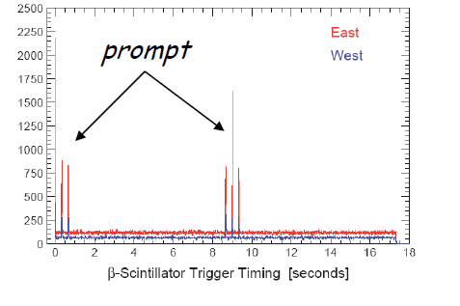
UCNA Experiment — General Approach
Novel features: UCN from pulsed spallation source
MWPC + plastic scintillator as β detector
Ultimate Goal: 0.2% measurement of A (δA/A = 0.2%)
Neutron Polarization
  UCN (can produce >99% polarization with 7T magnetic field)
  Copper and diamond-like carbon coated neutron guide (low depolarization)
Background
  Pulsed UCN source
  MWPC+Plastic scintillator
Electron backscattering
  MWPC+Plastic scintillator
Fiducial volume selection
  MWPC
Plaster et al., PR C 86, 055501 (2012)

Slide 15
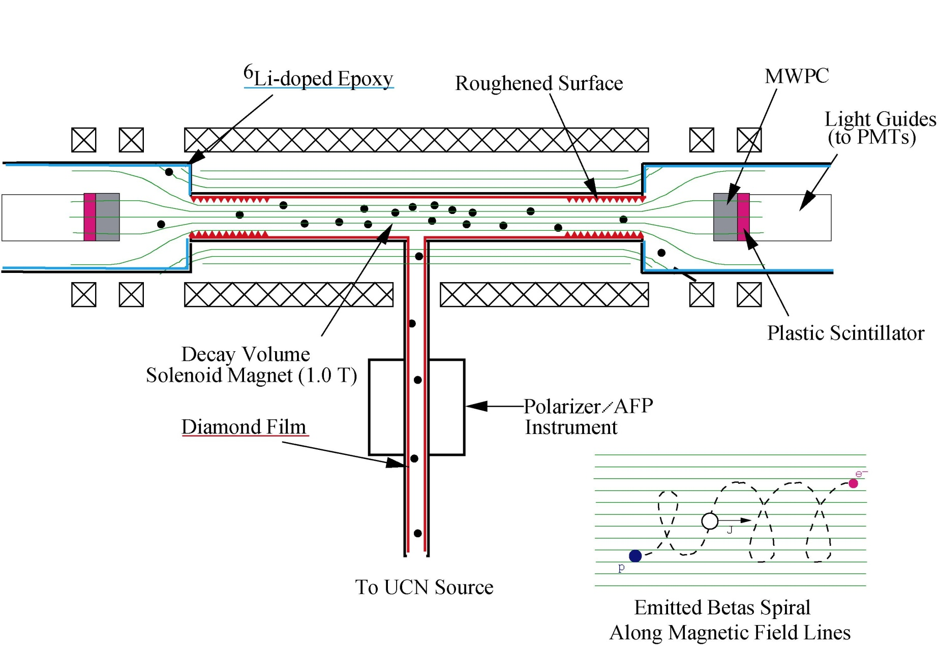
UCNA Experiment — Apparatus
Field Expansion Region
Decay Trap Window
Neutron Absorber

Slide 16
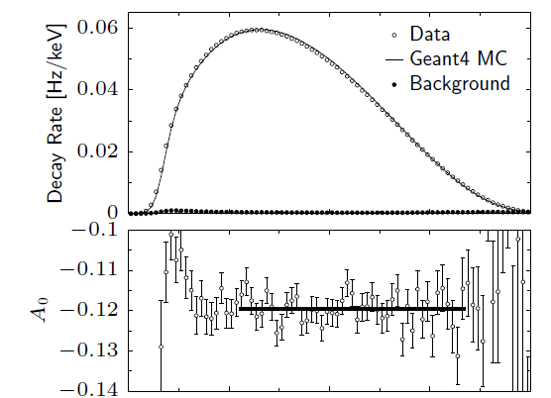
UCNA Status
Taking production data since 2009 using LANL UCN source
Latest result: A=-0.11954(112)
Mendenhall et al., arXiv 1210.7048 (2012)

Slide 17
Nab experiment in design stage
Nab will measure a,b at SNS in US
  Recall a=electron-neutrino correlation
  Reconstruct opening angle from E_{p}, E_{e}
  E_{e} from Si detectors, E_{p} from TOF

Slide 18
Neutron Lifetime affects BBN
Primordial nucleosynthesis:
σ_{ν} ~ 1/τ_{n}
τ_{n}
t = 1 s
t = 150 s
n-mass fraction
Δm = m_{n} − m_{p} = 1.3 MeV
Temperature (K)
Dubbers 2013
And ratio of He/n depends directly on n lifetime: 1% lifetime uncertainty shifts calculated He fraction of Y=0.2480+/- .0003 by 0.0015, or 5 sigma!

Slide 19

Lifetime uncertainty has grown recently
And central value has shifted by almost 1%!
Serebrov et al.,
PL B 605, 72 (2005)
Pichlmaier et al.,
PL B 693, 221 (2010)
Beam Method: Count the dying
Bottle method: count the survivors
Danger: absolute monitor efficiency needed!
Wietfeldt and Greene,
Rev. Mod. Phys. 83, 1173 (2011)

Slide 20
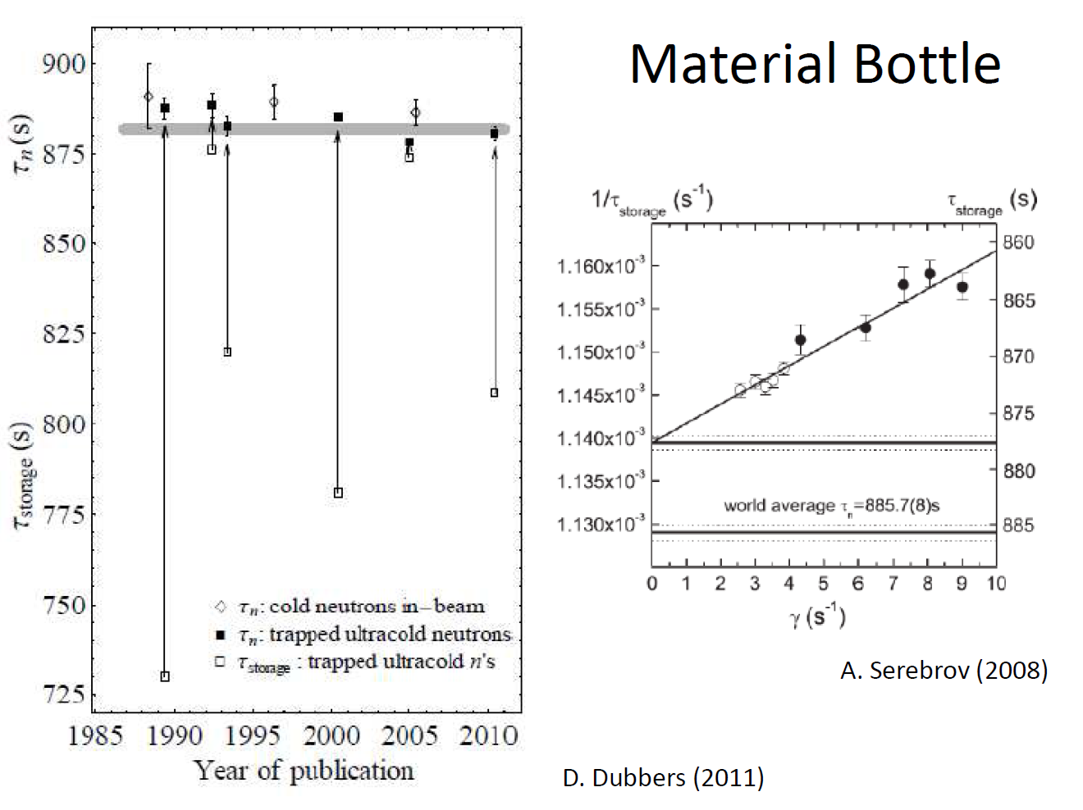
Material bottle experiments involved 100 s extrapolations due to wall losses

Slide 21
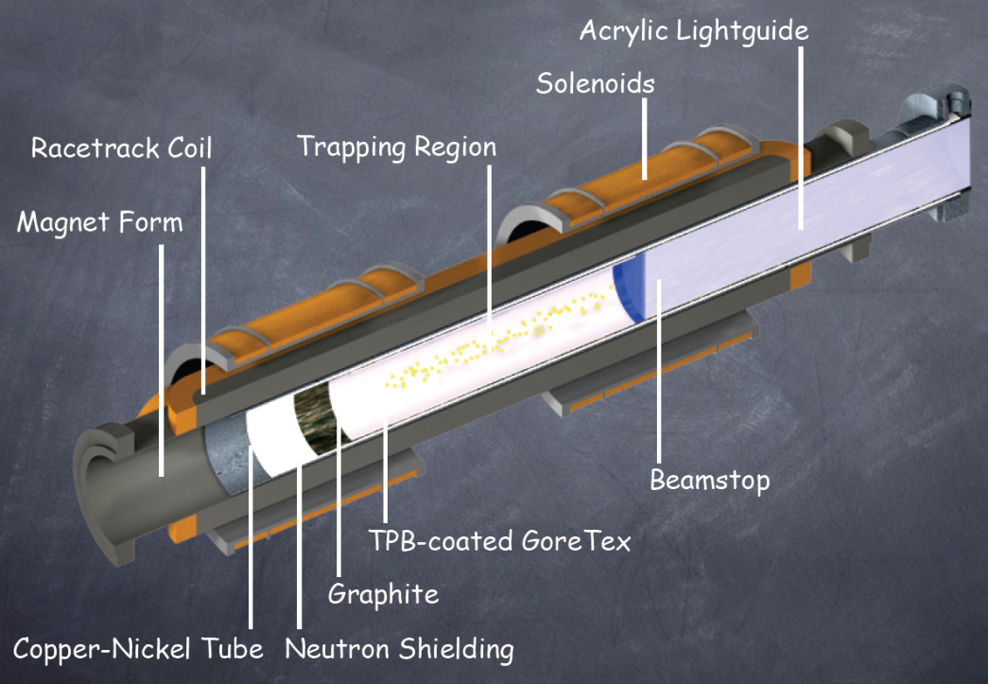
Solution: eliminate wall losses using magnetic bottle
A new crop of experiments using magnetic traps is now under development
Stern-Gerlach effect repels polarized neutrons from walls
ILL Ezhov Bottle filled with vacuum
NIST UCN trap filled with superfluid 4He
Both have acquired commissioning data;
HOPE at Munich also in design stage

Slide 22
Penelope experiment under development
Superconducting multipole
  Field zero in center eliminated by inner conductors
Filled with UCN from FRM-2 through gap in bottom
Decay products detected at top, guided by field lines
Spectrum cleaned using absorber lowered from top
Magnet now under construction
1.2 m

Slide 23
An outstanding problem: phase space evolution
Neutron losses on scale of neutron lifetime (quasibound orbits)
Detector efficiency changes with time
Must fill phase space evenly, quickly: chaos!
Symmetric Trap has stable orbits
Asymmetric Trap has chaotic orbits
C.-Y. Liu, 2012

Slide 24
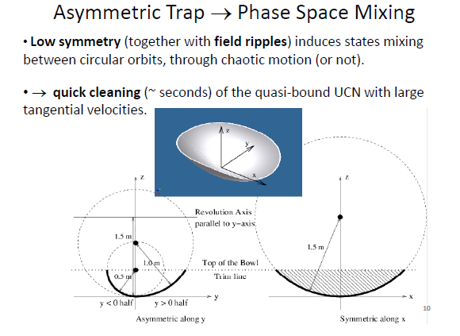
UCNTau experiment designed to overcome phase space issues

Slide 25
UCNTau Experiment now commissioning
Asymmetric array of permanent magnets
Holding field coils maintain polarization
UCNs from Los Alamos source filled through door in bottom
Neutrons to be counted by absorption on vanadium foil inserted in midplane of trap, activation counted ex-situ.
Has stored neutrons in trap for first time.

Slide 26
New beam-type experiment also nearing first results at J-Parc
Time Projection Chamber
with ³He-⁴He-CO₂ gas
Shield
Electrons are counted
Polarized pulse-beam
e⁻
E
Spin flipper
Rise time ~10μs
Polarizing
supermirrors
p
Zr Window
Beam
Catcher
1m
TPC detects electrons from n decay and protons from n-absorption on 3He simultaneously
Leading systematic uncertainty expected to be pressure of 3He
Physics run planned for 2013
Takahito Yamada, U. Tokyo, 2012

Slide 27
Conclusions
Precision neutron beta decay measurements can search for physics beyond the standard model with a reach competitive with HEP
And also underlie wide areas of nuclear and particle physics
Beta decay correlation experiments in progress and next generation in development: overconstrained SM parameters allow search for BSM effects
Neutron lifetime problem needs experimental resolution: it is coming, with new experiments worldwide approaching production data
Review papers:
  Dubbers and Schmidt, Rev. Mod. Phys. 83, 1111 (2011)
  Abele, Pro. Part. Nucl. Phys. 60, 1 (2008)
  Wietfeldt and Greene, Rev. Mod. Phys. 83, 1173 (2011)
Thank you to my collaborators and especially Dirk Dubbers, Bastian Maerkisch, Hartmut Abele, Chen-Yu Liu, Albert Young

