Slide 1
NEMO Phase II
Acoustic positioning system (or the “zombie”)
FACTS:
- Standard ACSA-LBL calibration procedure:
Measure distance between LBL-beacons with ROV and ACSA-calibration tool (1 cm)
Calibration tool is is lost
- Standard ACSA-LBL calibration monitoring:
Acoustically measure distance between LBL and tower base (monitoring station): ToE
Monitoring station is broken
- LBL will be deployed after tower unfurling
We will not have target (accurate!!!) positioning
What can we do ?
Without LBL (only the beacon at the tower base and the “spanish” beacon)
With full uncalibrated LBL (4 beacons around the tower and 1 beacon at the tower base)

Slide 2
NEMO Phase II: Acoustic positioning system (or the “zombie”)
Scenario 1) the ROV is close to the tower during unfurling ? Or far away ?
Available instruments (all-switched on during unfurling or not ?)
CTDs (floor 1 and floor 7)
resolution in depth: 1 m (floor 1) - 0.5 m (floor 7)
Compasses (all floors)
resolution 1° (but no calibration …)
Tower base ACSA beacon (not time syncronised with the apparatus)
measure distances between hydrophones (Time Difference of Arrival)
200 us on floor 1 (100 m): well measurable
5 us on floor 8 (380 m): our limit (without post processing)
cross-check results with available instrumentation
Tower base Spanish beacon (time syncronised with the apparatus)
measure absolute distances between beacon and hydrophone (Time of Arrival)
same resolution
Cross-check results with available instrumentation
Expected resolution: Order of 1 m per PMT (z) ..maybe better using all instruments
in average as in phase 1 !!! Assuming slow movemets of the tower and almost fixed position
→ Important: compare with tower mechanical mode

Slide 3
NEMO Phase II: Acoustic positioning system (or the “zombie”)
Scenario 2)
We have all the previous stuff and …
LBL ACSA beacon around the tower (not time syncronised with the apparatus)
measure distances between hydrophones (Time Difference of Arrival)
<5 us on each floor 1 (400 m): our limit (without post processing)
1.5 ms between floors: well measurable
Expected overall resolution depends on accuracy of USBL fixes (beacon positions)
If we run long term average
Assuming slow movemets of the tower and almost fixed position
We could improve the resolution under optimal condition order of 1 m
Time dependent
Cross-check results with available instrumentation … could improve the result
Important: compare with tower mechanical mode

Slide 4
Backup

Slide 5
Hardware
Hydrophones + AcouBoards
Floors 1,2,3,6 (SMID), 7 (Valencia FFR) ,8 (Eralngen Piezo) OK
Problems: Floor 0 (monitoring station), Floor 5 lost
DAQ OK
3 Acoustic Servers + RME
1 ACSA
2 “Acoufilters”
Long Baseline OK
5 Beacons + tripods + battery packs
Calibration Tool + ROV Tested
Software
INFN OK
AcouServer, AcouRun, AcouFilters (bioacoustics, positioning, later: nu search)
ACSA OK
Extract TOA, TOA Viewer, Poistion reconstruction (not usable)
To be finalised:
Exchange of data ACSA-INFN Database (CTD, Positions)
Tower Visualization --- offline…. If possible
ACSA Position recontruction will run using Floor 1 as monitoring station (<1 m resolution)

Slide 6
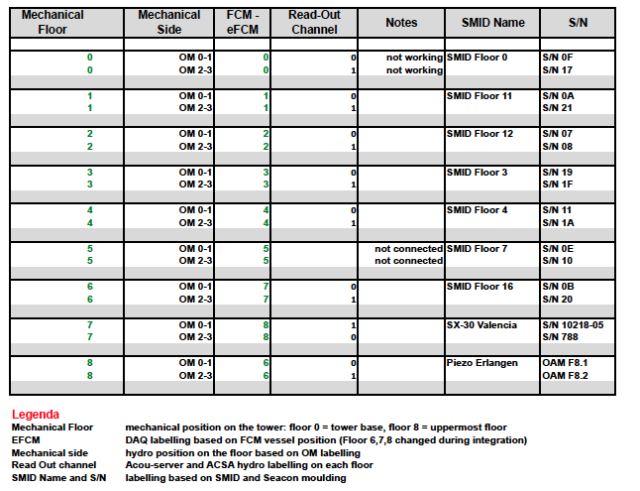

Slide 7
Long Baseline Positioning
Beacon 2
North
400 m
Beacon 5
West
Beacon 1
Tower Base
Beacon 3
East
Beacon 4
South

