Slide 1
NSAC Long Range Plan Report
Donald Geesaman
Argonne National Laboratory
Chair, US Department of Energy/National Science Foundation Nuclear Science Advisory Committee
IUPAP Working Group 9 on
International Cooperation in Nuclear Physics Symposium
LNF
1 June 2013

Slide 2
Nuclear Physics helps define the history of the universe
Baryon asymmetry of the universe
Quark – Hadron Phase Transition
Properties of Hadrons
Properties of Nuclei
Energy production in stars
How are the heavy elements produced
Neutron stars and supernovae
Neutrino, properties,
Applications
Indeed it is the time scales and the bottlenecks in the nuclear physics of stars and chemical evolution that determine why the universe looks like it does.

Slide 3
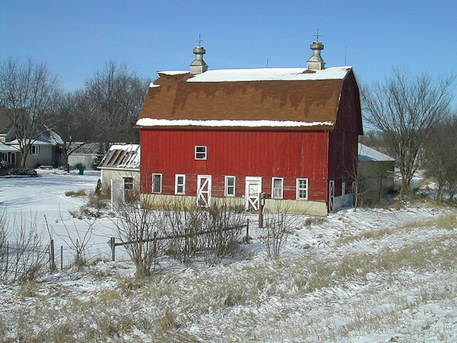
Barns are painted red because of the Physics of Dying Stars
Red paint is cheap because stars make lots of iron and oxygen, and Fe₂O₃
absorbs yellow, green and blue light and appears red.
The nuclear binding curve in action.
http://blogs.smithsonianmag.com/smartnews/2013/05/barns-are-painted-red-because-of-the-physics-of-dying-stars/

Slide 4
The 2007 Long Range Plan
Led by
Robert
Tribble

Slide 5
Science Questions
Quantum Chromodynamics
What are the phases of strongly interacting matter and what roles do they play in the cosmos?
What is the internal landscape of the nucleon?
What does QCD predict for strongly interacting matter?
What governs the transitions of quarks and gluons into pions and nucleons?
What is the role of gluons and gluon self-interactions in nucleons and nuclei?
What determines the key features of QCD, and what is their relation to the nature of gravity and space time?

Slide 6
Science Questions
Nuclei and Nuclear Astrophysics
What is the nature of the nuclear force that binds protons and neutrons into stable nuclei and rare isotopes?
What is the origin of simple patterns in complex nuclei?
What is the nature of neutrons stars and dense nuclear matter?
What is the origin of the elements in the cosmos
What are the nuclear reactions that drive stars and stellar explosions?

Slide 7
Science Questions
Fundamental Symmetries and Neutrinos
What is the nature of the neutrinos, what are their masses and how have they shaped the evolution of the universe?
Why is there now more visible matter than antimatter in the universe?
What are the unseen forces that were present at the dawn of the universe but disappeared from view as the universe cooled?

Slide 8
Recommendations of the 2007 NSAC Long Range Plan
Recommendation I
We recommend completion of the 12 GeV CEBAF Upgrade at Jefferson Lab. The Upgrade will enable new insights into the structure of the nucleon, the transition between the hadronic and quark/gluon descriptions of nuclei, and the nature of confinement.
Recommendation II
We recommend construction of the Facility for Rare Isotope Beams (FRIB), a world-leading facility for the study of nuclear structure, reactions, and astrophysics. Experiments with the new isotopes produced at FRIB will lead to a comprehensive description of nuclei, elucidate the origin of the elements in the cosmos, provide an understanding of matter in the crust of neutron stars, and establish the scientific foundation for innovative applications of nuclear science to society.

Slide 9
Recommendation III
We recommend a targeted program of experiments to investigate neutrino properties and fundamental symmetries. These experiments aim to discover the nature of the neutrino, yet-unseen violations of time-reversal symmetry, and other key ingredients of the New Standard Model of fundamental interactions. Construction of a Deep Underground Science and Engineering Laboratory is vital to U.S. leadership in core aspects of this initiative.
Recommendation IV
The experiments at the Relativistic Heavy Ion Collider have discovered a new state of matter at extreme temperature and density—a quark-gluon plasma that exhibits unexpected, almost perfect liquid dynamical behavior. We recommend implementation of the RHIC II luminosity upgrade, together with detector improvements, to determine the properties of this new state of matter.
Recommendations for the further future
Initiatives

Slide 10
What has happened since 2007
Construction of the JLAB 12 GeV upgrade is almost complete.
A site has been selected for FRIB and it will undergo a “base-line” review this summer. (cost and schedule)
The RHIC Luminosity upgrade was completed at about 1/10 the initially estimated cost.
While the US underground science program has been negatively impacted by the cancelation of DUSEL, NP is supporting a DBD prototype experiment at the Homestake mine.
R&D and technology confirmation stage efforts continue on EDM measurements and neutrino-less double beta decay.

Slide 11
There has been substantial progress around the world (very incomplete list)
Collisions of Pb beams and p+Pb at LHC
RIKEN grows in capability and construction is progressing at SPIRAL II, GSI and ISAC. New investments in Korea.
Neutrino properties are being measured with greater precision and θ₁₃ is sizable. France, China, Korea
New Heavy elements, Germany, Japan, Russia

Slide 12
There Has Been a Substantial Jolt to the World Economy
The 2007 Long Range Plan was based on a doubling of the budget of the DOE Office of Science and National Science Foundation over 10 years.
Last year, NSAC was charged to provide advise on implementing the priorities and recommendations of the 2007 Long Range Plan in light of projected budgetary constraints.
An NSAC Subcommittee, chaired by Bob Tribble was asked to address this by January 2013.

Slide 13
The Subcommittee Examined the Science Case in Light of Recent Progress
“The subcommittee was unanimous in reaffirming the LRP vision for the field. Each of the recommendations is supported by an extremely compelling science case. If any one part is excised, it will be a significant loss to the U.S. in terms of scientific accomplishments, scientific leadership, development of important new applications, and education of a technically skilled workforce to support homeland security and economic development.
The subcommittee report clearly presented what would be lost under no-growth scenarios in terms of
Science
Workforce
Future capabilities

Slide 14
2-4 Lines Summary of Science
CEBAF-12 GeV Combination of beam power and energy
Excited gluon fields in hadrons
Orbital motion of quarks and contribution to the proton’s spin.
Precision tests of the standard model
Exquisite tests of nuclear models
RHIC Broad range of energy and world’s only polarized proton collider
Energy scan to search for QCD critical point. Initial scans suggest RHIC covers the right energy range.
Gluon and antiquark contributions to proton spin
Energy dependence of transport coefficients in strongly interacting quark gluon matter
Possible evidence for local topological parity violation
FRIB Highest beam intensities and reaccelerated rare isotope beams
Highest reach in nuclei far from stability and along paths of astrophysical processes.
US access to broad range of new isotopes for applications, stockpile stewardship and national security.

Slide 15
Other Options
The subcommittee was unanimous in endorsing the modest growth budget scenario as the minimum level of support that is needed to maintain a viable long-term U.S. nuclear science program that encompasses the vision of the Long Range Plan.

Slide 16
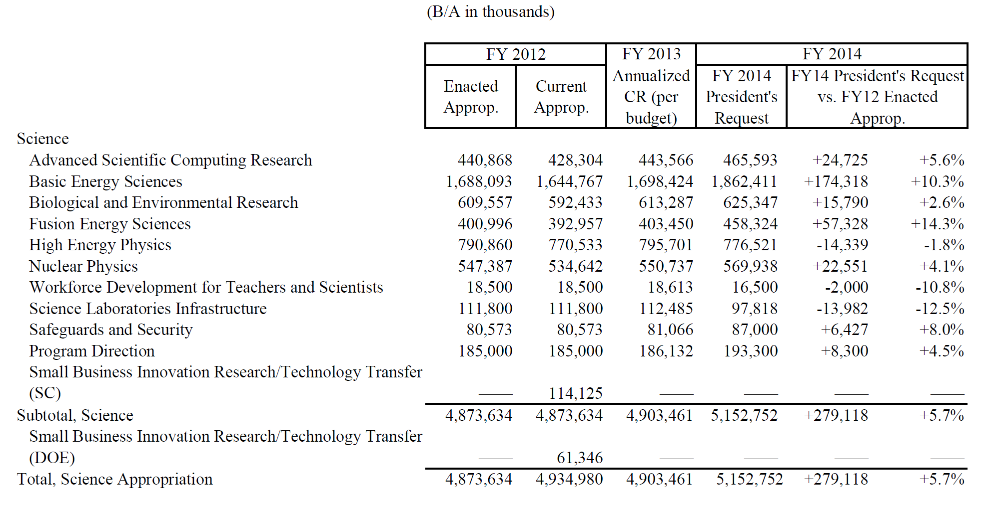
Office of Science FY 2014 Budget Request to Congress
Nuclear Physics FY14 $570M at the level of Modest Growth Budget

Slide 17
Director of the DOE Office of Science Presentation on FY14 Budget

Slide 21
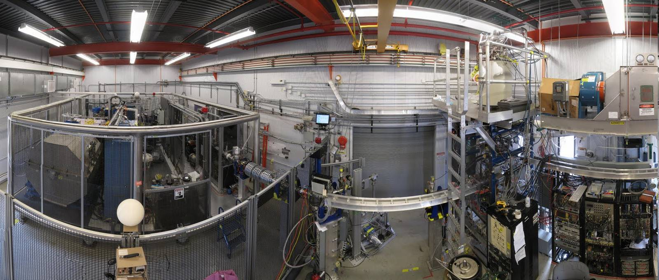
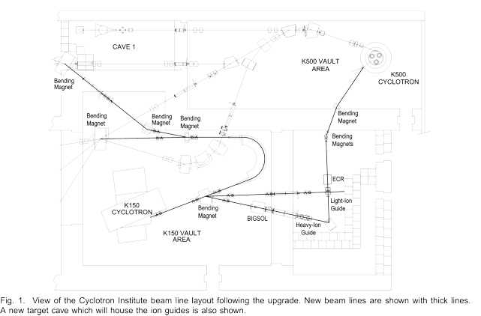
And Much More
Californium Rare Ion Breeder Upgrades delivers first beams at Argonne
New high intensity accelerator for nuclear astrophysics at Notre Dame
Texas A&M Cyclotron Upgrade Project progressing.
Involvement in 6 efforts in neutrino-less double beta decay experiments
Neutron and Nuclear Electric Dipole Moment Experiments make major progress
Gamma ray tracking array GRETINA has very successful first production run at NSCL.
Measurement of neutron radius of Pb in parity violating electron scattering at JLab.
Upgrades of RHIC detectors
Far-reaching and efficient utilization of advanced computing in nuclear theory, Lattice, Quantum Many Body Techniques, Density Functional ...

Slide 22
Summary
US Nuclear Science program continues to follow guidance of the 2007 Long Range Plan
There is a great deal of fiscal uncertainty in the U.S. with the unknown consequences of sequestration
The President’s budget show a continued emphasis to invest in nuclear science
My crystal ball indicates a bright future, but it may be a bumpy flight getting there.

