Slide 1
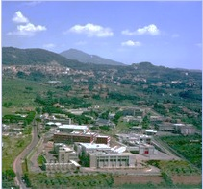

Role of NuPECC (in short)
….after the Long Range Plan 2010
ongoing activities
Eu projects
Publications
Angela Bracco - W9 meeting at LNF - May 31 2013

Slide 2
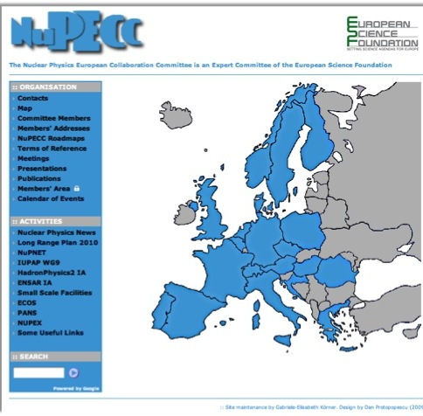
Promote Nuclear science
and collaborations
Strategic planning
exchanges
with
AnPHA
NSAC
+ ALAFNA
29 (+5) Members 20 Countries
ECT* and FAIR
6000 Physicists and engineer

Slide 3
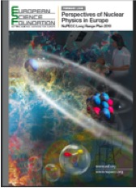
Long range Plan
Objectives
Review status of the field
• Issue recommendations
to advance the science and its applications in Europe
• Develop action plan (roadmap) for:
Building new large-scale Research Infrastructures
Upgrading existing Nuclear Physics facilities
Collaborate closely with smaller scale facilities
support EU FP7 ( FP8) projects ( IAs, ERA-net )
• Put European Nuclear Physics into global context
−NSAC (DoE & NSF) in USA, ANPhA in Asia,
ALAFNA in Latin America
−IUPAP and OECD Global Science Forum
December 2010

Slide 4





Scientific themes
Hadron Physics
Phases of Strongly Interacting Matter
Nuclear Structure & Dynamics
Nuclear Astrophysics
Fundamental Interactions
6) Nuclear Physics Tools & Applications
All aspects of Nucleon, Nuclei and hot dense nuclear matter

Slide 5
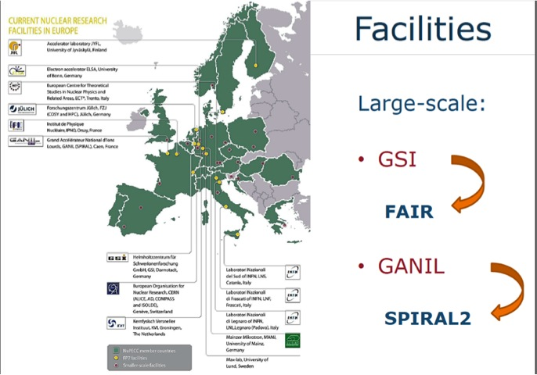
Facilities for Nuclear Physics
facilitiesf
Facilities for
Nuclear and
Hadronic Physics
in Europe

Slide 6
NuPECC LRP (2010)
FAIR and SPIRAL2 (ESFRI)
HIE-ISOLDE and SPES
Existing Laboratories
ALICE at CERN
ELI_NP (ESFRI)
Instrumentation (AGATA)
Theory
Applications
New Facilities and Major upgrades
FAIR
>2025
Existing
Facilities
ALTO
COSY
MAMI
LNF
Jyvaskyla
LNS
KVI
….
e-A collider
SPIRAL2
E
U
R
I
S
O
L
HIE-ISOLDE
SPES
>2025
ELI_NP
2014
15
16
17
18
19
20

Slide 7
STATUS OF ESFRI FACILITY
UNDER CONSTRUCTION

Slide 8
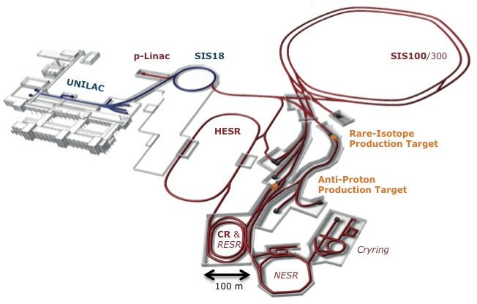
FAIR- Facility for Antiproton & Ion Research
Nuclear Structure & Astrophysics
(Rare-isotope beams)
Hadron Physics
(Stored and cooled
14 GeV/c anti-protons)
p-Linac
SIS18
SIS100/300
UNILAC
QCD-Phase Diagram
(HI beams 2 to 45 GeV/u)
HESR
Rare-Isotope
Production Target
Fundamental Symmetries
& Ultra-High EM Fields
(Antiprotons & highly stripped ions)
Anti-Proton
Production Target
Dense Bulk Plasmas
(Ion-beam bunch compression
& petawatt-laser)
CR &
RESR
Cryring
Materials Science & Radiation Biology
(Ion & antiproton beams)
NESR
100 m
Accelerator Physics

Slide 9
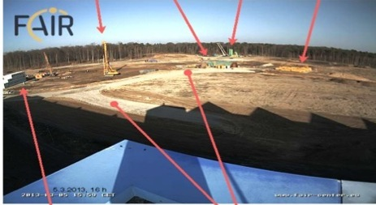
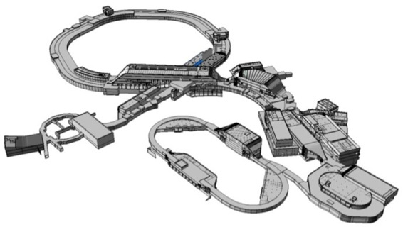
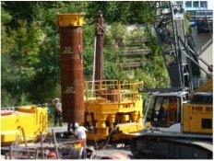
FAIR - Civil Construction
Synchrotrons: 1.1 km
With beamlines: 3.2 km
Existing
SIS 18
Total area > 200 000 m2
Area buildings ~ 98 000 m2
Usable area ~ 135 000 m2
Volume of buildings ~ 1 049 000 m3
Substructure:~ 1500 pillars, up to 65 m deep

Slide 10
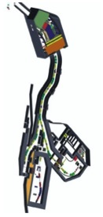
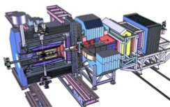
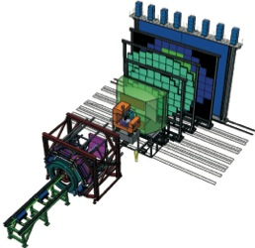
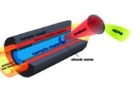
FAIR : 4 pillars for experiments
PANDA
NUSTAR - Nuclear structure and
Astrophysics with RIB beams produced
with In-flight method
PANDA - Hadron dynamics
with anti-protons in a
storage ring
CBM – Compressed Barion Matter experiment with heavy ions
APPA - Atomic, Plasma Physics and Applications.
NUSTAR
CBM
APPA

Slide 11
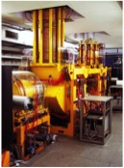
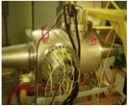
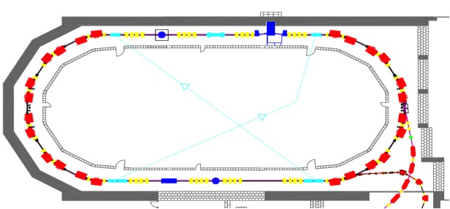
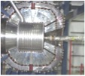

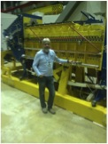

HESR Prototyping and Tests at COSY
Pellet Target
WASA
Residual Gas
Profile Monitor
Barrier Bucket Cavity
Stochastic Cooling
2 MeV
e-Cooler
Notes:
11

Slide 12
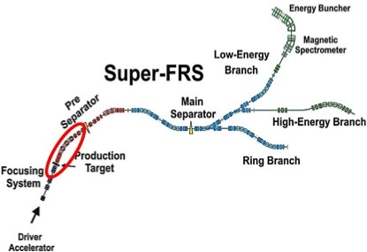
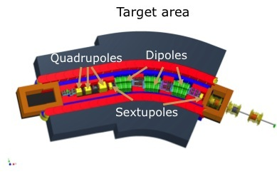
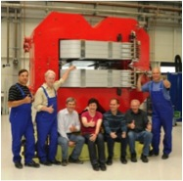
Experiment NuSTAR
Radiation Resistant Magnets
Normal conducting magnets using mineral insulated cable
3 dipole, 3 quadrupole, and 2 sextupole magnets
Prototype dipole built and tested by BINP
Prototype dipole delivered and assembled at GSI
Target area
Quadrupoles
Dipoles
Sextupoles

Slide 13
Timeline MSV
2011
2012
2013
2014
2015
2016
2017
2018
2019
6
7
8
9
10
11
12
6
Submission building permits
Site preparation
Civil construction contracts
Building of accelerator & detector components
Completion of basic civil construction work
Installation & commissioning of accelerators and detectors
Data taking
7
8
9
10
11
12

Slide 14

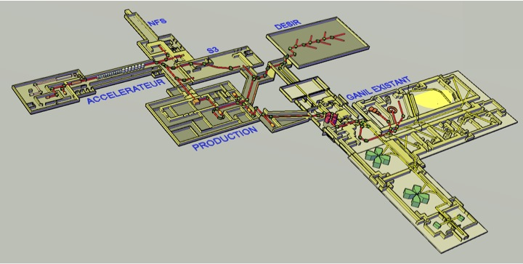
SPIRAL2 under construction
Phase 1: High intensity stable beams + Experimental rooms (S³ + NFS)
Phase 2: High-intensity low-energy (DESIR) & post-accelerated Radioactive Ion Beam facility
CIME cyclotron RIB at 1-20 AMeV (up to 9 AMeV for FF)
NFS
DESIR
Phase 1
S3
Current GANIL facility
SPIRAL2 LINAC
LINAC:
33 MeV p,
40 MeV d (5mA)
14.5 A.MeV HI (1mA)
RIB production hall
Phase 2
RIB Production Cave
Up to 10¹⁴ fiss./sec.
DESIR Low-energy RIB facility
Cost: 210 M€ + 40 M€ detectors
Notes:
For those who don’t know what SPIRAL2 is, Let me start by a brief description of the project. Here you have the layout of this facility which will be constructed in two phases. The first phase which is presently in construction is based …
Attached to this fisrt phase, two new experimental are also under construction : one dedicated to NFS and the other which will host the new S3 spectrometer, I will describe later.
The second phase which in the detail design phase, will concern the production building …. New DESIR facility recentky funded …
This facility will deliver in a near future, both high intensity stable beams and and intensity of radioactive beams.
Here you have the layout of the facility

Slide 15
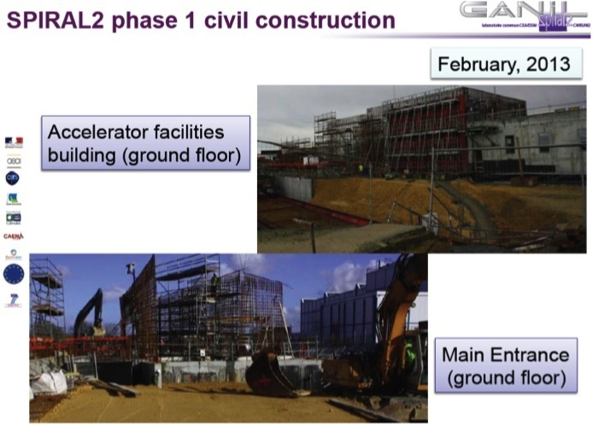

Slide 16
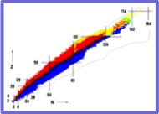

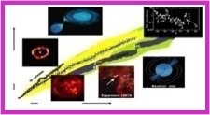


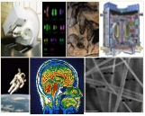

Nuclear structure
EOS
Liquid-gas phase
Isospin dependence
Nuclear Astrophysics
GANIL/SPIRAL2
Science
Multi-disciplinary research
& Applications
Fundamental Interactions

Slide 17
Timeline GANIL & SPIRAL2
I 2012 I 2013 I 2014 I 2015 I 2016
GANIL
4 months
6 m.
8 m.?
8 m.?
8 m.?
New beams
SPIRAL1 (1+)
End 2014 (N+)
AGATA at GANIL
Civil Construction
Phase 1
LINAC, NFS, S3
Commis
-sioning
Stable ion beams from LINAC
LoI Day 1
SPIRAL2 Phase1
Update
Com.
NFS Experiments
PAC NFS
PAC S³
S3 Experiments
Com.
End Detailed Design
Civil Construction and assembly of equipments
Phase 2
RIB, DESIR
Commis-sioning
Phase 1
LoI Day 1
SPIRAL2 Phase 2
Update
PAC
Phase 2
RIB

Slide 18
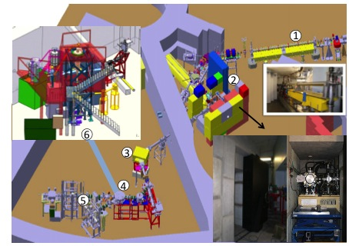
ALTO Facility at IPNO ORSAY
inauguration in May 13 2013
First facility employing Photofisssion
to produced
radioactive beams (low energy)
Niche for scientific program.
Beta decay spectroscopy
nuclear orientation experiment
Strong connections
needed for the
developments of phase-2 of SPIRAL2
Electron Linac 50 MeV;
Target ion ISOL source vault, 3. Mass separator, 4. Kicker- Bender,

Slide 19

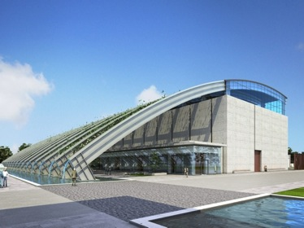
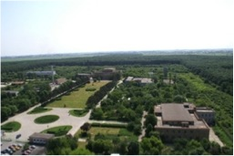
Extreme Light Infrastructure
2006 – ELI on ESFRI Roadmap
2007-2010 ELI-PP (FP7) –
ELI-DC (Delivery Consortium): April 2010
ELI-Beamlines (Czech Republic) –
ELI-Attoseconds (Hungary)
  ELI-Nuclear Physics (Romania)
ELI-NP
in ‘Nuclear Physics Long Range Plan in Europe’ as a major facility
ELI-NP
19

Slide 20
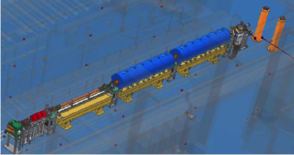
ELI-Nuclear Physics
Large equipments:
Ultra-short pulse high power laser system, 2 x 10PW maximum power
0.5% band width 10⁴ photons/eVs.
Gamma beam, high intensity, tunable energy up to 20MeV,
produced by Compton scattering of a laser beam
on a 700 MeV electron beam produced by a warm LINAC
Buildings: 33000sqm total
Experiments:
8 experimental areas,
Interaction chambers, Beam transportation
8 auxiliary laboratories
Nuclear Structure- Nuclear Astrophysics and Applications
e⁻ LINAC
20

Slide 21
STATUS OF
EU PROJECTS
and
Major upgrades
at existing facilities

Slide 22
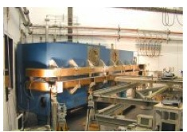
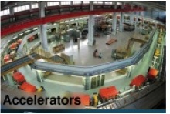

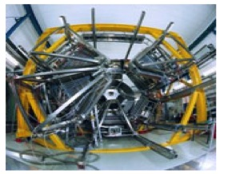
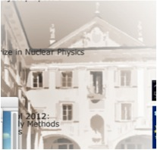
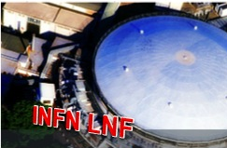
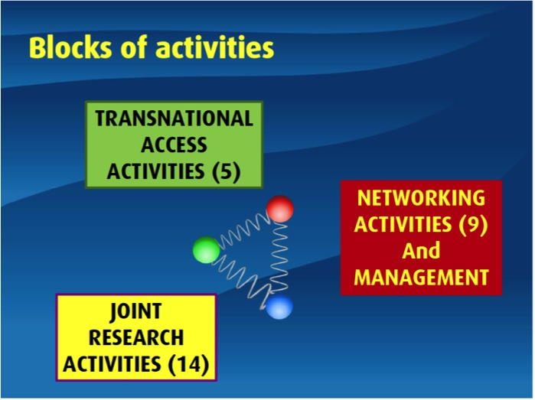
COSY
MAMI
FACILITIES in
TRANSNATIONAL ACCESS (5)
GSI
ECT*
JOiNT RESEACH ACTIVITIES (14)
NETWORKING (9)

Slide 23
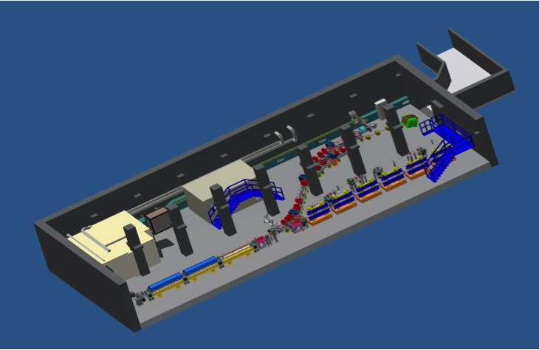
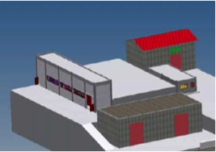
SPARC_LAB
Sources for Plasma Accelerators and Radiation Compton with Lasers And Beams
A facility based on
the unique combination of
high brightness electron beams (150 MeV) with
high intensity ultra-short laser pulses
500 keV 10¹⁰ fotoni/s bandwidth 5%
Notes:
to realise external injection into the plasma bubble. This requires extensive R&D work on the control and synchronization of electron beams on the few femtosecond scale.
To realize external injection into the plasma bubble requires extensive R&D work into the sincronization of the electron beam on the few femtosecond scale.

Slide 24
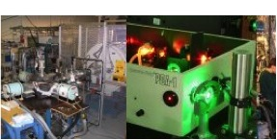
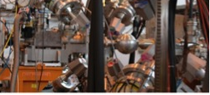

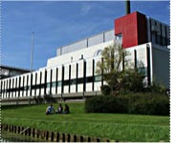
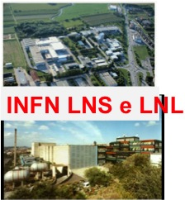
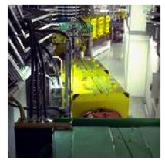
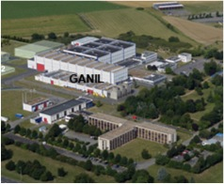
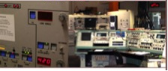
Nuclear
Structure
FACILITIES
ISOLDE
Jyvaskyla
KVI
LNL and LNS
TRANSNATIONAL ACCESS (7)
GSI
GANIL
ALTO
JOiNT RESEACH ACTIVITIES (7)
NETWORKING (6)

Slide 25

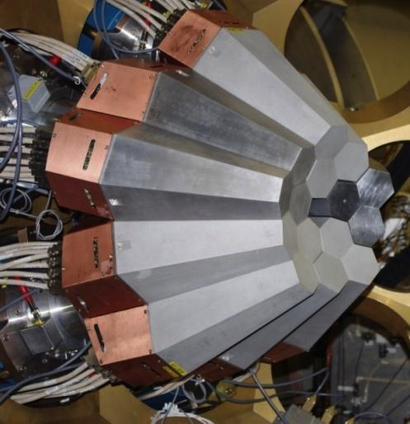
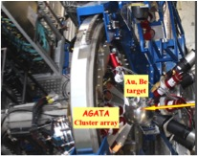
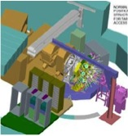
Stable beams –
Moderately n rich nuclei
( Lifetimes measurements)
To bridge the RIB results
on the N/Z evolution of
shell and collective modes
AGATA
at LNL
2010-2011
RIB from fragmentation
In flight emission up to 400 MeV/u
New shells
Pygmy resonance and M1 transitions
Shape coexistance
AGATA
at GSI
2012-2014
Heavy Stable beams –
(incl ²³⁸U)
Exotic unstable nuclei
Moderately neutron and proton
rich nuclei
AGATA
at GANIL
From 2014

Slide 26

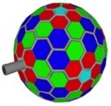

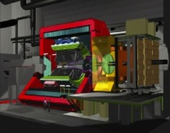

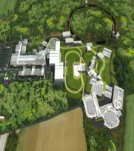

Towards transnational funding of Nuclear Physics Research Infrastructures and associated equipments
☞ To help developing EU Programmes and Policy for research infrastructures (Very important in relation with future calls in Particular for HORIZON20 aligned with our needs!!!)
AGATA
ISOLDE-
SPES LNL-LNS-
JVYL - ALTO
GANIL—GSI
MAMI - COSY
LNF
EasternNetwork
FAIR
GSI- FAIR
GANIL-SPIRAL2
ALICE-LHC

Slide 27
Major upgrades
at existing facilities
…..radioactive ion beams

Slide 28

HIE-ISOLDE Project
3 beam lines
ENERGY:
  Energy upgrade and lower energy capacity
      Wider range of radioactive beams
      Variable energy range from 1.2 up to 10 MeV/u
      Availability of all ISOLDE radioactive beams
INTENSITY:
ISOLDE proton driver beam intensity upgrade (LINAC4 +PSB)
Increase in Intensity expected of a factor of 3
    Target and frontend upgrade
QUALITY:
ISOLDE radioactive ion beam quality:
    Purity, emittance: Selectivity
    Time structure: bunching

Slide 29




SPES layout (LNL –INFN)
Driver : cyclotron high intensity proton
ISOL target Fission Products
Post acceleration : ALPI linear accelerator
Upgraded (e.g. lower-β cryostats (from 3 to 5,5 MV/m)
Applied physics
ISOL FACILITY

Slide 30






ISOL Roadmap in EUROPE
TODAY
SPIRAL -
ALTO-IPNO
LNS - EXCYT
2015-2025
FROM 2025

Slide 31




Facilities with other main scientific objectives :
sharing of nuclear techniques and accelerator developments
ESFRI infrastructures
From
very
large
To very small
facilities
Accelerator developments for
high intensity- in common with other fields
ISOL@MYRRHA
RFQ cooler and buncher
Low-resolution mass separator
High-resolution mass separator
ESS (spallaton source) at LUND
MYRRHA-Accelerator driven reactor
(Moulden)
Ion Technologies for material science
and other applications

Slide 32
Nuclear Physics
within
the European strategy
for Particle Physics 2013
Preparatory group->Strategy group
Individual town meetings
Town meeting in Krakow: 10-12 september 2012
Drafting meeting in Erice: 21-25 January 2013
Approval by CERN Council: 21 March 2013
Presentation to EU in Brussels: 29-30 May 2013

Slide 33

NuclearPhysics @ CERN
k) A variety of research lines at the boundary between particle and nuclear physics require dedicated experiments. The CERN Laboratory should maintain its capability to perform unique experiments. CERN should continue to work with NuPECC on topics of mutual interest.
ALICE
EXPERIMENT
    “Europe’s top priority should be the exploitation of the full potential of the LHC, including the high-luminosity upgrade of the machine and detectors with a view to collecting ten times more data than in the initial design, by around 2030. This upgrade programme will also provide further exciting opportunities for the study of flavour physics and the quark-gluon plasma.”

Slide 34
NuPECC publication
…..in preparation

Slide 35
Brochure- Nuclear Physics for Medicine
to give a comprehensive overview of how fundamental
nuclear-physics research (in its broadest sense) had and will continue to have an impact on developments in medicine.
It will reflect the state-of-the-art as well as future prospects. The document will serve to inform the scientific community (beyond the nuclear-physics community)
Three different chapters have been identified
hadron therapy,
Imaging
medical radioisotopes
Town meeting on November 18 2013

Slide 36
Conclusions
Efforts in the realization of the Nuclear Physics ESFRI facilities FAIR and SPIRAL2 – strong international involvments
Smaller size projects SPES and HE-ISOLDE progressing. Good coordination with other projects producing RIB worldwide.
European Laboratories (including small scale facilities for applications and astrophysics) are operating with scientific and technical ties with FAIR and SPIRAL2
ALICE – a program is well plan up to 2025 (strategic planning of CERN)
The construction of ELI-NP in Bucarest (as part of the rumanian pillars of ELI) is about to start. Experiments complementing the RIB program.
Instrumentation developments: the traveling AGATA detector is enhancing the connections in the scientific programs at different facilities.
Full support to theory and ECT*
Application programs at all facilities – good coordination with EU funding

Slide 37
NuPECC LRP (2010)
FAIR and SPIRAL2 (ESFRI)
HIE-ISOLDE ans SPES
Existing Laboratories
ALICE at CERN
ELI_NP (ESFRI)
Instrumentation (AGATA)
Theory
Applications
New Facilities and Major upgrades
FAIR
Existing
Facilities
ALTO
COSY
MAMI
LNF
Jyvaskyla
LNS
KVI
….
SPIRAL2
E
U
R
I
S
O
L
HIE-ISOLDE
SPES
>2025
ELI_NP
2014
15
16
17
18
19
20

