Slide 1
Nuclear Physics Serving Society
Donald Geesaman
Argonne National Laboratory
IUPAP Working Group 9 Nuclear Science Symposium
May 31, 2013

Slide 2
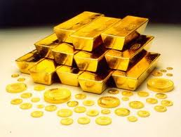
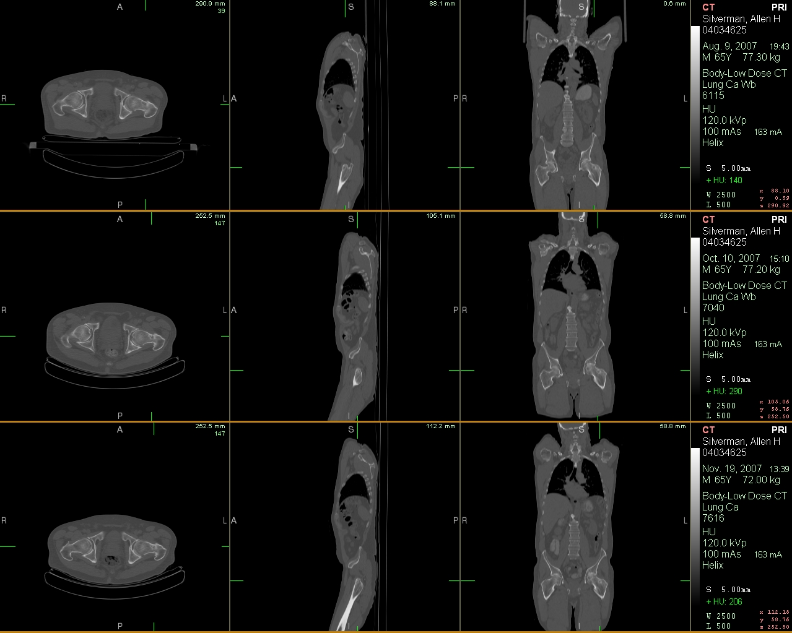
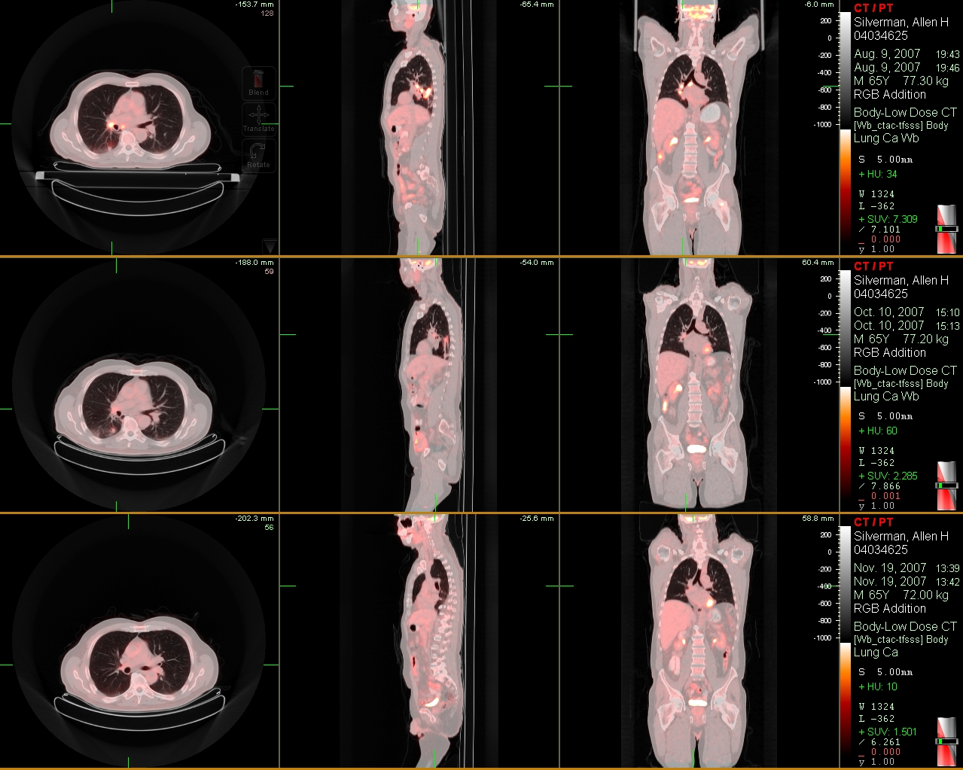
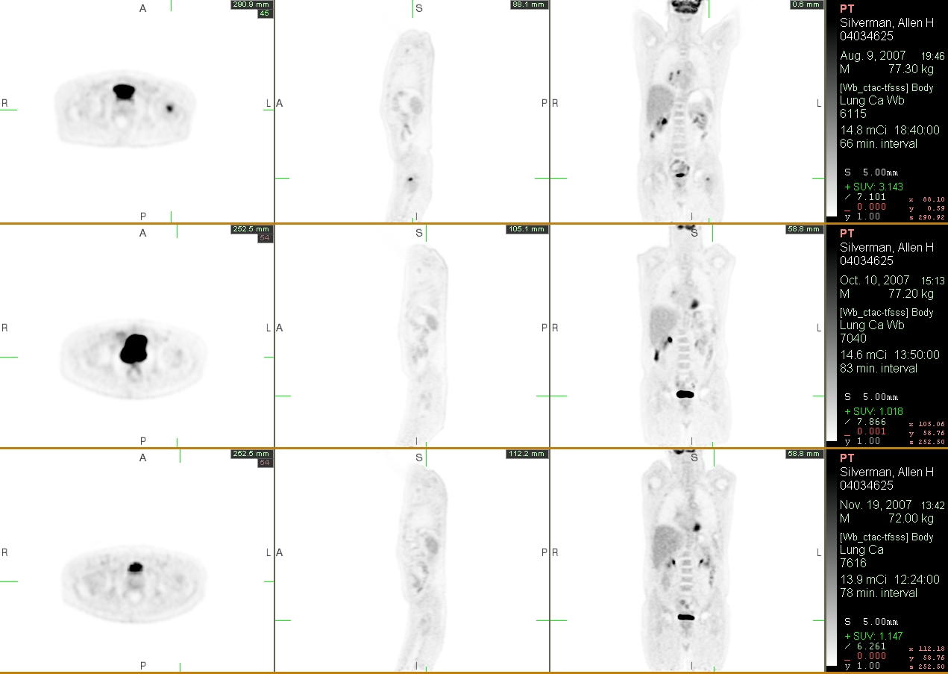
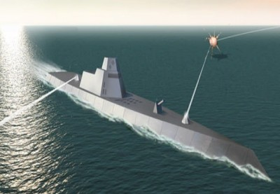
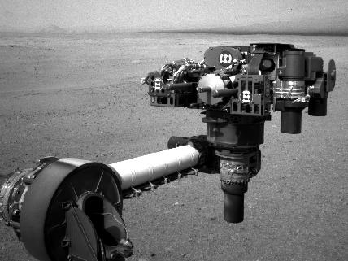
WEALTH
HEALTH
WOW
STEALTH

Slide 3
Outline
Wealth
  Accelerators in Industry
  Bore-hole logging
  Atom Trap Trace Analysis and groundwater
Health
  Ion beam therapy
  Positron emission tomography
  New isotopes for diagnostics and therapeutics
Stealth
  Nuclear Submarines
  Nuclear Forensics
  Non-proliferation
  Zero field NMR for detecting Nitrogen
WOW
  Power supplies for space-craft
  Probing the earth’s mantle
Nuclear Power applications will be covered by Bernard Frois

Slide 4
Wealth
Accelerators in Industry
In focusing on industry, I will not talk about the pioneering work in nuclear physics in future accelerators, such as the demonstration of energy-recovery linacs or new classes of high power superconducting cavities .
Bore-hole logging
Groundwater Resources

Slide 5
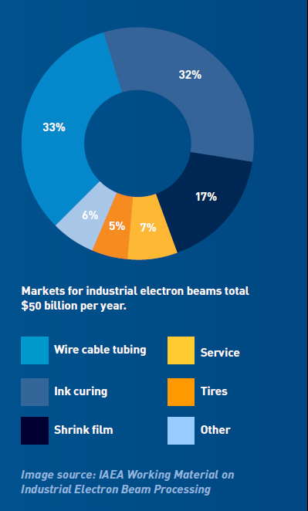

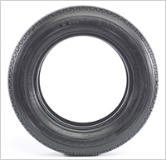
Accelerators in Industry
Approximately 1700 high current electron accelerators producing 10’s of billions of dollars of value-added products, cross linking polymers.
Shrink wrap for food
Tires
From Accelerator for America

Slide 6
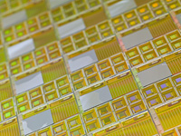
Semiconductor industry
About 10000 accelerators are in use worldwide to dope semiconductors for computer chips
There are three methods of doping
Doping during growth
Ion implantation
Diffusion - quite limited effectiveness for nanostructures
Advantages of ion implantation
Excellent control of dopant concentrations
Independent of solubility limits
Disadvantages
Always induces damage to irradiated material. Usually must be annealed.
From Accelerator for America

Slide 7
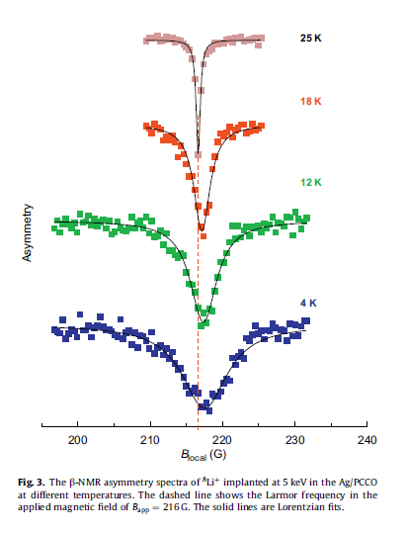
Nuclear Techniques such as β-NMR are well suited for probing magnetic properties of nanostructures and thin films
TRIUMF H. Saadaoui et el.,
Physica B 404, 727 (2009)
Li-8 implanted in a 40 nm thick Ag layer
The resonance in Ag broadens below Tc as expected from the vortex lattice in the underlying superconductor. However the lineshape is nearly symmetric with the absence of a high field tail and exhibits a slight positive shift of the average field below Tc.

Slide 8
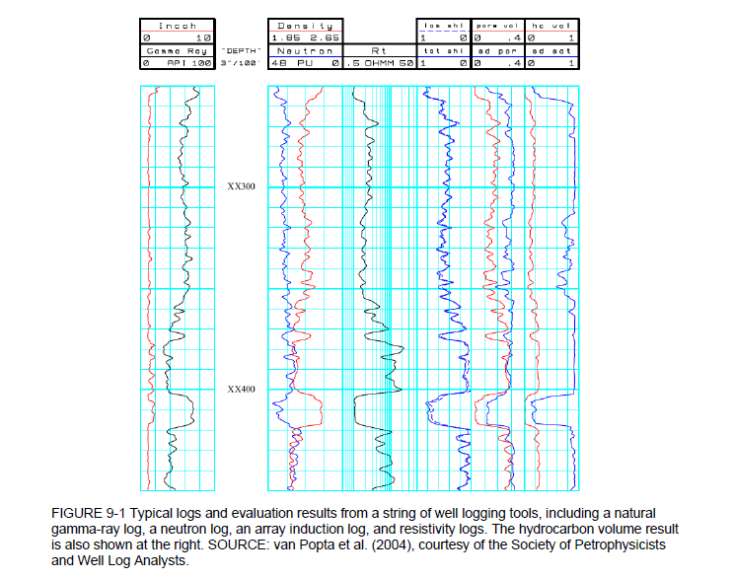
Finding Oil
Bore Hole Logging
Typically Cs-137 for mono-energetic gamma’s and
Am-Be, d-t generators or Cf-252 for neutrons.
These analyses can determine porosity, water content and density.

Slide 9
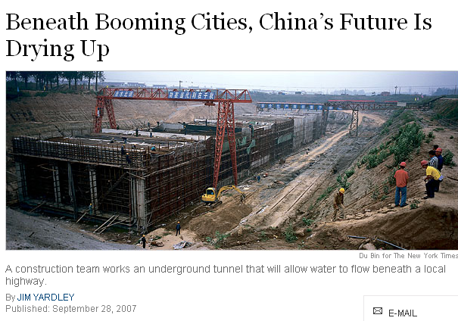
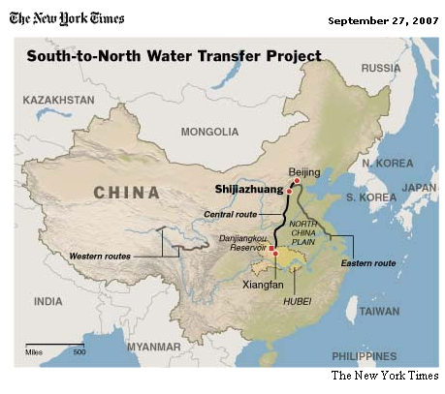
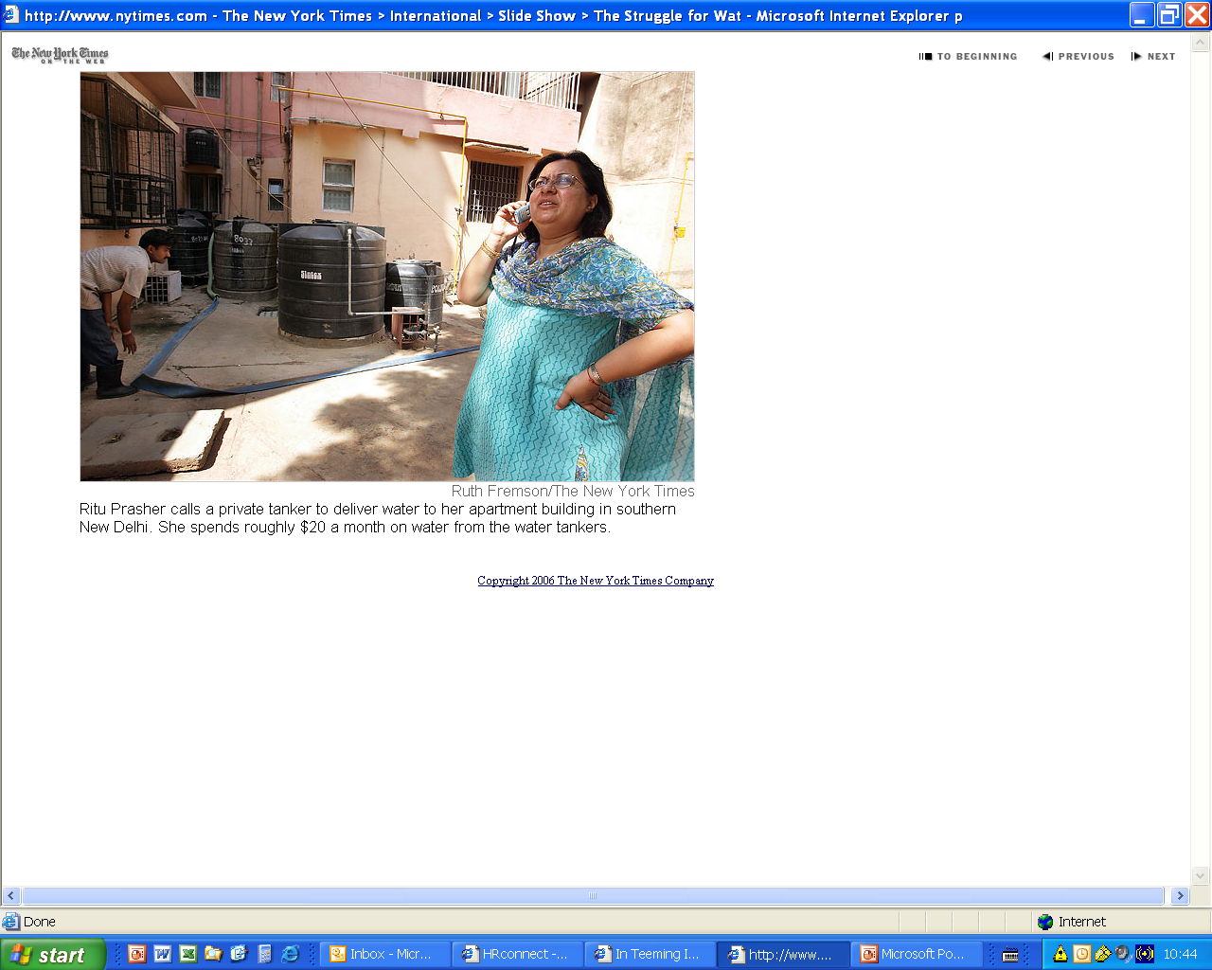
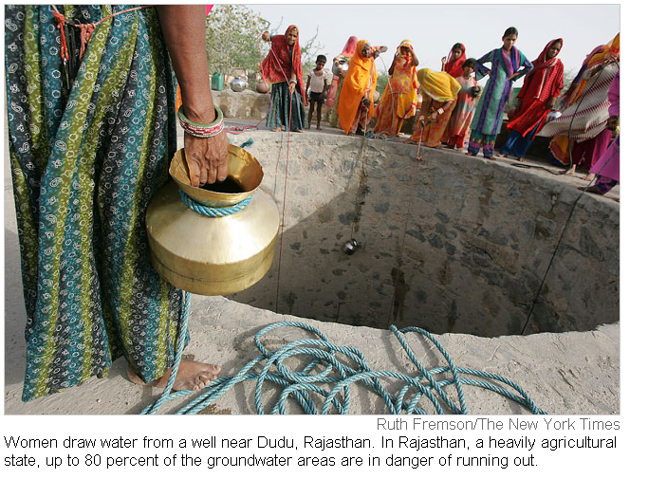
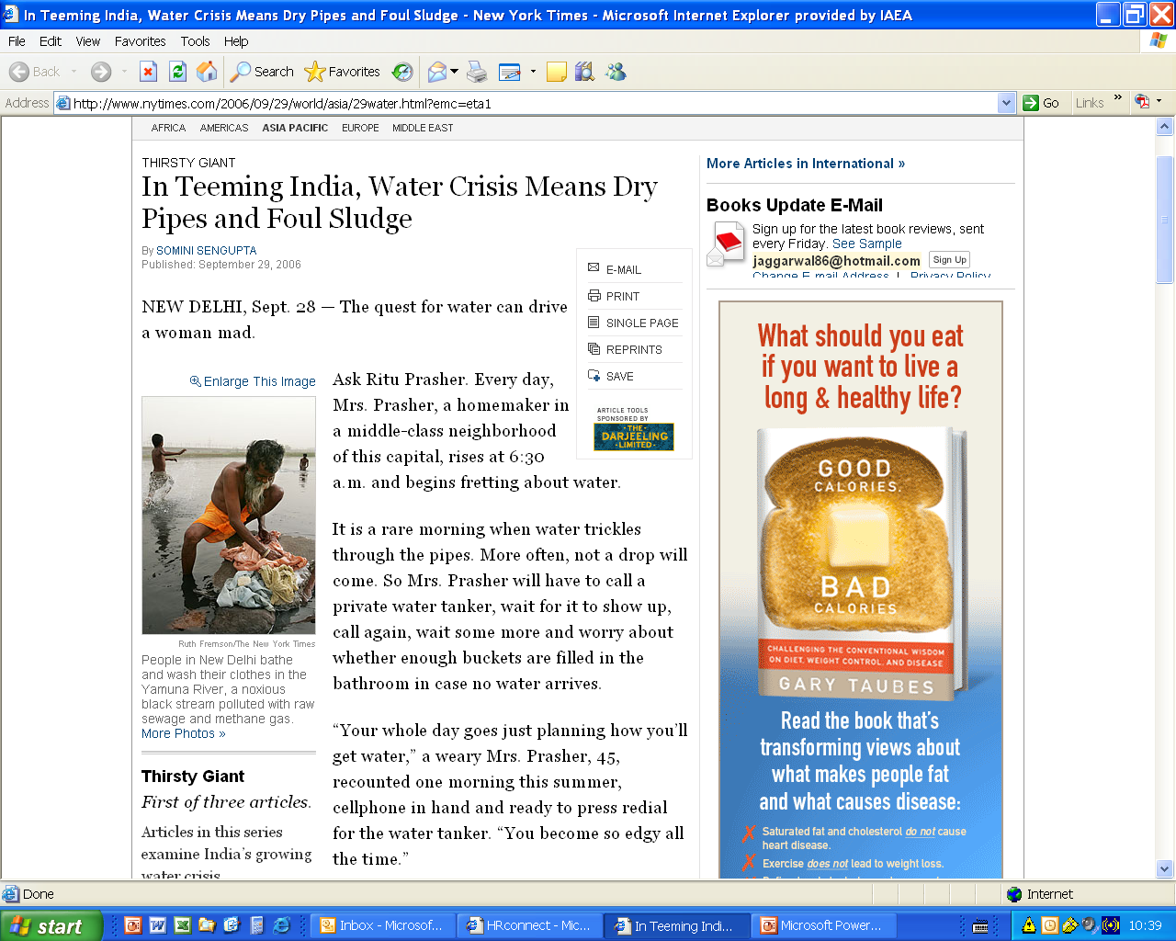
Decreasing Freshwater Availability and Scarcity
Pradeep Aggarwal, IAEA, International Workshop on Tracer Applications of Noble Gas Isotopes
THIRSTY GIANT
India Digs Deeper, but Wells Are Drying Up

Slide 10
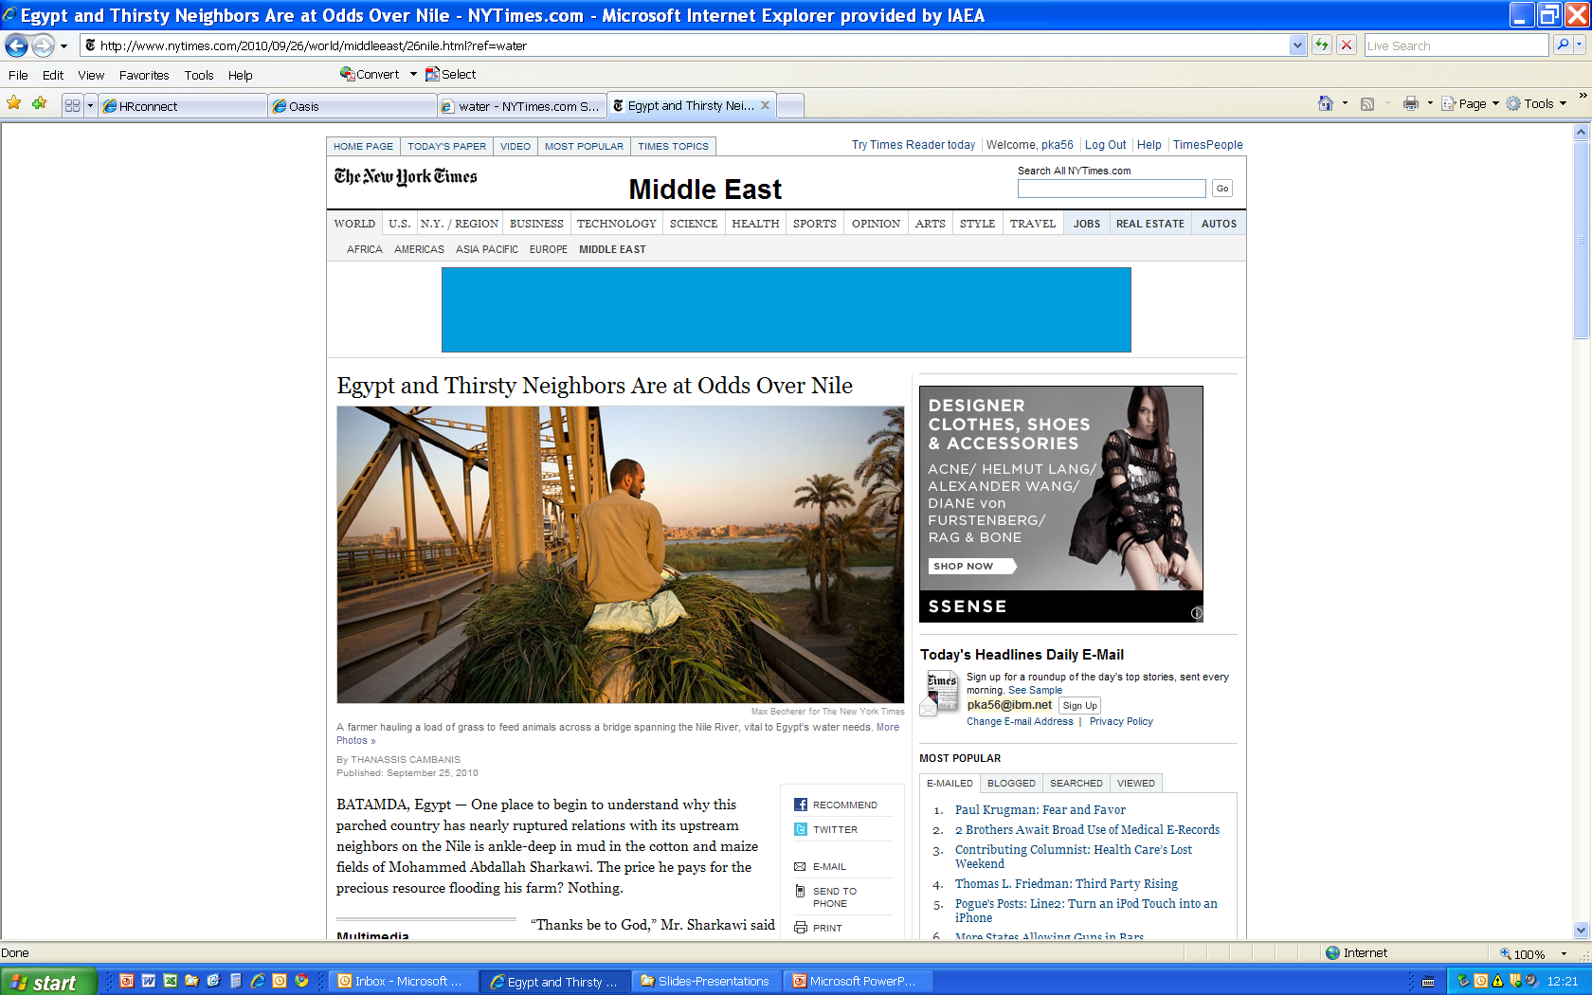

Slide 11
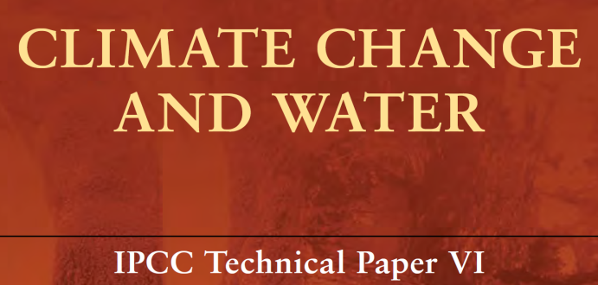

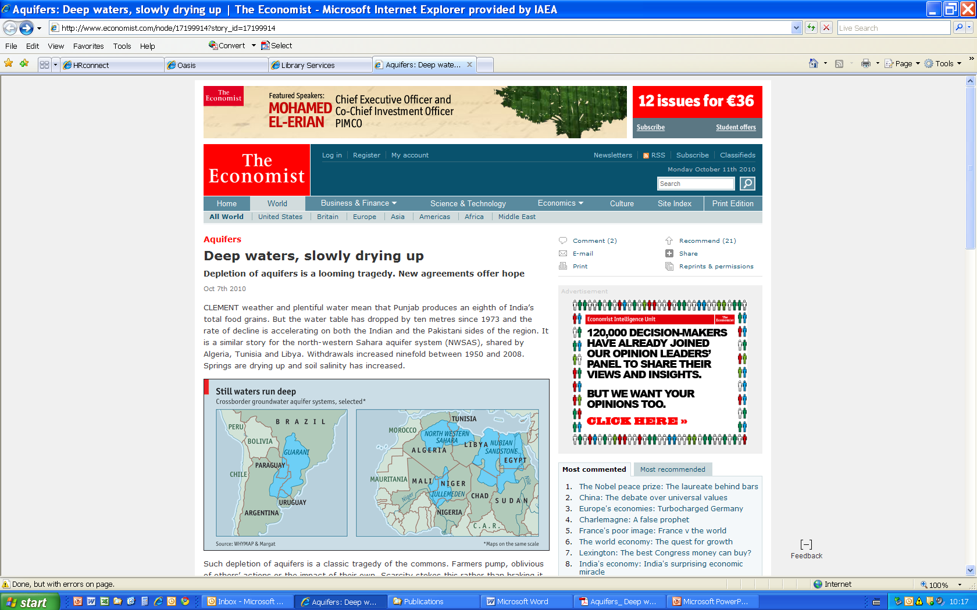
Continued recognition of the need for water resources data and comprehensive assessments
1977 UN Water Conference
Mar del Plata, Argentina
...incomplete and incompatible data for managing water
…need scientific understanding and monitoring of aquifers…
2007
2009
October, 2010

Slide 12
IAEA projects in >60 countries are/will be using isotope age dating with multiple tracers

Slide 13
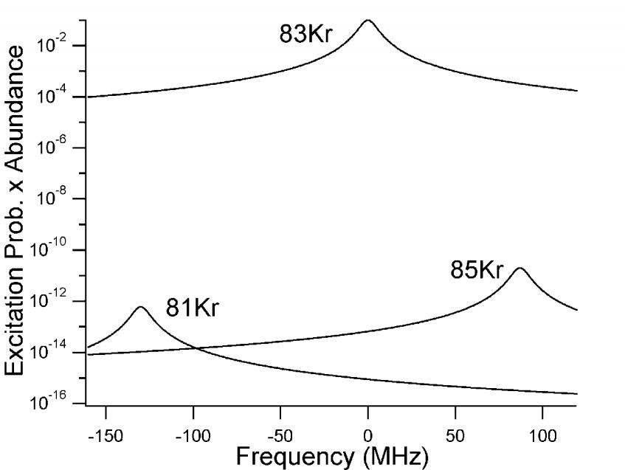
Laser Methods Based on Isotope Shifts
Isotope shift due to the change in nuclear mass, charge radii and moments
Kr-78 80 82 84 86 Kr-81 83 85
-997
-713
-130 0 87
Laser Frequency (MHz)
Krypton-81
Half-life 229000 years
Atmospheric Abundance
Kr-81/Kr: 6 x 10⁻¹³
Produced by cosmic rays in the upper atmosphere
1s₅--2p₉
811nm
Prob x I.A.

Slide 14
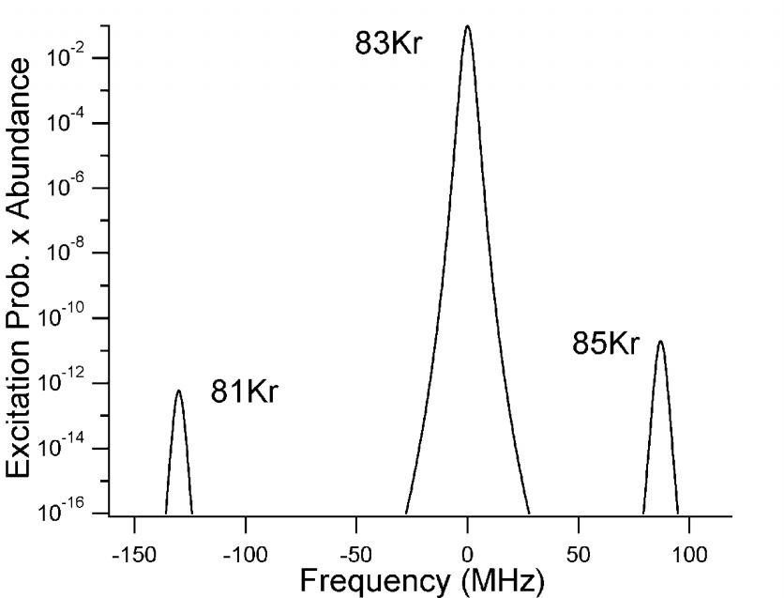
Laser Methods Based on Isotope Shifts
Isotope shift due to the change in nuclear mass, charge radii and moments
Kr-78 80 82 84 86 Kr-81 83 85
-997
-713
-130 0 87
Laser Frequency (MHz)
1s₅--2p₉
811nm
10 photons
(Prob)¹⁰ x I.A.

Slide 15
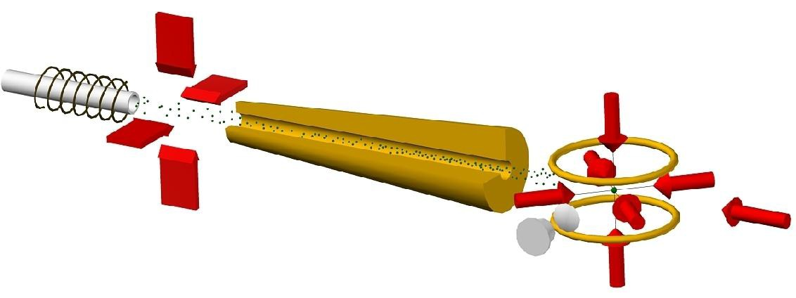
Atom Trap Trace Analysis - ATTA – Krypton
5p[5/2]₃
811 nm
Metastable τ ≈ 40 sec
5s[3/2]₂
10 eV
electron collision
4p⁶
Ground-level
Laser Atom Traps work on millions of photons
ATTA-1: Chen et al., Science 286, 1139 (1999)
Developed by Zheng-tian Lu and his collaborators at Argonne National Laboratory

Slide 16
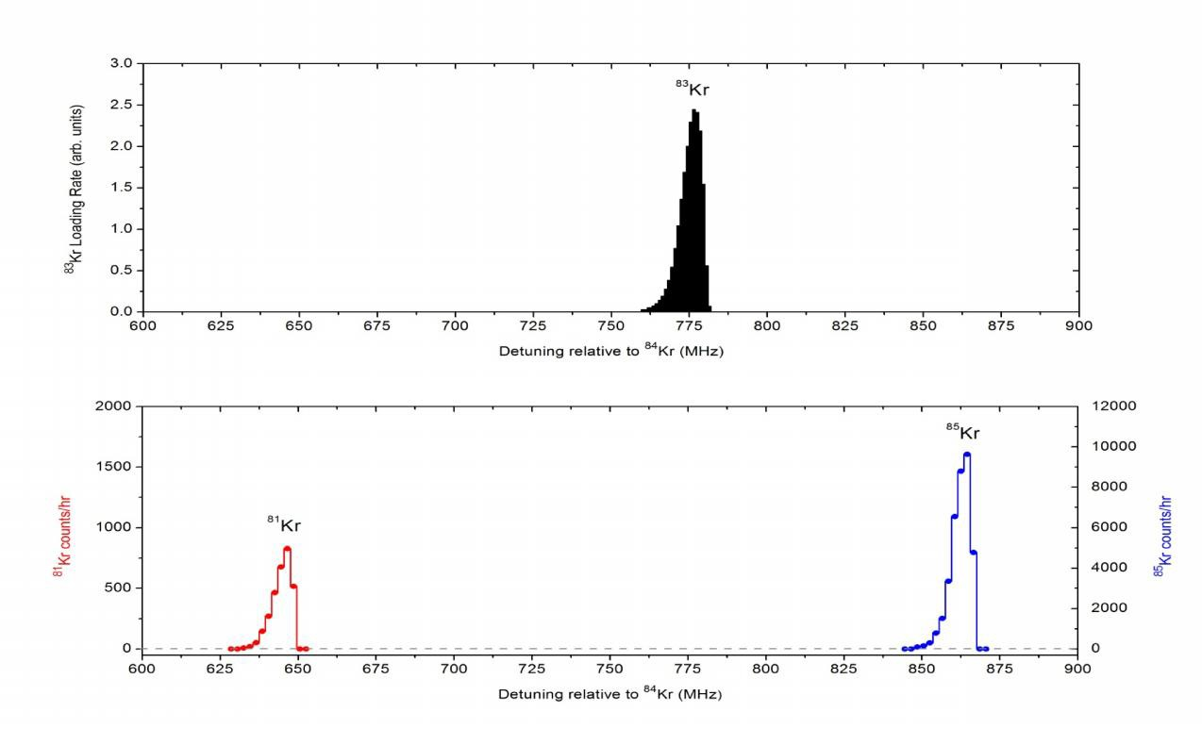
Trap Fluorescence
8 2 _{K}
r
8 6 _{K}
r
)
t i
.
r
n
(u
.
b
la
o
u
r F
p a
T
0
0
0
0
. 3
8 0 _{K}
r
8 4 _{K}
8 3 _{K}
r
. 2
r
. 1
7 8 _{K}
r
8 1 _{K}
8 5 _{K}
r
r
. 0
- 1 0 0 0
- 8 0 0
- 6 0 0
- 4 0 0
- 2 0 0
0
2 0 0
Loading Rate
⁸³Kr, 10%
Atoms / hour
Atoms / hour
⁸⁵Kr, 10 ppt
⁸¹Kr, 0.5 ppt

Slide 17
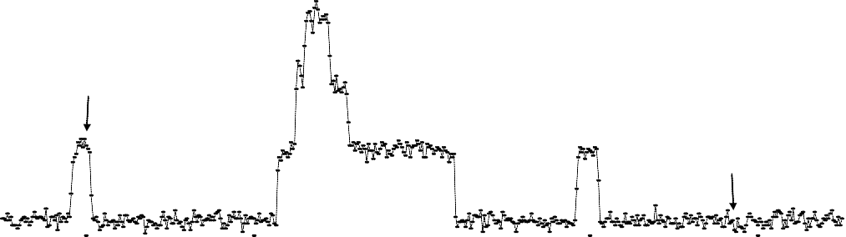
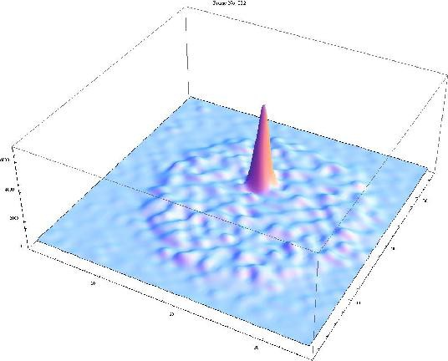
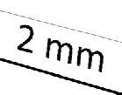
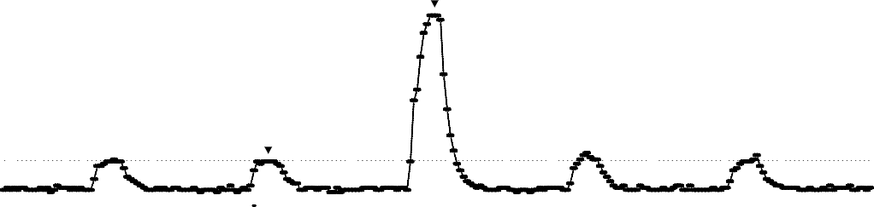
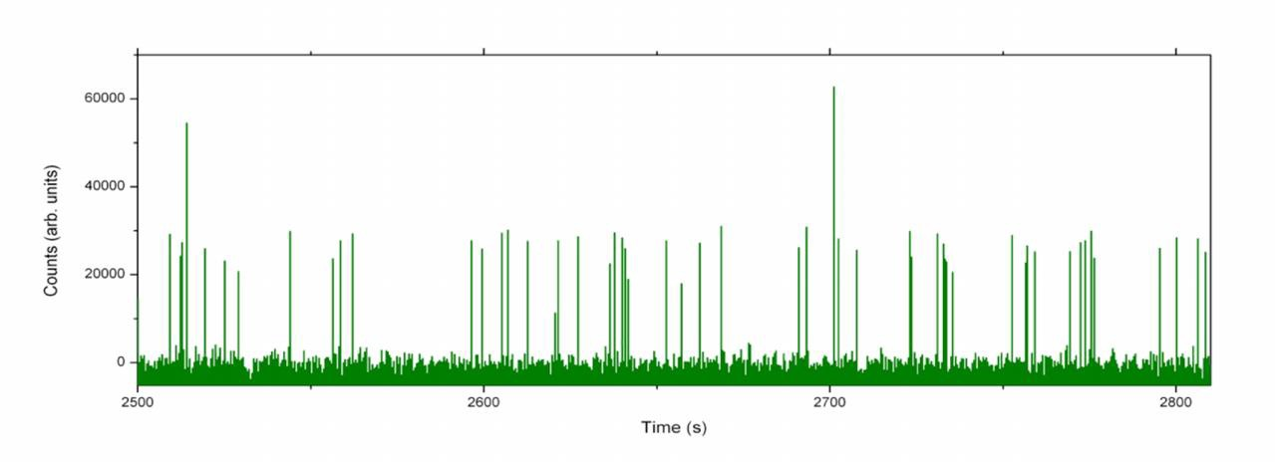

Single Atom Detection
2 5 _{8 3 K r}
)
^{z} 2 0
H
( O n e A t o m
k
e 1 5
c
n
e
c 1 0
e B a c k g r o u n d
s
r
o ₅
u
l
F
0
0 5 1 0 1 5 2 0 2 5
T i m e (s e c )
) ² ⁵ O n e A t o m ₈ ₁
H K r
z
( 2 0
k
e
t
R 1 5 <Single atom signal> = 1600 counts
a
i <Background> = 340 ± 30 counts
g
n
r 1 0
e
t
t B a c k g r o u n d
a
c ₅
S
n
o
t ₀
o
h
P 0 . 0 0 . 5 1 . 0 1 . 5 2 . 0 2 . 5
T i m e (s e c )
CCD image profile
of a single ⁸¹Kr atom
⁸¹Kr / Kr = 5 x 10⁻¹³ = 0.5 ppt
ATTA-3
) 8 1 _{K r}
ATTA-2
z 2 0
H
k
(
e 1 5
t a
R
t 1 0
.
t
a
c
S
5
n
o
t
o
h 0
P
0 1 2 3 4 5
T i m e (m i n . )

Slide 18
⁸¹Kr Dating: From Dream to Practice
Polar Ice
Groundwater
10² 10 1
₁₀-3 ₁₀-2 ₁₀-1
Water or Ice
Sample Size (kg)
10⁷
10⁶
10⁵
10⁴
10³
Efficiency
₁₀-8
₁₀-7
₁₀-6
₁₀-5
₁₀-4
1
LLC ATTA-1
1969 1999
AMS ATTA-2
1997 2003
ATTA-3 2011
Present Status of ATTA-3:
Selectivity requirement: Done;
Efficiency requirements: Practical, but far from perfection
ATTA-1: Chen et al., Science (1999)
ATTA-2: Du et al., Geophys. Res. Lett. (2003)
ATTA-3: Jiang et al., Geochim. Cosmochim. Acta (2012)

Slide 19

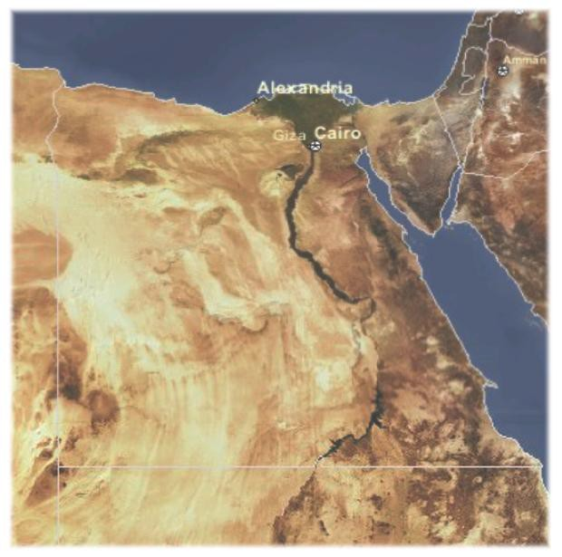
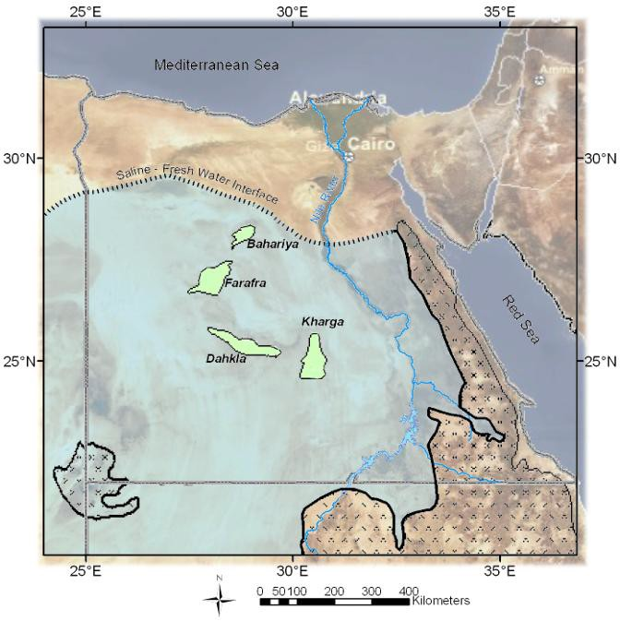
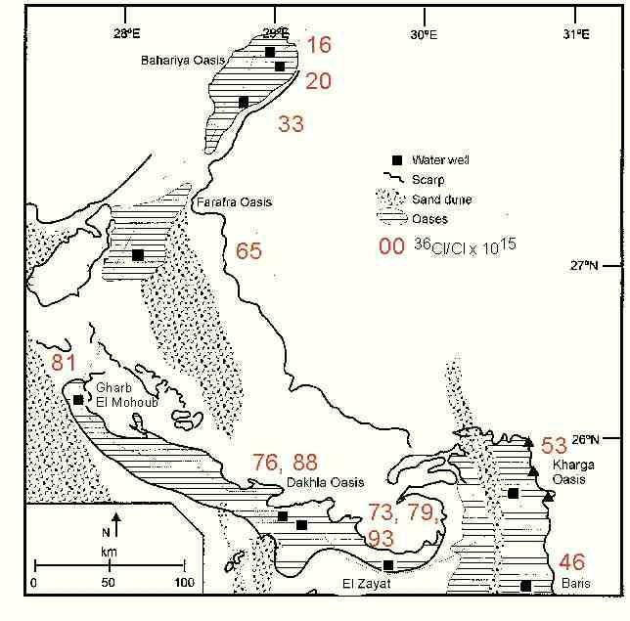
One Million Years of Nubian Aquifer
Groundwater History
Neil Sturchio et al., Geophys. Res. Lett. (2004)
Analyses performed with ATTA-2
Groundwater at six sites dated;
Flow direction and speed deduced.
+0.6
1.0_{−0.2} Myr
333±44 kyr
678±75 kyr
Uweinat Uplift
212±42 kyr
488±45 kyr
391±46 kyr

Slide 20
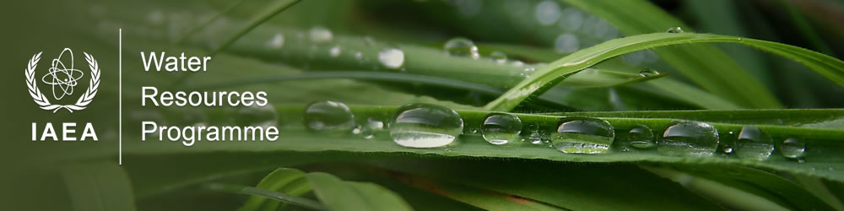
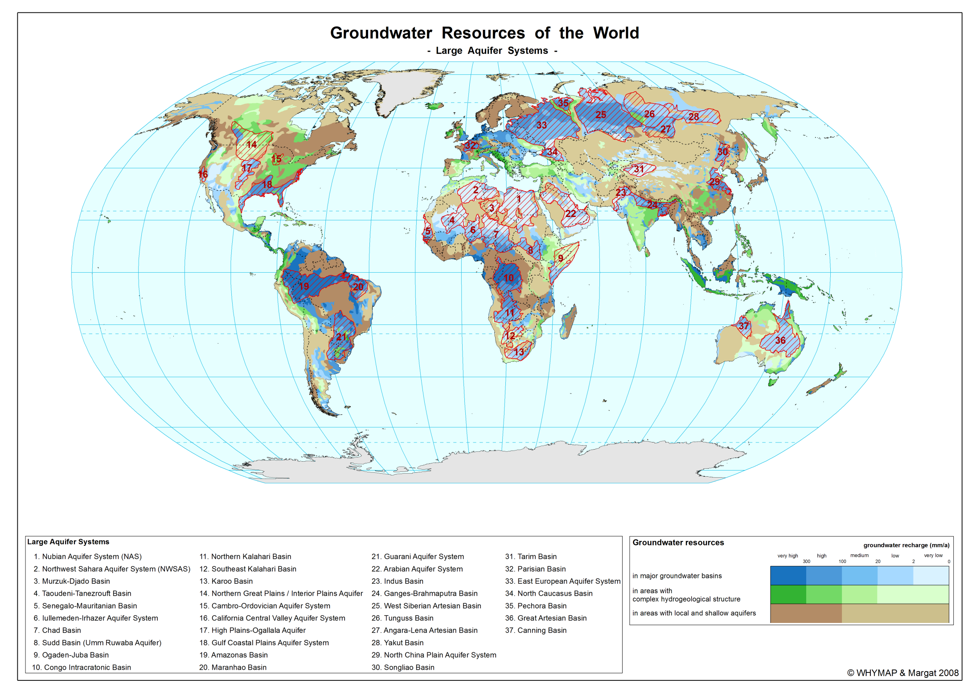
Mapping
In collaboration with the Hydrology Sector, International Atomic Energy Agency (IAEA)
Yellowstone: Yokochi et al., Chem. Geo. 339, 43 (2013)
WIPP: Sturchio et al., in prep. (2013)
Great Artesian Basin: Purtschert et al., in prep. (2013)
Gurani Aquifer: Aggarwal et al., in prep. (2013)
20
Notes:
Worldwide Hydrogeological Mapping and Assessment Programme (WHYMAP)
UNESCO - United Nations Educational, Scientific and Cultural Organization

Slide 21
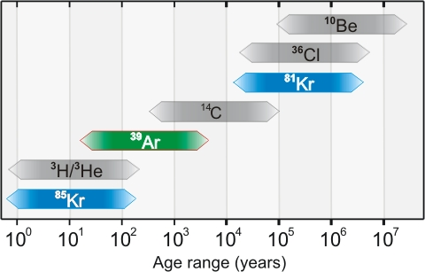
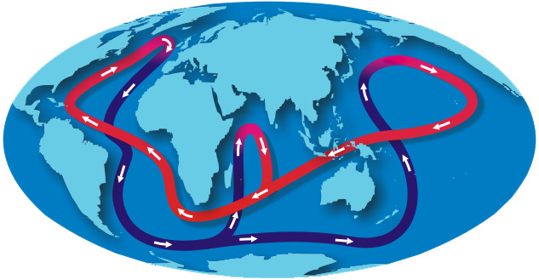
Range of isotopes with simple chemistry
International Workshop on
Tracer Applications of Noble Gas Isotopes
June 2012
http://www.phy.anl.gov/events/tangr2012/index.html
Graph from noaa.gov
Also used for analysis of noble gas impurities in dark matter/ double beta decay experiment
The Great Conveyor
Responsible for the past abrupt climate changes;
A whole cycle takes about 2,000 years.
Current challenges
Continue to improve efficiency for creating meta-stables
Reduce memory effects

Slide 22
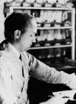
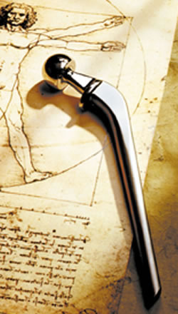
Health
Within a few years of the invention of the cyclotron Ernest Lawrence’s brother John started treating a leukemia patient with a radioactive isotope of phosphorus.
John Lawrence became
known as the father of
nuclear medicine
Cornelius Tobias at
UC-Berkeley performed
initial proton and helium
ion radiobiology
experiments, followed almost immediately by a clinical Phase I/II trial involving 30 patients led by John Lawrence.
Particle Beam Therapy
Gamma
Neutron
Proton
Heavy ion
Isotopes for diagnostics and therapy
Ion implantation of artificial joints
Blood sterilization

Slide 23
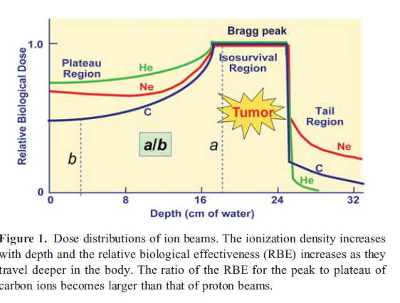
Proton and Ion Therapy
More than 30 proton therapy centers
5 Carbon ion therapy centers
Several more under construction or planned
Pioneering work at LBNL
Then
HIMAC/NIRS Chiba, Japan
GSI Darmstadt, Germany
…

Slide 24
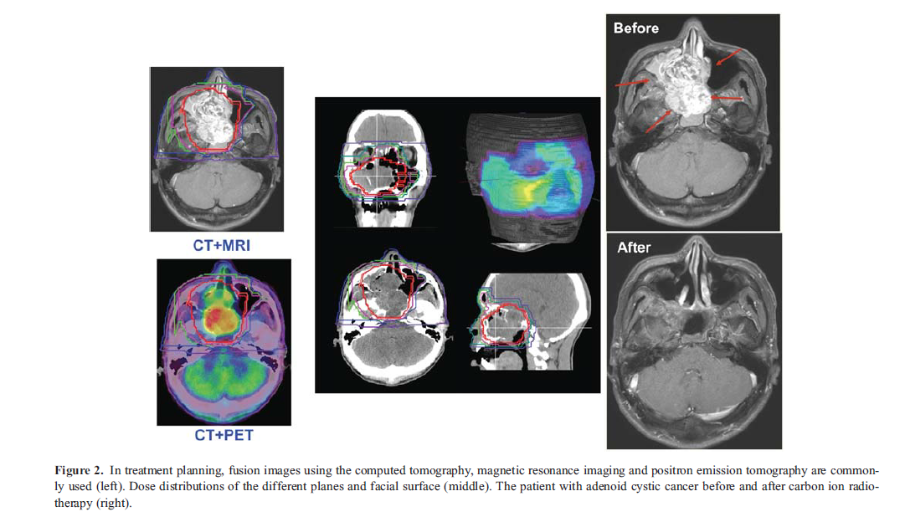
C-12 ion Treatment of Adenoid Cystic Cancer
From Tsujii and Kamada, Jpn. J. Clin. Oncol. 42 (2012)

Slide 25
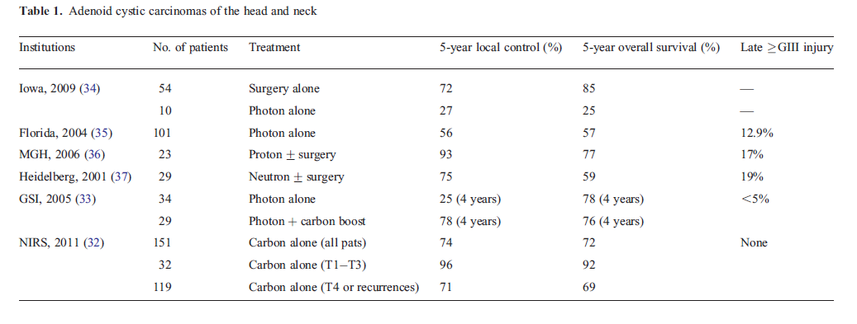
Comparison of treatment options for Adenoid Cystic Carcinomas
From Tsujii and Kamada, Jpn. J. Clin. Oncol. 42 (2012)

Slide 26
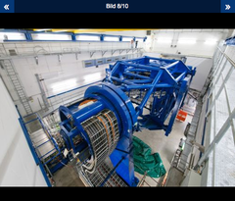
Heidelberg Ion-Beam
Therapy Center
Medical innovations:
HIT is the world’s first ion therapy facility with intensity-modulated raster scanning, the world’s most precise radiotherapy method.
HIT is the world’s first heavy ion treatment facility with a 360° rotating beam delivery system (gantry).
HIT is Europe’s first combined treatment facility using protons and heavy ions for radiation therapy.
HIT is the first facility to use cooperating robots for automated imaging and ultrahigh-precision patient positioning.
At present the following types of tumors are irradiated at HIT:
chordomas and chondrosarcomas at the base of the skull
salivary gland carcinomas (including adenoid cystic carcinomas)
chordomas and chondrosarcomas in the pelvic region
pediatric tumors
neuro-oncological tumors
liver cell carcinomas
inoperable recurrent rectal cancer
inoperable bone sarcomas
prostate cancer

Slide 27
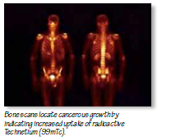
Health
Medical Isotopes
Diagnostics
  Gamma emitters
    Single photo emission tomography
  Beta+ emitters
    Positron emission tomography
Therapy
  Auger, Beta and alpha emitters
World-wide about 30 Million procedures per year. Tc-99m Single Photon Emission Computed Tomography (SPECT) is the most common.
Recent shortages with fleet of aging reactors.
In many cases the economic model for production is severely skewed.
“Historical foundations created an economic unsustainable industry.”
See the OECD analysis of for Mo/Tc.
http://www.oecd-nea.org/med-radio/reports/MO-99.pdf

Slide 28
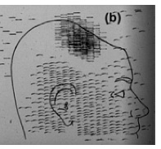
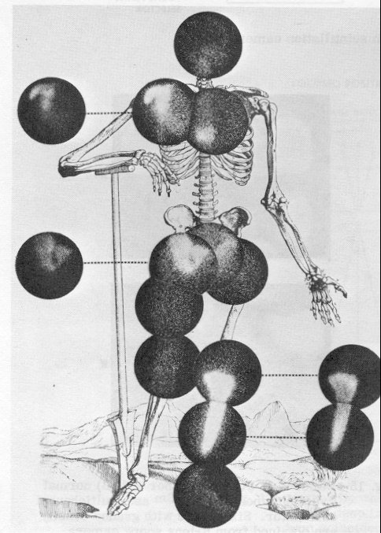
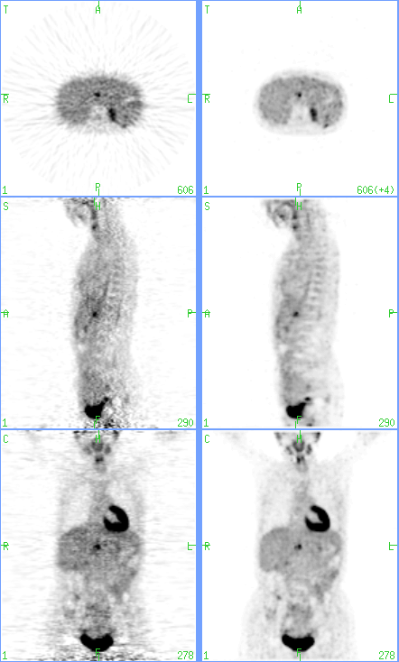
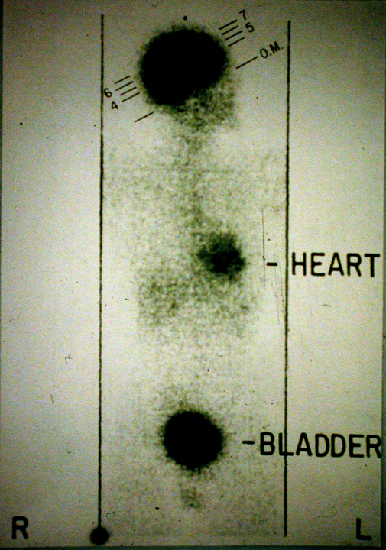
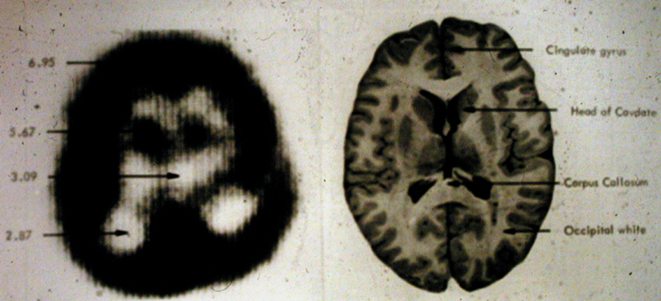
PET 6 decades of development
1953
1965
1976
Count difference of positron emitter between 2 detectors
FDG PET
¹⁸F w/ gamma camera
Thanks to Joel Karp U.Penn
1980-90’s
iterative
FBP
2001 - present
3D PET/CT

Slide 29
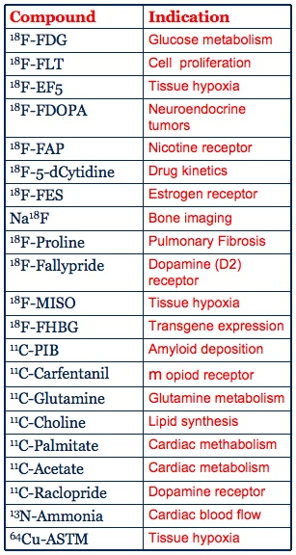
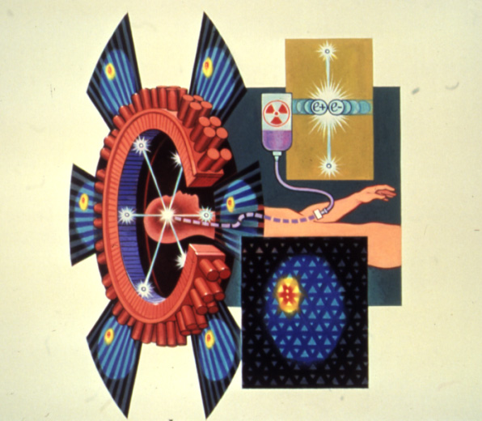
Positron Emission Tomography
p (22 MeV) + ¹⁸O -> n + ¹⁸F
Fluorodeoxyglucose
Clinical studies
Clinical trials
National Geographic January 1987

Slide 30
What are the needs and challenges?
Goals: image quality and image quantitation
Clinical studies – whole-body scans in 10-20 minutes
Research studies – dynamic acquisition (depends on tracer)
Scan statistics
  Detectors with high stopping power
  3D geometry (no collimation)
  Large axial field-of-view
Spatial resolution
  Detectors with high intrinsic resolution (small crystals)
  Image reconstruction with optimized parameters, modeled PSF
Accurate quantitation
  Corrections for scatter, randoms, attenuation
  Corrections for dead-time; both detector and electronic

Slide 31
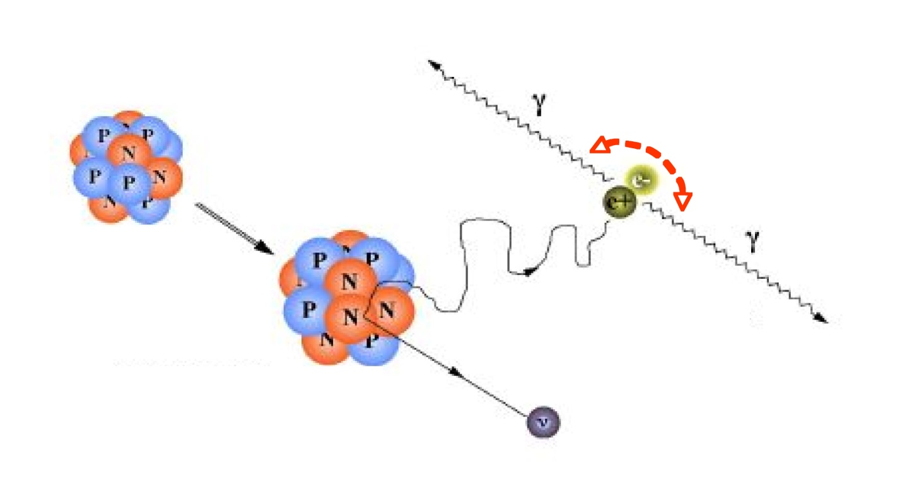



What is measured with PET?
True events
R
Scatter events
b
~180˚
True coincidence
Random coincidence
(~2τ . singles²)
a
Scattered coincidence
Coincidence?
Record event
Small BMI
Large BMI

Slide 32







Detector development in Nuclear Medicine
1957 Anger camera
1962 Nuclear Chicago
1974 Searle: single-head SPECT
7 PMTs
1976 University of Chicago: PET w/ NaI
1986 CTI: PET w/ BGO -> LSO
1990’s Adac UGM

Slide 33

Time-of-flight assisted reconstruction
Time-of-flight (TOF) assisted reconstruction improves SNR
back-projection TOF
t₁
t₂
Fast detector and electronics enable TOF, but do not require compromise of other aspects of system performance: e.g. spatial resolution or sensitivity
Δt = 600 ps Δx = 9 cm
Improved detectability
p83s0
nonTOF
TOF
nonTOF
?
TOF
Colon Cancer; abdominal lesion BMI = 46.5

Slide 34




Philips Gemini TF (2006)
Commercial TOF PET/CT
Axial FOV: 18 cm
Sensitivity: 7%
Spatial Resolution: 4.7 mm
Energy Resolution: 11%
Timing resolution: 600 ps (500 ps in 2010)
Crystal-based energy and timing offset calibration
28 detector modules
28 modules
1012 crystals/module
Energy resolution crystal map
Timing offset crystal map
Notes:
34

Slide 35



How to improve imaging performance
GATE computer simulations
Improve timing resolution
Courtesy H. Thoen, U. Gent
Improve spatial resolution
Timing resolution 600 ps
Pixel size 2.6-mm
Notes:
35

Slide 36
Photo-detectors for PET
 | PMTs | APDs | SiPMs
PET/CT | ✓ | ✓ | ✓
TOF PET/CT | ✓ | x | ✓
PET/MRI | x | ✓ | ✓
TOF PET/MRI | x | x | ✓

Slide 37











Clinical PET/MR (sequential)
D
B
E
A
C
F
Prostate CA
68 y/o Male w/ prostate CA (Gleason 10, PSA 6) for staging.
Whole-body PET shows disseminated disease in abdomen & pelvis (A).
PET/MR confirms prostate cancer (arrow head) encompassing left gland & most of the right gland (C). Additional hypermetabolic metastatic spread (arrows) into pelvic bone (B-F) positive on FDG-PET & MR.
(A,C-F) 301 MBq 18F-choline, 67 kg / 193 cm patient, 60 min uptake time, 9 beds x 1.3 min
(B-F) T2w VISTA (TE: 150, TR 2227, 0.7,0.7,0.8) post 25 mL DOTAREM, Cardiac-32 coil
Courtesy A. Kalemis, Philips Healthcare

Slide 38




Motion correction:
B-spline non-rigid image registration
PET/MR (simultaneous)
motion estimation based on real-time trueFISP MR images, and utilizes liver’s intrinsic texture which does not vary in time.
Courtesy Georges El-Fakhri, Harvard, MGH
End-inspiration (Isrc)
End-exhalation (Itar)
C=2.2
C=3.2
C=2.8
C=2.0
C=2.7
C=2.5
No motion correction
Gated
Motion corrected
Notes:
Contrast improvement achieved with MR-based motion correction.
Applying tagged MR acquisition on liver during in vivo human PET acquisition is a challenging task mainly due to the fact that the MR tags only last about 1 second in liver tissue whereas normal respiratory cycle is about 5 seconds. The motion estimation based on real-time trueFISP MR images is immune from this complication because it utilizes liver’s intrinsic texture under trueFISP technique which does not vary in time.
Movie TRUE-FISP / Gated PET

Slide 39
PET Summary
Significant improvement in position-sensitive scintillation detectors
  Application to single-photon and PET systems: animal to human
  PMT and Anger-logic still primary choice for light read-out
Solid-state readout offers many advantages
  Small devices allows for compact detector design
  MR-compatibility leads to integration of PET/MR
  Arrays allow 1:1 coupling or light-sharing (Anger-logic)
  SiPMs offer better timing (TOF PET) compared to APDs
Challenges and future directions for human (clinical) instruments
  Continued improvement of SiPMs – PDE, packing, stability, cost
  Integration of modalities, specifically PET/MR
  Improved quantitative accuracy – harmonized reconstruction
  Incorporation of new scintillation materials, e.g. ceramics

Slide 40


Motion Tracking Enabled Radioisotope Imaging
It is one thing to correct for breathing, it is another to follow a mouse in motion.
Decrease in uptake of DaTSCAN in awake vs anesthetized mice
JLab, ORNL, John Hopkins University

Slide 41


PET in Biochemical Research
Drug Addiction
Neuroimage 43, 756 (2008)
Methamphetamine clears from the brain more slowly than cocaine.
Searching for pharmokinetic links in abuse patterns
Joanna Fowler of BNL
National Medal of Science
"For her pioneering work in chemistry involving the synthesis of medical imaging compounds and her innovative applications of these compounds to human neuroscience, which have significantly advanced our understanding of the human brain and brain diseases including drug addiction."
In 1976, Fowler and her colleagues first synthesized 18F-flouorodeoxyglucose (FDG).

Slide 42

New Production Techniques for Isotopes Wanted !
Isotope pairs that combine imaging and therapy
  Cu-64 (PET) and Cu-67 (β)
  Y-86 (PET) and Y-90 (β)
  I-124 (PET) and I-131 (β)
  Pb-203(SPECT) and Pb-212 ($α)$
Alpha emitters
  Ac-225 (10 days) , At-211( 7.2 hr) , Pb-212 (10.6 hr)
  Recent R&D in U.S. isotopes program to test new production and generator mechanisms
  ISOLDE work on lower energy $α$ emitters – Tb-149 (4.1 h) [Beyer et al.]
Recent work at PSI looked at a quartet of terbium isotopes (J. Nucl. Med. 53, 1951 (2012).
  Tb-152 (PET) proton spallation on tantulum (17.5 h)
  Tb-155 (SPECT) proton spallation on tantulum (5.3 d)
  Tb-161 (β) n capture on Gd-161 (6.9 d)
  Tb-149 ($α)$ proton spallation on tantulum (4.1 h)
  Demonstrated excellent visualization and therapeutic efficacy
Similar to the appeal of carbon ion therapy
imaged with C-11

Slide 43

In U.S. DOE Office of Nuclear Physics Assumed Responsibility for Isotope Program in 2009
See http://www.sc.doe.gov/np/nsac/nsac.html

Slide 44
Stealth
Nuclear Submarines
Non-Proliferation
Nuclear Forensics
Portal Monitoring

Slide 45

Nuclear powered submarines with nuclear warheads were/are an essential element of the philosophy of Mutually Assured Destruction
Nuclear Submarines are currently deployed by United States, Russia, France, the United Kingdom, People's Republic of China, and India

Slide 46
Nuclear Forensics
Nuclear forensics – the ability to identify the source of nuclear material from radioactive debris – is critical to national defense and security. Swift and accurate forensic and attribution (identification) capabilities are vital to developing an appropriate national response to a nuclear event and preventing future attacks in a timely manner.
Nuclear forensics may support attribution efforts that serve to bolster national defenses against nuclear threats, across a wide spectrum, by:
encouraging nations to ensure the security of their nuclear and radiological materials or weapons to help prevent unwitting transfers to third parties through loss of control.
helping to trace the source of illicit materials and identify smuggling networks deterring nations from providing nuclear weapons or materials to terrorists disrupting terrorist plans in the incipient stages.
informing appropriate national and international decisions should a plot be uncovered or an attack occur.
assisting efforts to disrupt subsequent attacks.
helping to bring perpetrators and their accomplices to justice.
The required data on the effects on materials in a high neutron flux environment has many similarities with the data needed for astrophysical processes, especially in neutron reactions on unstable nuclei and excited states.

Slide 47
Non-proliferation
How can we reduce the use of highly enriched uranium?
Research reactor fuel based on lower enriched uranium
Isotope production of fission isotopes based on LEU
How can we identify covert activities?
Detection of reprocessing
Portal Monitoring to detect shipping of fissionable materials
  New requirements on simplicity and reliability of neutron detection in the face of shrinking supplies of He-3

Slide 48

Perhaps in the Future
Nuclear Quadrupole Resonance in Low Field environments
Ammonium
Nitrate

Slide 49

Wow
Hello from Mars

Slide 50


So you want to explore the solar system
You had better have 5 kg of
Pu-238 dioxide if you need 100 watts for 1 Martian Year.
The U.S. is running out of Pu-238 and is trying to restart a production line.

Slide 51



How do we see into the center of the earth?
Total Heat Flow at surface 47+/-2 TW
Geology predicts 16-42 TW of radioactive power
~20 % escapes to space as geoneutrinos
~80 % heats planet
Internal heating ~ 11-31 TW

Slide 52


Slide 53

Measuring the radioactive heating with geoneutrinos
S. Dye, Reviews of Geophysics 50, RG3007 (2012)
KL KAMLAND
BX BOREXINO
Min and Max
depend on assumptions on enrichment at core-mantle boundary
Future measurements can approach 15% errors

Slide 54
Useful Background Material
Accelerators for America's Future
Workshop on Ion Beam Therapy
http://science.energy.gov/~/media/hep/pdf/accelerator-rd-stewardship/Workshop_on_Ion_Beam_Therapy_Report_Final_R1.pdf
Accelerating Innovation: How Nuclear Physics benefits us all.
http://science.energy.gov/~/media/np/pdf/Accelerating_Innovation_9_01142011.pdf
Nuclear Physics, Exploring the Heart of Matter
NAS NP2010 report http://www.nap.edu/catalog.php?record_id=13438
Tracer Applications of Noble Gas Radionuclides in the Geosciences
http://www.phy.anl.gov/events/tangr2012/TANGR2012%20Whitepaper%2010-09-2012.pdf
In preparation: NuPECC Report "Nuclear Physics for Medicine"
  Hadron Therapy
  Imaging
  Radioisotope production
http://science.energy.gov/~/media/hep/pdf/accelerator-rd-stewardship/Report.pdf

Slide 55

Summary
I have explored a small selection of illustrations where nuclear technology, processes or data are essential for modern society.
If you walk down modern bio-chemical laboratories, you will see a vast majority are labeled with trefoils, indicating nuclear techniques are in use.
  Consider the impact of radioactive tracers (C-14) in understanding the Calvin cycle of photosynthesis, or the impact of the stable isotope tracers essential for nutrition studies.
What this says is that society needs a highly trained workforce in nuclear techniques and knowledge.
What is exciting and fun for us is important to society!

