Slide 1
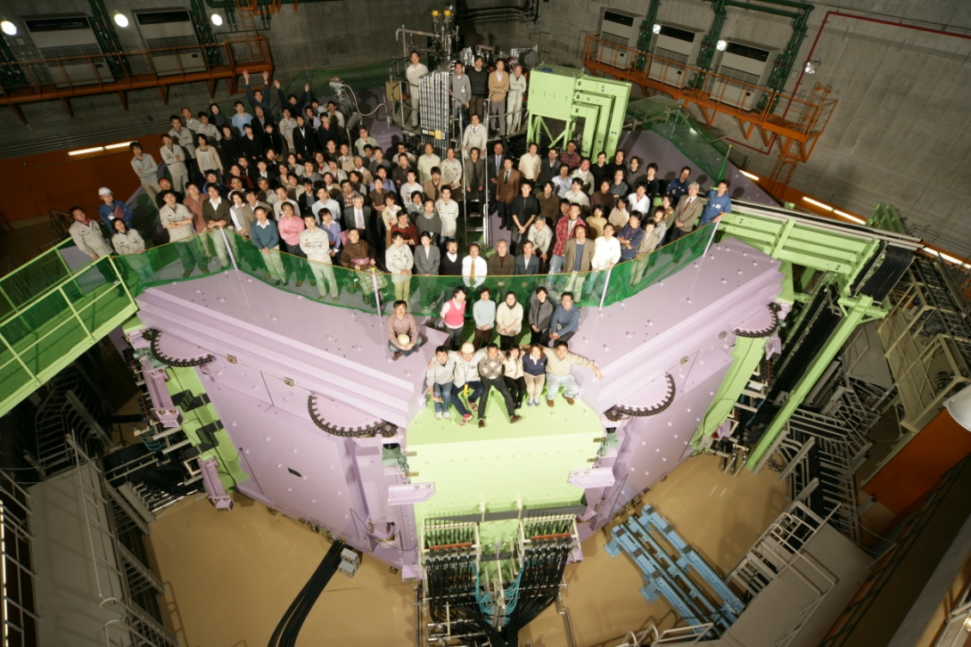
Future Nuclear Physics Facilities around the world
National - Regional – International
How we compete and how we collaborate
RIKEN
Nishina
Hideto En’yo
Director
RIKEN Nishina Center for Accelerator-Based Science
JuNe 1st 2013
Notes:
Good afternoon
I am talking about future nuclear physics facilities around the world.
I was asked by organizers to do this, and I accept.
However, by all means, this talk is beyond my ability.
Anyway I tried to present materials for our discussions.
I apporogize that our friend from Mext and KEK could not come to this meeting due to the radiation accident happened at JPARC last week. I hope they recover as soon as possible, but I think at least a half year JARC ceases its operation.

Slide 2
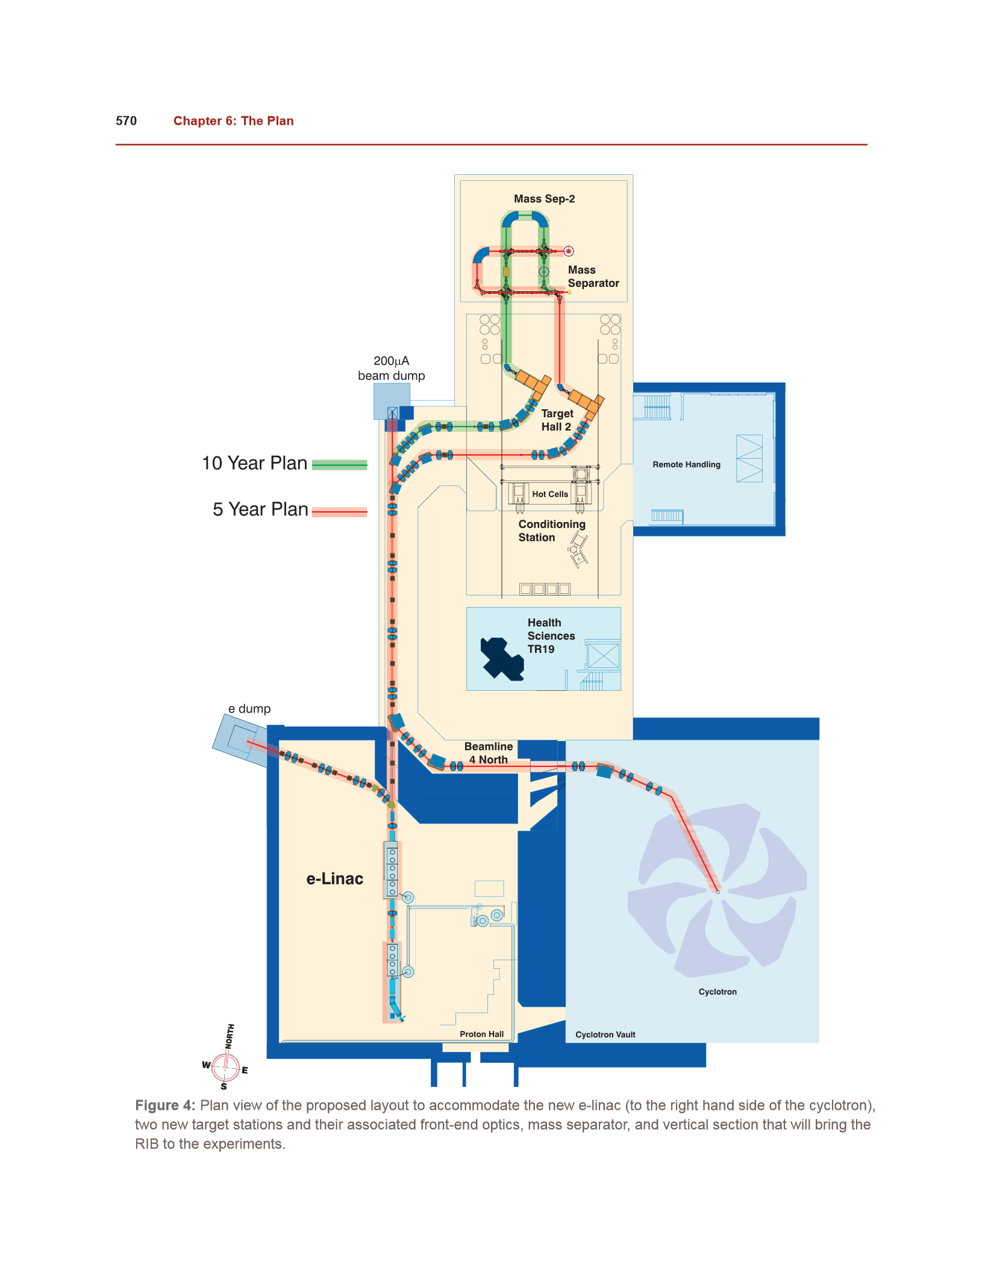
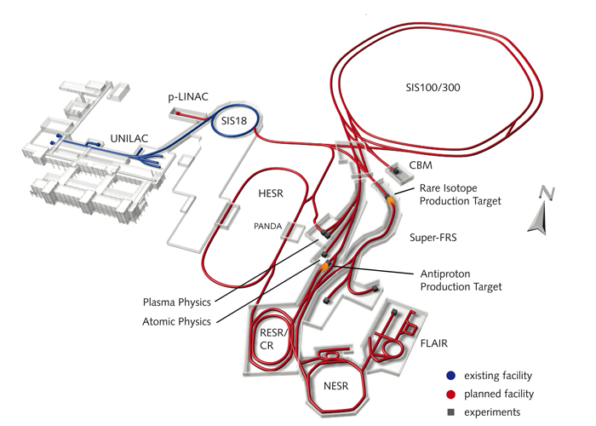
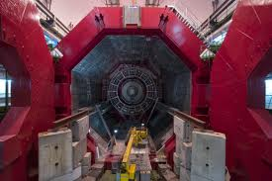
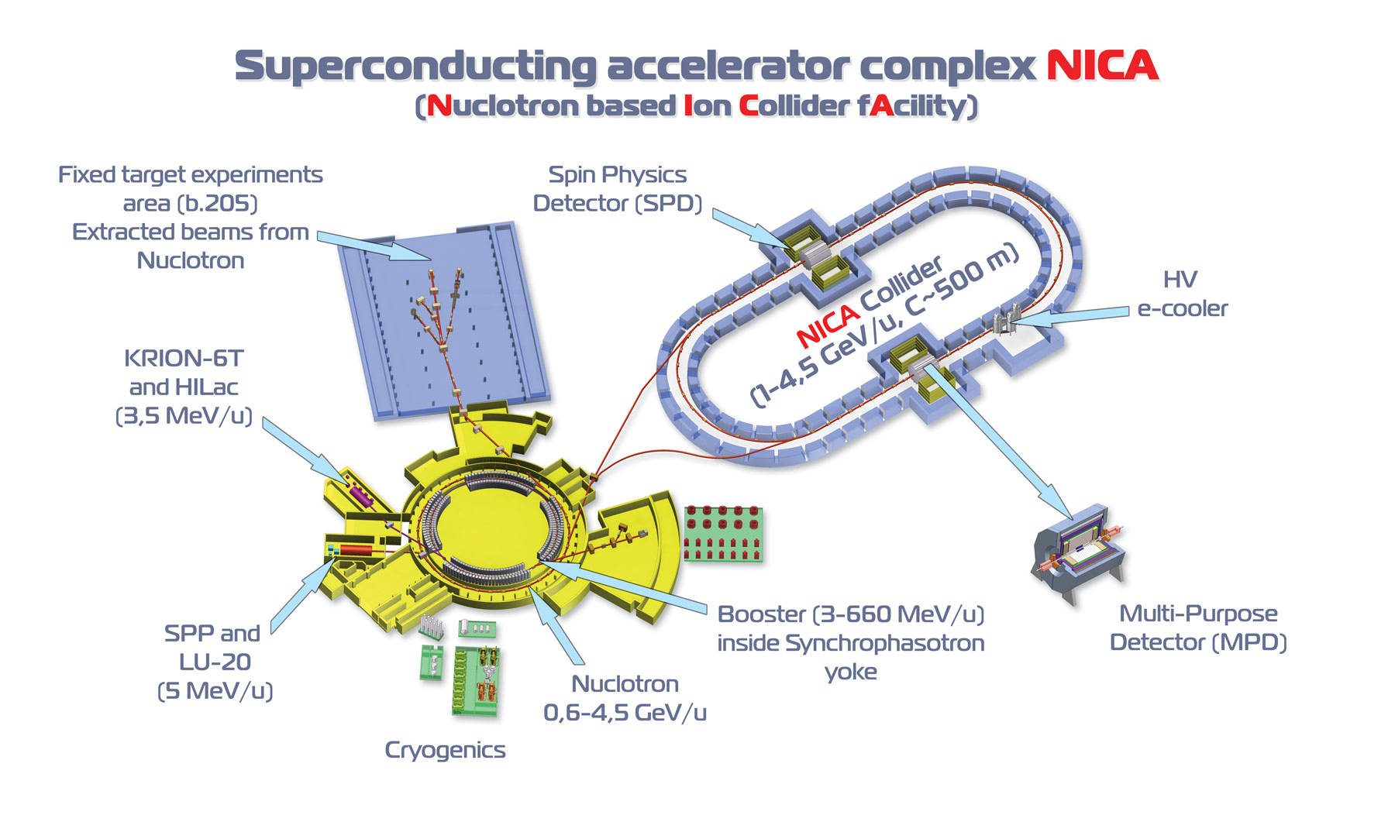
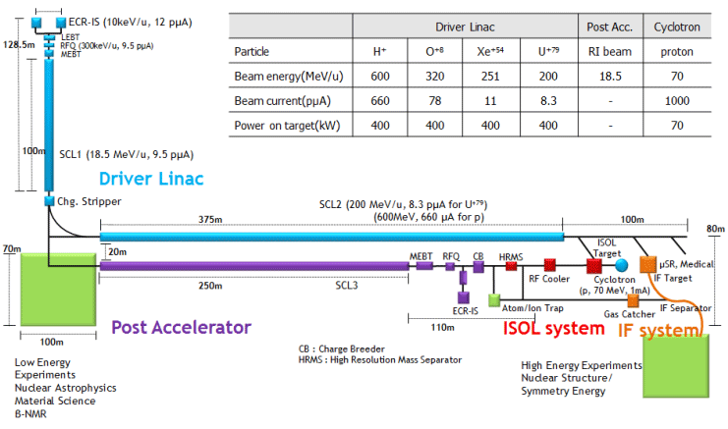

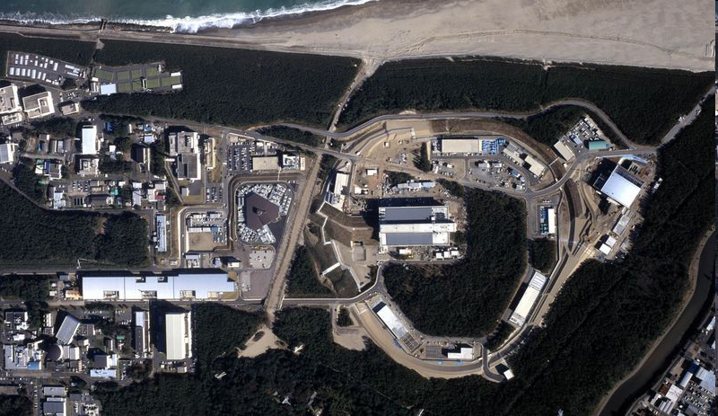
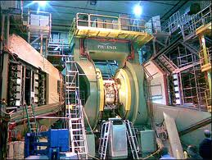
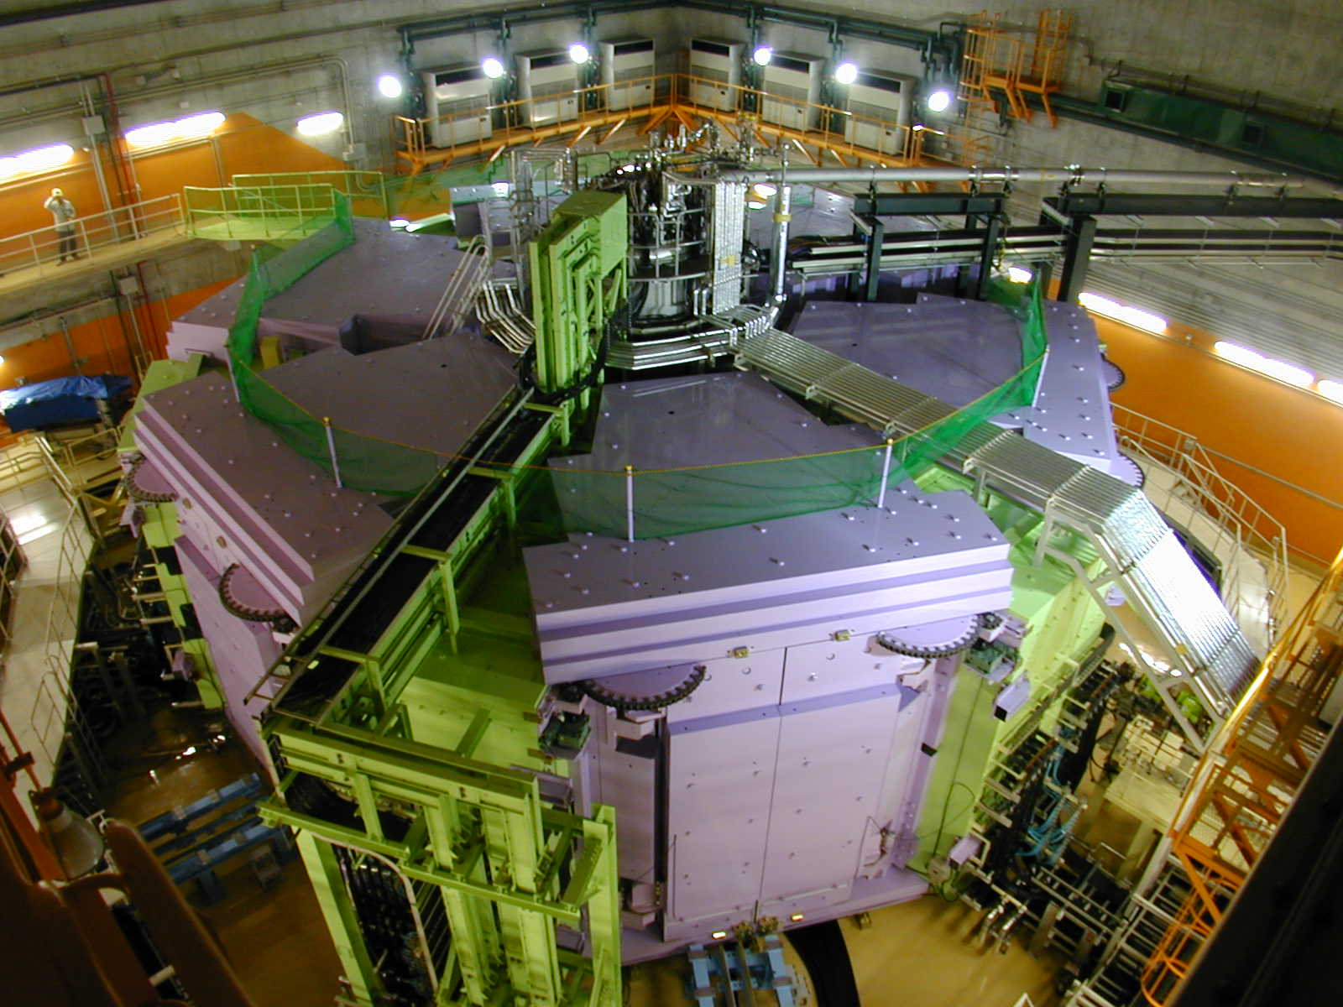
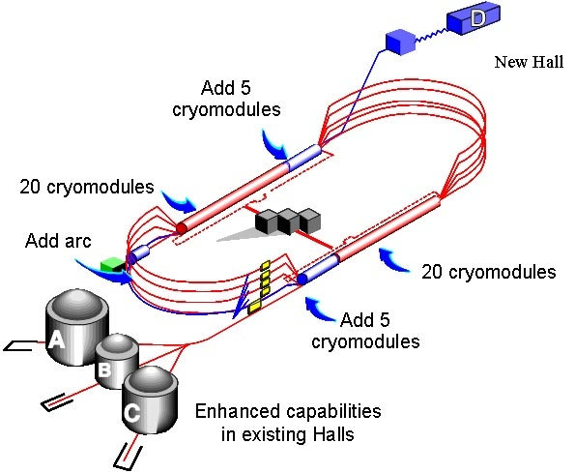
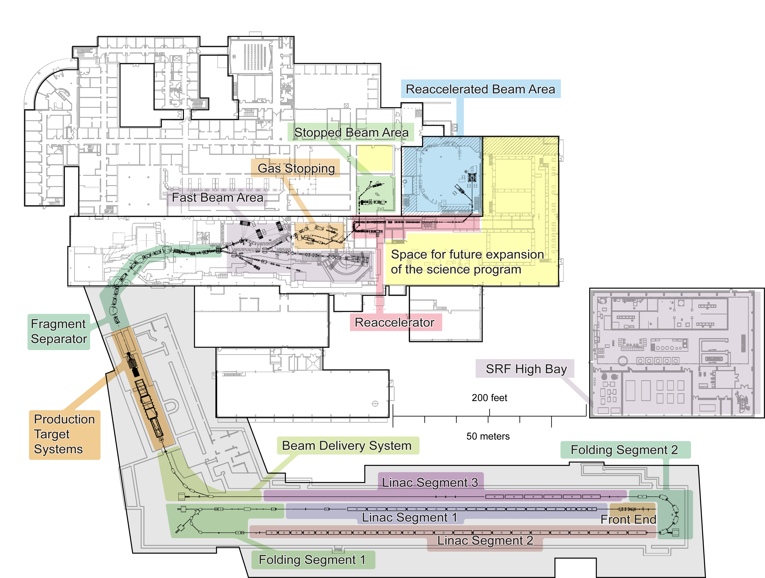
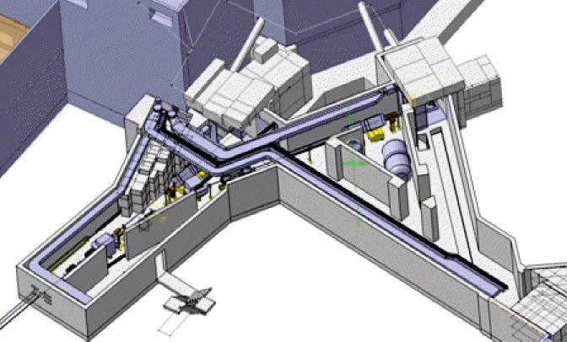
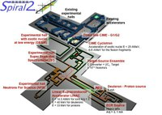
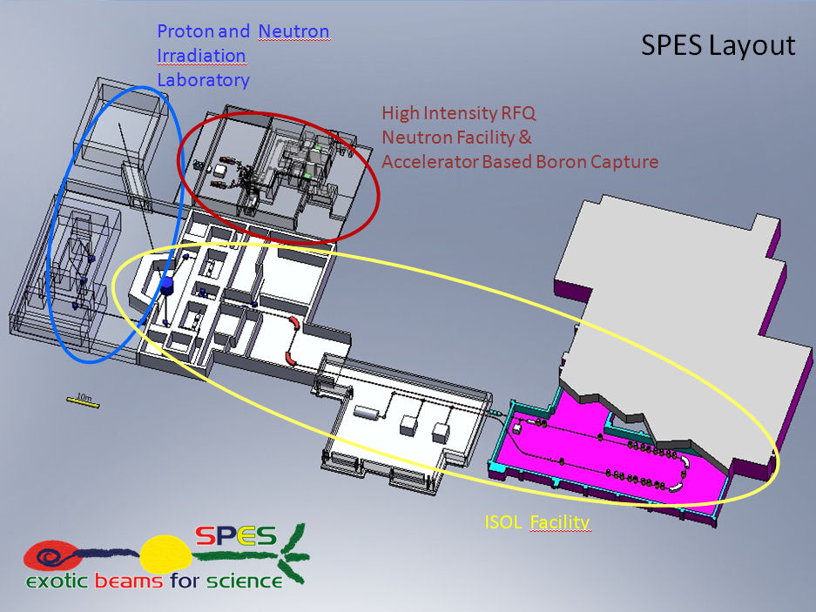
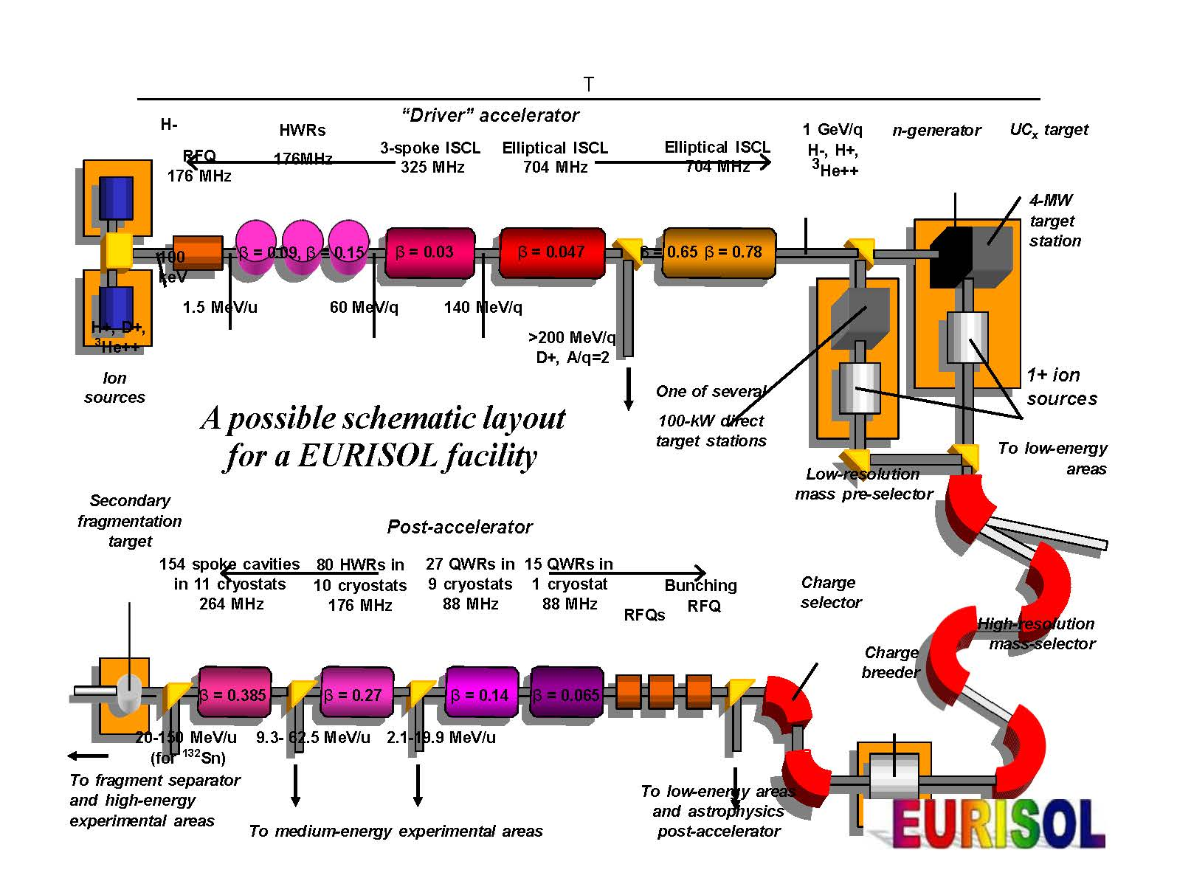
Today I mention….
AMERICA | EUROPE | ASIA
Notes:
Today I cover these facilities.
I hope your favorite is in the list.
If I have any omissions, please blame me.
I subdivided the world into to three region, America, Europe, and Asia.
Sorry for our friends from Africa and Oceania. This categorization is just symbolic.
But at least regional issues are somewhat important for our future.

Slide 3





Hyper-N New-hadrons
1980~~
KEK
TRISTAN
KEK
BELL
1999
KEK
sBELL
2014
1987
KEK
Proton 12GeV
1971
KEK/JAEA
J-PARC
2009
Numatron
~GeV/A
1980
/ spin
INS (U.T.)
FM Cyclotron
1 GeV ES
1955 founded
QGP
LBL
Bevalac
AGS
SPS
1990
RHIC
-- LHC
2000
RI-beam Halo-N
RIKEN
1931 founded
RIKEN
4th -160cm
1967
RIKEN
6th -RRC
1986
RIKEN
9th RIBF
2007
Notes:
Before moving into my main subject, I just want to tell you the history around KEK and RIKEN in Japan.
In 1980, we have only these, 12GeV PS at KEK,
Small cyclotrons in INS and RIKEN. None of them are world number one,
High energy people proposed TRISTAN e+e- collider. ( aiming at the top of the world)
Nuclear physicists proposed Numatoron, GeV/n machine, quite advanced.
Huge competition and trophy went to TRISTAN. Numatoron was dead.
This trend continued to BELL and sBELL upto now.
People likes QGP physics move out to LBL and AGS/SPS and RHIC/LHC, international cooperation., QGP physics.
RIKEN got powerful heavy ion acclerator , RING Cyclotron.
Gift was given from Bevalac, Forward fragmenation to create RI and discovery of neutron Halo.
Success in this machine was expanded to RIKEN RI beam factory.
Low energy nuclear physiciste joined to RIBF
And also RIKEN, joined RHIC and started high energy spin physics there.
People in HyperN and hadron has to stick to 12 GeV PS long time and finally got J-PARC.
We have now 3 world-level machine, B-factory, JPARC and
We could come here by moving this field to international cooperation, and
I should say japan has been very successful in the field of accelerator driven science.

Slide 4
Lessen leaned
If Japan had NUMATRON in 80th, We would not have JPARC nor RIBF at present.
Two Colliders (e+e, A+A) in a country ( at least in Japan) is beyond our nations ability.
We have sold High Energy A+A (Hot QCD) community to the international collaboration.
  Quite successful with 5 accelerators (2+1+2) to reach QGP
But none from scratch.
We have to be practical and wise.
SPS
200GeV
LHC
1.4+1.4 TeV
LBL
1GeV
AGS
10GeV
RHIC
200+200GeV
Notes:
What we learned is as follows.

Slide 5
National, Regional, International
Scale of the project
10 M$ | 50 M$ |  | 100 M$ |  | 500 M$ |  | 1,000 M$ | 5,000 M$ |  | 10,000M$
Institutional |  | national |  |  |  | regional |  |  | International
 |  |  |  | RHIC JLAB NICA |  |  | eRHIC JPARC FAIR | SSC LHC | ILC
ARIEL HIE-ISOLDE SPES |  |  |  | RIBF FRIB RISP SPIRAL2 |  |  | FAIR EURISOL CARIF
Rule of thumb
We do region wide collaboration due to Man-Power/Money-Power limitation
  Not by nature (do it by myself is scientist’s nature)
Good Facility wins the game.
Researches are international, Educations are often not (distance).
Good balance required (only one in the world is not a good approach)
and family life
Notes:
From the history happened for SSC/LHC or happening in ILC in the particle physics field.
We know 5B$ of the project cost is a sort of limit.
Above that we have to have only one in the world.
Because, we have manpower or money power limitation.
This limitation is not there by nature. Do it by myself is scientist’s nature. Otherwise we do it in our own nation or, in our own region.
However, we have so many facility with the price taged 500M$ to 2000M$ range.
If you compare the number to the high energy physic facilities, which are decreasing to have bigger machine, Nuclear physics is in a good shape.
However, if we count a total cost we are reaching the cost of ILC.
BTW, these are price tag I put each of project some time from the literature, sometime from the air.
So they can be wrong.
At lease we are tracing the same road where high energy people were once there.
We have to ask ourselves whether we have enough reseachers in the world to get full use of these facilities.
If not we have to segregate ourselves
And we know ---- read ----

Slide 6

Physics
Quark many body (Hot QCD) |  | Quark gluon plasma property of early universe
Quark many body (Cold QCD) |  | QCD chiral symmetry nucleon/meson structure
Nucleon many body |  | Ultimate nuclear picture nuclear property/structure (Hyper)
 |  | Element Genesis R/P process, Astrophysics
 |  | Island of stability Super heavy element/chem.
Fundamental Physics |  | Double beta, nEDM… Using rare RI/forbiidden decays
Computation |  | Ab-initio calculation Nuclear force in lattice, Shell model
Applications |  | Muon catalyzed fusion Nuclear transmutation
Notes:
Let me talk about physics, very roughly categorized.
Hot QCD, physics of quark many body system which was for quark gluon plasma. Property of early universe.
Many thing as common as hot QCD, cold QCD’s goal is chiral symmetry in QCD.
Nuclear physics as nucleon many body system has longest history.
The ultimate goal is to get ultimate picture of nuleus. For that we are doing millions of experiments for …..
This will leads us to the solution of element Genesis,
And some day we will reach Island of stability.
Nuclear physics also covers fundamental physics, physics of Lagrangean.
Especially for the cases employing rare RI or forbidden decay of nucleus.
To me neutron is one of rare RI.
We should realized computation come up to the front end.
Peta computing allows us to do the ab-initio calculation. Nuclear force in lattice QCD is very typical example.
As nuclear application I note muon catalyzed fusion or nuclear transmutation, as examples.
All these are big picture, needing many years of research but apparently worth to go.
To day I cover he first three categories, namely…………..

Slide 7
Physics promoting projects
 |  | America role-shared | Europe role sharing | Asia No-controle
Quark many body (Hot QCD) |  | RHIC | LHC(ALICE) FAIR(SIS300) | -
Quark many body (Cold QCD) |  | JLAB-12GeV eRHIC(eIC) | FAIR(SIS100) | JPARC Spring-8
 |  |  | NICA | HIRFL
Nucleon many body |  | FRIB | GSI/FAIR | RIBF
 |  |  |  | RISP
 |  | ARIEL/ISAC2 | SPIRAL2 SPES HIE-ISOLDE Dubna | HIRFL BRIEF
 |  |  | EURISOL | CARIF
Fundamental Physics / Computation / Applications
Two
body
Mean Field
Three Body
Mean Field
Notes:
Now I show you what proposing or constructing facilities will cover in each geographical region.
I would say, American continent is now well role-shared probably by the governments.
This means they are not comparing orange and orange any longer although they compare orange and apple frequently.
Europeans are seemingly trying sort of role-sharing by proposing EURISOL.
Asia is rally under no control. Every nations are chasing their own interest.
Mechanism working in America is two body interaction, even with significant mass difference.
In Europe, they can apply mean field theory, so many leading nations and EU exist.
In Asia the mechanism is three body weekly coupled. Anpha might be a key for ourslves.
And I believe we are together to construct a mean field theory applicable in the whole world.

Slide 8
Projects -- time line ---
Year |  |  | 2007 | 2008 | 2009 | 2010 | 2011 | 2012 | 2013 | 2014 | 2015 | 2016 | 2017 | 2018 | 2019 | 2020 | 2021 | 2022 | 2023 | 2024 | 2025 | 2026 | 2027
Fair |  |  | Const. |  |  |  |  |  |  |  | Exp |  | Complt
Jparc |  |  |  |  | Exp |  |  |  |  |  | 1MW
RHIC |  |  |  |  |  |  |  |  |  |  |  |  |  |  |  | eRHIC
LHC |  |  |  |  |  | Exp |  |  |  |  |  |  |  |  |  |  |  | HL-LHC
JLAB |  |  | Operating(old) |  |  |  |  |  |  |  | 12GeV Exp
NICA
Year |  |  | 2007 | 2008 | 2009 | 2010 | 2011 | 2012 | 2013 | 2014 | 2015 | 2016 | 2017 | 2018 | 2019 | 2020 | 2021 | 2022 | 2023 | 2024 | 2025 | 2026 | 2027
RIBF |  |  | Exp |  |  |  |  | Complete |  |  |  |  |  |  |  | RIBF2 ???
GSI |  |  | Const. |  |  |  |  |  |  |  | Exp |  | Complt
FRIB |  |  |  |  |  |  |  |  | Const. |  |  |  |  |  | Exp
ARIEL |  |  |  | Const |  |  |  |  | Exp |  | Complt
GANIL |  |  |  | Const |  |  |  |  |  | Exp |  | RIB Complt
SPES |  |  |  |  |  |  |  | Const |  |  |  | Exp
ISOLDE |  |  |  |  |  |  |  |  |  | 2 | 10 MeV
EURISOL
RISP |  |  |  |  |  |  |  |  | Const. |  |  |  | Exp
HIRFL |  |  | Operating |  |  |  |  |  |  |  | Upgrade? |  |  |  |  | HIAF ???
BRIEF |  |  | Const |  |  |  |  |  | Exp |  |  |  |  |  | CARIF?
Notes:
Now I lined up all the project in time line.
We are here now.
In the hot/cold QCD field, there aren’t so many projects, FAIR and JLAB upgrade are coming in few years.
And 10 yeas of scale, eRHIC HL-LHC are supposed to be on the table.
In Nucleon many body, there come so many new facilities in five year scale
There comes a lot of healthy competitions, and in 10 yeas scale we expect to have EURISOL, CARIF or RIBF2
Who will be a winner… that I do not know.
At least WG-9 is a meting to discuss our future in 10-20 years scale.
So these are the key project we should be aware of.

Slide 9
HOT QCD
AMERICA | EUROPE | ASIA
Notes:
Now I come to each subfield. Let me start from Hot QCD.
There are only few facilities in the world. Selected historically.

Slide 10
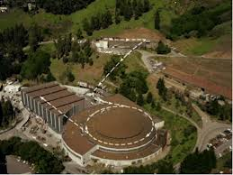
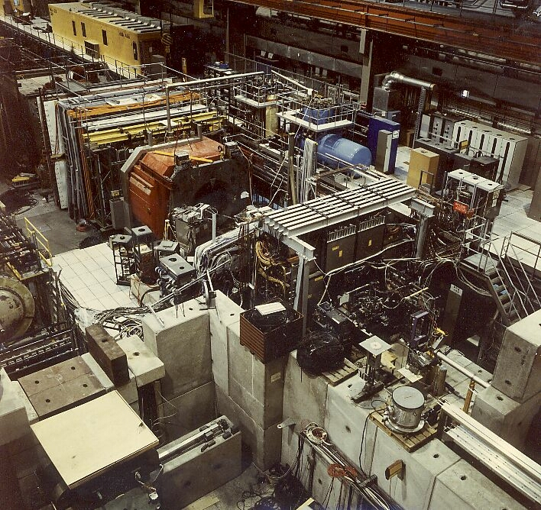
Hot QCD
1980 1990 2000 2010 2020
SPS
200GeV
LHC/ALICE
1.4+1.4 TeV
LBL
1GeV
AGS
10GeV
RHIC
200+200GeV
FAIR(SIS300)
NICA
High density
ISR
eRHIC
SSC
Notes:
This shows HOT QCD history.
It started in 1980th at LBL.
In 1990th we got SPS-HI and AGS-HI. I should say SPS project are helped a lot by researchers from ISR.
Until the very end of SPS, we are not sure whether we reached QGP or not.
In the year 2000 we got RHCI started, and we finally declared the discovery of new state of matter, after 25 years of search.
LHC and ALICE started 2010 and re-discovered new state of matter.
At KEK we have regular management committee, where ATLAS people reported their first physics result which was Jet Quenching.
I personally was very much proud of it.
ALICE has another 10-15 years of research period, I believe.
Around 2020 RHIC will quit from Hot QCD by having eRHIC, I presume.
And new comers are FAIR and hopefully NICA, moving into High density QCD field.

Slide 11
COLD QCD
AMERICA | EUROPE | ASIA
Notes:
Let me get into COLD QCD.
These are reading laboratories. White collors indicates to be funded or minor.

Slide 12
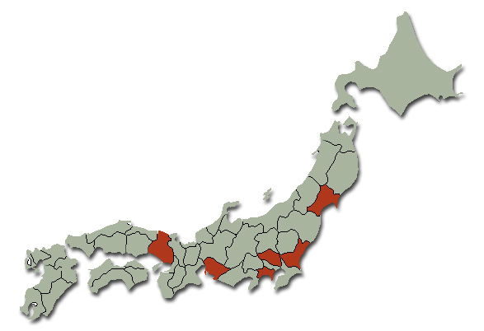
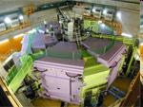
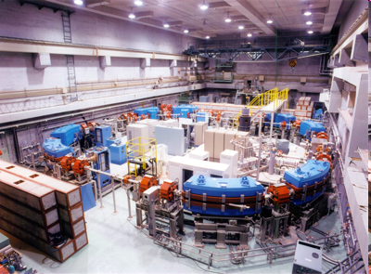
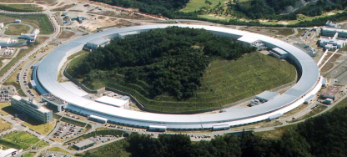
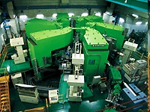
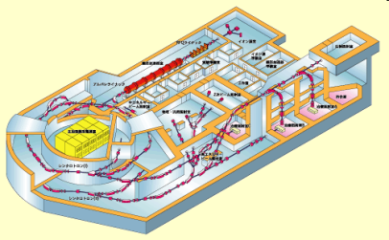
Japanese Accelerators for Nuclear Physics Community
Nishina Center, RIKEN
K2600 RIBF
Research Center for Electron Photon Science, Tohoku University (ELPH)
1.2GeV electron Stretcher
Spring-8 (RIKEN/JASRI)
8GeV e - Synchrotron
RCNP, Research Center for Nuclear Physics, Osaka University
K400 Cyclotron
National Institute of Radiological Sciences
800MeV/A Synchrotron
J-PARC, KEK/JAEA)
30GeV Proton Synchrotron
Notes:
Let me just mention the accelerators in Japan. 6 are usable by nuclear physics
We have 4 user facilities owned by nuclear physics community. READ.
Besides, in Chiba, NIRS has 800 MeV/A synchrotron, night and weekends are open for nuclear physicis
In RIKEN Harima institute, Spring 8 (8GeV ring for photons) has 2 beam lines for nuclear physics.
JPARC, Tohoku-ELPH and Sprig-8 LEPS are working for cold QCD.

Slide 13
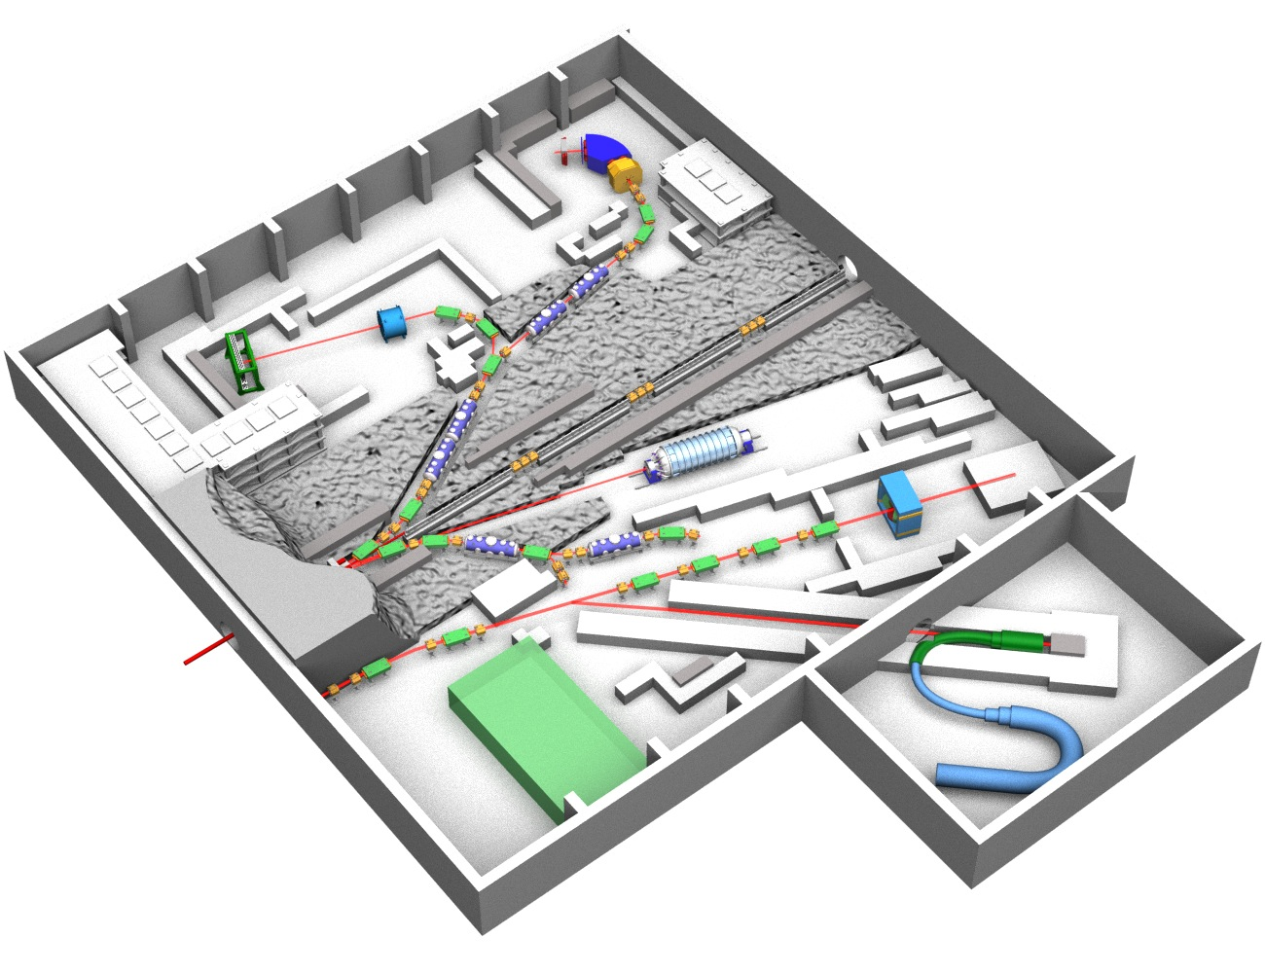
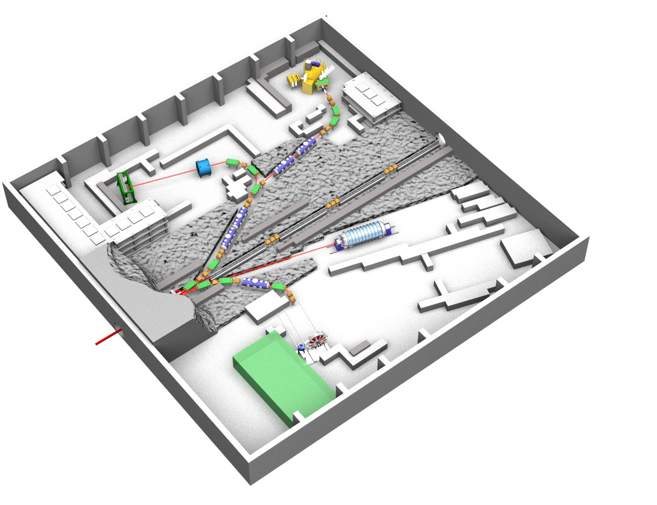
J-PARC/Japan
Strangeness Nuclear Physics
Hadron Physics
30GeV Proton Beam
Intensity > 10~20kW
→ Experiments with K beam starts soon
K1.8BR
K1.8
K⁰ Rare Decay
KL
Hadron mass
High Momentum
K1.1BR
μ→ e Conv.
Test Exp. &
Lepton Universality
COMET
Proton Beam Intensity ~100kW
Hall extension(*2.5) foreseen
Notes:
J-PARC is now a world leading facility using hadron beam.
For the moment beam lines are limited for ……
Last year they got a supplemental fund for two new beam line where hadron mass modification studies and mu-e converson experiment will be carried out.
Presently their intensity of proton is 10-20 kW, they are sure to reach 100kW soon.
And the extension of this hall by 2.5 is proposed.

Slide 14
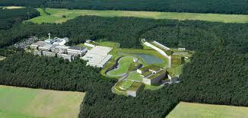
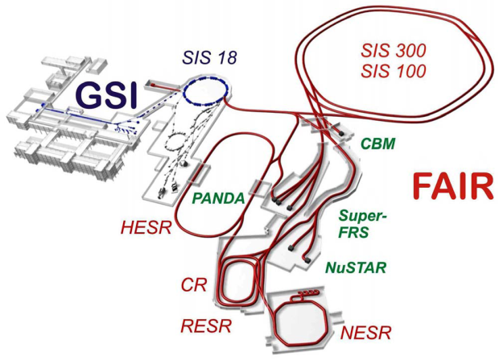
FAIR at GSI
Facility for Antiprotons and Ins Research
Very cleaver versatility
Greedy but Nich
Dual MR + cooler/storage rings
Field | Energy GeV/u | Average Intensity pps | Time Structure
Hot QCD (SIS300) | U^{92+:} 34 | 2x10⁹ | Slow ext <100s
Cold QCD (SIS100) | p 29 | 5x10¹² | Fast exit ≈ 25 ns
RIB (SIS100) | U²⁸⁺ 1.5 | ∼3·10¹¹ | Fast ext 60 ns Or CW
Notes:
FAIR will take of in a few years. This will be a europian leading facility
Covering Hot QCD, Cold QCD and RIbeam.
I think their accelerator is very cleaver with a lot of versatility.
SIS 300 for hot QCD, SIS 100 for cold QCD, and with RIBeam with projectile fragmentation.
Physics program is well sorted up, greedy and nich.
I mean by nich that they seem to have a policy, do something other facility cann’t do.
No neutrino, no hyper nucleus.
This versatility is not coming for free. Many rings to be built, it is a burden.

Slide 15
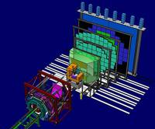
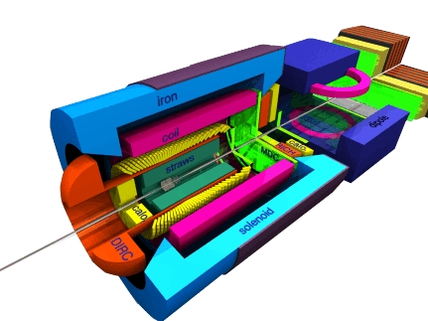
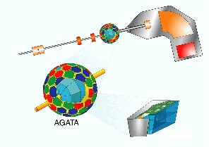
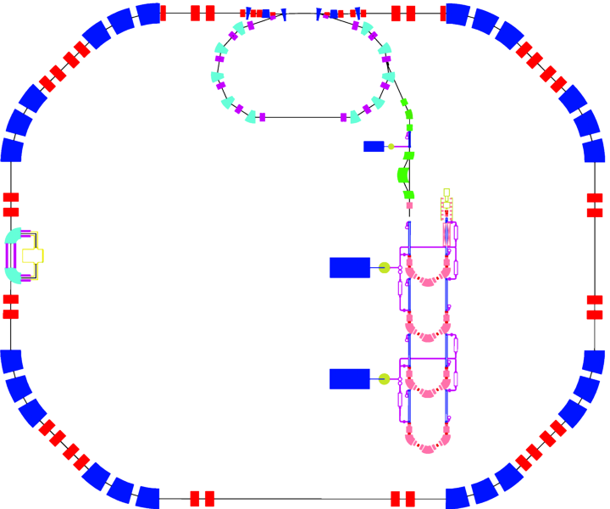
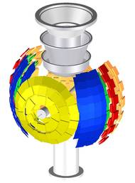
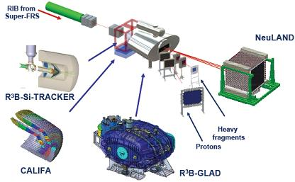
FAIR
Experimental highlights
Compressed
Barionic
Matter
QCD chiral symmetry breaking/restration
EOS at high baryon density
Origin of hadron masses
Quark confinement
Physics of neutron stars
PANDA Antiproton Annihilation at Darmstadt)
Glueballs and Hybrids
Charm in Nuclei
Charmonium
Hyper nuclei
D- meson Physics
NUclear
STructure,
Astrophysics and Reactions
Super FRS
DESPEC/HISPEC ELISe
EXL ILIMA
LaSpec MATS
R3B
Notes:
Their flag ships are CMB… for Dense QCD
PANDA… for cold QCD
I will come back NUSTAR later

Slide 16
NICA at JINR
Region once examined at SPS.
Hot QCD
⇩
Dense QCD
 | typical | √s_{NN} (GeV) | L_{average} (/cm²/s)
A+A | ¹⁹⁷Au⁷⁹⁺ +¹⁹⁷Au⁷⁹⁺ | 4 ÷11 | 10²⁷
p↑+p↑ | polarized | 12 ÷25
d↑+d↑ | polarized | 4 ÷13.8
Notes:
NICA stands for …. JINR.
As far as I understand they are not funded yet.
This is say small RHIC, A+A pol-p+pol-p collider at lower energy which RHIC could reach but with miserable luminosity.
As same as FAIR, they are going to dig a new area high dense QCD. Where, however, once search by SPS HI project.
Is new success will come or nor, like RHIC and LHC is the real key for our future research.

Slide 17
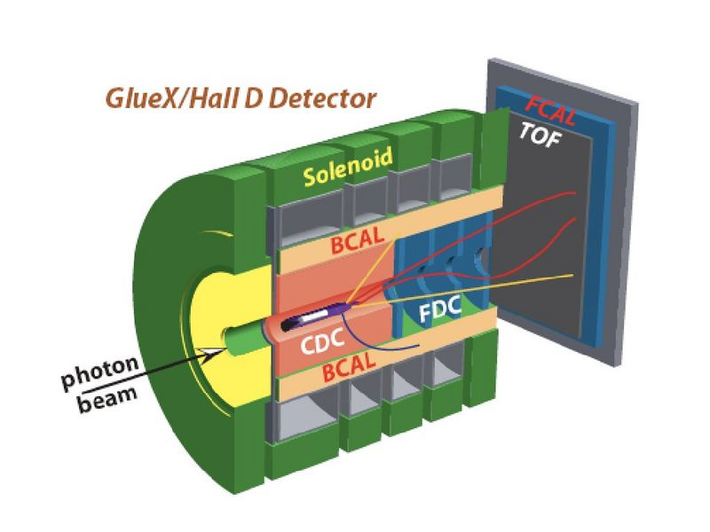
J-LAB in USA
12 GeV Upgrade
highly cost effective due to existing features of CEBAF.
To 24 GeV in the future.
New experimental Hall D
  bremsstrahlung beam
  New solenoid detector
Notes:
JLAB in USA is about complete its 12 GeV ugrade.
READ

Slide 18
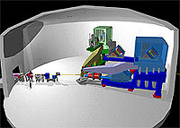
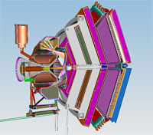
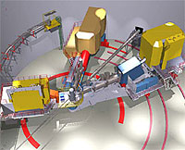
JLAB12GeV other research highlight
 | Hall A – Beamline Upgrade Continued use with existing spectrometer pair and for special set-up experiments.
 | Hall B - CLAS Upgrade new magnets and detectors forward-focused reaction products at the increased luminosity.
 | Hall C – SHMS Super High Momentum Spectrometer or in addition to the existing High Momentum Spectrometer (HMS).
Notes:
Also, they are upgrading existing detectors…..

Slide 19
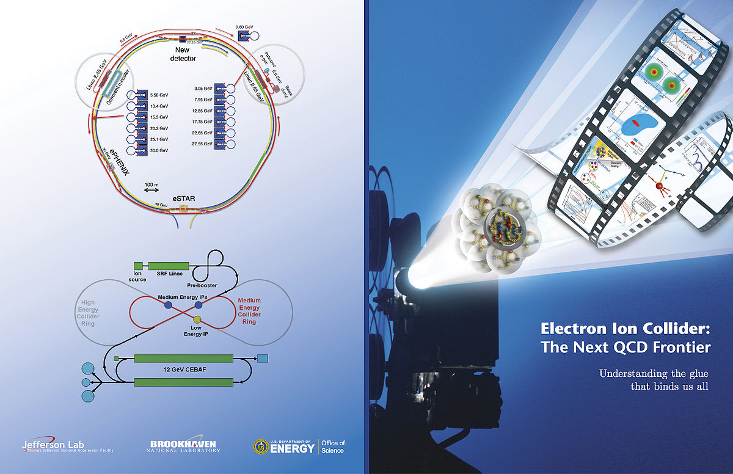
eRHIC (or eIC) to be the world's first electron-nucleus collider
eRHIC = RHIC + (5~10) GeV electron ring
ultimately to 20 or even 30 GeV in the future
ep Luminosity 100 times of HERA accelerator at DESY (and polarized).
Nucleon spin structure, low-x physics, geometrical sccalig…..
Notes:
Finally I should mention eRHIC or eIC
To be the world first electron-nucleus collider.
They havn’t decided whether BNL or Jefferson should host it
Though, here I just assume eRHIC to represent this project.
Read the slide

Slide 20
Cold QCD laboratories
Less compared to 20 years ago due to the collider projects in CERN and BNL (pain we paid)
Many scientists moved to Hot QCD
There are many-but-small electron-beam laboratories around the world.
Good balance realized
eIC migt be a key to the future, NICA is an interesting option
B factory is another important addition !
 |  | America | Europe | Asia
Hadronic beams |  | - ! - | FAIR (CERN SPS) | JPARC HIRFL
Electro Magnetic beams |  | JLAB-12GeV | (CERN muon) | Spring-8
e-A, p-A Collider |  | eRHIC(eIC) | - | -
A-A/p-p Colliders |  | - | NICA | -
Notes:
With this slide I summarize cold QCD laboratories.
READ
Eventually none in America, although BNL-AGS FNAL main injector can be used for cold QCD purpose.
With Electro Magnetic Probe, apparently JLAB 12 GeV is taking a leading role, with CERNs muon Spring-8’s gamma eam and many other laboratories around the world.

Slide 21
RIB facilities (ISOL to begin with)
AMERICA | EUROPE | ASIA
Notes:
Now I change my subject to RI beams
Rising field of nuclear physcs, at least with the number of facility proposal.
To begin with, I start with ISOL facility.

Slide 22




EURISOL
(1500M$ for European future & dream)
20 institutes and laboratories within Europe as full Participants,
20 institutions in Europe, North America and Asia as Contributors.
Contributors from non-European Countries
USA: ORNL, ANL, NSCL, FNAL
Canada: TRIUMF Korea: KAERI Japan: JAEA
Notes:
EURISOL is the EU based 1500M$ project
READ

Slide 23
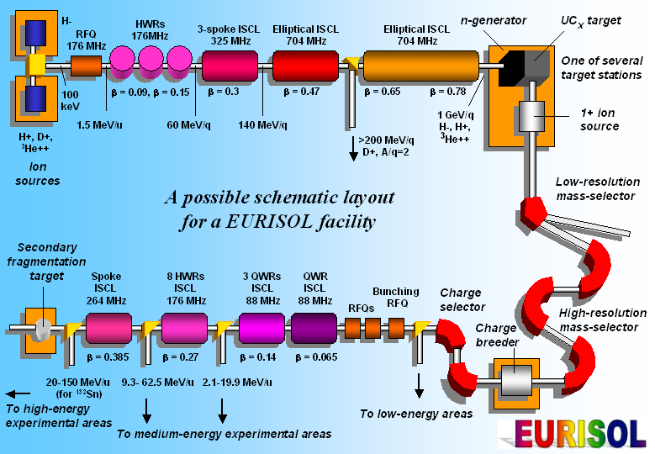
Clever European Strategy
ISOL projects, such as SPIRAL2 at GANIL, HIE-ISOLDE at CERN and SPES at LNL, Legnaro, are now regarded as “intermediate” .
FAIR
Future Two Goals
FAIR/EURISL complementary
HIE-ISOLDE
SPIRAL2
SPES
EURISOL
Notes:
I think having EURISOL is very clever idea for European strategy.
In their design study they write as follows.
First, they determined their future is two compliments. FAIR and EURISOL.
They also say READ
This sounds to me, All eurpean agree for the future, so that today please give us these.

Slide 24
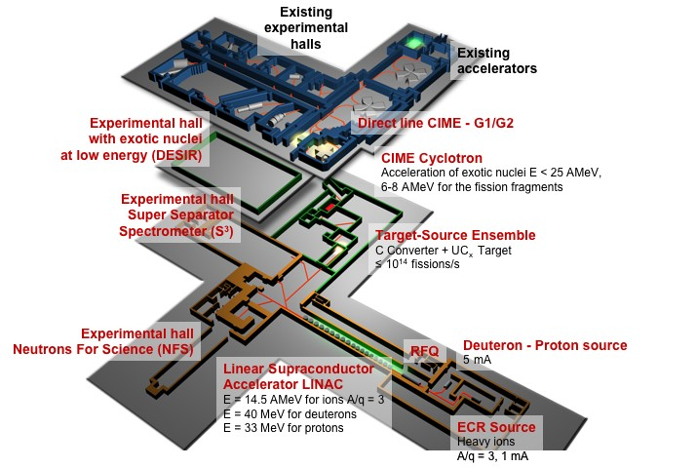
Great “intermediate” Facilities
SPIRAL2
HIE-ISOLDE
SPES
SC linac (d)
DESIR facility: Disintegration, Excitation and Storage of Radioactive Ions
NFS: Neutron For Science
S3: Super Separator Spectrometer
RI to CHIME: post acc. (Existing cyclotron) in 2016
Notes:
These intermediate facilities are not minor. They are great.
HIE Isolde is a sort of natural extension of the present facility with a strong post accclerator.
SPES in ITAY is simple but powerful ISOL project in LENEALO
They are the project a few hundred million $ but SPIRAL2 in GANIL is different.
It double the present GANIL facility.
READ

Slide 25
ISOLs: past, present and future
Nation | Facility | Beam |  | Target |  | Post acceleration
 |  | Beam | Power (kw) | Dirct/ Conv | Fissions/s | Method | MeV/A | 132Sn/s
CERN | ISOLDE | p 1Gev 2000μA | 0.4 | both | 4*10¹² | Linac | 3 | 1*10⁷
USA | HRIBF | p 40MeV 10μA | 0.4 | Direct | 4*10¹¹ | Tandem | 4 | 2*10⁵
JAPAN | TRIAC | p 30MeV 3μA | 0.9 | Direct | 1*10¹¹ | IH Linac | 1 | 1*10⁵
CANADA | ARIEL | e 50MeV 10000μA p 500MeV 100μA | ~100 | Direct | 1*10¹⁴
CERN | HIE ISOLDE |  |  | Both | 4*10¹² | SC Linac | 5-10 | 2*10⁸
FRANCE | SPIRAL2 | d 40MeV 5000μA | 200 | Convert | 1*10¹⁴ | Cyclotron | 3-10 | 2*10⁹
ITALY | SPES | p 40MeV 200μA | 8 | Direct | 1*10¹³ | SC Linac | 10 | 3*10⁸
EUROPE | EURISOL | p 1GeV 5000 μA | 4000 | Both | 1*10¹⁵ | SC Linac | 20-150 | 4*10¹¹
Notes:
With this slide I tried to summarize ISOLS; post, present and future.
Blues are present facility 10^11 fissions /s providing 132Sn 10^**/s typically
Oranges are European “intermediate” facilities 10^12-13 fissions/s. with 132Sn of 10^***
At the bottom European’s dream EURIAL is listed. With 10^******
In addition CANADIAN has ARIEL which provides 10^*** fissions /s which I come to momentarily.

Slide 26
ARIEL @TRIUMF/CANADA
(Advanced Rare Isotope Laboratory)
To ISAC 1&II
Sc e- Linac 50 MeV, 10 mA CW
Proton beamline 500MeV100 μA
Two new high-power ISOL
• Mass separated transport to ISAC-I /II
Starting with 25MeV(100kW) e-beam
50-75MeV 10mA with ERL in future
Goal 1*10¹⁴ fissions/s
Comparable to EUROPEAN intermediates.
Notes:
ARIEL stands for ////
READ
As far as I understand electron linac development is collaborated with their activity for ILC.
I see in TRIUMF very good collaboration among nuclear and particle physicists, may be the best in the world.

Slide 27
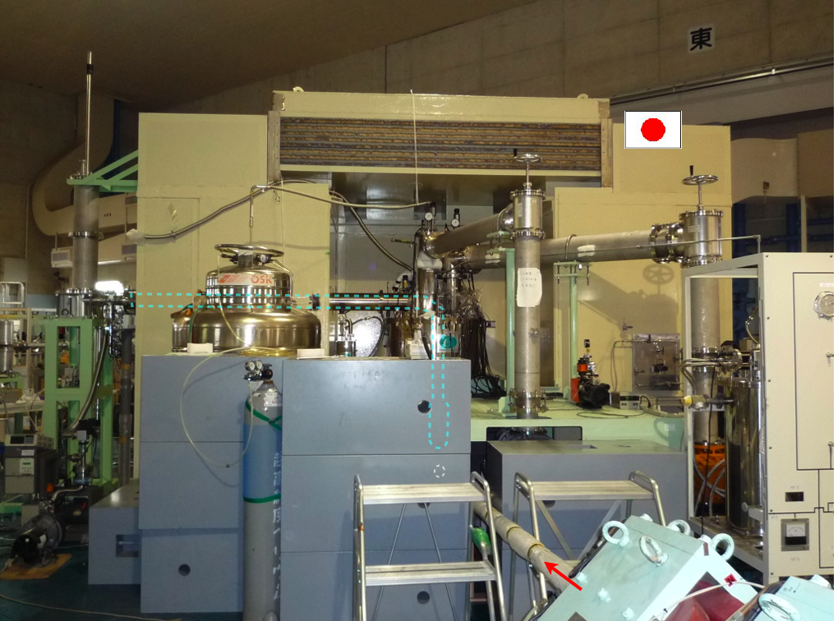
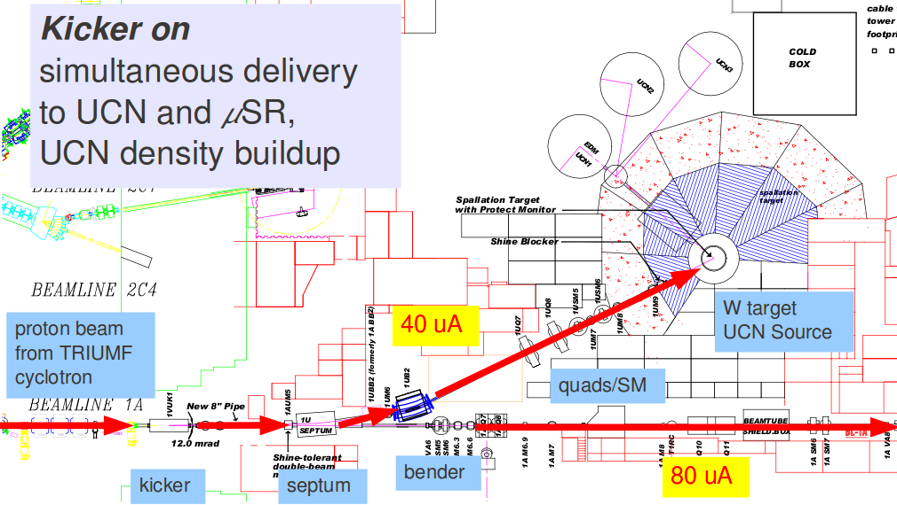
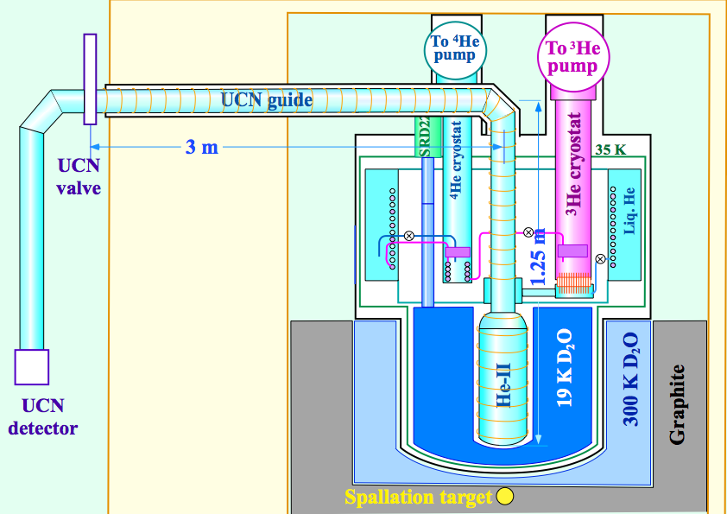
KEK’s UCN RCNP>TRIUMF
Ultra cold neutron
Notes:
Another good example is Ultra cold neuton.
KEK’s UCN source is now operating in RCNP in JAPAN, will be moved to TRIUMF

Slide 28
UCN TRIUMF-KEK-RCNP
Place | PWR | Method | Source | E(nev) | T(s) | ρ_{UCN} ^{/cm3 source} | ρ_{UCN} /cm3 ^{exp.}
TRIUMF KEK RCNP | 20kW | Spallation |  | 210 | 150 | 5×10⁴ | 5800* (90neV)
ILL | 60 MW | n beam | He-II | 250 | 150 | ** | 1000 (250neV)
SNS | 1 MW | n beam | He-II | 134 | 500 | ** | 150
LANL | 125kW | spallation | SD2 | 250 | 1.6 | ** | 30* (180 neV)
PSI | 1 MW | spallation | SD2 | 250 | 6 | 2000 (2m³⁾ | 1000 (250neV)
Munich | 20 MW | reactor | SD2 | 250 | ** | 1×10⁴ | **
* ρ at experimental port, ** no data
Notes:
They are foreseeing to win over the other facility ( not only the spallation facilities but also reactor facility) on the number of trapped neutron.
This is a very good example of nuclear physicist doing fundamental physiccs,.

Slide 29
RIB in ASIA
AMERICA | EUROPE | ASIA
Notes:
Let me introduce Ribeam in ASIA

Slide 30
CARIF (Beijing ISOL)
China Advanced Rare Ion-beam Facility
Chinese EURISOL (not Asianisol)
CARR 60MW
Chinese Advanced Research Reactor
Post acceleration up to 100MeV/c
Notes:
CARIF stands for ……
This is Chinese EURISAL

Slide 31
CARIF vs EURISOL
Nation | Facility | Beam |  | Target |  | Post acceleration
 |  | Beam | Power (kw) | Dirct/ Conv | Fissions/s | Method | MeV/A | 132Sn/s
CANADA | ARIEL | e 50MeV 10000μA p 500MeV 100μA | ~100 | Direct | 1*10¹⁴
CERN | HIE ISOLDE |  |  | Both | 4*10¹² | SC Linac | 5-10 | 2*10⁸
FRANCE | SPIRAL2 | d 40MeV 5000μA | 200 | Convert | 1*10¹⁴ | Cyclotron | 3-10 | 2*10⁹
ITALY | SPES | p 40MeV 200μA | 8 | Direct | 1*10¹³ | SC Linac | 10 | 3*10⁸
EUROPE | EURISOL | p 1GeV 5000 μA | 4M | Both | 1*10¹⁵ | SC Linac | 20-150 | 4*10¹¹
CHINA | CARIF | Reactor | 6M |  | 2*10¹⁵ | Linac | >100 | 5*10¹⁰
Present RIKEN RIBF can deliver 200MeV 132Sn with 3*10⁵/s (regularly)
Will reach 3*10⁶/s by 2015
Notes:
Here I just compares EURISOL and CARIF despite the difference in Driver expecting performance is indeed comparable.
100 time stronger the soon-to-be-ready facilities.

Slide 32
China - Before CARIF
Notes:
Before CARIF come, Chinese has two facilities.

Slide 33
Wish we are similar …..
IMP Lanzhou, budget history
100M$
ADS (phase I) approved with 300M$
Notes:
Once I have surprised a lot with the budget profile of IMP Lanzhou.
This looks like a exponential groth. We excepting chineese, all of us feels wish we are similar.
So no financial problem seemingly in china. They got ADS approved I heard.

Slide 34
Competitions in far east
 | Year | 2007 | 2008 | 2009 | 2010 | 2011 | 2012 | 2013 | 2014 | 2015 | 2016 | 2017 | 2018 | 2019 | 2020 | 2021 | 2022 | 2023 | 2024 | 2025
J | RIBF PF | Start Exp |  |  |  |  | Complete Construction
 |  |  |  |  |  |  |  |  |  |  |  |  |  |  | RIBF2 ???
K | RISP both |  |  |  |  |  |  | Start Cont. |  |  |  | Start Exp
C | HIRFL ISOL | Operating |  |  |  |  |  |  |  | Upgrade?
 |  |  |  |  |  |  |  |  |  |  |  |  |  |  | HIAF : High Intensity Accelerator Facility ???
 | BRIEF2 ISOL | Construction |  |  |  |  |  | Start Exp
 | CARIF ISOL |  |  |  |  |  | CARISOL Ready |  |  | Construction |  |  |  | Start Exp
Though, ASIA No Regional Consensus within ASIA. CARIF can be a ASIANI-SOL. Who can be a “Projectile Fragmentation” leader in 2020 ?
Notes:
This summarized competition I far east,
For
RIBF in RIKEN is delivering the most powerful beam in the world.
BUT
Presently Korean has RISP project to get online in 5 years.
China has variety:
IMP Lanzhou has HIRFL operating, and to be upgraded in a few years, and foreseeing HIAF in 10 years.
CIEA’s BRIEF2 will take off soon, and CARIF in 10 year scale.
READ.

Slide 35
RIB facilities (Projectile Fragmentation)
AMERICA | EUROPE | ASIA
Notes:
So it’s a time to come into the PF facilities.

Slide 36
Projectile Fragmentation Facilities
ISOL + post acceleration v.s.
Projectile Fragmentation
 |  | America | Europe | Asia
Projectile Fragmentation with sub/few GeV Uranium |  | MSU/FRIB | GSI/FAIR | RIKEN/RIBF
PF + ISOL |  |  |  | RISP/RAON
ISOL + 10MeV post AC |  | ARIEL/ISAC2 | SPIRAL2 SPES HIE-ISOLDE | HIRFL BRIEF
ISOL + 100MeV post AC |  |  | EURISOL | CARIF
Notes:
With this slide I compare PF facilities with
Read the table.

Slide 37
RISP
RAON
IBS
Rare Isotope Science project promotes machine called
(라온) formerly called KoRIA, at
Institute for Basic Science in Korea
Notes:
As I have just mentioned /////
They have SC linac for proton to Uranium as similar as FRIB plans
it can feed either ISOL or Fragmentation separator.
Even they have a plan to have a high power cyclotron to feed the ISOL.
This will be ready, hopefully in 5 years.

Slide 38
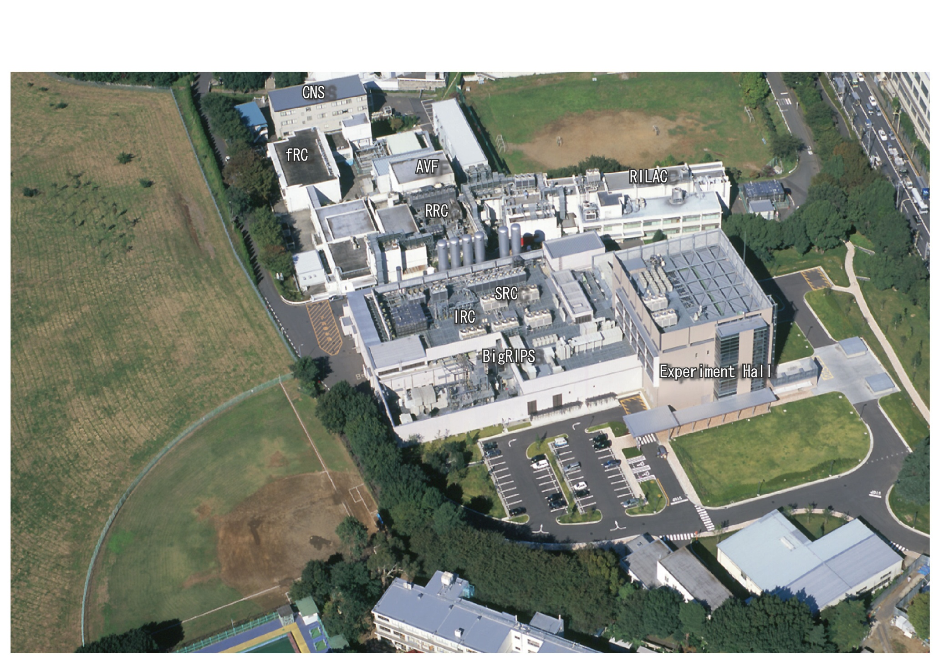
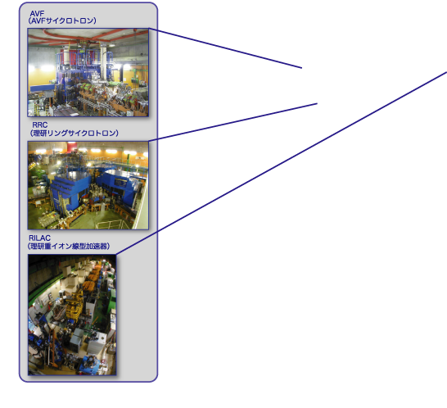
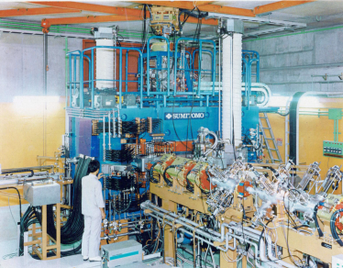
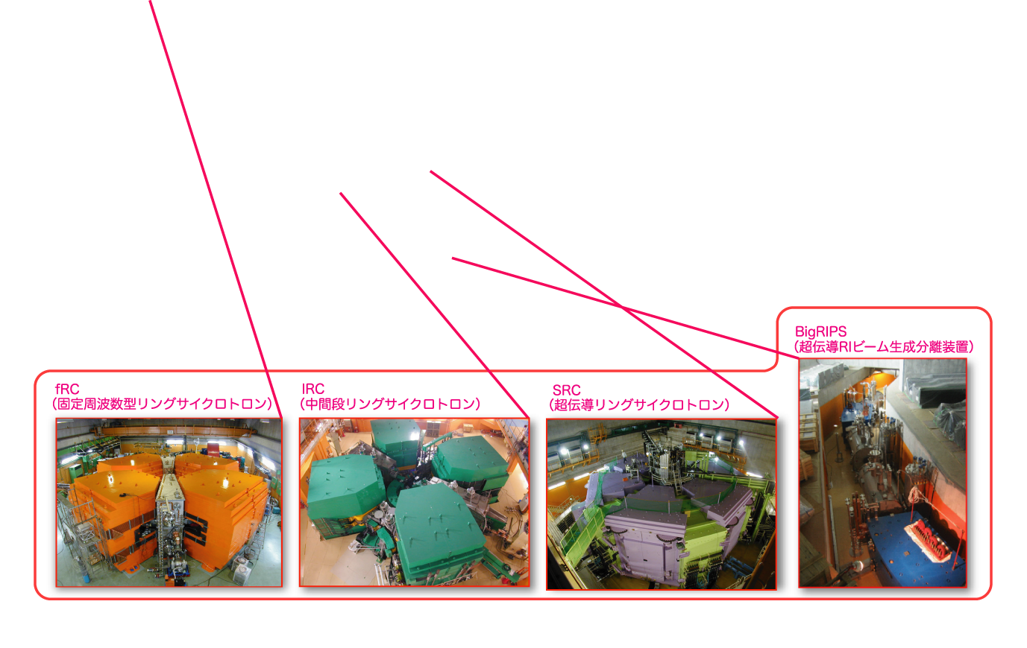
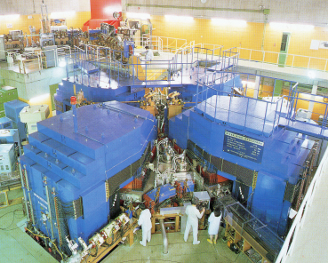
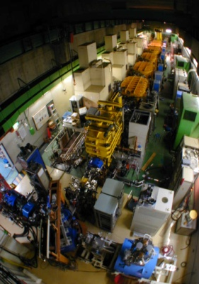
RI Beam Factory (RIBF), RIKEN Nishina Center
AVF Cyclotron
Old facility
Const. :1975~1990/160M$
Operation since 1986
5th
RRC
(Riken Ring Cyclotron)
6th
New facility
Const. :1997~2006/450M$
Operation since 2007
RIBF: 1997 ~ (2012)
50 BJYen
RILAC
(Riken Heavy Ion LINAC)
BigRIPS (Superconducting
RI Beam Separator )
fRC (fixed-Frequency Ring Cyclotron)
IRC (Intermediate-Stage Ring Cyclotron)
SRC (Superconducting Ring Cyclotron)
7th
8th
9th
38
Notes:
38
RIKEN Nishina Center is operating RIBF since 2007.
Highest 345 MeV Ulanium intensity presently

Slide 39
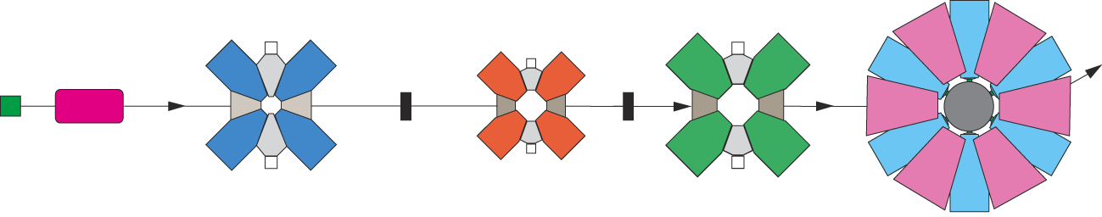




RIBF beam improvements
Uranium beam intensity reached 1000 times compared to the beginning.
RRC
fRC
IRC
RILAC2
SCECR
Typical configuration
He
Be
SRC
RIBF Goal (U)
RIBF present
GSI present
He gas charge
Stripper
RIBF Start
New Injector
Improvement on
Transmission &
Stability
fRC modification
(K570=>K700)
SC-ECR introduced
Notes:
39
Typical operation is 4 cyclotron cascading after the LINAC,
We needed relatively long time to crank up the intensity. But it becomes on track.
To come here we needed many developments we hadn’t expect we planned.
Especially, development of gas filled charge stripper was important invention.
We are foreseeing to reach 100pnA with 345MeV Uranium beam.

Slide 40

RIBF Upgrade Options – Long-term plan, after 5 years.
Option 0: ISOL or PF+ Post Acceleration (more exotic beams)
Option 1: Super Conducting fRC(stripper 2->1)
Option 2: SC-Linac (1st section: 5MeV-SHE, 2nd section 11MeV-fRC)
HE-RIBs
SHE
search
SC Linac
Post-Acc.
SLOWRI
SC Linac
Big-RIPS
RILAC2
RRC
fRC
SRC
S-fRC
IRC
He
N2
RILAC1
35+
65+
35+
86+
27%
5%
17%
27%
ISOL
SRF (d 40MeV/2mA)
Notes:
However we know that world competitors coming up, so that we need to upgrade our facility, say beyond 5 years from now.
The first choice is so called option 0:
We are seriously discussing which is better either to have ISOL or sticking to PF.
Post acceleration is to get more exotic beams.
Presently we are inclined to stick to PF concept only.
Nevertheless we need to increase uranium intensity.
Beyond Uranium of 100pnA we need a new idea.
The option one is to change the fRC to super conducting magnet.
By doing so we can reduce the charges tripper to one.
This will be a major kick for intensity upgrade. Of about factor 5., 500pnA.
Option2 is to have SC linac (1set section to SHE search and second section (11MeV/n) to fRC.
Guestimate is 10thousands particle nano amps.

Slide 41
RIKEN RIBF Accelerator
Future Prospects
Options for Future Project
 |  | RIBF Present | RIBF 2015 | RIBF Option 1 | RIBF Option 2 |  | FRIB/RISP Goal
Current (pnA) | Heavy(Xe-U) | 15-27.0 | 50-100 | 1,000 | 10,000 (exceed present facility rad. limit) |  | 8,000
 | Medium (⁴⁸Ca) | 415 | 1,000
 | Light(¹⁸O) | 1,000 | 1,000
Uranium Wattage |  | 1.2 kW | 4kW | 80kW | 800kW |  | 400kW
Beam Energy/nucleon |  | 345MeV | 345MeV | 345MeV | 345MeV |  | 200MeV
#stripper |  | 2(C/C) | 2(He/N2) | 1(Gas) | 2(Gas) |  | 0
Config. |  | RILAC2 fRC(69+) IRC,SRC | RILAC2 fRC(65+) IRC.SRC | RILAC2 SC-fRC IRC,SRC | SC-LINAC fRC IRC,SRC |  | SC-LINAC
Notes:
With this table, you can compare present status of RIBF with our option1 and 2,
And also with FRIB/RISP.

Slide 42
FRIB at MSU
Notes:
FRIB at MSU is really a next generation PF facility.
400kW LINAC followed by a fragmentation separator, and experimental hall.
This is partially funded by Michigan state and waiing for DOE approval for construction.
They have future option to be equipped with energy dubling, and ISOL.

Slide 43
FAIR at GSI
Facility for Antiprotons and Ins Research
Very cleaver versatility
Greedy but Nich
Dual MR + cooler/storage rings
Field | Energy GeV/u | Average Intensity pps | Time Structure
Hot QCD (SIS300) | U^{92+:} 34 | 2x10⁹ | Slow ext <100s
Cold QCD (SIS100) | p 29 | 5x10¹² | Fast exit ≈ 25 ns
RIB (SIS100) | U²⁸⁺ 1.5 | ∼3·10¹¹ | Fast ext 60 ns Or CW
Notes:
FAIR at GSI is another giant. As I told you before
Using SIS100 with U28+ beam, they say they can improve the RI intensity by factor 100 to 1000.

Slide 44
FAIR RIB
NUclear STructure,Astrophysics and Reactions
Super FRS
DESPEC/HISPEC (Decay Spectroscopy/High-Resolution Spectroscopy)
ELISe (Electron-Ion Scattering in a Storage Ring)
EXL (Exotic nuclei studied in light-ion induced reactions at the NESR storage ring) experiment
ILIMA (Isomeric Beams, Lifetimes and Masses)
LaSpec (Laser Spectroscopy)
MATS (Precision Measurements of very short-lived nuclei with Advanced Trapping System)
R3B (Reactions with Relativistic Radioactive Beams)
SuperFRS (Super Fragment Separator) project
Notes:
Variety of nuclear structure experiments are planned, some new and some inherited from old SIS age.
Some need a ring.
At top of that they will have new fragment separator called FRS.

Slide 45
Scores
Nation | Facility | Beam |  | Target |  | Post acceleration
 |  | Beam | Power (kw) | Dirct/ Conv/PF | Fissions/s Beam pnA | Method | MeV/A | 132Sn/s
ISOL coming | ARIEL | e 50MeV 10000μA p 500MeV 100μA | ~100 | Direct | 1*10¹⁴ |  |  | 2*10⁹
 | HIE ISOLDE |  |  | Both | 4*10¹² | SC Linac | 5-10 | 2*10⁸
 | SPIRAL2 | d 40MeV 5000μA | 200 | Convert | 1*10¹⁴ | Cyclotron | 3-10 | 2*10⁹
 | SPES | p 40MeV 200μA | 8 | Direct | 1*10¹³ | SC Linac | 10 | 3*10⁸
Super ISOL | EURISOL | p 1GeV 5000 μA | 4M | D&C | 1*10¹⁵ | SC Linac | 20-150 | 4*10¹¹
 | CARIF | Reactor | 6M | reactor | 2*10¹⁵ | Linac | >100 | 5*10¹⁰
PF coming | FRIB | U+33 200MeV | 400 | PF | 8300 pnA | - | - | 10⁸~10⁹
 | RISP | U+79 200MeV | 400 | PF | 8000 pNA | - | - | 10⁸~10⁹
 | FAIR | U+28 1500MeV | 10 | PF | 50 pnA | - | - | 10⁷~10⁸
PF running | RIBF2015 | U+86 345MeV | 4 | PF | 100 pnA | - | - | 3*10⁶
Notes:
With this slide I compare all the future RI beam facilities compared to the present Japanese RIBF at the reference at the bottom.
There are many details to be compared but to give you a very brief feeling;
In 5 years RIBF is defeated by say factor 10-100 by new PF facilities.
Also in 5 years of scale RIKEN RIBF is defeated by 100-1000 by new ISOL Facilities, also their energy is are bit lower.
And 10-15 years once super ISOL project come to life then RIBF is defeated by a factor of 10K. With comparable post acceleration.
I should say this is the glory way in order to proceed RI beam science.

Slide 46
Super Heavy Element
AMERICA | EUROPE | ASIA
Notes:
Last subject is super-heavy elements

Slide 47


Ultimate goal
Notes:
Ultimate goal is island of stability where the universe could not reach neither by Bigbang nor super nova explosion.
If we could reach, it will be a victory of humankind.

Slide 48

New event; 113th element (3rd of ²⁷⁸113)
 |  |  |  |  |  |  |  |  |  |  |  |  |  |  | ²⁹⁴118
 |  |  |  |  |  |  |  |  |  |  |  |  | ²⁹⁰Lv | ²⁹¹Lv
 |  |  |  |  |  |  |  |  |  |  | ²⁸⁶Fl | ²⁸⁷Fl
 |  |  |  |  |  |  |  |  | ²⁸²Cn
 |  |  |  |  |  | ²⁷⁵Hs
 |  | ²⁶⁷Rf
RIKEN Nishia
²⁰⁹Bi-based, ⁷⁹CaZn induced
Cold fusion reactions
118
117 |  |  |  |  |  |  |  |  |  |  |  |  |  |  | ²⁹³117 | ²⁹⁴117
116
115 |  |  |  |  |  |  |  |  |  |  | ²⁸⁷115 | ²⁸⁸115 | ²⁸⁹115 | ²⁹⁰115
114
113 |  |  |  |  |  |  |  | ²⁸²113 | ²⁸³113 | ²⁸⁴113 | ²⁸⁵113 | ²⁸⁶113
 |  |  |  |  |  | ²⁷⁸Rg | ²⁷⁹Rg | ²⁸⁰Rg | ²⁸¹Rg | ²⁸²Rg
 |  |  |  | ²⁷⁴Mt | ²⁷⁵Mt | ²⁷⁶Mt |  | ²⁷⁸Mt
 |  | ²⁷⁰Bh | ²⁷¹Bh | ²⁷²Bh |  | ²⁷⁴Bh
²⁶⁶Db | ²⁶⁷Db | ²⁶⁸Db |  | ²⁷⁰Db
α
²⁹³117
²⁰⁹Bi + ⁷⁰Zn → n
²⁸⁹115
²⁴⁹Bk + ⁴⁸Ca → 4n
α
²⁸⁹115
α
²⁷⁸113
113
112 |  |  |  |  |  |  |  |  |  |  |  |  |  | ²⁷⁷Cn
111 |  |  |  |  |  |  |  |  |  | ²⁷²Rg
110 |  |  |  |  |  |  |  | ²⁶⁹Ds | ²⁷⁰Ds | ²⁷¹Ds |  | ²⁷³Ds
109 |  |  |  |  |  | ²⁶⁶Mt |  | ²⁶⁸Mt
108 |  |  |  | ²⁶³Hs |  | ²⁶⁵Hs | ²⁶⁶Hs | ²⁶⁷Hs |  | ²⁶⁹Hs | ²⁷⁰Hs | ²⁷¹Hs
107 |  |  | ²⁶¹Bh | ²⁶²Bh |  | ²⁶⁴Bh |  | ²⁶⁶Bh | ²⁶⁷Bh
106 | ²⁵⁸Sg | ²⁵⁹Sg |  | ²⁶¹Sg |  | ²⁶³Sg
105 |  |  | ²⁵⁹Db | ²⁶⁰Db
104 | ²⁵⁶Rf |  |  |  | ²⁶⁰Rf | ²⁶¹Rf | ²⁶²Rf
103 | ²⁵⁵Lr |  | ²⁵⁷Lr | ²⁵⁸Lr | ²⁵⁹Lr | ²⁶⁰Lr | ²⁶¹Lr | ²⁶²Lr
102 |  |  | ²⁵⁶No |  | ²⁵⁸No |  | ²⁶⁰No |  | ²⁶²No
101 | ²⁵³Md | ²⁵⁴Md |  |  |  |  | ²⁵⁹Md | ²⁶⁰Md
100 | ²⁵²Fm |  | ²⁵⁴Fm | ²⁵⁵Fm |  | ²⁵⁷Fm | ²⁵⁸Fm | ²⁵⁹Fm
99 | ²⁵¹Es |  | ²⁵³Es |  |  | ²⁵⁶Es | ²⁵⁷Es
98 | ²⁵⁰Cf | ²⁵¹Cf | ²⁵²Cf | ²⁵³Cf | ²⁵⁴Cf | ²⁵⁵Cf | ²⁵⁶Cf
²⁷⁸113
²⁸⁵113
α
α
²⁸⁵113
α
²⁴³Am + ⁴⁸Ca → 2n
Known Nuclei
²⁷⁴Rg
FLNR/LLNR/GSI/LBNL
Actinide-based, ⁴⁸Ca induced
Hot fusion reactions
既知核種
²⁷⁴Rg
²⁸¹Rg
α
²⁸¹Rg
SF
²⁷⁹Ds
SF
²⁷⁰Mt
α
²⁷⁰Mt
²⁶⁴Hs
²⁶⁶Bh
α
²⁶⁶Bh
²⁶⁰Sg
²⁶²Sg
²⁶⁵Sg
²⁶⁶Sg
²⁷¹Sg
²⁵⁷Db
²⁶¹Db
²⁶²Db
²⁶³Db
²⁶²Db
²⁵⁸Db
²⁶²Db
α
²⁵⁷Rf
²⁵⁸Rf
²⁵⁹Rf
²⁶³Rf
²⁵⁶Lr
²⁵⁸Lr
α
²⁵⁴No
²⁵⁵No
²⁵⁷No
²⁵⁹No
²⁵⁴Md
²⁵⁵Md
²⁵⁶Md
²⁵⁷Md
²⁵⁸Md
²⁵³Fm
²⁵⁴Fm
²⁵⁶Fm
α
²⁵²Es
²⁵⁴ES
²⁵⁵Es
²⁵⁰Cf
Notes:
I desperately want to show you this picture.
Last summer RIKEN created
the new 113th event which has 6 +1 consequent alpha decays deep into the known nuclei.
We wish to have Japanese name for it by winning over the battle with four nation collaboration at Dubna.
But what will be happening afterword?

Slide 49
Electronic structure
of SHE-atoms
protons →
Search for
new shells
A=294
Chemical properties of the SHE
Nuclear structure and decay properties of the SHN
Search for SHE
in Nature
neutrons →
Yu. Oganessian “SHE in JINR” 109-th Session of the SC of JINR, Feb. 17-18, 2011, Dubna
Notes:
49
We believe the island f stability is nearing but not reachable by the present technology.

Slide 50
Road map ?
 |  | 2012 | 2013 | 2014 | 2015 | 2016 | 2017 | 2018 | 2019
Dubna (FLNR) |  | 2.5uA48Ca |  |  | 3.0
 |  | New accelerator/setup |  |  |  |  | 20uA
RIKEN | Cold | 10puA
 | Hot |  | preparation |  | to Z119/120
 | Chem
GSI | Hot/X |  |  |  |  |  | ??
Z=119/120 may be reachable, but not beyond
Beam time becomes too long
Target becomes too rare (expensive M$s)
Need to collaborate
New idea wanted (n-rich RI + Actinoid + multi nucleon transfer)
Notes:
This is a sort f road map for super heavy element.
In few years FLNR will have new accllerator to provide 20microamps of Ca 48.
RIKEN has completed its misson for 113th element, and will join the hot fusion race after a few years of preparation. Meantime we do super heavy chemical experiments.
GSI will be back again in 5 years I hope.
So READ.

Slide 51







K-computer (RIKEN, Kobe)
LINPACK
Strategic Programs for Innovative Research
(Governmental initiative, 5M$/year/field)
Field 1: Predictable life science, healthcare and drug discovery foundation
Field 2: New Materials and Energy Creation
Field 3: Projection of Planet Earth Variations for Mitigating Natural Disasters
Field 4: Next-generation manufacturing technology
Field 5: The origin of matter and the universe
1P-Flops
1T-Flops
Notes:
Before closing my talk
Let me mention some for the K-computer.
About 10 years ago Japan got the first place in the LINPACK contest, but has been bad since then
Last year we completed K computer at got the first place again, event though the CECOIA took over back the top again, a year after.
This usually is a stupid competition, and doesn’t means much.
But this time is a bit different.
Since K-computer is THE NATIONAL PROJECT of JAPAN, the government set the strategic Program for innovation Research.
The government set 5 field of science, and funded the budget frame of 5M$/year/field. Totally soft money.
The list start from healthcarem, New Material, Mitigating Natural Disaster, Manufacturing,
And the 5th is surprisingly the basic science, Origin of Matter and Universe.

Slide 52








Field 5:
The origin of matter and the universe
Strategic Programs for Innovative Research
NN, YN, 3body force
From Lattice QCD
Lattice QCD
YoshinobuKuramashi
Unification of physics of Hyper nuclei and unstable nuclei
Tetsuo
Hatsuda
Nuclear
Structure
Hoyle state reproduction with Monte Carlo shell model
Shinya Aoki
Director
TakaharuOtsuka
To apply, theorists had to declare
5-year deliverables
for
5M$/year/field.
K computer costed 1200M$
Bridge over cluster model-ers and shell model-ers
Early Star
Formation
Junichiro
Makino
Supernova
Explosion
Dai Shibata
Notes:
The Field 5 incudes 4 pillars. Within that Lattice Nuclear force and ab-initio shellmodel calculation is included.
To apply this fund, theorists had to determined 5-year deliverable,
I guess the first time in their life.
The some of the deliverables are;
From Lattice QCD, they going to determined NN,YN, and 3 body forces,
Once it is done, unification of hyper nuclear physics and unstable nuclear physics will be made.
In other word, put JPARC and RIKEN-RIBF on the same ground.
From nuclear structure, they declare to reproduce//////
Once it done, it bridges over cm and sm.
In other word, RCNP and RIKEN-RIBF on the same ground.
Very innovative, I hope.

Slide 53
Summary remarks
 | Beams | America | Europe | Asia
Hot QCD | A+A | RHIC | LHC(ALICE) FAIR(SIS300) NICA | - | Success Story Also in dense QCD?
Cold QCD | hadron | - | FAIR(SIS100) | JPARC HIRFL | Missing American
 | e- | JLAB-12GeV |  | Spring-8 | 1+many
 | collider | eRHIC(eIC) | NICA |  | 1 in the world
RI Beam | Proj Frag | FRIB | GSI/FAIR | RIBF | Regionally well covered. Asian needs more interaction
 | Both |  |  | RISP
 | ISOL | ARIEL | SPIRAL2 SPES HIE-ISOLDE | HIRFL BRIEF
 | Super ISOL | -- | EURISOL | CARIF | FRIB ugrade?
Notes:
This table summarizes what I talked about.

Slide 54

Reductionism to Holism
In the 20th century, physics was dominated by “reductionism.” We believed by finding the smallest unit of matter, the understanding of the large would naturally follow. This belief in reductionism, aided by the success of quantum theory, made it possible for us to achieve extraordinary precision in theoretical predictions, which are in turn confirmed by accurate measurements. This led us to discover that all known matter is made of 12 elementary particles, 6 quarks and 6 leptons. However, in the second half of the last century we encountered two serious puzzles; one is our inability to observe any of the 6 quarks individually, and the other is the dichotomy between the concept of symmetry that our theory is based upon and the violation of symmetry observed by experiments. These two puzzles brought us to a threshold of a new direction.
I think the physics in the 21st century will be dominated by “Holism.” The understanding of the small cannot be separated from the examination of the large. To understand why quarks cannot be seen individually we must explore the confinement mechanism of the physical vacuum state. To connect the symmetry violations of our present universe with the fundamental symmetry principles in our theory, we must again probe the evolution of symmetry change of the entire universe, from a seemingly perfect symmetrical beginning (big bang) to the present asymmetrical state. Thus the study of elementary particles cannot be separated from the macroscopic system at large. RHIC is the first high energy accelerator designed to explore the structure of the physical vacuum as well as possible forms of new states of matter.
Notes:
I close my talk by citing the words by T.D. Lee.
This century is the era of Holism, physics of many body system.

