Slide 1
NEUTRINO COSMOLOGY AFTER PLANCK
ν_{e} ν_{μ}
ν_{τ}
STEEN HANNESTAD, AARHUS UNIVERSITY
PISA, 20 SEPTEMBER 2013

Slide 2
Fermion Mass Spectrum
Q = −1/3
d
s
b
Q = +2/3
u
c
t
Charged Leptons
e
μ
τ
All flavors
Neutrinos
ν₃
1
10
100
1
10
100
1
10
100
1
10
100
1
10
100
1
meV
eV
keV
MeV
GeV
TeV

Slide 3
NEUTRINO MIXING
FLAVOUR STATES
PROPAGATION STATES
MIXING MATRIX (UNITARY)

Slide 4
FLAVOUR STATES
PROPAGATION STATES
MIXING MATRIX (UNITARY)
”SOLAR ANGLE”

Slide 5
FLAVOUR STATES
PROPAGATION STATES
MIXING MATRIX (UNITARY)
”ATMOSPHERIC ANGLE”

Slide 6
FLAVOUR STATES
PROPAGATION STATES
MIXING MATRIX (UNITARY)
”REACTOR ANGLE”

Slide 7
FLAVOUR STATES
PROPAGATION STATES
MIXING MATRIX (UNITARY)
LATE-TIME COSMOLOGY IS (ALMOST)
INSENSITIVE TO THE MIXING STRUCTURE

Slide 8
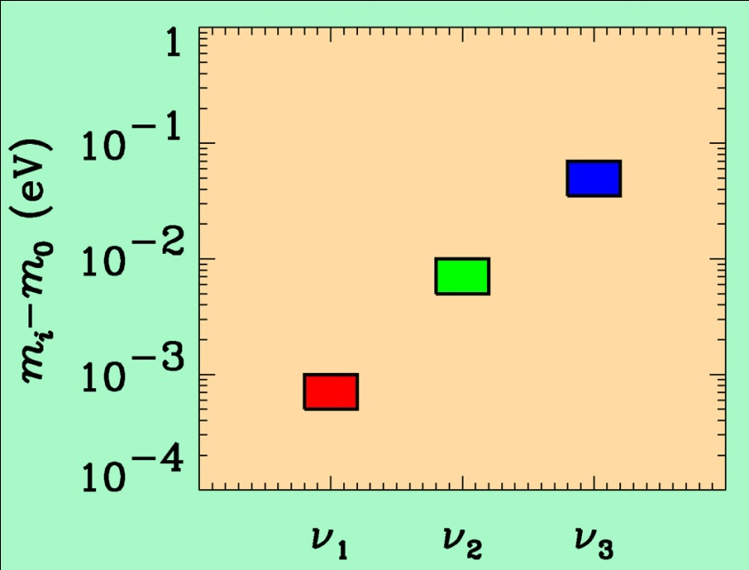
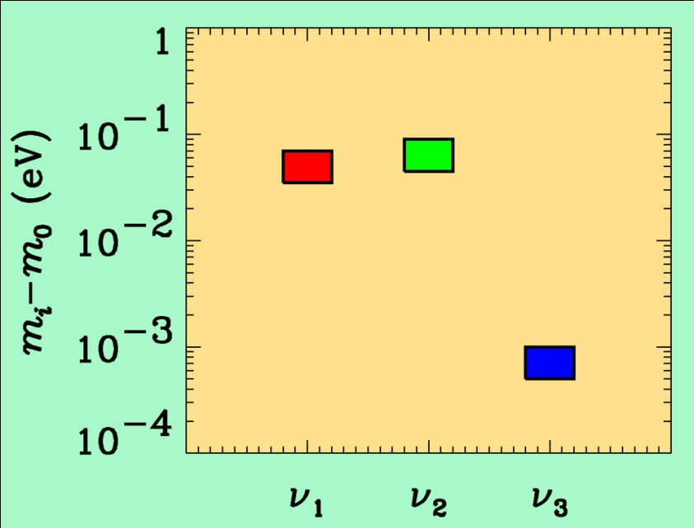
If neutrino masses are hierarchical then oscillation experiments
do not give information on the absolute value of neutrino masses
ATMO. ν
K2K
MINOS
SOLAR ν
KAMLAND
Normal hierarchy
Inverted hierarchy
However, if neutrino masses are degenerate
no information can be gained from such experiments.
Experiments which rely on either the kinematics of neutrino mass
or the spin-flip in neutrinoless double beta decay are the most
efficient for measuring m₀

Slide 9
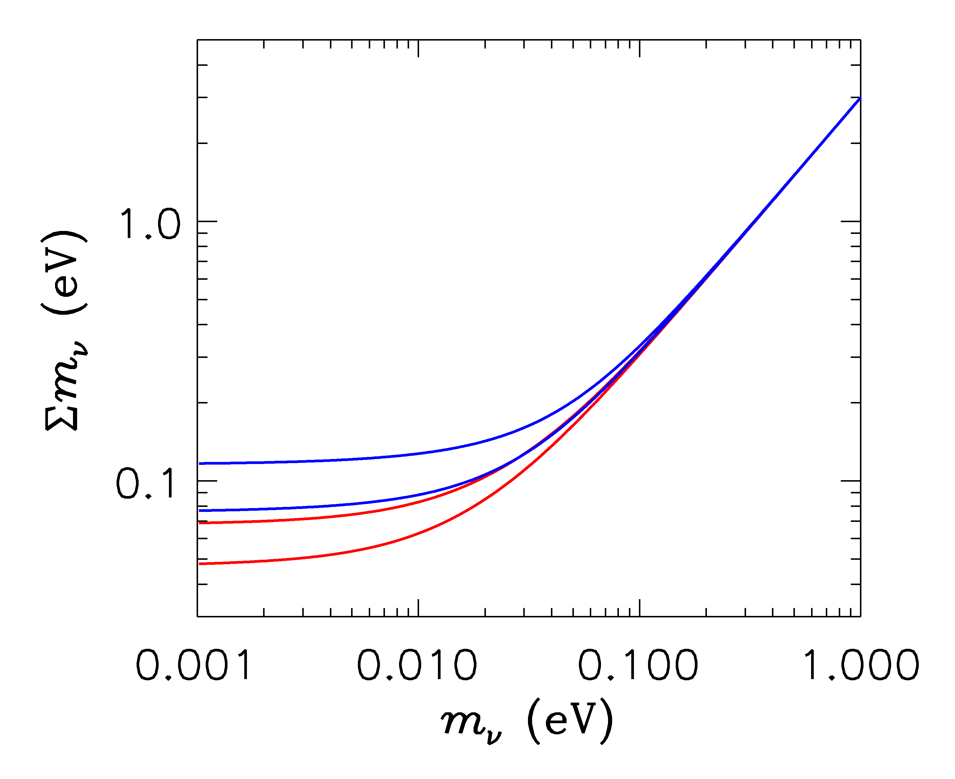
HIERARCHICAL
DEGENERATE
INVERTED
NORMAL
LIGHTEST

Slide 10
Tritium decay endpoint measurements have provided limits
on the electron neutrino mass
Mainz experiment, final analysis (Kraus et al.)
This translates into a limit on the sum of the three mass
eigenstates
This sensitivity will be improved by at least an order of
magnitude by KATRIN

Slide 11
NEUTRINO MASS AND ENERGY DENSITY
FROM COSMOLOGY
NEUTRINOS AFFECT STRUCTURE FORMATION
BECAUSE THEY ARE A SOURCE OF DARK MATTER
(n ~ 100 cm⁻³)
FROM
HOWEVER, eV NEUTRINOS ARE DIFFERENT FROM CDM
BECAUSE THEY FREE STREAM
SCALES SMALLER THAN d_{FS} DAMPED AWAY, LEADS TO
SUPPRESSION OF POWER ON SMALL SCALES

Slide 12
N-BODY SIMULATIONS OF ΛCDM WITH AND WITHOUT
NEUTRINO MASS (768 Mpc³) – GADGET 2
256
Mpc

Slide 13
AVAILABLE COSMOLOGICAL DATA

Slide 14
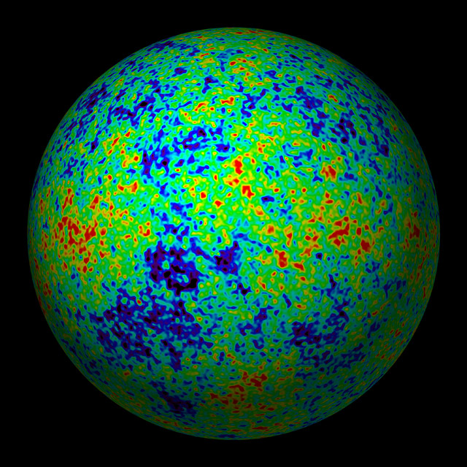
THE COSMIC MICROWAVE BACKGROUND
CMB TEMPERATURE MAP

Slide 15
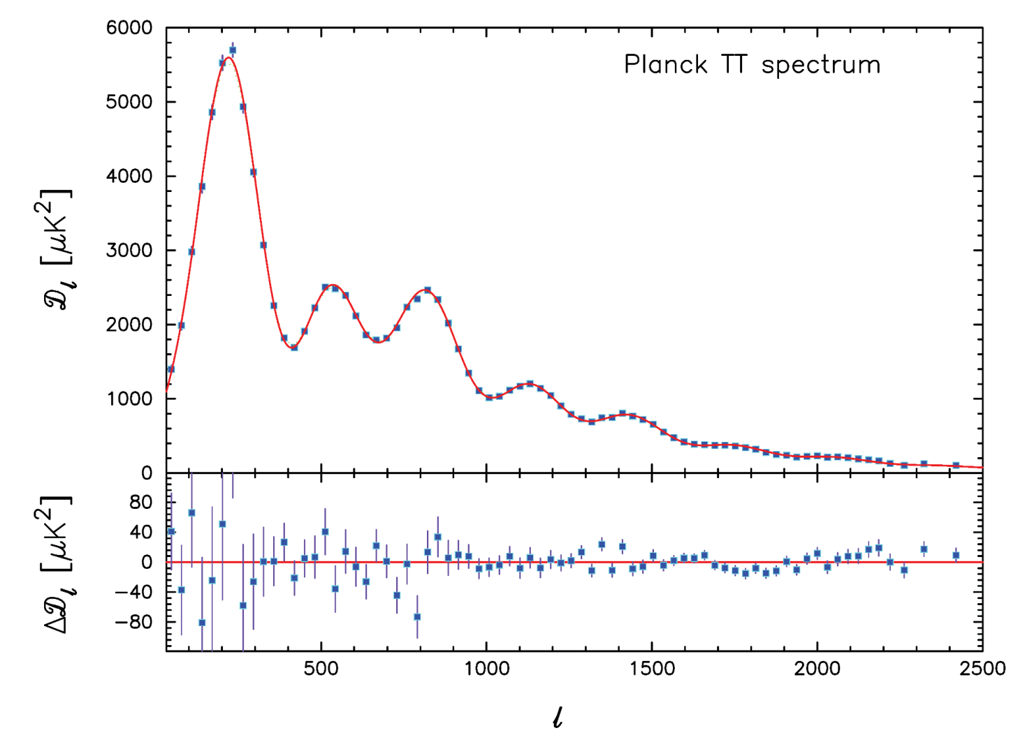
PLANCK TEMPERATURE POWER SPECTRUM
ADE ET AL, ARXIV 1303.5076
ADDITIONAL DATA ON SMALLER SCALES FROM
ATACAMA COSMOLOGY TELESCOPE (Sievers et al. 2013)
SOUTH POLE TELESCOPE (Hou et al. 2012)

Slide 16
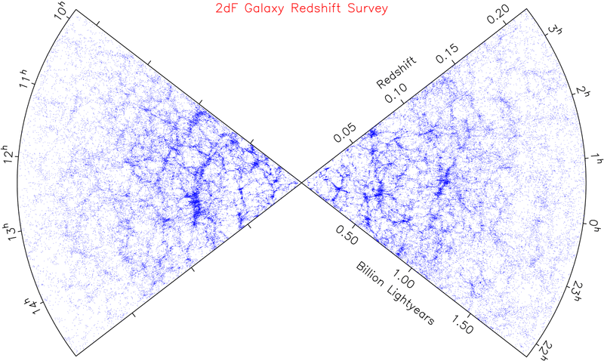
LARGE SCALE STRUCTURE SURVEYS - 2dF AND SDSS

Slide 17
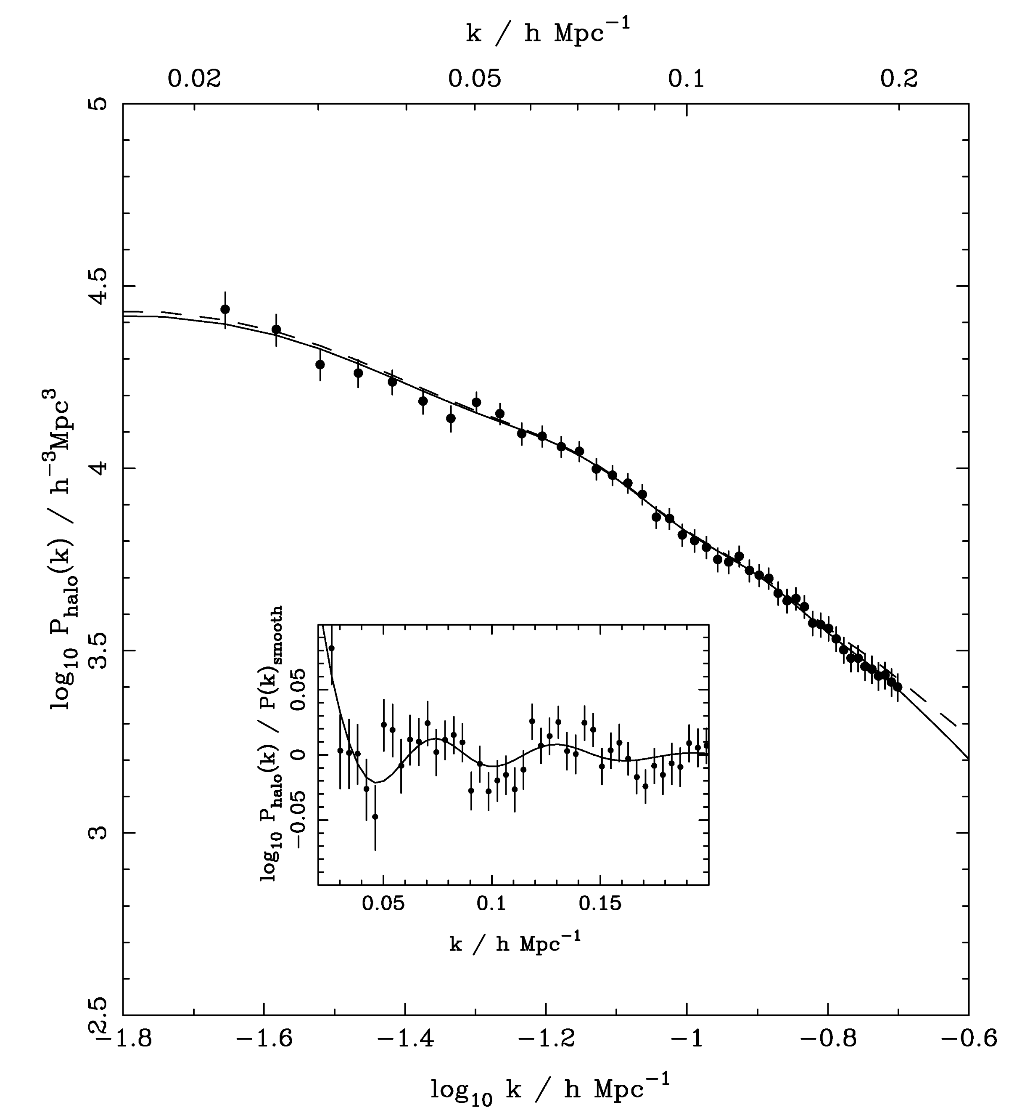
SDSS DR-7
LRG SPECTRUM
(Reid et al ’09)

Slide 18
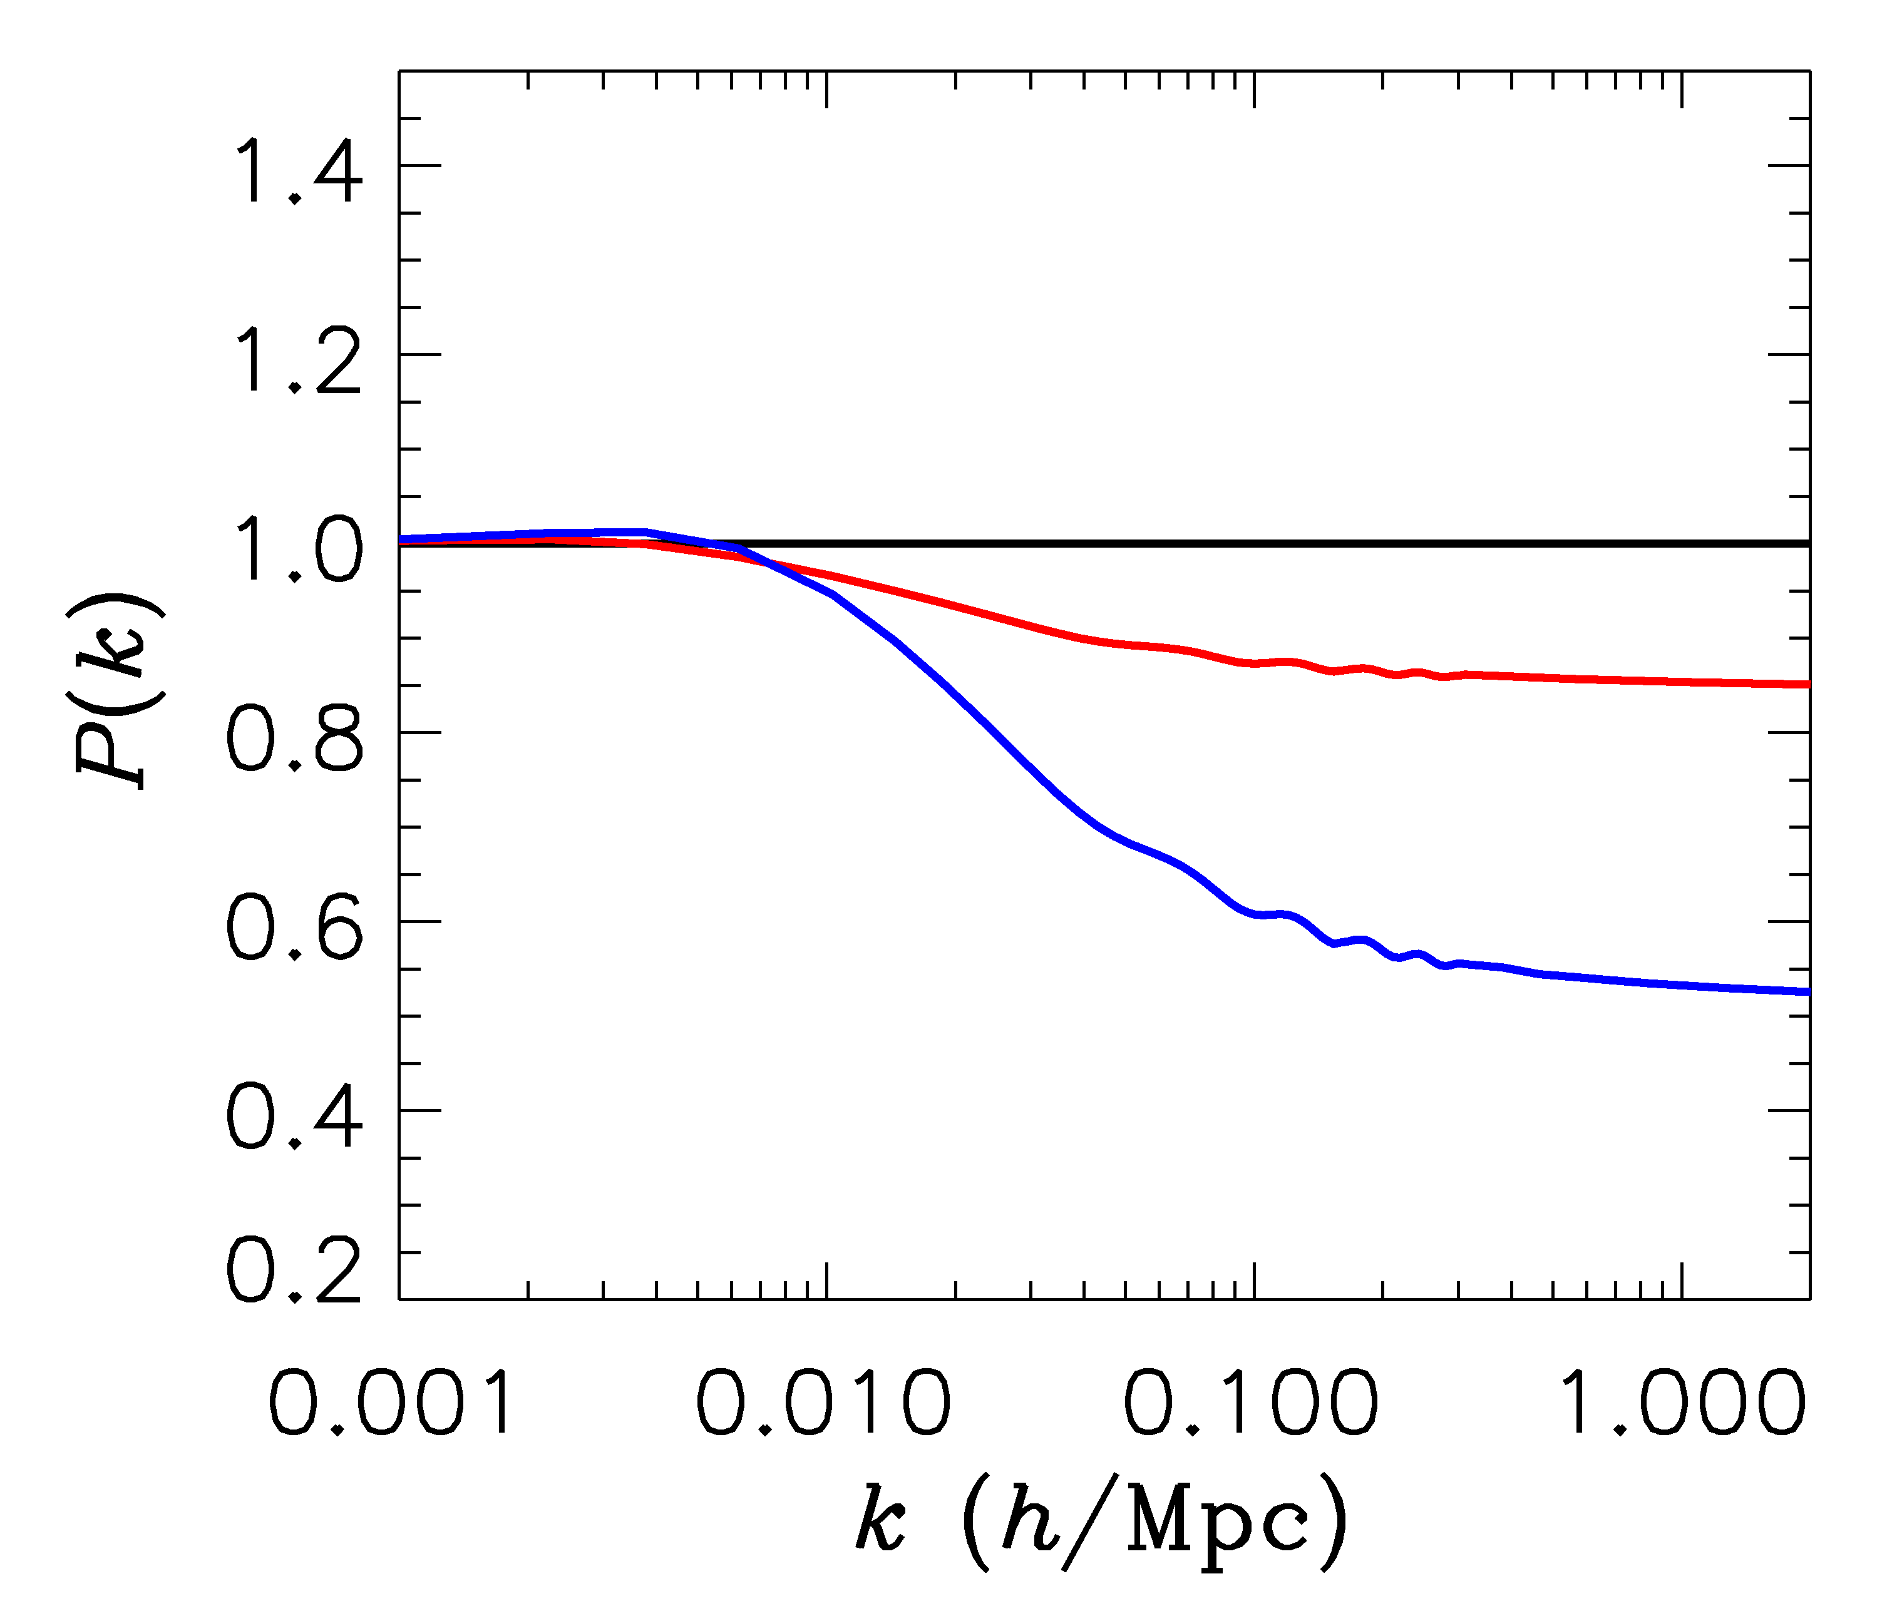
FINITE NEUTRINO MASSES SUPPRESS THE MATTER POWER
SPECTRUM ON SCALES SMALLER THAN THE FREE-STREAMING
LENGTH
Sm = 0 eV
P(k)/P(k,m_{ν}=0)
Sm = 0.3 eV
Sm = 1 eV

Slide 19
NOW, WHAT ABOUT NEUTRINO
PHYSICS?

Slide 20
WHAT IS THE PRESENT BOUND ON THE NEUTRINO MASS?
DEPENDS ON DATA SETS USED AND ALLOWED PARAMETERS
THERE ARE MANY ANALYSES IN THE LITERATURE
arXiv:1303.5076 (Planck)

Slide 21
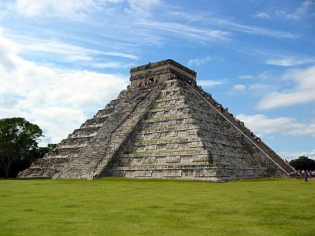
THE NEUTRINO MASS FROM COSMOLOGY PLOT
More data
+Ly-alpha
~ 0.2 eV
0.2-0.3 eV
0.2-0.3 eV
+ SNI-a
+WL
~ 0.5 eV
0.5-0.6 eV
0.5-0.6 eV
+ SDSS
0.4 eV
~ 1 eV
1-2 eV
CMB only
1.1 eV
~ 2 eV
2.? eV
??? eV
Minimal
ΛCDM
+N_{ν}
+w+……
Larger model
space

Slide 22
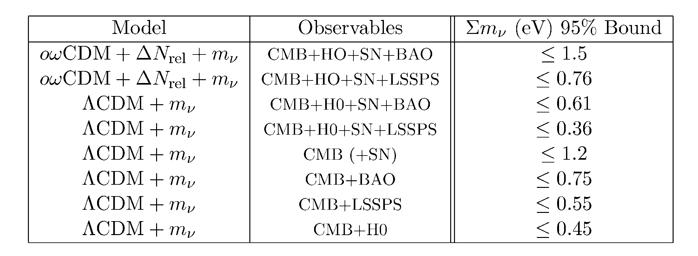
Gonzalez-Garcia et al., arxiv:1006.3795

Slide 23
WHAT IS N_{ν}?
A MEASURE OF THE ENERGY DENSITY IN NON-INTERACTING
RADIATION IN THE EARLY UNIVERSE
THE STANDARD MODEL PREDICTION IS
Mangano et al., hep-ph/0506164
BUT ADDITIONAL LIGHT PARTICLES (STERILE NEUTRINOS,
AXIONS, MAJORONS,…..) COULD MAKE IT HIGHER

Slide 24
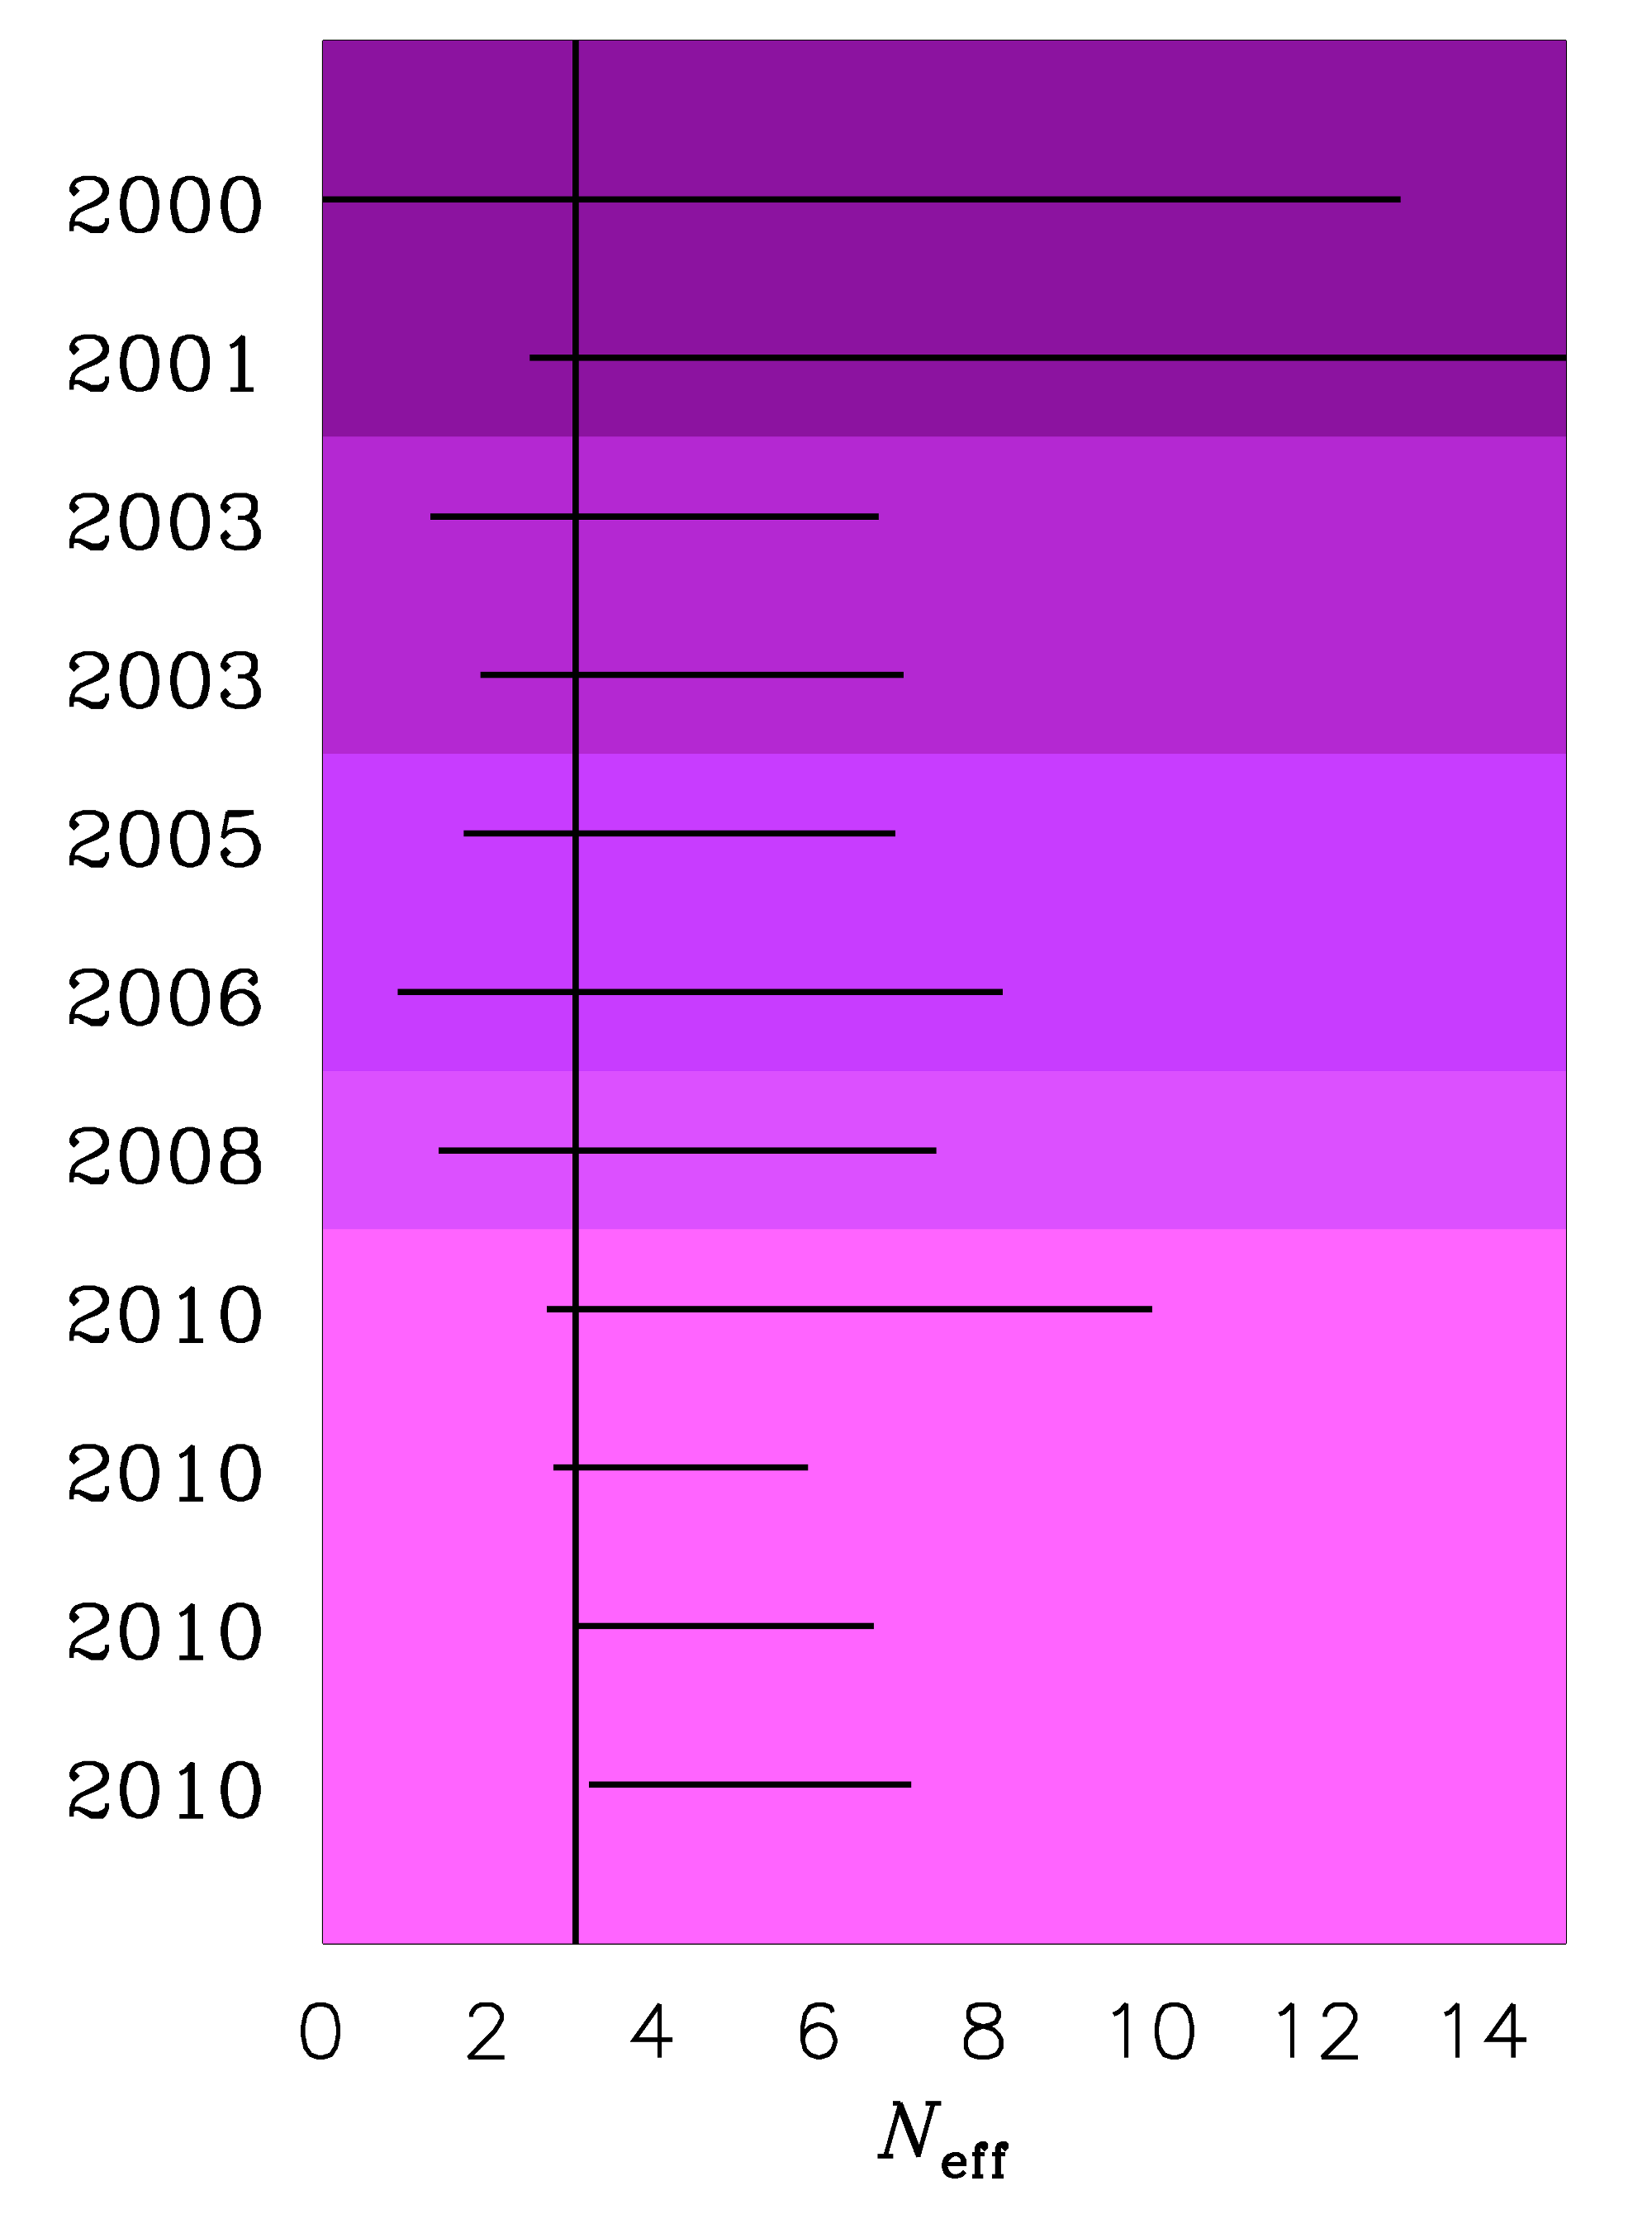
TIME EVOLUTION OF
THE 95% BOUND ON
N_{ν}
Pre-WMAP
WMAP-1
WMAP-3
WMAP-5
WMAP-7

Slide 25
$N_{eff}={3.36}_{−0.64}^{+0.68}$ @ 95% Planck only
$N_{eff}={3.52}_{−0.45}^{+0.48}$ @ 95% Planck+BAO+H₀
THE SITUATION IS (UNFORTUNATELY) NOT YET RESOLVED….

Slide 26
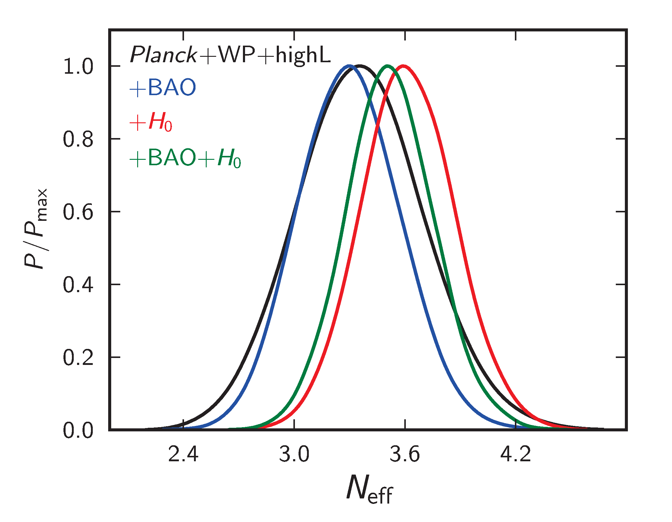
ADE ET AL. 2013

Slide 27
THE CULPRIT IS THE HUBBLE PARAMETER
MEASUREMENT
$$H_{0}=67.3±1.2 \text{Planck}\text{, }\text{assuming} \text{L}\text{CDM}$$
$H_{0}=74±2$ HST data
CAN BE MADE (MORE) CONSISTENT PROVIDED THERE IS ”DARK RADIATION”

Slide 28
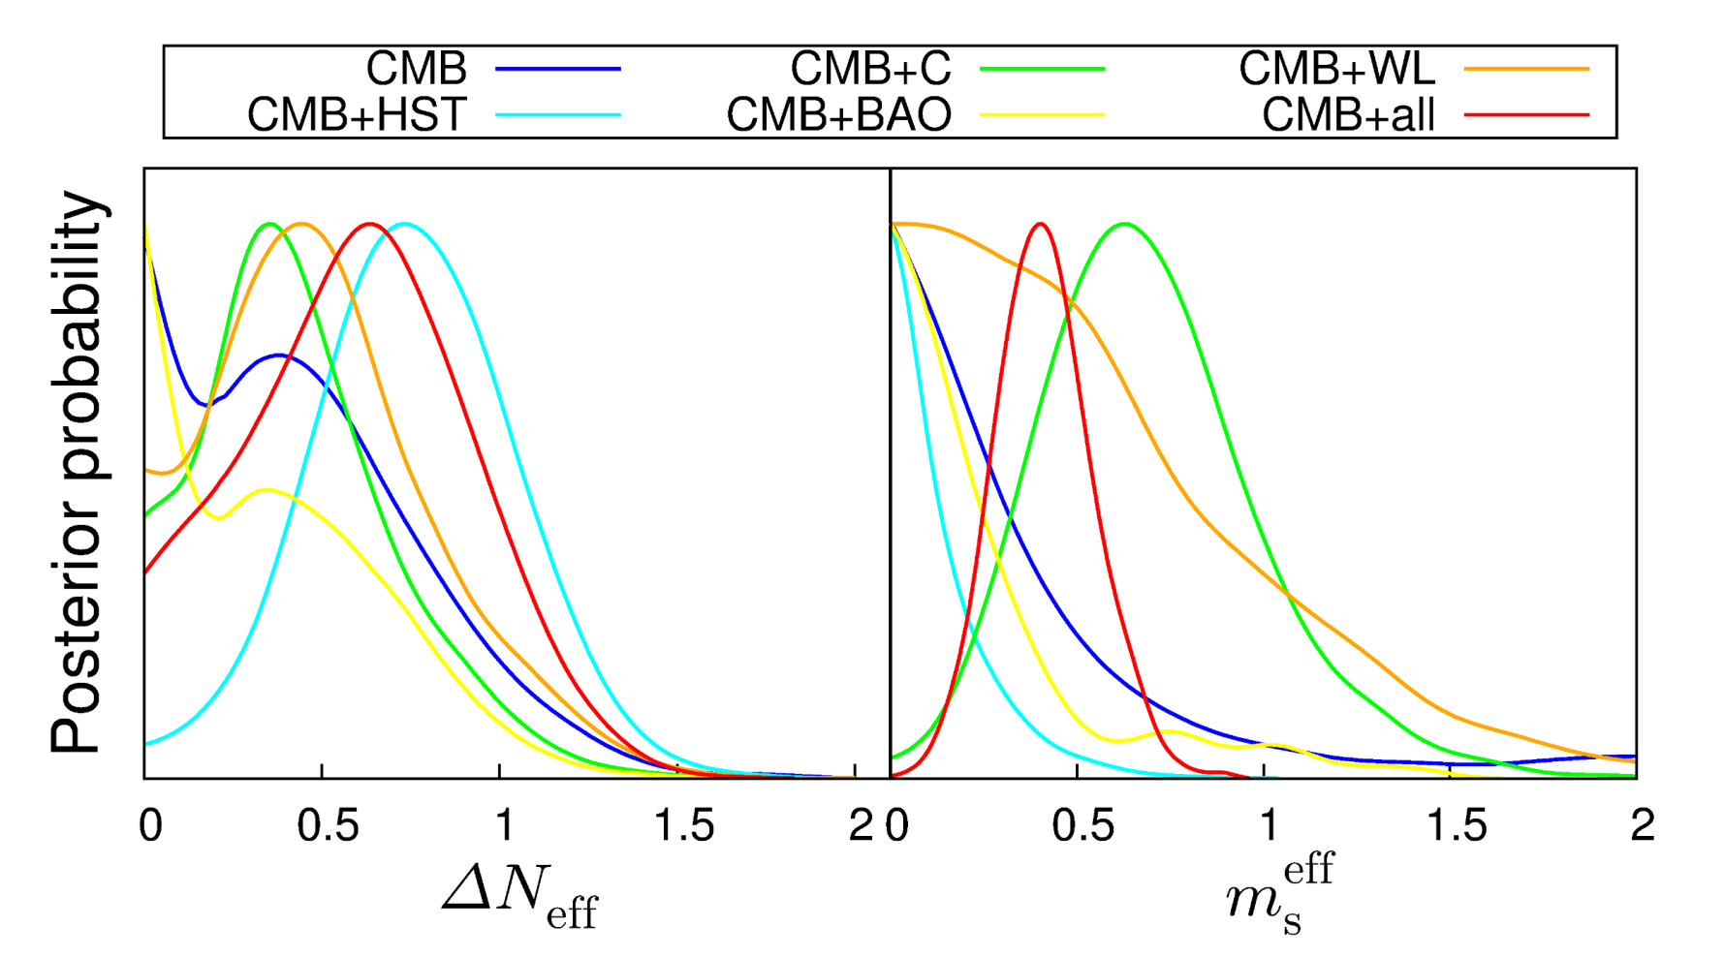
HAMANN & HASENKAMP 2013

Slide 29
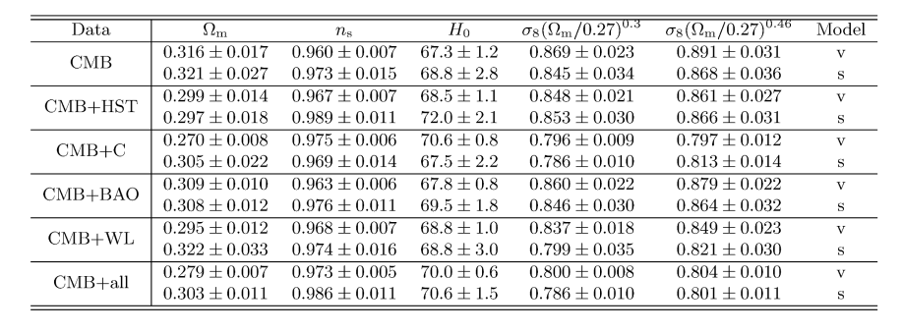
HAMANN & HASENKAMP 2013

Slide 30
COULD THERE BE A PROBLEM WITH THE PLANCK 217 GHz CHANNEL?
(TALK BY DAVE SPERGEL AT COSMO)
REMOVAL OF THE 217 GHz DATA YIELDS A VALUE OF H₀ CONSISTENT
WITH WMAP (69.7 +/- 1.4)

Slide 31
A STERILE NEUTRINO IS PERHAPS THE MOST OBVIOUS CANDIDATE
FOR AN EXPLANATION OF THE POSSIBLE EXTRA ENERGY DENSITY
ASSUMING A NUMBER OF ADDITIONAL STERILE STATES OF
APPROXIMATELY EQUAL MASS, TWO QUALITATIVELY DIFFERENT
HIERARCHIES EMERGE
ν_{s}
ν_{A}
ν_{A}
ν_{s}
3+N
N+3

Slide 32
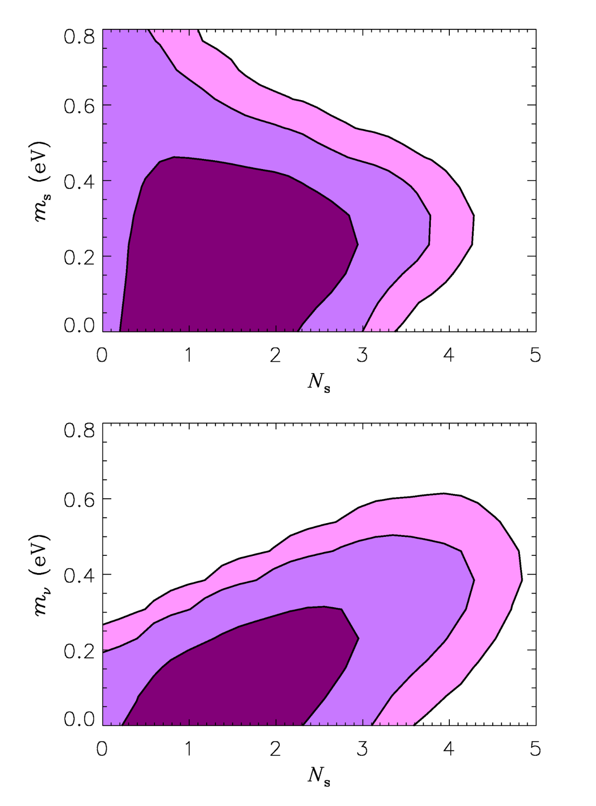
Hamann, STH, Raffelt, Tamborra,
Wong, arxiv:1006.5276 (PRL)
”3+N”
WDM LIMIT
N+3
See also
Dodelson et al. 2006
Melchiorri et al. 2009
Acero & Lesgourgues 2009
Hamann et al 2011
Joudaki et al 2012
Motohashi et al. 2012
Archidiacono et al 2012, 2013
and many others

Slide 33
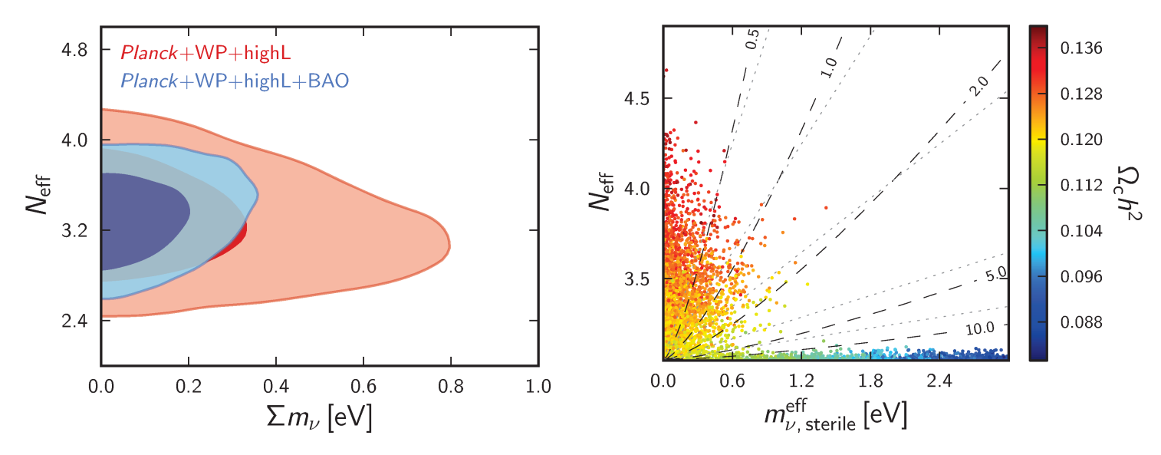
ADE ET AL. 2013 (WITHOUT HUBBLE DATA!)

Slide 34
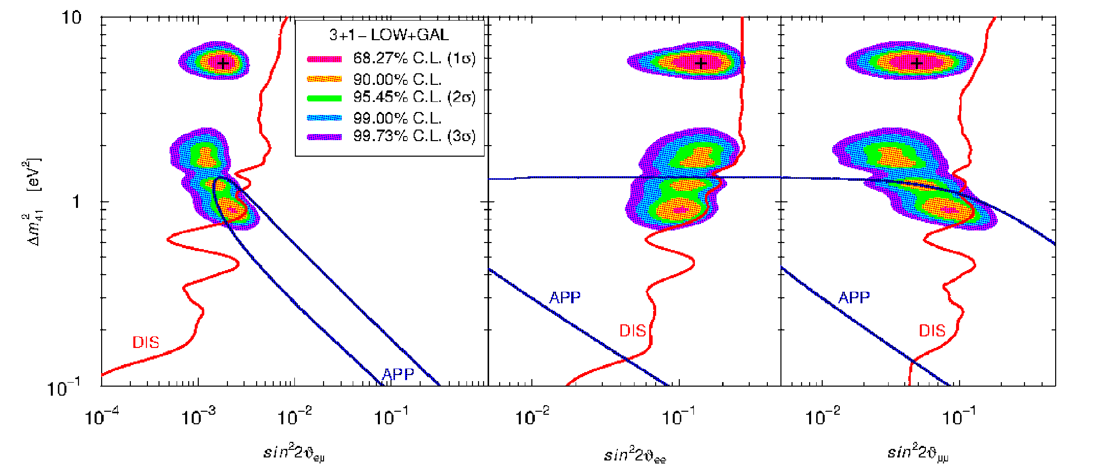
THERE ARE A NUMBER OF HINTS FROM EXPERIMENTS THAT A
FOURTH, eV-MASS STERILE STATE MIGHT BE NEEDED:
LSND, MiniBoone, reactor anomaly, Gallium
(TALK BY CARLO GIUNTI)
Giunti & Laveder 2011 (and many other analyses)

Slide 35
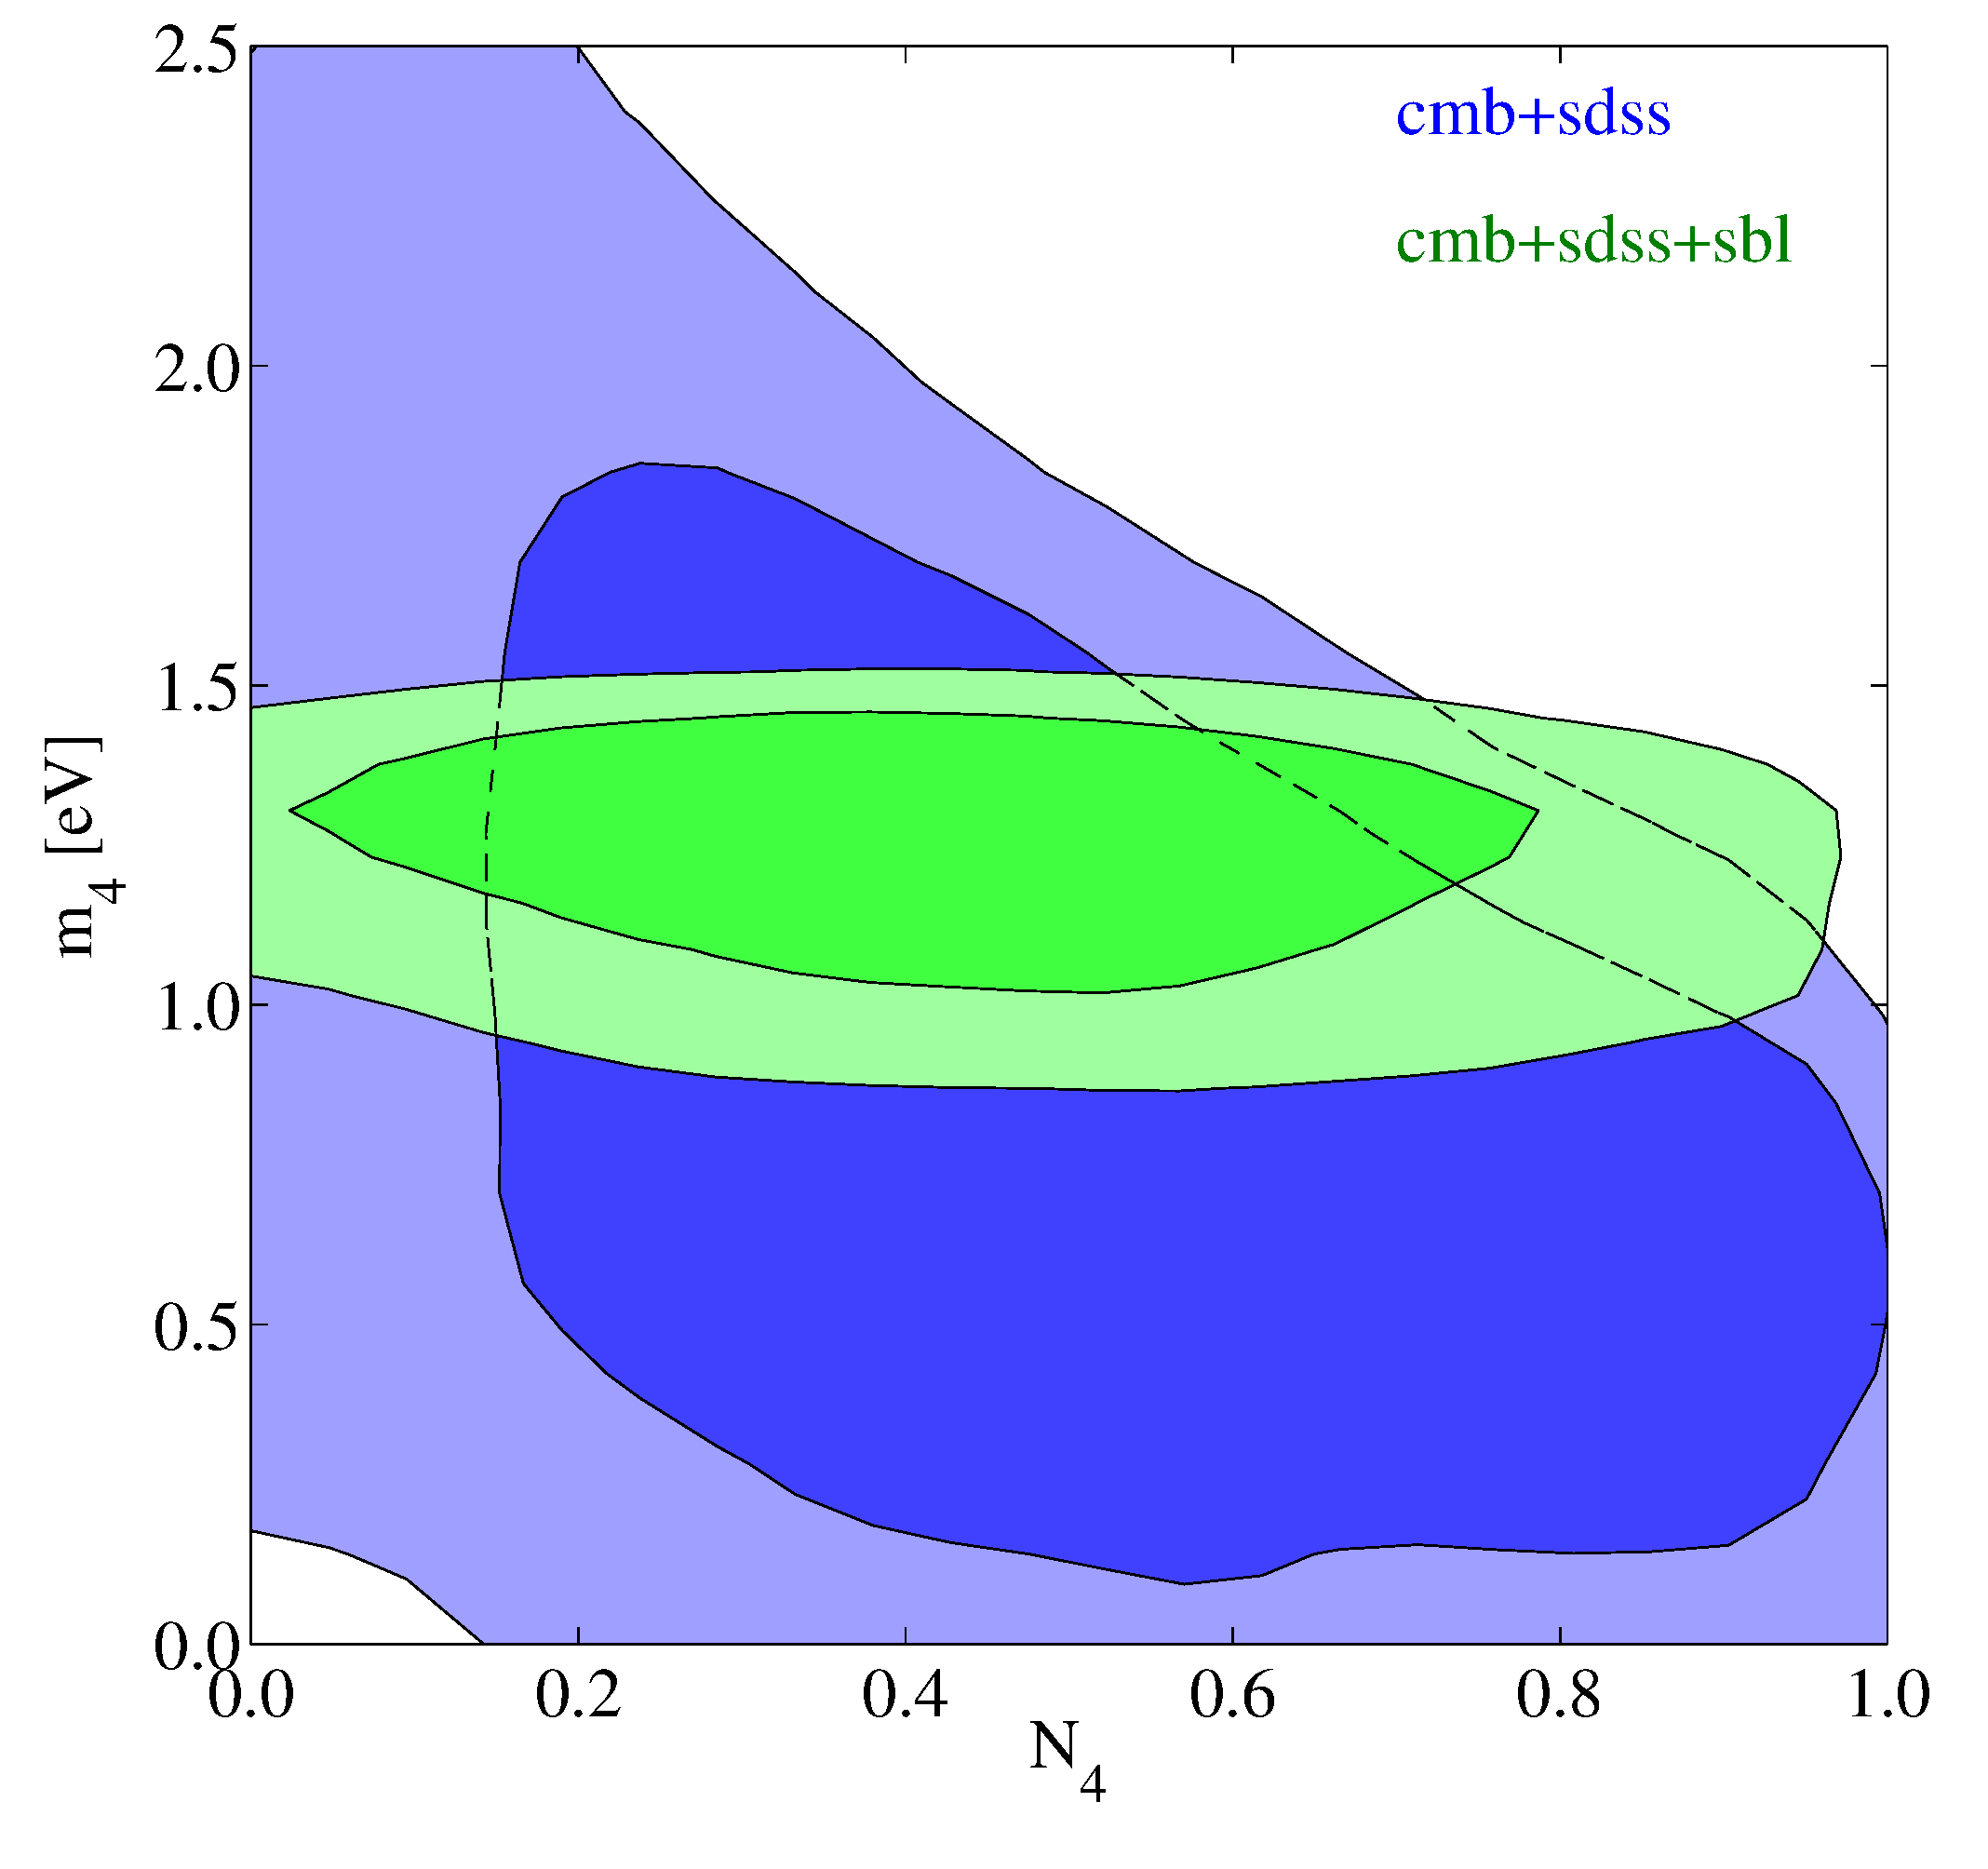
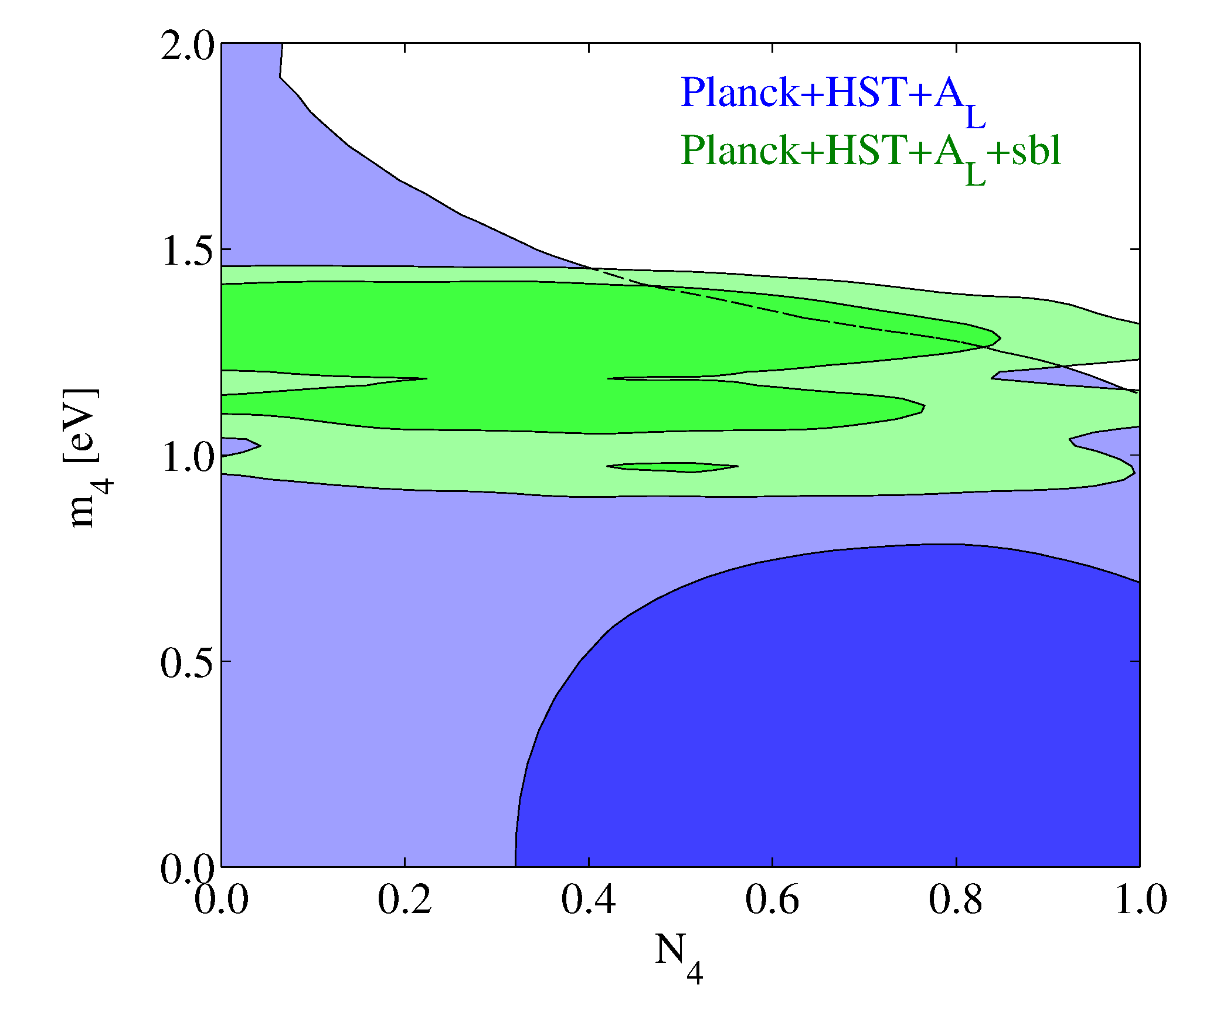
Archidiacono, Fornengo, Giunti, STH, Melchiorri, arXiv:1302.6720 (PRD)

Slide 36
HOW DO THESE TWO HINTS FIT TOGETHER? CAN THEY BE
EXPLAINED BY THE SAME PHYSICS?
SHORT ANSWER: IT IS DIFFICULT WITHOUT MODIFYING COSMOLOGY
BUT DEPENDS ON THE SPECIFIC ANALYSIS
(Hamann et al. 2011, Joudaki 2012)
A LARGE PRIMORDIAL LEPTON ASYMMETRY CAN RECONCILE THE
DATA (STH, Tamborra, Tram 2012)

Slide 37
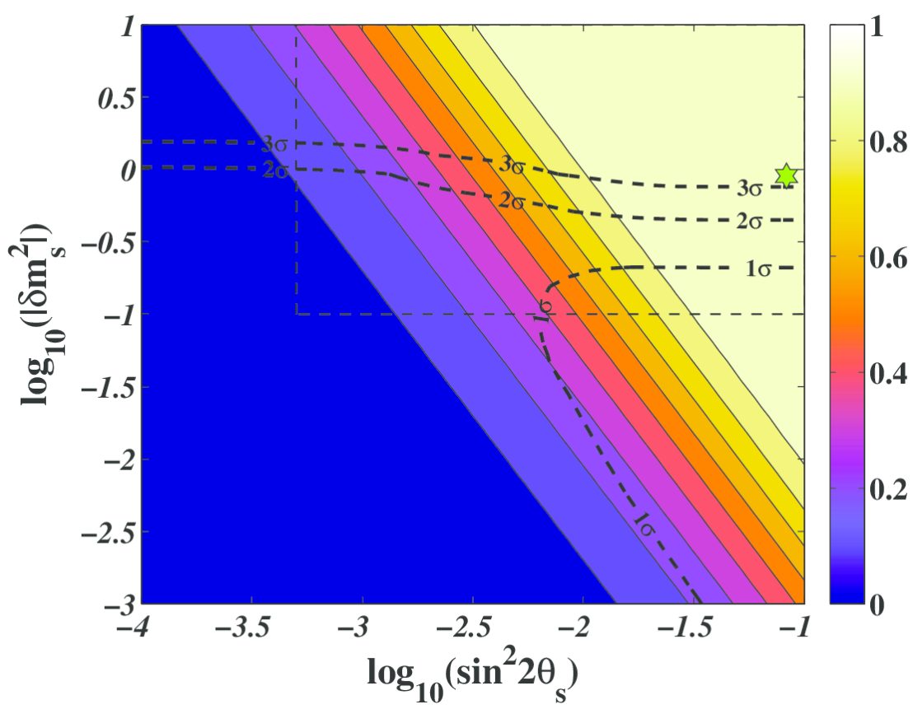
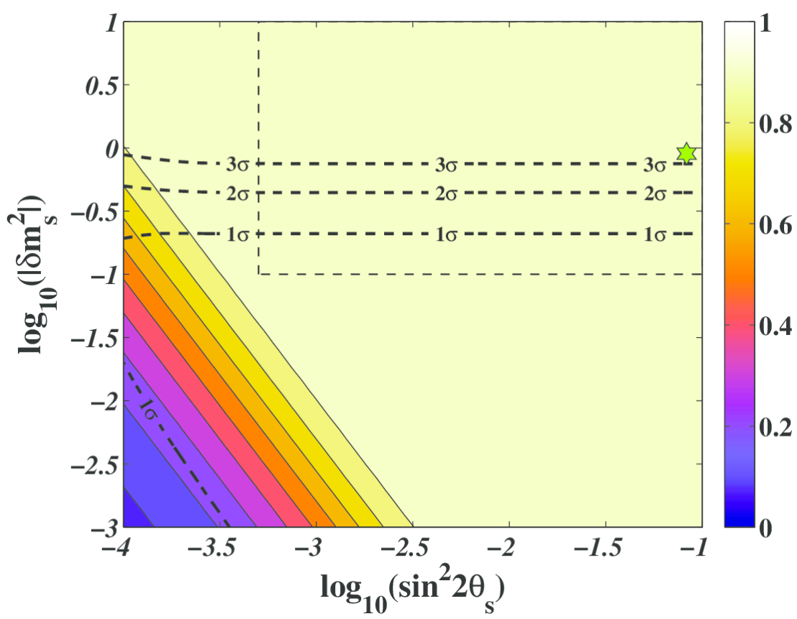
STERILE NEUTRINO THERMALISATION WITH ZERO LEPTON ASYMMETRY
STH, Tamborra, Tram 2012

Slide 38
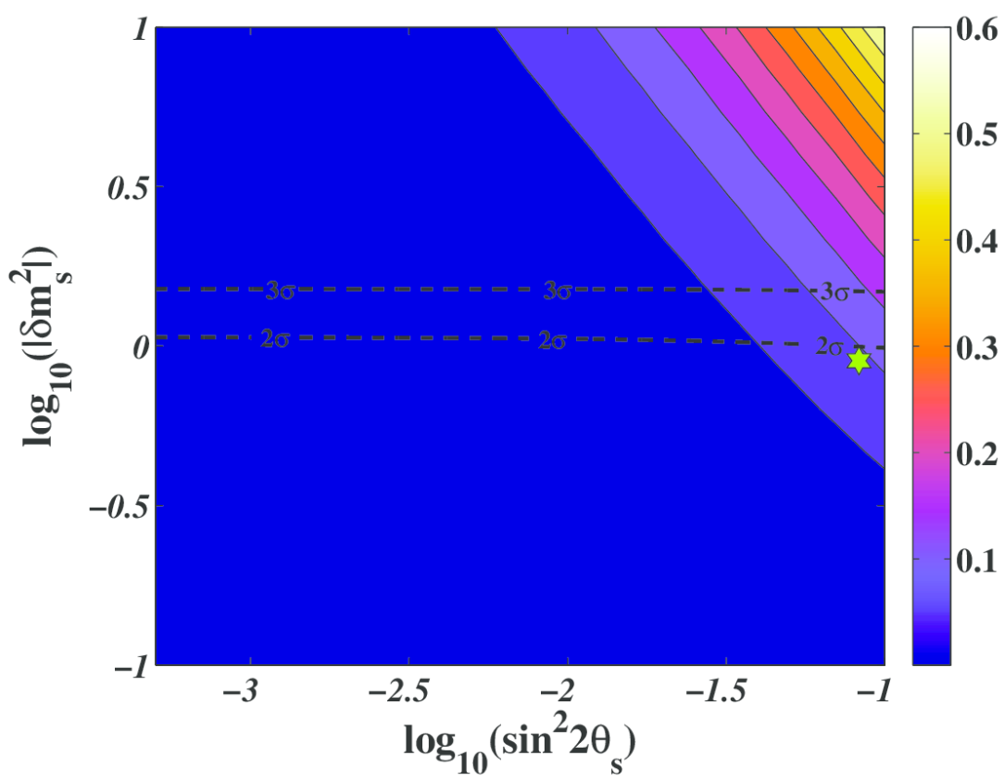
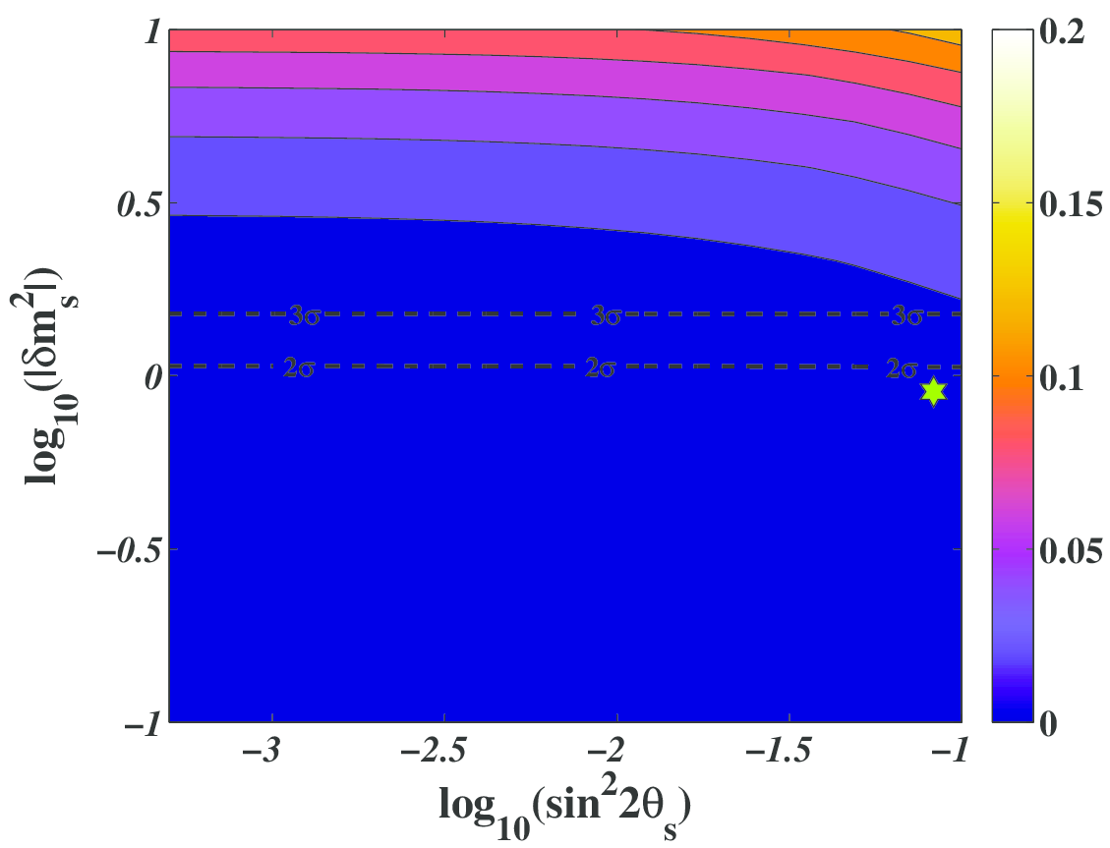
STERILE NEUTRINO THERMALISATION WITH LARGE LEPTON ASYMMETRY
3σ
3σ
STH, Tamborra, Tram 2012

Slide 39
WHAT IS IN STORE FOR THE FUTURE?
BETTER CMB POLARIZATION MEASUREMENTS
(PLANCK)
LARGE SCALE STRUCTURE SURVEYS AT HIGHER
REDSHIFT AND IN LARGER VOLUMES
MEASUREMENTS OF WEAK GRAVITATIONAL LENSING
ON LARGE SCALES

Slide 40
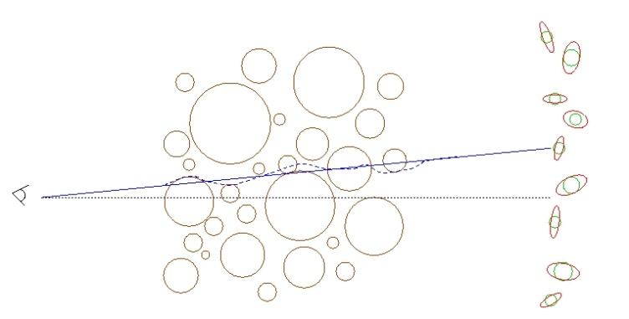
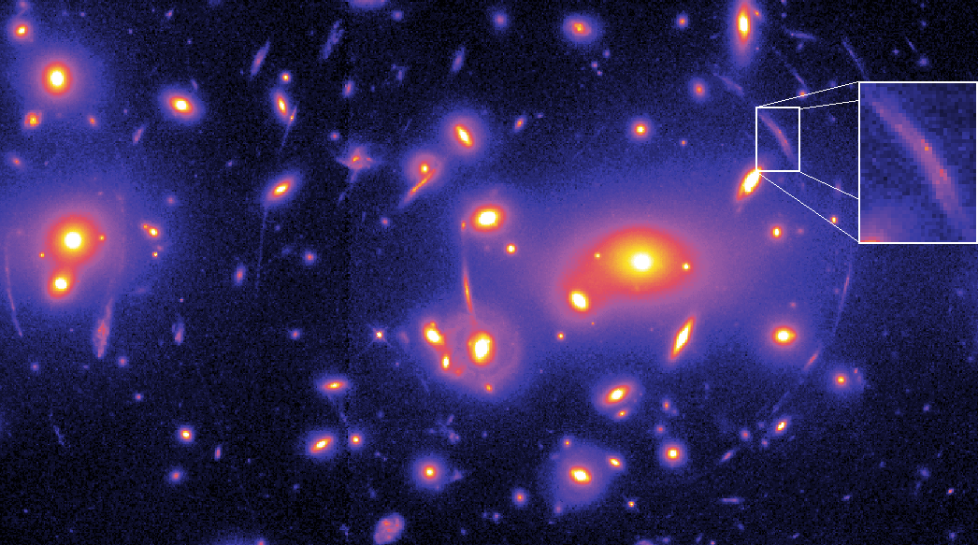
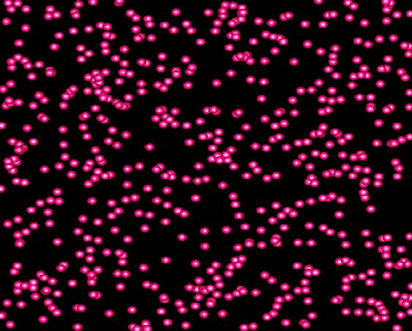
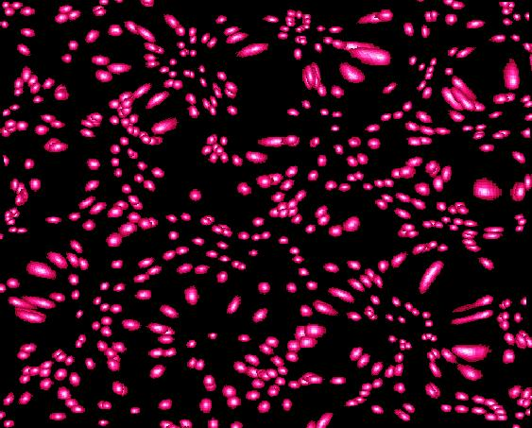
WEAK LENSING – A POWERFUL PROBE FOR THE FUTURE
Distortion of background images by foreground matter
Unlensed Lensed

Slide 41
FROM A WEAK LENSING SURVEY THE ANGULAR POWER SPECTRUM
CAN BE CONSTRUCTED, JUST LIKE IN THE CASE OF CMB
MATTER POWER SPECTRUM (NON-LINEAR)
WEIGHT FUNCTION
DESCRIBING LENSING
PROBABILITY
(SEE FOR INSTANCE JAIN & SELJAK ’96, ABAZAJIAN & DODELSON ’03,
SIMPSON & BRIDLE ’04)

Slide 42
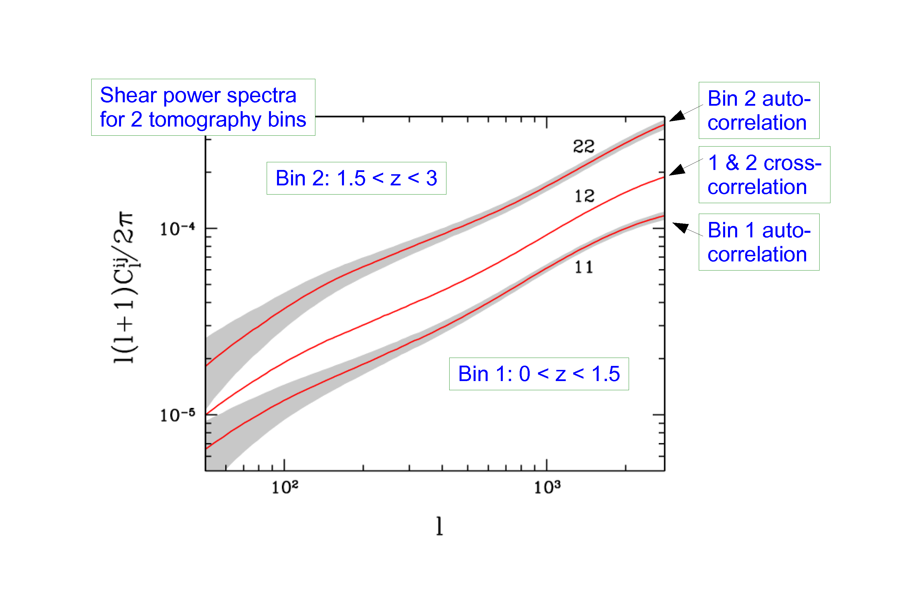
STH, TU, WONG 2006

Slide 43
EUCLID
ESA M-CLASS MISSION
2019
SELECTED OCTOBER 2011

Slide 44
EUCLID WILL FEATURE:
A WEAK LENSING MEASUREMENT OUT TO z ~ 2, COVERING
APPROXIMATELY 20,000 deg²
(THIS WILL BE MAINLY PHOTOMETRIC)
A GALAXY SURVEY OF ABOUT few x 10⁷ GALAXIES (75 x SDSS)
A WEAK LENSING BASED CLUSTER SURVEY

Slide 45
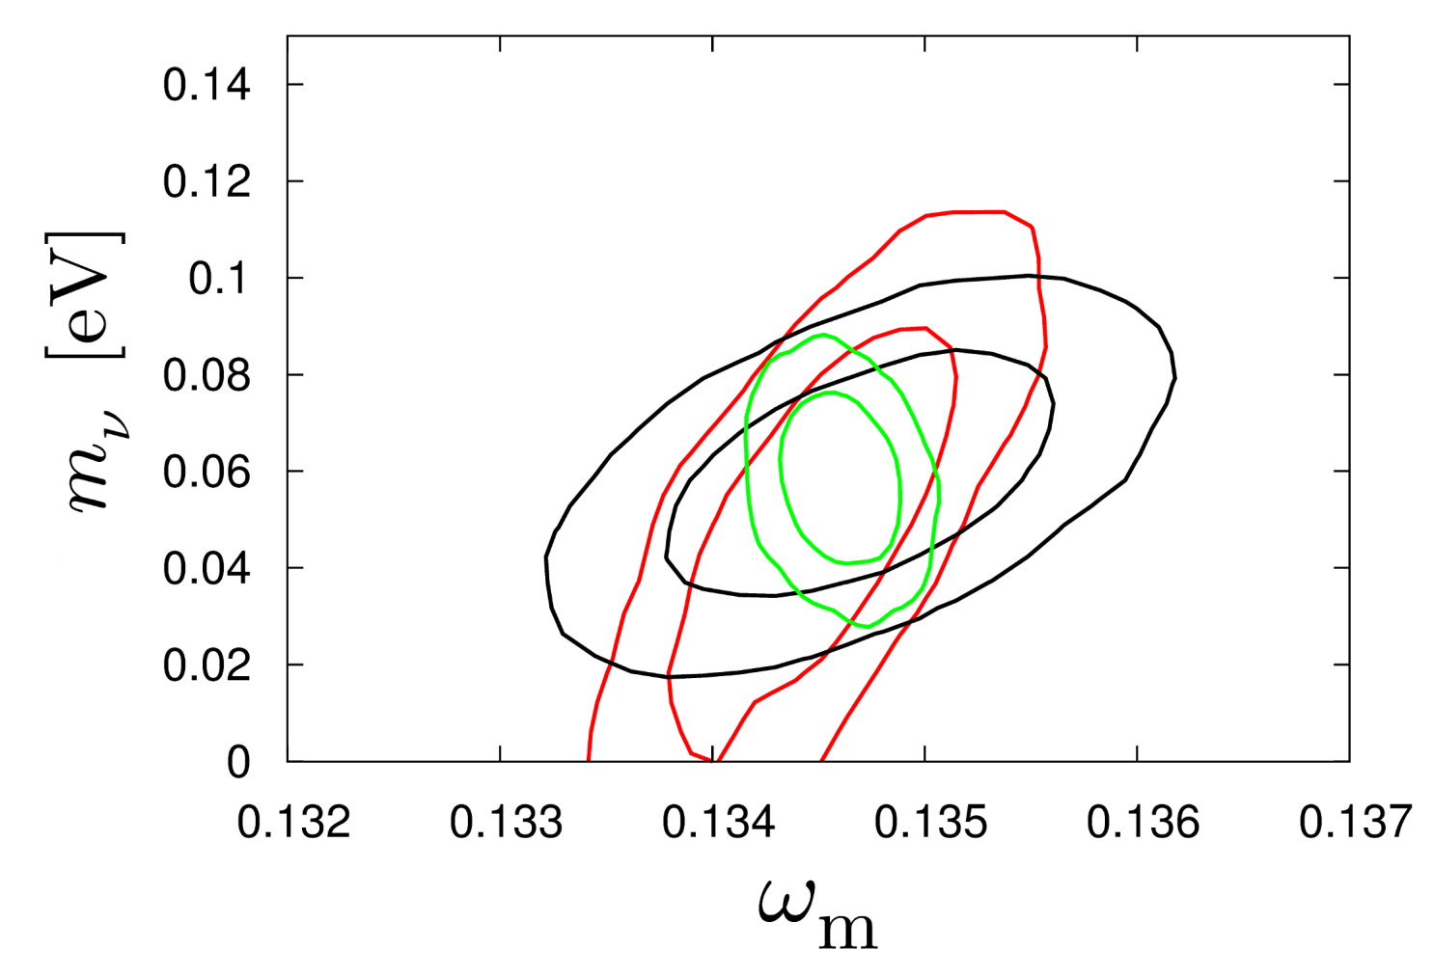
HAMANN, STH, WONG 2012: COMBINING THE EUCLID WL AND GALAXY
SURVEYS WILL ALLOW FOR AT A 2.5-5σ DETECTION OF THE NORMAL
HIERARCHY (DEPENDING ON ASSUMPTIONS ABOUT BIAS)
CMB+WL
CMB+WL+GAL
CMB+GAL
arXiv:1209.1043

Slide 46
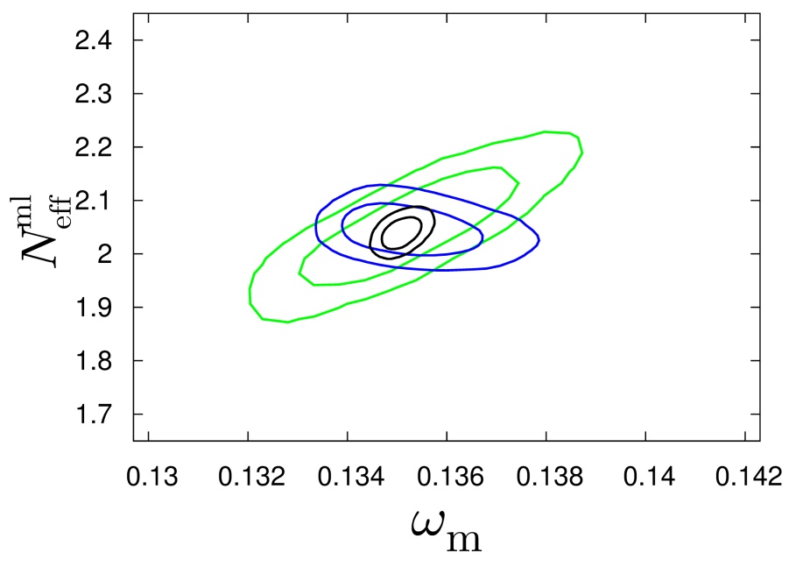
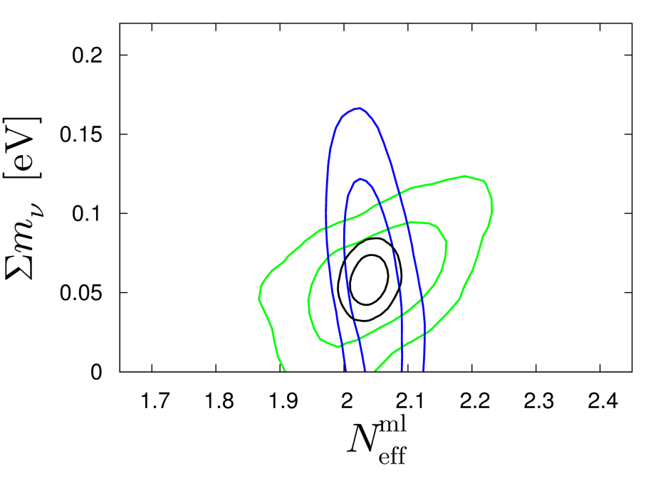
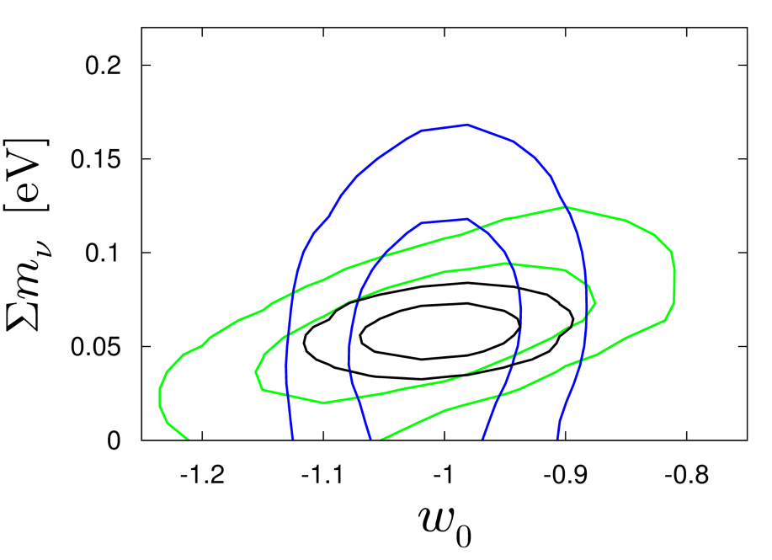
Basse, Bjælde, Hamann, STH, Wong 2013: Adding information on the
cluster mass function will allow for a 5σ detection of non-zero neutrino
mass, even in very complex cosmological models with time-varying
dark energy
arXiv:1304.2321
(JCAP)
CMB+CL
CMB+GAL+WL
ALL

Slide 47
THIS SOUNDS GREAT, BUT UNFORTUNATELY THE THEORETICIANS
CANNOT JUST LEAN BACK AND WAIT FOR FANTASTIC NEW DATA
TO ARRIVE…..

Slide 48
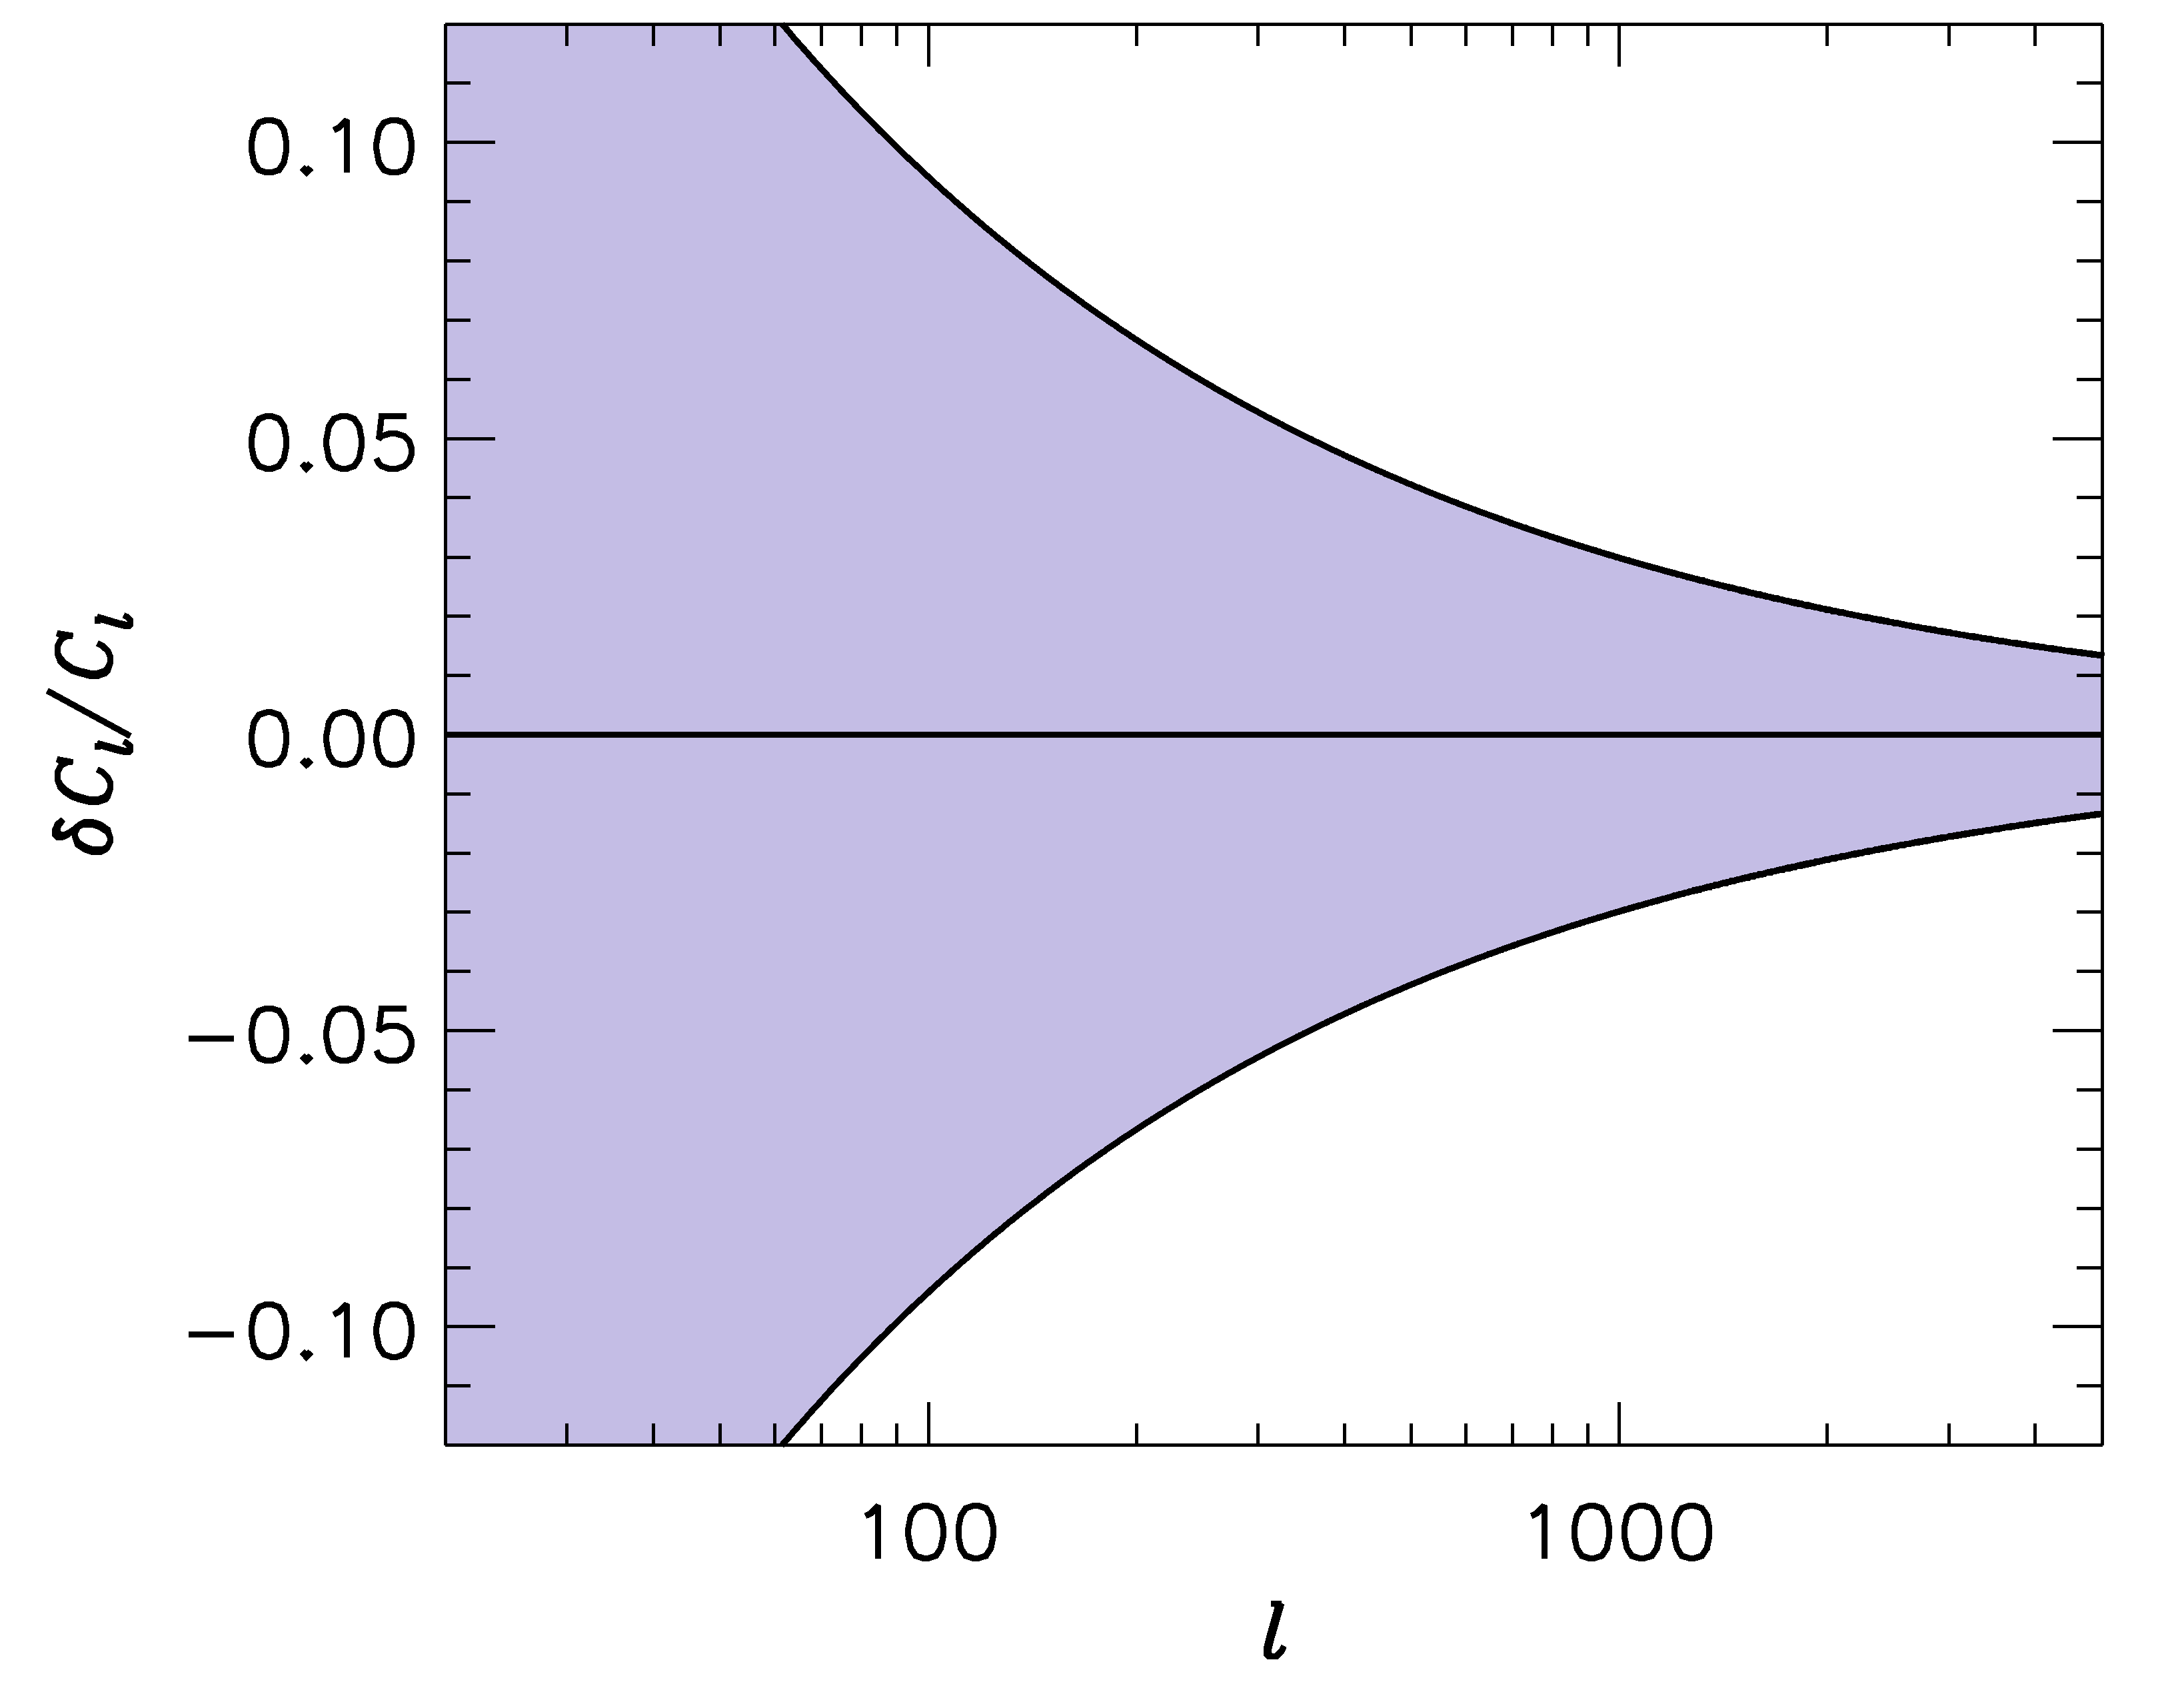
FUTURE SURVEYS LIKE EUCLID WILL PROBE THE POWER SPECTRUM
TO ~ 1-2 PERCENT PRECISION
-1
COSMIC VARIANCE
ERROR BARS
WE SHOULD BE ABLE TO CALCULATE THE POWER SPECTRUM
TO AT LEAST THE SAME PRECISION!

Slide 49
IN ORDER TO CALCULATE THE POWER SPECTRUM TO 1%
ON THESE SCALES, A LARGE NUMBER OF EFFECTS MUST
BE TAKEN INTO ACCOUNT
BARYONIC PHYSICS – STAR FORMATION, SN FEEDBACK,…..
NEUTRINOS, EVEN WITH NORMAL HIERARCHY
NON-LINEAR GRAVITY
……………………..

Slide 50
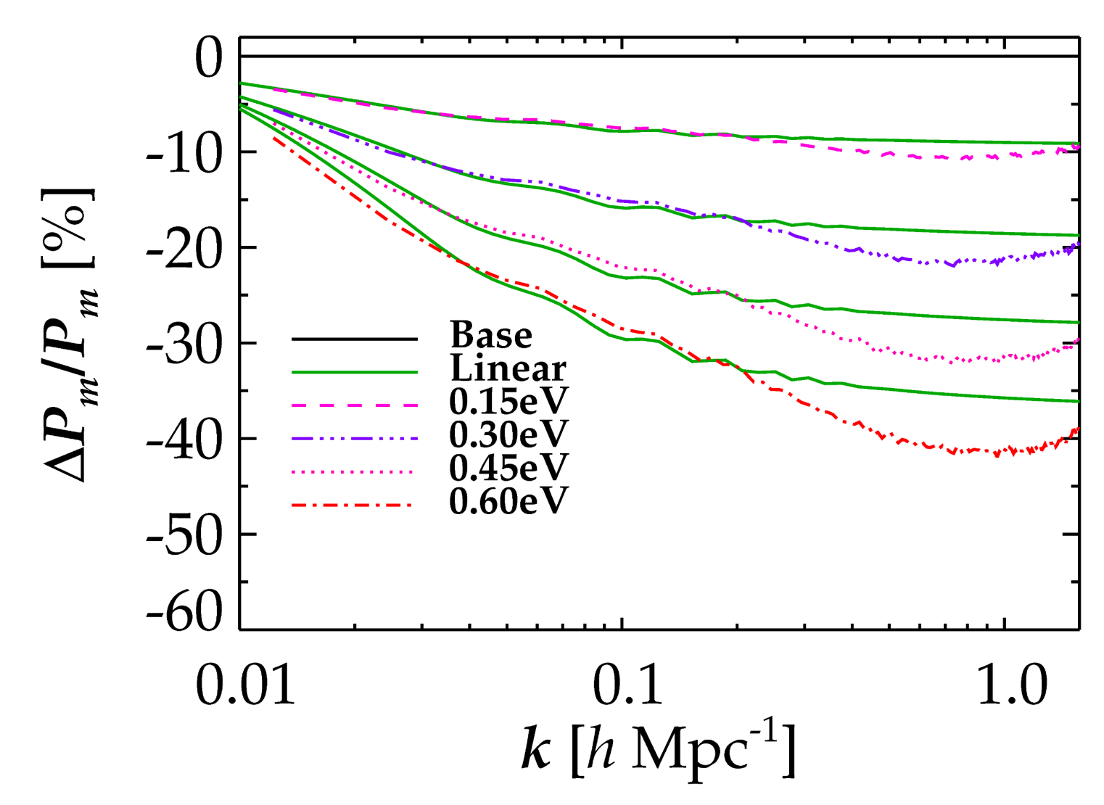
NON-LINEAR EVOLUTION PROVIDES AN ADDITIONAL SUPPRESSION OF
FLUCTUATION POWER IN MODELS WITH MASSIVE NEUTRINOS
LINEAR THEORY
FULL NON-LINEAR
Brandbyge, STH, Haugbølle, Thomsen ’08
Brandbyge & STH ’09, ’10, Viel, Haehnelt, Springel ’10
STH, Haugbølle & Schultz ’12, Wagner, Verde & Jimenez ’12
Ali-Hamoud & Bird ‘12

Slide 51
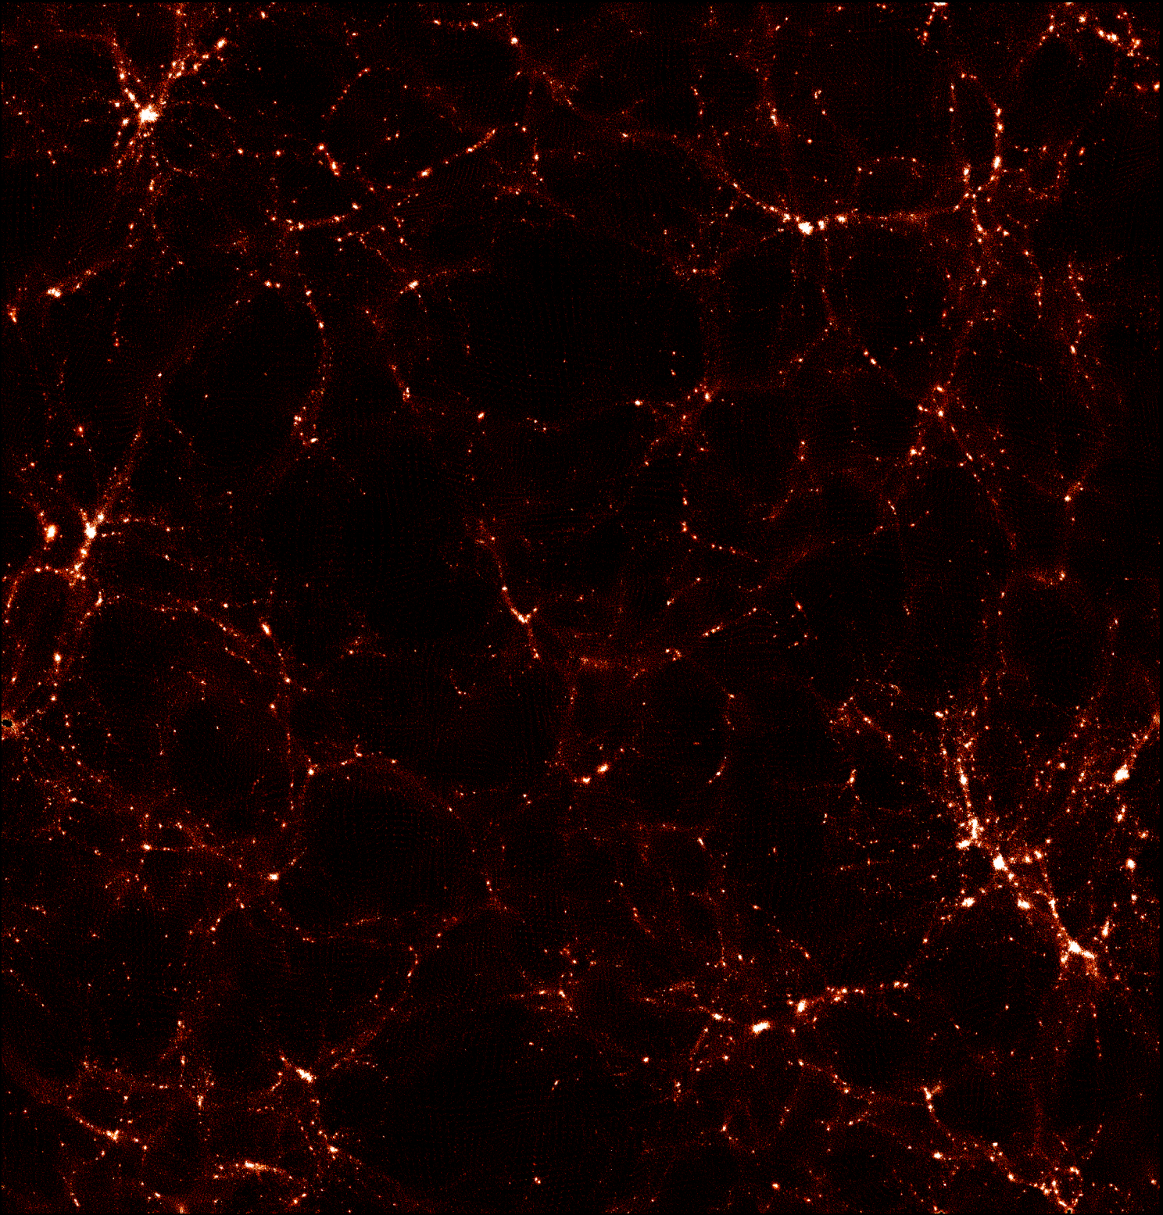
CDM
STH, Haugbølle & Schultz ’12

Slide 52
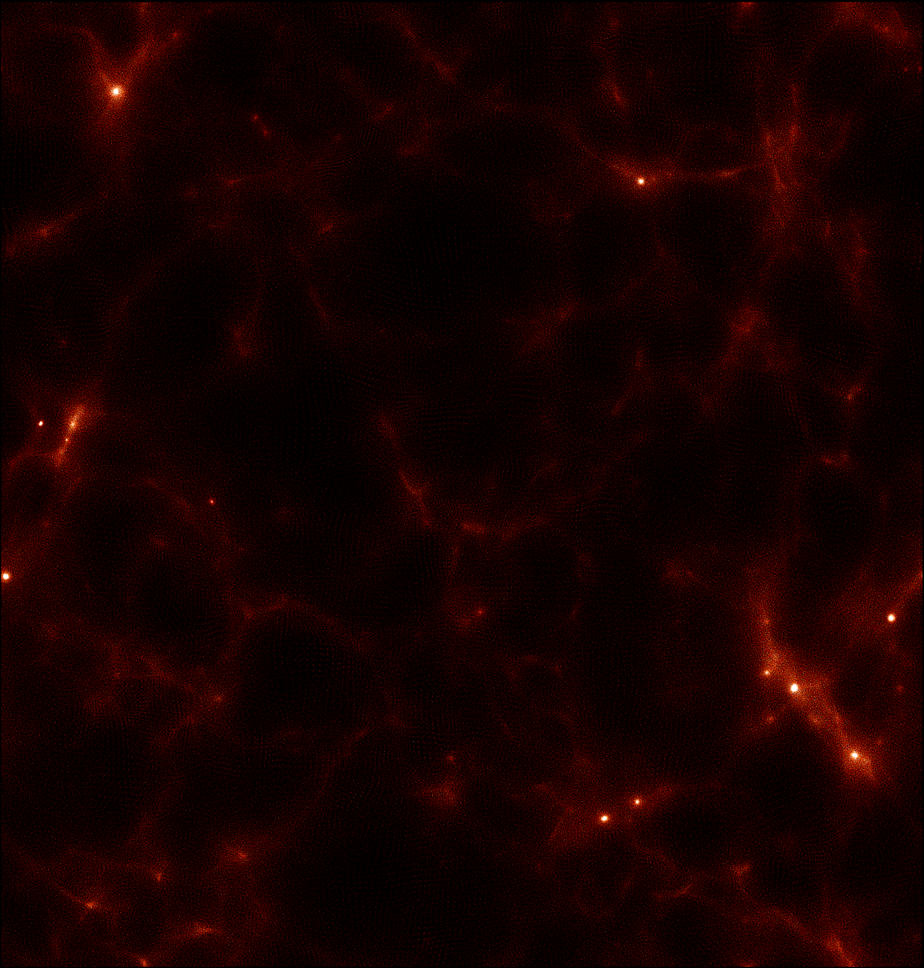
Neutrinos
STH, Haugbølle & Schultz ’12

Slide 53
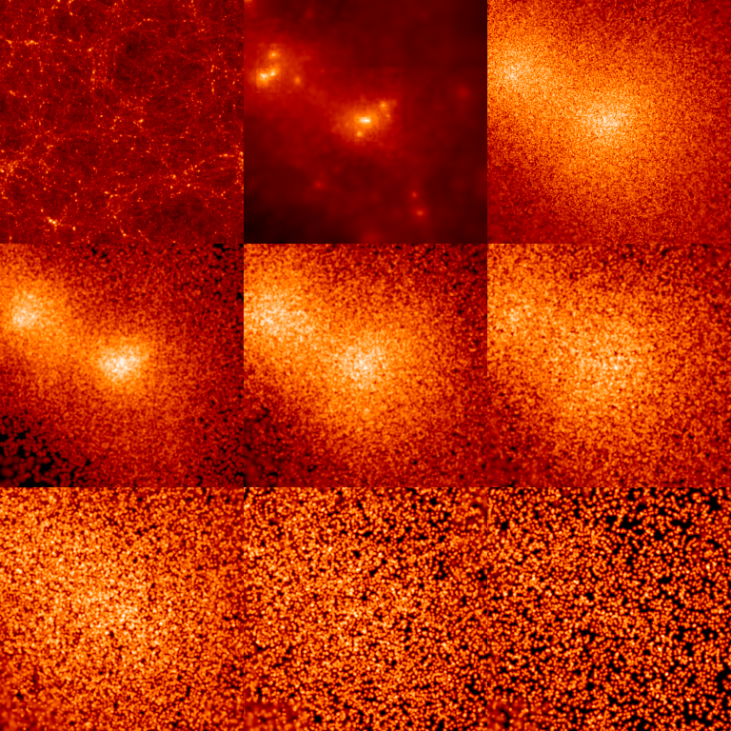
INDIVIDUAL HALO PROPERTIES
CDM
ν
512 h⁻¹ Mpc
0 < p/T < 1
1 < p/T < 2
2 < p/T < 3
3 < p/T < 4
4 < p/T < 5
5 < p/T < 6

Slide 54
CONCLUSIONS
NEUTRINO PHYSICS IS PERHAPS THE PRIME EXAMPLE OF HOW
TO USE COSMOLOGY TO DO PARTICLE PHYSICS
THE BOUND ON NEUTRINO MASSES IS SIGNIFICANTLY
STRONGER THAN WHAT CAN BE OBTAINED FROM DIRECT
EXPERIMENTS, ALBEIT MUCH MORE MODEL DEPENDENT
COSMOLOGICAL DATA MIGHT ACTUALLY BE POINTING TO
PHYSICS BEYOND THE STANDARD MODEL IN THE FORM OF
STERILE NEUTRINOS
NEW DATA FROM EUCLID WILL PROVIDE A
POSITIVE DETECTION OF A NON-ZERO NEUTRINO MASS

