Slide 1
Atmospheric Neutrinos
45 min
Y. Suzuki
Kamioka Observatory, ICRR, and
Kavli, IPMU, the University of Tokyo

Slide 2
2013, this year
The centennial of the birth of B. Pontecorvo
15 years after the discovery of the neutrino oscillation in atmospheric neutrinos
A turning point of the neutrino oscillation study
  All the mass difference and the mixing angles were precisely determined
  Non zero θ₁₃ (the last mixing angle) were established
    2011: ν_{μ} → ν_{e} appearance: (6 e-like events/1.5±0.3 backgrounds) by T2K experiment
      First indication of non-zero θ₁₃ (2.5σ)
    2012: disappearance of ν_{e} → ν_{x} by 3 reactor neutrino experiments
      Precise measurement of θ₁₃: (most precise data) Daya Bay 7.7 σ
    2013: ν_{μ} → ν_{e} appearance: (28 events/ 4.63±0.53 backgrounds ) by T2K experiment
      7.5 σ
    Day Bay: increased the significance

Slide 3
New direction of neutrino oscillation study
Best parameter value from a single experiment (except solar ν)
Future of neutrino oscillation (common understanding)
Mass hierarchy, CP phase, Octant of θ₂₃
  ➔ Atmospheric neutrinos can contribute for these studies
Another important subjects on neutrinos (not by ν oscill.)
  Determine Majorana nature and its phase
  ⬅ 0ν double beta decay

Slide 4
Contents of my talk today
History (towards the discovery of the neutrino oscillation)
Present status (mostly the results from SK)
Future Prospects (A mega-ton detector)
Notes:
← the centennial of B. Pontecorvo’s birth

Slide 5
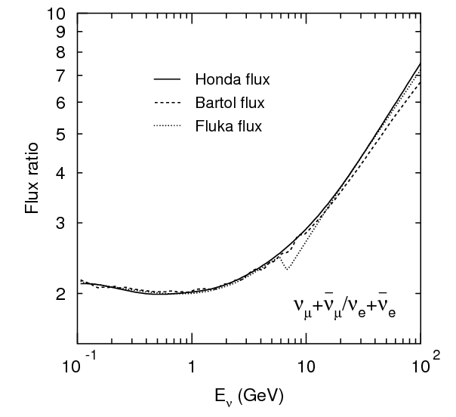
Atmospheric Neutrinos
Primary cosmic rays
(protons, He, , ,)
p/He + N → π/K + X
π/K → μ + ν_{μ}
μ → e + ν_{e} + ν_{μ}
L=10∼20 km
π±, K±
For the low energy limit
  μ’s decay before reaching the ground
  ν_{μ} : ν_{e} = 2 : 1
μ±
ν_{μ}
e±
For higher energy: π/K → μ+ν_{μ}
e+ν_{μ}+ν_{e}
ν_{μ}
ν_{e}
Flux ratio
ν_{μ}+ ν_{μ}
ν_{e}+ ν_{e}
2
10⁻¹ 1 10 10²
E_{ν}(GeV)

Slide 6
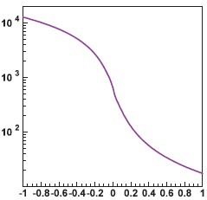
Atmospheric Neutrino Events
13,000km
L = ∼10∼13,000 km
Wide range of path-length
(3 orders)
E = ∼0.1∼10,000 GeV
Wide range of the energy
(5 orders)
Flight path-length (km)
~10km
Up
Down
zenith angle (cosθ)

Slide 7
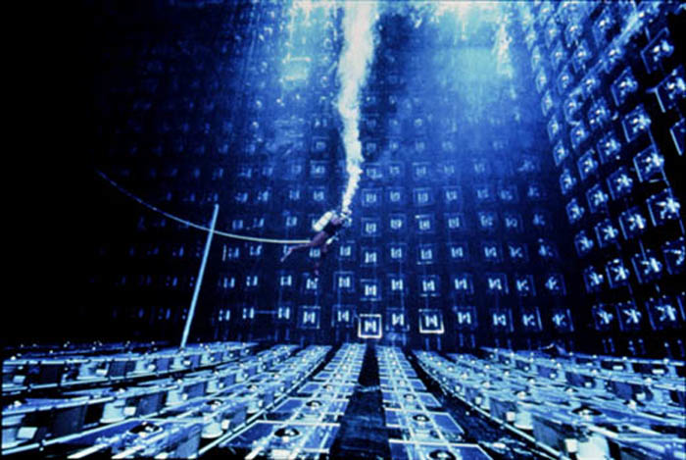
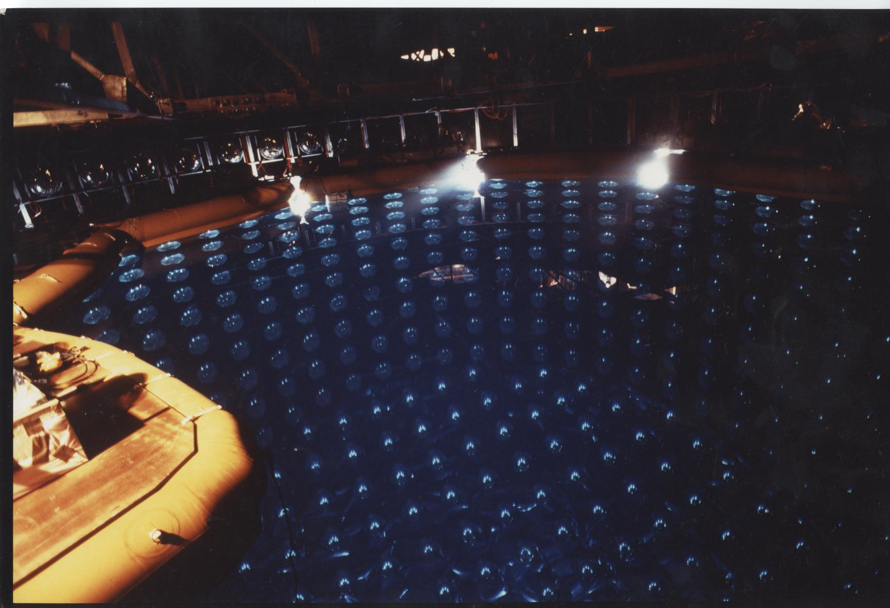
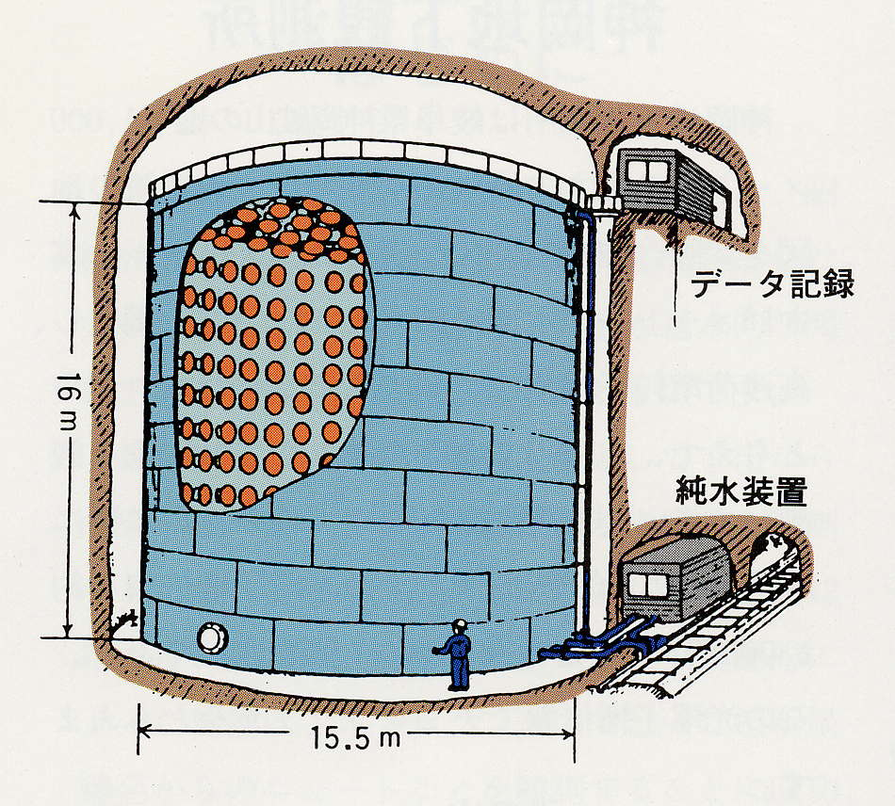
Early Indication
Atmospheric Neutrinos were the background for proton decay search in large detectors in 80’s.
IMB
Kamiokande
Kamiokande
3000 ton (inner mass) Water Cherenkov detector
2140 ton fiducial mass for the atmospheric neutrino analysis
∼1000 50 cm diameter photo-multiplier tubes
8000 tons /4500 tons
A Hint for the neutrino oscillation came from atmospheric neutrino anomaly observed in 1988 by Kamiokande

Slide 8
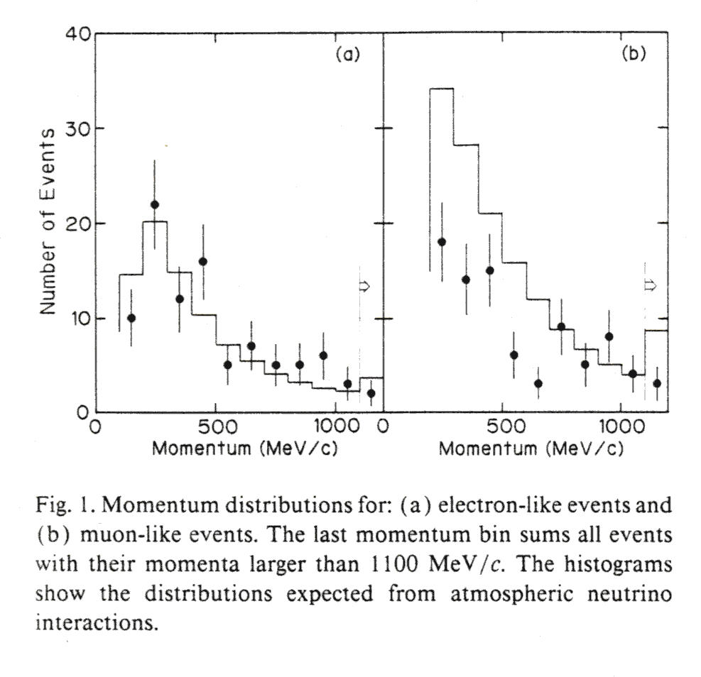
Early Indication
Kamokande Observed fewer μ-like events in atmospheric ν interactions than expected
R= (Obs./MC)μ-like = 59±7% (stat.)
Phys. Lett. in 1988
e-like
μ-like
Momentum (MeV/c)

Slide 9
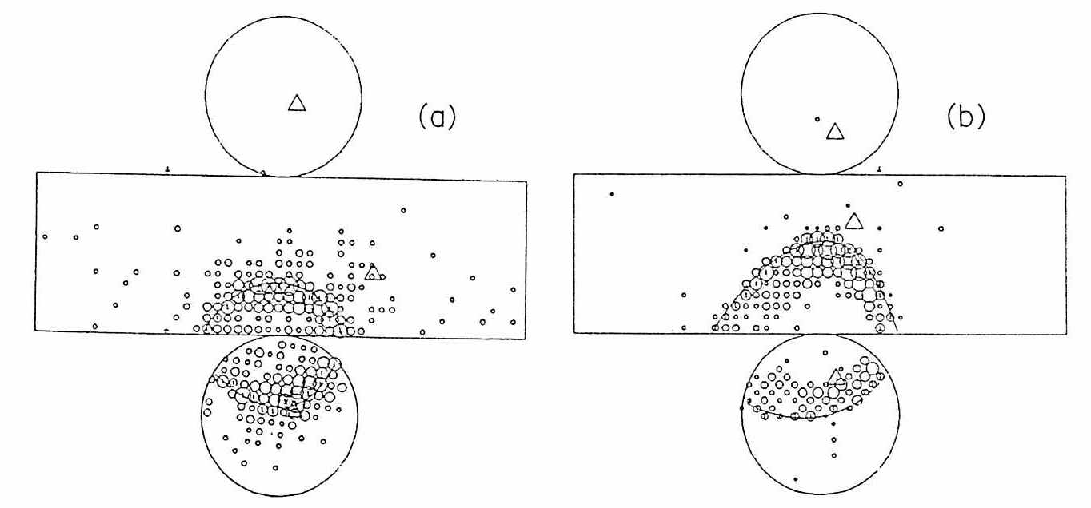
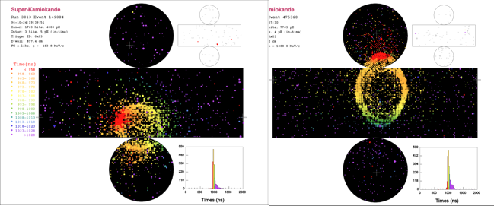
μ/e separation
e-like
events
μ-like
events
Kamiokande
Super-K

Slide 10
Kamiokande result
Why this observation was not widely accepted as a neutrino oscillation?
Probably the reasons were the followings
  Statistic was small
  Results strongly depend upon the atmospheric neutrino flux calculations
  There were large uncertainties in the flux calculations
    Primary cosmic ray flux, primary interactions, secondary particles productions, decays, earth’s magnetic fields, modulations, parameters for atmosphere,………

Slide 11
Kamiokande result
  Another important issue was that theorists did not believe ‘large mixing’. This was the prejudice that mixing must be small like quark mixing.
  In late 80’s, neutrinos were one of the candidates of dark matter particles and the mass needed was ∼ O(1 eV) which contradicted with the indication from atmospheric neutrinos unless strong degeneracy was assumed
  The earth size is just so to observe atmospheric neutrino oscillation which people thought ‘fine tuning’.

Slide 12
Further Confusions in early 90’s
When Kamiokande presented the neutrino anomaly, there were other experiments inconsistent with Kamokande results.
Especially two experiments using Fe calorimeter provided no deficits
There was an argument about systematics between Water Cherenkov and Fe calorimeter, but this was solved in 1997 by another Fe calorimeter experiment, Soudan-2 provided consistent results with Kamiokande

Slide 13
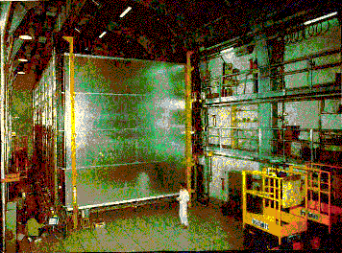
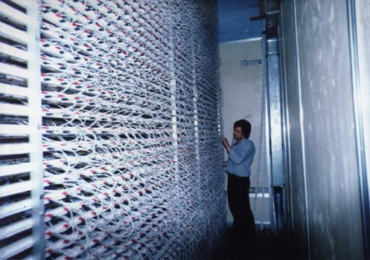
R measurement in 90’s
1988
1992
Frejus
(Fe-calor.)
700 ton
(Fe-calor.)
130 ton
Nusex
(Fe-calor.)
1997
In early 90’s, there are some confusion among the data

Slide 14
Not easy to see the anomaly by other methods
Atmospheric neutrino oscill. : Δm₂₃²∼2.4x10⁻³eV²
  Accelerator long baseline experiments in late 80’s and early 90’s (baselines were ∼ laboratory scale < km) were not able to reach the sensitivity to test atmospheric ν anomaly:
    Δm² ∼ E/L ∼ 1 GeV/1 km ∼ 1 eV²
  Sensitivity: three orders of magnitude worse than needed
  Later (in 2003) the long baseline accelerator experiments confirmed the atmospheric neutrino oscillation (first by K2K):
    Δm² ∼ E/L ∼ 1.5 GeV/250km = 6 x 10⁻³ eV²

Slide 15
To establish the oscillation
In order to ‘establish’ the atmospheric neutrino anomaly as a neutrino oscillation, it is necessary to have an evidence which does not depend on the ‘flux calculations’

Slide 16
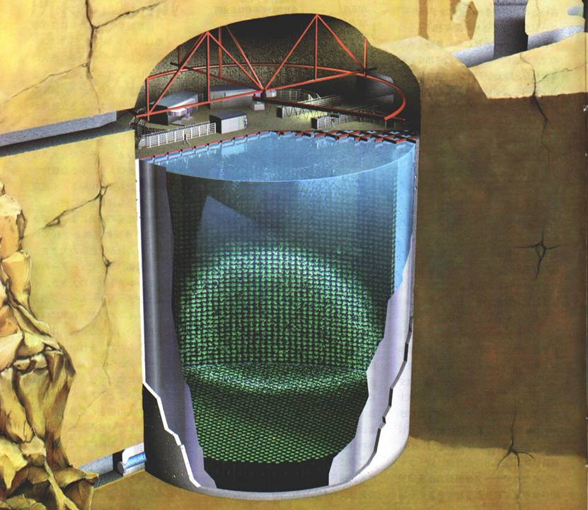
Break through came from Super-Kamiokande
Super-K is a 50,000 tons Water Cherenkov detector
Started to take data in 1996
Fiducial mass is more than 10 time of Kamiokande for the atmospheric neutrino analysis.
It accumulates about 10 atmospheric neutrino events per day.
C Scientific American
ν
42m
39m
11,146 PMTs (ID)
  50 cm in diameter
  40% coverage
1,885 PMTs (OD)
  20 cm in diameter
Japan – US collaboration

Slide 17







SK Collaboration
1998
2013
1998
2013
ICRR 27 23
IPMU -- 2
Fukuoka Tech -- 1
Gifu 1 1
KEK 9 11
Kobe 3 2
Kyoto -- 6
Miyagi 1 1
Nagoya -- 4
Niigata 8 --
Okayama -- 5
Osaka 5 1
Tohoku 13 --
SW Shizuoka -- 1
Tokyo 1 3
Tokyo Tech 5 --
Tokai 2 1
Boston 14 4
BNL 1 1
Irvine 9 7
California State 2 3
Duke -- 5
George Mason 1 --
Hawaii 6 3
Los Alamos 1 --
Louisiana State 3 --
Maryland 4 --
Stony Brook 8 5
Washington 6 3
Warsaw(Poland) 1 1
UAM(Spain) -- 1
Chonnam(Korea) -- 3
Seoul National(Korea) -- 1
Sungkyunkwan(Korea) -- 1
Tsinghya(China) -- 4
Regina(Canada) -- 1
British C.(Canada) -- 3
Toronto(Canada) -- 2
TRIUMF(Canada) -- 2
Japan 75 62
USA 55 31
Poland 1 1
Spain -- 1
Korea -- 5
China -- 4
Canada -- 8
Total 131 112
T2K is a separated collaboration
  - Not all the SK collaborators are involved in T2K
New countries (Spain, Korea, China, Canada) joined

Slide 18
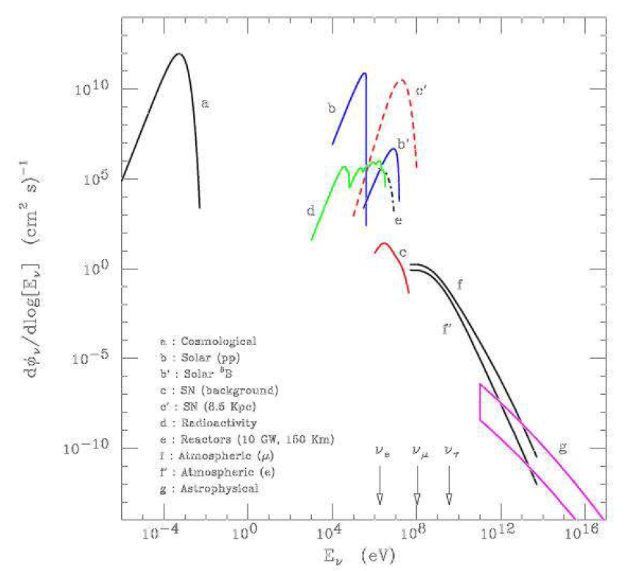
Wide Energy Range and
A variety of Physics Objectives
Trigger (Software):
  50% efficiency @ 3.3MeV
  100% eff. for E_{kin} > 4.0 MeV
Trigger Rate
  3.5 kHz
Solar neutrinos (< 15 MeV):
∼15 events /day
Supernova ν’s (10∼20 MeV):
∼8000 events @10 kpc
Atmospheric Neutrinos (< a few 100s GeV):
∼10 events /day
Super-K
10
5
0
5
10
Solar
pp-ν
Supernova (8.5kpc)
6 p.e. / MeV
Resolution
(solar/supernova ν)
14.2% @10MeV
(atmospheric ν)
1.7+0.7/ E(GeV) %
(single ring μ)
Geo
-ν
Solar ⁸B-ν
log(E_{ν}φ_{ν} [/ cm² s sr])
Supernova
relic
Atmospheric ν
Astrophysical
1MeV 1GeV 1TeV 1PeV
log(E_{ν})

Slide 19
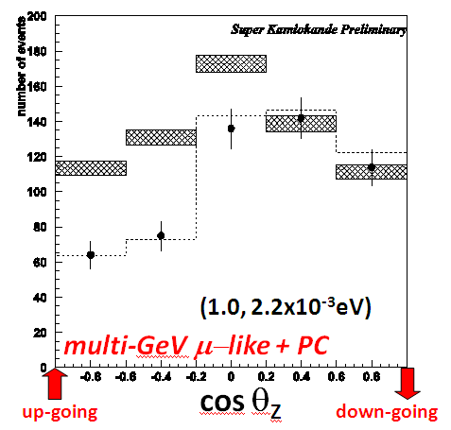
Discovery of Atmospheric ν Oscillation
June 1998, two years after the start of SK,
  we have obtained a definitive evidence of a neutrino oscillation.
  we found an asymmetry in a zenith angle distribution where we observed deficits of up-going ν_{μ}
The results are essentially independent of the flux calculations
➔ Discovery of Neutrino Oscillation
Δχ² = 69.8 for no oscillation

Slide 20
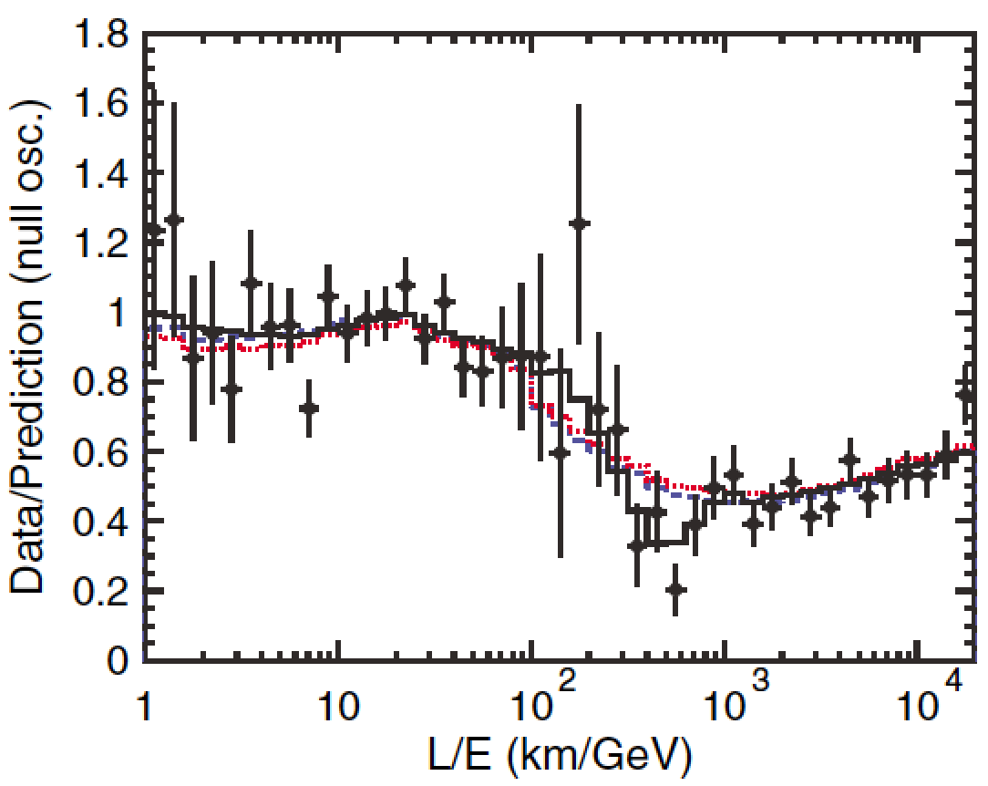
Additional evidence and confirmation after the discovery
In 2004, oscillatory pattern was observed in the L/E plot of atmospheric neutrinos (Super-K)

Slide 21
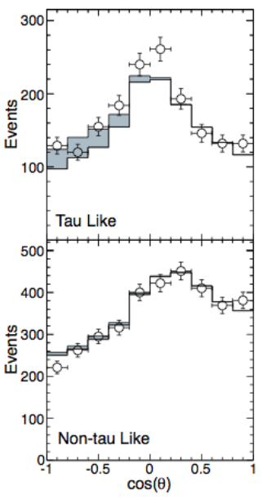
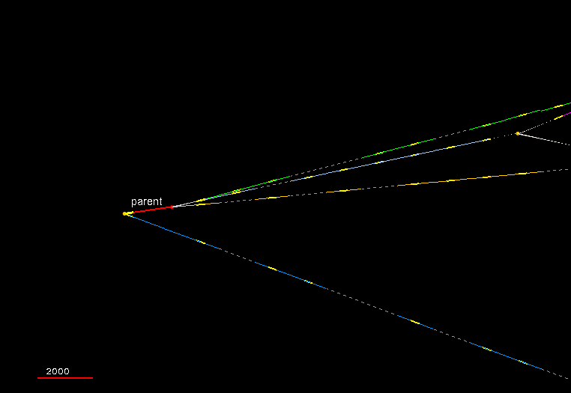
Evidence for ν_{τ} appearance
In 2013, ν_{τ} appearance was observed (Super-K)
  statistical analysis: 3.8 σ effect
  ➔ confirmation of ν_{μ} → ν_{τ} oscillation (SK)
Direct tau appearance by OPERA (CERN to Gran Sasso)
  3 events by 2013 (by emulsion chamber)
2nd ν_{τ} candidate τ → 3h
June 2012

Slide 22
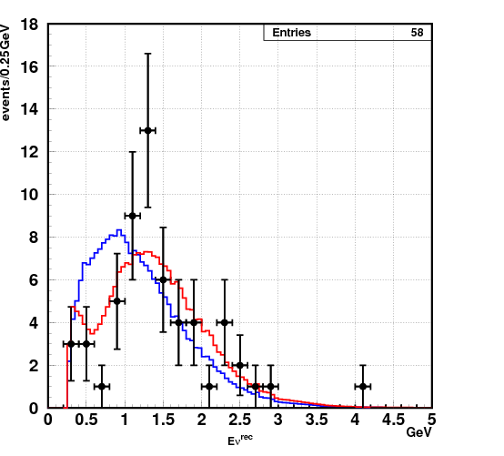
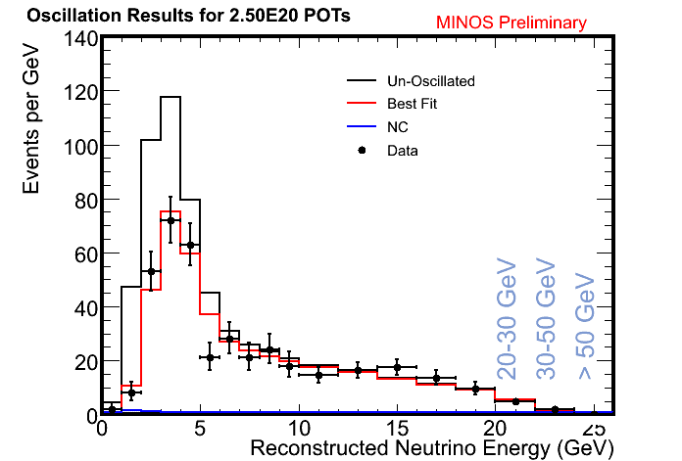
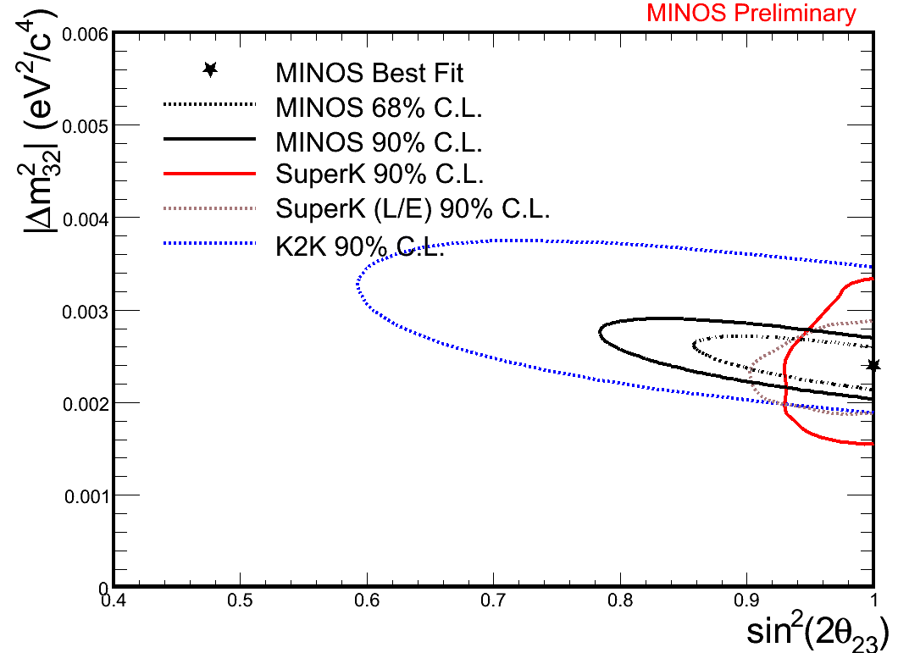
Confirmation of the atmospheric neutrino oscillation by accelerator LBL experiments
There were accelerator long baseline neutrino oscillation experiments in early 2000’s
  K2K(KEK to Kamioka): baseline∼250 km E_{ν}=1.4 GeV
  MINOS(Fermilab to Soudan): baseline 735 km E_{ν} = a few GeV (Wide band)
K2K and MINOS confirmed the atmospheric neutrino oscillation by man-made neutrinos
K2K final (2004)
2007
112: Observed
58: Expected
2.5x10²⁰ POT
In 2007 data

Slide 23
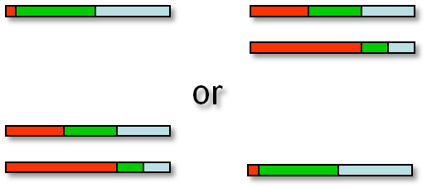
Current status of the atmospheric neutrino oscillation
Normal
Mass
Hierarchy
Inverted
Mass
Hierarchy
For the last 15 yeas after the discovery of neutrino oscillations in atmospheric neutrinos, θ₂₃, Δm₂₃ and θ₁₃ were precisely determined, not only by the atmospheric neutrinos, but also by the accelerator long baseline experiments and the reactor experiments
ν_{e} ν_{μ} ν_{τ}
ν₃
ν₂
ν₁
ν₂
ν₁
ν₃
Current and future important issues for the atmospheric neutrinos are to obtain indications for the octant of θ₂₃ (if θ₂₃≠π/4) and mass hierarchy, and to get hints for CP violation
Most of the information arose from ν_{e} appearance in the three flavor oscillation analysis
➔ Results from Super-K

Slide 24
Data Accumulated
Phase | SK-I | SK-II | SK-III | SK-IV | Total
Periods | 96-Apr 〜01-Jun | 02-Dec 〜05-Nov | 06-Jul 〜08-Sep | 08-Sep 〜running
ID PMTs | 11,146 (40%) | 5,182 (19%) | 11,129 (40%) | 11,129 (40%)
Electronics | ATM | ATM | ATM | QBEE
Trigger | Hardware | Hardware | Hardware | Software
Atm ν FC+PC (days) | 1489 days | 799 days | 518 days | 1417 days (< ‘13 Mar) | 4,213 days (< ‘13 Mar)
(# of ev.) | 12,299+902 | 6,610+427 | 4,355+344 | 11,513+960 | 34,777+2,633
Atm ν up-μ (days) | 1646 days | 828 days | 636 days | 1417 days (< ‘13 Mar) | 4,527 days (< ‘13 Mar)
(# of ev.) | 2,328 | 1,094 | 945 | 2,085 | 6,452
Solar ν (days) | 1496 days | 791 days | 547.9 days | 1069.3 days (< ‘12 Mar) | 3904 days (< ‘12 Mar)
(# of ev.) | 22,404 ev. | 7,212.8 ev. | 8,147.9 ev. | 19,809.4 ev. | 57,574.1 ev.
Proton decay | 91.7 kt・yr | 49.2 kt・yr | 31.9 kt・yr | 46.5 kt・yr (< ‘11 Mar) | 220 kt・yr

Slide 25
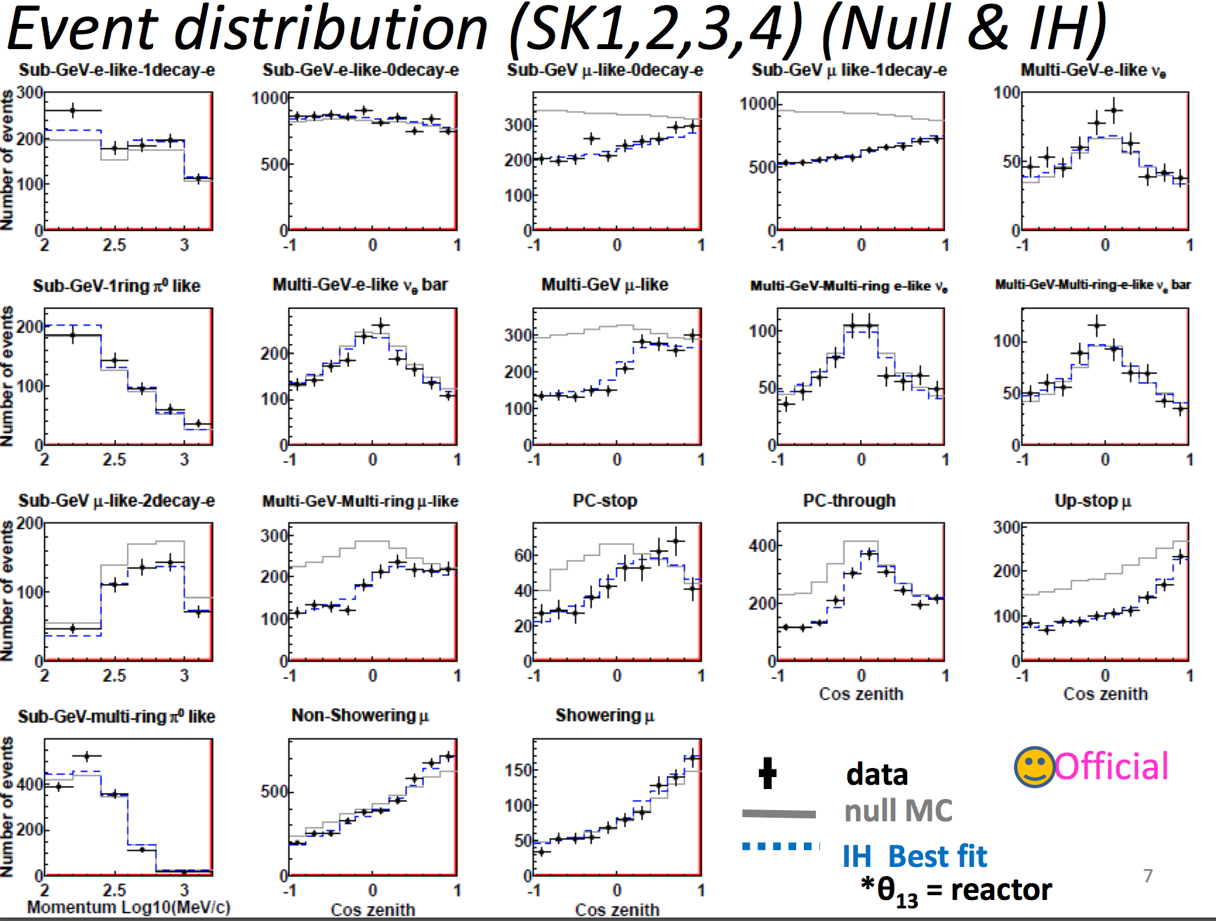
Event Distribution (SK-I, II, III, IV) (Latest Results <March-2013)
(No oscillation)

Slide 26
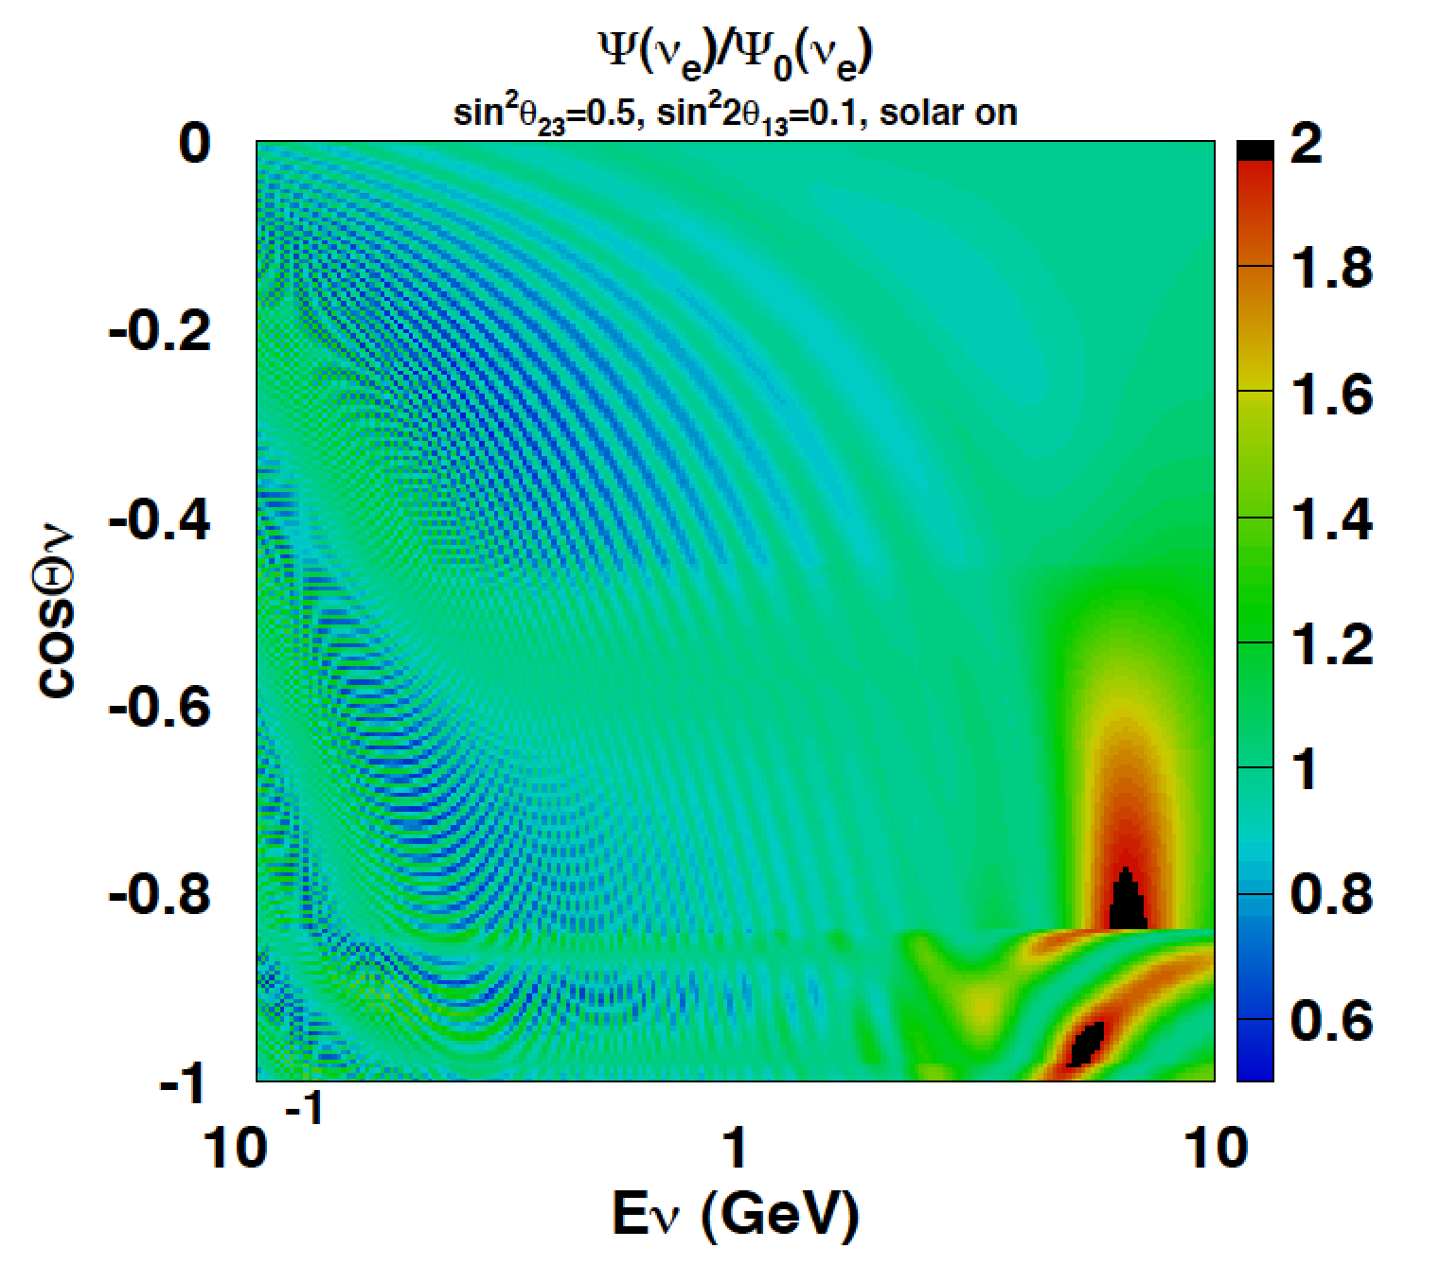
3 flavor analysis
ν_{e} appearance in 3 flavor oscillation
~ : mixing angle in matter
P₂ = |A_{eμ}|²: ν_{μ} → ν_{e} in matter
R₂ = Re(A*_{ee}A_{eμ}), I₂ = Im(A*_{ee}A_{eμ})
Solar term
Interference term; δ_{CP}
Ue3 term; matter enhancement
Negligible Ue3 term
Mass hierarchy
  Ue3 matter enhancement
    Δm₁₃²=2.4x10⁻³ eV² ➔ ∼10GeV
  Resonance condition (±V∼Δm²)
    NMH ➔ ν undergoes resonance, but not ν
    IMH ➔ ν undergoes resonance, but not ν
Octant of θ₂₃
  Many places: different ways to show up for different samples
CP-phase
  Interference term (Higher resonance eff is better)
➔ Atmospheric neutrinos have a clear signature of those effects if statistics is high enough.
_
_

Slide 27
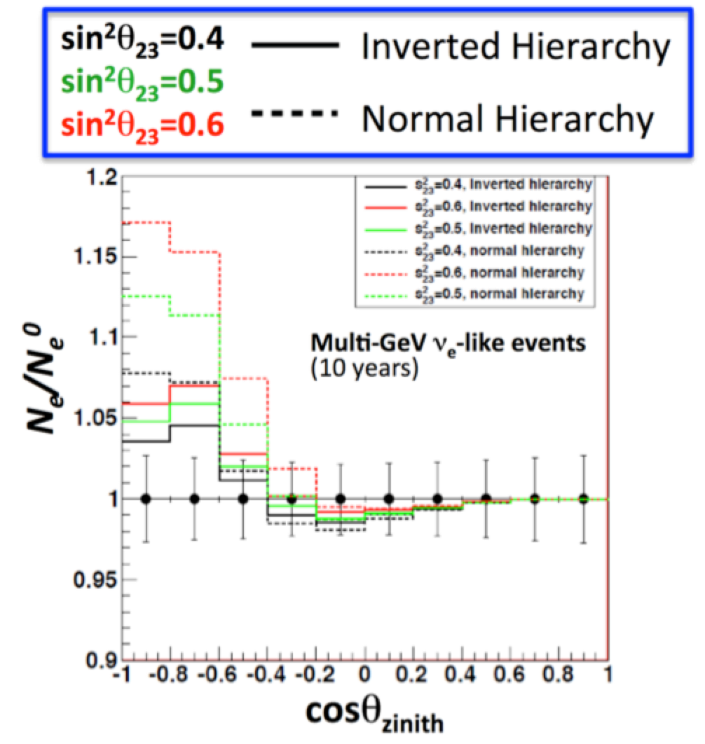
Multi-GeV sample
R. Wendell for HK study
Resonance Effects: 5∼15%,
  Normal MH > Inverted MH
Difference of MH is larger for cos²θ₂₃ > 0.5
  ➔ SK may indicate ∼2σ level effect in a few more years if ‘the parameters are lucky for us’
Since MH is a kind of on/off, therefore 2∼3 experiments showing 2∼3σ effect may be enough to determine!
We have made ν_{e} (ν_{e}) enhanced samples
  ν_{e} → larger y=(E-E’)/E
  → larger # of π → diff. # of decay-e
HK: 10 years
Error bar size for SK: 20 years
A few more years from now

Slide 28
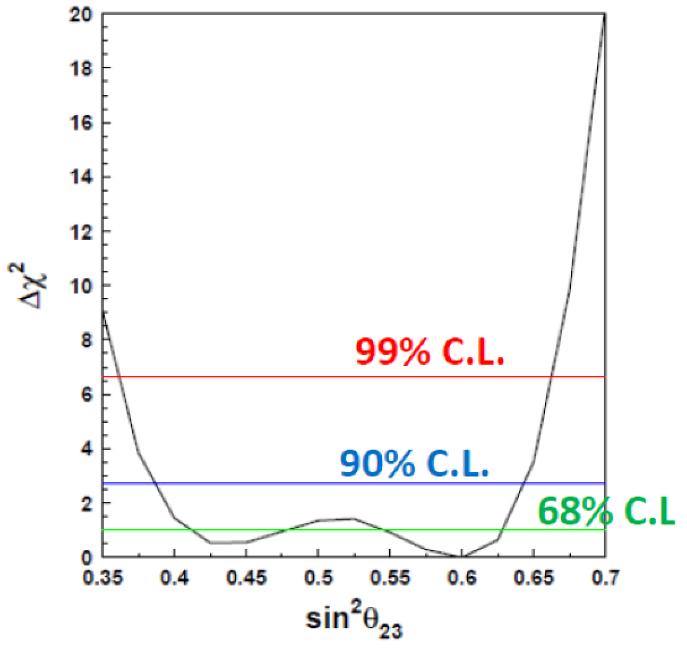
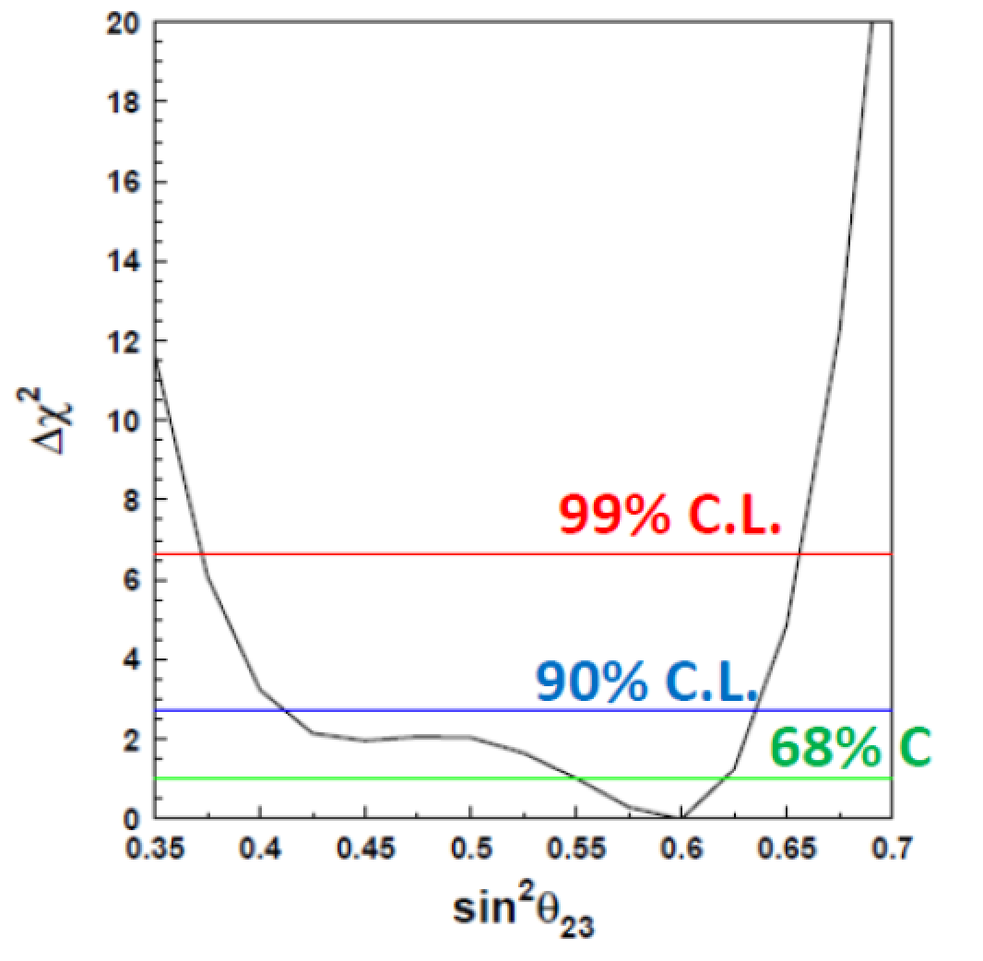
Octant
Current situation of atmospheric ν
θ₂₃ Octant
Super-Kamiokande atmospheric neutrino 3 flavor analysis
--- θ₁₃ fixed at the best value
Normal Mass Hierarchy
Inverted Mass Hierarchy
sin²θ₂₃
sin²θ₂₃
Super-K data favor the second octant of θ₂₃ regardless of the assumed hierarchy

Slide 29
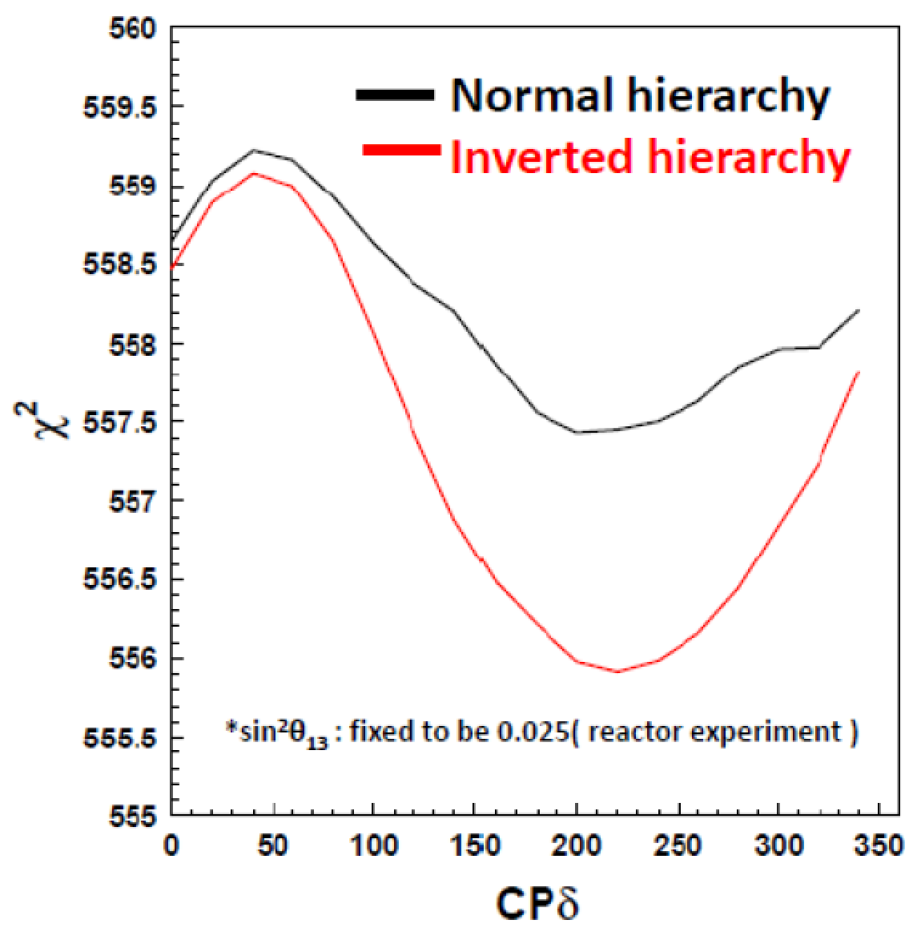
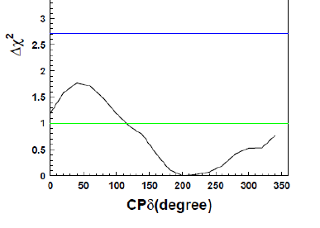
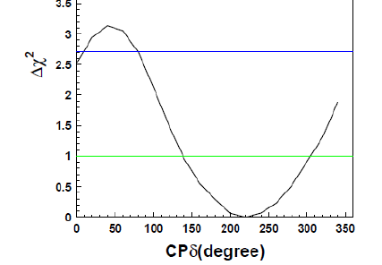
Mass Hierarchy and
CP phase
--- θ₁₃ fixed at the best value
Normal Hierarchy
90% C.L.
68% C.L.
NH: χ²_{min} = 557.7 / 477 dof
IH : χ²_{min} = 556.2 / 477 dof
χ²_{min} (NH) − χ²_{min} (IH)= 1.51
Inverted Hierarchy
90% C.L.
Small χ² for the inverted MH
Super-K data favor δ_{cp} = 220 degrees over 40 degrees regardless of the assumed hierarchy
Preference is stronger in the inverted hierarchy fit
68% C.L.

Slide 30
Future
Discuss a future Water Cherenkov Detector, Hyper-Kamiokande

Slide 31
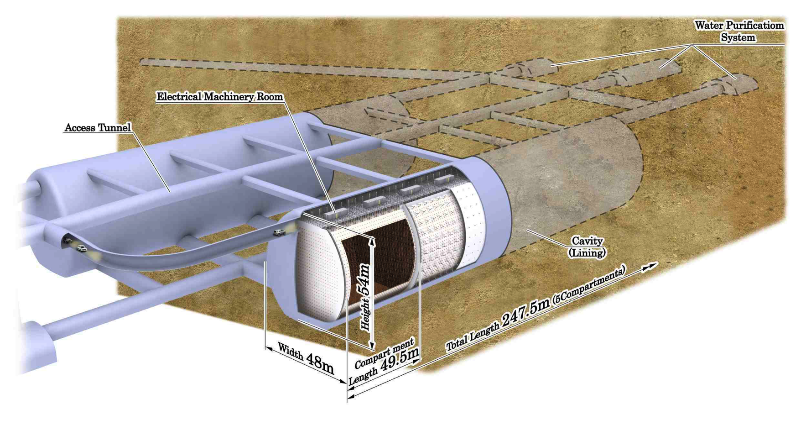
Hyper-Kamiokande Detector
Reference: LOI by Hyper-K WG, arXiv: 1109.3262 [hep-ex]
Total vol. ∼1 Megaton
  Outer vol. 0.2 Mton
  Inner vol. 0.74 Mton
Fiducial vol. 0.56 Mton
  (0.056 Mton x 10 comp.)
  X 25 of Super-Kamiokande
Photo-sensors
99,000 of 50 cm diameter light sensors for the Inner Detector (20% photo-coverage ⬄ 40% (SK))
  [May need higher sensor density compartment]
25,000 of 20 cm φ light sensors for the Outer Detector

Slide 32
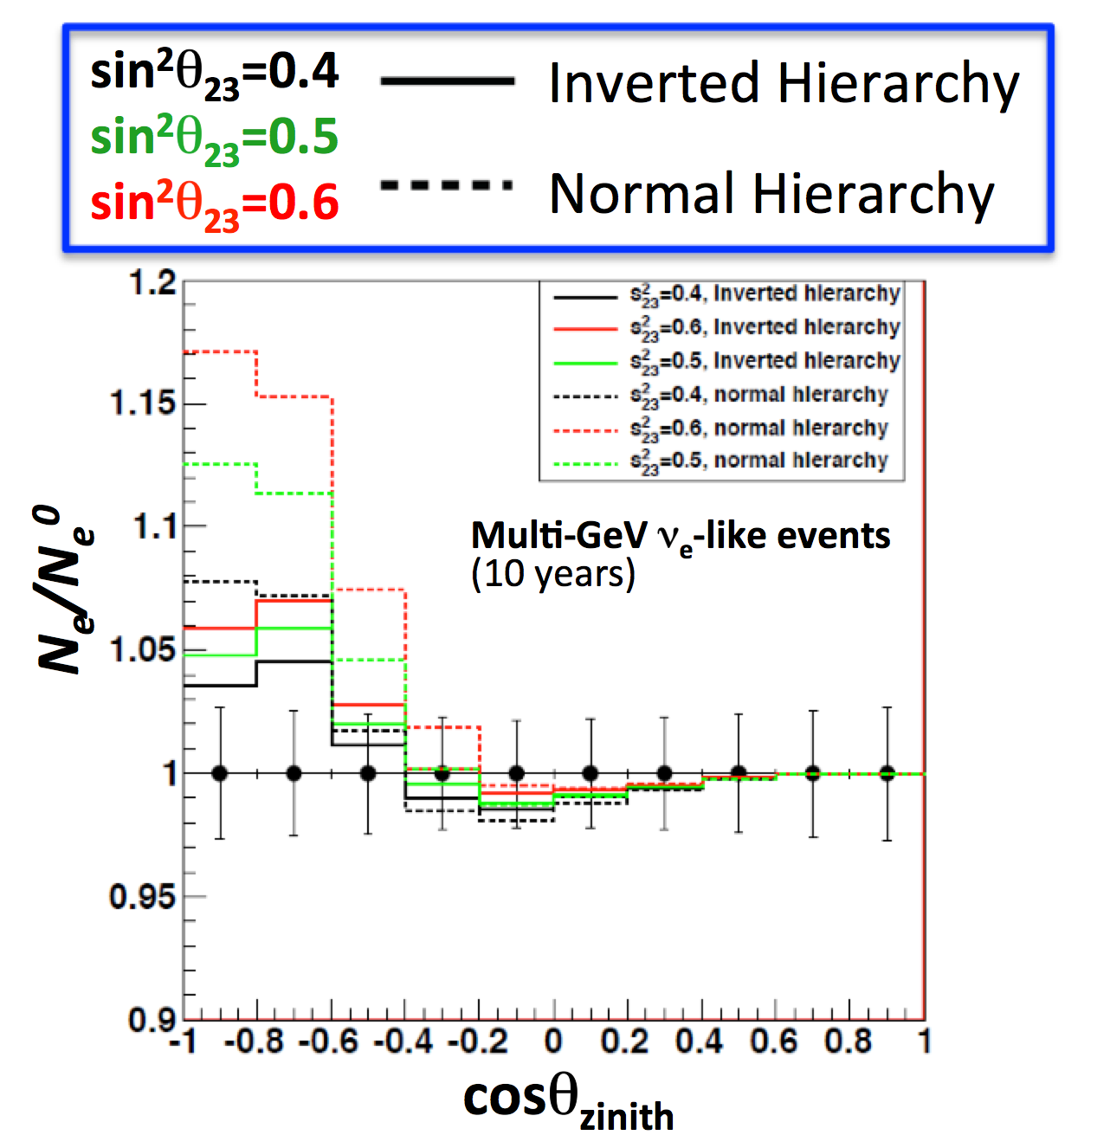
HK Atmospheric neutrinos
ν_{e} appearance in 3 flavor oscillation
~ : mixing angle in matter
P₂ = |A_{eμ}|²: ν_{μ} → ν_{e} in matter
R₂ = Re(A*_{ee}A_{eμ}), I₂ = Im(A*_{ee}A_{eμ})
Solar term
Interference term; δ_{CP}
Ue3 term; matter enhancement
Negligible Ue3 term
Mass hierarchy
  Ue3 matter enhancement
    Δm₁₃²=2.4x10⁻³ eV² ➔ ∼10GeV
  Resonance condition (±V∼Δm²)
    ν⬄NMH, but ν⬄IMH
Octant of θ₂₃
  Many places: different ways to show up for different samples
CP-phase
  Interference term
➔ Atmospheric neutrinos have a clear signature of those effects
_

Slide 33
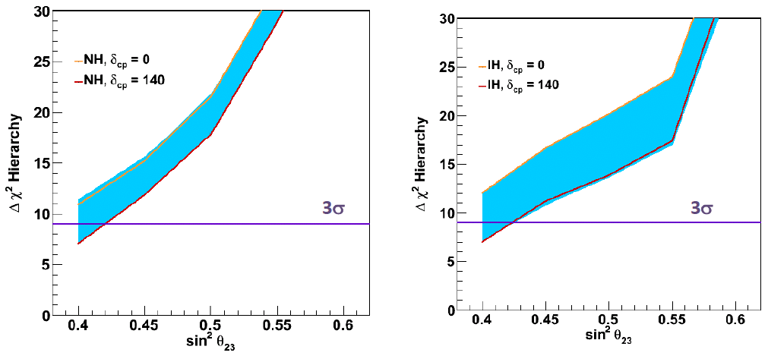
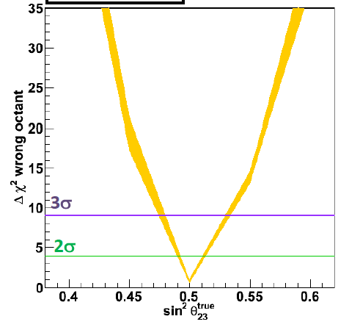
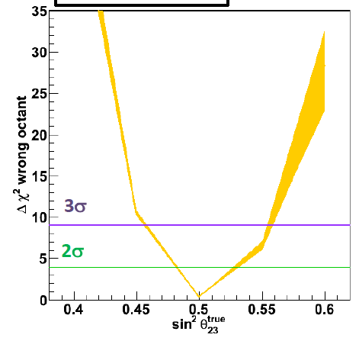
Mass Hierarchy and Octant
Δχ² hierarchy (wrong hierarchy rejection)
Mass hierarchy determination
sin²2θ₁₃=0.10 fixed
Thickness of band: range of CP
Sensitivity depends on θ₂₃
Mass Hierarchy will be determined @>3σ for sin²θ₂₃ > 0.42 (0.43)[normal(inverted)]
θ₂₃ Octant determination
sin²2θ₁₃=0.10 fixed
Octant can be determined @ >3σ if sin²θ₂₃ < 0.47 (0.45) and sin²θ₂₃ > 0.53 (0.56) for normal (inverted) mass hierarchy
10 years
10 years
Normal Mass Hierarchy
Inverted Mass Hierarchy
10 years
10 years
True NMH
MH unknown
True IMH
MH unknown

Slide 34
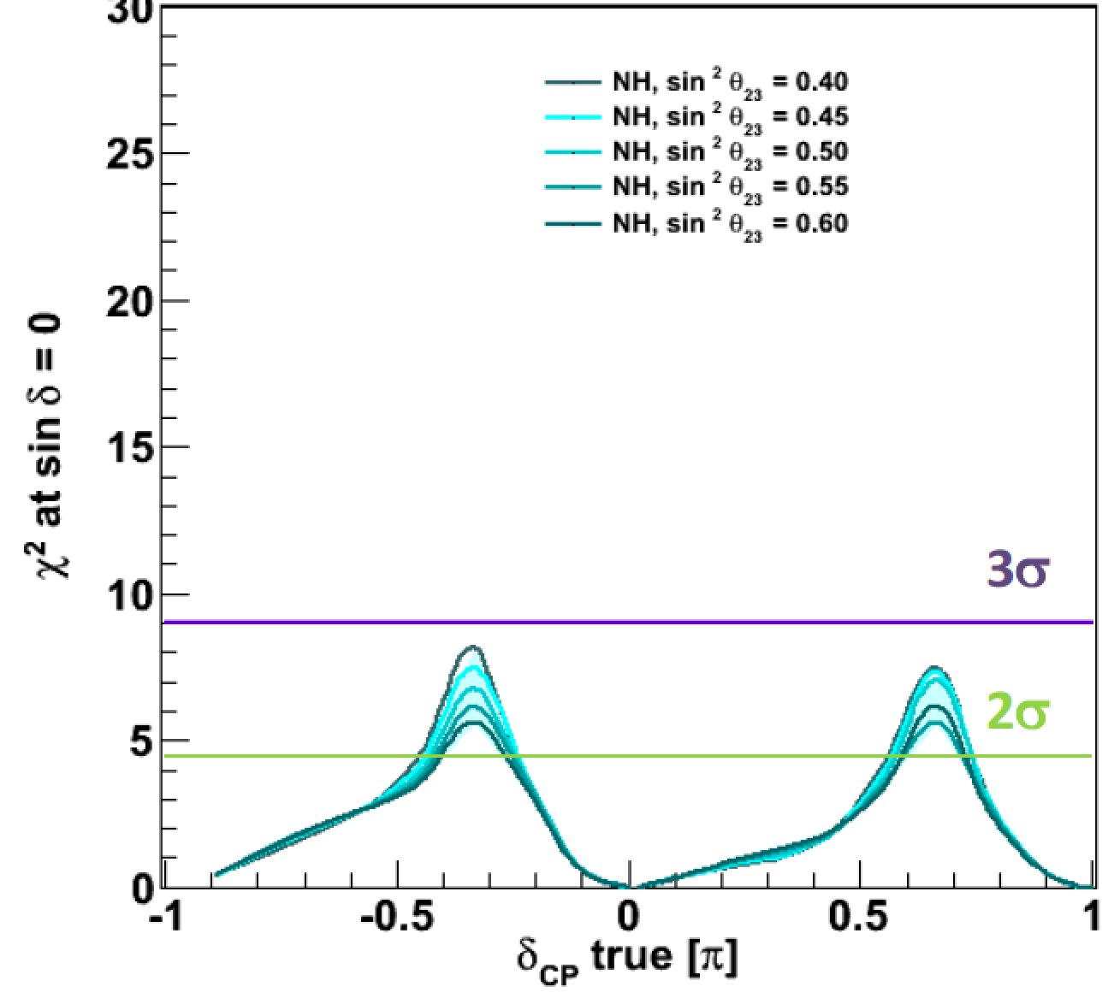
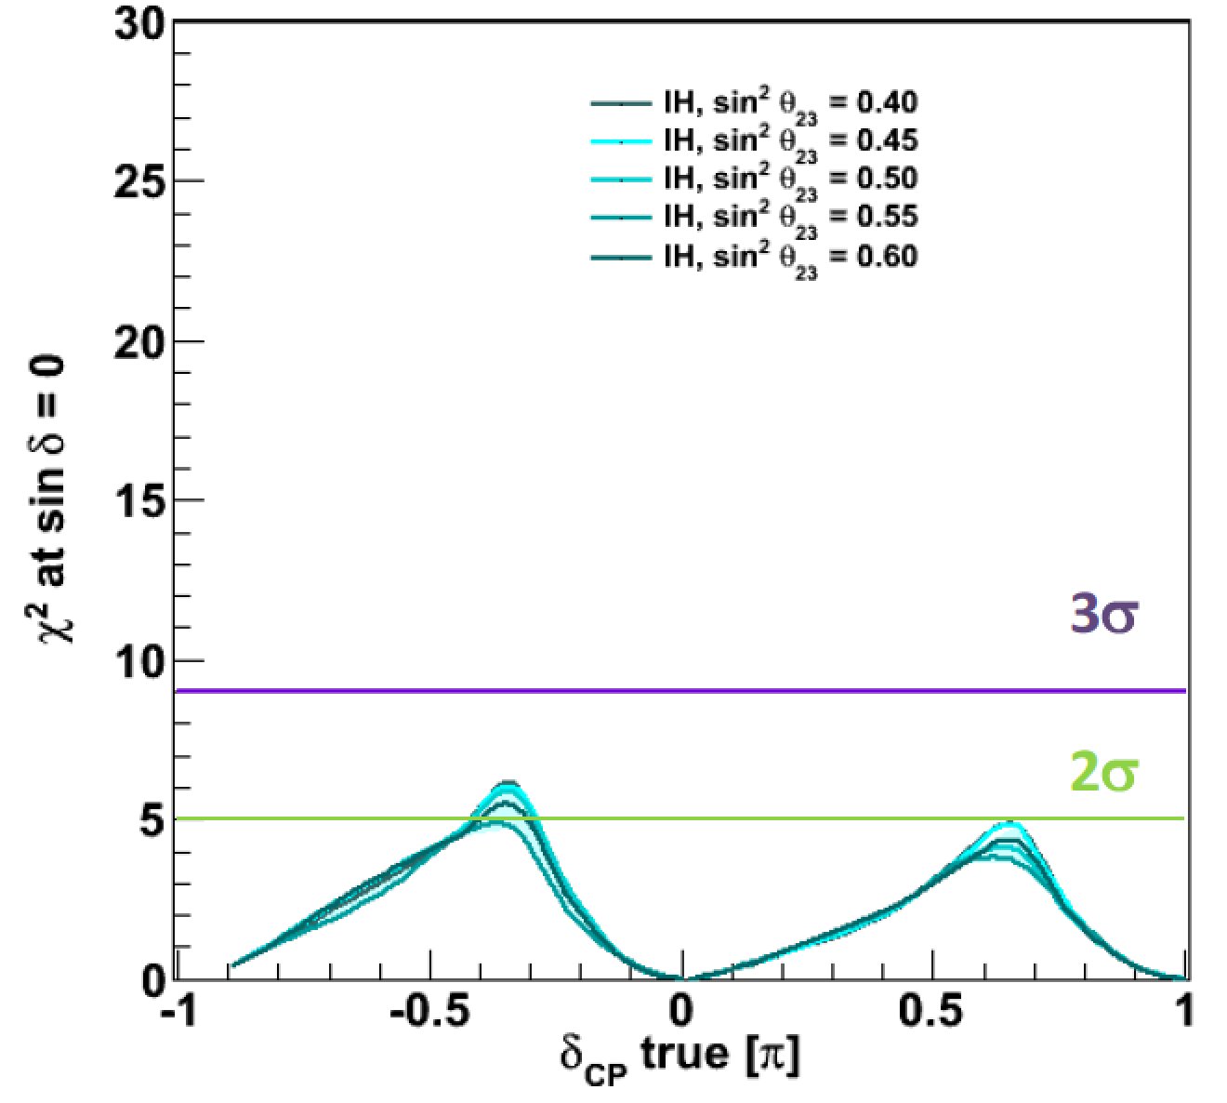
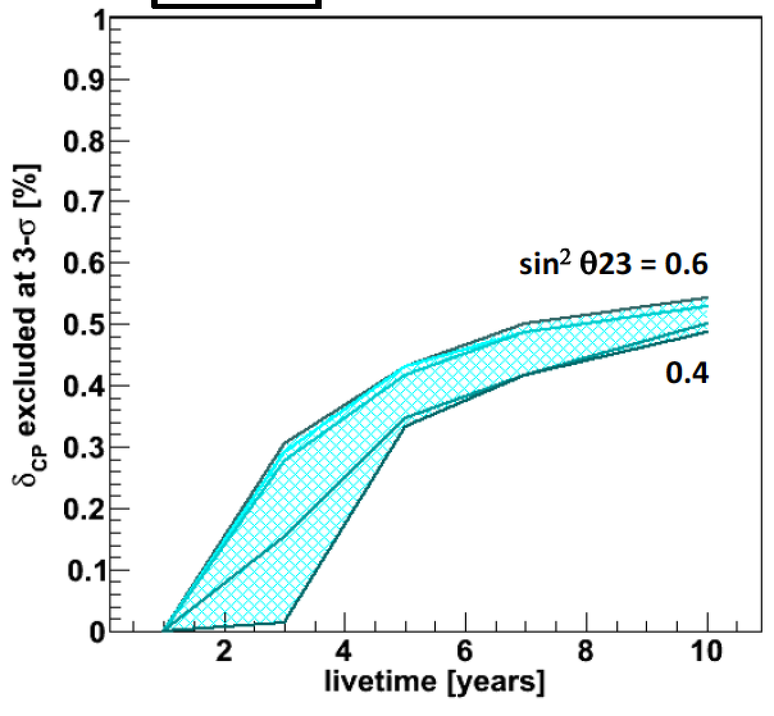
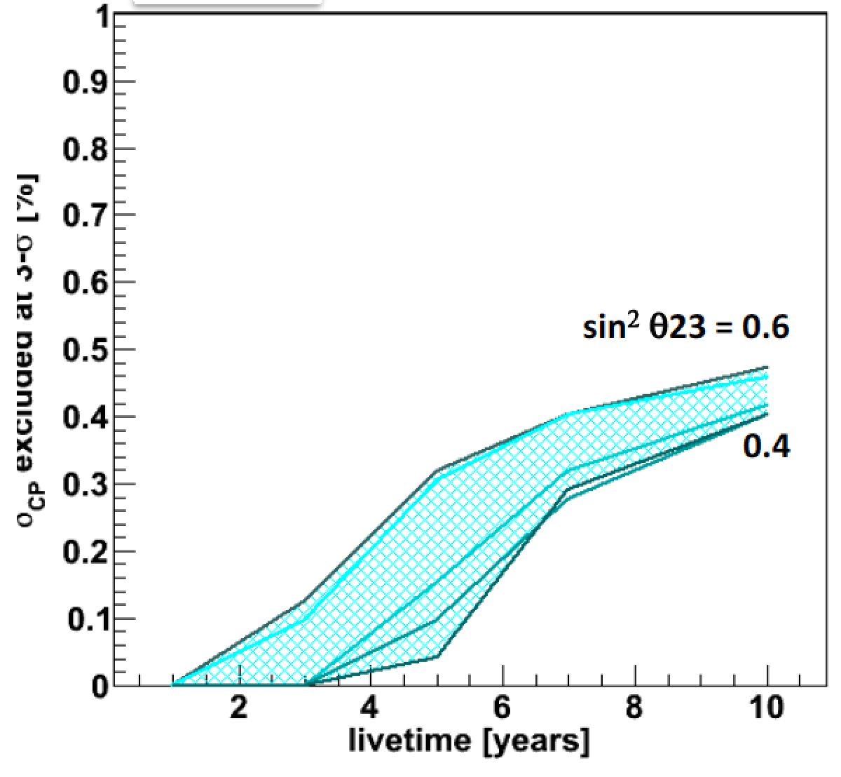
CP Violation in atmospheric ν
Exclusion of sin δ_{CP} = 0
sin²2θ₁₃=0.1: fixed
Normal Mass Hierarchy
MH: unknown
Inverted Mass Hierarchy
MH: unknown
Δχ² to δ_{cp}=0, π
HK: 10 yrs
Assume MH unknown
→ Not much constraint
sin²2θ₁₃=0.1: fixed
Fraction of δ_{CP} excluded at 3σ for a fixed value of δ_{CP}
MH is known
The constraint from atmospheric neutrinos can place on δ_{cp} is about 50% of the range
Normal Mass Hierarchy
MH: known
Inverted Mass Hierarchy
MH: known

Slide 35
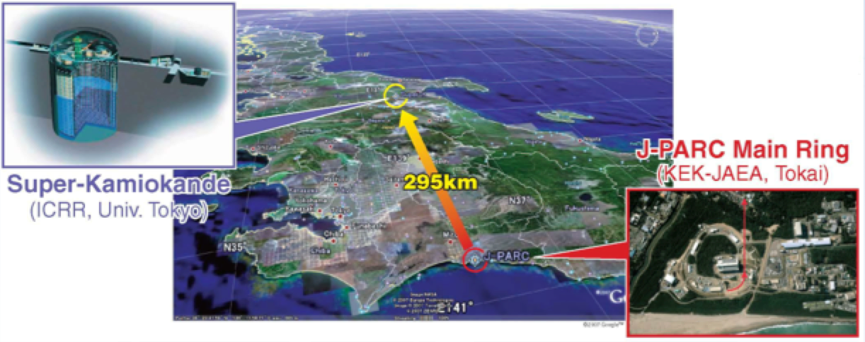
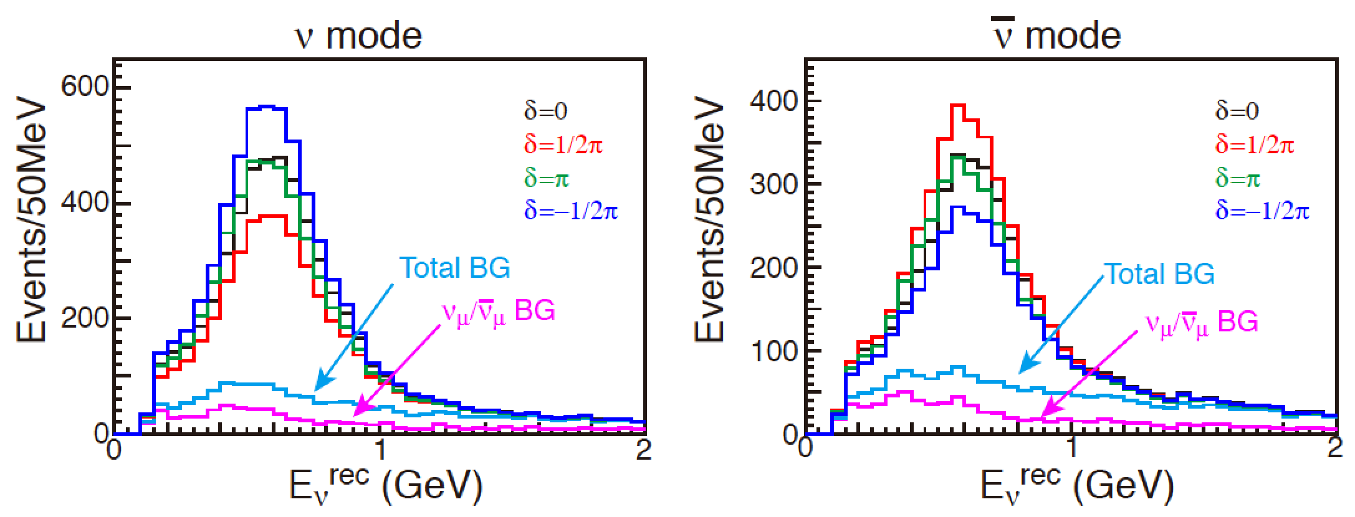
CPV measurement w/ J-PARC ν
Extension of T2K with Hyper-K
Distance: 295 km (short)
less matter effect: good for CP measurement
2.5 deg. Off-Axis Beam
➔ low energy (∼0.6 GeV) and narrow band beam
Similar to T2K ⬄ LBNE, LBNO
Hyper-Kamiokande
(Kamioka, Observatory,
ICRR, Univ. of Tokyo)
(-)
(-)
Look for ν_{μ} → ν_{e} appearance
Assumption: Total 7.5 MW year of running
ν mode: 0.75 MW x 3 yrs and ν mode: 0.75 MW x 7 years
After reconstruction and selections
sin²2θ₁₃=0.1
sin²2θ₂₃=1.0
sin²2θ₁₃=0.1
sin²2θ₂₃=1.0
Reconstructed
Neutrino Energy

Slide 36
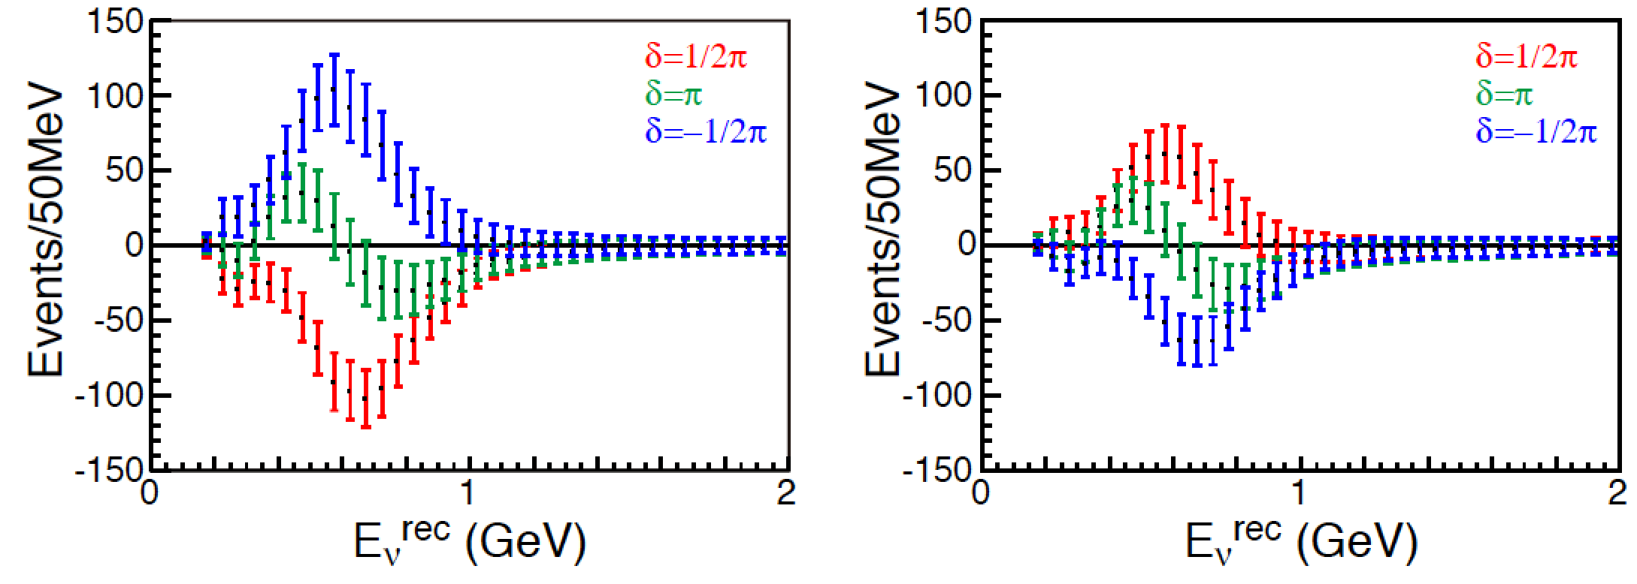
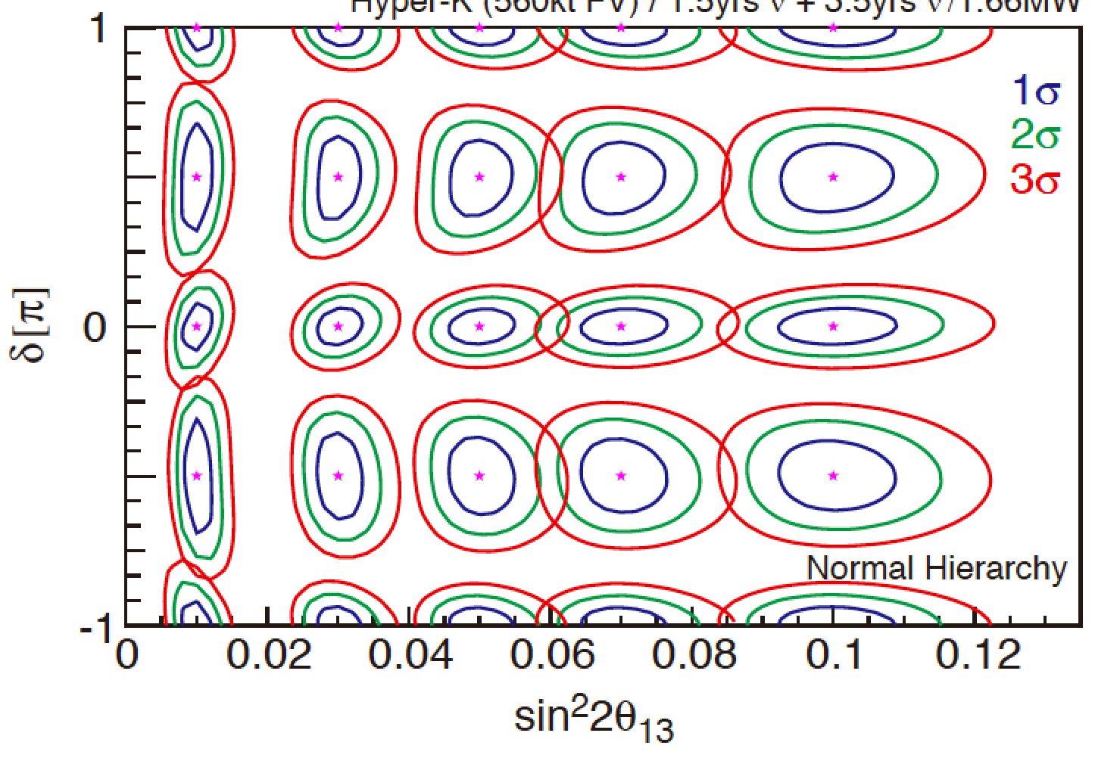
CPV measurement w/ J-PARC ν
Extension of T2K with Hyper-K
For total 7.5 MWyr of running
∼3,500 ν_{e} signal (total ∼1600 BG); ∼2,000 ν_{e} signal (Total ∼2000 BG)
Major BG: Beam ν_{e}/ν_{e} and NCπ⁰;
Wrong sign appearance of ν_{e} in ν_{μ} beam
ν
ν
Difference of the reconstructed neutrino energy distribution for δ_{CP} = 1/2π, π,-1/2π from δ_{CP} = 0 case
Reactor
θ₁₃: 1σ
( )
5% systematics on signal, ν_{μ} BG, ν_{e} BG
➔
δ_{CP} resolution < 10º (@ δ_{CP}=0)
Fractional δ range (CP can be discovered):
  74% with more than 3σ (known MH)
  55% with more than 3σ (MH not-known)
( )
Notes:
S/N ~ 2 for HK
S/N ~ 4 = 16.4/4
New pi0 rejection for T2K
HE region 1.25-2 GeV is included for HK

Slide 37
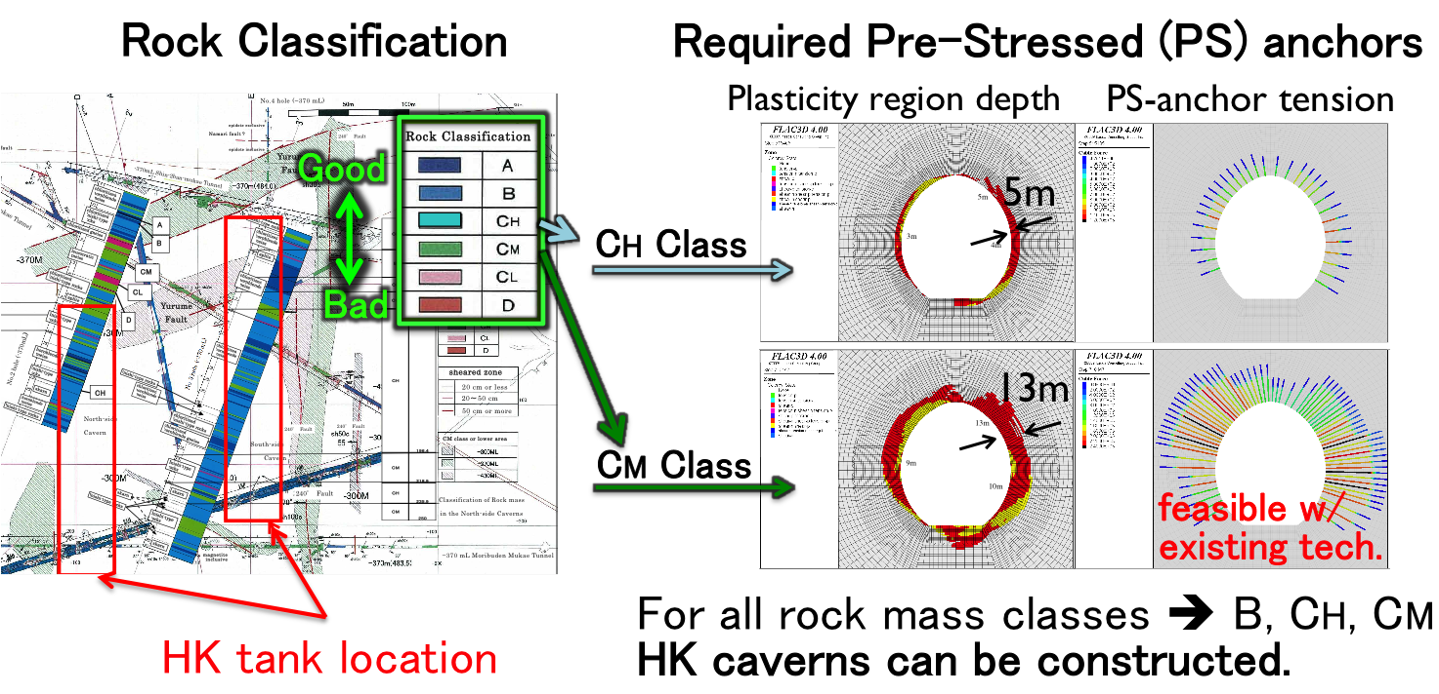
A candidate site and
Cavern stability analysis
Candidate site
  8 km south from Super-K
  648 m of rock overburden (1,750 m.w.e)
Notes:
目安としては、サポート（PSアンカー等）の届く範囲内。20m程度以
内。
上記の通り、Plasticity region depthがアンカーの届く範囲内におさま
っており、
PSアンカー応力が限界を超えていないことが条件です。黒のは、超えている。4本ある。

Slide 38
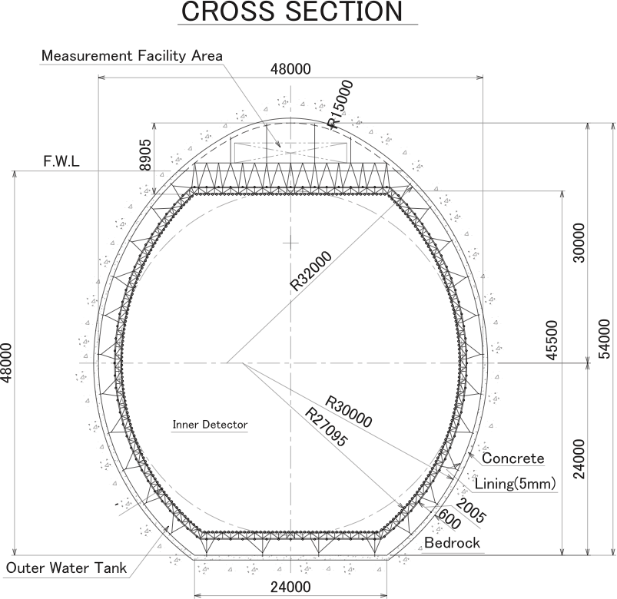
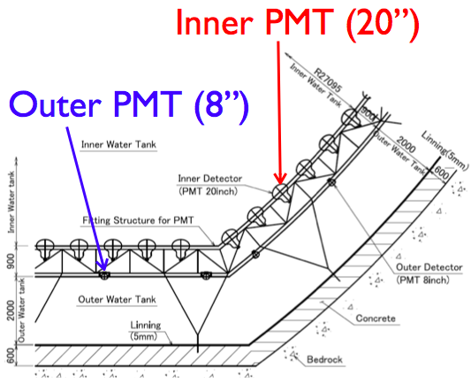
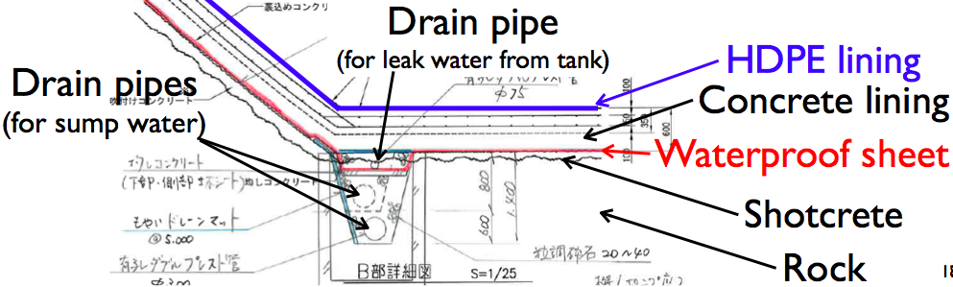
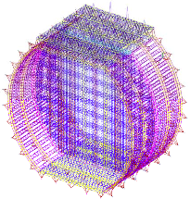
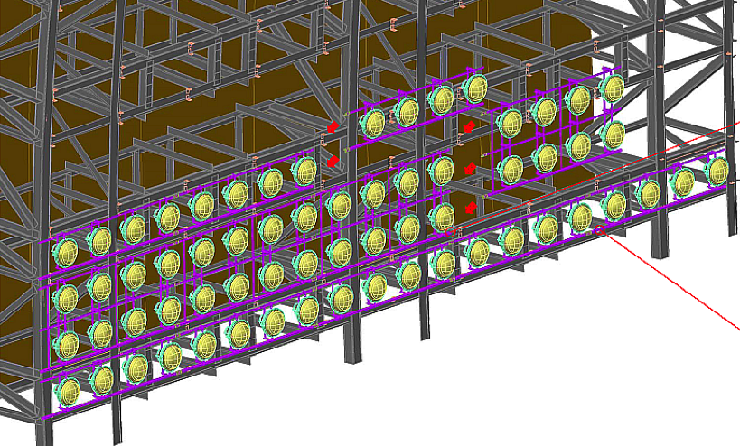
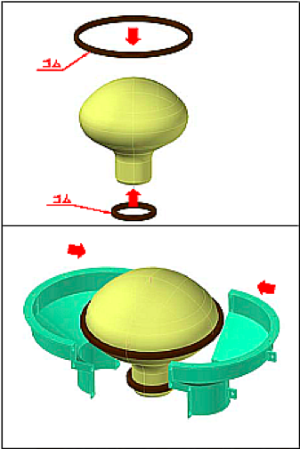
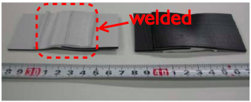
Tank and photo-sensor support
Baseline design of the water containment system and photo-sensor support are ready
Build a prototype detector (1kt)
  Funding request approved
Lining & drain system
Photo-sensor
support
Mounting Photo-sensor
Housing
Polyethylene sheet

Slide 39
Photo-sensor
Candidates for ID sensor
  50 cm Hybrid Photo Detector (HPD)
  (New 20” PMT as backup)
20 cm HPD prototype under evaluation
  Showing good basic performance.
  Proof test in a water tank (EGADS 200 ton) start soon.
50 cm HPD prototype is expected in a few month
8” HPD

Slide 40
Schedule
Construction start
Operation
HK construction takes ∼7 years
-4 | -3 | -2 | -1 | 1 | 2 | 3 | 4 | 5 | 6 | 7 | 8 | 9
Tunnels
Cavity excavation
Concrete, liner
HPD support, HPD installation
Photo-sensor R&D
HPD production
Prep. for glass valve
Water filling

Slide 41
Summary
After the discovery of the neutrino oscillation in atmospheric neutrinos in 1998, the study of the neutrino oscillation gets into the new stage.
We will explore the Mass Hierarchy, CP phase, Octant of θ₂₃ and so on. The future study of neutrino oscillation (especially CP phase) may explain the origin of the matter of the Universe, in conjunction with the determination of Majorana nature of neutrinos
The atmospheric neutrinos are again expected to make a crucial role in future studies.
Stay tune for the results from Super-K and a progress of Hyper-K

Slide 43
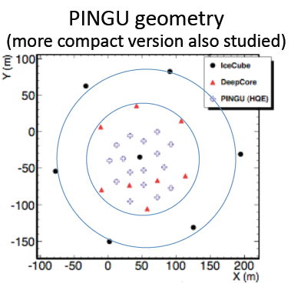


Quick MH ?
PINGU ?
  Add 20 strings with ~1000 optical modules inside the IceCUBE Deep Core region
  Expected energy threshold of 1 GeV
  Multi-Megaton effective mass
  Shorter path to the MH
    E. Akhmedov, S. Razzaque, A. Smirnov: arXiv: 1205.7071v2
S^{tot} = 7.2σ for 10% systematics
S^{tot} = 3.0σ for 10% systematics
σ_{E} =2 GeV, σ_{θ} =11.3º
σ_{E} =4 GeV, σ_{θ} =22.5º

