Slide 1


CERN now and in the future
Sergio Bertolucci
CERN

Slide 2
LHC: status
LHC run 1 ended on February 14, 2013
A fantastic concurrency of exceptional performances from the accelerators, experiments and computing
LS1 is now in full swing, while data analysis is proceeding at full speed.
A very busy and important period in front of us

Slide 3
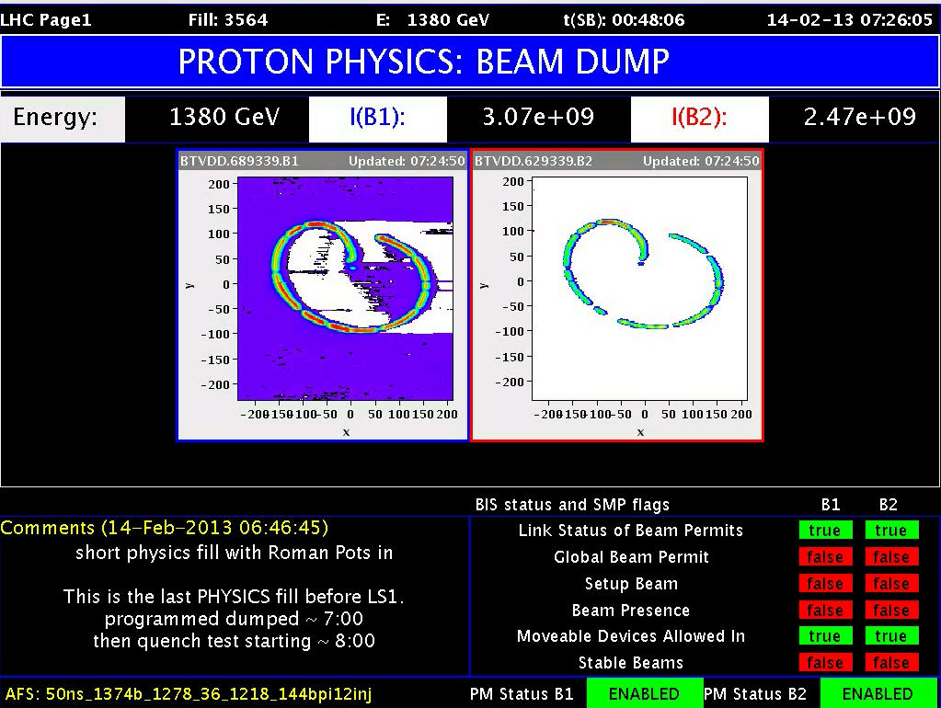
THE LAST PHYSICS BEAM OF LHC RUN 1 (2009 - 2013)

Slide 4
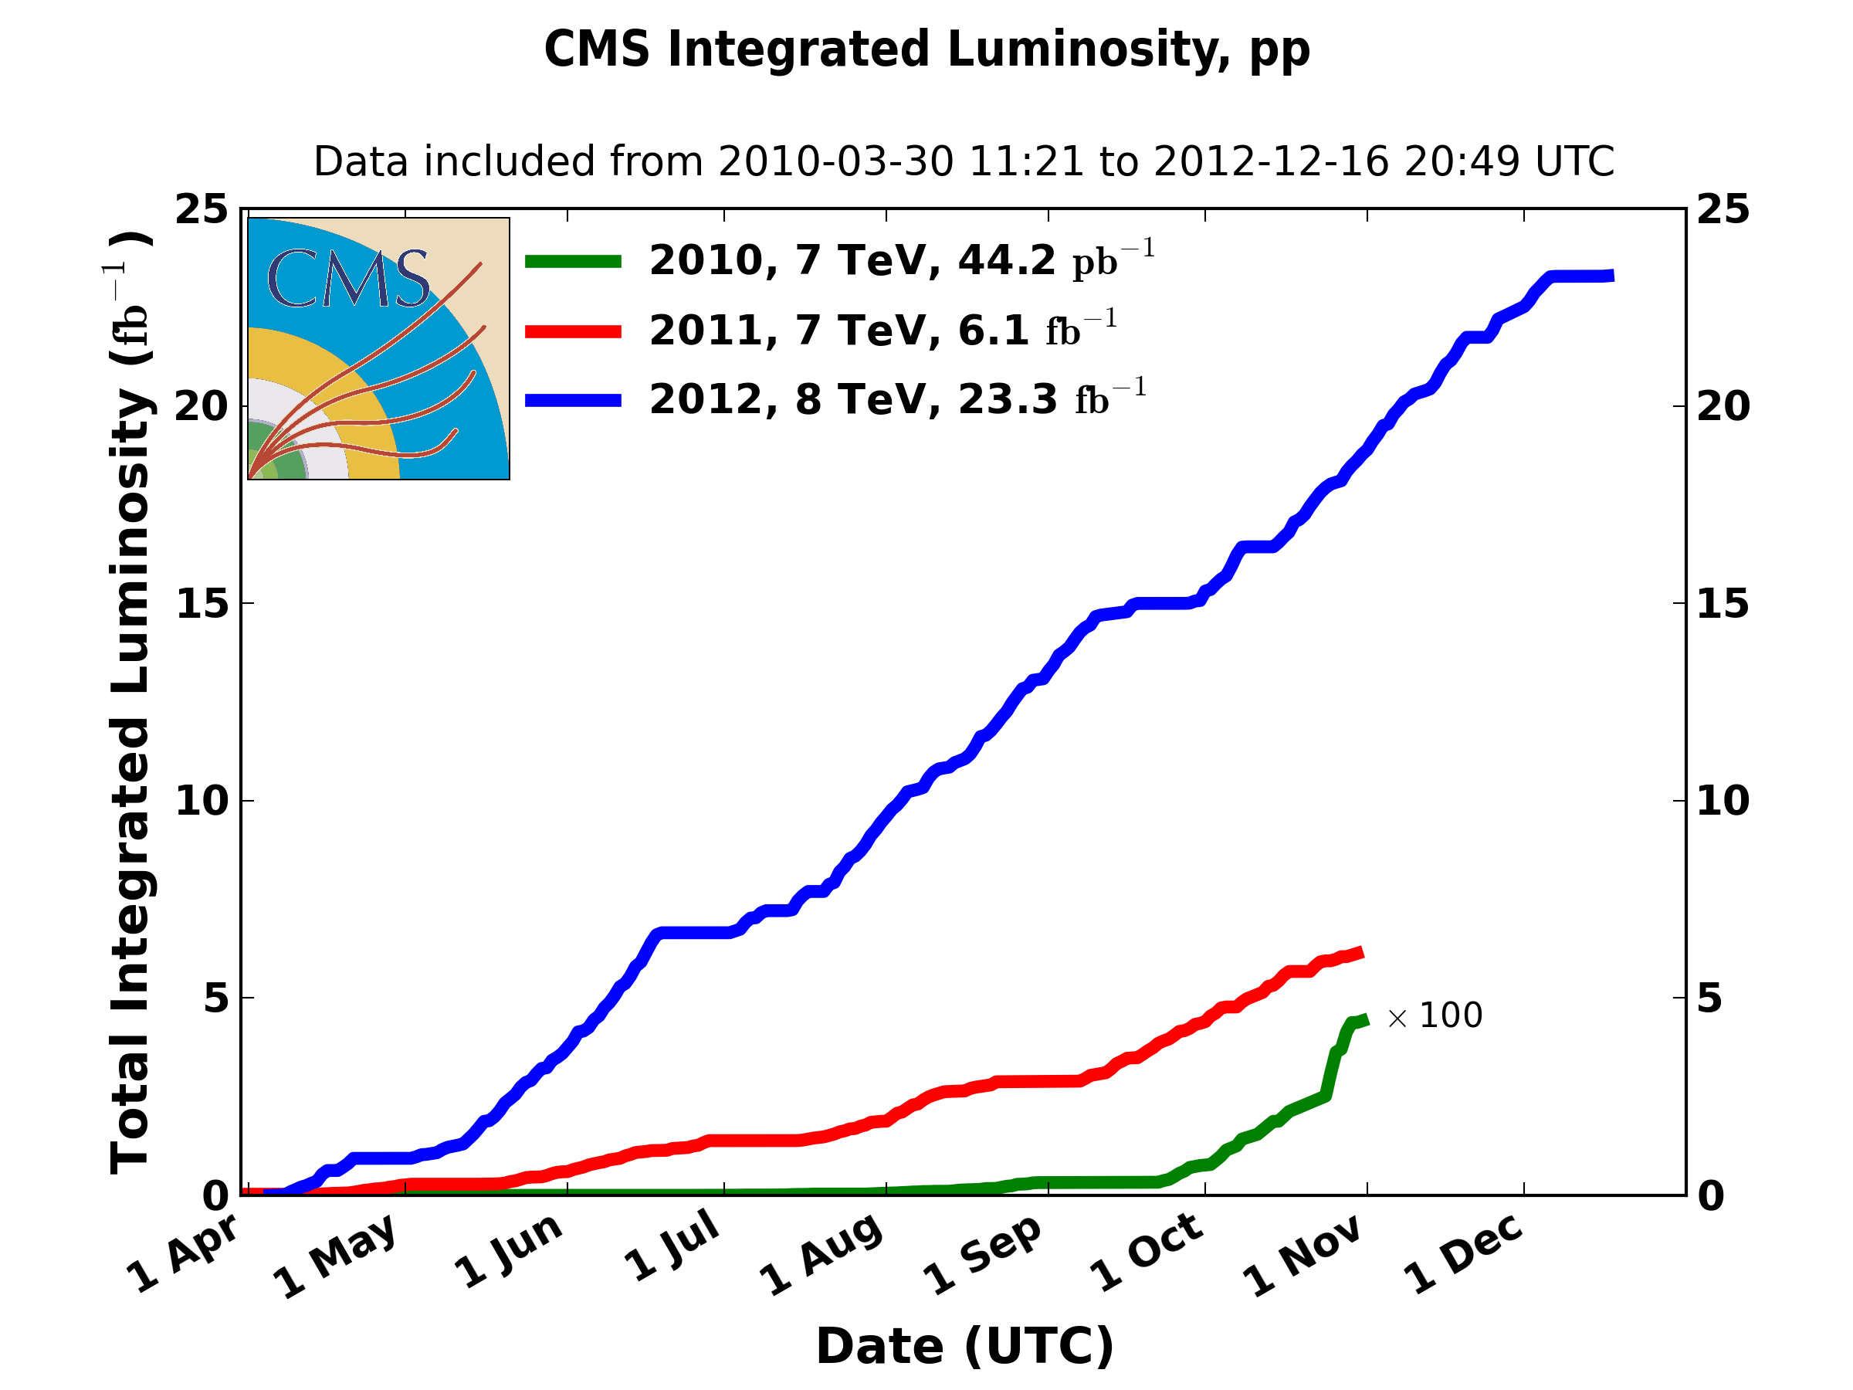
Last 3 years

Slide 5
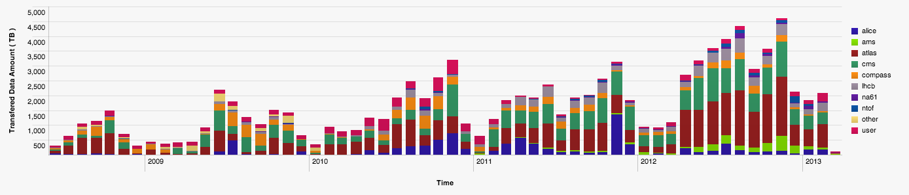
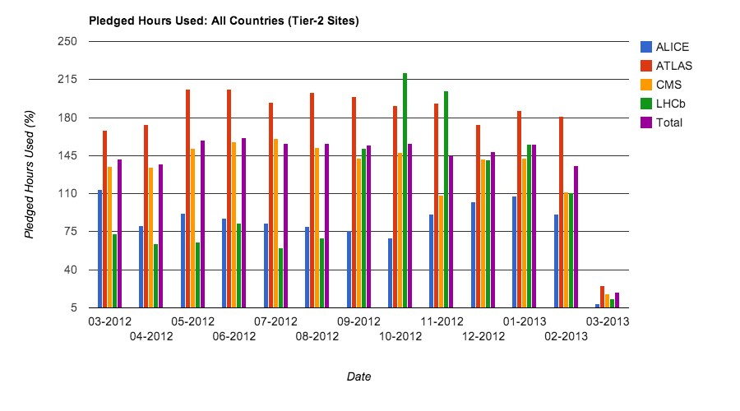
WLCG Status
Record amounts of data acquired ~30 PB in 2012; CERN archive now ~100 PB
Peaks of >4.6 PB/week in November
Data written into Castor per week
All resources fully used:
~ 2 million jobs/day
Use of CPU vs pledges (plot shows Tier 2s)
>100% for Tier 1 & 2
Occupation of Tier 0 will → 100% during LS1

Slide 6
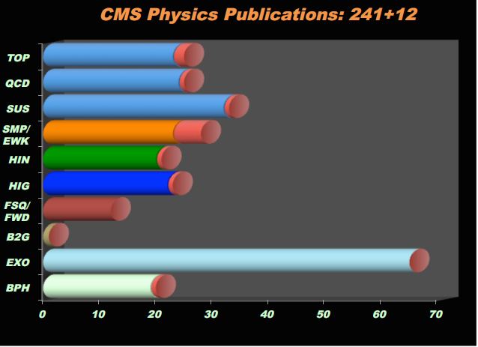
Published papers
LHCb
+
66 from ALICE
9 from TOTEM
9 from LHCf

Slide 7
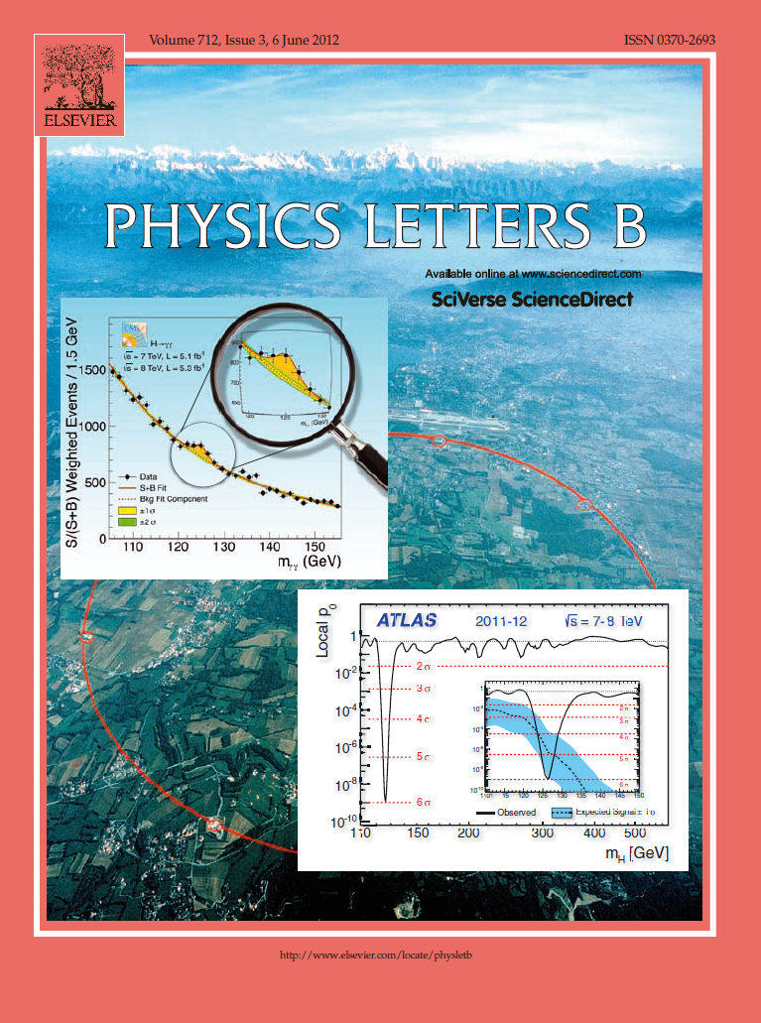

The highlight of a remarkable year 2012

Slide 8
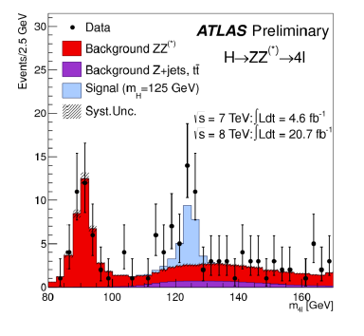
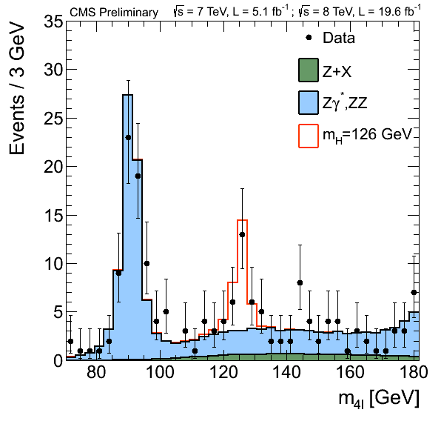
A new particle: no doubt that it is there…
By now we can establish it with a single decay channel!
e.g. H → ZZ → 4l

Slide 9
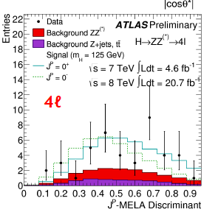
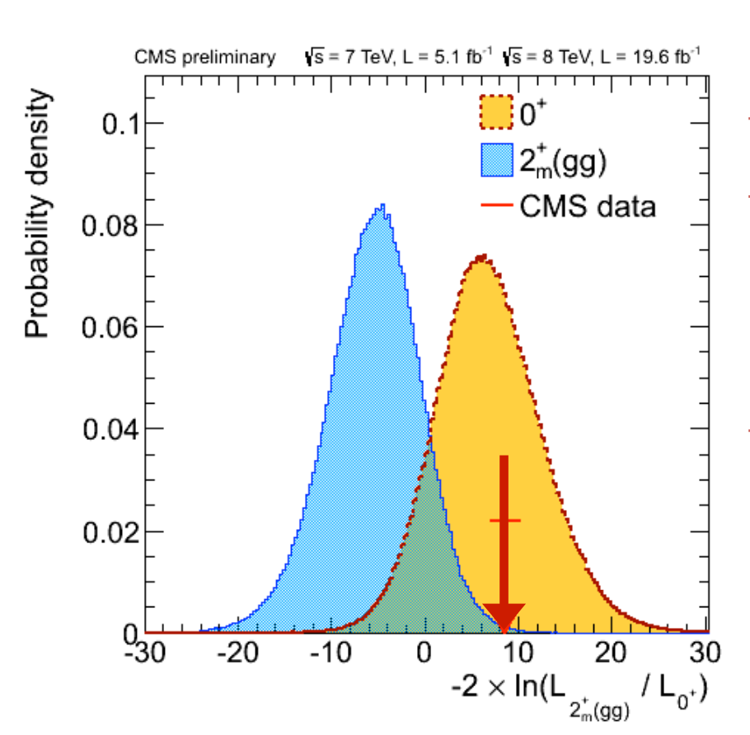
…it prefers 0⁺ quantum numbers

Slide 10
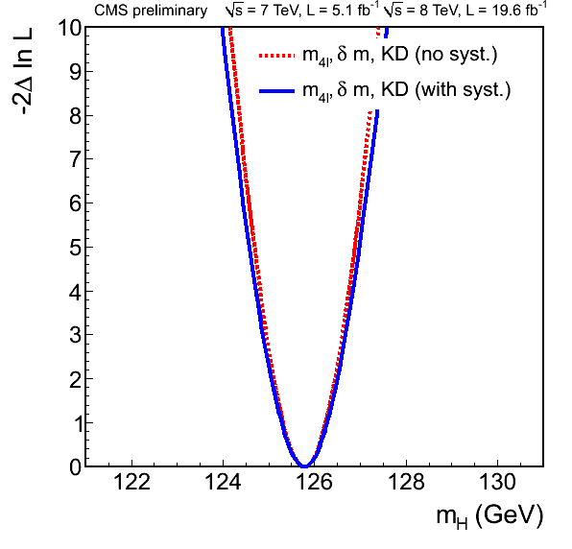
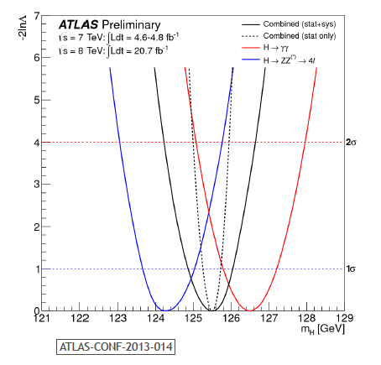


…its mass is measured to .5%

Slide 11
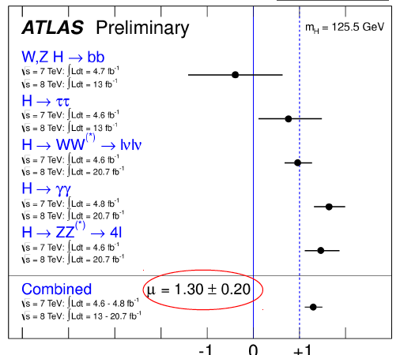
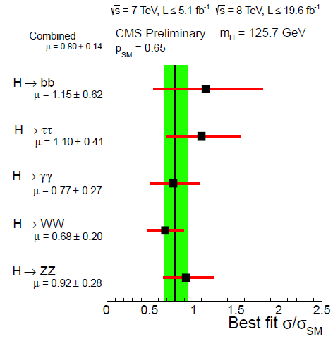
…and the signal strength is compatible with a SM Higgs
μ = 0.80±0.14

Slide 12
But, despite its success…
…. we know that the Standard Model is not complete because:
It doesn’t solve the hierarchy problem
It has no explanation for dark matter/dark energy
Its mechanisms of CPV are too small to explain matter/antimatter imbalance
It cannot provide a QFT of gravitation
….etc

Slide 13
Where we stand
There is a new boson of mass ~125 GeV, with properties consistent with the SM Higgs, within the current uncertainties. More data needed to ascertain the nature of this object.
So far, no indications of BSM physics from direct searches at the High E Frontier:
  colored SUSY particles (first generations) ruled out up to O(1 TeV), for a light LSP;
  “natural” SUSY probed at level of a few hundred GeV of 3rd generation spartners;
  exotica: heavy objects probed up to masses of 2-3 TeV;
  a lot of room still to be explored, 14 TeV will be essential!

Slide 14



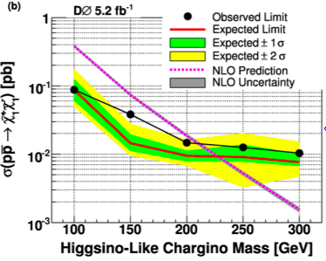

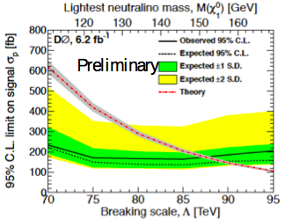
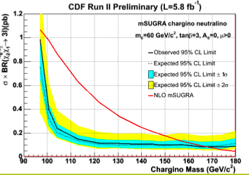

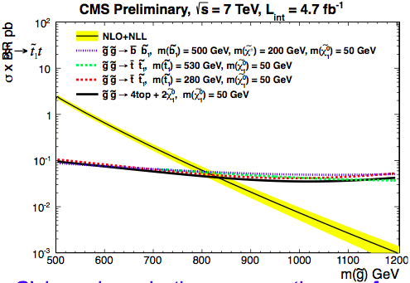
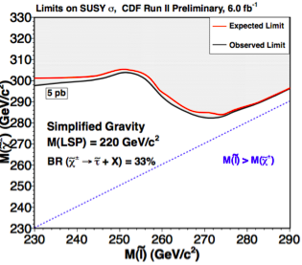


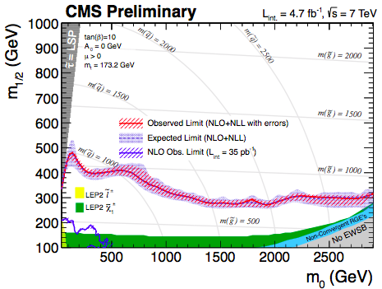

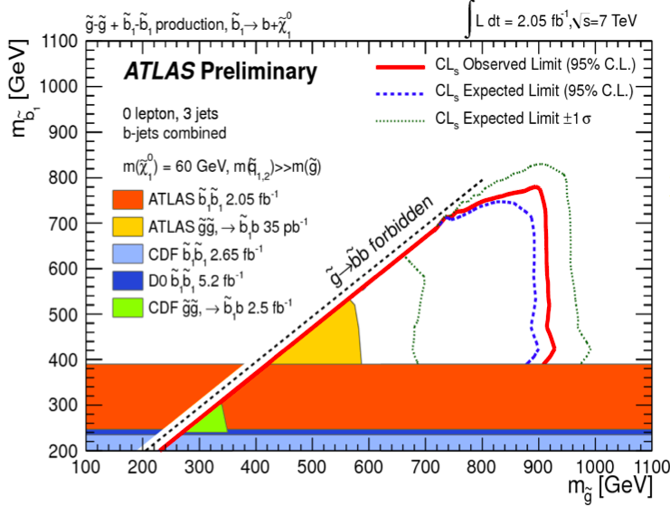

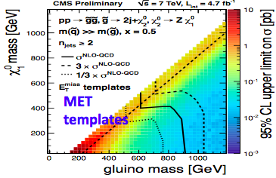

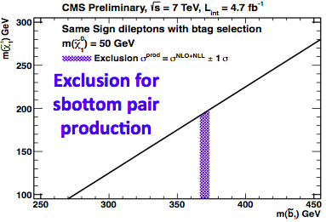
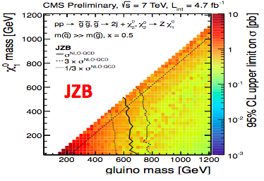

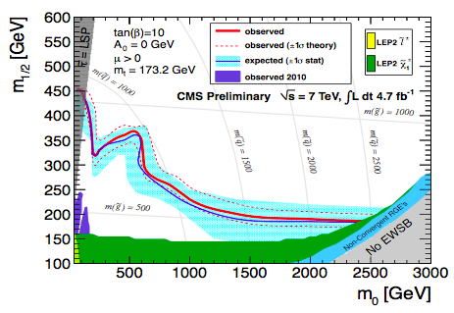



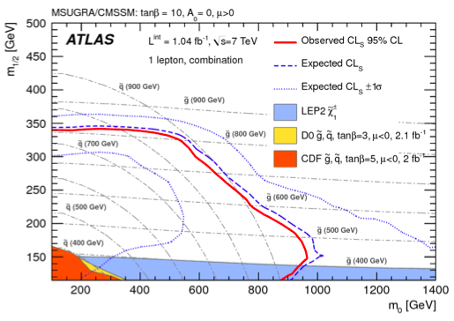
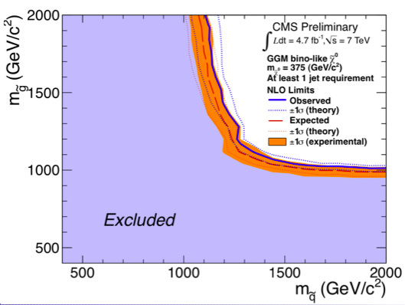
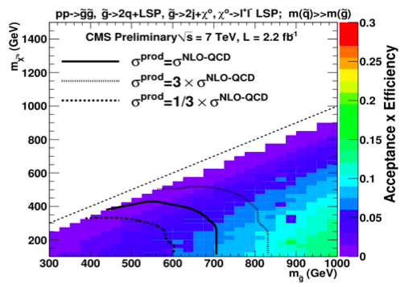

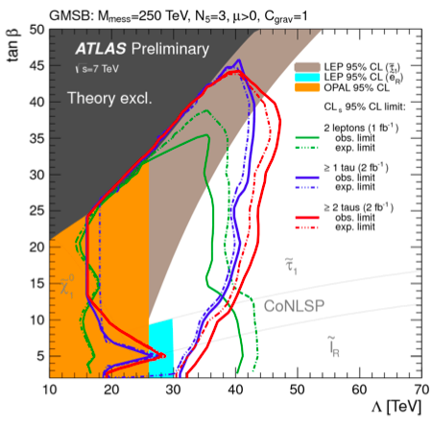

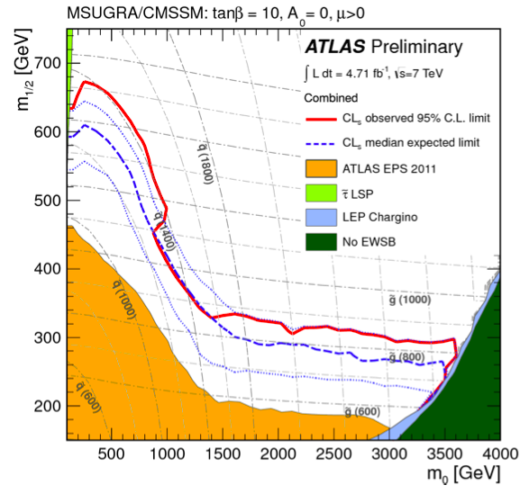


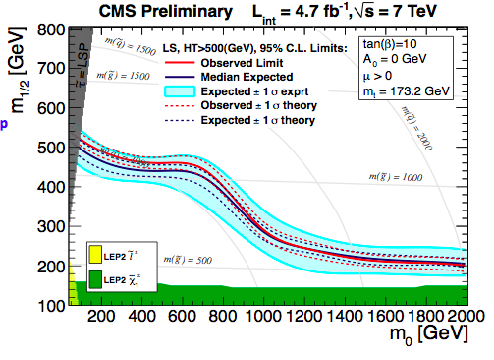
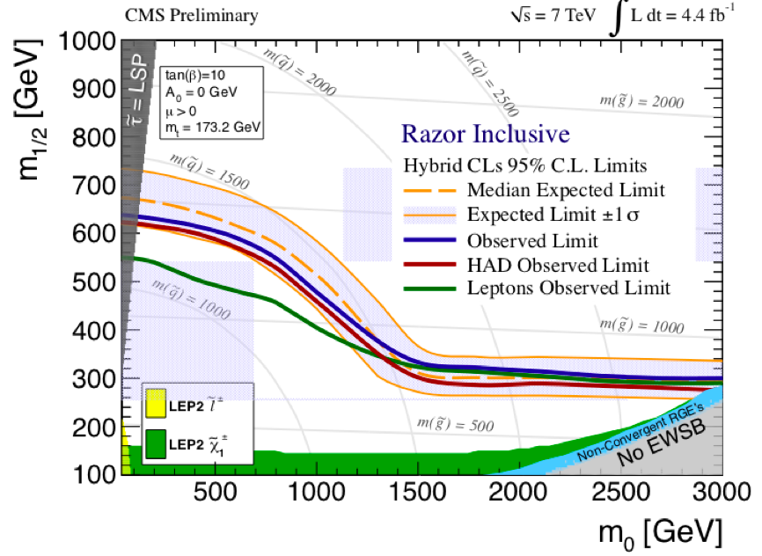


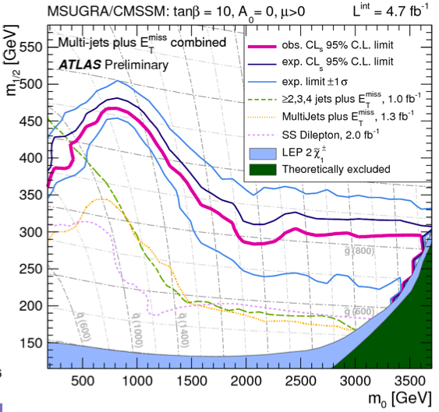
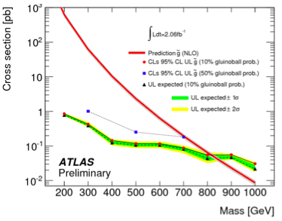


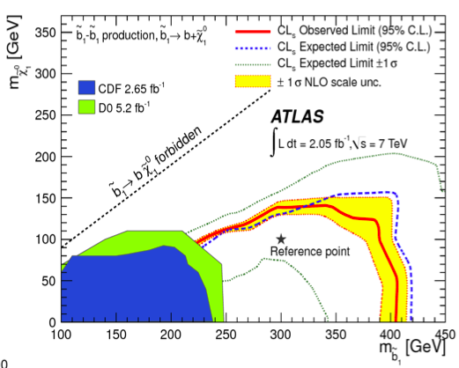


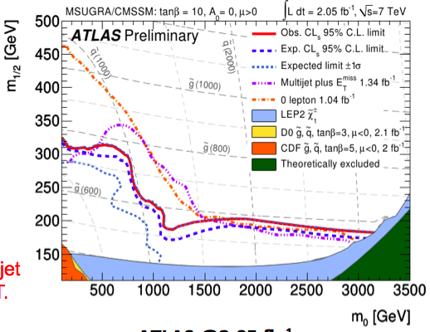
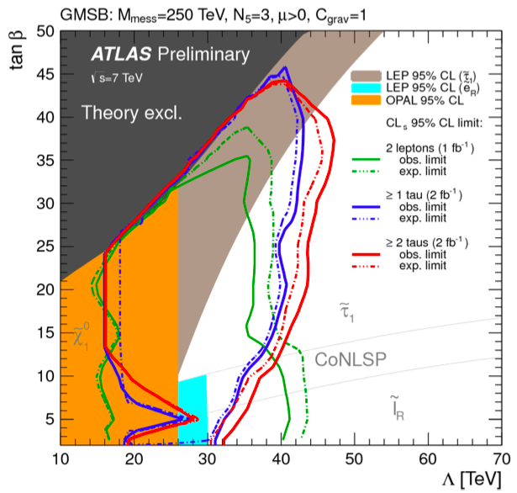
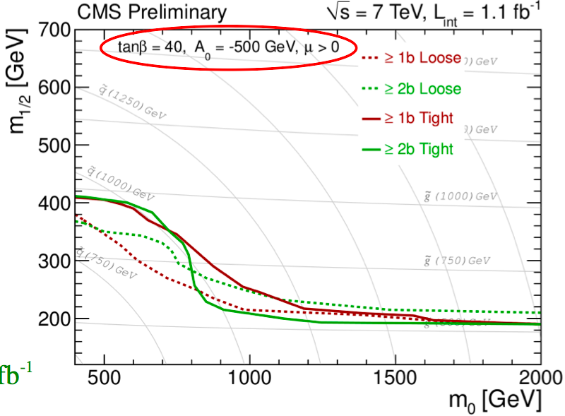


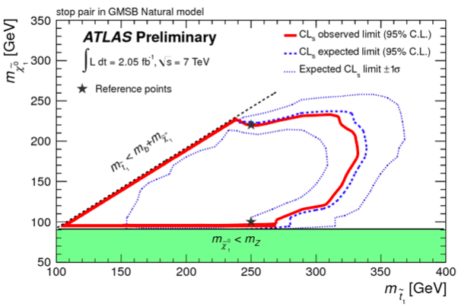

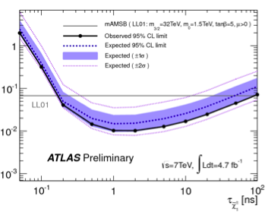

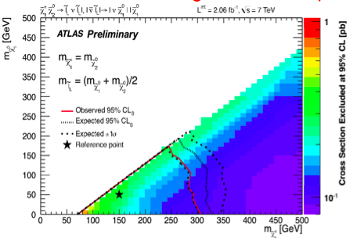
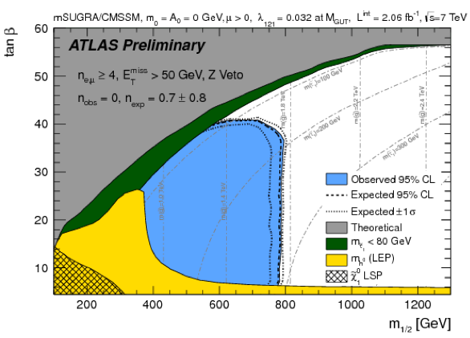
BSM: we have searched....
eg. exclusions plots shown at Moriond QCD 2012....

Slide 15
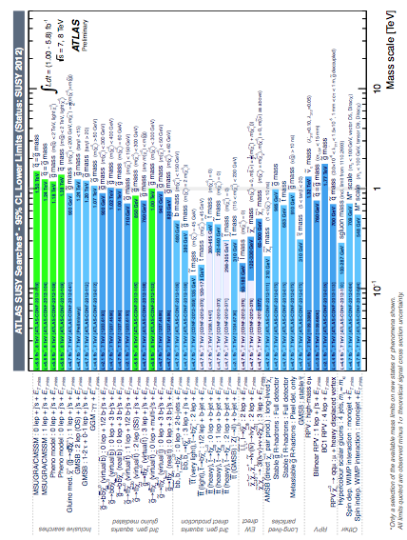
The big picture
inclusive searches
https://twiki.cern.ch/twiki/bin/view/AtlasPublic/CombinedSummaryPlots
Natural SUSY
long-lived particles,
eg. split SUSY
RPV

Slide 16
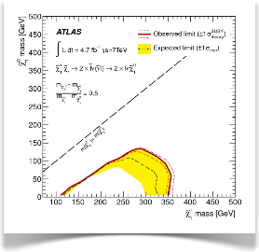
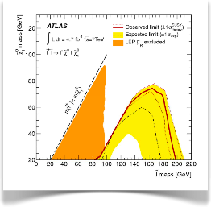
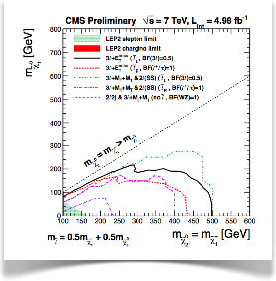

SUSY health
The experiments have already explored a very vast range of masses and parameters
Though, too early to declare SUSY’s death, since there remain important parameter regions to be explored, and because
  Difficult or impossible to give “absolute” limits, since basically always assumptions involved
  limits quickly degrade or disappear when raising m(LSP) beyond several hundreds of GeV
  inclusive searches often assume degenerate 1st and 2nd generation squarks. Limits decrease (by several hundreds of GeV) if this is given up
  simplified models make strong assumptions on branching ratios, masses of intermediate states
  theory uncertainties (cross sections/scales/pdfs, initial state radiation)

Slide 17
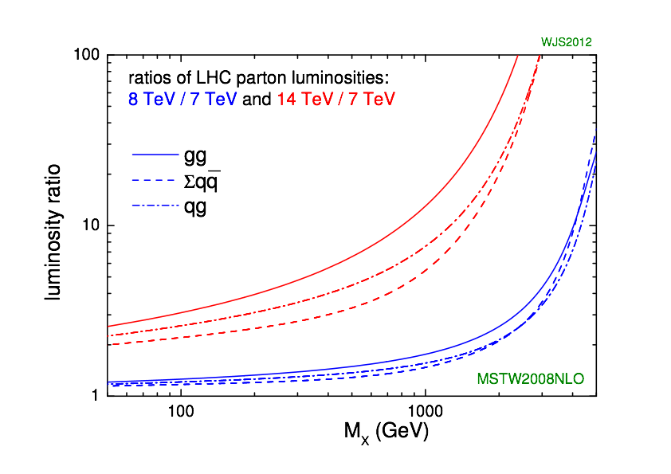
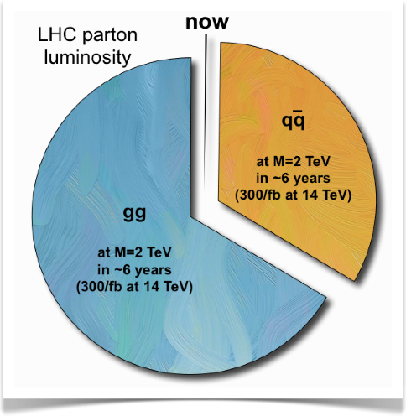

Parton luminosities
from http://www.hep.phy.cam.ac.uk/~wjs/plots/plots.html
40-50
rise because of steep
fall-off of the lower-energy PDF, at large x
2 TeV
for a fixed mass scale
G. Rolandi, private comm.

Slide 18
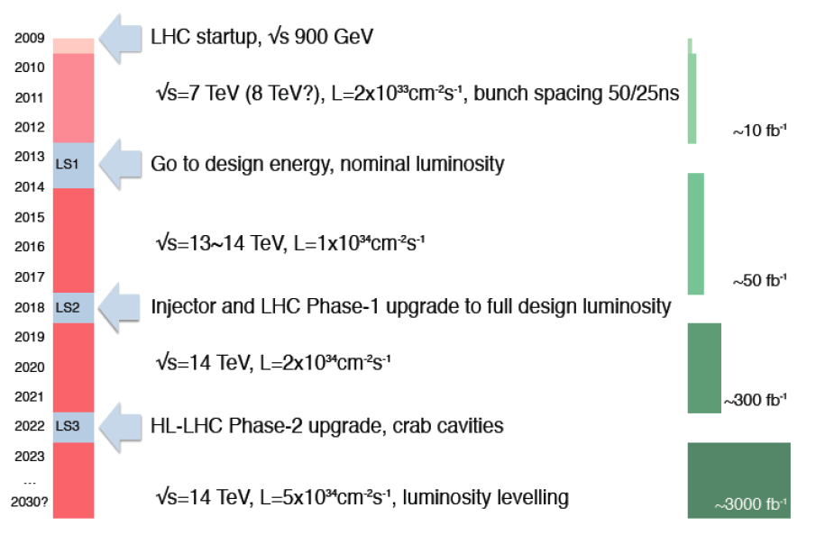
LHC, the next 20 years
LHC startup, √s = 900 GeV
4x
, bunch spacing 50 ns
√s=7~8 TeV, L=6x10³³ cm⁻² s⁻¹, bunch spacing 50 ns
~20-25 fb⁻¹
Go to design energy, nominal luminosity
√s=13~14 TeV, L~1x10³⁴ cm⁻² s⁻¹, bunch spacing 25 ns
, bunch spacing 25 ns
~75-100 fb⁻¹
Injector and LHC Phase-1 upgrade to ultimate design luminosity
√s=14 TeV, L~2x10³⁴ cm⁻² s⁻¹, bunch spacing 25 ns
, bunch spacing 25 ns
~350 fb⁻¹
HL-LHC Phase-2 upgrade, IR, crab cavities?
?, IR
√s=14 TeV, L=5x10³⁴ cm⁻² s⁻¹, luminosity levelling

Slide 19
The machine – LS1
Repair defective interconnects
Consolidate all interconnects with new design
Finish off pressure release valves (DN200)
Bring all necessary equipment up to the level needed for 7TeV/beam

Slide 20
Then…
E=6.5TeV
β* = 0.5m (maybe 0.4)
All other conditions as in 2012 i.e. LHC availability same, etc..

Slide 21
The experiments
A new mode of operations:
All busy in repairs, consolidations, first upgrades
Massive amount of work, with a very tight schedule…
…while keeping looking at the data, prepare for the next energy
…and proceed to a very substantial progress in their computing models.
It will need a massive recommissioning, if they want to be at the same readiness level as in 2010

Slide 22
The experiments, upgrades
Fully engaged in the LS2 upgrades, which is particularly demanding for LHCb and ALICE
Active R&D programs on the BIG upgrades in 2022
Need to use the coming run to better focus the program

Slide 23
Extending the reach…
Weak boson scattering
Higgs properties
Supersymmetry searches and measurements
Exotics
t properties
Rare decays
CPV
..etc
Experiments are planning a workshop in October 2013 to assess their physics reach and the implications on the detector upgrades and associated R&D

Slide 24
HL-LHC: the detector upgrades
Both ATLAS and CMS detectors are planning important upgrades to stand the harsher running conditions at HL-LHC: pile-up, rates, radiation damage
  Pile-up ~ 4-5 times more pile-up then today
Plan: keep detector performance for main physics objects at the same level as we have today
  Improved trigger system
  New tracking systems
  Improved forward detectors
  ….

Slide 25

and beyond LHC ?
Notes:
25

Slide 26
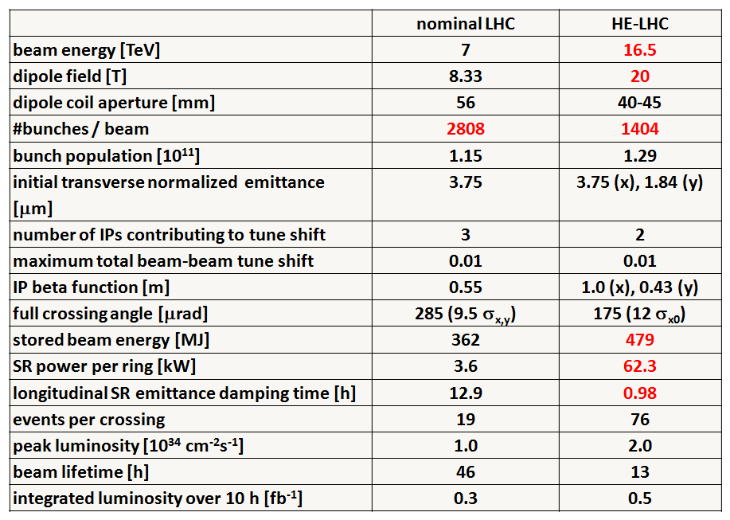
Preliminary HE-LHC - parameters
Not only luminosity: High Energy LHC
Very preliminary with large error bars

Slide 27

HE-LHC – LHC modifications
HE-LHC
2030-33
SPS+,
1.3 TeV, 2030-33
2-GeV Booster
Linac4

Slide 28

Thinking BIG
This large tunnel would also allow e+e- and e-p collisions as well as pp collisions
HE-LHC dipole design will piggy back on the high gradient quadrupole R&D needed for HL-LHC
  Would allow an increase in energy by factor of 2-2.5
SHE-LHC (??SSC) needs a 80km tunnel
  In conjunction with the high field magnets would allow a factor of (2-2.5)x(80/27) = 6-7.5 times LHC (42-52 TeV/beam)

Slide 29
The Particle Physics Landscape at CERN
High Energy Frontier
LHC
Hadronic Matter
deconfinement
non-perturbative QCD
hadron structure
Low Energy
heavy flavours / rare decays
neutrino oscillations
anti-matter
Non-accelerator
dark matter
astroparticles
Multidisciplinary
climate, medicine
Non-LHC Particle Physics = o(1000) physicists / o(20) experiments
In the past 1.5 year
Several breakthroughs !
Steady progress of other programs
New mid-term and long-term projects started or in discussion

Slide 30


Slide 31


Slide 32


Slide 33


Slide 34
In summary
2010-2012: extraordinary years!
But we are just at the beginning of a long journey.
By now, experimental results are dictating the agenda of the field.
We need to accelerate the reflection on next steps
Interesting times in front of us!

Slide 35
Thank you!

