Slide 1
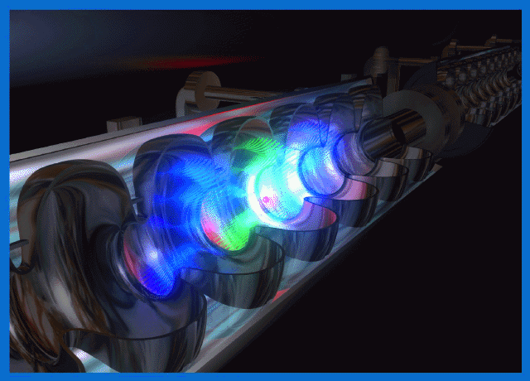
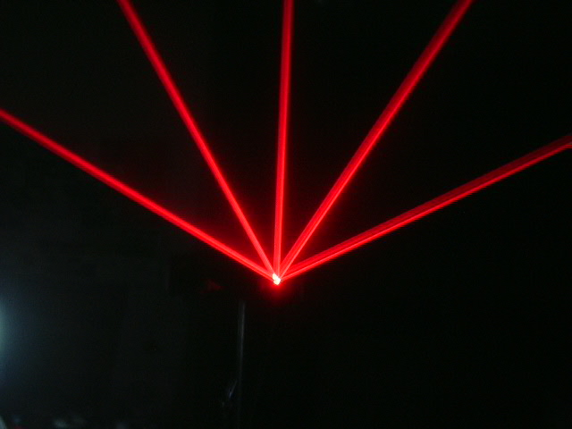
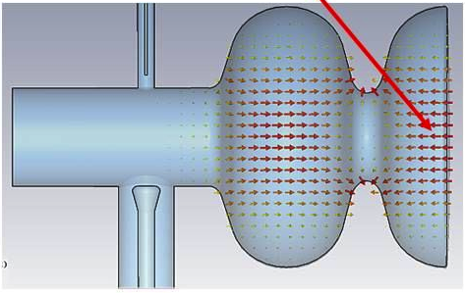
I R I D E is a large infrastructure for fundamental and applied physics research. Conceived as an innovative and evolutionary tool for multi-disciplinary investigations in a wide field of scientific, technological and industrial applications, it will be a high intensity “particle beams factory”,
n
e⁺
PWA
3
GeV
1.5
GeV
1.5
GeV
CRYO
CRYO
Interdisciplinary Research Infrastructure with Dual Electron linac&laser

Slide 2
Lunedì 11/02 si è tenuta una riunione a LNF di “Preparazione alla Giornata di Studio” su IRIDE, da organizzarsi a LNF il 14 e 15 marzo
Scopo della giornata: organizzare i Working Groups per il CDR. Ogni WG avrà 2-3 conveners che descriveranno lo stato delle tematiche del WG, le interazioni con gli altri WG e i problemi da affrontare per la stesura del CDR
Il CDR è atteso entro l’estate
La partecipazione della nostra Sezione è prevista molto consistente e rilevante

Slide 3
WG1: Electron Machine (SC Linac and Cryogenics) MI A) Physics of and with FELs (including Detectors) MI B) THz C) Neutron Source E) Injectors MI
WG2: Photon Machine (Lasers and Optical Systems) MI A) Nuclear Physics MI B) gamma-gamma and electron-gamma colliders MI C) Comtpon Sources MI
WG3: Electron-Positron and El.-El. Collider MI
WG4: Advanced Accelerator R&D MI
WG5: Site, Infrastructure, Implementation Plan

Slide 5
I R I D E
Interdisciplinary Research Infrastructure with Dual Electron linacs
Massimo.Ferrario@lnf.infn.it
on behalf of
D. Alesini¹, M. P. Anania¹, M. Angelone, D. Babusci¹, A. Bacci³, A. Balerna¹, M. Bellaveglia¹, M. Benfatto¹, R. Boni¹, R. Bonifacio⁷, M. Boscolo¹, F. Bossi¹, B. Buonomo¹, M. Castellano¹, L. Catani⁴, M. Cestelli-Guidi¹, V. Chiarella¹, A. Clozza¹, A. Cianchi⁴, R. Cimino¹, F. Ciocci¹⁴, E. Chiadroni¹, C. Curceanu¹, S. Dabagov¹, G. Dattoli¹⁴, P. De Felice⁵, G. Delle Monache¹, D. Di Gioacchino¹, D. Di Giovenale¹, E. Di Palma¹⁴, G. Di Pirro¹, A. Doria¹⁴, U. Dosselli¹, A. Drago¹, A. Esposito¹, R. Faccini², M. Ferrario¹, G. P. Gallerano¹⁴, A. Gallo¹, M. Gambaccini¹¹, C. Gatti¹, G. Gatti¹, A. Ghigo¹, L. Giannessi¹⁴, F. Giorgianni², E. Giovenale¹⁴, C. Guaraldo¹, R. Gunnella⁸, S. Ivashyn¹², S. Loreti⁵, S. Lupi², A. Marcelli¹, C. Mariani¹⁶, M. Mattioli², G. Mazzitelli¹, P. Michelato³, M. Migliorati², C. Milardi¹, E. Milotti¹³, S. Morante⁴, D. Moricciani², A. Mostacci², V. Muccifora¹, P. Musumeci¹⁰, E. Pace¹, C. Pagani³, L. Palumbo², M. Pedio, A. Perrone⁹, A. Petralia¹⁴, V. Petrillo³, P. Pierini³, A. Pietropaolo, M. Pillon, R. Pompili⁴, C. Quaresima¹⁵, L. Quintieri⁵, J. V. Rau, C. Ronsivalle¹⁴, J. B. Rosenzweig¹⁰, A. R. Rossi³, E. Sabia¹⁴, L. Serafini³, D. Sertore³, O. Shekhovtsova¹², I. Spassovsky¹⁴, T. Spadaro¹, B. Spataro¹, V. Surrenti¹⁴, A. Tenore¹, A. Torre¹⁴, C. Vaccarezza¹, A. Vacchi¹³, P. Valente², G. Venanzoni¹, S. Vescovi¹, F. Villa¹, N. Zema¹⁵, M. Zobov¹.

Slide 7
I R I D E
Interdisciplinary Research Infrastructure with Dual Electron linac&laser
Massimo.Ferrario@lnf.infn.it
on behalf of
(1) INFN-LNF
(2) INFN and Universita’ di Roma”La Sapienza”
(3) INFN and Universita’ di Milano
(4) INFN and Universita’ di Roma”Tor Vergata”
(5) Istituto Nazionale di Metrologia delle Radiazioni Ionizzanti, ENEA C R Casaccia.
(7) Universidade Federal da Paraiba, Brazil
(8) Universita’ di Camerino
(9) INFN and Universita’ del Salento
(10) UCLA, Los Angeles, USA
(11) INFN and Universita’ di Ferrara
(12) ITP NSC KIPT, Kharkov, Ukraine
(13) INFN and Universita’ di Trieste
(14) ENEA – Frascati
(15) CNR
(16) CNISM and Universita’ di Roma”La Sapienza”

Slide 8
We can foresee a large number of possible activities, among them:
Science with Free Electron Lasers (FEL) from infrared to X-rays,
Nuclear photonics with Compton back-scattering g-rays sources,
Fundamental physics investigations with low energy linear colliders
Advanced Neutron sources by photo-production,
Science with THz radiation sources,
Physics with high power/intensity lasers,
R&D on advanced accelerator concepts including plasma accelerators and polarized positron sources
ILC technology implementation
Detector development for X-ray FEL and Linear Colliders
R&D in accelerator technology and industrial spin – off

Slide 9
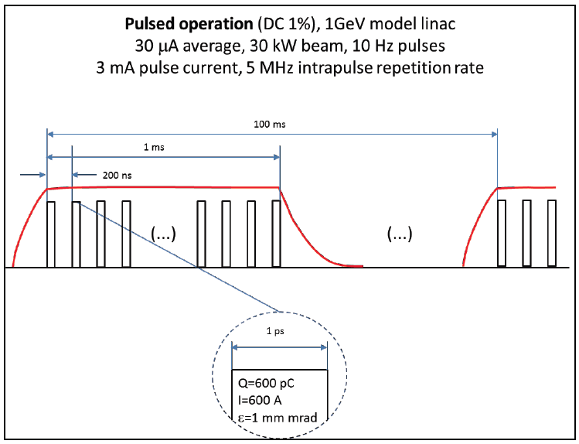
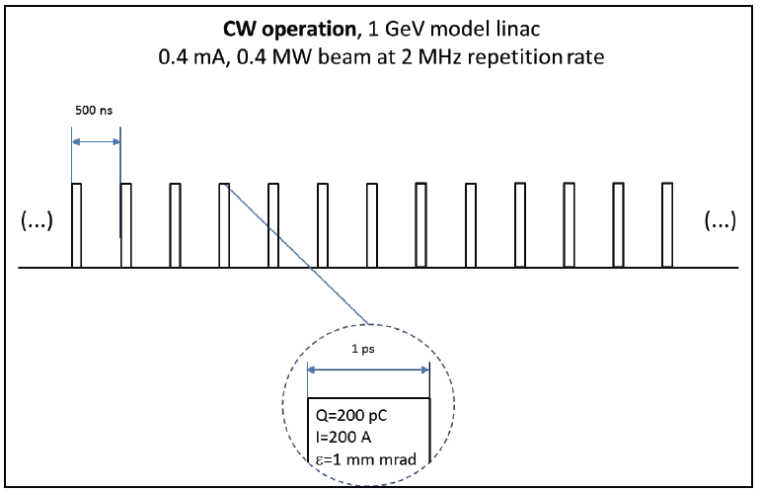
The main feature of a SC linac relevant for IRIDE is the possibility to operate the machine in continuous (CW) or quasi-continuous wave (qCW) mode with high average beam power (>1 MW) and high average current (>300 μA). The CW or qCW choice, combined with a proper bunch distribution scheme, offers the most versatile solution to provide bunches to a number of different experiments, as could be envisaged in a multi-purpose facility.

Slide 10
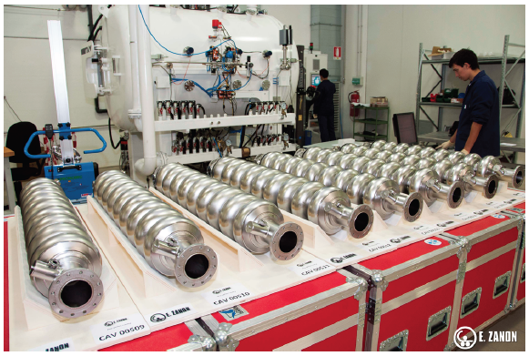
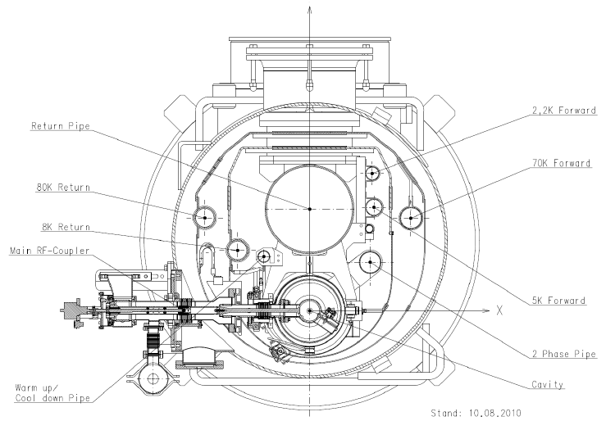
INFN is in a leading position in the SC RF technology, with knowledge and strong capabilities in the design, engineering and industrial realization of all the main component of a superconducting radiofrequency accelerator. INFN strongly participated to TESLA since the early design stages through the final engineering and shares the know-how and has the recognized intellectual property of several main components one of which is the cryo-module concept and its evolution.

Slide 11
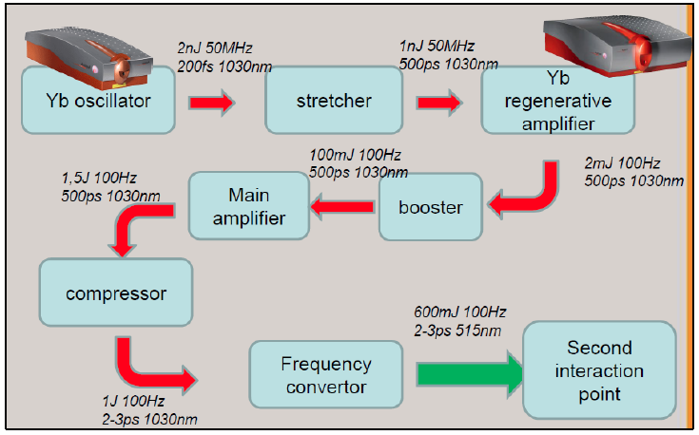
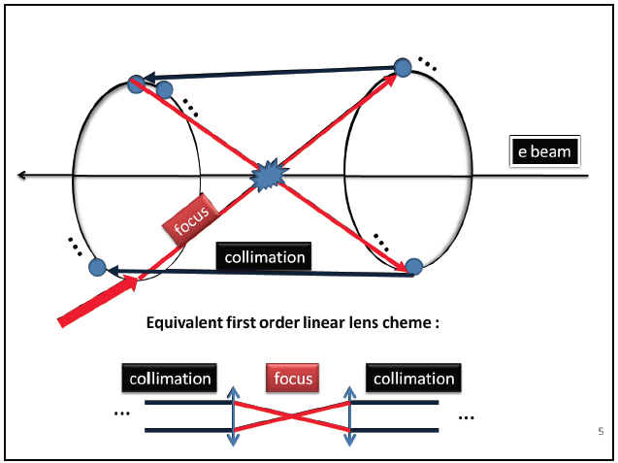
The laser system complex is deputed to deliver optical photon beams able to fulfill the several requirements of the IRIDE facility:
drivers of photo-cathodes for electron beam generation
colliding laser pulses to drive the back-scattering Compton (Yb:YAG, 100 W, 1 J, 0.1% bw)
drivers for high advanced acceleration experiments (Ti:Sa, 1 PW, 10²² W/cm²)

Slide 12
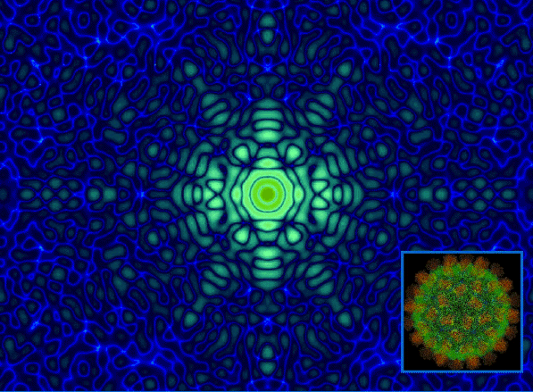
Science with FEL
The IRIDE project will provide a new concept of FEL facility by merging the two technologies of FEL oscillators and fourth generation radiation sources by developing a facility providing radiation from IR to EUV to the nm region down to Å level using a mechanism of emission already successfully tested at SPARC.
3
GeV
1.5
GeV
1.5
GeV
CRYO
CRYO

Slide 13
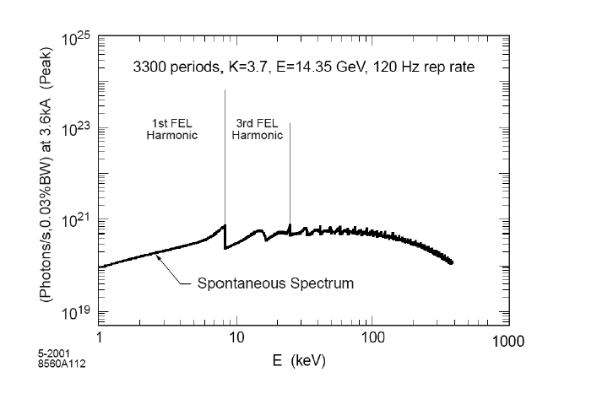
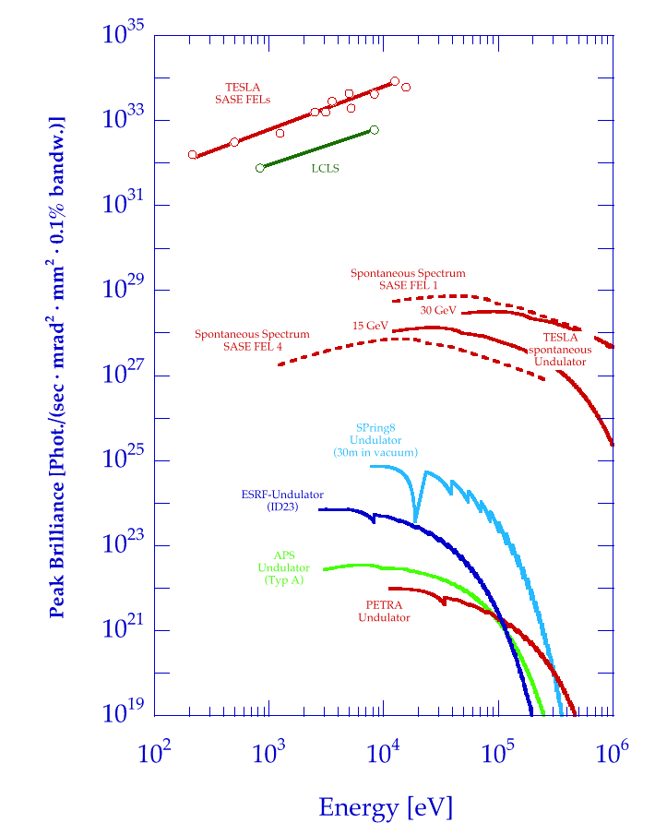
A Free Electron Laser is a device that converts a fraction of the electron kinetic energy into coherent radiation via a collective instability in a long undulator
12.4
1.24
0.124
l (nm)
SPARX
Radiation properties:
GW power - Monocromaticity - Tunability from IR to X– Short pulses

Slide 14
Science with FEL

Slide 15
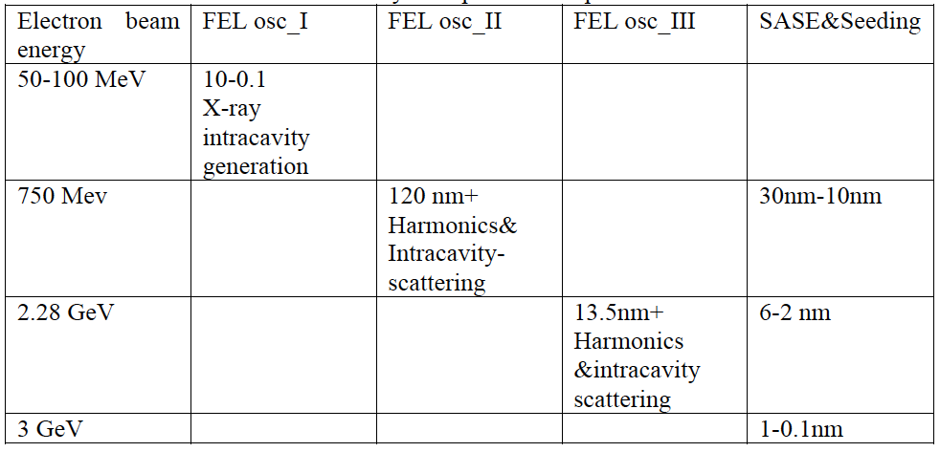

Slide 16
Neutron Source
A Neutron Source can be realized by photo-production sending high energy electrons on a suitable high Z target. This kind of source allows to obtain neutrons with an energy spectrum that spans over more than 9 decades of energy from few meV up to hundred of MeV, even if most of them have energy around the nuclear equilibrium temperature of the target material (for W, it is around 1 MeV)
n
3
GeV
1.5
GeV
1.5
GeV
CRYO
CRYO

Slide 17
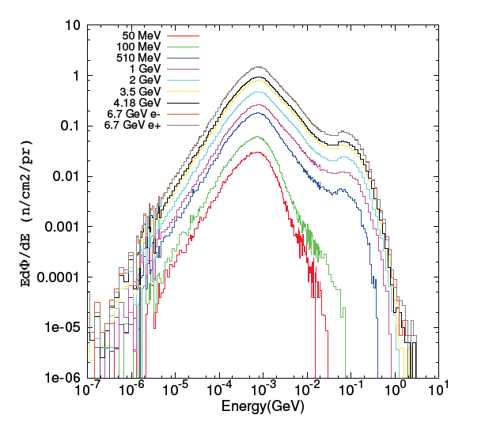
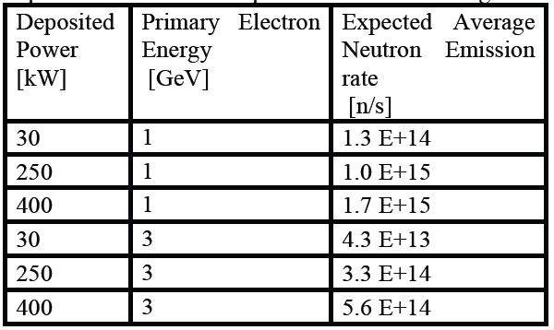
Neutron Source
This source may be suitable for multiple applications, ranging from material analysis for industrial and cultural heritages purposes to chip irradiation and metrology. These applications envisage the development of properly designed beam lines with neutron moderation and possibly cold/thermal neutron transport systems. The proposed new facility will represent a great opportunity for research and development of neutron instrumentation (e.g. detectors) as well as training of young scientist in the use and development of neutron techniques.

Slide 18
Neutron Source
Neutron Resonance Capture Analysis (NRCA): Each resonance is the fingerprint of a nuclear specie (isotopical recognition) thus allowing for the elemental material analysis (qualitative and quantitative) especially on metallic samples (e.g. cultural heritages).
Bragg Edge Transmission (BET): By means of this technique, stresses and strain in bulky samples can be analysed. This analysis is very important for both industrial as well as cultural heritages applications.
Chip irradiation : In order to test the robustness of electronic devices to neutron field in a few minutes, neutron beams produced at facilities are desirable as the may provide an almost atmospheric-like neutron spectrum but several order of magnitude more intense.
Radiography and Tomography (NR, NT): By means of radiography it is possible to obtain an image of a object that evidences the internal structure, by rotating the sample with respect to the incident beam and collecting images for each angular position a 3D image of the object is obtained (tomography).
Neutron metrology: In this context, The Italian National Institute of Ionization radiation Metrology (INMRI) is interested in having in Italy (and especially in Roma area) a high energy neutron source in order to develop primary standards for neutron emission rate and energy spectrum calibration

Slide 19
Advanced γ-ray Compton Source
Thestate of the art in producing high brilliance/spectral density mono-chromatic γ-ray beams will be soon enhanced, stepping up from the present performances (γ-ray beams with bandwidth nearly 3% and spectral density of about 100 photons/s.eV) up to what is considered the threshold for Nuclear Photonics, i.e. a bandwidth of the γ-ray beam lower than 0.3% and a spectral density larger than 10⁴ photons/s.eV.
e⁺
3
GeV
1.5
GeV
1.5
GeV
CRYO
CRYO

Slide 20
Advanced γ-ray Compton Source
studies of the nucleus structure at the Pigmy and Giant Dipole Resonance with unprecedented resolution in reconstructing the nuclear states: this is crucial also to understand some unknown processes in the stellar nucleo-sinthesys
studies of two level barionc states in the high energy resonance of the nuclei, above 20 MeV and up to 60 MeV, crucial to reconstruct the equation of state of the nuclear matter
detection and imaging of fissile and strategic material with isotopic reconstruction of the components with large impact on the national security scenario
remote sensing and diagnosys of nuclear wastes in containers, with reconstruciotn of the isoptope and nuclear composition of the waste material, with large impact on the atomic energy scenario
medical imaging and therapy

Slide 21
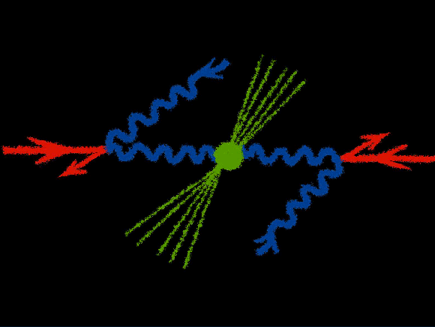
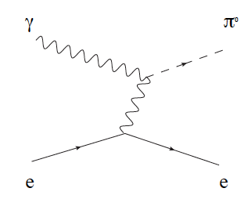
γ-e Linear Collider
The precise measurement of the π⁰ width through the process e γ → π⁰ e (Primakoff effect), and the search for light dark bosons in the energy region of few to hundreds MeV. These measurements, which provide important tests of the Standard Model, are not possible at present electron-photon colliders due to the low photon intensities of the machines.
πº width measurement: the axial anomaly of Adler, Bell and Jackiw (non-conservation of the axial vector current) is responsible for the decay of the neutral pion into two photons. It bridges in QCD the strong dynamics of infrared physics at low energies (pions) with the perturbative description in terms of quarks and gluons at high energies. The anomaly allows to gain insights into the strong interaction dynamics of QCD and has received great attention from theorists over many years.

Slide 22
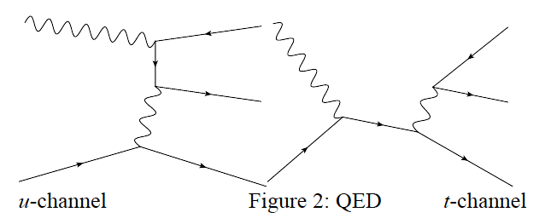
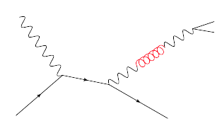
γ-e Linear Collider
Search for dark forces: several puzzling astrophysical observations (PAMELA abundance of positrons, ATIC excess, WMAP haze, INTEGRAL signal) could be explained on a common ground by existence of a new, beyond-standard-model (BSM), weakly interacting boson “U”. The mass of the U boson is expected to be at MeV or GeV scale. Such a particle would be a slim dark matter candidate and, technically, a gauge boson of a "hidden sector" abelian symmetry group U(1).
At IRIDE we can search for U boson via the lepton triplet production process in the electron-photon collision. The main QED process of the lepton triplet production is through u channel exchange (“BH diagram”) and the t channel exchange (“VCS diagram”).
The U-boson contribution is included as the t-channel part with the photon line modified by the mixing with the U.

Slide 23
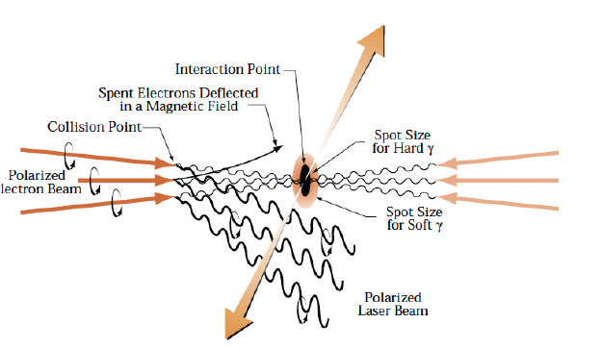
γ-γ Linear Collider
The vacuum of QED poses some still unsolved challenges which are central not only in the context of field theory, but also of super-symmetry and string theory as well. The elastic photon-photon scattering offers unique opportunities to probe the nature of QED vacuum. We propose an experiment to observe photon-photon scattering in the range 1 MeV – 2 MeV CM energy, i.e., near the peak of the QED cross-section. In addition a low-energy photon-photon collider investigation could lead to the necessary technology developments and prepare the ground for a higher energy complex, while still providing a rich testing ground for QED, and, more generally, QFT.

Slide 24
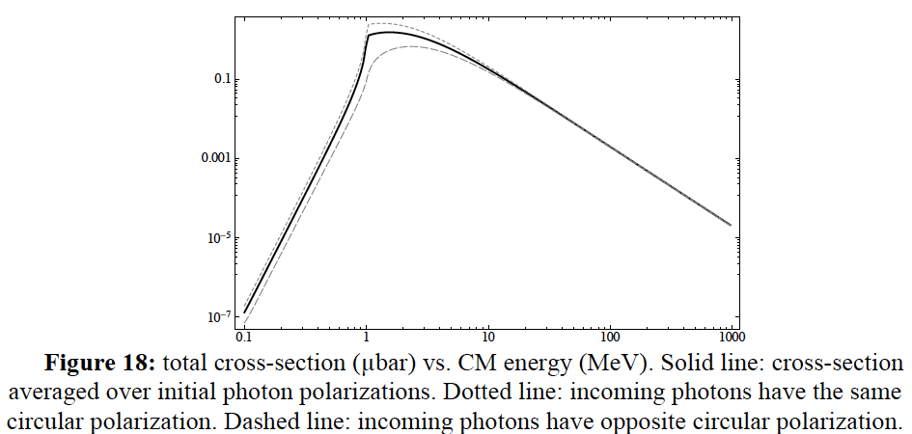
γ-γ Linear Collider
The most striking failing of QFT is the huge mismatch between the measured energy density of vacuum and the energy density of the ground level of the fundamental fields which is wrong by something like 120 orders of magnitude.
a photon-photon scattering experiment with photon energies in the 0.5-0.8 MeV range – where the cross-section is reasonably large, would be an important test of our understanding of the QED vacuum.
This experiment needs a low-energy photon-photon collider, and a photon detection apparatus which is very similar to that current PET scanners

Slide 25
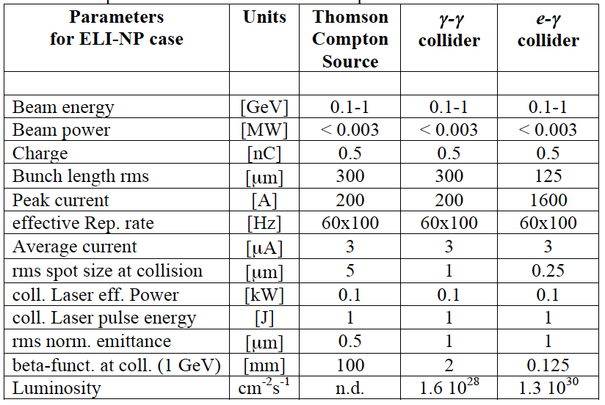
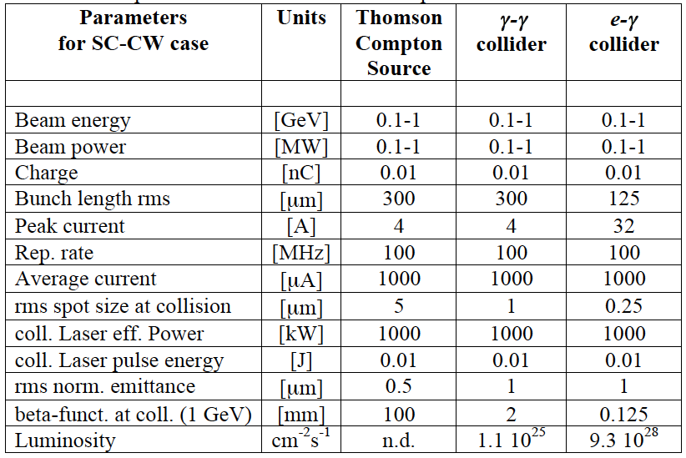
Luminosity and beam requirements

Slide 26
e⁺ e⁻ Linear Collider
An electron-positron collider with luminosity of 10³² cm⁻²s⁻¹ with center of mass energy ranging from the mass of the φ-resonance 1 GeV up to ∼3.0 GeV, would complement high-energy experiment at the LHC and future linear collider (ILC). Such a machine can easily collect an integrated luminosity of about 5 fb⁻¹ in a few years of data taking.
This will allow one to measure the e⁺e⁻ cross section to hadrons with a total fractional accuracy of 1%, a level of knowledge that has relevant implications for the determination of SM observables, like, the g-2 of the muon and the effective fine-structure constant at the M_{Z} scale. The latter are, through quantum effects, sensitive to possible bSM physics at scales of the order of hundred GeV or TeV.
e⁺
3
GeV
1.5
GeV
1.5
GeV
CRYO
CRYO

Slide 27
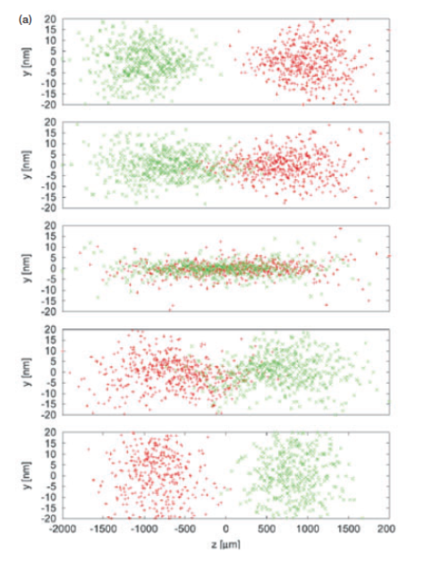
A primary effect of the electron-positron interaction is an enhancement of the luminosity due to the pinch effect [2], i. e. the reduction of the cross section of both beams occurring at the IP due to self focusing forces, see Fig. 22, that is included in the luminosity definition through the factor H_{D}.

Slide 28
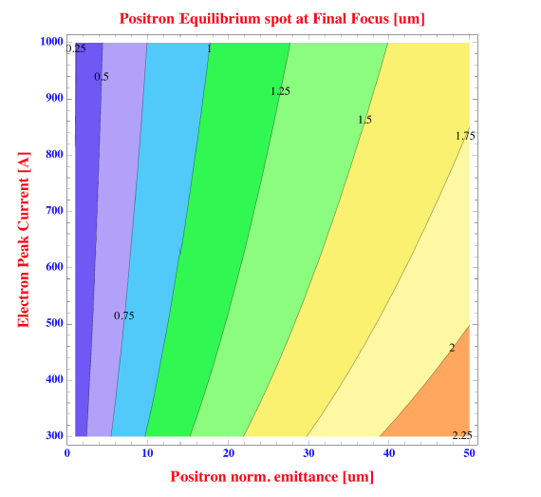
Under the previous condition the positron beam spot size remains constant during the interaction due to the balance between its own defocusing emittance pressure and the counter-propagating electron beam focusing effect.

Slide 29
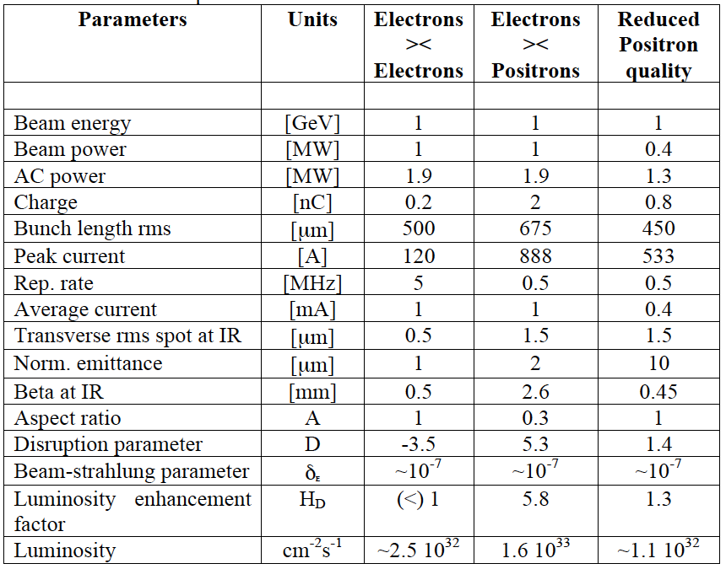

Slide 30
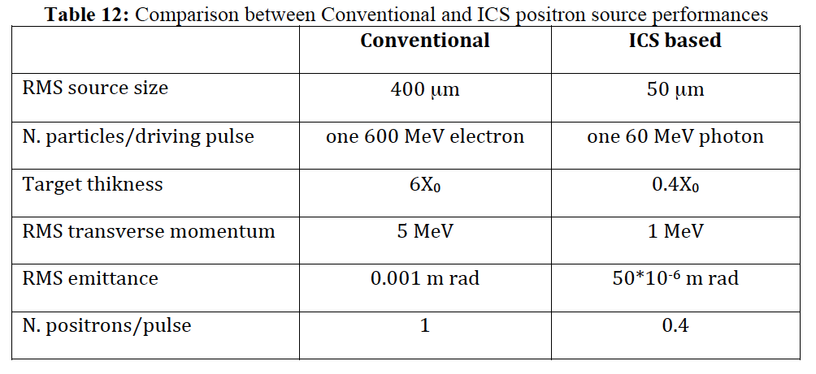
For the peak brightness the main advantage of driving the conversion directly with a photon beam relies on the possibility of using thinner targets. The emittance of the positron beam emerging from the target is determined by the source size and the beam divergence.

Slide 31
Preliminary cost evaluation – step 1 (?)
n
PWA
1.5
GeV
e⁺
CRYO

Slide 32
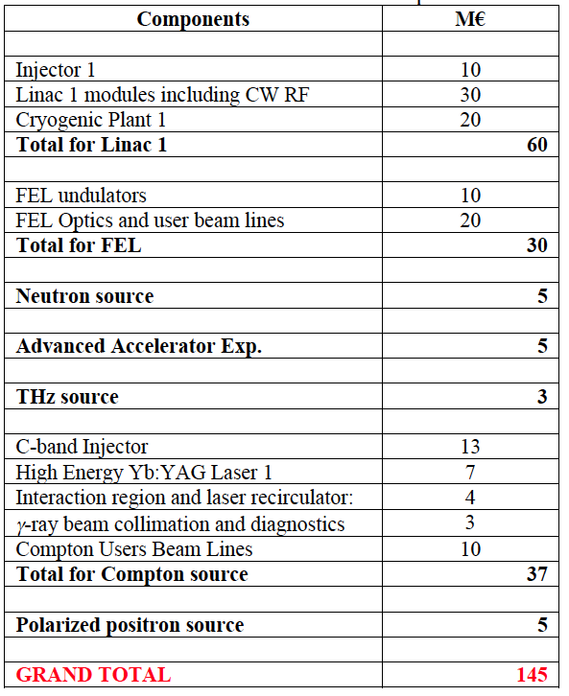
Preliminary cost evaluation – step 1

Slide 33
Preliminary cost evaluation – step 2
n
e⁺
PWA
3
GeV
1.5
GeV
1.5
GeV
CRYO
CRYO

Slide 34
Preliminary cost evaluation – step 2

Slide 35
To Do List
Preliminary Proposal is almost ready
Kick Off Meeting by the end of February
One day international meeting on June 2 during EAAC 2013
Conceptual Design Report ready for Summer

Slide 36
